Slide 1

Introduction to HLA 4
for the Cloud
Björn Möller & Fredrik Antelius
Pitch Technologies

Slide 2
Agenda
Introduction
High-Level Architecture (HLA) for the Warfighter
Technical capabilities of HLA
Common federation object models
Cloud simulation environments with HLA 4
Common considerations
  LVC gateways, performance, tools and security
Summary and additional reading

Slide 3
Learning Objectives
After taking this tutorial, you should be able to:
Describe the requirements for interoperability in distributed simulation
Explain the principles of the HLA standard
Explain how the HLA standard is used for distributed training purposes
Describe the new features of HLA 4
Describe how to build Cloud simulation environments using HLA 4
  New for 2025

Slide 4



Purpose of HLA
Provide one single interoperability standard
  Meet a broad set of distributed simulation requirements
  Support training, analysis, test & evaluation, concept development, engineering, etc.
  Support a variety of domains and sub-domains with different and evolving object models
Enable reuse of simulation components, thus reducing cost
  Vendor-neutral interoperability through open standardization
  Facilitate an open eco-system for COTS, GOTS and in-house simulations
COTS = Commercial-off-the-shelf
GOTS = Government-off-the-shelf
IEEE = Institute of Electrical and Electronics Engineers
SISO = Simulation Interoperability Standards Organization

Slide 5



Overview of HLA Capabilities
Connect
Exchange
information
Synchronize
Manage &
Monitor
Object
models
Connect simulations running on different hosts
Services for information exchange using publish-subscribe and filtering
Services for synchronization of startup, execution and simulation time
Services for managing and monitoring the simulations
Support for object models for different domains

Slide 6
HLA Timeline
(HLA 1.0)
(HLA 1.1)
(HLA 1.2)
IEEE
1516-2010
“HLA Evolved”
IEEE
1516-2025
“HLA 4”
DMSO
HLA 1.3
IEEE
1516-2000
Proto-federations
1995
2000
2005
2010
2015
2020
2025
HLA was initiated in the US DoD in the early 1990s
After developing several proto-federations, HLA 1.3 was released in 1998
It was brought to open standardization through IEEE, resulting in
HLA IEEE 1516-2000
The standard was updated in 2010 with several new features – “HLA Evolved”
The latest version of the standard is “HLA 4”
  Published by IEEE in 2025

Slide 7
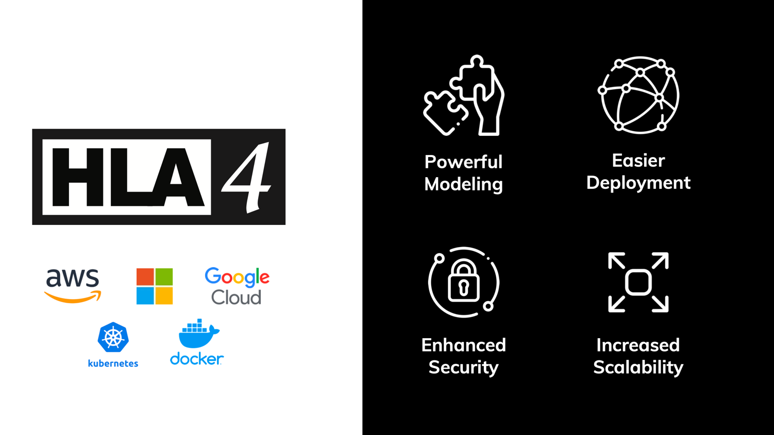
What’s new in HLA 4?

Slide 8
Key HLA Concepts
Federate A
Federate B
Federate C
Federation Object Model
<FOM>
<Shared object classes>
<Shared interaction classes>
<More>
</FOM>
Runtime Infrastructure (RTI)
Each participating member is called a Federate
Information is exchanged using a Runtime Infrastructure (RTI)
The information exchange follows a Federation Object Model (FOM)
The federates together with the FOM and the RTI are called a Federation
A session with a federation is called a Federation Execution

Slide 9
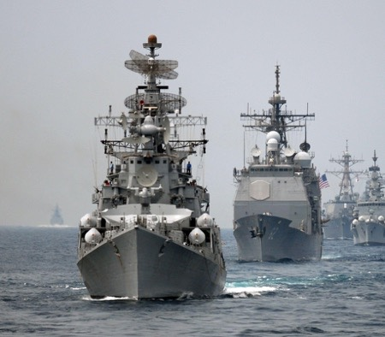
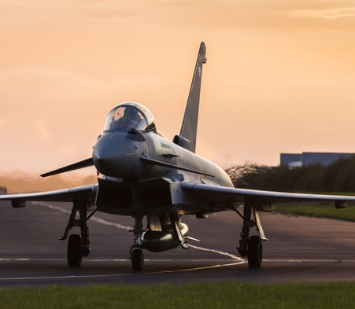
HLA for LVC Platform Training
Purpose:
  Platform training, communication skills, joint and combined exercises, mission rehearsal, etc
Federates:
  Platform simulators, radio simulations, sensor simulations, visualizers/viewers, data loggers
Sample FOMs:
  Platforms, Warfare, Radio, Tactical Data Links (Link 16), Weather, Radar, Jamming, IFF, Enumerations (platform types), laser engagement
Examples:
  UK Royal Air Force “Gladiator”
  US Navy Continuous Training Environment

Slide 10
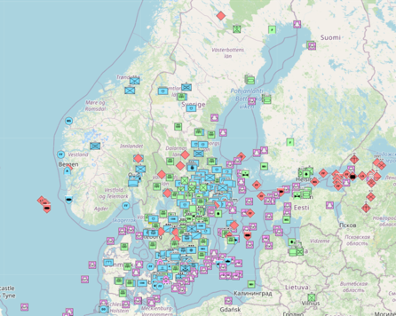
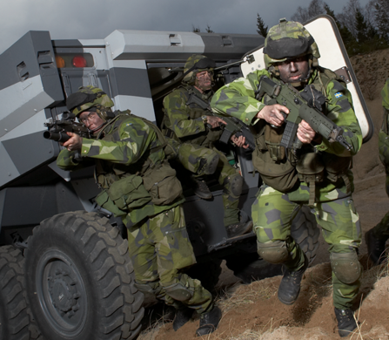
HLA for Command and Control Training
Purpose:
  Command post exercises, leadership and decision training, joint and multinational exercises, tactics development
Federates:
  Aggregate level simulations, interfaces to C2 systems, radio simulations, sensor/tracker simulations, visualizers/viewers, data loggers
Sample FOMs and standards:
  Aggregates, Order of battle, Platforms, Warfare, Radio, Tactical Data Links (Link 16), AIS, Weather, Cyber
  Military scenario description language
Examples:
  Viking, US-Swedish lead training with 30 nations
  and NATO, United Nations and NGO participants

Slide 11
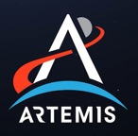
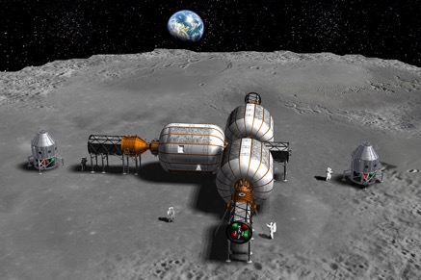
HLA for Space Simulation
Purpose:
  Simulation for concept, design, analysis, production, testing, training and ultimately flight.
  Simulate in any reference frame/coordinate system, not only geocentric systems
Federates:
  Space vehicles, space environment, sensors, navigation
Sample FOMs:
  SpaceFOM, Radio, Environment, Navigation
Examples:
  NASA Artemis ”Return to the Moon” with simulations from major contractors
  ESA Harwell Robotics Lab, VV&A
  Simulation Exploration Experience (Academic)

Slide 12
HLA Services
Federate A
Federate B
Federate C
Federation Object Model
<FOM>
<Shared object classes>
<Shared interaction classes>
<More>
</FOM>
Runtime Infrastructure (RTI)
The RTI provides simulation services to the federates:
  Connect and join simulators together
  Declare information interest and intent with publish & subscribe
  Exchange information about entities and events
  Transfer modeling responsibility between simulators
  Run in faster or slower than real-time, or run as fast as possible
  Handle large scale scenarios with filtering, e.g. geographical filtering

Slide 13
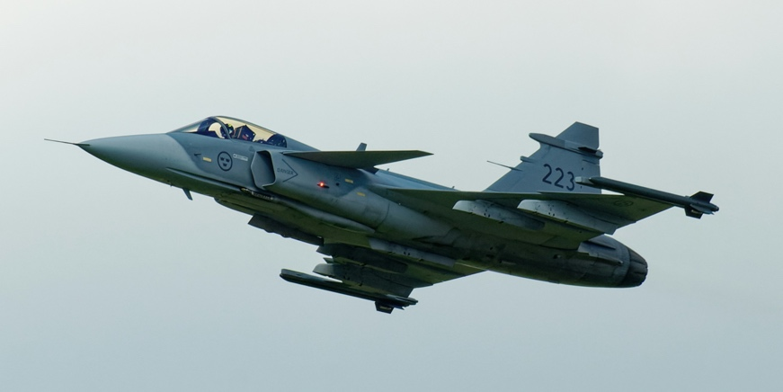
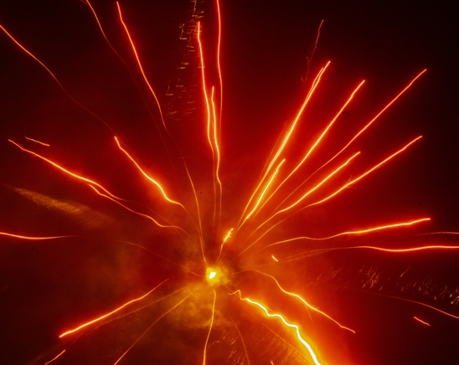
Objects vs. Interactions
The HLA shares data between federates via two mechanisms:
Objects for entities
  Persistent
  Usually represent long-lived entities in the federation
  State is represented by attributes
  State can be partially updated by owning federate
  Example: Aircraft, Human
Interactions for events
  Not persistent
  Usually represent events in the federation
  State is represented by parameters
  Full state must be sent in the interaction
  Example: Fire, Detonation,
  Radio signal

Slide 14
HLA uses the Publish/Subscribe Pattern
A federate can publish the information that it produces to the federation.
Publish truck,
aircraft, command
Publish aircraft,
command
Publish weather
Publish truck,
aircraft
Subscribe truck,
aircraft
Subscribe aircraft,
weather, command
Subscribe aircraft,
weather, command
Subscribe command
Federate A
Federate B
Federate C
Federate X
Runtime Infrastructure
A federate can publish the information that it produces to the federation
Another federate can subscribe to information that it requires.
  Publishing and subscribing is based on the Federation Object Model (FOM)
The RTI routes any relevant information to a subscribing federate – no need for federates to connect directly to other federates.
  Allows for multiple RTI implementations, including central server and peer-to-peer
Enables interoperability and reuse

Slide 15
Overview of Federation Execution Lifecycle
Federate
RTI
Create Federation Execution
Join Federation Execution
Startup
Establish Initial Data Requirements
via Publish and Subscribe
Register Object Instances
Update Attribute Values
Discover Objects
Operations
Update/Reflect Attribute Values
Send/Receive Interactions
Register/Discover Objects
Delete/Remove Objects
Shutdown
Resign Federation Execution
Destroy Federation Execution

Slide 16
Federation Management
Purpose: Establish well-managed sessions with a controlled set of simulations.
Functionality: Creating federation executions. Coordinated start-up. Synchronization points. Check pointing.
Essential HLA Services
  Connect to the RTI, create and join federation execution.
  Resign. Destroy federation execution. Disconnect.
  Synchronization points.
  Save/restore.

Slide 17


Declaration Management
Purpose: Declare what data each federate will send or wishes to receive, based on the federation object model (FOM), in order to optimize the data exchange.
Functionality: Publish and subscribe object classes with attributes, and interaction classes with parameters.
Essential HLA Services
  Publish.
  Subscribe.
Publish
Subscribe
Subscribe
Publish

Slide 18
Object Management
Purpose: Data exchange.
Functionality: Create and delete object instances that are shared between federates. Update their attributes. Send and receive interactions.
Essential HLA Services
  Register, discover, delete and remove object instances.
  Update and reflect attribute values.
  Send and receive interactions.
  Request updates.

Slide 19
Ownership Management
Sample use case: enable a constructive simulation to hand over the responsibility for simulating an aircraft to a virtual simulation.
Functionality: Hand over the ownership (responsibility for updating) of attributes from one federate to another during execution. This can be either “push” or “pull,” and with or without negotiation.
Essential HLA Services:
  Request ownership acquisition for an attribute.
  Divest ownership for an attribute.
  Query attribute ownership.

Slide 20
Time Management
Sample use case: run exercises in real-time, scaled real-time, varying speed, as-fast-as-possible. Run Monte-Carlo simulations as fast as possible.
Functionality: Manage the time advancement for federates and time-stamped data exchange between federates for consistency and repeatability. This can be time-stepped or event-driven.
Essential HLA Services:
  Enable/disable sending and receiving of time-stamped data.
  Request and grant advancement to a given time.
  Request and grant advancement to the time of the next message.
  Query the RTI for current time values.

Slide 21
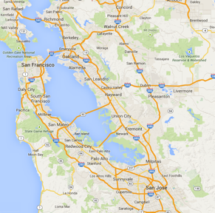

Data Distribution Management
Sample use case: build large federations by enabling federates to focus on a smaller part of the battlefield or on entities belonging to a particular force.
Functionality: Enable federates to filter data not only on class and attribute, but also on their static or dynamic data (like friendly/opposing or latitude/longitude).
Essential HLA Services:
  Create and modify regions that specify data ranges for filtering.
  Send attribute updates and interactions with associated regions.
  Subscribe to attributes and interactions with associated regions.
0
1
2
3
4
5
6
7
8
9
10
11
12
13
14
15

Slide 22
HLA Fault Tolerance
Federate
Lost!
Federate
Lost!
Not Connected!
Federate
Federate
Federate
RTI
HLA includes a mechanism for fault tolerance
  Connected federates can discover that a federate has been lost
  The lost federate can discover that it has lost connection
Enables several design patterns (fail-over federates, reconnecting federates, …)

Slide 23
Information Model in a FOM
Object Class
Identification
  Name, version, purpose, etc.
Object Classes with Attributes
Interaction Classes with Parameters
Data Types
  Simple, records, enumerations, etc.
  Used for Attributes and Parameters
Aircraft
Type
Marking
Position
Interaction Class
MunitionFire
FiringObject
TargetObject
MunitionType
Data type
PositionRecord
Latitude
Longitude
Altitude

Slide 24
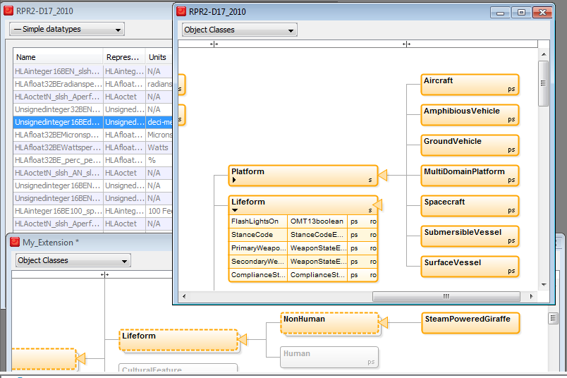
Object Class Example
A hierarchical visual representation

Slide 25










Common Aerospace and Defense FOMs
NATO NETN FOM Modules
The RPR FOM 2.0 is the most commonly used FOM for defense simulation
  RPR FOM 3 now being finalized
  IFF, InfOps, etc.
  Download from www.sisostds.org
NATO Education and Training Network FOM (NETN)
  Builds on top of RPR FOM
  Growing number of modules
  Download from github.com/AMSP-04/
SISO Space Reference FOM
EUROCAE Air Traffic Management FOM
Medical FOM (US Army)
METOC
Communi-
cation
Networks
Entity
Tasking &
Reporting
CBRN
Organization
AIS
Multi
Resolution
Modeling
Transfer of
Modeling
Responsibility
RPR FOM Modules
Physical
Entities
Aggregates
Radio
Logistics
Synthetic
Environment
Warfare
Underwater
Acoustics
Minefield
Simulation
Management
Emissions

Slide 26
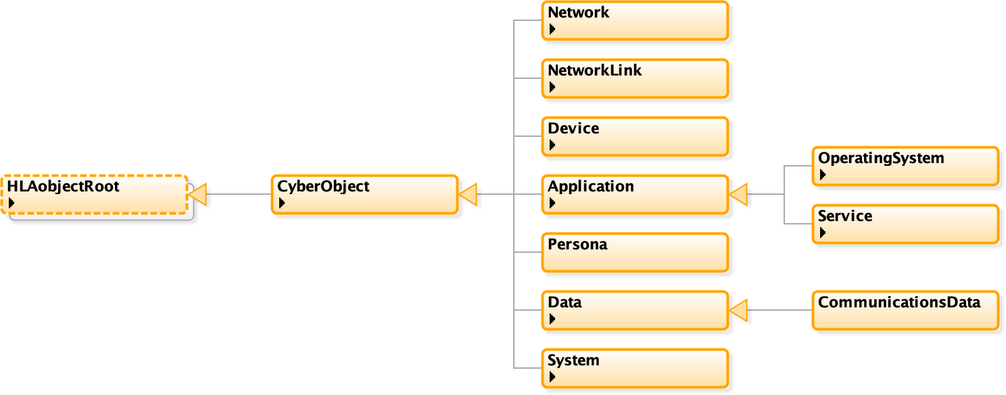
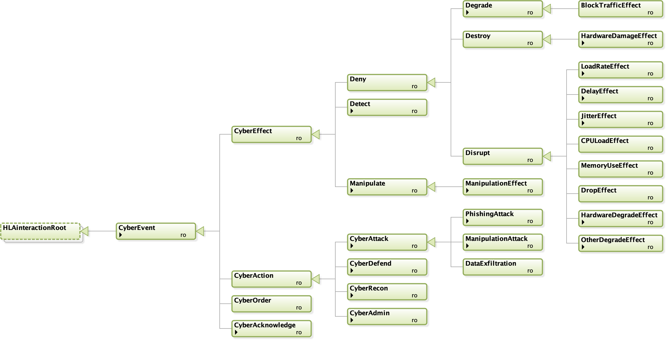
Cyber Data Exchange Model (DEM) and
Federation Object Model (FOM)
SISO has developed a Cyber FOM standard to represent cyber events and objects.
The Cyber FOM enables integration of cyber simulations, cyber ranges,
and kinetic simulations.

Slide 27
Why use Cloud for Simulation?
Enables rapid scaling of simulation resource with elastic scalability
  From small tests to large federations
Flexible for many use cases
  Training, distributed exercises, system validation, and experimentation
  Enables integration with cloud-native services for data processing, storage, and analytics
Quick deployment of new environments
Pay-as-you-go and Evergreen IT
  Reduces hardware investments, maintenance and operational overhead
Supports collaboration and sharing of simulation results in real time
  Teams can access simulations securely from anywhere

Slide 28


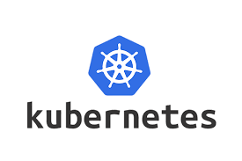


Key Cloud Concepts
Public Cloud
  Provided by external vendors like AWS and Azure on shared infrastructure
Private Cloud
  Dedicated infrastructure operated for a single organisation
Hybrid Cloud
  Combine on-premise resources with cloud infrastructure for flexibility and resilience
Containers
  Lightweight units to package and run simulation components, usually with Docker
Orchestration
  Automated management and scaling of containers, usually with Kubernetes
Cloud-based Technologies
  Use of Docker, Kubernetes, and related services to standardise deployments

Slide 29








Federate Protocol (HLA 4)
A federate can call the RTI using a protocol instead of calling a local library
Separates the federate from the RTI
Better support for Live with 4G/5G links
Cloud friendly client/server communications
Encrypted and Authenticated communication with TLS 1.3
Additional languages/OS
Standardized API
Standardized protocol
Federate
Federate
Network
“Join” API call
“Join” network packet
RTI Lib (LRC)
RTI Server
Network
Network

Slide 30

HLA 4 Federate Protocol Deployment in the Cloud
Cloud
CGF
Data Logger
RTI
Protocol over
4G/5G
Protocol
Protocol
Protocol over
4G/5G
Live training
Site A
Site B
Federate
Federate
Deploy large CPU consumers in the Cloud
Deploy large GPU consumers locally
Collect Big Data in the Cloud
Connect live systems over 4G/5G
Point-to-point communication
Fault tolerance and fast reconnect

Slide 31


HLA 4: Federate Authentication and Cloud Security
Federates may be required to provide credentials to connect and join a federation
Support for passwords, PKI certificates (X.509), etc.
Flexible mechanism through plug-in
May connect to existing authorization services
May implement different policies
Also useful for Zero Trust Architectures
Certificate
Authority
Private Key
Certificate
Certificate
Certificate
Federate A
Federate B
Federate C
Runtime Infrastructure (RTI)
Public Key

Slide 32
Scalability & Elasticity with DDM
0
1
2
3
0
1
2
3
4
5
6
7
4
5
6
7
8
9
10
11
8
10
11
12
13
14
15
12
13
14
15
Filter on Lat/Long
Filter on air, land, sea, space
Filter on friendly, opposing, neutral
Modern RTIs can deliver a million updates/second to a federate, but few federates, can process that incoming data rate
  Use elastic CPUs to scale horizontally to split the work across more federates
Reducing the data flow to each federate is the key to scalability
  HLA Data Distribution Management (DDM) provides powerful ways to filter data
  HLA 4 makes it possible to extend reference FOMs with tailored DDM

Slide 33
HLA 4 Based Architecture for Cloud, Scalability and MSaaS
On-site
Public or Private Cloud
Classic Training System
HLA 4 Federate Protocol + Authentication
HLA 4 RTI
RPR FOM
Game Based Trainer
HLA 4 Federate Protocol + Authentication
L16 FOM
Web Based Client
https/html/REST/WebSockets/etc.
Web Server
HLA 4 API
or protocol
NATO FOM
C2 System
C2 Sim/C2 Protocol/NVG/etc.
C2
Gateway
HLA 4 API
or protocol
Space FOM
Data Recorder
HLA 4 API
or protocol
HLA 4 supports mixed cloud and on-site deployment
Scalable CGFs and data recorders may execute in cloud environments
Training audience may operate classic training systems, web-based interfaces or game-based trainers
Custom FOM
Scalable
CGF
HLA 4 API
or protocol

Slide 34
More Features in HLA 4
Directed Interactions
  Send interactions directly to instances
Flexible Object Model Merging
  Easier to reuse existing federates and FOMs
  Easier to extend reference FOMs
Fault tolerance – handling unplanned leaving federate
Improved usability
  Default switches
  Specify for what attributes values are required vs optional
  More complete and flexible Dimension specification

Slide 35
HLA and LVC – Gateways
DIS
Link 16
Command and Control
Federate
DIS Gateway
L16 Gateway
C2 Gateway
Runtime Infrastructure (RTI)
HLA can handle both Live, Virtual and Constructive simulation
In LVC settings, information may still need to be bridged between different architectures
Standard FOMs exist for bridging
  The RPR FOM matches the DIS information model
  Tactical Data Link (TDL) such as Link 16
  C2SIM – connect to C2 systems
Custom gateways may be needed

Slide 36

HLA and Performance
HLA is a standard
  It has no particular performance
Actual RTI implementations exhibit performance
  May be optimized for different use cases
Sample RTI performance on regular Windows workstations in 2020
  Hundreds of systems
  100 000’s of updates per second, typically up to 90% of the network’s raw bandwidth
  900 Mbps on Gigabit LAN
  100 000 object instances
  Latency of 0.13 ms on 100 Mbps LAN
Common federation bottlenecks:
  LAN bandwidth
  WAN latency and bandwidth
  Federate processing time for incoming data
Plan for performance!
  Analyze performance requirements
  Analyze federate and network capabilities

Slide 37
HLA and Tools
Sample tool chain
OMT Editor
Code Generator
RTI
Data Logger
2D/3D
Visualizer
A wide range of HLA compliant tools and federates are available
Development tools (OMT editor, middleware, code generators, data loggers)
Visualizers (2D, 3D, game based, …)
Federates (Computer Generated Forces, flight models, dynamics, …)
Bridges (HLA-DIS, HLA-HLA, HLA-TENA, HLA-games, HLA-DDS, …)
TENA = Test and Training Enabling Architecture
DDS = Data Distribution Services

Slide 38
HLA and Cross Domain Security/MLS
CDS/MLS solution
Simulation
Simulation
Proxy
Guard
Proxy
Simulation
Simulation
RTI
Policy
RTI
Low Domain
Release
High Domain
It is possible to simulate with controlled data exchange between classification levels
The federation is partitioned into different domains
  May be different classifications within one nation or simulation between different nations
There are security solutions that can connect to multiple domains, provide separation and release data based on a release policy
  Different topologies: one host, several hosts, hardware/software guards, etc.
  Different solutions meet different levels of assurance

Slide 39

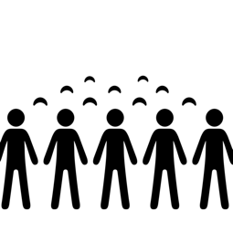

HLA Benefits
Secure
Secure authentication
Secure transportation
Cross-domain security
Proven
Viking, the largest CiMiC exercise
UK Royal Air Force
Down-selected by NASA
Scalable
Millions of entities
Hundreds of systems
<0.1 ms latency

Slide 40
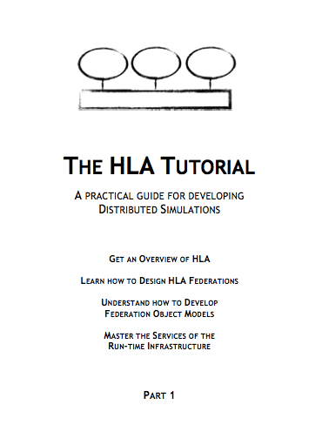
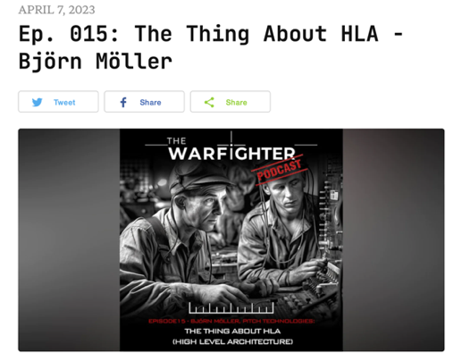
Additional Reading
The standard
  HLA IEEE 1516-2025 www.ieee.org
HLA podcast – an introduction
  https://www.warfighterpodcast.com/
The HLA Tutorial – for developers
  Free, redistributable PDF
  www.pitchtechnologies.com/hlatutorial
Plenty of SISO papers
  www.sisostds.org
  ResearchGate
The HLA Product Development Group
discussion archives
  www.sisostds.org

Slide 41
Learning Objectives Revisited
After taking this tutorial, you should be able to:
Describe the requirements for interoperability in distributed simulation
Explain the principles of the HLA standard
Explain how the HLA standard is used for distributed training purposes
Describe the new features of HLA 4
Describe how to build Cloud simulation environments using HLA 4

Slide 42
Questions?
Björn Möller
Fredrik Antelius
Bjorn.Moller@pitch.se
Fredrik.Antelius@pitch.se

