Slide 1




Distributed Live Virtual Constructive (LVC) Event Process
Michael J. O’Connor
Simon Goerger
Kenneth G. LeSueur
Roy F. Zinser
LTC John Furr
(Army Futures Command)
Ed Lerz
(Huntington Ingles Industries)
Brett Boren
Tilghman Turner

Slide 2
Learning Objectives
Describe and apply the 9-step Distributed LVC Event Process, including the identification of critical roles and responsibilities required for successful event outcomes.
Execute and validate the event environment as outlined in Step 7 (Integrate & Validate the Event Environment) of the Distributed LVC Event Process, including conducting integration testing and iterative validation to confirm system reliability and accuracy.
Analyze the relationship between the Distributed LVC Event Process and the overall Event Life Cycle, including the impact of each process step on planning, execution, and post-event assessment.
Apply process-driven risk mitigation strategies in distributed LVC event integration, including identifying common failure points and implementing corrective actions to prevent invalid configurations.

Slide 3
Agenda: LVC Integration Tutorial
Topic | Presenter | Estimated time (min)
Purpose & Background of the Process | Brett Boren | 5
Step 1: Project Initiation | Simon Goerger | 5
Step 2: Perform Conceptual Analysis | Simon Goerger | 3
Step 3: Conduct Wargame Exercise | Simon Goerger | 3
Step 4: Develop Digital Twin | Simon Goerger | 5
Step 5: Design Operational Wrap-Around | Ed Lerz | 5
Step 6: Develop Operational Wrap-Around | Ed Lerz | 5
Step 7: Integrate & Validate Environment | Roy Zinser | 45
Step 8: Plan & Execute Event | LTC John Furr | 2
Step 9: Analyze Data and Evaluate Results | LTC John Furr | 2
Applying the Process to the Stages of an Event Cycle | LTC John Furr | 5
Wrap –up | Brett Boren | 5
 |  | 90 min

Slide 4
Typical Distributed LVC Event Common Problems
Conducted to support many different domains
  Training, testing & evaluation, research & development, concept development, acquisition, and mission rehearsal
Complex environments
  Unique networks
  Multiple Security Classifications
  Encroaching cyber / information security controls (RMF, ATOs, etc.)
  Evolving Mission Command / C4I Systems
  Need to develop novel M&S and data
  Vague and/or conflicting Objectives
  Multiple Stakeholders
For many years, a small set of very experienced teams created these environments
  Events with less skilled teams often failed, overran costs, or did not meet schedule
Short timelines, busy schedules, & other ongoing work and events
  These all distract from the detailed work needed to build and integrate complex environments
Must generate trusted data and results
  An incorrectly created environment can lead to negative training, false test results, bad research, and failed missions
Notes:
LVC Events are complex and difficult to plan and execute.
The requirement for highly technical SMEs and detailed Project Management is a very high hurdle to cross.
Getting it wrong means failed expectations, wasted money, and time.

Slide 5
Purpose of a defined LVC Event Process
Solving the common problems of Distributed LVC events requires:
A useful Life Cycle framework to reduce risk when building complex M&S environments
A well-defined process that:
  Allows for less reliance on highly skilled practitioners
  Is comprehensive, but easy to tailor
  Is repeatable
Notes:
We're going to show you a process and event life cycle structure that helps teams successfully complete complex distributed LVC events.

Slide 6
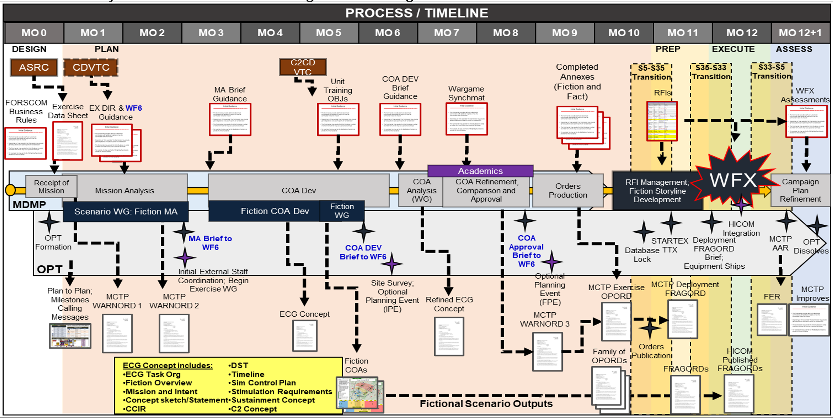
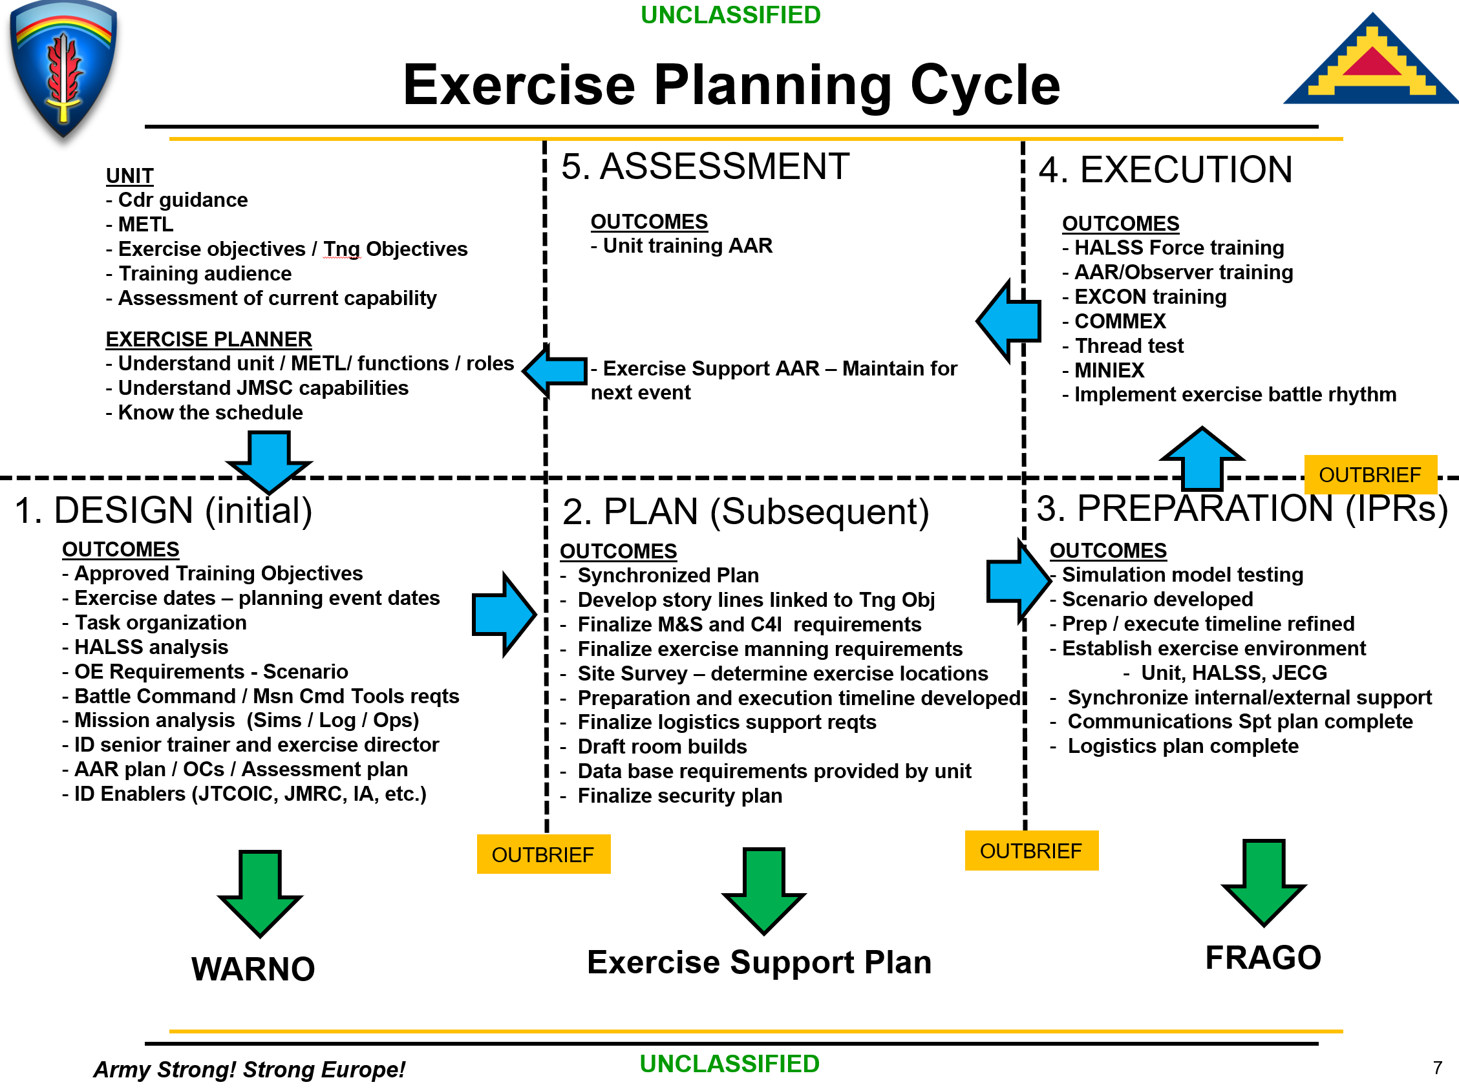
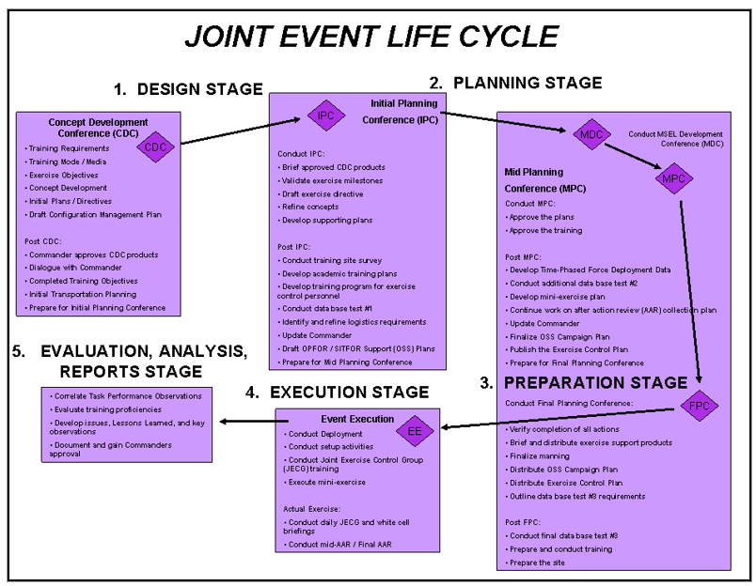
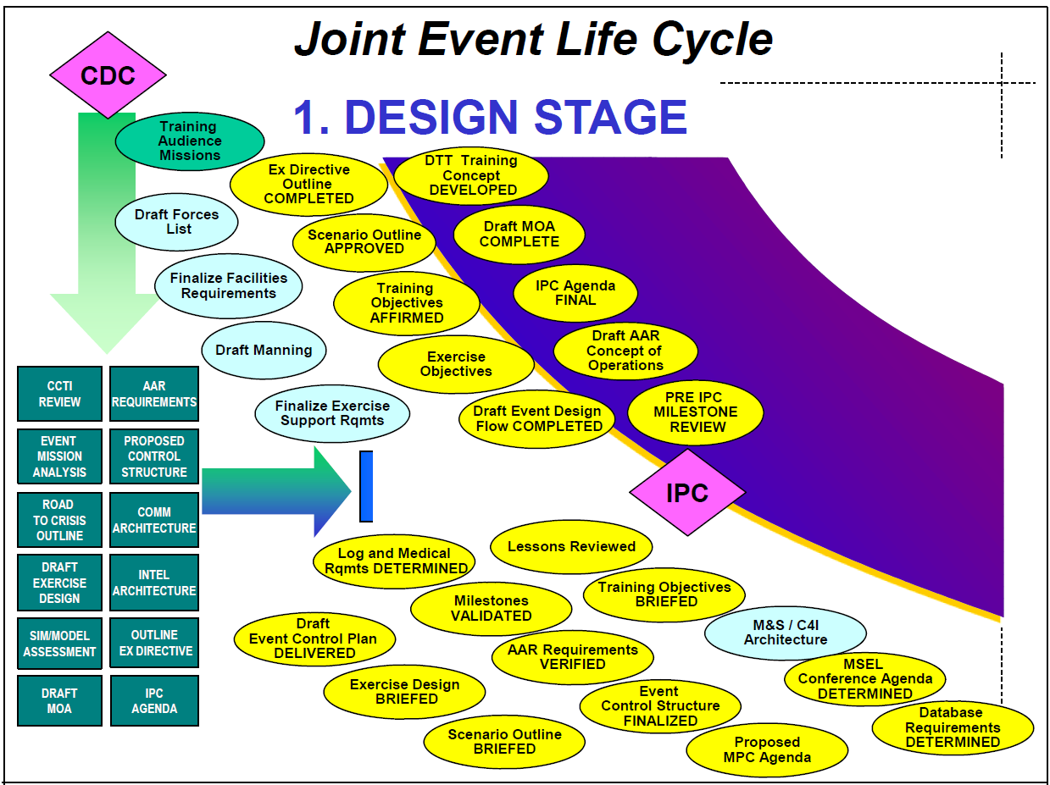
How does this fit with other existing Life Cycles?
JELC
JLVC
MCTP
KBSC
JMSC
NTC / JRTC
Local MTC
Notes:
Organizations with well established Life cycles, regimented integration processes, defined databases, and programmatic control of simulations and object models generally don’t need another process or changes to their integration activities…
Until the environment is forced to adapt to new, unique, or unproven LVC components – then what we’ll present here is useful for those types of exotic circumstances.

Slide 7



Distributed LVC Event Life Cycle
5 Stages
DESIGN
PLAN
PREPARE
EXECUTE
ASSESS
CDC
IPC
Wargame
MDC
MPC
MSC
FPC
TIM
IRR
ERR
AAR
Event Life Cycles provide a framework for building and conducting a distributed LVC event
These Life Cycles still lack the detailed process for how to create and test the LVC products that provide the environment
Workgroups are not enough
AAR: After Action Review
CDC: Concept Development Conf.
ERR: Execution Readiness Review
FPC: Final Planning Conf.
IPC: Initial Planning Conf.
IRR: Integration Readiness Review
MDC: MSEL Development Conf.
MPC: Mid Planning Conf.
MSC: MSEL Synch Conference
TIM: Technical Interchange Meeting
Notes:
It’s common for most organizations to start with the Joint Staff Joint Exercise Life Cycle, the JELC as the framework for their own event process
The JELC defines the sequence of stages and activities for high level Training Exercises
However, the Training Communities' M&S tools, Data, Terrain, etc. are much more “Turn-key” than other communities, therefore the JELC overlooks the more detailed technical requirements faced by other communities of practice.
So, while the Experimentation, T&E, Acquisition, & Analysis events often borrow some of the JECL Structures and stages, they have unique LVC challenges that require additional process steps.
Experience has led most communities to develop or implement localized event processes to accomplish their respective tasks; but personnel turnover and high OPTEMPO make codifying a defined set of activities difficult
The Distributed LVC Event Process provides a framework for every event.
The process supports a full event life cycle through Design, Plan, Prepare, Execute, and Assess stages, with milestones across the life cycle to provide ongoing guidance, monitor progress, identify challenges, establish tasking, and provide a breakpoint between each stage.
The Event Life Cycle is intended to guide event planners in a methodical application of the Event Process that ensures that milestones are accomplished prior to the record runs.
What’s needed is a detailed process that provides guidance on how to progress thru the life cycle, that is comprehensive, but easy to tailor, and repeatable.

Slide 8
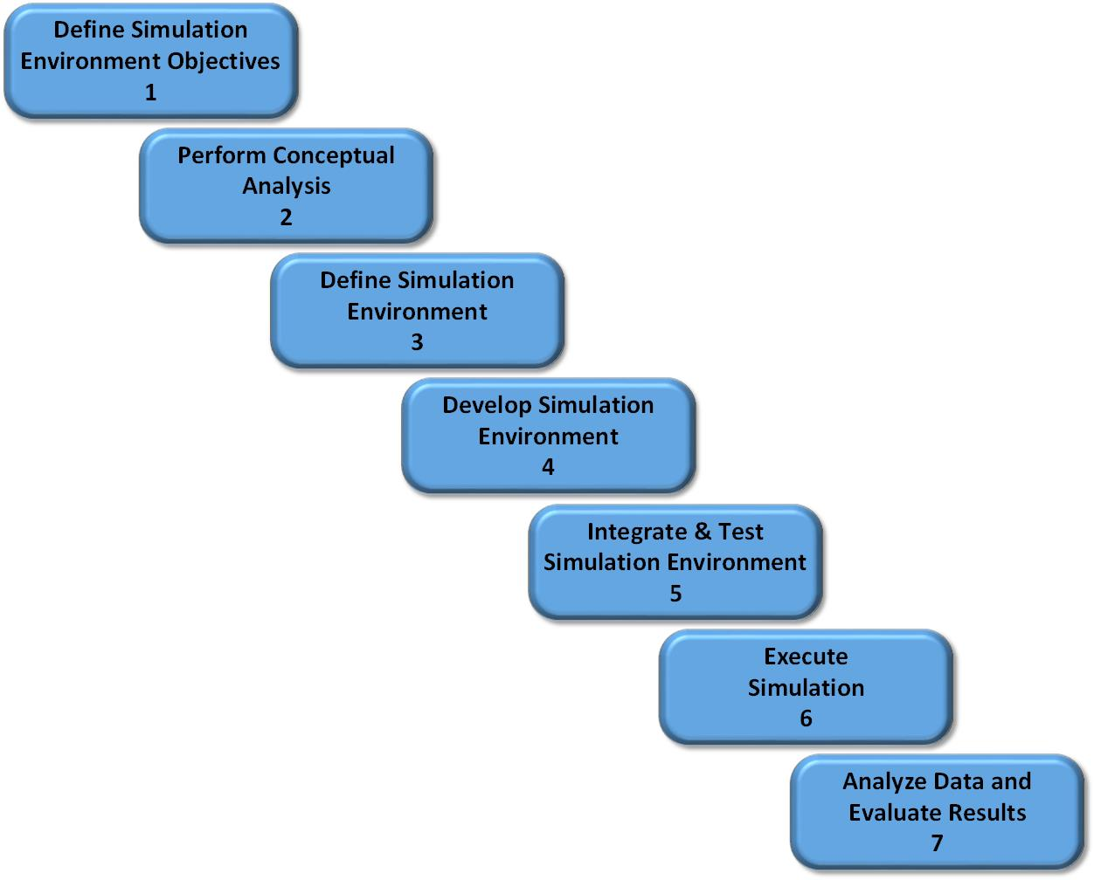
DSEEP
Distributed Simulation Engineering and Execution Process (DSEEP)
IEEE Std 1730-2010, developed by Simulation Interoperability Standards Organization (SISO)
Distributed simulation architecture independent
Process model for the integration of distributed simulations
The Process model must be instantiated with a set of processes and supporting material
DSEEP divides each step into activities
Notes:
DSEEP is a model of a process – you can’t take DSEEP and begin applying to an event – .

Slide 9
Distributed LVC Event Process
This is an instantiated process based on the DSEEP model
The steps and activities support all Event Live Cycle conferences and stages
The processes documented here are based on years of experience integrating distributed LVC simulation events
Distributed simulation events come in varied sizes and have different objectives, but the same approach can be used for all of them with some tailoring
This tutorial describes how to tailor activities based on the size and nature of the event being planned

Slide 10
It Is All About Risk
There are many risks in Integrating and Executing a distributed event
But there are two fundamental risks:
  Risk that integration will fail, preventing execution
  Risk of building an invalid LVC environment, which could lead to unreliable results
Notes:
You can use the Big Bang technique and be successful – but risky.

Slide 11
Integration Failure Risk
This risk is readily apparent to all participants
Causes of the risk:
  Poorly defined objectives results in building the wrong environment
  Incomplete planning leaves gaps in the environment
  Lack of documentation means all the required interfaces are not present
  Inadequate testing does not find issues with system behaviors
Results of the risk:
  Environment only partially meets objectives
  Integration fails completely and the team cannot execute record runs

Slide 12
Invalid Environment Risk
This risk is likely not recognized before conducting the event
Causes of this Risk:
  Lack of understanding the real-world environment
  Creating artificial virtual interoperability that does not exist in the real-world environment
  Not validating the virtual environment
Results of the Risk:
  For R&D focused events the results may drive research in wrong directions
  For Training Events, participants may receive negative training that could result in real world accidents
  For Acquisition focused events, leaders may make poor decisions
  For Test & Evaluation (T&E) events, inaccurate test results may overstate or understate performance metrics

Slide 13
Process to Mitigate Risk
Both risks are bad outcomes of an integration
The Invalid Environment Risk is more significant because the failure will not become apparent until later in the event life cycle (if at all)
A well-defined process does not eliminate the risk, but does mitigate it
A process only works if the team follows it, everyone must embrace the process
  Top-level management support is critical! If mangers do not consider the process important, shortcuts and missed steps will jeopardize the record runs
  Practitioners must receive training on the process and accept the reasons to follow it
When there is schedule pressure, the leadership almost always abandons the process
  The schedule pressure often results from not following the process (e.g., poor planning)
  Further process shortcuts create more schedule slippage, or induces added risks
The verification activities in the process mitigate the Integration Failure risk
The validation activities in the process mitigate the Incorrect Environment risk

Slide 14
Process Steps
Step 1
Step 2
Step 3
Step 4
Step 5
Step 6
Step 7
Step 8
Step 9
Project Initiation
Perform Conceptual Analysis
Conduct Wargame Exercise
Develop
Digital Twin
Design Operational Wrap-Around
Develop Operational Wrap-Around
Integrate & Validate Environment
Plan & Execute
Event
Analyze Data and Evaluate Results
Develop
Objectives
Develop
Scenario
Wargame Preparation
Select
Digital Twin Applications
Select
Wrap-Around Applications
Develop
System Interface Model
Plan
Integration
Plan
Execution
Analysis & Evaluation
1.1
2.1
3.1
4.1
5.1
6.1
7.1
8.1
9.1
Conduct
Initial Planning
Develop
Conceptual Model
Conduct Wargame
Acquire Resources
Design
Environment
Establish Environment Agreements
Integrate Environment
Conduct
Record Runs
Reporting
1.2
2.2
3.2
4.2
5.2
6.2
7.2
8.2
9.2
Develop Environment Requirements
Post
Wargame Analysis
Build
Digital Twin
Design
Wrap-Around
Applications
Develop
Wrap-Around Applications
Validate Environment
Prepare
Data Outputs
Lessons Learned & Retirement
2.3
3.3
4.3
5.3
6.3
7.3
8.3
9.3
Wargame Reporting
Implement Wrap-Around Infrastructure
3.4
6.4
Notes:
We’ve instantiated 9 Steps, 28 Activities, and Multiple Inputs, Tasks, and Outputs per Activity
Even though it appears linear ,and generally runs from left-to-right in sequence; many Steps & Activities are iterated throughout the process as products mature
The overall goal is to address the entire process – Tailoring to the Scale & Scope of the event are very important.
We’ve executed this process in the course of a couple of very focused weeks to a full year.

Slide 15
Process is not sequential
5 Stages
DESIGN
PLAN
PREPARE
EXECUTE
ASSESS
Wargame
TIM
CDC
IPC
MDC
MPC
MSC
FPC
IRR
ERR
AAR
Step 1
Step 2
Step 3
Step 4
Step 5
Step 6
Step 7
Step 8
Step 9
Project Initiation
Perform Conceptual Analysis
Conduct Wargame Exercise
Develop
Digital Twin
Design Operational Wrap-Around
Develop Operational Wrap-Around
Integrate & Validate Environment
Plan & Execute
Event
Analyze Data and Evaluate Results
Develop
Objectives
Develop
Scenario
Wargame Preparation
Select
Digital Twin Applications
Select
Wrap-Around Applications
Develop
System Interface Model
Plan
Integration
Plan
Execution
Analysis & Evaluation
1.1
2.1
3.1
4.1
5.1
6.1
7.1
8.1
9.1
Conduct
Initial Planning
Develop
Conceptual Model
Conduct Wargame
Acquire Resources
Design
Environment
Establish Environment Agreements
Integrate Environment
Conduct
Record Runs
Reporting
1.2
2.2
3.2
4.2
5.2
6.2
7.2
8.2
9.2
Develop Environment Requirements
Post
Wargame Analysis
Build
Digital Twin
Design
Wrap-Around
Applications
Develop
Wrap-Around Applications
Validate Environment
Prepare
Data Outputs
Lessons Learned & Retirement
2.3
3.3
4.3
5.3
6.3
7.3
8.3
9.3
Wargame Reporting
Implement Wrap-Around Infrastructure
AAR: After Action Review
CDC: Concept Development Conf.
ERR: Execution Readiness Review
FPC: Final Planning Conf.
IPC: Initial Planning Conf.
IRR: Integration Readiness Review
MDC: MSEL Development Conf.
MPC: Mid Planning Conf.
MSC: MSEL Synch Conference
TIM: Technical Interchange Meeting
3.4
6.4
Notes:
First thing to recognize is that there’s not a 1:1 transition from the Process Steps & Activities to Event Life Cycle Stages.
The process generally runs Left to Right; but it is not a full waterfall. There are Activities and Tasks that apply across the event stages.

Slide 16
Step 1: Project Initiation
Step 1
Step 2
Step 3
Step 4
Step 5
Step 6
Step 7
Step 8
Step 9
Project Initiation
Perform Conceptual Analysis
Conduct Wargame Exercise
Develop
Digital Twin
Design Operational Wrap-Around
Develop Operational Wrap-Around
Integrate & Validate Environment
Plan & Execute
Event
Analyze Data and Evaluate Results
Develop
Objectives
Develop
Scenario
Wargame Preparation
Select
Digital Twin Applications
Select
Wrap-Around Applications
Develop
System Interface Model
Plan
Integration
Plan
Execution
Analysis & Evaluation
1.1
2.1
3.1
4.1
5.1
6.1
7.1
8.1
9.1
Conduct
Initial Planning
Develop
Conceptual Model
Conduct Wargame
Acquire Resources
Design
Environment
Establish Environment Agreements
Integrate Environment
Conduct
Record Runs
Reporting
1.2
2.2
3.2
4.2
5.2
6.2
7.2
8.2
9.2
Develop Environment Requirements
Post
Wargame Analysis
Build
Digital Twin
Design
Wrap-Around
Applications
Develop
Wrap-Around Applications
Validate Environment
Prepare
Data Outputs
Lessons Learned & Retirement
2.3
3.3
4.3
5.3
6.3
7.3
8.3
9.3
Wargame Reporting
Implement Wrap-Around Infrastructure
3.4
6.4
Notes:
The purpose of Step 1: Project Initiation; is to formally define the objectives and to initiate planning for the Event. Support and participation from the System Owner is critical throughout this step to provide guidance and scope the Event

Slide 17
Step 2 : Perform Conceptual Analysis
Step 1
Step 2
Step 3
Step 4
Step 5
Step 6
Step 7
Step 8
Step 9
Project Initiation
Perform Conceptual Analysis
Conduct Wargame Exercise
Develop
Digital Twin
Design Operational Wrap-Around
Develop Operational Wrap-Around
Integrate & Validate Environment
Plan & Execute
Event
Analyze Data and Evaluate Results
Develop
Objectives
Develop
Scenario
Wargame Preparation
Select
Digital Twin Applications
Select
Wrap-Around Applications
Develop
System Interface Model
Plan
Integration
Plan
Execution
Analysis & Evaluation
1.1
2.1
3.1
4.1
5.1
6.1
7.1
8.1
9.1
Conduct
Initial Planning
Develop
Conceptual Model
Conduct Wargame
Acquire Resources
Design
Environment
Establish Environment Agreements
Integrate Environment
Conduct
Record Runs
Reporting
1.2
2.2
3.2
4.2
5.2
6.2
7.2
8.2
9.2
Develop Environment Requirements
Post
Wargame Analysis
Build
Digital Twin
Design
Wrap-Around
Applications
Develop
Wrap-Around Applications
Validate Environment
Prepare
Data Outputs
Lessons Learned & Retirement
2.3
3.3
4.3
5.3
6.3
7.3
8.3
9.3
Wargame Reporting
Implement Wrap-Around Infrastructure
3.4
6.4
Notes:
Step 2: Conceptual Analysis: The purpose of this step is to define an appropriate environment for the event.
The Scenario provides the relevant context for operations.
The conceptual model provides the detailed knowledge of the systems or assets that are the focus for the event.
The Scenario, Conceptual Model, and the event objectives enable the development of a set of highly specific environment requirements for use in following Steps

Slide 18
Step 3 : Conduct Wargame
Step 1
Step 2
Step 3
Step 4
Step 5
Step 6
Step 7
Step 8
Step 9
Project Initiation
Perform Conceptual Analysis
Conduct Wargame Exercise
Develop
Digital Twin
Design Operational Wrap-Around
Develop Operational Wrap-Around
Integrate & Validate Environment
Plan & Execute
Event
Analyze Data and Evaluate Results
Develop
Objectives
Develop
Scenario
Wargame Preparation
Select
Digital Twin Applications
Select
Wrap-Around Applications
Develop
System Interface Model
Plan
Integration
Plan
Execution
Analysis & Evaluation
1.1
2.1
3.1
4.1
5.1
6.1
7.1
8.1
9.1
Conduct
Initial Planning
Develop
Conceptual Model
Conduct Wargame
Acquire Resources
Design
Environment
Establish Environment Agreements
Integrate Environment
Conduct
Record Runs
Reporting
1.2
2.2
3.2
4.2
5.2
6.2
7.2
8.2
9.2
Develop Environment Requirements
Post
Wargame Analysis
Build
Digital Twin
Design
Wrap-Around
Applications
Develop
Wrap-Around Applications
Validate Environment
Prepare
Data Outputs
Lessons Learned & Retirement
2.3
3.3
4.3
5.3
6.3
7.3
8.3
9.3
Wargame Reporting
Implement Wrap-Around Infrastructure
3.4
6.4
Notes:
This step is focused on building an understanding of the conceptual model and the scenario.
Conducting a Wargame helps identify insights, issues, or problems early before they begin to build the event environment.
If the event includes significant cyber operations or is a focused cyber testing event, the team should utilize the specialized Cyber Table Top (CTT) in lieu or in addition to a scenario wargame.
The CTT is a widely adopted form of Mission Based Cyber Risk Assessment that produces prioritized, mission-focused cyber Event objectives.
Next slides gives a bit more of an overview of wargames for those unfamiliar with the concept

Slide 19
Step 4 : Develop the Digital Twin
Step 1
Step 2
Step 3
Step 4
Step 5
Step 6
Step 7
Step 8
Step 9
Project Initiation
Perform Conceptual Analysis
Conduct Wargame Exercise
Develop
Digital Twin
Design Operational Wrap-Around
Develop Operational Wrap-Around
Integrate & Validate Environment
Plan & Execute
Event
Analyze Data and Evaluate Results
Develop
Objectives
Develop
Scenario
Wargame Preparation
Select
Digital Twin Applications
Select
Wrap-Around Applications
Develop
System Interface Model
Plan
Integration
Plan
Execution
Analysis & Evaluation
1.1
2.1
3.1
4.1
5.1
6.1
7.1
8.1
9.1
Conduct
Initial Planning
Develop
Conceptual Model
Conduct Wargame
Acquire Resources
Design
Environment
Establish Environment Agreements
Integrate Environment
Conduct
Record Runs
Reporting
1.2
2.2
3.2
4.2
5.2
6.2
7.2
8.2
9.2
Develop Environment Requirements
Post
Wargame Analysis
Build
Digital Twin
Design
Wrap-Around
Applications
Develop
Wrap-Around Applications
Validate Environment
Prepare
Data Outputs
Lessons Learned & Retirement
2.3
3.3
4.3
5.3
6.3
7.3
8.3
9.3
“Digital Twin” = Digital Twin Analog, Live Systems, Command & Control Systems, HITL, HWIL, or System Under Test
Wargame Reporting
Implement Wrap-Around Infrastructure
3.4
6.4
Notes:
This step creates a digital twin of the prime item or items for the event
We’ll define how we use the term Digital Twin on the next slide

Slide 20
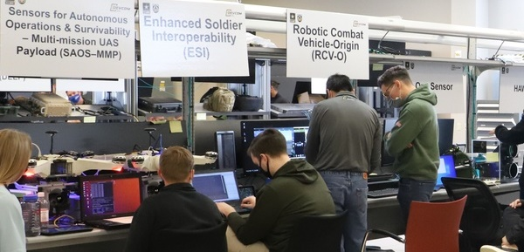
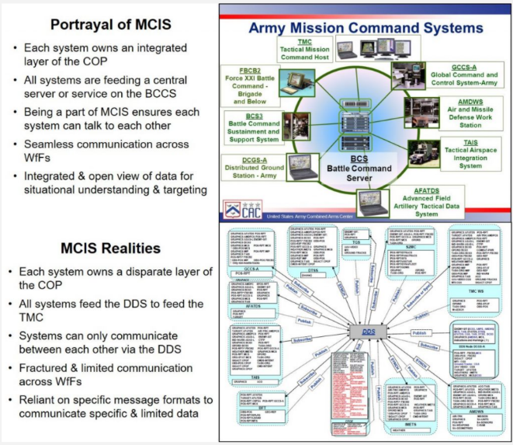
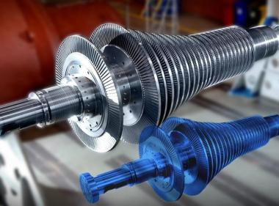
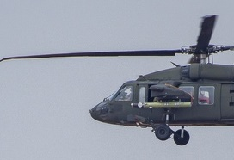
Digital Twin
Build
Digital Twin
4.3
“Digital Twin” = virtual representation that serves as the real-time digital counterpart of a physical object, Live Systems, Command & Control Systems, Hardware-in-the-Loop (HWIL), or the actual System Under Test
Essentially the “Live” component of the LVC event
Few events will have a full “real-world”/ “Live” element, so the team must create some representation of the actual system, organization, etc. to support the event.
Notes:
“Digital Twin” encompasses all systems of the Live component of the Live-Virtual-Constructive event environment.
This process uses the Digital Twin term to describe the systems used by role players or that are the focus of testing or evaluation event analysis.
“Digital Twin” may include a virtual representation that servs as the real-time digital counterpart of a physical object.
An example of this is a software models of active-duty aircraft flight computers.
This process also includes other live components in the Digital Twin term including:
hardware-in-the-loop system components
vehicle or aircraft platforms,
mission command information systems,
or other physical or virtual systems under test. Examples of these include:
establishing a replicated command post with CPCE, TAIS, AMDWS, and AFATDS;
aircraft cockpit simulators; actual Stryker C2 vehicles;
or even an actual AH-64 aircraft in a hanger connected to virtual and constructive simulations that directly stimulate the aircraft’s sensors and flight computers.
All these components are grouped under the term “Digital Twin” applications.
Graphics Source:
https://mwi.usma.edu/90s-america-online-dial-internet-fixing-armys-horribly-outdated-digital-information-systems/
https://www.dvidshub.net/search/?filter[type]=image&filter[tags][]=project-convergence&filter[date]=19691231-20220214&sort=date
https://www.ge.com/research/technology-domains/software-analytics/physical-digital-analytics

Slide 21
Step 5 : Design Operational Wrap Around
Step 1
Step 2
Step 3
Step 4
Step 5
Step 6
Step 7
Step 8
Step 9
Project Initiation
Perform Conceptual Analysis
Conduct Wargame Exercise
Develop
Digital Twin
Design Operational Wrap-Around
Develop Operational Wrap-Around
Integrate & Validate Environment
Plan & Execute
Event
Analyze Data and Evaluate Results
Develop
Objectives
Develop
Scenario
Wargame Preparation
Select
Digital Twin Applications
Select
Wrap-Around Applications
Develop
System Interface Model
Plan
Integration
Plan
Execution
Analysis & Evaluation
1.1
2.1
3.1
4.1
5.1
6.1
7.1
8.1
9.1
Conduct
Initial Planning
Develop
Conceptual Model
Conduct Wargame
Acquire Resources
Design
Environment
Establish Environment Agreements
Integrate Environment
Conduct
Record Runs
Reporting
1.2
2.2
3.2
4.2
5.2
6.2
7.2
8.2
9.2
Develop Environment Requirements
Post
Wargame Analysis
Build
Digital Twin
Design
Wrap-Around
Applications
Develop
Wrap-Around Applications
Validate Environment
Prepare
Data Outputs
Lessons Learned & Retirement
2.3
3.3
4.3
5.3
6.3
7.3
8.3
9.3
Wargame Reporting
“Applications” = Software, Tools, System, Force Structure, Entities, Terrain, etc.
Implement Wrap-Around Infrastructure
3.4
6.4
Notes:
The purpose of this step of the Distributed LVC Event Process is to design the operational wrap-around components for the event.
“Operational Wrap-Around” or just “Warp-Around” is the term used to describe the Live-Virtual-Constructive (LVC) simulations, cyber tools, management tools, and data collection tools required to envelop the “Digital Twin” in an operationally correct and relevant wrap-around.
The digital twin and the operational wrap-around provide the full Event Environment.
Simulations, software, systems, datasets, and other tools that fill a defined role in the environment are known as “member applications”.
The main activities in this step include
identifying existing or requirements for new member applications,
designing the infrastructure architectures,
and systems architectures that connects the SUT digital twin and member applications together.

Slide 22
Activity 5.2: Design the Event Environment
Step 5
Design Operational Wrap-Around
5.2 Design Event Environment
5.2 Lead Role: Technical Coordinator
Inputs
Tasks & Techniques
Outputs
Conceptual Model
Event Environment requirements
List of selected digital twin and member applications & hardware
Analyze the environment requirements, digital twin and wrap-around application lists, and conceptual models
Evaluate the need for bridging or cross-domain solutions
Identify & diagram the infrastructure architecture for facilities, network, and hardware
Identify & diagram the system architecture for ports and protocols and system connectivity
Infrastructure Architecture:
  Site facility diagram
  Network diagram
  Hardware diagram
System architecture
  Connectivity diagram
  Ports & Protocols list
Notes:
Once all digital twin (if required) and wrap-around software and hardware have been identified, the next major activity is to design the Event Environment.
This includes design of the infrastructure and system architectures.
Identifying the infrastructure architecture includes documenting and diagraming the design for all physical components of the Event Environment build and configure the Event Environment including:
the facilities,
physical locations (server room, network closet, lab spaces, event rooms, etc.),
network components,
and hardware (servers, workstations, routers, switches, etc.).
Designing the system architecture includes documenting and diagraming the logical and physical: hardware, networks, software, and member applications that connect all systems in the Event Environment. The team should document the ports and protocols used by all member applications.
This Activity is focused on the underpinnings of the environment: how the different applications, tools, and systems will communicate.
From hardware to software to network protocols; the technical design happens in this Activity.
Many teams create elaborate “Horse Blankets” and Systems Engineering diagrams to visualize the event architecture.
Next slide shows some Infrastructure Architecture typical diagrams

Slide 23
Infrastructure Architecture Diagrams
Design
Environment
5.2
Network Diagram
Footprint Diagram
Hardware diagram
Notes:
Infrastructure Architecture diagrams often include facility footprints, network diagrams, and server room diagrams.
Facility footprints typically diagram the layout of event spaces or rooms with computer systems, live vehicles, tactical headquarters equipment, and even desks, chairs, and briefing equipment.
Network diagrams depict how devices like computers and network components work together, how the physical and virtual networks function and they allow the teams to build, troubleshoot, and ensure security and compliance. The network diagrams often show details for physical connections, virtual network and VLANS, subnets and IP addresses.
Hardware architecture diagrams often depict the physical layout of servers and network gear with the wiring connections between them.
Most organizations use Visio or similar diagraming software, or systems engineering software tools like Cameo or Enterprise Architect to create their architecture diagrams.
Next slide shows the System Architecture Diagram that we typically use

Slide 24
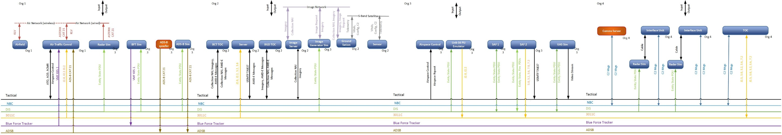
System Architecture: Connectivity Diagram
Design
Environment
5.2
The purpose of this diagram is to convey the connectivity between systems
The representation and data vary by event
Key data: Protocol, messages, and system names
Ease of briefing is a key consideration in selecting a diagram format or tool
Notes:
System Architecture diagrams often include member applications grouped by physical location with logical network connections between systems.
These connectivity diagrams are a framework that shows the application system names, the logical networks, protocols, and message types.
RTC uses a format known as the “Guitar String” that is created in Visio and is designed to facilitate briefing and use during technical working groups.
Next slide shows a more detailed view of the connectivity diagram

Slide 25
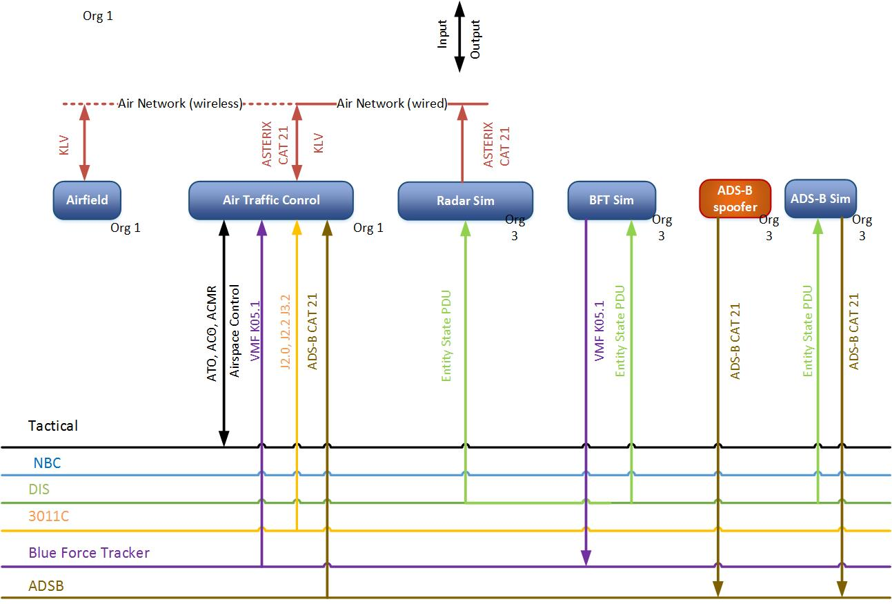
Connectivity Diagram Detail
Design
Environment
5.2
Notes:
The Connectivity Diagram should include member applications grouped by physical location with logical network connections between systems and details about the message types, formats, PDUs, etc. between systems.

Slide 26
Step 6 : Develop Operational Wrap-Around
Step 1
Step 2
Step 3
Step 4
Step 5
Step 6
Step 7
Step 8
Step 9
Project Initiation
Perform Conceptual Analysis
Conduct Wargame Exercise
Develop
Digital Twin
Design Operational Wrap-Around
Develop Operational Wrap-Around
Integrate & Validate Environment
Plan & Execute
Event
Analyze Data and Evaluate Results
Develop
Objectives
Develop
Scenario
Wargame Preparation
Select
Digital Twin Applications
Select
Wrap-Around Applications
Develop
System Interface Model
Plan
Integration
Plan
Execution
Analysis & Evaluation
1.1
2.1
3.1
4.1
5.1
6.1
7.1
8.1
9.1
Conduct
Initial Planning
Develop
Conceptual Model
Conduct Wargame
Acquire Resources
Design
Environment
Establish Environment Agreements
Integrate Environment
Conduct
Record Runs
Reporting
1.2
2.2
3.2
4.2
5.2
6.2
7.2
8.2
9.2
Develop Environment Requirements
Post
Wargame Analysis
Build
Digital Twin
Design
Wrap-Around
Applications
Develop
Wrap-Around Applications
Validate Environment
Prepare
Data Outputs
Lessons Learned & Retirement
2.3
3.3
4.3
5.3
6.3
7.3
8.3
9.3
Wargame Reporting
Implement Wrap-Around Infrastructure
3.4
6.4
“Applications” = Software, Tools, Systems, Datasets, Force Structure, Entities, Terrain, etc.
Notes:
The purpose of this step of the Distributed LVC Event Process is to define the information that will exchange between applications during runtime, modify or acquire member applications, and prepare the physical environment for integration and execution.

Slide 27
Activity 6.1: Develop the System Interface Model
Step 6
Develop Operational Wrap-Around
6.1 Develop System Interface Model
6.1 Lead Role: Technical Coordinator
Inputs
Tasks & Techniques
Outputs
Conceptual Model
Event Environment design & Connectivity Diagrams
Application Interfaces from Digital Twin, M&S applications, and Analysis Applications
Environment agreements on simulation interconnectivity or interoperability models / standards, enumerations, formats, etc.
Data dictionary elements from existing repositories
Review applicable member applications and data dictionaries to identify relevant protocol and message
Identify and diagram the sequence of data, message pathways, and data flow between member applications elements
Develop a system interface matrix that documents each pair of sender, receiver, message data types, protocol, and network
Verify that the System Interface Matrix supports the Event environment design and the conceptual model
System interface model including interface matrix
Notes:
This activity is focused on expanding the event design to document the specific message interfaces between applications.
The key output is the System Interface Model or Matrix.
For the Event Environment to operate properly, the Digital Twin, wrap-around simulation, and supporting member applications must interact.
The applications and supporting infrastructure must support specific protocols required for the unique Event Environment.
Most applications use common and industry standard protocols and messaging formats (e.g. TCP, UDP, HTML, SNMP, etc.).
Model and Simulation applications may require unique protocols and messaging formats (e.g. DIS, HLA, TENA, etc.) particular to the M&S domain.
Unique Digital Twin Mission Command Information Systems applications likely also require domain specific protocols and messaging formats (e.g. DDS, PASS, JVMF, Link16, etc.).
Cyber defense and threat systems may also utilize common or unique protocols or messaging support (e.g. EIGRP, etc.).
The team may require Interface Control Documents (ICD) or data flow or interface diagrams for all Digital Twin, M&S, Cyber, Analysis, and other applications.
This can be represented several ways based on the event. The next few slides will discuss more details and show samples for the Interface Matrix.

Slide 28
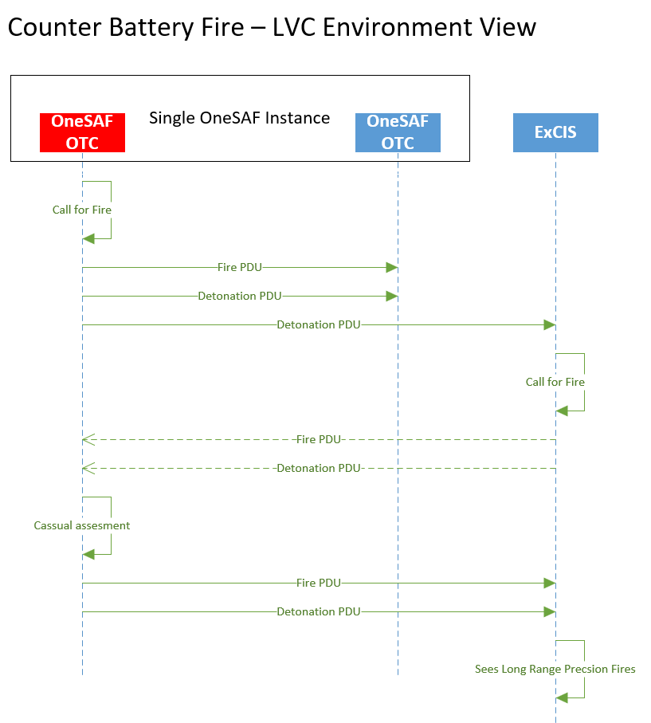
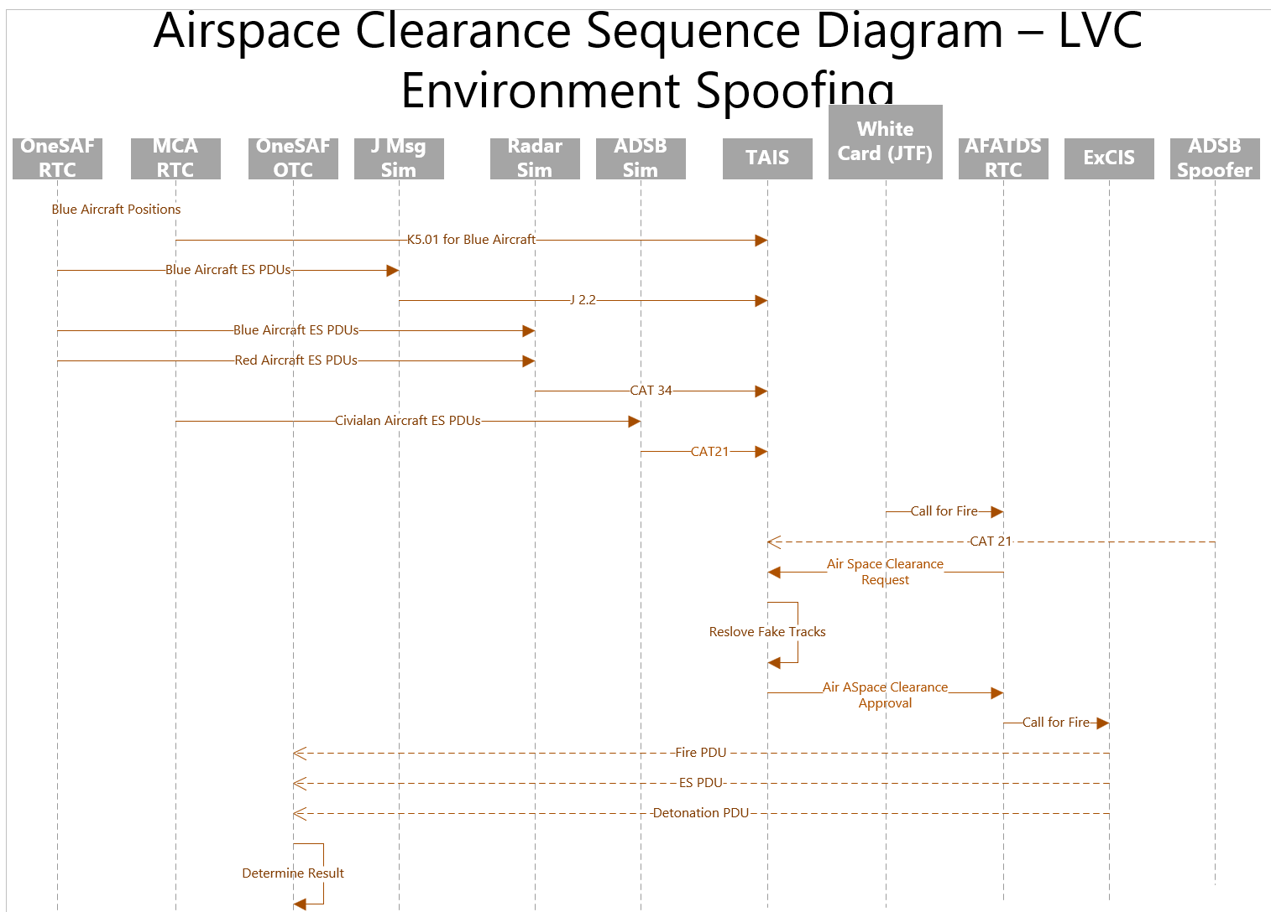
Systems Interface Model(s)

Slide 29
Interface Matrix
Develop
System Interface Model
6.1
The Interface Matrix documents all messages sent and received in the distributed LVC environment
  This includes all simulation and tactical messages
It is based on the data documented in the Connectivity Diagram
  Update the Connectivity Diagram if the team finds more interfaces when creating the Interface Matrix
Heavily used in Activity 7.2 to integrate the environment
In addition to listing each Source / Target / Message, the matrix includes all the configuration information for the interface
  All the configuration data may not be known in the first versions of the matrix
Notes:
The System Interface Model must document the interfaces, interactions, protocols, and message transmissions sent and received between all applications in the environment.
At a minimum, a table is needed that lists the sending system, receiving system, message, and transport details.
The connectivity diagram created in Activity 5.2 (Design the Event Environment) and the environment agreements on interoperability or interconnectivity from Activity 6.2 help identify the details required to fully document the complete message sets.
The matrix should include one row for each data message by source and target, with columns for all information required to configure and test the correct system interactions.
Developing a comprehensive System Interface Model ensures that the Event Environment fully supports all required capabilities and interactions between the various member applications and hardware and is essential to successfully integrating the environment in the next step of the LVC Event Process.
The next slides show a sample and specific instructions for creating and using the System Interface Matrix.

Slide 30
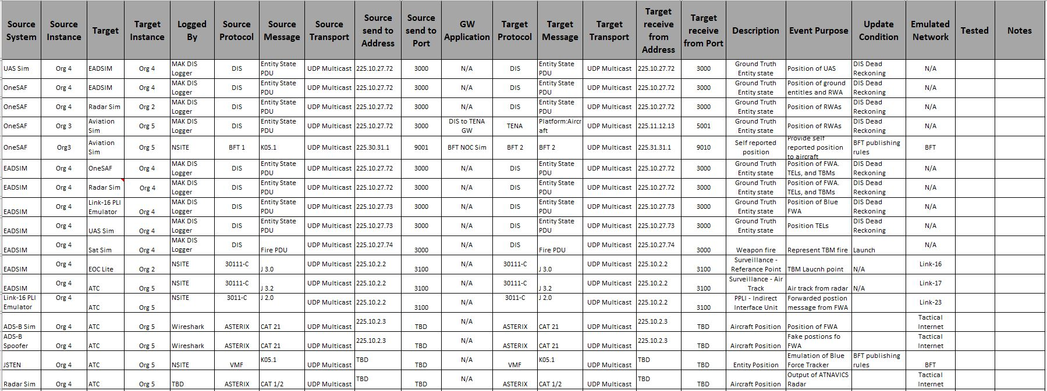
Interface Matrix (Sample)
Develop
System Interface Model
6.1
One row for each data message by source and target
Columns for all information needed to configure and test the systems
All addresses are notional

Slide 31
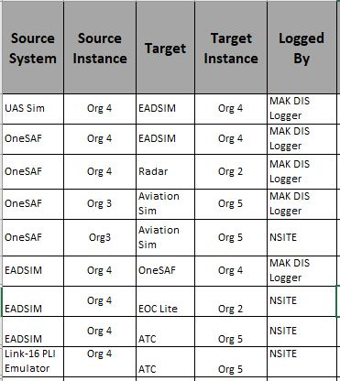
Interface Matrix Detail (1 of 3)
Develop
System Interface Model
6.1
System that is the source of the message
It is critical to list how to log the message
System that is the Target of the message
There may be more than one instance of the system potentially at different sites
There is a line for every source/target pair even if it is the same message

Slide 32
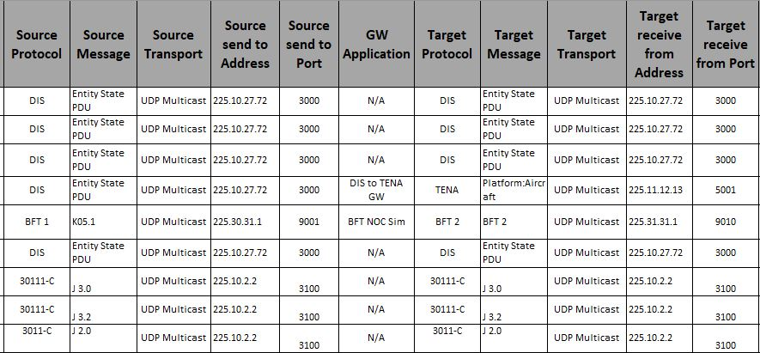
Interface Matrix Detail (2 of 3)
Develop
System Interface Model
Name of Gateway Application
6.1
Protocol can be distributed sim or tactical
The actual message being sent
Transport Examples: UDP Multicast, UDP Broadcast, TCP Unicast
There may be a “middle-man” between the sending and receiving applications
Therefore the address the message is sent to may not be the one the target application receives it on
The most common example of this is distributed simulation gateways, but is also used for some tactical systems as well
Address to send message to
Port to send the message to
All addresses are notional

Slide 33
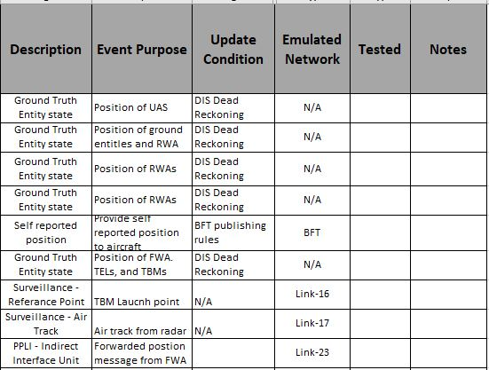
Interface Matrix Detail (3 of 3)
Develop
System Interface Model
6.1
Description of the message
Indicates confirmation of receipt of the message by the target
The name of real network the message would be sent on, or the VLAN used in the Event
The specific purpose of the message for the event, the same message may have different purposes based on the source/target pair
Update condition may be trigger based or rate based

Slide 34
Step 7 : Integrate & Validate Environment
Step 1
Step 2
Step 3
Step 4
Step 5
Step 6
Step 7
Step 8
Step 9
Project Initiation
Perform Conceptual Analysis
Conduct Wargame Exercise
Develop
Digital Twin
Design Operational Wrap-Around
Develop Operational Wrap-Around
Integrate & Validate Environment
Plan & Execute
Event
Analyze Data and Evaluate Results
Develop
Objectives
Develop
Scenario
Wargame Preparation
Select
Digital Twin Applications
Select
Wrap-Around Applications
Develop
System Interface Model
Plan
Integration
Plan
Execution
Analysis & Evaluation
1.1
2.1
3.1
4.1
5.1
6.1
7.1
8.1
9.1
Conduct
Initial Planning
Develop
Conceptual Model
Conduct Wargame
Acquire Resources
Design
Environment
Establish Environment Agreements
Integrate Environment
Conduct
Record Runs
Reporting
1.2
2.2
3.2
4.2
5.2
6.2
7.2
8.2
9.2
Develop Environment Requirements
Post
Wargame Analysis
Build
Digital Twin
Design
Wrap-Around
Applications
Develop
Wrap-Around Applications
Validate Environment
Prepare
Data Outputs
Lessons Learned & Retirement
2.3
3.3
4.3
5.3
6.3
7.3
8.3
9.3
Wargame Reporting
Implement Wrap-Around Infrastructure
3.4
6.4
Notes:
The purpose of this step of the Distributed LVC Event Process is to
plan,
integrate,
verify,
and validate
the systems, hardware, databases, and applications of the network, Digital Twin, and M&S wrap around for the event environment prior to execution.
A key part of the integration is the execution of the 7 integration blocks (defined in the following slides)
The plan is created in activity 7.1
Integration Blocks 1 through 6 are performed in activity 7.2
Block 7 is performed in activity 7.3

Slide 35
Activity 7.1: Plan Integration
Step 7
Integrate & Validate Event Environment
7.1 Plan Integration
7.1 Lead Role: Technical Coordinator
Inputs
Tasks & Techniques
Outputs
Scenario
Event Environment requirements
Validation Criteria
Event Environment design documentation and diagrams
System Interface Model
Event Environment Agreements
Draft Analysis Plan
Develop the Integration methodology for Event Environment integration
Write the Integration plan and publish to the event CoP
Write the Spiral Integration plans for each scheduled Spiral
Update the Configuration Management plan with procedures for establishing and managing configuration baselines
Conduct the Technical Integration Meeting (TIM)
Conduct the Integration Readiness Review (IRR)
Integration plan including each Spiral Plan
Formal VV&A Plans
Configuration Management Plan
IRR Approval to begin Integration
Notes:
This Activity develops the detailed plan for integration testing.
The Integration Plan should fully describe the tasks to check and confirm the technical implementation, verification, and validation of the environment.

Slide 36
Integration Planning
Plan
Integration
7.1
Integration Plan
Integration Blocks
  Set of activity blocks to integrate a distributed simulation system
Integration Planning
  Mapping activity blocks to integration spirals
  Scheduling integration spirals
  Integration Plan development
Spiral Planning
  Expanding Integration Plan
  Developing detailed integration spiral plan

Slide 37
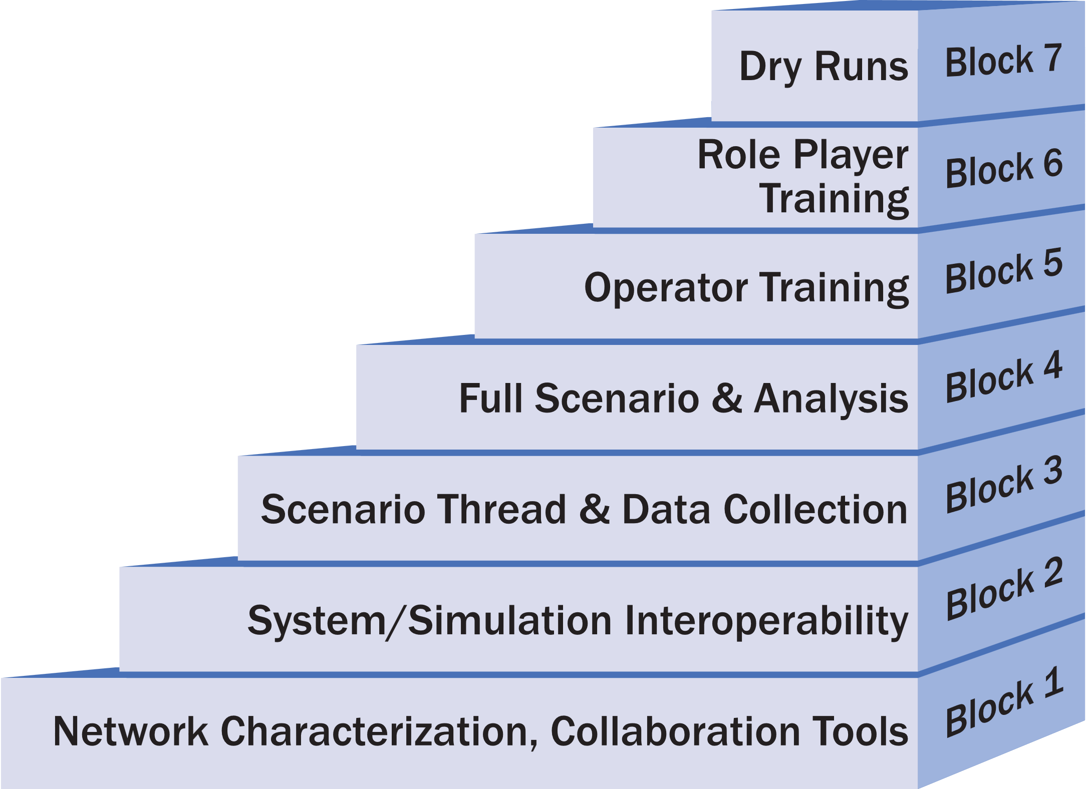
Integration Blocks (Overview 1 of 2)
Plan
Integration
7.1
We divide the activities to integrate the system into a series of seven blocks
Each block has a focus
Each block builds on earlier blocks
Tailor the block activities based on the nature of the event

Slide 38
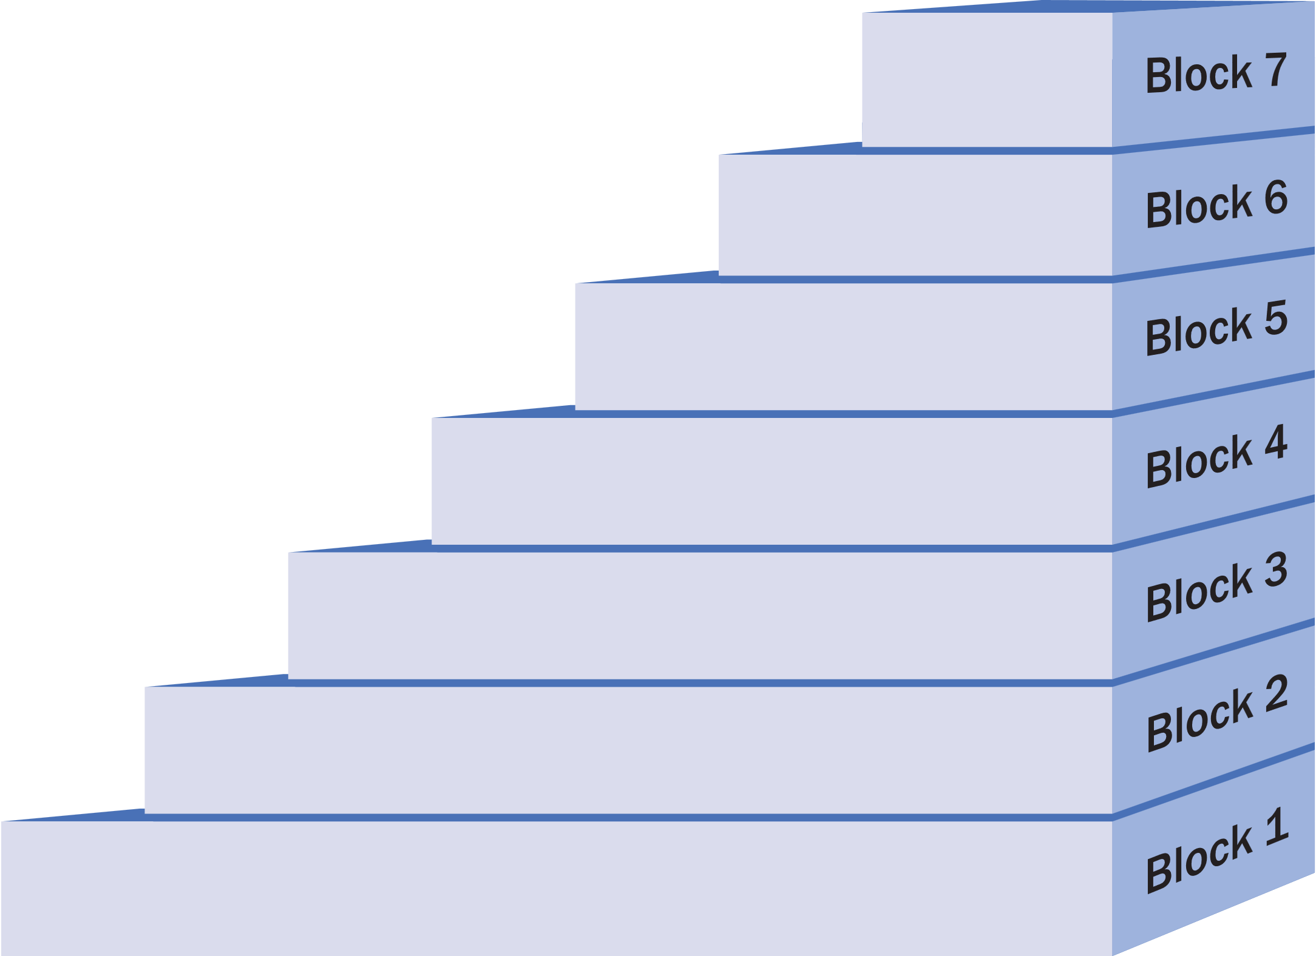
Integration Blocks (Overview 2 of 2)
Plan
Integration
7.1
Dry runs of all scenarios
Here we show the major tasks that occur during each block
Train role players on new equipment
Tain role players on new processes
Verify scenario timing with role players
Optional
Train all operators on the simulation or tactical systems
Train data collection operators on required tools
Train operators on processes they will be executing
Optional
Verify event timing | Perform full data collection | Perform full data analysis
Verify there is no extraneous network traffic
Verify that the scenarios can be executed in the allotted time
Verify that the network can support the load of the full scenario
Execute all scenario threads | Perform full data collection
Verify that all data required for analysis is being collected
Verify that required analysis can be performed
Initialize the environment using the defined procedures
Pairwise tests all interfaces | Weapon/target pairs | Verify critical enumerations | Terrain correlation
Test all multicast addresses | Full Distributed simulation architecture
Simulation initialization activity data | Critical data collection requirements | Analysis using collected data
Full mesh Ping | Network characterization | Checkout commercial and VOIP phones | Multicast transport
Maximum Transmission Unit (MTU) size | Time-to-Live (TTL) | Distributed simulation architecture | Test routes through emulate network
Coordination tool training | Access to coordination tools | Network monitoring software Time Server
Notes:
This is not meant to be readable

Slide 39
Integration Blocks – Cyber, Live, & Multi Architecture
Plan
Integration
7.1
Live systems scenarios
Final verification of
multi architectures
Execute complete
red threats
Some events may need more tasks
  Live systems
  Multiple distributed simulation architectures
  Cyber events
Role players trained and certified
Verify red threats
Train cyber defense team
Train Operators on use and safety
Train red threat
Live systems activities
Multi-architecture activities
Cyber activities
Live Vehicle Timing
Verify there are no data collection issues related to multiple architectures
Repeat each verified scenario with cyber threats
Perform full cyber data collection
Operate live system threads Timelines for live systems Range Safety
Verify data collection across all architectures | Verify startup procedures for all architectures
Execute any cyber-specific threads | Perform cyber data collection | Test cyber visualization tools
Pairwise test with live interfaces | Terrain correlation of critical live areas
Fully test distributed sim architectures | Test all gateway instances | Verify gateway enumeration translations
Verify all objects in interoperability intersection
Verify cyber threat tools | Verify cyber data collection tools | Test cyber threat tools messaging
Live System Interfaces
Verify each Architecture/SDEM Federation individually | Integrate Architecture/SDEM enclaves at all sites | Verify basic connectivity across all Architecture/SDEM enclaves | Test each Gateway | Verify there are no loops between enclaves
Verify Cyber systems network connectivity
39
Notes:
This is not meant to be readable

Slide 40
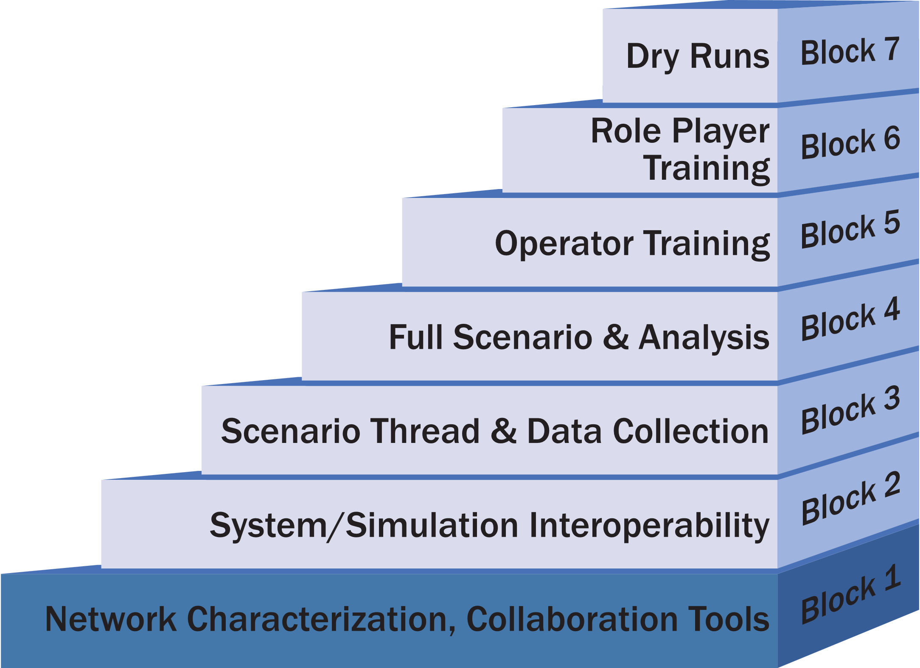
Block 1: Network Characterization, Collaboration Tools
Plan
Integration
7.1
Block 1 activities focus on establishing:
  the network
  infrastructure tools
The minimum entrance requirements for this block are:
  all sites on the network
  infrastructure tools installed

Slide 41
Block 1 : Network Characterization, Collaboration Tools (1 of 3)
Plan
Integration
7.1
General
Ping all sites from all other sites to verify full mesh connectivity
Find network latencies, jitter, and bandwidth by performing full mesh network characterization
Checkout commercial voice and VOIP coordination lines
If multicast transport is needed, verify at least one multicast address is working to make sure the rendezvous point is configured correctly
Determine the correct Maximum Transmission Unit (MTU) size for the network, and make sure all computers have correctly set the MTU
  MTU size is critical when using tunnels or encryptors
Verify systems have Time-to-Live (TTL) set based on network configuration

Slide 42
Block 1 : Network Characterization, Collaboration Tools (2 of 3)
Plan
Integration
7.1
General
Check out connectivity using the selected distributed simulation architecture(s)
Verify all sites have access to coordination/collaboration tools
Train the team on coordination tools including chat, file share, Time Ordered Event List (TOEL) server, visualization, and VTC
Implement and test network monitoring system
Verify all sites have access to a time server
If using emulated networks – verify routes through the emulated network
Live
Test connectivity to software and systems used to convert live data to simulation

Slide 43
Block 1 : Network Characterization, Collaboration Tools (3 of 3)
Plan
Integration
7.1
Multi-Architecture
Verify each Architecture / SDEM Federation individually
Integrate Architecture/SDEM enclaves at all sites
Verify basic connectivity across all Architecture/SDEM enclaves
Test an instance of each Gateway
Verify there are no loops between enclaves
Cyber
Verify Cyber systems network connectivity
SDEM: Simulation Data Exchange Model

Slide 44
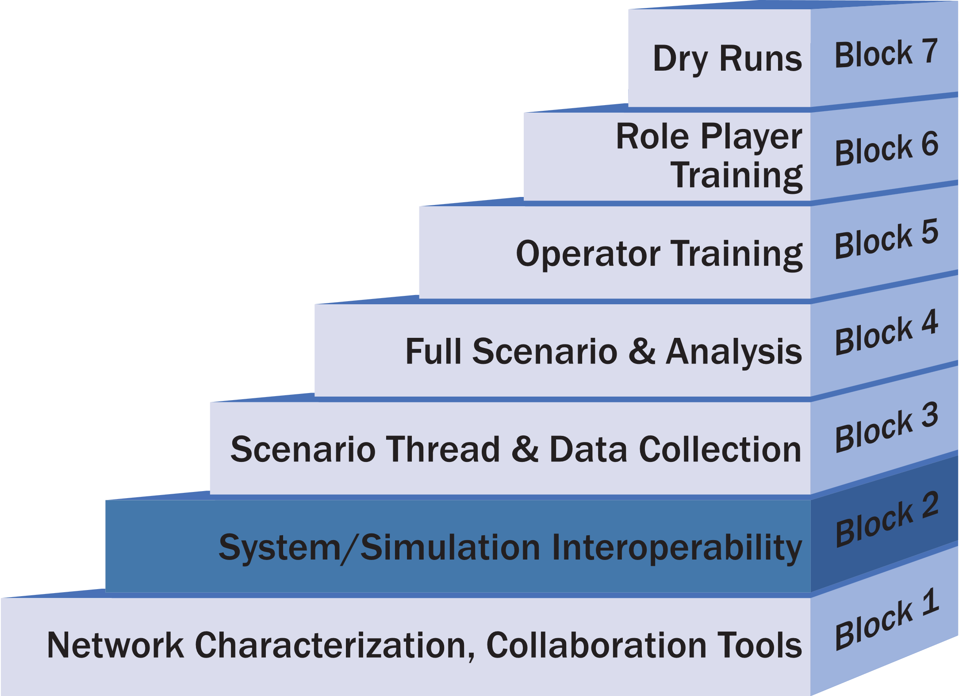
Block 2: System/Simulation Interoperability (1 of 4)
Plan
Integration
7.1
Block 2 Activities focus on: integration and testing the message interchanges between systems; checking enumerations between applications, testing parametric data and performance interactions between entities, and terrain correlation
The minimum entrance requirement for this block is an interface matrix showing all data exchanged between systems
It may be necessary to develop temporary data files, configurations, or stimulations to test pair-wise messaging between simulations/systems

Slide 45
Block 2: System/Simulation Interoperability (2 of 4)
Plan
Integration
7.1
General
Perform pairwise tests of all defined interfaces
Verify that all weapon/target pairs work as expected
Verify that critical enumerations process correctly
Perform terrain correlation to the level needed for the event
Test all multicast addresses
Fully test distributed simulation architecture
Collect data for simulation initialization activities
Check critical data collection requirements
Perform limited analysis using collected data

Slide 46
Block 2: System/Simulation Interoperability (3 of 4)
Plan
Integration
7.1
Live
Use surrogates to perform pairwise tests with live interface systems if the live systems are not available
Verify terrain correlation with live systems in critical areas
Multi-Architecture
Fully test distributed sim architectures across all sites
Test all gateway instances
Verify gateway enumeration translations
Verify all objects in Interoperability Intersection

Slide 47
Block 2: System/Simulation Interoperability (4 of 4)
Plan
Integration
7.1
Cyber
Verify cyber threat tools
Verify cyber data collection tools
If cyber threat tools send messages to other systems, include the cyber tools in pair-wise testing

Slide 48
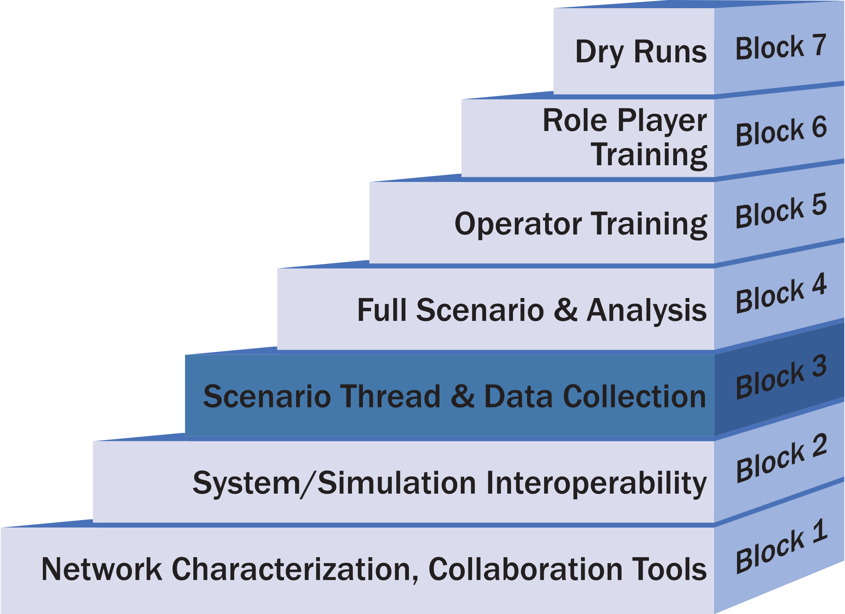
Block 3: Scenario Thread & Data Collection
Plan
Integration
7.1
Block 3 Activities focus on testing scenario threads
The minimum entrance requirement is having all scenarios defined
Develop a set of configuration files in advance to execute the test threads
Issues found in thread testing include
  Timing issues: Cannot perform all activities in the time specified
  Message issues: The simulations or tactical systems do not generate the expected output from the inputs
  Capability issues: The simulations or tactical systems cannot or do not perform the activities
Resolution of issues may require:
  Changes to the simulations
  Change in tactics
  Modification of the scenario

Slide 49
Scenario Testing Concept
Plan
Integration
7.1
Avoid the “Big-Bang” approach, running the scenario full up the first time
Review the scenario to look for:
  Activities that repeat multiple times
  Critical activities that are key to the scenario
  New or novel activities, not exercised before
  Very complex activities
  Activities that involve many participants
Document the message flows and actions needed for each of the identified threads
GOAL: eliminate issues at a small scale before attempting the full scenario

Slide 50
Definitions
Plan
Integration
7.1
Scenario: The scenario is the overall set of simulation and tactical activities that create an operationally relevant LVC environment
  Multiple similar activities that occur simultaneously
  Multiple different activities that occur simultaneously
  Involves all participants in the event
  Is long in duration
  Includes initial conditions for all entities (i.e., starting location, fuel state, etc.)
Thread: A thread is a single important scenario chain of actions, or actions that are likely to repeat throughout the scenario.
  Is a single activity
  Involves a subset of participants in the event
  Is short in duration
  Includes the conditions for the entities involved in the thread at start of the thread

Slide 51
Block 3: Scenario Thread & Data Collection (1 of 2)
Plan
Integration
7.1
General
Execute all scenario threads and verify correct execution
Perform full data collection for each thread
Verify data collection needed analysis for each thread
Verify analysts can perform needed analysis
Initialize the environment using the defined procedures
Live
Operate live systems as part of threads
Plan the timelines to get live vehicles on station
Ensure threads do not violate range safety constraints

Slide 52
Block 3: Scenario Thread & Data Collection (2 of 4)
Plan
Integration
7.1
Multi-Architecture
Verify data collection across multiple architectures
Verify startup procedures are correct for the multi-architectures
Cyber
Execute cyber specific threads
Perform cyber data collection
Test cyber visualization tools

Slide 53
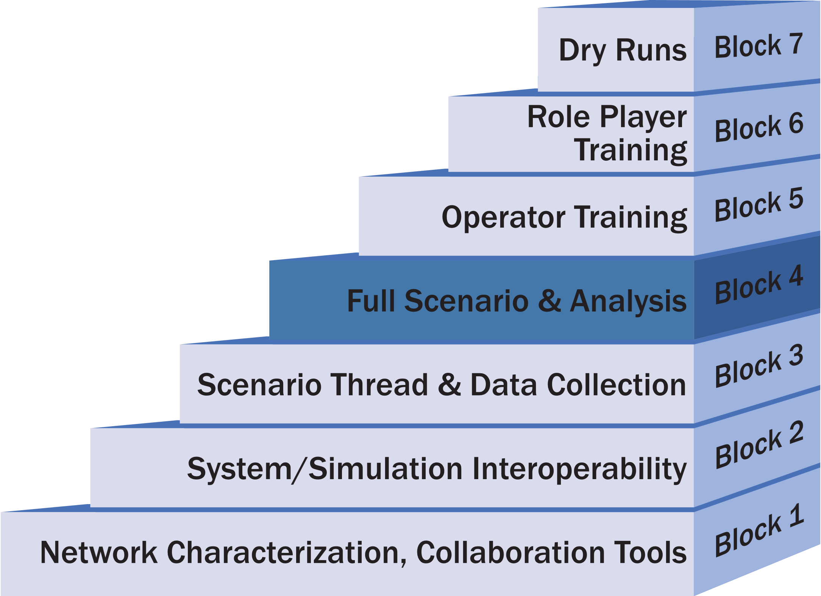
Block 4: Full Scenario & Analysis (1 of 3)
Plan
Integration
7.1
Block 4 activities focus on executing full scenarios
Conduct complete data analysis
The minimum entrance requirement is to verify all scenario threads

Slide 54
Block 4: Full Scenario & Analysis (2 of 3)
Plan
Integration
7.1
General
Execute each scenario to verify event timing
Perform full data collection for each scenario
Perform full data analysis for each scenario
Verify that the team can execute required number of scenarios in the allotted time
Verify that the network can support the load of the full scenario
Verify there is no extraneous network traffic
Live
Verify timing of live vehicles as part of the scenario

Slide 55
Block 4: Full Scenario & Analysis (3 of 3)
Plan
Integration
7.1
Multi-Architecture
Verify there are no data collection issues across the multiple architectures
Cyber
Repeat each verified scenario with cyber threats
Perform full cyber data collection
Perform full cyber analysis for each scenario

Slide 56
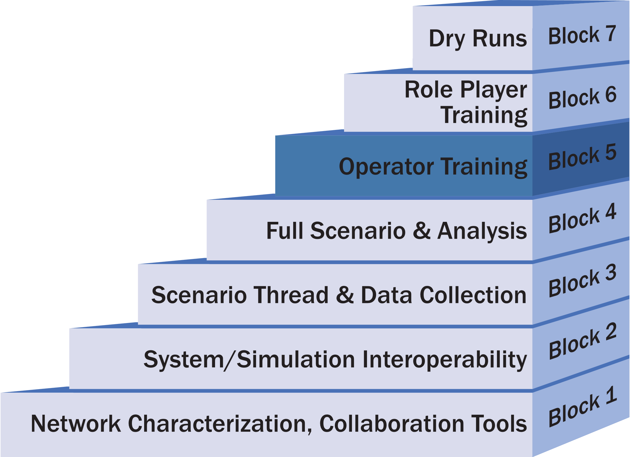
Block 5: Operator Training (1 of 2)
Plan
Integration
7.1
Block 5 activities focus on training simulation operators on the systems and tools
Depending on the requirements for the event, operator training may occur during prior activities

Slide 57
Block 5: Operator Training (2 of 2)
Plan
Integration
7.1
General
Train all operators on the simulation or tactical system they will be using
Train data collection operators on required tools including digital and manual collection
Train operators on processes they will be executing
Live
Train all operators on the use and safety requirements of live systems
Cyber
Train red threat operators

Slide 58
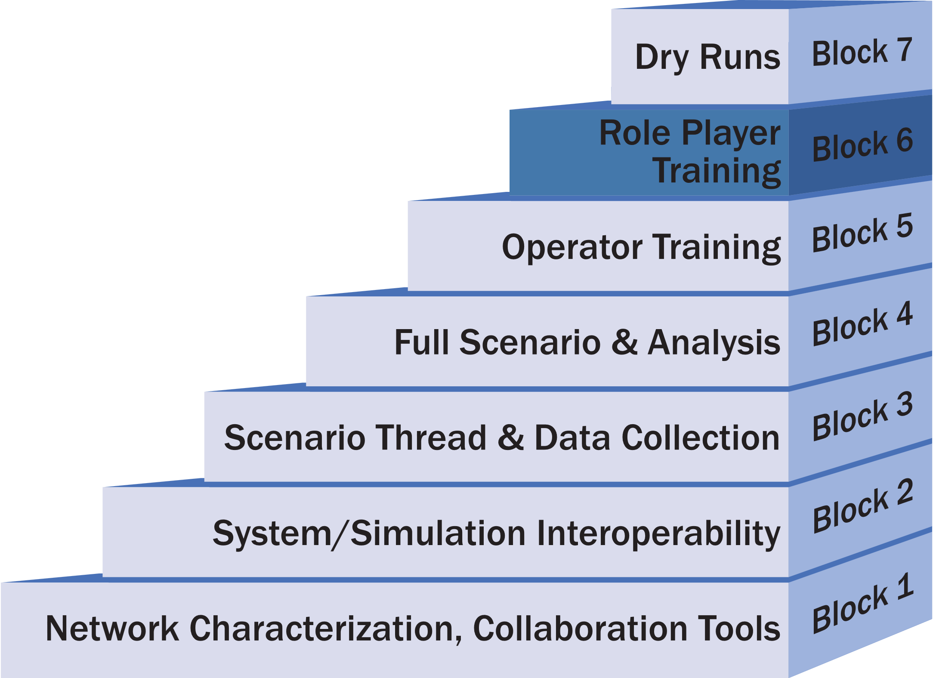
Block 6: Role Player Training (1 of 2)
Plan
Integration
7.1
Block 6 activities focus on training role players
Omit this block if there are no role players
Conduct dedicated Role Player training when:
  The event equipment is new to the role players
  If the event Tactics, Techniques, or Procedures (TTPs) are different than the ones the role players normally use
Cyber threat introduction if applicable to the event

Slide 59
Block 6: Role Player Training (2 of 2)
Plan
Integration
7.1
General
Train role players on new equipment
Train role players on new processes
Verify scenario timing with role players
Verify role players can perform or react to cyber threats
Live
Train and/or certify roles players to operate the live systems
Cyber
Verify red threats
Cyber defense team training

Slide 60
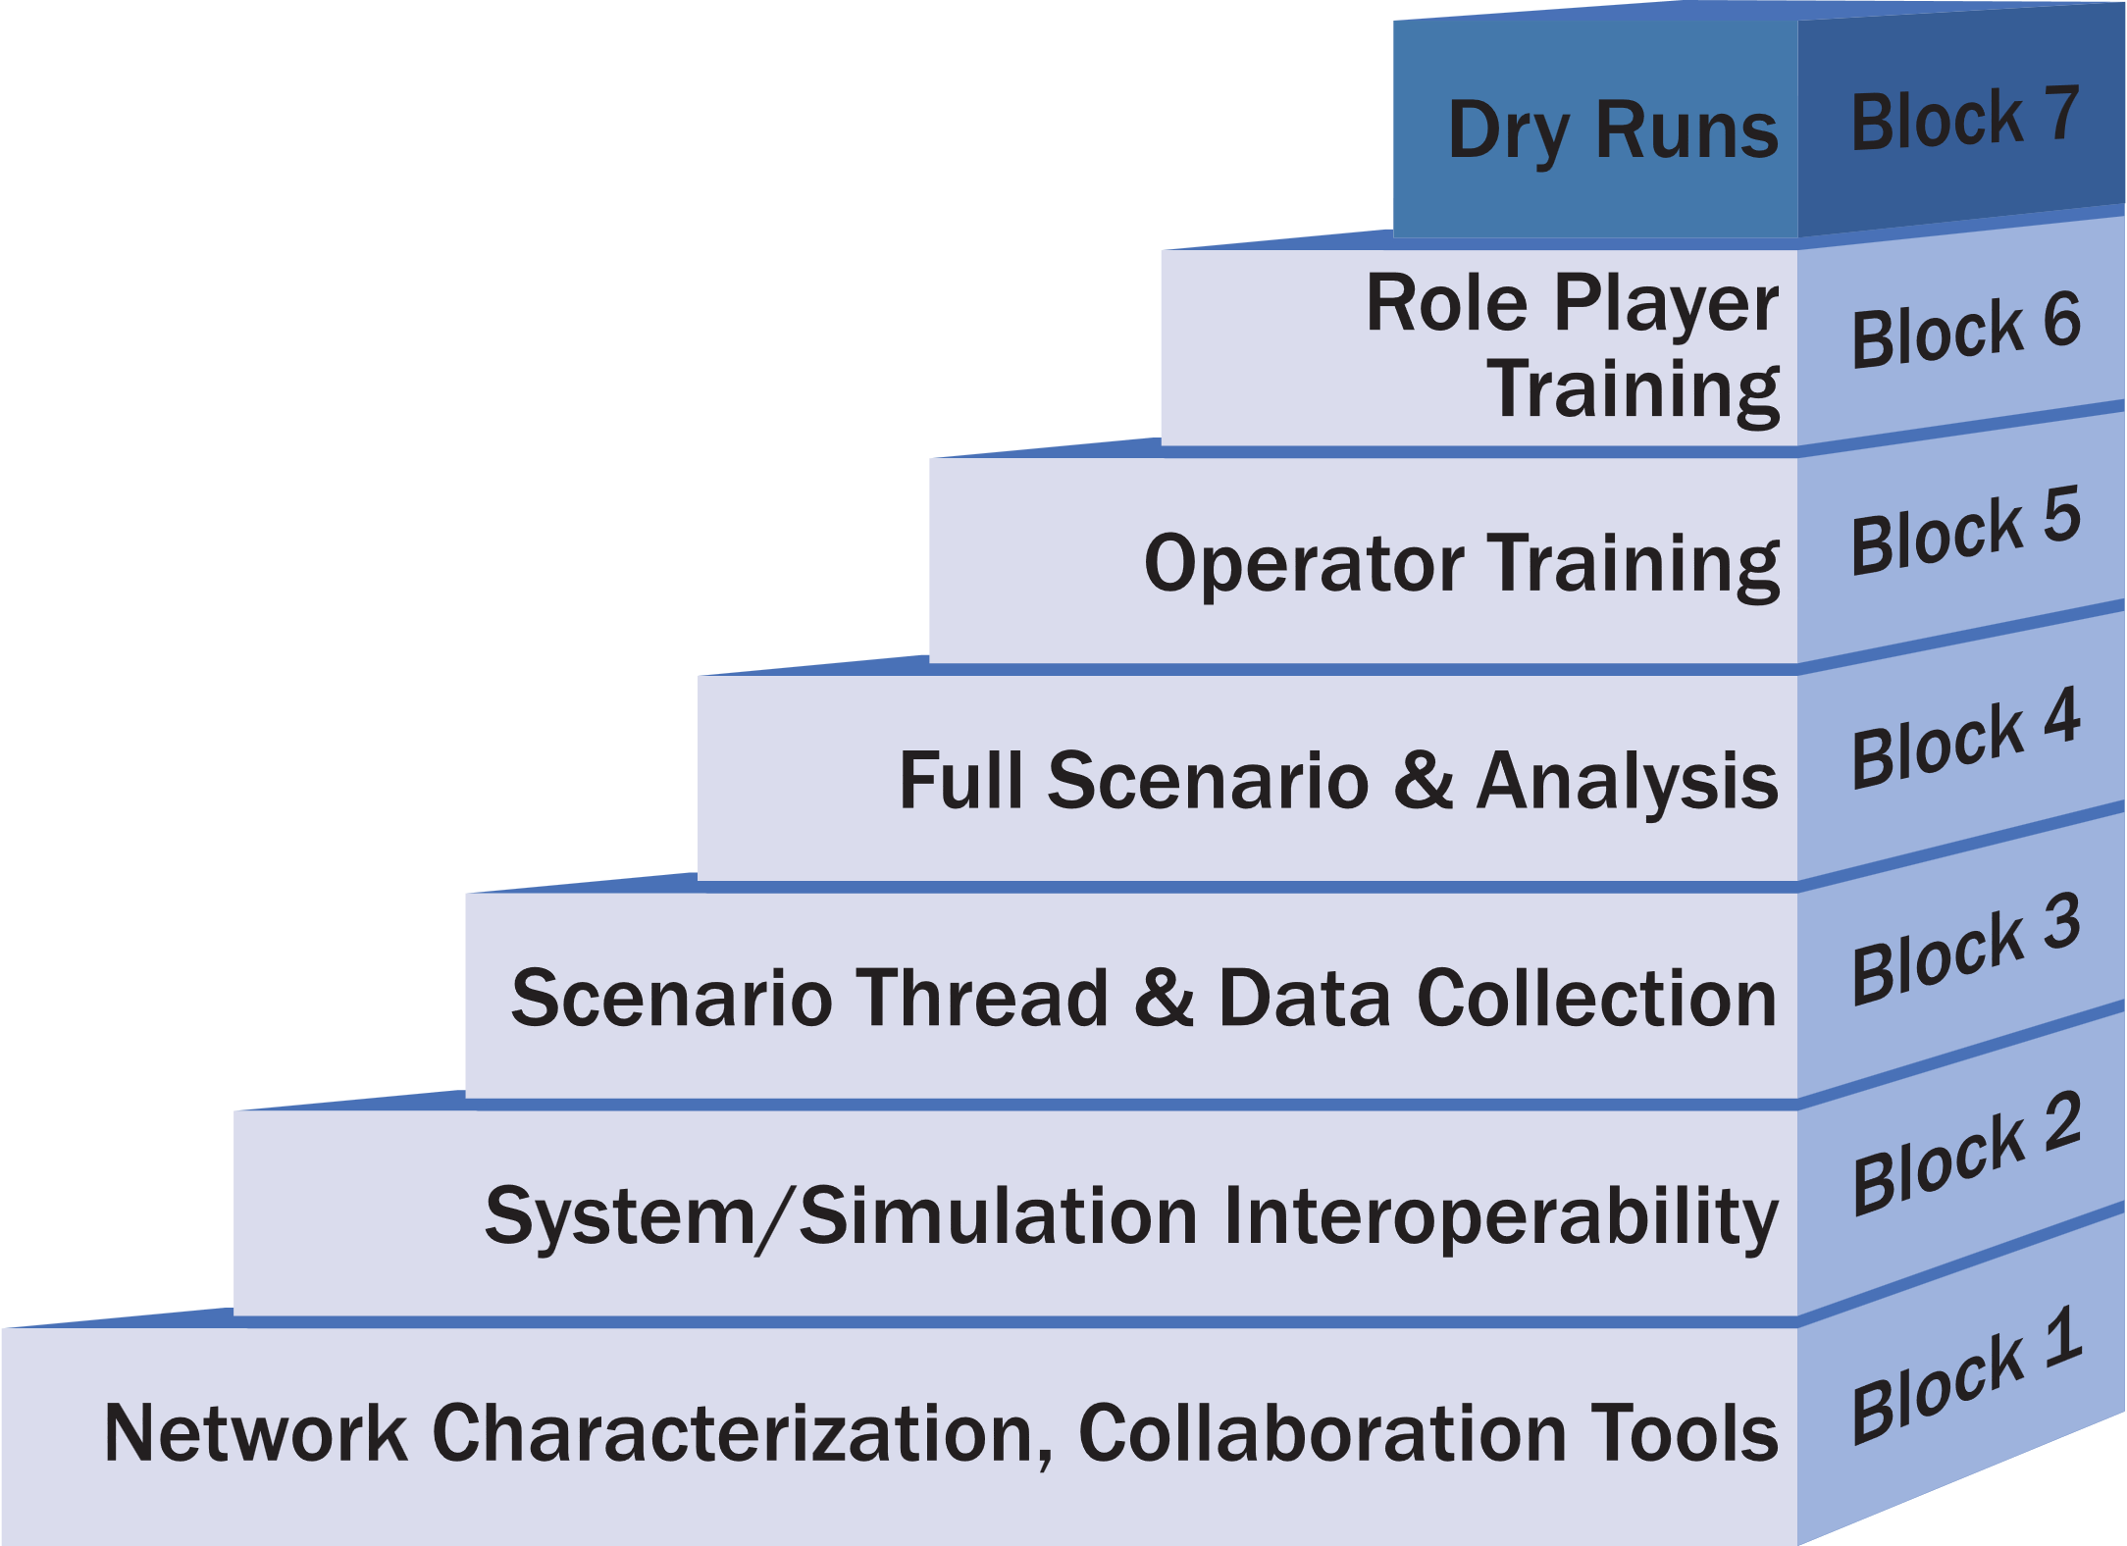
Block 7: Dry Runs (1 of 2)
Plan
Integration
7.1
Block 7 activities focus on conducting dry-runs of scenarios
This set of activities is required when data collection, test, or training requirements are dependent on an exact scenario execution

Slide 61
Block 7: Dry Runs (2 of 2)
Plan
Integration
7.1
General
Run each scenario with full data collection and role players
Live
For each of the scenarios, conduct at least one dry run with all live systems
Multi-Architecture
Final verification of distributed simulation architectures used in the event
Cyber
Execute complete red threats

Slide 62
Integration Planning - Spiral Scheduling
Plan
Integration
7.1
The number, duration, and schedule of the integration spirals is dependent on the nature of the event and the participating sites
In general, schedule each spiral for one week
A nominal schedule for a medium sized event is three integration spirals over three months, with the following assumptions:
  Medium sized event with experienced sites
  Neither dedicated operator nor role play training is required
  The number and complexity of the scenarios is such that the team can perform both Block 3 and 4 activities in a single spiral

Slide 63
Nominal Spiral Schedule
Plan
Integration
Spiral | Activities | Week
Spiral 1 | Block 1 | Week 1
 |  | Week 2
 |  | Week 3
Spiral 2 | Block 2 | Week 4
 |  | Week 5
 |  | Week 6
Spiral 3 | Block 3 & Block 4 | Week 7
 |  | Week 8
 |  | Week 9
Spiral 4 (Dry Runs) | Block 7 | Week 10
Execution | Record Runs | Week 11
7.1

Slide 64
Scheduling Considerations
Plan
Integration
7.1
The time between the spirals is as important as the spiral
Conducting spirals too close together will not allow time to address issues found or prepare for the next spiral
In general, plan at least two weeks between integration spirals
An exception for performing Block 5 and 6 back-to-back
The amount of time between spirals is also dependent on the confidence level that the team can perform all spiral activities in the time scheduled for each spiral

Slide 65
Example Spiral Tasks
Plan
Integration
7.1
ID | Task
1 | Establish network connectivity between DTCC and JOIN Lab
2 | Characterize network performance over several days and times of day
3 | RTC users log-in to Confluence using accounts on Active Directory
4 | JOIN Lab users log-in to Confluence using accounts on Active Directory
5 | Have a TENA application (Canary) join TENA EM at DTCC
6 | Pass TENA platform data from DTCC to SIMDIS located at JOIN Lab
7 | Test VOIP call manager
Notes:
Example of the objectives that might be listed in the Integration Plan

Slide 66
Example Entrance Criteria
Plan
Integration
Site | Entrance Criteria
All | Verify site is available to participate in spiral
All | ISA signed and approved
All | User accounts created for at least one person at each NLT Friday 13 November 2015
Org1 | JMN in place
NOC | JMN in place
DTCC | JMN in place
NOC | Verify all CSTB PoC Sites connected on JMN
Org1 | Network check (ping test)
Org2 | Network check (ping test)
NOC | Establish multicast Rendezvous Point (RP)
DTCC | Distribute VoIP phone information to all sites
NOC | VoIP call manager operational
NOC | Chat server operational
DTCC | Confluence site created
DTCC | Adobe site created
All | Download network characterization tools from Confluence
Org1 | Have Linux computer on the network for network characterization tool
Org2 | Have Linux computer on the network for network characterization tool
NOC | Have Linux computer on the network for network characterization tool
DTCC | Have Linux computer on the network for network characterization tool
DTCC | Configure collaboration tools to use event LDAP
7.1
Notes:
Examples of the Entrance Criteria in an Integration Plan

Slide 67
Exit Criteria Example
Plan
Integration
7.1
Site | Exit Criteria
Org1 | Verify all user accounts for the distributed sites
All | Network performance is sufficient for event requirements
All | VoIP, chat, and Confluence between participating sites verified
All | Verified All sites connected to JMN
DTCC | Verified multicast group functionality
DTCC | Verified network monitoring approach
All | Infrastructure training complete: Confluence, Adobe Connect, Chat, and EventMan
Notes:
Example of an exit Criteria

Slide 68
Detailed Spiral Planning
Plan
Integration
7.1
Write and publish a Spiral Plan for each integration spiral
  The Integration Plan is the basis for each Spiral Plan
  Extend and refine the list of tasks, entrance criteria, and exit criteria as needed
Any unmet exit criteria or other issues from the previous spiral are also inputs to later Spiral Plans
  If there are many unmet tasks from the previous spiral, teams may need to schedule and plan an interim spiral
The Spiral Plan is based on a template that teams can modify to meet the needs of a specific program

Slide 69
Spiral Plan Content
Plan
Integration
7.1
Overview of the spiral
List of participating sites
Communication Plan: primary and backup phone lines
Tasks
Terrain databases
Entrance Criteria
Exit Criteria
Detailed schedule of the spiral

Slide 70
Detailed Spiral Schedule Example
Plan
Integration
7.1
Tuesday February 4
  9:00 AM Coordination teleconference
  9:30 AM Conduct network testing
  10:00 AM Verify Confluence/Active Directory interface
  11:00 AM Lunch
  12:00 PM Conduct network testing
  1:00 PM Have TENA Canary at JOIN connect to TENA EM at RTC
  3:00 PM Daily hotwash
Wednesday February 5
  9:00 AM Coordination teleconference
  9:30 AM Conduct network testing
  10:00 AM Publish TENA Platforms at RTC view on SIMDIS at JOIN
  11:00 AM Lunch
  12:00 PM Conduct network testing
  1:00 PM Setup and Test VOIP phones
  3:00 PM Daily hotwash

Slide 71
Activity 7.2: Integrate the Event Environment
Step 7
Integrate & Validate Event Environment
7.2 Integrate Event Environment
7.2 Lead Role: Technical Coordinator
Inputs
Tasks & Techniques
Outputs
Integration Plan
Event Planning Documents
Digital Twin & Wrap Around applications
Implemented Event Environment infrastructure
Supporting Databases
Execute Spiral Integration Blocks 1-6
Ping testing & pairwise tests of all defined interfaces
Terrain correlation
Entity performance data testing
Fully test distributed sim architectures across all sites
Execute all scenario threads and verify correct execution
Perform full data collection for each scenario
Train all operators on the simulation or tactical systems
Role Player Training
Planning document updates
Spiral Reports upon completion of each spiral
Integrated Event Environment
Draft Accreditation decision / memorandum
Notes:
The purpose of this activity is to bring the Digital Twin, M&S wrap-around applications, data collection tools, and any Event management tools into an integrated Event Environment.
This requires that all hardware and software assets are properly installed and interconnected in a configuration that can support the System Interface Model and Event Environment agreements.
The Technical Workgroup team and Analysis Workgroup teams should execute Spiral Integration Blocks 1 – 6 during this Activity in accordance with the Spiral Integration plan developed in the previous activity.

Slide 72
Spiral Execution
Integrate Environment
7.2
Hotwash: The team should review all the tasks assigned to the spiral and determine the status of their completion on the final day of each spiral should
Review the exit criteria and the status for each criterion determined
Write and publish a Spiral Report should at the completion of each spiral to document the results
  A critical element of the Spiral Report is any uncompleted activities being shifted to the following spiral

Slide 73
Initialization TOEL
Integrate Environment
7.2
Goal: Develop a repeatable approach to initializing the wrap-around environment
Teams should use a Timed Ordered Event List (TOEL) to initialize the Wrap-around environment
Collect data for the TOEL in Step 7.2
Initialize each system in the environment using the TOEL
Each time the system is initialized, changes are made to the TOEL to cover more actions
It is desirable to start all systems (simulation, tactical, etc.) from a cold start
  This ensures creation of a stable environment

Slide 74
Verification
Validate Environment
7.3
Completing Integration Blocks 1-6 provides sufficient information to verify the M&S and technical environment
  Do they work as designed?
Formal Verification will require completing respective agency processes and documentation
  MIL-STD-3022 documentation
  ATEC Pam 73-21
  Etc.
Notes:
7.2 completes the Verification of the models and the Federation Environment.
The early blocks gives the Technical Working Group, EXCON, and Analysts the opportunity to determine the extent the model and environment/federation, input data, and simulation output data represent the intended functions as defined in the application and environment design products.
The block testing is focused on testing for completeness, correctness, and consistency.

Slide 75
Activity 7.3: Validate the Event Environment
Step 7
Integrate & Validate Event Environment
7.3 Validate Event Environment
7.3 Lead Role: Event Lead, Technical Coordinator
Inputs
Tasks & Techniques
Outputs
Detailed Planning Documents
Event Environment Agreements
Event Environment description
Integrated Event Environment
Event Environment validation criteria
BLOCK 7: “Dry Runs”. Run each scenario with full data collection and role players
At least one run with all live systems per scenario
Final validation of the Environment
Final validation of the Digital Twin systems
Final validation of the wrap-around systems and M&S
Final validation of the Data Collection techniques
Rehearsed cyber attacks and MSEL process if applicable
Rehearsed Execution Control Plan, EXCON, and White Cell processes
Event Readiness Review (ERR)
Validated Event Environment:
  Digital Twin
  Role Player Training
  Wrap-Around system performance
  Wrap-Around entity & behaviors
  Runtime data collection
Event Director decision to Validate & Accredit the Event Environment
Event Director approval to commence event execution
Notes:
The purpose of this activity is to validate that the Event digital twin and wrap-around applications can interoperate to the degree required for the Event.
This activity completes the last task of technical preparation, Block 7: Dry Runs of the scenario/vignettes.
The desired output from this activity is an integrated, verified, validated, and approved Event Environment.
If early integration and verification uncover obstacles to successful validation and accreditation, the Technical Working Group must take corrective actions.
Conducting a full rehearsal, often called a MINIEX or Dry Run, of the Event scenarios ensures that the Event Environment is fully functional and correctly represents the Digital Twin and the operational wrap-around.
Corrective actions may require additional Event-fix-Event iterations.
An Execution Readiness Review (ERR) is the final programmatic meeting prior to the start of Event.
In this meeting, the Event Conductor briefs the status of the technical preparation, reviews any gaps or issues that remain, describes any significant deviations from the Digital Twin or Wrap-Around plan, and makes a recommendation to proceed or not proceed with Event execution.

Slide 76
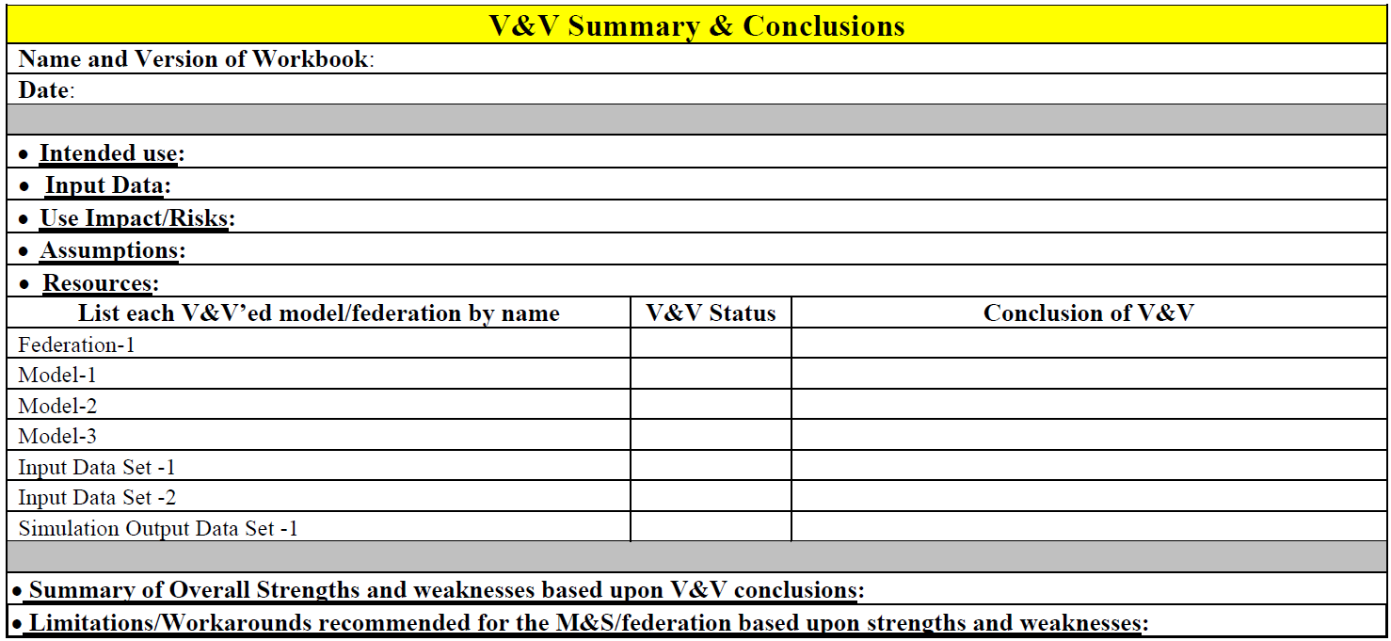
Validation
Validate Environment
7.3
Completing all Integration Blocks provides sufficient information validate the models and federation environment
Formal V&V will require completing respective agency documentation
  MIL-STD-3022
  ATEC Pam 73-21
  etc.
Notes:
7.3 completes the Validation and Accreditation of the Federation or Event Environment.
The full Scenario rehearsals or Dry Runs gives the EXCON, Role Players, and Analysts the opportunity to determine the extent the models and federation environment represents the desired effects and ability to achieve the event objectives.
This assessment is provided to the Event Director during the Execution Readiness Review for official determination of the acceptability of the models and federation environment for the purpose of this event.
Formal VV&A requirements will include detailed documentation and defined accreditation authorities.

Slide 77
Event Readiness Review (ERR)
Validate Environment
7.3
The Event Director must accredit the environment and direct the team to proceed with record runs once the LVC Environment is fully integrated and validated
  The Technical Coordinator presents the technical readiness of the environment
  The Analysis lead reports on the readiness of analysis and data collection
  The Battle-master presents the readiness of the scenario and the level of operational realism
If the Event Director is not satisfied; document any deficiencies design a plan to address them
Notes:
Covered during the Life Cycle discussion

Slide 78
Step 8 : Execute Event
Step 1
Step 2
Step 3
Step 4
Step 5
Step 6
Step 7
Step 8
Step 9
Project Initiation
Perform Conceptual Analysis
Conduct Wargame Exercise
Develop
Digital Twin
Design Operational Wrap-Around
Develop Operational Wrap-Around
Integrate & Validate Environment
Plan & Execute
Event
Analyze Data and Evaluate Results
Develop
Objectives
Develop
Scenario
Wargame Preparation
Select
Digital Twin Applications
Select
Wrap-Around Applications
Develop
System Interface Model
Plan
Integration
Plan
Execution
Analysis & Evaluation
1.1
2.1
3.1
4.1
5.1
6.1
7.1
8.1
9.1
Conduct
Initial Planning
Develop
Conceptual Model
Conduct Wargame
Acquire Resources
Design
Environment
Establish Environment Agreements
Integrate Environment
Conduct
Record Runs
Reporting
1.2
2.2
3.2
4.2
5.2
6.2
7.2
8.2
9.2
Develop Environment Requirements
Post
Wargame Analysis
Build
Digital Twin
Design
Wrap-Around
Applications
Develop
Wrap-Around Applications
Validate Environment
Prepare
Data Outputs
Lessons Learned & Retirement
2.3
3.3
4.3
5.3
6.3
7.3
8.3
9.3
Wargame Reporting
Implement Wrap-Around Infrastructure
3.4
6.4
Notes:
The purpose of this step of the RTC LVC Event Process is to finalize detailed planning, execute record runs to meet the event objectives, and prepare any collected data for analysis in subsequent steps.
Initial planning documents created in Activity 1.2 are refined and finalized.
These documents provide the guidance and control measures needed to successfully execute record runs.
Record Runs see the event team and role players working through the scenarios and vignettes to generate data needed to meet the event objectives.
Finally, all collected data is prepared and passed to the analysis team for evaluation.

Slide 79
Step 9 : Analyze Data and Evaluate Results
Step 1
Step 2
Step 3
Step 4
Step 5
Step 6
Step 7
Step 8
Step 9
Project Initiation
Perform Conceptual Analysis
Conduct Wargame Exercise
Develop
Digital Twin
Design Operational Wrap-Around
Develop Operational Wrap-Around
Integrate & Validate Environment
Plan & Execute
Event
Analyze Data and Evaluate Results
Develop
Objectives
Develop
Scenario
Wargame Preparation
Select
Digital Twin Applications
Select
Wrap-Around Applications
Develop
System Interface Model
Plan
Integration
Plan
Execution
Analysis & Evaluation
1.1
2.1
3.1
4.1
5.1
6.1
7.1
8.1
9.1
Conduct
Initial Planning
Develop
Conceptual Model
Conduct Wargame
Acquire Resources
Design
Environment
Establish Environment Agreements
Integrate Environment
Conduct
Record Runs
Reporting
1.2
2.2
3.2
4.2
5.2
6.2
7.2
8.2
9.2
Develop Environment Requirements
Post
Wargame Analysis
Build
Digital Twin
Design
Wrap-Around
Applications
Develop
Wrap-Around Applications
Validate Environment
Prepare
Data Outputs
Lessons Learned & Retirement
2.3
3.3
4.3
5.3
6.3
7.3
8.3
9.3
Wargame Reporting
Implement Wrap-Around Infrastructure
3.4
6.4
Notes:
The purpose of this step of the is to analyze and evaluate the collected event data to meet the event goals and to report the results back to the Event Customer or System Owner.
An After-Action Review should be conducted to review lessons learned from the event and recommended additions to the process
And any event retirement actions are completed to wrap up the event

Slide 80
Stages of the Event Life Cycle
5 Stages
DESIGN
PLAN
PREPARE
EXECUTE
ASSESS
CDC
IPC
Wargame
MDC
MPC
MSC
FPC
TIM
IRR
ERR
AAR
How do you APPLY the Process Steps to the Stages of an Event Life Cycle??
AAR: After Action Review
CDC: Concept Development Conf.
ERR: Execution Readiness Review
FPC: Final Planning Conf.
IPC: Initial Planning Conf.
IRR: Integration Readiness Review
MDC: MSEL Development Conf.
MPC: Mid Planning Conf.
MSC: MSEL Synch Conference
TIM: Technical Interchange Meeting
Notes:
We’ve reviewed the 9 Steps and the 28 Activities of the Distributed Event Process. But no one puts all the process steps and activities on a schedule or POA&M.
Way back in Activity 1.1 we discussed the Tailoring. Teams may abbreviate or omit Process Steps or activities as applicable. For example, some events may not require a Digital Twin or may reuse entire event environments.
Similarly small events may not require all the Life Cycle conferences. Tailoring the Life Cycle involves assessing which of the planning conferences are needed given the scale and complexity of the event. So, Teams may omit formal planning conferences in lieu of In-Progress-Reviews (IPR)s or informal working group sessions.
Don’t get too hung up on the “Conference” title; your event may not need a formal, in-person, multi-day “Conference”, but I’d offer that planners and event leads should consider how and where to provide ongoing guidance, monitor progress, identify challenges, establish tasking, and provide approvals.
The archetypal conferences, meetings, and progress reviews shown here are a good starting point for understanding the entire process, so we’ll walk thru the Event Life cycle and show the alignment of the process across the stages.

Slide 81
Applying the Process Steps to the Event Cycle
5 Stages
DESIGN
PLAN
PREPARE
EXECUTE
ASSESS
Wargame
TIM
CDC
IPC
MDC
MPC
MSC
FPC
IRR
ERR
AAR
Step 1
Step 2
Step 3
Step 4
Step 5
Step 6
Step 7
Step 8
Step 9
Project Initiation
Perform Conceptual Analysis
Conduct Wargame Exercise
Develop
Digital Twin
Design Operational Wrap-Around
Develop Operational Wrap-Around
Integrate & Validate Environment
Plan & Execute
Event
Analyze Data and Evaluate Results
Develop
Objectives
Develop
Scenario
Wargame Preparation
Select
Digital Twin Applications
Select
Wrap-Around Applications
Develop
System Interface Model
Plan
Integration
Plan
Execution
Analysis & Evaluation
1.1
2.1
3.1
4.1
5.1
6.1
7.1
8.1
9.1
Conduct
Initial Planning
Develop
Conceptual Model
Conduct Wargame
Acquire Resources
Design
Environment
Establish Environment Agreements
Integrate Environment
Conduct
Record Runs
Reporting
1.2
2.2
3.2
4.2
5.2
6.2
7.2
8.2
9.2
Develop Environment Requirements
Post
Wargame Analysis
Build
Digital Twin
Design
Wrap-Around
Applications
Develop
Wrap-Around Applications
Validate Environment
Prepare
Data Outputs
Lessons Learned & Retirement
2.3
3.3
4.3
5.3
6.3
7.3
8.3
9.3
Wargame Reporting
Implement Wrap-Around Infrastructure
AAR: After Action Review
CDC: Concept Development Conf.
ERR: Execution Readiness Review
FPC: Final Planning Conf.
IPC: Initial Planning Conf.
IRR: Integration Readiness Review
MDC: MSEL Development Conf.
MPC: Mid Planning Conf.
MSC: MSEL Synch Conference
TIM: Technical Interchange Meeting
3.4
6.4
Notes:
First thing to recognize is that there’s not a 1:1 transition from the Process Steps & Activities to Event Life Cycle Stages.
The process generally runs Left to Right; but it is not a full waterfall. There are Activities and Tasks that apply across the event stages.

Slide 82


Conduct the Initial Planning Conference (IPC)
5 Stages
DESIGN
PLAN
PREPARE
EXECUTE
ASSESS
CDC
IPC
MDC
MPC
FPC
IRR
ERR
AAR
Purpose is to (1) purpose is to finalize Event Guidance, (2) define requirements, and (3) initiate detailed planning.
Inputs
Tasks & Techniques
Outputs
Approved Event Objectives
Initial planning documents
Draft event requirements
Key Lessons Learned
Potential issues and implications
Draft Scenario Road-to-Crisis
Initial conceptual Model
Begin drafting the Event Control Plan (ECP)
Travel requirements
Rough draft of the simulation played items list
Support requests / taskings to supporting organizations
Concept for Scenario and Road-to-Conflict
Refine Digital Twin & Wrap-Around requirements
Develop the POA&M
Final Process Tailoring based on event scale & scope
Wargame Preparation
Plenary & Breakout workgroup sessions
Workgroups at the IPC
Scenario WG
Technical WG (Digital Twin, M&S)
Network WG
Analysis WG
Security
EXCON (Event Management, Support, & Logistics)
Draft Event Control Plan (ECP)
Detailed Conceptual Model
Draft Event requirements
Initial Event Support manning document
Initial Data Collection, Reduction, and Analysis Plan
Initial VV&A Plan
Initial KM / CM Plan
Initial Security Plan
Draft network Interconnect Service Agreements (ISO) if required
Draft ATO if required
Wargame guidance & Preparation
1.1
8.1
1.2
2.2
1.2
2.3
1.2
8.1
1.2
2.1
8.1
2.2
8.1
8.1
8.1
6.2
6.2
3.1
Notes:
The Design stage ends at completion of the Initial Planning Conference (IPC)
The purpose of the IPC is to finalize event guidance, formally define requirements, and initiate detailed planning.
Again, the multiple Process Steps contribute to the input of the IPC and rely on IPC outputs.
The tasks listed here are a good starting point for an agenda and help define IPC breakout groups
The outputs of the IPC show the linkage to several of the Process activities.
Next, we’ll look graphicly at the Step & activities that contribute to or receive inputs from the IPC.

Slide 83
Initial Planning Conference (IPC) supporting Activities
5 Stages
DESIGN
PLAN
PREPARE
EXECUTE
ASSESS
CDC
IPC
MDC
MPC
FPC
IRR
ERR
AAR
Step 1
Step 2
Step 3
Step 4
Step 5
Step 6
Step 7
Step 8
Step 9
Project Initiation
Perform Conceptual Analysis
Conduct Wargame Exercise
Develop
Digital Twin
Design Operational Wrap-Around
Develop Operational Wrap-Around
Integrate & Validate Environment
Plan & Execute
Event
Analyze Data and Evaluate Results
Develop
Objectives
Develop
Scenario
Wargame Preparation
Select
Digital Twin Applications
Select
Wrap-Around Applications
Develop
System Interface Model
Plan
Integration
Plan
Execution
Analysis & Evaluation
1.1
2.1
3.1
4.1
5.1
6.1
7.1
8.1
9.1
Conduct
Initial Planning
Develop
Conceptual Model
Conduct Wargame
Acquire Resources
Design
Environment
Establish Environment Agreements
Integrate Environment
Conduct
Record Runs
Reporting
1.2
2.2
3.2
4.2
5.2
6.2
7.2
8.2
9.2
Develop Environment Requirements
Post
Wargame Analysis
Build
Digital Twin
Design
Wrap-Around
Applications
Develop
Wrap-Around Applications
Validate Environment
Prepare
Data Outputs
Lessons Learned & Retirement
2.3
3.3
4.3
5.3
6.3
7.3
8.3
9.3
Wargame Reporting
Implement Wrap-Around Infrastructure
3.4
6.4
Notes:
Here we show the Process activities that contribute to the IPC at the End of the Design Stage.
Following the IPC, the Event moves into the Planning Stage where the team will design, and development of the environment.

Slide 84
MSEL Development Conference (MDC) Activities
5 Stages
DESIGN
PLAN
PREPARE
EXECUTE
ASSESS
CDC
IPC
MDC
MPC
FPC
IRR
ERR
AAR
Step 1
Step 2
Step 3
Step 4
Step 5
Step 6
Step 7
Step 8
Step 9
Project Initiation
Perform Conceptual Analysis
Conduct Wargame Exercise
Develop
Digital Twin
Design Operational Wrap-Around
Develop Operational Wrap-Around
Integrate & Validate Environment
Plan & Execute
Event
Analyze Data and Evaluate Results
Develop
Objectives
Develop
Scenario
Wargame Preparation
Select
Digital Twin Applications
Select
Wrap-Around Applications
Develop
System Interface Model
Plan
Integration
Plan
Execution
Analysis & Evaluation
1.1
2.1
3.1
4.1
5.1
6.1
7.1
8.1
9.1
Conduct
Initial Planning
Develop
Conceptual Model
Conduct Wargame
Acquire Resources
Design
Environment
Establish Environment Agreements
Integrate Environment
Conduct
Record Runs
Reporting
1.2
2.2
3.2
4.2
5.2
6.2
7.2
8.2
9.2
Develop Environment Requirements
Post
Wargame Analysis
Build
Digital Twin
Design
Wrap-Around
Applications
Develop
Wrap-Around Applications
Validate Environment
Prepare
Data Outputs
Lessons Learned & Retirement
2.3
3.3
4.3
5.3
6.3
7.3
8.3
9.3
Wargame Reporting
Implement Wrap-Around Infrastructure
3.4
6.4
Notes:
Here we show the Process activities that contribute to the MSEL Development Conference
Note that results from the wargame frequently supports the development of injects

Slide 85
Mid Planning Conference (MPC) supporting Activities
5 Stages
DESIGN
PLAN
PREPARE
EXECUTE
ASSESS
CDC
IPC
MDC
MPC
FPC
IRR
ERR
AAR
Step 1
Step 2
Step 3
Step 4
Step 5
Step 6
Step 7
Step 8
Step 9
Project Initiation
Perform Conceptual Analysis
Conduct Wargame Exercise
Develop
Digital Twin
Design Operational Wrap-Around
Develop Operational Wrap-Around
Integrate & Validate Environment
Plan & Execute
Event
Analyze Data and Evaluate Results
Develop
Objectives
Develop
Scenario
Wargame Preparation
Select
Digital Twin Applications
Select
Wrap-Around Applications
Develop
System Interface Model
Plan
Integration
Plan
Execution
Analysis & Evaluation
1.1
2.1
3.1
4.1
5.1
6.1
7.1
8.1
9.1
Conduct
Initial Planning
Develop
Conceptual Model
Conduct Wargame
Acquire Resources
Design
Environment
Establish Environment Agreements
Integrate Environment
Conduct
Record Runs
Reporting
1.2
2.2
3.2
4.2
5.2
6.2
7.2
8.2
9.2
Develop Environment Requirements
Post
Wargame Analysis
Build
Digital Twin
Design
Wrap-Around
Applications
Develop
Wrap-Around Applications
Validate Environment
Prepare
Data Outputs
Lessons Learned & Retirement
2.3
3.3
4.3
5.3
6.3
7.3
8.3
9.3
Wargame Reporting
Implement Wrap-Around Infrastructure
3.4
6.4
Notes:
Here we show the Process activities that contribute to the MPC.

Slide 86
Final Planning Conference (FPC) supporting Activities
5 Stages
DESIGN
PLAN
PREPARE
EXECUTE
ASSESS
CDC
IPC
MDC
MPC
FPC
IRR
ERR
AAR
Step 1
Step 2
Step 3
Step 4
Step 5
Step 6
Step 7
Step 8
Step 9
Project Initiation
Perform Conceptual Analysis
Conduct Wargame Exercise
Develop
Digital Twin
Design Operational Wrap-Around
Develop Operational Wrap-Around
Integrate & Validate Environment
Plan & Execute
Event
Analyze Data and Evaluate Results
Develop
Objectives
Develop
Scenario
Wargame Preparation
Select
Digital Twin Applications
Select
Wrap-Around Applications
Develop
System Interface Model
Plan
Integration
Plan
Execution
Analysis & Evaluation
1.1
2.1
3.1
4.1
5.1
6.1
7.1
8.1
9.1
Conduct
Initial Planning
Develop
Conceptual Model
Conduct Wargame
Acquire Resources
Design
Environment
Establish Environment Agreements
Integrate Environment
Conduct
Record Runs
Reporting
1.2
2.2
3.2
4.2
5.2
6.2
7.2
8.2
9.2
Develop Environment Requirements
Post
Wargame Analysis
Build
Digital Twin
Design
Wrap-Around
Applications
Develop
Wrap-Around Applications
Validate Environment
Prepare
Data Outputs
Lessons Learned & Retirement
2.3
3.3
4.3
5.3
6.3
7.3
8.3
9.3
Wargame Reporting
Implement Wrap-Around Infrastructure
3.4
6.4
Notes:
Here we show the Process activities that contribute to the FPC.

Slide 87
The FULL overlay of Activities to the Life Cycle
5 Stages
DESIGN
PLAN
PREPARE
EXECUTE
ASSESS
CDC
IPC
Wargame
MDC
MPC
MSC
FPC
TIM
IRR
ERR
ARR
Step 1
Step 2
Step 3
Step 4
Step 5
Step 6
Step 7
Step 8
Step 9
Project Initiation
Perform Conceptual Analysis
Conduct Wargame Exercise
Develop
Digital Twin
Design Operational Wrap-Around
Develop Operational Wrap-Around
Integrate & Validate Environment
Plan & Execute
Event
Analyze Data and Evaluate Results
Develop
Objectives
Develop
Scenario
Wargame Preparation
Select
Digital Twin Applications
Select
Wrap-Around Applications
Develop
System Interface Model
Plan
Integration
Plan
Execution
Analysis & Evaluation
1.1
2.1
3.1
4.1
5.1
6.1
7.1
8.1
9.1
Conduct
Initial Planning
Develop
Conceptual Model
Conduct Wargame
Acquire Resources
Design
Environment
Establish Environment Agreements
Integrate Environment
Conduct
Record Runs
Reporting
1.2
2.2
3.2
4.2
5.2
6.2
7.2
8.2
9.2
Develop Environment Requirements
Post
Wargame Analysis
Build
Digital Twin
Design
Wrap-Around
Applications
Develop
Wrap-Around Applications
Validate Environment
Prepare
Data Outputs
Lessons Learned & Retirement
2.3
3.3
4.3
5.3
6.3
7.3
8.3
9.3
Wargame Reporting
Implement Wrap-Around Infrastructure
3.4
6.4
Notes:
Walking thru each Step, Activity, Stage, and Conference was daunting…
But now we have a fully instantiated process for conducting any Distributed LVC event as this very intuitive single diagram shows!
On to the Wrap Up!

Slide 88
Wrap-Up
All distributed LVC events follow a typical Life Cycle.
A successful distributed LVC event depends on the completeness and correctness of the environment created.
A well-defined process provides the structure for a verification and validation of the environment by ensuring that the team follows all required products and procedures.
The goal of the process is to mitigate risk.
  The activities in the process lessen the risk that the creation of complete environment will fail
  Following the validation activities in the process will reduce the chance of creating an incorrect environment that could have long reaching impacts
Use this structured approach to de-risk your next LVC event—and ensure mission success.
Notes:
Don't "Wing It"
Use this process and life cycle structure
Modify it for your unique domain & tailor the depth and breath of the process & life cycle for each event
Carefully consider the steps and activities essential to successful verification & validation of the complete environment.
Finally, end the brief with anecdote from CABAIL about how it would have been a complete failure w/o the process.

Slide 89
Closing Comments & Questions
Distributed Live Virtual Constructive (LVC) Event Process
Michael J. O’Connor
moconnor@trideum.com
Simon Goerger
sgoerger@trideum.com
Kenneth G. LeSueur
klesueur@trideum.com
Roy Zinser
rzinser@trideum.com
LTC John Furr
john.m.furr.mil@army.mil
(Army Futures Command)
Ed Lerz
edward.lerz@hii-tsd.com
(Huntington Ingles Industries)
Brett Boren
brett.a.boren.civ@army.mil
Tilghman Turner
tilghman.a.turner.civ@army.mil

