Slide 1
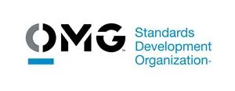
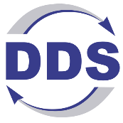
Achieving Secure and Scalable Interoperability: OMG DDS for MOSA-Compliant LVC Training
Presenter 1, Rob Proctor/Real-Time Innovations, RTI
Presenter 2, Dave Whitten/Real-Time Innovations, RTI

Slide 2
Agenda
Intro to Data Distribution Service (DDS) an Object Management Group (OMG) Standard
  The history and makeup up the OMG DDS standards
Introduction to Interoperability vs Interconnectivity, composability
  What are the different levels of interoperability
  What are the requirements for semantic interoperability
  What is a compostable system
The Modular Open Systems Approach (MOSA) and the US DoD Data Strategy
  Why is the DoD calling for Data-Centricity
  Why are these are required for all DoD systems
The Data Distribution Service (DDS) an Object Management Group (OMG) Standard
  How do the features of OMG DDS provide interoperability within and between systems, including APIs, Quality of Service (QoS), Discovery, and Wide Area Network (WAN) connectivity
Intro to OMG DDS Secure, an OMG Standard
  Authentication, Role-Based Access Control, Encryption, Data Tagging, and Event Logging
  Fine-grained security configuration including securing individual data topics
Examples of securing real-time distributed LVC simulations with OMG DDS

Slide 3
Tutorial Learning Objectives
After taking this tutorial, you should be able to:
Understand the Layers of Interoperability: Explain the different layers of interoperability in defense training systems and why achieving semantic interoperability is critical for modular and scalable architectures.
Describe OMG DDS and its Role in MOSA Compliance: Understand the Object Management Group’s Data Distribution Service (OMG DDS) standard and its advantages in building distributed LVC simulations. Learn why DDS serves as the transport for operational system standards used for modularity and how it supports the DoD's Modular Open Systems Approach (MOSA) mandate.
Know that you can implement Multi-Level Security (MLS) in Distributed Training: Learn the principles of the OMG DDS Secure standard and how it enables Multi-Level Security (MLS) across distributed training environments, addressing security challenges over WAN, cloud, RF, and lossy networks—capabilities not natively provided by traditional simulation standards like HLA, DIS, TENA, and CTIA.
Explain how OMG DDS seamlessly connects with existing simulation architectures such as TENA, HLA, and DIS, enabling cross-platform interoperability and supporting large-scale defense training initiatives like SCARS program for the USAF.
Explain how to utilize OMG DDS for Secure Hardware-in-the-Loop (HIL) and Distributed Training: Examine how DDS enables real-time, secure, distributed LVC training at scale, supporting Hardware-in-the-Loop (HIL) simulations and ensuring reliable data exchange in mission-critical environments.\

Slide 4
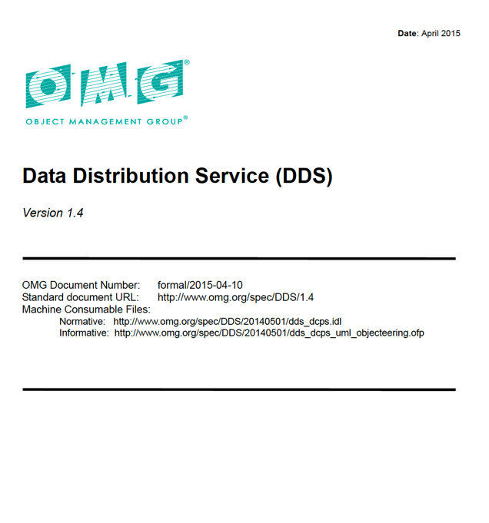
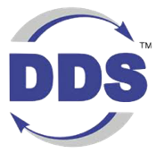
OMG Data Distribution Service Standard
From OMG, systems software standards organization
  Digital Twin Consortium
  MOF, SysML v2,UML, XML, IDL, CORBA, DDS
  Standard can be downloaded for free by anyone
  More than a dozen commercial implementations available
First version of the OMG DDS standard was released in 2004
  Most recent updates were 2024
DDS is really a family of 14 standards

Slide 5
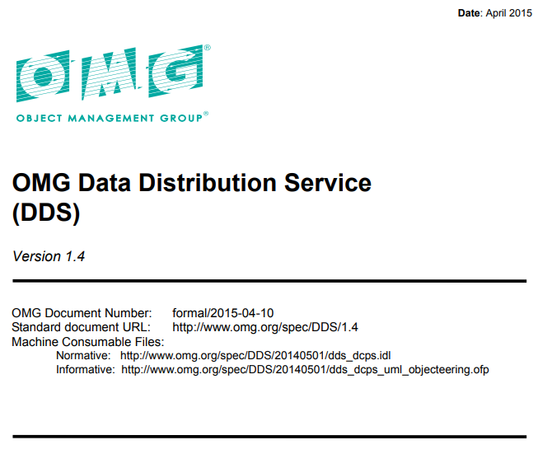
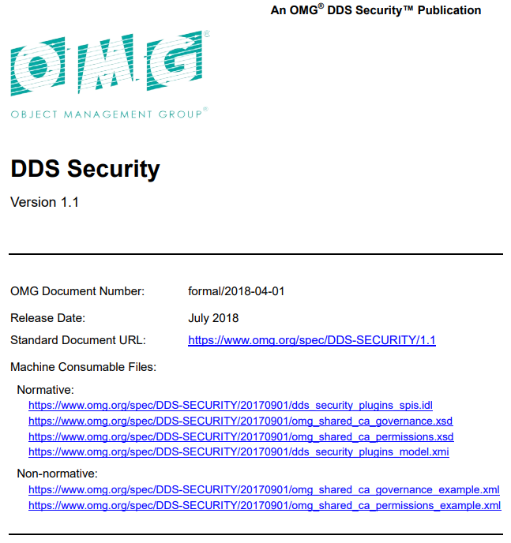
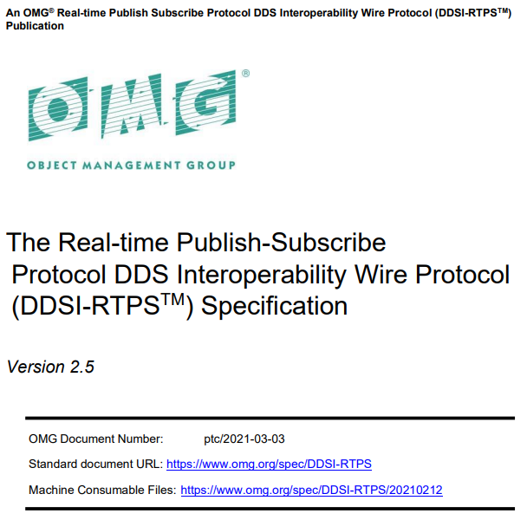
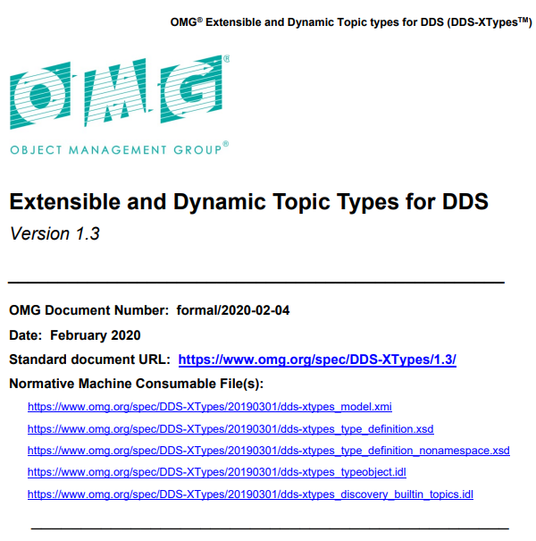
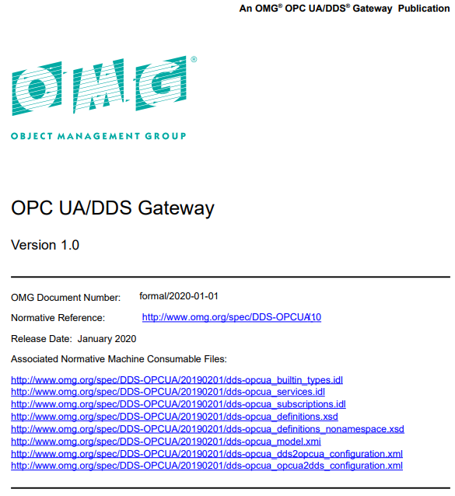
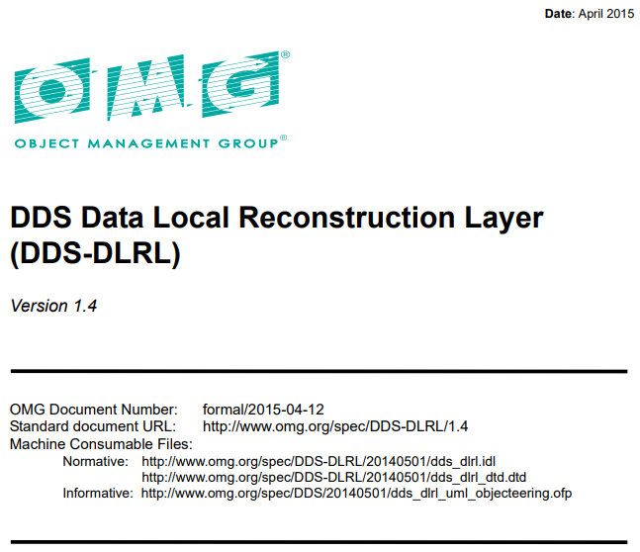
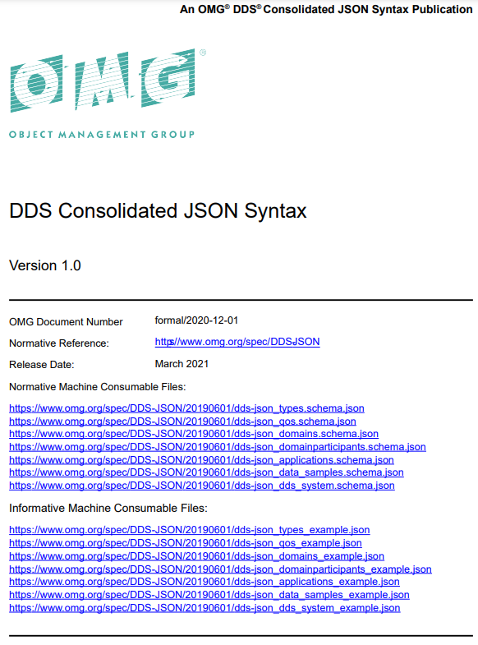
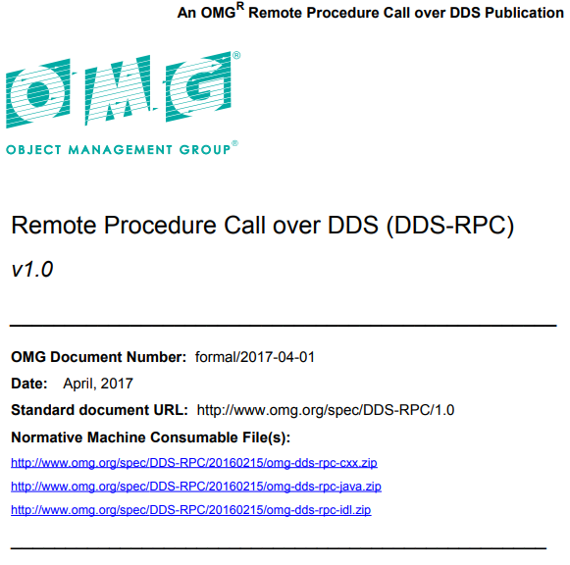
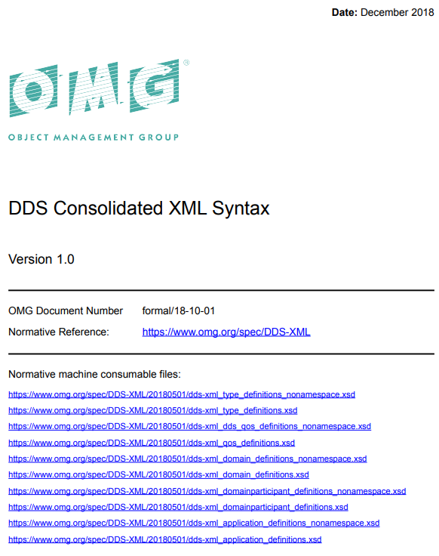
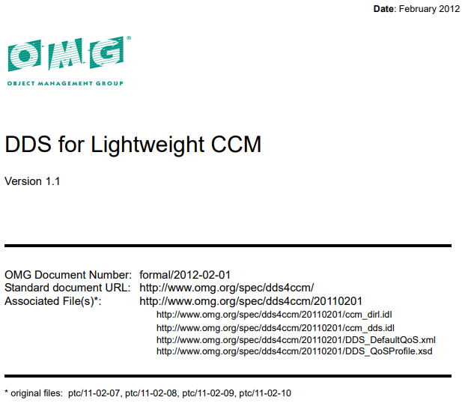
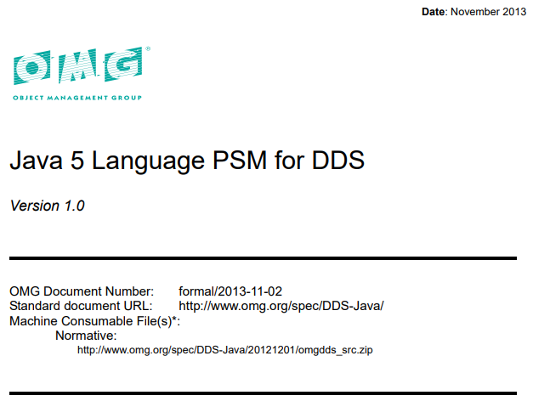
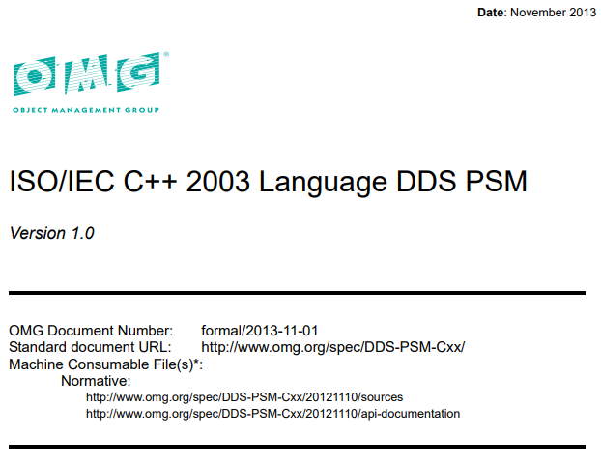
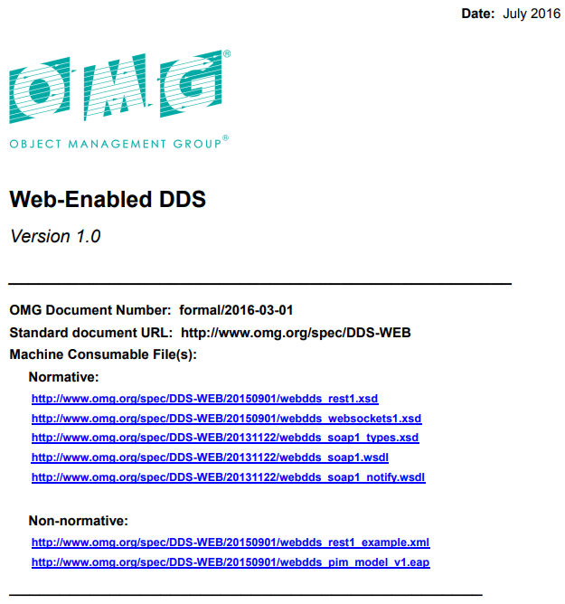
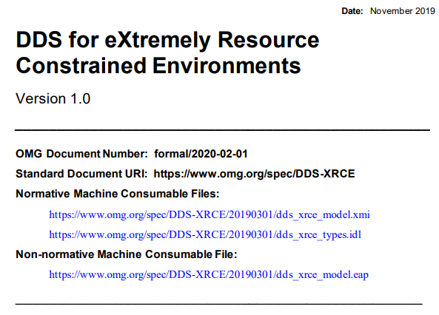
OMG DDS is a Family of Standards
www.omg.org/spec/category/omg-data-distribution-service/

Slide 6
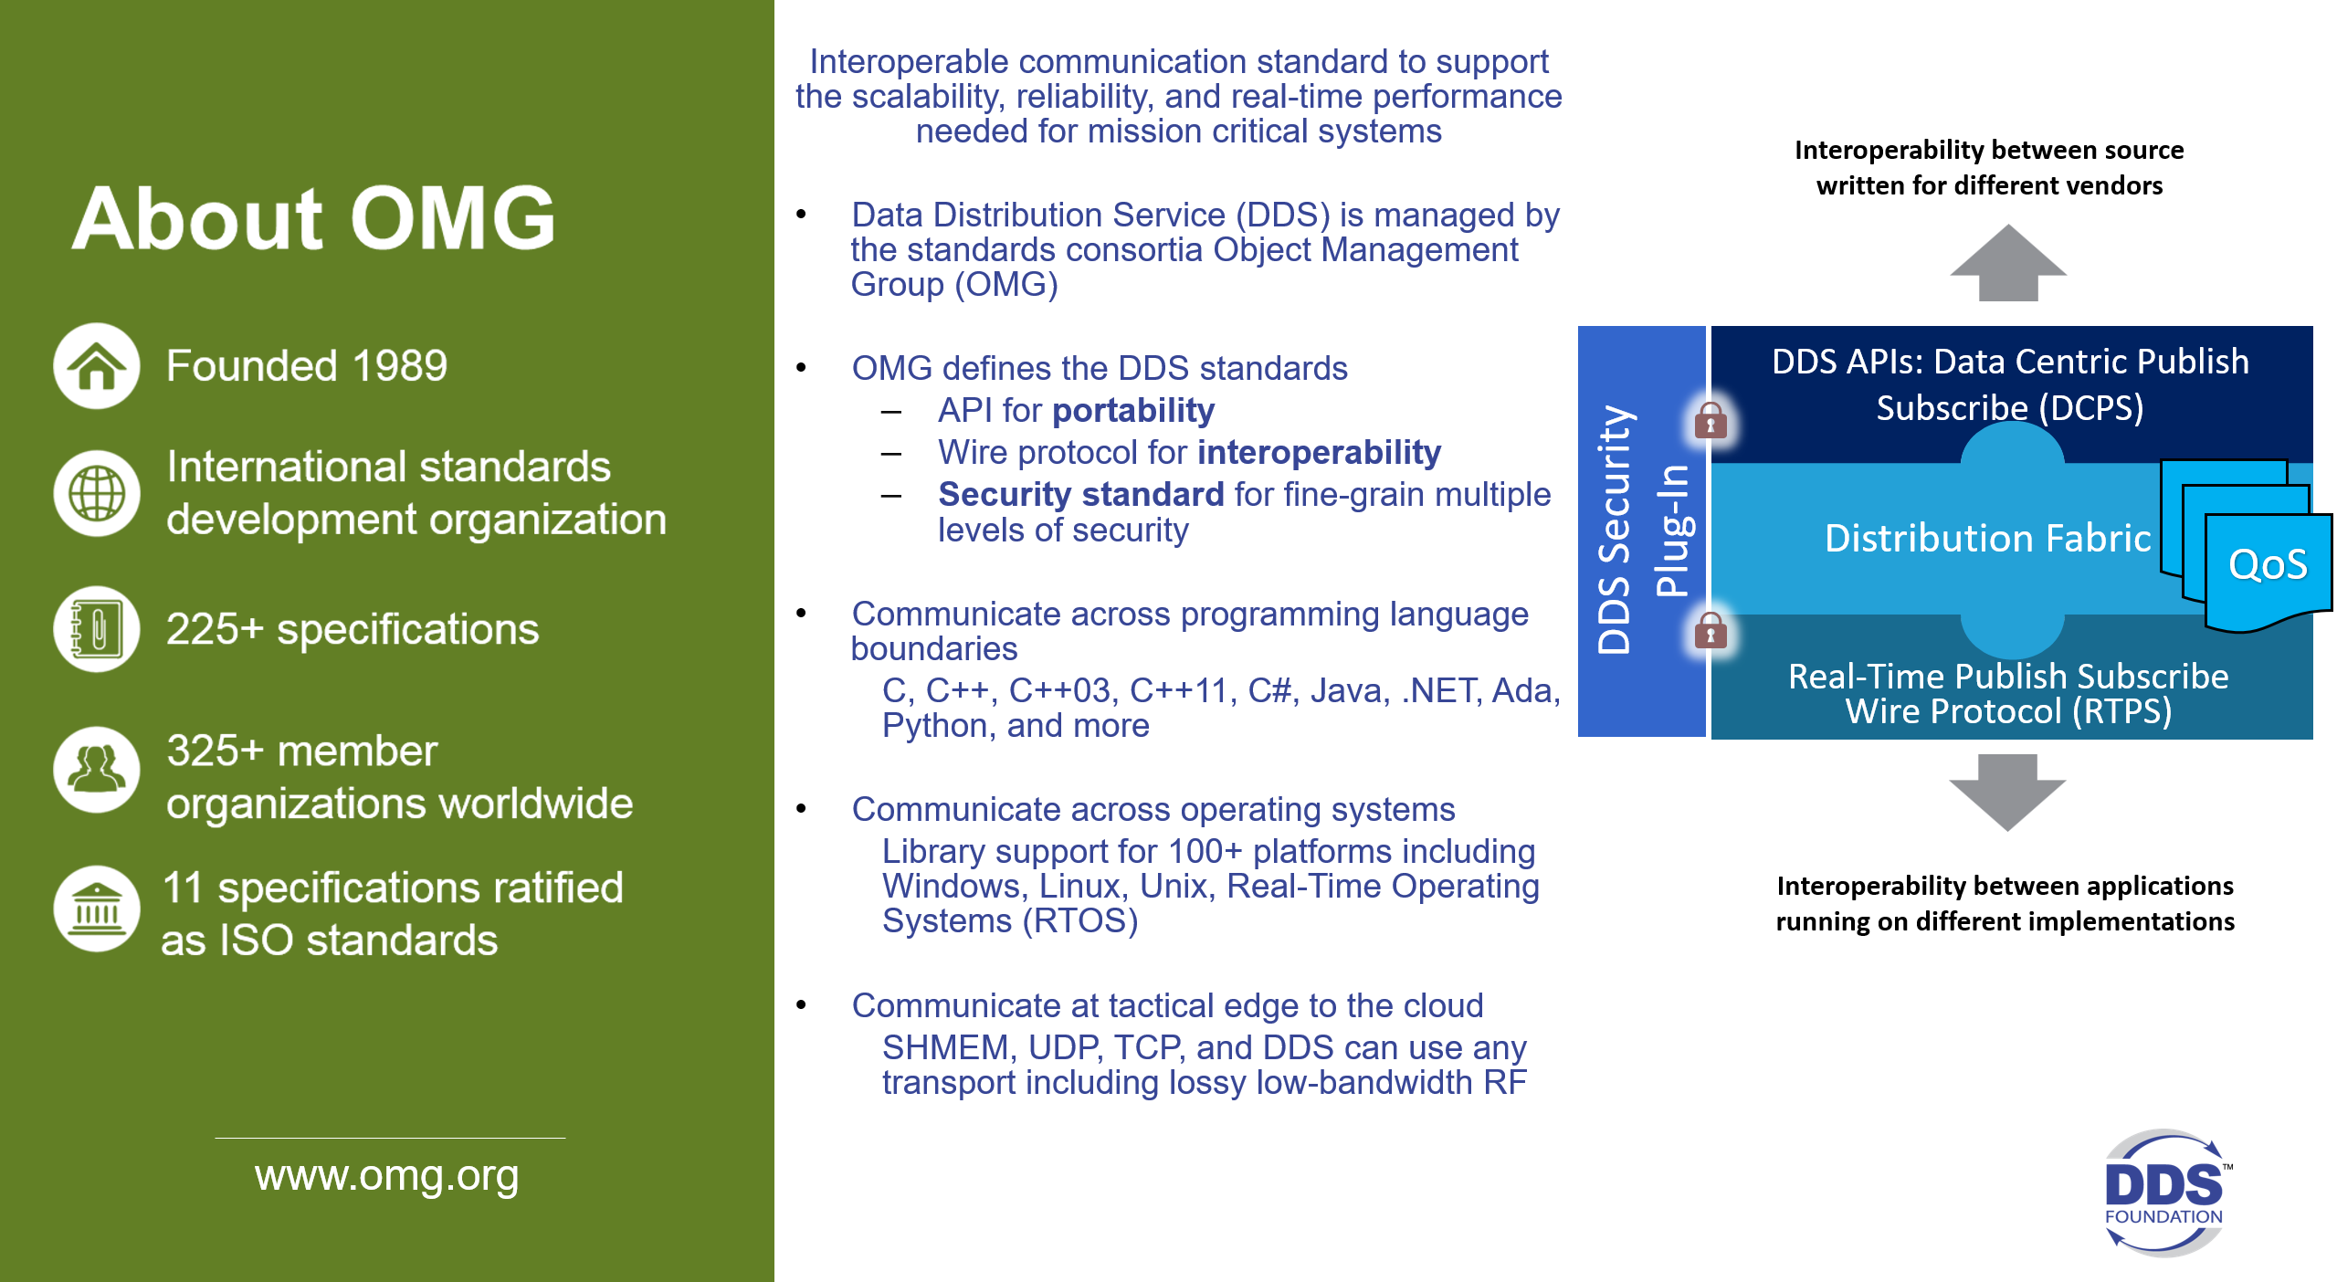
OMG Data Distribution Service Standard
Notes:
OMG DDS is a standard for data-centric connectivity and interoperability for real-time systems
Data-Centric Publish-Subscribe model for distributed application communication and integration
Standardizes wire protocol, serialization format and API
OMG DDS is open and multi-vendor
Open Standard and Open Source
12+ implementations

Slide 7
OMG Data Distribution Service Standard
OMG DDS is Publish-Subscribe, Data-Centric, and Peer-to-Peer
  OMG DDS also supports request-reply and queueing
Designed for real-time mission critical and safety critical systems
  Started in Robotics and SW Defined Radios using Tactical Data Links
  Navy wanted it turned into an open standard, now widely used in the Navy
OMG DDS applications share large amounts of data quickly, securely, and reliably at massive scale
OMG DDS provides location transparency, decentralized operation, dynamic scalability, and real-time performance
Its widespread use in distributed real-time military systems has led to strong interest in the modeling, simulation and training community

Slide 8
OMG DDS is made for real-time interoperability
OMG DDS defines
  Open API for portability
  Open wire protocol for interoperability
    Transport agnostic
  Open explicit defined QoS and discovery
    Highly configurable
Multiple language bindings
  C, C++, Java, C# .NET, Ada
  LabVIEW, MATLAB/Simulink
  Python, NodeJS
Multi platform support
  Windows, Linux, Unix, embedded OS, Docker, Kubernetes
Application
Standard
API
OMG DDS Middleware
Data Management (QoS)
OMG DDS Security
Standard
Protocol
UDP
TCP
RT-WAN
Shmem
Operating System

Slide 9
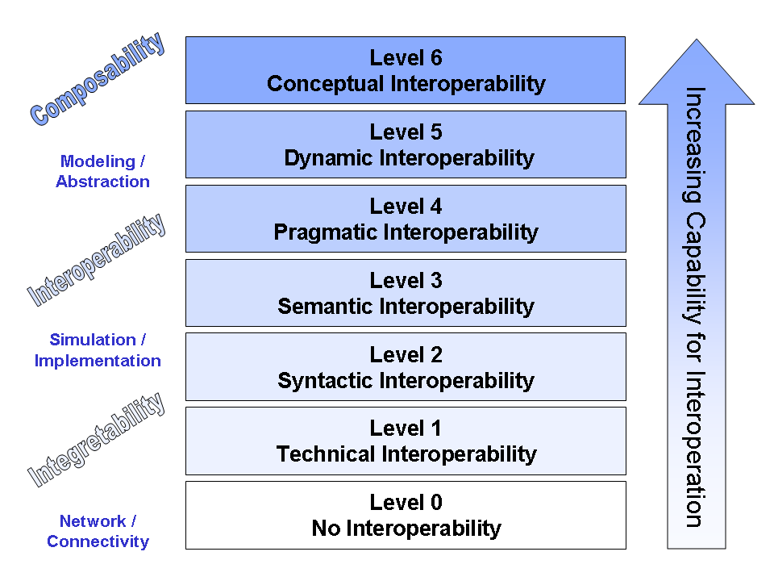
Levels of Interoperability
Shared data context
Shared data structure
Shared opaque data
The Industrial Internet of Things Volume G5: Connectivity Framework
https://www.iiconsortium.org/pdf/IIC_PUB_G5_V1.01_PB_20180228.pdf
Notes:
IIRA defines: Connectivity = Infrastructure for Communications Interoperability
Example: Two people are integrable (level 1) if both are able to speak and listen; interoperable (level 2) if they speak the same language; and composable (level 3+) if they share similar educational background so that enables them to collaborate on specific tasks.
Syntactic interoperability: make it easy to share types. Evolve those types. Be typesafe
Semantic interoperability: select an existing or industry-specific model and use it. Generic data modeling is hard. Mandate all lower levels.
Stop here. Above this is human work
Level 0: Stand-alone systems. No Interoperability.
Level 1: Technical Interoperability. A communication protocol exists for exchanging data between participating systems. On this level, a communication infrastructure is established allowing systems to exchange bits and bytes, and the underlying networks and protocols are unambiguously defined.
Level 2: Syntactic Interoperability. A common structure to exchange information; i.e., a common data format is used. On this level, a common protocol to structure the data is used; the format of the information exchange is unambiguously defined. This layer defines structure.
Level 3: Semantic Interoperability. The meaning of the data is shared; the content of the information exchange requests are unambiguously defined. This layer defines (word) meaning. There is a related but slightly different interpretation of the phrase semantic interoperability, which is closer to what is here termed Conceptual Interoperability, i.e. information in a form whose meaning is independent of the application generating or using it.
Level 4: Pragmatic Interoperability is reached when the interoperating systems are aware of the methods and procedures that each system is employing. In other words, the use of the data – or the context of its application – is understood by the participating systems; the context in which the information is exchanged is unambiguously defined. This layer puts the (word) meaning into context.
Level 5: Dynamic Interoperability: As a system operates on data over time, the state of that system will change, and this includes the assumptions and constraints that affect its data interchange....
Level 6: Conceptual Interoperability …

Slide 10
IIoT Connectivity Stack Model
Participant X
Participant Y
Distributed Data
Interoperability and Management
Information (Data in Context)
Distributed Data
Interoperability and Management
Semantic
Interoperability
(data context)
Information
Framework
Data (State, Events, Streams)
Framework
Syntactic
Interoperability
(data structures)
Connectivity
Transport
Messages
Transport
Technical
Interoperability
(bytes)
IICF Focus
Network
Packets
Network
Networking
Link
Frames
Link
Physical
Bits
Physical
The Industrial Internet of Things Volume G5: Connectivity Framework
https://www.iiconsortium.org/pdf/IIC_PUB_G5_V1.01_PB_20180228.pdf
Notes:
Framework & Transport Layer
How to get interoperable data?
What is the lingua franca?
Get all parties to communicate!
Assume, Networking layer already setup
People know how to do this
Recognize the other layers

Slide 11
OMG DDS Interoperability
OMG DDS is
  An interoperability framework for Real-Time systems that is transport agnostic
  OMG DDS uses the notion of a logical software-based Databus
  OMG DDS supports ANY data model, and makes the Data itself the interface
  In fact, the OMG DDS connectivity framework is something that you build upon when you set out to create a new interoperability standard based on an industry-specific data model
  The result is that OMG DDS underpins a lot of familiar standards…
OMG DDS provides interoperability between
  Other implementations of OMG DDS
  Any communication standards (DIS, TENA, HLA, Modbus, OPC-UA, etc.)
  1000s of DoD live systems
OMG DDS is foundational for data-centricity and MOSA
Notes:
Current simulation standards are a great what and why. DDS is the best how.

Slide 12
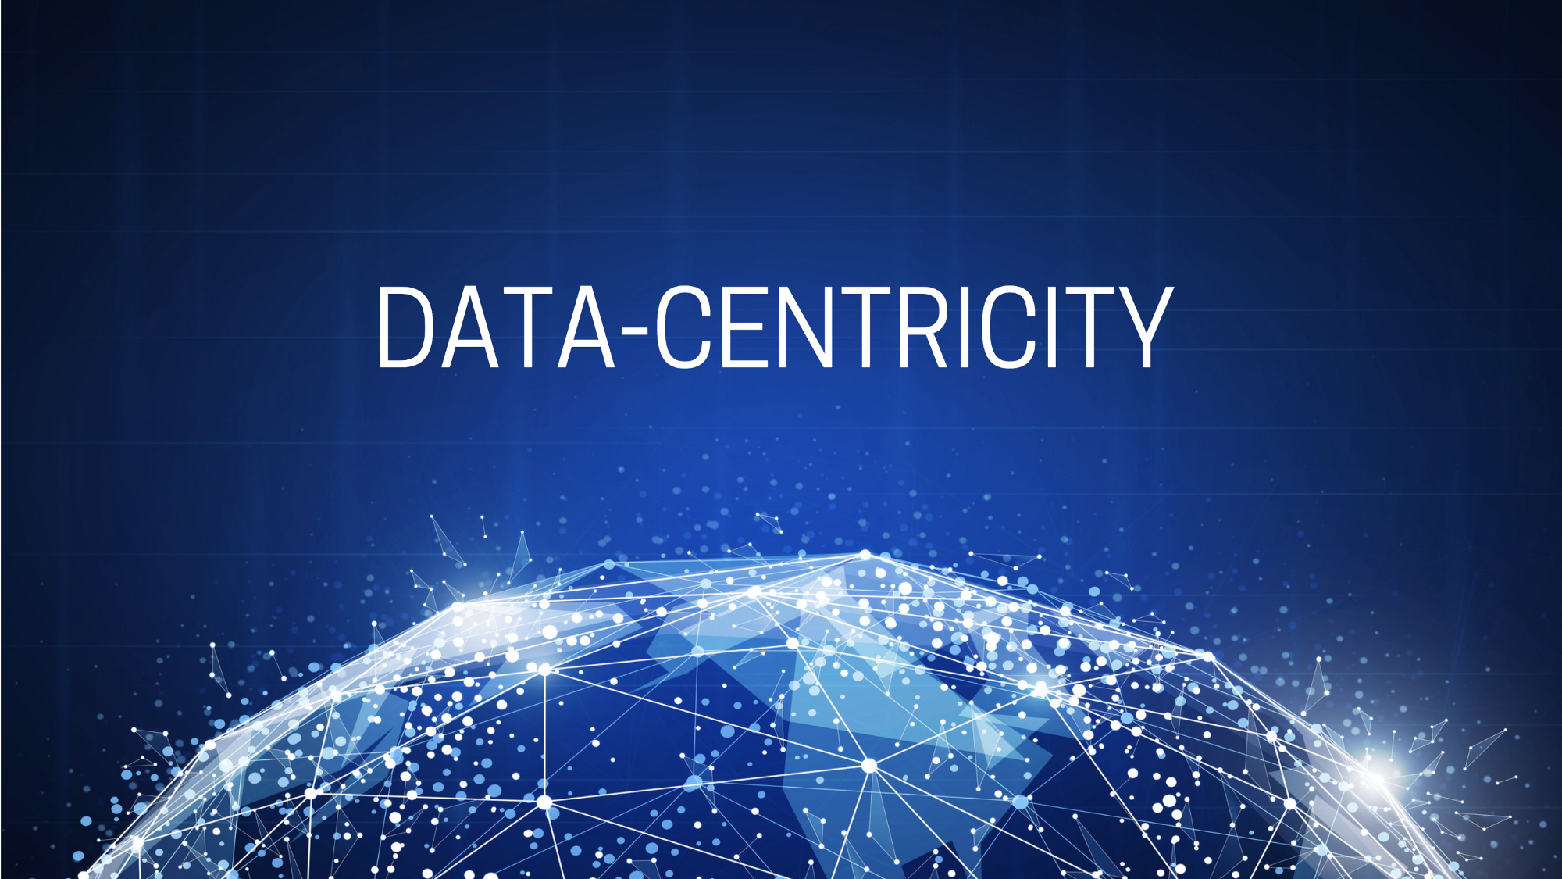
Data-Centricity Definition
Data centric refers to an architecture where data is the primary and permanent asset, and applications come and go

Slide 13
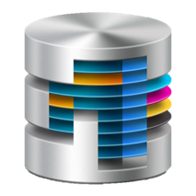
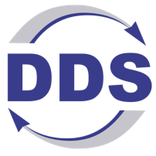
About Data Centricity
Data Centricity Definition
The interface is the data
The infrastructure understands that data
The system manages the data and imposes rules on how applications exchange data
Application
Application
Message centric
Remote Objects
SOAs
Data
Application
Application
Database
Databus
Data centric storage and
searching of old data
Data centric sharing and
filtering of data in motion
SELECT * FROM ShapeData
WHERE color=‘RED’ AND shapesize > 10;
cft = create_contentfilteredtopic_with_filter(
”MyFiltered_topic”, ShapeData_topic,
”(color MATCH ‘RED’) AND (shapesize > 10)”, … );
Notes:
The interface is the data.
There are no artificial wrappers or blockers to that interface like messages, or objects, or files, or access patterns.
The infrastructure understands that data.
This enables filtering/searching, tools, & selectivity. It decouples applications from the data and thereby removes much of the complexity from the applications.
The system manages the data and imposes rules on how applications exchange data.
This provides a notion of "truth". It enables data lifetimes, data model matching, CRUD interfaces, etc.
Databases are data-centric storage. They fit all the above:
a) Data tables directly describe data. Unstructured databases also provide direct data access. Applications interact only with the table, not with the location of the data in a file.
b) The database provides an environment to search, match, and manage data. I can access data, or write a tool that manipulates the data without talking to whoever put the data there. SQL is a language that leverages this power.
c) The database imposes ACID properties. The data won't get corrupted, etc. In a system, the data in the database is Truth. (what's the right value of this data?)
DDS is a data-centric communications. a "databus". It also fits all of the above:
a) IDL defines data types, and then you interact with those types.
b) You can filter data, write tools, & select what you want directly. We also leverage an SGL-like capability.
c) The databus imposes QoS rules. The notion of truth is very well defined. It includes timing (how old is this data? how fast will I get it?)
In summary, data-centric systems manage state directly. Applications interact by directly accessing that state. Note that the method of storage or the pattern of interaction is orthogonal.
If you want a sound bite, I had one in my 2012 webinar on "The single most important decision in designing your distributed system":
Will the apps manage truth & the infrastructure exchange messages?
Or
Will the infrastructure manage truth& the apps exchange state?
Common “truth” for integration
Extreme reliability & scalability
Right data, right time, right place
Intelligence in the infrastructure
not complexity in the application code
No startup dependencies
Generic tools and analyzers

Slide 14
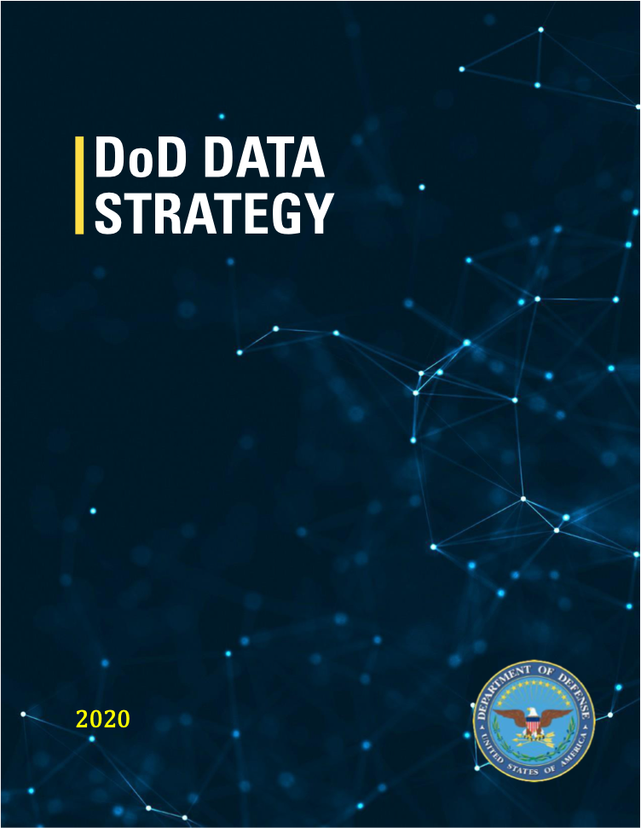
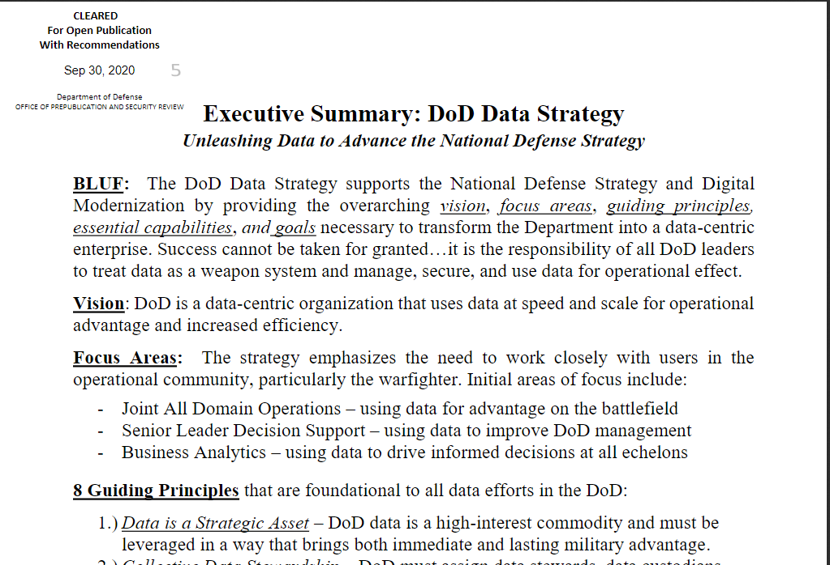
The Demand for Data-Centricity also applies to LVC
DoD Data Strategy
Unleashing Data to Advance the National Defense Strategy
“It is the responsibility of all DoD leaders to treat data as a weapon system and manage, secure, and use data for operational effect”
Vision: “The DoD is a data-centric organization that uses data at speed and scale for operational advantage and increased efficiency”
Data-Centricity
“DoD is a
data-centric organization”
“Data is a Strategic Asset”
Notes:
Vision: “The DoD is a data-centric organization that uses data at speed and scale for operational advantage and increased efficiency”
One of the guiding principles:
Data for Artificial Intelligence Training – Data sets for A.I. training and
algorithmic models will increasingly become the DoD’s most valuable digital
assets and we must create a framework for managing them across the data lifecycle
that provides protected visibility and responsible brokerage.

Slide 15
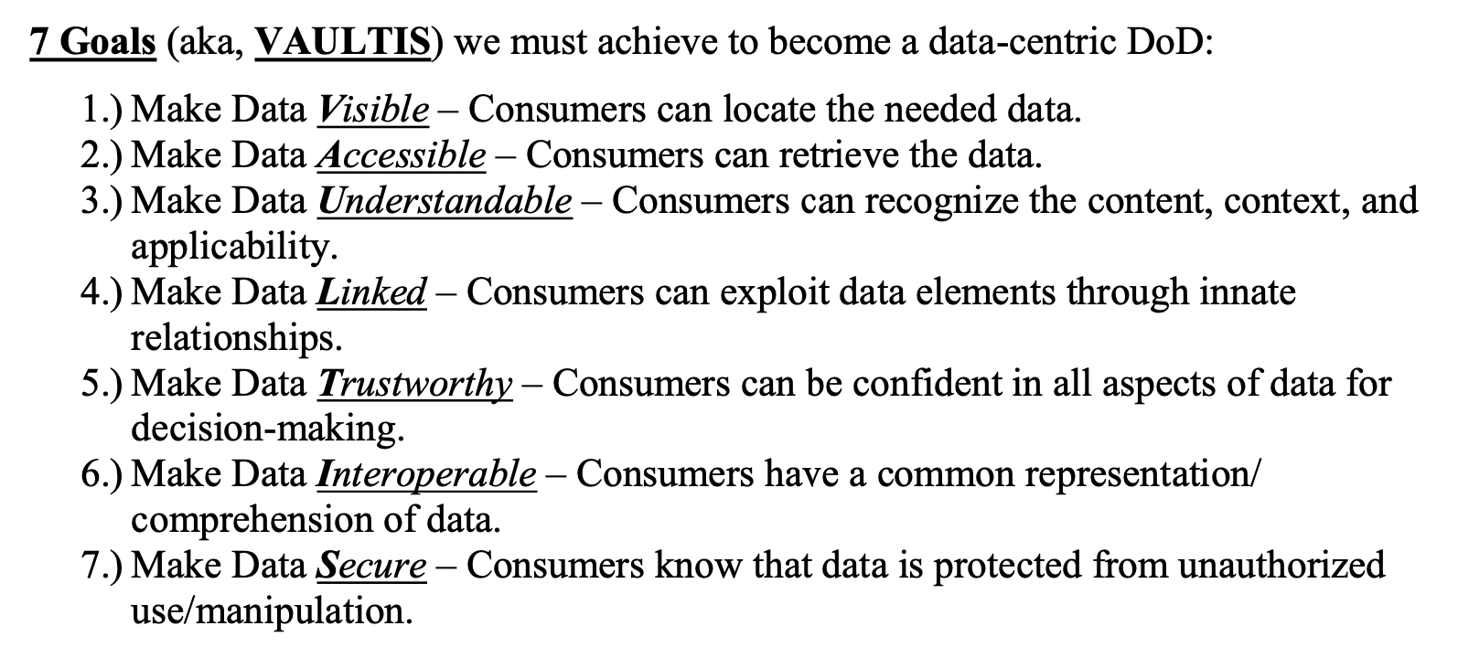
7 Goals to Becoming a Data-Centric DoD
From DoD Data Strategy (https://media.defense.gov/2020/Oct/08/2002514180/-1/-1/0/DOD-DATA-STRATEGY.PDF)
Notes:
VAUL&I: are core DDS data-centric, data-model capabilities
T&S: Trustworthy and Secure are enable by DDS Secure
1. Make Data Visible -- Consumers can locate the needed data
2. Make Data Accessible -- Consumers can retrieve the data
3. Make Data Understandable -- Consumers can recognize the content, context, and applicability
4. Make Data Linked - Consumers can exploit data elements through innate relationships
5. Make Data Interoperable -- Consumers have a common representation / comprehension of data
6. Make Data Trustworthy -- Consumers can be confident in all aspects of data for decision-making
7. Make Data Secure -- Consumers know that data is protected from unauthorized use / manipulation
So, sims for training need to be interoperable meanwhile there are these new MOSA and Data-Centric requirement mandates.

Slide 16
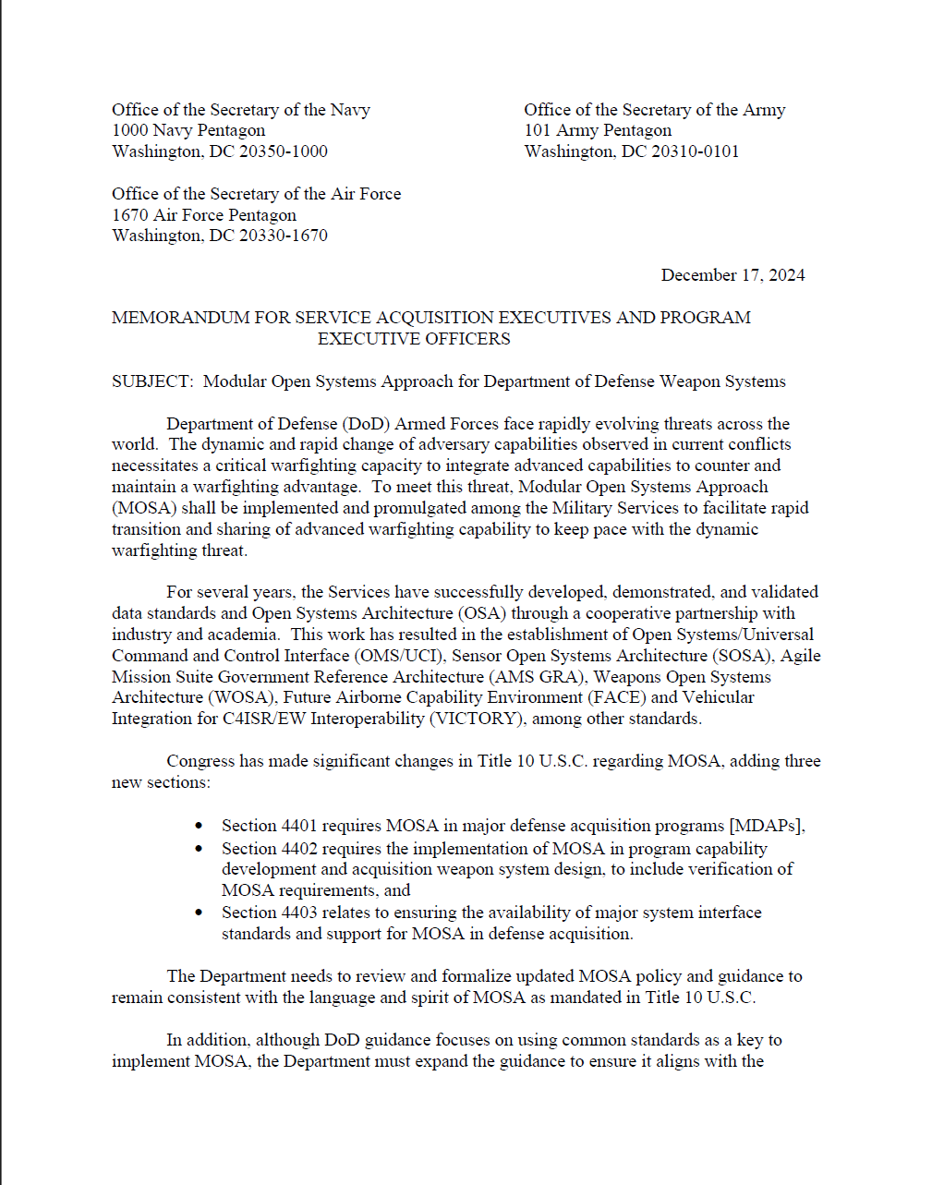
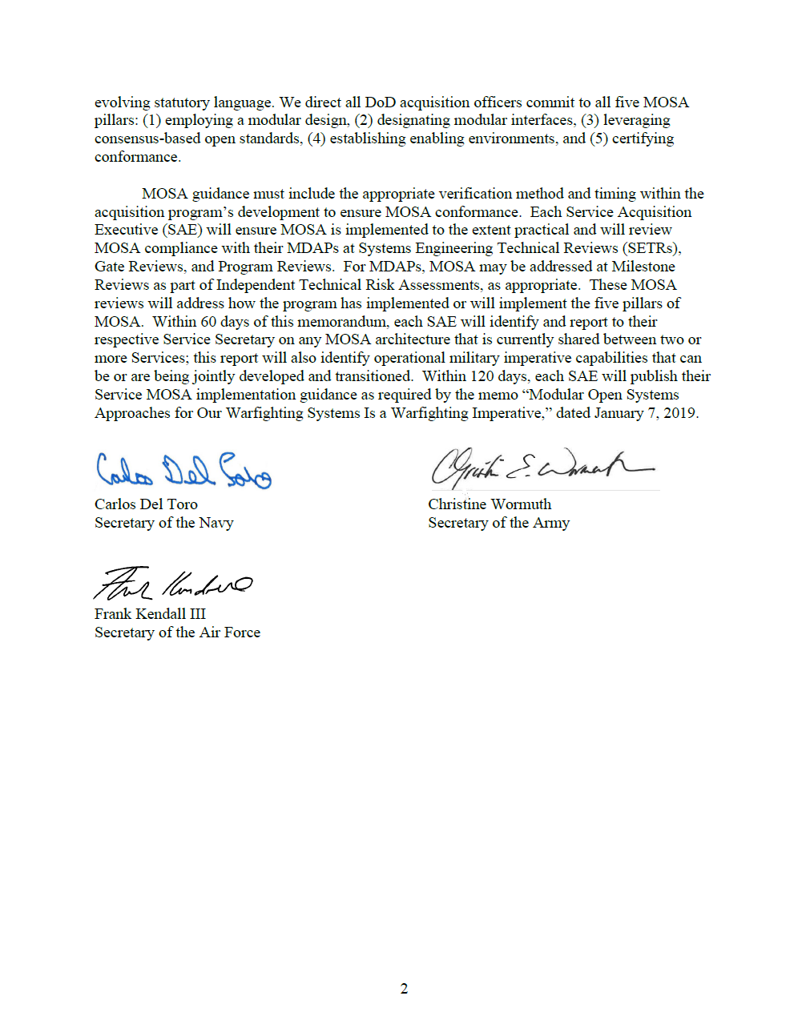
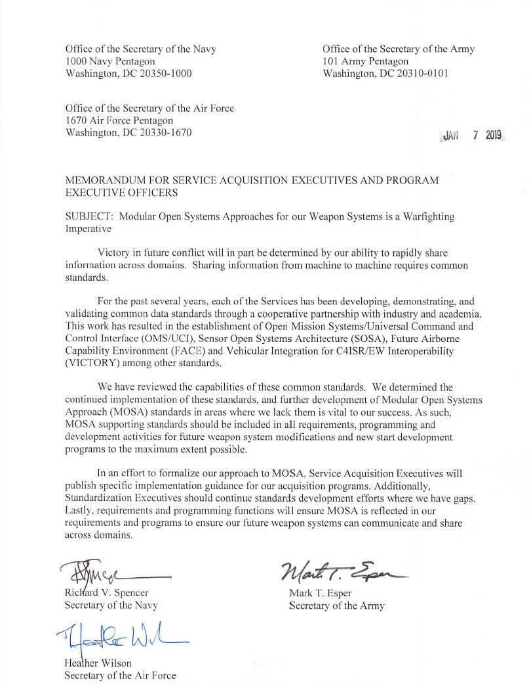
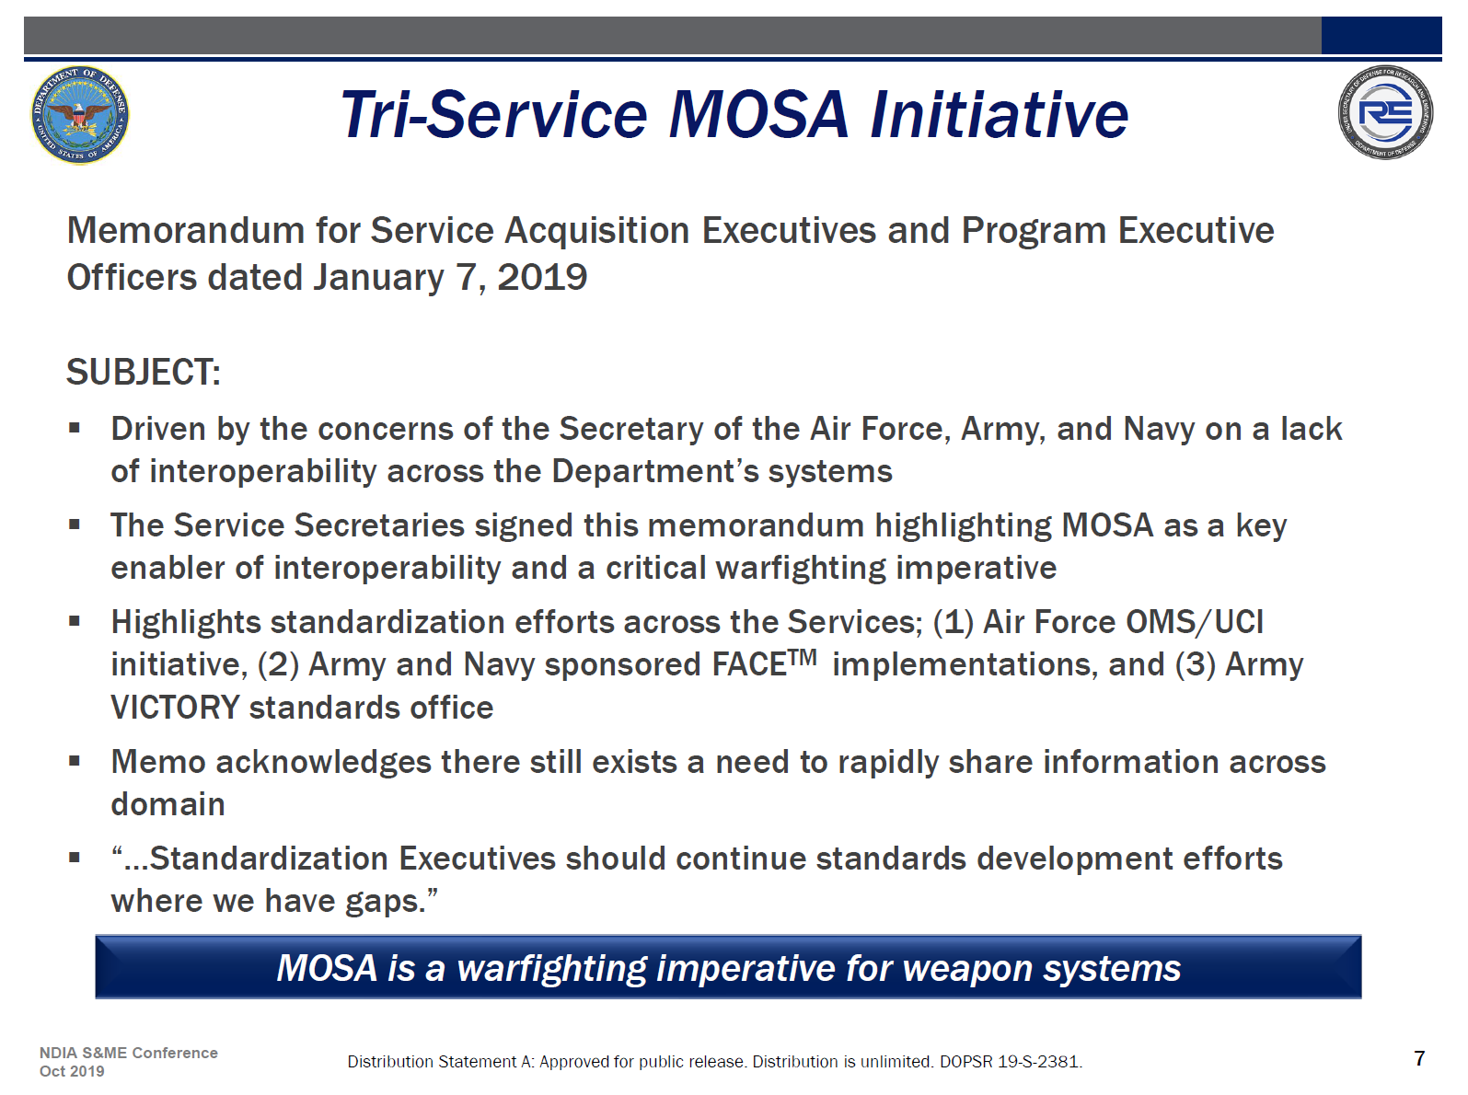
Tri-Service MOSA Initiative builds on Data Centricity
REAFFIRMED AGAIN IN DECEMBER 2024

Slide 17
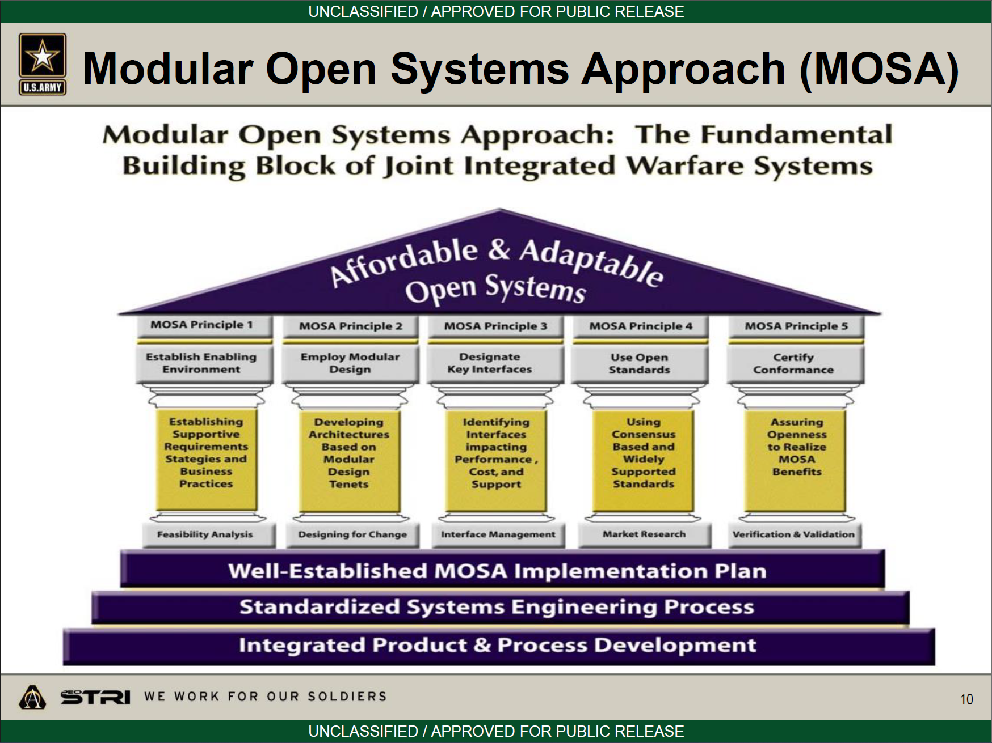

Modular Open Systems Approach (MOSA)
Across the Joint forces in the MS&T community, the need for MOSA has been fully embraced
MOSA has five main principles
  Establish Enabling Environments
  Employ Modular Design
  Designate Key Interfaces
  Use Open Standards
  Certify Conformance
PEO STRI Presentation

Slide 18
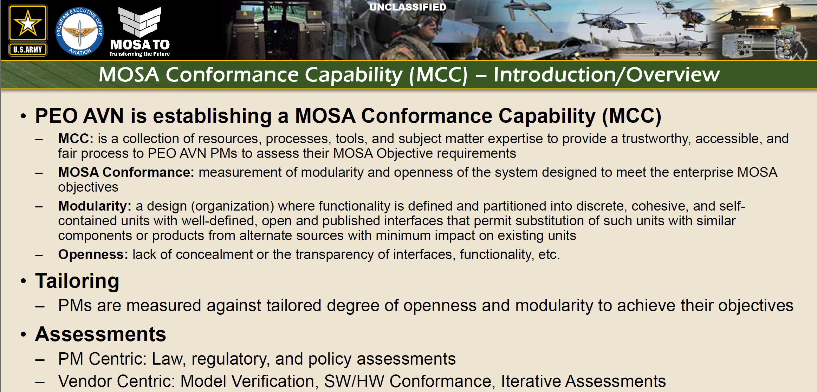
PEO’s across the DOD have fully adopted MOSA

Slide 19
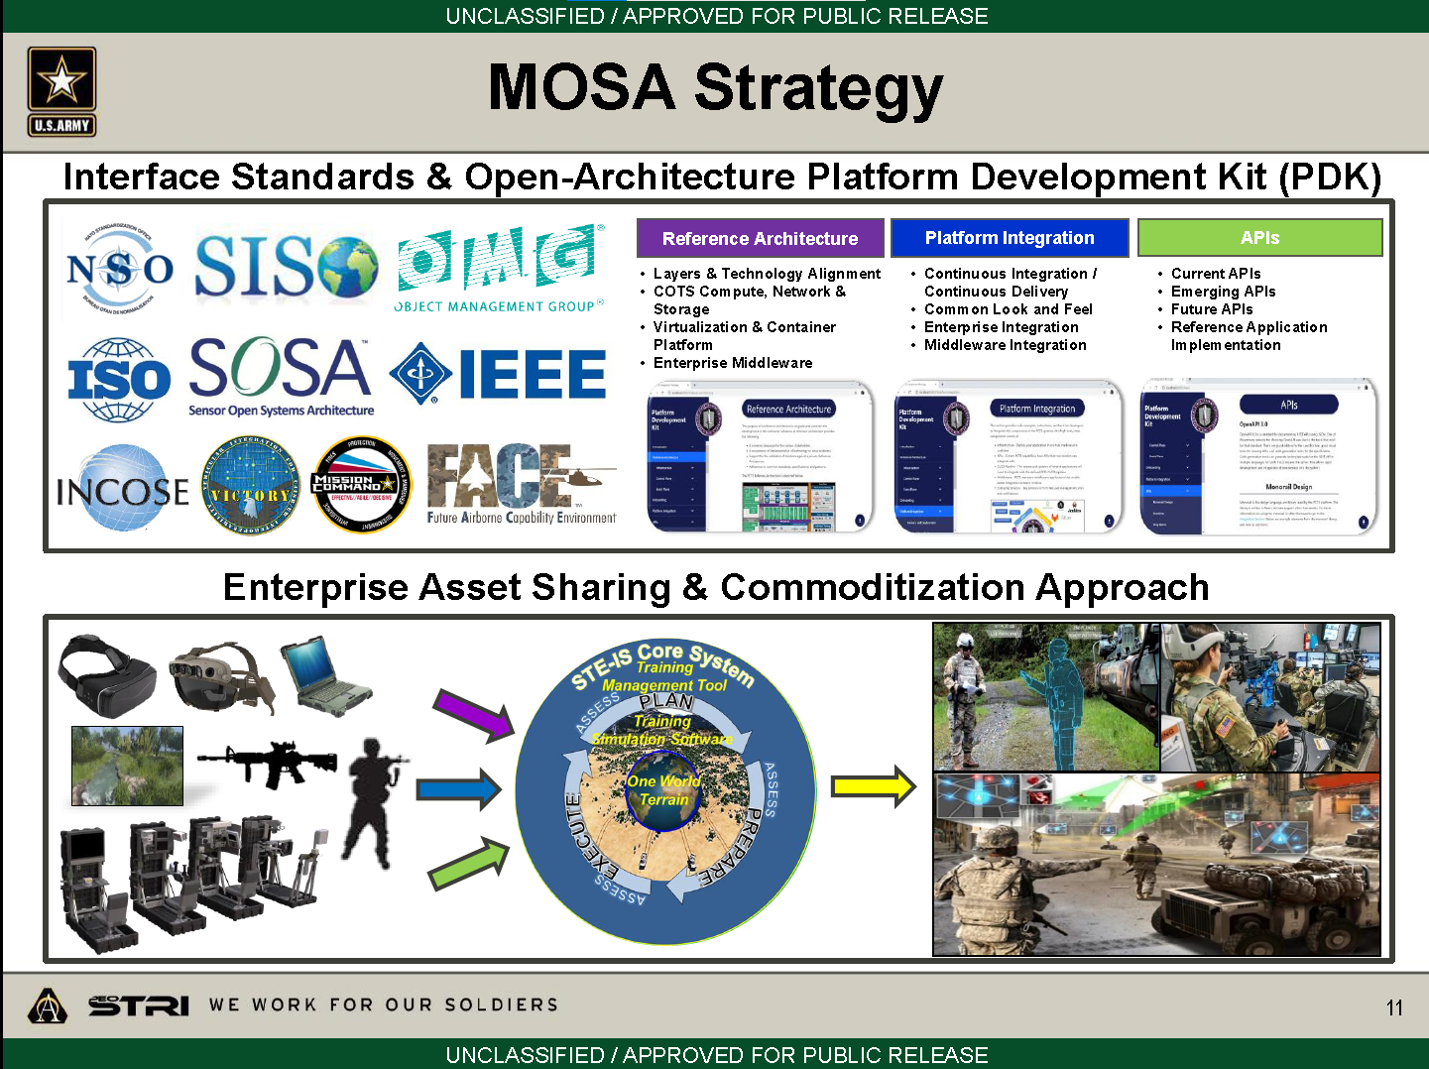

PEO STRI MOSA Strategy

Slide 20
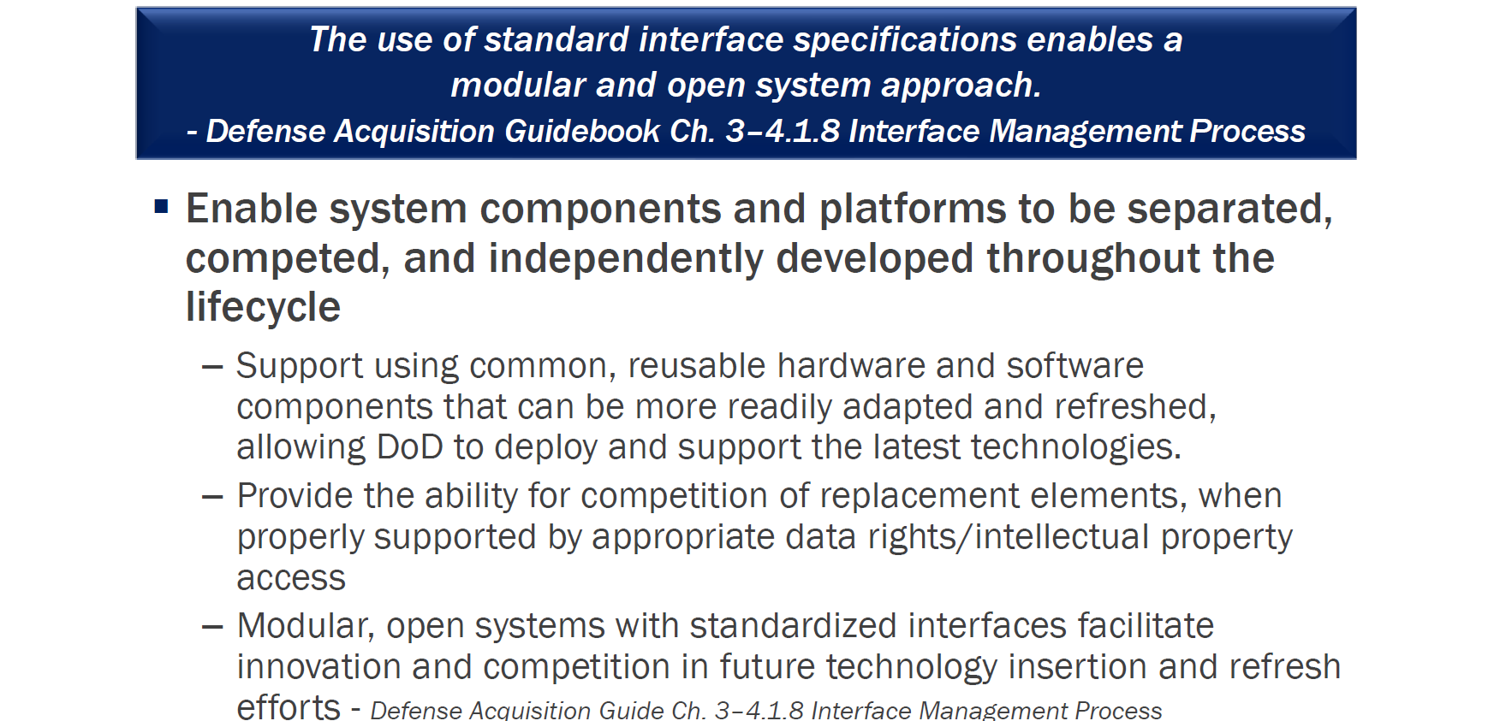
MOSA Goals in Standardization

Slide 21
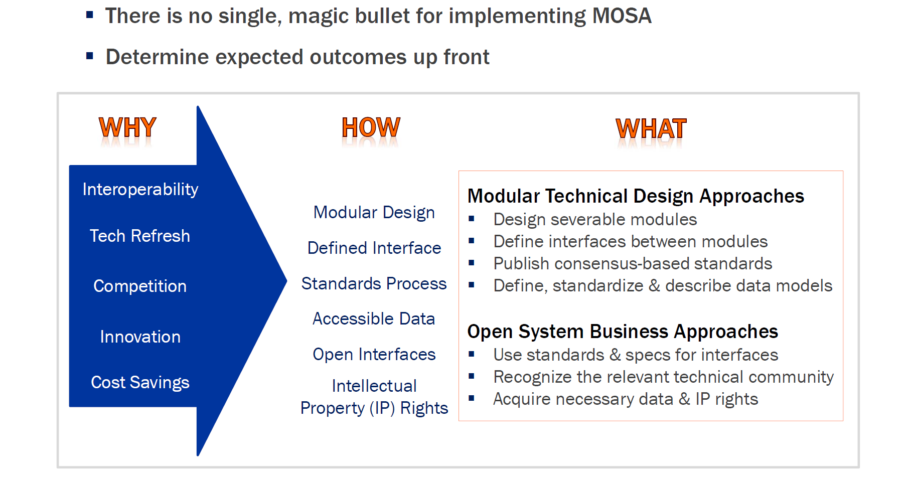
MOSA Benefits and Approaches

Slide 22
OMG DDS is Under the Hood of MOSA and Other Industry Standards
Standard | Industry
Modular Healthcare Simulation and Education System (MoHSES) | Simulation / Healthcare
ALert MAnagement Service (ALAMS) | Defense
Application Management and Systems Monitoring (AMSM) | Defense
Future Airborne Capabilities Environment (FACE) | Defense
Generic Vehicle Architecture (GVA) NATO Generic Vehicle Architecture (NGVA) | Defense
Land Open Systems Architecture (LOSA) | Defense
Medical Simulation Training Architecture (MSTA) | Simulation / Healthcare
Open Field Message Bus (OpenFMB) | Power / Energy
Open Mission Systems (OMS) | Aerospace
Open Process Automation Forum (OPAF) | Process Automation
Standard | Industry
Open Robotics Robotic Operating System v2 (ROS2) | Horizontal / Robotics
Sensor Open System Architecture (SOSA) | Defense
Tactical Microgrid Standards Consortium (TMSC) | Energy
Unmanned Systems (UxS) Control Segment (UCS) Architecture | Defense
Robot Operating System-Military; Robotic Technology Kernel (ROS-M and RTK) | Defense / Robotics
Joint Architecture for Unmanned Systems (JAUS) | Defense / Robotics
Naval Open Systems Architecture (OSA) | Defense
Control Architecture for Robotic Agent Command and Sensing (CARACaS) | Aerospace / Autonomous Vehicles
Multi-Robot Operator Control Unit (MOCU) | Aerospace / Robotics
Unmanned Maritime Autonomy Architecture (UMAA) | Defense / Autonomous Vehicles

Slide 23
Why is OMG DDS so widely used ‘under the hood’ for these standards?
Hypertext Transfer Protocol (HTTP) – UNIVERSAL TRANSPORT
Representational State Transfer (REST) – UNIVERSAL API
  Used together they build the vast majority of web-based applications
  Good for human speed, but tends to be 1-1; you connect to the bank, email, website, etc.
But what about real-time applications?
  And live real-time systems that might have communication needs such as:
    1 to many
    many to 1
    many to many (thousands of actual participants to millions of entities)
    with real-time speeds and security requirements

Slide 24
What is the Data Distribution Standard?
App 1
Java
Windows
App 2
C++11
Linux
App 3
C++
RTOS
App 4
C
Bare Metal
DDS
DDS
DDS
DDS
Custom RF
Transport
UDP
TCP
SHMEM
DDS Databus
DDS libraries provide APIs that abstract away transport specific implementation
Pub/sub pattern means any application can consume or produce data
Common wire protocol enables transport agnostic communication
Loosely coupled with peer endpoint discovery with negotiated quality of service

Slide 25



Peer Discovery
Global Data
Space
Track data
Sub
Pub
Sub
DDS DataBus
Track
Subscribe Track
I’m alive
I’m alive
I publish Track
The process by which Publishers and Subscribers find each other is discovery. Generically think of it as a broadcast announcement by a publisher, and potential subscribers responding to it to determine interest. Note, the discovery process happens often meaning DDS provides loosely coupled endpoints.

Slide 26
Publish/Subscribe with data-centricity
Global Data
Space
struct Track{
long sensorID; //@Key
long targetID; // @Key
float targetX;
float targetY;
float targetZ;
}
Track data
Sub
Pub
Sub
DDS DataBus
One of the strengths of DDS is the data model is hard-typed and shared. This means DDS can apply intelligence to messages since it can understand the contents. This is what we call data-centricity.

Slide 27
Data-centricity in action
Global Data
Space
struct Track{
long sensorID; //@Key
long targetID; // @Key
float targetX;
float targetY;
float targetZ;
}
Track data
Sub
Pub
Sub
DDS DataBus
I publish Track
Subscribe Track w CF
Content filter
targetX > 500 &&
targetX < 1000 &&
targetY > 250 &&
target < 750
Subscriber is only interested in track data that fits the SQL-like expression above(Content Filter). The Content Filter itself is propagated to the publisher. If no one is interested in a particular sample based on that filter, that packet is NOT transmitted(vs sent and ignored by subscriber).

Slide 28
How is DDS data-centric?
Data that is shared on a DDS databus is defined via an OMG-defined specification called Interface Definition Language(IDL)
  https://www.omg.org/spec/IDL/
IDL defines the data member types for user defined data types
IDL is a shared data model across DDS applications that are interested in a particular type of data
This enables DDS to know what the data looks like so that it can handle serialization/deserialization, endianness, and allows distributed intelligence based on the contents
Simple IDL example:
struct Track{
long sensorID; //@key
long targetID; //@key
float targetX;
float targetY;
float targetZ;
}

Slide 29
Data Model Extensibility
Final Type
Type definitions are strictly defined
Extensible Type
Newer applications can add fields to existing base types
This means you can use new message contents on new aspects of a system and not break or need to modify the legacy component
Mutable Type
Type representations can differ from each other with Additions, Deletions and Transpositions
Support for Optional Fields
Base Type
Extended Type
struct Track{
long sensorID; //@key
long targetID; //@key
float targetX;
float targetY;
float targetZ;
}
struct timedTrack{
long sensorID; //@key
long targetID; //@key
float targetX;
float targetY;
float targetZ;
double timestamp;
}

Slide 30


Quality of Service Shapes the Data Flow
Track Topic
Reliable; 5 Hz; get history
Sub
Pub
Best effort; 10 Hz; get history
Sub
Publish reliably
10 Hz
600 sample history
Best effort; 1 Hz; no history
Sub
Discovery matches publishers and subscribers of a topic
Topics are tied to shared data type(again defined by IDL), allowing a smarter bus
Quality of Service describing application data needs must be compatible to communicate. QoS is propagated during the discovery
Specifying and relying only on these data properties enables decoupled, resilient systems
QoS is defined in XML or can be set programmatically

Slide 31
DDS Quality of Service Types
Deadline
Time Based Filter
Partition
Resource Limits
Batching
Reliability
Content Filtering
Presentation
Latency Budget
Transports
Destination Order
Durability
Lifespan
Flow Control
Multi-Channel
Liveliness
Ownership
History
User, Group, Topic Data
sync Publisher
Under each high level QoS type are various configuration options you can tune to exactly your use case

Slide 32
QoS Use Case – Add Reliability to Transport
Deadline
Time Based Filter
Partition
Resource Limits
Batching
Reliability
Content Filtering
Presentation
Latency Budget
Transports
Destination Order
Durability
Lifespan
Flow Control
Multi-Channel
Liveliness
Ownership
History
User, Group, Topic Data
Async Publisher
Add reliability to non-reliable transports. Note even reliability is highly configurable and you can tune it(set retry attempts, disable positive acknowledgements, etc)

Slide 33
QoS Use Case – Handling Late Joining Subscribers
Deadline
Time Based Filter
Partition
Resource Limits
Batching
Reliability
Content Filtering
Presentation
Latency Budget
Transports
Destination Order
Durability
Lifespan
Flow Control
Multi-Channel
Liveliness
Ownership
History
User, Group, Topic Data
Async Publisher
Deliver data to late joining subscribers as they join the network. Durability has multiple supported “types” and history/resource limits determine how much data is stored.

Slide 34
QoS Use Case – Add Reliability to Transport
Deadline
Time Based Filter
Partition
Resource Limits
Batching
Reliability
Content Filtering
Presentation
Latency Budget
Transports
Destination Order
Durability
Lifespan
Flow Control
Multi-Channel
Liveliness
Ownership
History
User, Group, Topic Data
Async Publisher
DDS supports multiple publishers publishing the same topic. Ownership lets you assign a “strength” to each source of data, enabling a primary with redundant backups.

Slide 35
OMG DDS Publish Subscribe API: Entities
DomainParticipant
Create & manage connection to OMG DDS Databus

Slide 36
OMG DDS Publish Subscribe API: Entities
DomainParticipant
<< creates >>
Topic
Create a proxy to a topic in the application

Slide 37
OMG DDS Publish Subscribe API: Entities
DomainParticipant
<< creates >>
<< creates >>
Manages group of DataWriters
Manages group of DataReaders
Publisher
Topic
Subscriber
<< creates >>
<< creates >>
DataWriter
DataReader

Slide 38
OMG DDS Publish Subscribe API: Entities
DomainParticipant
Publisher
Topic
Subscriber
<< creates >>
<< creates >>
DataWriter
<< uses >>
DataReader
<< uses >>
Publishes data to OMG DDS Topic
Subscribes to data from OMG DDS Topic

Slide 39
OMG DDS Databus
A DDS Databus is the concept where data is continuously flowing between any number of publishers and subscribers that share interest in the same collection of topics. This is visually represented as -
There are multiple reasons a system may have multiple instances of a DDS Databus. For instance -
  Different DomainParticipant domain_id logically segment the network and limits the scope of discovery network traffic. Different domain_ids may be used for either performance reasons, or to logically separate topics by subsystem
  Different networks (UDPv4, UDPv6, TCP/IP, etc) that are part of the same system will each have at least one DDS Databus each
  Different OMG DDS security configurations (more on this later)
OMG DDS Databus

Slide 40

OMG DDS at Scale - Layered Databus
A layered DDS Databus is an architecture where the various DDS Databuses are bridged so that data can still be shared between the logical segments
This enables OMG DDS to be applied at essentially unlimited scale since you mitigate performance issues and the complexity of dealing with large amounts of topics
Shared Global Dataspace
DDS Sensor Databus
Applications can join multiple domains and bridge data as needed
Data can also be transformed during bridging as needed to align data models, etc
DDS Command Databus
DDS Status Databus

Slide 41
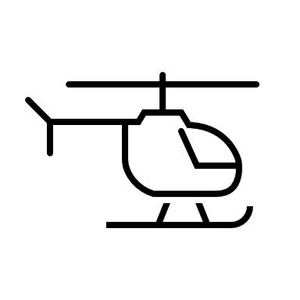
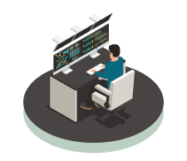
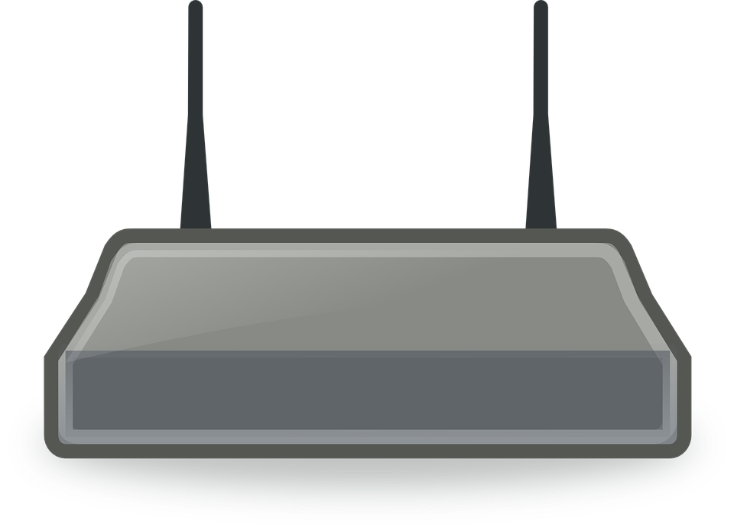

Wide Area Distributed Applications
Asset at the Edge
On-site Operation Center
Wide area distributed applications have more technical challenges
Network changes over time (ex. Wi-Fi to Cellular)
Scalability of data transport and cloud services
Edge device authentication and data security
INTELLIGENT LOGGING AND ANALYTICS, ASSISTANCE
MULTI-VEHICLE ANALYTICS, ASSIST, STORE & FORWARD LOGGING
NAT
NAT
OMG DDS WAN Databus
Cloud
Remote Monitoring, Analytics and Assistance
NAT
MULTI-SITE ANALYTICS & ML, STORE LOGGING

Slide 42
OMG DDS real-time WAN Transport
Smart transport enabling secure, scalable, and high-performance communication over WANs, including public networks
Features include:
UDP based WAN connectivity
Network Address Translator (NAT) traversal
Support for IP mobility
No third-party system dependence, such as STUN servers
Direct Edge-Edge communication
OMG DDS Databus @ Edge
Real-Time WAN Transport
Gateway
OMG DDS Databus @ WAN
Real-Time WAN Transport
OMG DDS Application

Slide 43

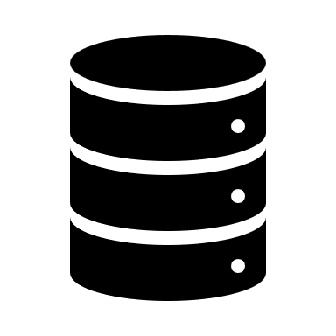



OMG DDS Across a WAN
Edge-to-Data Center connectivity across a WAN
Edge-to-Edge connectivity across a WAN
OMG DDS connectivity within Data Centers and Edge Systems
Data
Center
Analyze
Store
Aggregate
Databus
NAT
Real-Time WAN Transport
OMG DDS WAN Databus
Edge
Systems
NAT
Databus
System Component
Real-Time WAN Transport
Notes:
Not only can edge systems communicate back to a central system, but they can also communicate with each other.

Slide 44
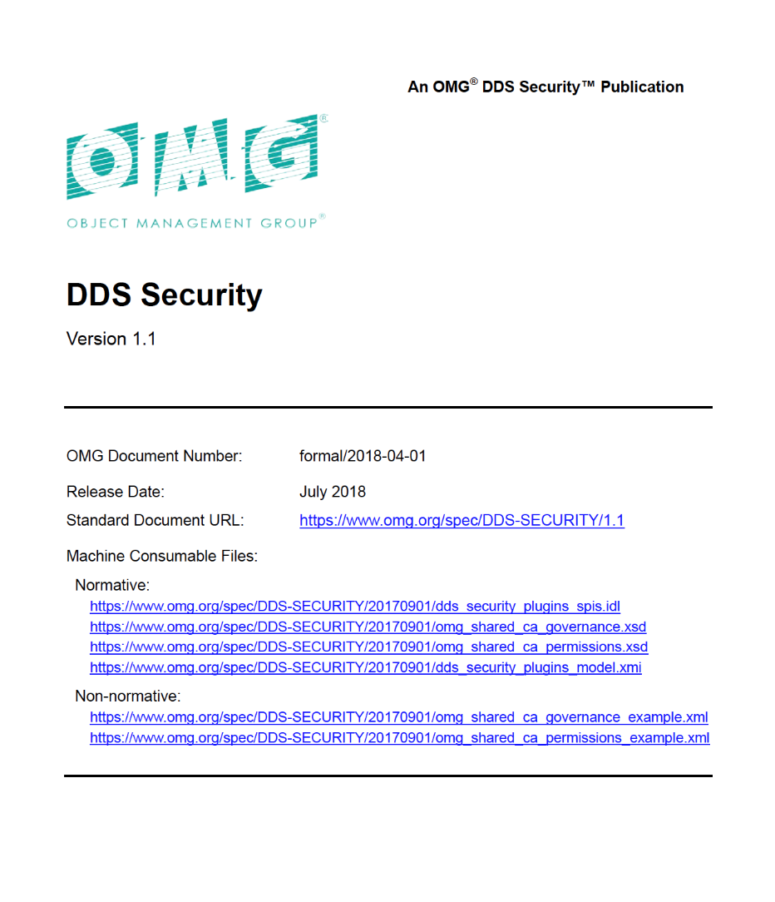
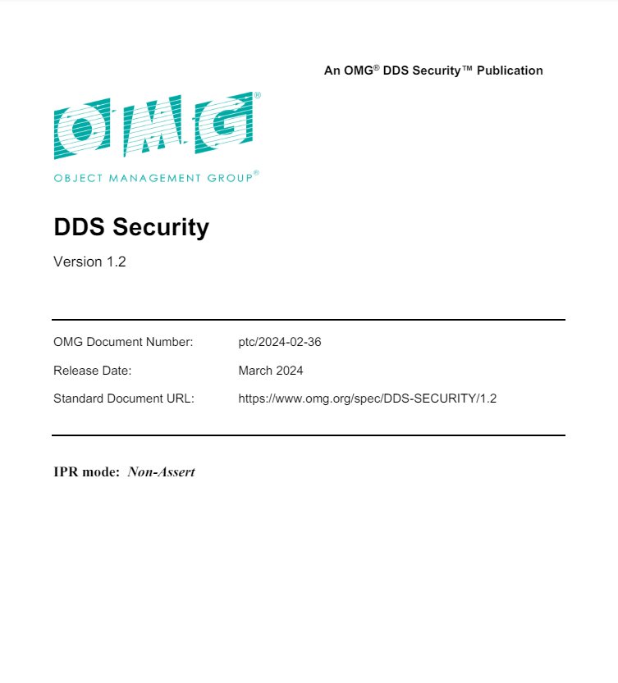

OMG DDS Security Standard
OMG released the DDS Security specification (v1.2) in March 2024
Collaboratively developed by several OMG DDS vendors
Defines:
  OMG DDS Security Model
  Service Plugin Interface (SPI) Architecture

Slide 45
OMG DDS Security Standard
Security Plugs into OMG DDS Middleware
  Secures data-in-motion throughout the system
  Can easily take DIS PDUs or TENA / HLA FOMs and convert them to Secure OMG DDS Topics
  Programming language and Operating System interoperability
Decentralized, Peer-to-Peer, and Highly Configurable
  Fine-grained access control and security levels for each topic and partition
  Each participant separately authenticated through mutual authentication
OMG DDS Security has been vetted at the Cybersecurity Warfare ranges at Quantico, VA and Orlando, FL
  USAF has funded a SBIR project for Multi-Level Security for LVC simulations
OMG DDS Security is a natural fit for Multi-Domain Operations systems
  Joint Battle Command Platform JBC-P
  Integrated Air and Missile Defense Battle Control System IBCS
  Cooperative Engagement Capability CEC
  Universal Ground Control Station UGCS
  All branches of the military, including Space Force, use OMG DDS

Slide 46
OMG DDS: Data-Centric, Fine-Grained Security
Per-Data-Topic Security
  Control r,w access for each function
  Ensures proper dataflow operation
Complete Protection
  Discovery authentication
  Data-centric access control
  Cryptography
  Tagging and logging
  Non-repudiation
  Secure multicast
  100% standards compliant
Simulate
Visualize
Control
Operator
Applications
Data Topics
BaseEntity
Detonation
Fire
Data Topic Security model:
Simulate: Fire(r), BaseEntity(w)
Visualize: BaseEntity(r), Detonation(w)
Control: BaseEntity(r), Fire(w)
Operator: *(r), Fire(w)

Slide 47
Pluggable Architecture
Requires trivial or no change to existing OMG DDS apps and adapters
Includes default plugins; customizable
Runs over any transport
  Including low bandwidth, unreliable
  Does not require TCP or IP
  Multicast for scalability, low latency
Completely decentralized
  High performance and scalability
  No single point of failure
Application
Authentication
OMG DDS Security Library
Access Control
Encryption
Logging
Data Tagging
Any Transport
(e.g., TCP, UDP, multicast, RT-WAN, shared memory…)

Slide 48
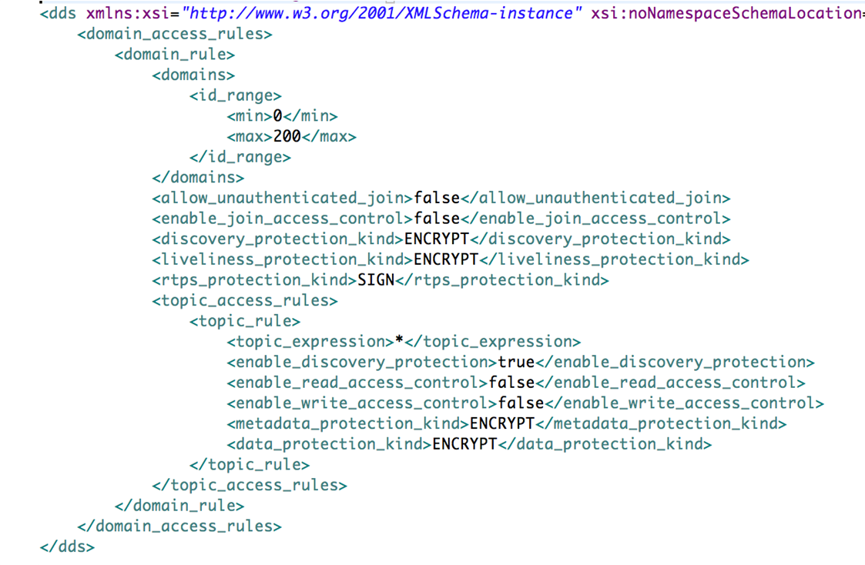
Domain Governance File
The domain governance document is an XML document that specifies which OMG DDS domain IDs shall be protected and the details of the protection
It is signed by the permissions CA

Slide 49
Configuration Possibilities
Are “legacy” or un-identified applications allowed in the Domain?
  If yes, an unauthenticated application will:
    See the “unsecured” discovery Topics
    Be allowed to read/write the “unsecured” Topics
Is a particular Topic discovered over protected discovery?
  If so, it can only be seen by “authenticated applications”
Is access to a particular Topic protected?
  If so, only authenticated applications with the correct permissions can read/write
Is data on a particular Topic protected? How?
  If so, data will be sent signed or encrypted then signed
Are all protocol messages signed? Encrypted?
  If so, only authenticated and authorized applications will see anything

Slide 50
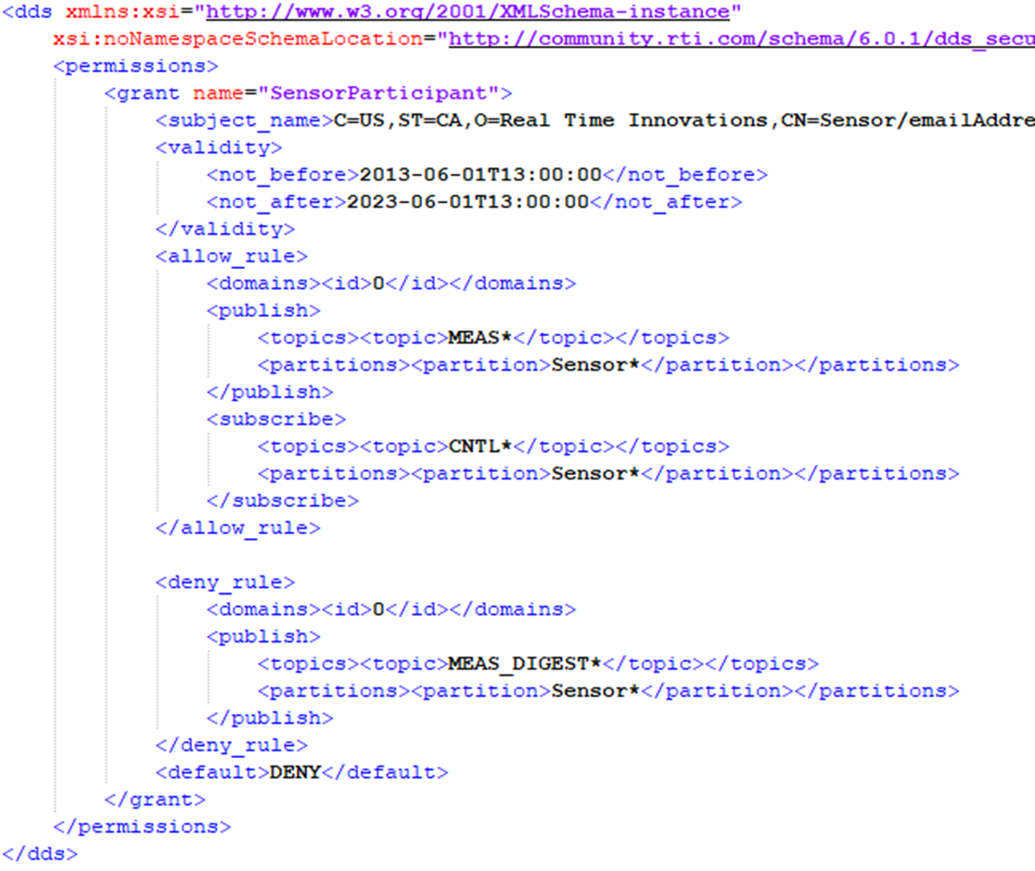
Permissions Document
For each participant, specifies:
What domains it can join
What Topics it can read/write
What Partitions allowed for publish and subscribe
What Tags are associated with Readers & Writers

Slide 51
Configuring & Deploying OMG DDS Security
Participant 1
Participant 2
P1 Permissions File
P2 Permissions File
P1 Identity Certificate
P2 Identity Certificate
P1 App
P2 App
P1 Private Key
P2 Private Key
Shared By All Participants
Domain Governance
Document
Identity CA Public Certificate
Permissions CA Public Certificate

Slide 52
Using OMG DDS with distributed LVC simulations
Can leverage/ integrate existing system software
  Over one thousand separate DoD systems (Navy, Air, Army) use OMG DDS
    OMG DDS is mandated by Navy OA for combat management systems
    OMG DDS specified by US DoD for the unmanned vehicle control (OSD-UCS)
    OMG DDS specified by UK-MOD for all Ground Vehicle Architectures
    OMG DDS is a transport for MOSA standards, FACE, SOSA, OMS, UCI
With OMG DDS, simulation systems are able to reuse and integrate software components from actual systems
  This has already been happening for years
OMG DDS is the logical technology for integrating disparate data models in distributed LVC

Slide 53
DAF M&S Standards Range Fan Provides Focus
Categories Follow NATO Stds “bins”
Info Exchange
Data Models
M&S Interoperability
COTS Examples
MAK (COTS)
DAF/USA
Synthetic Physical Environment
General/NATO
DDS
Priority
BIFROST
Data CFT
(External)
MSSV
Expand GRID use?
Conceptual Modelling and Scenarios
KR
Army
LLMs w/M&S SBIRs
Gov Sim Interface (GSI) in JSE
Ontology?
Simulation Analysis and Evaluation
MBX
Simulators
GSI
Ansys
(COTS)
Priority
New Metadata Std (SISO)
GRAs
SCARS
HLA 4.0
JSE
Ontologies?
OGC
UAF
M&S Misc
Style
Guides
TENA
etc
SysMLv2
Metadata Std
SEDRIS
Microservices/
Lightweight, etc
Test
SysML
HLA
Standard Model Library
M&S Methodology, Architecture and Process
CMMS
CyberDEM
AI
What is missing?
DIS
Performance Improvement Tools
FEDEP
C2SIM
MLS
VV&A
Today
Future

Slide 54
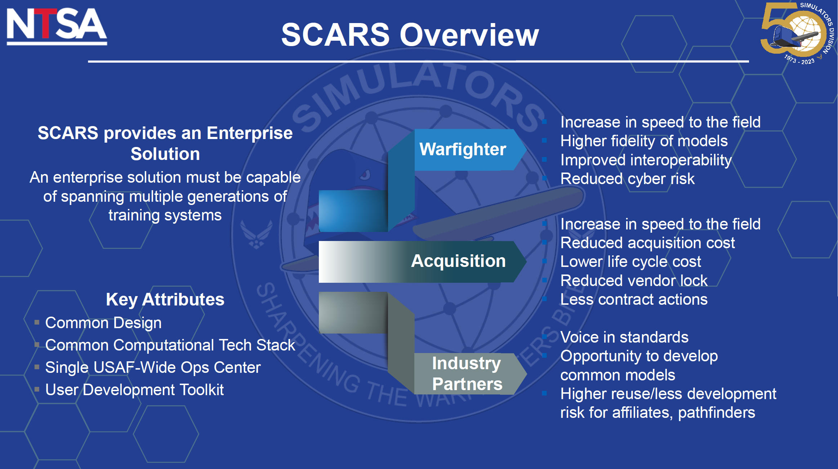
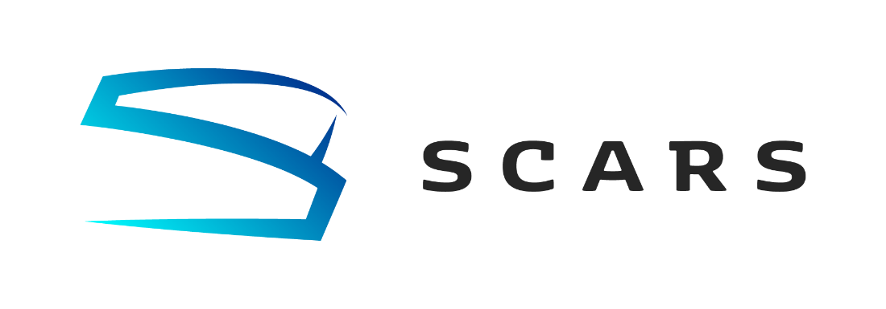
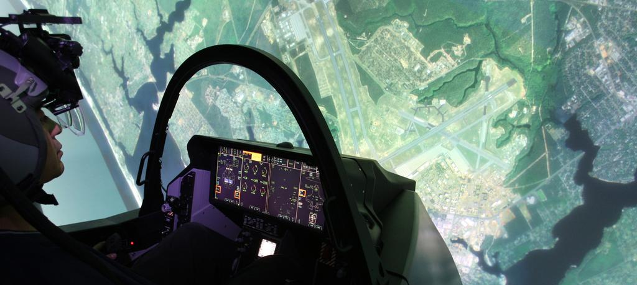
Air Force’s Simulators Common Architecture Requirements and Standards (SCARS) program

Slide 55
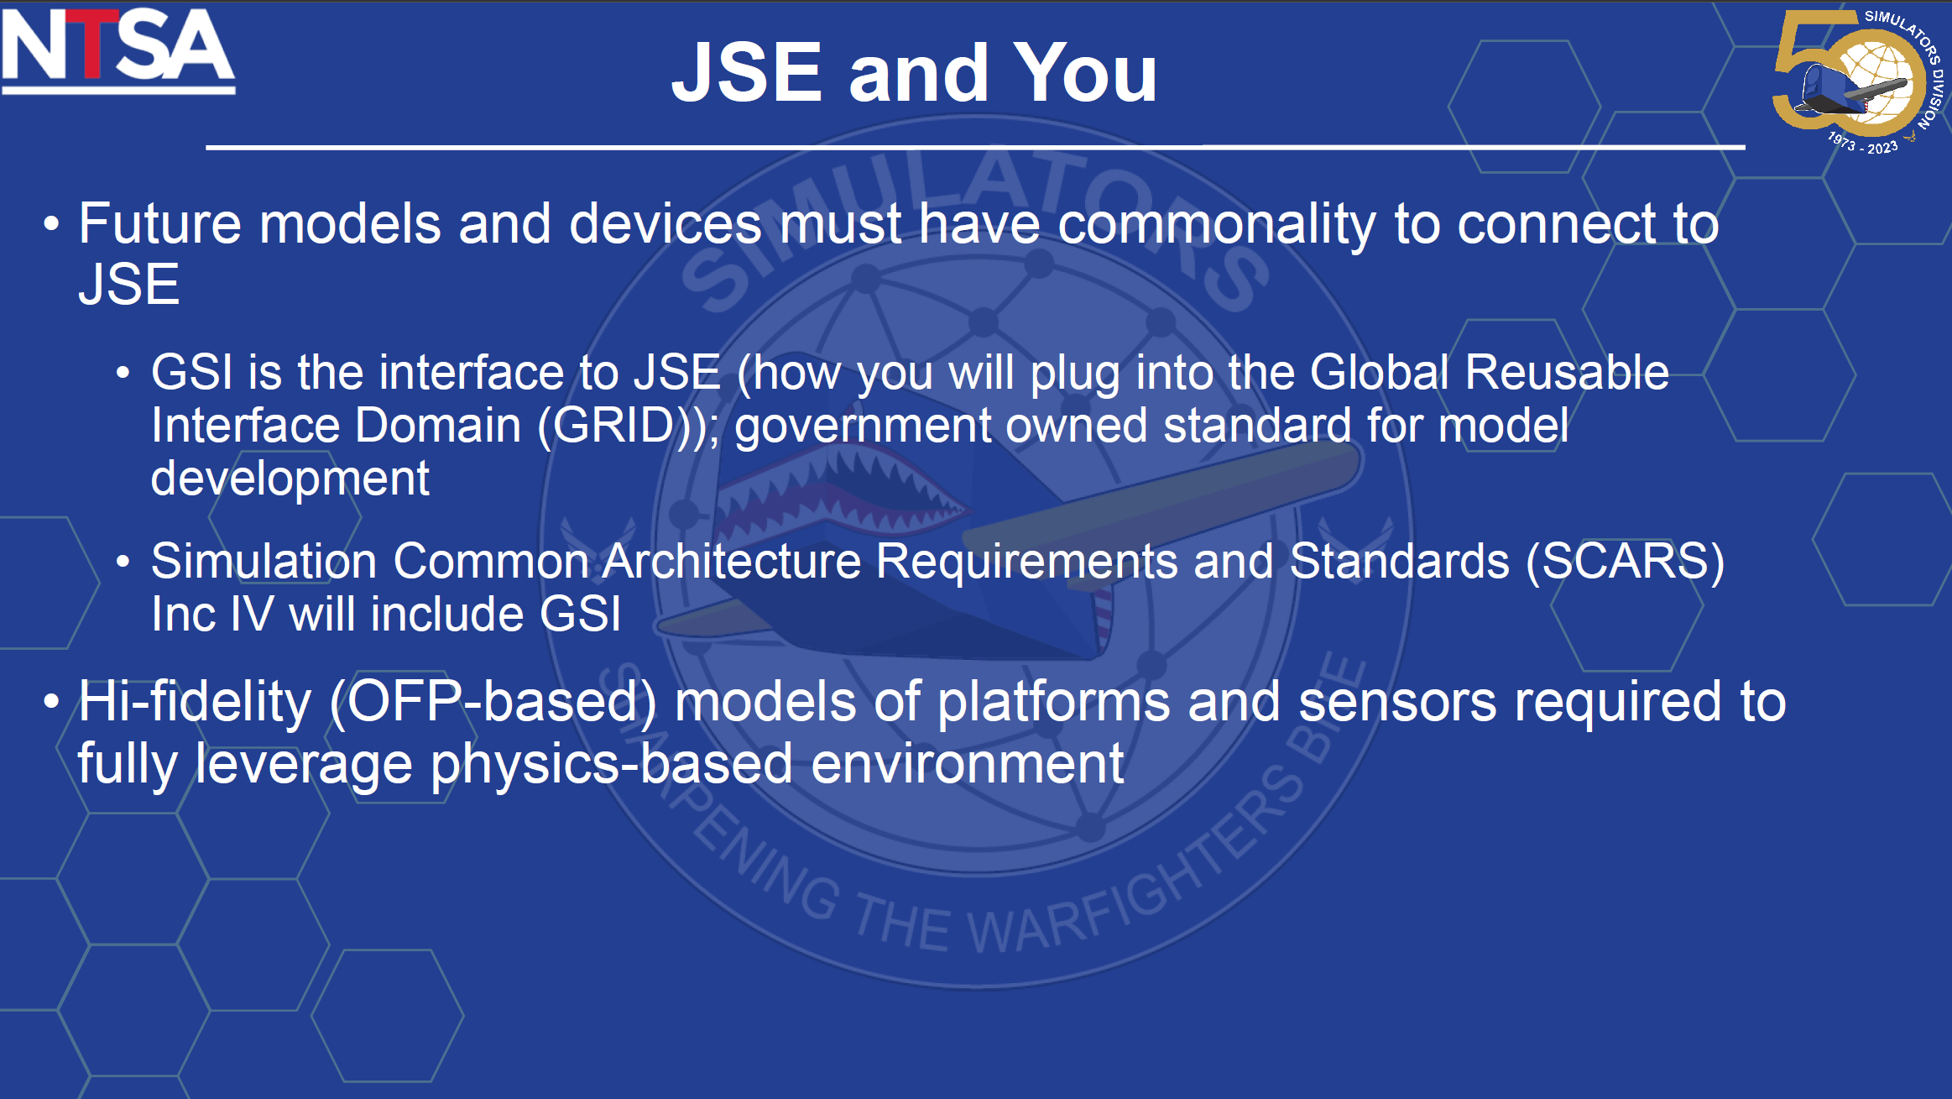
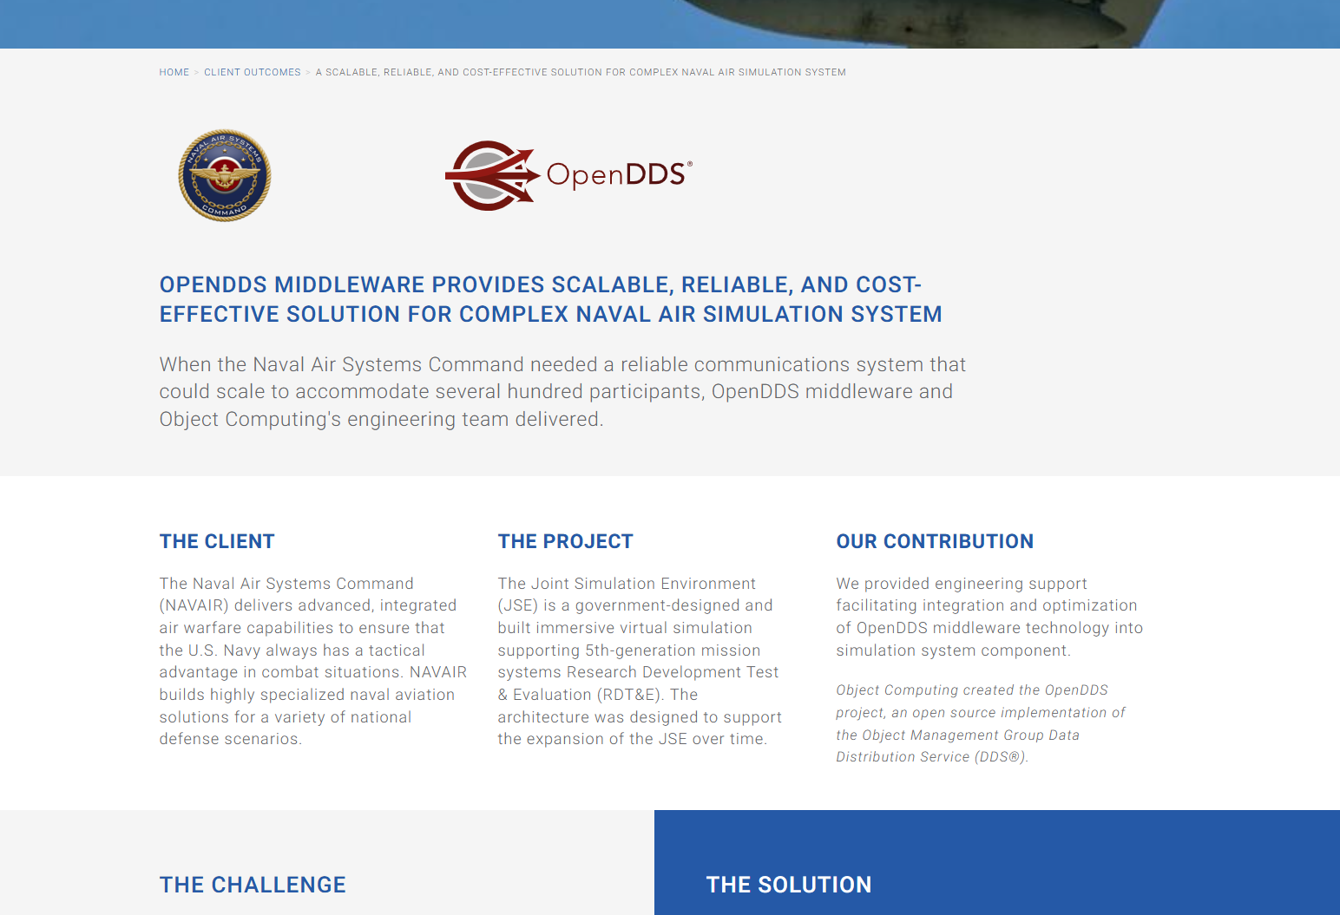
Joint Synthetic Environment

Slide 56
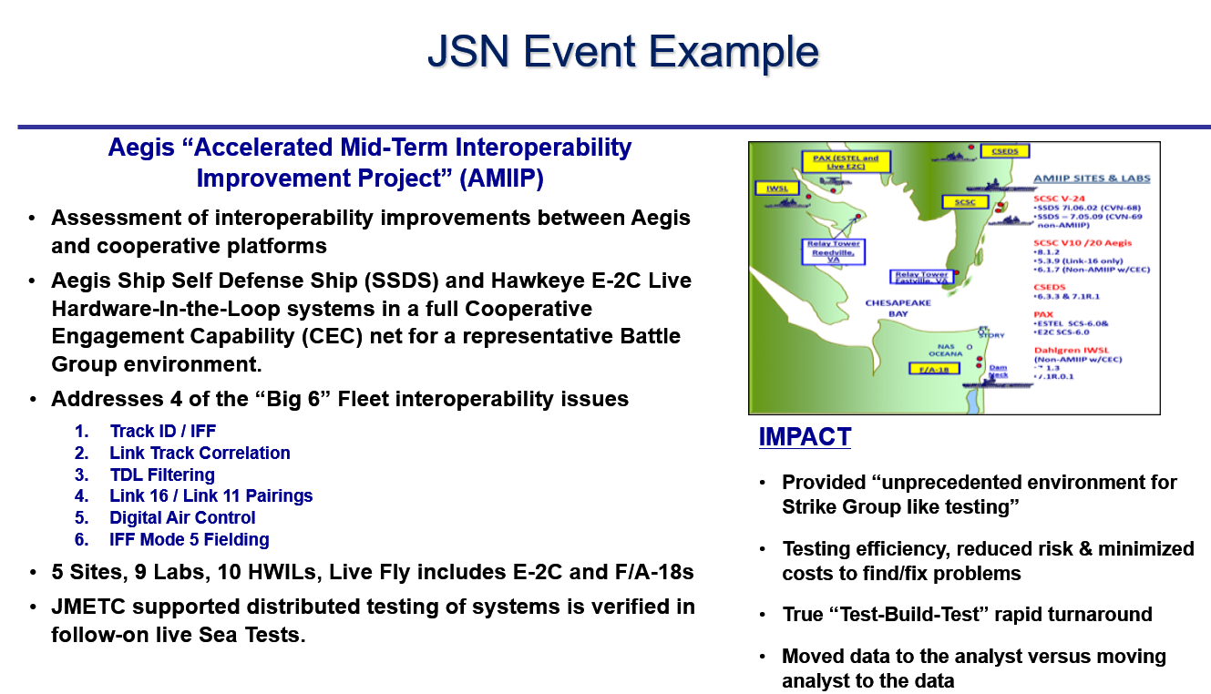
Live OMG DDS Systems with TENA in Simulation: JMETC

Slide 57
Securing distributed LVC simulations with OMG DDS
Can leverage/integrate mission data
  Recorded data from actual mission execution could be combined with simulation data and be used for training
    This approach is already followed in the US Navy OATM
  Rapid feedback from mission to training is key to an agile and effective force.
Can leverage/integrate OMG DDS Security into new distributed simulations
  Secure training and simulations over WAN/Cloud/RF/Lossy Networks/TDL
  Role-based access allow for joint Coalition forces to train alongside US forces
  Multiple SBIRs with different defense agencies for secure LVC simulations

Slide 58
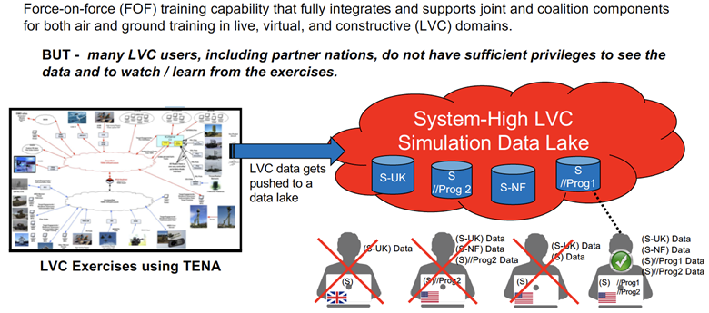
Multi Level Secure MLS, Live Virtual Constructive LVC Simulations

Slide 59


Multi Level Secure LVC Simulations
Hybrid solution enabling interoperation of existing TENA systems via TENA-DDS Gateway with a NextGen TENA that is fully DDS compliant
Notes:
Through Prism (joint GTRI/RTI) program work and through as yet funded/awarded JLVC J7 work for AFAMS, RTI, on a single HLA/RPRFOM3 federation utilizing RTI Connext DDS will provide:
The ability to tag and filter data based on ABAC or RBAC for publish and subscribe of RPRFOM 3 data. The qualities of Service that will be available to the HLA RPRFOM will far exceed current and planned (HLA4) QoS and capabilities
The ability to use trusted guard/MLS separation of tagged data on a single domain. Single domain can have 'partitioned' topics and can also now utilize participant partitions This includes UNCLASS effects visible to all workstations; T/S methods visible to T/S workstations, etc.
The entire point of prism is that AAR couldn't previously happen because data from different classifications was stored in the data lake at system high, effectively locking out all non system high participants post action. With Prism (and abilities provided to it by RTI Connext Secure) this disperate data was/is tagged correctly, allowing for AAR at multiple levels of security
In essence, all askes; 4a-->4d, are addressed by RTI after or in conjunction with proposed JLVC work for AFAMS.

Slide 60

Multi Level Secure MLS, Live Virtual Constructive LVC Simulations

Slide 61


Future Is Not That Far Off…
Secure DDS with Commercial Cloud Native Credential Management

Slide 62


Secure DDS-Enabled HLA Federate-Based JLVC
Could Also Integrate With Other Simulation Technologies
Cameo / Ansible
Zero Trust Provisioning Solution
([Apps], DDS QoS, Security Policies)
MBSE + Deployment-Time Security Policy Models
Federate User-Level
DDS Permissions
Provision user device with DDS Security Artifacts based upon CAC/Credentials
(Zero Trust Provisioning)
HLA Federate
HLA Federate
HLA Federate
Federate-Level
DDS Permissions
Trusted Gateway Device
Trusted Gateway Device
Trusted Gateway Device
Provision device with DDS Security Artifacts based upon Federate Credentials
HLA-DDS Gateway
HLA-DDS Gateway
HLA-DDS Gateway
Potentially a hardened router, remotely managed if US-based,
locally managed if coalition partner
Pluggable Data Tagger
Pluggable Data Tagger
Pluggable Data Tagger
Policy Engine
Policy Engine
Policy Engine
Federate-Level DDS Permissions
Federate-Level DDS Permissions
Federate-Level DDS Permissions
Secure DDS DataBus
Live Platforms
Sensors
DIS
C4I
Etc.
Pathway to Integration with Broad Ecosystem

Slide 63

Global Connectivity for USAF Training Simulations

Slide 64


Missile Defense Agency – Objective Simulation Framework
Fully Distributed, Real-Time,
Secure Cyber Situational Awareness for MDA OSF

Slide 65









Mixed-Reality Wargaming Platform
Cloud
A Hierarchical, Loosely-Coupled Design Enables:
Local Ownership
Disconnected Operation
Open Architecture
Capability-as-a-Service
  e.g., AI, Simulation, Data, Devices
Management
Logging
Analytics
Other
Services
Secure Global OMG DDS Databus
Secure
Gateway
Protocol/Data Interoperability
Data Routing/Filtering
Management
Logging
Analytics
Secure Cross-System OMG DDS Databus (Local/Regional)
OMG DDS
Processing Location Agnostic / Transparent
DataBus
Gateway
AI Training
Scenarios
Protocol
Gateway
One World
Terrain
Protocol XYZ
OtherSim
Autonomous Systems
AI/ML/DL
Augmented
Reality
Real World Twin
Local Mgmt
Simulated Worlds
Simulation DataBus
Simulation DataBus
Real World
Sim@ NATO 2
Simulation Connext DataBus
Sim@ NATO 1
Air
Helo
Sim@ SOCOM
Edge
Unity
Unreal
Maritime
Ground
Simulated
Actors
Digital
Twins

Slide 66



CCDC Aviation& Missile Center - SED System Integration Labs
Hardware-in-the-Loop labs for the UH-60V, CH-47F and AH-64E Army Helicopters

Slide 67

CCDC AvMC S3I - Apache AH-64E
HAT/HOT
Flight Model
Visuals
Flight
Controls
Visuals
Image Generators
Database
OMG DDS
Data Record /
Playback
Data Analysis
Workstation
TBD
LabVIEW
Science
Experiments
RadAlt Model
Aberdeen I/O
ADC Model
EGI Model

Slide 68

PEO Aviation - Combat Aviation Brigade Architecture Integration Lab CABAIL
AH-64E and CH-47F SILs already use OMG DDS to reduce hardware and development costs for HIL experimentation
JBC-P Network Operations Center(NOC) was re-architected using OMG DDS for significant code reduction and performance improvement

Slide 69
Conclusions
DDS is a mature standard from the OMG
  Platform neutral: Operating Systems and Programming Languages
  Mandated and deployed worldwide in many military systems with demanding real-time applications
  Portable API DCPS and Interoperable Wire Protocol RTPS
  Deployed DDS Security Standard specification
OMG DDS focuses on efficient data-distribution for real-time &
high-performance systems
OMG DDS is suited for integration of distributed training systems
  Authentication, Role-Based Access to data, Multiple Levels of Security (MLS)
  Evolvable Type System
  Real-Time Quality of Service (QoS)
  Integration and reuse of operational system software and mission data

Slide 70
Original Tutorial Learning Objectives
After taking this tutorial you should be able to:
Describe how OMG DDS enables semantic interoperability
Describe the OMG DDS standard
Explain the principles of the OMG DDS Secure standard for securing communications between distributed simulations over WAN/Cloud/RF/Lossy networks
Explain how OMG DDS works with the simulation architectures TENA, HLA and DIS
Summarize how OMG DDS works with real-world Hardware In the Loop (HIL) for secure distributed LVC simulations at scale
Describe how OMG DDS is working within SISO

