Slide 1

A Practical Guide to Using Open Tools for Well-Defined Competencies
Learning Engineering of Multi-Platform, Multi-Domain, Mission-Ready Skills Definitions
Jim Goodell, INFERable, a Public Benefit Corporation
Unclassified

Slide 2
What is a Competency?
Before we start…
What do you think?
What is a competency?
Notes:
“Thank you all for attending this tutorial ‘A Practical Guide to Using Open Tools for Well-Defined Competencies” Before we get started I’d like hear from some of you. How would you define a competency?”
(take 2-3 people hand raises – 1-2 minutes)

Slide 3
Introduction: Preview of Tutorial
WHY well-defined and sharable competency definitions are needed.
CHALLENGES in defining competencies well.
PROCESSES for creating well-defined competency definitions.
HOW AI Tools Can Help. …demonstration.
STANDARDS for INTEROPERABILITY
Notes:
Here’s our agenda for the next 90 minutes:
1. We’ll examine WHY well-defined and sharable competency definitions are needed.
2. We’ll examine CHALENGES in defining competencies for precision, granularity, context and interoperability. In other words, why “well-defined” is hard.
3. I’ll explain some PROCESSES for competency definition development.
4. HOW AI-enabled, standards-based automation tools can streamline the process. With DEMONSTRATION of a tool that can help with the process.
5. We’ll examine STANDARDS for INTEROPERABILITY and machine-readability for the Total Learning Architecture.
Let’s look at our learning objectives…

Slide 4

Learning Objectives
At the end of this tutorial you should be able to:
EXPLAIN
the value of Sharable Competency Definitions.
DEFINE what it means for a competency to be well-defined.
IDENTIFY common challenges.
IDENTIFY free and open tools.
APPLY best practices for creating and structuring competency definitions.
Notes:
At the end of this tutorial you should be able to :
Explain the value of Sharable Competency Definitions (IEEE 1484.20.3) for interoperability across advanced distributed learning environments.
Define what it means for a competency to be well-defined, drawing from IEEE 1484.20.2 and other relevant sources.
Identify common challenges in developing competency definitions, including issues of precision, granularity, and cross-platform usability.
Identify free and open tools to automate the development and iterative refinement of well-defined competency frameworks.
Apply best practices for creating and structuring competency definitions to ensure their suitability for multi-domain training contexts and digital learning ecosystems.

Slide 5
Learning Modalities in this Session
Expository
Social
Worked Example
Practice
Notes:
In this tutorial we’re going to be incorporating several learning modalities. We’ll mix in just a little social learning (like the opening prompt and Q&A at the end) and I’ll end with some links to practice resources to continue your learning after the tutorial.

Slide 6
Learning Modalities in this Session
Expository
Practice
Social
Worked Example
Notes:
Let’s unpack that.

Slide 7
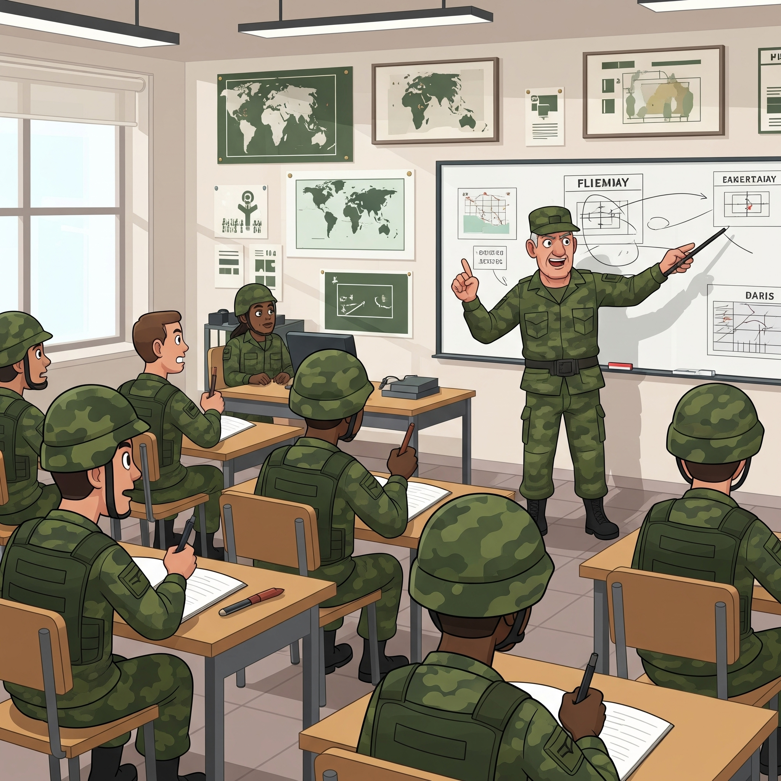
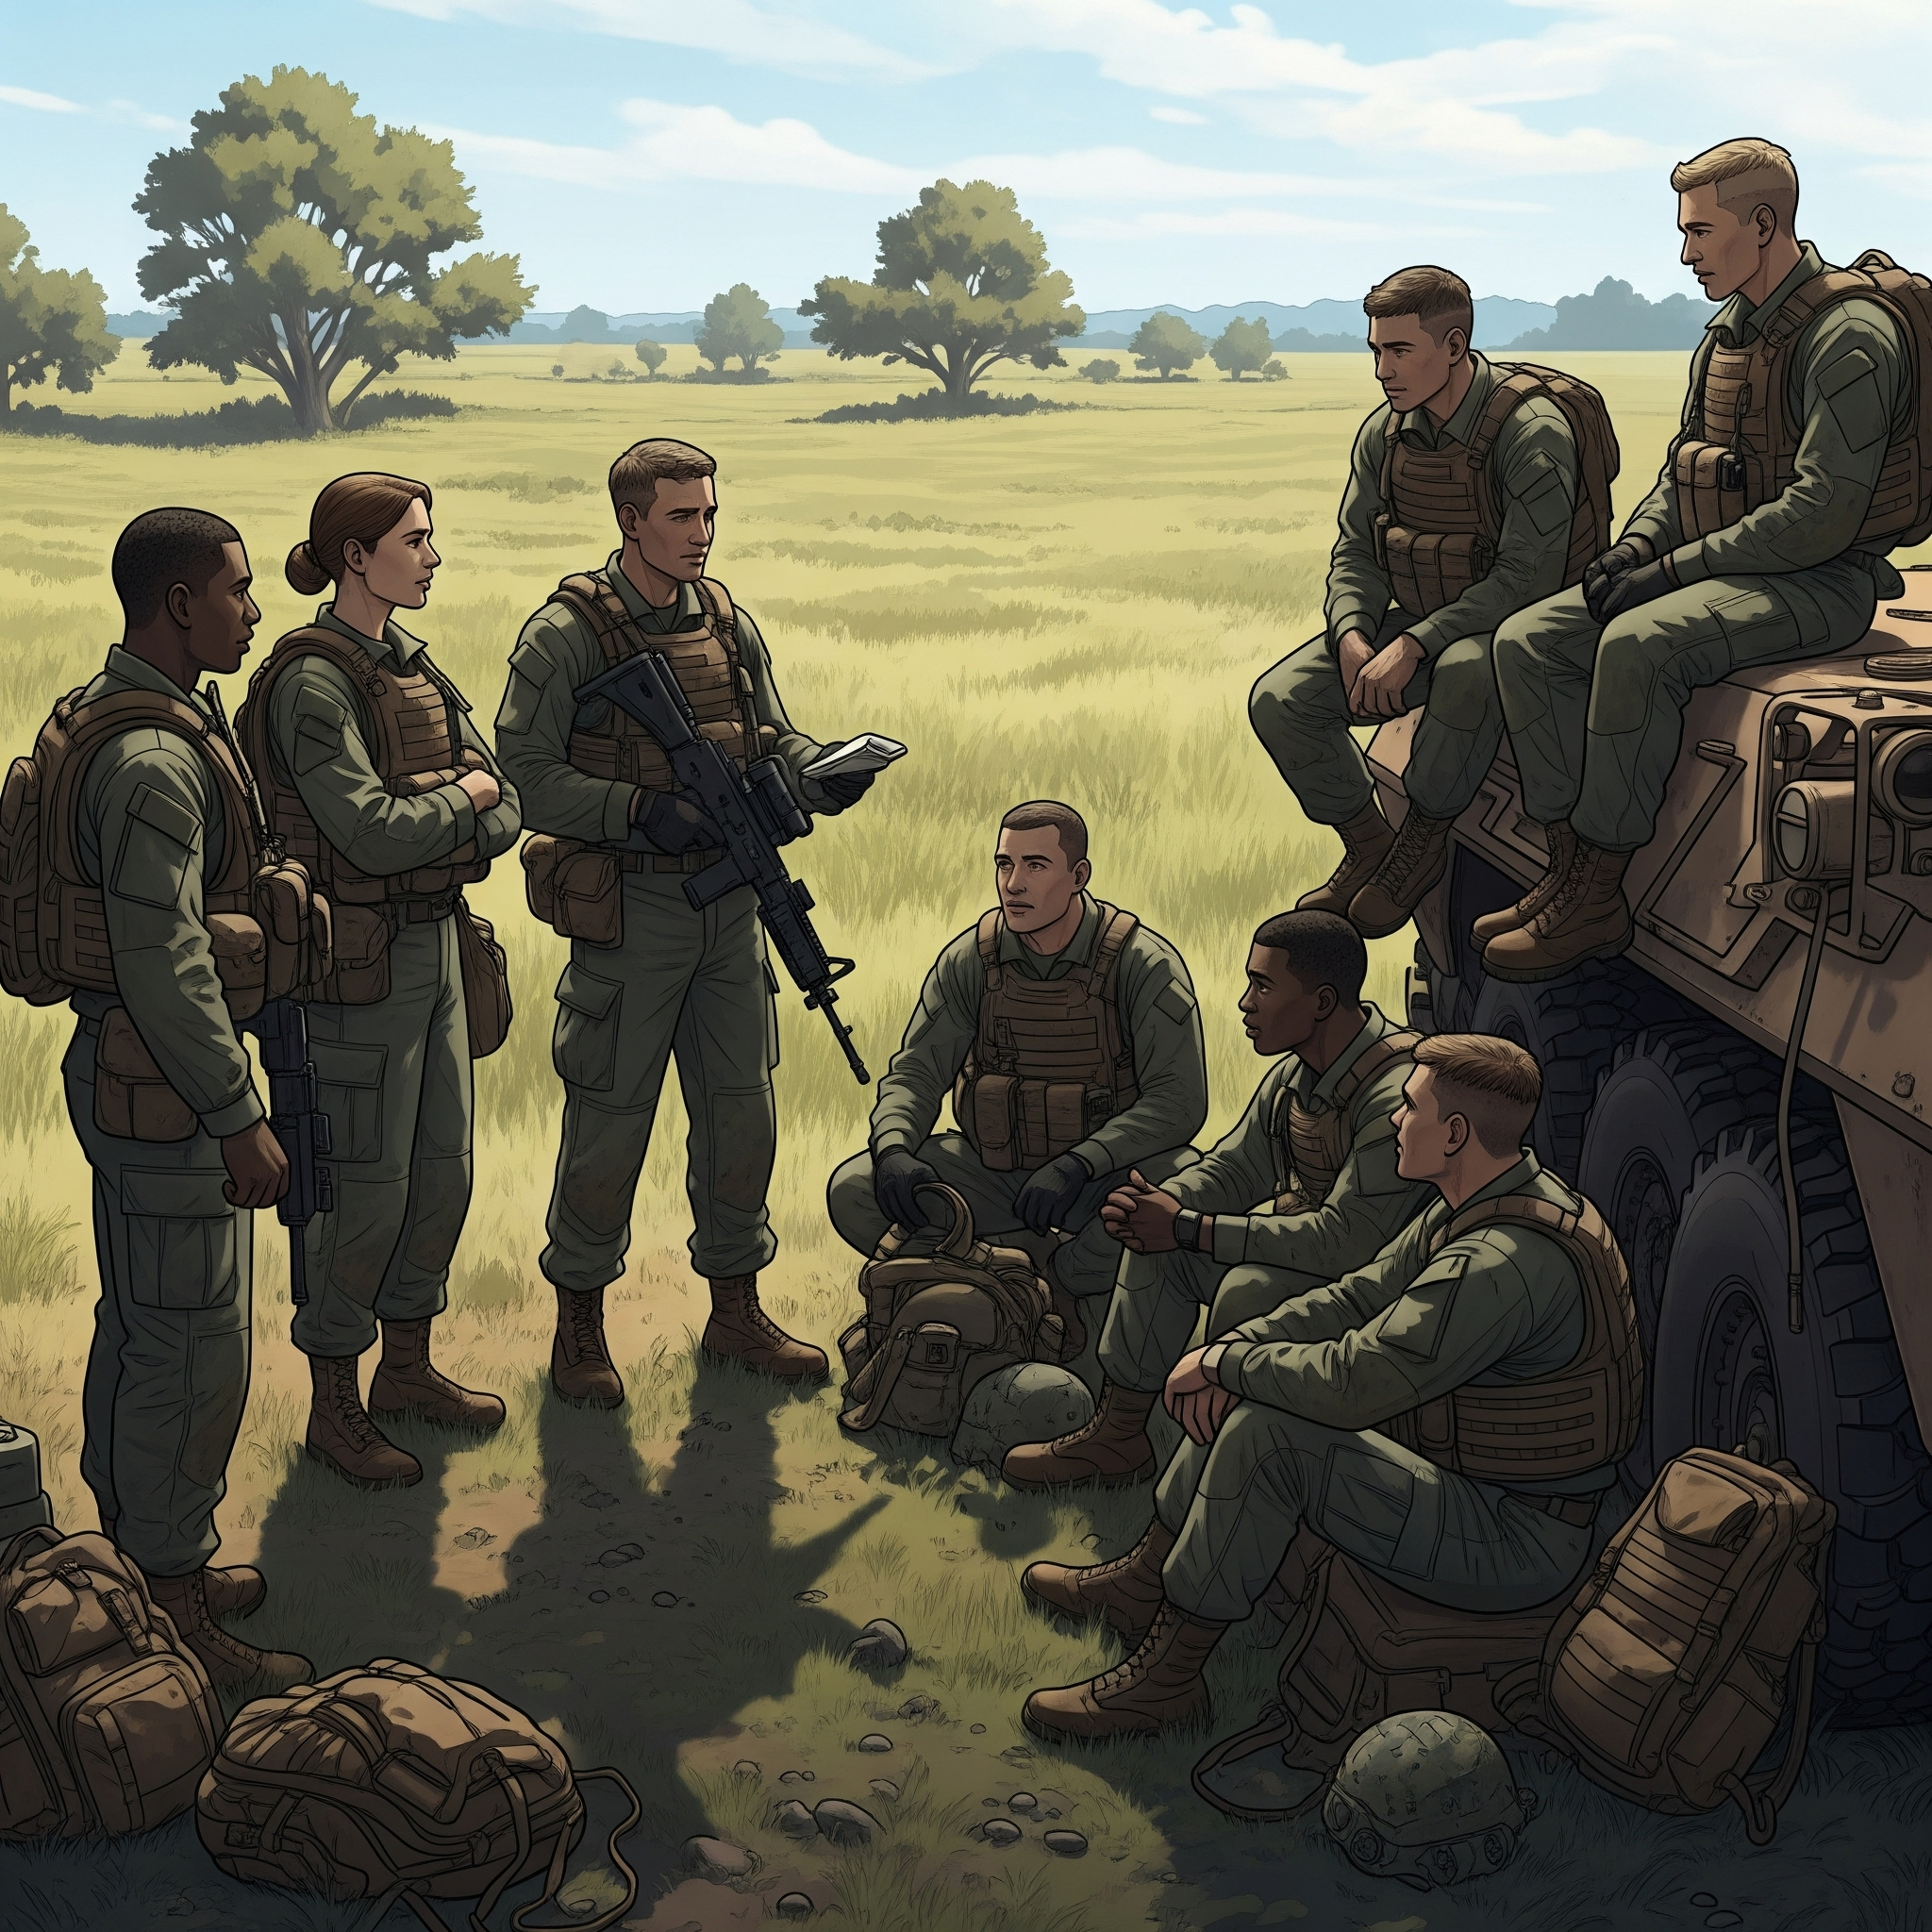
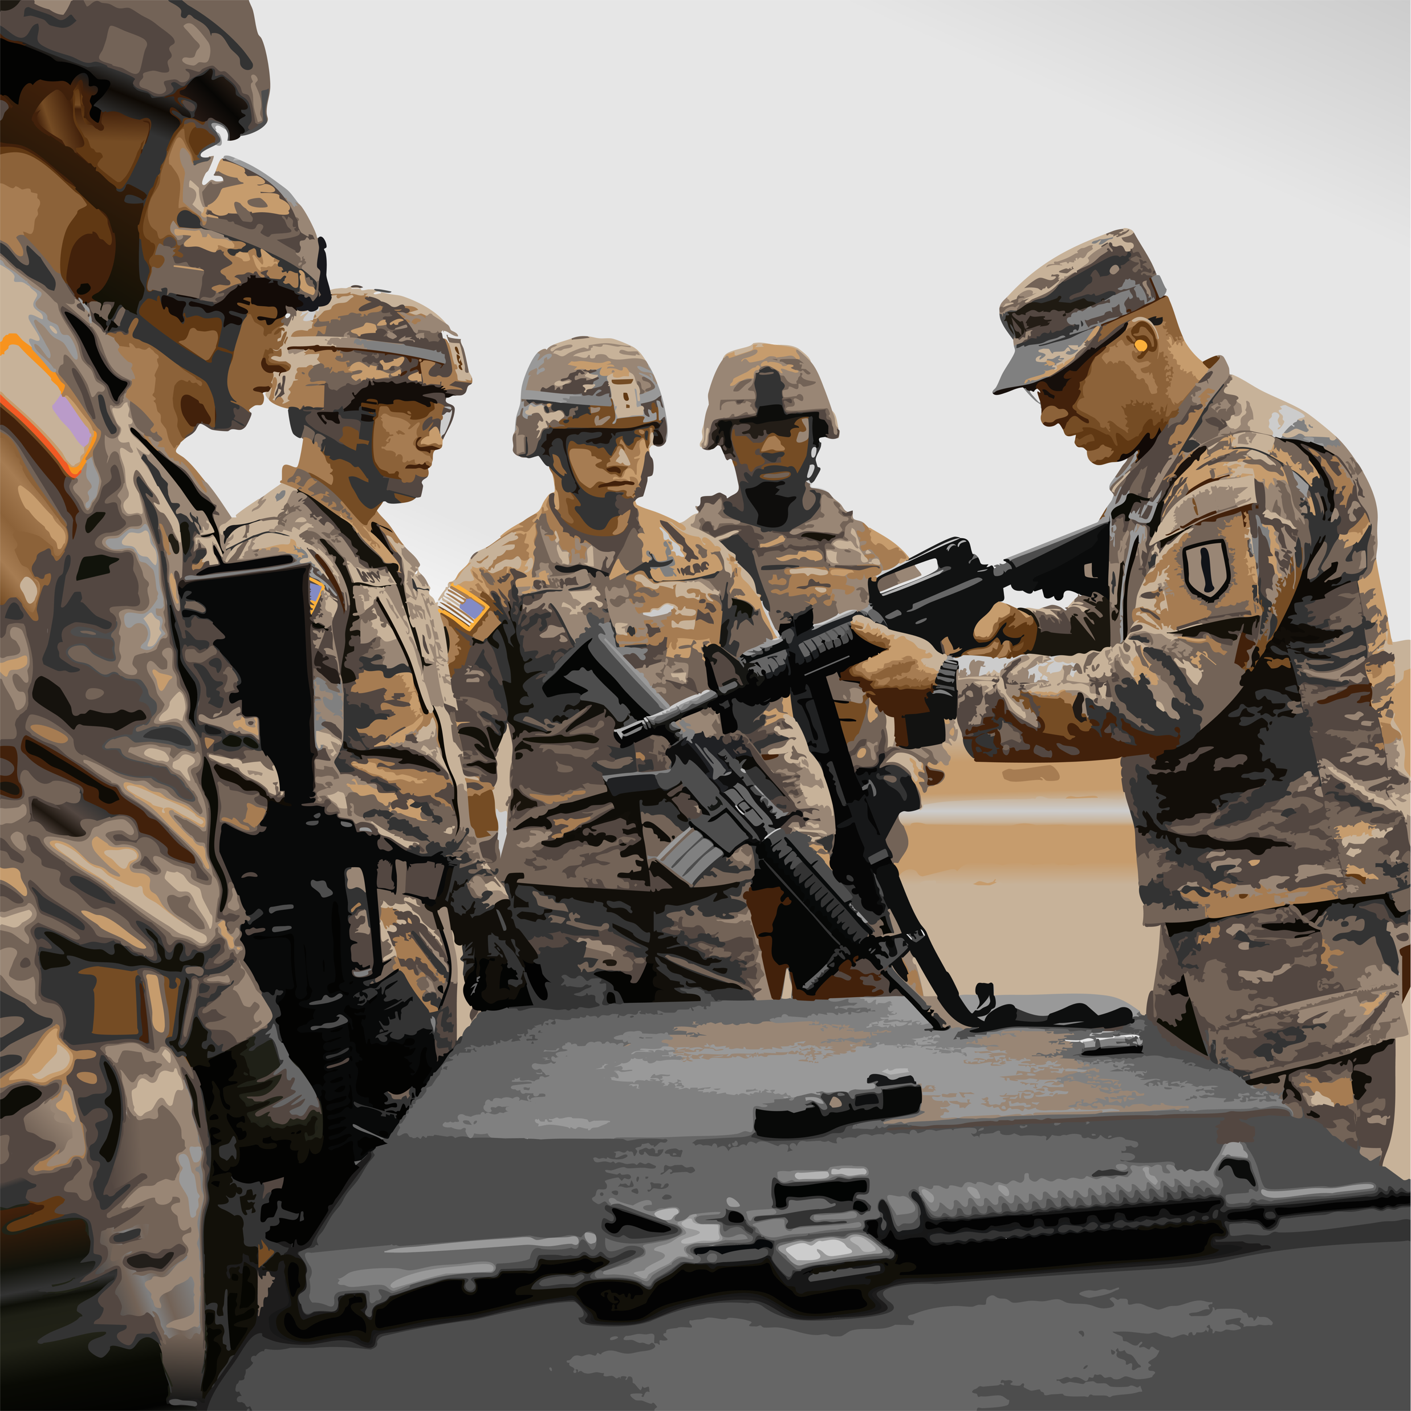

Learning Modalities in this Session
Expository
Expository
Social
Worked Example
Practice
Introducing Concepts
Meaning & Engagement (limited here Q&A discussions)
Deeper Understanding of Application
Building Expertise (with feedback) (via post-tutorial resources)
Notes:
Developing expertise requires multiple modalities of learning.
Expository learning, including lectures, text and video resources, is good for introducing or reinforcing concepts and making connections to prior learning…like we’re doing here today.
Social learning is good for building leaning and engagement and developing team competencies. (In this tutorial we’ll limit that to Q&A and reflections due the the room constraints.)
Worked examples are when an expert works through how to do something. It can build deeper understanding, especially for applying skills and transferring to new contexts. I’ll use worked examples of some processes and tools for developing and encoding competencies.
Perhaps the most valuable modality of building from novice to expert is practice with feedback. We’re not going to do that here, but we’ll give you links to some resources that you can use later to practice we cover today.

Slide 8
Why Well-Defined and Sharable?
Expository
“Skills and competencies will be the currency to enable the free movement of workers both geographically and economically. To support these, there need to be well-defined competencies.”
(IEEE 1484.20.2)
EXPLAIN
the value of Sharable Competency Definitions.
Note: In this tutorial and in IEEE standards ”competencies” is broadly defined.
Notes:
The authors of the IEEE Recommended Practice for Defining Competencies recognized a growing for competencies as a “currency” for life-long-learning, worker mobility, and productivity.
In this tutorial and IEEE standards ”competencies” is broadly defined as describing the set of skills and behaviors required in the performance of a task or activity within a specific context.
This may include skills, knowledge, ability, attitude, habit of practice, behavior, or learning outcome. It may also include definitions of tasks and how to evaluate performance on tasks.

Slide 9
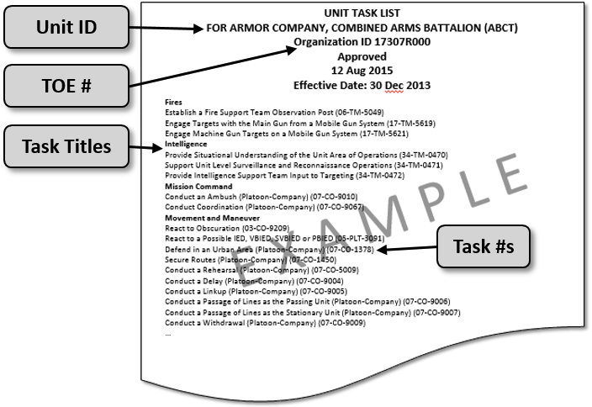
Army Example
Expository
“Major elements of a unit task list”
(from Army TRADOC Pamphlet 350-70-1)
Notes:
From a literature review, interviews, and prior experience we know that the U.S. Military services are among the top organizations in the world in terms of the effort and rigor used in defining and documenting competencies down to the task level. These are used as the basis of training, evaluation and promotion. A lot is at stake.
Here’s an example from the Army. This is a great example of breaking down categories of tasks and identifying discrete tasks. For example, the Army has "Mission Area Competencies”, “Unit Essential Tasks”, “Job specific Taks” and “Supporting Collective Tasks” . And these task definitions are pairs with assessment protocols and tools that address performance of tasks in different contexts and under various conditions. Most other organizations have not and cannot conduct this level of task analysis. As I go on with the tutorial, I’ll show some examples from the other services and some potential opportunities for further leadership.

Slide 10
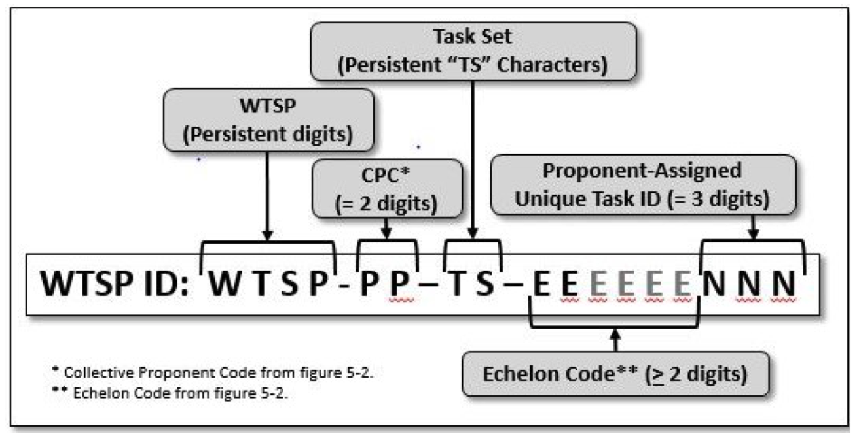
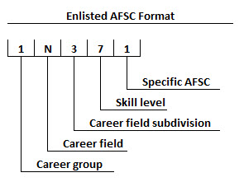
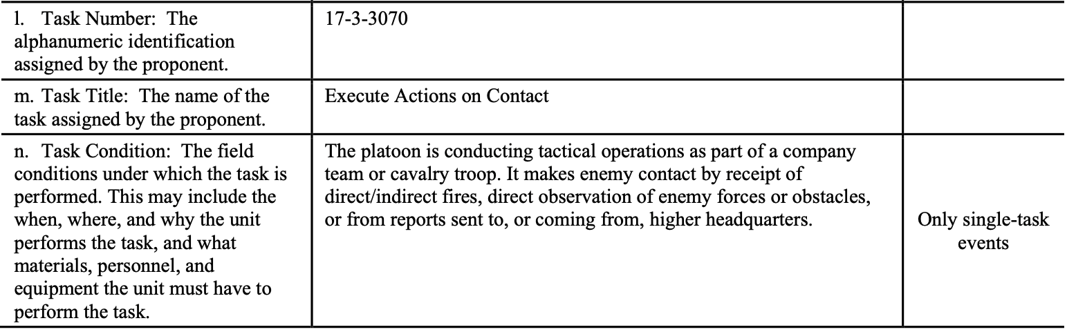
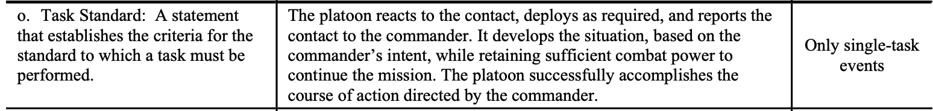
Why Well-Defined and Sharable?
Expository
U.S. Military Examples
Example WTSP elements
Conley, Raymond E. and Albert A. Robbert, Air Force Officer Specialty Structure: Reviewing the Fundamentals. Santa Monica, CA: RAND Corporation, 2009. https://www.rand.org/pubs/technical_reports/TR637.html. Also available in print form.
https://upload.wikimedia.org/wikipedia/commons/6/63/Enlisted_AFSC_Format.jpg
Villanueva, V., Email describing Air Force Specialty Training Standards. 26 February, 2025.
https://adminpubs.tradoc.army.mil/pamphlets/TP350-70-1.pdf
Notes:
These task lists are often organized by occupation, like the military occupational specialty code (MOS code) a nine-character code used by the Army and Marine Corps to identify a specific job. TRADOC Pamphlet 350-70-1 defines artifacts such as the Warfighter Training Support Packages (WTSP) that includes definition of tasks and numbering scheme for labeling those definitions. It also includes guidance for Analysis for Collective and individual Tasks, Opposing Forces (OPFOR) Tasks, Task Conditions, standards for labeling proficiency levels, Drill definitions and evaluation protocols. (click) The Air Force and Space Force has the Air Force Specialty Code (AFSC) a 5 character code, and Specialty Training Standards that address competency definitions under each AFSC. Within each AFSC competencies are defined for training and evaluation. These need to be defined for over 200 specialties in addition to sets of shared competencies that all Airmen should possess.
Navy uses the Navy Enlisted Classification (NEC) system supplements the rating designators for enlisted members.
These are some example of variations in the naming and structuring of competency frameworks. This shows complicated structures for competency frameworks that can vary by service and context. This is one of several… (click)

Slide 12

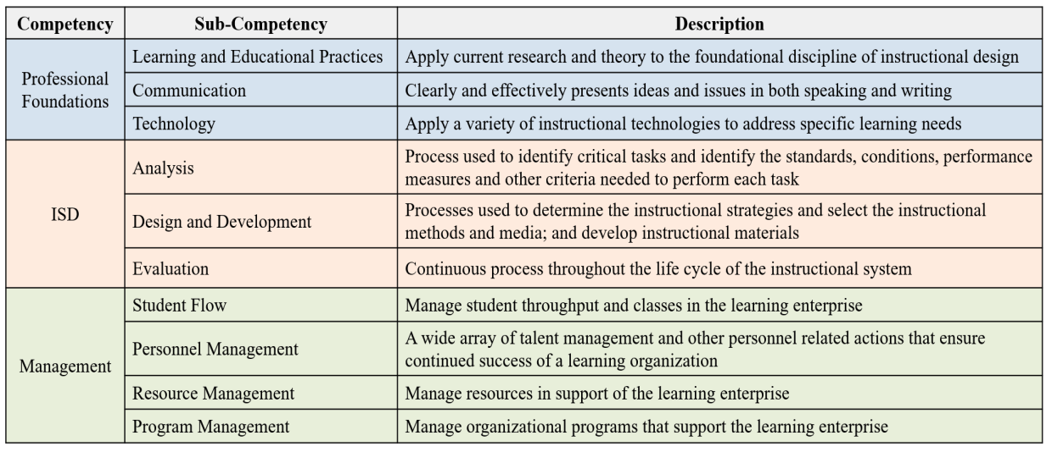
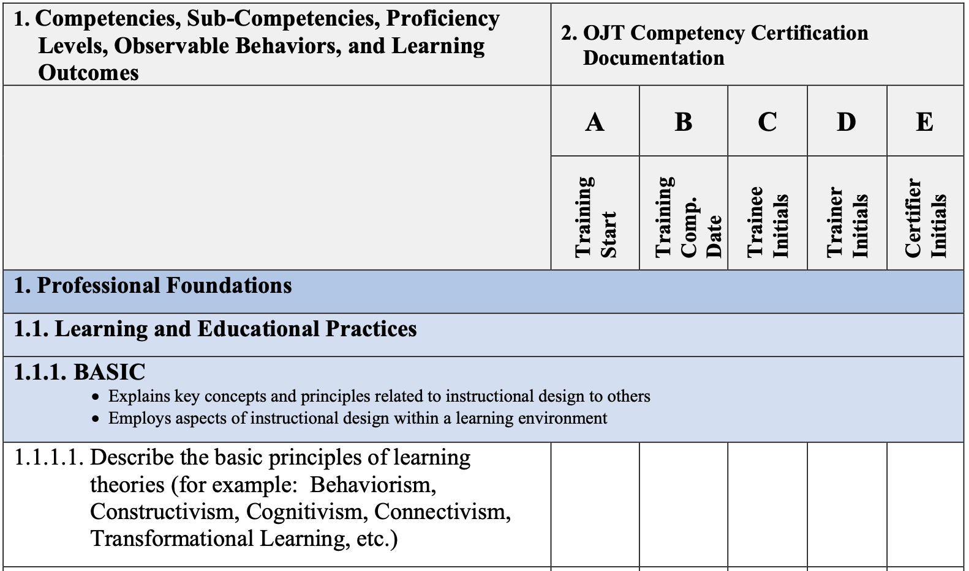
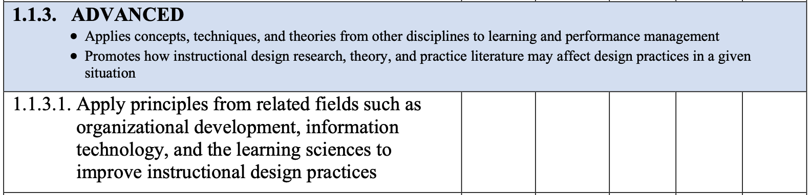
Air Force Career Field Education and Training
Expository
IDENTIFY common challenges.
https://static.e-publishing.af.mil/production/1/af_a1/publication/cfetp1750/cfetp1750.pdf
Notes:
Here’s an example of a career field education and training plan from the Air Force. In this structure, the levels of development are part of the hierarchy. (click) This shows the that Basic is a level of development defined for the instructional systems occupational series. This is level of career development not level of performance on an assessment. In other cases the same words “Basic” or “Advanced” on a rubric assessing performance on any given task.

Slide 13

RAND Study
Expository
Finding:
“Current processes for determining skill requirements are useful but limited. Skill qualifications and training are not centrally managed by any single USAF-wide system, making it difficult to compare skill supply and demand across specialties or to identify skill trends.”
Recommendation: “Invest in infrastructure and workflows that automate skill tracking and support cross-functional comparisons.
Design features to support analytic processing and options for centralizing new information on skill requirements are needed. In addition, the Air Force Personnel Center (AFPC), with policy direction from Manpower, Personnel and Services (AF/A1), and Air Education and Training Command (AETC) should incorporate opportunities to leverage NLP to extract and synthesize skill demands.
https://www.rand.org/pubs/research_reports/RRA2323-1.html
Notes:
A 2024 RAND Report found that Air Force skills management was not centrally managed making it difficult to compare skill supply and demand across specialties or to identify skill trends.” The report recommended Investing in infrastructure and workflows that automate skill tracking and support cross-functional comparisons. And that Air Education and Training Command (AETC) should incorporate opportunities to leverage NLP to extract and synthesize skill demands.
Later in the tutorial I’m going to show you a free tool that uses NLP and LLMs to do just that.
But this is not just an Air Force problem. One of the challenges is that legacy methods of defining competencies are labor intensive ,expensive and imprecise.

Slide 14
Challenges Include
Expository
A. Labor-intensive nature of task analysis and cognitive task analysis
B. Imprecise language, lack of contextual adaptability, and insufficient granularity
C. Competency frameworks are not structured for cross-platform usability
Notes:
(click) Weve talked about the labor intensive nature of developing well-defined competencies.
(click) Getting the language right is difficult, especially when words can mean different things to different units. And the granularity of definitions that work for describing a high level milestone on a career pathway is likely not be granular enough to provide formative feedback to learners.
(click) Competency frameworks locked in paper documents and managed by different units limit their ability to work across data systems and contexts.

Slide 15

What is a Well-Defined Competency?
Expository
Specific, Measurable Outcomes
Tasks
Knowledge
DEFINE what it means for a competency to be well-defined.
Skills
Abilities
IEEE Recommended Practice for Defining Competencies
IEEE Std 1484.20.2™-2022
Clear Context
COMPETENCY
Clear Conditions
Defined Levels of Proficiency
Behavioral Indicators
Assessment Specifications
Notes:
Now let's delve into what makes a competency "well-defined," according to the authoritative IEEE 1484.20.2 standard and other key sources.
At its core, a well-defined competency is like a precisely cut crystal – multi-faceted, clear, and observable. [ALL THESE ITEMS]
It's not just about what someone "knows," but what they can do with that knowledge, the skills they possess, and the behaviors they exhibit in real-world contexts.
Think of it as a comprehensive description that includes:
Specific, Measurable Outcomes: What observable actions or results indicate the competency? This moves beyond vague statements to concrete evidence.
Specific measurable outcomes, require specifically defined tasks.
Associated Knowledge, Skills, and Abilities (KSAs): Are the foundational elements that underpin the competency. These are the building blocks, but not sufficient alone. It also requires…
Clear Context: Under what circumstances is this competency demonstrated?
Clear Conditions: What tools, information, or environment are involved? A competency in "communication" looks different in a crisis than in a casual team meeting.
Defined Levels of Proficiency: How can we differentiate between a novice, a practitioner, and an expert? Rubrics and proficiency scales are crucial here.
Behavioral Indicators: What specific actions or practices demonstrate the competency in action?
IEEE 1484.20.2 emphasizes the importance of a structured and standardized approach to defining competencies to ensure they are unambiguous, shareable, and interoperable across different systems and organizations. This level of precision is vital for effective learning, assessment, and talent management, allowing us to accurately identify, develop, and leverage human capabilities.
This structure is not just about discrete elements, but competency definitions as nodes in an ontology and the relationships between those nodes.

Slide 16
What is a Well-Defined Competency?
Expository
understandable and informative for humans…
with metadata appropriately structured to be machine-readable
Specific, Measurable Outcomes
Tasks
Knowledge
Machine-readable
metadata:
discoverable,
transformable,
tradeable,
transparent,
assure confidentiality
assure well-defined
Skills
Abilities
IEEE Recommended Practice for Defining Competencies
IEEE Std 1484.20.2™-2022
Clear Context
COMPETENCY
Clear Conditions
Defined Levels of Proficiency
Behavioral Indicators
Assessment Specifications
Notes:
The standard also specifies that Competency definitions and frameworks should consist of well-written competency statements that are understandable and informative for humans but also with metadata appropriately structured…so that competency definitions and frameworks can be machine-readable and tagged to be discoverable, transformable, tradeable, transparent, as well as assure confidentiality and well-definedness.

Slide 17
What is a Well-Defined Competency?
Expository
Weak:
“Able to hit on an 8-inch steel plate at 100 yards”
Measurable but not specific enough
No clear context
No proficiency levels defined
No clear conditions (e.g. weather, weapon)
Better:
“Consistently achieves a minimum* of hits on an 8-inch steel plate at 100 yards, with an M4/M4A1, within prescribed time limits and from prone position. In clear and dry weather conditions on flat ground.
*Levels:
90% -- Advanced
80% -- Qualified
<80% -- Unqualified
…
(What’s missing?)
Specific, Measurable Outcomes
Tasks
Knowledge
Skills
Abilities
Clear Context
COMPETENCY
Clear Conditions
Defined Levels of Proficiency
Behavioral Indicators
Assessment Specifications
Notes:
So let’s take a marksmanship example. (Disclaimer: This is not real, and I’m not a subject matter expert, I just made it up for an illustration.) On the left [use build to talk trough weakness]
The right is more specific, with context and conditions, including the terrain, weapon, and weather. The “prescribe time limit” should be defined here or as linked data. (I’ll show you later how linked parts of a definition can be a best practice.)

Slide 18
Competency Structures
Expository
IEEE Recommended Practice for Defining Competencies
"competency definition": A resource that includes:
A statement that describes a competency
And may include:
a specific context and
reference definitions of potential levels of proficiency.
"competence": the ability to perform an activity or task, or groups of activities or tasks.
Notes:
Before I go on, I need to clear up something about terminology. There are different words used by different communities. Even across the Services there are different works to mean the same things and same words to mean different things. From a data perspective, and from the IEEE standards, the word “Competency “ is broadly defined. It is any of the nodes in that competency ontology or framework. In the Army what we call a competency framework is called a set of “Mission Area Competencies” or “Unit Essential Taks” and the rubric for evaluation may be part of a “Training and Evaluation Outline Report”. In the Air Force there are competency frameworks organized by career field and “Specialty Training Standards (STS)” and “Occupational Competency Models (OCM)” for mapping those competencies to training. Other terms include Personnel Qualification Standards (PQS) and Leadership Development Framework (LDF).
The IEEE data model for competency definitions can support any of these frameworks or ontologies, regardless of what their called. And any the “competency definition” object can contain information about any skill, knowledge, ability, task, behavior, performance, or habit of practice or define the contexts and conditions under which a task is performed. According to the "IEEE Recommended Practice for Defining Competencies" standard, a "competency definition" is a resource that includes a statement describing a competency and may also include a specific context and reference definitions for potential levels of proficiency.
Where as a “competence” is the ability to perform an activity or task, or groups of activities or tasks.

Slide 19
Different Competency Structures
Expository
You say MOS.
I say AFSC.
They say NEC.
Let’s call the whole thing off?

Slide 20
What is a Competency
Expository
MOS / JOB
Task
Subtask
Subtask
Task
Subtask
Different ways of organizing and categorizing.
Unit Collective Task
Task
Subtask
Criterion
Notes:
In developing the standards we recognized that different organizations use different organizing approaches. Even within one organization there may be different organizing structures, e.g. for individual vs. collective tasks. Often it is a hierarchy, but the levels in that hierarchy vary. And what is at the root of the hierarchy varies. So the structure may look different based on how its being organized event within the same organizational unit, for example, by M.O.S. or a Unit Collective Tasks.

Slide 21
What is a Competency
Expository
MOS / JOB
Task
Subtask
Subtask
Task
Subtask
Different ways of organizing and categorizing.
What are the dimensions for organizing competencies?
Air Force Example: Equipment Maintenance
Command Level – Reach of Influent
Collective Tasks
---------------
 | MAJCOM | Squadron/Wing | Flight | Work Center
Equipment Type
Part Type
Notes:
Here’s an example showing how Air Force Equipment Maintenance competencies could be organized on 2 dimensions, by level of command or level of influence, and by equipment type. (click) But there could be another dimension for subsystem or part type. Maybe two types of equipment use the same part or subsystem, and so a maintenance technician is qualified on 2 platforms. (It would be valuable to see the same set of tasks organized that way.) Here we have too many dimensions to organize this as a simple hierarchy. …This calls for Shareable Competency Definitions that can be reused and mapped as ontologies rather than a fixed hierarchy, or that there could be separate hierarchal frameworks for different purposes, but reusing the same competency definitions.

Slide 22
Fit for purpose

Slide 23
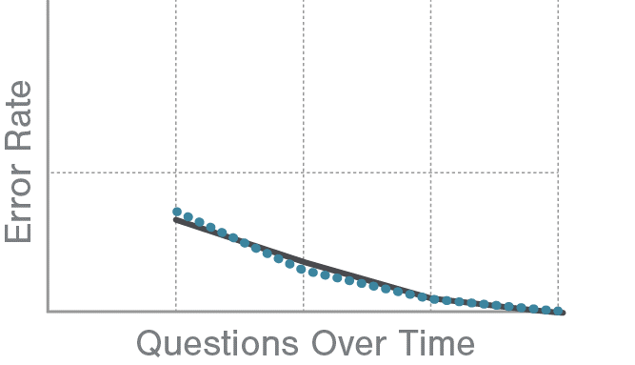
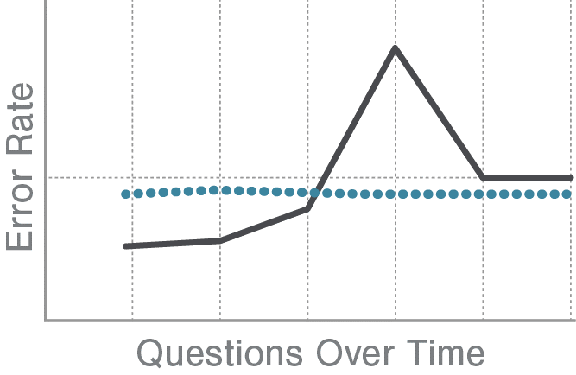
Learning Curve Analysis for Data Verified Competency Assessment
Expository
Data-verified specificity for fit-to-purpose competency definitions
Notes:
Learning curve analysis is one way we can determine if competency definitions, rubrics for assessments, and performance assessment specifications are defined at the right granularity to assess competence on a task. [Tell story about K12 math platform discovery that assessment items were not correctly specified.]
The graph on the left matches what’s expected, learners make less errors with more practice. The graph on the right tells us we should check our assumptions about the content and assessment, and its alignment to standards.
For some uses of competency definitions, they should be defined only at a high level for human consumption. Too many task or competency definitions are too much for a human to manage. But in othe cases, like specific assessment and feedback for learning. We need data-verified specificity.

Slide 24
Forgetting Curve Analysis for Training Optimization
Expository
People forget things…
Notes:
There’s another kind of curve that is valuable in this area of competence. Forgetting cuves. Did you know that people can forget things?
Over a century ago Heman Ebbihause pioneered research on forgetting and forgetting curves. We have a century of research and some great machine learning algorithms, like the one used by the language learning platform Duo Lingo to predict when you’re going to forget a word. Why is this important? Because the most efficient time to practice is right before you forget. Since people forget things at different rates. A lot of money and time is wasted with fixed retraining or reassessment schedules. The truth is that we can collect performance data continuously and use AI inference detection to optimize competency-based learning and assessment.

Slide 25
Fit for purpose the right level of granularity or precision.
Notes:
The definition needed to define an occupation, evaluate performance, or give formative feedback. For occupations we need a manageable number of tasks defined at a high level for human consumption and management. To give learner the best feedback we need to need to define granular tasks and assessment observations at a lower level because we want to understand the the root cause of the error or weakness that can be remediated. Some models may define common errors and their links to formative feedback or interventions that could cause improved performance.

Slide 26
Quick Review.
Notes:
Let’s shift gears to the IEEE technical standard.

Slide 27
What is a Well-Defined Competency?
Expository
understandable and informative for humans…
with metadata appropriately structured to be machine-readable
Specific, Measurable Outcomes
Tasks
Knowledge
Machine-readable
metadata:
discoverable,
transformable,
tradeable,
transparent,
assure confidentiality
assure well-defined
Skills
Abilities
IEEE Recommended Practice for Defining Competencies
IEEE Std 1484.20.2™-2022
Clear Context
COMPETENCY
Clear Conditions
Defined Levels of Proficiency
Behavioral Indicators
fit for purpose
Assessment Specifications
Notes:
The standard also specifies that Competency definitions and frameworks should consist of well-written competency statements that are understandable and informative for humans but also with metadata appropriately structured…so that competency definitions and frameworks can be machine-readable and tagged to be discoverable, transformable, tradeable, transparent, as well as assure confidentiality and well-definedness.

Slide 28
Competency definitions as metadata.
Notes:
Let’s shift gears to the IEEE technical standard.

Slide 29

Why Sharable Competency Definitions?
Expository
Why?
Notes:
We already touched upon some of the reasons for machine-readable encoding of competency definitions like data-verified specificity and the flexibility to organize the same definitions in different ways and reuse definitions across contexts. Some additional reasons have to do with linking the competency definitions in data, to activities, to curriculum, to simulation scenarios, to assessment protocols, etc. In the past, we were limited to human observation of human performance. Today we can instrument any activity, anywhere in the world. IEEE has a standard called Experience API that does just that. With the right sensors we can continuously monitor performance and predict success on any mission or task in ways that we could never do from human observation alone. We can also optimize learning by combining this data with what is known about how people learn…and what we can discover about how groups learn and adjust for individual learning differences. Shrable Competency Definitions allow for data-informed optimization of learning and optimization of performance.

Slide 30








IEEE Standards Supporting the Total Learning Architecture
Expository
Adaptive Instructional Systems
IEEE P2247.x
Learner and team feedback.
Stage | Stimulus Content, Events, Experiences | Response Learner Actions and Context Instrumentation | Inference & Filtering | Assertion | Record | Self-sovereign Records
Standards | Learning Object Metadata (LMT) IEEE P2881 | Experience API (xAPI) IEEE P9274.x |  | Competency Assertions Shareable Competency Definitions IEEE P1484.20.3 Well-defined Competency Definitions (RP) IEEE P1484.20.2 | Enterprise Learner Records IEEE P2997 | LER Ecosystem (RP) IEEE P1484.2
Data Scope | Learning content, presentation, simulation | Learning experience data | Logic and inference models | Linking competency definitions to assertions | Other data definition/model standards | Digital wallet and verifiable credential standards
System Components | Edge systems Delivering learning experiences | Sensors, LRS | Filtering algorithms, recommenders, and inference engines | Competency assertion management systems | Enterprise learner record repository | Edge system: Digital wallets & services
Learning Record Store
Notes:
This slide shows the standards that make up the total learning architecture developed by the DoD’s Advanced Distributed Learning Initiative and formalized by the IEEE. If you're not familiar with IEEE, it is the largest technical professional and standards organization in the world. It is the standards organization behind WiFi and Bluetooth. [Walk through the TLA standards and how they work together across the data pipeline.]

Slide 31
Army Synthetic Training Environment Example.
Notes:
Here’s one example from a presentation that Dr. Benjamin Goldberg and I presented in 2023 of how the Shareable Competency Definition Standard is used with other standards as part of the Total Learning Architecture.

Slide 32
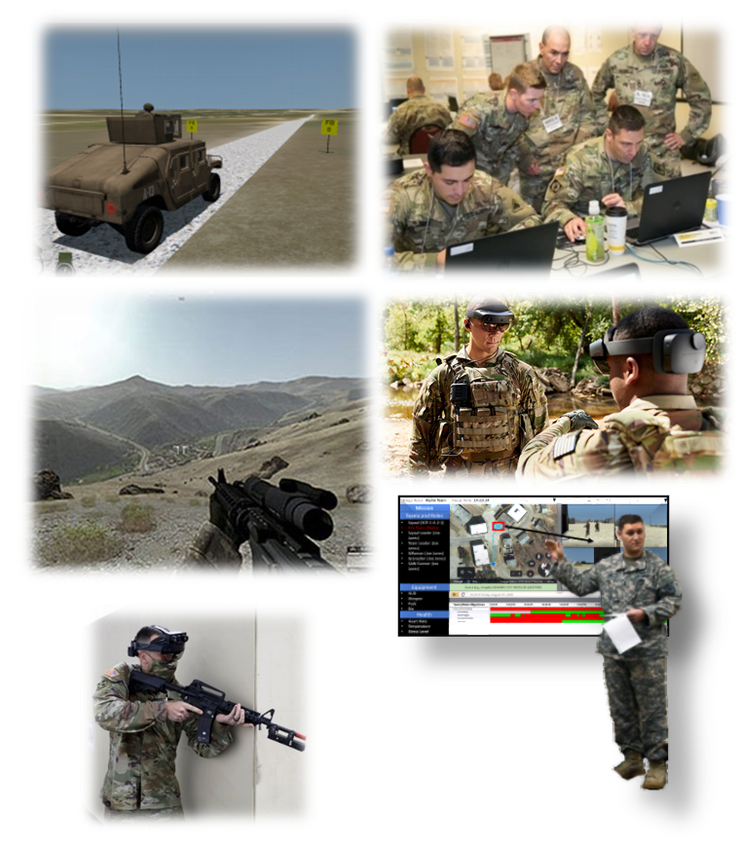
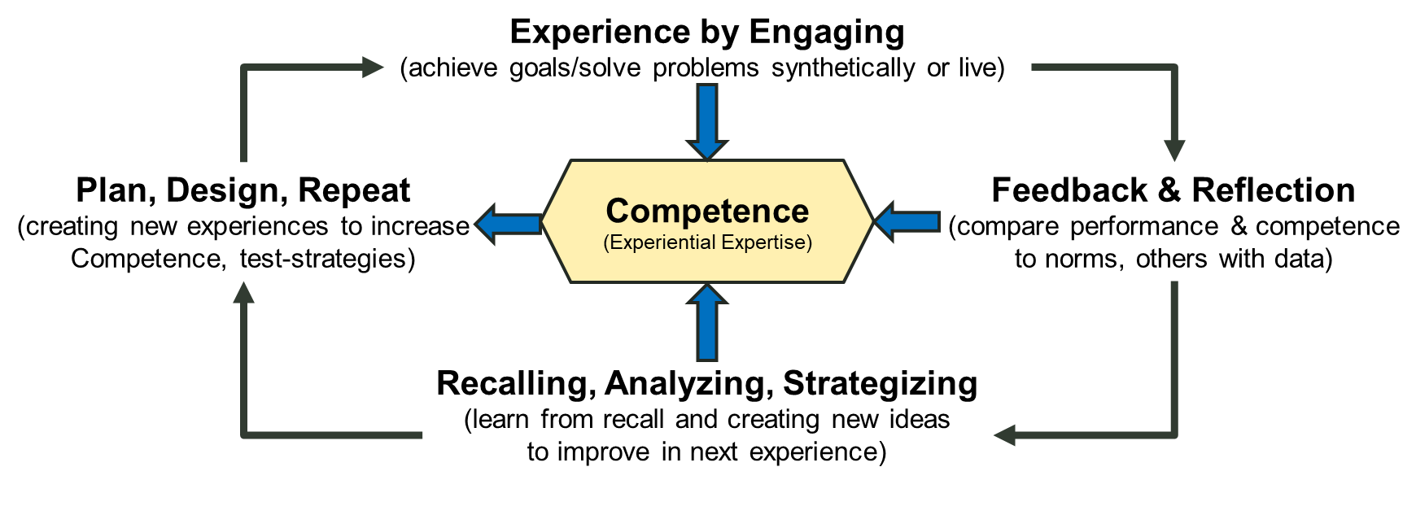
Army Example
Competency-Based Experiential Learning
Engage in Training Experience
Include Strategies in New Training Experience
ACT
Reflect on Performance
DO
CHECK
PLAN
Identify Strategies to Facilitate Improvement
Learning sciences research findings reinforce the importance of deliberate practice, feedback, reflection, and training assessments to guide skill development.
Adapted from: Goldberg, B., Goodell, J. (2023) “Learning Engineering: Adapting L&D for the Future of Work and Learning”. Learning Solutions 2023.
Notes:
The following example is adapted from a presentation I did with Ben Goldberg of the US ARMY DEVCOM Simulation
Center for the Learning Solutions 2023. This build from the learning science research about the value of experiential learning. (click) At the center are definitions of experiential expertise.

Slide 33
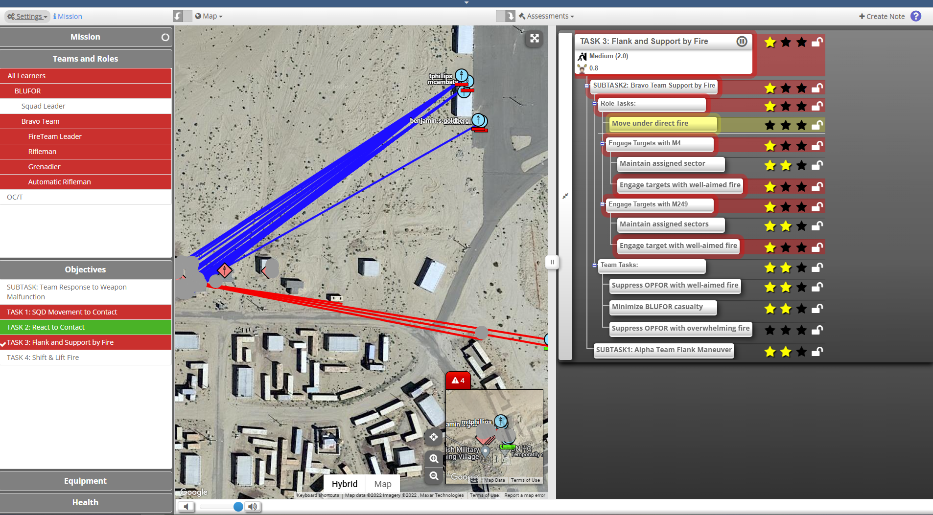
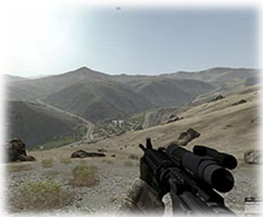
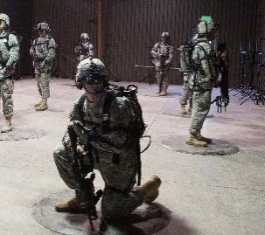
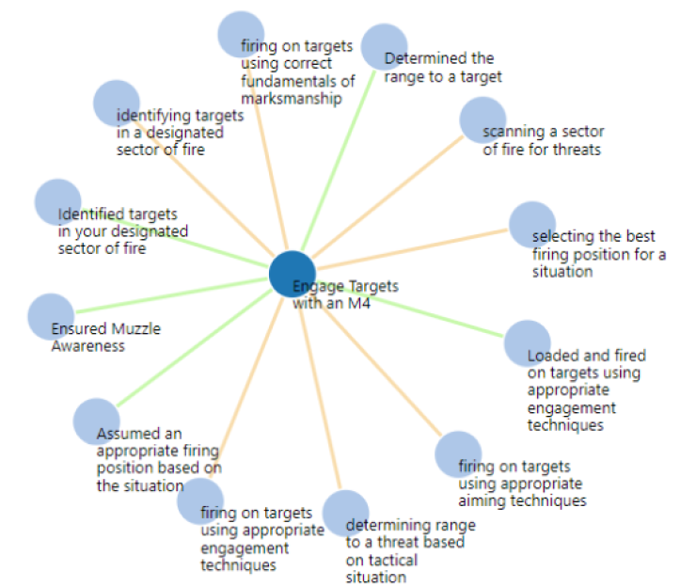
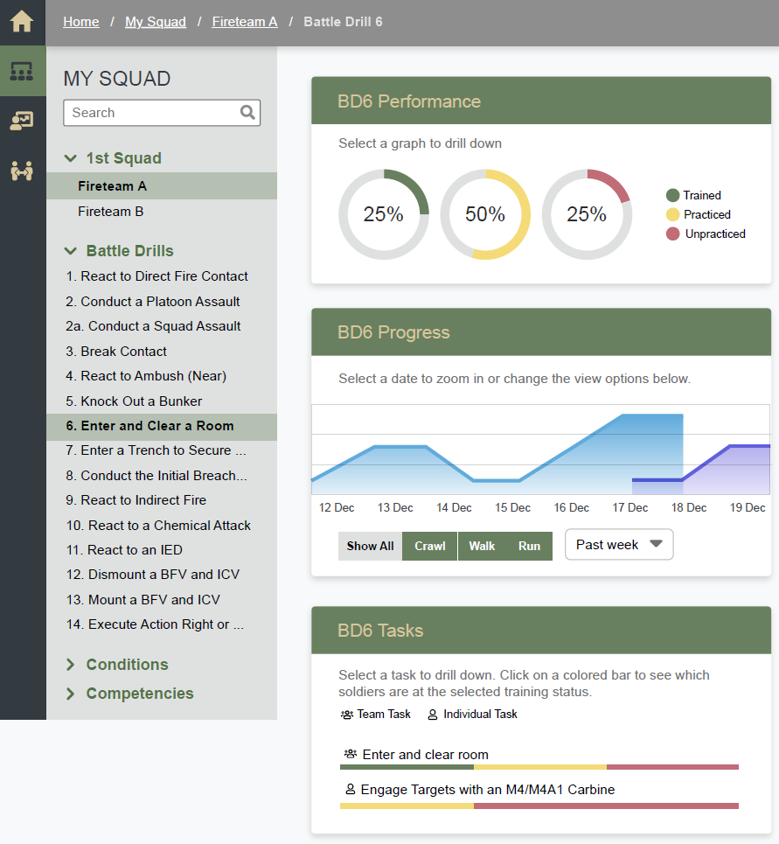
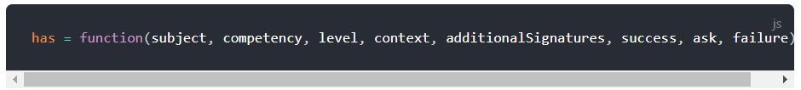
Army Example
Synthetic Training Environment Experiential Learning for Readiness (STEEL-R): A data strategy grounded in learning engineering
Plan
Prepare
Execute
Assess
Experience Design Tool (xDT) and Scenario Generation
Longitudinal Training and Education Data
Training Environment
GIFT
Noisy LRS
Competency Framework
Competency Dashboard
Experience Navigator
Competency
Assertion
Evidence
Evidence
Evidence
Transactional LRS
Simulation Trace Data
xAPI
Statements
Data-Driven Evidence Statements
xAPI
Statements
Adapted from: Goldberg, B., Goodell, J. (2023) “Learning Engineering: Adapting L&D for the Future of Work and Learning”. Learning Solutions 2023.
Notes:
The Synthetic Training Environment Experiential Learning for Readiness (STEEL-R) works across field training simulations and virtual reality platforms. Scenarios are linked to competency definitions, including expected task performance and expected responses to stimulus, and expected dos and don’ts for soldiers in the scenario. For example, flagging is pointing a weapon at one’s own squad member. Instrumented weapons have sensors to collect weapon positions and detect flagging. Capturing experiences and conditions as xAPI data and linking those experiences competency levels and discovering opportunities for learning through after action review feedback. In this case the STEEL-R project has used a system called CaSS to manage competency framework data and support alignment to standards. Those competency definitions are encoded as machine readable data linked to scenarios, xAPi statements, and competency assertions.

Slide 34
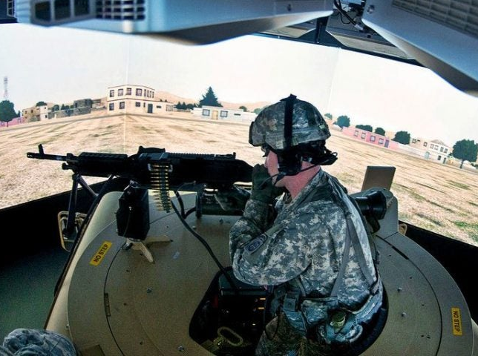
Army Example
The Data Strategy: Goals
(1) Military training is a multi-modal data world with rich raw data sources
Interoperability, preservation, and traceability of data are required
(2) We need a strategy to collect and translate these data sources into contextualized and actionable insights
Leverage open standards for data and opensource technologies in the implementation to levels the playing field across industry, systems, and Government
(3) Ensure the STEEL-R approach can scale in terms of the echelon of application, across multiple training systems, and that its data is reusable across the enterprise
Adapted from: Goldberg, B., Goodell, J. (2023) “Learning Engineering: Adapting L&D for the Future of Work and Learning”. Learning Solutions 2023.
Notes:
STEEL-R recognizes that [read 3 items]

Slide 35
Army Example
The Data Strategy: Standards
IEEE LTSC standards
P9274.1.1 xAPI
P9274.2.1 xAPI Profiles
P2881 Learning Object/Activity Metadata
1484.20.3 Shareable Competency Definitions
P2997 Enterprise Learner Records
Adapted from: Goldberg, B., Goodell, J. (2023) “Learning Engineering: Adapting L&D for the Future of Work and Learning”. Learning Solutions 2023.
Notes:
The SCD standard is a key part of the data strategy.

Slide 36
What is a Sharable Competency Definition
Expository
What?
Notes:
But we’re here to talk about competency definitions so let’s refocus. IEEE 1484.20.3 is a Data Model for Sharable Competency Definitions. It is a data model standard with some open source resources for implementation of that model. Let’s unpack that…

Slide 37
What is a Sharable Competency Definition?
Expository
6 Objects
Class | Definition
Competency Definition | A resource that states a capability or behavior that an actor may learn or be able to do within a given context with references to potential levels of competence, a mastery threshold, and other contextualizing metadata.
Competency Framework | A resource that identifies a collection of logically related Competency Definitions, Competency Associations, and contextualizing metadata.
Resource Association | A resource that defines a relationship between two resources.
Rubric | A resource that defines a set of criteria or indicators that assist in determining whether an actor possesses a given competence or level of proficiency in a task or work product.
Rubric Criterion | A resource that defines a single criterion by which one aspect of an actor’s competence may be evaluated.
Rubric Criterion Level | A resource that defines a degree or level of competence.
Notes:
Here are the 6 data objects that make up the model. [Talk briefly about each.]

Slide 38
Properties of a Sharable Competency Definition Object
Expository
Name | Definition
id | Globally unique identifier that allows a system to retrieve or reference this resource. [URI or IRI]
competencyStatement | Human readable expression that describes a competency.
competencyLevel | Resource identifying a level of competence or grade that is achieved in the referenced Rubric by this CompetencyDefinition.
description | Narrative in plain language that describes and may contextualize this resource.
hasCompetencyFramework | CompetencyFramework to which this resource belongs.
hasCriterion | Resource identifying a specific criterion in a Rubric.
name | Name of this resource.
referenceCode | Human-decipherable identifier that uses a set of semantically cohesive categories or facets that are meaningfully combined, such as “Math.G.C.A.2.” interpreted as subject=Mathematics, category=Geometry, strand=Circles, substrand= Arcs and an instance number.
resourceAssociation | ResourceAssociation used within this resource.
type | Type, class, or category of the competency.
typeLabel | Human readable label for type, class, or category of this CompetencyDefinition.
Notes:
Here are the properties in the Competency Definition object. Note that the bolded rows represent required properties. There are only 2. Am ID that must be an URI or IRI. (A URL is a good and acceptable way to meet this requirement. And the competency statement. The other properties are not required in all use cases but may be needed to support any given use case.

Slide 39
An Example
Worked Example
Consistently achieves a minimum of 80% hits in the "A" zone of a C-zone target at 200-300 yards, within prescribed time limits and from various positions (e.g., prone, kneeling, standing).
Name | Definition
id | https://example.gov/USCG/f8b6e2d4-1a93-4c7b-b5e0-1f2a3b4c5d6e
competencyStatement | Consistently achieves a minimum of 90% hits on an 8-inch steel plate at 100 yards, or 80% hits in the "A" zone of a C-zone target at 200-300 yards, within prescribed time limits and from various positions (e.g., prone, kneeling, standing).
Assessment
Notes:
Let’s take a look at a simple example of a marksmanship competency. We can see that a lot of the features of a well-defined competency are packed into this statement, like the contexts and conditions by which the competency may be assessed. This example actually packs in multiple assessment criteria (% of hits, distance from target, prone, kneeling, standing. When defining assessment and evaluation we would need multiple assessments for this one competency.

Slide 40
A More Reusable Example
Worked Example
Core definition
Context attribute
Name | Definition
id | https://example.gov/USCG/f8b6e2d4-1a93-4c7b-b5e0-1f2a3b4c526e
competencyStatement | Consistently achieves the specified minimum hits in the "A" zone of a C-zone target at specified distance, within prescribed time limits and from prescribed distance.
typeLabel | Skill
Name | Definition
id | https://example.gov/USCG/f8b6e2d4-1a93-4c7b-b5e0-1f2a3b4c2d6e
competencyStatement | Distance from target 200-300 yards
typeLabel | Context
Assessment
LMT
IEEE 2881 Standard for Learning Metadata Terms
Notes:
But consider this… The SCD standard supports separating the core definition from the context and conditions.
[Read the generic and context definitions]
This can help manage the SCD when changes in the security environment, equipment, and policy require criteria variable changes. The core competency definition can stay the same and just be linked to the specifics.
This also support more discoverable resources, like assessment resources that may be instrumented using another IEEE standard 2881 for Learning Metadata Terms.

Slide 41
What is a Well-Defined Competency?
Expository
Specific, Measurable Outcomes
Tasks
Knowledge
Skills
Abilities
IEEE Recommended Practice for Defining Competencies
IEEE Std 1484.20.2™-2022
Clear Context
COMPETENCY
Clear Conditions
Defined Levels of Proficiency
Behavioral Indicators
Assessment Specifications
Notes:
Remember that a well-defined competency definitions includes:
Specific, Measurable Outcomes
Associated Knowledge, Skills, and Abilities
Clear Context:
Clear Conditions
Defined Levels of Proficiency
Behavioral Indicators
Assessment Specifications
The SCD modernizes the management and use of well-defined competency definitions.

Slide 42
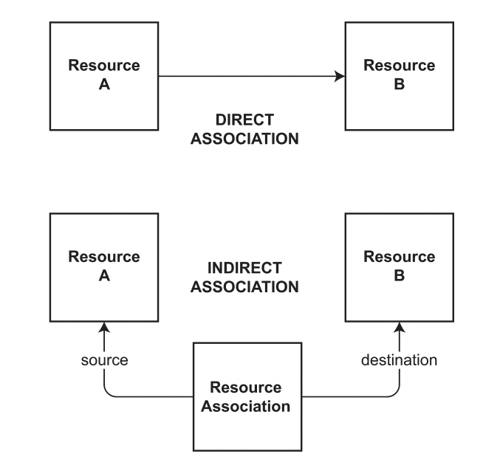
Relationships
Expository
resourceAssociation property
of CompetencyDefinition
ResourceAssociation object
Notes:
The relationship between these parts of a well-defined competency definitions—such as linking a core definition to a context definition-- are supported in 2 ways in the IEEE data model standard.

Slide 43
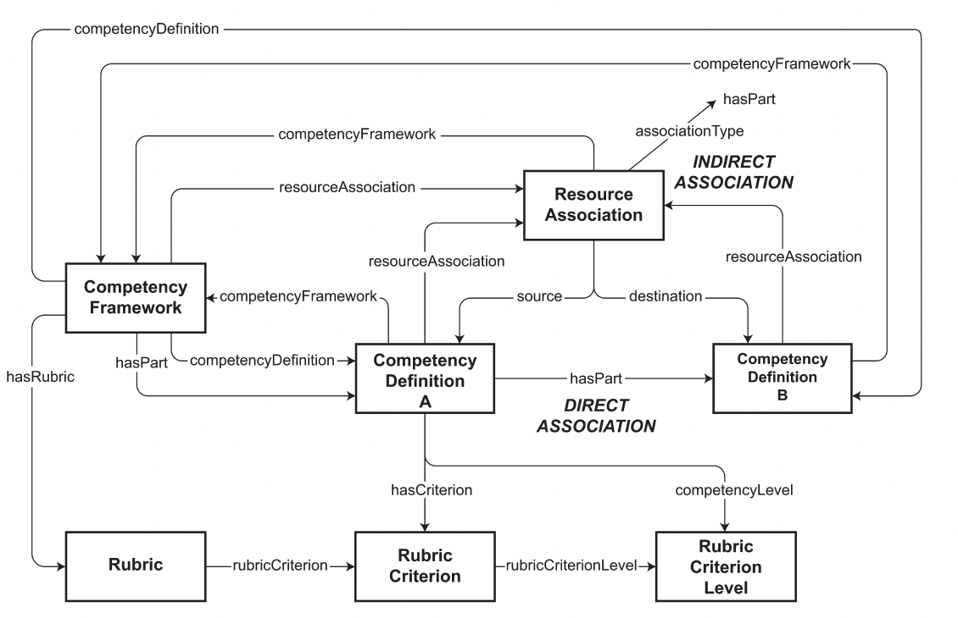
What is a Sharable Competency Definition
Expository
Notes:
So let’s take a look at the rest of the model. This text is hard to read so lets zoom in…(click)

Slide 44

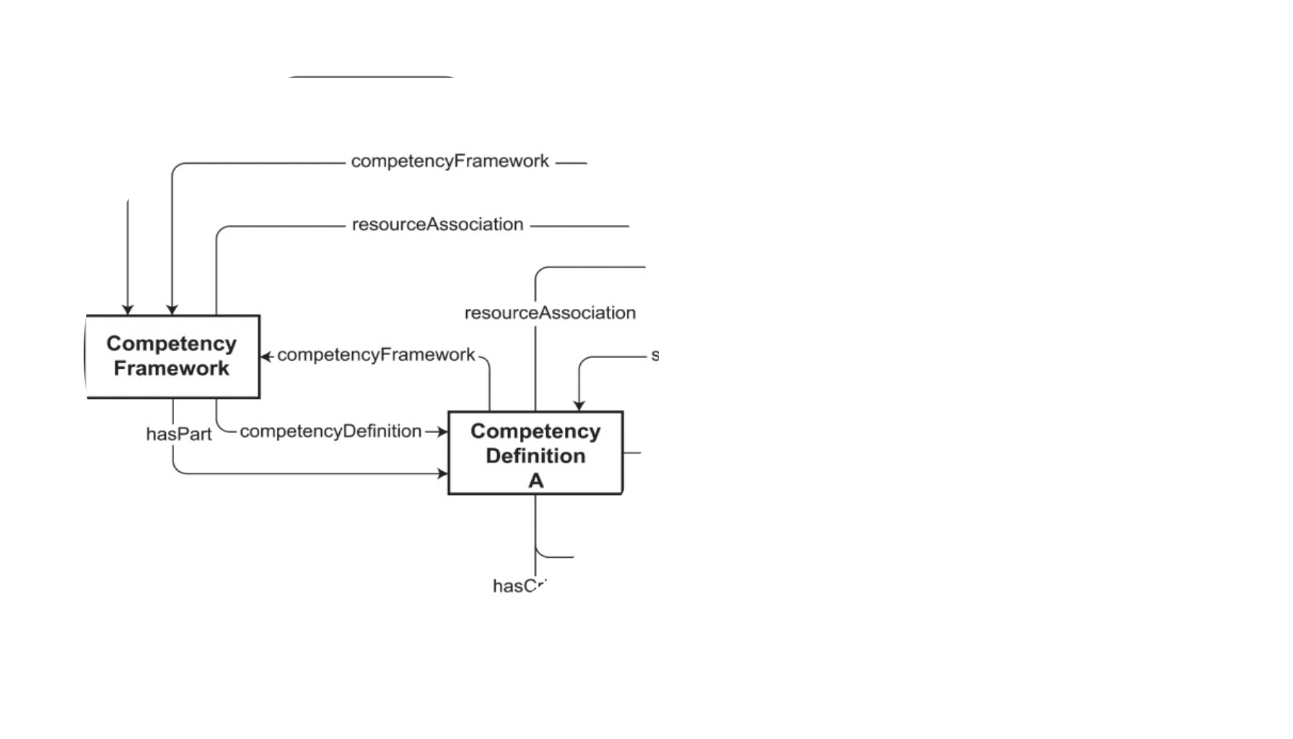

What is a Sharable Competency Definition
Expository
Notes:
[Describe the objects.]

Slide 45
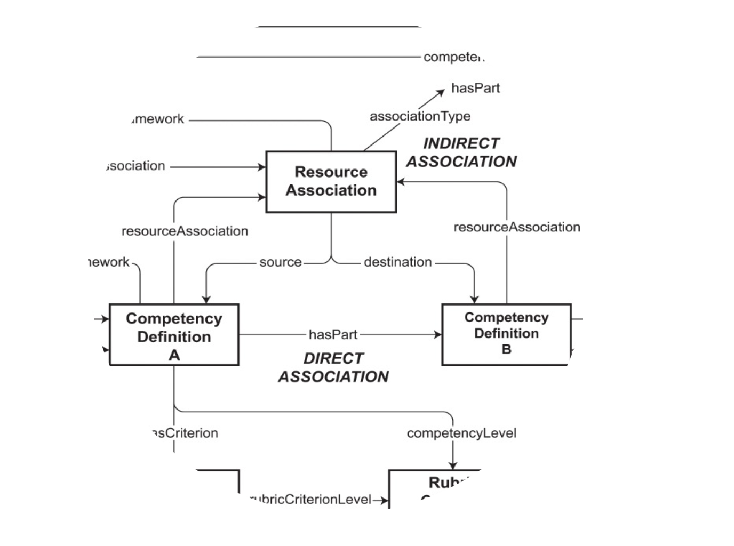
What is a Sharable Competency Definition
Expository
Notes:
Another key part of the standard is how the resources relate to one another. [Describe the objects.]

Slide 46
A More Reusable Example
Worked Example
Core definition
Context & Conditions attributes
Name | Definition
id | https://example.gov/USCG/f8b6e2d4-1a93-4c7b-b5e0-1f2a3b4c526e
competencyStatement | Consistently achieves the specified minimum hits in the "A" zone of a C-zone target at specified distance, within prescribed time limits and from prescribed.
typeLabel | Skill
Name | Definition
id | https://example.gov/USCG/f8b6e2d4-1a93-4c7b-b5e0-1f2a3b4c2d6e
competencyStatement | Distance from target 200-300 yards
typeLabel | Context
Name | Definition
id | https://example.gov/USCG/f8b6e2d4-1a93-4c7b-b5e0-1f2a3b4c2d6e
competencyStatement | From DDG 51
typeLabel | Context
Assessment
Notes:
We can expand this to add multiple contexts. For example, if this is a Navy framework we can add context of marksmanship from a destroyer, in the Atlantic, with choppy conditions. The context can be as specific as needed. It also can specify conditions. You’ll notice that the core definition stays the same. This is valuable from a data usability and insights perspective.

Slide 47
IDENTIFY free and open tools.
Notes:
So let’s shift from challenges to solutions. For the rest of the tutorial I’ll give some examples of of some AI and automation tools that can remove some of the burden of developing, managing, and using well-define competencies.

Slide 48
Open Tools for Competency Framework Development
Expository
A. Managing competencies as both human and machine readable
B. Automation tools for development, iterative refinement
C. Learning analytics for validation
D. Process and tools for generating, structuring, and refining competency definitions
Notes:
Let’s start with an example tool for managing competencies for both human and machine readability.

Slide 49
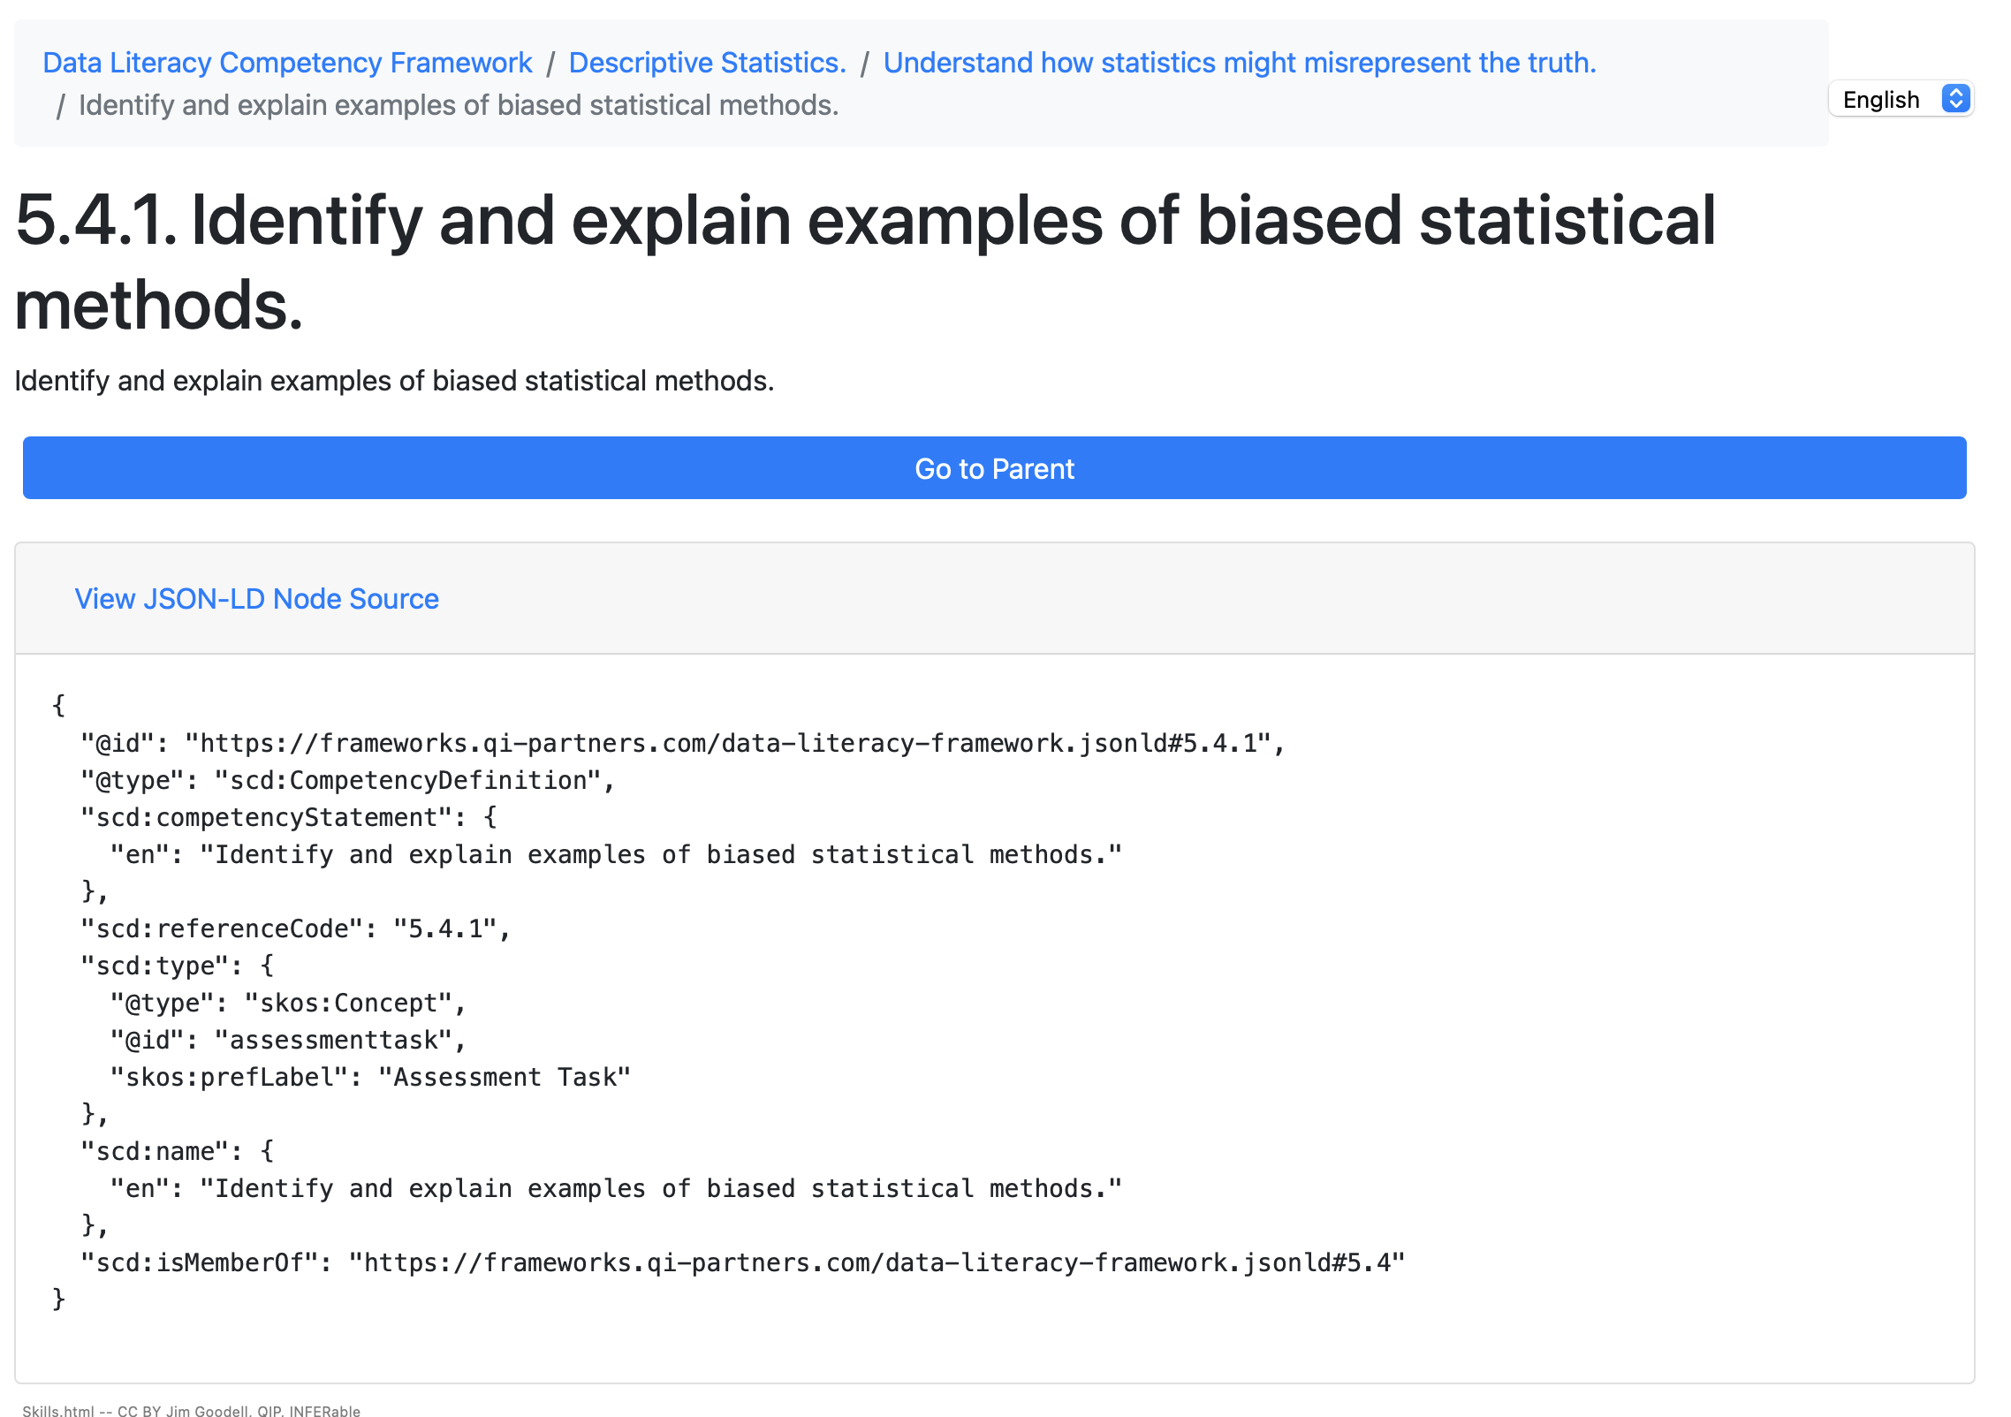
Example of Competency Definition Data
Worked Example
Notes:
One challenges is bridging from current systems that define and use competency definitions for human consumption with the need to transition to machine readable. How do we make these ontologies work for to support current protocols for human observation and evaluation while supporting new data instrumentation methods.
Here’s a tool that I developed for displaying both human and machine readable nodes in a competency framework. At the end of the presentation I’ll provide a link so you can try this yourself.
You can see the bread crumbs at the top showing the path in the hierarchy where this competency is defined.
But this tool also allows the user to see the definition encoded in the IEEE Sharable Competency Definition format…

Slide 50
Example of Competency Definition Data
Worked Example
http://jgoodell2.github.io/unesco/skills_ieee.html
Notes:
Here you can see the machine readable code with additional metadata, such as that this node represents an assessment task. So it might be linked to a Rubric.

Slide 51
Open Tools for Competency Framework Development
Expository
A. Managing competencies as both human and machine readable
B. Automation tools for development, iterative refinement
C. Learning analytics for validation
D. Process and tools for generating, structuring, and refining competency definitions
Notes:
How do we automate labor intensive best practices for well-defined competencies such as cognitive task analysis. [Explain CTA]

Slide 52
Example of Automating Cognitive Task Analysis
Worked Example
LLM Explainer Video Transcripts Processor:
Identifying Goals
Identifying Decision Points
Identifying Judgments
Task/subtask Diagram/Graph
Knowledge Audit
Cognitive Demands Table:
Process steps or subtasks
Difficult Cognitive Elements
Why Difficult?
Common Errors
Cues and Strategies Used
Prompt for LLM: Cognitive Task Analysis (CTA) of Expert Explainer Videos
“You are an expert cognitive scientist and AI assistant specializing in human-computer interaction and knowledge representation. Your task is to perform a comprehensive Cognitive Task Analysis (CTA) on a set of provided transcripts from multiple expert explainer videos, all addressing a common task. The goal is to synthesize the expert knowledge and processes into a structured, actionable representation.
Input:
You will be provided with a series of transcripts, each labeled with an identifier (e.g., Transcript_ExpertA, Transcript_ExpertB). Each transcript represents an expert explaining or demonstrating a common task.
Overall Goal:
To generate a detailed Cognitive Task Analysis that captures the following aspects across all expert perspectives:
Goal Generation: The overarching goals and a hierarchical breakdown of subgoals for the common task.
Decision Making: Key decision points within the task, the criteria used for making those decisions, and the expected outcomes of different choices.
Judgments: Implicit and explicit judgments experts make, the information they rely on for these judgments, and how these judgments influence the task flow.
Knowledge Audit: The essential domain knowledge, conceptual understandings, and procedural knowledge required to perform the task effectively.
Cognitive Demands Table: An analysis of the challenging cognitive elements, their sources of difficulty, common errors, and expert strategies for mitigation.
JSON-LD Task Graph: A structured, machine-readable representation of the task flow, integrating goals, subtasks, decision logic, and contextual information.
Specific Output Requirements:
Your output should be structured into the following sections: …
Notes:
We did some experiments to see if LLMs can help automate cognitive and physical task analysis. In this first example, my goal was to create prompts for instructing the LLM to analyze transcripts from explainer videos and produce some representation of the expert’s thinking process that could be further refined into a competency framework. And we crated a prompt for use in your favorite gen AI platform. It tells the Gen AI to analyze the tasks and Goals including the language used to identify the explicit and implicit goals of the speaker(s), statements of intent, desired outcomes, and the overall purpose of the communication.
Then to analyze Decision Making, identifying points in the transcript where choices are made, or where the speaker is considering different options, looking for language that indicates deliberation, evaluation, and selection, and trying to infer the criteria used to make these decisions.
It then instructs the Gen AI to analyze statements that express evaluations, assessments, or opinions, look for evidence of how the speaker is weighing information, making predictions, or forming conclusions, and attempt to understand the basis for those judgements.
It asks for several outputs: (1) Task Diagram/Graph including: Goals and subgoals. Decision points. The flow of information. Where possible, to add inferred metacognitive processes. (2) The 2nd output is a Knowledge Audit (3) The 3rd is a Cognitive Demands Table
And the 4th (click)

Slide 53
Example of Automating Cognitive Task Analysis
Worked Example
Prompt for LLM: Cognitive Task Analysis (CTA) of Expert Explainer Videos (part 2)
… JSON-LD Example Output: {
"@context": {
// ... (as defined above)
},
"@graph": [
{
"@id": "_Goal_ConnectDevice",
"@type": "Goal",
"description": "Successfully connect the device to the network."
},
{
"@id": "_Task_InitialPowerCheck",
"@type": "Task",
"description": "Verify the device has power and is turned on.",
"dependsOn": ["_Goal_ConnectDevice"], // This task is part of achieving the connection goal
"leadsTo": "_Decision_IsPoweredOn"
},
{
"@id": "_Decision_IsPoweredOn",
"@type": "DecisionPoint",
"description": "Is the device powered on?",
"truePath": "_Task_CheckNetworkCable",
"falsePath": "_Task_TroubleshootPower",
"metacognition": "Expert thinks: 'This is the most common initial fault, always check power first.'"
},
{
"@id": "_Task_TroubleshootPower",
"@type": "Task",
"description": "Diagnose and resolve power issues.",
"leadsTo": "_Decision_IsPoweredOn", // Loop back after troubleshooting
"requiredFor": ["_Tool_Multimeter"]
},
{
"@id": "_Tool_Multimeter",
"@type": "Tool",
"description": "Digital multimeter for voltage testing.",
"type": "Hardware"
}
// ... more nodes
]
}
Notes:
…Is a machine readable graph. This screen is for the geeks in the audience. What you’re seeing is part of the prompt that gives the generative AI an example of the encoded format for the output graph.

Slide 54
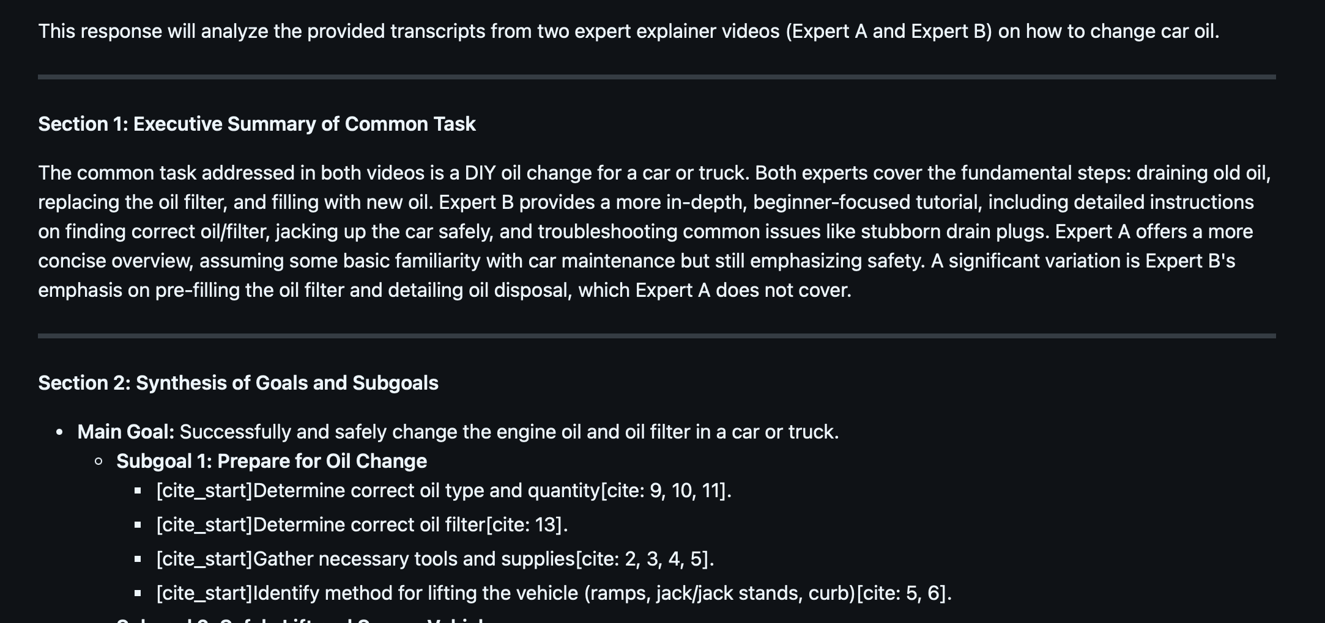
Example of Automating Cognitive Task Analysis
Worked Example
Prompt for LLM: Cognitive Task Analysis (CTA) of Expert Explainer Videos - Output
Notes:
And here is some of the human-readable output after feeding in two transcripts of explainer videos. [Although it may not be “human readable” in this room…but I’ll give you a link to the files at the end of the tutorial.]
More research is needed on tuning the prompt and discovering how many input transcripts are optimal. More research could also develop methods to automate the validation of outputs, with humans in the loop.

Slide 55
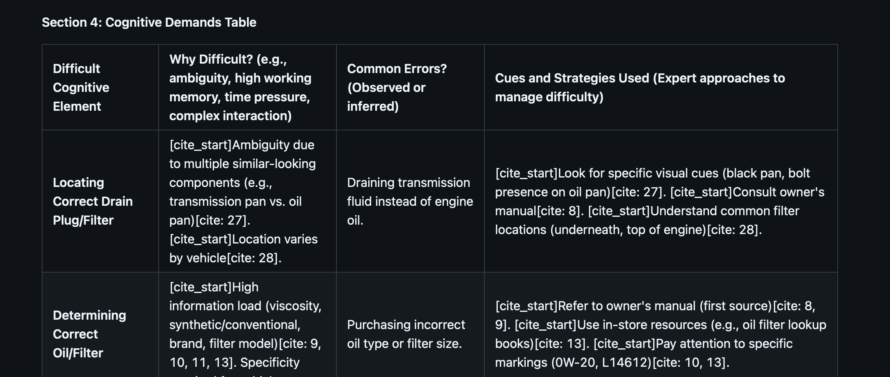
Example of Automating Cognitive Task Analysis
Worked Example
Prompt for LLM: Cognitive Task Analysis (CTA) of Expert Explainer Videos - Output
Notes:
Here’s the cognitive demands table with task descriptions and decision logic.

Slide 56
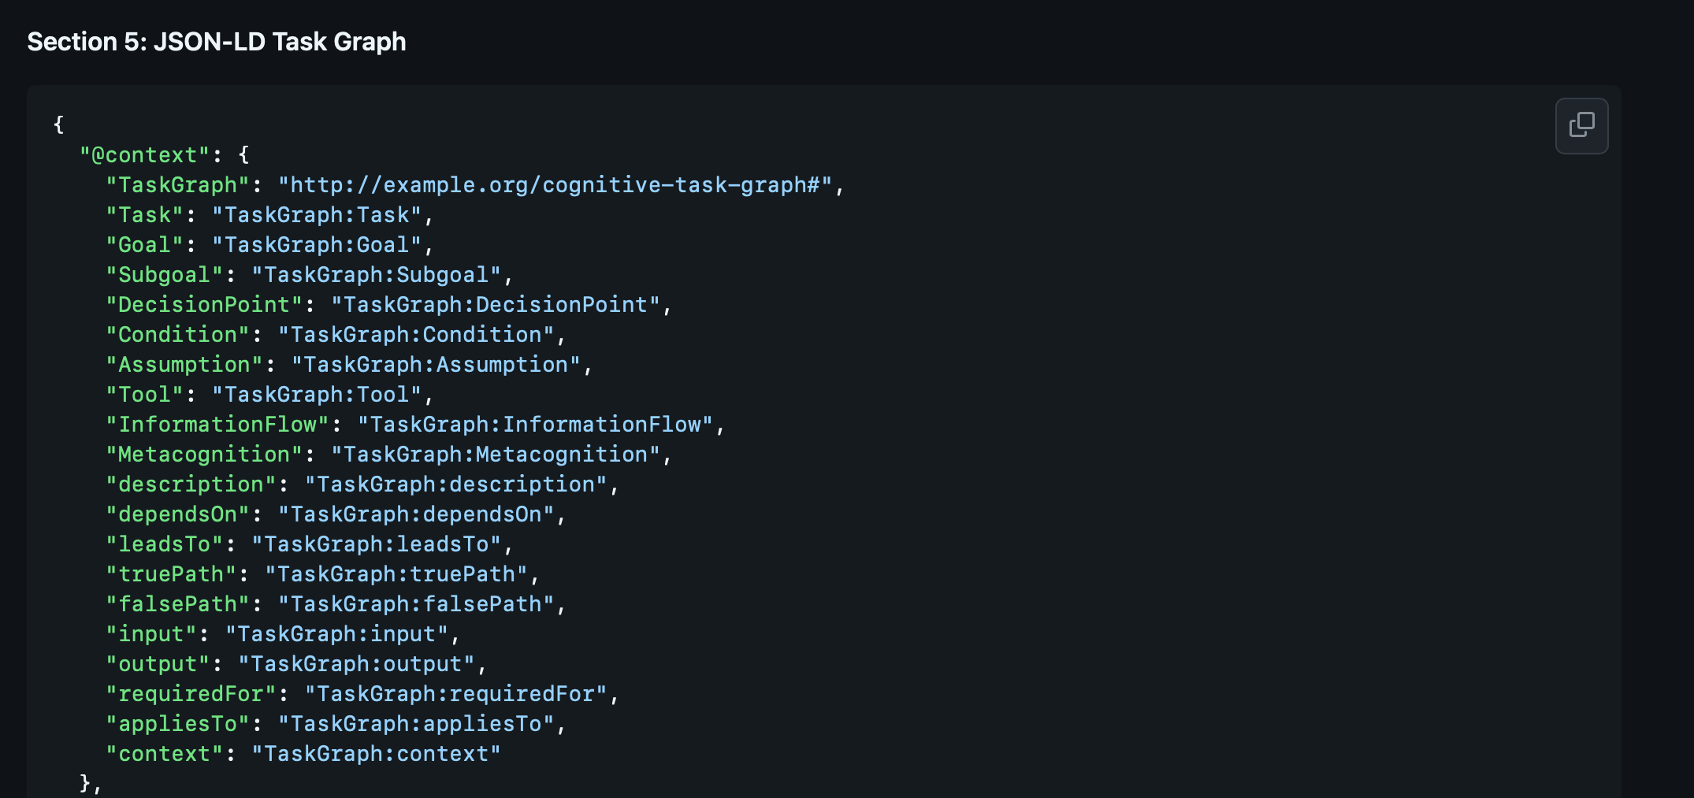
Example of Automating Cognitive Task Analysis
Worked Example
Prompt for LLM: Cognitive Task Analysis (CTA) of Expert Explainer Videos - Output
Notes:
And finaly, here’s the machine-readable encoding of the graph. With more research this could be transformed in to the SCD standard for task descriptions and logic that could support adaptive instructional systems and simulation environment.

Slide 57
Open Tools for Competency Framework Development
Expository
A. Managing competencies as both human and machine readable
B. Automation tools for development, iterative refinement
C. Learning analytics for validation
D. Process and tools for generating, structuring, and refining competency definitions
Notes:
Even with rigorous development, competency definitions can lack precision or be developed with incorrect assumptions or the resources (such as assessment and evaluation instruments) can be related to a wrong competency. We can use learning analytics techniques like learning curve analysis to discover imperfections so we can iterativly improve the definitions and linked resources.

Slide 58
Aligned Well-Defined Competency
Worked Example
Notes:
Remember learning curve analysis helps verifying alignment between performance tasks and competency definitions. (click) That a outlier blip on the curve can tell us that something is off with the assumptions about the set of performance tasks and alignment to a single task definition. (Incidentally, that is a difference between learning sciences and learning engineering. Scientists often ignore outlier data as noise. Engineers are more interested in the outlier data. )

Slide 59
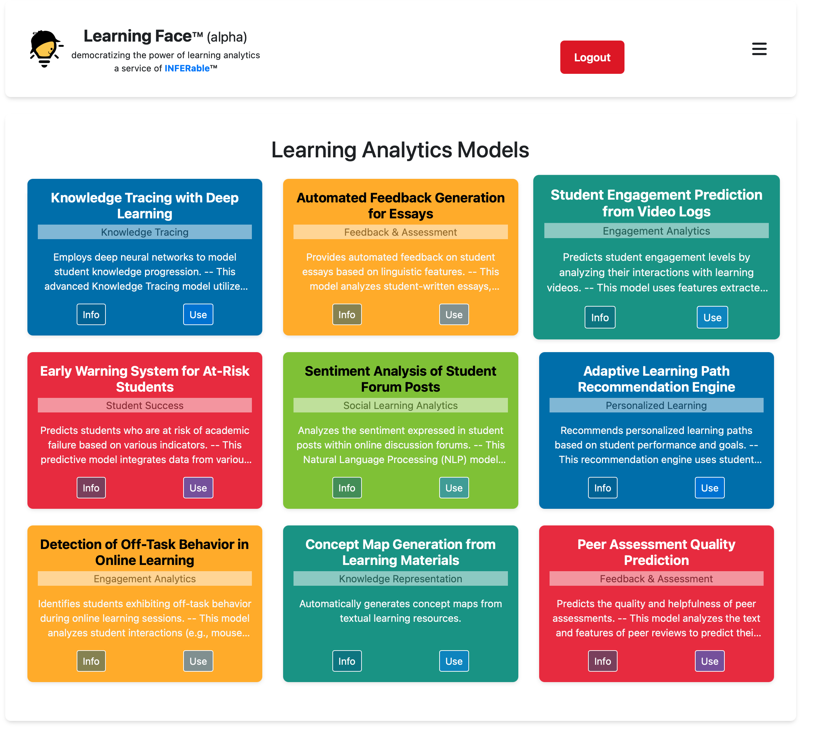

Openly Published Analysis Tool
Expository
LearningFace.ai
Notes:
I created this site to democratize access to analysis models like learning curve analysis, and I’ve asked researchers to publish their model and techniques there that support inferences about learning as well as optimization of resources and data used for learning.

Slide 60
Open Tools for Competency Framework Development
Expository
A. Managing competencies as both human and machine readable
B. Automation tools for development, iterative refinement
C. Learning analytics for validation
D. Process and tools for generating, structuring, and refining competency definitions
Notes:
The final set of open source resources are on the IEEE’s own open source site.

Slide 61
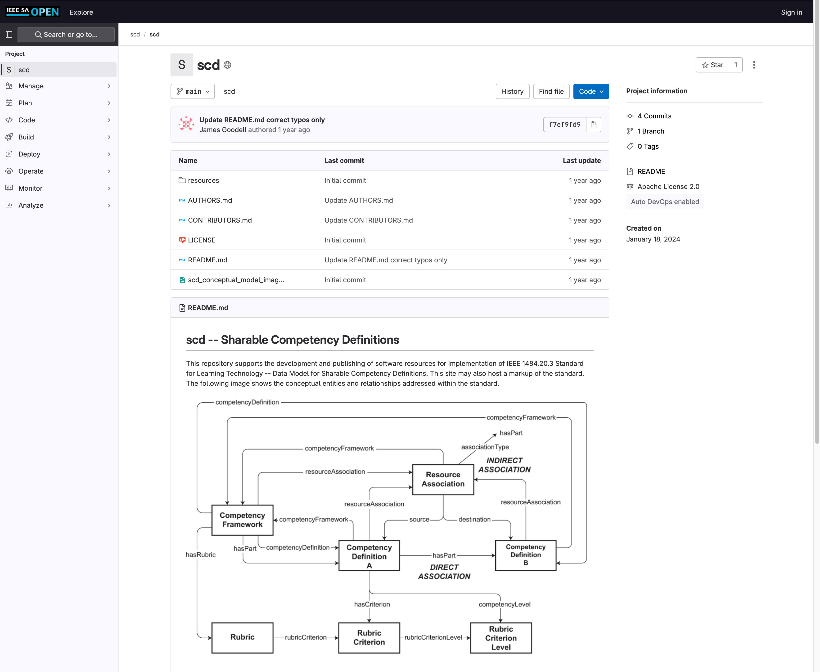
Process and tools for generating, structuring, validating and refining competency definitions
Worked Example
opensource.ieee.org/scd/scd
Notes:
[Screenshots] At this site you can find resources to support use of the standards, including serialization formats and examples.

Slide 62
Final Check: Use of Well-Define Sharable Competency Definitions
Expository
We covered:
Guidelines for creating or curating clear, measurable, fit-to-purpose and adaptable competencies
Mapping competencies to learning objectives, activities, content and assessments using Learning Metadata Terms (IEEE 2881)
Strategies for ensuring multi-domain applicability and interoperability
Referencing sharable competency definitions in instrumentation of learning and performance, e.g. with xAPI (IEEE 9274.x.x) and in simulation systems
Notes:
[Tell em what you told them.] Add script.

Slide 63
Using Open Tools for Well-Defined Competencies
Expository
Specific, Measurable Outcomes
Wait!
We’re done but you’re not.
Tasks
Knowledge
Machine-readable
metadata:
discoverable,
transformable,
tradeable,
transparent,
assure confidentiality
assure well-defined
Skills
Abilities
understandable and informative for humans…
with metadata appropriately structured to be machine-readable
Fit for purpose
Clear Context
COMPETENCY
Clear Conditions
Defined Levels of Proficiency
Behavioral Indicators
Assessment Specifications
Notes:
That ends today’s tutorial. But wait!

Slide 64
Now It’s Your Turn
Put it into
Practice
APPLY best practices for creating and structuring competency definitions.
Notes:
Remember that building expertise requires deliberate practice, feedback, reflection, and training assessments to guide skill development. So I’m going to leave you with an opportunity to put this into practice.
(click) And that was one of our learning objectives. Hopefully you have enough knowledge now to apply what you’ve learned…and some tools…

Slide 65
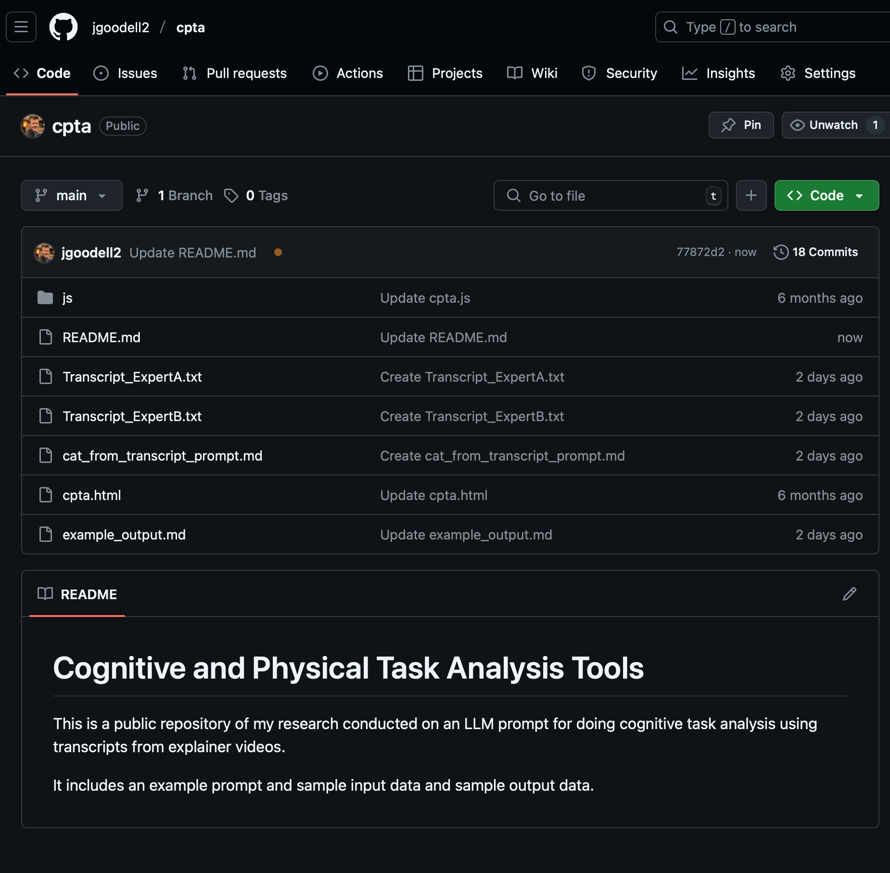

A Repo With the Open Tools Demonstrated
https://github.com/jgoodell2/cpta/
CTA from Transcripts Prompt: https://github.com/jgoodell2/cpta/blob/main/cat_from_transcript_prompt.md
Notes:
Finally, here is the link to the repository with the LLM prompt I used to analyze the explainer video transcripts. Grab a copy of the text for yourself and try modifying it with your favorite secure LLM like NIPRGPT or the Army Enterprise LLM Workspace .

Slide 66



Open Resources & Standards Community
https://opensource.ieee.org/scd/scd/
https://sagroups.ieee.org/1484-20-3/
https://sagroups.ieee.org/1484-20-3/subscribe-to-email-reflector/
Notes:
Here are links to the open source repo for the IEEE SCD. And to continue your learning in community join the email reflector for the workgroup.

Slide 67
Q & A

