Slide 1


IEEE 1278TM Standard for Distributed Interactive Simulation (DIS):
Concepts and Techniques
Robert Murray, SimPhonics, Inc.
bobmurray222@gmail.com
Lance Call, AFRL/CAEUSA
lance.call.ctr@us.af.mil
Oct 2, 2025

Slide 2
Disclaimer
Any comments and interpretations of the Institute of Electrical and Electronics Engineers (IEEE) Standards discussed in this tutorial do not represent the view of the IEEE, IEEE-Standards Association its members or affiliates

Slide 3
Learning Objectives
The student will be able to explain the capabilities of DIS
What problems it solves
Capabilities for Live-Virtual-Constructive (LVC) Simulation Networking
The history of DIS will allow the student to discuss:
How it has evolved
Its future direction
The student will be able to explain the key definitions and concepts of DIS
The student will be able to describe the technical details of:
The type of information conveyed by DIS
Techniques for distributing real-time high-fidelity simulation data over wide area networks

Slide 4
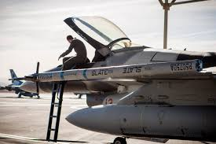
Intended Audience
Modeling and simulation implementors and managers who require an understanding of
Distributed simulation in the Live, Virtual, and Constructive (LVC) domains
Specifics of how DIS meets of the requirements of interoperability between the widely varying types of geographically distributed LVC simulations
Photo by RHA (Will Graver)
DIS based Secure LVC Advanced Training Environment (SLATE) Pod – Nellis 2018

Slide 5

Tutorial Outline - Goals
Goal – Fully Integrated LVC
The Past
History of networked simulation
The Present
The IEEE 1278TM DIS standard and how it is developed
Key definitions and concepts
Function and organization of DIS Protocol Data Units
Technical details of providing high-fidelity real-time information exchange
Improvements from the 1995 to the 2012 DIS (DIS V7) standards
The Future: The development of the next version of the DIS (DIS V8)
https://www.istockphoto.com/photos/future-and-past-signpost

Slide 6
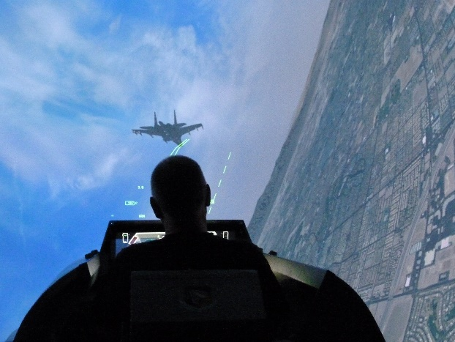
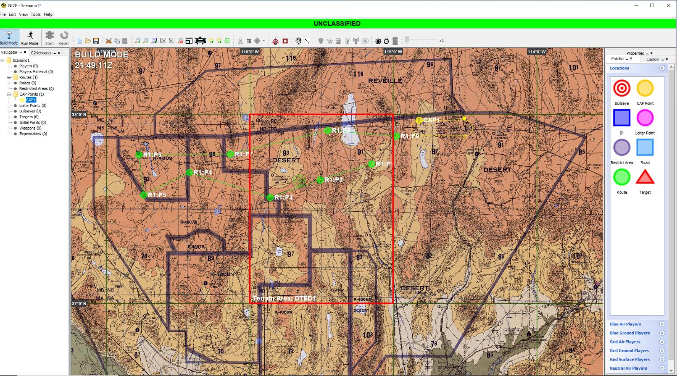
LVC Simulation
Live – real humans operating real systems not in actual warfare
Virtual – real humans operating simulated systems
Constructive – simulated humans operating simulated systems
LVC is the common term for simulations suitable for:
Integrating live platforms into a simulation environment
Constructive simulations to add realism to human training or mission system test
Live
Virtual
Constructive
Photo by RHA (Will Graver)
Photo by RHA
Graphic by RHA

Slide 7
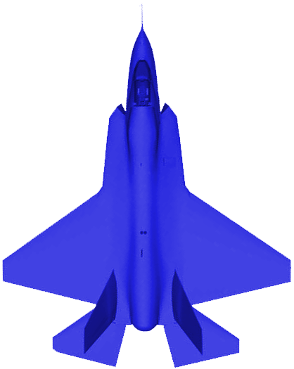



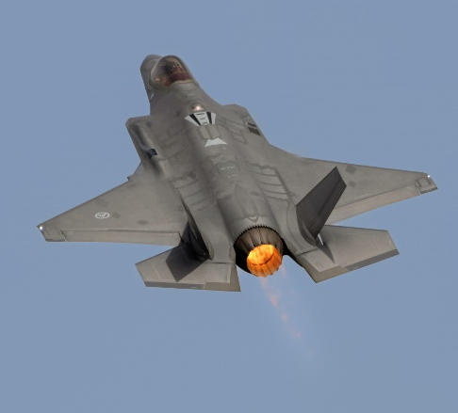
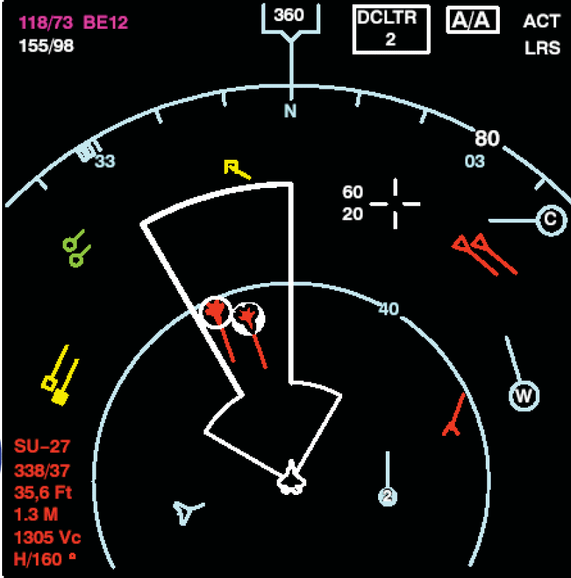




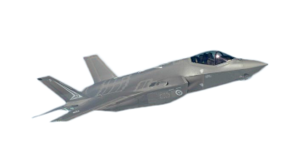



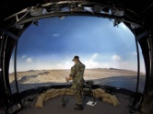
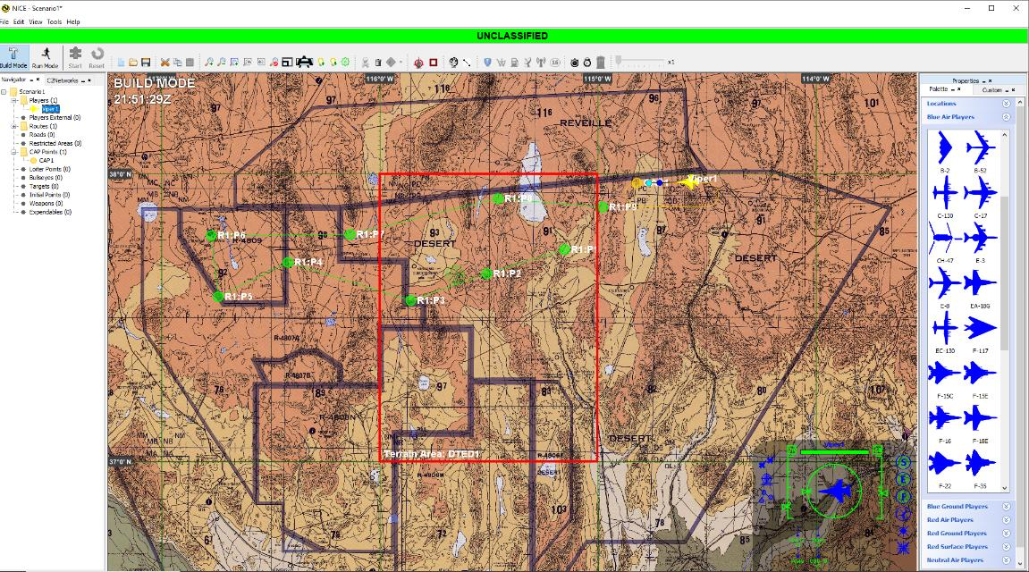
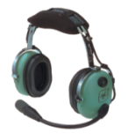






Goal is Fully Integrated LVC
HMD
L
4th Gen
V
Radar
5th Gen
C-DIS
Encrypt
Red Air /
Aggressor
Pod/LRU
5G-ATW
RWR/ESM
1553/1760 Bus
Photo by RHA
AWACS/GCI
ECM
A/C TSPI
DIS Voice Radios
Photo by Lance Call
Future
DIS Standard MADL
JTAC
MADL
DIS Standard Link16
Photo by RHA
UAV
Link16
Weapon
Servers
C
Voice Radio
DIS
Voice Radio
UHF/VHF
Computer
Generated Forces
Graphic by RHA
DIS LAN/WAN
Graphic by RHA

Slide 8
Desired Capabilities of LVC Networking
Real-time simulation at entity level (weapons platforms, munitions, etc.)
Generally, effects-based or basic physics simulation instead of highly detailed physics models
Simulation interoperability of:
See and be seen with accurate visual and time-space-position information (TSPI)
Weapons engagement with fair fight damage assessment
Radar, infrared sensors, laser designators, underwater acoustics, and associated jamming
Radio and Network communications models for Voice and Data
Collisions, Logistics, Synthetic Environment, Information Operations
Simulation Management
Start/Stop, simulator initialization and control, data logging, analysis and debrief

Slide 9
Tutorial Outline - History
Goal - Fully Integrated LVC
The Past
History of networked simulation
The Present
The IEEE 1278TM DIS standard and how it is developed
Key definitions and concepts
Function and organization of DIS Protocol Data Units
Technical details of providing high-fidelity real-time information exchange
Improvements from the 1995 to the 2012 DIS (DIS V7) standards
The Future: The development of the next version of the DIS (DIS V8)
https://www.istockphoto.com/photos/future-and-past-signpost

Slide 10
The Beginning
Pre-1990’s custom interfaces - limited networks
The Defense Advanced Research Projects Agency (DARPA) created the SIMNET program in the 1980’s to test simulation networking techniques
In 1989 DIS workshops started and went until 1996 leveraging SIMNET
Decision to involve IEEE to learn how to create and publish standards
The first DIS standard in 1993 based on SIMNET
Refinements in 1995 & additions in 1998
The 1995/1998 standard became widely implemented

Slide 11
SISO
Simulation Interoperability Standards Organization (SISO) (Non-Profit) created in 1997 which replaced the DIS workshops
SISO is an approved IEEE standards committee for simulation standards
IEEE Std 1278™ DIS
IEEE Std 1516™ High Level Architecture (HLA)
IEEE Std 1730™ Distributed Simulation Engineering and Execution Process (DSEEP)
SISO also develops a wide range of non-IEEE simulation standards
Command and Control, Distributed Debrief, Common Image Generator Interface, Coalition Battle Management Language, Military Scenario Definition Language, and many more
Guidance and Reference products e.g., simulation enumerations SISO-REF-030
Anyone can join SISO and participate

Slide 12
DIS Versions
V1 - DIS PDU version 1.0 (May 1992)
V2 - IEEE Std 1278TM-1993 (Gen 1)
V3 - DIS PDU version 2.0 – draft (May 1993)
V4 - DIS PDU version 2.0 – draft (Mar 1994)
V5 - IEEE Std 1278.1TM-1995 (Gen 2)
V6 - IEEE Std 1278.1aTM-1998 (Gen 2)
V7 - IEEE Std 1278.1TM-2012 (Gen 2)
V8 - IEEE Std 1278.1TM – Next Version 2026? (Gen 3) In Work

Slide 13
Tutorial Outline - Present
Goal - Fully Integrated LVC
The Past
LVC simulation and its use for training, R&D, and engineering
History of networked simulation
The Present
The IEEE 1278TM DIS standard and how it is developed
Key definitions and concepts
Function and organization of DIS Protocol Data Units
Technical details of providing high-fidelity real-time information exchange
Improvements from the 1995 to the 2012 DIS (DIS V7) standards
The Future: The development of the next version of the DIS (DIS V8)
https://www.istockphoto.com/photos/future-and-past-signpost

Slide 14
Current DIS Development Process
SISO holds a yearly workshop in Orlando in February
Simulation Innovation Workshop (SIW)
But most standards development work is done virtually
Weekly telecons to review proposed standards content
When a significant amount of content is ready, the drafting process starts
This begins the formal IEEE process, expected to be done within 4 years
The draft standard content is reviewed, and comments submitted
Voting process resolves conflicts (SISO members vote)
When draft is ready, it is handed to IEEE for the final balloting process
Balloting is open to a larger population, even outside of SISO
IEEE publishes the standards after a final edit

Slide 15
IEEE 1278 Distributed Interactive Simulation
Distributed Interactive Simulation (DIS)
Time and space coherent synthetic representation of world environments
Designed for linking the interactive, free-play activities of participants in operational simulation exercises
Synthetic environment is created through real-time exchange of data units between distributed, computationally autonomous simulation applications
Simulators may be present in one location or may be distributed geographically
Defined by the IEEE 1278™ family of standards
DIS defines standard network Protocol Data Units (PDUs)
Syntax (data format) and semantics (rules) for data exchange and simulation interoperability

Slide 16
Distributed Mission Operations Network

Slide 17
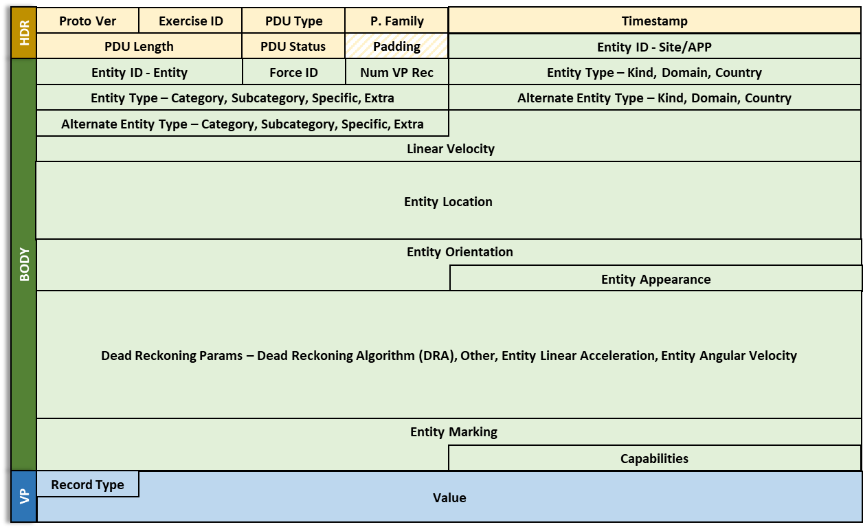
Protocol Data Unit (PDU) Entity State V7 Example
Operating System network stack inserts PDU in datagram / packet for transfer on network

Slide 18
DIS Documentation Relationships
Distributed Interactive Simulation standards, recommended practices, and related documents
Current DIS V7
IEEE Std 1278.1TM- 2012
Standard for DIS
—
Application Protocols
IEEE Std 1278.2TM-
2015
Standard for DIS
—
Communications Services and Protocols
IEEE 1730TM-2010
Distributed Simulation Engineering and Execution Process
IEEE 1278.4TM-1997
Rec. Prac. for DIS —
Verification, Validation, and Accreditation
SISO-REF-010 Enumerations for Simulation Interoperability

Slide 19
DIS Documentation Relationships
Distributed Interactive Simulation standards, recommended practices, and related documents
Future DIS V8
IEEE Std 1278.1TM- 202X
Standard for DIS
—
Application Protocols
IEEE Std 1278.2TM-
2015
Standard for DIS
—
Communications Services and Protocols
IEEE 1730TM-2010
Distributed Simulation Engineering and Execution Process
IEEE 1278.4TM-1997
Rec. Prac. for DIS —
Verification, Validation, and Accreditation
SISO-REF-010 Enumerations for Simulation Interoperability
SISO-REF-030 Reference for DIS/RPR FOM Records

Slide 20
Key DIS Concepts
No central computer controls the entire simulation exercise
No single point of failure
Every node is independent
No Central Node

Slide 21
Key DIS Concepts
Autonomous simulation applications are responsible for maintaining the state of one or more simulation entities
A standard network protocol is used for communicating ground truth data
Changes in the state of an entity are communicated by its controlling simulation application
Perception of entities or events is determined by the receiving application
Dead reckoning algorithms are used to reduce communications processing
Stateful information is sent at a minimum heartbeat rate or when an error threshold is exceeded

Slide 22
Key DIS Definitions
Simulation application:
Executing software on a host computer that models all or part of the representation of one or more simulation entities and/or phenomena in the virtual world
Receives and processes information concerning entities created by peer simulation applications through the exchange of DIS PDUs
More than one simulation application may simultaneously execute on a host computer
Host Computer:
Computer connected to simulation network that supports one or more simulation application
Simulation entity:
An object in the synthetic environment that is created and controlled by a simulation application and affected by the exchange of DIS PDUs IEEE Std 1278.1TM-2012, Clause 3.1

Slide 23
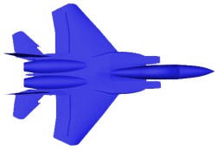
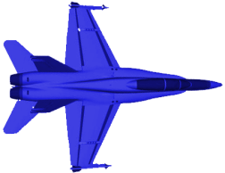

Key DIS Definitions (cont.)
Simulation exercise:
An exercise that consists of one or more interacting simulation applications
Simulations participating in the same simulation exercise share a common identifying number called the exercise identifier
Simulations utilize correlated representations of the synthetic environment in which they operate
Exercise ID
1
1
1
1
1
1
9
9
9
Exercise ID
DIS Net

Slide 24
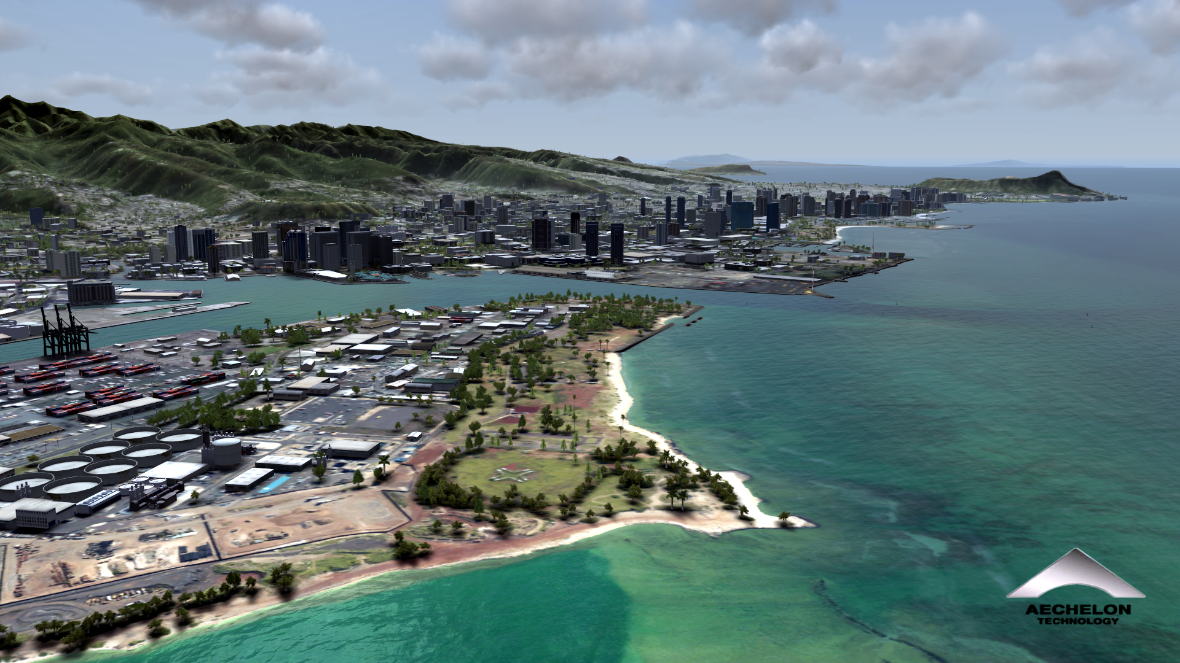
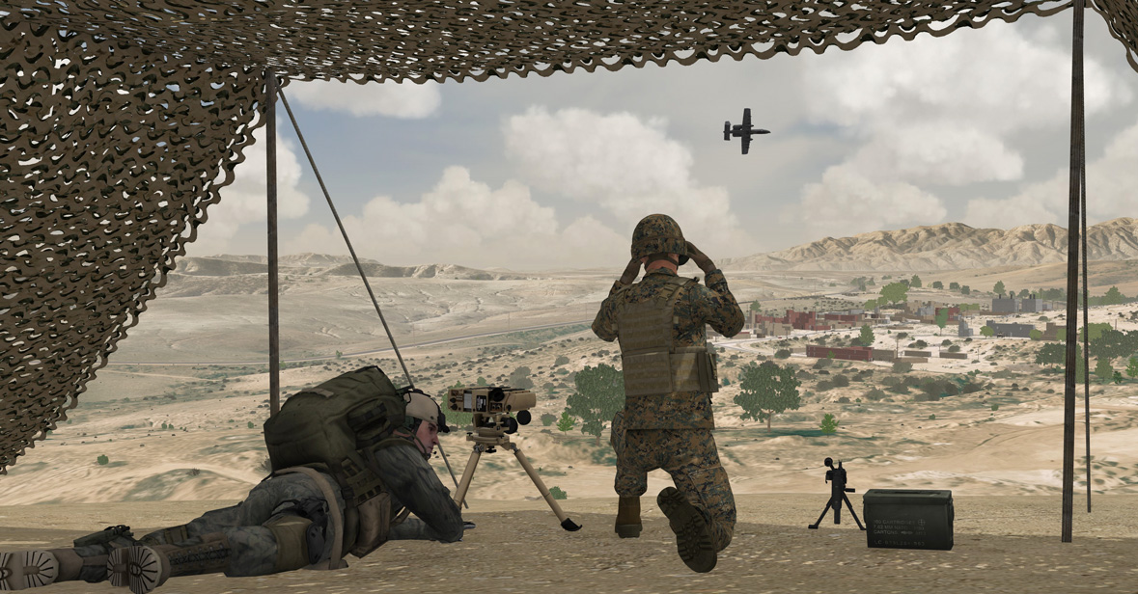
Key DIS Definitions (cont.)
Simulation environment:
The operational virtual environment surrounding the simulation entities
Includes terrain, atmospheric, and oceanographic information
Participants in the same DIS exercise will be using environment information that is adequately correlated for the type of exercise to be performed
Image provided by Aechelon Technologies (aechelon.com/case-studies)
Image provided by Meta VR (https://image-society.org/IMG/1905.html)

Slide 25
Network Considerations
PDUs are sent using broadcast or multicast addressing (one to many simultaneous)
Broadcast – every computer on the Local Area Network will receive the PDU
Broadcast does not work on Wide Area Networks
Some type of gateway is necessary at the LAN/WAN boundary to translate addresses
Multicast – every computer that has joined the multicast address group will receive the PDU, an efficient publish/subscribe mechanism
Multicast on WANs is now possible, or use Generic Routing Encapsulation (GRE) to tunnel
PDUs are almost always sent using User Datagram Protocol (UDP/IP) transport
Best effort – no guarantee of delivery, but networks can be designed to be very reliable
Unicast addressing with TCP/IP* (reliable) transport can be used, but uncommon
IEEE 1278.2™-2015 has details of design for real-time networks
* Transmission Control Protocol / Internet Protocol

Slide 26
DIS PDUs by Families
Entity information/interaction
Entity State – fundamental position and appearance of an entity
Collision – convey details of tactically significant collisions
Attribute PDU (new in V7) – adds PDU extensibility and partial updates
Logical Object State (new in DIS V8) – adds ability to define a role, association, or relationship of logical or actual entities e.g. Commander/Lead/Wingman
Warfare
Fire – launch munitions or expendables, fire a gun
Detonation – details of a weapons hit or explosion
Directed Energy Fire (new in V7) – deposition of an energy weapon
Entity Damage Status (new in V7) – damage fed back to firing entity

Slide 27
DIS PDUs by Families (Cont)
Logistics
Service Request
Resupply Offer, Resupply Received, Resupply Cancel
Repair Complete, Repair Response
Simulation Management
Create Entity, Remove Entity
Start/Resume, Stop/Freeze
Acknowledge
Action Request, Action Response
Data Query, Set Data, Data – use to set initial conditions, weapons reload etc.
Event Report, Comment – data for after action review
Application Control (new in V8) – allocate applications to exercises, application health

Slide 28
DIS PDUs by Families (Cont)
Distributed Emission Regeneration
Electromagnetic Emission – Radar and radar jamming
Designator (renamed Laser in DIS V8) – all uses of lasers that are not a weapon
Underwater Acoustics – Sonar, passive acoustic sensors
IFF – Identification Friend or Foe, military and civilian transponders and interrogators
Communications
Transmitter, Intercom Control (renamed Communications Node in DIS V8) – state of radios and comm nodes (intercoms, phones)
Signal – transfer of communications voice and data
Logical Network State (new in DIS V8) – Define logical networks that may or may not be modelled explicitly

Slide 29
DIS PDUs by Families (Cont)
Entity Management
Aggregate State – entity grouping e.g. brigade, battalion, company
Transfer Ownership – hand off control of an entity to another simulator
Synthetic Environment
Environmental Processes – smoke, contrails, dust, obscurants, toxic chemicals
Gridded Data – dynamic terrain, soil, vegetation, weather
Linear, and Areal Objects - dynamic objects such as craters, trenches, cultural features with damage
Environment Objects are now Entities in DIS V8
Weather based on Common Image Generator Interface (CIGI)(new in V8)
Information Operations (new in V7)
Simulate the use of electronic warfare, computer network attack, military deception to influence or disrupt decision making
Information Operations Action – transmits predicted effects of an attack
Information Operations Response – reports actual effects

Slide 30
World Coordinates
Φ = latitude
North Pole
Z
λ = longitude
a = major axis
Geocentric Cartesian Coordinates
Position and Orientation
WGS-84 elliptical Earth model
Units in meters and radians
DIS V8 will clarify that geoid gravity model is not included
Mean Sea Level is modeled as the WGS-84 ellipsoid
Altitude is height above ellipsoid
b = minor axis
Prime Meridian
X,Y,Z = GCC position
b
Z
r
a
Φ
a
Y
λ
p
X
Y
X
Equator

Slide 31
Entity Type Identification
Hierarchical designation of Entity Type
Enumerations are listed in SISO-REF-010
Over 20,000 entity types
ENTITY TYPE RECORD
Entity Kind | 8-bit enumeration
Domain | 8-bit enumeration
Country of design | 16-bit enumeration
Category | 8-bit enumeration
Sub-Category | 8-bit enumeration
Specific | 8-bit enumeration
Extra | 8-bit enumeration

Slide 32
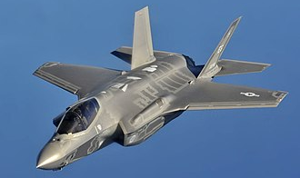
Examples of Type Enumerations
 | Kind | Domain | Country | Category | Sub-Category | Specific | Extra
F-35A CTOL | 1 | 2 | 225 | 1 | 12 | 1 | -
Platform
Air
USA
Fighter
F-35
A
Kind
Platform
Munition
Life Form
Environmental
Cultural feature
Supply
Radio
Expendable
Sensor/Emitter
C2 Logical Object
Linear Object
Areal Object
Image https://en.wikipedia.org/wiki/Lockheed_Martin_F-35_Lightning_II
Notes:
Kind – 1 – Platform
Domain – 2 – Air
Country – 225 – USA
Category – 1 – Fighter/Air Defense
Sub-Category – 12 – F-35
Specific – 1 – F-35A CTOL

Slide 33
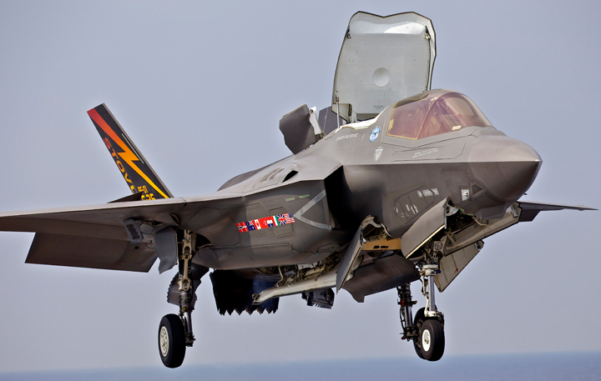
Examples of Type Enumerations
 | Kind | Domain | Country | Category | Sub-Category | Specific | Extra
F-35C Naval | 1 | 2 | 225 | 1 | 12 | 2 | -
Platform
Air
USA
Fighter
F-35
C
Kind
Platform
Munition
Life Form
Environmental
Cultural feature
Supply
Radio
Expendable
Sensor/Emitter
C2 Logical Object
Linear Object
Areal Object
Image by Google Images: Howmet Aerospace
Notes:
Kind – 1 – Platform
Domain – 2 – Air
Country – 225 – USA
Category – 1 – Fighter/Air Defense
Sub-Category – 12 – F-35
Specific – 2 – F-35C NAVAL

Slide 34
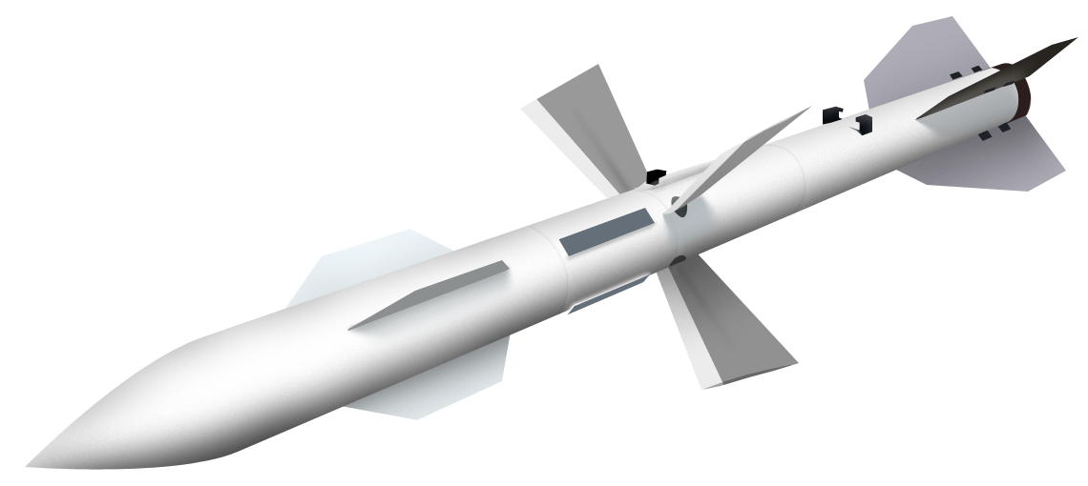
Examples of Type Enumerations
 | Kind | Domain | Country | Category | Sub-Category | Specific | Extra
AA-10C Alamo | 2 | 1 | 222 | 1 | 10 | 3 | -
Munition
Anti-Air
Russia
Guided
AA-10
C
Kind
Platform
Munition
Life Form
Environmental
Cultural feature
Supply
Radio
Expendable
Sensor/Emitter
C2 Logical Object
Linear Object
Areal Object
Image by AA-10C Wikipedia
Notes:
Kind – 1 – Platform
Domain – 2 – Air
Country – 225 – USA
Category – 1 – Fighter/Air Defense
Sub-Category – 12 – F-35
Specific – 2 – F-35C NAVAL

Slide 35

Entity Instance Identification
Combination of 3 numbers identify individual instances of entities and objects
Exercises assign site numbers
Sites assign numbers to simulations at the site
Sims assign entity numbers
14:100:4
14:100:2
14:100:3
14:100:1
Site | 16-bit unsigned integer | 14 (AFRL)
Application | 16-bit unsigned integer | 100 (NICE)
Entity | 16-bit unsigned integer | 1(1 to N)

Slide 36
Dead Reckoning Basics
Entity sender publishes state and information needed to predict state over time
Velocity (rate of change), acceleration
Receivers dead reckon (extrapolate) between updates
Sender also extrapolates its own entity to know what receivers see
New PDU issued when error between truth and extrapolation exceeds a threshold
Dead reckoning solves three problems
Significantly reduces the PDU issuance rate, requiring less network bandwidth
Compensates for network latency
Corrects position error due to unsynchronized simulation frame times

Slide 37
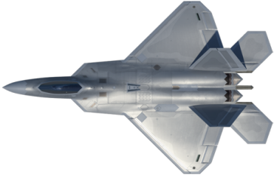
Dead Reckoning and Smoothing
Entity sends update when error > threshold (Error checked in each of 3 axes)
If any exceeds threshold, send update
Receiver extrapolates between updates
Spatial jump at update is smoothed over the next few seconds (Velocity error)
Error 1 meter
Green Line: Internal “truth” model (sender)
Red Line: Dead Reckoned (extrapolated) model
(sender and receiver)
Blue Line: Smoothing model (receiver)

Slide 38
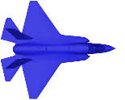
Positional Dead Reckoning, “World” DRA 2-5
Dead Reckoning Algorithm 2 and 3
P = P_{update} + VΔt (1st Order)
where Δt is time since last update
Dead Reckoning Algorithm 4 and 5
P = P_{update} + VΔt + ½AΔt² (2nd Order)
Extrapolates to a parabolic path through space
Linear
Parabolic

Slide 39
Positional Dead Reckoning, “Body” DRA 6-9
DRA 6-9 use rotation rate and body coordinate velocity and acceleration to achieve better prediction of turning vehicles
Extrapolates to a circular or spiral path through space
Math is more complicated and not used as much as DRA 2-5
Performs much better in some situations, should be used more
No change in DIS V7 but errors in the math formulas were fixed
See E.7.3 in IEEE Std 1278.1TM-2012
Circular
Pos = Pos₀ + [R₀]_{b->w}([R1]*Vel_{b} + [R2]*Acel_{b})

Slide 40
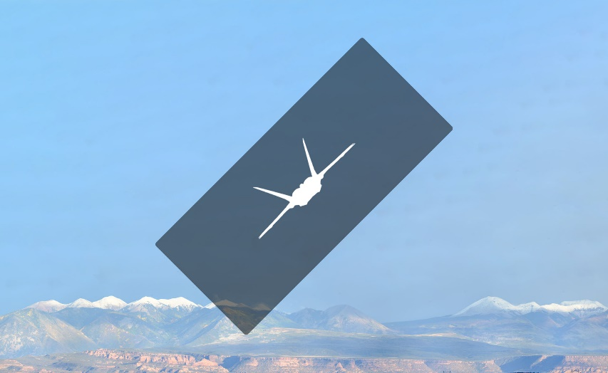
Rotational Dead Reckoning
DRA 2, 5, 6, 9 have no rotational dead reckoning
DRA 3, 4, 7, 8 all have the same rotational DR formula
[R_{D}]_{w->b} = [DR][R₀]_{w->br}
Rotation rates are required
Entity State PDU: rotation rates are given as a vector ω in body coordinates
Direction of vector is axis of rotation
Magnitude |ω| is rate of rotation about axis
Receivers extrapolate orientation by rotating an entity about the axis by angle |ω|Δt, used to form the [DR] matrix
There is no acceleration in this math
(1st Order)

Slide 41
Dead Reckoning for DIS V8
DIS V8 makes distinction between “algorithm” and “formula”
Position DR formulas renamed
Parabolic Formula (formerly World algorithms 2-5)
Circular Formula (formerly Body algorithms 6-9)
Only one algorithm for moving entities
Algorithm chooses the best DR formula
Now called the Combined Parabolic Circular (CPC) Dead Reckoning Algorithm
CPC algorithm enumeration is 10

Slide 42
Formula Results Comparison
This shows a 500 knot turning aircraft with 20 seconds of extrapolation
Circular vs Parabolic is apparent
~1200 meter error
See SISO paper
2019-SIW-034
CPC algorithm in DIS V8 chooses the best formula
Circular if applicable
Parabolic otherwise

Slide 43
CPC DRA Code Implementation
A reference code implementation of the CPC DR Algorithm is available in SourceForge, Version 1.0 matches DIS V8 Draft 1
https://sourceforge.net/projects/dsu/
Written in C for easy use by multiple languages
Implements both position extrapolation formulas
Implements rotation extrapolation
Includes the improved orientation threshold method
Coordinate Conversion code (Lat/Lon/Alt to Earth Centered Earth Fixed) included
Not needed for CPC DRA, but helps in testing it
Have converted the C-Code to Java in 3 days

Slide 44
Consequences of DR
Less Bandwidth Required
Updates may occur at any time, not at fixed time intervals
Data rate is variable, higher when A/C are performing maneuvers, and lower when flying straight and level, leading to variability in traffic and therefore required bandwidth is more difficult to determine
Stationary entities only update at heartbeat period (30-120 Stationary ≈ 1 moving)
Number of entities is a lousy measure of network bandwidth!
Latency in sending or processing an update will result in positional errors larger than the threshold value
If thresholds are checked at a low rate the errors are larger than the threshold value

Slide 45
Heartbeats and Timeouts
PDUs are categorized as stateful (persistent info) or transient (one-time event)
Stateful PDUs are issued at least at the minimum heartbeat rate
This solves two problems
Late joiners get the full state of the exercise within one heartbeat period
If a PDU is dropped due to network error, the next update arrives within a heartbeat period
The default heartbeat period for each PDU type is listed in the DIS standard
Heartbeats vary from 5 to 60 seconds depending on PDU type and conditions
Exercises can change heartbeat periods by agreement
Receivers keep a timeout timer for each entity
If no information has arrived within 2.4 heartbeat periods, the entity is discarded
Solves the problem of simulation crashes or if the entity deactivation PDU is dropped

Slide 46
Techniques to Solve Network Issues
Network latency and jitter – due to speed of light and network processing time
Dead Reckoning compensates for position error due to network delay and frame differences
Issuance and receipt rules mitigate effects of latency
e.g., sender transmits that detonation or collision hit target, receiver determines damage
Bandwidth – both the size and number of PDUs consume network resources
Efficient PDU design with a binary format to send the minimum data necessary
PDU sent only when a parameter change exceeds a threshold value
Dead Reckoning - TSPI data sent every few seconds instead of every simulation frame
Design for reduced data, e.g. receiver lookup table with a single index in PDU
Network Reliability – PDUs get lost, it’s rare but it happens
Efficient PDU design helps prevent overloading networks, reduces dropped data
State data repeated at least at regular heartbeat interval

Slide 47
DIS 2012 (V7)
New and improved rules vs V5/6
Lessons learned from over 15 years of use
Additional Annexes and extensive clarifications
The 2012 standard is 747 pages vs 330 pages previously
V7 Uses former padding fields to maintain compatibility with Versions 5/6
V7 sims can add new information, old sims ignore it
Rules for interoperability between Version 5/6 and V7 are defined
Mixed version exercises are allowed
A single sim may issue version 5, 6 and 7 PDUs
IFF
Mode 5 and Mode S added
Five new PDUs (see DIS PDU by Families slides)

Slide 48
Other Simulation Networking Standards
Test and Training Enabling Architecture (TENA)
Connects systems on a live training range – uses US Government owned middleware
Common Training Instrumentation Architecture (CTIA)
Connectivity for live soldier training
Compressed DIS (SISO-STD-023.2024) (For DIS V7)
New SISO standard that compresses DIS data to connect over low bandwidth networks/busses (e.g. LVC), designed to be easily translated to/from regular DIS
HLA – High Level Architecture
IEEE Std 1516™ High Level Architecture (HLA)
A general-purpose network solution to connect any type of simulation
Includes time management services for discrete event simulation
Private company Run Time Interface (middleware)

Slide 49


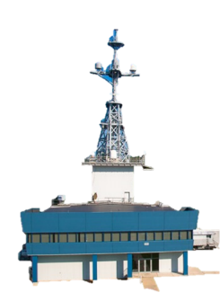





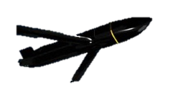



An LVC Exercise with DIS/C-DIS/HLA
Atlantic Test Range (ATR)
SLATE Ground Station
& Link Inject to Live (LITL)
HLA
Westover RRU
NAS JAX
Virtual
MH-60R
SAIL
(BFTT)
DIS
Pax RRU
C-DIS
Live
EA-18G
Live Guised Red Air
Manned Flight Simulator (MFS)
Constructive Weapons Fly-out
(F/A-18 Cockpit Surrogates)
(F-35 Effects Based Sim)
(LCTs)
LEGEND
Virtual
F/A-18E/F
Blue Live
Blue Virtual
Red Constructive
5GATW
NCTE
SDREN
Virtual
MH-60R
Live
F/A-18E/F
Constructive Threats
Virtual
F-35
NAVAIR Public Release 2021-394 Distribution Statement A - "Approved for public release; distribution is unlimited"

Slide 50
How HLA is Different than DIS
The High Level Architecture standard has three parts
Framework and Rules
Application Programming Interface (API) specification
Object Model Template specification
Template for creating a Federation Object Model (FOM)
HLA provides publish/subscribe services for distributing data and managing time
But doesn’t specify what that data is (syntax) or rules of using it (semantics)
Each federation of simulations is responsible for defining its FOM
Typically, a consensus design among all the simulations that are being federated
The Run-Time Infrastructure (RTI) is middleware that implements the HLA API
The network protocol is designed by the RTI developers, not standardized

Slide 51
How HLA/TENA are Different than DIS
DIS
Know format
PDU over Ethernet
SIM 1
SIM 2
Multicast
HLA & TENA
Unknown Format over any Transport
RTI
Middleware
RTI
Middleware
SIM 1
API
API
SIM 2
Vendor Specific
Publish/Subscribe
Version Specific
Publish/Subscribe

Slide 52
RPR FOM
SISO developed the Real-time Platform Reference FOM (RPR FOM)
SISO-STD-001
Converts DIS PDU contents into an HLA FOM
SISO standard is the Guidance, Rationale, and Interoperability Modalities (GRIM) 2015
Still need the DIS standard for the semantics, i.e., the rules for using the FOM
For example, the DIS is the only standard that defines Dead Reckoning, weapon interactions, etc.
RPR FOM Versions
RPR FOM 2 (2015) matches DIS V6
RPR FOM 3 (2025?) matches DIS V7
RPR FOM 4 (202X) is planned for DIS V8

Slide 53



HLA-TENA-DIS Translation
 | DIS | HLA | TENA
Interface | Ethernet | API/RTI | API/RTI
Transport | Ethernet Known Message formats | Not Defined | Not Defined
Syntax | DIS | FOM | OM
Semantics | DIS | FOM | OM
RPR
RPR
Translatable
Translation between DIS/HLA/TENA requires equivalent FOM/OM (RPR) representations to DIS

Slide 54
HLA-TENA-DIS Translation
 | DIS | HLA | TENA
Interface | Ethernet | API/RTI | API/RTI
Transport | Ethernet Known Message formats | Not Defined | Not Defined
Syntax | DIS | FOM | OM
Semantics | DIS | FOM | OM
Orange
Green
NOT Translatable
Translation between DIS/HLA/TENA requires equivalent FOM/OM (RPR) representations to DIS

Slide 55
Tutorial Outline - Future
Goal - Fully Integrated LVC
The Past
History of networked simulation
The Present
The IEEE 1278TM DIS standard and how it is developed
Key definitions and concepts
Function and organization of DIS Protocol Data Units
Technical details of providing high-fidelity real-time information exchange
Improvements from the 1995 to the 2012 DIS (DIS V7) standards
The Future: The development of the next version of the DIS (DIS V8)
https://www.istockphoto.com/photos/future-and-past-signpost

Slide 56
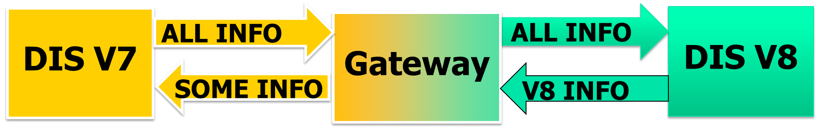
Currently in Development - DIS V8
We have learned a lot in the 30 years since DIS was originally developed
Computers are way faster, graphics way better, much higher fidelity is possible
We are running out of tricks to extend the protocol and maintain compatibility
The time is right for DIS V8 to have a new generation PDU design
This requires breaking PDU compatibility with previous versions of DIS
V8 is being designed for “Translation Compatibility” so that run-time translation to/from V7 is practical, although not necessarily trivial

Slide 57
Consistent PDU Design
Every PDU type will have this basic format:
Header
Fixed Body
Any number of Extension Records – allows added fidelity & extensibility
The fixed body has the basic fidelity information
Fixed in format and length, no variability allowed
Quick initial processing by receiver for interest management
Extension Records allow additional information/fidelity

Slide 58
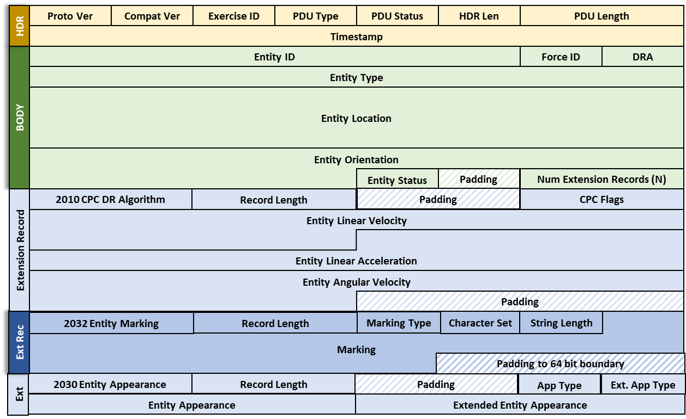
Example DIS V8 Entity State PDU
Fixed Header
Fixed Body
Variable
Extension
Records

Slide 59
PDU Extensibility
DIS V8 breaks direct compatibility to allow more extensibility
DIS V8 users can add custom extension records to PDUs to meet their unique needs
We expect many extension records in the future to support higher fidelity
Basic required/existing information extension records documented in IEEE1278.1
SISO-REF-030 documents new standardized extension records
Expected to be updated yearly using the SISO standards process
Range of Extension Record IDs reserved for user defined custom extension records
Users/groups can define proprietary or classified custom extension records and document them internally rather than putting them in SISO-REF-030

Slide 60
Machine Readable Syntax Definition
Clean PDU design enables formal language to describe PDU format
<DISsyntax xmlns:xsi="http://www.w3.org/2001/XMLSchema-instance"
xsi:noNamespaceSchemaLocation="DISsyntax.xsd">
<PDU name="Entity State" PDUType="1" protocolFamily="1" baseLength=“96">
<FixedRecordField name="Header" type="HeaderRecord"/>
<FixedRecordField name="Entity ID" type="EntityIdentifierRecord"/>
<EnumField name="Force ID" type="enum8" enumTableUID="6"/>
<EnumField name="Dead Reckoning Algorithm" type="enum8" enumTableUID="44"/>
<FixedRecordField name="Entity Type" type="EntityTypeRecord"/>
<AdaptiveRecordField name="Entity Appearance" type="EntityAppearanceRecord"
discriminant="Entity Type" field1=“Entity Kind" field2="Domain"/>
<AdaptiveRecordField name="Capabilities" type="CapabilitiesRecord"
discriminant="Entity Type" field1=“Entity Kind" field2="Domain"/>
<FixedRecordField name="Entity Location" type=“WorldCoordinatesRecord"/>
<FixedRecordField name="Entity Orientation" type="EulerAnglesRecord"/>
<FixedRecordField name =“Entity Marking” type="EntityMarkingRecord"/>
<NumericField name="Padding" type="uint32"/>
<NumericField name="Padding" type="uint16"/>
<ExtensionRecordSet>
<CountField name="Number of Extension Records" type="uint16"/>
<ExtensionRecordFields/>
</ExtensionRecordSet>
</PDU>
</DISsyntax>
Enables auto code generation
Wireshark dissectors
Marshalling code
Possible Auto FOM generation

Slide 61
Partial Updates
Partial Updates – Only send items that have changed

Slide 62
AESA Radar/Jammer
Support for AESA radar and advanced jamming (see 2023-SIW-001)
Re-design of EE PDU, 12 new extension records for high fidelity radar and jamming

Slide 63
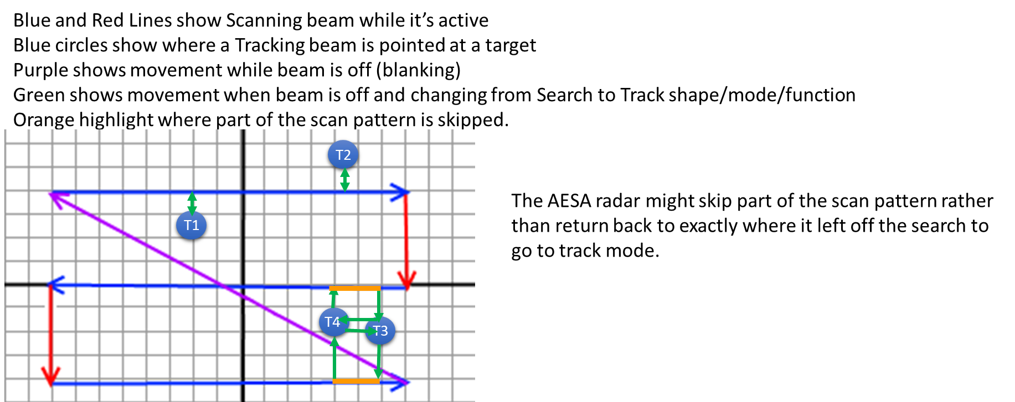
Complex AESA Radar Scans
3-Bar Scan + 4 Tgts

Slide 64
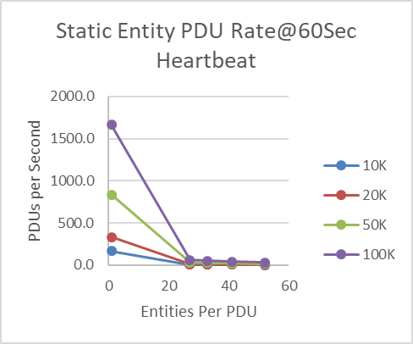
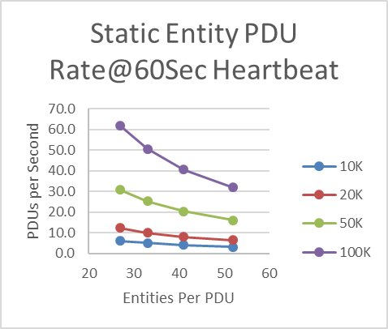
Multiple Entities in a single PDU
New Multiple Entity records to update a very large number of entities efficiently
Large exercises of 100K to a million entities envisioned
DIS V7 uses up to 41X PDUs 4X bandwidth
Expanded Scale
V7
V8
V8

Slide 65
Gridded Data
Gridded Data PDU overhauled to simplify use & support weather
110°W
105°W
100°W
40°N
6x6
1
10
11
60x60
60x60
60x60
High Res & Low Res Tiles
21
1001
1002
1003
60x60
60x60
60x60
31
1004
1005
1006
35°N
41
51
61
71
81
6x6
30°N
91
100

Slide 66
Other Improvements in DIS V8
New SIMAN Application Control PDU
Simulator device discovery, exercise control, and simulator health monitoring
Communications improvements
Better definition of radio vs non-radio communication (intercom, telephone, etc.)
Transmitter and Communications Node PDUs better align with Information Operations PDUs
New Weather PDU easier to define conditions that are not on a regular grid
Patterned somewhat after CIGI (SISO-STD-013-2024) weather
There will be a Compressed DIS Version for DIS V8

Slide 67
Other Improvements for DIS V8
Better, simpler timestamp
64-bit integer, microseconds since Jan 1, 1970, no rollover
Combine entities and environmental objects
Point (Merged with Cultural Features), Linear, Areal objects now use Entity State PDU
Avoids duplication between the old environmental object types and entity types
Single Dead Reckoning Algorithm that works for all moving entities
New IFF Interactive PDU for higher fidelity IFF interrogation
Will reduce PDU count from 72 to 43 (40% reduction)

Slide 68
Status of DIS V8
8 years of work by Product Support Group (PSG) within SISO
Product Development Group (PDG) stood up in 2021, starting the IEEE drafting process (4-year time limit)
Draft 4 published Dec 2024 – 95% complete, 300 comments, 530 pages
Draft 5 published Sept 2025
All sections of the standard have near-final content
All 43 PDUs, many extensions records, 4 annexes
About 100 comments on Draft 5
SISO-REF-030 V1.0 Sept 2025 (~200 pages)
Remaining work
Draft 6 completion
IEEE balloting, comment resolution, and publishing

Slide 69
Obtaining the DIS Standard
The DIS standard can be purchased directly from IEEE
Many companies have access to IEEE products for their employees
SISO members have access to IEEE standards developed by SISO
Annual membership is $95, less than the cost of an IEEE standard publication
Or, 1 year of membership is included in the SISO workshop registration fee
Any SISO member can join the DIS Product Development Group (PDG), get access to the DIS V8 drafts, and participate creating the standard and balloting

Slide 70
What You’ve Learned
The problem DIS solves
The capabilities of Live-Virtual-Constructive (LVC) Simulation Networking
The history of DIS
How it has evolved
Future direction
Key Definitions and Concepts
Technical details of
The type of information conveyed by DIS
Techniques for distributing real-time high-fidelity simulation data

Slide 71
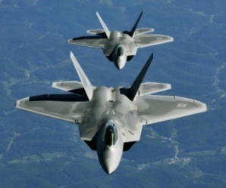
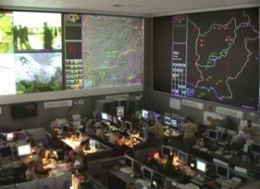
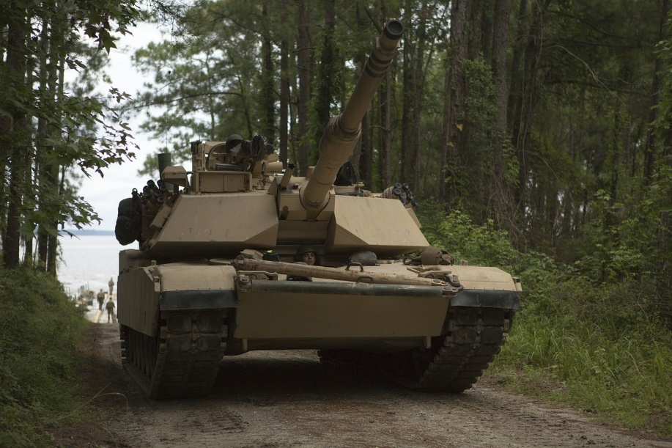
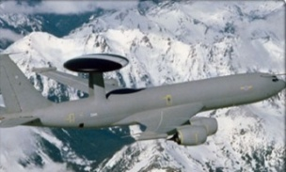
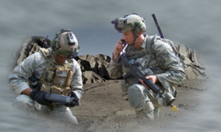
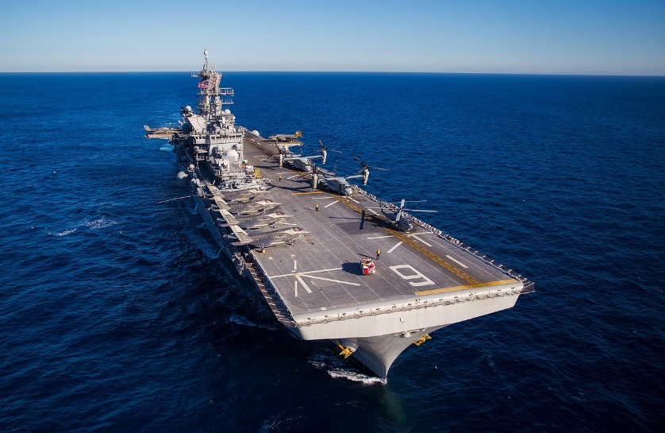
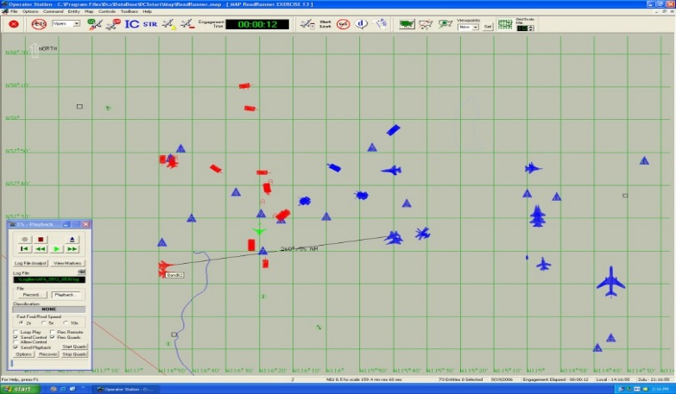
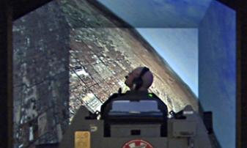
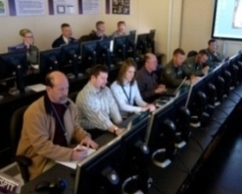
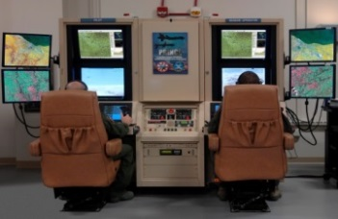
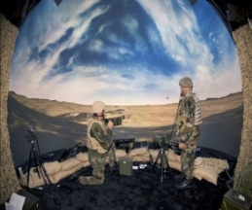



Questions?
Image by RHA
Image by pixabay
Image by RHA
Image by pixabay
Graphic by RHA
Image by RHA

