Slide 1


Enhancing CBRN Response Readiness using a
Mental Model Matrix
Angela Leek, Ph.D., CHP
Summit Exercises and Training LLC and Iowa State University
Jeff Skinner, M.D.
Summit Exercises and Training LLC
Nir Keren, Ph.D.
Iowa State University
© 2024 Summit Exercises and Training LLC – All Rights Reserved

Slide 2
Disclosures
This tutorial was developed based on research that was conducted through
Iowa State University
and partially funded by the National Institute of Occupational Safety and Health
The Heartland Center for Occupational Health and Safety Research Center (ERC) Project # T42 OH008491-16

Slide 3
Tutorial Learning Objectives
Articulate the role of the Expected Mental Model State (EMMS) Diagnostic Matrix in critical mission and Chemical, Biological, Radiological, Nuclear (CBRN) preparedness
Apply the EMMS Diagnostic Matrix and framework to identify gaps in responders' or soldiers’ mental models
Leverage insights from the EMMS Diagnostic Matrix to enhance CBRN Response Training

Slide 4
CBRN Threat Overview
Increasing number and variety of groups potentially using Improvised Nuclear Devices (IND), Radiological Dispersal Devices (RDD), or Radiological Exposure Devices (RED).
State actors with nuclear materials and expertise might collaborate with terrorists, evidenced by blurred lines between state and non-state actors (e.g., Wagner Group, Hamas, Hezbollah, ISIS).
U.S.-based accelerationist groups actively recruiting military personnel, with growing domestic and international terrorist links.
Online technical information and social media are fueling extremist radicalization and partisanship.
(NAS, 2023)

Slide 5


Challenges of Radiological/Nuclear Incident Response
The invisible nature of radiation requires specialized detection and measurement;
The lack of familiarity with technical units and conversion factors used in radiation incidents can complicate the understanding and application of risk assessment; and
Radiation incidents are highly infrequent, limiting real-world repetitive practice opportunities.
(Leek et al., 2024a)

Slide 6
Real-world evidence of potential impacts to response
Fukushima Daiichi nuclear power plant accident (2011)
70% of responders reported low confidence in their capabilities
78% indicated a willingness to respond without hesitation
Impacted by marital status, self-confidence, incentive, and family understanding
(Yamada et al., 2020 and Iyama et al., 2020)
Paramedics and willingness to respond
Forty incident types presented across natural and terrorism related incidents
Nuclear and radiological were categorized as most unfamiliar and invoked the most fear
(Smith et al., 2011)
Healthcare workers willingness to respond
90% willing to respond to natural disasters
Reduced to 40% for disasters involving radiological or nuclear
(Lanzilotti et al., 2011)

Slide 7




What causes Fear and Misconceptions About Radiation Risks?
If mental models are built from accurate and comprehensive information, they will serve well.
If they are built with gaps in understanding or fed with improper beliefs or biases, they may cause errors in judgement or action.
Insights influence mental model
Mental Models
(what do I think will happen)
Reality
(what really happens)
Can you see any component of this mental model system missing from radiation incident response?
Used to develop predictions, decision, expectations

Slide 8


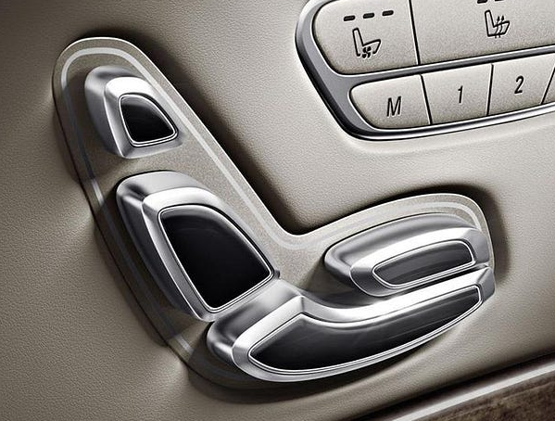
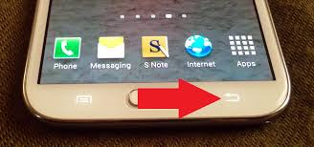
Mental Model Overview
Like a map in someone's head that helps them understand how things work and predict what will happen next.
Models concentrate the world into understandable and useable chunks
People develop mental models based on their knowledge of the world, perception, imagination, and experiences.
Norman, D. A. (2013). The design of everyday things. MIT Press.

Slide 9
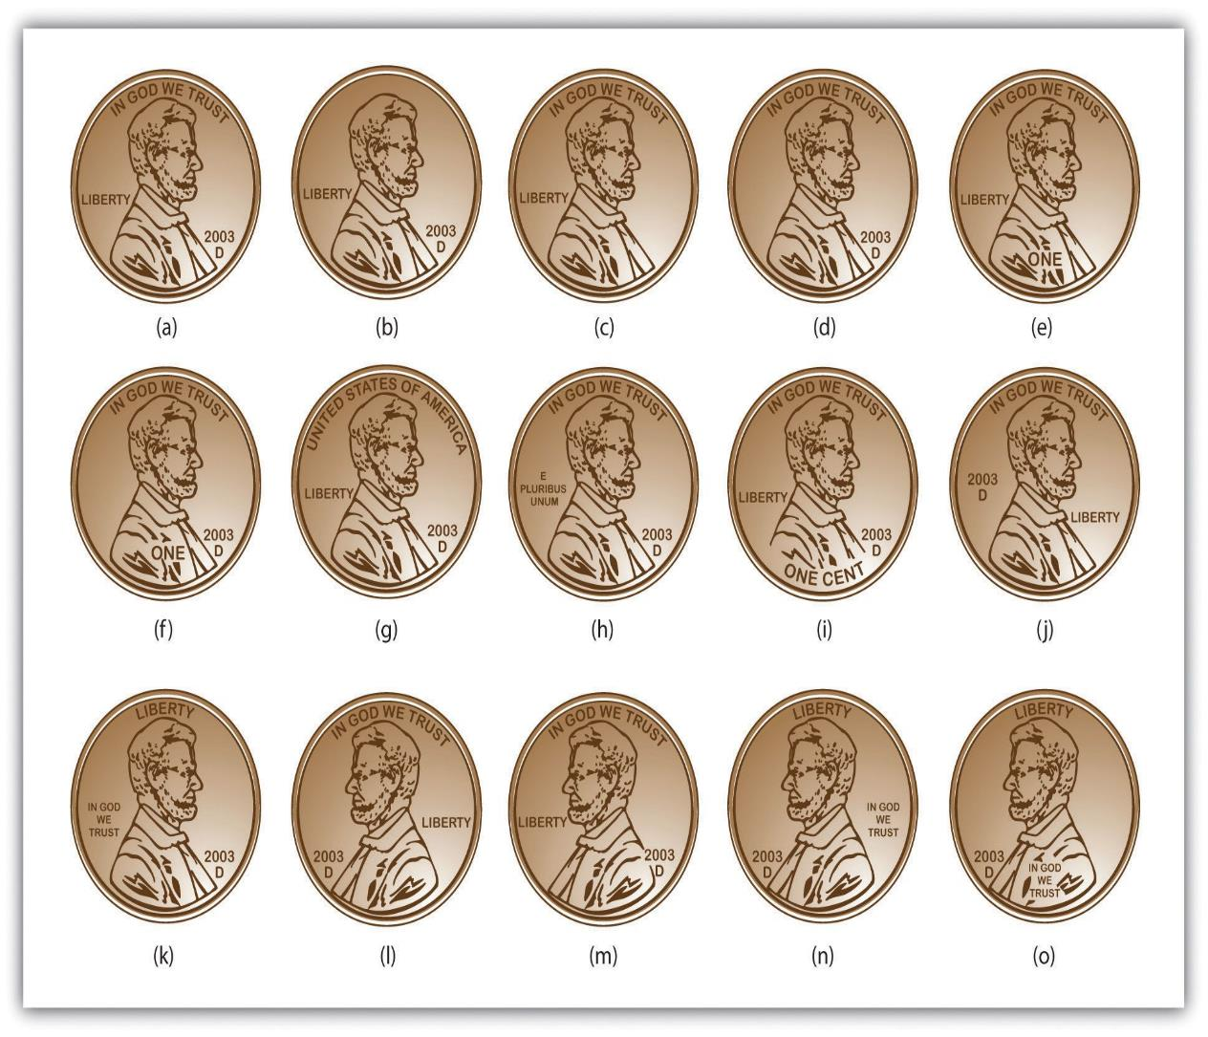
Mental Model Overview
Mental Models allow us to quickly sort through immense amounts of data to operate in the world
We recognize a penny, but do not need to know all the specifics details…
In emergency response – what if those details are critical to properly respond?
https://lawsonblake.com/design-of-everyday-things-don-norman/

Slide 10
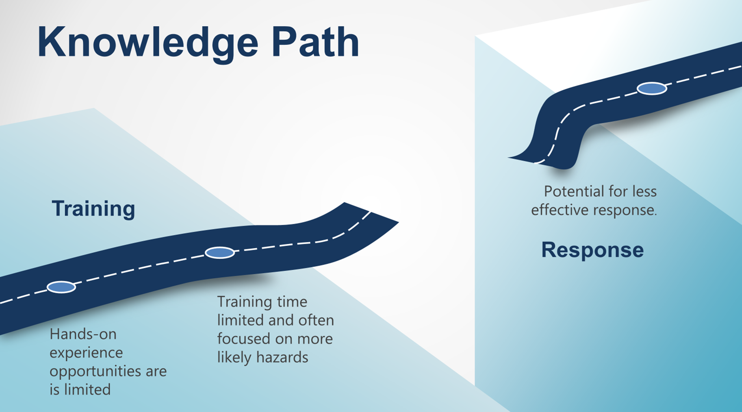
How can we identify gaps in individual mental models?

Slide 11

How can we identify gaps in individual mental models?
EVALUATION
FRAMEWORK
AND
CASE STUDY
Assess understanding of radiation and incident response specific to:
HAZMAT Technicians
and
Radiological Dispersal Device Incidents

Slide 12
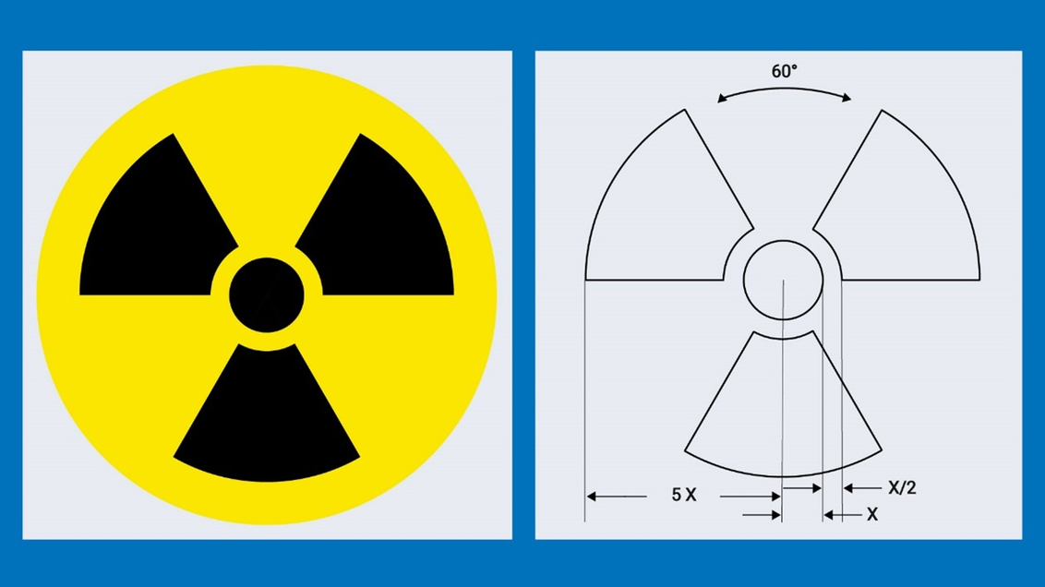
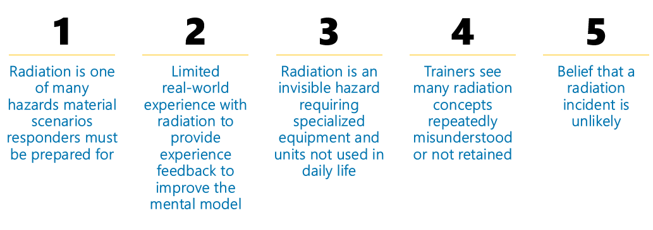
What makes people more susceptible to develop incomplete mental models for radiation and radiological emergency response?

Slide 13
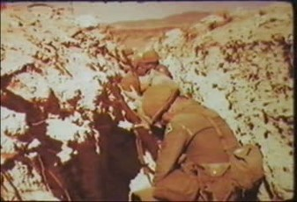
DoD Perspectives
What was Exercise Desert Rock?
Are concerns about suboptimal mental models equally relevant in the DoD space?
Which other areas of emergency response training or CBRN topics face similar challenges?”

Slide 14
Establish Expected Mental Model
What should be understood?
Develop EMMS Diagnostic Matrix
Develop crosswalk and mental model elicitation tools.
Elicit the individual mental models
What do they actually understand?
Identify and address gaps in understanding
Comparing the expected and individual mental models and addressing gaps.
Measure impact of gaps on response
Do gaps in understanding result in improper assessment of a response scene?
(Leek et al., 2024a; Leek et al., 2024b; Leek et al., 2024c)

Slide 15
Establishing the Expected Mental Model State (EMMS)
Focus Group of experts in radiological and nuclear incident response
Nationally recognized guidance documents outlining response priorities for RDD
Focus group members were selected based on diverse and substantial qualifications in radiation protection and emergency response, including:
Advanced degrees in radiation protection or related fields
Certified Health Physicist (CHP)
National Council on Radiation Protection and Measurement (NCRP) member
Extensive experience in radiation emergency preparedness and response
Instrumental role in developing key national and international guidance
Meet FEMA's criteria for Type 1 Radiological Operations Support Specialist
(Leek et al., 2024a)

Slide 16
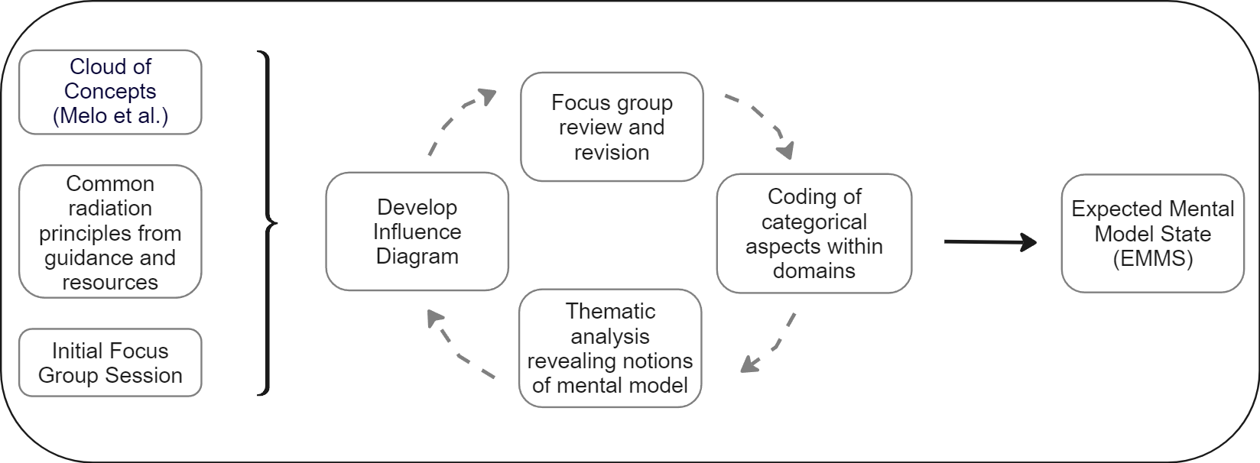
Establishing the Expected Mental Model State (EMMS)
(Leek et al., 2024a)

Slide 17
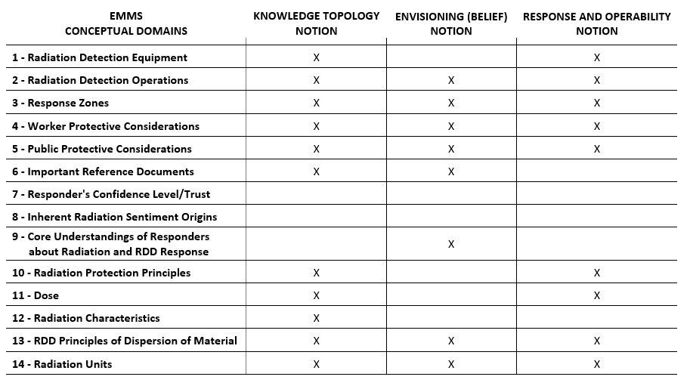
Establishing the Expected Mental Model State (EMMS)
(Leek et al., 2024a)

Slide 18
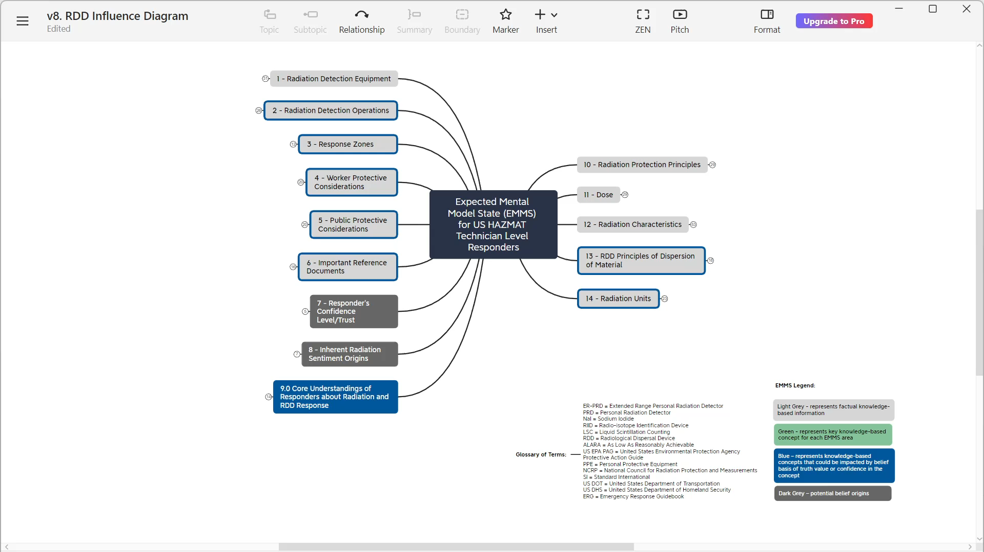
Expected Mental Model State (EMMS) Influence Diagram
(Leek et al., 2024a)

Slide 19

(Leek et al., 2024a)

Slide 20
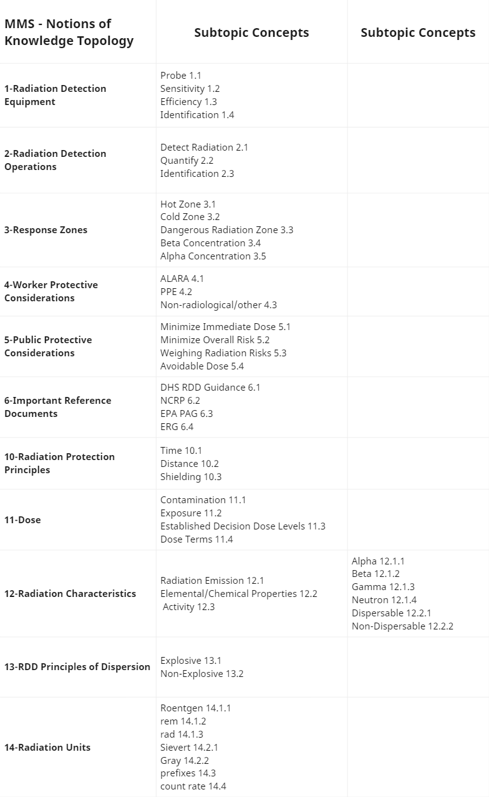
Expected Mental Model State (EMMS) for HAZMAT Technicians and RDD Incidents
(Leek et al., 2024a)

Slide 21
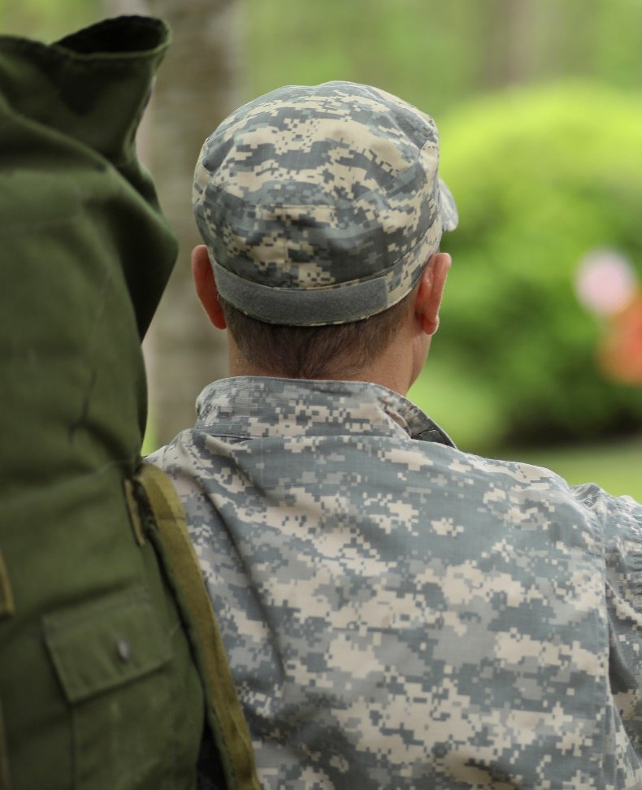
DoD Perspectives
What resources and personnel would the DoD use to establish the expected mental model for soldiers?
Doctrine
DTRA/USANCA
Defense/Army Science Board
Other experts/Advisory Groups

Slide 22
Establish Expected Mental Model
What should be understood?
Develop EMMS Diagnostic Matrix
Develop crosswalk and mental model elicitation tools.
Elicit the individual mental models
What do they actually understand?
Identify and address gaps in understanding
Comparing the expected and individual mental models and addressing gaps.
Measure impact of gaps on response
Do gaps in understanding result in improper assessment of a response scene?

Slide 23
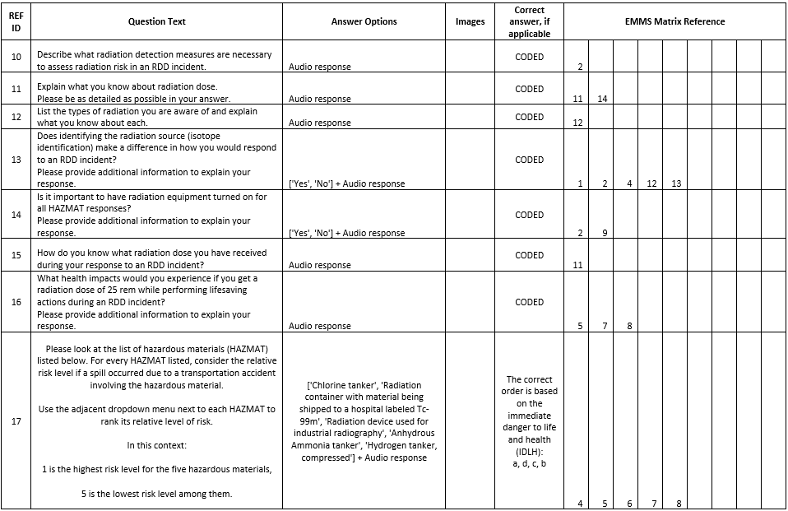
Establishing and Using the EMMS Diagnostic Matrix
(Leek et al., 2024b)

Slide 24
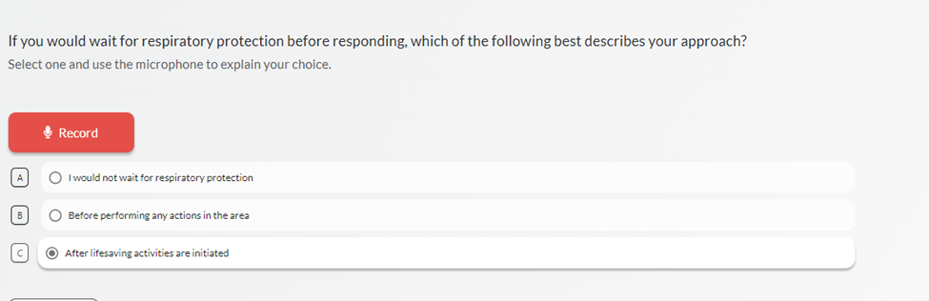
Establishing and Using the EMMS Diagnostic Matrix
Survey Questions built in phonic.ai to allow recording of audio response
(qualitative assessment)
(Leek et al., 2024b)

Slide 25
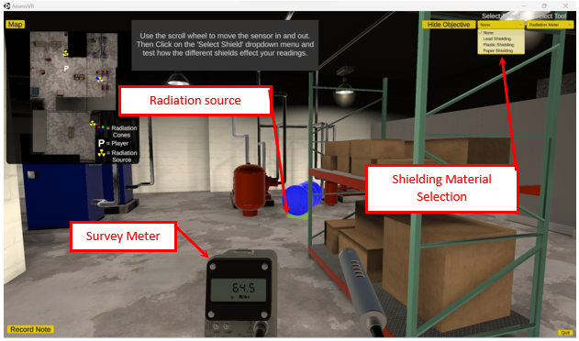
Establishing and Using the EMMS Diagnostic Matrix
Computer-based simulation activities in AssessRadVR
Qualitative assessment of actions completed mapped to EMMS
(Leek et al., 2024b)

Slide 26
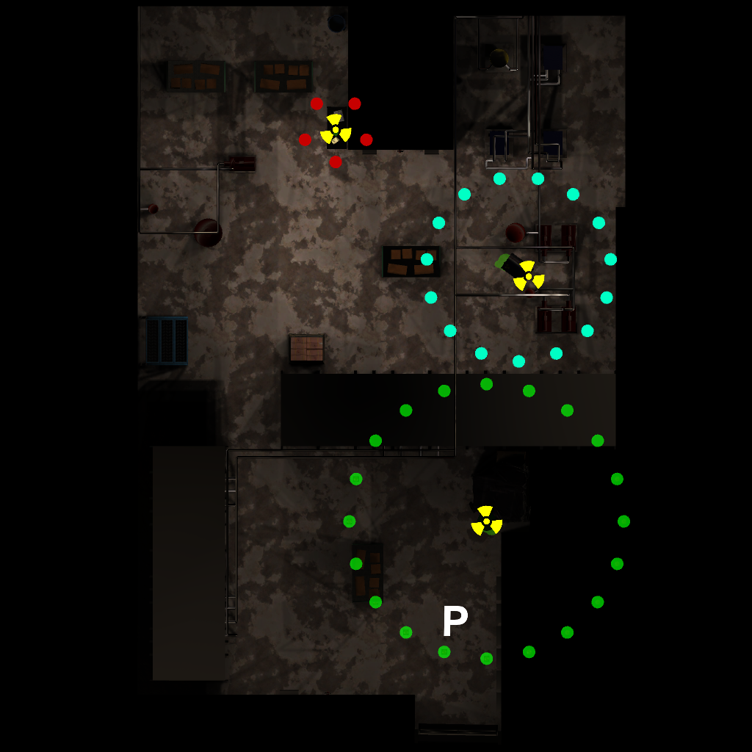
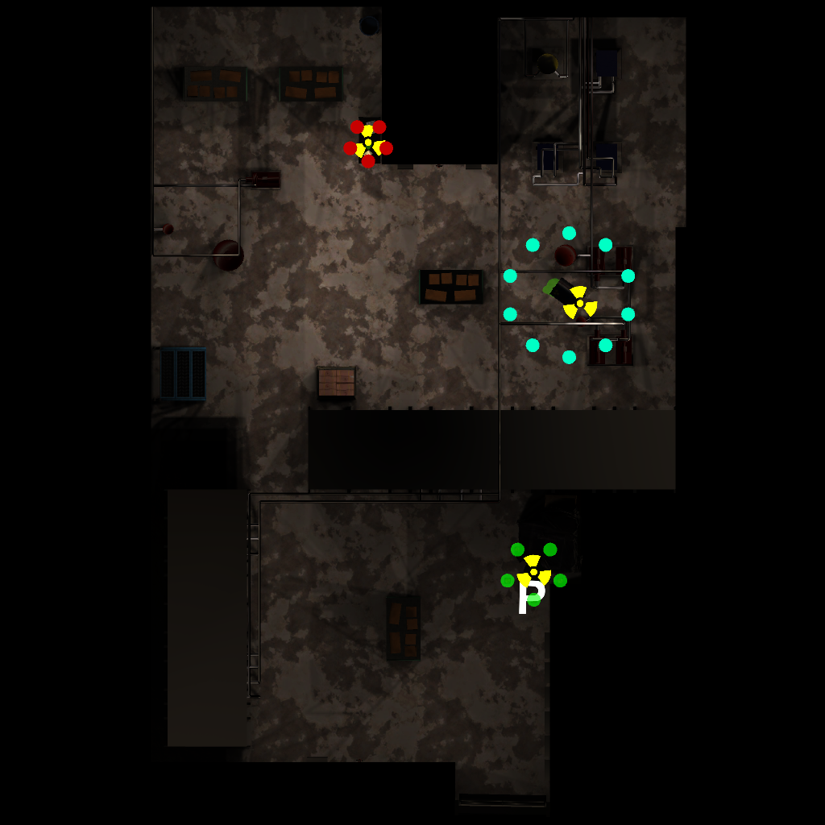
AssessRadVR Simulation Outputs
Example Responder Audio Statement
“At this moment I'm facing a source on a table and it has 10 microrems per hour as my reading on my radiation meter and the reading does not change with increasing the distance between myself and the source or using different types of shielding.
So I have a barrel on the ground leaking some substance, it has a trefoil marking on the barrel itself. This is a beta source because the number lowered when I was using a plastic shielding. The reading was significantly lower using the plastic shielding and I also placed cones down at where the source is reading 2 millirems as our action level.
So here I have a barrel with a trefoil marking on it, indicating it's a radiation source. It's leaking from the bottom, the barrel is upright. This is a gamma source as the paper and plastic shielding did not significantly drop the reading on the radiation meter, but the lead was able to decrease the reading. And I also placed cones at 2 millirems per hour distance.”
(Leek et al., 2024b)

Slide 27
DoD Perspectives
Is the DoD prepared to operate on a radiologically contaminated battlefield?
Discuss how EMMS based on doctrine/advisory groups could potentially be mapped into an EMMS Diagnostic Matrix
How could existing simulations or assessments be adapted to provide information on the soldier’s mental model to map back to an EMMS?

Slide 28
Establish Expected Mental Model
What should be understood?
Develop EMMS Diagnostic Matrix
Develop crosswalk and mental model elicitation tools.
Elicit the individual mental models
What do they actually understand?
Identify and address gaps in understanding
Comparing the expected and individual mental models and addressing gaps.
Measure impact of gaps on response
Do gaps in understanding result in improper assessment of a response scene?

Slide 29
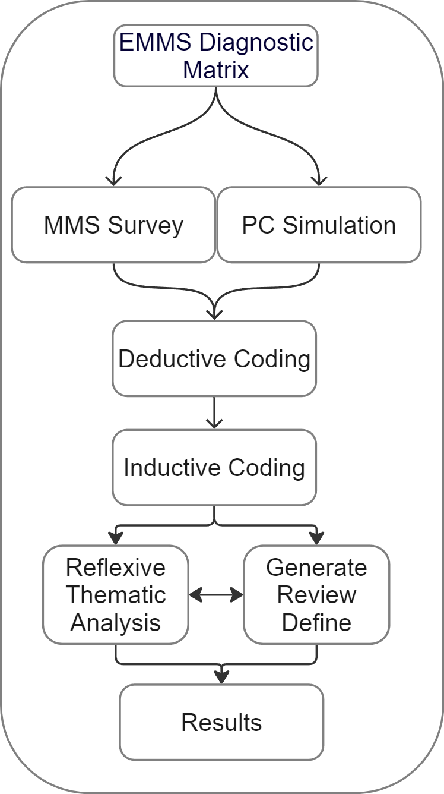
Eliciting the Mental Model from individual HAZMAT Technicians
Survey and Simulation Activities conducted in-person
112 responders
Technician or Specialist level
Four fire departments across the nation
NY, CA, TX, IA
Large Urban Area Security Initiative (UASI) to midsize urban
Data collected and analyzed using grounded theory methodology and reflexive thematic analysis
(Leek et al., 2024b)

Slide 30
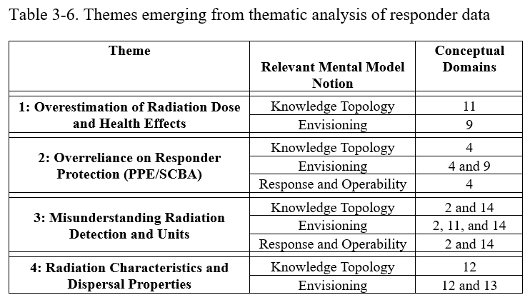
Results from MMS Elicitation
(Leek et al., 2024b)

Slide 31
DoD Perspectives
How might these findings improve DoD preparedness?
How might a specific military application of this framework result in different results?
Different response environment
Different operational environment
Different mission objectives

Slide 32
Establish Expected Mental Model
What should be understood?
Develop EMMS Diagnostic Matrix
Develop crosswalk and mental model elicitation tools.
Elicit the individual mental models and identify gaps
Comparing the expected and individual mental models for gaps in understanding
Address gaps in understanding
Evaluating and developing training to address identified gaps.
Measure impact of gaps on response
Do gaps in understanding result in improper assessment of a response scene?

Slide 33

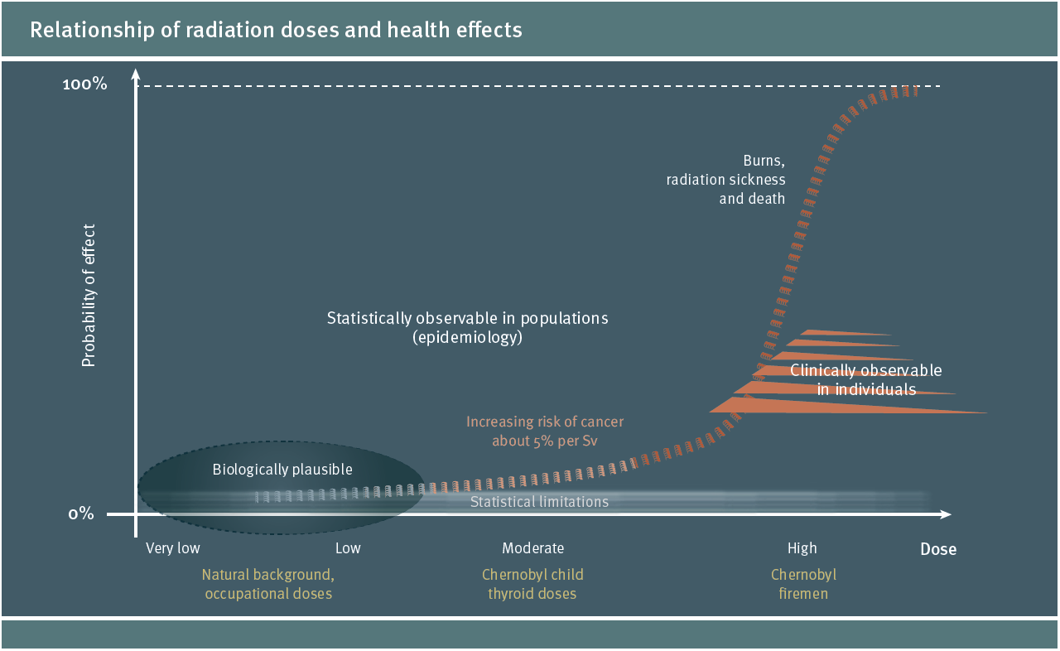
How identified gaps can be applied to enhance training or simulations?
Consider wording in training or references that might be contributing to misconceptions.
Can additional context be provided specific to identified gap?

Slide 34
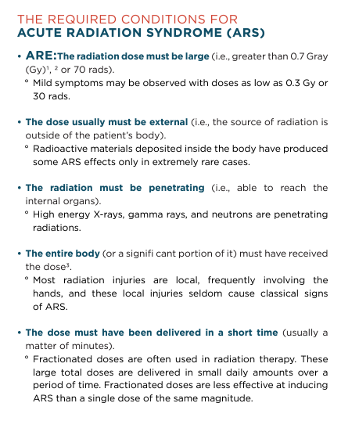
How identified gaps can be applied to enhance training or simulations?
https://emergency.cdc.gov/radiation/pdf/ars.pdf

Slide 35

Centers for Disease Control and Prevention. (2023). Acute radiation syndrome: A fact sheet for physicians. U.S. Department of Health & Human Services. https://www.cdc.gov/nceh/radiation/emergencies/arsphysicianfactsheet.htm.

Slide 36
How identified gaps can be applied to enhance training or simulations?
Training focuses on:
Occupational or emergency “limits”
and
Acute Radiation Syndrome symptoms
What about the large range in between?
Are we leaving this open to interpretation that ARS begins at top “limits”?
UNEP; RADIATION EFFECTS and SOURCES http://www.unscear.org/unscear/en/publications/booklet.html?print

Slide 37
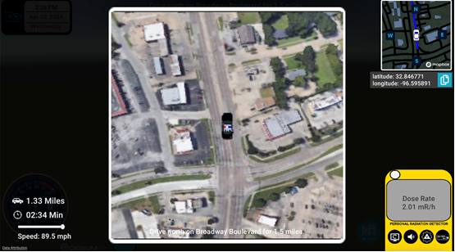
How identified gaps can be applied to enhance training or simulations?
https://www.radiationemergencyservices.com/radteamsim-route

Slide 38
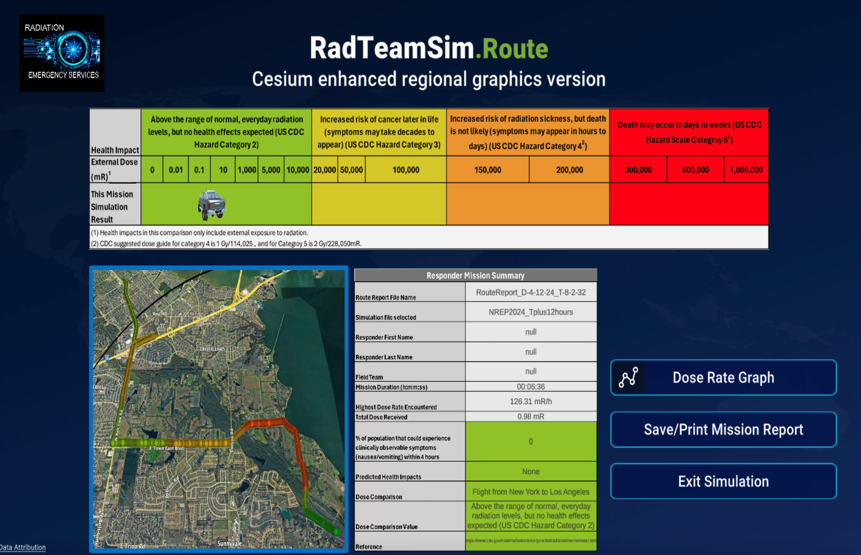
How identified gaps can be applied to enhance training or simulations?
https://www.radiationemergencyservices.com/radteamsim-route

Slide 39
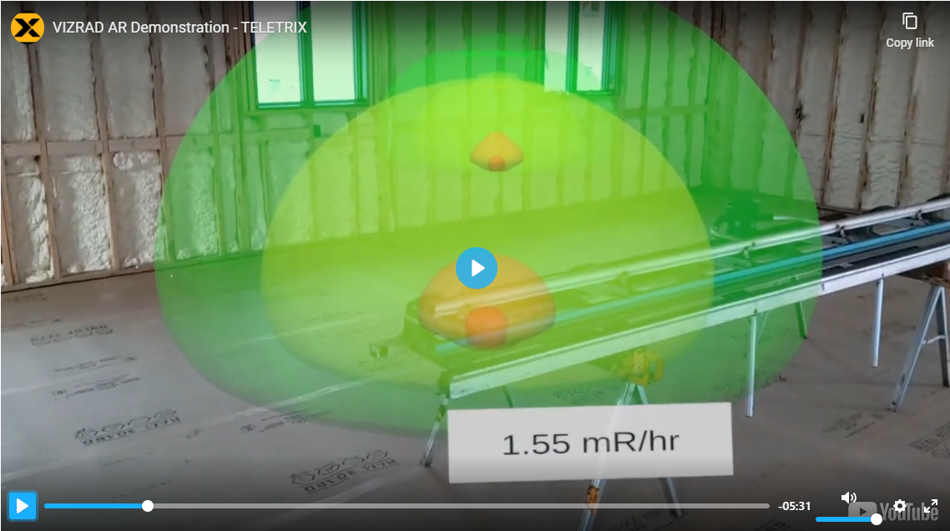
How identified gaps can be applied to enhance training or simulations?
https://teletrix.com/vizrad-ar/

Slide 40
DoD Perspectives
What simulations already exist that might be used to enhance mental models?
What modifications to existing military simulations would be necessary to address specific gaps in assessing soldiers' mental models?

Slide 41
Establish Expected Mental Model
What should be understood?
Develop EMMS Diagnostic Matrix
Develop crosswalk and mental model elicitation tools.
Elicit the individual mental models
What do they actually understand?
Identify and address gaps in understanding
Comparing the expected and individual mental models and addressing gaps.
Measure impact of gaps on response
Do gaps in understanding result in improper assessment of a response scene?

Slide 42
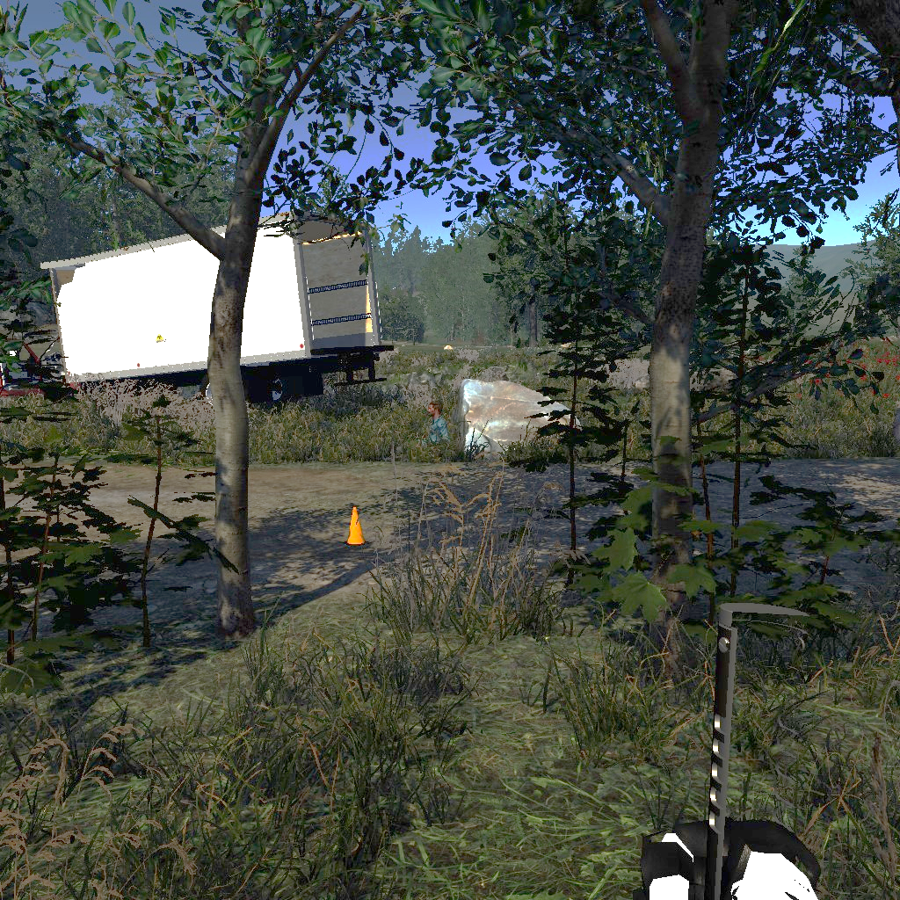
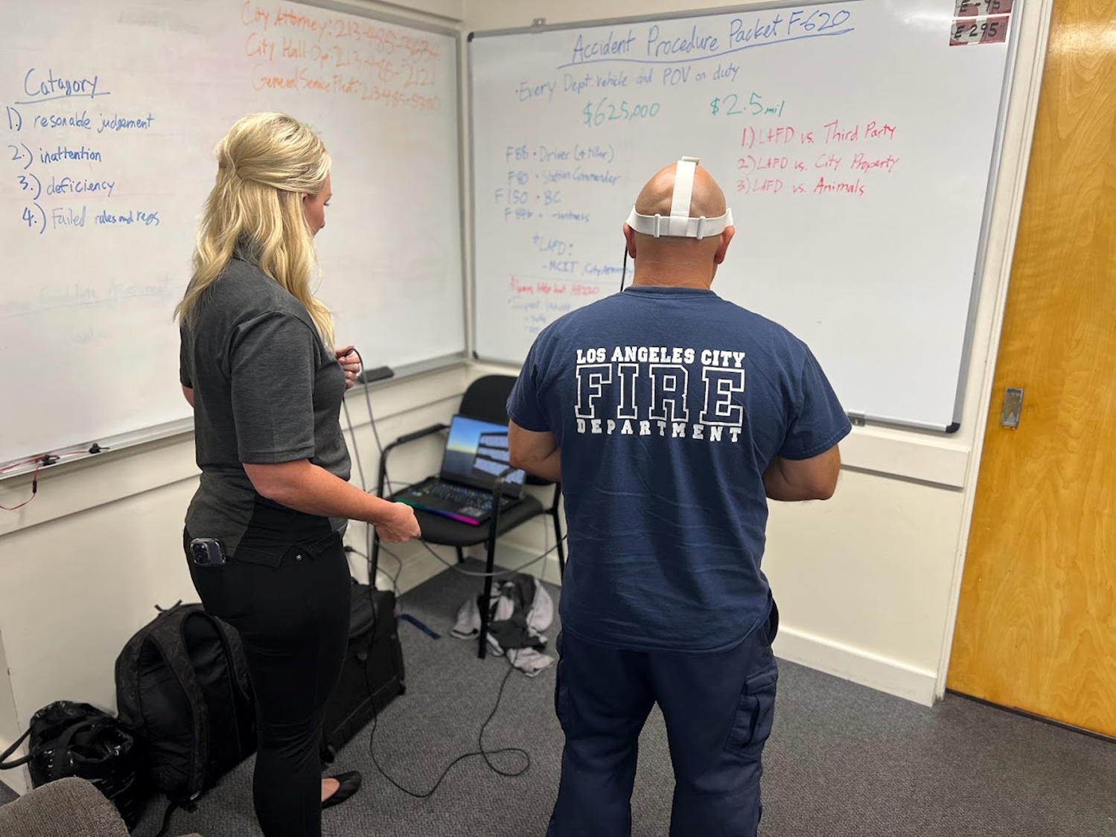
Refine general findings to emphasize potential impact on response
Specific theme elements were prioritized based on their potential to impact response actions, as assessed through VR simulated environments and structured response quality metrics
Qualitative assessment of:
Observed actions and verbalized statements made during the simulation;
Responses to post-simulation survey questions

Slide 43
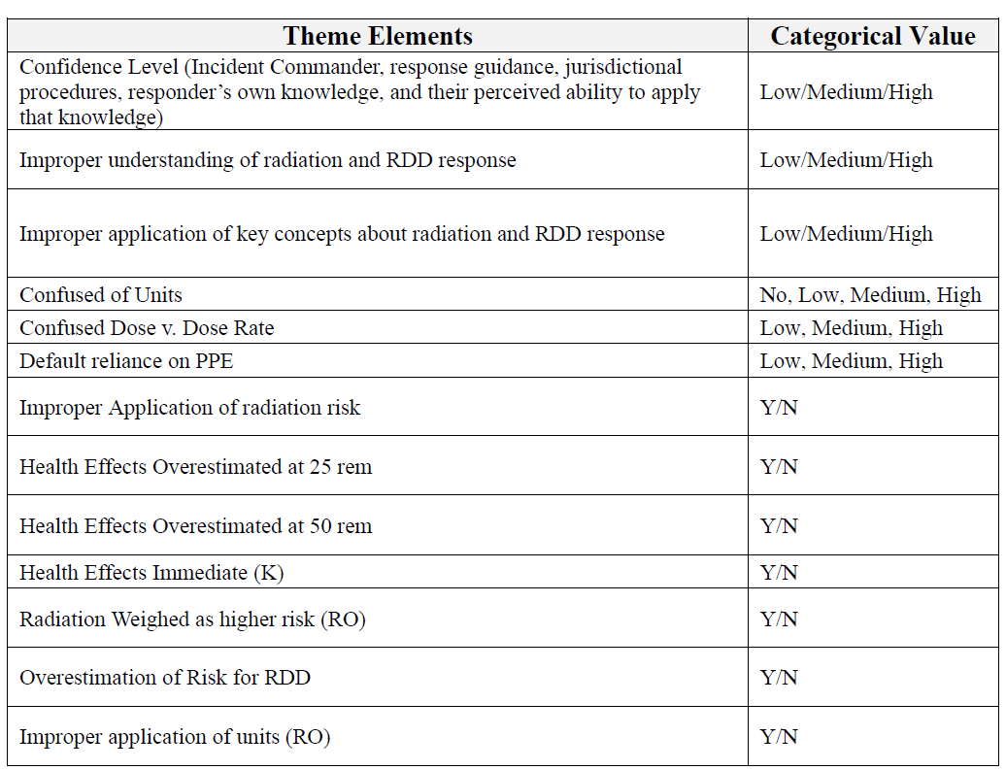
Refine general findings to emphasize potential impact on response
(Leek et al., 2024c)

Slide 44
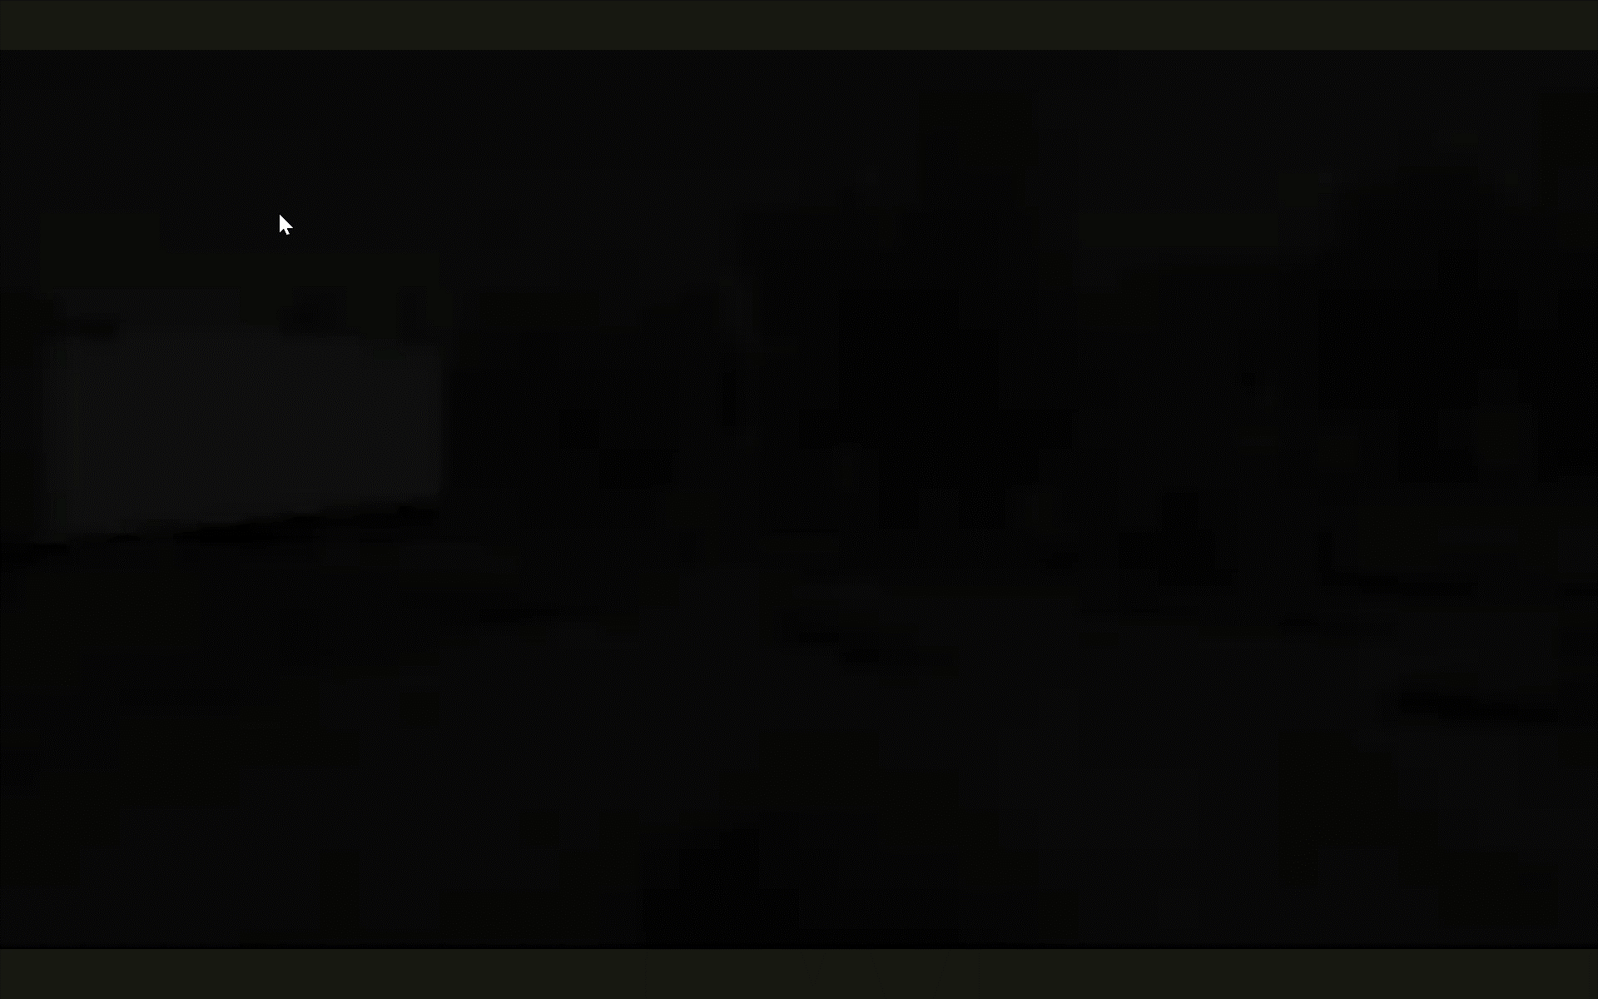
(Leek et al., 2024c)

Slide 45
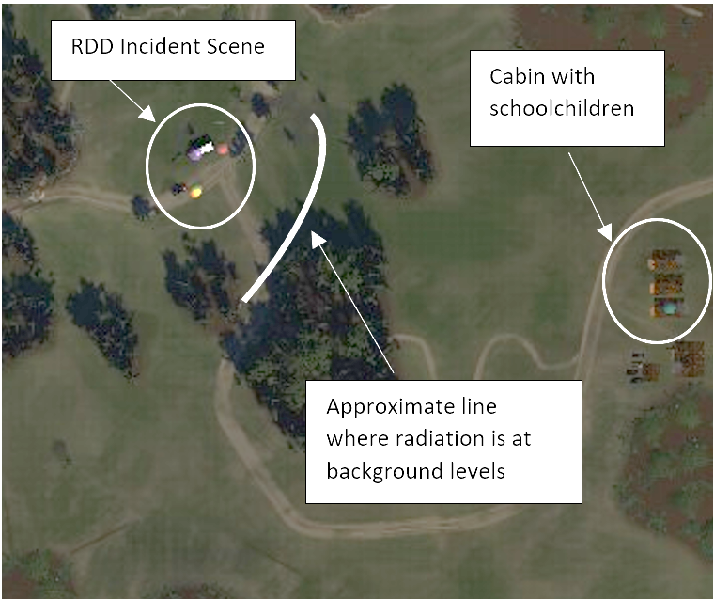
(Leek et al., 2024c)

Slide 46
Example Responder Statements
“And appears to be a man on the floor behind the truck. He seems to be in a high level of radiation. Might be the driver.
Upon further inspection, it looks like the source is coming from the back of this truck, getting very high readings, using the stone as a shield, which could allude us to what type of radiation it is.
Any closer than this. I'm getting readings that are unsafe. This guy might be in trouble without the proper gear. I don't know if it's worth getting him or not. I still unsure what it is.
I see that there is a placard on the side that says radioactive seven on the placard would have to check with my yard to see what the actual source could be. But at this point, I would stay back trying to keep everyone away from the area and I guess wait for, you know, hazmat units, proper hazmat units to arrive. Keep everybody away. “
(Leek et al., 2024c)

Slide 47
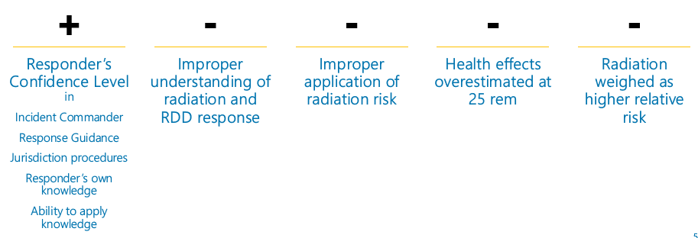

Which topics were found to impact response scores?
(Leek et al., 2024c)

Slide 48
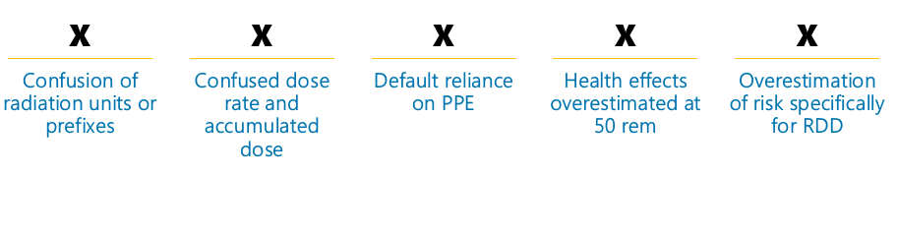
Which topics were NOT found to impact response scores?
(Leek et al., 2024c)

Slide 49
DoD Perspectives
How can these weighted findings be utilized within the DoD?
How could applying this framework to specific military scenarios yield different results?
Different response environment
Different operational environment
Different mission objectives

Slide 50
Conclusions and Next Steps – Case Study
Many of the identified gaps or misunderstanding are no surprise to those training responders, but this work confirms themes most prevalent across multiple teams.
The evaluation framework can systematically assess groups or individuals to help understand their needs and focus training efforts.
For those topical areas not tied to lower response quality scores, more exploration is needed:
It is possible that response guidance and procedures are promoting proper actions?
What about when the incident doesn’t follow the outlined procedure?
Responders need a robust mental model to lean on to make real-time decisions.

Slide 51
Conclusions and Next Steps for DoD
CBRN incident response, particularly radiological and nuclear, present a challenge to adequately understand the critical concepts that must be at the ready, but are rarely practiced in DoD space
How could a framework like this be beneficial to focus training and assessment efforts on understanding at mental model level and not just slide presentations and knowledge checks?
Soldiers and Commanders need a robust mental model to lean on to make real-time decisions.

Slide 52
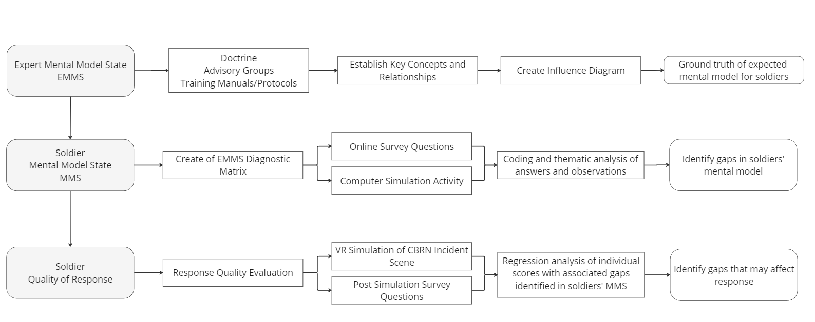
EMMS Framework Overview
This approach would allow the DoD to systematically analyze and evaluate how well soldiers' mental models align with established doctrine and expert recommendations.

Slide 53
References
Iyama, K., Takano, Y., Takahashi, T., & Hasegawa, A. (2020). Factors associated with the intention to participate in activities during a nuclear disaster situation among firefighters. Journal of Radiation Research, 61(6), 871–875. https://doi.org/10.1093/jrr/rraa061
Leek, A. (2023). The hidden factor: Characterizing the influence of responder mental models on the quality of radiological dispersal device incident response (Publication No. 21285) [Doctoral dissertation, Iowa State University]. Iowa State University Digital Repository. https://dr.lib.iastate.edu/bitstreams/e3fe0fed-9804-4ca1-b10a-6296ee76c383/download
Leek, Angela E.; Keren, Nir; Blumenthal, Daniel; Irwin, William; Musolino, Stephen. (2024a). HAZMAT Technician-level Emergency Response: A Mental Model Framework for Radiological Dispersal Device (RDD) Incidents. Health Physics 127(2):p 317-325, August 2024. | DOI: 10.1097/HP.0000000000001809
Leek, Angela, Keren, Nir, Shelley, Mack, Franke, Warren, Mosher, Gretchen, Simpson, Stephen, Rice, Timothy, & Hayden, H.. (2024b). Assessing the Mental Model State of Emergency Responders in the Context of Radiological Dispersal Device (RDD) Incidents: A Multi-state Study. Health Physics. 10.1097/HP.0000000000001856.
Leek, A., Keren, N., Shelley, M., Franke, W., Mosher, G., Simpson, S., Rice, T., & Lawson, A. (2024c). Influence of Mental Model-Derived Themes on the Quality of Radiological Emergency Response by HAZMAT Technicians: Insights from a Case Study. “In Press”, Health Phys. 2024
National Academies of Sciences, Engineering, and Medicine. (2023). Nuclear Terrorism: Assessment of US Strategies to Prevent, Counter, and Respond. Washington, DC: The National Academies Press. https://doi.org/10.17226/27215

Slide 54
References
Norman, D. A. (2013). The design of everyday things. MIT Press.
Smith, E. C., Burkle, F. M., Jr, & Archer, F. L. (2011). Fear, familiarity, and the perception of risk: a quantitative analysis of disaster-specific concerns of paramedics. Disaster medicine and public health preparedness, 5(1), 46–53. https://doi.org/10.1001/dmp.10-v4n2-hre10008
Yamada, K., Yamaguchi, I., Urata, H., &amp; Hayashida, N. (2020). Survey of awareness of radiation disasters among firefighters in a Japanese prefecture without nuclear power plants. PLOS ONE, 15(7). https://doi.org/10.1371/journal.pone.023664

Slide 55

Further Discussion/Questions

Slide 56
Thank you for your attention!
Enhancing CBRN Response Readiness using a
Mental Model Matrix
Angela Leek, Ph.D., CHP
Summit Exercises and Training LLC and Iowa State University
angelaleek@summitet.com
aleek@iastate.edu
Jeff Skinner, M.D.
Summit Exercises and Training LLC
jeffskinner@summitet.com
Nir Keren, Ph.D.
Iowa State University
nir@iastate.edu

