Slide 1
How the Brain Creates Reality; Enhancing the Reality Experience with Large Area Haptic Feedback
Tutorial # 24T61
Bill Phillips, BEEE, MA Counseling
President and Owner, Clark Synthesis, Inc.
bill@clarksynthesis.com

Slide 2

Learning Objectives
By the close of this tutorial the attendees will be able to:
Identify the 10 fundamentals of reality
Identify the 8 human sensory systems
Explain how the brain creates reality experiences
Describe how simulators work with the body and the brain for learning
Describe how large area haptic feedback works with the brain to improve learning

Slide 3

Outline
Introduction to Reality
The Body Supplies the Data
The Brain Processes Emotions
The Brain Processes Memories
The Brain Creates Reality Experiences
Simulators and Experience Creation
Recommendations for Simulator Designers
Using Large Area Haptic Feedback to Improve the Reality Experience
And Finally…

Slide 4
Reality Processing: Functional Model

Slide 5
Reality Processing: Functional Model

Slide 6


The Brain Creates the Reality Experience
Reality exists only in the mind
Reality exists only in the present moment
The brain is constantly updating the Reality Experience

Slide 7




Reality is Learned Over Time
A baby starts learning their reality in the womb
Learning continues until the early to mid 20s when brain development is complete
Depending on a person’s choices, learning can continue the rest of their life.

Slide 8

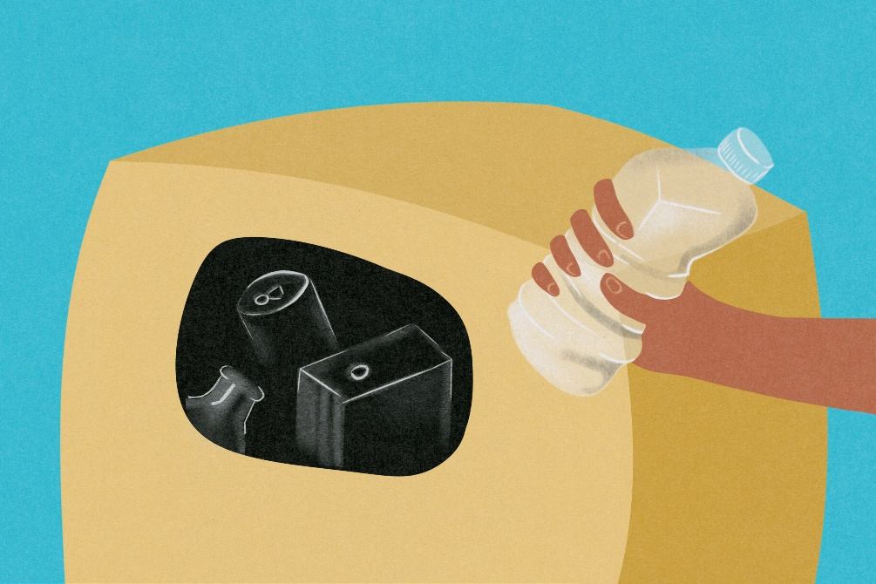
Learning/Forgetting
How does the brain learn?
The brain stores experience data
How does the brain forget?
The brain doesn’t store the experience data (not important)
The brain purges the experience data

Slide 9





10 Fundamentals of Reality
What a person sees
What a person smells
What a person hears
What a person tastes
What a person touches

Slide 10





10 Fundamentals of Reality
Balance
Movement
Feel Internally
Feel Externally
Emotional Responses

Slide 11
Outline
Introduction to Reality
The Body Supplies the Data
The Brain Processes Emotions
The Brain Processes Memories
The Brain Creates Reality Experiences
Simulators and Experience Creation
Recommendations for Simulator Designers
Using Large Area Haptic Feedback to Improve the Reality Experience
And Finally…

Slide 12
Reality Processing: Functional Model

Slide 13
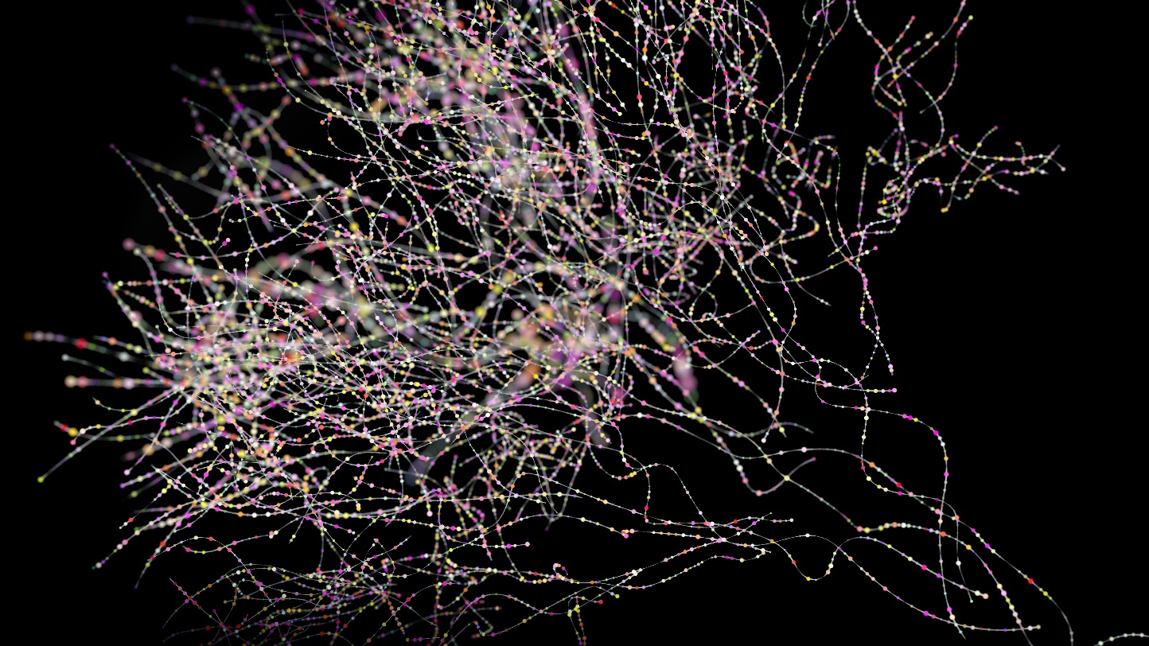
A Complex System of Nerves
There are over 220 different kinds of nerves in the human body
There are over 3000 different types of brain cells
It is estimated that the human body contains from 75,000,000,000 to 125,000,000,000 neurons with the majority of the neurons in the brain

Slide 14

Vision Sensory System
Rods
Very sensitive to low levels of light
Enable night vision
See in gray scale
0ver 100,000,000 rods in each eye

Slide 15
Vision Sensory System
Cones
Less sensitive to light
Enable day vision
See in color
0ver 6,000,000 cones in each eye

Slide 16

Taste Sensory System
Humans have between 2,000 and 10,000 taste buds
Sweet
Savory (Umani)
Bitter
Sour
Salty

Slide 17


Smell Sensory System
Humans have between 200 and 400 olfactory receptors
Can discern 10,000 odors
How the smell system works is not well understood

Slide 18
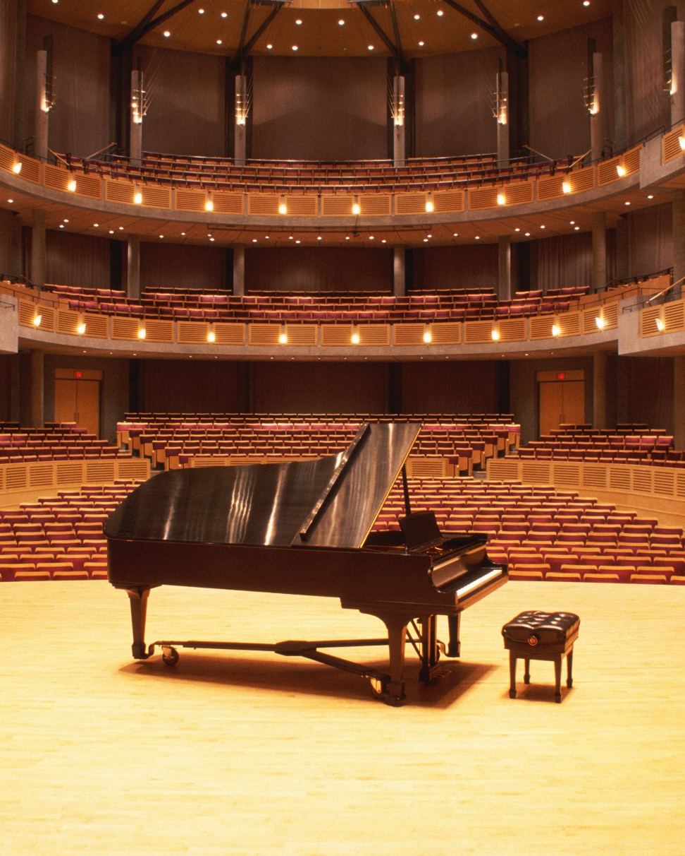
Hearing Sensory System
Hearing occurs in the inner ear with cochlear hair cells
Around 15,500 in each ear
Physically move with sound waves via eardrum
Physically move with sound waves via bone conduction
Convert motion to electrical signals

Slide 19

Balance Sensory System
Balance is sensed in the inner ear with vestibular hair cells
In a fluid environment
Sense linear and rotational motion

Slide 20


Muscle Movement Sensory System
Muscle spindles
Around 50,000 muscle spindles in the human body
Detect muscle lengthening
Detect muscle shortening

Slide 21


Touch Sensory System
Mechanoreceptors
Skin movement
Skin stretching
Hair movement

Slide 22


Touch Sensory System
Mechanoreceptors
Finger position
Pressure (Object Handling)
Movement

Slide 23


Touch Sensory System
Mechanoreceptors
Vibration Sensing
Textures

Slide 24


Touch Sensory System
Nociceptors
Sense Pain

Slide 25


Touch Sensory System
Thermoreceptors
Sense Heat
Sense Cold

Slide 26
Outline
Introduction to Reality
The Body Supplies the Data
The Brain Processes Emotions
The Brain Processes Memories
The Brain Creates Reality Experiences
Simulators and Experience Creation
Recommendations for Simulator Designers
Using Large Area Haptic Feedback to Improve the Reality Experience
And Finally…

Slide 27





The Brain Processes Emotions
The brain recalls past experience data that relates to the current experience data
The brain compares the current experience data to recalled experience data
Emotions are extracted from recalled experience data
The brain adds emotions to the current Reality Experience

Slide 28

The Brain Processes Emotions
What if there are no similar experiences?
The brain extracts emotions from somewhere and adds them to the current experience.

Slide 29
Outline
Introduction to Reality
The Body Supplies the Data
The Brain Processes Emotions
The Brain Processes Memories
The Brain Creates Reality Experiences
Simulators and Experience Creation
Recommendations for Simulator Designers
Using Large Area Haptic Feedback to Improve the Reality Experience
And Finally…

Slide 30
Reality Processing: Functional Model

Slide 31


Explicity / Conscious Memory
Facts
Events

Slide 32




Implicit / Unconscious Memory
Life Experiences
Emotions
Reward Processing
Habit Formation
Motor Memory

Slide 33
Outline
Introduction to Reality
The Body Supplies the Data
The Brain Processes Emotions
The Brain Processes Memories
The Brain Creates Reality Experiences
Simulators and Experience Creation
Recommendations for Simulator Designers
Using Large Area Haptic Feedback to Improve the Reality Experience
And Finally…

Slide 34
Reality Processing: Functional Model

Slide 35

The Brain Creates Reality Experiences
The brain:
Receives data from the sensory systems
Filters the data
Combines the data
Adds memory information
Adds emotional information
Synthesizes an experience of reality

Slide 36



Not Enough Data?
What happens if the brain does not get enough data?
The brain will continue to create the reality experience by filling in the gaps

Slide 37
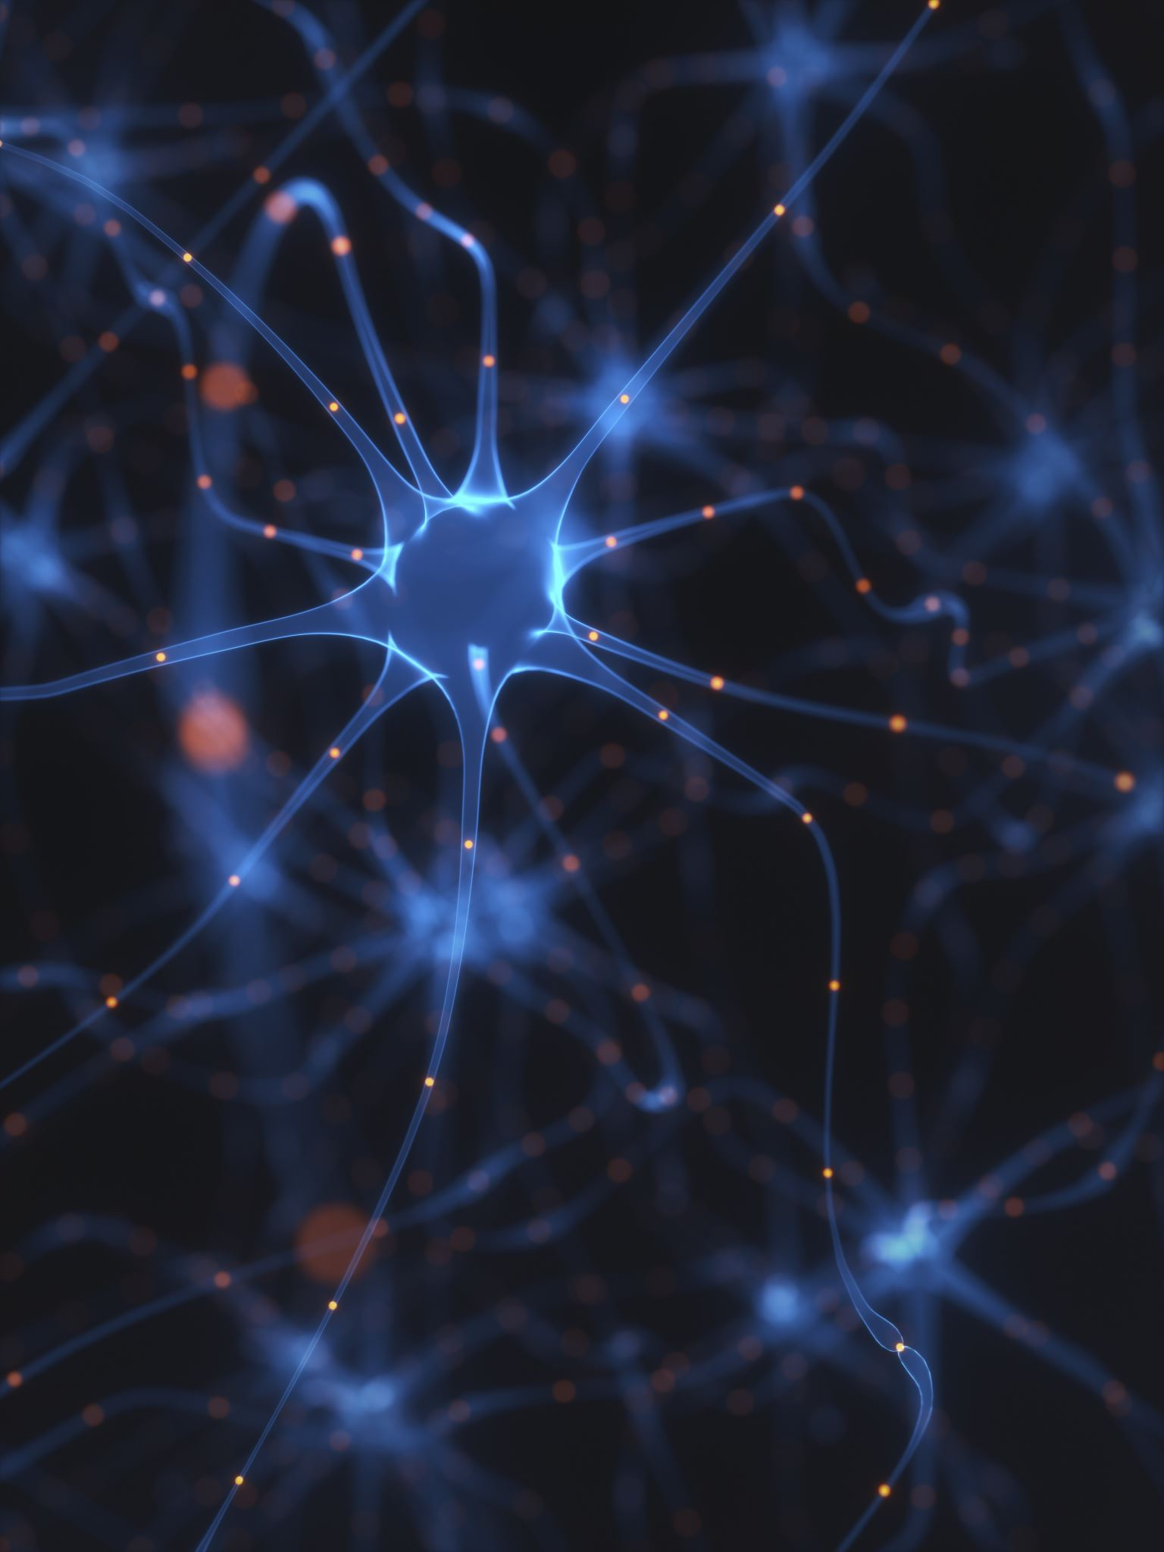
The Brain Creates Normalizes New Reality Experiences
The brain grows more neurons to store experiences
The connections to the new neurons are called neural pathways
When an experience is repeated, the brain improves the neural pathway, making it easier to retrieve the stored experience
The easier the retrieval, the more the experience feels normal

Slide 38
Outline
Introduction to Reality
The Body Supplies the Data
The Brain Processes Emotions
The Brain Processes Memories
The Brain Creates Reality Experiences
Simulators and Experience Creation
Recommendations for Simulator Designers
Using Large Area Haptic Feedback to Improve the Reality Experience
And Finally…

Slide 39
Reality Processing: Functional Model
Repeated training improves experience accuracy and recall

Slide 40
Simulators and Experience Creation
Repeated training improves experience accuracy and recall

Slide 41
Simulators and Experience Creation
Repeated training improves experience accuracy and recall

Slide 42


Simulators and Reality Experience Accuracy
To increase Reality Experience accuracy, the simulator must provide as many sensory inputs to the body as possible

Slide 43

Simulators and Sensory Inputs
More sensory inputs = more realistic experiences
Higher quality sensory inputs = better transference of what has been learned to the real world

Slide 44
Outline
Introduction to Reality
The Body Supplies the Data
The Brain Processes Emotions
The Brain Processes Memories
The Brain Creates Reality Experiences
Simulators and Experience Creation
Recommendations for Simulator Designers
Using Large Area Haptic Feedback to Improve the Reality Experience
And Finally…

Slide 45

Sensory Data is Analob
All sensory nerves create analog information for the brain
The best stimuli are analog

Slide 46

Low Threshold Sensory Nerves
Some sensory nerves are very sensitive
What those nerves sense is subtle
Don’t be afraid to turn down the intensity

Slide 47
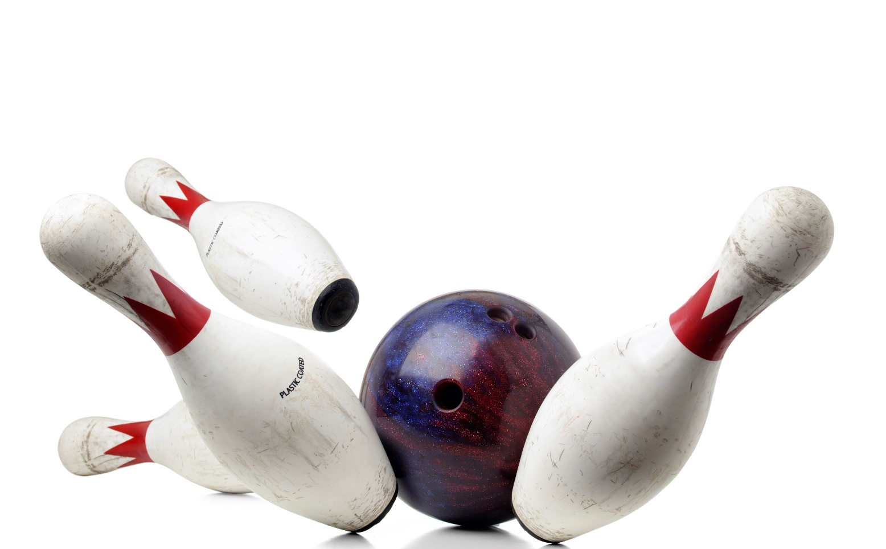
High Threshold Sensory Nerves
Some sensory nerves are less sensitive
More powerful stimuli are needed

Slide 48

Watch Out for Nerve Saturation
Sensory nerves are subject to saturation
Stimuli should not be too powerful for too long
The sensory nerves may turn off
Sensory nerves that are “asleep” can reduce learning

Slide 49

Watch Out for Nerve Adaption
Sensory nerves are subject to adaption
Repeated stimuli may cause the sensory nerves’ output to decrease over time

Slide 50

Allow Nerves to Desaturate
Sensory nerves are subject to desaturation
Powerful stimuli may need to be turned down or off to give the sensory nerves time to recover

Slide 51
Outline
Introduction to Reality
The Body Supplies the Data
The Brain Processes Emotions
The Brain Processes Memories
The Brain Creates Reality Experiences
Simulators and Experience Creation
Recommendations for Simulator Designers
Using Large Area Haptic Feedback to Improve the Reality Experience
And Finally…

Slide 52

Tactile Sound
Definitions
Tactile Sound
Audio stimuli that is sensed with the touch sensory system
Other sensory systems may be activated

Slide 53

Haptics Motion Platform
Definitions
Haptics
Artificial forces between virtual worlds and the user’s body
Motion Platform
A hardware device that moves the entire body resulting in a sense of physical motion and gravity
Jerald, J. (2015). The VR book : human-centered design for virtual reality. New York: Association For Computing Machinery.

Slide 54


Small Areal Haptic Feedback Large Area Haptic Feedback
Small Area Haptic Feedback
Haptic feedback limited to small areas, such as fingers, hands, and wrists
Large Area Haptic Feedback
Haptic feedback sense across large body areas, or even the entire body

Slide 55





Everyday Large Area Haptic Feedback
Everyday Large Area Haptic Feedback
Cars / Trucks
Buses
Trains
Subways

Slide 56
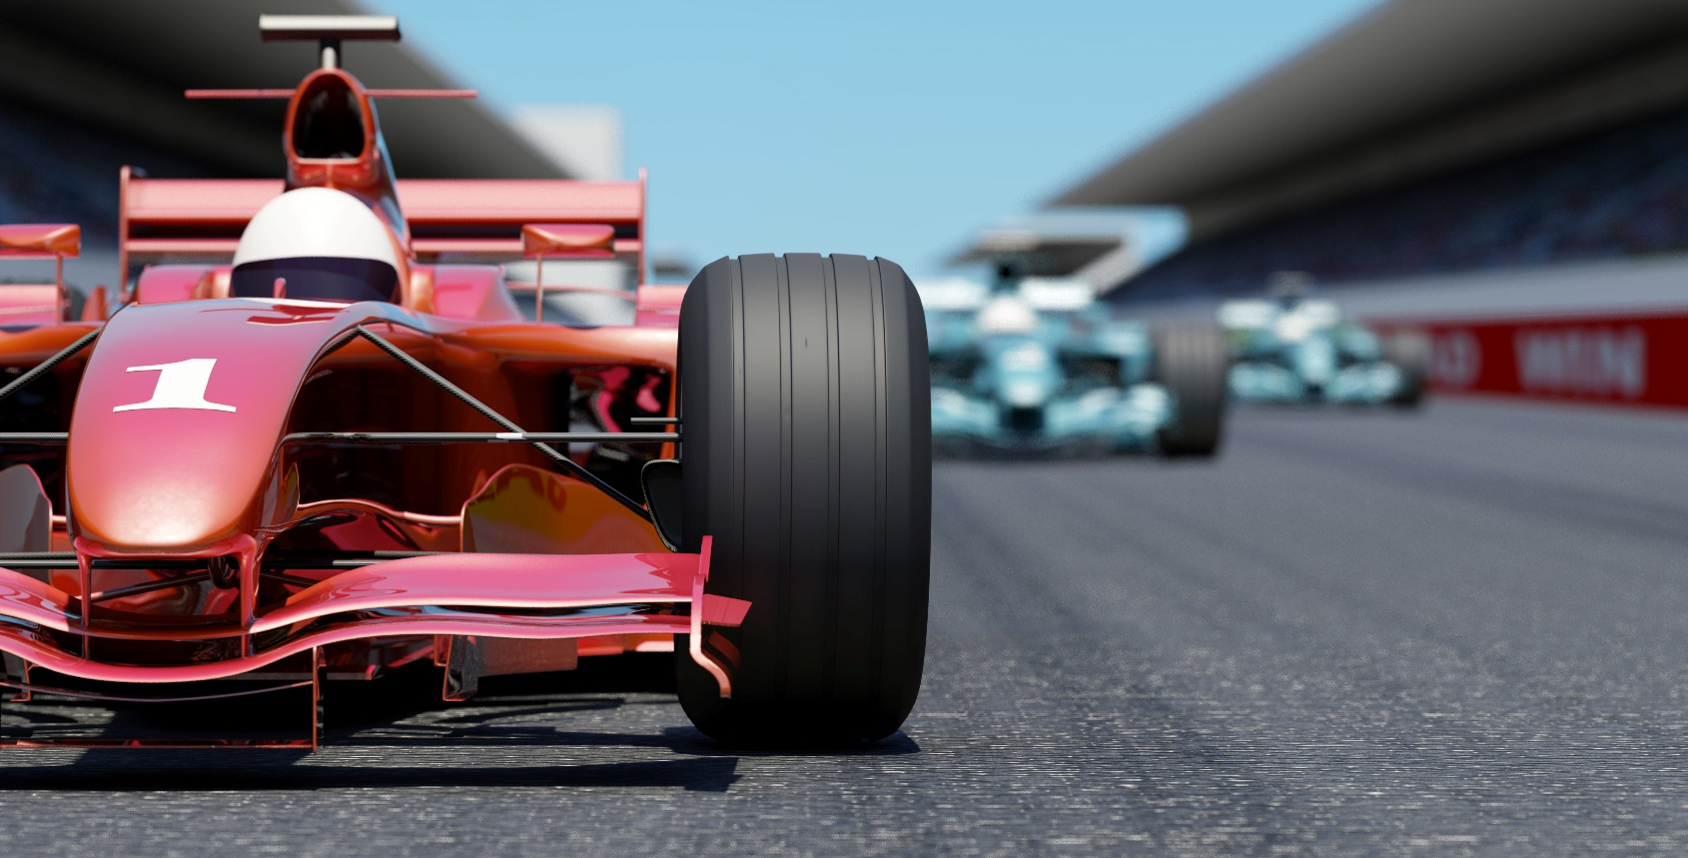
Elements of Large Area Haptic Feedback
Vibrations are delivered with tactile sound transducers that turn audio into vibration
Motion delivered with motion systems
In some situations, vibrations combined with visual cues can substitute for motion at a much lower cost

Slide 57


Advantages of Large Area Haptic Feedback
It delivers the cues that the brain needs to create a more accurate reality experience
It increases hearing through bone conduction
It increases the feeling of immersion

Slide 58

Example: Driving Simulator
Driving Simulator: Large Area Haptic Feedback stimuli:
Engine
Exhaust System
Tires rolling on ground / road surface
Wind noise
Brakes

Slide 59
Outline
Introduction to Reality
The Body Supplies the Data
The Brain Processes Emotions
The Brain Processes Memories
The Brain Creates Reality Experiences
Simulators and Experience Creation
Recommendations for Simulator Designers
Using Large Area Haptic Feedback to Improve the Reality Experience
And Finally…

Slide 60

And Finally…
Simulators and training that work closely with the body’s sensory systems and with the brain’s reality processing -
Reduce the distance between the simulator environment and the real world
Increase the sense of immersion
Deliver a more realistic training experience
Increase learning effectiveness
Increase speed of skill transference

Slide 61
References
American Academy of Ophthalmology. (2018, December 19). Rods. Retrieved from American Academy of Ophthalmology website: https://www.aao.org/eye-health/anatomy/rods
Gulati, A. (2015). Understanding neurogenesis in the adult human brain. Indian Journal of Pharmacology, 47(6), 583. https://doi.org/10.4103/0253-7613.169598
Hawkins, J. (2019). Human ear - Organ of Corti. In Encyclopædia Britannica. Retrieved from https://www.britannica.com/science/ear/Organ-of-Corti
How does our sense of taste work? (2016). In www.ncbi.nlm.nih.gov. Institute for Quality and Efficiency in Health Care (IQWiG). Retrieved from https://www.ncbi.nlm.nih.gov/books/NBK279408/#:~:text=The%20taste%20buds%20are%20located
Iheanacho, F., & Vellipuram, A. R. (2022). Physiology, Mechanoreceptors. Retrieved from PubMed website: https://pubmed.ncbi.nlm.nih.gov/31082112/
Institute for Quality and Efficiency in Health Care. (2017, September 7). How does our sense of balance work? Retrieved from Nih.gov website: https://www.ncbi.nlm.nih.gov/books/NBK279394/
Jerald, J. (2015). The VR book : human-centered design for virtual reality. New York: Association For Computing Machinery .

Slide 62
References
Kröger, S., & Watkins, B. (2021). Muscle spindle function in healthy and diseased muscle. Skeletal Muscle, 11(1). https://doi.org/10.1186/s13395-020-00258-x
Lent, R., Azevedo, F. A. C., Andrade-Moraes, C. H., & Pinto, A. V. O. (2011). How many neurons do you have? Some dogmas of quantitative neuroscience under revision. European Journal of Neuroscience, 35(1), 1–9. https://doi.org/10.1111/j.1460-9568.2011.07923.x
List of nerves of the human body. (2024, May 2). Retrieved July 7, 2024, from Wikipedia website: https://en.wikipedia.org/wiki/List_of_nerves_of_the_human_body
Magdalena Balcerak Jackson, & Brendan Balcerak Jackson. (2024). Immersive Experience and Virtual Reality. Philosophy & Technology, 37(1). https://doi.org/10.1007/s13347-024-00707-1
Marzvanyan, A., & Alhawaj, A. F. (2023, August 14). Physiology, Sensory Receptors. Retrieved from PubMed website: https://www.ncbi.nlm.nih.gov/books/NBK539861/
Mcleod, S. (2023, June 16). Long-Term Memory | Simply Psychology. Retrieved from Simplypsychology.org website: https://www.simplypsychology.org/long-term-memory.html
Rinaldi, A. (2007). The scent of life. The exquisite complexity of the sense of smell in animals and humans. EMBO Reports, 8(7), 629–633. https://doi.org/10.1038/sj.embor.7401029

Slide 63
References
Rolla, G., Vasconcelos, G., & Figueiredo, N. M. (2022). Virtual Reality, Embodiment, and Allusion: an Ecological-Enactive Approach. Philosophy & Technology, 35(4). https://doi.org/10.1007/s13347-022-00589-1
Scientists build largest maps to date of cells in human brain. (2023, October 31). Retrieved from National Institutes of Health (NIH) website: https://www.nih.gov/news-events/nih-research-matters/scientists-build-largest-maps-date-cells-human-brain
Siegel, S. (2021). The Contents of Perception (E. N. Zalta, Ed.). Retrieved July 7, 2024, from Stanford Encyclopedia of Philosophy website: https://plato.stanford.edu/entries/perception-contents/#:~:text=In%20contemporary%20philosophy%2C%20the%20phrase

