Slide 1

Introduction to HLA 4
Björn Möller & Fredrik Antelius
Pitch Technologies

Slide 2
Agenda
Introduction
High-Level Architecture (HLA) for the Warfighter
Technical capabilities of HLA
Common federation object models
HLA 4 Overview
Common considerations
LVC gateways, performance, tools and security
Summary and additional reading

Slide 3
Learning Objectives
After taking this tutorial you should be able to:
Describe the requirements for interoperability in distributed simulation
Explain the principles of the HLA standard
Explain how the HLA standard is used for distributed training purposes
Describe the new features of HLA 4
Describe some common Federation Object Models (FOMs) for defense training

Slide 4



Purpose of HLA
Provide one single interoperability standard
Meet a broad set of distributed simulation requirements
Support training, analysis, test & evaluation, concept development, engineering, etc.
Support a variety of domains and sub-domains with different and evolving object models
Enable reuse of simulation components, thus reducing cost
Vendor-neutral interoperability through open standardization
Facilitate an open eco-system for COTS, GOTS and in-house simulations
COTS = Commercial-off-the-shelf
GOTS = Government-off-the-shelf
IEEE = Institute of Electrical and Electronics Engineers
SISO = Simulation Interoperability Standards Organization

Slide 5



Overview of HLA Capabilities
Connect
Exchange
information
Synchronize
Manage &
Monitor
Object models
Connect simulations running on different hosts
Services for information exchange using publish-subscribe and filtering
Services for synchronization of startup, execution and simulation time
Services for managing and monitoring the simulations
Support for object models for different domains

Slide 6
HLA Timeline
(HLA 1.0)
(HLA 1.1) (HLA 1.2)
IEEE
1516-2010
“HLA Evolved”
IEEE
1516-202x
”HLA 4”
DMSO HLA 1.3
IEEE
1516-2000
Proto-federations
1995
2000
2005
2010
2015
2020
HLA was initiated in the US DoD in the early 1990s
After developing several proto-federations, HLA 1.3 was released in 1998
It was brought to open standardization through IEEE, resulting in HLA IEEE 1516-2000
The standard was updated in 2010 with several new features – “HLA Evolved”
The standard is currently under revision – “HLA 4”
Passed balloting 2023

Slide 7
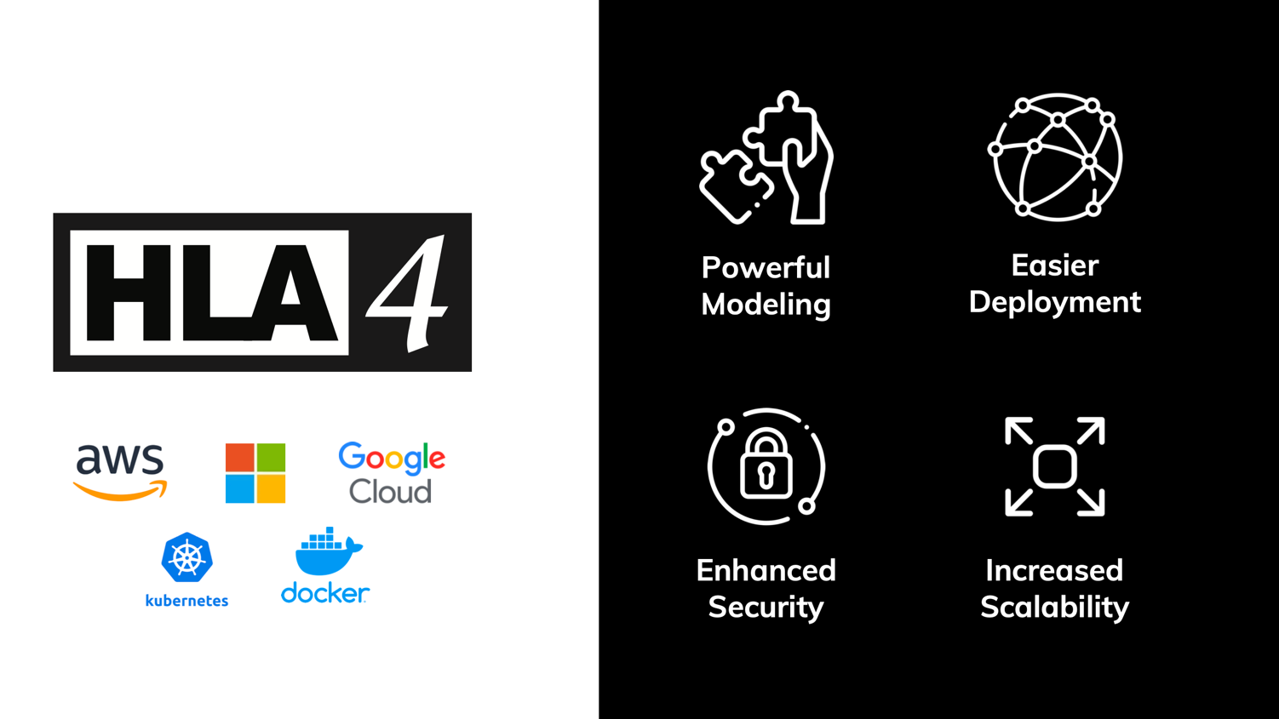
What’s new in HLA 4?

Slide 8
Key HLA Concepts
Federate A
Federate B
Federate C
Federation Object Model <FOM>
<Shared object classes>
<Shared interaction classes>
<More>
</FOM>
Runtime Infrastructure (RTI)
Each participating member is called a Federate
Information is exchanged using a Runtime Infrastructure (RTI)
The information exchange follows a Federation Object Model (FOM)
The federates together with the FOM and the RTI are called a Federation
A session with a federation is called a Federation Execution

Slide 9
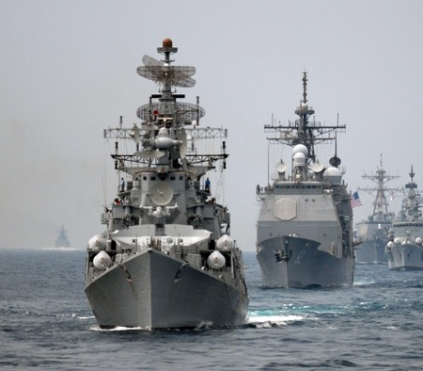
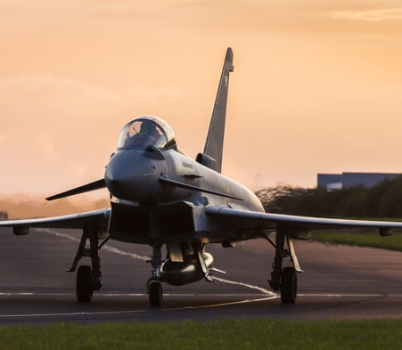
HLA for LVC Platform Training
Purpose:
Platform training, communication skills, joint and combined exercises, mission rehearsal, etc
Federates:
Platform simulators, radio simulations, sensor simulations, visualizers/viewers, data loggers
Sample FOMs:
Platforms, Warfare, Radio, Tactical Data Links (Link 16), Weather, Radar, Jamming, IFF, Enumerations (platform types), laser engagement
Examples:
UK Royal Air Force “Gladiator”
US Navy Continuous Training Environment

Slide 10
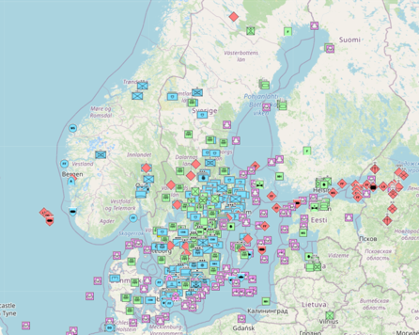
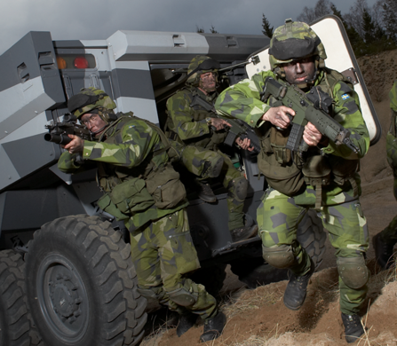
HLA for Command and Control Training
Purpose:
Command post exercises, leadership and decision training, joint and multinational exercises, tactics development
Federates:
Aggregate level simulations, interfaces to C2 systems, radio simulations, sensor/tracker simulations, visualizers/viewers, data loggers
Sample FOMs and standards:
Aggregates, Order of battle, Platforms, Warfare, Radio, Tactical Data Links (Link 16), AIS, Weather, Cyber
Military scenario description language
Examples:
Viking, US-Swedish lead training with 30 nations and NATO, United Nations and NGO participants

Slide 11
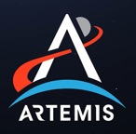
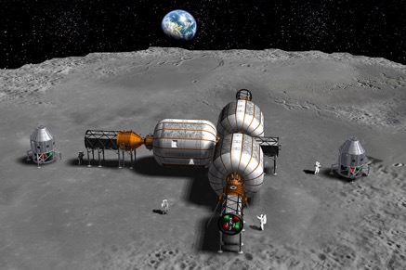
HLA for Space Simulation
Purpose:
Simulation for concept, design, analysis, production, testing, training and ultimately flight.
Simulate in any reference frame/coordinate system, not only geocentric systems
Federates:
Space vehicles, space environment, sensors, navigation
Sample FOMs:
SpaceFOM, Radio, Environment, Navigation
Examples:
NASA Artemis ”Return to the Moon” with simulations from major contractors
ESA Harwell Robotics Lab, VV&A
Simulation Exploration Experience (Academic)

Slide 12
HLA Services
Federate A
Federate B
Federate C
Federation Object Model <FOM>
<Shared object classes>
<Shared interaction classes>
<More>
</FOM>
Runtime Infrastructure (RTI)
The RTI provides simulation services to the federates:
Connect and join simulators together
Declare information interest and intent with publish & subscribe
Exchange information about entities and events
Transfer modeling responsibility between simulators
Run in faster or slower than real-time, or run as fast as possible
Handle large scale scenarios with filtering, e.g. geographical filtering

Slide 13
Objects vs. Interactions
The HLA shares data between federates via two mechanisms:
Objects for entities
Persistent
Usually represent long-lived entities in the federation
State is represented by attributes
State can be partially updated by owning federate
Example: Aircraft, Human
Interactions for events
Not persistent
Usually represent events in the federation
State is represented by parameters
Full state must be sent in the interaction
Example: Fire, Radio signal

Slide 14
HLA uses the Publish/Subscribe Pattern
A federate can publish the information that it produces to the federation.
Publish truck,
aircraft, command
Publish aircraft,
command
Publish weather
Publish truck,
aircraft
Subscribe truck,
aircraft
Subscribe aircraft,
weather, command
Subscribe aircraft,
weather, command
Subscribe command
Federate A
Federate B
Federate C
Federate X
Runtime Infrastructure
A federate can publish the information that it produces to the federation
Another federate can subscribe to information that it requires.
Publishing and subscribing is based on the Federation Object Model (FOM)
The RTI routes any relevant information to a subscribing federate – no need for federates to connect directly to other federates.
Allows for multiple RTI implementations, including central server and peer-to-peer
Enables interoperability and reuse

Slide 15
Overview of Federation Execution Lifecycle
Federate
RTI
Create Federation Execution
Join Federation Execution
Startup
Establish Initial Data Requirements
via Publish and Subscribe
Register Object Instances
Update Attribute Values
Discover Objects
Operations
Update/Reflect Attribute Values
Send/Receive Interactions
Register/Discover Objects
Delete/Remove Objects
Shutdown
Resign Federation Execution
Destroy Federation Execution

Slide 16
Federation Management
Purpose: Establish well-managed sessions with a controlled set of simulations.
Functionality: Creating federation executions. Coordinated start-up. Synchronization points. Check pointing.
Essential HLA Services
Connect to the RTI, create and join federation execution.
Resign. Destroy federation execution. Disconnect.
Synchronization points.
Save/restore.

Slide 17


Declaration Management
Purpose: Declare what data each federate will send or wishes to receive, based on the federation object model (FOM), in order to optimize the data exchange.
Functionality: Publish and subscribe object classes with attributes, and interaction classes with parameters.
Essential HLA Services
Publish.
Subscribe.
Publish
Subscribe
Subscribe
Publish

Slide 18
Object Management
Purpose: Data exchange.
Functionality: Create and delete object instances that are shared between federates. Update their attributes. Send and receive interactions.
Essential HLA Services
Register, discover, delete and remove object instances.
Update and reflect attribute values.
Send and receive interactions.
Request updates.

Slide 19
Ownership Management
Sample use case: enable a constructive simulation to hand over the responsibility for simulating an aircraft to a virtual simulation.
Functionality: Hand over the ownership (responsibility for updating) of attributes from one federate to another during execution. This can be either “push” or “pull,” and with or without negotiation.
Essential HLA Services:
Request ownership acquisition for an attribute.
Divest ownership for an attribute.
Query attribute ownership.

Slide 20
Time Management
Sample use case: run exercises in real-time, scaled real-time, varying speed, as-fast-as-possible. Run Monte-Carlo simulations as fast as possible.
Functionality: Manage the time advancement for federates and time-stamped data exchange between federates for consistency and repeatability. This can be time-stepped or event-driven.
Essential HLA Services:
Enable/disable sending and receiving of time-stamped data.
Request and grant advancement to a given time.
Request and grant advancement to the time of the next message.
Query the RTI for current time values.

Slide 21
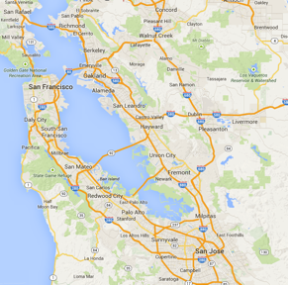

Data Distribution Management
Sample use case: build large federations by enabling federates to focus on a smaller part of the battlefield or on entities belonging to a particular force.
Functionality: Enable federates to filter data not only on class and attribute, but also on their static or dynamic data (like friendly/opposing or latitude/longitude).
Essential HLA Services:
Create and modify regions that specify data ranges for filtering.
Send attribute updates and interactions with associated regions.
Subscribe to attributes and interactions with associated regions.
0
1
2
3
4
5
6
7
8
9
10
11
12
13
14
15

Slide 22
HLA Fault Tolerance
Federate Lost!
Federate Lost!
Not Connected!
Federate
Federate
Federate
RTI
HLA includes a mechanism for fault tolerance
Connected federates can discover that a federate has been lost
The lost federate can discover that it has lost connection
Enables several design patterns (fail-over federates, reconnecting federates, …)

Slide 23
Object Model Template – Minimal Version
Object Class
Identification
Name, version, purpose, etc.
Object Classes with Attributes
Interaction Classes with Parameters
Data Types
Simple, records, enumerations, etc.
Used for Attributes and Parameters
Aircraft
Type
Marking
Position
Interaction Class
MunitionFire
FiringObject
TargetObject
MunitionType
Data type
PositionRecord
Latitude
Longitude
Altitude

Slide 24
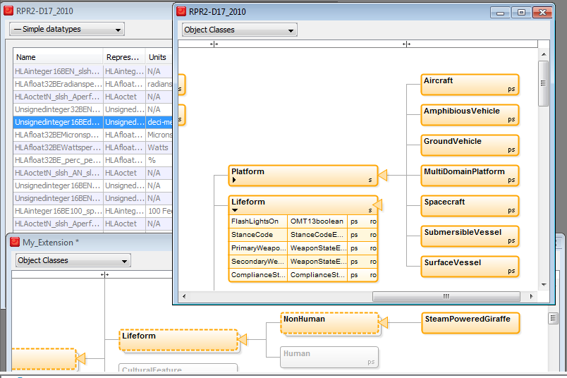
Object Class Structure Table Example
A hierarchical visual representation

Slide 25
Object Model Template – Full Version
Object model identification table
Object class structure table
Interaction class structure table
Attribute table
Parameter table
Dimension table
Time representation table
User-supplied tag table
Synchronization table
Transportation type table
Update rate table
Switches table
Datatype tables
Notes table

Slide 26
FOM Modules
All Objects and Interactions
Weapons
Platforms
Radio
Common Data
The same FOM, but split into modules
Remember: It was a long time ago since we gave up developing computer programs as one large chunk of code.
More efficient and flexible development, maintenance, reuse and standardization
Projects/programs can reuse and extend standardized modules and add their own modules.

Slide 27
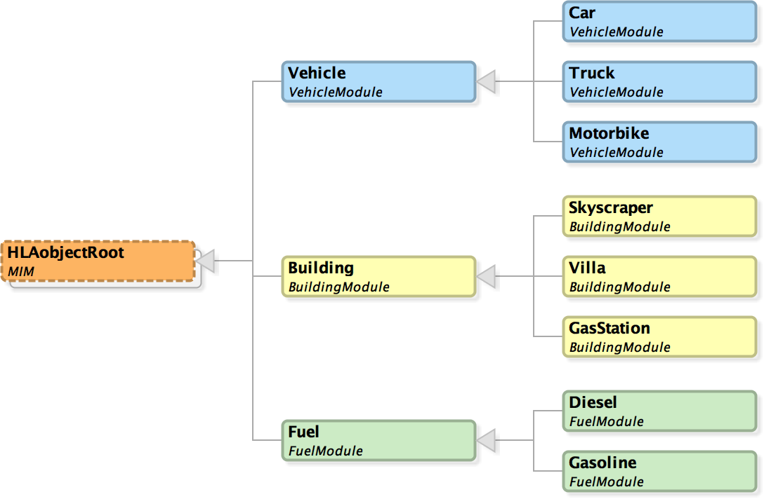
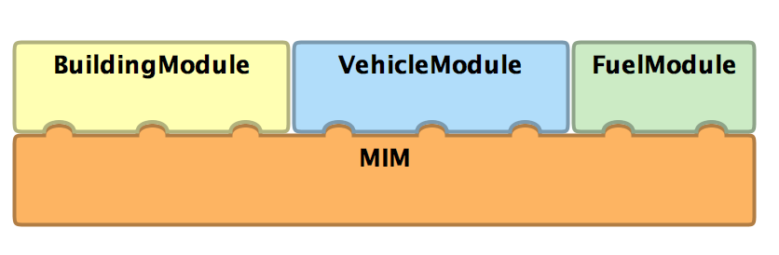
FOM Module Example
Modules
Object Classes

Slide 28










Common Aerospace and Defense FOMs
NATO NETN FOM Modules
The RPR FOM 2.0 is the most commonly used FOM for defense simulation
RPR FOM 3 now being finalized
IFF, InfOps, etc.
Download from www.sisostds.org
NATO Education and Training Network FOM (NETN)
Builds on top of RPR FOM
Growing number of modules
Download from github.com/AMSP-04/
SISO Space Reference FOM
EUROCAE Air Traffic Management FOM
Medical FOM (US Army)
METOC
Communi-
cation Networks
Entity
Tasking & Reporting
CBRN
Organization
AIS
Multi Resolution
Modeling
Transfer of Modeling Responsibility
RPR FOM Modules
Physical Entities
Aggregates
Radio
Logistics
Synthetic Environment
Warfare
Underwater
Acoustics
Minefield
Simulation Management
Emissions

Slide 29
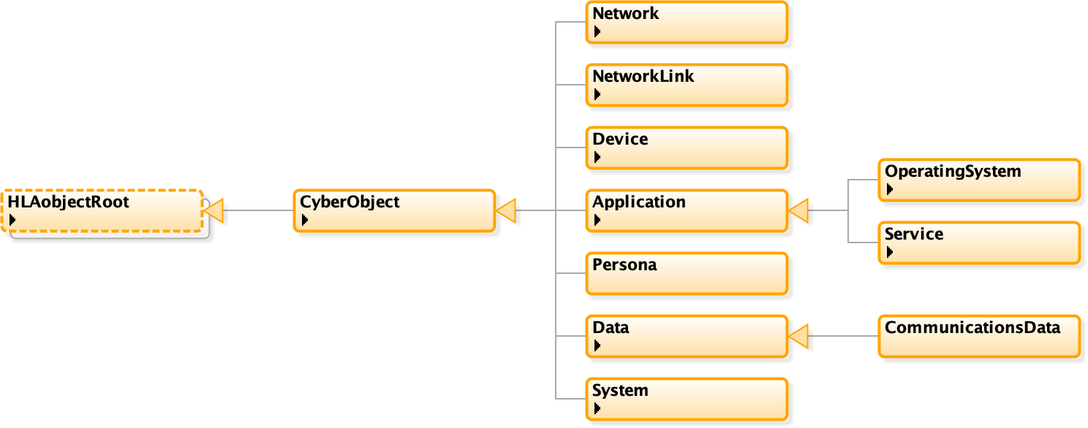
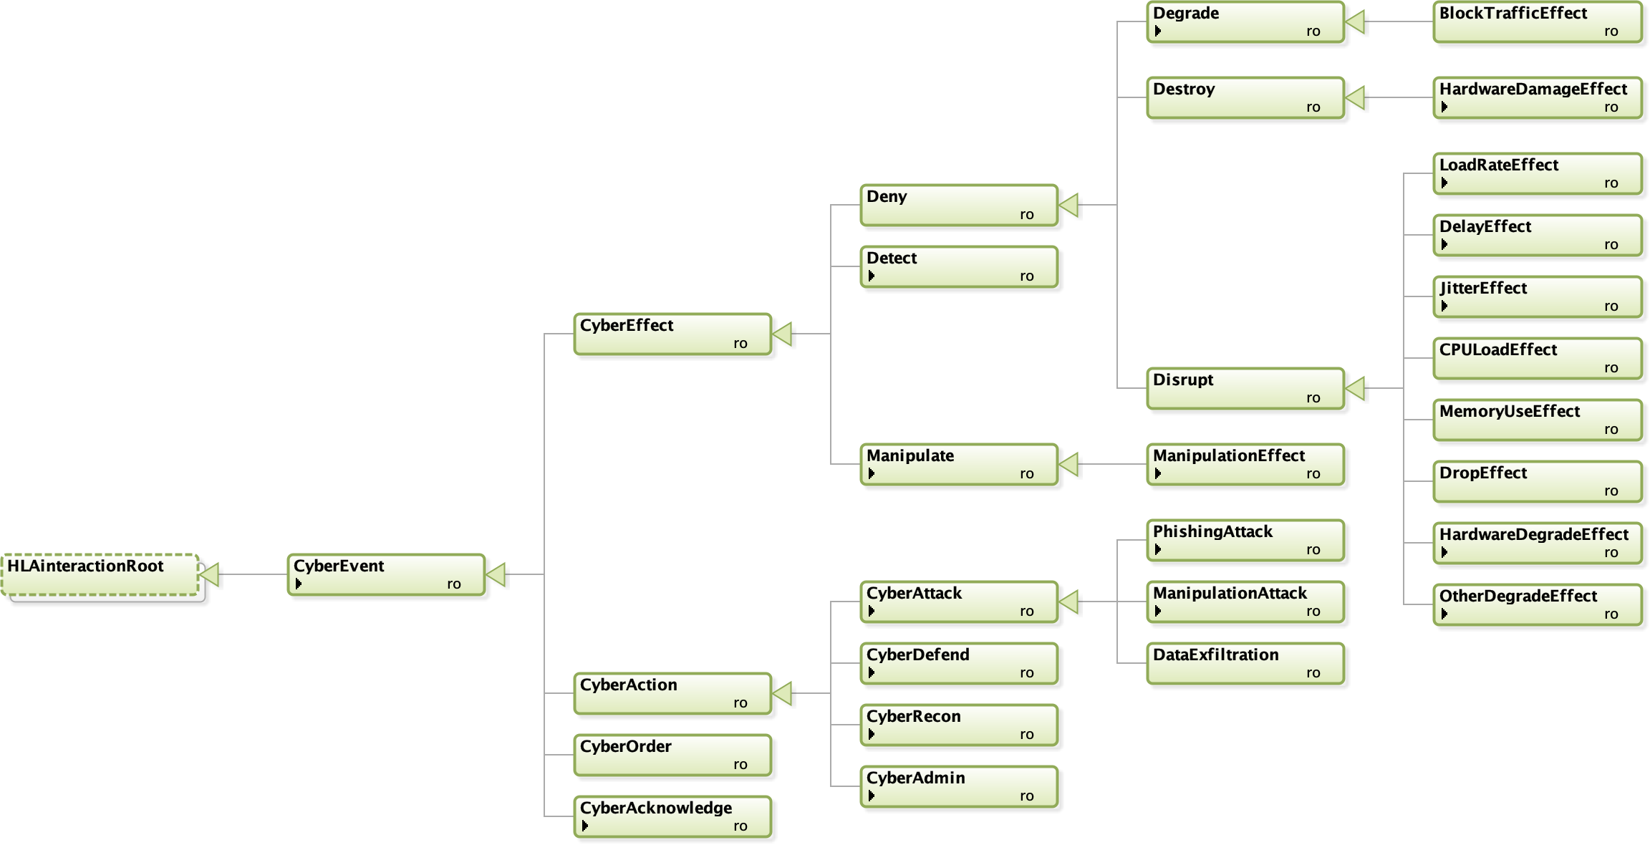
Cyber Data Exchange Model (DEM) and Federation Object Model (FOM)
SISO is developing a Cyber FOM standard to represent cyber events and objects.
The Cyber FOM will enable integration of cyber simulations, cyber ranges, and kinetic simulations.

Slide 30

Important New Features in HLA 4
More powerful modeling
Directed Interactions
Easier to extend reference FOMs
Security
Secure authorization of federates
Secure communication
Deployment
Support unreliable links, like 3G/4G/5G
Support more programming languages
Increased vendor-independence
Scalability
Cloud-based simulation with local deployment
“Elastic cloud” scalability
Improved data distribution management
Business models
Modeling and Simulation as a Service
HLA 4 passed IEEE Balloting in 2023

Slide 31
Object Modeling: Directed Interactions
Classic “Global” Interactions
Directed Interactions
StartDriving
Delivered to all
subscribing federates.
StartDriving
Delivered to subscribing
federates that model (update) a particular car.

Slide 32
Object Modeling: Easier to Extend Models
Standardized “Reference Object Models” are one of the key benefits with HLA. They provide a baseline for interoperability. They are key for reuse.
HLA 4 adds several features that makes it easier to extend existing information models with application-specific data.
Example: add attributes to already defined object classes
Standard Aircraft
Entity Type
Entity ID
Side
Spatial (position etc.)
Damage State
Extensions
Maintenance Date
Maintenance Type

Slide 33
Scalability: Improved DDM
0
1
2
3
0
1
2
3
4
5
6
7
4
5
6
7
8
9
10
11
8
10
11
12
13
14
15
12
13
14
15
Filter on Lat/Long
Filter on air, land, sea, space
Filter on friendly, opposing, neutral
Modern RTIs can deliver a million updates/second to a federate, but few, if any federates, can process that incoming data rate
Reducing the data flow to each federate is the key to scalability
HLA Data Distribution Management (DDM) provides powerful ways to filter data
HLA 4 makes it possible to extend reference FOMs with tailored DDM

Slide 34


Federate Authentication
Federates may be required to provide credentials to connect and join a federation
Support for passwords, PKI certificates (X.509), etc.
Flexible mechanism through plug-in
May connect to existing authorization services
May implement different policies
Also useful for Zero Trust Architectures
Certificate
Authority
Private Key
Certificate
Certificate
Certificate
Federate A
Federate B
Federate C
Runtime Infrastructure (RTI)
Public Key

Slide 35







Federate Protocol
A federate can call the RTI using a protocol instead of calling a local library
Separates the federate from the RTI
Better support for Live with 4G/5G links
More cloud-friendly (containers, etc.)
Simplifies accreditation
Additional languages/OS
Standardized API
Standardized protocol
Federate
Federate
Network
“Join” API call
“Join” network packet
RTI Lib (LRC)
RTI Server
Network
Network

Slide 36

Deployment Examples: Cloud and Live Training
Cloud
Live training
CGF
Data Logger
RTI
3G/4G
Radio
3G/4G
Radio
Host
Host
Protocol
Protocol
Host
CGF
Visualizer
RTI
LRC
LRC
Site A
Site B
Federate
Federate
Deploy large CPU consumers in the Cloud
Deploy large GPU consumers locally
Collect Big Data in the Cloud
Connect live systems over 4G/5G
Point-to-point communication
Fault tolerance and fast reconnect

Slide 37
HLA 4 Based Architecture for Cloud, Scalability and MSaaS
On-site
Public or Private Cloud
Classic Training System
HLA 4 Federate Protocol + Authentication
HLA 4 RTI
RPR FOM
Game Based Trainer
HLA 4 Federate Protocol + Authentication
L16 FOM
Web Based Client
https/html/REST/Vert.x/etc.
Web Server
HLA 4 API
or protocol
NATO FOM
C2 System
C2 Sim/C2 Protocol
C2 Gateway
HLA 4 API
or protocol
Space FOM
Data Recorder
HLA 4 API
or protocol
HLA 4 supports mixed cloud and on-site deployment
Scalable CGFs and data recorders may execute in cloud environments
Training audience may operate classic training systems, web-based interfaces or game-based trainers
Custom FOM
Scalable CGF
HLA 4 API
or protocol

Slide 38
More New Features in HLA 4
Better support for scalability through enhanced DDM
Easier to specify dimensions for entire object class, inheritance to subclasses
Add DDM to existing FOMs using separate module
More complete and flexible Dimension specification
Relaxed DDM
Many minor improvements
Ownership management – user supplied tags
Specify for what attributes values are required vs optional
Fault tolerance – handling unplanned leaving federate
New datatypes to better support RPR FOM
Glyph that follows html conventions
Switches – defaults
Exception handling
Updated sample FOM modules

Slide 39
HLA and LVC – Gateways
DIS
Link 16
Command and Control
Federate
DIS Gateway
L16 Gateway
C2 Gateway
Runtime Infrastructure (RTI)
HLA can handle both Live, Virtual and Constructive simulation
In LVC settings, information may still need to be bridged between different architectures
Standard FOMs exist for bridging
The RPR FOM matches the DIS information model
Tactical Data Link (TDL) such as Link 16
C2SIM – connect to C2 systems
Custom gateways may be needed

Slide 40

HLA and Performance
HLA is a standard
It has no particular performance
Actual RTI implementations exhibit performance
May be optimized for different use cases
Sample RTI performance on regular Windows workstations in 2020
Hundreds of systems
100 000’s of updates per second, typically up to 90% of the network’s raw bandwidth
900 Mbps on Gigabit LAN
100 000 object instances
Latency of 0.13 ms on 100 Mbps LAN
Common federation bottlenecks:
LAN bandwidth
WAN latency and bandwidth
Federate processing time for incoming data
Plan for performance!
Analyze performance requirements
Analyze federate and network capabilities

Slide 41
HLA and Tools
Sample tool chain
OMT Editor
Code Generator
RTI
Data Logger
2D/3D Visualizer
A wide range of HLA compliant tools and federates are available
Development tools (OMT editor, middleware, code generators, data loggers)
Visualizers (2D, 3D, game based, …)
Federates (Computer Generated Forces, flight models, dynamics, …)
Bridges (HLA-DIS, HLA-HLA, HLA-TENA, HLA-games, HLA-DDS, …)
TENA = Test and Training Enabling Architecture
DDS = Data Distribution Services

Slide 42
HLA and Cross Domain Security/MLS
CDS/MLS solution
Simulation
Simulation
Proxy
Guard
Proxy
Simulation
Simulation
RTI
Policy
RTI
Low Domain
Release
High Domain
It is possible to simulate with controlled data exchange between classification levels
The federation is partitioned into different domains
May be different classifications within one nation or simulation between different nations
There are security solutions that can connect to multiple domains, provide separation and release data based on a release policy
Different topologies: one host, several hosts, hardware/software guards, etc.
Different solutions meet different levels of assurance

Slide 43

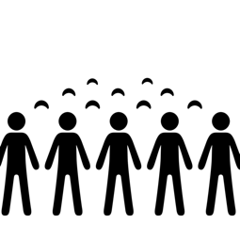

HLA Benefits
Secure
Secure authentication
Secure transportation
Cross-domain security
Proven
Viking, the largest CiMiC exercise
UK Royal Air Force
Down-selected by NASA
Scalable
Millions of entities
Hundreds of systems
<0.1 ms latency

Slide 44
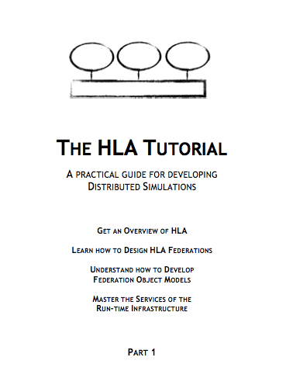
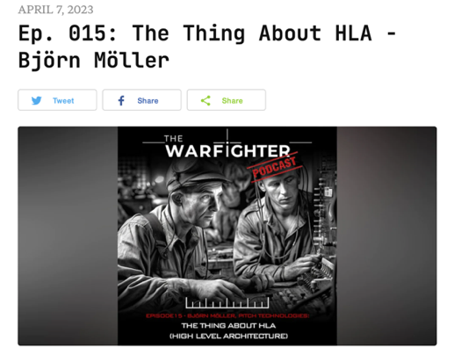
Additional Reading
The standard
HLA IEEE 1516-2010 www.ieee.org
HLA podcast – an introduction
https://www.warfighterpodcast.com/
The HLA Tutorial – for developers
Free, redistributable PDF
www.pitchtechnologies.com/hlatutorial
Plenty of SISO papers
www.sisostds.org
ResearchGate
The HLA Product Development Group discussion archives
www.sisostds.org

Slide 45
Learning Objectives Revisited
After taking this tutorial you should be able to:
Describe the requirements for interoperability in distributed simulation
Explain the principles of the HLA standard
Explain how the HLA standard is used for distributed training purposes
Describe the new features of HLA 4
Describe some common Federation Object Models (FOMs) for defense training

Slide 46
Questions?
Björn Möller
Fredrik Antelius
Bjorn.Moller@pitch.se
Fredrik.Antelius@pitch.se

