Slide 1
Evolution of RF Signal Visualization from Spectrum Analyzers to Augmented Reality – Topic #24T49
Jad Meouchy, BadVR, Inc.
Suzanne Borders, BadVR, Inc.

Slide 2
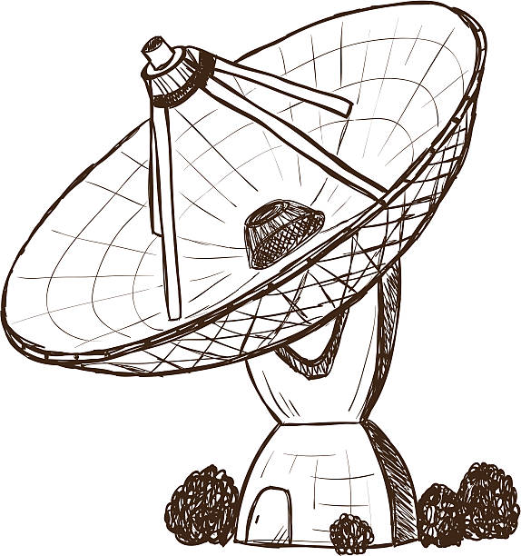
Tutorial Overview
5 min | Introduction and Learning Objectives
10 min | Background on Radio Frequencies
10 min | Traditional Signal Visualization
30 min | Immersive Signal Visualization
10 min | Summary and Conclusions
5 min | Acknowledgements
10 min | Q&A
2

Slide 3
Learning Objectives
Understand challenges of existing tools for radio signal analysis and visualization
Discover new AR/VR & AI immersive technologies for signals intelligence, electronic warfare, and communications networking
Develop technical insight into applying new tools in both real and simulated environments
Assess future impact of 3D signal visualization on modeling, simulation, and training

Slide 4
Terminology and Concepts
Fourier Transform – Mathematical function that converts time-domain signal data into frequency-domain magnitudes and phases
Modulation/Demodulation – Encoding and extracting information from a carrier wave
RSSI – Received signal strength indication, a measurement of received power
TSCM – Technical Surveillance Countermeasures, colloquially understood as “bug hunting”
Immersion, AR, VR – a collection of holographic technologies including Augmented Reality and Virtual Reality
Metaverse – Umbrella buzzword representing the next generation of 3D computing and connectivity
SIGINT – Signals Intelligence, intelligence gathering by interception of signal communications between people
Spatial Anchors – Specific locations in virtual space that persist in the real world

Slide 5
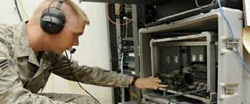
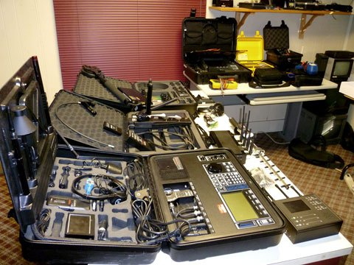
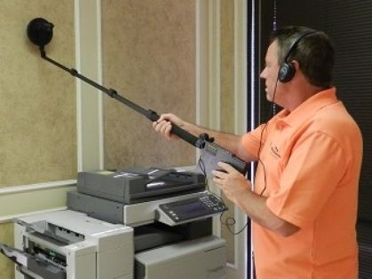
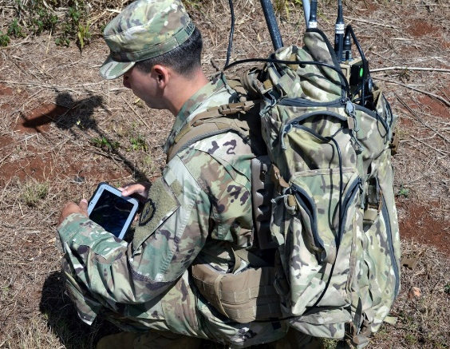
The Challenge
Traditional modeling and visualization tools are no longer suitable to address the scale and complexity of modern signals
Complicated
Cumbersome
Slow
Distracting

Slide 6
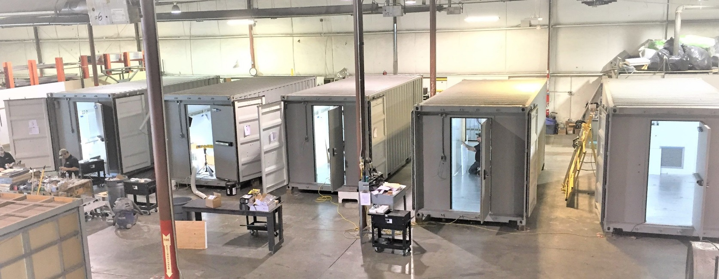
Security Implications
Wireless is a primary attack vector
Backdoors are hidden inside chip firmware by foreign manufacturers
100’s millions people affected by breaches
Defense industry spends billions each year for SIGINT, EW, and wireless security
Secure facilities typically restrict wireless
Meeting rooms are shielded from RF

Slide 7

Impact
Training
Reduce education burden for learning RF
Increase access to signals awareness
Modeling
AI/ML-powered radio propagation
Ideation and predictive analytics
Simulation
Reproduction of complex signal fields
Comms systems planning and testing

Slide 8
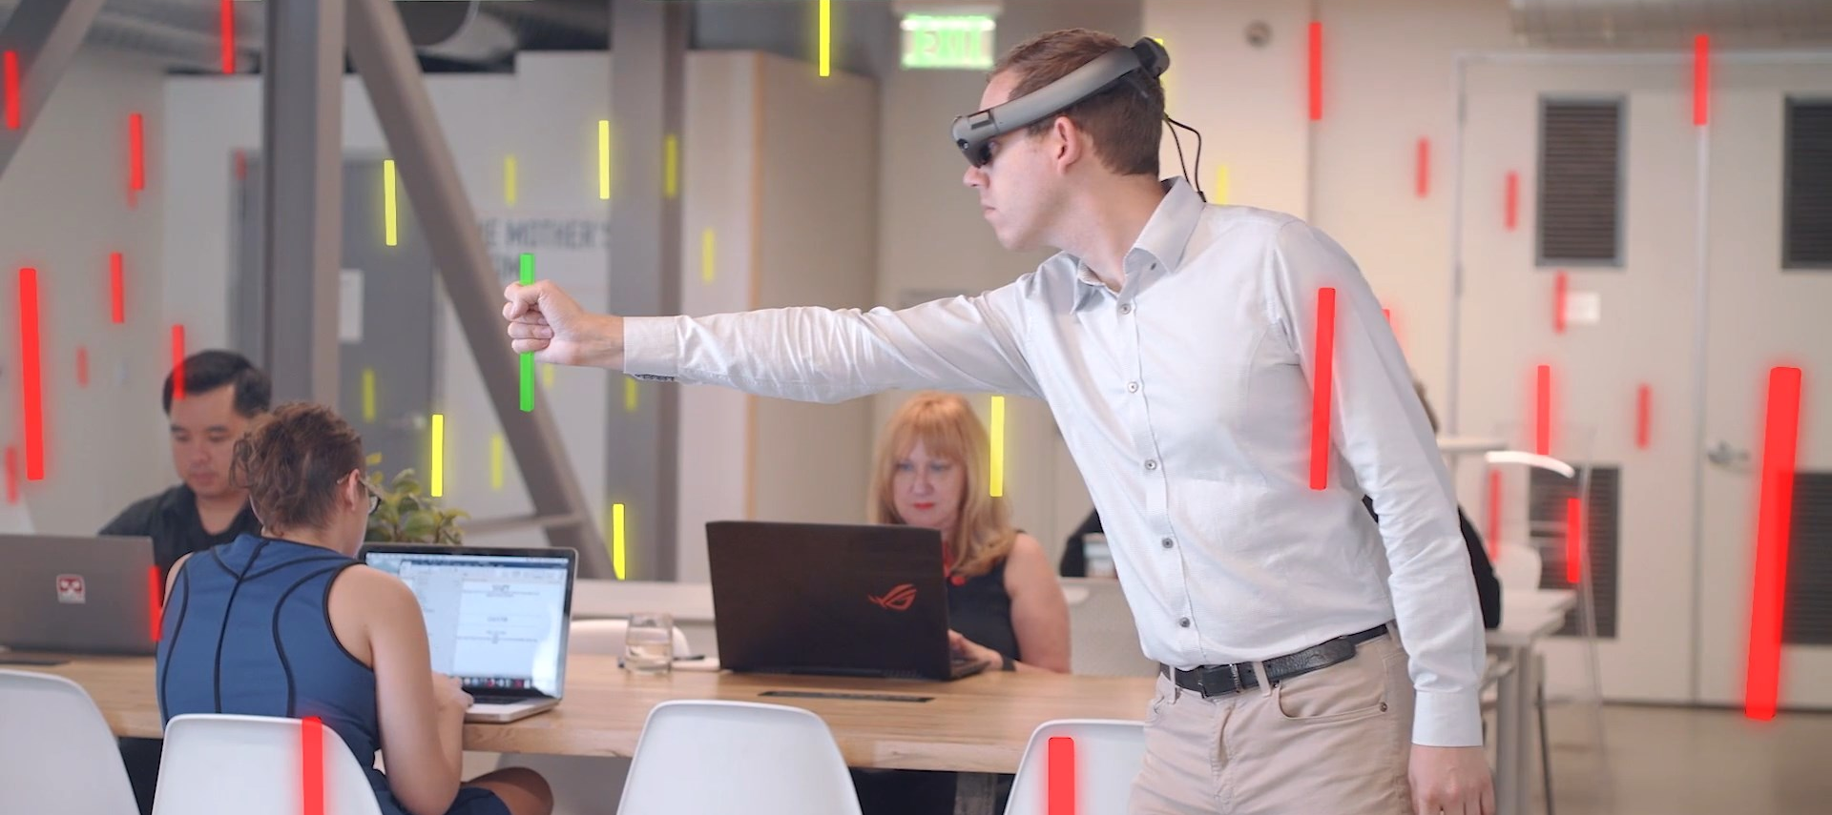
Immersive Signal Visualization

Slide 9
Background on Radio Frequencies

Slide 10
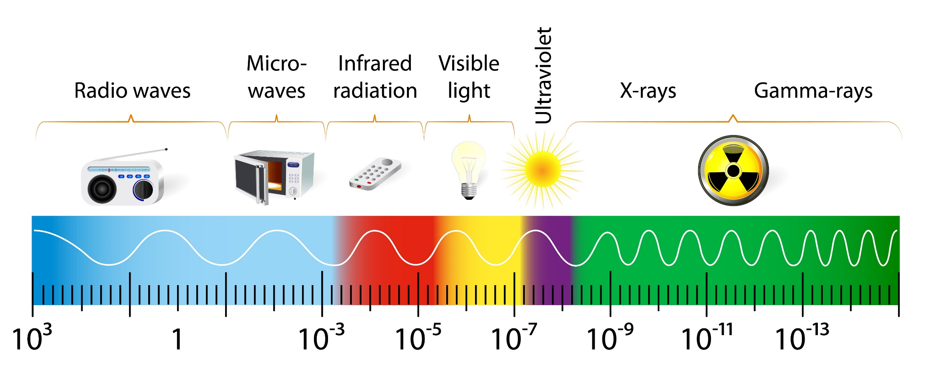
Introducing The Spectrum
The Electromagnetic Spectrum
Hz
Hz

Slide 11
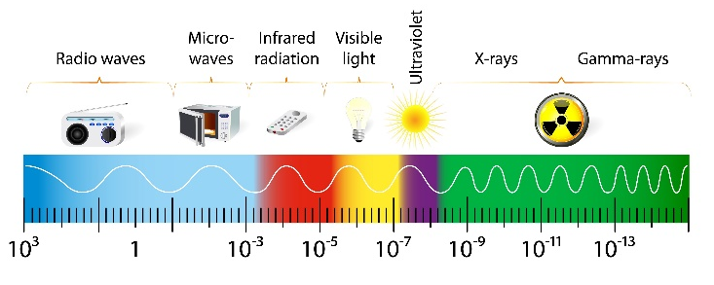
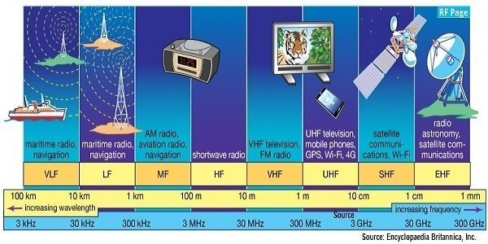
Radio Frequencies
TeraSense

Slide 12
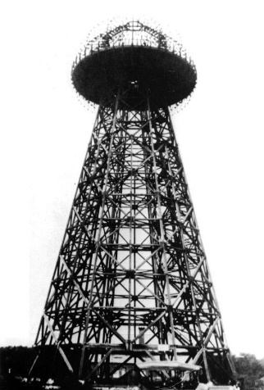

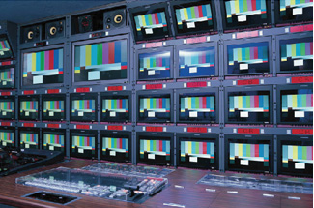
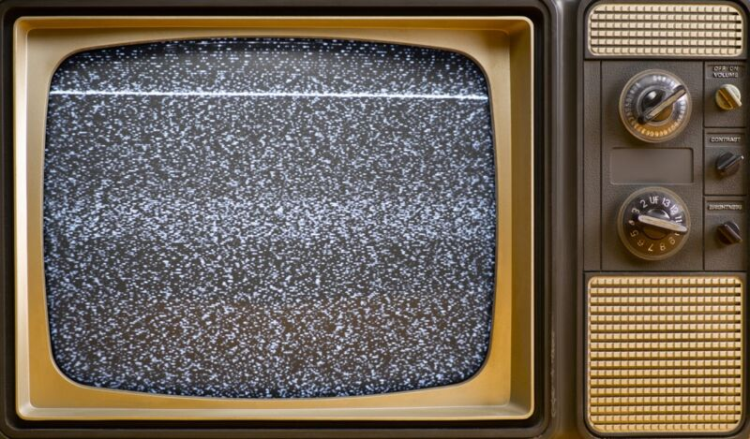
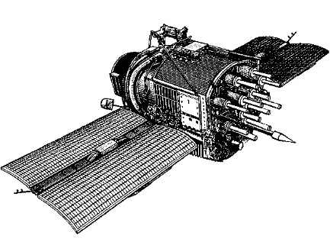

Notable Moments in RF History
Testing radio transmissions
FCC is formed
Digital broadcasting gains popularity
1890s
1928
1934
1978
1990s
Present
First television broadcast
NAVSTAR 1
GPS satellite
5G, smart cities, self-driving cars

Slide 13
DoD Use Of Radio Spectrum

Slide 14
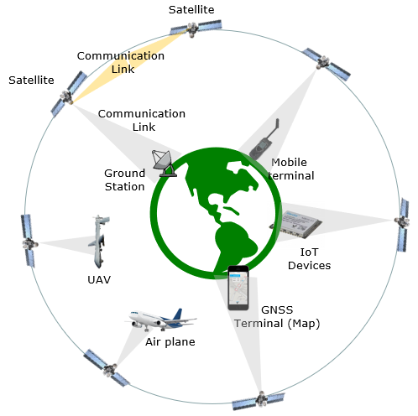
Satellite Frequency Bands

Slide 15
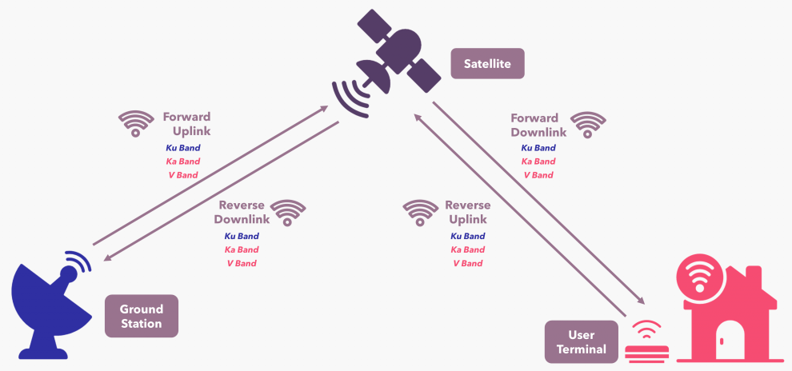
Starlink Example

Slide 16
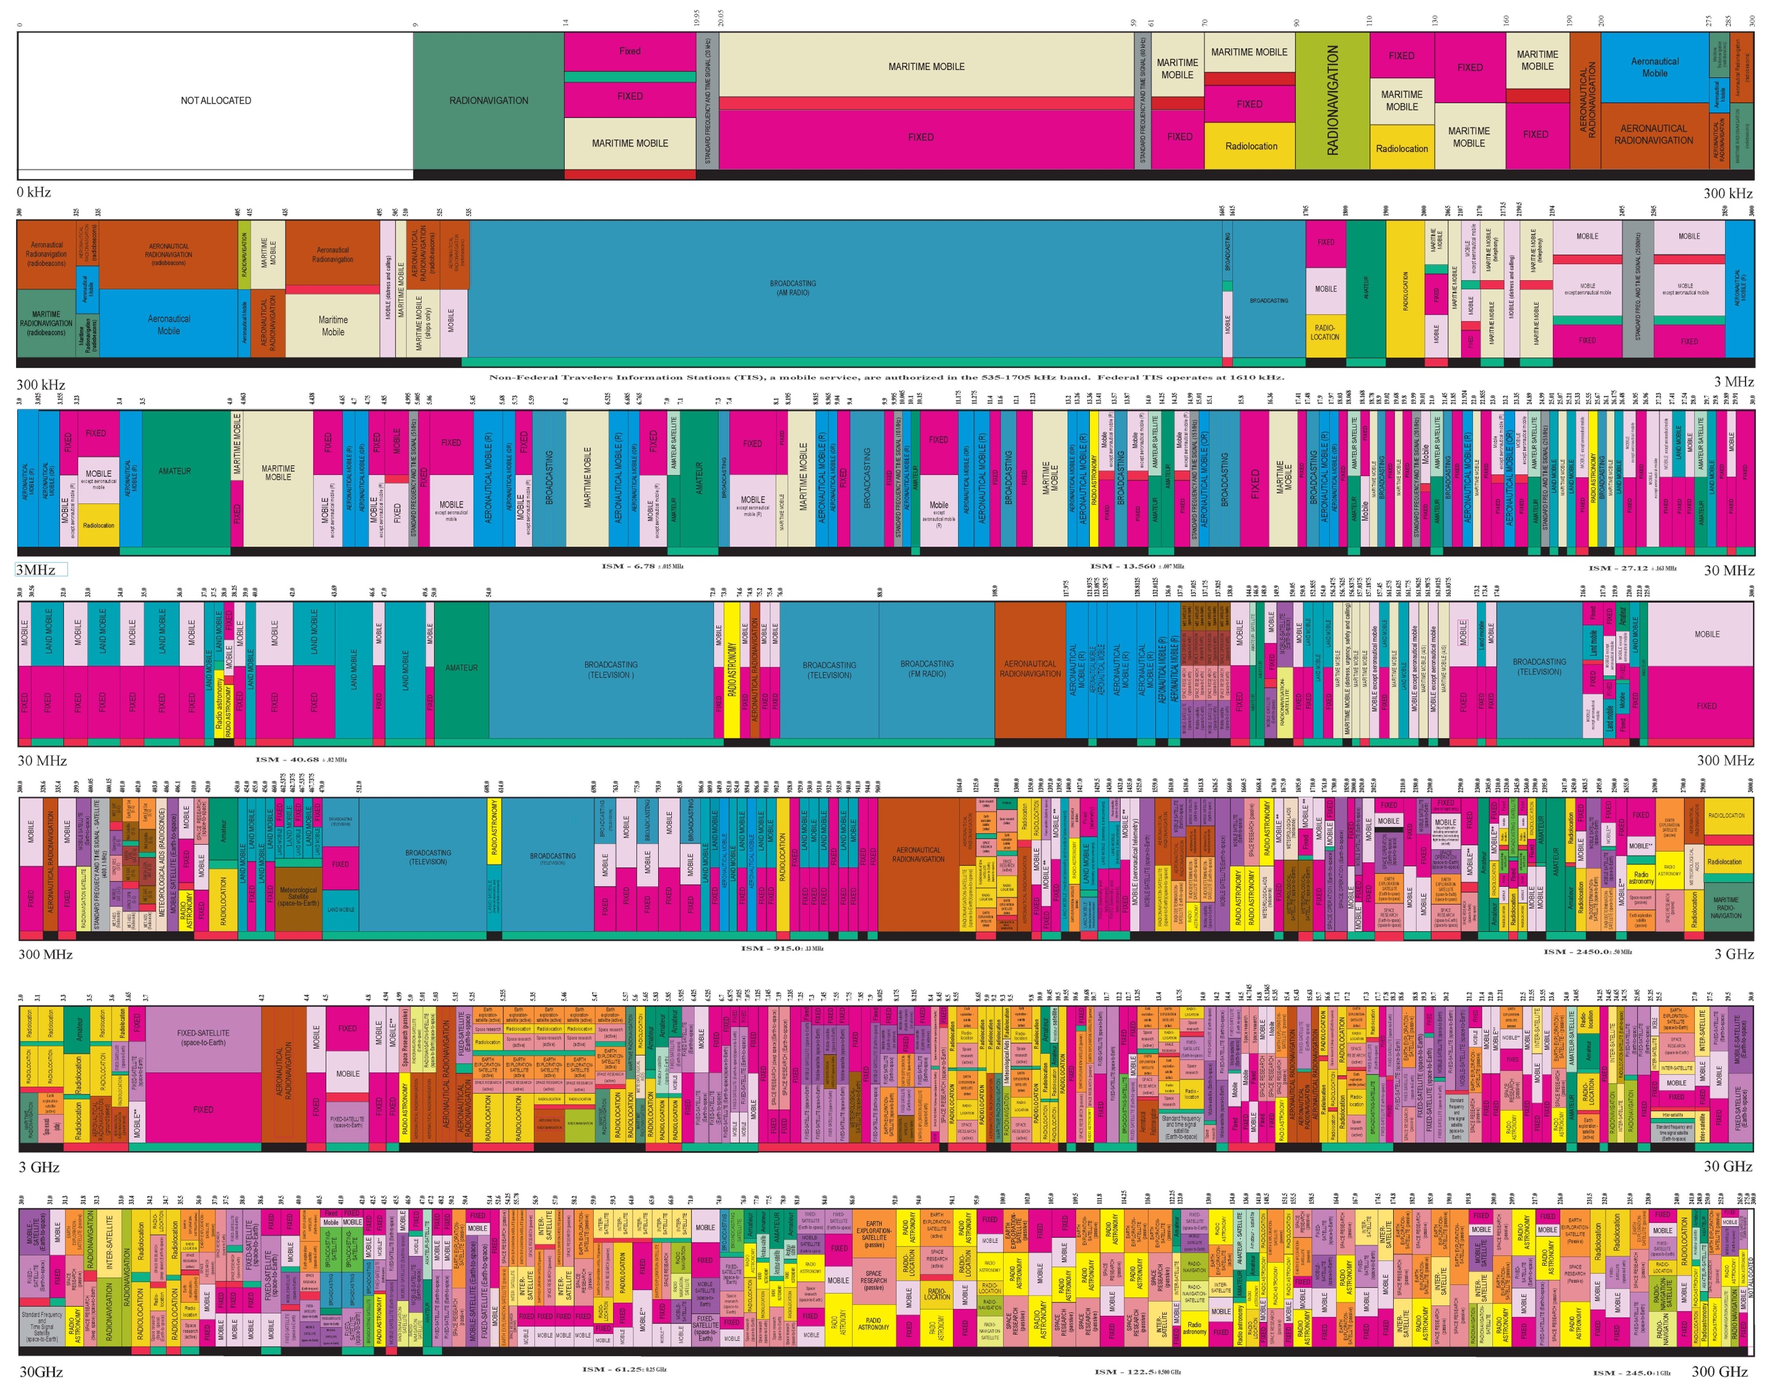
Regulating The Spectrum
Federal Communications Commission (FCC)
Assign operating ranges for civ/mil
Certify RF-emitting devices
Prevent interference

Slide 17
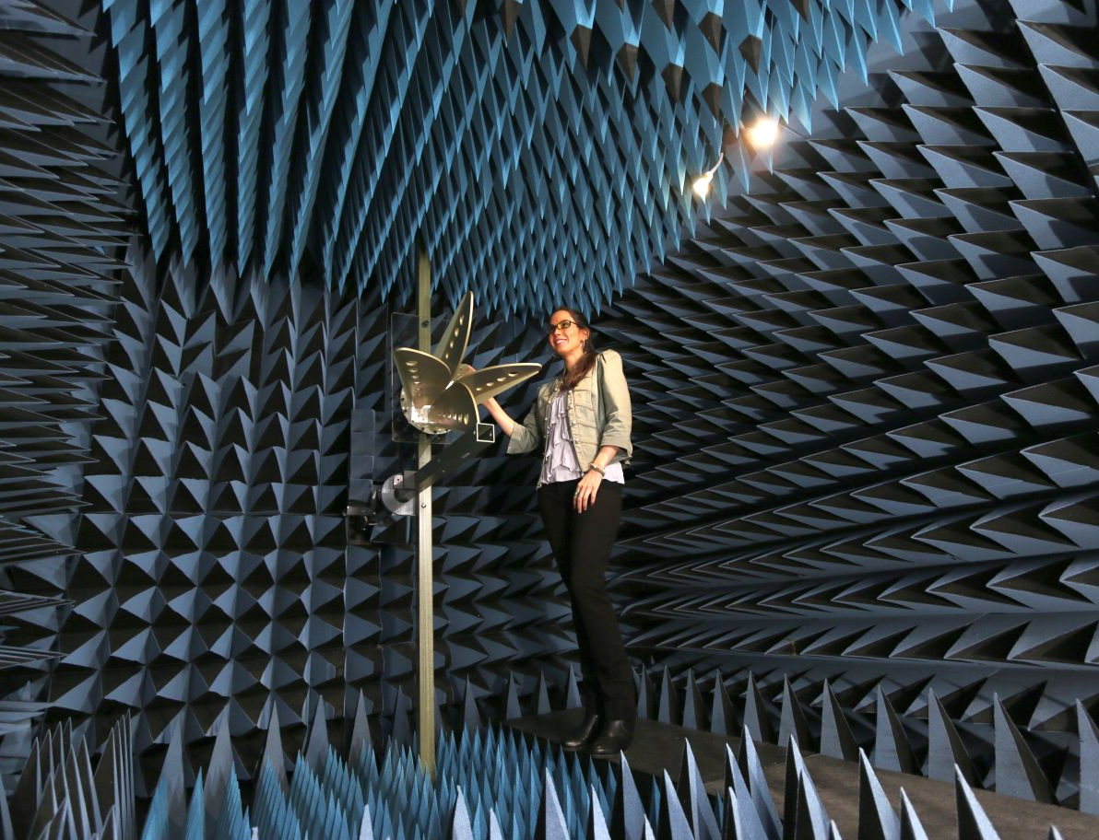
Anechoic Chambers
Fully shielded room with RF-absorbing wall materials
Measure antenna gain, efficiency, and radiation pattern
Controlled evaluation of RF emission
Ensure compliance with standards

Slide 18
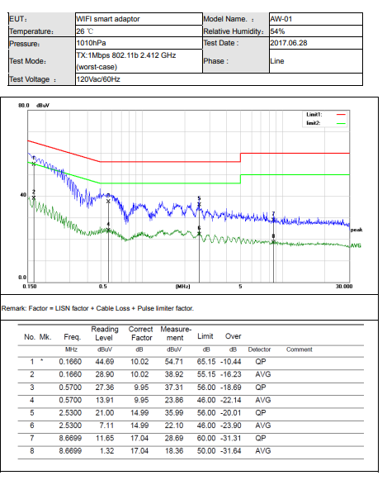
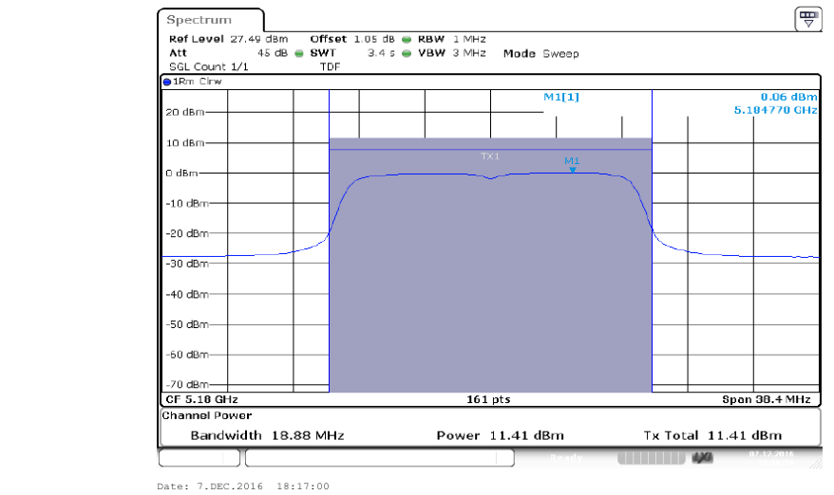
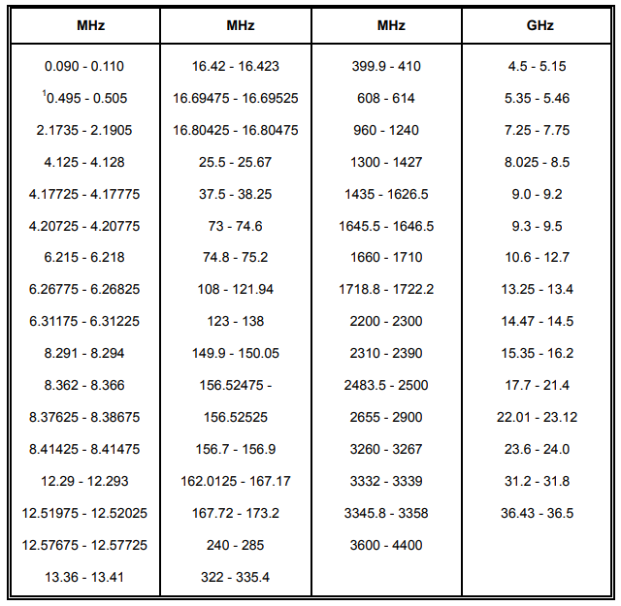
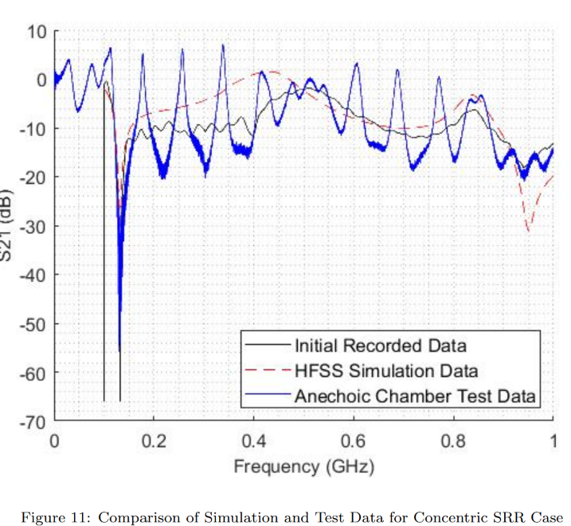
Examples of Lab Testing Reports

Slide 19
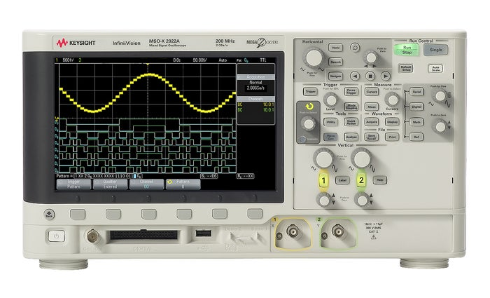
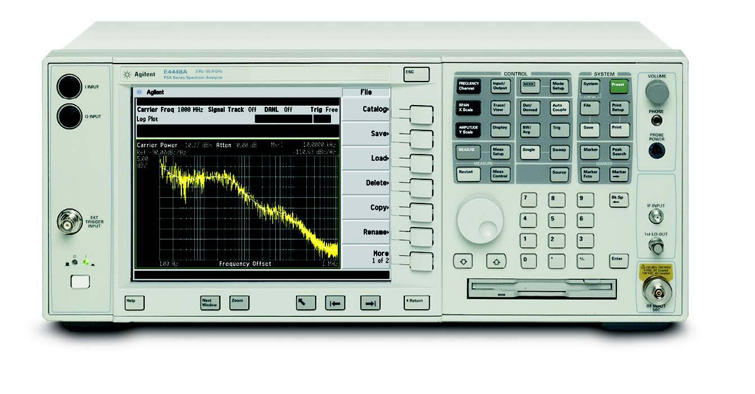
Common Laboratory Equipment
Oscilloscope
Spectrum Analyzer
Graphical indication of voltage change
Plot of 1D signal over time
Measure signal power across a freq range
Display amplitude over signal frequency

Slide 20
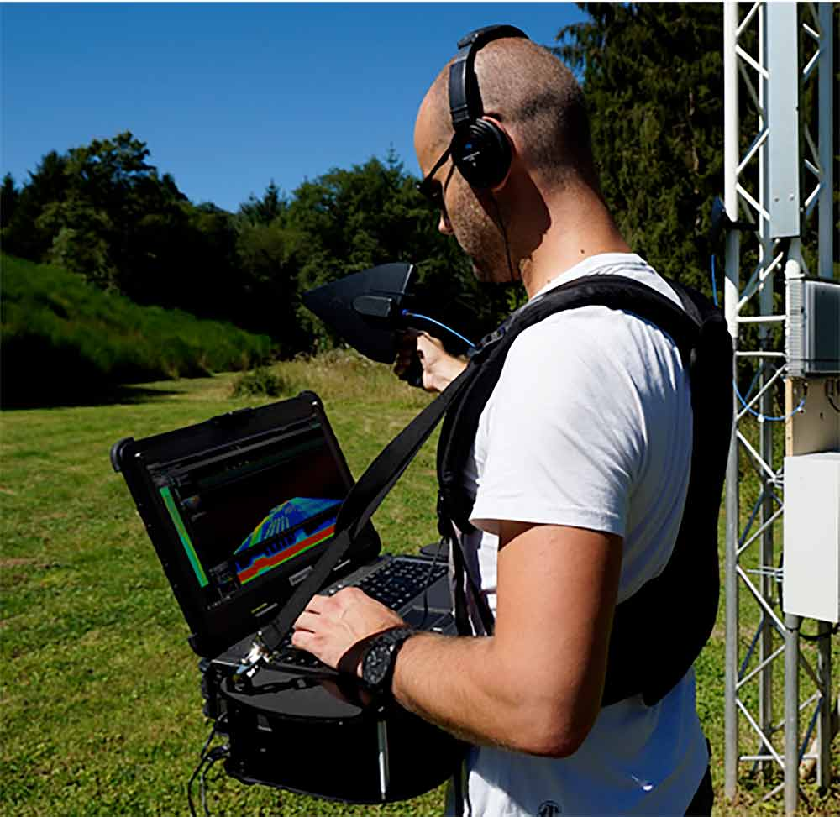
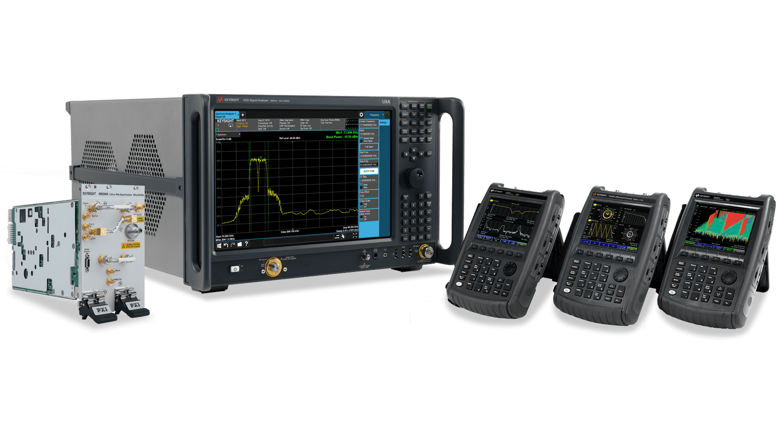
Portable Analysis Tools
Field tools are made portable with mounted screens and audio outputs

Slide 21
Traditional Signal Visualization

Slide 22
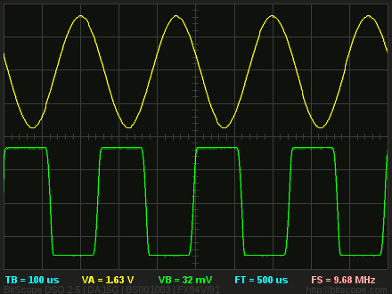
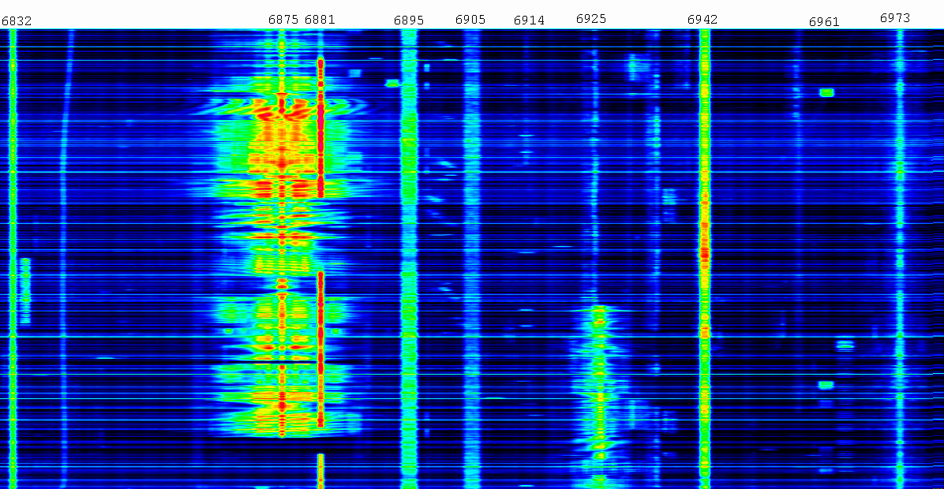
1D Signal Visualization
Oscilloscope
Waterfall Display
Low information density
Small display sizes
Needs logging
High information density
Frequently on laptops and tablets
Continuous scrolling top to bottom

Slide 23
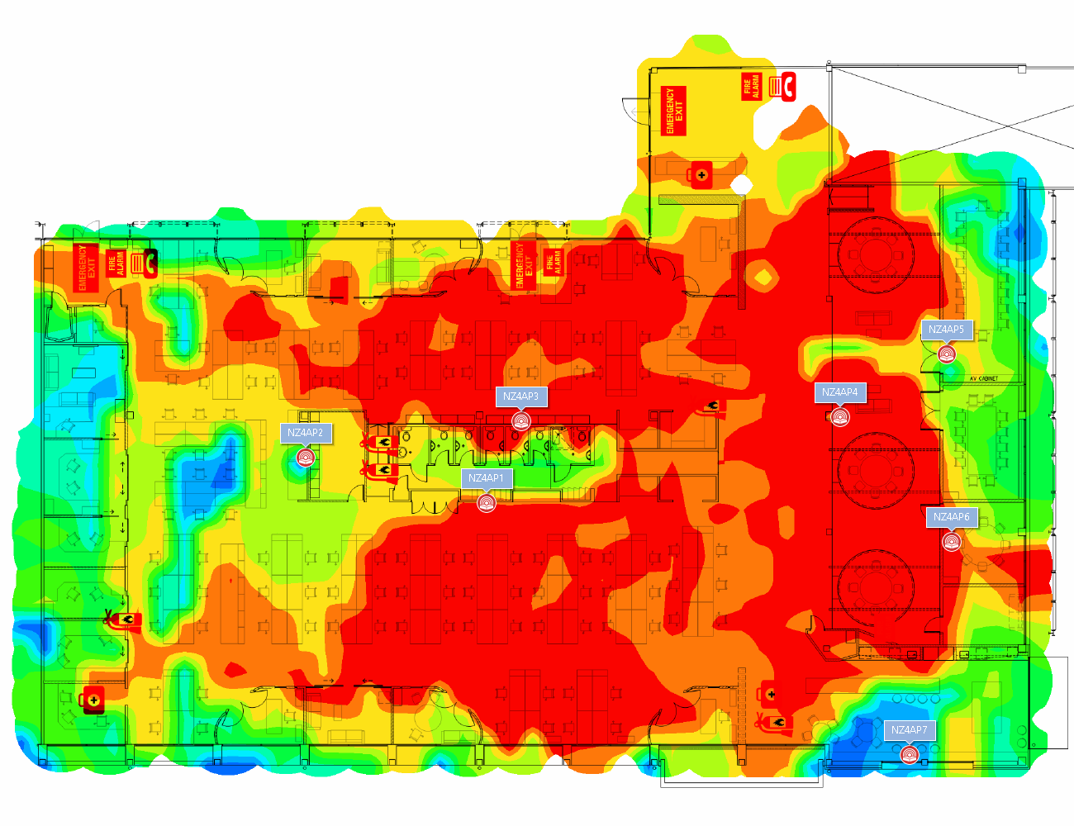
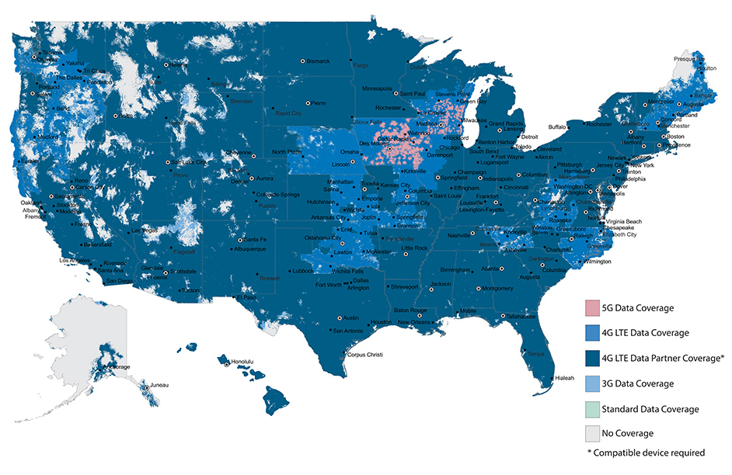
2D Signal Visualization
Heatmaps represent X-Y samples and projected values of signal strength
Reflects real world space
Typically extrapolated
“Can you hear me now?” only shows outdoor coverage
***Shows highest speeds; better coverage may be available at slower speeds

Slide 24
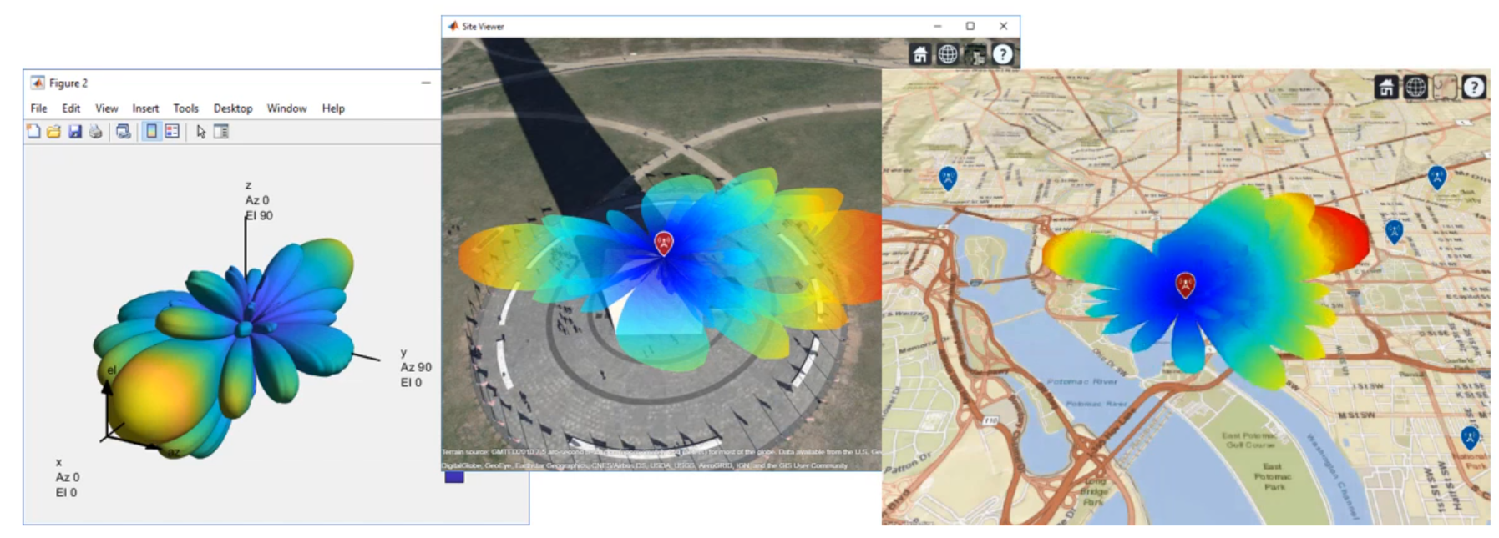
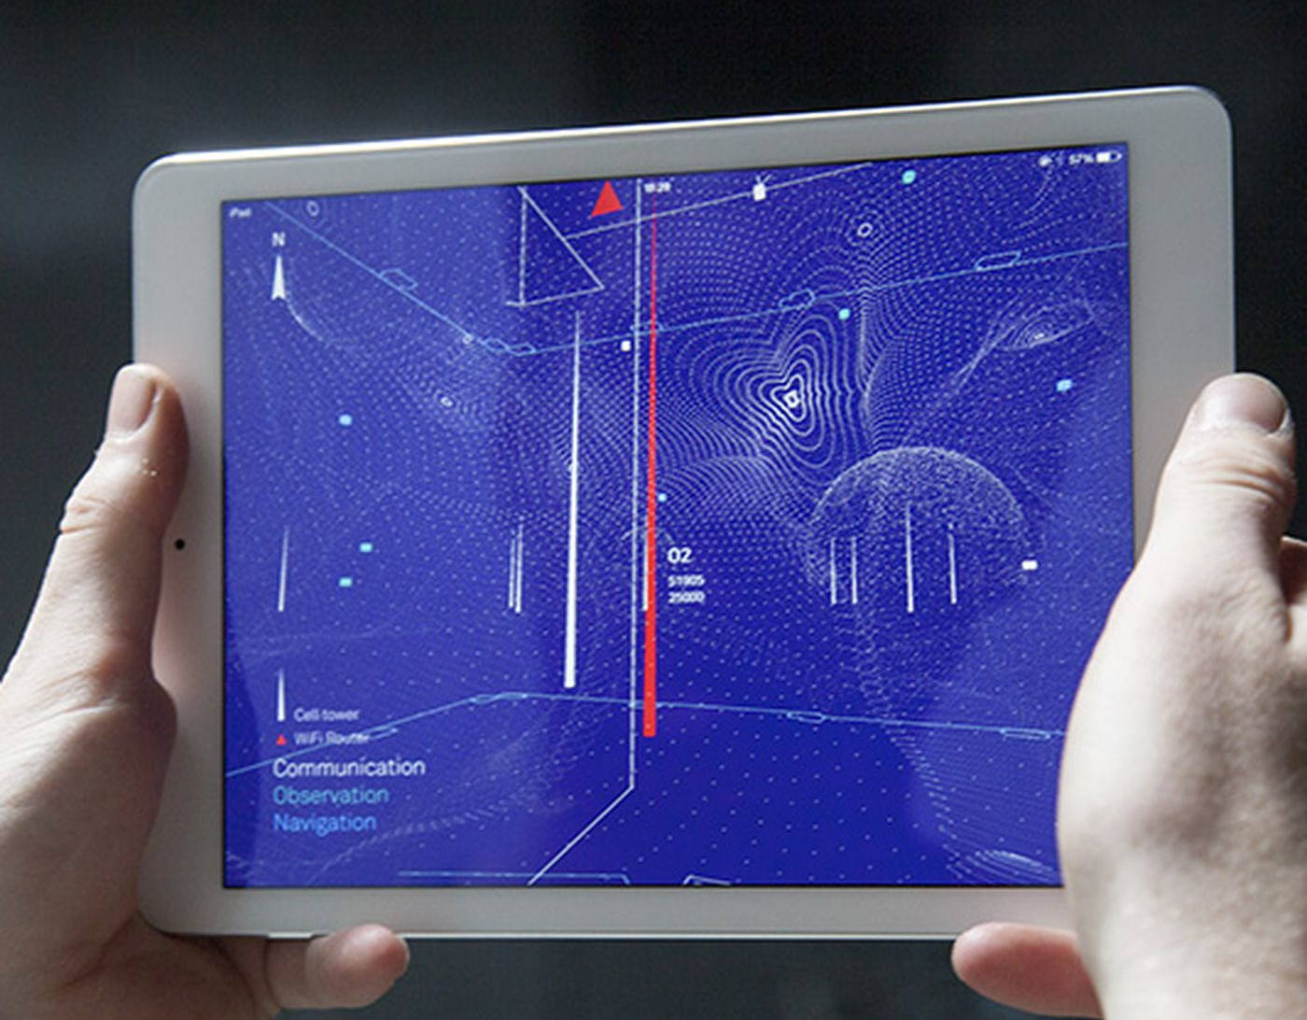
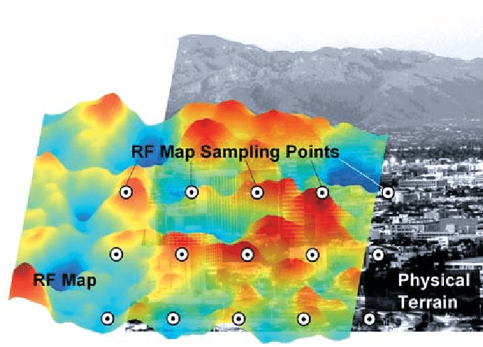
3D Signal Visualization
Adds Z dimension
Performs advanced modeling
Uses graphics and gaming engines
Important to keep up w/UAS tech progress

Slide 25
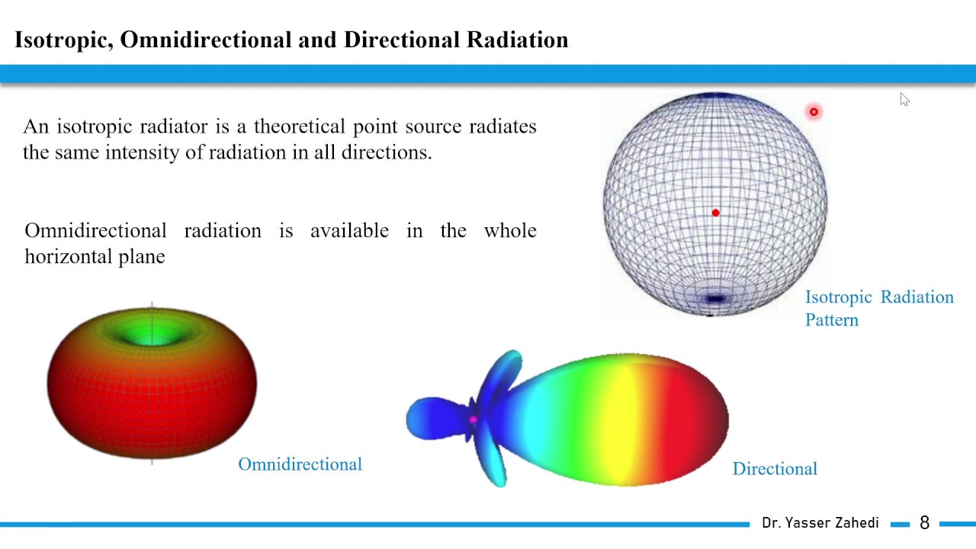
Antenna Radiation Patterns
Graphic of the directional (Angular) dependence of the strength of the radio waves from the antenna or other source, power based on distance

Slide 26
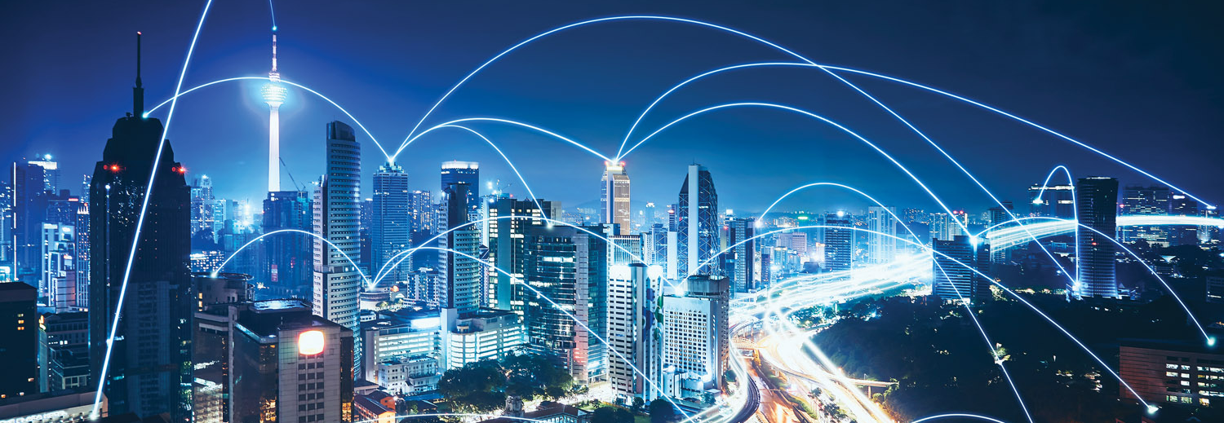
Real-World Behavior
All objects, manufactured and natural, interact with wireless signals, especially in dense urban environments

Slide 27

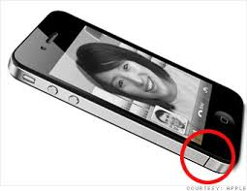
Interference
Modern steel/concrete/tinted glass buildings are “radio opaque”
Material density causes attenuation
Trees and foliage can block RF
Metallic surfaces can cause counterintuitive radio reflections
Human bodies interfere also; remember “antenna gate”
Anderson (2017)

Slide 28
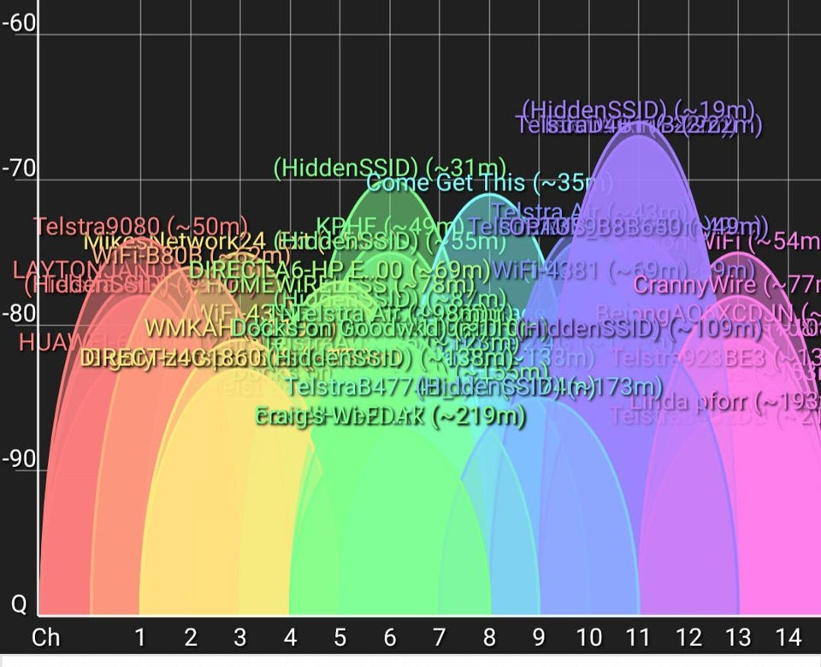
Channel Congestion
There are a fixed number of Wi-Fi, Bluetooth, Cell, etc. channels
With too many connected devices, channels become saturated
Net result is denial of service
Infrastructure never designed volume
IoT is already a worst-case scenario

Slide 29
Challenges of 5G & LEO
 | 5G | LEO
Infrastructure | Build 1M small cells and base stations | Manufacture and launch 30K satellites
Spectrum | Businesses fight for access to frequency bands | Managing constellations is highly technical
Interference | mmWave blocked by foliage and buildings | Weather, handover, doppler shift, coexistence
Latency | Needs edge compute resources | Large distances, must obey laws of physics

Slide 30
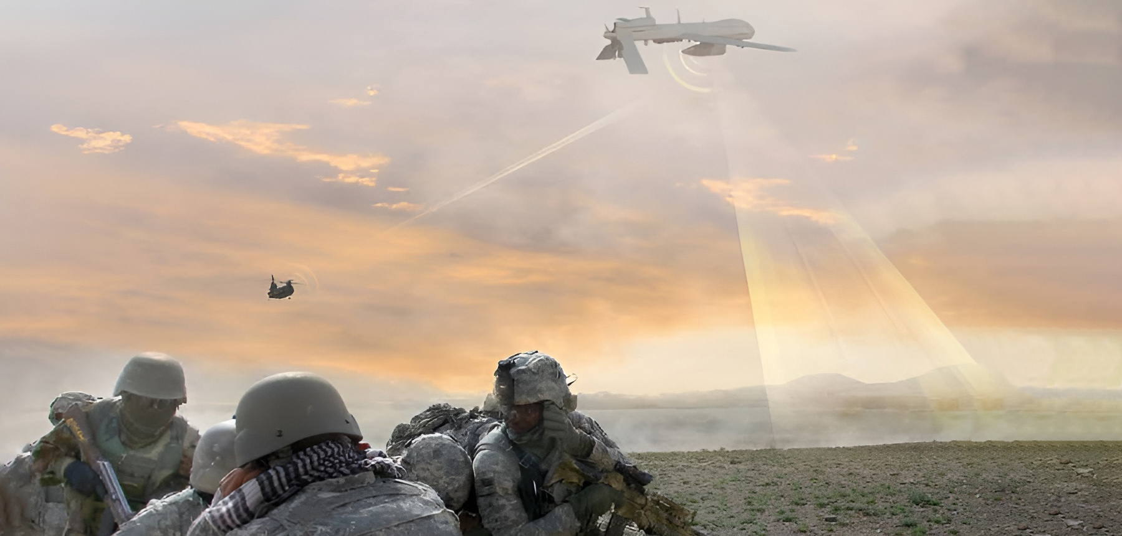
Signals Intelligence (SIGINT)
Ability to seize, retain and exploit the spectrum is critical to battlefield superiority
SIGINT & EW capabilities are being added to manned and unmanned vehicles

Slide 31
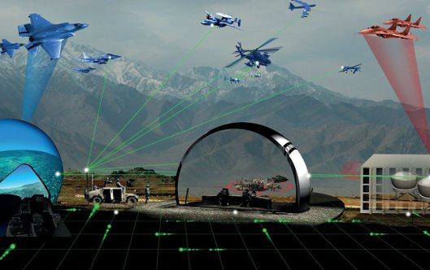
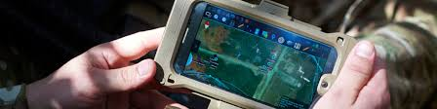
Resilient Training Environments
LVC Simulation
Everyone expects reliable comms fabric
Must create testing/sims to prepare for degraded / disconnected activity
Model jamming, injection, and cyberattacks
Support both BLUFOR and OPFOR endeavors (comms, intel, EW, etc.)
EXAMPLE: RF mesh network with connected ATAK during live training

Slide 32
Immersive Signal Visualization
Definition and Impact

Slide 33
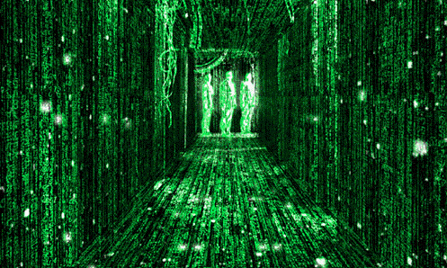
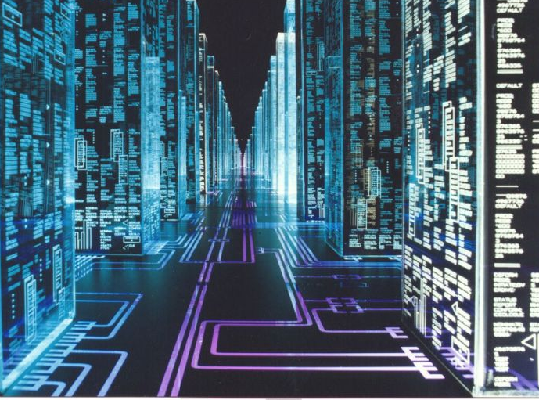
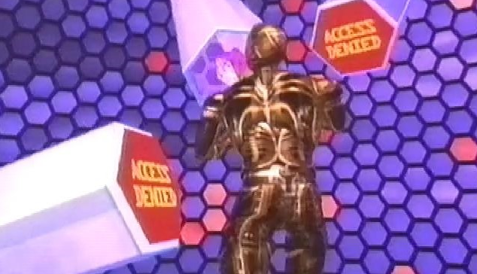
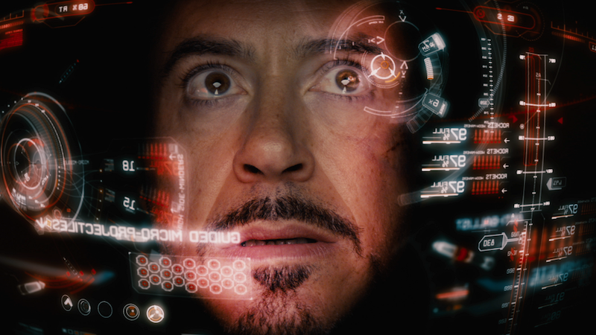
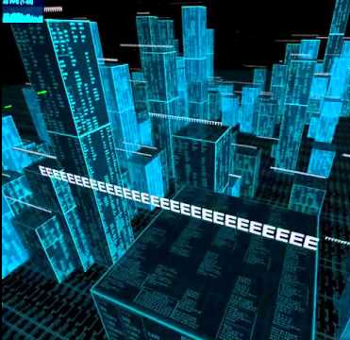
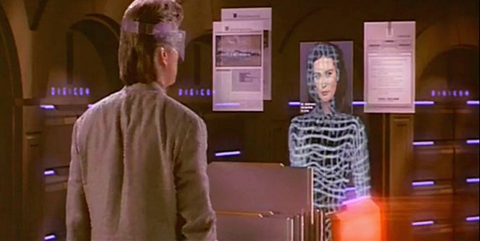
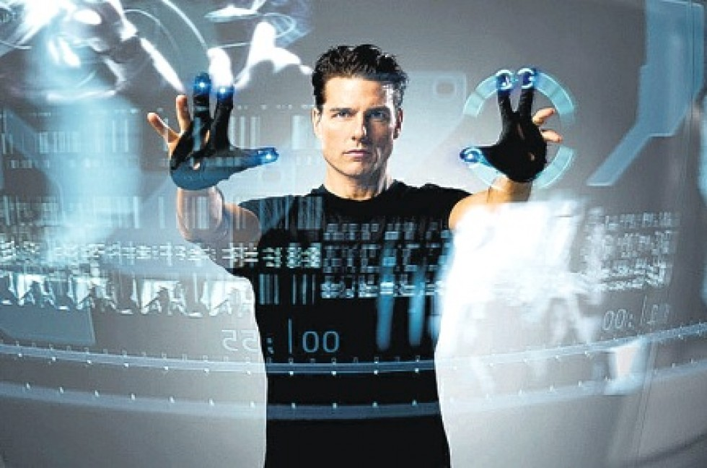
Immersive / AR / VR / Metaverse

Slide 34
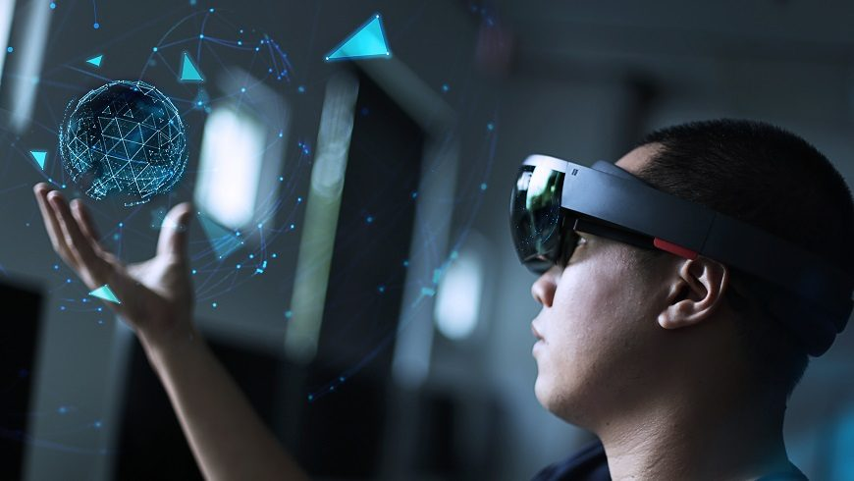
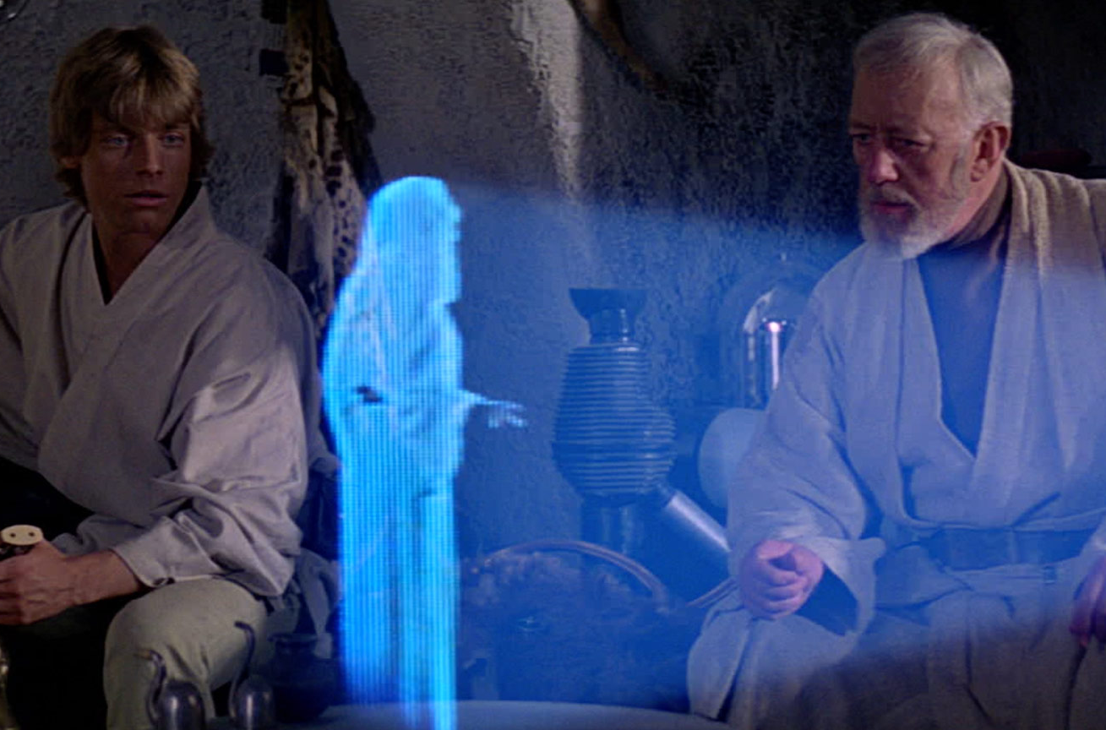
Augmented Reality (AR)
Overlay holograms into real-world objects and environments
Merge the real and the virtual using sensors and trackers

Slide 35
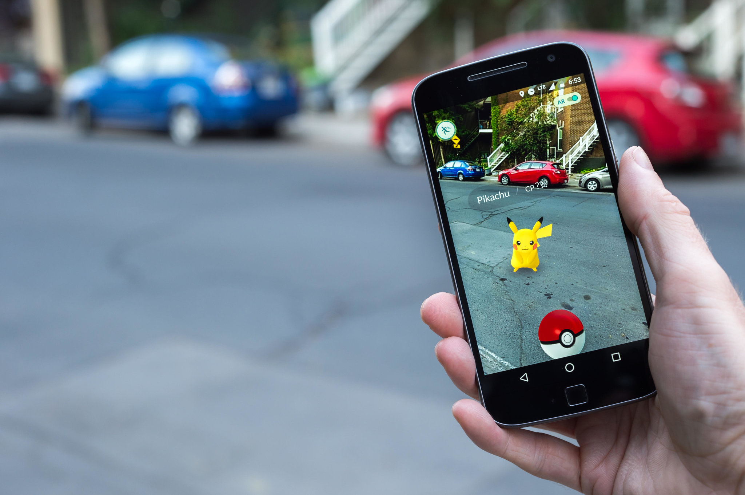





Examples

Slide 36

Spatial Awareness
Spatial mapping and computational geometry understand your physical space to provide situational awareness

Slide 37




Equipment
Popular current and upcoming AR headsets
Magic Leap 2
Qualcomm (Reference Design)
Microsoft HoloLens 2
Meta Orion

Slide 38






Device Pros and Cons
Strengths
Good battery life
Wireless connectivity
Spatial awareness
Weaknesses
Limited FOV
Durability & brightness
High hardware cost
Opportunities
Size and weight
Integrated biometrics
AI/ML assistants

Slide 39

Increased Adoption
Pandemic sped adoption of immersive technologies
Enhanced use in education, training, virtual events, etc.
Example: US Army immersive combat training in Synthetic Training Environment
Ball et. Al, 2021, World Economic Forum, 2022

Slide 40




AR Signal Visualization
Early mainstream implementations of AR signals

Slide 41


AR Signal Visualization (cont’d)
Research focusing on AR, spatial mapping and ray tracing channel prediction algorithms to visualize wireless channels in real-time

Slide 42
Immersive Signal Visualization
Design & Development

Slide 43

Design Considerations
Hardware Display
Field-of-view (FOV) limitations
Indoor/outdoor affects holograms
Hands-free w/ gesture and voice

Slide 44

Design Considerations (cont’d)
User Interface
Ergonomics of interactables
Direct interaction with objects versus onscreen controls
Colors, shapes, and symbology
Multi-User interactions

Slide 45






Example of 3D Spatial Signals
Intuitive perception of Relative Signal Strength Indicator (RSSI)

Slide 46



Interaction Methods
Enables users to access contextual information with simple movements and gestures

Slide 47


Holograms
To skeuomorphism or not?
Density of information
Sizing of symbols

Slide 48



Example: Direction Finding
Find the strongest emitting device
Show relative distance and bearing, for navigation

Slide 49




Example: HUD
Heads-Up Display
Persistent information
Track head angle
Clear center area

Slide 50


HUD Implementation
View seen through lens of heads-up display

Slide 51


Example: Relative Positioning
Show user in context with all available data,
track according to a single reference point

Slide 52


User Engagement
Augment user’s senses with surface patterns and a “slicing” tool
Imbue tracked hands with surface modeling to “feel” wireless signals
Cut into 3D RF model volume to perform cross-section analysis

Slide 53









Integration of Sensor Peripherals
Ubertooth One
RTL-SDR
Enterprise SDR

Slide 54

Common Operating Picture
Paint simulated signals and effects into a mission planning interface

Slide 55




Bridging 2D to AR

Slide 56

Spatial Signal Simulation
Spatial representation of observable signals
Highly dynamic indoor environment
Used for modeling networks
Signal source

Slide 57

Model Validation
On-site signal collection in network telecoms lab
Walk along path with device away from signal source
Collect data on position, direction and signal strength

Slide 58

Affiliation With AI/ML
On-the-fly control and interaction with the AI/ML algorithms
to assist the user in their quest for discovering insight

Slide 59

Defensive vs. Offensive
Find transmitting devices inside SCIF
Identify and locate target device, disable
Model EW jamming range and source
Detect incoming drones

Slide 60

Testing and Tuning
Only 3-5 min hands-on training
Swift detection of random spectrum attack
Full physical discovery of source attack device

Slide 61

Operational Deployment

Slide 62
Best Practices
Leverage real-world concepts
Draw inspiration from media
Add visual/auditory feedback
Embrace ergonomics
Minimize text

Slide 63
Summary and Conclusion

Slide 64

Future Work
Smart Cities
IoT sensor networks
5G, 6G, 7G, and beyond
Construction preplanning
Transportation
Aviation systems
Connected mobility
Traffic smart metering
Health
Safe training
Remote surgery
Extrasensory perception
Alharbi et. Al. (2019)

Slide 65



Additional Signals
Chemical, biological, radiological and nuclear (CBRN) sensor data
Software Defined Radios (SDR)
Ubertooth/Bluetooth devices
Medical devices
Utilize AI/ML
NIH (2022) , Wikimedia (2005)

Slide 66

Into Space
Space Defense
Improve modeling effectiveness
Anti-Access/Area denial strategies target RF communications to inhibit movement
Jamming of signals for low-power satellites, and counter-jamming
Reduce freedom of action
Airbus

Slide 67



Takeaway
Immersive technology will enhance modeling of signals in real world
Cumbersome, focused on screen instead of scene, 1D/2D
Preserve use of hands, ​maintain situational awareness,​ expand comprehension in 3D

Slide 68
Revisit Goals
Confirm Learning Objectives
Understand challenges of existing tools for radio signal analysis and visualization
Discover new AR/VR & AI immersive technologies for signals intelligence, electronic warfare, and communications networking
Develop technical insight into applying new tools in both real and simulated environments
Assess future impact of 3D signal visualization on modeling, simulation, and training

Slide 69
Bibliography
Airbus. https://airbusus.com/laser-communication/
Anderson (2017). “Reduce EMI to Improve Radio Range”. https://medium.com/tempo-automation/improve-radio-range-by-lowering-emi-dac7135f77f9
Alharbi et. Al. (2019). “Roles and Challenges of Network Sensors in Smart Cities”. https://iopscience.iop.org/article/10.1088/1755-1315/322/1/012002/pdf
Altium (2017). “How to Choose a Test Lab for FCC Certification of IoT Products”. https://www.altium.com/subscription
Antenna Test Lab. “What is an Anechoic Chamber?”. https://antennatestlab.com/antenna-education-tutorials/what-is-an-anechoic-chamber
ARSensor. https://play.google.com/store/apps/details?id=com.ken.arsensor&hl=en_US&gl=US
ARwave. https://apps.apple.com/us/app/ar-wave-visualization-of-wifi/id1470866212
Army Futures Command (2022). “Synthetic Training Environment offers multi-dimensional combat preparation”. https://www.army.mil/article/254005/synthetic_training_environment_offers_multi_dimensional_combat_preparation
Ball et. Al. (2021). “Virtual reality adoption during the COVID-19 pandemic: A uses and gratifications perspective”. https://www.sciencedirect.com/science/article/pii/S0736585321001672
BAE. "Unmanned SIGINT/Electronic Warfare". https://www.baesystems.com/en/product/unmanned-sigint-electronic-warfare
Bloom (2001). “What is Bloom’s Taxonomy”. https://bloomstaxonomy.net/
FrontierUS. https://frontiercomputercorp.com/specifying-the-right-antenna/

Slide 70
Bibliography (cont’d)
HouseTechLab. “Difference between spectrum analyzer and oscilloscope” https://housetechlab.com/difference-between-spectrum-analyzer-and-oscilloscope/
iBWave. https://info.ibwave.com/augmented-reality/
Koutitas et. Al. (2020). “In Situ Wireless Channel Visualization Using Augmented Reality and Ray Tracing”. https://www.mdpi.com/1424-8220/20/3/690/htm
McKinsey (2018). “The road to 5G: The inevitable growth of infrastructure cost”. https://www.mckinsey.com/industries/technology-media-and-telecommunications/our-insights/the-road-to-5g-the-inevitable-growth-of-infrastructure-cost
NBC (2015). “App Visualizes Radio Waves From Cell Towers, Satellites Around You”. https://www.nbcnews.com/tech/innovation/app-visualizes-radio-waves-cell-towers-satellites-around-you-n469781
NIH (2022). “Electric & Magnetic Fields”. https://www.niehs.nih.gov/health/topics/agents/emf/index.cfm
NTIA (2016). https://www.ntia.doc.gov/files/ntia/publications/january_2016_spectrum_wall_chart.pdf
Pieper (2018). “Introducing WiFiman”. https://blog.ui.com/2018/12/11/introducing-wifiman/
RF Page (2021). “What are Radio Frequency bands and its uses?”. https://www.rfpage.com/what-are-radio-frequency-bands-and-its-uses/
Rockwell Collins (2016). "LVC demonstration completed by Rockwell Collins in France, U.K., and U.S." https://militaryembedded.com/radar-ew/test/lvc-demonstration-completed-by-rockwell-collins-in-france-u-k-and-u-s
TeraSense. “Radio Frequency Bands”. https://terasense.com/terahertz-technology/radio-frequency-bands/

Slide 71
Bibliography (cont’d)
Wikimedia (2005). https://commons.wikimedia.org/wiki/File:An_instructor_at_the_Defence_NBC_Centre_operates_the_Manportable_Chemical_Agent_Detector_MOD_45148143.jpg
Wikitude (2021). “How to Apply UX Design Principles in Augmented Reality”. https://www.wikitude.com/blog-ux-design-for-augmented-reality/
World Economic Forum (2022). “Immersive Media Technologies: The Acceleration of Augmented and Virtual Reality in the Wake of COVID-19”. https://www3.weforum.org/docs/WEF_Immersive_Media_Technologies_2022.pdf

Slide 72
Contact Info
BadVR, Inc.
10312 Norris Ave. Ste. D​
Pacoima, CA 91331
(833) 600-DATA
Jad Meouchy, CTO​
jad@badvr.com
Suzanne Borders, CEO​
suzanne@badvr.com

