Slide 1
Generative AI Applied to Rapid Development of Simulation and Modeling Assets - Topic #24T48
Jad Meouchy, BadVR
Suzanne Borders, BadVR

Slide 2
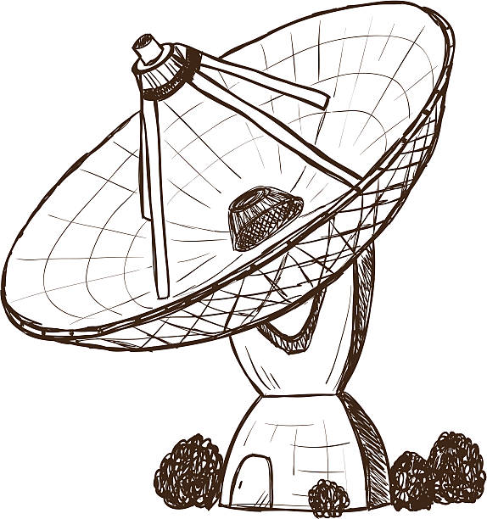
Tutorial Overview
5 min | Introduction and Learning Objectives
15 min | Traditional Asset Production
20 min | Generative Tools and Techniques
20 min | Step-by-Step Walkthrough
10 min | Summary and Conclusions
5 min | Acknowledgements
10 min | Q&A
1

Slide 3
Learning Objectives
Understand challenges of existing simulation asset production pipelines
Recognize the strengths, weaknesses, and trajectory of disruptive new image synthesis technology
Learn applied techniques and methods to begin using generative AI immediately
2

Slide 4
Terminology and Concepts
AI/ML – Computer systems and algorithms that can perform tasks and make decisions typically requiring human intelligence.
Conditional Generative Models – ML models that generate new samples based on conditions or constraints, for targeted data generation.
Deep Learning – ML subset for training complex models from large datasets.
Generative Adversarial Networks (GANs) – Class of ML models with dual neural networks that compete/learn from each other to yield realistic outputs.
NeRF – A method, based on deep learning, used to reconstruct 3D representations from 2D images.
Latent Space – High-dimensional, continuous representation of internal model encoding; each point in latent space is a unique input/output configuration.
Autoencoders – Neural network models used for unsupervised learning, typically feature extraction.
Large Language Model (LLM) – AI model trained on vast text datasets to understand and generate human-like language.
ChatGPT – Conversational AI based on the Generative Pre-trained Transformer architecture.
Style Transfer – Extracting the artistic style from one image and applying to another.
3

Slide 5
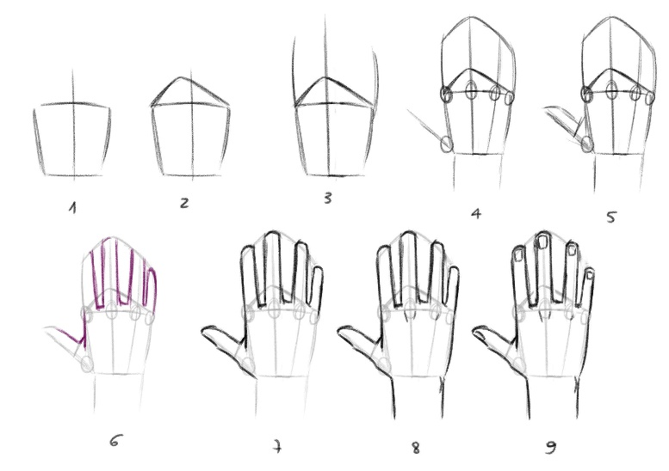
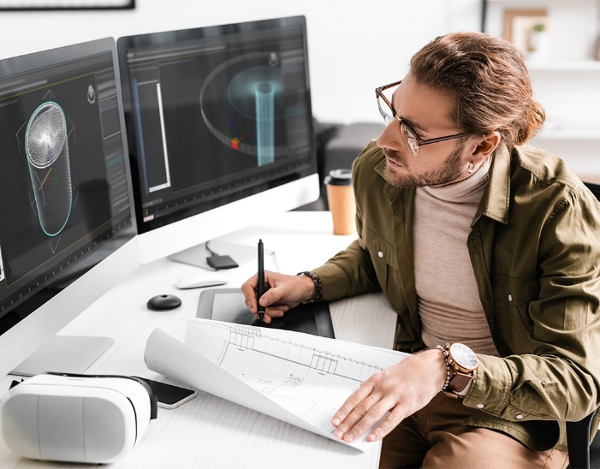
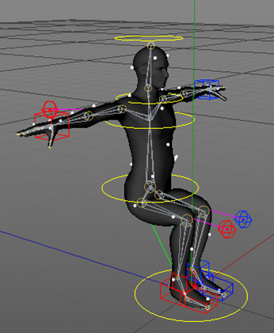
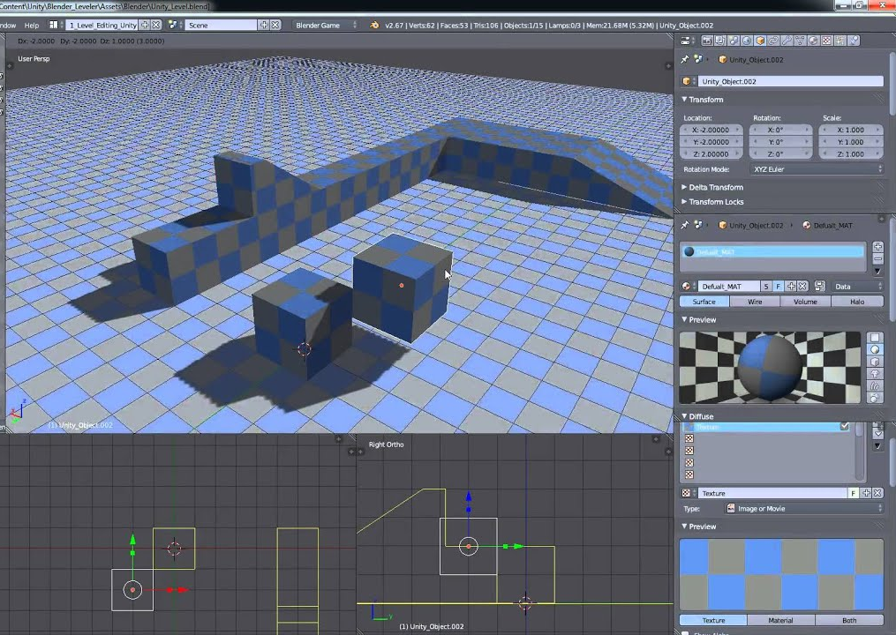
Challenge
Asset production for modeling and simulation is an expensive, slow, and highly technical process
SLOW
EXPENSIVE
TECHNICAL
COMPLEX
4

Slide 6
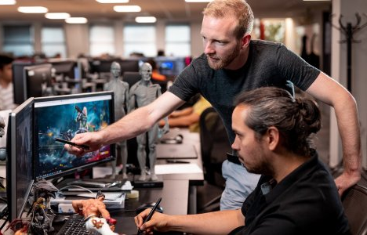
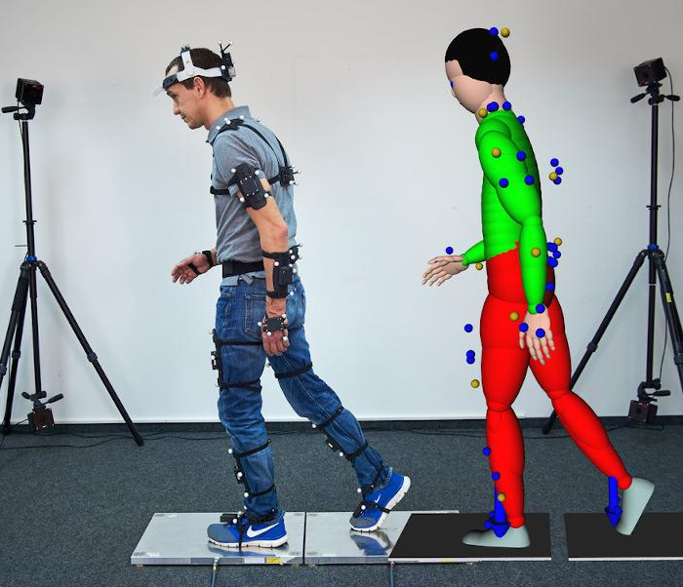
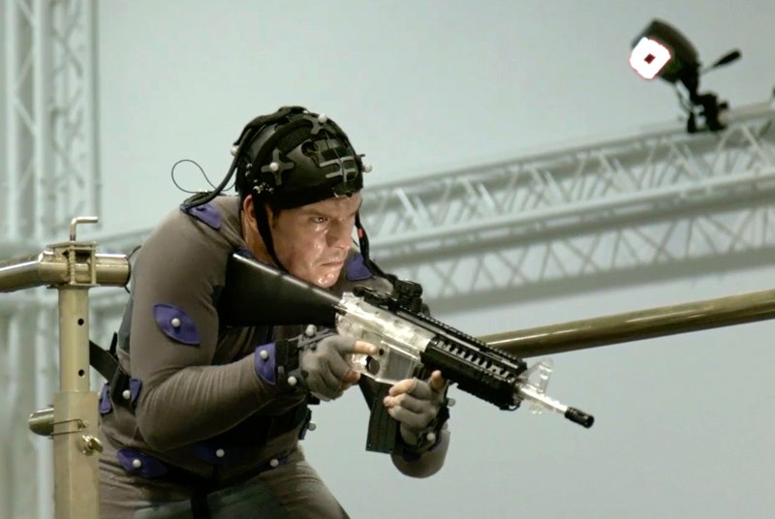
Workflow Implications
Complexity impedes individual productivity
Resource intensiveness hinders timely communication
Difficult or impossible to conduct rapid development process
Many simulations become cost prohibitive
Requires coordination between artists, engineers, managers, and end users
Limited domestic talent pool available to contribute, raising security issues
5

Slide 7
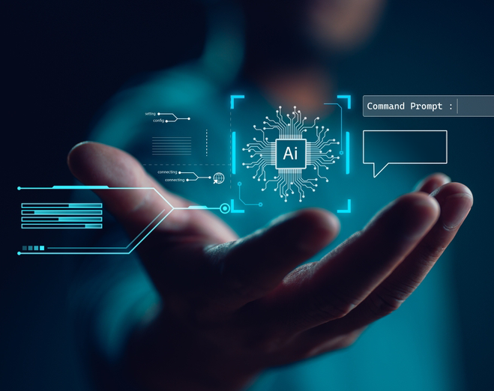
Impact of Potential Solutions
Training
Adapt rapidly to changing digital landscape
Reduce cost of curriculum development
Modeling
Empower non-artists to contribute
Enhance realism through better sampling
Simulation
Generate scenarios from intelligence reports
Free human resources through automation
6

Slide 8
Traditional Asset Production
7

Slide 9
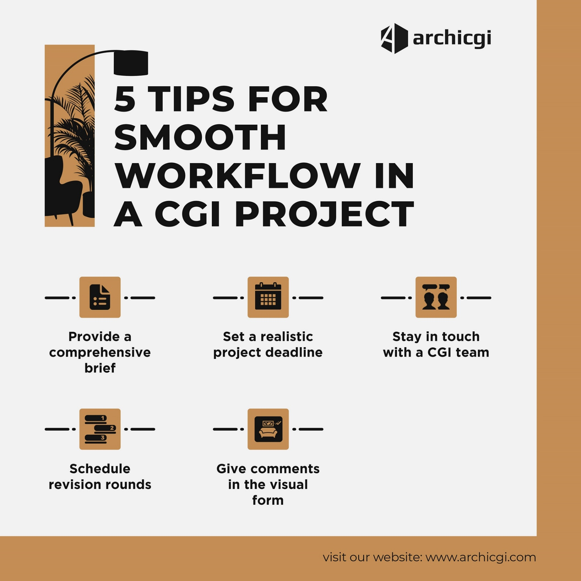
How To “3D”
Write a brief
Find an artist
Negotiate a rate
Review and iterate for days
Hand deliverable to engineers
The “creative brief” is a requirements document critical for outlining the goals, budget, and visual style.
8

Slide 10
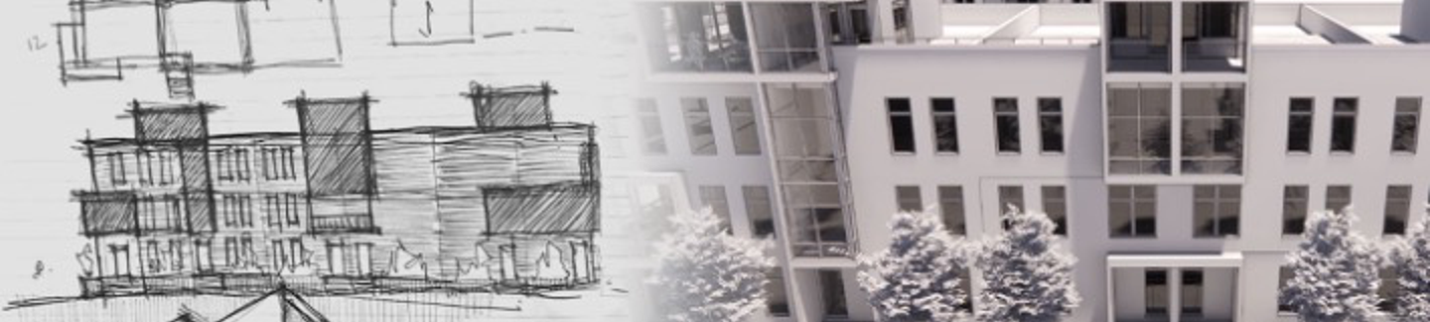
Default Artist Workflow
Modeling
Rigging
Texturing
Define shape and structure, frame, and subcomponents
Add virtual skeleton, joints, and controls for realistic posing
Apply colors, patterns, and surface properties like materials
9

Slide 11
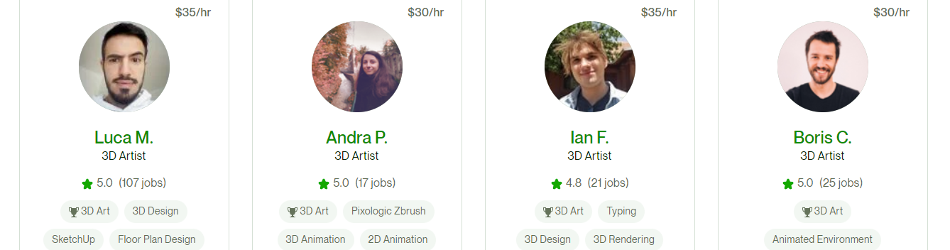
Cost Estimates
The highest cost is turnaround time easily in days or even weeks, depending on the complexity of the model.
Resource Type | Typical Rate
Freelancers and Independent Artists | $25-150/hr
In-House Artists and Designers | $50-100K/yr
Studio or Agency | $500 - $5,000 per model
10

Slide 12
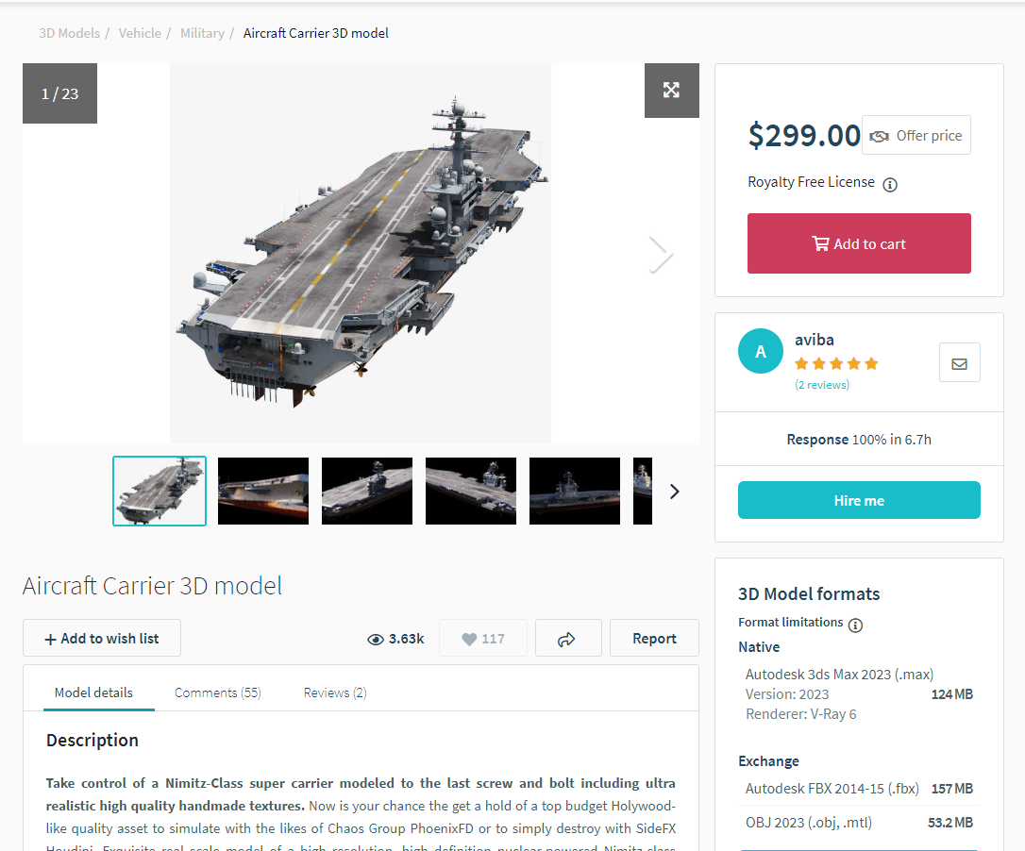
Online Resource Libraries
There are many sites to find pre-made objects that are already textured, rigged, and ready for drag & drop import, at a cost
1st party integration into Unity and Unreal Engine
Thousands of existing objects for immediate purchase
Inconsistent accuracy for real-world objects like aircraft
Typical costs from $20-$100
Often requires cleanup
11

Slide 13
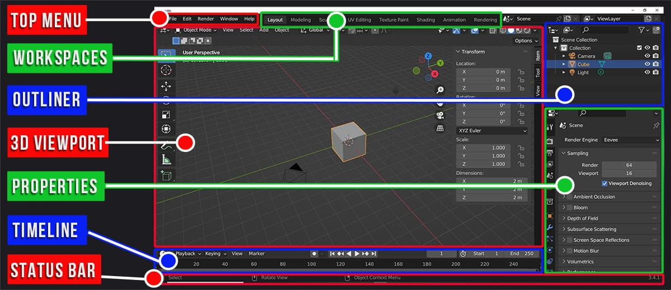
Basic Modeling With Blender (FREE)
12

Slide 14
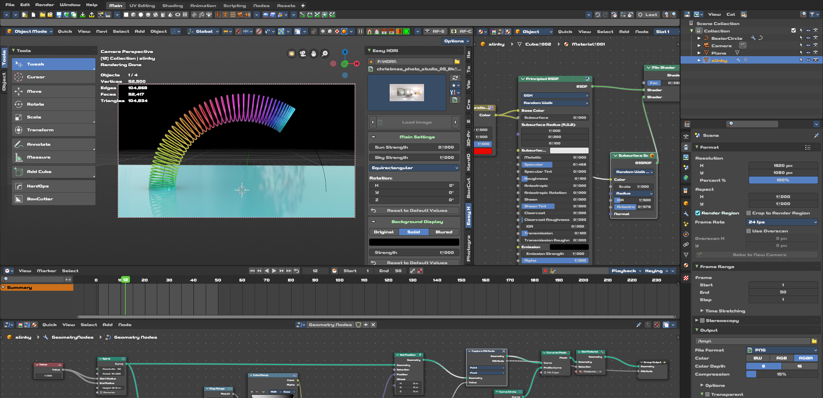
Advanced Modeling (PAID)
Incorporating physics simulations can become highly technical
13

Slide 15
3D Modeling Tools
 | Blender | ZBrush | Cinema 4D | Maya | 3DS Max | Sketchup
Company | Open Source | MAXON | MAXON | Autodesk | Autodesk | Trimble
Founded | 2003 | 1999 | 1990 | 1998 | 1990 | 1999
Features | Animation Skinning | Brushes Sculpting Hi-poly | Procedural Rigging Animation | MOCAP NURBS VFX | Characters Scripting Splines | Architecture Mobility AR/VR
Difficulty | +++++ | +++ | + | +++ | +++ | ++
Cost | Free | $33/mo | $69/mo | $1,875/yr | $1,875/yr | $349/yr
14

Slide 16
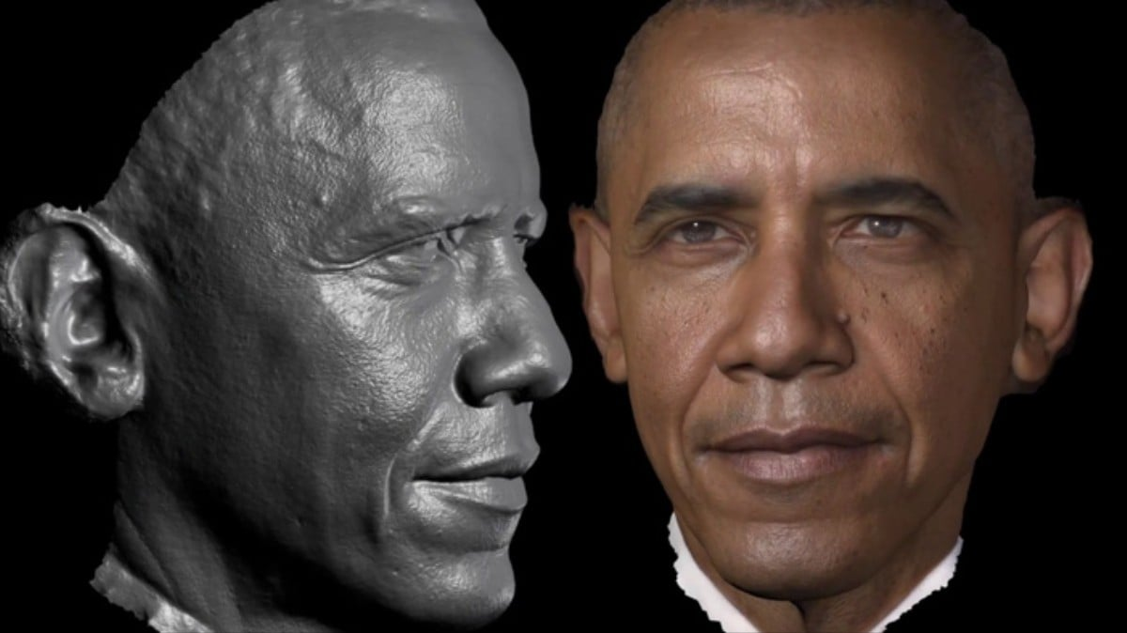
Future Challenges Of Traditional Workflows
Technical Burden
Costs increase as realism expectations rise
Standards and formats continue to evolve; must stay current with latest edits
Maintain interoperability with new rendering outputs like AR/VR and volumetrics
Automation will be disruptive
Accessibility and Communication
Tools must improve to incorporate non-technical stakeholders
Need to support remote participants in all stages of review and feedback
15

Slide 17
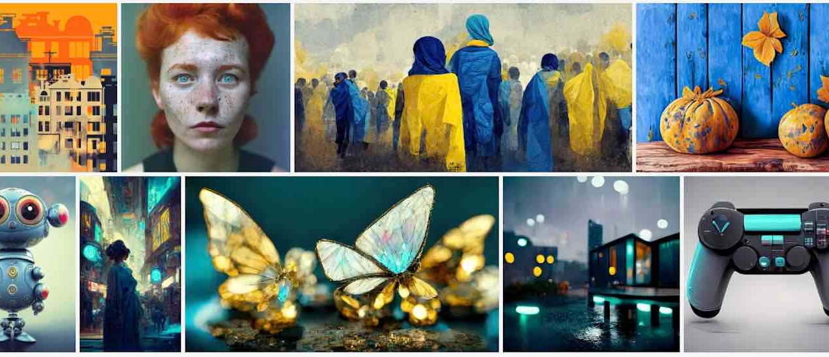
Generative Tools and Techniques
16

Slide 18
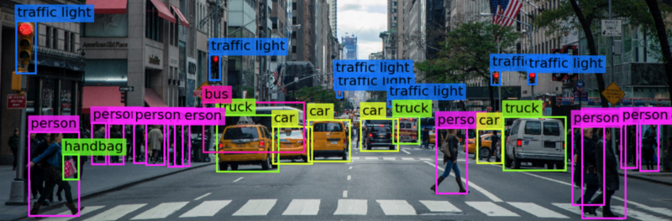
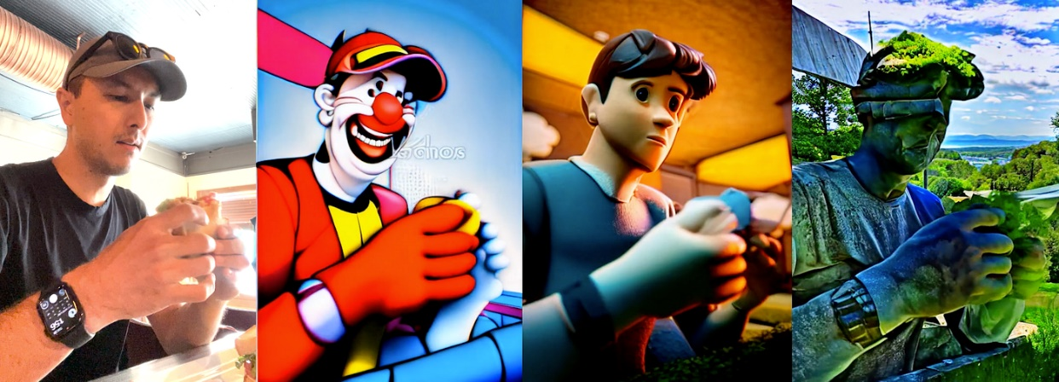
What Is AI?
What is AI?
Range of techniques enabling machines to learn, perceive, and make decisions
Applied across robotics, computer vision, data analysis, etc.
Potential replacement for elements of human workforce and industry
What is Generative AI?
Branch of AI to generate new content, such as images, text, or audio
Uses deep learning and neural networks to make output resembling training data
Applies to image and text synthesis, creative design, and data augmentation

Slide 19
History of Generative AI
Neural Networks
AlphaGo Victory
DALL-E
Perceptron by Frank Rosenblatt in 1957
DeepMind’s AI defeats human world Go champion
OpenAI introduces model capable of text-to-image
1950s
2014
2016
2018
2020
2022
GAN’s
GPT-2 Release
Stable Diffusion
Ian Goodfellow, et al. create GAI foundational work
Large-scale language model for text generation
Open source model brings GAI to offline use
19

Slide 20
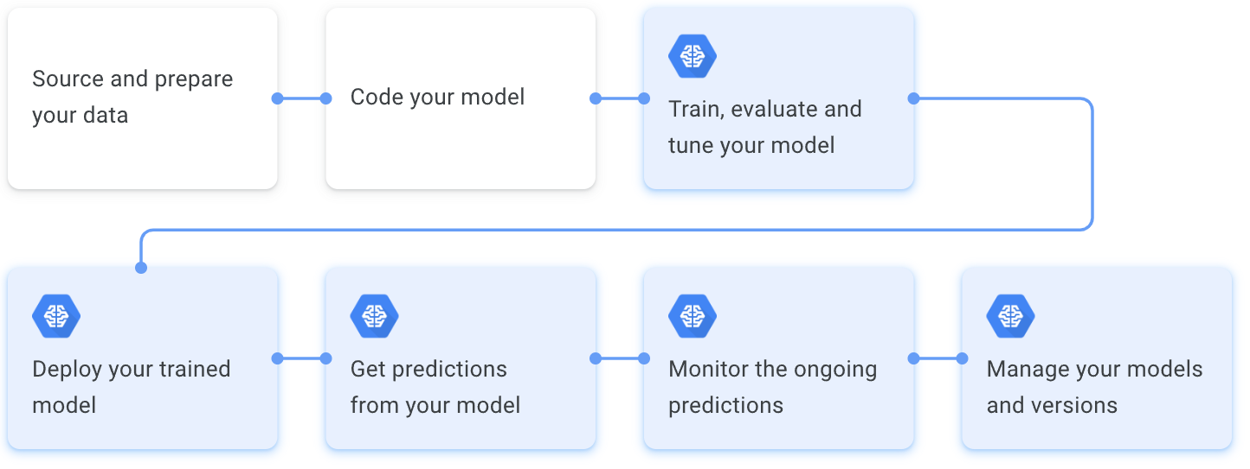
Typical Workflow
18

Slide 21
Real World Use Cases
Low-cost, high-speed, secure asset creation at the edge for text, 2D, and 3D workflows
Red Teaming and Adversarial Modeling
Simulate adversarial behaviors and strategies
Terrain Generation and Tactical Planning
Generate terrains and landscapes of real-world
Autonomous Systems Testing
Simulate scenarios to evaluate autonomous navigation algorithms
Mission Rehearsal and Analysis
Create simulated mission scenarios for rehearsal
Model potential enemy actions
Evaluate vulnerabilities and defense of systems
Develop advanced countermeasures
Conduct virtual exercises and simulations
Evaluate different tactical approaches
Analyze impact of terrain on military operations
Assess performance and robustness of drones
Model unmanned systems for pilot improvement
Mimic natural enemy behaviors and tactics
Assess potential risks and optimize strategies
20

Slide 22
Subjective Review of 3rd Party GenAI
 | ChatGPT | Midjourney | Stable Diffusion | DALL-E / Point-E | Omniverse | DeepMind
Company | OpenAI | Midjourney, Inc. | Stability AI | OpenAI | Nvidia | Google
Released | 2022 | 2022 | 2022 | 2021 | 2021 | 2023
Features | Popular Text to text | Photoreal Online only | Offline Modular Community | Easy Artistic | Scalable Difficult | ?? ??
Quality | 6 | 8 | 7 | 5 | 6 | ??
Cost | $20/mo | $10-30/mo | Free | $0.040 / img | Free | N/A
21

Slide 23
Latest Research Projects
Most public projects are abandoned after 6-9 months, seemingly after failing to attract investment capital
NVIDIA’s LATTE3D
3DFY.ai
Meshy
Alpha3D
Claims 10-12 sec for gen w/ A6000
Limited to furniture and gaming models
Excellent quality results
Trained with ChatGPT
Community sharing area
Gaming oriented
Emphasis on texturing and PBR modeling
Simple interface
Not commercialized
$0.99 per asset
Results comparable to method in this tutorial
Text prompt based
NVIDIA’s EDIFY 3D
With Shutterstock as a paid service
In developer beta
2-3min per prompt
Varied results

Slide 24
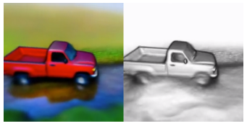
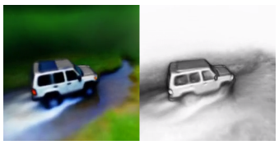
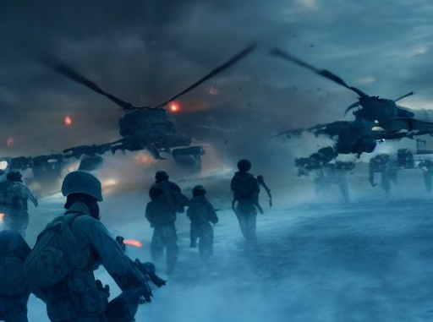
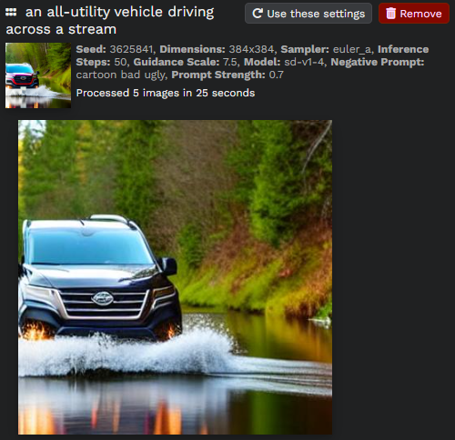
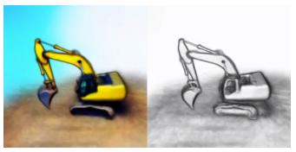
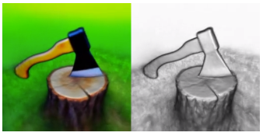
Sample Outputs
These are all generated by 3rd party AI tools
‘Dense maps’ – textured, 3D models of polygon geometry, created from 2D, AI-generated images
red pickup truck driving across a stream
all-utility vehicle driving across a stream
soldiers evacuating by helicopter at night
tree stump with an axe buried in it
construction excavator
22

Slide 25
The Art and Science of Prompts
A prompt for a generative AI system is a specific input, such as text or an image, that serves as a starting point or instruction for the system to generate a desired output.
Negative Prompting
Guiding generative AI away from undesirable or suboptimal outputs
Providing instructions that discourage specific content or biases
Influencing the AI system to avoid generating certain types of content
Style Transfer
Transforming the visual style of an image or artwork
Applying the characteristics and aesthetics of one image onto another
Using neural networks to recreate an image in a different style
23

Slide 26
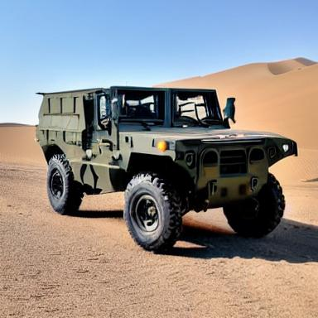
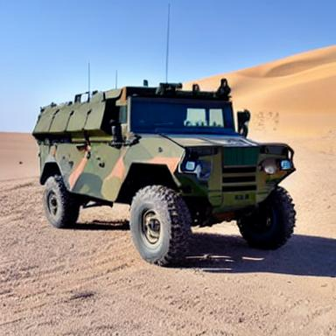
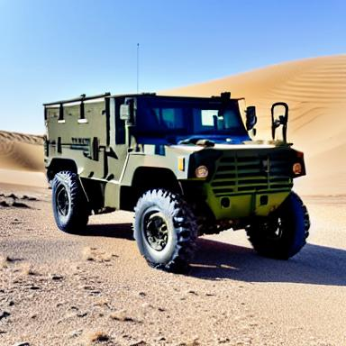
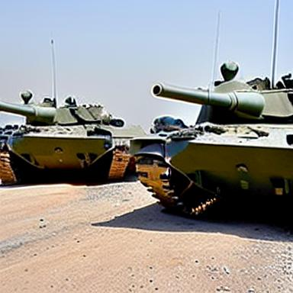
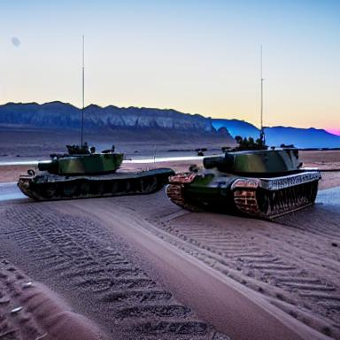
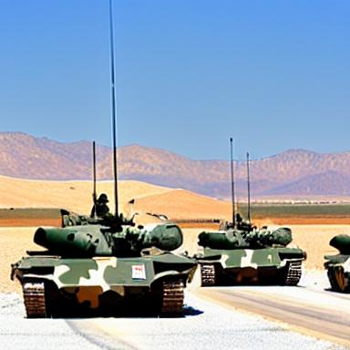
Prompts That Succeeded
military vehicle in the desert
three us army tanks in the desert
These images were generated by an open-source program called Stable Diffusion
24

Slide 27
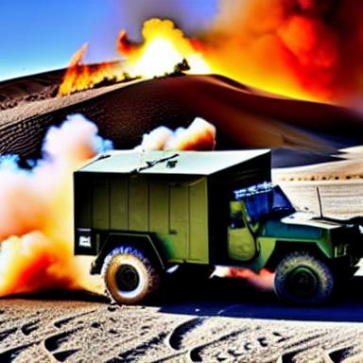
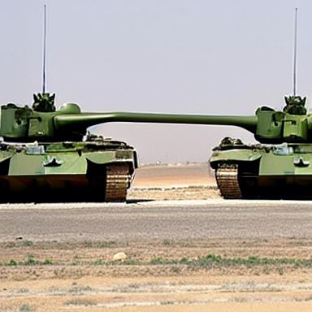
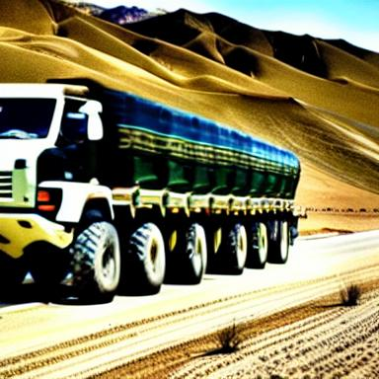
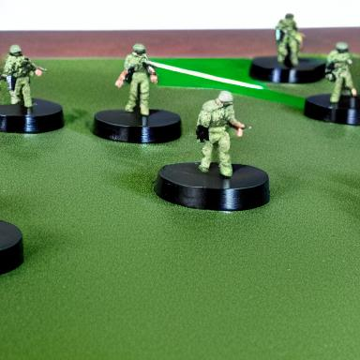
Prompts That Failed
military vehicle in the desert on fire
two us army tanks covering each other
5 military vehicles in convoy in the desert
agile combat deployment
These images were generated by an open-source program called Stable Diffusion
25

Slide 28
Creating Prompts
Specify detailed parameters, characteristics, specifications
  naval vessel with a length of 400 feet
  equipped with a turret
Reference real-world examples, images, or data of existing military assets
  in the Mojave Desert
  formation of F16’s
Incorporate mission requirements and tailor the prompts to align with objectives
  carrying 8 soldiers
  at night
Generate multiple prompts, evaluate the results, and iterate on them to refine
  carrying 8 Army soldiers
  at night with no moonlight
26

Slide 29

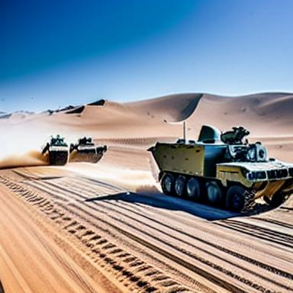

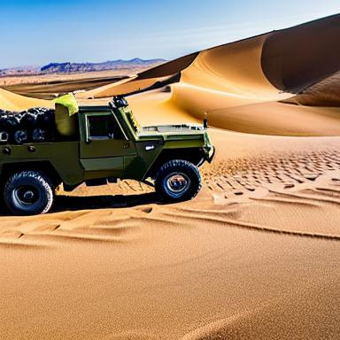
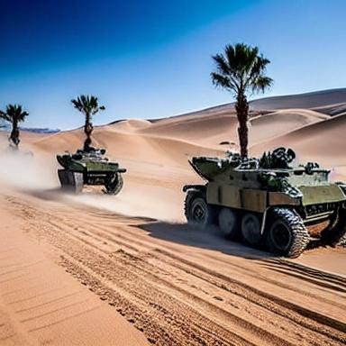
Using Prompts to Create Prompts
You can instruct ChatGPT (or similar) to write prompts for the image generators
please provide 3 new example prompts based on my previous prompt history
“Generate a military simulation asset of an unnamed aerial vehicle (UAV) with a wingspan of 15 feet, capable of vertical take-off and landing (VTOL), and equipped with infrared imaging technology.”
“Create a military simulation asset of an armored personnel carrier (APC) with a maximum speed of 60 miles per hour, capable of carrying 10 personnel, and equipped with a remote-controlled turret system.”
“Generate a military simulation asset of a naval vessel resembling a guided-missile destroyer with a length of 500 feet, radar-evading capabilities, and a displacement of 10,000 tons.”
These images were generated by an open-source program called Stable Diffusion
27

Slide 30
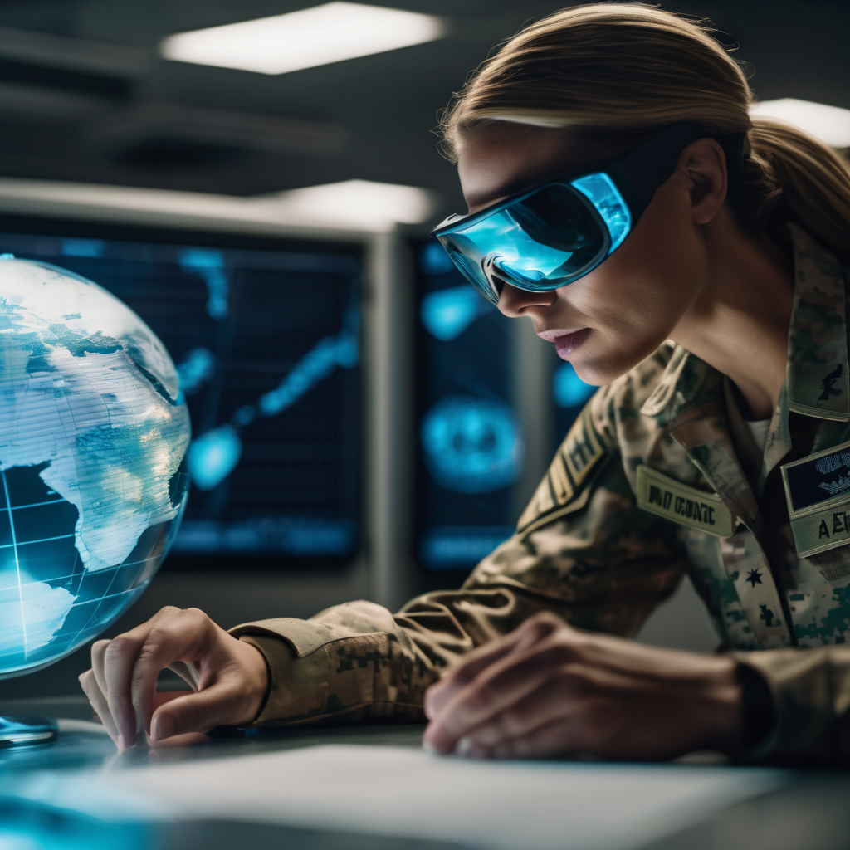
Advanced Prompts (1)
Prompt
cinematic film still of a female soldier looking at a globe map, inside an emergency operations center, shallow depth of field, vignette, highly detailed, Hollywood movie, medium shot
Negative
anime, cartoon, graphic, text, painting, crayon, graphite, abstract, glitch, deformed, mutated, ugly, disfigured
These images were generated by an open-source program called Stable Diffusion
28

Slide 31
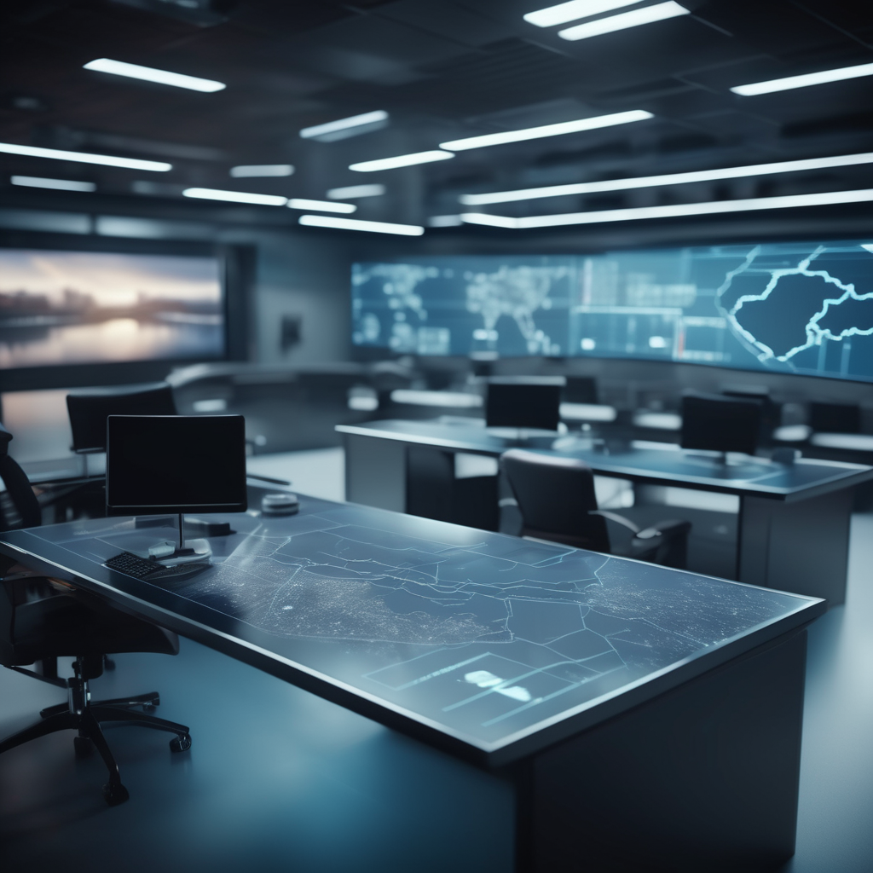
Advanced Prompts (2)
Prompt
cinematic film still an empty emergency operations center with maps on the tables, shallow depth of field, vignette, highly detailed, Hollywood movie, medium shot
Negative
anime, cartoon, graphic, text, painting, crayon, graphite, abstract, glitch, deformed, mutated, ugly, disfigured
These images were generated by an open-source program called Stable Diffusion
29

Slide 32
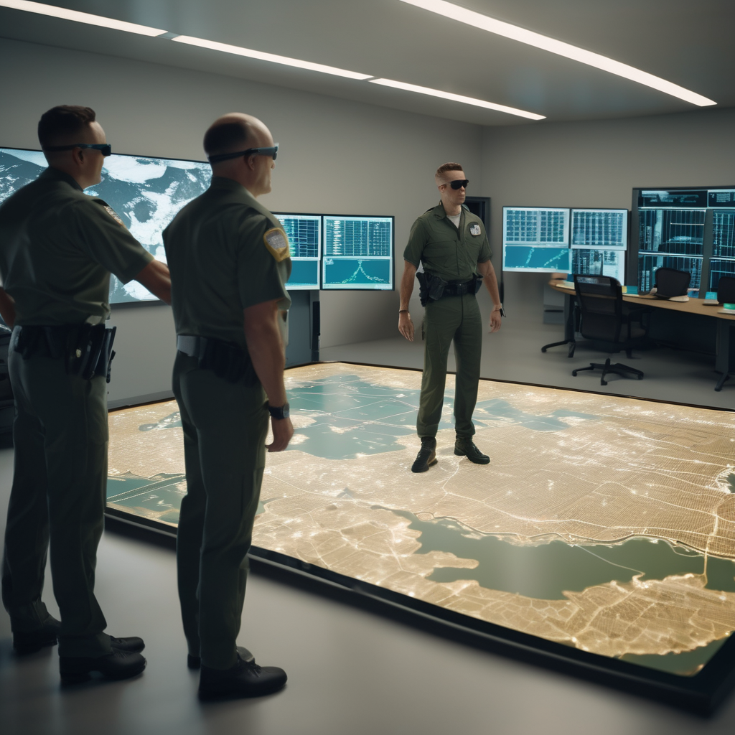
Advanced Prompts (3)
Prompt
one commander and two soldiers standing on top of a map on the floor, inside an emergency operations center, vignette, highly detailed, wide shot
Negative
anime, cartoon, graphic, text, painting, crayon, graphite, abstract, glitch, deformed, mutated, ugly, disfigured
These images were generated by an open-source program called Stable Diffusion
30

Slide 33
Step-by-Step Walkthrough
31

Slide 34
Prompt -> 3D Workflow
Enter prompt into 2D GenAI
Batch generate photos of multiple angles of object
Use AI to calculate photo positions and angles
Use photogrammetry (or similar) to convert into 3D
Import into preferred program, cleanup if needed
Optionally, run auto-LOD for use in sims
32

Slide 35
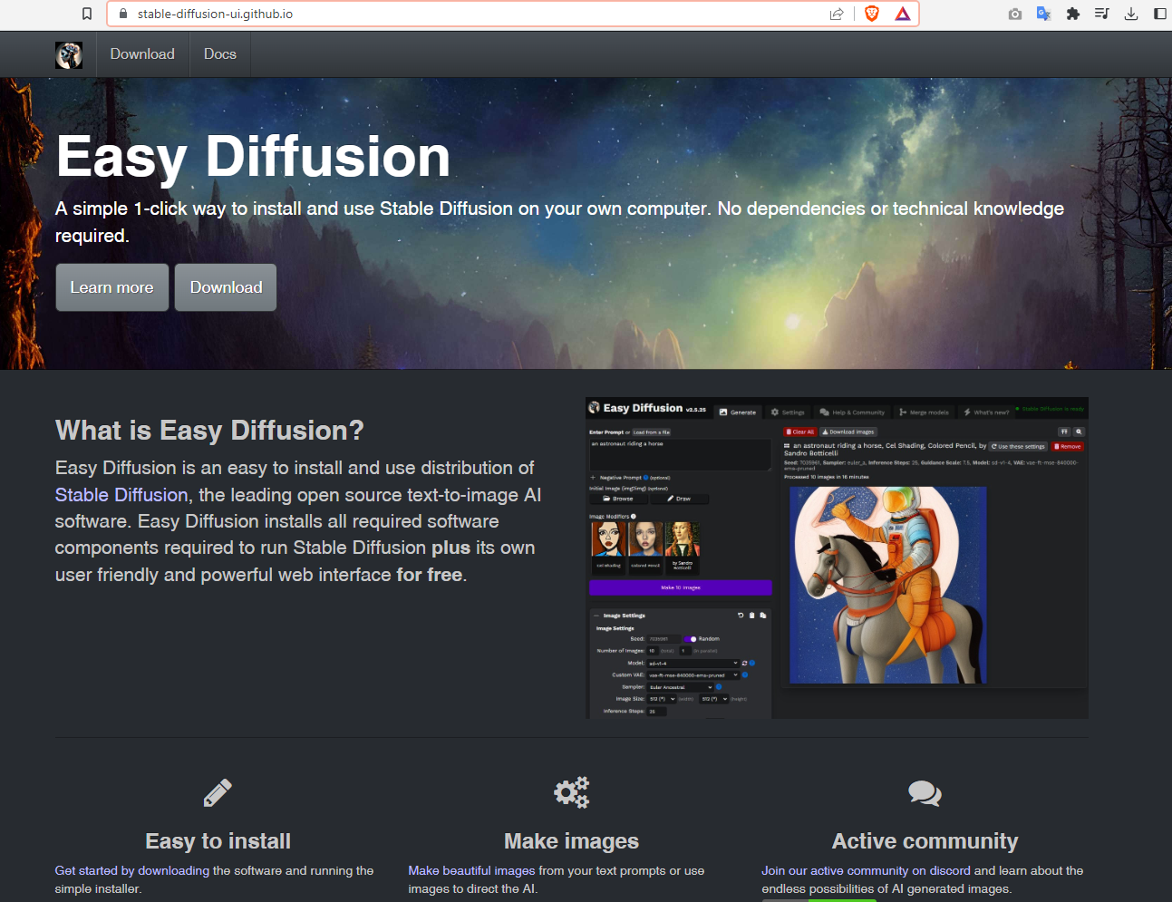
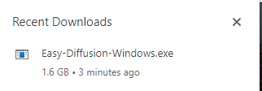
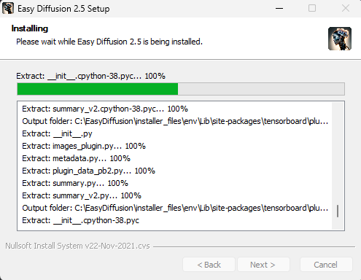
Start With Something Easy
Download from 3rd party website and install, will take 5-15 minutes to complete
32

Slide 36
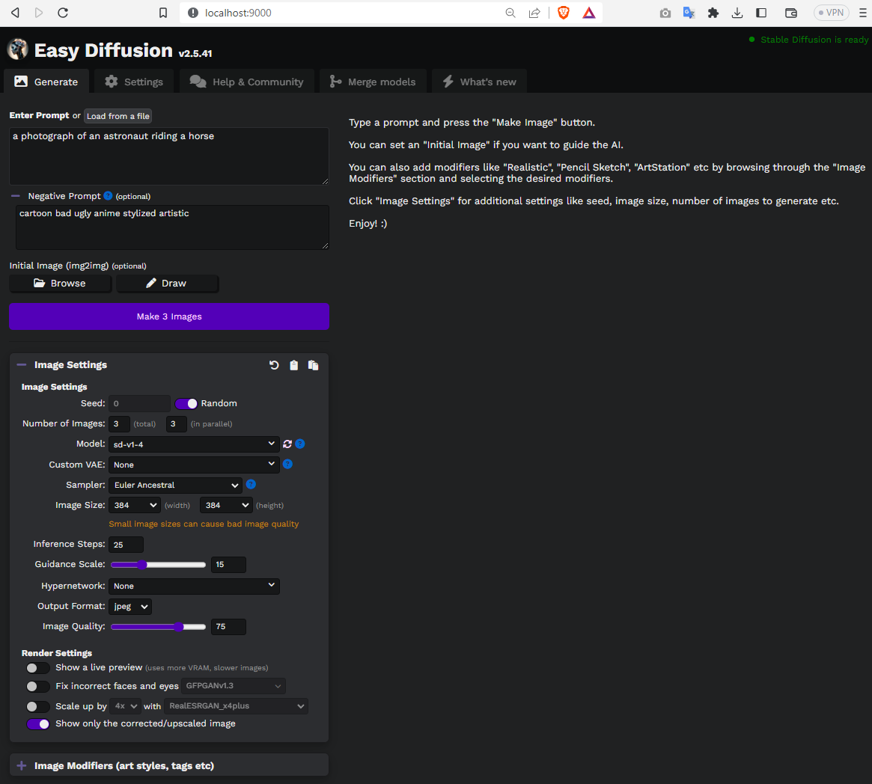
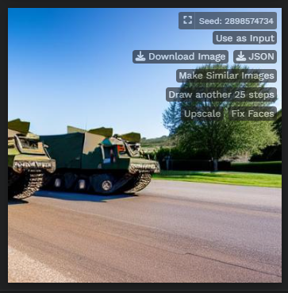
Text-to-2D Example: Stable Diffusion
Launch user interface from web browser
Enter prompts as text, specify negative prompts, many extras
Operates completely offline = relatively secure
Runs on $200 GPU (GTX 1080), fast on $700 GPU (RTX 3090), very fast on $1500 GPU (4090)
33

Slide 37
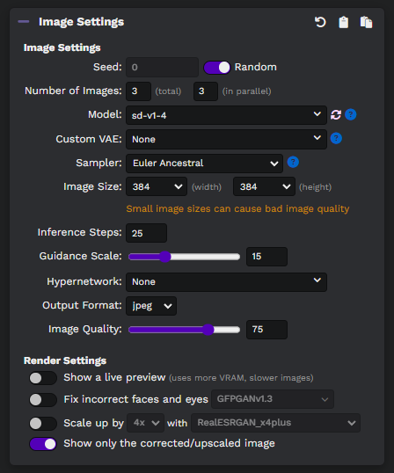
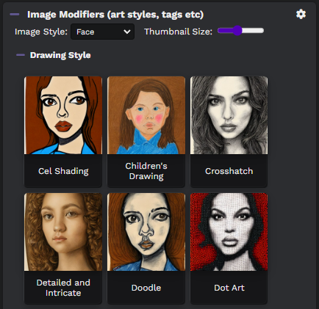
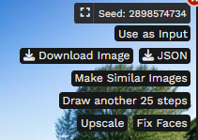
Using Extra Features
Click contextual buttons to generate more images, increase size, use as seed for refinement, adjust style, change image resolution, etc.
34

Slide 38





Text-to-3D Example: Nvidia Edify-3D
Text-to-3D or Image-to-3D
Enter prompt or upload image (image not public)
Wait ~1min for 2D image preview
Confirm to generate 3D, wait 3-5min
Download as GLB, USDZ
File size for traffic cone 3MB
Appears to use the same outlined workflow
https://build.nvidia.com/shutterstock/edify-3d (3rd party)
“F35 aircraft”
35

Slide 39

Text-to-3D Example: Dreamfusion
Neural Rendering Fields (NeRFs) are special AIs that represent a 3D model
NeRFs are normally generated from image sets
Dreamfusion generates these images with Stable Diffusion and text prompts
Text prompt generates images which are used to train the NeRF
Then export as a mesh into Unity, Unreal, etc.
https://dreamfusion3d.github.io​ (3rd party)
35

Slide 40


Example: Google Colab
DreamFusion can also be run on Google Colab, a cloud-based environment with access to GPUs
To run Dreamfusion on Colab, input a prompt in the Training & Testing block
Click "run all" to run the code and start training
36

Slide 41


Local Setups: Prerequisites
Install Python 3.8+
2. Verify install and update pip
C:\Users\user> python -V
Python 3.11.0
C:\Users\user> python -m ensurepip --upgrade
Looking in links: c:\Users\user\AppData\Local\Temp\tmphrg1awd_
Requirement already satisfied: pip in c:\python311\lib\site-packages (22.3)
3. Install git
4. Clone repository
C:\Users\user\Desktop> git clone https://github.com/ashawkey/stable-dreamfusion.git
Cloning into 'stable-dreamfusion'...
remote: Enumerating objects: 1252, done.
remote: Counting objects: 100% (634/634), done.
remote: Compressing objects: 100% (150/150), done.
remote: Total 1252 (delta 508), reused 544 (delta 484), pack-reused 618
Receiving objects: 100% (1252/1252), 17.12 MiB | 4.79 MiB/s, done.
Resolving deltas: 100% (761/761), done.
C:\Users\user\Desktop> cd stable-dreamfusion
C:\Users\user\Desktop\stable-dreamfusion>
37

Slide 42
Local Setups: Install Dependencies
Install required Python modules automatically
C:\Users\user\Desktop\stable-dreamfusion>pip install -r requirements.txt
Collecting tqdm
Downloading tqdm-4.65.0-py3-none-any.whl (77 kB)
━━━━━━━━━━━━━━━━━━━━━━━━━━━━━ 77.1/77.1 kB 4.2 MB/s eta 0:00:00
Collecting rich
Downloading rich-13.4.2-py3-none-any.whl (239 kB)
━━━━━━━━━━━━━━━━━━━━━━━━━━━━ 239.4/239.4 kB 4.9 MB/s eta 0:00:00
Collecting ninja
Downloading ninja-1.11.1-py2.py3-none-win_amd64.whl (313 kB)
━━━━━━━━━━━━━━━━━━━━━━━━━━━━ 313.0/313.0 kB 4.9 MB/s eta 0:00:00
2. Download checkpoints (if using image prompt)
C:\Users\user\Desktop\stable-dreamfusion> cd pretrained/zero123
C:\Users\user\Desktop\stable-dreamfusion\pretrained\zero123>
wget https://huggingface.co/cvlab/zero123-weights/resolve/main/105000.ckpt
C:\Users\user\Desktop\stable-dreamfusion> mkdir pretrained/omnidata
C:\Users\user\Desktop\stable-dreamfusion> cd pretrained/omnidata
C:\Users\user\Desktop\stable-dreamfusion\pretrained\omnidata>
gdown '1Jrh-bRnJEjyMCS7f-WsaFlccfPjJPPHI&confirm=t'
C:\Users\user\Desktop\stable-dreamfusion\pretrained\omnidata>
gdown '1wNxVO4vVbDEMEpnAi_jwQObf2MFodcBR&confirm=t'
38

Slide 43

Local Training
Multiple settings to train the system locally
Does not require internet access or external accounts
Runs on your computer with your hardware
Pass a text prompt, or a "negative" prompt to exclude information from the generation
Once training starts it will iterate over many epochs and will take a bit of time
# train with text prompt (with the default settings)
python main.py --text "an orange dog" --workspace dog -O
# reduce stable-diffusion memory usage if the program crashes
python main.py --text "an orange dog" --workspace dog -O --vram_O
# pass a phrase to exclude
python main.py --text "a dog" --negative "blue" --workspace dog -O
39

Slide 44
Local Training (Cont’d)
This command line follows your text prompt to generate the images and begin training the neural network against them to create a mesh
# --text : The text description of what you want to generate.
# Up to a point a more detailed prompt is better
#
# --workspace : The name of the folder where the model will be saved
#
# -O : Enables fp16 and cuda_ray, i.e. instant-ngp-like occupancy
# grid based acceleration (Using O2 instead of O will use basic
# NeRF instead of instant-ngp)
python main.py --text "an image of a tank" --workspace tank -O
40

Slide 45



Processing Into A 3D Mesh
The renderings begin fuzzy and then clarify as the computer processes the imagery into a 3D object
# Test by exporting a 360-video to check the result
C:\Users\user\Desktop\stable-dreamfusion>
python main.py --workspace tank -O --test
# Export the results to a textured mesh (obj)
C:\Users\user\Desktop\stable-dreamfusion>
python main.py --workspace tank -O -test -save_mesh
41

Slide 46

Example: Reference Photograph
Generating From Public Images
Use online image search to find base images to convert to 3D assets
Alternatively, take your own photograph, making sure the background is clear
All major search engines have image search for photographs and illustrations
42

Slide 47



Local Training With Image
Process photograph into 3D images using a command line script
python preprocess_image.py Cone.png
43

Slide 48

Train Image For Final Output
Conduct multiple iterations of image training to refine the model with a more accurate texture that reflects original intent
python main.py -O --image ../cone_rgba.png --workspace cone --dmtet --iters 5000
44

Slide 49

Final Result
Import Final Output
Drag/Drop into simulation software like Unity or Unreal
Scale to proper size
Duplicate as needed
Begin using as asset
45

Slide 50
Summary and Conclusion
46

Slide 51


Photo->3D Workflow
Get source image or text prompt
Feed to AI as sequence
Export as 3D model
Import into engine
47

Slide 52
Anticipated Challenges
Quality and Usage
Algorithms are still rough for general purpose use, improving every day
Must learn how to write prompts and run command lines for AI tools
Tooling is not consumer friendly (yet)
AR/VR requires high-efficiency and low polygon models, not there yet
Safety and Security
AI has inherent biases that are largely unmeasured or immeasurable
Cannot prevent others from using the same tools, cannot protect IP
Potential future legal issues with AI being almost completely unregulated
This system could be weaponized
48

Slide 53


Takeaway
Generative AI is already replacing some manual asset production and empowering a global force in a digital world
Expensive, slow, highly technical process restricted to trained artists and engineers
Democratize asset creation by reducing input to a text/voice prompt for all echelons
49

Slide 54
Revisit Goals
Understand challenges of existing simulation asset production pipelines
Recognize the strengths, weaknesses, and trajectory of disruptive new image synthesis technology
Learn applied techniques and methods to begin using generative AI immediately
50

Slide 55
Bibliography
Acar, Oguz (2023). “AI Prompt Engineering Isn’t the Future”. https://hbr.org/2023/06/ai-prompt-engineering-isnt-the-future
Accenture (2023). “AI for everyone”. https://www.accenture.com/us-en/insights/technology/generative-ai
Antonucci, G., Bottino, A., & Culmone, R. (2021). “A Review of Artificial Intelligence Techniques Applied to Simulation and Modelling for Manufacturing”. https://aiche.onlinelibrary.wiley.com/doi/full/10.1002/amp2.10159
Agarwal, R. (2023). “From Words to Pictures: Text to Image Generation with Stable Diffusion XL”. https://rahulaga.medium.com/from-words-to-pictures-text-to-image-generation-with-stable-diffusion-xl-9c7def83e25e
Army Futures Command (2022). “Synthetic Training Environment offers multi-dimensional combat preparation”. https://www.army.mil/article/254005/synthetic_training_environment_offers_multi_dimensional_combat_preparation
Bloom (2001). “What is Bloom’s Taxonomy”. https://bloomstaxonomy.net
Cao et al. (2022). “A Survey on Generative Diffusion Models”. https://arxiv.org/abs/2209.02646
Cuenca, P et al. (2023). “Using LoRA for Efficient Stable Diffusion Fine-Tuning”. https://huggingface.co/blog/lora
Google (2022). “Prompt Engineering for Generative AI”. https://developers.google.com/machine-learning/resources/prompt-eng
Hu, L. (2022). “Stable Diffusion, DreamFusion, Make-A-Video, Imagen Video, and What’s Next”. https://towardsdatascience.com/generative-ai-878909fb7868
Hu, M. (2023). “Advanced Medical Imaging with Language Models”. https://arxiv.org/abs/2304.04920
51

Slide 56
Bibliography (Cont’d)
Koidan, K. (2023). “Experimenting with Lighting Effects in Midjourney.” https://kikiandmozart.beehiiv.com/p/lighting-effects-in-midjourney
McKinsey (2023). “What is generative AI?”. https://www.mckinsey.com/featured-insights/mckinsey-explainers/what-is-generative-ai
Monge (2022). “How To Easily Run DreamFusion Text To 3D AI For Free”. https://medium.com/mlearning-ai/how-to-easily-run-dreamfusion-ai-text-to-3d-for-free-32e6cecb82d
Nyakundi, H. (2023). “How to Communicate with ChatGPT – A Guide to Prompt Engineering”. https://www.freecodecamp.org/news/how-to-communicate-with-ai-tools-prompt-engineering
Poole et al. (2022). “DreamFusion: Text-to-3D using 2D Diffusion”. https://arxiv.org/abs/2209.14988
Ramesh, R. (2023). “How to Engineer the Perfect Stable Diffusion Prompt”. https://blog.segmind.com/guide-to-prompt-engineering-for-stable-diffusion/
Sean, X. (2023). “Fine-tuning LLMs Made Easy with LoRA and Generative AI-Stable Diffusion LoRA”. https://xiaosean5408.medium.com/fine-tuning-llms-made-easy-with-lora-and-generative-ai-stable-diffusion-lora-39ff27480fda
Stable Diffusion Art (2023). “Stable Diffusion prompt: a definitive guide”. https://stable-diffusion-art.com/prompt-guide
Tang, J. (2022). “Stable-dreamfusion: Text-to-3D with Stable-diffusion”. https://github.com/ashawkey/stable-dreamfusion
Yubin (2023). “33 Fantastic SDXL v1.0 Prompts (Many Styles with Prompt Templates)”. https://aituts.com/sdxl-prompts/
52

Slide 57

Contact Info
10312 Norris Ave. Ste. D​
Pacoima, CA 91331
(833) 600-DATA
Jad Meouchy, CTO​
jad@badvr.com
Suzanne Borders, CEO​
suzanne@badvr.com

