Slide 1

Making the Case: Building Strong M&S Verification and Validation Evidence
Simone M. Youngblood
The Johns Hopkins University Applied Physics Laboratory
240-228-7958 Simone.Youngblood@jhuapl.edu
Katherine M. Ruben
The Johns Hopkins University Applied Physics Laboratory
240-228-9148 Katherine.Ruben@jhuapl.edu

Slide 2
Making the Case Tutorial Learning Objectives
Primary Objective: Identify the key steps that can be taken to build strong Verification and Validation (V&V) evidence while accounting for resource impacts.
Key Learning Objectives:
  Define and distinguish key verification and validation terms
  Identify important characteristics of available verification test strategies
  Construct an effective referent in non-ideal circumstances
  Recognize the key elements (metrics, methods) that support rigorous validation.
  Match validation methods to the available referent
  Determine the unique V&V challenges applied to Agile and Autonomous based Modeling and Simulation (M&S)

Slide 3
Presentation Outline
Definitions that establish the common lexicon
  Terms
  Setting boundaries by defining the intended use
Building a strong verification case
  Defining M&S Requirements
  Leveraging existing verification data
  Leveraging developer testing
  Supplemental V&V testing
Building a strong validation referent
  Developing the referent as the basis for validation comparison
  Challenges and obstacles to developing the referent
  Best practices and obstacle mitigation
  Examples
Building a strong validation case
  Defining validation metrics
  Selecting and applying the appropriate method
  Examples
Verification and Validation methods that apply to Agile and Autonomous based M&S
  Determining the unique V&V challenges associated with Agile and Autonomous based M&S
  Selecting and applying the appropriate method
Conclusions

Slide 4
Learning Strategy
Learning Strategy | Define and distinguish key verification and validation terms | Identify important characteristics of available verification test strategies | Construct an effective referent in non-ideal circumstances | Recognize the key elements (metrics, methods) that support rigorous validation | Match validation methods to the available referent | Determine the unique V&V challenges applied to Agile and Autonomous based M&S
Definitions that establish a common lexicon
Building a strong verification case
Building a strong validation referent
Building a strong validation case
V&V of the A’s

Slide 5
Tutorial Motivation
Historically V&V tutorials focused on
  Fundamental relationships and processes
  Validation techniques
  Recommended Practices and Guidance documents
Rigorous V&V
  Ensures credible simulation of complex systems
  Reduces risk of negative training
V&V continues to evolve to address
  Advances in simulation technology
  Integration with agile software development and project management strategies
  Increasingly sparse real world referent data
  M&S of evolving DoD technologies such as autonomous systems
  Application of new modeling techniques such as those based on machine learning and/or artificial intelligence
5

Slide 6
Presentation Outline
Definitions that establish the common lexicon
  Terms
  Setting boundaries by defining the intended use
Building a strong verification case
Building a strong validation referent
Building a strong validation case
Verification and Validation methods that apply to Agile and Autonomous based M&S
Conclusions

Slide 7
Terms: Verification and Validation
Verification The process of determining that a model implementation and its associated data accurately represents the developer’s conceptual description and specifications. [DOD, 2009]
  Transformational accuracy [Balci, 2002]
    Transform specifications to code
  Software engineering quality
    Software engineering methods apply
Validation Determining the degree to which a model or simulation and its associated data are an accurate representation of the real world from the perspective of the intended uses of the model. [DOD, 2009]
Comparing model results with experimental data [Velten, 2009]
  Representational accuracy [Balci, 2002]
    Recreate simuland with results
  Modeling quality
    Special validation methods needed

Slide 8
Terms: Simuland and Referent
Simuland The subject of a model or simulation.
  A real-world (or notional) system of interest
  Object, phenomenon, or process to be simulated
Referent The body of knowledge available to the modeler or validation agent regarding the simuland.
  Quantitative and formal, e.g., differential equations for aircraft flight dynamics
  Qualitative and informal, e.g., pilot’s expectation of buffet before stall
Referent: “The best of most appropriate codified body of information available that describes characteristics and behavior of the reality represented in the simulation from the perspective of validation assessment for the intended uses of the simulation.”

Slide 9
Terms: Accreditation, Acceptance, and Certification
Accreditation The official certification that a model, simulation, or distributed simulation is acceptable for use for a specific purpose [DOD, 2009].
  Evidentiary requirements and acceptance / acceptability criteria are set by the accreditation authority
  Accreditation authority is granted by instruction
  Accreditation agents (usually independent of the developers and the accreditation authority organization) can be used to coordinate activities, provide assessment and make recommendations
Acceptance is a concept applied by organization if formal accreditation is not specified.
  Certification and / or accreditation is the outcome from an acceptance process
  Establishing acceptance / acceptability criteria is fundamental to the process
Model developer / Proponent may provide accreditation recommendation letters that a particular model or simulation provides a credible representation compared to the test objectives and intended use.
  Methods, techniques, and criteria are at the discretion of the developer

Slide 10
Terms: Intended Use
Intended use The purpose for or function of a model; what the model will be used for; the problem to be addressed by the model. [DOD, 2012]
Characteristics [Piersall, 2014]
  “Not a capability, solution, or implementation”
  Expressed from the perspective of the user
  Should be formally specified
“Any attempt to suppress the role of the intentions of the investigator, B, leads to circular definitions or to ambiguities about essential features ...” [Minsky, 1965]
“Modeling and simulation is always goal-driven, … , we should know the purpose of our potential model before we sit down to create it.” [Cellier, 1991]

Slide 11
Intended Use Categories
Modeling and Simulation Intended Use Descriptions [Piersall, 2015]
  Concept Evaluation
  Developmental Engineering
  Testing and Verification
  Assessment
  Training
  Operational Support

Slide 12
The VV&A Process Overlaid onto the M&S Use Process
PROBLEM SOLVING PROCESS
Define Problem
Establish
Objectives
Accept & Record
Solution
Analyze Results
Repository
Select
Approaches
Non-M&S Methods
Apply
Results
Define Intended Use
M&S USE PROCESS
Execute and Prepare Results
M&S Method
M&S Development/Preparation Process
Prepare M&S for Use
Define
M&S Rqmts
yes
Make Accreditation Decision
no
Verification and Validation Process
Plan
Approach
Accreditation / Certification Process
12

Slide 13
Level of Interoperability
interoperability: The ability of a member application to provide services to and/or accept services from other member applications and to use the services so exchanged to enable the member applications to operate effectively together.
technical interoperability: A state of a distributed simulation characterized by implementation of a communication protocol for exchanging data between member applications (adapted from [Tolk, 2006])
syntactic interoperability: A state of a distributed simulation characterized by implementation of a common structure to exchange information (adapted from [Tolk, 2006])
semantic interoperability: A state of a distributed simulation characterized by use of a common information exchange model
logical interoperability: A state of a distributed simulation characterized by understanding of the member applications of the context within which information is being exchanged (adapted from [Tolk, 2006])
substantive interoperability: A state of a distributed simulation characterized by understanding of the state changes in the assumptions and constraints of each member application and the ability of the member applications to react to those changes (adapted from [Tolk, 2006])

Slide 14
Setting V&V Boundaries on Intended Uses
Referent Quality
Empirical Data
Simulation Data
Theoretical Data
SME Knowledge
Operational Support
Assessment
Intended Uses
Testing and Verification
Training
Developmental Engineering
Concept Evaluation
SME Recommendation
Verification
Certification
Validation
V&V Rigor

Slide 15
Verification and Validation Composite Model
Plan the V&V Effort
  Develop the V&V Approach
  Identify the V&V Resources
  Build the V&V Schedule
  Estimate the V&V Costs
  Prepare the V&V Plan
  Execute & Evolve the V&V Plan
Apply Relevant Historical Information
  Collect & Analyze Developer Accounts of Simulation Capabilities & Limitations
  Collect & Analyze the V&V and Testing Histories
  Collect & Analyze Prior Use History
  Integrate & Employ the Historical Evidence
Verify & Validate the Simulation Conceptual Model
  Verify the Simulation Conceptual Model
  Validate the Simulation Conceptual Model
  Verify & Validate Available Scenarios
  Integrate & Employ the Conceptual Model V&V Evidence
Perform Supplemental Verification
  Determine the Scope of Supplemental Verification Needed
  Verify the Simulation Design Products
  Verify the Simulation Object Code
  Verify the Simulation Executable
  Verify the Development Products against the Simulation Conceptual Model
  Verify the Development Products for Standards Compliance
Apply the Verification Products to Validation
  Infer the Simulation Capabilities from the Verification Products
  Infer the Simulation Limitations from the Verification Products
  Infer the Information Gaps from the Verification Products
  Employ the Verification Evidence
Verify & Validate the Data & Knowledge Sets
  Identify the Data & Knowledge Sources & Their Pedigrees
  Verify the Data & Knowledge Sets
  Validate Data & Knowledge Sets Where Needed
  Integrate & Employ the Data & Knowledge V&V Evidence
Validate Simulation Results
  Leverage Developer Test Results for Results Validation
  Derive Results Validation Test Scenarios
  Plan for Results Validation
  Collect Simulation Output for Results Validation
  Integrate & Employ the Validation Testing Results
Integrate the V&V Evidence
  Integrate the V&V Evidence
  Prepare the V&V Report
  Support Any Archival of the V&V Products
[NATO, 2012]

Slide 16
Tailoring the VV&A Processes
Use Risks
Use Risk from Unknown Simulation Uncertainties
Use Risk from Uncertainties in V&V Results
VV&A Resources
Time Available to Perform VV&A
Personnel Required to Perform VV&A
Information Available to Support VV&A
Consequences of Any Simulation Limitations on the Intended Use
Every VV&A problem is differs in
  Uses of simulations
    M&S requirements
    Tolerable use risks
  Resource constraints
    Available information
    People & skills
    Funding
    Time
  When VV&A starts in the simulation life cycle
No single set of VV&A activities & tasks can efficiently accommodate all of these differences.
16

Slide 17
Presentation Outline
Definitions that establish the common lexicon
Building a strong verification case
  Defining M&S Requirements
  Leveraging existing verification data
  Leveraging developer testing
  Supplemental V&V testing
Building a strong validation referent
Building a strong validation case
Verification and Validation methods that apply to Agile and Autonomous based M&S
Conclusions

Slide 18
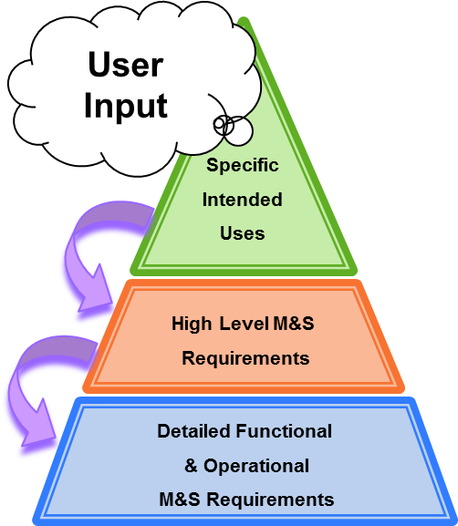
M&S Requirements Framework
M&S
  Chosen as part of the solution to a program question
  Represents real-world entities, effects and phenomena
Specific Intended Use (SIU)
  Describe decisions and information used for that decision that will be provided by the M&S
  Are narratives written from the perspective of the user
High Level Requirements (HLRs)
  Capability statements derived from SIUs
  Intended as executive summary of M&S scope
  Describe general categories of the simulation environment
  Describe logical groupings of disciplinary factors and effects
Detail Level Requirements (DLRs)
  Mandatory provisions written as obligatory “shall” statements
  Derived from HLRs
  Trace directly between user needs and what developer provides
  Ultimate guidance to design, development, and testing activities
  Address representational and operational needs

Slide 19
Defining M&S Requirements
Assessment Driven M&S Needs
Simulation Conceptual Model
Stakeholder Intended Uses
Assessment Metrics
Blue Force, Red Force,
Communications, Natural Environment
M&S System Requirements Document
M&S Design and Development
Assessment Plan
M&S Integration and V&V Testing
Scenarios
M&S Execution
Analysis and Assessment
Data for Assessment

Slide 20
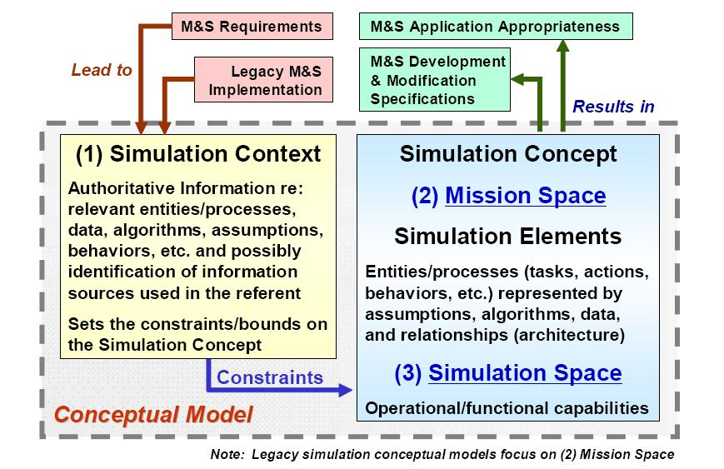
Simulation Conceptual Modeling
MBSE offers a rich framework for capturing conceptual model artifacts and information; e.g. Use Case, Sequence and Block Definition diagrams

Slide 21
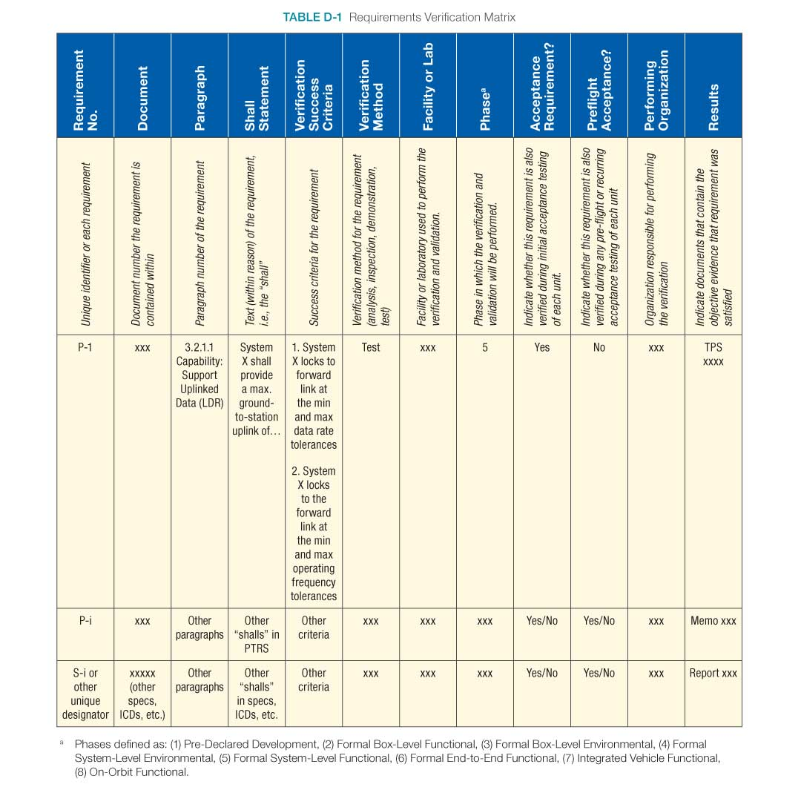
Leveraging Existing Simulation Verification Data
Sample Documentation
Necessitated by widespread adoption of agile software development practices
Supported by rigorous configuration management of M&S requirements, developmental M&S products and strict version control
Enabled by the use of integrated requirements management and testing tools
  Evolving requirements
  Requirements attributes enabling dynamic status tracking
  Synchronous requirements and verification test development
  Automated traceability views
Downloaded from [NASA, 2023] on 6/21/23

Slide 22
Leveraging Developer Testing
Federation / distributed simulation development often undergoes levels of testing
  Unit
  Pairwise
  Multi-way
  Integrated
  At scale
Simulation environment differences
Testing within federated environments
  Substitutes for interactions with M&S participants
Testing scope and negative testing
22

Slide 23
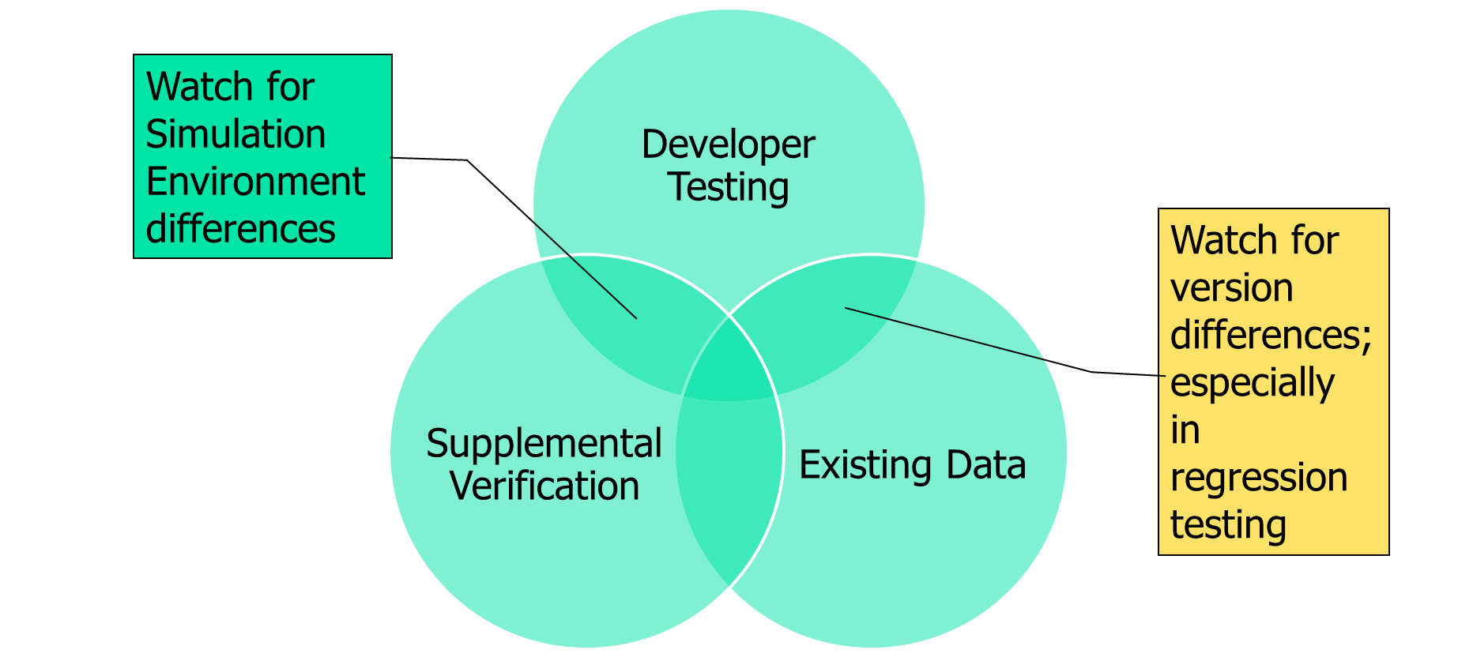
Supplemental Simulation Verification Testing
Supplemental is not Regression
Regression implies an exact duplication of previously executed testing
Supplemental may be
  Additional test at the same level
  Test case replication at a different levels
  Comparison between levels
Benefits from / for digital engineering

Slide 24
Presentation Outline
Definitions that establish the common lexicon
Building a strong verification case
Building a strong validation referent
  Developing the referent as the basis for validation comparison
  Challenges and obstacles to developing the referent
  Best practices and obstacle mitigation
  Examples
Building a strong validation case
Verification and Validation methods that apply to Agile and Autonomous based M&S
Conclusions

Slide 25
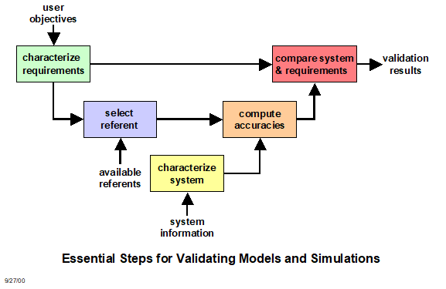
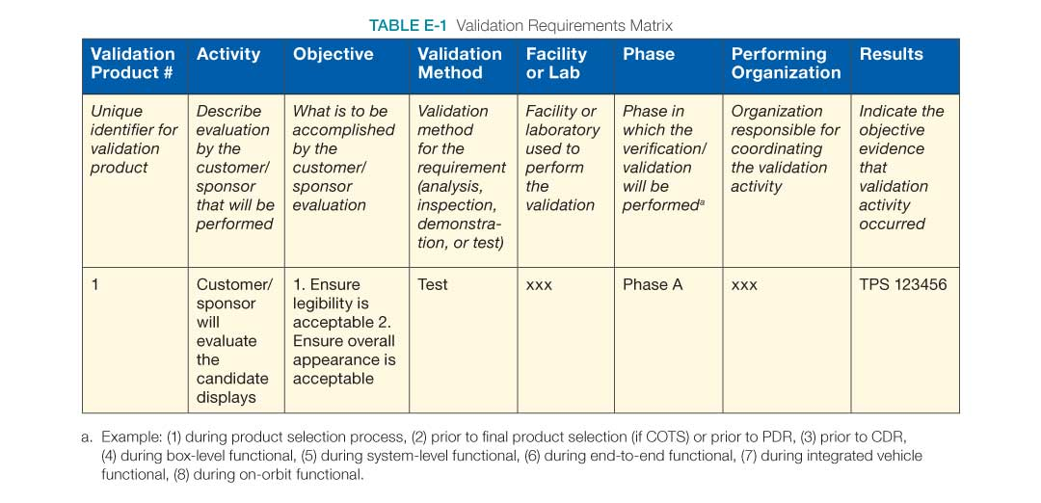
Essential Steps for Validating Models and Simulations
Sample Documentation
Downloaded from [NASA, 2023] on 6/21/23
Retrieved from [RPG, 2011]

Slide 26
The Ideal Referent
Covers the operational/domain space of interest as bounded by the intended use [Gilmore, 2016]
  Provides data on the aspects of the operational envelope/behavior space that will be covered by the M&S
  Addresses variations in factors affecting performance/behavior w. r. t. response variables of interest
  Supports interpolation between known data points vice extrapolation
Is drawn from observations of the simuland [RPG, 2011]
  Under controlled circumstances such as tests and experiments
  Under natural or operational circumstances
Is drawn from authoritative data
  Test data adjudicated by Data Authentication Group review to address measurement errors, incomplete data, etc. [ATEC, 2004]
Identifies any areas of known uncertainty

Slide 27
Referent Sources
Empirical data; observations of the simuland, collected either under controlled circumstances, e.g., tests or experiments, or in the field
Theoretical data; calculated using equations or algorithms that describe simuland characteristics, behaviors, and relationships; equations known or assumed to be correct
Simulation data; results generated by simulations; models known or assumed to be valid
Subject Matter Expert knowledge
Combinations of these

Slide 28
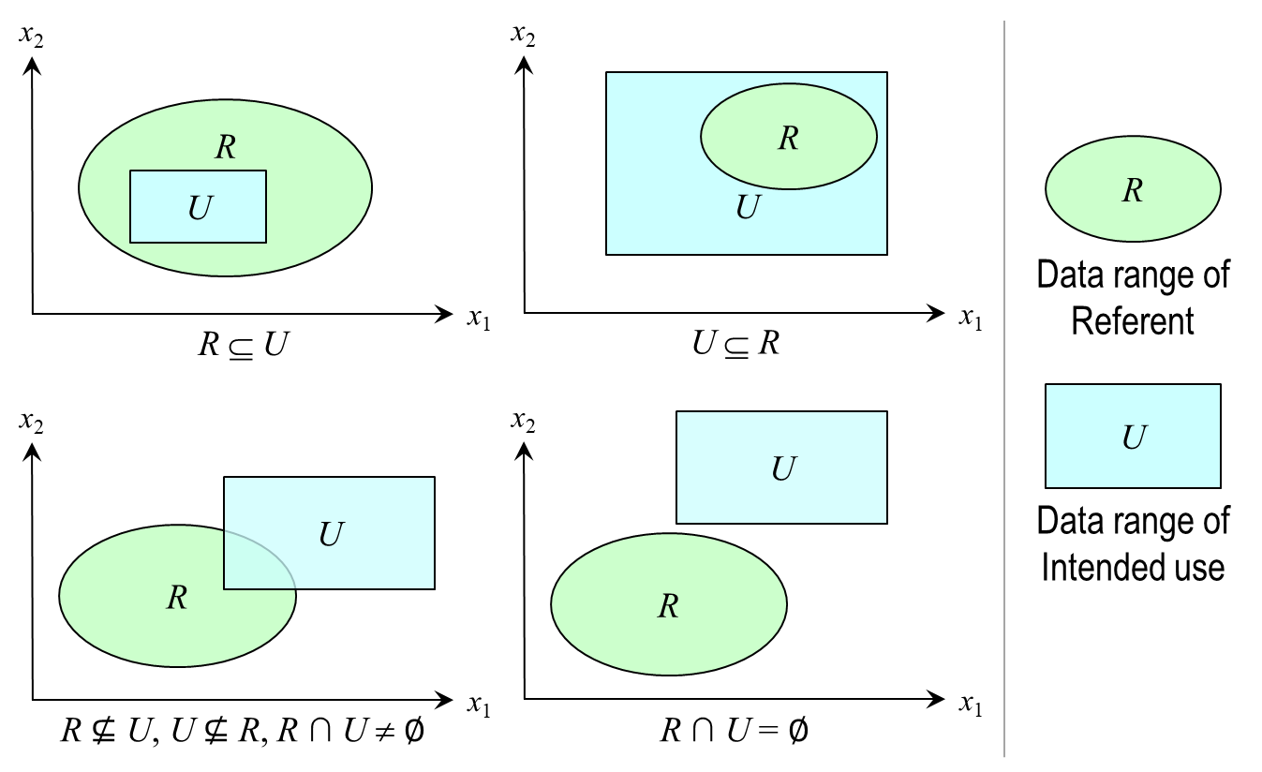
Referent Challenges and Obstacles
Ill defined intended use
  Lack of definition of the model/simulation’s coverage of the domain space
  Lack of test scenarios that will align test and simulation data
Inconsistencies between referent and simulation data
  Metrics of interest
  Factors that affect performance
Limited/no referent data available
  Complexity of system/behaviors represented imposes limitations (e.g., resource, economic) on the development of quantitative referent data
  Domain of Interest does not support quantitative referent development (e.g., Department of Energy, NASA)
Economic limitations
28

Slide 29
Referent Best Practices
Start early – validation referents take time to develop
  Need to identify scope of information needed
  Need to coordinate with others (e.g., testers, Subject Matter Expert (SMEs)) to produce referent data
  Need to budget for referent development
Ensure accreditation authority concurrence
“Grow” referent information over time
  Leverage all sources of test data (e.g., ground test, HWIL, live fire)
Maximize extent of referent coverage of the operational/behavioral space as defined by the intended use
Define areas of uncertainty
  Limitations of M&S coverage
  Limitations of referent data

Slide 30
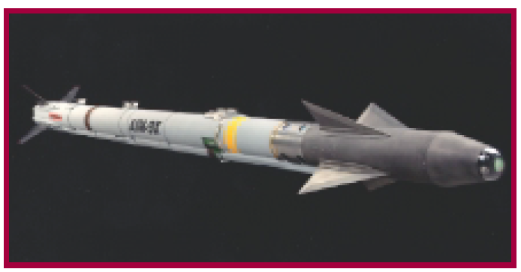
AIM9X: Simulation Enhanced Operational Test
Limited test shots, with maximum operational envelope coverage to support validation referent development
Adopted Model-Test-Model [Mansager, 1994] paradigm to continually assess validation referent development
Applied a statistical methodology (Fisher Test) to validate the simulation
Validated M&S used to satisfy all system performance requirements [IDA, 2001]
Significantly decreased the number of test shots (Development Test and Operational Test) needed [DOT&E, 2000]
AIM9X awarded National Training and Simulation Association (NTSA) 2001 M&S Industry Award
AIM9X Missile

Slide 31
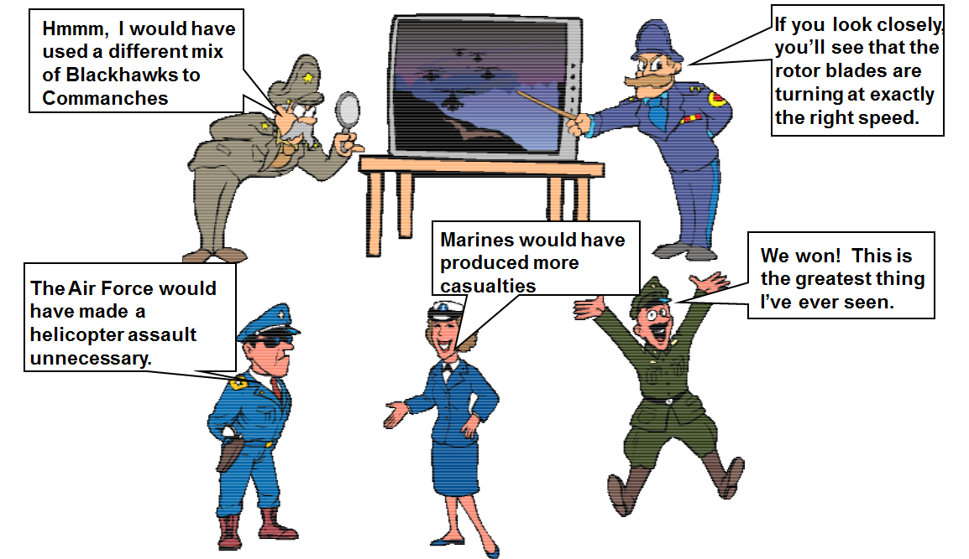
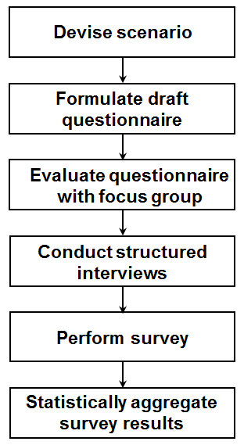
Developing a Rigorous SME Referent
Validation focus was a campaign-level simulation that modeled multi-sided joint theater warfare
No real world referent available for comparison - reliant on SME assessment
Increase SME sample size (from one to multiple)
Apply best practice in survey research to develop questionnaire
Statistical aggregation of survey results enabled identification of common trends as well as the meaningful assignment of uncertainties to the referent characteristics
Knowledge of referent uncertainty is necessary for evaluating M&S use risk
Simulation Results
Simulation Referent
Differencing
Student’s T-test
Validation Results
Accuracies
Confidences
31

Slide 32
Challenges Associated with Rigorous Validation
Referent
  Coverage
  Availability
Selection of Validation Method
  Driven by available Referent Data
  Characteristics of Validation Metric (e.g., point value, time series, multimodal)
Viability of Validation Method
  Measuring the performance of the validation methods used to assess model accuracy
Understanding Uncertainty

Slide 33
Presentation Outline
Definitions that establish the common lexicon
Building a strong verification case
Building a strong validation referent
Building a strong validation case
  Defining validation metrics
  Selecting and applying the appropriate method
  Quantifying validation uncertainty
  Examples
Verification and Validation methods that apply to Agile and Autonomous based M&S
Conclusions

Slide 34
Motivation
Decision makers are demanding that previous “informal” methods of validation be supplemented or replace with quantitative, defensible, rigorous methods
All M&S, when used to support operational tests and evaluations, should not be accredited until a rigorous comparison of live data to the model's predictions is done … and those predictions are found to have replicated live results with sufficient accuracy for the intended evaluation in the intended domain [Gilmore, 2016]
I expect the validation of M&S to include the same rigorous statistical and analytical principles that have become standard practice when designing live tests. [Gilmore, 2016]

Slide 35
Validation Metrics
Coming from Accreditation Authority
What if this doesn’t exist
  User: Final Measures/Metrics
    Not measurable
    Many times a result of post-processing
  Collaboration with the Test and Evaluation (T&E) community
  Basis of Comparison
    Accessible measures that combine to create metrics
    Insight into performance for the sake of comparison
    Relatable to the referent

Slide 36
Deriving Measures and Acceptability Criteria

Slide 37

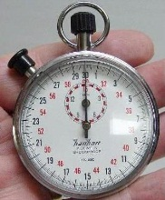
V&V Methods Considerations
01010100010100101
10010101000100101
10101011101010111
10110010100101000
10010101101010101
h(t) = –4.9t² + vt + s
Model
Referent
Certain methods apply best to specific types of model
Certain methods require specific types or amounts of referent data
Method
Some methods require more resources than others
Some methods require specific skills to apply
Resources
Skills
Problems can arise if the considerations conflict

Slide 38
Referent to Validation Method Mapping
Sources of
referent information
Forms of referent information
Applicable rigorous
validation methods
Empirical data
Single observation or few observations
Confidence intervals
Multivariate confidence intervals
Theoretical data
Many observations
Hypothesis tests for means, variances, proportions, and distributions
Simulation data
Paired observations
Regression analysis
Subject Matter
Expert knowledge
Expectations and
experience
Structured face validation
Turing test

Slide 39
Confidence Intervals
Validation concept and interpretation
  Useful when only one (or few) simuland observations available
  Determine if simuland observation consistent with model results
  Calculate confidence interval for model response variable
  If confidence interval contains observed simuland value(s),
  then model considered valid for that response variable
Comments
  Interval calculated from simulations is for model, not simuland
  Population is all possible simulations with the model, sample is the simulations actually executed
  No statistical justification or refutation for validation interpretation

Slide 40
Hypothesis Testing
Validation concept and interpretation
  Useful when multiple simuland observations available
  Test whether simuland observations consistent with model results
  Perform hypothesis test comparing means, variances, and/or distributions of simuland and model for response variable
  If hypothesis test does not reject assumption of validity, then model considered valid for that response variable
Comments
  Simuland population is all possible observations, sample is the observations actually obtained
  Model population is all possible simulations with the model, sample is the simulations actually executed
  Conventional assumption (null hypothesis) is that the parameters being tested are equal, i.e., model is valid

Slide 41
Point Value Referent Data vs Time Series
Point Value: A single sample metric from a referent data set
  Examples:
    Miss distance
    Time of flight
    Percent of time in a specific mode
Time Series: A time series of single sample metrics from a referent data set
  Examples:
    Position
    Orientation
Regardless of time series or point value, both are considered a single sample of the underlying distribution, since the flight test represents only one sample.

Slide 42
Advanced Validation Methods
Spectral analysis [Fishman, 1967] [Naylor, 1971] [McNickle, 2004]
Standardized time series [Schruben, 1983] [Chen, 1987] [Goldsman, 1990]
Regression analysis [Kleijnen, 1998]
Bootstrapping [Kleijnen, 2000] [Kleijnen, 2001]
Granger causality [Granger, 1969]

Slide 43
Presentation Outline
Definitions that establish the common lexicon
Building a strong verification case
Building a strong validation referent
Building a strong validation case
Verification and Validation methods that apply to Agile and Autonomous based M&S
  Determining the unique V&V challenges associated with Agile and Autonomous based M&S
  Selecting and applying the appropriate method
Conclusions

Slide 44
V&V and AGILE Development
44

Slide 45
V&V of M&S Developed using AGILE methods
Systematic Literature Review to determine [Itzik, 2023]
  RQ1: What software project characteristics has the research community investigated extensively for compatibility with the agile methodology?
  RQ2: Is there consensus (positive or negative) about the compatibility of diverse software project characteristics with the agile methodology?
  RQ3: Which software project characteristics show little or no evidence of compatibility with the agile methodology?
A balance needs to be achieved between the Software Development Lifecycle (e.g., architecture, development, Quality Assurance, etc.) vs. Knowledge Areas (e.g., quality, budget, schedule, risk, etc.)
“Yet, despite evidence of highly positive effects on requirements during the development phase and on quality and communication during both the development and QA phases, the agile methodology does not appear to be compatible with large-scale, complex projects, projects with distributed settings, or whose team members are not sufficiently skilled. In such cases, it is advised to revise the agile methodology or use a hybrid or plan-driven approach.” [Itzik, 2023]
45

Slide 46
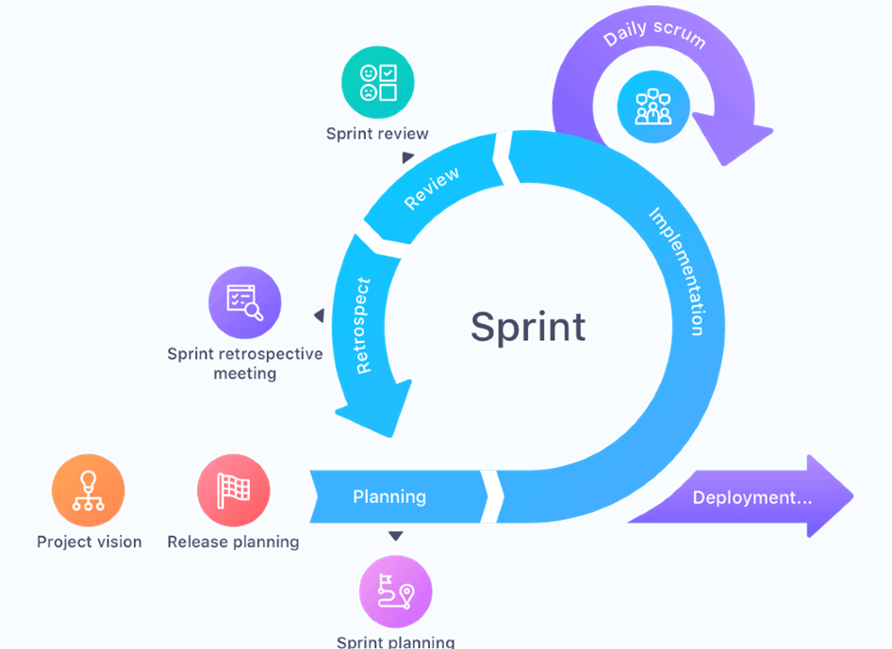
Adapting the V&V Process to Agile Development
Agile development
  Specify the solution incrementally
  All the V-model activities happen but in smaller, concurrent sprints
M&S V&V is aligned with V-model
  V&V activities should occur incrementally
  V&V evidence will be generated in smaller, concurrent batches
Simulation
Model
Capability
Feature
Simulation Verification and Validation
Model Validation
Capability Verification
Feature Requirements Generation
[Henderson, 2023]
46

Slide 47
Adapting the V&V Process to Agile Development: A Software V&V Case Study
Software V&V in Agile Methods [Vera, 2020]
  In the V-model, V&V occurs at the end of the process (right side of the V)
  Early studies de-valued V&V in Agile development (more costly development, overwhelming documentation requirements)
  “Companies seek a combination of well-balanced processes in terms of documentation, stability, assurance, and predictability while remaining agile and timely.”
47

Slide 48
Adapting the V&V Process to Agile Development: A Software V&V Case Study
System Requirements Review
Project Planning Strategy Assessment
Identify Process Improvement Opportunities
Management Review of the V&V Effort
Scoping the V&V Effort
V&V Plan Generation
Sprint
Requirements Evaluation
Criticality Analysis
Interface Analysis
Common V&V Tasks Key
Design Evaluation
Implementing additional recommended V&V activities only increased development within the software case study by 14%
Software V&V Tasks Key
Acquisition Support V&V
Software Component Test Execution
Software Requirements V&V
Software Integration Test V&V
Source Code and Source Code Documentation Evaluation
Project Planning V&V
Software Design V&V
Software Qualification Test V&V
Software Integration Test Execution
V&V Management
Software Construction V&V
Software Acceptance Test V&V
Software Qualification Test Execution
Software Acceptance Test Execution
V&V Final Report Generation
48

Slide 49
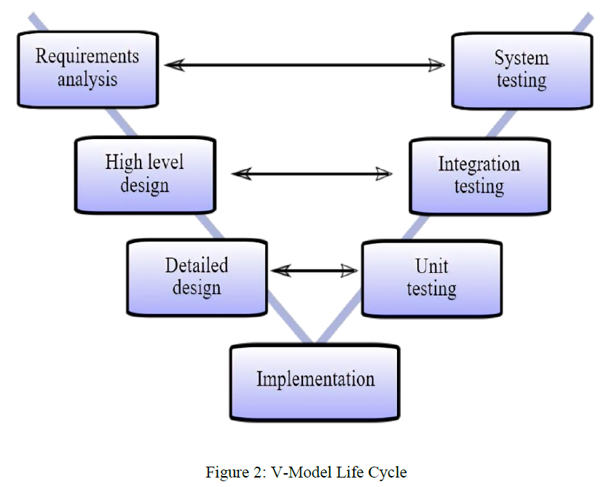
A Hybrid “V-model”
Retains Key Elements of the V Model and the front and back end of the Process
V-Model Life Cycle [Babu, 2023]
Incorporates the iteration of the Agile Process
at the design and testing phases
49

Slide 50
Incremental Development and V&V within the AGILE Development Paradigm
Prioritized Product Backlog
Product Results Validation
Priority | Hi Level Requirements
1
2
3
4
5
etc
Planning Increment Content
Priority | Hi Level Requirements
1
2
3
Planning Increment
Integration Integration Verification
Sprint Backlog
Sprint
Hi Level Requirement Priority | Decomposed/ Detailed Requirements
1 | 1a
 | 1b
 | 1c
2 | 2a
Design Design Verification Develop Implementation Verification

Slide 51
V&V and Autonomous Systems
51

Slide 52
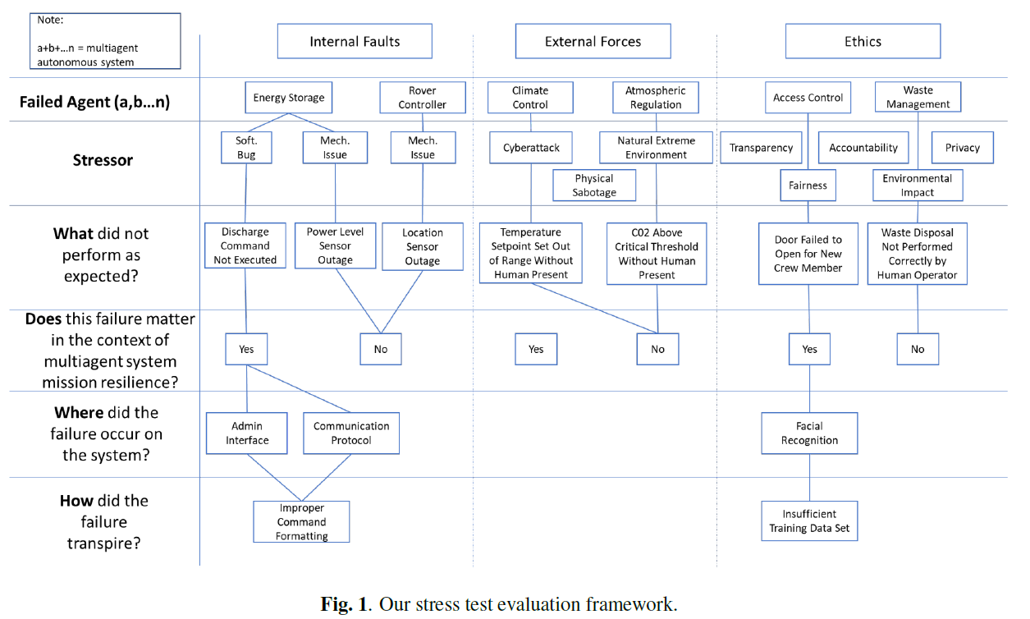
V&V of M&S Modeling Autonomous Systems
Overview
Challenges for V&V of Autonomous Systems [Gross, 2016]
  State-space explosion
  Unpredictable environments
  Emergent behavior
  Human-machine communication
“…autonomous agents change at run-time given that they are constantly learning and making decisions in undefined environments.” [Falco, 2021]
Stress Testing Evaluation Framework – leverages and expands concepts of Fault Tree analysis; see also Failure Modes and Effects Analysis (FMEA) [DOD, 1949]
Applied to every autonomous agent within a system
[Falco, 2021]
52

Slide 53
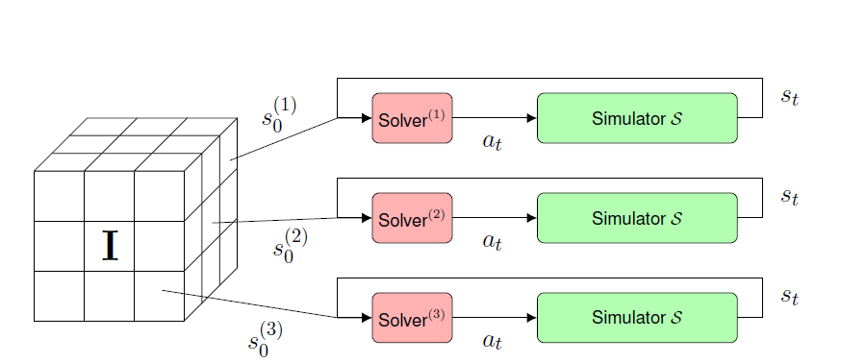
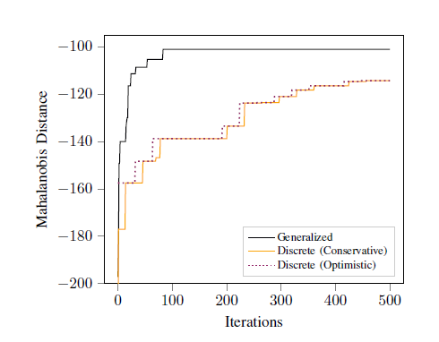
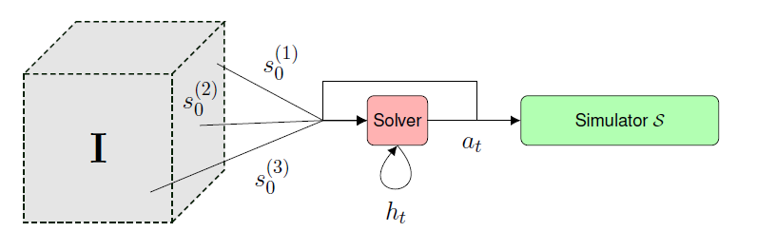
V&V of M&S Modeling Autonomous Systems
Key Issues
Adaptive Stress Testing (AST): Discrete Method
  [Koren, 2019]
  [Koren, 2019]
Models and simulations of autonomous systems are used to provide V&V evidence of the system itself
  “Simulation can offer an inexpensive complement to field testing for evaluating the safety of autonomous vehicles.” [Koren, 2019]
  “However, the space of edge-cases that can cause the autonomous vehicle to fail is vast.” [Koren, 2019]
Many of the Challenges relevant to V&V of Autonomous Systems apply to M&S of those same systems
  State space explosion
  Integrating heterogeneous evidence
  Appropriate reuse of evidence
AST: Generalized Method
  [Koren, 2019]
Several Deep Reinforcement Learning Solvers are replaced by a Recurrent Neural Network Solver
53

Slide 54
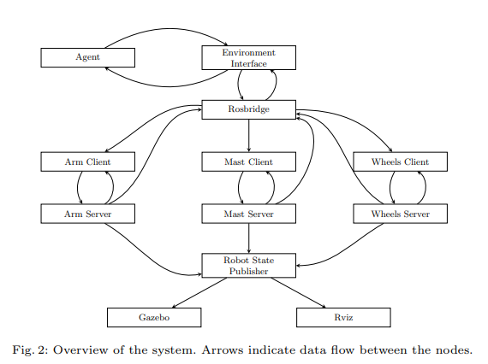
V&V of M&S Modeling Autonomous Systems:
A Case Study
Simulation of Curiosity Rover
Heterogeneous Verification
  Verify properties at different levels of abstraction; multiple appropriate techniques vs one sometimes inappropriate technique
  Agent verification: Model Checking
  Verify appropriate agent decision from environment data: program verifier
  Verify appropriate Agent-Client-Server sequence: program verifier of Communicating Sequential Processes (CSP) model
  Runtime Verification: Monitoring communication pathways
Model Check
Program Verifier
Program Verifier
CSP Model
[Cardoso, 2020]
54

Slide 55
Presentation Outline
Definitions that establish the common lexicon
Building a strong verification case
Building a strong validation referent
Building a strong validation case
Verification and Validation methods that apply to Agile and Autonomous based M&S
Conclusions

Slide 56
Conclusions and Recommendations
Verification activities provide a necessary foundation for rigorous validation
Quality and quantity of referent effects validation rigor
  Rigorous validation is possible, but it depends on an effective referent,
  i.e., sufficient data, well aligned with the model’s intended use
  Acquiring an effective referent should be started early in the simulation life cycle
  Given the best possible referent, a range of quantitative validation methods are available
Application of statistical validation methods
  Most quantitative (statistical) validation methods make specific assumptions
  If a statistical method is used when the assumptions are not met,
  its results are meaningless and potentially misleading
Integrating V&V into the AGILE development process yields smaller, more frequent sets of evidence to accumulate into the full body of knowledge
Issues with V&V of AI-based systems (such as autonomous systems) extend to M&S of those systems.
V&V of simulations of autonomous system can use heterogenous or compositional methods

Slide 57
Contact Information
Simone M. Youngblood
  The Johns Hopkins University Applied Physics Laboratory
  240-228-7958
  Simone.Youngblood@jhuapl.edu
Kathy M. Ruben
  The Johns Hopkins University Applied Physics Laboratory
  240-228-9148
  Katherine.Ruben@jhuapl.edu

Slide 58
References and bibliography (1 of 4)
[ATEC, 2004] Army Test and Evaluation Command (ATEC) Pamphlet 73-1, System Test and Evaluation Procedures, April 19 2004.
[Babu, 2023] Babu, L.G., Zhivete Model -A Hybrid of V Model and Agile Scrum for Product Development, Article in International Journal of Scientific Research and Management Studies, December 2023.
[Balci, 1998] O. Balci, “Verification, Validation, and Testing”, in J. Banks (Editor), Handbook of Simulation: Principles, Methodology, Advances,
Applications, and Practice, John Wiley & Sons, New York NY, 1998, pp. 335-393.
[Balci, 2002] O. Balci, R. E. Nance, J. D. Arthur and W. F. Ormsby, “Expanding Our Horizons in Verification, Validation, and Accreditation Research
and Practice”, Proceedings of the 2002 Winter Simulation Conference, San Diego CA, December 8-11 2002, pp. 653-663.
[Cellier, 1991] F. E. Cellier, Continuous System Modeling, Springer-Verlag, New York NY, 1991.
[Cardoso, 2020] Cardoso, Rafael C., Marie Farell, Matt Luckcuck, Angelo Ferrando, and Michael Fisher, dated 2020, online at https://arxiv.org/abs/2007.10045.
[DOD, 1949] Department of Defense, MIL-STD-1629 United States Department of Defense (9 November 1949). MIL-P-1629 – Procedures for performing a failure mode effect and critical analysis.
[DOD, 2009] Department of Defense, Instruction 5000.61, M&S VV&A, 2009.
[DOD, 2012] Department of Defense Standard Practice, MIL-STD-3022 with Change 1, Documentation of Verification, Validation, and Accreditation
(VV&A) for Models and Simulations, April 5 2012.
[DOT&E, 2000] DOT&E Report, AIM-9X Sidewinder Air-to-Air Missile, 2000.
[Falco, 2021] G. Falco and L. Gilpin, “A Stress Testing Framework For Autonomous System Verification And Validation (V&V)” presented at IEEE International Conference on Autonomous Systems (ICAS), Montreal, Canada, 2021.
[Fischer, 2001] K. Fischer, “AIM-9X…Surpassing the M&S Challenge,” Unpublished presentation, 2001.
[Fishman, 1967] G. S. Fishman and P. J. Kiviat, “The Analysis of Simulation-Generated Time Series”, Management Science, Vol. 13, 1967, pp. 525-557.

Slide 59
References and bibliography (2 of 4)
[Gilmore, 2016] Director Operational Test and Evaluation Memorandum, Guidance on the Validation of Models and Simulation used in Operational
Test and Live Fire Assessments, 14 March 2016.
[Goldsman, 1990] D. Goldsman and L. Schruben, “Confidence Interval Estimators Using Standardized Time Series”, Management Science, Vol. 36, No. 3, March 1990, pp. 393-397.
[Granger, 1969] C. W. J. Granger, “Investigating Causal Relations by Econometric Models and Cross-spectral Methods”, Econometrica, Vol. 37, No. 3, pp. 424-438.
[Gross, 2016] “Verification and Validation of Complex and Autonomous Systems” presented at Air Force Research Laboratory 11th Annual V&V Summit, 14-15 September, 2016.
[Henderson, 2023] How To Manage A Sprint Cycle More Effectively, retrieved from https://niftypm.com/blog/manage-sprint-cycle/ July 2024.
[Itzik, 2023] “Does agile methodology fit all characteristics of software projects? Review and analysis”, Empirical Software Engineering (2023) 28:105.
[Kleijnen, 1998] J. P. C. Kleijnen, B. Bettonvil, and W. Van Groenendaal, “Validation of Trace-Driven Simulation Models: A Novel Regression Test”, Management Science, Vol. 44, 1998, pp. 812-819.
[Kleijnen, 2000] J. P. C. Kleijnen, R.C.H. Cheng, and B. Bettonvil, “Validation of Trace-Driven Simulation Models: More on Bootstrap Techniques”, Proceedings of the 2000 Winter Simulation Conference, Orlando FL, December 10-13 2000, pp. 882-892.
[Kleijnen, 2001] J. P. C. Kleijnen, R.C.H. Cheng, and B. Bettonvil, “Validation of Trace-Driven Simulation Models: Bootstrap Tests”, Management Science, Vol. 47, 2001, pp.1533-1538.

Slide 60
References and bibliography (3 of 4)
[Koren, 2019] M. Koren and M. Kochenderfer, “Efficient Autonomy Validation in Simulation with Adaptive Stress Testing”, 2019 IEEE Intelligent Transportation Systems Conference (ITSC), Auckland, NZ, October 27-30, 2019.
[McNickle, 2004] D. McNickle, G. C. Ewing, and K. Pawlikowski, “Refining Spectral Analysis for Confidence Interval Estimation in Sequential Simulation”, Proceedings of the 16th European Simulation Symposium, Budapest Hungary, October 17-20 2004, pp. 99-103.
[IDA, 2001] AIM-9X: A Modeling and Simulation Success Story, IDA Research Summaries, Vol. 8, Number 1, Summer/Fall 2001, pp. 8-12.
[Mansager, 1994] B. Mansager, Model Test Model, Naval Postgraduate School Technical Report NPS-MS-94-007.
[Minsky, 1965] M. L. Minsky, Matter, Mind, and Models, Artificial Intelligence Memo No. 77, Massachusetts Institute of Technology, March 1965,
Online at http://dspace.mit.edu/bitstream/handle/1721.1/6119/AIM-077.pdf ?sequence=2, Accessed, July 19 2015.
[NASA, 2023] Requirements Verification Matrix, downloaded from https://www.nasa.gov/sites/default/files/thumbnails/image/seh_app-d_table_d1.jpg on June 21, 2023.
[NATO, 2012] NATO RTO Technical Report “Risk-Based Tailoring of the Verification, Validation, and Accreditation/Acceptance Processes”, TR-MSG-054, February 2012.
[Piersall, 2014] C. H. Piersall and F. E. Grange, “The Necessity of Intended Use Specification for Successful Modeling and Simulation of
System-of-Systems”, CrossTalk, September/October 2014, pp. 20-24.
[Piersall, 2015] W. Seay, C. H. Piersall, D. Lucia, and K. Englander, MDA report 20-MDA-10542, March 2015, (approved for public release 30 Jul 20).
[RPG, 2011] DoD VV&A Recommended Practices Guide, RPG Validation Referent Special Topic Paper, https://www.cto.mil/sea/vva, January 2011.

Slide 61
References and bibliography (4 of 4)
[Schruben, 1983] L. Schruben, “Confidence Interval Estimation Using Standardized Time Series”, Operations Research, Vol. 31, No. 6, November-December 1983, pp. 1090-1108.
[Tolk, 2006] W. G. Wang, A. Tolk and W. P. Wang, "The levels of conceptual interoperability model: Applying systems engineering principles to M&S," in Proceedings of the 2009 Spring Simulation Multiconference, San Diego, March 22-27, 2009.
[Velten, 2009] K. Velten, Mathematical Modeling and Simulation, WILEY-VCH, Weinheim Germany, 2009.
[Vera, 2020] Vera, A. and Espinosa, A., Applying Verification and Validation in Agile Methods: a tough road discipline, Transformacion Digital en las Organizaciones, Universidad Catolica de Cuenca, p 129 – 139, November 2020.

