Slide 1



Harnessing Physiology for Peak Human Performance in Training and Simulation
Emily Mills, Ph.D., Design Interactive, Inc.
Robert Furberg, Ph.D., JPEO CBRND
Charles Rowan, Ph.D., Interim Director, The MOVES Institute at the NPS
Rebecca Kwasinski, M.S., Design Interactive, Inc.
Non-presenting authors:
Nina Fletcher, Ph.D., Design Interactive, Inc.
Victoria Olko, Design Interactive, Inc.

Slide 2



What You’ll Learn
1
Learners will remember and understand how physiological measurements can be beneficial to training and simulation environments by providing at least three example use cases.
2
Learners will be able to apply the eight recommended steps of integrating physiological sensing. ​
3
Learners will be able to evaluate physiological data test plans in accordance with best practices.
LO = Learning Objective

Slide 3

Tutorial Overview
Harnessing Physiology for Peak Human Performance in Training and Simulation
Current State of the Field
Areas of Opportunity
Recommended Approach & Best Practices
Tools to Enable This Process
Take Home Messages
Q&A

Slide 4

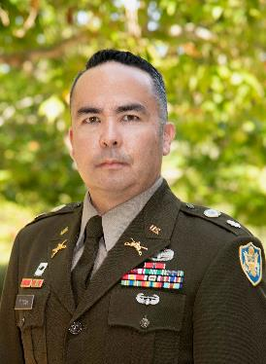
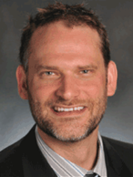

Speakers
Emily Mills, Ph.D.
Biomedical Engineer
RDT&E Portfolio Manager at Design Interactive
Charles Rowan, Ph.D.
Interim Director, The MOVES Institute at the NPS
Robert Furberg, Ph.D.
Wearables MFT for Informatics at JPEO CBRND
Rebecca Kwasinski, M.S.
Research Associate III & Data Scientist at Design Interactive

Slide 5


Current State of the Field
Areas of Opportunity
Definitions of Physiological Monitoring
Significance to Training and Simulation
Use Cases for Training & Simulation
Barriers to Success​
&
LO 1

Slide 6





Defining Physiological Monitoring Options
Who: | Clinical, Academia, Industry, Military
What: | Individual On-body Sensors, Group Monitoring
When: | Real-time, Post Processing, Longitudinal
Where: | Clinical Settings, Research, Training, Operations
Why: | Health Status, Performance Level, Training Support
How: | On-body, Off-body, Multimodal Devices
LO 1

Slide 7
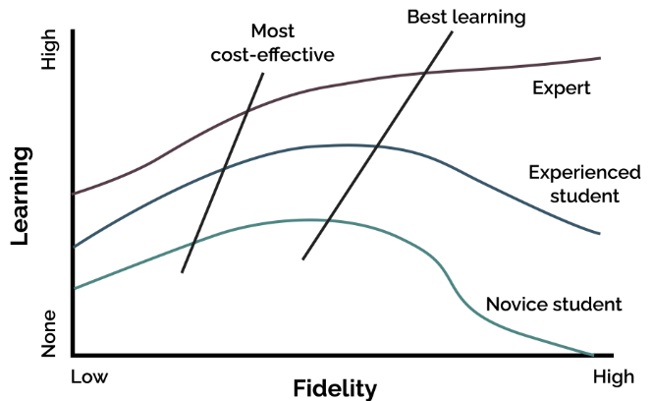
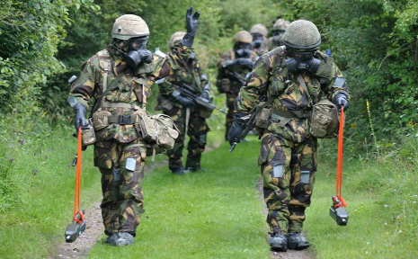
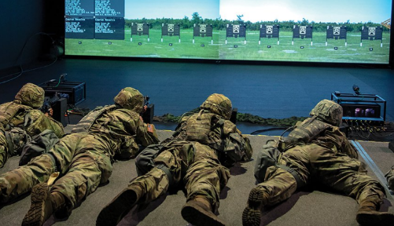
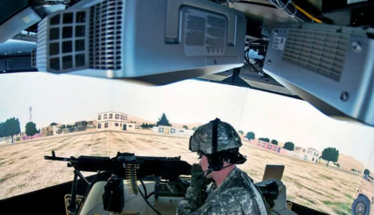
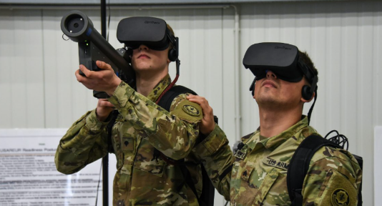
Defining the Training Ecosystem
Who: | Academies, School Houses
What: | Basic Training, Career Training, Cognitive Skills, Physical Abilities
When: | Throughout Careers
Where: | Field, Outdoor, Indoor, Simulators
Why: | Proficiency, Readiness, Amplifying Human Talent and Performance
How: | Courses, Practice, Assessments
Alessi 1988
Argon Electronics
National Defense Magazine
Army Technology
Modern War Institute
LO 1

Slide 8
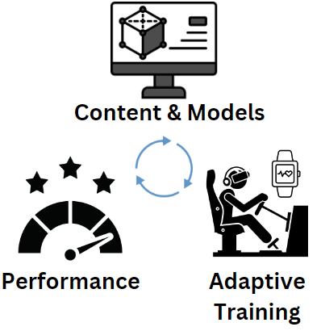
Tying Human and Training Together
Actions
Mechanisms
Outcomes
Physio Data Capture
Research (Lab, Training, Operational Environment)
Data Visualizations (Individual, Squad, Command)
Improve Training (e.g., Austere Environments)
Aid Decision Support
Automated Detection
Data Comprehension
Global Performance Optimization
Automating Documentation (Medic)
Safety (Heat, Skill Erosion, Altered Decision Making, Chem/Bio)
Predictive Modelling
Increased Team Dynamics
Achieve intimate HMI to increase coordination and collaboration between humans and training systems
LO 1

Slide 9
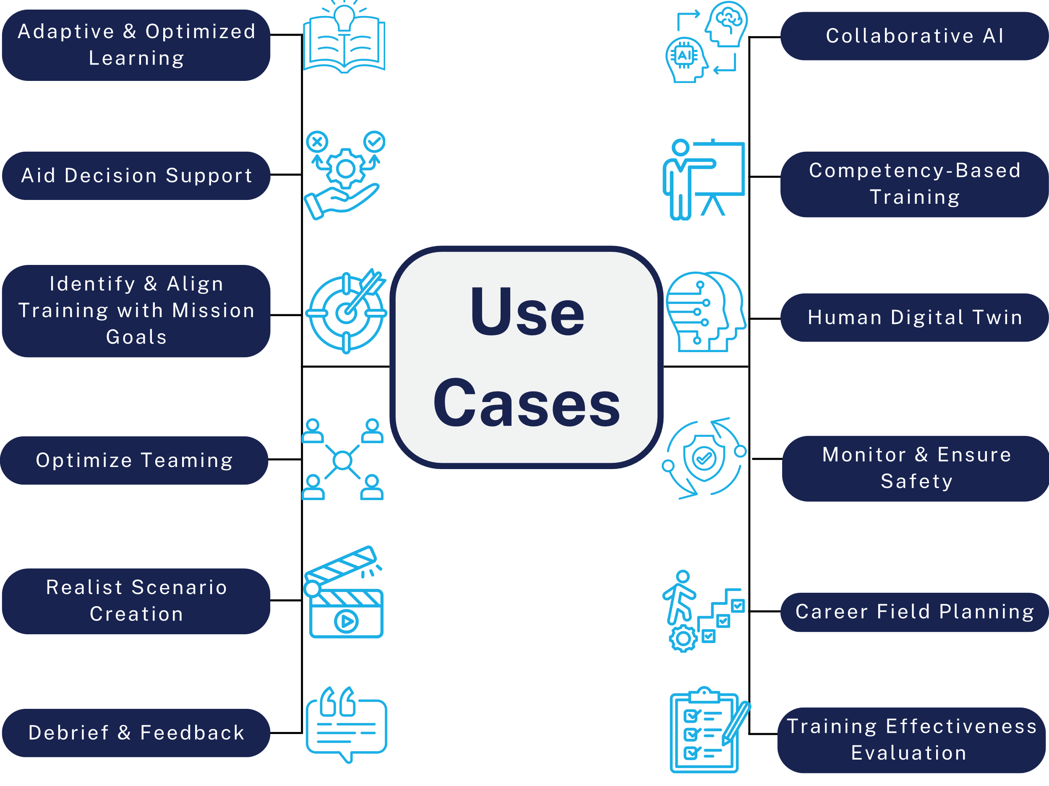
Use Cases for Physiological Sensing in Training & Simulation
LO 1

Slide 10
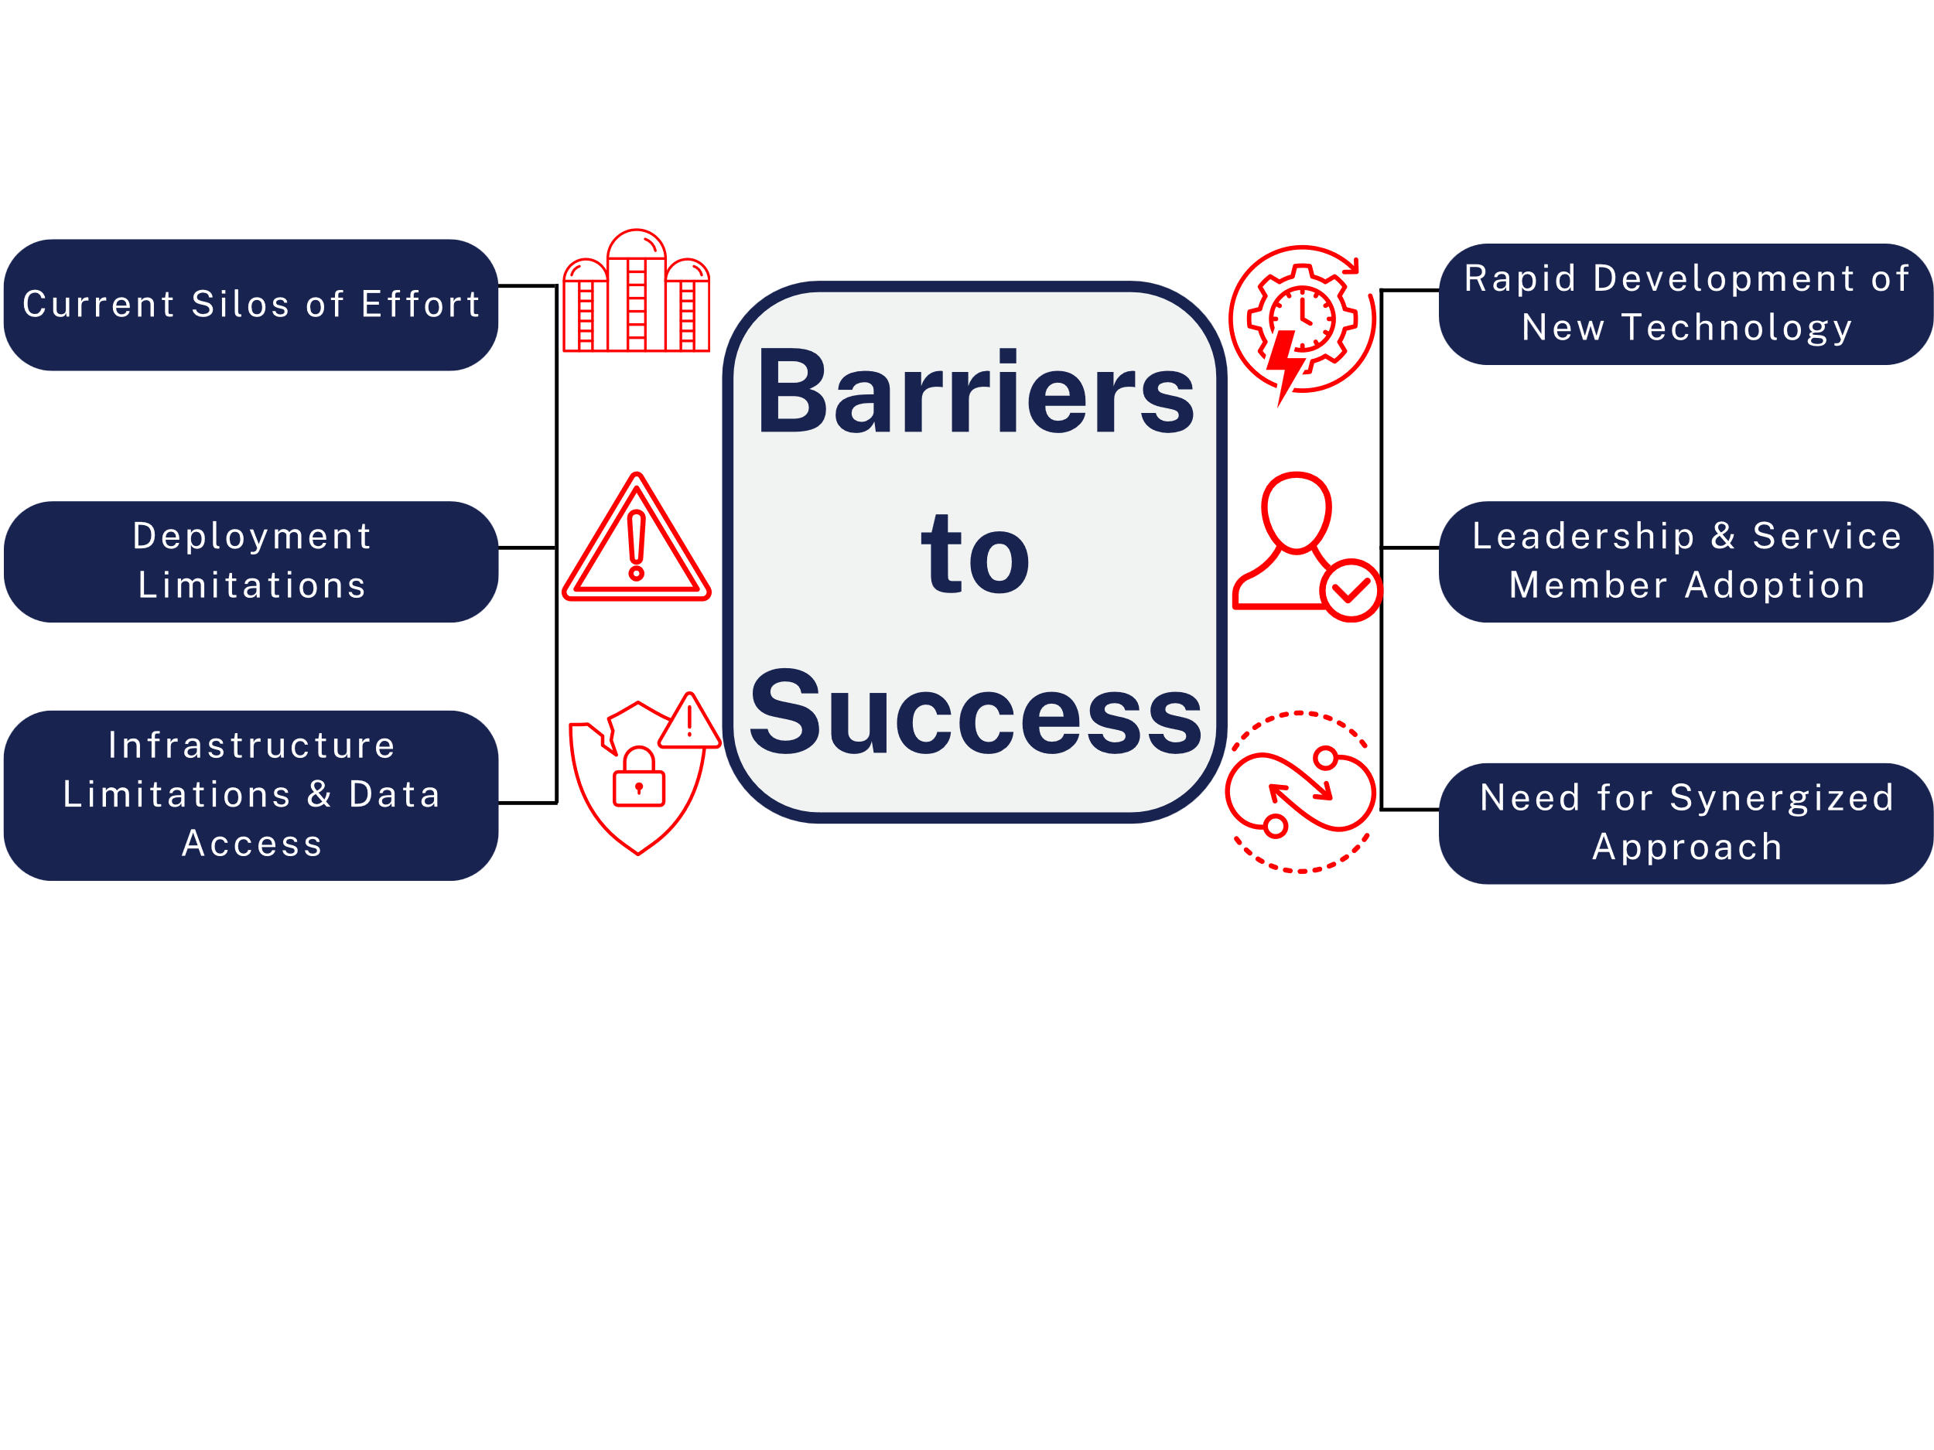
Potential Risks
LO 1

Slide 11
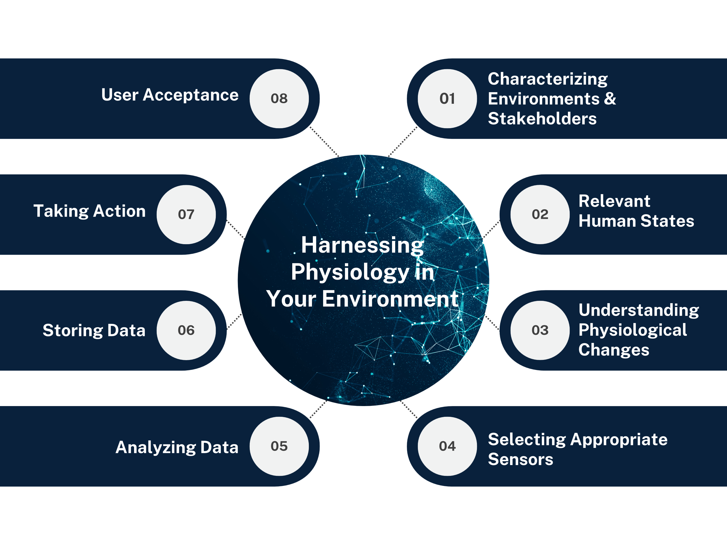
Recommended Approach & Best Practices
​Eight Steps for Physiological Monitoring
LO 2

Slide 12
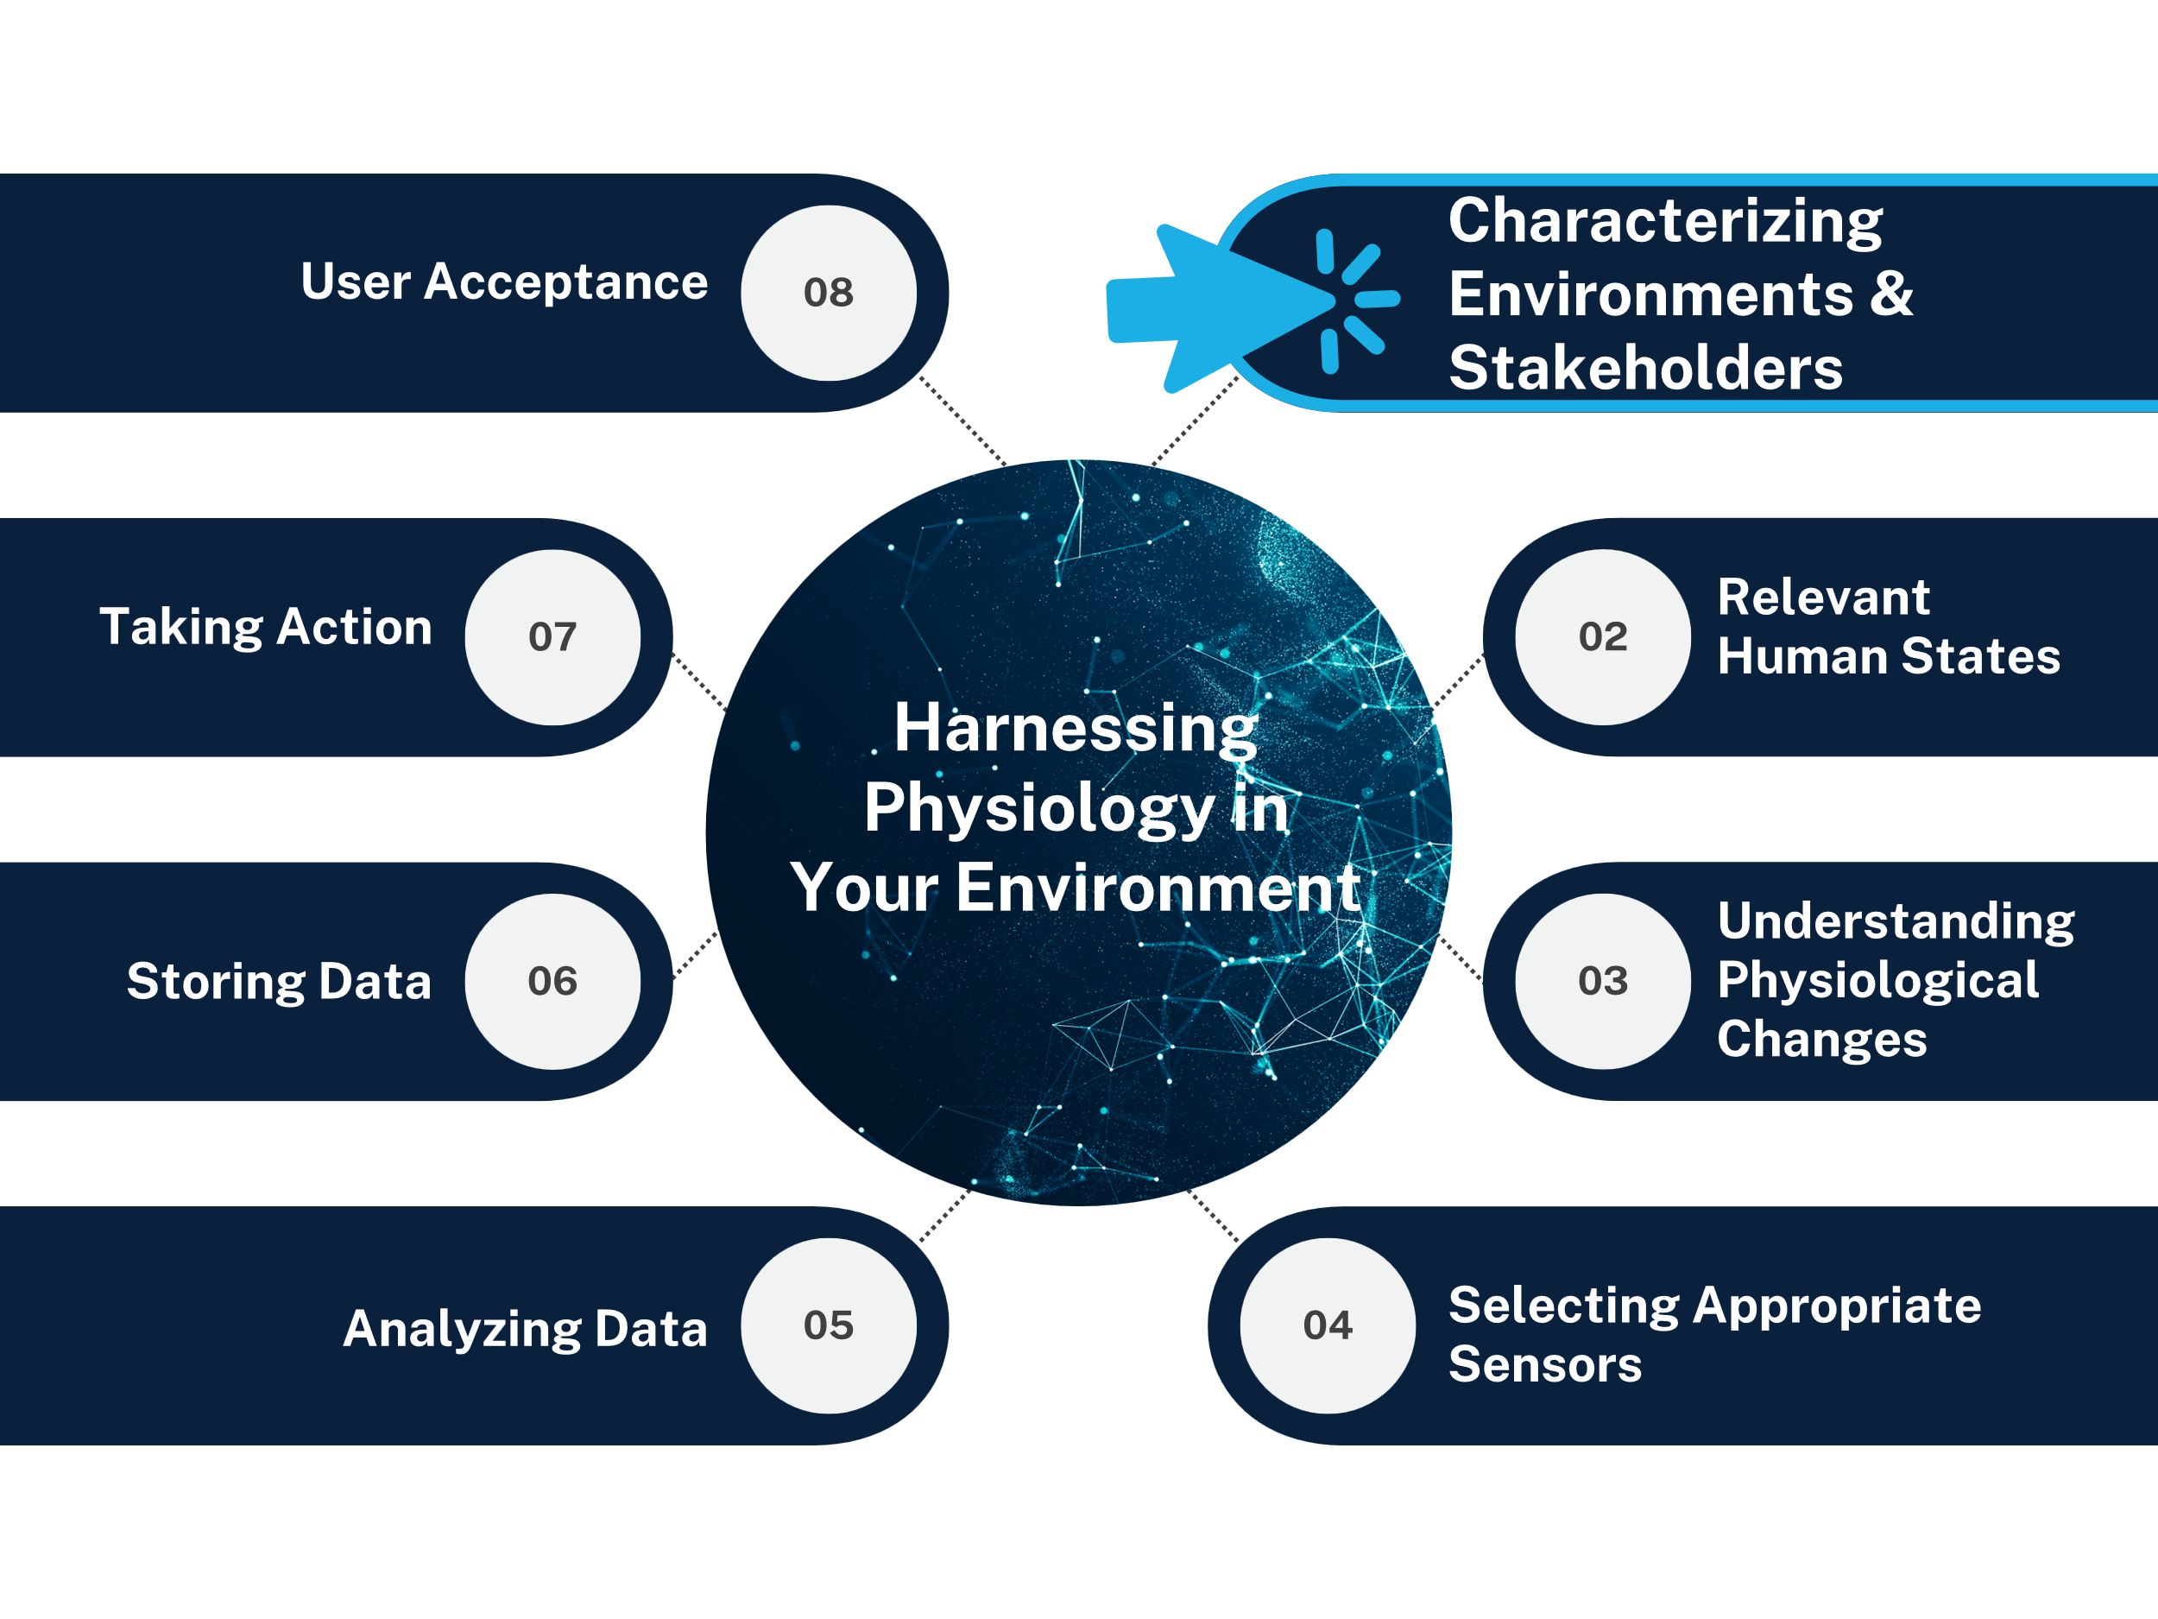
Recommended Approach & Best Practices
​Eight Steps for Physiological Monitoring
LO 2

Slide 13
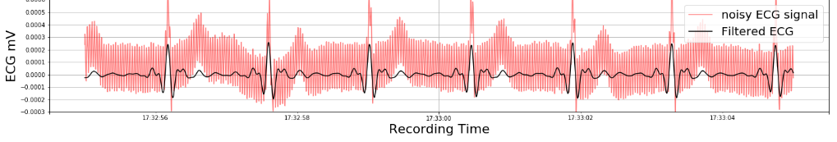
Characterizing Environments & Stakeholders
Q1: Describe contextual and environmental considerations stakeholders should consider to ensure good data and long-term adoption.
Context: Tasks, equipment,
  networks, security
Environmental: Lighting,
  time of day, temperature, humidity, electrical noise
Short-term: Link human data to training performance data
Long-term: Link bi-directional communication from human and training
Adoption: Plan for user acceptance early, constant communication throughout the process
LO 2

Slide 14
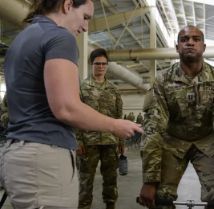
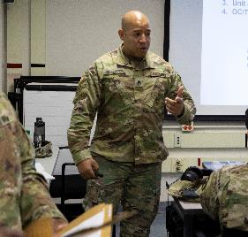
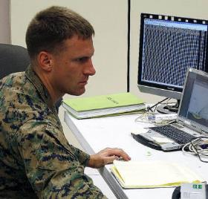


Characterizing Environments & Stakeholders
Q2: Describe how stakeholder and organizational needs vary and how to delineate these needs up front?
Scientist/Researcher
Observer Coach / Trainer
Command Ops Lead
Medical/Health
Trainee
LO 2

Slide 15
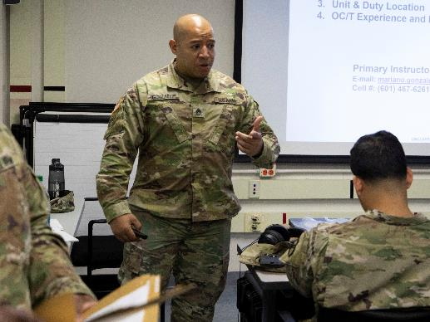
Persona Example
Maximizing training effectiveness | Providing safety & situational awareness | Enhancing skill acquisition & retention
The Observer Coach/Trainer aims to successfully address and adapt the multifaceted aspects of enhancing soldier readiness, safety, and performance evaluation. Wearable sensors allow them to monitor soldiers' physical and cognitive performance during training. Their insights, strategies, and training methodologies, in turn, benefit the accuracy, security and impact of wearable sensors for training evaluation and improvements.
Although the Observer Coach/Trainer works with trainees day-to-day to provide instruction, feedback, and evaluation directed at skill and performance enhancement, they also coordinate closely with command leadership, other trainers, analysts, health professionals, R&D teams, and logistics/support staff and allies. This diverse range of collaborators are essential for their development of effective training programs and the successful integration of sensor technologies.
LO 2

Slide 16
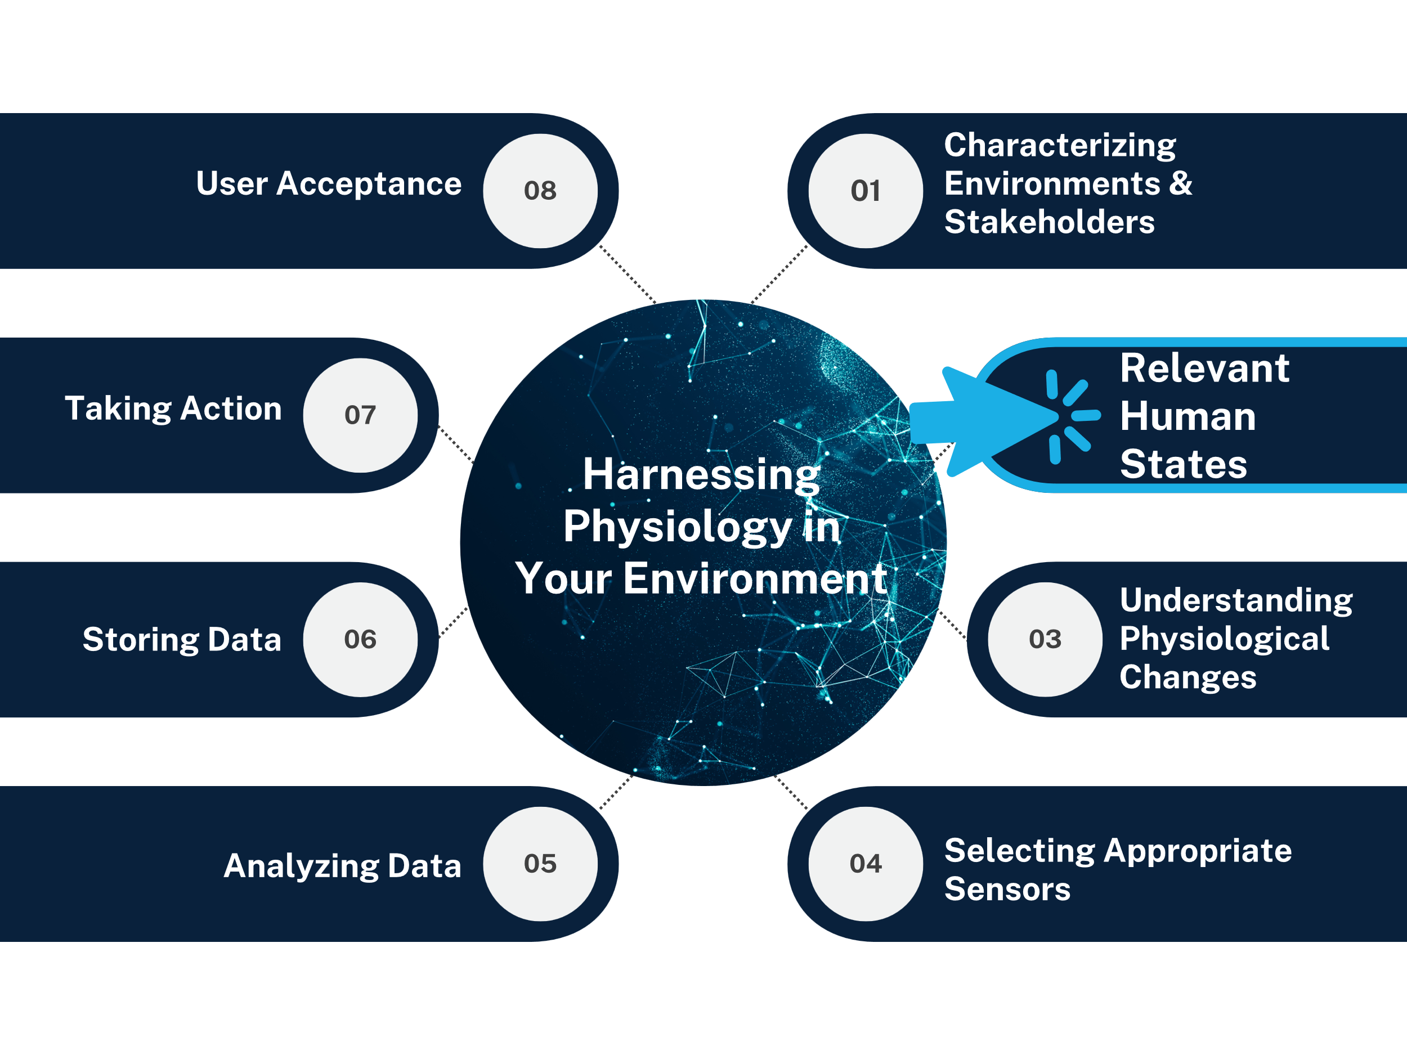
Recommended Approach & Best Practices
​Eight Steps for Physiological Monitoring
LO 2

Slide 17

Relevant Human States
Q1: Describe the breadth of human states and how focused or broad people should be in selecting states of interest.
User States
Understand current problems (have a purpose)
Focus on states that will enable actionable changes
What are individuals repeatedly experiencing?
  Sleep
  Fatigue
  Readiness
  Stress
  Emotion
  Cognitive State
  Heat Stress
  Attention
  Repetitive Motion
  Activity​
  Team Effectiveness ​
  Motion Sickness ​
  Engagement ​
  Resilience​
  Position​
  Exposure​
  Illness ​
LO 2

Slide 18


Relevant Human States
Q2: Describe what user states are critical to learning and how understanding these states is beneficial to training and simulation.
Engagement
Stress
Mental Acuity
Resilience
Workload
Confidence
Competency & Performance
LO 2

Slide 19
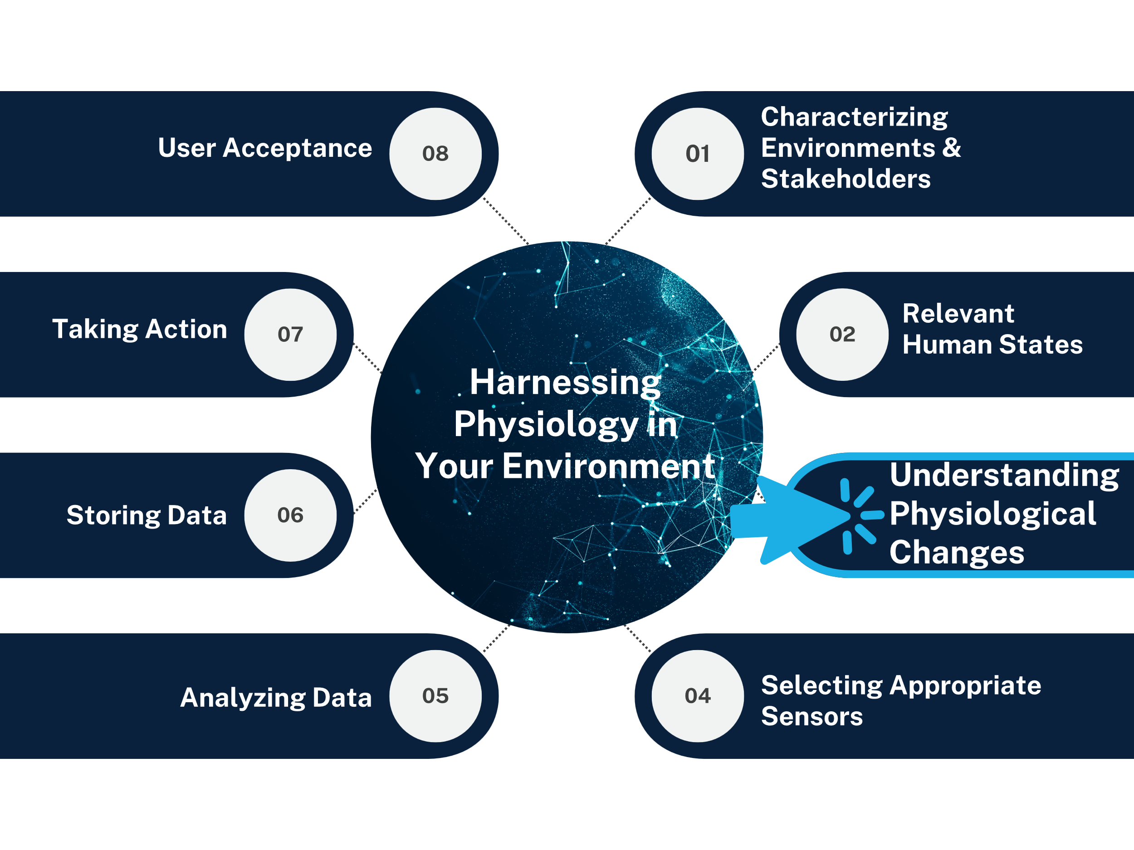
Recommended Approach & Best Practices
​Eight Steps for Physiological Monitoring
LO 2

Slide 20
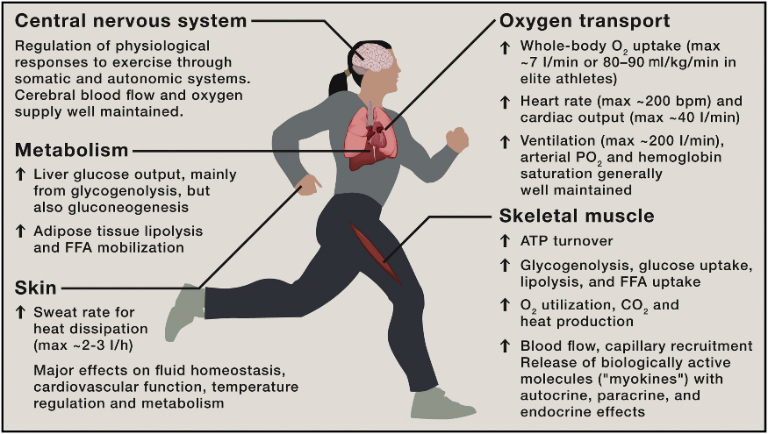
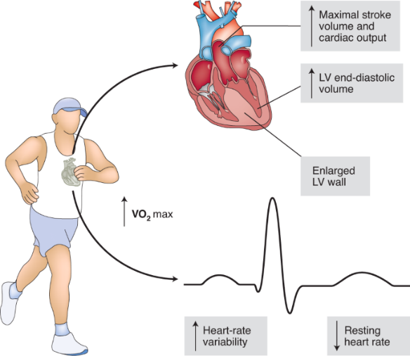
Understanding Physiological Changes
Q1: Provide examples primary and downstream physiological changes and how they map to user states.
Acute Response to Exercise
Longitudinal Effects of Exercise
Hawley et al., Cell (2014)
Moreira et al., Nature Metabolism (2020)
LO 2

Slide 21

Understanding Physiological Changes
Q2: Describe contextual considerations for understanding specific physiological changes.
Individual Differences
Age, gender, skill-level, anthropometry, personality, chronic conditions
Tying to longitudinal digital twin
Correlated Changes
Exercise
Overlapping changes (e.g., stress & workload)
Environmental Effects
Humidity, lighting, seasonality
LO 2

Slide 22
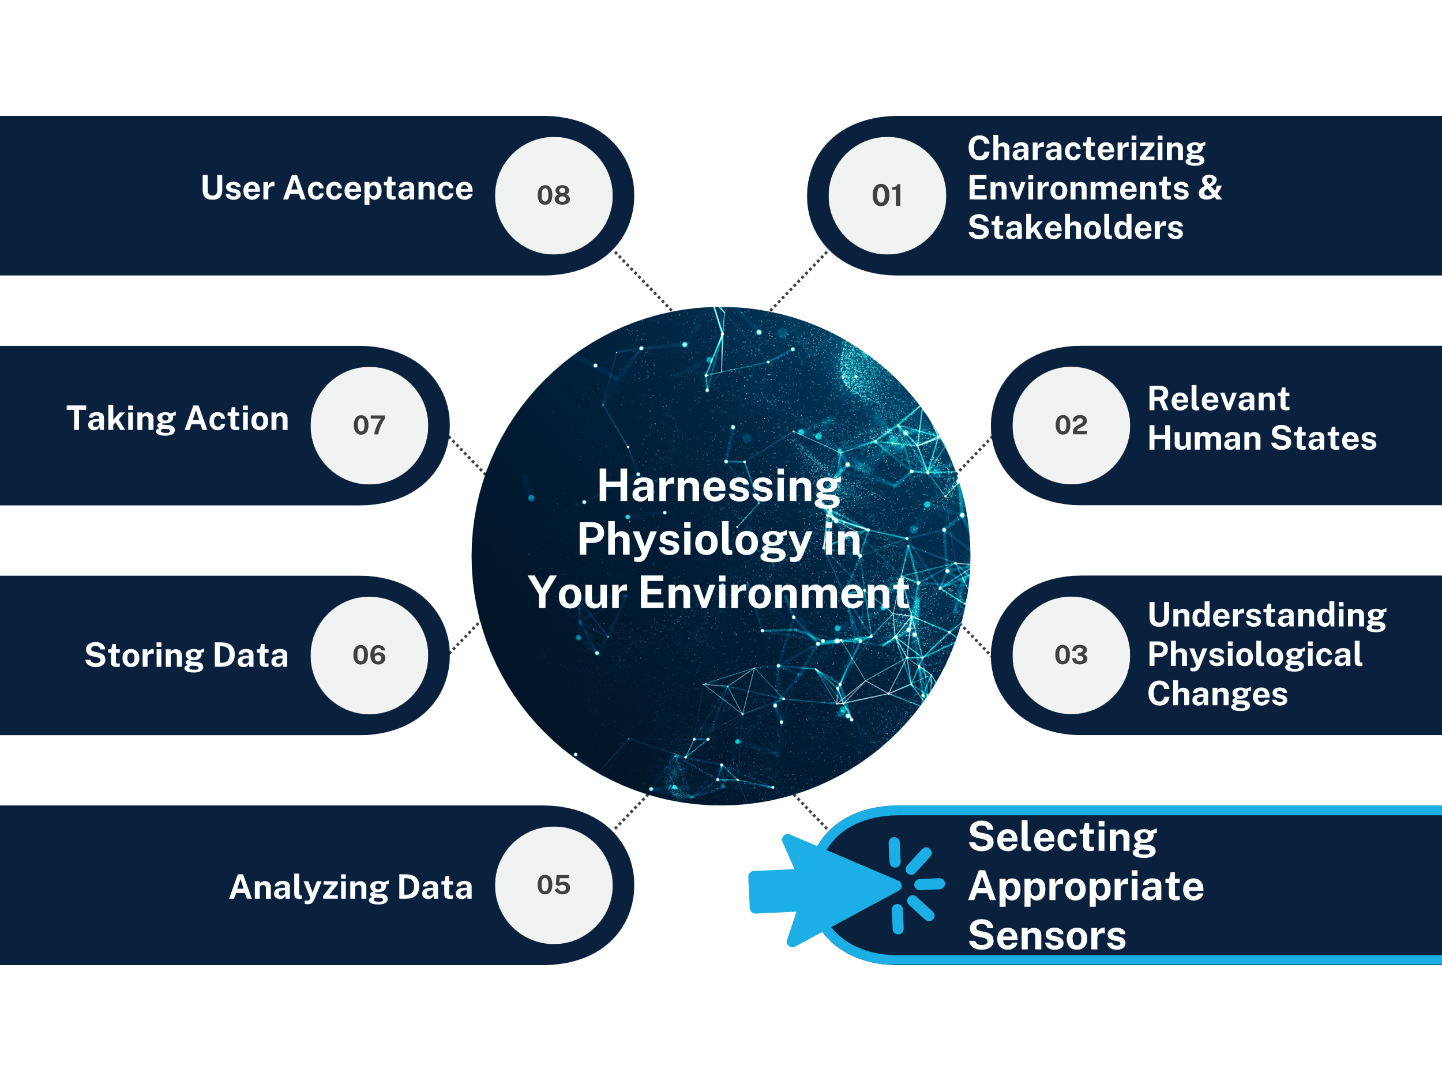
Recommended Approach & Best Practices
​Eight Steps for Physiological Monitoring
LO 2

Slide 23
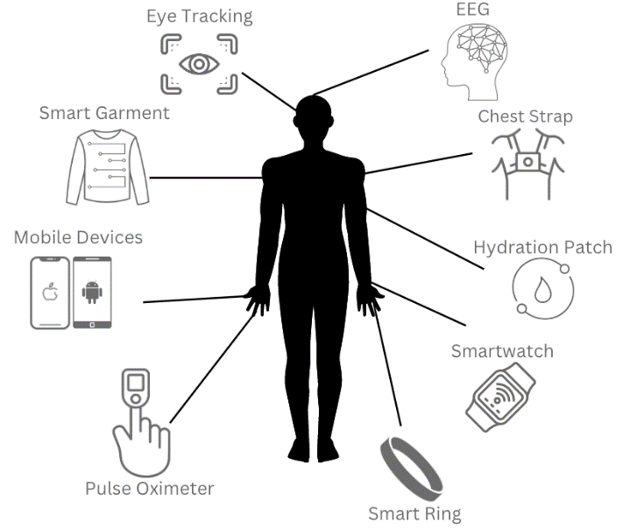
Selecting Appropriate Sensors
Q1: Describe the current market and innovations in physiological sensing, and what do you look for when evaluating new devices?
Innovations:
Increased availability of EDA
Flexible materials (e-tattoos, fabrics)
Off-body sensing (voice, IR cameras)
What to Look For:
Supported Data Streams
Data Integration Considerations
Data Benchmarking & 3rd Party Validation (accuracy)
Use Cases & Context
LO 2

Slide 24
Selecting Appropriate Sensors
Q2: What considerations does the military have for device selection?
Sensor Types
Data Features
Multi-Sensing
Use Case Specific
Security
Network
Scalability
Form Factors
  Accelerometers
  ECG
  Thermometers
  PPG
  Eye Tracking
  EDA
  Respiration Bands
  Video
  Hydration Patches
  Microphones
  EEG
  Gyroscope
  Magnetometer
  GPS
  System Clock
  Heart Rate
  Heart Rate Variability (time & frequency)
  Pulse Rate Variability
  Oxygen Saturation (SpO2)
  Respiration Rate
  Pupillometry
  Fixation (location and time)
  Saccade
  Blink
  Smooth Pursuit
  Visual Search
  Skin Conductance Level
  Linear Acceleration
  Rotational Acceleration
  Magnitude of Magnetic Fields
  Facial Expression
  EEG Waves (across frequencies)
  ACH Level
  Lactose Level
  Glucose Level
  Location
LO 2

Slide 25
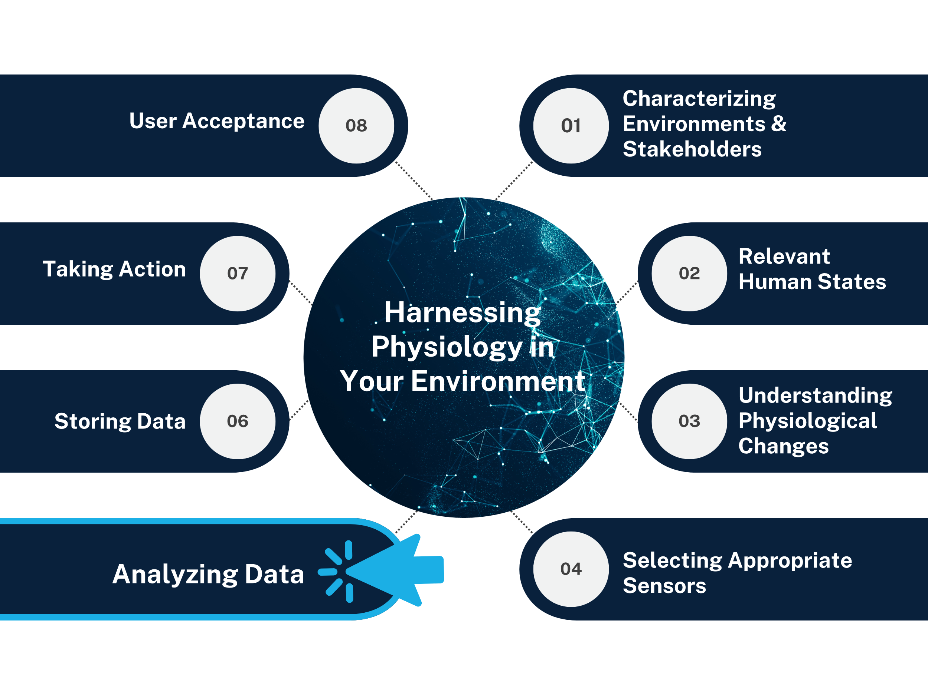
Recommended Approach & Best Practices
​Eight Steps for Physiological Monitoring
LO 2

Slide 26
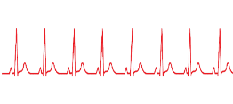
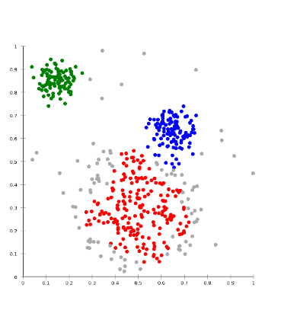
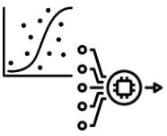
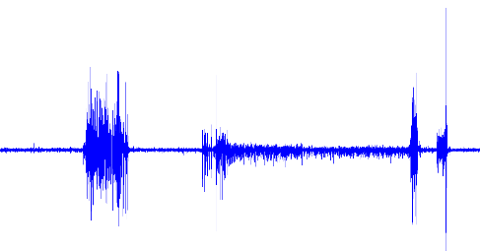

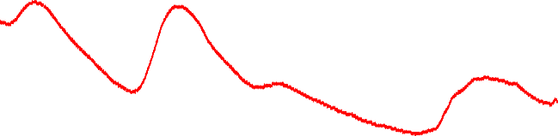
Analyzing Data
Q1: Describe current best-in-class data science methods for handling and interpreting physiological data and what emerging methods you are most excited about?
    Data synchronization methods
    Various data science methods
    Model validation levels
      Within training set, cross-validation, generalization
    Multimodal data (losing signal, look at the next)
Features
Classifiers
LO 2

Slide 27
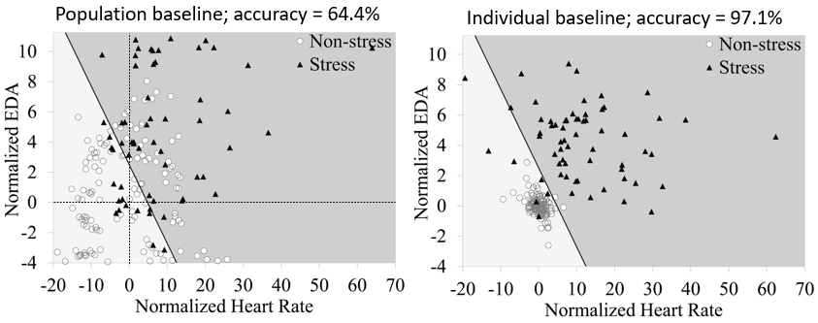
Analyzing Data
Q2: What are specific data considerations you feel are critical to appropriate interpretation within a given context?
Individualization of data
Tying data to larger context (scenario, environment)
Scalability of analytics (e.g., containerization, on-device computing)
Acknowledgement and mitigation of potential researcher biases
Winslow, et al. Front Psych (2016)
LO 2

Slide 28
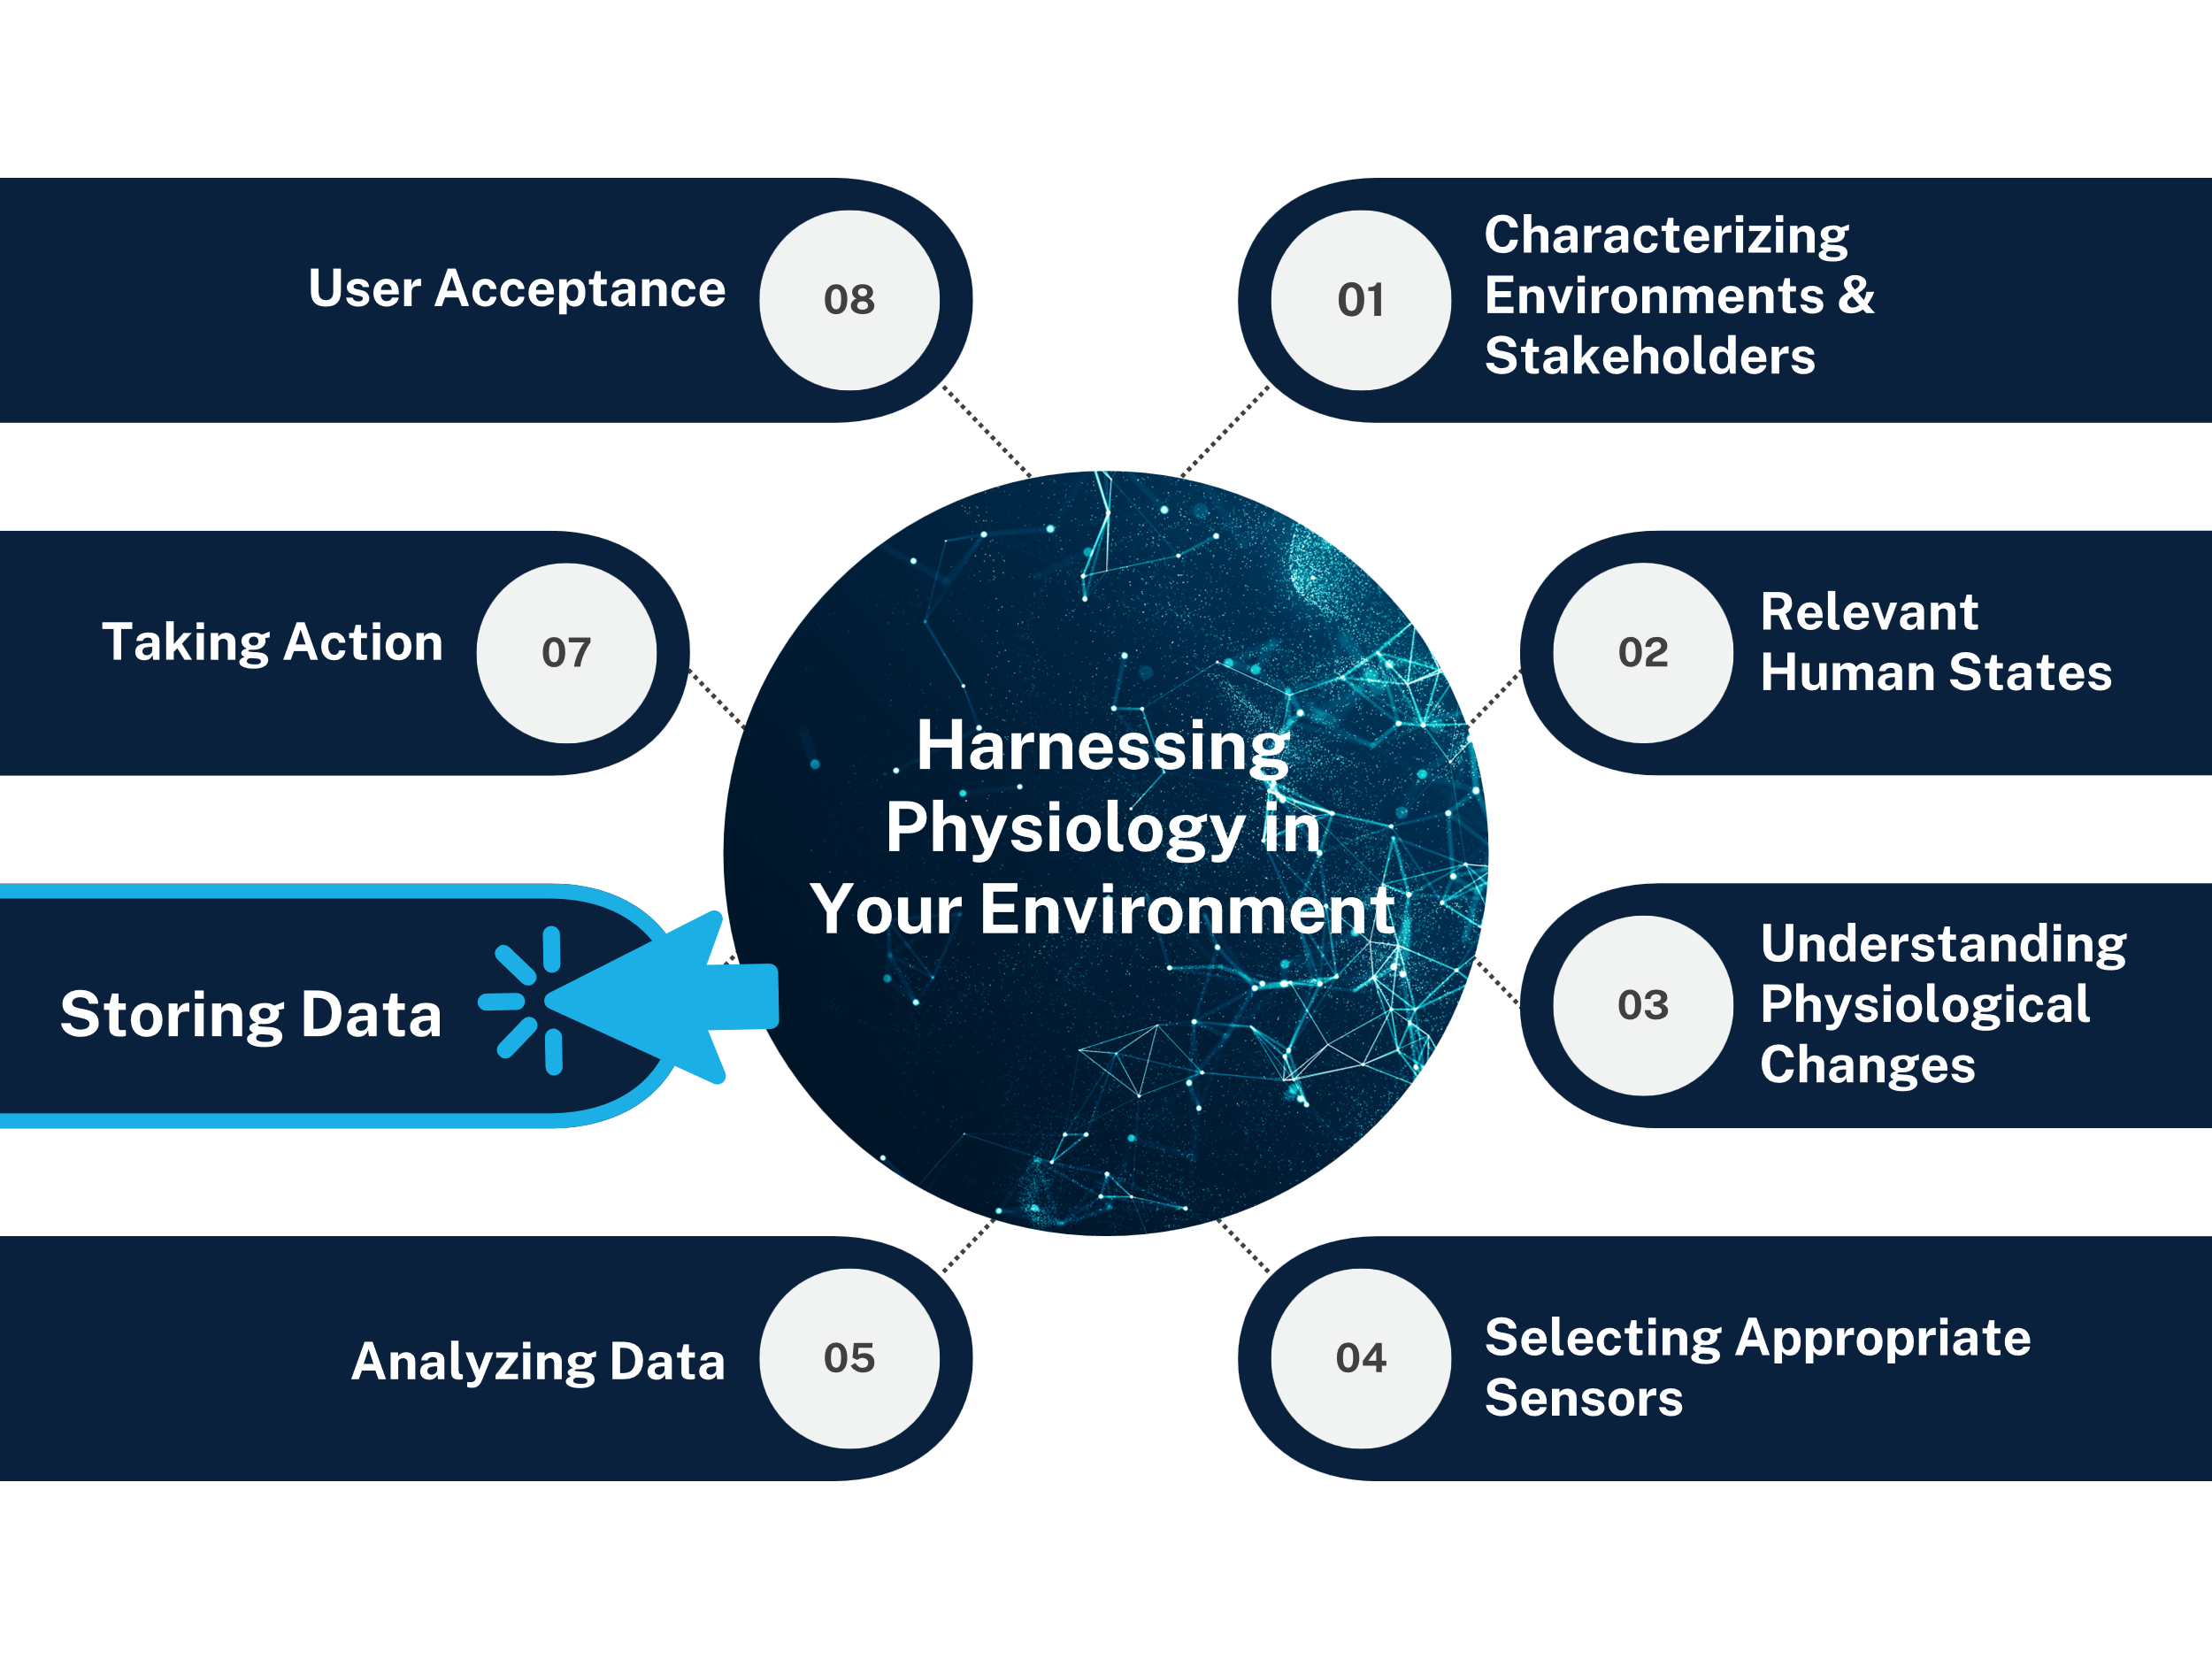
Recommended Approach & Best Practices
​Eight Steps for Physiological Monitoring
LO 2

Slide 29



Storing Data
Q1: What are current trends available to store, label, and control physiological data, and what military considerations are there?
    Location Options: On device, mesh networks, cloud, secure servers
    Common Data Standards: No widely accepted data model – though people are making recommendations
    Longitudinal Data Tagging: Metadata information, unique person identifiers across systems
LO 2

Slide 30

Storing Data
Q2: How can standardized data processes support digital transformation and impactful results?
Close the Human-System Loop & Increase ROI/Impact
Existing Workflows
+
Knowledge
+
Context
+
Human State
Connected
Digital Twins
Connected
Digital Phenotypes
Descriptive Intelligence
Predictive Intelligence
Prescriptive Intelligence
Symbiotic Intelligence
Asset Twins
Psychomotor Behavior
Process Twins
Cognitive State
Performance Twins
Physiological State
LO 2

Slide 31
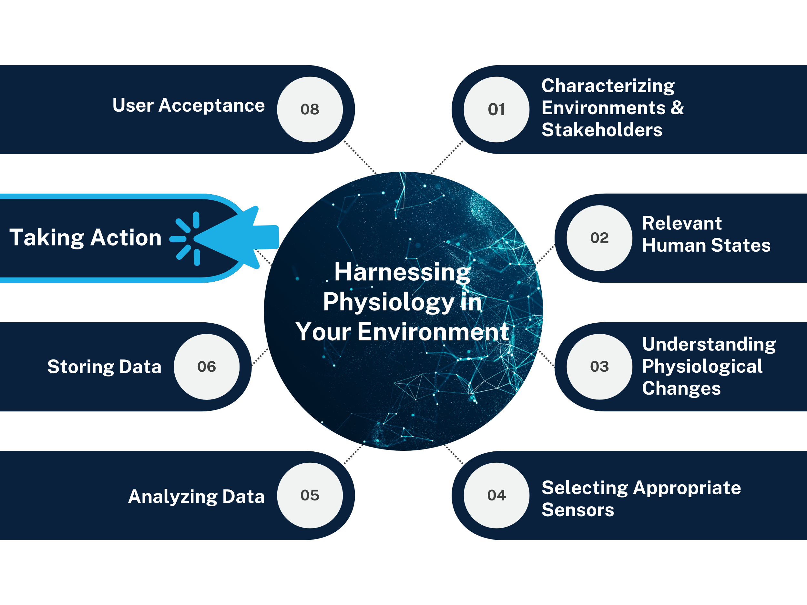
Recommended Approach & Best Practices
​Eight Steps for Physiological Monitoring
LO 2

Slide 32
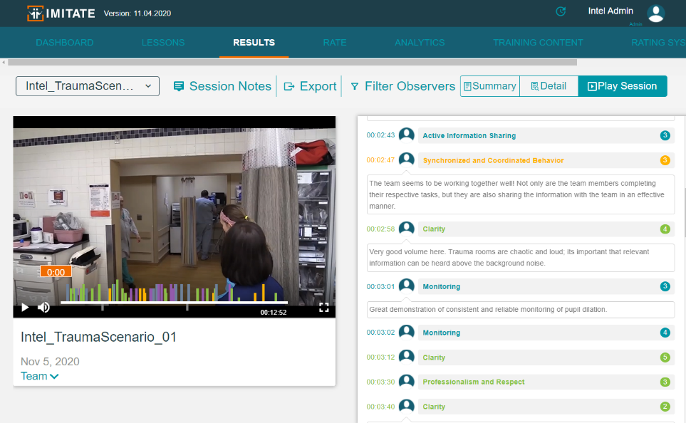
Taking Action
Q1: What are your recommendations for bridging the chasm between new data analytics and implementation?
    How to quickly convey real-time data to trainers?
    User interface/interaction considerations
    Integration with military systems
    Track behavioral changes, command-level changes
LO 2

Slide 33

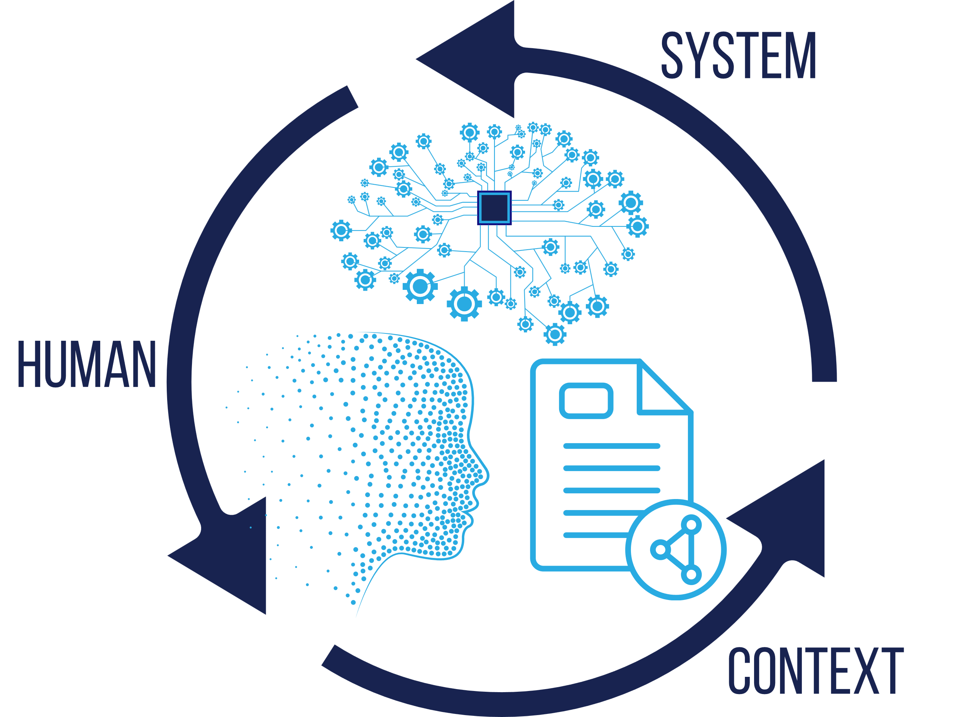

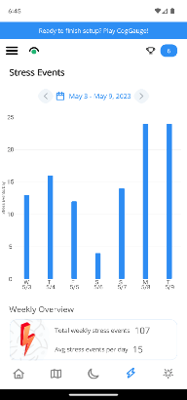

Taking Action
Q2: What are the biggest actions that will be supported if physiological data is integrated into training and simulation?
Optimized Learning
Individualized Instruction
Holistic & Longitudinal Performance
Proficiency Tracking
Realistic & Adaptive Training
Individual Insights
LO 2

Slide 34
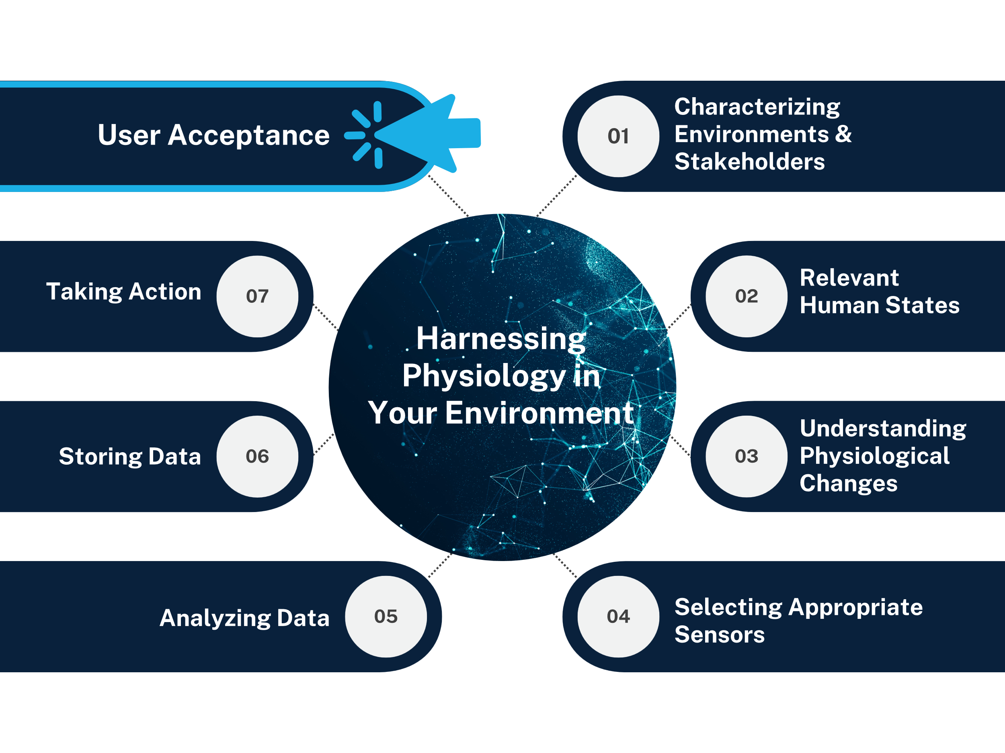
Recommended Approach & Best Practices
​Eight Steps for Physiological Monitoring
LO 2

Slide 35
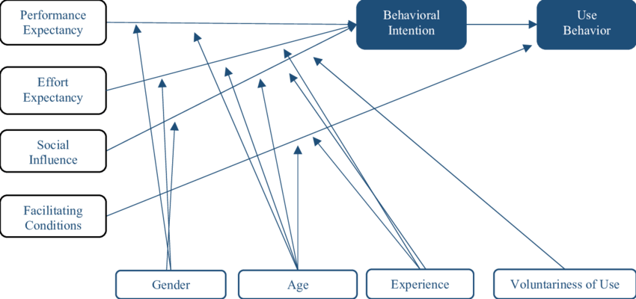
User Acceptance
Q1: For physiological devices and actionable tools: what are the various types or models of user acceptance?
    Models of Acceptance: Technology acceptance model (TAM), unified theory of acceptance and use of technology (UTAUT)
Venkatesh et al., 2003
LO 2

Slide 36

User Acceptance
Q2: For physiological devices and actionable tools: what are considerations when looking to gain user buy-in and how do you overcome resistance?
    Adoption and Trust: Requires bi-directional feedback and communication. Start early in training pipeline.
    Various Echelons: Tie back to personas and what each level of user requires – evaluate appropriately.
LO 2

Slide 37
Available Tools
Example Roadmap
Common Hardware
Common Software
Available Infrastructure
Other resources
Hypothetical implementation and how to follow the 8-step guide.
&
LO 3

Slide 38
Tools to Enable the Process
    Hardware
    Software
    Infrastructure
    Other Resources
    Commercial Devices (e.g., Garmin, Fitbit, Oura)
    Emerging Sensors from Academia and Industry
    Proprietary Device Packages
    Multi-device Synchronization
    Data Analytics Platforms
    AI/ML Systems
    Avoid ‘Black Box’
    Data Lakes
    Common Data Models
    Edge Computing
    Longitudinal Tracking (Common Identifiers)
    Best Practice Guides
    DoD Reviews and Existing Personas
LO 3

Slide 39


Physiological Integration Scenario
Typical Approach:
An organization wants to increase performance metrics
from their simulated training environment. They believe
physiological monitoring is the way to go. They did the
following:
  Searched online for a device that gives them physiological data
  Purchased 500 new wearable devices
  Had trainees start wearing the devices during training
  Had trouble accessing parts of the data
  Aren’t sure what to do with the data they have
  Stored data on separate devices
  Thus far, they’ve invested $250K+ in equipment and over 600 labor hours
LO 3

Slide 40
Optimizing an Integration Approach for Success
Consider the intended audience and long-term needs – constant communication
Consider the nuances of their training environment
Plan what user states and performance outcomes that will be useful
Talk to SMEs to understand what physiological responses will associate with those outcomes
LO 3

Slide 41
Optimizing an Integration Approach for Success
Conduct market research
    Look for benchmarked and validated devices
    Look for data availability, especially for military environments
Selecting Appropriate Sensors
    Individualize the data
    Ensure the data formats align with needs
    Make a plan to transform raw data into performance metrics
LO 3

Slide 42
Optimizing an Integration Approach for Success
Make a plan to store data. Don’t keep data on separate machines in various formats.
Integrate data into existing training performance reviews
Ensure constant communication to relevant stakeholders and end users.
Don’t wait until the end and have to combat negative impressions based on limited feedback and demonstrated benefit.
LO 3

Slide 43

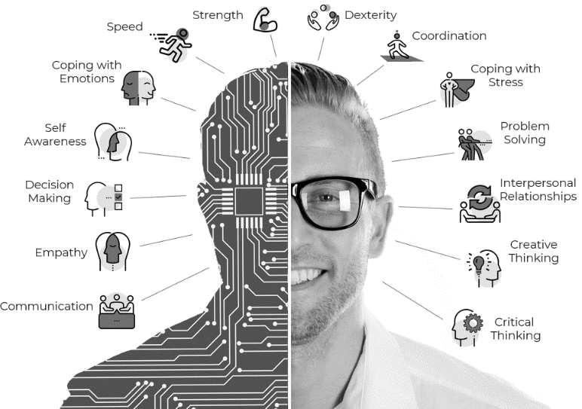
Take Home Messages
  Summary:
  Bi-directional human-system information flow and communication will be critical as technology moves into Industry 5.0.
  Don’t wade into these waters blindly. Setting a strategic plan will make all the difference and prevent common roadblocks.
  Don’t need to stand-up a program of record to do this – leverage the experts and existing tools and resources.
  Remember the end goal: empowering humans to optimize training and workflows, ensure faster cross-training, develop human-autonomy configurations, and ensure readiness.

Slide 44


Acknowledgments & How to Reach Us
  Next Steps:
  We’re here to help – connect with us.
  Take information back to your communities
  Acknowledgements:
  Special thank you to our I/ITSEC bird dog, Dr. Summer Rebensky.
  I/ITSEC Committee
  Contact Us:
  emily.mills@designinteractive.net
  robert.d.furberg.ctr@usa.army.mil
  charles.rowan@nps.edu
  rebecca.kwasinski@designinteractive.net

Slide 45
Question & Answer

Slide 46
References
Slide 7
https://www.argonelectronics.com/blog/army-cbrne-training-how-to-prepare-for-major-chemical-weapons-events
https://www.nationaldefensemagazine.org/articles/2019/12/2/army-spending-big-on-training-modeling-simulation
https://www.army-technology.com/features/live-vs-virtual-training/
https://mwi.westpoint.edu/flight-simulator-fight-simulator-vr-war/
https://www.radiant.digital/does-fidelity-matter-in-simulation-based-learning/
Slide 20
Hawley JA, Hargreaves M, Joyner MJ, Zierath JR. Integrative biology of exercise. Cell. 2014 Nov 6;159(4):738-49. doi: 10.1016/j.cell.2014.10.029. PMID: 25417152.
Moreira JBN, Wohlwend M, Wisløff U. Exercise and cardiac health: physiological and molecular insights. Nat Metab. 2020 Sep;2(9):829-839. doi: 10.1038/s42255-020-0262-1. Epub 2020 Aug 17. PMID: 32807982.
Slide 27
Winslow BD, Chadderdon GL, Dechmerowski SJ, Jones DL, Kalkstein S, Greene JL and Gehrman P (2016) Development and Clinical Evaluation of an mHealth Application for Stress Management. Front. Psychiatry 7:130. doi: 10.3389/fpsyt.2016.00130
Slide 35
Venkatesh, Viswanath, et al. “User Acceptance of Information Technology: Toward a Unified View.” MIS Quarterly, vol. 27, no. 3, 2003, pp. 425–78. JSTOR, https://doi.org/10.2307/30036540.

