Slide 1
24T38 Digital Twins: KISS
Keep It Simple Silly
December 2-6, 2024
Ryan Thomas
John Niles
Brett Moushon
Chris Hussey

Slide 2

Agenda
01
02
03
04
05
06
Introductions
Defining a digital twin
Building a digital twin
Making digital twins more efficient
Digital twins in simulation and training
Digital twin best practices

Slide 3
Learning Objectives
Understanding of what a digital twin is, common language terms, and definitions to use when talking about digital twins
How to build a digital twin for monitoring DOD assets (facilities, buildings, vessels, etc.)
Learn about novel technology integrations that are making digital twins more efficient.
Roles that digital twins can play in simulation and training.
Best practices for digital twins that transfer from the private sector to the DOD

Slide 4


John Niles – Anser Advisory
Technology consultant helping owners develop strategies for and execute digital transformation initiatives.
Well versed in construction technologies such as, virtual design and construction (VDC), building information modeling (BIM), augmented, virtual, and mixed reality (AR/VR/MR), robotics, and reality capture (laser scanning, aerial photography, 360-degree cameras).
Industry experience in mission-critical facilities, aerospace, datacenters, and commercial real estate.
Frequent speaker on reality capture for owners at industry events and Advisory Group member of Reality Capture Network.
Lead author on peer-reviewed publications published by Digital Twin Consortium: “Reality Capture User Guide,” and “Reality Capture, A Digital Twin Foundation.”

Slide 5

Ryan Thomas – Allen 3D
Scanning enthusiast and technology implementer dedicated to transforming the way businesses operate in the architecture, engineering, and construction (AEC) industries.
Industry experience in datacenters, utilities, oil & gas, DoD, DoT and industrial manufacturing.
Frequent attendee and contributor at Reality Capture Network, World of Concrete, UAV Expo, Autodesk University, ConExpo, and Geoweek.
At Allen3D, a leading technology services and modeling company, we specialize in providing innovative solutions that bridge the gap between scanning, processing data, and delivering high-quality deliverables.

Slide 6

Brett Moushon
25+ years experience in the technical software and consulting services in the worlds of real time, data driven Digital Twins, Program/Project Management, CAD/CAM/CAE, Virtual Prototyping, Virtual & Augmented Reality, and Enterprise Solutions.
Focus on helping owners leverage digital twins and the power of digital transformation.
Industry experience in DoD, aerospace & defense contractors, energy/utilities, industrial manufacturing, oil & gas, entertainment, and commercial real estate.
We are a software-agnostic systems integrator that works with change agents looking to transform their real estate portfolios through digital transformation.

Slide 7

Chris Hussey - Anser Advisory
25+ years experience in the technical software and consulting services in the worlds of real time, data driven Digital Twins, Program/Project Management, CAD/CAM/CAE, Virtual Prototyping, Virtual & Augmented Reality, and Enterprise Level Project Controls.
Focus on helping owners leverage digital twins and the power of digital transformation.
Industry experience in DoD, aerospace & defense contractors, energy/utilities, industrial manufacturing, oil & gas, entertainment, and commercial real estate.
We are a software-agnostic systems integrator that works with change agents looking to transform their real estate portfolios through digital transformation.

Slide 8
What is a Digital Twin?
RT
What is a Digital Twin?
  What are the common language terms and definitions to use when talking about digital twins?
  What other key terms are associated to Digital Twins?
  What processes are associated to developing digital Twins?
  A digital twin is different than a model and/or simulation in that your receiving equipment performance feedback.

Slide 9

Definition - KISS
RT
Keep It Simple Silly!
Notes:
Keep
It
Simple
Silly

Slide 10
Definition - KISS
RT
Keep
It
Simple
Silly
Notes:
Keep
It
Simple
Silly

Slide 11
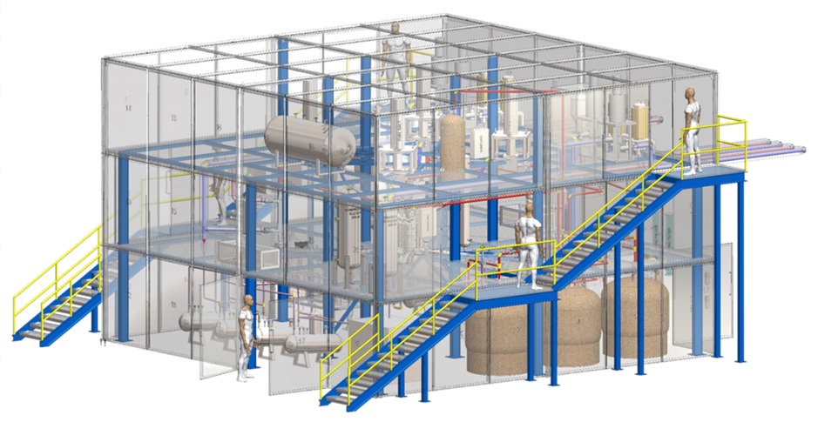
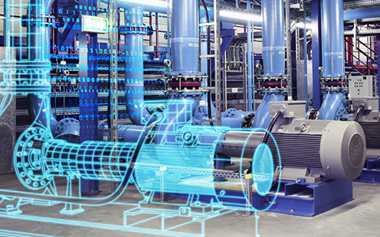
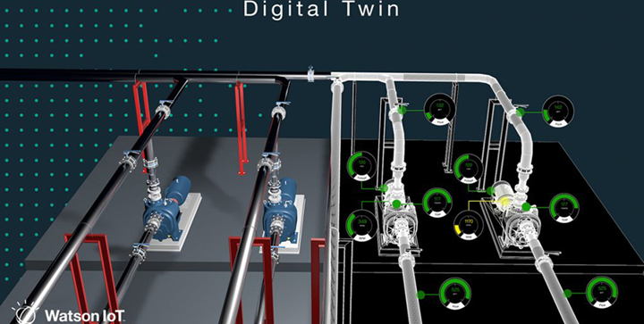
Digital Twin – Definition
JN
A Digital Twin is a virtual representation of real-world entities and processes and their interactions, synchronized at a specified frequency and fidelity.
Digital twins are motivated by outcomes, tailored to use cases, powered by integration, built on data, and implemented in IT/OT systems.

Slide 12
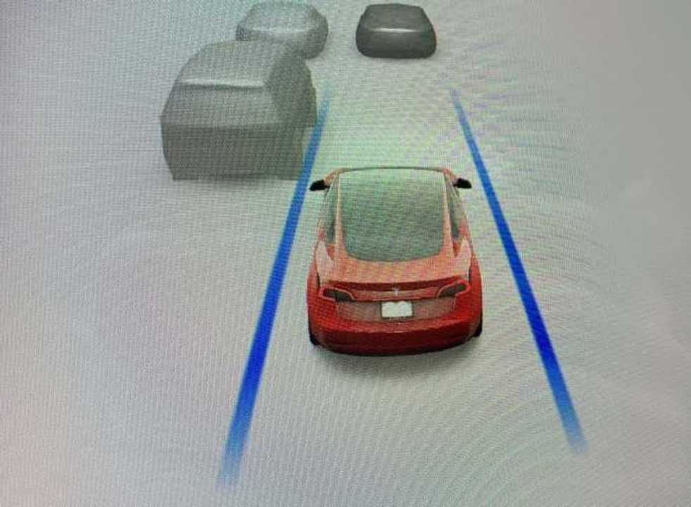
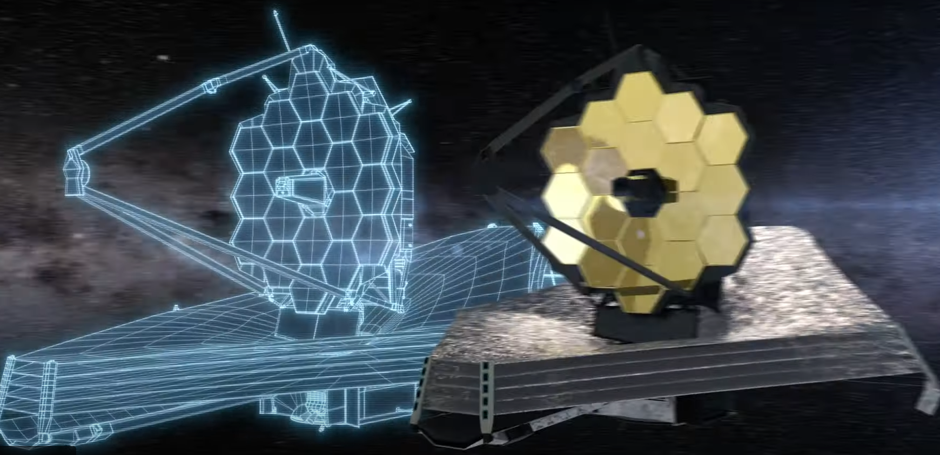
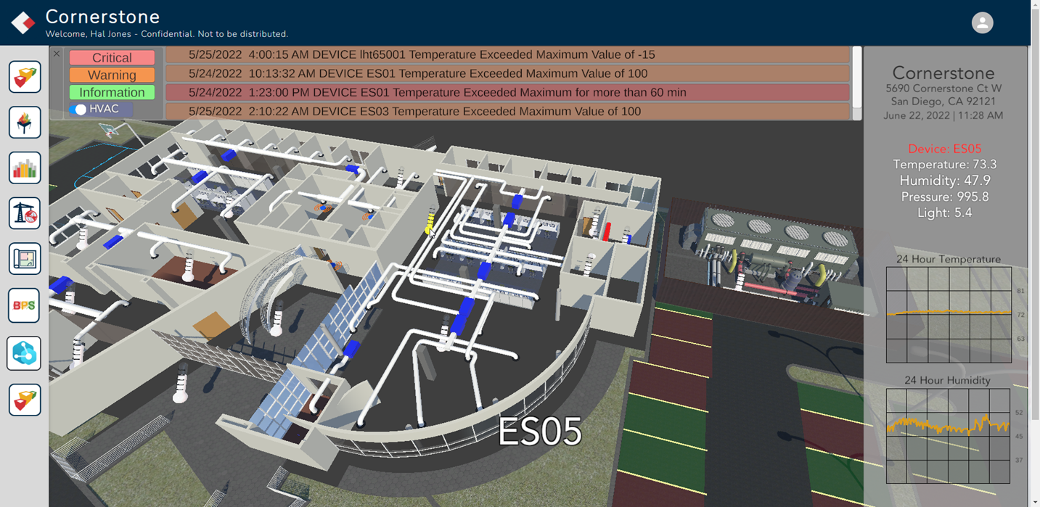
Digital Twin – Examples
JN
Digital twins are motivated by outcomes, tailored to use cases, powered by integration, built on data, and implemented in IT/OT systems.
Mass produced
Multi sensor
Internet Enabled
Leverage Same Parts
One of One
Highly Complex
Complex Telemetry
Simple to Understand
One of One
Highly Complex
Complex Equipment
Simple to Understand

Slide 13
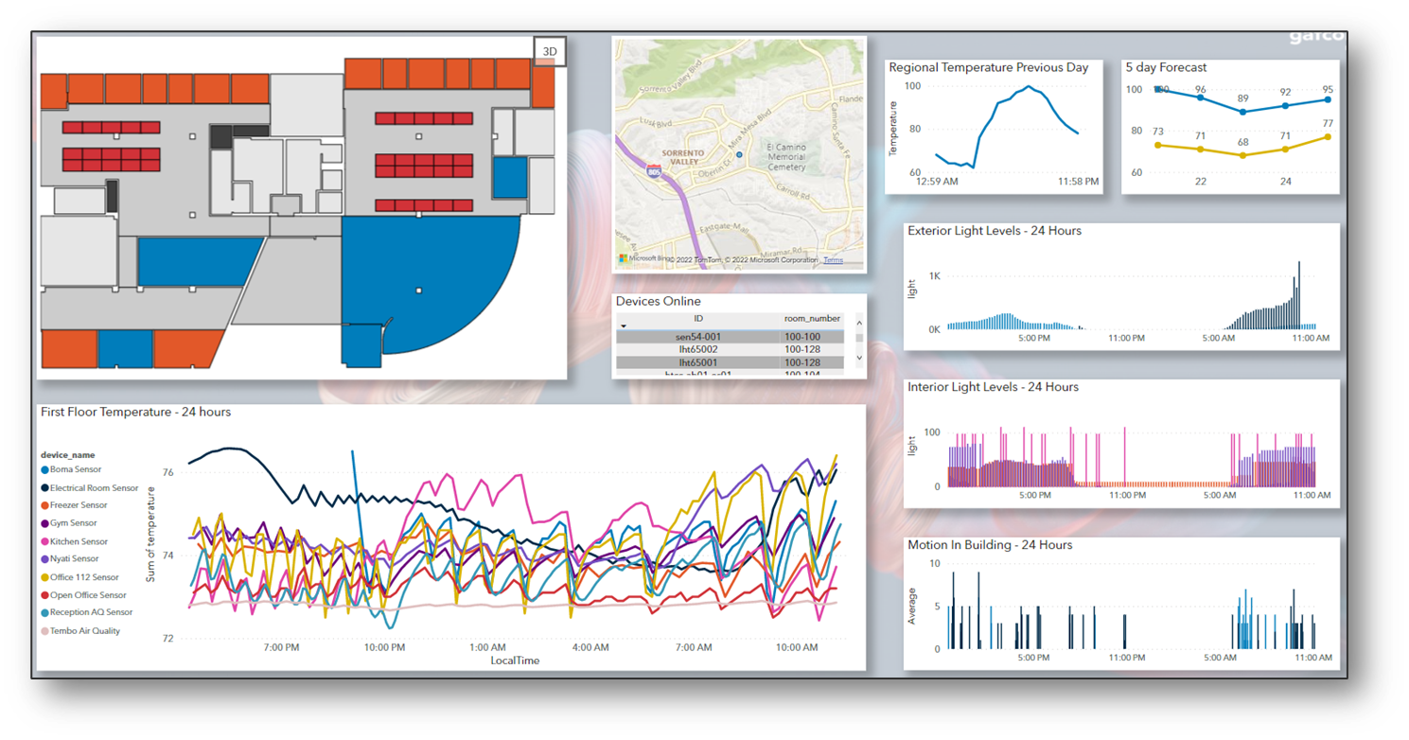
What is a Digital Twin
JN
A digital twin is a virtual representation of real-world entities and processes, synchronized at a specified frequency and fidelity.
Digital twin systems transform business by accelerating holistic understanding, optimal decision-making, and effective action.
Digital twins use real-time and historical data to represent the past and present and simulate predicted futures.
Digital twins are motivated by outcomes, tailored to use cases, powered by integration, built on data, guided by domain knowledge, and implemented in IT/OT systems.
Source: Definition of a Digital Twin - Digital Twin Consortium

Slide 14
Additional Definitions
JN
    IoT (Internet of Things): A network of devices that can communicate with each other, gather and share data, and be remotely monitored and controlled.
    IoA (Internet of Assets): The next step in how people perceive the internet, IoA refers to the direct and provable ownership of internet assets
Visualization: The representation of an object, situation, or set of information as a chart or other image. A video systems allow visualization of the entire building or campus“.
    Smart Data types: Represent a smaller data sets that provide meaningful, valuable, and actionable information.
    A/E/C/O: Architecture/Engineering/Contracting/Operations
    Digital Thread: A mechanism for correlating information across multiple dimensions of the virtual representation... relies on stable, consistent real-world identifiers to "join" across different repositories of information.”
    Digital Twin System: A system-of-systems that implements a digital twin.
    Reality Capture: Reality Capture is process from creating 3D models out of unordered photographs or laser scans without seams.
    Digital Building Lifecycle: A process in which digital data is passed from one design to construction to operations and design in the future.
Notes:
Digital Twins – Why now?

Slide 15


Notable Tech Enablers and Related Concepts
RT
Reality Capture
Industry 4.0
Game Engines
IoT
Metaverse
PLM
Computer Vision
UAS/ Robotics
Smart Building/Infrastructure
Smart City/Community
AI/ML
Industrialized Construction
DfMA
Cloud/ Edge Computing
Data Management
Simulation
Geospatial
Mixed Reality (AR/VR)
BIM/CAD
BI

Slide 16
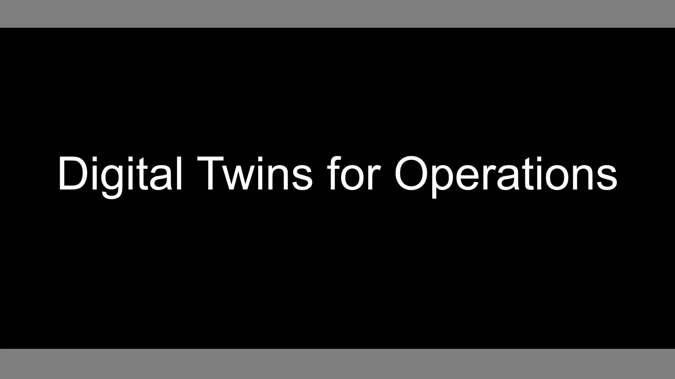
What is a Digital Twin and Why is it Beneficial
RT

Slide 17
Why Digital Twins
RT
Owners must manage and easily access drawings, blueprints, permits, and more...
624 Hours per year unsuccessfully searching for data
416 Hours per year spent recreating data

Slide 18
Industrial Revolution to Digital Revolution
RT
1st Industrial Revolution
MECHANICAL
2nd Industrial Revolution
ELECTRICAL
3rd Industrial Revolution
INFORMATION TECHNOLOGY
4th Industrial Revolution DIGITAL
5th Industrial Revolution ARTIFICIAL INTELLIGENCE
1800
1900
2000
2010
2024
COMPUTER AIDED DESIGN
IoT/IoA
BUILDING INFORMATION MODELING
DIGITAL TWINS
AI ENABLED DESIGN
Source: I/ITSEC 2023: Digital Engineering Tutorial Basic Principles
Notes:
state of technology progression into context.

Slide 19

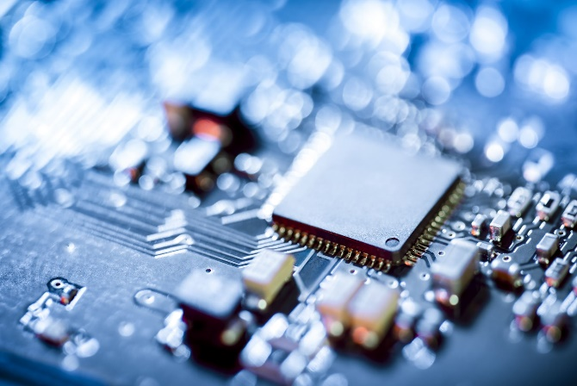




Relevance
JN
More data…
More capacity…
The opportunity to transform how we understand, predict, and manage change in our built world…
Better Algorithms…
More computers…
More connected…
Notes:
The concept accelerating advancement and convergence of technologies is transforming our ability to visualize, simulate, predict, and control our physical world.

Slide 20
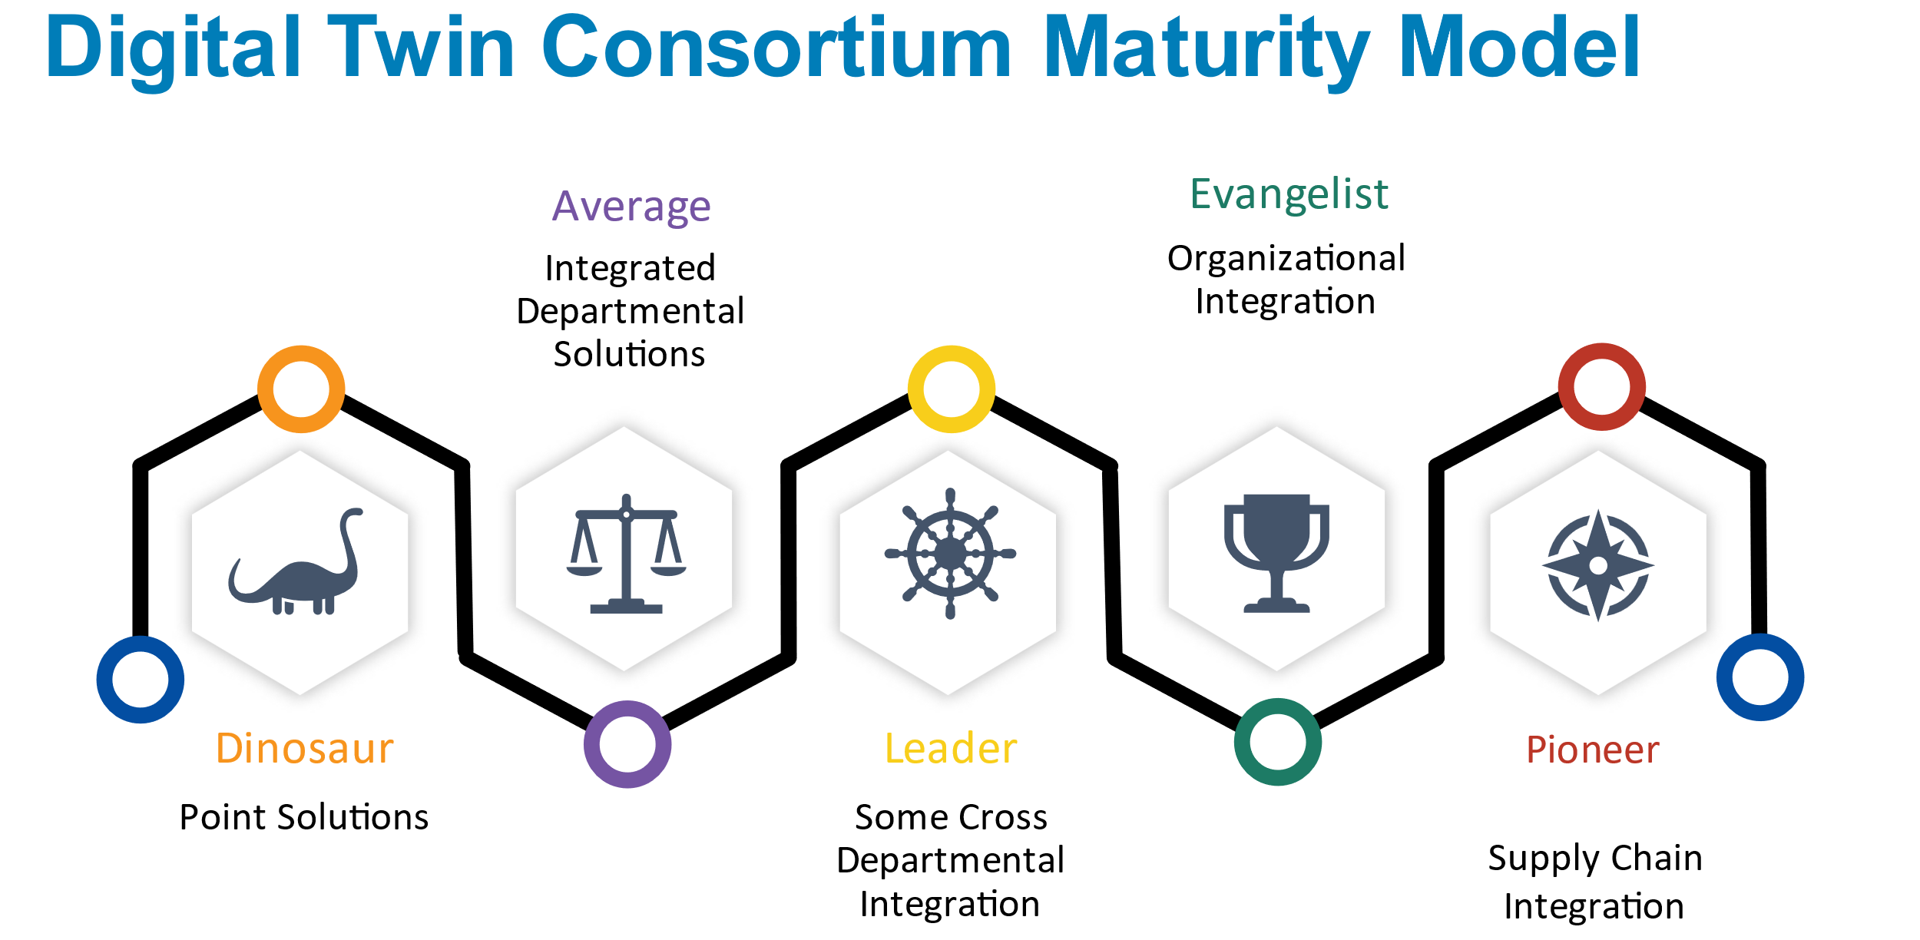
Maturity Assessment
The second model was an organization maturity model. That model, if you read the paper behind it, has five areas of decomposition that we believe are required to realize value from a digital twin and which are:
1. Organizational Structure
2. Organizational Performance
3. The Evolution of the Digital Thread
4. The Integration of Business Functions
5. The use of Catalog and Repeatable Design and Construction Elements

Slide 21
Building a digital twin for monitoring assets
RT
How do you build a digital twin for monitoring DOD assets (facilities, buildings, vessels, etc.)?
Workflow, high level overview
Levels of details
Use case for assets
Use case for facilities

Slide 22







Digital Building Lifecycle
RT
Plan/Design
Manufacture/Fabricate
Lifecycle
Improve/Retrofit
Deliver/Assemble
Operate/Maintain
Test/Commission

Slide 23
BIM to Twin
JN
Visualization and Management of the 2D and 3D Space
Physical Asset Equipment Management
Documentation, Structured and Unstructured
Monitor the Dynamics of Occupation (IoA)
Organizational Model and Insights
Cost Performance
Real Time Physical Performance and Control (IoT)
Historical Performance; Prediction; Improvement
Actively Manage the Space
Optimize Physical Equipment Performance
Compile Total Cost of Ownership
Use and Update Documentation
Automate and Control the Asset Environments
Simulate and Predict
Quick Decision-Making Response from Visualization
Notes:
This report defines smart-building initiatives as those that use data-gathering sensors and analytics to better manage facilities costs, energy consumption, infrastructure maintenance, and use of physical space.

Slide 24
Where Should an Owner Start?
JN
How do you wish you could improve your ability to understand, predict, manage its performance of your built assets?
Business Outcomes
Use Cases
When would a digital twin of a built asset (or a related process) improve your ability to understand, predict, manage its performance in the real world?

Slide 25
Where Should an Owner Start?
JN
Gap Analysis & Roadmap
Roadmap
Proof of Concept/Pilot
Business Outcomes
Requirements - Business
Use Cases
Requirements -
Technical/ Functional
DT System Deployment
Evaluation and Recommendations

Slide 26

Proving the Concept
JN
A Digital Twin Proof of Concept focused on a high leverage problem allows you to evaluate approach, create advocacy, and build momentum within your organization.
Digital twins represent a new concept and implementation requires change to processes and the introduction of new tech and systems.
We focus on using digital twins to solve problems that are currently not addressed (or are poorly addressed) by systems you already have in place.
Focusing (initially) on solving clear, narrowly defined problems allows you to get quick wins, establish creditability and cultivate internal champions.
Managing organizational change is a complex, continuous process that impacts many stakeholder groups - many of whom are resistant to change.
Notes:
Digital twins represent a new concept for many organizations and implementation requires changes to process and the introduction of new technologies and systems.
Managing organizational change is a complex, continuous process that impacts many stakeholder groups - many of whom are resistant to change.
Focusing (initially) on solving clear, narrowly defined problems allows you to get quick wins, establish creditability and cultivate internal champions.
We focus on using digital twins to solve problems that are currently not addressed (or are poorly addressed) by systems you already have in place.
A Proof of Concept (and/or) a Pilot focused on a high leverage problem allows you to more easily allocate budget, resource and procure services.
We provide a packaged service for a Digital Twin POC, at a fixed-fee price, time-boxed, with a focus on delivering a tangible prototype and an evaluation of the benefits - and risks - of scaling the solution across the organization.

Slide 27
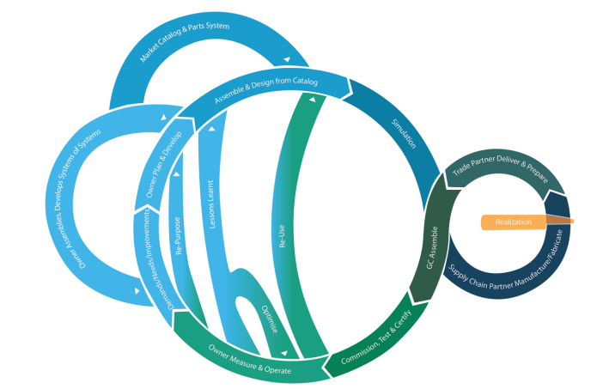
Implementing a Digital Building Lifecycle
JN
BIM based but not just BIM
  Building Information Model
  Building Information Modeling
  Building Information Management
Establishes the Digital Thread
Asset based workflow
  Asset defined as a thing, system or a space
  Virtual asset converted to physical asset
Asset Tag (Data key) links:
  2D to 3D
  Schedule
  Cost
  Embodied Carbon
  Properties and Documents
Infrastructure Lifecycle: A Case for Change A Digital Twin Consortium Technical Brief 2022-01-04

Slide 28
Guiding Principles
JN
Configurable
Extensible
Scalable
Modular
Reliable
Client can modify the solution to accommodate change to future organizational requirements.
Client can integrate new technologies and systems as their organization and the industry evolve.
Client can use the solution to provide a reliable foundation for expansion across the enterprise.
Client can have a Digital Twin solution that provides agility and resiliency for the enterprise.
Client can have peace of mind that the technology will continue to be supported by the vendor.
Notes:
:45
It’s configurable and can accommodate change over time
ANIMATION!
It’s extensible and will allow you to integrate new technologies and systems.
ANIMATION!
It’s scalable and is something that can be expanded for the entire campus and beyond.
ANIMATION!
It’s modular and will give you much needed agility and resiliency in its implementation and management.
ANIMATION!
And it’s reliable. This technology will continue to be supported by the vendor - you!

Slide 29
Digital Twin System Proof of Concept (POC) SOW
JN
Perform Discovery
Perform Gap Analysis
Implement DT System POC
Plan DT System POC Implementation
Evaluate DT System POC
Fact-finding exercise to understand our client’s organization; and the drivers, pain points, and desired outcomes for key stakeholders.
Analysis of the gap (including the reasons for and implications of the gap) between their current state and desired end state.
Definition of POC system requirements based on priorities identified in gap analysis and the documentation of implementation approach.
The specification, build, and deployment of the digital twin system required to address client’s desired use cases.
The presentation of the DT System POC to the client to jointly assess the viability of concept and to recommend next steps

Slide 30
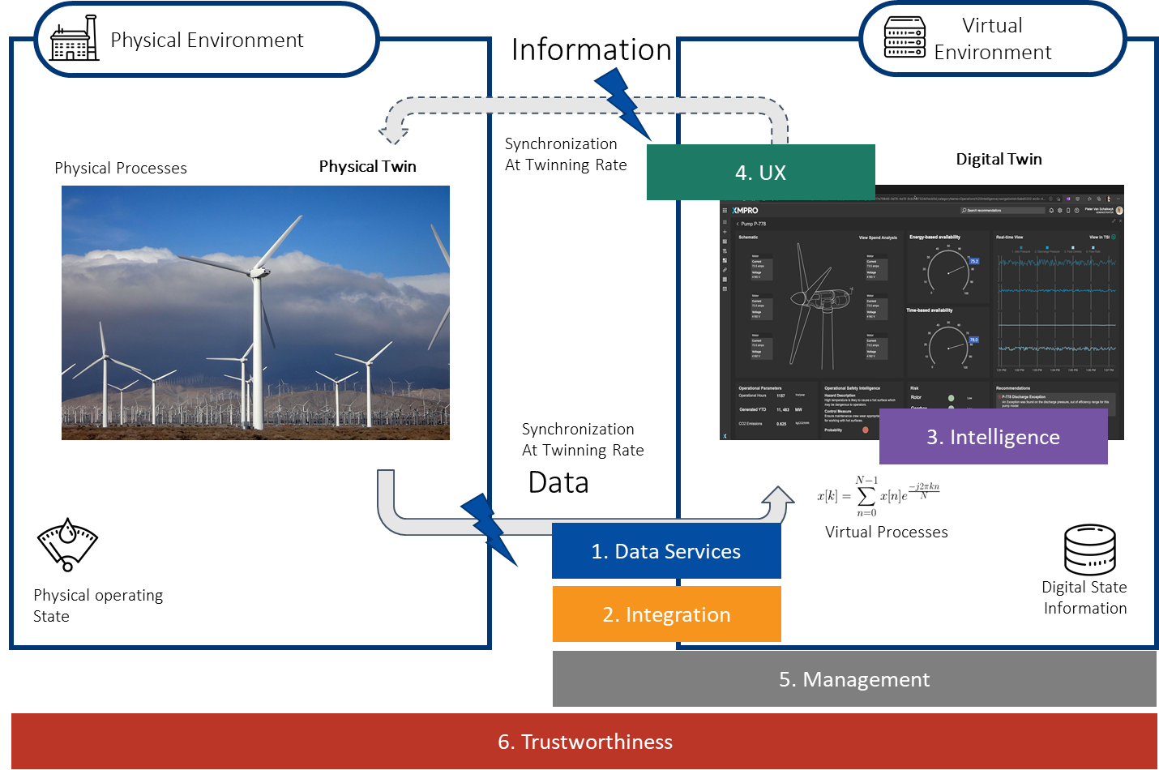
Digital Twin System Capabilities
JN
No | Category Name | Category Description
1 | Data Services | Enables data access, ingestion and data management across the platform from the edge to the cloud. It establishes the physical to virtual connection and receives data directly from equipment sensors or control systems, performs localized processing, and distributes to other tiers
2 | Integration | Enables data access to existing internal and external enterprise systems and applications. Enables communication across different digital twins.
3 | Intelligence | Provides an environment for the development and deployment of industrial Digital Twin solution. It provides the services for data integration, basic and advanced analytics, AI, orchestration, and other Digital Twin process capabilities.
4 | UX | Provides the user with the ability to interact with Digital Twins and visualize its data.
5 | Management | System and ecosystem management capabilities
6 | Trustworthiness | Security, privacy, safety, reliability, and resilience capabilities

Slide 31
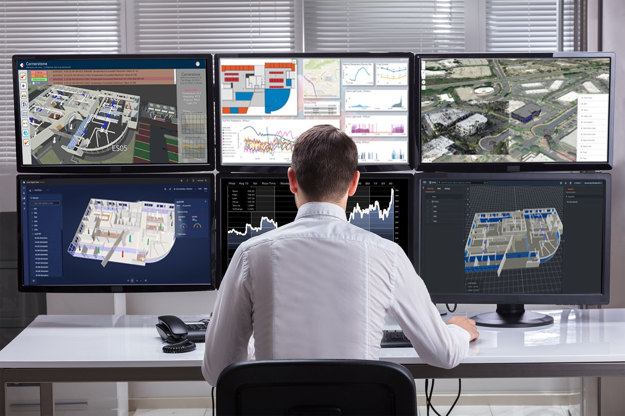
Embrace a Software-agnostic Approach
JN
Data is the cornerstone
Using the same data sources, you can analyze and visualize information in multiple ways.
Real-time 3D Visualization
Performance Analytics Dashboard
GIS / Point-cloud
IoT-based Telemetry
Asset Performance Analytics
Space Utilization

Slide 32
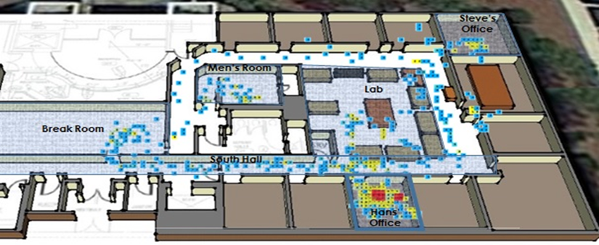
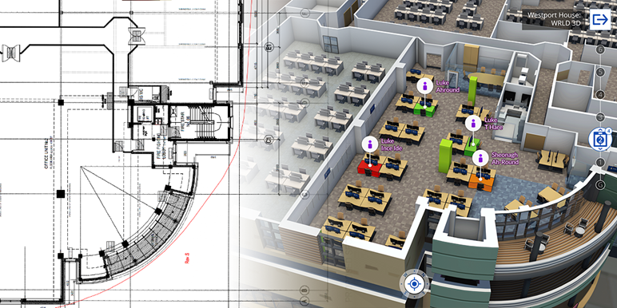
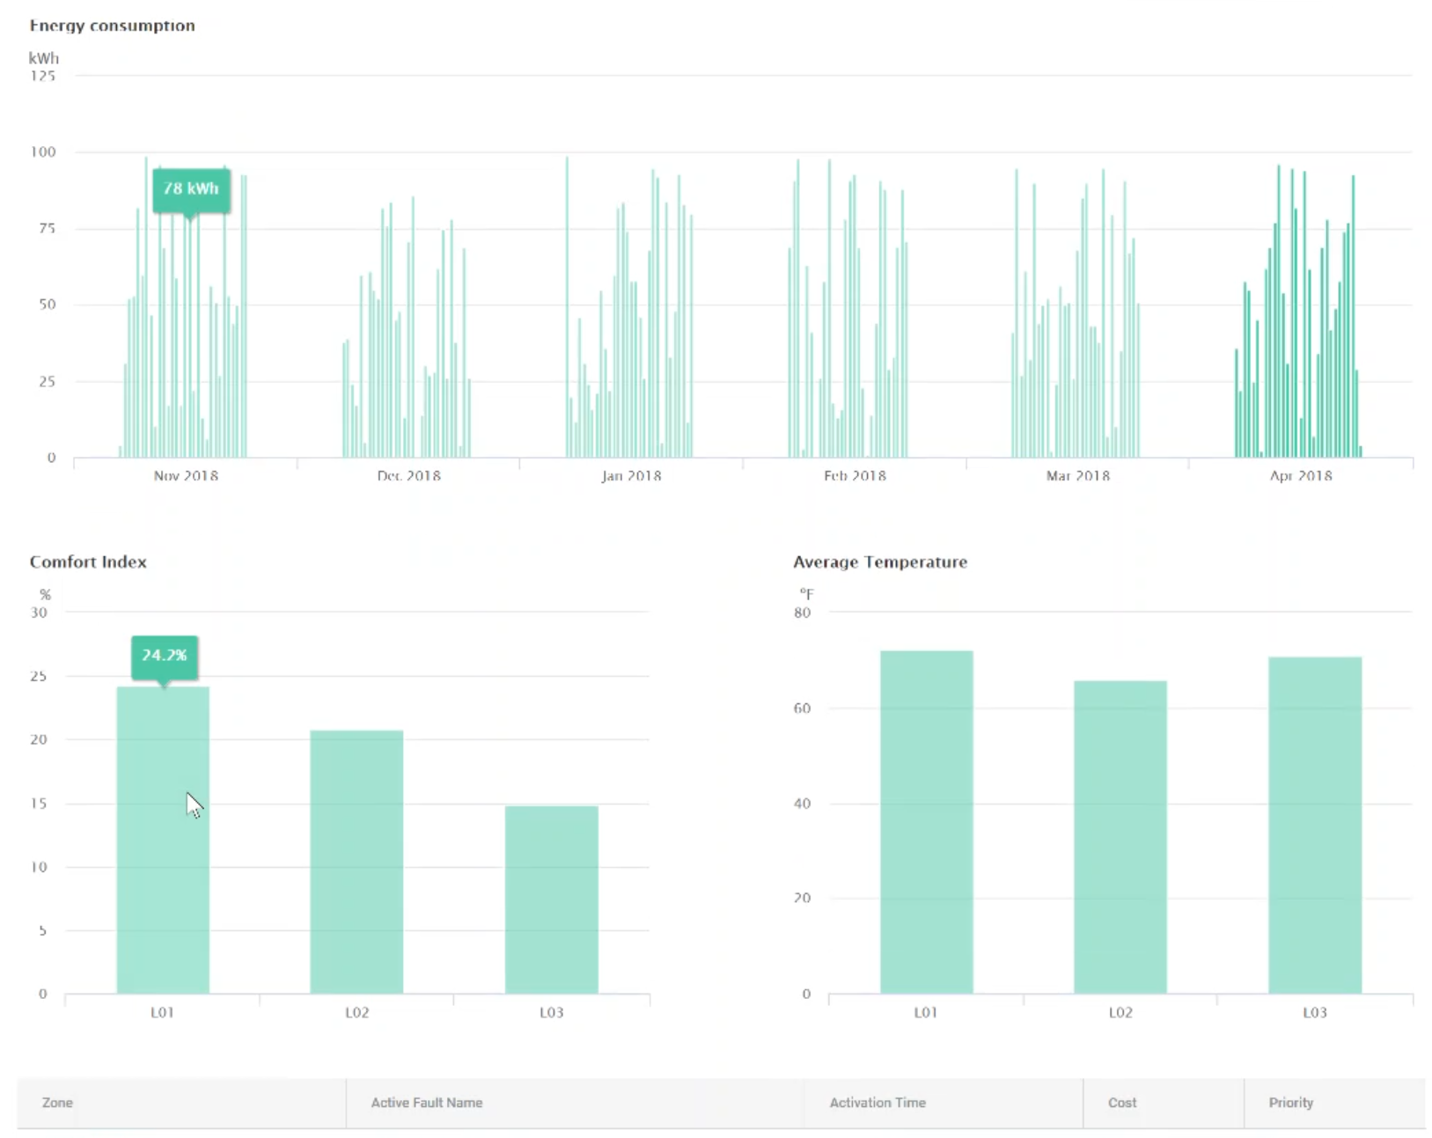
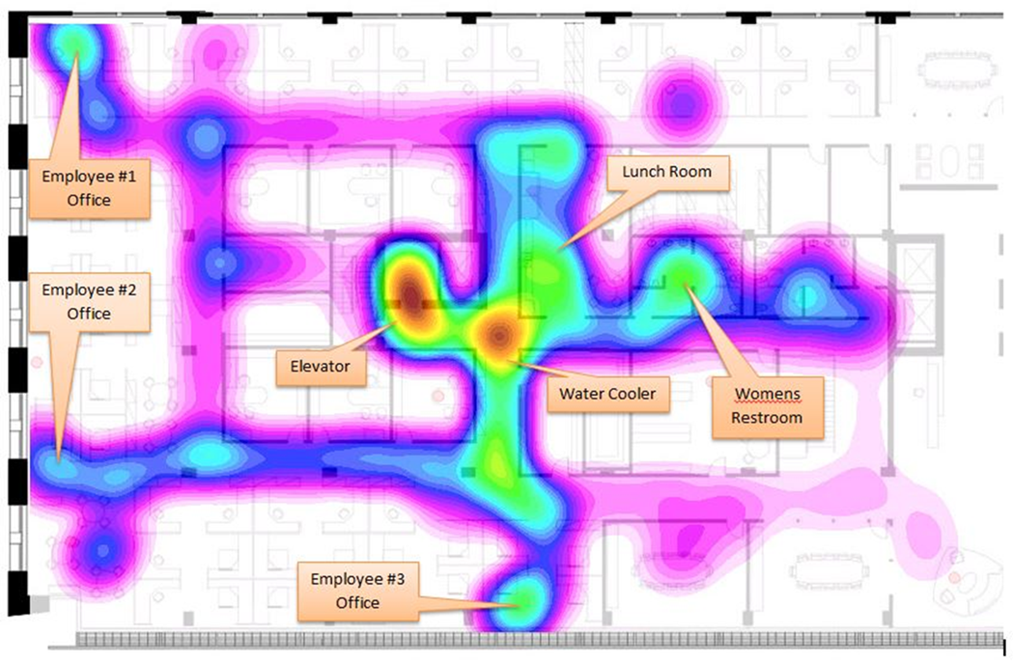
Digital Twin for Real-Time Analytics and Decision Making
JN

Slide 33
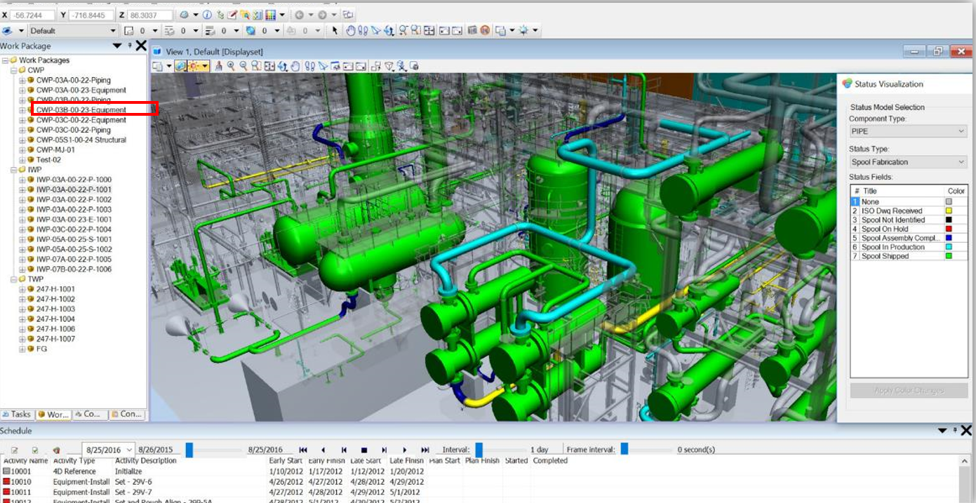
Digital Twin Lifecycle
JN
Model Work Package Integration

Slide 34
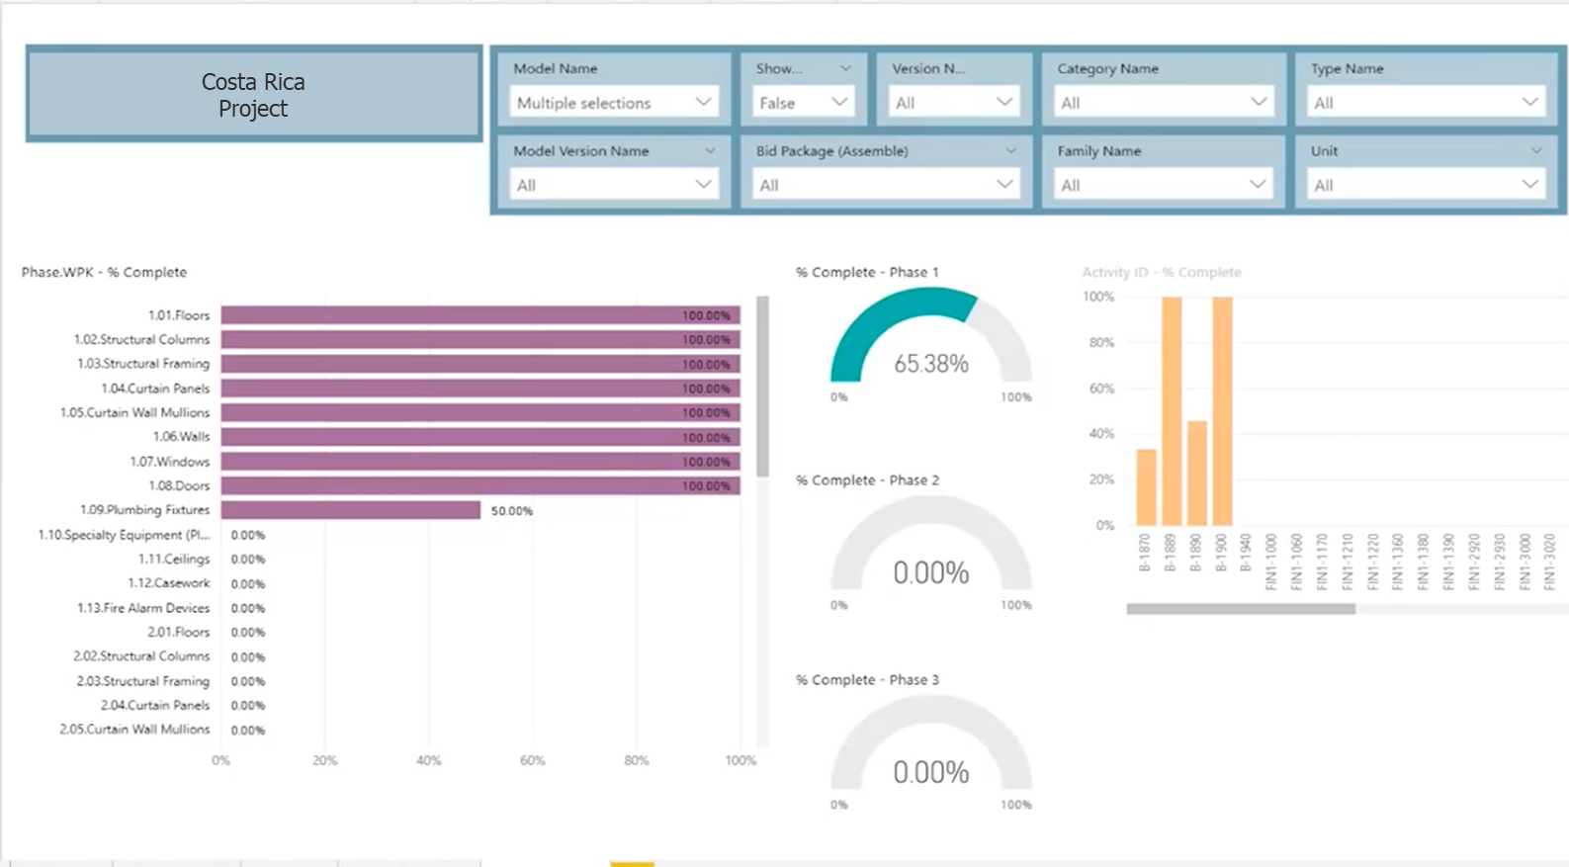
Digital Twin Lifecycle
JN
Project Controls Integration

Slide 35
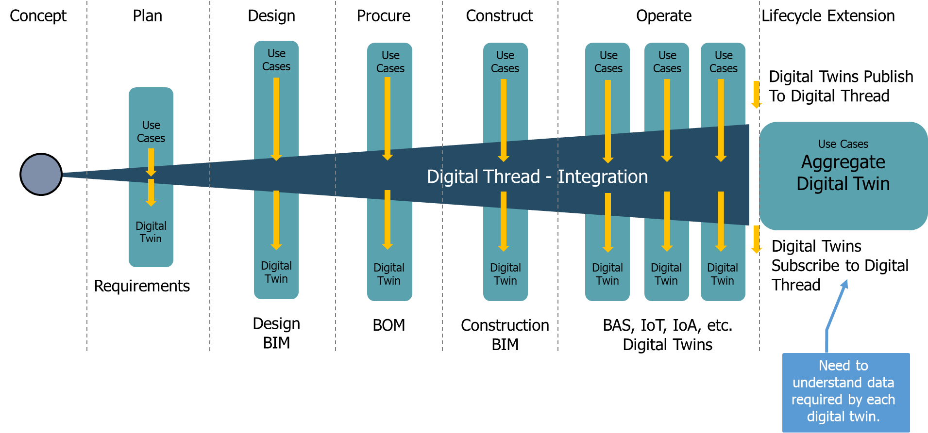
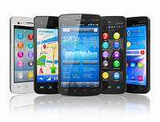
The Digital Thread / System of Systems - Benefits
JN
Providing owners with full digital-twin value requires end-to-end integration, with established design and engineering guidelines, a common data platform and language, and relentless oversight.
Up to 60% of data can be lost in design and construction.
Multiple siloed applications are expensive to create and maintain.
Manual data transformation is expensive and error prone.

Slide 36
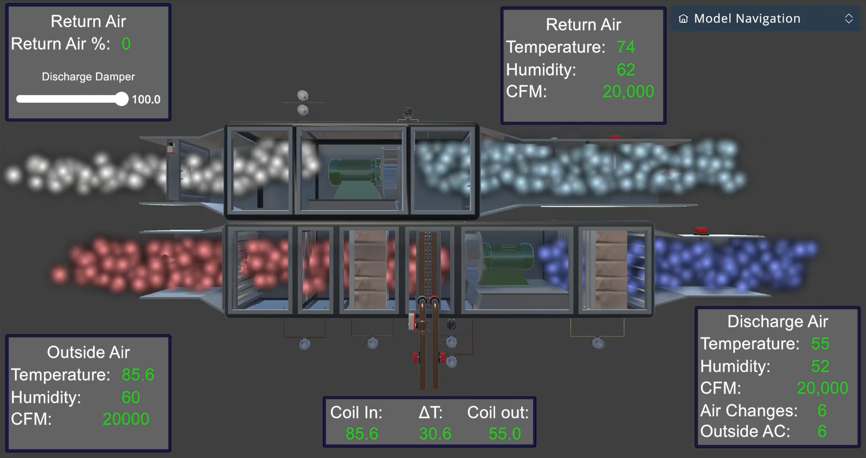
The Smart Phone Analogy – Operations and Maintenance
JN
Monitor and control air flow to improve building health.

Slide 37
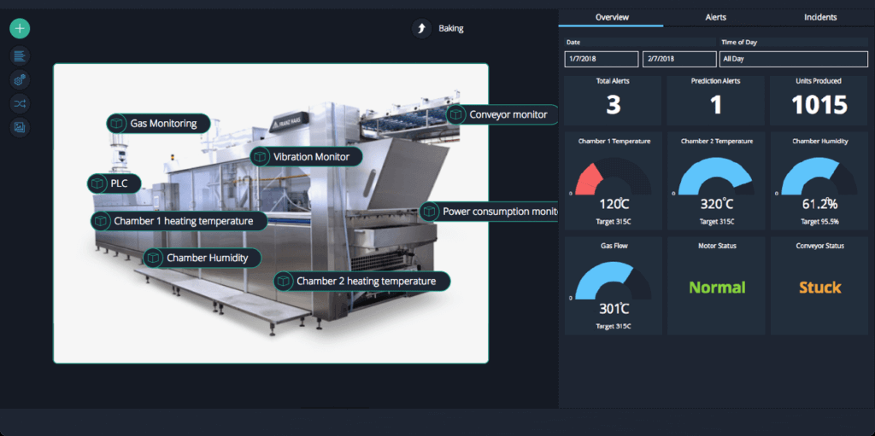

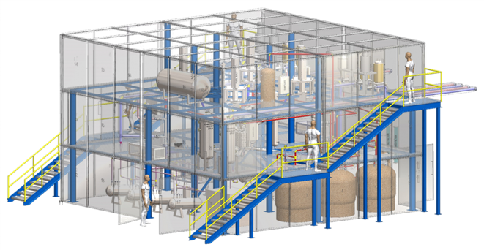
Sensors in Real-Time: Digital Twin Monitoring & Analysis
JN

Slide 38
How to get started
Vision Statement – unite the Team
Owner’s Project Requirements (not all projects are equal)
BIM and Data Standards
Design and Construction contracts aligned with approach
Common Data Environment (CDE)
Steering Committee
Project Management Office (PMO)
Internal communications program
BIM Facilitator/BIM SME – the Virtual Project Manager
JN
Nine essential components of an owner-centric approach to a comprehensive, holistic Digital Building Lifecycle Program

Slide 39



Standards and Accountability are Critical to Implementation
JN
Communicate
Collaborate
Correlate
Foundation for the integration of operations with the built environment.
Obstacles
  Data Standards
  Siloed Processes
  Inter-department Cooperation
The elimination of paper and paper- based systems through digitization allows our communication to be more effective and delivered via users' system of choice.
Addressing this legacy issue is referred to as the elimination of yesterday’s problems.
Communication both enables and drives collaboration. Implementing a digital building lifecycle consolidates that collaboration and drives the need to rethink project delivery frameworks.
The process to enable a digital thread to support the digital building lifecycle is referred to as today's problem.
When all parts are coordinated, process standardization produces clean data that, with context, provides information; and with learning can be transformed into knowledge; and applied as competitive advantage.
Tomorrow’s problems will be solved through prediction and closed loop analysis.

Slide 40
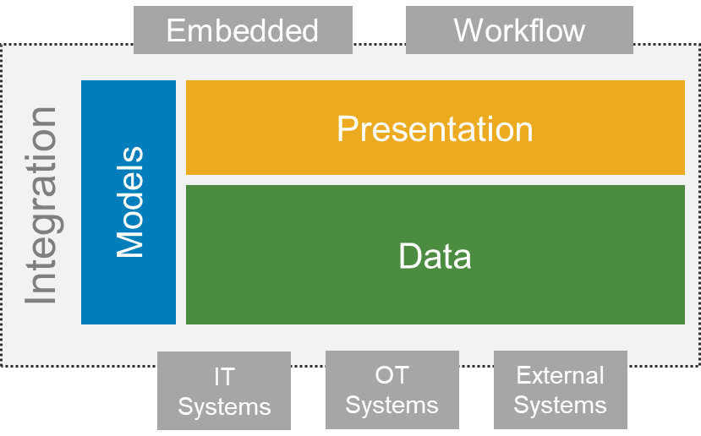
Composition of a Digital Twin
JN
Spec and build models for the digital twin.
Configure/develop UX platforms and interfaces that enable digital twin use cases.
Integrate applications and data sources to create a digital twin system.
Implement data management infrastructure for a digital thread.

Slide 41

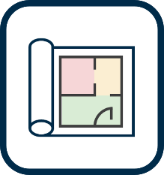








Example Digital Twin System
JN
Digital Twin System
Our DT Solution
and/or IWMS
Applications
and/or IWMS

Slide 42
Reference Summary, Questions and Discussion
CH
5
ENTERPRISE
Predictive and analytics capability (what-ifs)
Integration with AI and machine learning
Organizational democratization of data
Integrated, evolutionary and managed improvement
Extensible from buildings to campus and cities
Building Information Management
Owner Driven PMO
Leadership and Strategy;
Business Benefits;
Governance; Communications and Outreach;
Program Road Map;
Resourcing.
4
PROACTIVE
Predictive Modeling (e.g. Weather and influence on building performance)
Simulation (Physics based, human behavior, traffic patterns)
Closed Loop Analysis to improve overall performance
Organizational Risk Management and Mitigation
Energy Conservation Measures
3
REACTIVE
IoT and IoA Data Integration (e.g. sensors, weather, spaces and people integration)
Asset Data Integration
Alerts and Triggers
Human and Health Related
Visualization and analysis of real time and historical data
STRUCTURED
2
Technical Architecture with emphasis on integration with existing systems
Data Architecture (alignment) and Digitization of Existing Process with emphasis on clean data acquisition
Graphic Representation to support Context of Data Display
Alignment with reality capture for existing buildings
IT / OT governance and interface
FOUNDATIONAL
1
Assessment
Organizational Goals (Business Case), Assessment, Mobilization, and Development and Communication of Initial Use Cases
Assessment and Improvement of BIM and Data Standards including audits and enforcement
Process Integration to produce clean data and eliminate data silos
Steering Committee, Governance and Change Management, including baseline performance to support business case
Training, adoption and celebration of initial successes

Slide 43
Digital Twin System Capabilities
CH
1
Data Acquisition & Ingestion
9
Synthetic Data Generation
17
Enterprise System Integration
23
Edge AI and Intelligence
29
Prediction
39
Basic Visualization
45
Dashboards
2
Data Streaming
10
Ontology Management
18
Eng. System Integration
24
Command and Control
30
Machine Learning ML
40
Advanced Visualization
46
Continuous Intelligence
3
Data Transformation
11
Digital Twin (DT) Model Repository
19
OT/IoT System Integration
25
Orchestration
31
Artificial Intelligence AI
35
Prescriptive Recommendations
41
Real-time Monitoring
47
Business Intelligence
4
Data Contextualization
12
DT Instance Repository
20
Digital Twin Integration
26
Alerts and Notifications
32
Federated Learning
36
Business Rules
42
Entity Relationship Visualization
48
BPM and Workflow
5
Batch Processing
13
Temporal Data Store
21
Collab platform integration
27
Reporting
33
Simulation
37
Distributed Ledger & Smart Contracts
43
Augmented Reality AR
49
Gaming Engine Visualization
6
Real-time Processing
14
Data Storage & Archive Services
22
API Services
28
Data Analysis and Analytics
34
Mathematical Analytics
38
Composition
44
Virtual Reality VR
50
3D rendering
7
Data PubSub Push
15
Simulation Model Repository
52
Device Management
54
Event Logging
56
Data Encryption
58
Security
60
Safety
51
Gamification
8
Data Aggregation
16
AI Model Repository
53
System Monitoring
55
Data Governance
57
Device Security
59
Privacy
61
Reliability
62
Resilience
Data Services
Integration
Intelligence
UX
Management
Trustworthiness
Source: Digital Twin Consortium, Digital Twin Capabilities Periodic Table

Slide 44
Example: 3D Smart Building Dashboard
CH
1
Data Acquisition & Ingestion
9
Synthetic Data Generation
17
Enterprise System Integration
39
Basic Visualization
45
Dashboards
2
Data Streaming
10
Ontology Management
18
Eng. System Integration
40
Advanced Visualization
3
Data Transformation
11
Digital Twin (DT) Model Repository
19
OT/IoT System Integration
25
Orchestration
41
Real-time Monitoring
47
Business Intelligence
4
Data Contextualization
12
DT Instance Repository
26
Alerts and Notifications
36
Business Rules
42
Entity Relationship Visualization
48
BPM and Workflow
5
Batch Processing
13
Temporal Data Store
21
Collab platform integration
27
Reporting
49
Gaming Engine Visualization
6
Real-time Processing
14
Data Storage & Archive Services
28
Data Analysis and Analytics
7
Data PubSub Push
54
Event Logging
8
Data Aggregation
59
Privacy
61
Reliability
62
Resilience
Data Services
Integration
Intelligence
UX
Management
Trustworthiness

Slide 45
Digital Twin System POC – Resource and Deliverables
CH
Engagement Manager
Recommendations
(eg Project Charters)
Implementation Plan/ PMP
Project Manager*
Digital Twin System Specifications
Business Analyst(s)
Domain SME(s)
Solution Architect(s)
DevOps
Project Admin Documentation (e.g. meeting minutes, status reports)
Business Requirements
Use Cases
Technical Requirements
Gap Analysis
*Could be Engagement Manager

Slide 46
Example Framework for Proof of Concept(s)
JN
Use a digital twin to simulate expected performance
Use a digital twin to diagnose delta in simulated vs actual performance and recommend resolution
Use a digital twin to measure actual performance
Use a digital twin to predict future performance delta in simulation vs actual performance and recommend mitigation
Use a digital twin to compare simulated vs historical performance
Use a digital twin to resolve/mitigate delta in simulation vs actual performance
First projects should be less complex to implement, deliver quick wins, and provide a foundation…
…for more complex use cases that deliver greater value in future.

Slide 47
What technology integrations are making digital twins more efficient?
JN
What technology integrations are making digital twins more efficient?
  Common Data Environments
  AR/VR/XR (Augmented Reality/Virtual Reality/Extended Reality
  Reality capture
  Machine Learning (ML)
  Sensor fusion platforms
  IoT/IoA
  Gaming engines
  AI (Artificial Intelligence)

Slide 48




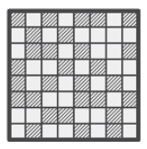





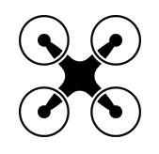


Connecting Data with a Common Data Environment
JN
POINT CLOUD STORAGE
TERRESTRIAL SCANNING
DESIGN BIM
MOBILE SCANNING
CONSTRUCTION BIM
360 PHOTOGRAMMETRY
COMMON DATA ENVIRONMENT
BIM ENABLED ROBOTICS
GEOSPATIAL DATA
AR/VR/MR
PMIS
DRONES
GROUND PENETRATING RADAR
MOBILE DATA

Slide 49
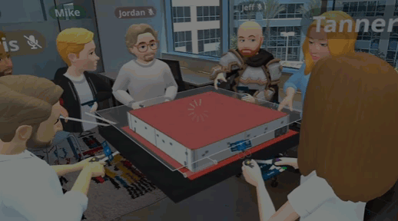
Digital Engineering Technology considerations for Operations
JN
Operations Review
  Simulation and Virtual Reality: Creating realistic simulations and virtual environments to train personnel in a safe and controlled setting providing hands-on training without the need for physical equipment.
  Security Review: Utilizing data analytics to track and assess camera locations, Field of Views, Planting and Landscaping feedback and optimize physical security system well in advance of construction.
  Remote Learning: Facilitating remote and asynchronous training through online platforms, enabling continuous learning and reducing geographical constraints.
  Interactive Manuals: Replacing traditional paper manuals with digital, interactive guides that are more accessible, searchable, and adaptable to different skill levels.
Maintenance
  Predictive Maintenance: Using data analytics, sensors, and machine learning to predict equipment failures and schedule maintenance proactively, reducing downtime and costs.
  Digital Twins: Creating digital replicas (digital twins) of physical assets or systems to monitor their real-time performance, enabling more effective maintenance strategies.
  Augmented Reality (AR): Providing maintenance personnel with AR-based tools and information overlays, enhancing their ability to diagnose and repair equipment on-site.
  Documentation and Records: Digitizing maintenance records, service manuals, and asset histories for easier access and analysis, aiding in decision-making and compliance.
Source: Resolve VR
Advanced digital technologies and methodologies to revolutionize how training and maintenance tasks are carried out.

Slide 50
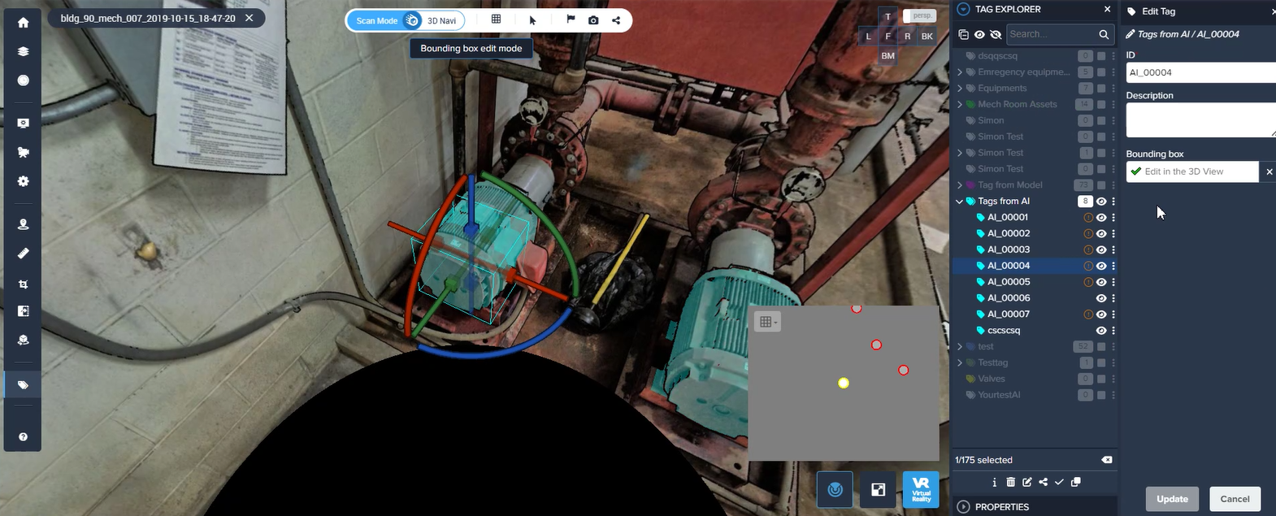
BIM and Reality Capture
JN
Object Context Recognition using AI in Cintoo

Slide 51
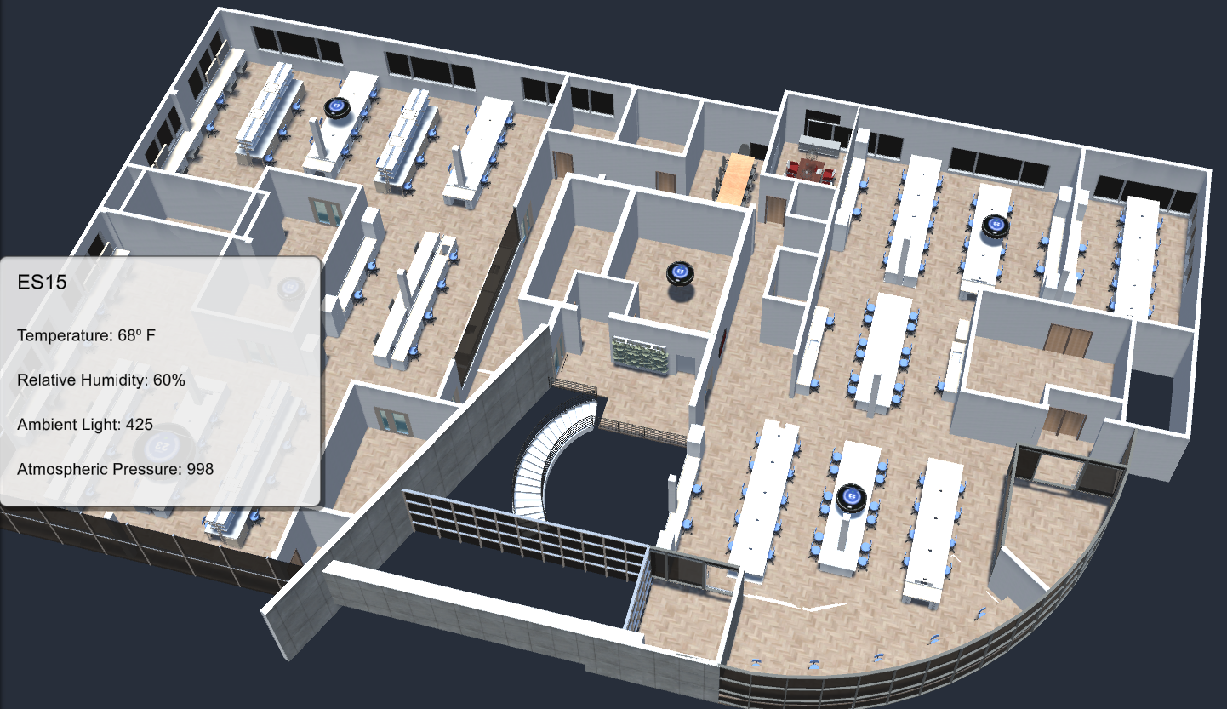
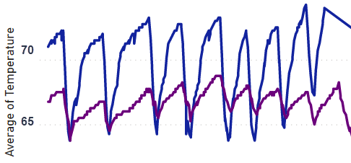
Monitor Building Health
Leveraging the as-built 3D facility model to provide spatial context, live data from IoT sensors, equipment and the building management system can be accessed to provide real-time visibility into building health and performance.
Data can be displayed as current conditions or as a time-series to provide the insight you require.

Slide 52
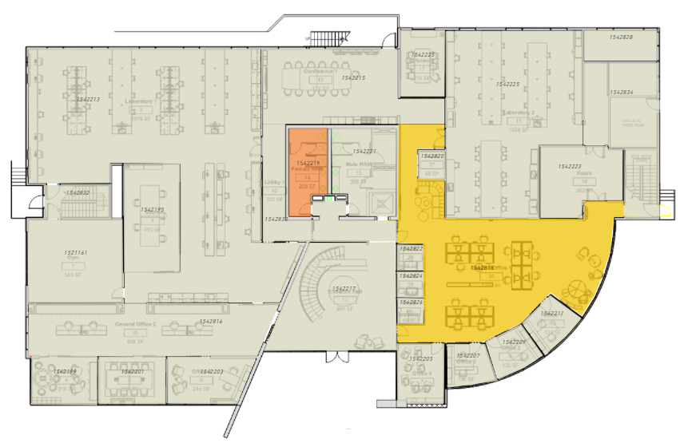
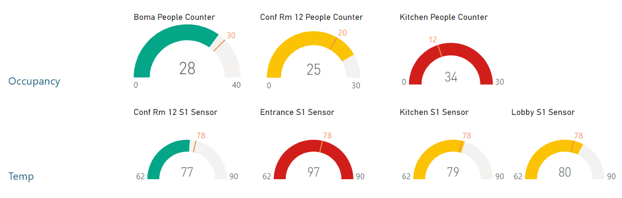
JN
Track Usage and
Predict Maintenance
Interactive dashboards provide real-time data and visual feedback on facility usage, building conditions and overall building health compared to established KPIs.
Rules and logic-based analytics can provide notifications when systems are operating outside desired parameters to predict the need for maintenance and generate workorders before issues arise.

Slide 53
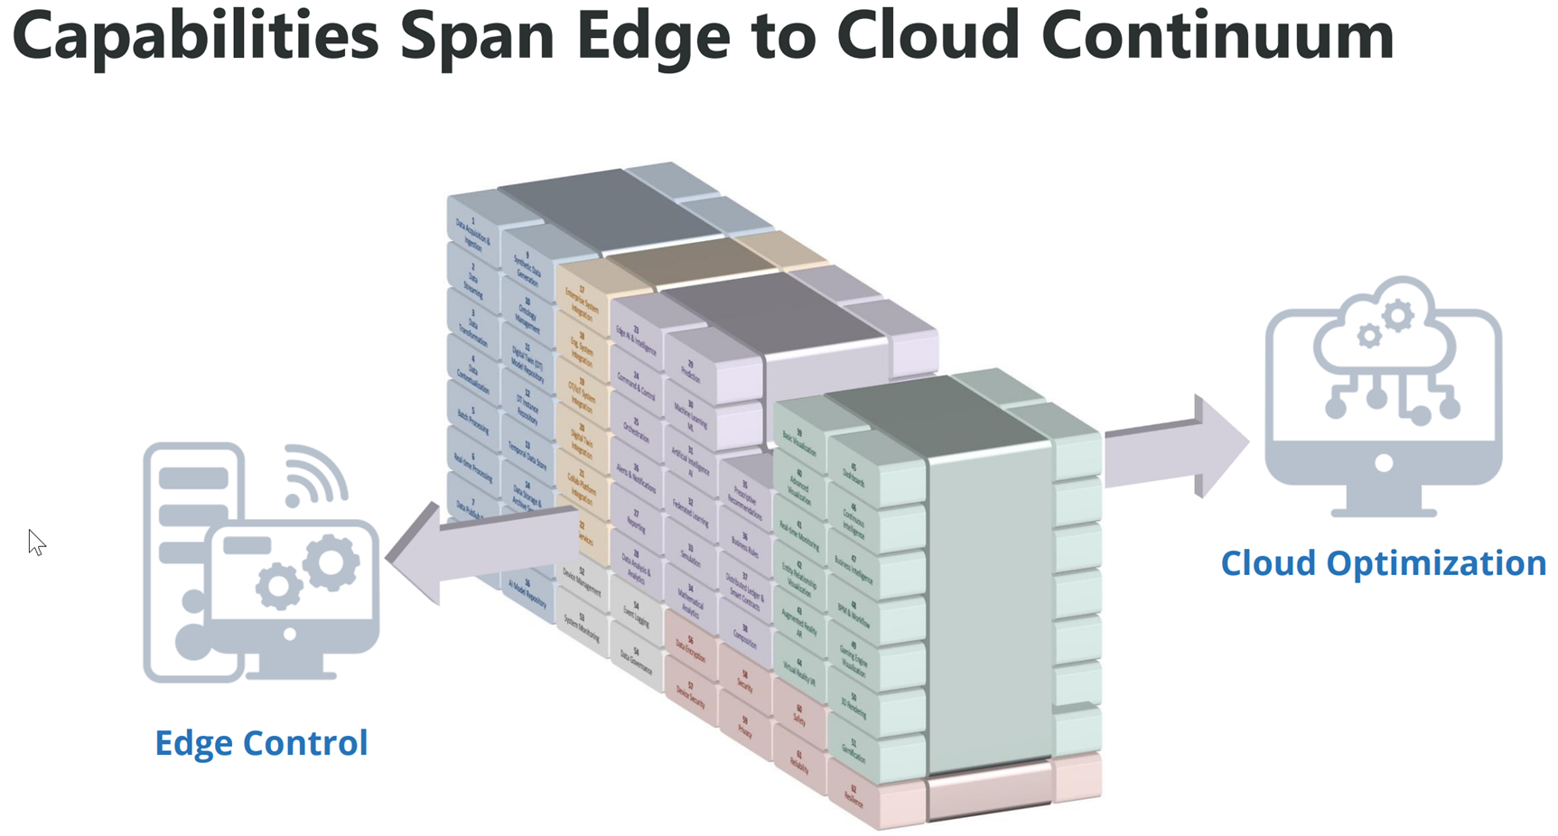
Digital Twin System Capabilities
JN

Slide 54
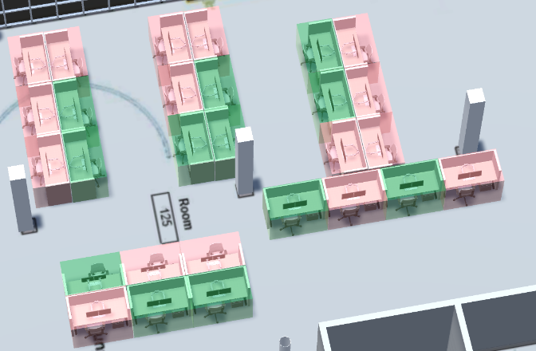
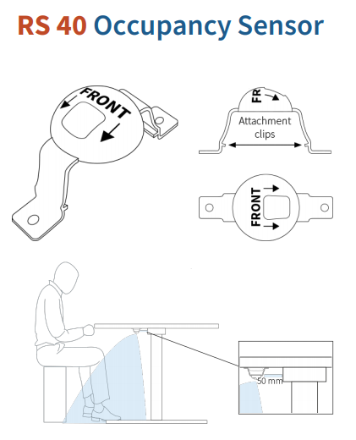
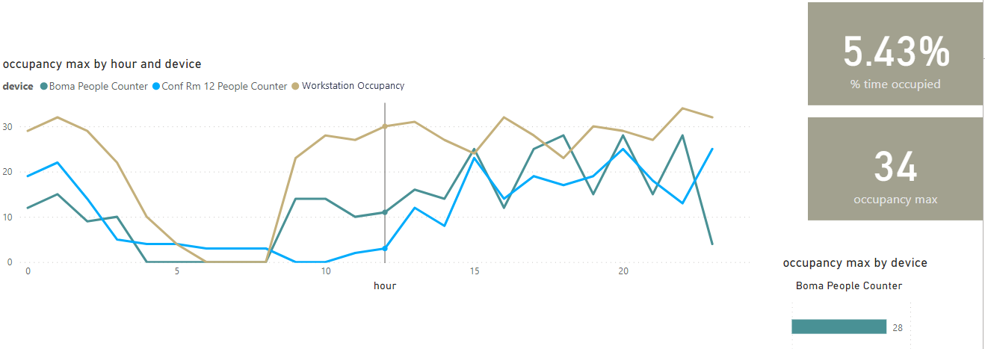
Track Usage
JN
Whether it is a conference room or an individual workstation, IoT based solutions can provide visibility into current occupancy and use over time.
Usage can be displayed in Dashboards and within the 3D Model to provide visual or spatial context.
Hospitality and reservation systems can utilize the data to optimize use of space and dynamically update availability.

Slide 55
What role can digital twins play in simulation and training?
JN
What role can digital twins play in simulation and training?
  Maintenance on trainer systems and support equipment.
  Simulations on operational security.
  EHS simulations.
  human performance feedback.
  operational visibility for program efficacy.
  enhancements for job specific and facility specific training.
  democratize training through data consolidation.
  less logistics to train personnel.
  less time between need for training and getting training.

Slide 56
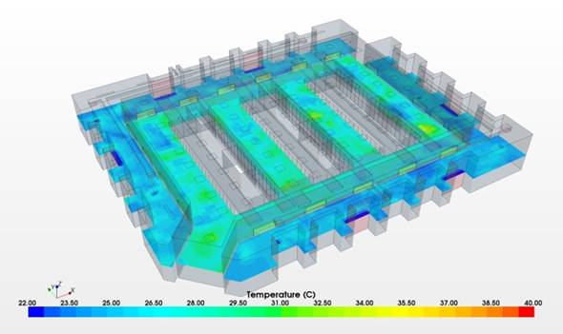
POC #1 Example – Simulate
JN
Description: Apply a physics-based simulation of building energy performance using virtual sensers and engineering models.
Benefits
  Measure expected energy performance of building with higher fidelity
  Improve building energy performance baselining process
  Enables simulation at scale without physical installation of new devices
Approach
  Perform discovery*
  Draft gap analysis*
  Collect data and prepare digital model(s)*
  Perform simulation and prepare report
  Evaluate POC and recommend next steps*
Deliverables
  Simulation Model specification
  Simulation Model(s)
  Simulation Report (pdf and Dashboard)
  POC Evaluation and Recommendations
*Can be integrated/aligned into other POC scopes

Slide 57
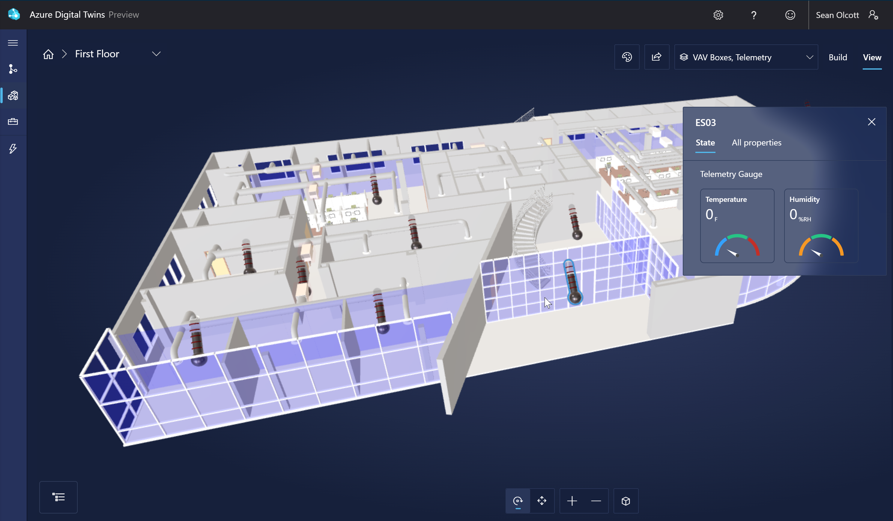
POC #2 Example – Measure
JN
Description: Capture and visualize historical building energy performance using an Independent Data Layer.
Benefits
  Unlock data currently stored in siloed systems
  Enable interoperability across existing systems
  Provide improved access to and control of your energy performance data
Approach
  Perform discovery*
  Draft gap analysis*
  Design data model and solution architecture
  Collect data and prepare digital model(s)*
  Implement data management infrastructure and data visualization
  Demonstrate solution
  Evaluate POC and recommend next steps*
Deliverables
  Data model (relational and graph)
  Proposed solution architecture
  Data management infrastructure implemented on enterprise grade platform (e.g. Azure)
  Integration pipelines for subset of historical data
  Data visualization demonstration
  POC Evaluation and Recommendations
*Can be integrated/aligned into other POC scopes

Slide 58
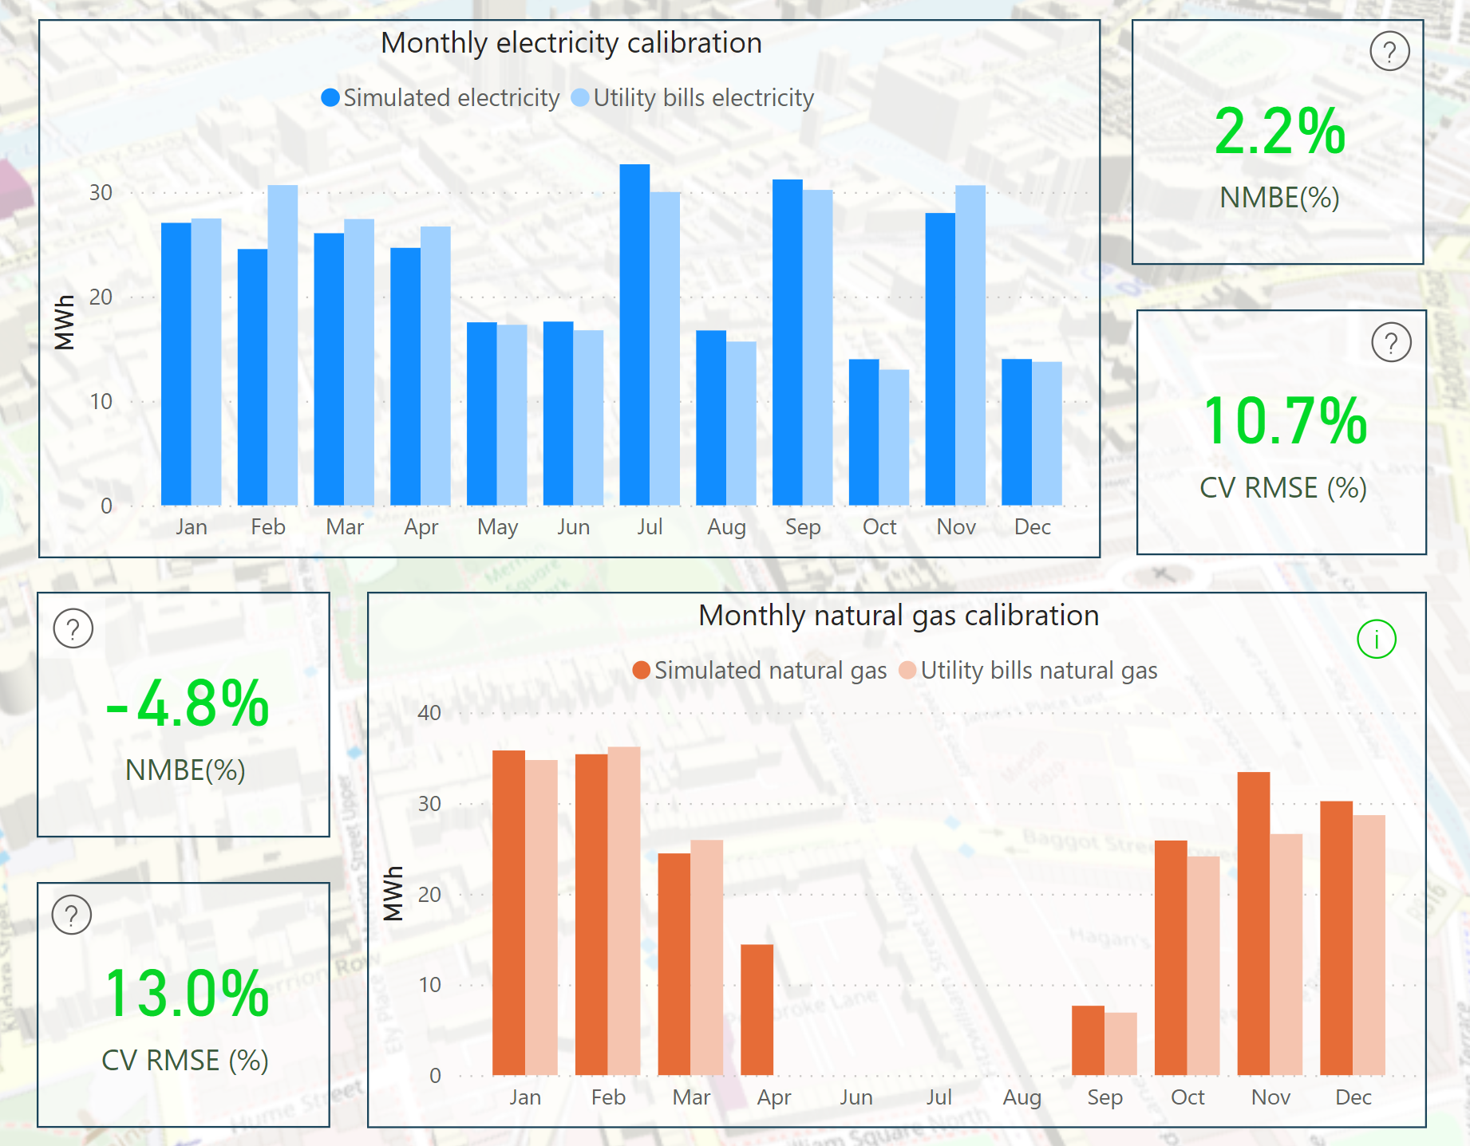
POC #3 Example – Compare
JN
Description: Perform an analysis of actual building energy performance relative to simulated building energy performance.
Benefits:
  Enable holistic building systems audit and continuous calibration
  Provide data validation and performance feedback loop
  Improve decision-making and planning for energy conservation strategy
Approach
  Perform discovery*
  Draft gap analysis*
  Design data model and solution architecture*
  Implement data management infrastructure and analytics
  Demonstrate solution
  Evaluate POC and recommend next steps*
Deliverables
  Data model
  Digital Model(s)
  BI Dashboard for Simulation vs Actual
  POC Evaluation and Recommendations
*Can be integrated/aligned into other POC scopes

Slide 59



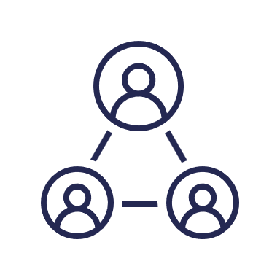
Benefits Summary
JN
Digital Twin
Information silos
Communicate
Point solutions
ERP, CRM, HRIS
Data Integration
Data Lakes
Data Warehouse
Analytics
Dashboards
Lack of predictability
Planning
Design
Construction
Commissioning
Operations
Tenant Improvements
Revamp
Retrofit
Demolition
Organizational disfunction
IoT
IT/OT
Limited visibility
Change management
Built
World
Technology
IoA
ESG+H
Systems
Integration
Project delays
Paper trails
Activities
People Related
Product Related
Manufacturing
Support
Productivity
Collaborate
Cost overruns
Correlate
People & Process
Increase Predictability
Mitigate Risk
System of Systems
Notes:
Animated version: 5 clicks

Slide 60
Benefits Summary
JN
Digital Twin
Communicate
Planning
Design
Construction
Commissioning
Operations
Tenant Improvements
Revamp
Retrofit
Demolition
ERP, CRM, HRIS
Data Integration
Data Lakes
Data Warehouse
Analytics
Dashboards
IoT
IT/OT
Built
World
Technology
IoA
ESG+H
Systems
Integration
Activities
People Related
Product Related
Manufacturing
Support
Productivity
Collaborate
Correlate
People & Process
System of Systems
Notes:
Animated version: 5 clicks

Slide 61
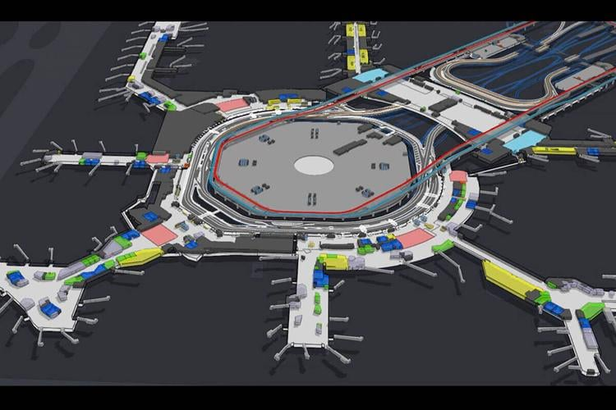
Best practices for digital twins to the DOD
CH
AEC
  Safety and Compliance
Manufacturing
  Moving more products more efficiently.
Entertainment
  Efficiency and guest safety.
Security
  Asset and Equipment tracking.

Slide 62
Use Cases for Digital Twins in DOD Real Estate
CH
When would a digital twin of a built asset (or a related process) improve your ability to understand, predict, and manage its performance in the real world?
During design… when you can integrate point cloud models in BIM authoring models so that design team works within high fidelity representation of real-world constraints.
During construction… when you can validate pay applications by evaluating IoT data related to site activity and reality capture data documenting completed work.
During closeout… when you can verify that installed work matches as-builts and complies with design requirements by integrating point cloud models with project BIM models.
During operations… when you can evaluate actual building energy performance with expected performance by comparing IoT data and physics-based simulations.
During capital planning… when you can analyze actual space utilization using IoT data and reliably predict future program requirements.

Slide 63





Top Five Technical Lessons Learned
CH
BIM is just a single element in the solution
While a BIM-centric data model is important BIM cannot do it all – standards make it happen
Multiple systems will be needed for a lifecycle approach
A single software vendor will not be able to provide the full solution
Start with the end in mind
Focus on the reason for the building, not just the building
Use technology to transform the process
Applying technology to an inefficient process will create waste faster
Technology cannot provide all the solutions
This is as much about change management as technology

Slide 64





Top Five Change Management Lessons Learned
CH
Focus on participation of existing staff.
This cannot be done to an organization
Leaders must lead
The tone of the transformation is reflected in how the leaders communicate about it
Coordination is critical
A Transformation Program structure is critical for road map, governance and much more
Don’t forget that this is more about people than technology
The changes should enable people to thrive in a secure manner that breaks down barriers
Plan to roll out the approach progressively
A “big bang” approach has too much risk in an environment in which projects extend for several years

Slide 65

Closing
Full understanding of what a digital twin is, common language terms, and definitions to use when talking about digital twins

Slide 66

Closing
Understanding of what a digital twin is, common language terms, and definitions to use when talking about digital twins
How to build a digital twin for monitoring DOD assets (facilities, buildings, vessels, etc.)

Slide 67

Closing
Understanding of what a digital twin is, common language terms, and definitions to use when talking about digital twins
How to build a digital twin for monitoring DOD assets (facilities, buildings, vessels, etc.)
Learn about novel technology integrations that are making digital twins more efficient.

Slide 68

Closing
Understanding of what a digital twin is, common language terms, and definitions to use when talking about digital twins
How to build a digital twin for monitoring DOD assets (facilities, buildings, vessels, etc.)
Learn about novel technology integrations that are making digital twins more efficient.
Roles that digital twins can play in simulation and training.

Slide 69

Closing
Understanding of what a digital twin is, common language terms, and definitions to use when talking about digital twins
How to build a digital twin for monitoring DOD assets (facilities, buildings, vessels, etc.)
Learn about novel technology integrations that are making digital twins more efficient.
Roles that digital twins can play in simulation and training.
Best practices for digital twins that transfer from the private sector to the DOD

Slide 70




Questions
John Niles
Ryan Thomas
Chris Hussey

Slide 71
Fonts
Use big, sans-serif fonts (24-pt Arial Bold)
  These fonts could be a little smaller, but not much
  (20-pt Arial Bold)
  Serif fonts are harder to read at any given size and resolution (20-pt Times New Roman)
Use big, sans-serif fonts (18-pt Arial Bold)
  Unlikely you’d want anything smaller than this (16-pt Arial)
  Also, serif fonts are harder to read at any given size and resolution (16-pt TNR)
Use standard fonts
  Arial or Tahoma; not Helvetica
  If you must use non-standard fonts (but why??), then embed them:
    File | Save As | Tools | Save Options … | Embed True Type Fonts (18-pt Tahoma)
    This may cause font copyright problems in PowerPoint 2003!

Slide 72
Colors

Slide 73
Resources
Digital Engineering Body of Knowledge (DEBoK)
US AF Digital Transformation Guide
USD SE&A Web Site
  Digital Engineering Page
  Engineering References for Program Offices
    DoD Digital Engineering Fundamentals
    Digital Engineering Ecosystem Generic Requirements
    DoD Instruction 5000.88, Engineering of Defense Systems
    Engineering of Defense Systems Guidebook
    Systems Engineering Guidebook
    Systems Engineering Plan (SEP) Outline, Version 4.0
  The Digital Engineering, Modeling and Simulation (DEM&S) Glossary
Others
  DAU, CENG 001 Digital Engineering for DoD Consumers Credential (CLE084, MBSE)
  INCOSE SE Body of Knowledge (SEBoK)
  OMG MBSE WIKI
  CIMdata
  Digital Twin Consortium
  AIAA Digital Engineering Integration Committee- Digital Engineering Public Forum
  Systems Engineering Research Center (SERC)
  Digital Twins for the Built Environment
73
Notes:
Frank; Time hack 3 min

