Slide 1



Mitigation and Management of Minimize Cybersickness in the Design and Implementation of Learning Systems with Virtual Environments
Kay Stanney & Claire Hughes, Design Interactive
Perry McDowell, Naval Postgraduate School
LCDR Nicholas Adriaanse, RAN, NSWCDD DNA
NSWCDD-PN-24-00198 Distribution Statement A. Approved for public release: distribution is unlimited.
Notes:
Nick - 1

Slide 2
Learning Outcomes
Attendees will be able to describe the basic science of the causes and mitigating factors of cybersickness (CyS)
Attendees will be able to express how to design eXtended Reality (XR) solutions to minimize CyS effects in users
Attendees will be able to apply protocols to minimize the CyS impact of XR environments
Attendees will be able to use key actions/methods to design curricula which minimize CyS
Acronyms
CyS – Cybersickness
XR - eXtended Reality
Notes:
Nick – 1
Attendees will come away with a knowledge of cybersickness (CyS), including
causes and factors affecting CyS, as well as how to design virtual environments (VEs) and curricula to
minimize CyS effects upon students and learner outcomes.
This tutorial will provide attendees with a basic knowledge of the underlying causes of CyS, which factors aggravate or mitigate CyS, how CyS degrades learning, as well as how to design a VE system and create a curriculum to minimize CyS’s effects.
List mitigating factors

Slide 3
Audience
Designers of XR solutions
Program managers involved in creation and implementation of training systems utilizing XR
Curriculum managers designing and managing courses using XR
Instructors teaching classes using XR
Acronyms
XR - eXtended Reality
Notes:
Nick – 2
Won’t bog you down with the science – but a little bit is necessary to ensure we are all talking with the correct vocabulary. This is about practical application of the science to fielding a VE in a training environment.
Purpose: This tutorial is designed to provide those involved in producing and implementing VEs for training with a basic knowledge of CyS. This is significant because CyS can reduce the training effectiveness of systems utilizing VEs and visual simulations, even to the point of making it unusable. Mitigating the effects of CyS begins in the design of the system, where minor decisions can result in substantial differences in the CyS effects of the final system. Likewise, curricula design can greatly impact the degree that CyS affects students.
Militaries across the globe are planning on utilizing VEs to improve their training, whether they be traditional simulators using screens or the most up-to-date technology such as head mounted displays for virtual reality, augmented reality, mixed reality, or extended reality. There is a general belief among both the general public and the training community that the technological advancements in the latest generation of these devices have eliminated the effects of CyS.. However, this is decidedly not true

Slide 4
This Tutorial is NOT:
A deep dive into the science of CyS
A detailed design course for
Curriculum building/ADDIE
Virtual environments (VR/AR/games)
Training systems
Discussion on XR environmental safety
Acronyms
CyS - Cybersickness
XR - eXtended Reality
ADDIE – Analysis/ Design/Development/ Implementation/Evaluation
VR – Virtual reality
AR – Augmented reality
Notes:
Nick – 2

Slide 5
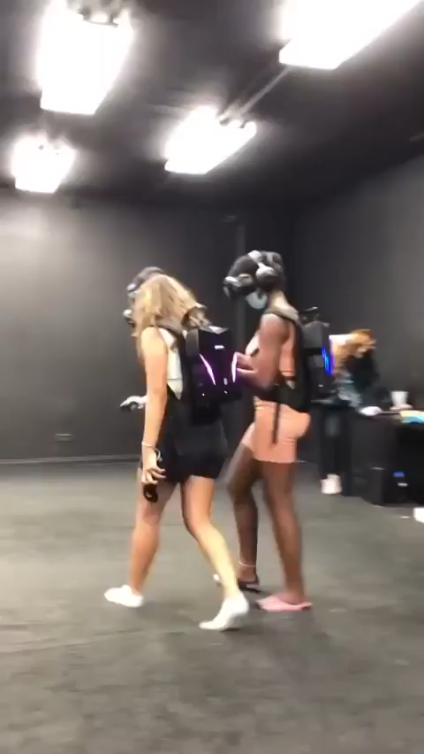
This is NOT Cybersickness
Notes:
Nick - 2

Slide 6
Agenda
Definition of CyS
Importance of CyS
CyS Science
Scientific factors that affect CyS
How to reduce CyS during the design and development phases
Protocols to reduce CyS for fielded systems
How to reduce CyS during curriculum design
Other factors
Conclusions
Acronyms
CyS - Cybersickness
Notes:
Nick: 2
Intro -> Agenda
Claire: (20mins)
Definition of CyS
Importance of CyS
CyS Science
Scientific factors that affect CyS
How to reduce CyS during the design and development phases
Perry: (20mins)
Protocols to reduce CyS for fielded systems
How to reduce CyS during curriculum design
Other factors SHOULD WE BE MORE SPECIFIC HERE
Conclude (10mins + 20mins questions/interaction)

Slide 7
Background Information
Introductory Material
Definition of CyS
CyS is a phenomenon that occurs when individuals experience symptoms while/after using simulation technology, such as flight simulators or XR training systems
Acronyms
CyS – Cybersickness
XR – eXtended Reality
Notes:
Perry – 0.5
Thank you Nick. I’m Perry McDowell, a researcher with the MOVES Institute at the Naval Postgraduate School. A former Naval officer, my work is primarily in the area of training, largely in games, VR/AR/etc.
On the screen is the general, generic definition that most people use. First point: we’re using the term “cybersickness” synonymously with “simulator sickness,” when they really are two different conditions. We’ll see why in a few slides.
However, those who don’t specifically study the field conflate them and this is the most common definition you will get if you ask those working in the M&S field.
CyS is a phenomenon that occurs when individuals experience symptoms while/after using simulation technology, such as flight simulators or VEs. These affect a large percentage of the user population, with some experiencing minor effects easily ignored and others being unable to utilize the system at all.
Now, this begs the question, what symptoms are we talking about… [CLICK]
ADD “/AFTER” AFTER “WHILE…”
CHANGE TITLE TO “BACKGROUND INFORMATION”

Slide 8
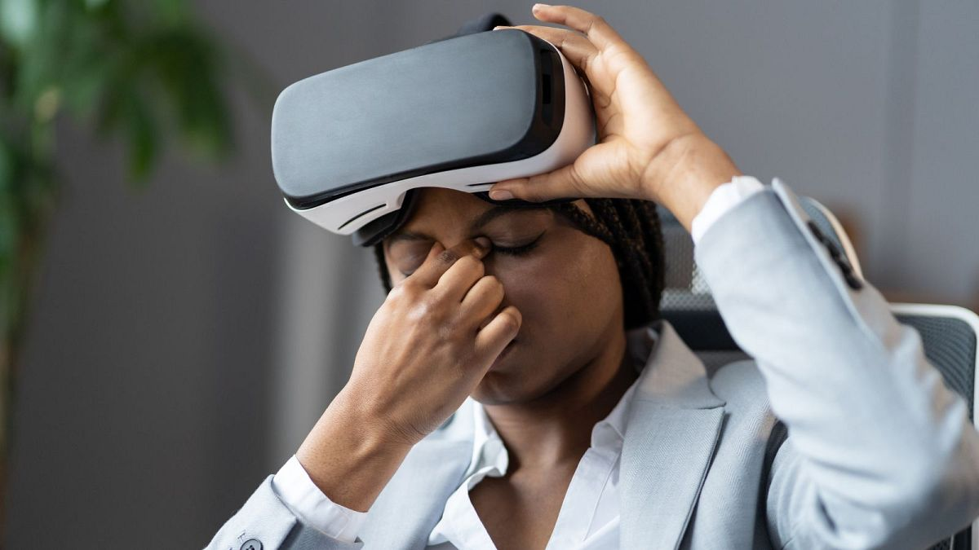
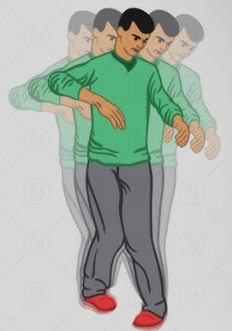
CyS Symptoms
During: XR Exposure
After: Adverse Physiological Maladaptation
Ataxia
Blurred Vision
Sopite Syndrome
After
Visual Disturbances
Reduced Dexterity
Headache
Pallor
Rapid Breathing
Dizziness
Blurred Vision
Eye Strain
During
Malaise
Vertigo
Sweating
Acronyms
CyS – Cybersickness
XR – eXtended Reality
Burping
Nausea
Vomiting
Notes:
Perry – 2.5
As we cover the symptoms, it’s also important to remember that not every user suffers each of these symptoms – suffering one or more is sufficient to be considered to be suffering cybersickness.
It’s also very important to note that our definition used the terms “during/after” because the symptoms of CyS don’t affect people only while they are in a VE. In fact, they can continue for several hours after leaving. And while many of the symptoms experienced during and after are similar, there are some differences.
So let’s start with the symptoms users might suffer while in the environment are:
Headache Dizziness Eye strain Vertigo
Sweating Nausea, up to reaching the point of Vomiting, albeit this severe a reaction is rare,
Burping Malaise Blurred vision Rapid breathing Pallor
The symptoms suffered after leaving the environment include:
Ataxia (basically clumsy movements that affect walking, balance, speech, swallowing, and eye movements.)
Sopite syndrome (Drowsiness, Fatigue, Mood changes, Apathy, and many similar feelings)
Reduced dexterity
Visual disturbances/blurred vision
The most common way of quantifying these symptoms is via the simulation sickness questionnaire (SSQ), which Kennedy and other proposed in their 1993 paper:. Users are asked to rank their level of discomfort in each of these [LASE SCREEN] common symptom areas from 0 (none) to 4 (severe) before and after exposure to the simulator or VE.
The SSQ breaks the symptoms down into three major areas: Ocular motor, Nausea, and Disorientation, where each of these [LASE SCREEN] symptoms falls into one of more of these categories. The users’ rankings are used to create a score in each area, and the three areas are combined in a weighted fashion to create an overall score.
Just as there are many symptoms, there are also many names for these effects… [CLICK]

Slide 9

Many Names for Similar Issues
Simulator sickness
Cybersickness
Virtual reality sickness
Virtual environment sickness
Simulation induced sickness
Cyberadaptation syndrome
Virtual environment adaptation syndrome (VEAS) [after NASA: Space Adaptation Syndrome]
Acronyms
VEAS - Virtua environment adaptation syndrome
Notes:
Perry - 1
Shown here. The first two listed here – simulator sickness and cybersickness – are the two that are in most common use and generally contain most of the issues covered in the others.
Unless you’re getting into very specific CyS research, if you see one of these terms in general discussion, you can normally treat them as synonymous.
The last two, where “sickness” is replaced with “syndrome”, are actually more correct, because this effect is not a “sickness” it happens to people without
However, studies have shown that the first two terms are NOT actually synonymous. A sickness, or illness, is usually a combination of a disease and other factors, while a syndrome is a set of symptoms that may or may not have a clear cause. This also occurs in otherwise healthy people.
[CLICK]

Slide 10
Simulator Sickness ≠ Cybersickness
Many people utilize catch-all term “cybersickness”
VR
AR
Simulator
Research has shown that symptoms of XR sickness and simulator sickness are significantly different
In simulator sickness, oculomotor symptoms predominated, followed by nausea and disorientation is the least least experienced symptom
In VR sickness, the effects are reversed – disorientation is the most prevalent symptom, followed by nausea, with oculomotor the least experienced symptom
In AR sickness, oculomotor symptoms predominated, followed by disorientation, with nausea as the least least experienced symptom
Additionally, the severity of effects three times greater in VR sickness than simulator sickness (Stanney et al., 1997)
Acronyms
VR – Virtual Reality
AR – Augmented Reality
XR - eXtended Reality
Notes:
Perry – 1.5
As I said, “cybersickness” has become the most common term used to describe symptoms in any type of computerized environment such as simulators or HMDs, but those in the field often break them down separately and here’s the reason. We do this because users generally feel different types of discomfort in “VR sickness” vs “AR sickness” vs “simulator sickness, with the differences in the orders of severity experienced in the three areas of the SSQ.
ADD:
CHANGE CAUSES TO SYMPTOMS??? ADD AR SICKNESS TO THAT SAME LINE???
COLOR THE TEXT TO MATCH THE COLORS USED IN THE PREVIOUS SLIDE???
ADD “THE” AFTER “VR SICKNESS”
ADD “IS” AFTER “DISORIENTATION”. ADD “THE” AFTER “OCULMOTOR”
ADD “THE” AFTER “NAUSEA AS”
ADD “THE” AFTER “ADDITIONALLY,”

Slide 11
Importance of CyS
Learning Objective 1a
Why CyS is important
Military using far more AR/VR/MR/XR in multiple areas
Acronyms
CyS – Cybersickness
VR – Virtual Reality
AR – Augmented Reality
MR – Mixed Reality
XR – eXtended Reality
Notes:
Perry - 0
So why do we think CyS is important?
Because simulators and other methods of computer-based visual training – and operations - are becoming far more common in the military.

Slide 12
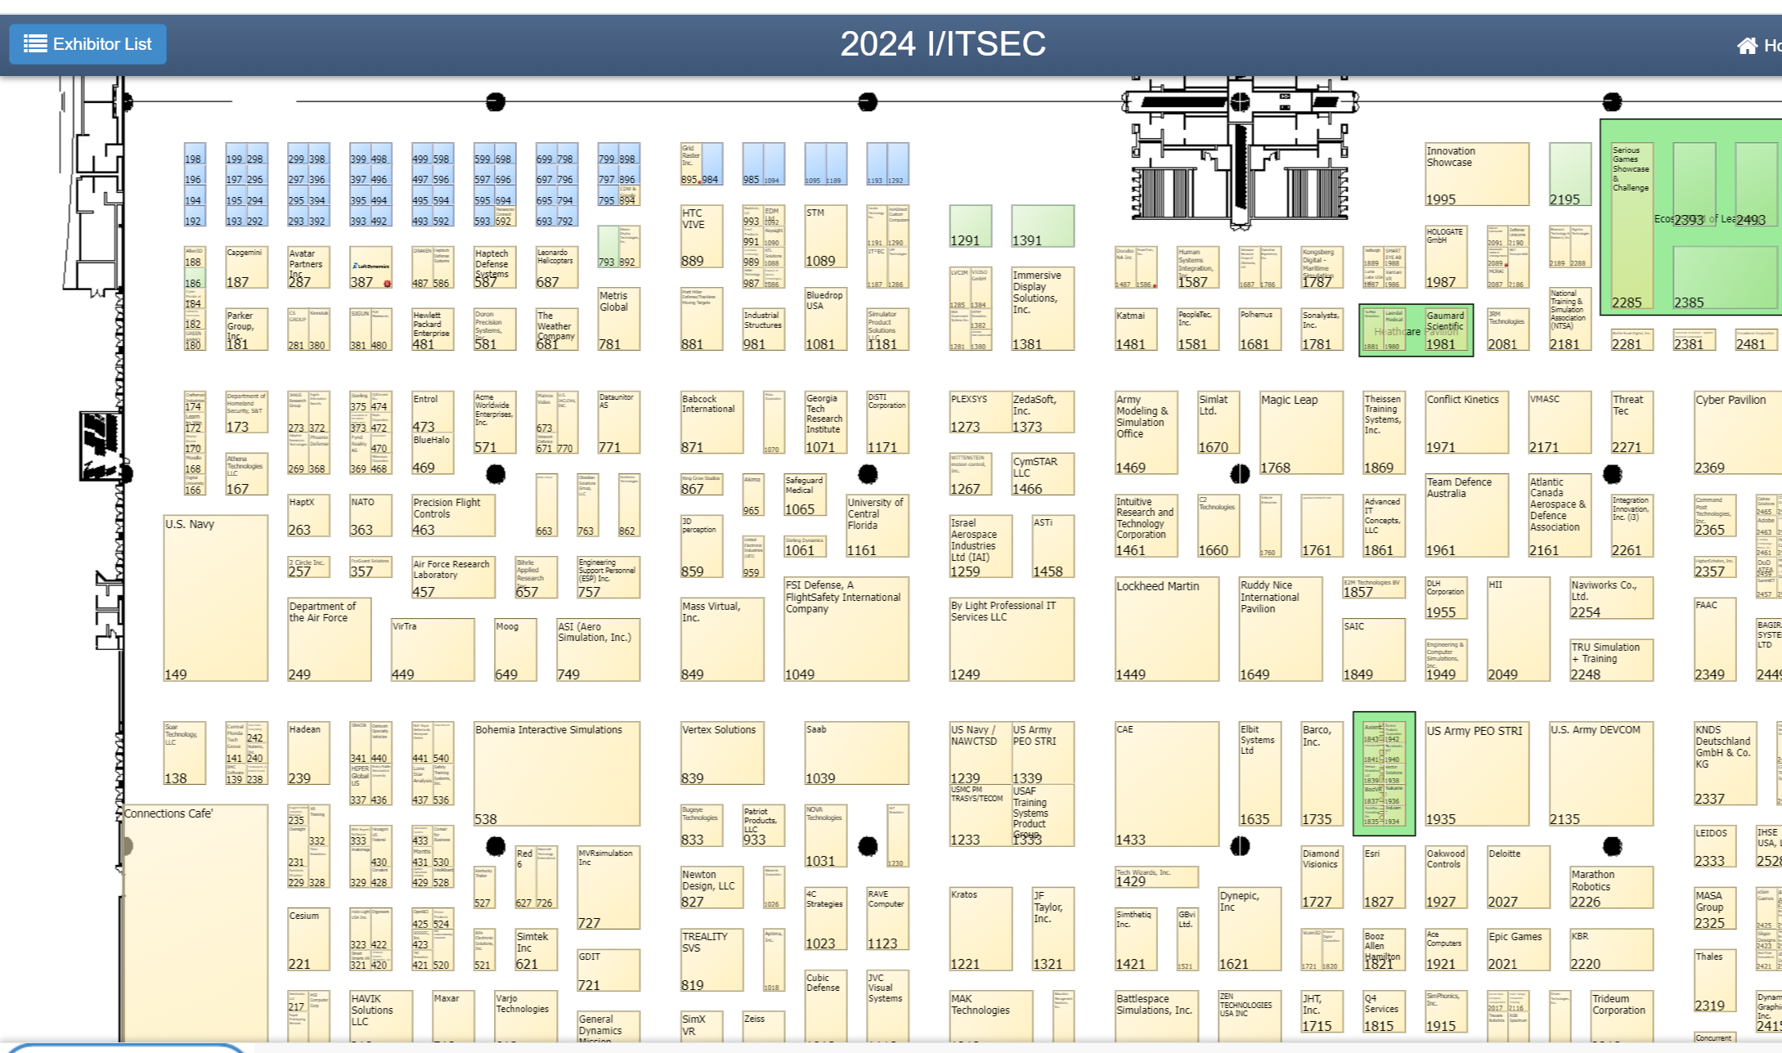
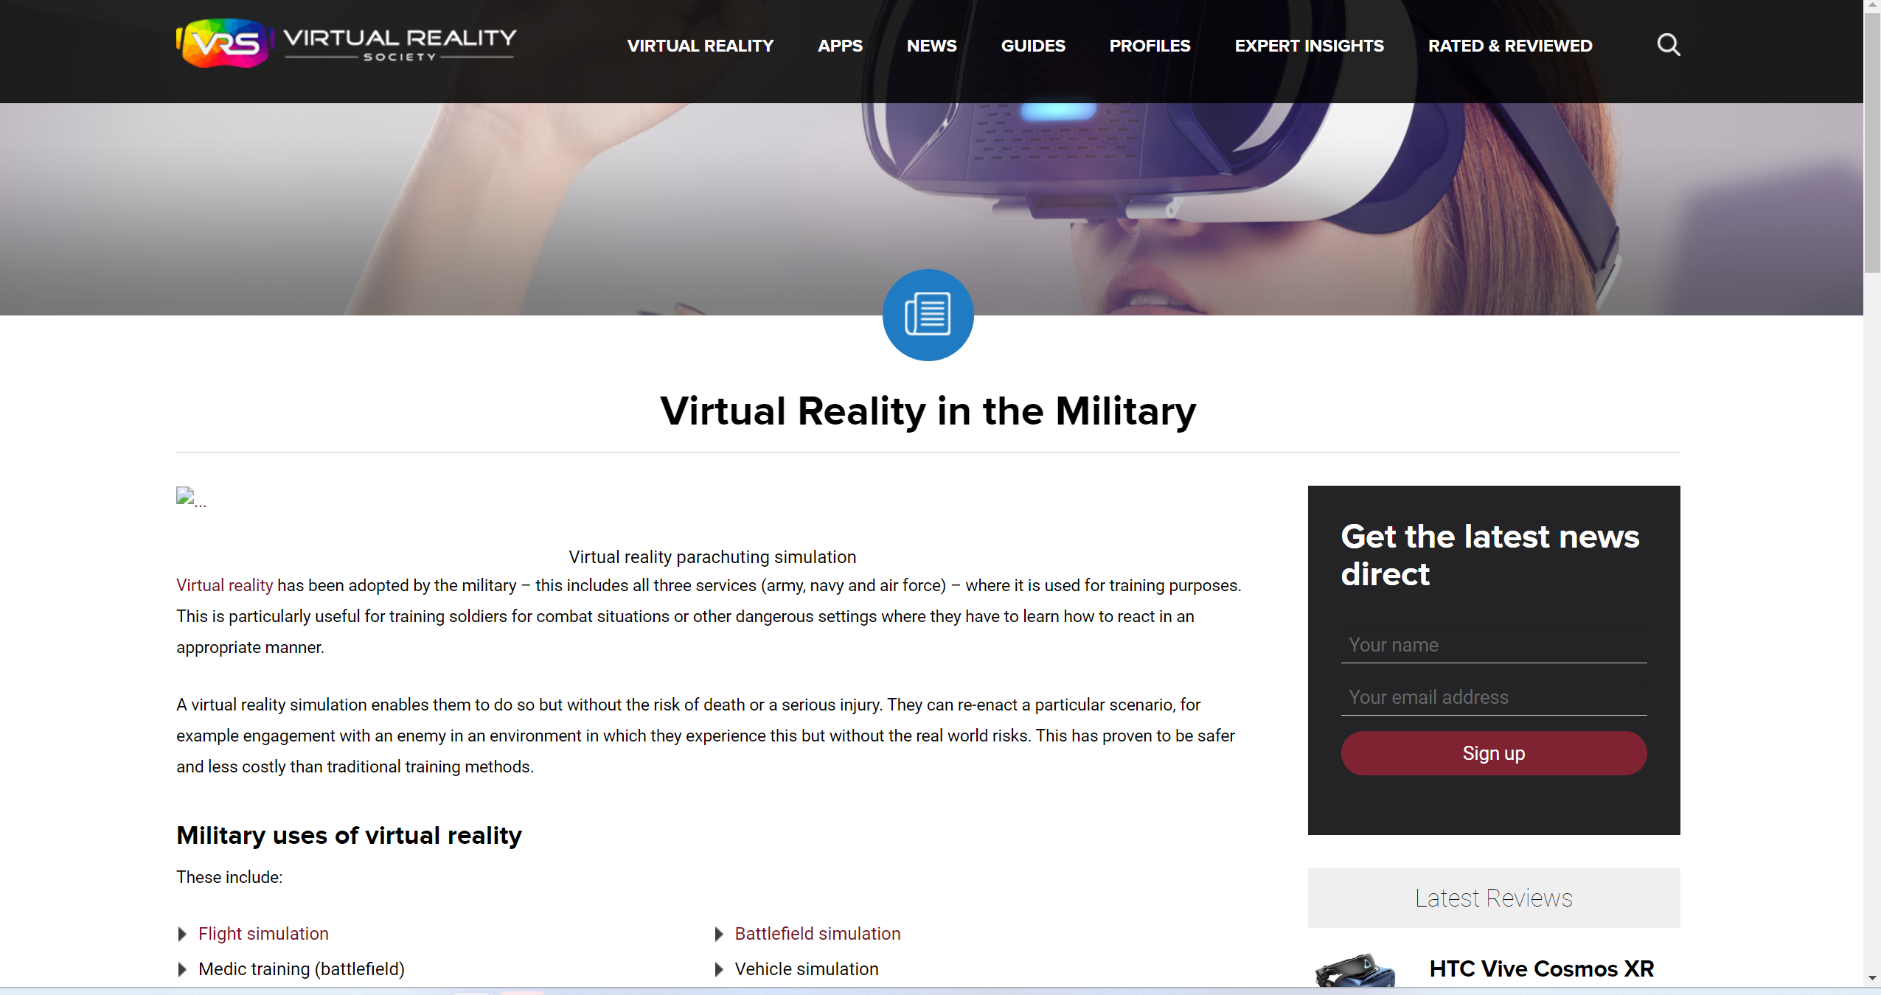
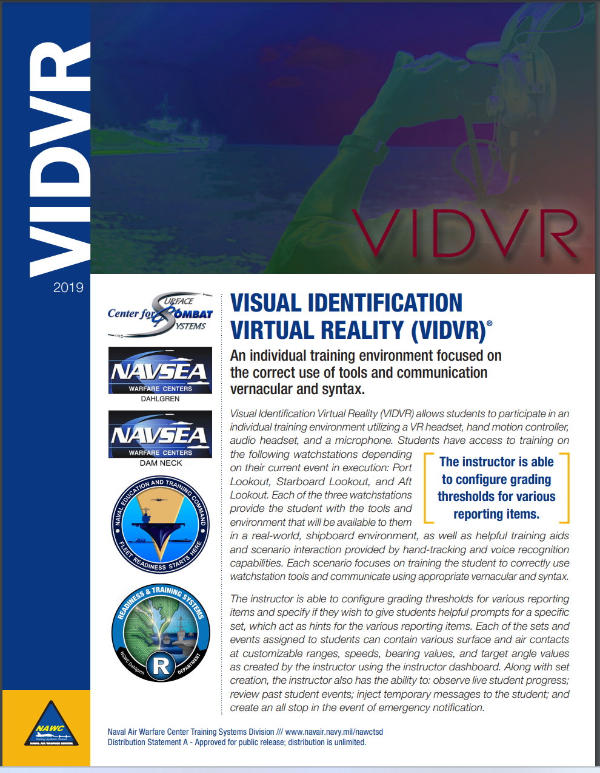

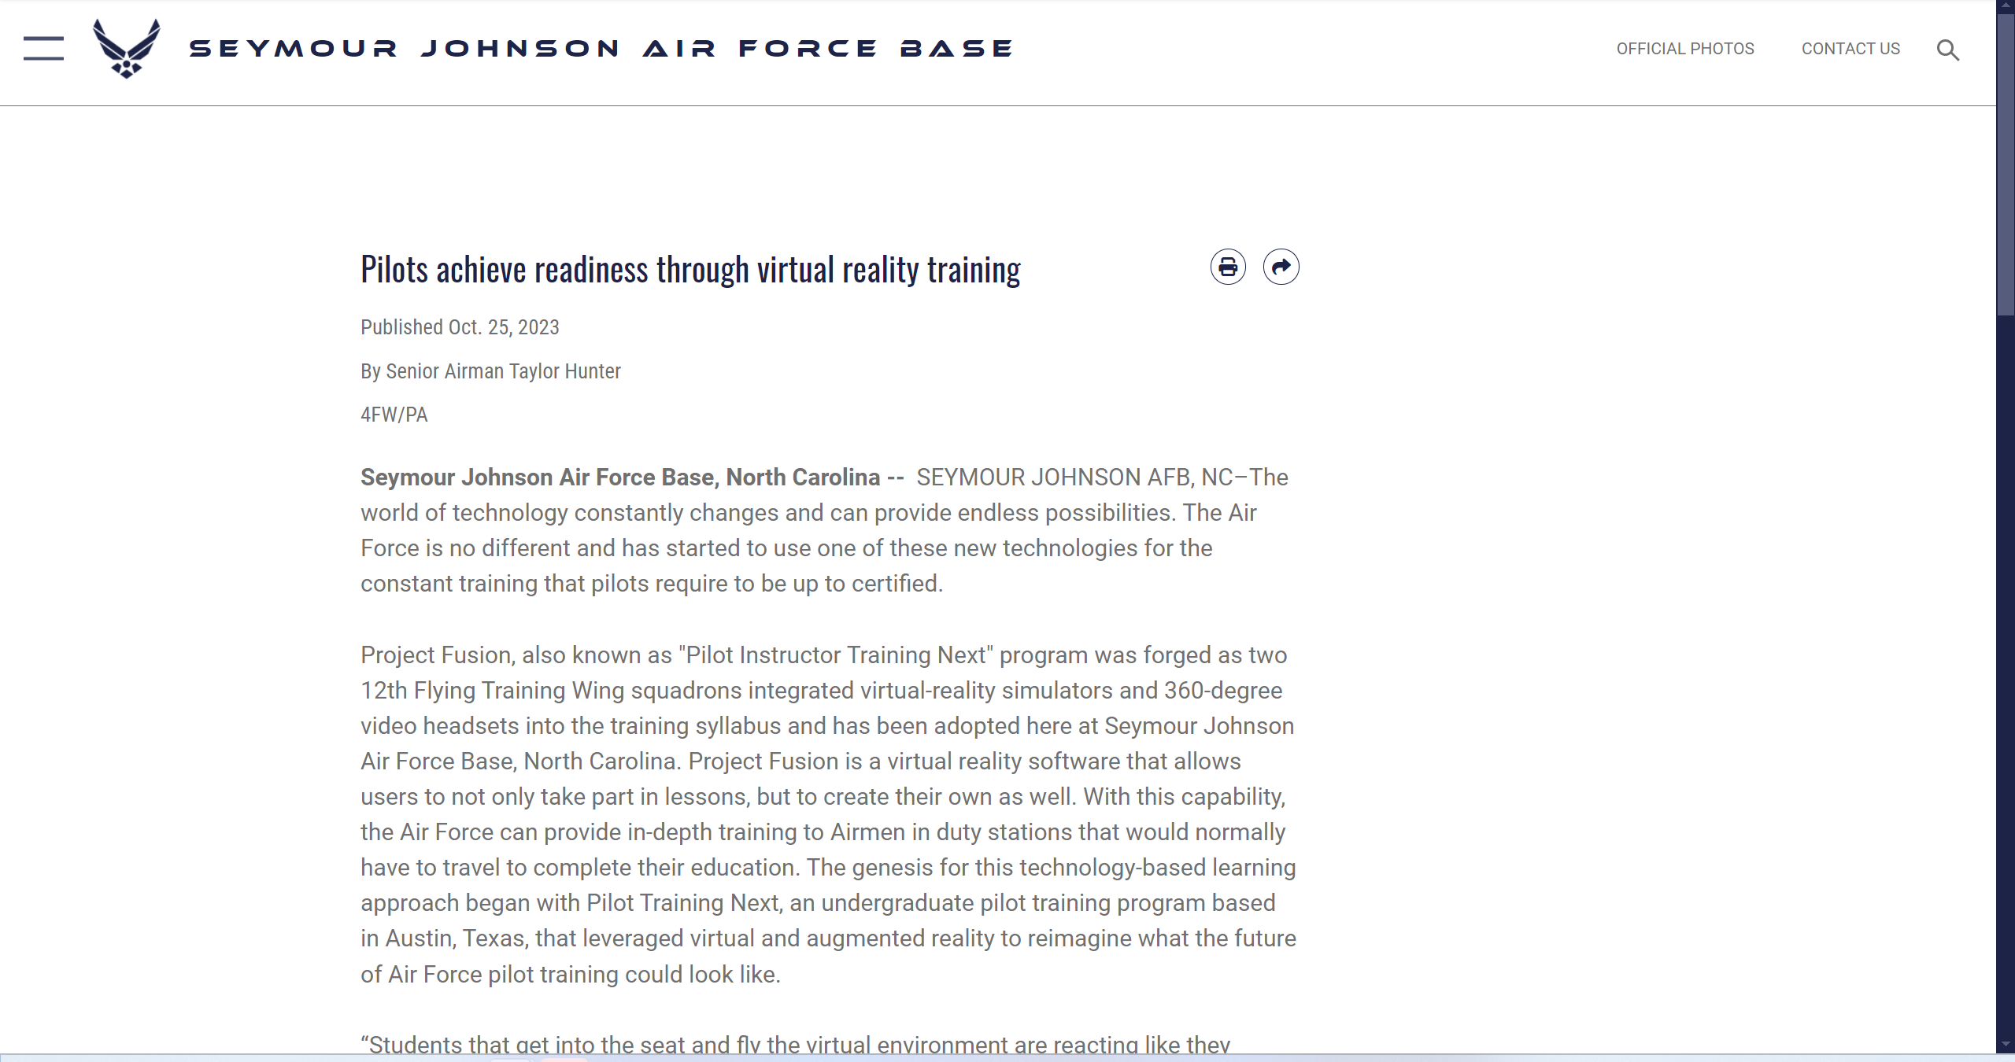
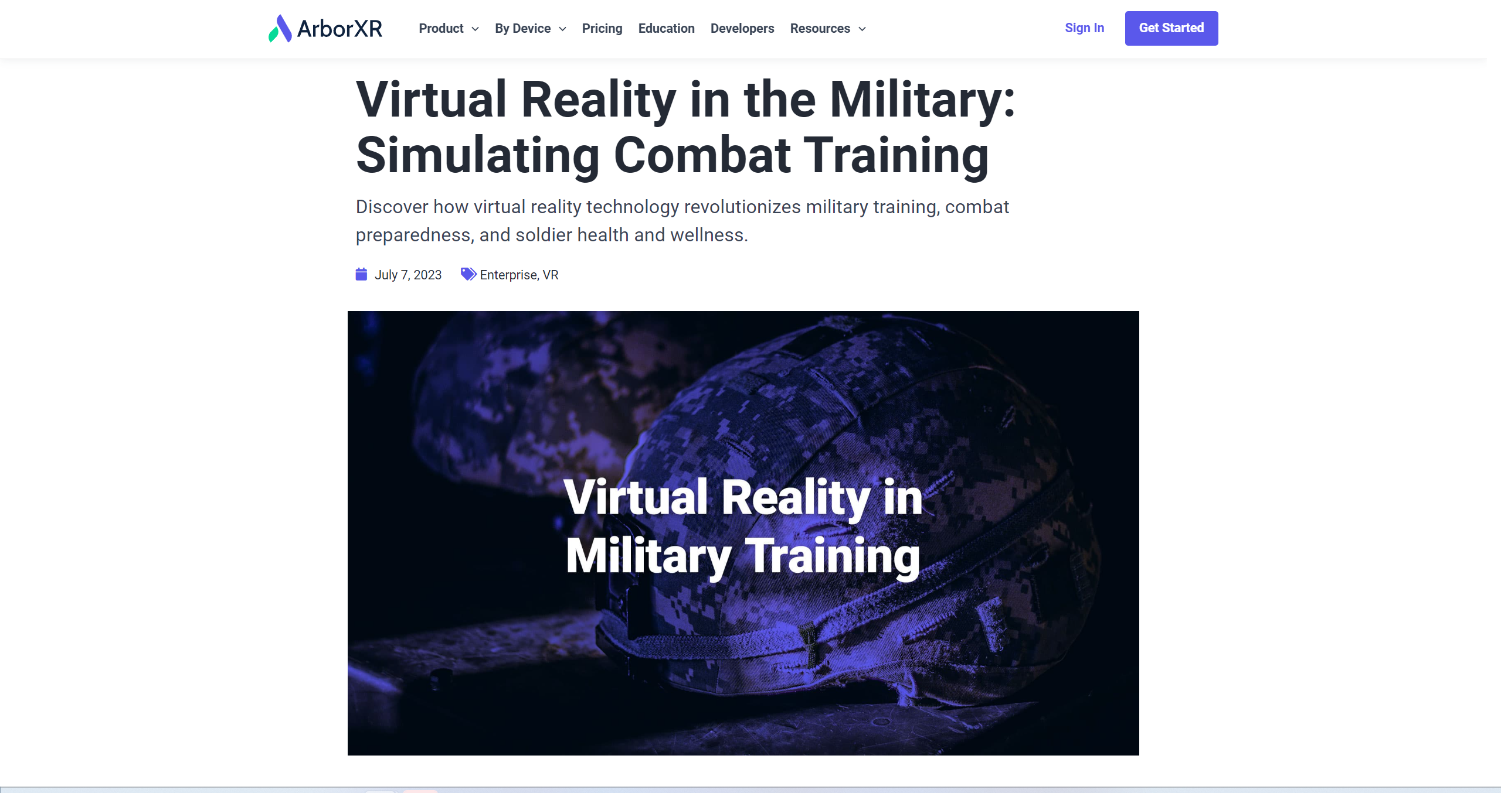

DoD using More AR/VR/MR/XR
Acronyms
Notes:
Perry – 0
NEED TO REHEARSE THIS ONE.
It’s used for
parachuting training…
pilot training by the USAF
Army for a wide range of training
By more and more companies both domestic and international
And what got us interested, the Navy for very basic training.
And beyond, training it’s also being implemented more for operational uses such as mission planning, visualization, even maintenance.
If you don’t believe me, when you walk the floor this week, see how many different booths have HMDs or simulators.
[CLICK]

Slide 13
Importance of CyS
Learning Objective 1a
Why CyS is important
Military using far more AR/VR/MR/XR in multiple areas
Despite claims, technology is unlikely to eliminate CyS
How CyS affects learners in/after VEs
CyS can have significant impact upon learning
Acronyms
CyS – Cybersickness
VR – Virtual Reality
AR – Augmented Reality
MR – Mixed Reality
XR – eXtended Reality
VE – Virtual Environment
Notes:
Perry – 1.5
But if the military is using this far more than in the past, shouldn’t it fully understand any potential issues with it?
If we’re putting Soldiers/Sailors/Airmen/Marines into these systems, we owe it to them that the systems are safe and aren’t causing issues for them.
Because, despite that claims of many of those building the latest and greatest head-worn systems, technology is unlikely to completely eliminate CyS. Claire will show you in a few minutes that the causes of CyS are not necessarily a hardware problem or a software problem, but primarily a wetware problem, i.e., .a human issue, that new technology is unlikely to eliminate for quite a while.
Also, we need to better understand the effects of CyS upon this VE-based learning paradigm. Think about many of the symptoms of cybersickness when in an environment
Headache Dizziness Eye strain Vertigo Nausea Malaise Blurred vision
And think about how well you would learn from a lecture or perform when you’re suffering from some or all of these symptoms. I’m not going to ask for a show of hands, but did anyone ever show up to an eight o’clock class hungover from the night before?
A quick personal anecdote: when I was a midshipman, we went to Pensacola for a week of aviation familiarization where we got to fly in T-34s. . (BTW, this was one month after Top Gun came out, so you can imagine what we were thinking walking around in flight suits.) I was smart enough not to go out the night before flying, but two nights before the flight, we all went out late. The next morning, I was suffering from CyS symptoms, and not paying attention to the class. I remember suddenly realizing that the subject being covered, although unlikely to be needed, would be extremely important to know if it was needed. The subject was “How to bail out of a T-34.” But even after realizing that, I don’t think I got very much out of the lecture. Luckily, my T-34 remained airborne.
So, imagine users trying to learn in a VE while battling symptoms that mimic a hangover.
Likewise, imagine utilizing an HMD for training in a morning class and then trying to learn in the afternoon when you are suffering from the post-exposure symptoms of
Ataxia (the clumsy movements that affect walking, balance, speech, swallowing, and eye movements.),
Sopite syndrome (Drowsiness, Fatigue, Mood changes, Apathy, Depression, Lethargy, Irritability, Malaise, and Impaired concentration), Visual disturbances/blurred vision
So VEs can be implemented to improve training effectiveness, but CyS might make it impossible to learn effectively in them.

Slide 14
Importance of CyS
Why tutorial attendees need to know about CyS
Choices in design and development of training system can greatly affect user’s CyS symptoms and often cannot be undone later
Curriculum designers must consider CyS in planning out a class that utilizes XRs to minimize harmful effects both during and after exposure
Class management can significantly affect CyS factors when XRs are used
Acronyms
CyS – Cybersickness
VE – Virtual Environment
Notes:
Perry – 1.5
So why is it important for you?
If you’re a program manager or someone involved in the acquisition program, you need to understand how CyS will affect the effectiveness of your product and ensure that requirements are written in such a way to reduce the likelihood of CyS as much as possible.
If you’re an engineer, you need to understand how your decisions, even innocuous ones, can have a major effect on causing CyS.
If you’re involved in designing curricula, you must understand the effects of CyS on your students and plan accordingly as you design and request new types of learning aids for your program.
If you’re involved in classroom management, when, for how long, and other factors can greatly affect the likelihood and severity of CyS symptoms.
[CLICK]

Slide 15
Why is CyS Important?
Safety & Health
Reduced training effectiveness
Don’t crash the student
Unwanted, unintended side effects
Decreased use of the system
Sales (of simulators, tickets, or software)
Liability
Acronyms
CyS - Cybersickness
Notes:
First, you don’t want a training system that inherently reduces training effectiveness - we need to better understand the effects on this new learning paradigm on learner performance.
We covered how hard it can be to learn in VEs or after using them, due to the symptoms of CyS.
Additionally, you don’t want to crash the student. There has been at least one incident when after training in a simulator, an experienced pilot drove his car into a ditch due to disorientation. (And, no, he hadn’t stopped at the O Club for a couple.) Also remember, that the effects of VEs are roughly 3x the effects of simulators. What should be the mandated delay between utilization of experiencing an environment and flying or another similarly difficult task. For example, if we have special forces doing mission rehearsal in an HMD close to go time, what happens when they parachute into the scene?
Likewise, there could be unintended consequences, such as negative training transfer. Claire is going to describe how minimizing head movements can reduce the effects of CyS. However, users may pick up habits in the environment (such as not scanning as widely as possible) because doing so in the environment increased CyS.issues.
If the students dislike using VEs or their performance isn’t improving with their use, the training commands won’t use them. Anyone who has spent time in the military has seen gear given to their units that didn’t provide the promised benefits. This gear ends up in a connex box, or a closet, or deep sixed.
And although we’ve addressed the military aspects so far, but don’t forget the second “I” in I/ITSEC: “industry”. If poorly designed, built or employed VEs don’t deliver or are unused, reorders will be negatively affected, as will a company’s profits. Not only can sales suffer, but there are also: liability for selling a product without sufficient warnings to customers outside the military.

Slide 16
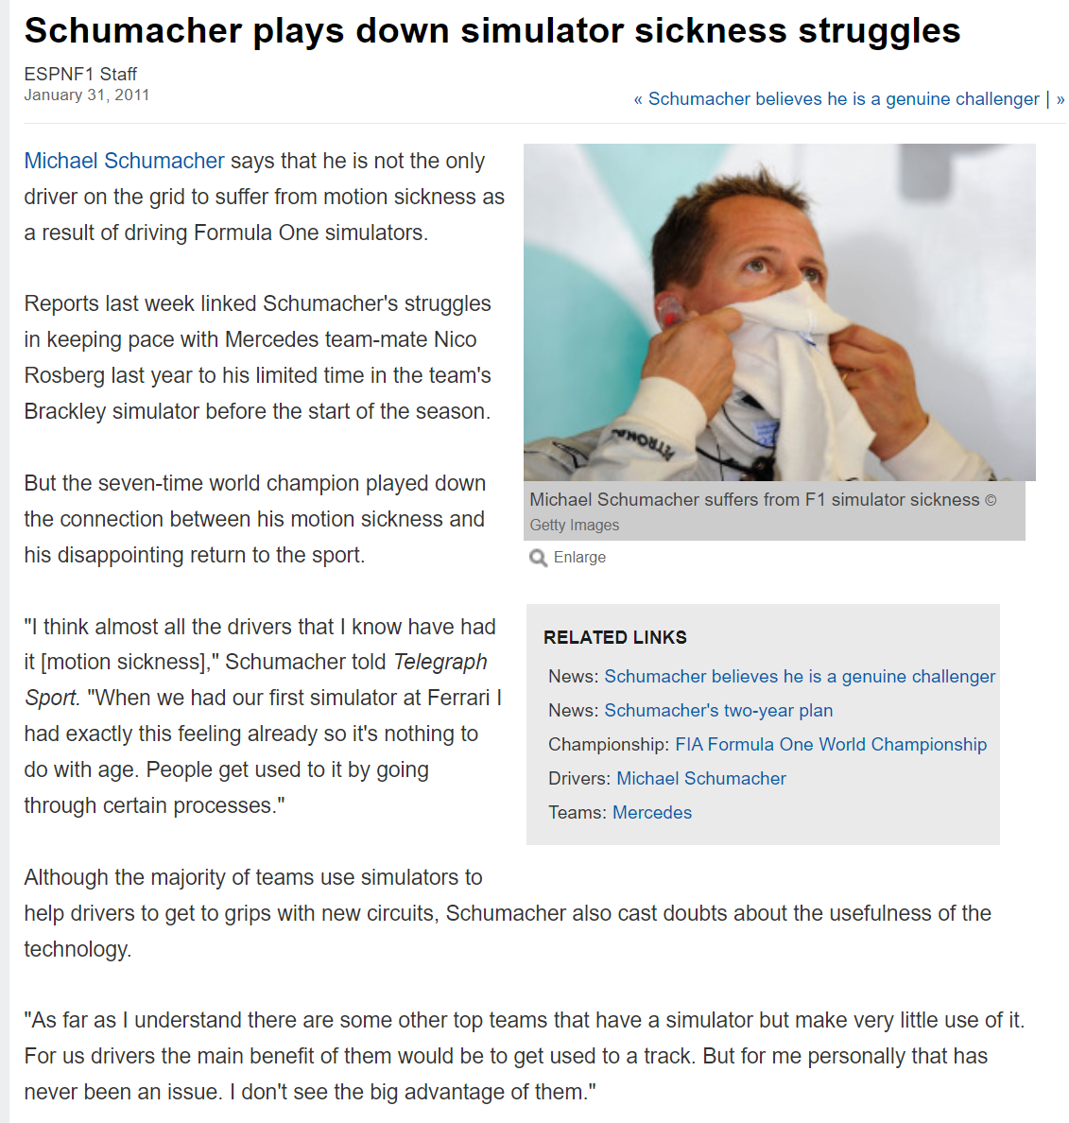
Notes:
And I’m going to leave you with a worst case that I’ll talk about again when talking about designing curricula.
Michael Schumacher won a record-setting seven Formula One World Drivers' Championship titles, a record which was tied by Lewis Hamilton in 2020. At the time of his retirement in 2006, Schumacher held the records for most wins (91), pole positions (68), and podium finishes (155), while some of his records still stand.
He returned to driving in 2010 for three years, he never won a race and never finished higher than eighth in the overall Formula One standings during his comeback. Now, there are lots of possible reasons for this, but one of them was that Schumacher suffered from CyS and could not use the simulators teams started to use to prepare drivers for new circuits.
So think about what we do with troops who are otherwise outstanding in their field but can’t use simulators or HMDs for training?
Now that I’ve covered a bit of the higher level items, our next speaker will be Claire Hughes, who will cover much of the science of CyS.

Slide 17
CyS Science
Scientific research findings on factors that affect CyS
Human
Hardware
Content
Interaction
Acronyms
CyS - Cybersickness
Notes:
Claire - 1
Possible useful references:
Cao, Z., Grandi, J., & Kopper, R. (2021). Granulated rest frames outperform field of view restrictors on visual search performance. Frontiers in Virtual Reality, 2, 604889.
Stauffert, J. P., Niebling, F., & Latoschik, M. E. (2020). Latency and cybersickness: Impact, causes, and measures. A review. Frontiers in Virtual Reality, 1, 582204.
Shahnewaz Ferdous, S. M., Chowdhury, T. I., Arafat, I. M., & Quarles, J. (2021). Static rest frame to improve postural stability in virtual and augmented reality. Frontiers in Virtual Reality, 1, 582169.

Slide 18
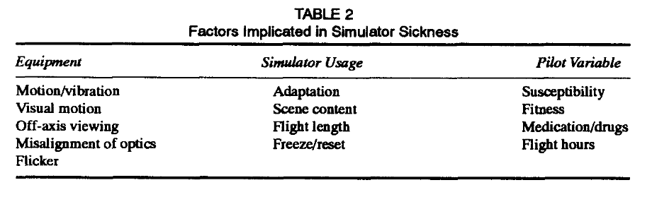
CyS Science
Polysymptomatic & Polygenic
“Therefore, it is possible (and it happens) that some people exhibit all the signs and symptoms in connection with their simulator exposure and others experience only a few. No one symptom predominates in all persons.” (Kennedy & Fowlkes (1992),pg. 25)
Acronyms
CyS - Cybersickness
Notes:
Claire -1.5

Slide 19
CyS Science
Learning Objective 1b
Describe basic science of causes and mitigating factors of CyS
Sensory Conflict Hypothesis
Evolutionary Hypothesis
Ecological Hypothesis
Multisensory Re-weighting Hypothesis
Acronyms
CyS - Cybersickness
Notes:
Claire -0.5
Learning objective 1b.

Slide 20
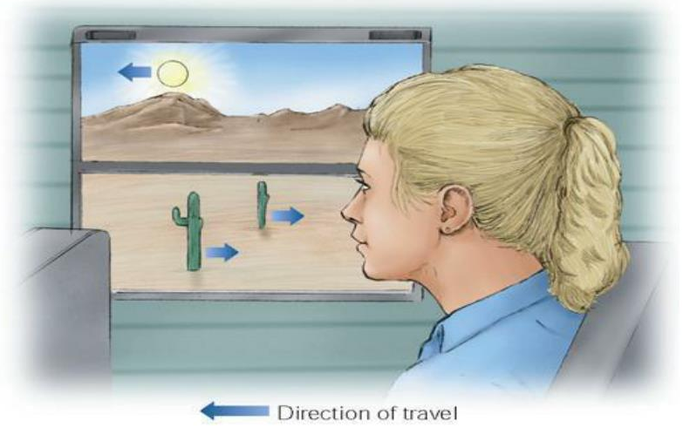
CyS Science
Sensory Conflict Hypothesis (or neural mismatch hypothesis; most cited)
CyS driven by discrepancy between expected and experienced sensory signals (visual, vestibular, proprioceptive)
Viewers can be particularly sensitive to motion parallax cues
Objects closer to you travel at faster speeds and in opposite direction; further objects travel slower and in same direction
Acronyms
CyS - Cybersickness
Notes:
Claire -2
Sensory Conflict Hypothesis (or neural mismatch hypothesis; most cited)
CyS driven by discrepancy between expected and experienced sensory signals (visual, vestibular, proprioceptive)
Viewers can be particularly sensitive to motion parallax cues
Example: Eyes perceive moving in a virtual world, but body does not feel motion because sitting still
Relevance: High level of individual variability in sensitivity to sensory depth cues varies
Design: Need to determine which sensory cues are particularly sickness-inducing

Slide 21
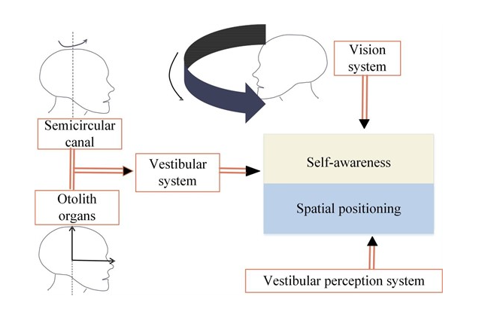
CyS Science
Evolutionary Hypothesis
CyS is seen as an evolutionary response to perceived toxins
Body’s defense mechanism against neurotoxins, causing nausea to expel them
Acronyms
CyS – Cybersickness
XR - eXtended Reality
HWD - Head Work Display
FOV - Field of View
Notes:
Claire -2
Evolutionary Hypothesis
CyS is seen as an evolutionary response to perceived toxins
Mechanism: Body’s defense mechanism against neurotoxins, causing nausea to expel them
Example: XR effects coordination of visual, vestibular, proprioceptive sensory systems, misinterpreted by body as hallucinations associated with ingestion of noxious substance that trigger emetic response to rid body of poison
Relevance: Sensorineural discordance due to HWD limitations (limited FOV, optical distortions, static projection depth planes, etc.)
Design: Design XR systems to minimize sensorineural discordance to prevent cybersickness and harmful maladaptation
Integrate eye tracking in HWDs to help capture adaptive changes and adjust visual content accordingly
Usage protocols can be used to drive adaptation to XR environments to help avoid sickness; such adaptation can be quick (visual coding) or gradual (end-state results)

Slide 22
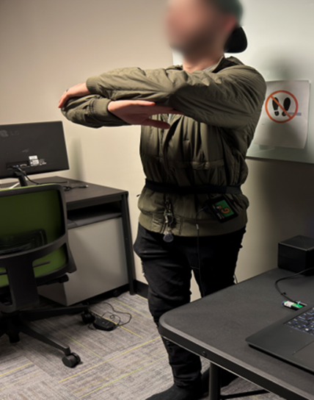
CyS Science
Ecological Hypothesis
CyS arises from prolonged postural instability (inability to maintain balance and posture in XR), focusing on movement control rather than sensory conflict
Acronyms
CyS – Cybersickness
XR – eXtended Reality
Notes:
Claire -2
Ecological Hypothesis
CyS arises from prolonged postural instability (inability to maintain balance and posture in XR), focusing on movement control rather than sensory conflict
Example: XR exposure can lead to altered specificity (e.g., visual accelerations and rotations unrelated to control of body), thus may use muscular force to resist these virtual motions but these control strategies for gaining postural stability will not work, which creates unintended divergence from a stable position causing postural instability
Relevance: As postural instability increases, motion sickness develops
Design: Design XR environments that promote postural stability by reducing unnecessary motion, providing stable reference points, and giving users control over their movements within the XR environment

Slide 23
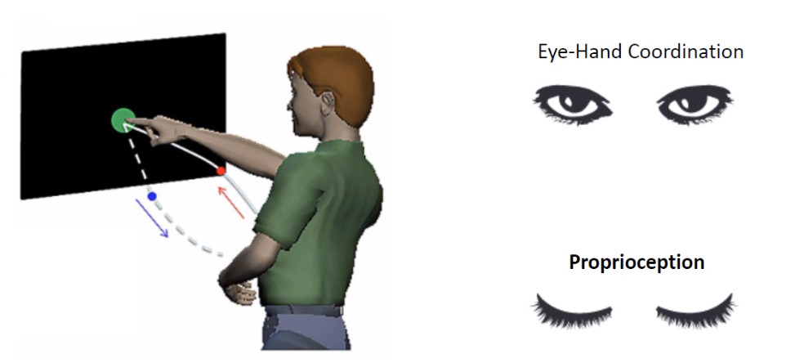
CyS Science
Multisensory Reweighting Hypothesis
Suggests that CNS adjusts importance, or “weight” it assigns to different sensory inputs to maintain balance and orientation during XR exposure
Shift in Felt Limb Position
Acronyms
CyS – Cybersickness
XR - eXtended Reality
CNS - Central Nervous System
Notes:
Claire - 2
Multisensory Reweighting Hypothesis
Suggests that CNS adjusts importance, or “weight” it assigns to different sensory inputs to maintain balance and orientation during XR exposure
Example: Brain re-weights sensory information to adapt to XR environments
Over time, CNS adapts by increasing weight of more reliable sensory inputs (e.g., vision) and decreasing weight of less reliable ones (e.g., vestibular cues) to reduce discomfort
Relevance: Can predict which individuals might be more susceptible to CyS based on their ability to re-weight sensory inputs effectively
Design: Design XR systems to provide most reliable sensory inputs, particularly visual cues, to help CNS prioritize accurate information
Implement adaptive feedback mechanisms that adjust sensory outputs based on real-time user interactions and sensory reliability
Allow users to customize sensory settings to match their individual sensory processing capabilities and preferences

Slide 24
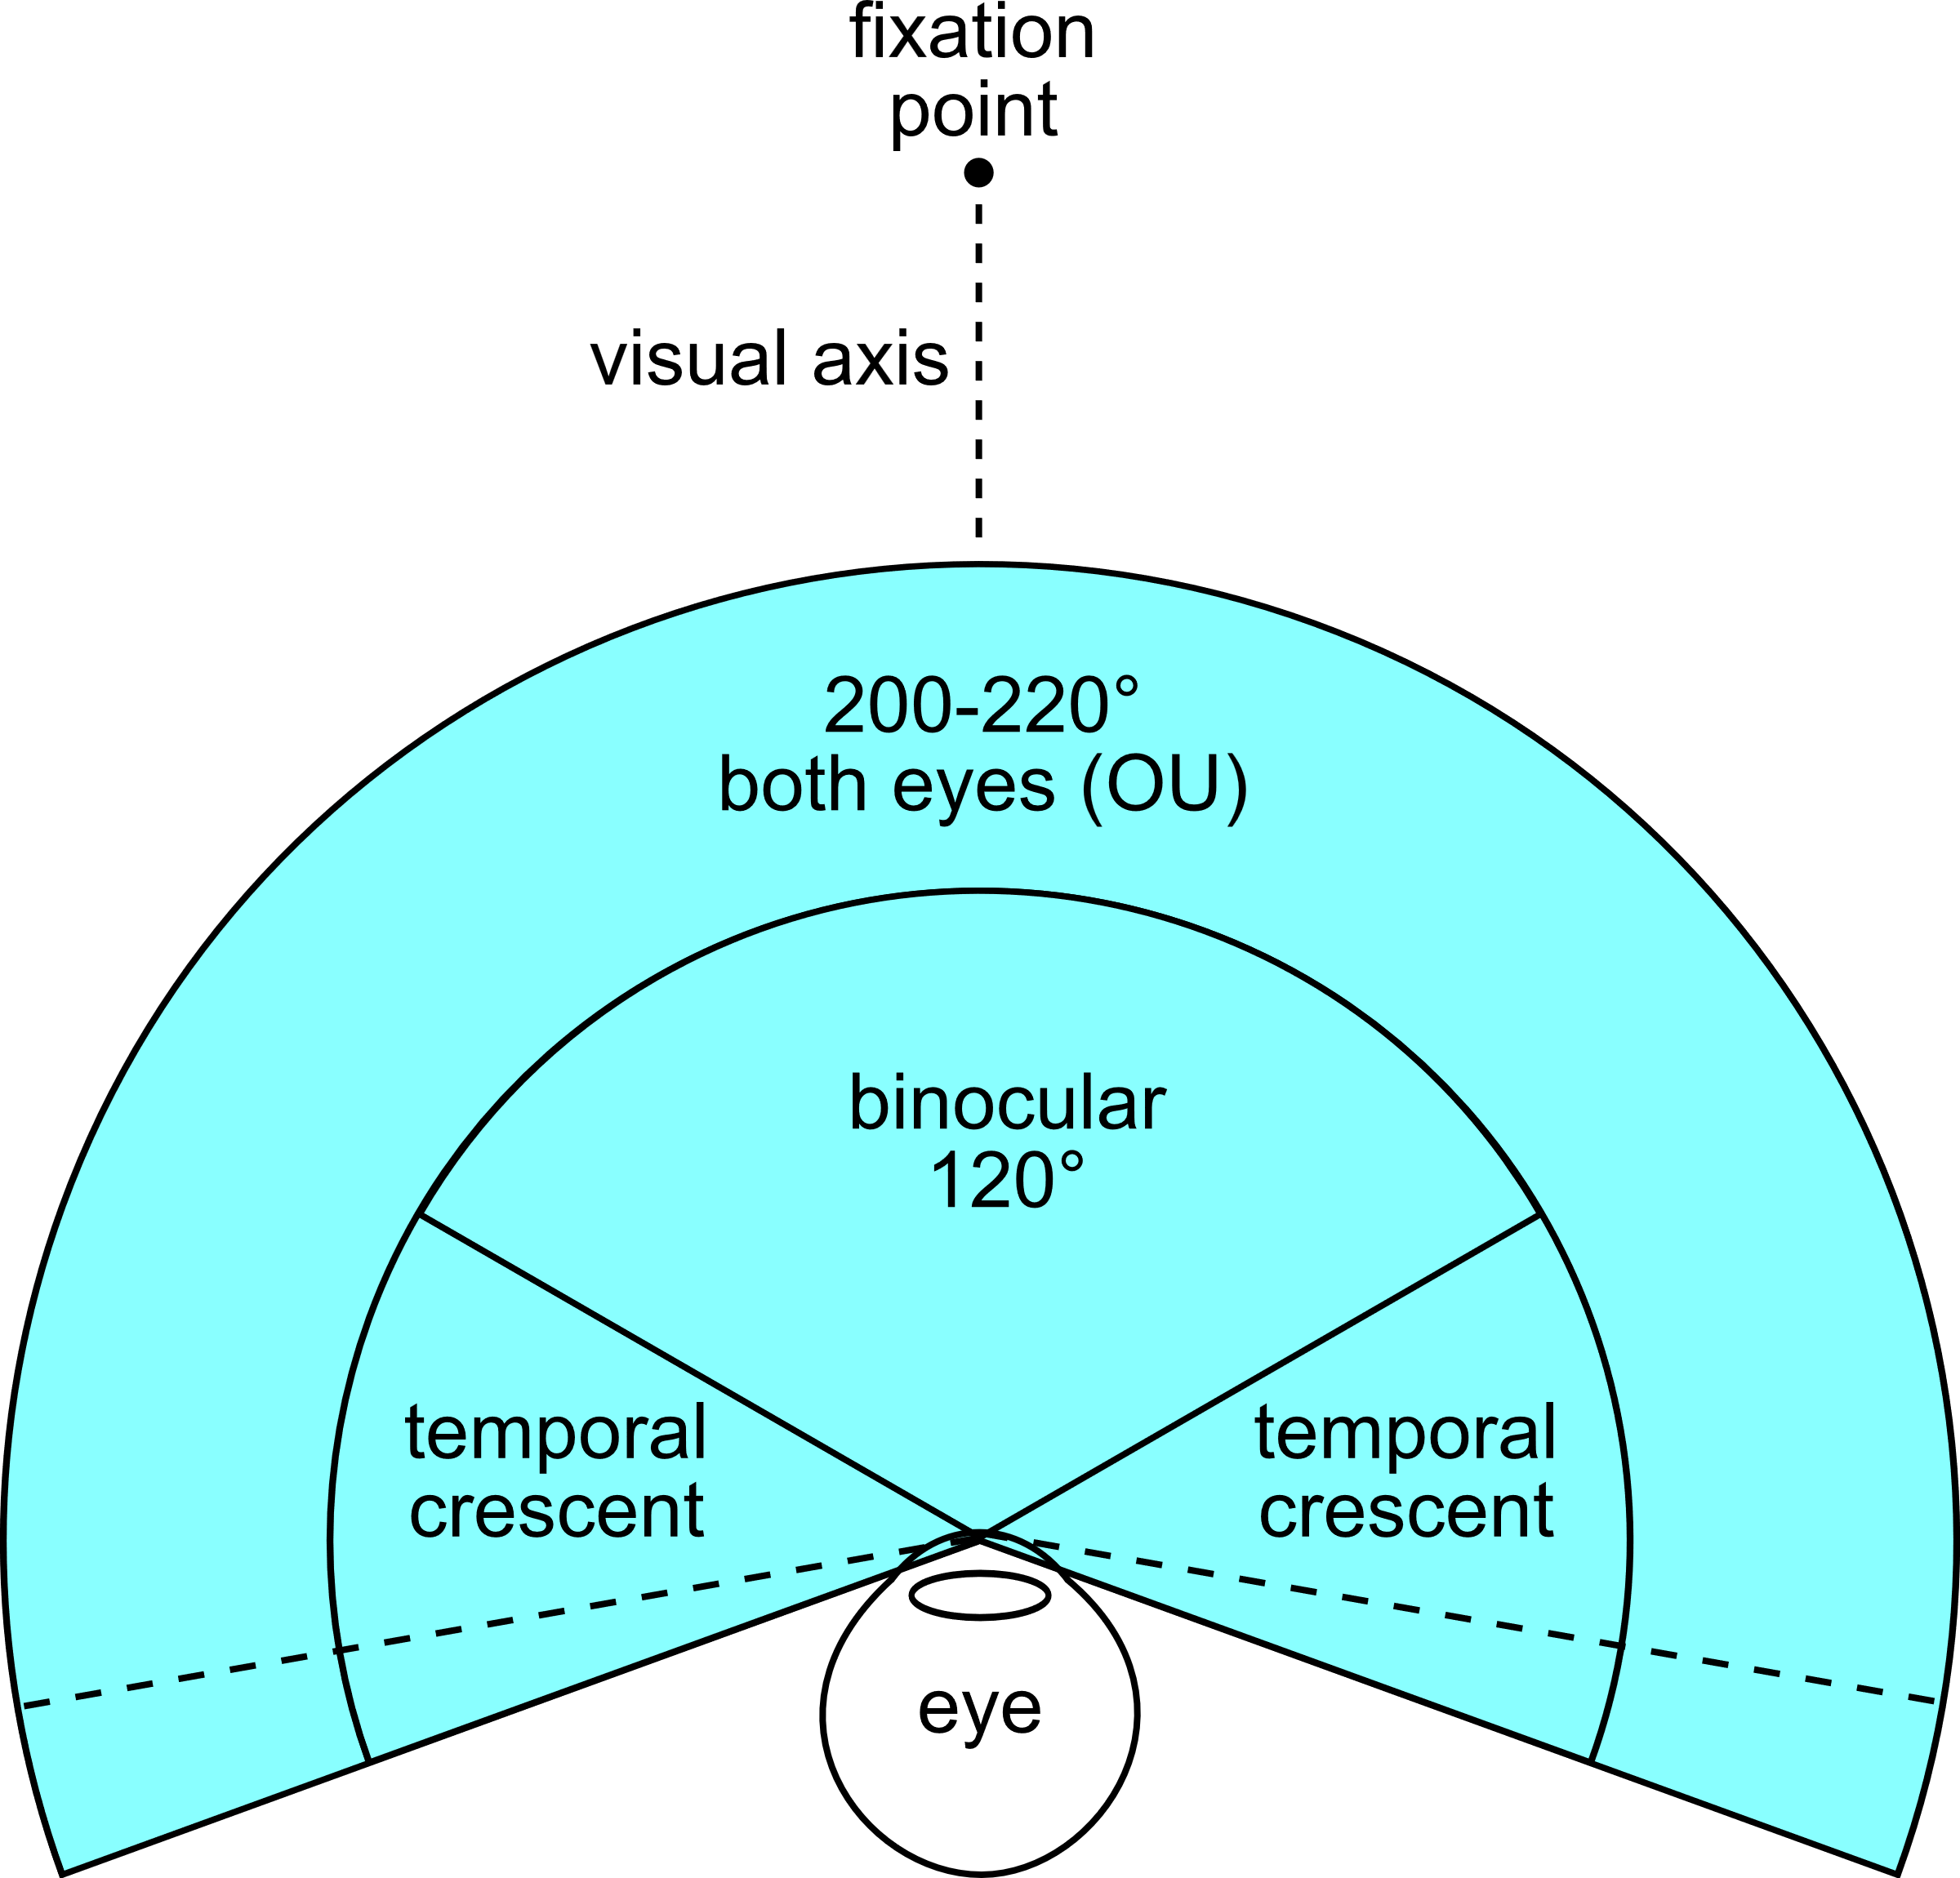
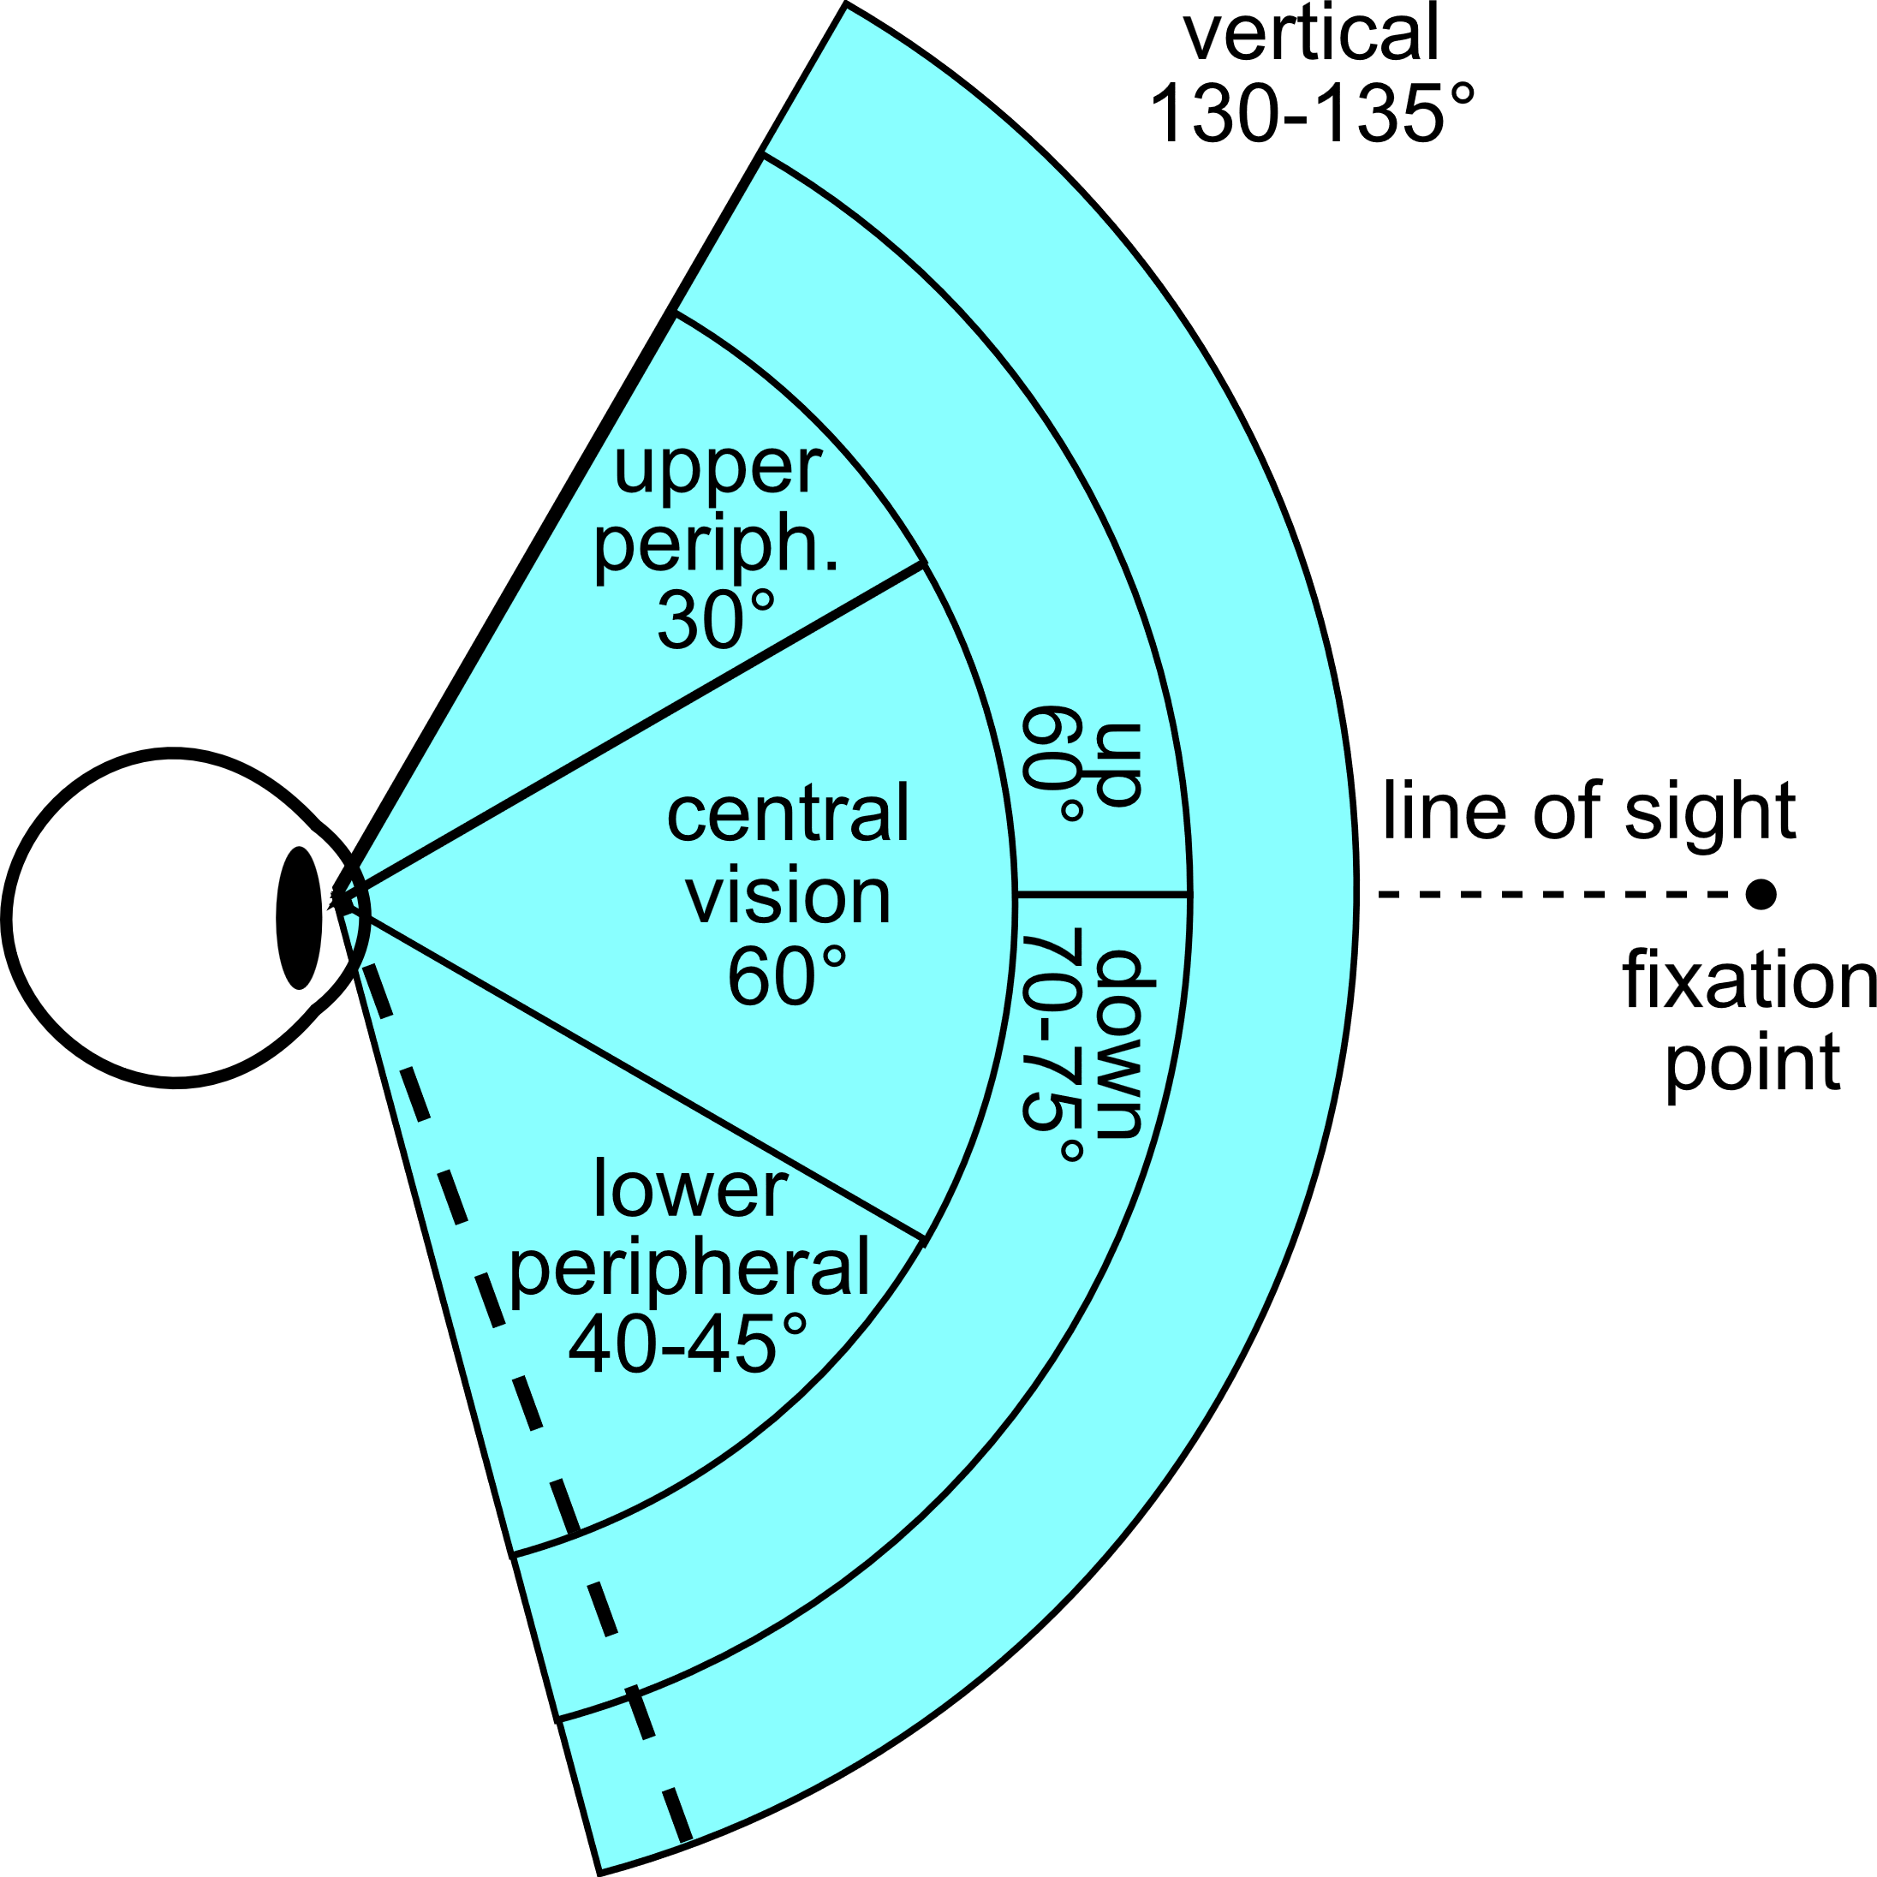
CyS Science – Hardware Factors
Field of View (FOV)
Depth of field
Tracking errors
Latency
Resolution
Acronyms
CyS – Cybersickness
FOV – Field of View
Notes:
Claire - 1

Slide 25
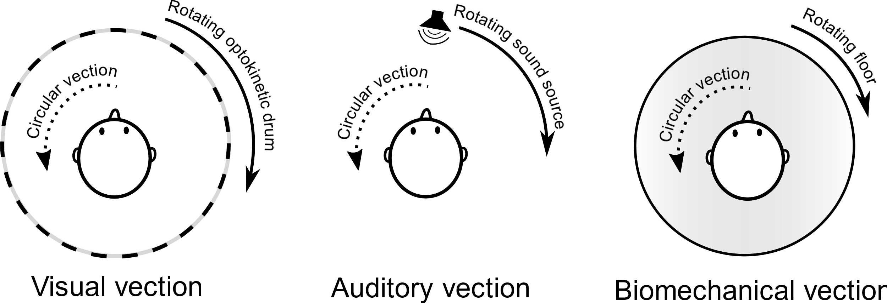
CyS Science – Content Factors
Vection
Optic Flow
Flicker
Visual lag
Rest frames
Visual realism
Acronyms
CyS - Cybersickness
Notes:
Claire - 1
https://en.wikipedia.org/wiki/Illusions_of_self-motion#/media/File:Vection_diagram.svg

Slide 26
Reduce CyS During Design and Development
Learning Objective 2
CyS must be THE key factor in design and development of XRs
If people can’t use it, does it matter how “good” the product is?
Test early/test often
Choice of input devices
Design XR stimulus to minimize CyS and associated adverse effects
Acronyms
CyS – Cybersickness
XR – eXtended Reality
Notes:
Claire – 0.5
Improvements in technology have reduced or eliminated some of the causes of CyS, but there are causes that are inherent in humans which technology is unlikely to eliminate. This means that everyone involved in the design, development, and implementation of training VEs must understand the causes of CyS, how to mitigate them, and how to create systems that reduce both the likelihood and severity of CyS symptoms. Otherwise, it will be impossible to properly utilize the incredible potential of these technologies.
Developers must test their design early in development process.
Weech, S., Calderon, C. M., & Barnett-Cowan, M. (2020). Sensory down-weighting in visual-postural coupling is linked with lower cybersickness. Frontiers in Virtual Reality, 1, 10.

Slide 27
CyS Mitigation Factors
Sensory Conflict Hypothesis
Upon initial XR exposure, minimize motion parallax cues to acclimate user to XR experience
Gradually step-up motion parallax cues over time, if user begins to feel discomfort, diminish motion parallax cues once again
Include options to minimize amount of head movement/motion parallax required
Use teleportation (but note that this can increase disorientation and hinder spatial awareness)
Add concordant motion (e.g., a motion-base to reduce visual-vestibular conflicts)
Ask observers to actively align head/body to behavior of virtual motion they are experiencing
Limit or slow forward speed and acceleration to reduce visual scene motion
When conflicts persist:
Provide visual cues that match vestibular system, such as by adding inertially stable visual motion cues (fixed-horizon)
Minimize vestibular cues through depth-of-field blur, peripheral blur, or dynamic field of view, latter of which involves modifying FOV based on speed and angular velocity
Acronyms
CyS – Cybersickness
XR - eXtended Reality
FOV - Field of View
Notes:
Claire – 2.5
Source: Stanney, K., Lawson, B. D., Rokers, B., Dennison, M., Fidopiastis, C., Stoffregen, T., … Fulvio, J. M. (2020). Identifying Causes of and Solutions for Cybersickness in Immersive Technology: Reformulation of a Research and Development Agenda. International Journal of Human–Computer Interaction, 36(19), 1783–1803. https://doi.org/10.1080/10447318.2020.1828535

Slide 28
CyS Mitigation Factors
Evolutionary Hypothesis
Foster sensory adaptation via perceptual recalibration by highlighting visuomotor discordances to engender a sense of body ownership and drive sensorimotor adaptation in XR environments
Foster sensory adaptation via visual-motor skill alterations by using representational feedback that appears to arise from manipulation of XR environment
Acronyms
CyS – Cybersickness
XR – eXtended Reality
Notes:
Claire - 2
Source: Stanney, K., Lawson, B. D., Rokers, B., Dennison, M., Fidopiastis, C., Stoffregen, T., … Fulvio, J. M. (2020). Identifying Causes of and Solutions for Cybersickness in Immersive Technology: Reformulation of a Research and Development Agenda. International Journal of Human–Computer Interaction, 36(19), 1783–1803. https://doi.org/10.1080/10447318.2020.1828535

Slide 29
CyS Mitigation Factors
Ecological Hypothesis
XR should be used while seated, and users should be encouraged to use a headrest
Design XR dynamics that support rather than degrade postural stability
Use motion sensor data (from headsets) to identify individuals at risk for cybersickness due to copious head movement not aligned with scene content
Modulate XR dynamics in real time to suppress unstable postural activity
Acronyms
CyS – Cybersickness
XR – eXtended Reality
Notes:
Claire - 2
Source: Stanney, K., Lawson, B. D., Rokers, B., Dennison, M., Fidopiastis, C., Stoffregen, T., … Fulvio, J. M. (2020). Identifying Causes of and Solutions for Cybersickness in Immersive Technology: Reformulation of a Research and Development Agenda. International Journal of Human–Computer Interaction, 36(19), 1783–1803. https://doi.org/10.1080/10447318.2020.1828535

Slide 30
CyS Mitigation Factors
Multisensory Reweighting
Promoting rapid re-weighting of multisensory cues may protect against provocative conditions of XR exposure
Facilitating vection might offer protection from cybersickness in XR
“Re-couple” multimodal cues, either by physically moving an observer along with visual self-motion or by stimulating vestibular sense with mild current (GVS) to replicate missing acceleration cues
Use vestibular noise to modulate cybersickness response
Consider using tDCS to reduce severity of cybersickness
Increase presence to lower cybersickness
Use positive smells and pleasant-sounding music to promote user comfort
Acronyms
CyS – Cybersickness
XR - eXtended Reality
GVS - Galvanic Vestibular Stimulation
tDCS - Transcranial Direct Current Stimulation
Notes:
Claire – 2.5
Source: Stanney, K., Lawson, B. D., Rokers, B., Dennison, M., Fidopiastis, C., Stoffregen, T., … Fulvio, J. M. (2020). Identifying Causes of and Solutions for Cybersickness in Immersive Technology: Reformulation of a Research and Development Agenda. International Journal of Human–Computer Interaction, 36(19), 1783–1803. https://doi.org/10.1080/10447318.2020.1828535

Slide 31
Protocols to Reduce CyS for Fielded Systems
Learning Objective 3
Quantify XR stimulus intensity
Quantify XR aftereffects of target system
Identify individual capacity of target user population to resist adverse effects of XR exposure
Provide warnings for those with severe susceptibility to issues
Promulgate usage protocols
Acronyms
CyS – Cybersickness
XR – eXtended Reality
Notes:
Nick - 1

Slide 32
Quantify XR Stimulus Intensity
Optical flow
Cumulative optical flow entropy
Horizontal flow, vertical flow, magnitude – contribute differently
Number of optical flow events can vary significantly between VE sequences (movement, elements in environment)
Difference between focused vs peripheral vision
Questionnaires
CyS susceptibility questionnaire (CSSQ)
Simulator sickness questionnaire (SSQ)
Visually induced motion sickness susceptibility questionnaire (VIMSSQ)
Virtual reality neuroscience questionnaire (VNSQ)
Acronyms
CyS – Cybersickness
XR – eXtended Reality
Notes:
Nick – 2.5
Optical flow is an approximation measure of image motion using projection of a 3D surface on a 2D plane. When analyzed in time sequence structures of the optical flow field can recover 3D motion and motion of the original sensor. Used in many computer vision tasks. It provides insight into motion regularity and complexity.
Using entropy metrics to characterise the signal of optical flow
Tian, N., & Boulic, R. (2024). The Least Increasing Aversion (LIA) Protocol: illustration on identifying individual susceptibility to cybersickness triggers. IEEE Transactions on Visualization and Computer Graphics
Smith, S. P. (2021). Comparing virtual environments for cybersickness using a cumulative optical flow entropy metric. IEEE Access, 9, 68898-68904.
We really need more data here for longer learning type experiences. The data is often focused on short (<15 minute), ride like experiences (rollercoasters) which doesn’t necessarily translate well into an educational setting.
Challenging to compare across systems as well. i.e. how much of the issue is due to limited resolution when comparing say Oculus DK 1 vs a Quest 3 or Varjo?
Does the frame rate that the data was captured at have an impact?
Kourtesis, P., Collina, S., Doumas, L. A., & MacPherson, S. E. (2019). Validation of the virtual reality neuroscience questionnaire: maximum duration of immersive virtual reality sessions without the presence of pertinent adverse symptomatology. Frontiers in human neuroscience, 13, 417.
MAKE QUESTIONNAIRES TOP LEVEL BULLET
ADD FMS TO LIST
REMOVES CSSQ BECAUSE IT IS PREDICTIVE???
Add biometrics under Questionnaires

Slide 33
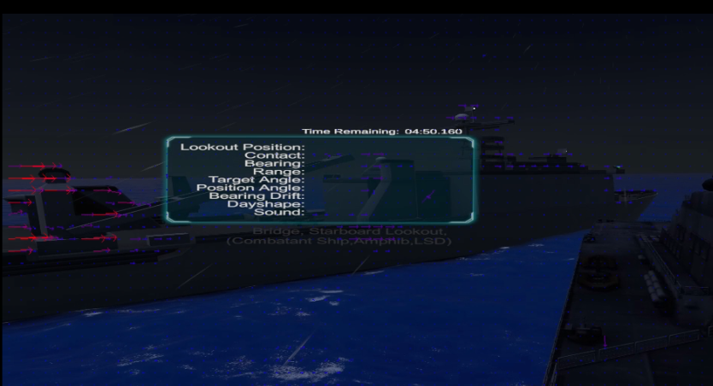
Optical Flow - VIDVR
Notes:
Nick -

Slide 34
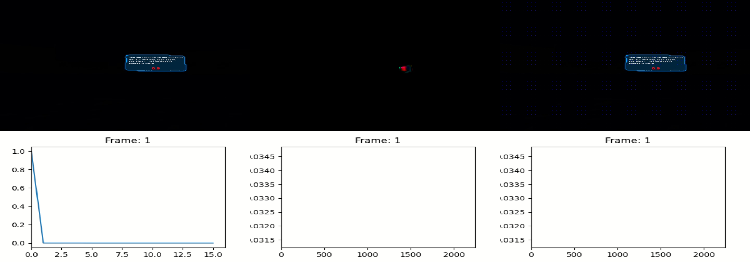
Cumulative Optical Flow Entropy Diagram – VIDVR #1
Notes:
Nick – 1.5

Slide 35
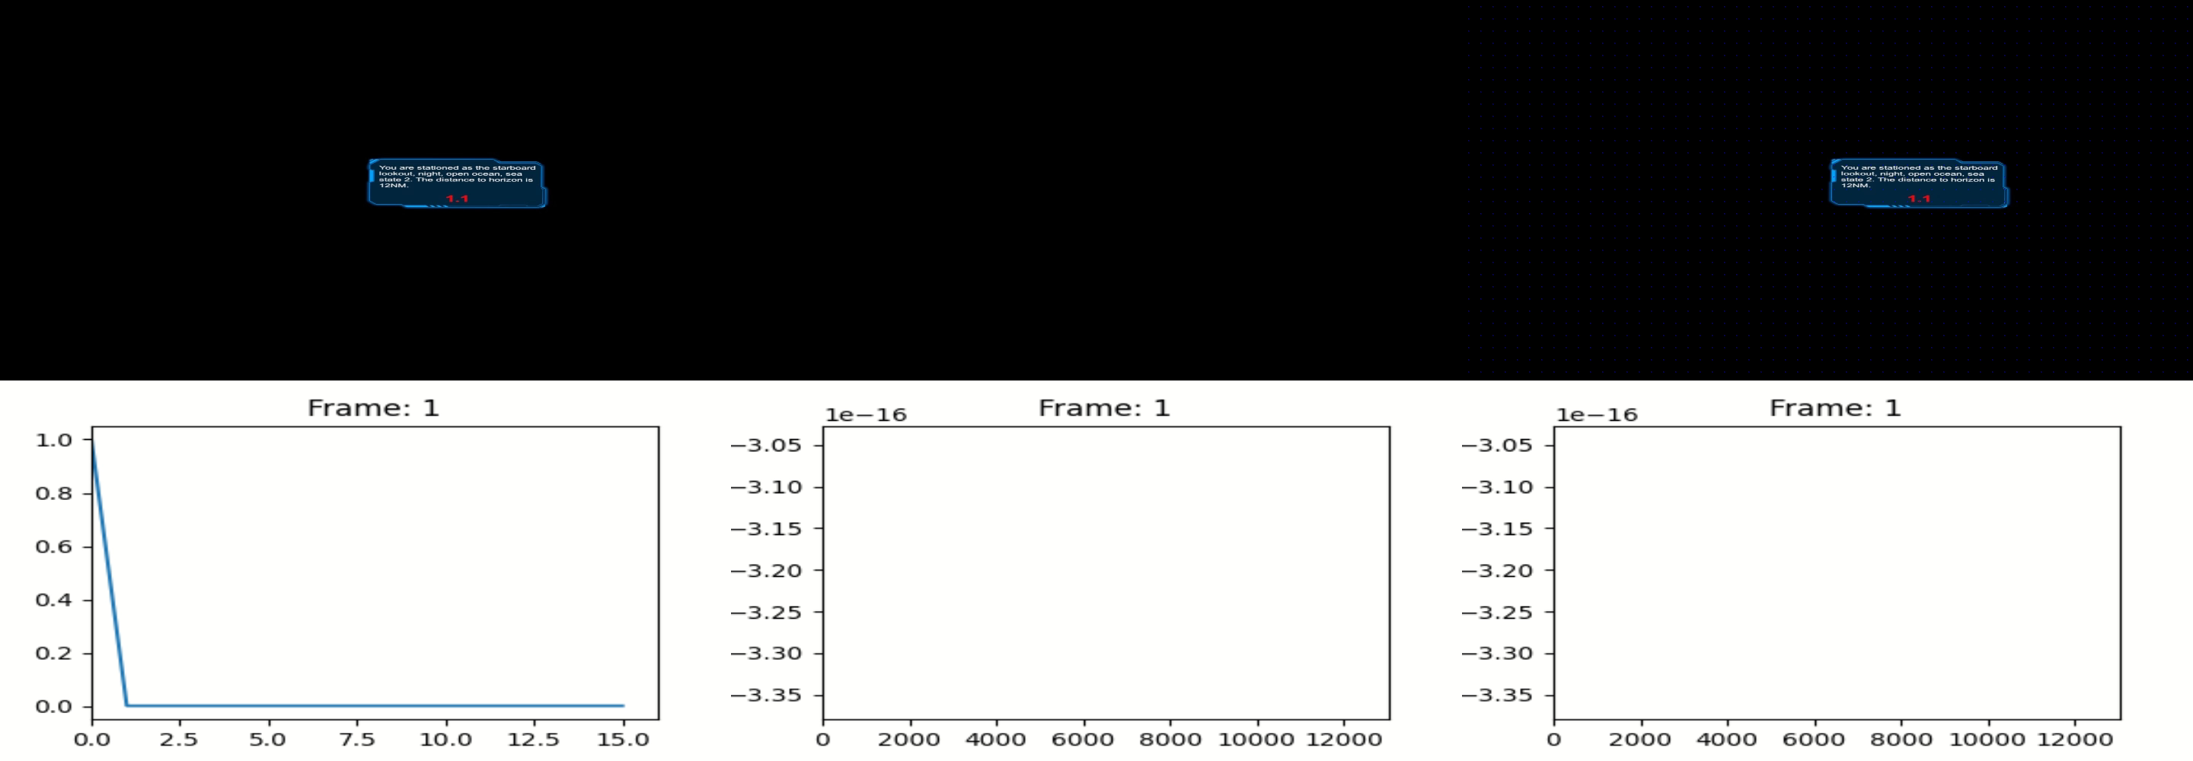
Cumulative Optical Flow Entropy Diagram – VIDVR #2
Notes:
Nick – 2.5

Slide 36
Guidance from XR Stimulus Quantification
Maximum session length
Cumulative session limits
Susceptibility index
Design of lessons
Acronyms
XR – eXtended Reality
Notes:
Nick - 1

Slide 37
Quantify XR Aftereffects of Target System
Questionnaires
Biometric States
Binocular vision impact
Postural instability
Visual acuity
Refractive error
Pupil size
EEG/ECG
Physiological states
Cognitive performance
Acronyms
EEG – Electrogastrogram
ECG - Electrocardiogram
Notes:
Nick – 2
Smith, S. P. (2021). Comparing virtual environments for cybersickness using a cumulative optical flow entropy metric. IEEE Access, 9, 68898-68904
Long, Y., Shen, Y., Guo, D., Wang, X., & Gu, Y. (2020). The Effects of Consumer-grade Virtual Reality Headsets on Adult Visual Function. Seminars in Ophthalmology, 35(3), 170–173. https://doi.org/10.1080/08820538.2020.1776342
Long term the amplitude of accommodation changed, but visual acuity, pupil size and refractive error remained unaffected
10 minutes, 2x day for 2 weeks – possibly well representative of a learning style activity?
Biases? Subjective measurements?

Slide 38
Guidance from XR Aftereffects Quantification
Post experience limitations
Management protocols for affected users
Training for instructors
Notes:
Nick – 1.5

Slide 39
Reduce CyS During Curriculum Design
Learning Objective 4
Key actions/methods to design curricula which minimize CyS
Adaptation
Individual susceptibility
Length of XR sessions
Number of sessions
Placement of XR sessions within curricula
Learning outcomes
Acronyms
CyS – Cybersickness
XR – eXtended Reality
Notes:
Perry – 0.5
Thanks Nick.
Regardless of how well the system is developed, how a curriculum designer implements VEs into the curriculum can have significant effects on how CyS impacts their students.
Now, like Claire and Nick, I will some give general guidelines on how to implement class design to minimize the likelihood and magnitude of CyS.
Adaptation is a key factor in CyS. Just as most people eventually become accustomed to a ship’s motion and their seasickness abates or disappears, multiple studies have shown that most – but not all - people can acclimatize themselves to the differences in sensory inputs from computer environments and mitigate the symptoms of CyS. Adaptation can also be affected by beginning the curriculum with shorter times in the environment and increasing as the class progresses. Likewise, the number of sessions per day should be minimized until it appears the students are fully adapted.
Throughout this lecture, we’ve described how everyone is different with regard to CyS and Nick also covered various questionnaires available to measure CyS. Investigating an individual’s susceptibility to CyS is something curriculum designers can add to the beginning of a course to evaluate the likelihood each student experiences CyS. If this can be done long before the time that all students begin using environments as part of their learning, it gives more time to bring them along slowly in adapting to the environment, which increases the likelihood of adaptation. For example, the curriculum designer may not be planning on using a HMD-based trainer until week 3, but if they administer a MSSQ and/or FMS to locate those students more likely to have issues, the designer can craft a program of extra instruction where susceptible students slowly increase their times in the simulator for them to adapt. Ideally, this initial test could also serve as a way to demonstrate parts of the big picture of the LOs
Additionally, given the fact that students may experience post-exposure symptoms, scheduling sessions to occur earlier in the day so that students’ symptoms have a chance to abate before they are driving. Likewise, if the curriculum included real world events, e.g., flight school where flights are part of the curriculum, there should be a marked separation between classes requiring simulator time and those events.
Finally, for training systems, which is what we focused upon in this tutorial, the ultimate metric of your system will be how well you meet your learning outcomes. If you’re using VEs for your curriculum and your students aren’t performing as well as you would like, you need to analyze the entire curriculum, including the sims. And one part of analyzing the VEs involves checking if your students aren’t learning in them because of CyS. If that is the cause, you might need to revamp your curricullum with some of the recommendations here to correct it.

Slide 40
Identify Individual Capacity of Target User Population
Adaptation
Motion sickness susceptibility questionnaire (MSSQ)
Fast motion sickness scale (FMS)
Significant differences in responses of individuals
Sex
Age
Past experience
VR time
Simulator time
Videogame time
Prior sickness susceptibility
Acronyms
MSSQ - Motion Sickness Susceptibility Questionnaire
FMS - Fast Motion Sickness Scale
VR – Virtual Reality
Notes:
Perry - 2
The Motion Sickness Susceptibility Questionnaire asks questions about how frequently a person has felt sick/nauseated in cars/busses/planes/ships/rides/etc. The MSSQ has been validated to predict sickness caused by virtual environments, such as cybersickness. Students can be given the MSSQ before entering an environment to predict their likelihood of getting sick.
Similarly, the Fast MS Scale (FMS), a verbal rating scale ranging from zero (no sickness at all) to 20 (frank sickness) as they experience the environment. Unlike the more detailed SSQ, where users report their levels of sickness after they leave the environment, in the FMS users report their level of sickness repeatedly WHILE IN the environment, as often as every minute. This can be used in early sessions to check the user’s level of sickness and end sessions early when users are beginning to have severe reactions because a severe reaction early can negatively influence their ability to adapt to the environment.
Also, although CyS affects each person differently, there are some predictors for CyS.
Sex is one, with women more likely to report in many early CyS studies. However, many researchers attribute that to the fact that early HMDs either could not adjust for inter-pupillary distance, or, if adjustable, that the lowest IPD was higher than required for many women. As the IPD settings have been expanded to address this, more recent studies are finding no differences between the sexes.
Age is another predictor, with younger people less likely to experience CyS than older people.
Similar to adaptation, the more time a person has spent in VEs, simulators or games, the less likely they are to experience CyS.

Slide 41
Other Factors
Design of training for those who cannot use VEs
Does it still achieve the LOs?
Does it fit into the schedule?
Does CyS become a selection criteria?
Acronyms
CyS – Cybersickness
VE – Virtual Environment
LO – Learning Outcome
Notes:
Perry – 1
Finally, I want to go back to the example of Michael Schumacher. Now obviously, this was a guy who could drive the car, but had couldn’t use the simulator to train, and it might have affected his ability to compete, and I asked you to think about that.
So what do you do in such a case?
What will you do to try and provide the training from sims/VEs to a student who just can’t adapt to using them? Ideally, you’re using these in your curriculum because they are producing better/faster training, so how can such a student still achieve the LOs in the given time?
And the long-term implication is whether susceptibility to CyS becomes a selection criteria for certain military specialties, the way vision is a criteria for pilots. You don’t want to tighten selection criteria too much, but how does a team operate if a member can’t train in a VE with the rest.

Slide 42
Discussion
How will you apply the information from this tutorial?
What additional questions does this tutorial raise for you?
What barriers exist to fully implementing best practices to minimize CyS in your virtual content?
Acronyms
CyS – Cybersickness
Notes:
All - 15

Slide 43
Conclusions
Early stages of building a XR for training must consider CyS because many mitigation strategies can only be implemented there
Failure to consider CyS throughout the process can render an XR training system ineffective or unusable
Acronyms
CyS – Cybersickness
XR – eXtended Reality
Notes:
All – 2.5

Slide 44
Questions?
Contact Details:
LCDR Nick Adriaanse
nicholas.j.adriaanse.fm@us.navy.mil
C: +1 419 908 9894
W: +1 757 492 8362
Kay Stanney
kay@designinteractive.net
W: +1 407 706 0977 x 223
Claire Hughes
claire.hughes@designinteractive.net
C: +1 386 506 9995
Perry McDowell
mcdowell@nps.edu
C: +1 831 915 8396
W: +1 831 656 7591

Slide 45
Key References
Stanney, K., Lawson, B. D., Rokers, B., Dennison, M., Fidopiastis, C., Stoffregen, T., … Fulvio, J. M. (2020). Identifying Causes of and Solutions for Cybersickness in Immersive Technology: Reformulation of a Research and Development Agenda. International Journal of Human–Computer Interaction, 36(19), 1783–1803. https://doi.org/10.1080/10447318.2020.1828535
Kennedy, R. S., & Fowlkes, J. E. (1992). Simulator sickness is polygenic and polysymptomatic: Implications for research. The International Journal of Aviation Psychology, 2(1), 23–38. https://doi.org/10.1207/s15327108ijap0201_2
Lawson, B. D., & Stanney, K. M. (2021). cybersickness in virtual reality and augmented reality. Frontiers in Virtual Reality, 2, 759682.
LaViola, J. J. (2000). A discussion of cybersickness in virtual environments. ACM Sigchi Bulletin 32(1), 47-56.
Lowood, H. E. (2023, 08 23). Virtual reality (VR) | Definition, Development, Technology, Examples, & Facts. Retrieved from Britannica.com: https://www.britannica.com/technology/virtual-reality
McCauley, M. E., & Sharkey, T. J. (1992). Cybersickness: Perception of Self-Motion in Virtual Environments. Presence: Teleoperators and Virtual Environments, 311-318.
Rebenitsch, L., & Owen, C. (2016). Review on cybersickness in applications and visual displays. Virtual Reality, 101-125.
Notes:
3 -4 key references from paper
Stanney Article
Stanney/Hale Book
La Viola
Lowood

Slide 46
Key References
Stanney, K.M., Graeber, D.A., & Kennedy, R.S. (2021). Virtual environment usage protocols (chapter 29). In W. Karwowski (ed.), Handbook of Standards and Guidelines in Ergonomics and Human Factors. Mahwah, NJ: Lawrence Erlbaum.
Stanney, Kay M., Claire L. Hughes, Peyton Bailey, Ernesto Ruiz, and Cali Fidopiastis. “Cybersickness in Immersive Training Environments.” In Human Factors in Simulation and Training, by Dennis A. Vincenzi, Mustapha Moloua, Peter A Hancock, James A. Pharmer, and James C. Ferraro, 159–80, 2nd ed. Boca Raton: CRC Press, 2023.
Riley, J., Stanney, K., Hughes, C., & Fidopiastis, C. (2022). Examining Technology, Human, and Contextual Factors Impacting AR Utility for Learning. In Interservice/Industry Training, Simulation, and Education Conference (I/ITSEC) November (Vol. 23).
Stanney, K., Kennedy, R., & Hale, K. (2014). Virtual Environment Usage Protocols. In K. S. Hale, & K. M. Stanney, Handbook of virtual environments: Design, implementation, and applications. (pp. 797-809). Boca Raton, FL: CRC Press.
Tian, N., Lopes, P., & Boulic, R. (2022). A review of cybersickness in head-mounted displays: raising attention to individual susceptibility. Virtual Reality, 26(4), 1409-1441
Tian, N., & Boulic, R. (2024). The Least Increasing Aversion (LIA) Protocol: illustration on identifying individual susceptibility to cybersickness triggers. IEEE Transactions on Visualization and Computer Graphics
Notes:
3 -4 key references from paper
Stanney Article
Stanney/Hale Book
La Viola
Lowood

