Slide 1



Mitigation and Management of Minimize Cybersickness in the Design and Implementation of Learning Systems with Virtual Environments
Kay Stanney & Claire Hughes, Design Interactive
Perry McDowell, Naval Postgraduate School
LCDR Nicholas Adriaanse, RAN, NSWCDD DNA
NSWCDD-PN-24-00198 Distribution Statement A. Approved for public release: distribution is unlimited.
Notes:
Nick

Slide 2
Learning Outcomes
Attendees will be able to describe the basic science of the causes and mitigating factors of cybersickness (CyS)
Attendees will be able to express how to design eXtended Reality (XR) solutions to minimize CyS effects in users
Attendees will be able to apply protocols to minimize the CyS impact of XR environments
Attendees will be able to use key actions/methods to design curricula which minimize CyS
Acronyms
CyS – Cybersickness
XR - eXtended Reality
Notes:
Nick
Attendees will come away with a knowledge of cybersickness (CyS), including
causes and factors affecting CyS, as well as how to design virtual environments (VEs) and curricula to
minimize CyS effects upon students and learner outcomes.
This tutorial will provide attendees with a basic knowledge of the underlying causes of CyS, which factors aggravate or mitigate CyS, how CyS degrades learning, as well as how to design a VE system and create a curriculum to minimize CyS’s effects.
List mitigating factors

Slide 3
Audience
Designers of XR solutions
Program managers involved in creation and implementation of training systems utilizing XR
Curriculum managers designing and managing courses using XR
Instructors teaching classes using XR
Acronyms
XR - eXtended Reality
Notes:
Nick
Won’t bog you down with the science – but a little bit is necessary to ensure we are all talking with the correct vocabulary. This is about practical application of the science to fielding a VE in a training environment.
Purpose: This tutorial is designed to provide those involved in producing and implementing VEs for training with a basic knowledge of CyS. This is significant because CyS can reduce the training effectiveness of systems utilizing VEs and visual simulations, even to the point of making it unusable. Mitigating the effects of CyS begins in the design of the system, where minor decisions can result in substantial differences in the CyS effects of the final system. Likewise, curricula design can greatly impact the degree that CyS affects students.
Militaries across the globe are planning on utilizing VEs to improve their training, whether they be traditional simulators using screens or the most up-to-date technology such as head mounted displays for virtual reality, augmented reality, mixed reality, or extended reality. There is a general belief among both the general public and the training community that the technological advancements in the latest generation of these devices have eliminated the effects of CyS.. However, this is decidedly not true

Slide 4
This Tutorial is NOT:
A deep dive into the science of CyS
A detailed design course for
Curriculum building/ADDIE
Virtual environments (VR/AR/games)
Training systems
Discussion on XR environmental safety
Acronyms
CyS - Cybersickness
XR - eXtended Reality
ADDIE – Analysis/ Design/Development/ Implementation/Evaluation
VR – Virtual reality
AR – Augmented reality
Notes:
Nick

Slide 5

This is NOT Cybersickness
Notes:
Nick

Slide 6
Agenda
Definition of CyS
Importance of CyS
CyS Science
Scientific factors that affect CyS
How to reduce CyS during the design and development phases
Protocols to reduce CyS for fielded systems
How to reduce CyS during curriculum design
Other factors
Conclusions
Acronyms
CyS - Cybersickness
Notes:
Nick: (10mins)
Intro -> Agenda
Claire: (20mins)
Definition of CyS
Importance of CyS
CyS Science
Scientific factors that affect CyS
How to reduce CyS during the design and development phases
Perry: (20mins)
Protocols to reduce CyS for fielded systems
How to reduce CyS during curriculum design
Other factors SHOULD WE BE MORE SPECIFIC HERE
Conclude (10mins + 20mins questions/interaction)

Slide 7
Definition of CyS
Learning Objective 1
Definition of CyS
CyS is a phenomenon that occurs when individuals experience symptoms while using simulation technology, such as flight simulators or XR training systems
Acronyms
CyS – Cybersickness
XR – eXtended Reality
Notes:
Perry
CyS is a phenomenon that occurs when individuals experience symptoms while using simulation technology, such as flight simulators or VEs. These symptoms include disorientation, dizziness nausea, headaches, eye strain, general discomfort, and fatigue as well as others. These affect a large percentage of the user population, with some experiencing minor effects easily ignored and others being unable to utilize the system at all.
Fairly meh definition without covering the symptoms (on next slide)

Slide 8
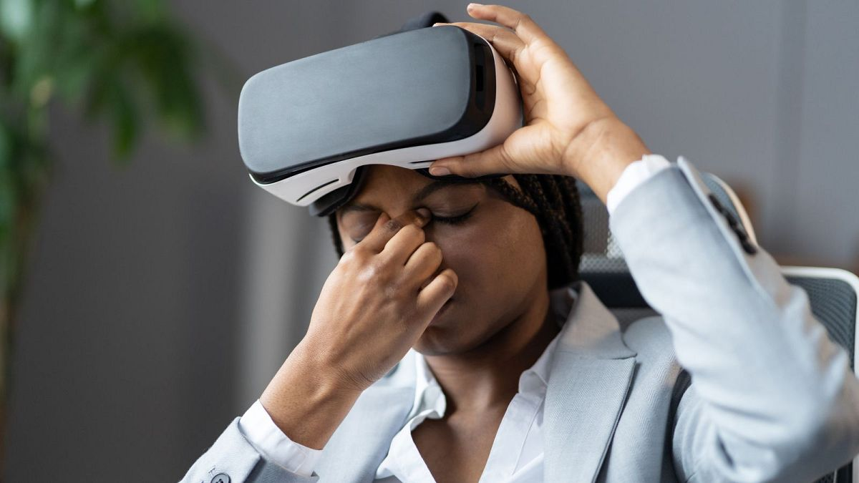

CyS Symptoms
During: XR Exposure
After: Adverse Physiological Maladaptation
Ataxia
Blurred Vision
Sopite Syndrome
After
Visual Disturbances
Reduced Dexterity
Headache
Pallor
Rapid Breathing
Dizziness
Blurred Vision
Eye Strain
During
Malaise
Vertigo
Sweating
Acronyms
XR – eXtended Reality
Burping
Nausea
Vomiting
Notes:
Perry
There are many causes of CyS. One of the primary causes of CyS is a mismatch between sensory inputs. A human’s brain is always comparing the multitude of sensory inputs it receives, and when two inputs apparently disagree, it creates issues. When a person uses a VE, their visual system perceives motion and movement cues, while their vestibular system in the inner ear does not sense corresponding physical motion. This sensory disconnect confuses the brain, leading to the feelings of disorientation and discomfort. In natural settings, our sensory inputs are usually synchronized, but VR can disrupt this harmony, resulting in CyS. The issues stem from the physiological responses (vestibular and visual perception) which are mostly driven by aspects outside of the system designer’s control.
Vection, which is the illusory self-motion in the absence of physical self-motion through space, produces some of the largest mismatches between the visual and vestibular systems and thus causes some of the most significant CyS effects. Some research posits that vection is a necessary condition for CyS to occur. The sense of vection increases with a higher rate of optical flow which increases as the user’s speed increases and distance from objects in the world decreases. Even though a low-flying helicopter is much slower than a jet at 35,000 feet, the proximity of the ground increases the optical flow and therefore vection, and therefore the likelihood and severity of CyS.
Content design is crucial when discussing the causes of CyS. Some VEs incorporate rapid and erratic movements, sudden changes in perspective, or intense visual effects. These elements can overload the senses and contribute to feelings of nausea and disorientation. Designers need to consider these factors when creating VR experiences to minimize the risk of CyS. Research has indicated that reducing locomotion with teleportation reduces the CyS symptoms. Many VR games have begun using teleportation vice locomotion to move throughout the virtual world.
Another cause of CyS is latency, the delay between a user's action and the corresponding response in the VE. When there's a noticeable delay in the VR system's response to the user's movements, it can lead to a discordance between what the user expects and what they perceive, further exacerbating feelings of nausea and discomfort.
The field of view (FOV) in virtual reality is another crucial factor in causing CyS. While many predicted that improving the FOV would reduce CyS, several studies have shown that increased FOV is correlated with higher instances of CyS. This has been attributed to the fact that peripheral movement causes more distress than central movement and is more prevalent in wider FOV systems. Several mitigation techniques for CyS actually involve limiting FOV for users, which is detrimental to training value in many VR training systems.
Individual susceptibility is an important variable in the onset of CyS. Just as some people are more prone to motion sickness during traditional travel, certain individuals are more susceptible to CyS. Factors such as age, previous history of motion sickness, and individual differences in sensory processing can influence how people respond to virtual reality environments. Because of the wide variation among users, generalizing guidelines may be impossible.
In recent years, advancements in virtual reality technology have aimed to address these causes of CyS.
Many potential solutions have been investigated such as motion platforms, direct vestibular stimulation, rest frames, and adaptation, calibration of inter-pupillary distance (IPD), ergonomics, and control with copious advice provided for system designers. High-resolution displays, improved tracking systems, higher frame rates, and reduced latency have all contributed to more comfortable and immersive VR experiences. Additionally, research into adaptive content design and locomotion techniques has sought to minimize the likelihood of inducing discomfort. One of the challenges for system users however is the difficulty of prediction which prevents an individual from knowing the effects they will experiencing without experimentation.

Slide 9

Many Names for Similar Issues
Simulator sickness
Cybersickness
Virtual reality sickness
Virtual environment sickness
Simulation induced sickness
Cyberadaptation syndrome
Virtual environment adaptation syndrome (VEAS) [after NASA: Space Adaptation Syndrome]
Acronyms
CyS - Cybersickness
Notes:
Perry
Many people will use different terms to describe this…

Slide 10
Simulator Sickness ≠ Cybersickness
Many people utilize catch-all term “cybersickness”
VR
AR
Simulator
Research has shown that causes of XR sickness and simulator sickness are significantly different
In simulator sickness, oculomotor symptoms predominated, followed by nausea and disorientation as least least experienced symptom
In VR sickness, effects are reversed – disorientation most prevalent symptom, followed by nausea, with oculomotor least experienced symptom
In AR sickness, oculomotor symptoms predominated, followed by disorientation, with nausea as least least experienced symptom
Additionally, severity of effects three times greater in VR sickness than simulator sickness (Stanney et al., 1997)
Acronyms
VR – Virtual Reality
AR – Augmented Reality
XR - eXtended Reality
Notes:
Perry
However, CyS researchers are more careful about their terms because there are differences between different causes.

Slide 11
Importance of CyS
Learning Objective 1
Why CyS is important
Military using far more AR/VR/MR/XR in multiple areas
Acronyms
CyS – Cybersickness
VR – Virtual Reality
AR – Augmented Reality
MR – Mixed Reality
XR – eXtended Reality
Notes:
Perry
CyS is a phenomenon that occurs when individuals experience symptoms while using simulation technology, such as flight simulators or VEs. These symptoms include disorientation, dizziness nausea, headaches, eye strain, general discomfort, and fatigue as well as others. These affect a large percentage of the user population, with some experiencing minor effects easily ignored and others being unable to utilize the system at all.
Lawson, B. D., & Stanney, K. M. (2021). cybersickness in virtual reality and augmented reality. Frontiers in Virtual Reality, 2, 759682.

Slide 12

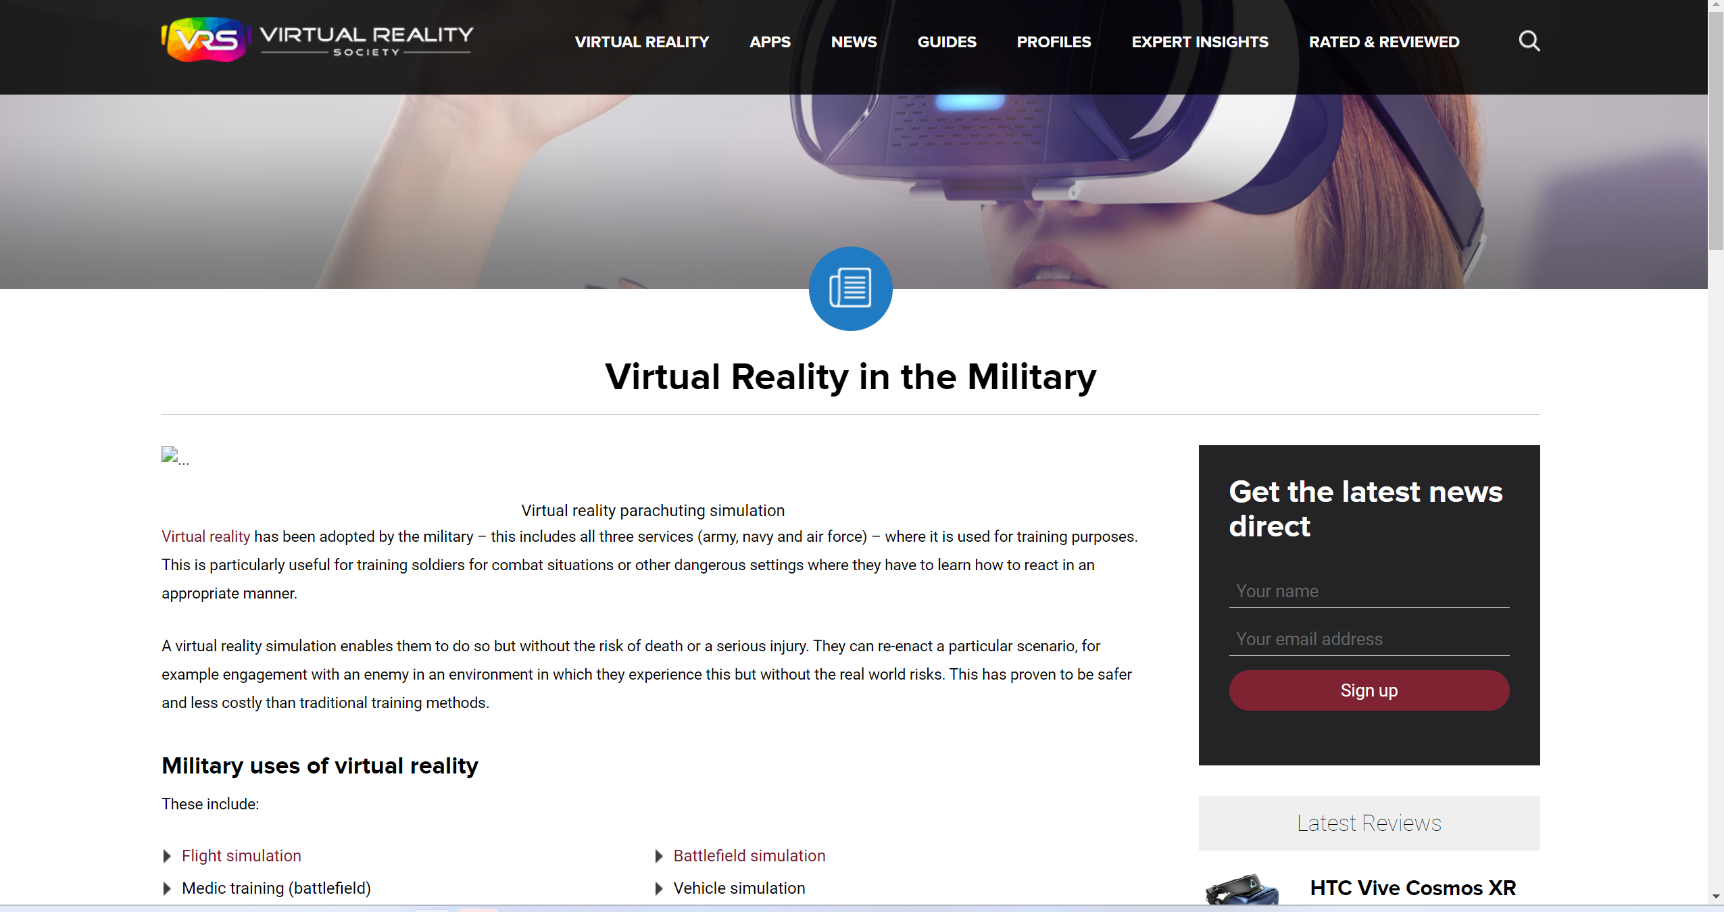
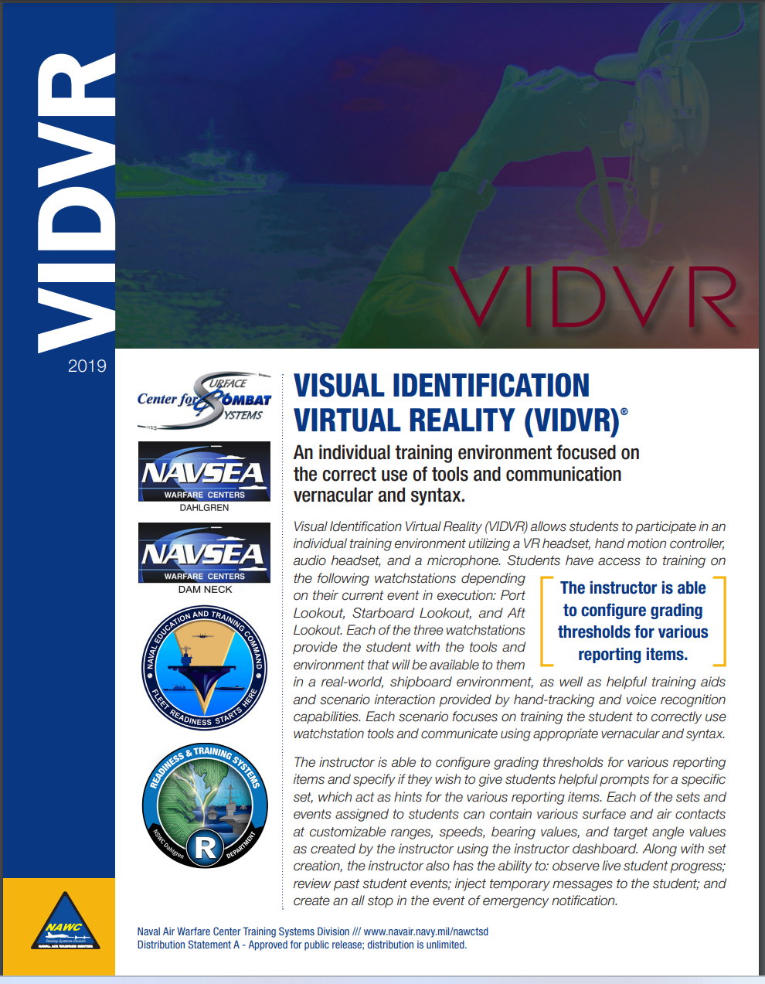

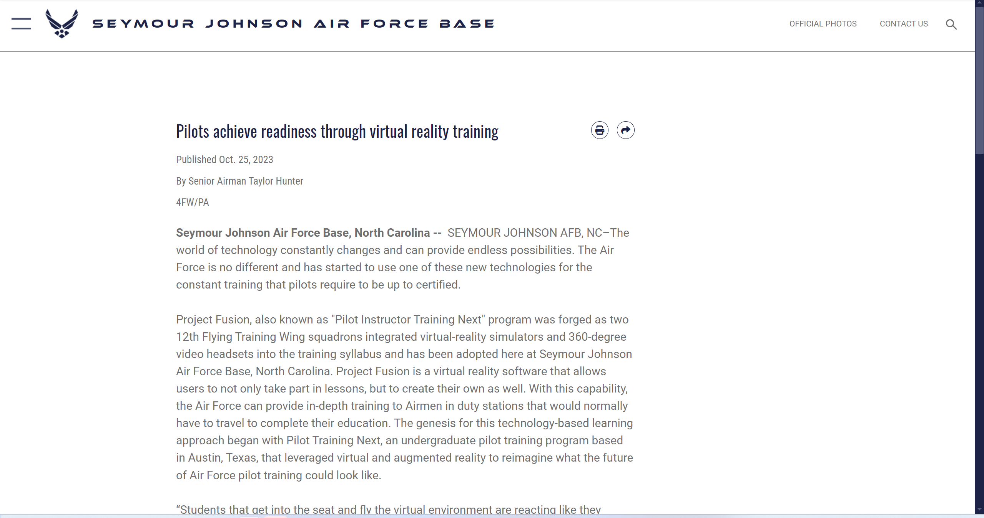
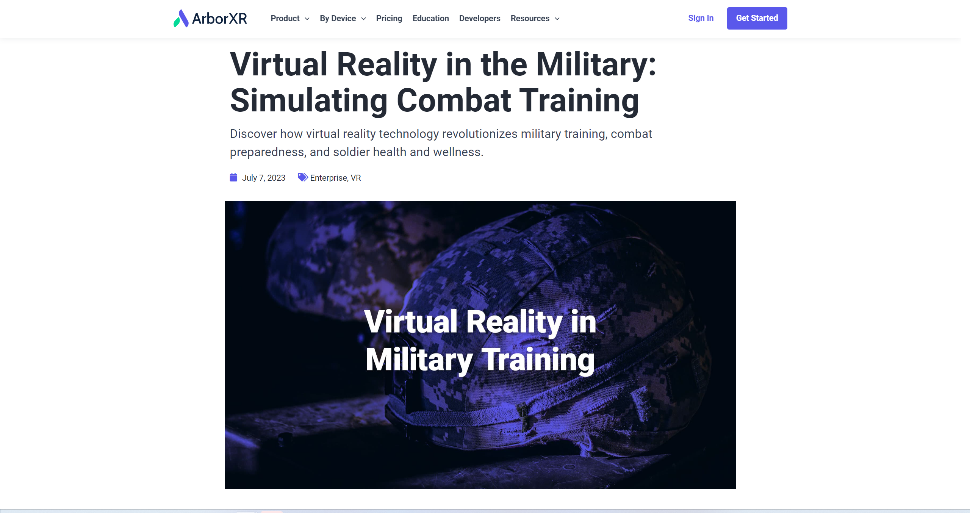

DoD using More AR/VR/MR/XR
Acronyms
Notes:
Perry

Slide 13
Importance of CyS
Learning Objective 1
Why CyS is important
Military using far more AR/VR/MR/XR in multiple areas
Despite claims, technology is unlikely to eliminate CyS
How CyS affects learners in VEs
CyS can have significant impact upon learning
Acronyms
CyS – Cybersickness
VR – Virtual Reality
AR – Augmented Reality
MR – Mixed Reality
XR – eXtended Reality
VE – Virtual Environment
Notes:
Perry
CyS is a phenomenon that occurs when individuals experience symptoms while using simulation technology, such as flight simulators or VEs. These symptoms include disorientation, dizziness nausea, headaches, eye strain, general discomfort, and fatigue as well as others. These affect a large percentage of the user population, with some experiencing minor effects easily ignored and others being unable to utilize the system at all.
Lawson, B. D., & Stanney, K. M. (2021). cybersickness in virtual reality and augmented reality. Frontiers in Virtual Reality, 2, 759682.

Slide 14
Importance of CyS
Why tutorial attendees need to know about CyS
Choices in design and development of training system can greatly affect user’s CyS symptoms and often cannot be undone later
Curriculum designers must consider CyS in planning out a class that utilizes XRs to minimize harmful effects both during and after exposure
Class management can significantly affect CyS factors when XRs are used
Acronyms
CyS – Cybersickness
VE – Virtual Environment
Notes:
Perry
CyS is a phenomenon that occurs when individuals experience symptoms while using simulation technology, such as flight simulators or VEs. These symptoms include disorientation, dizziness nausea, headaches, eye strain, general discomfort, and fatigue as well as others. These affect a large percentage of the user population, with some experiencing minor effects easily ignored and others being unable to utilize the system at all.

Slide 15
Why is CyS Important?
Safety & Health
Don’t crash the student
Unwanted, unintended side effects
Liability
Sales (of simulators, tickets, or software)
Decreased use of the system
Reduced training effectiveness
Acronyms
CyS - Cybersickness
Notes:
Perry

Slide 16
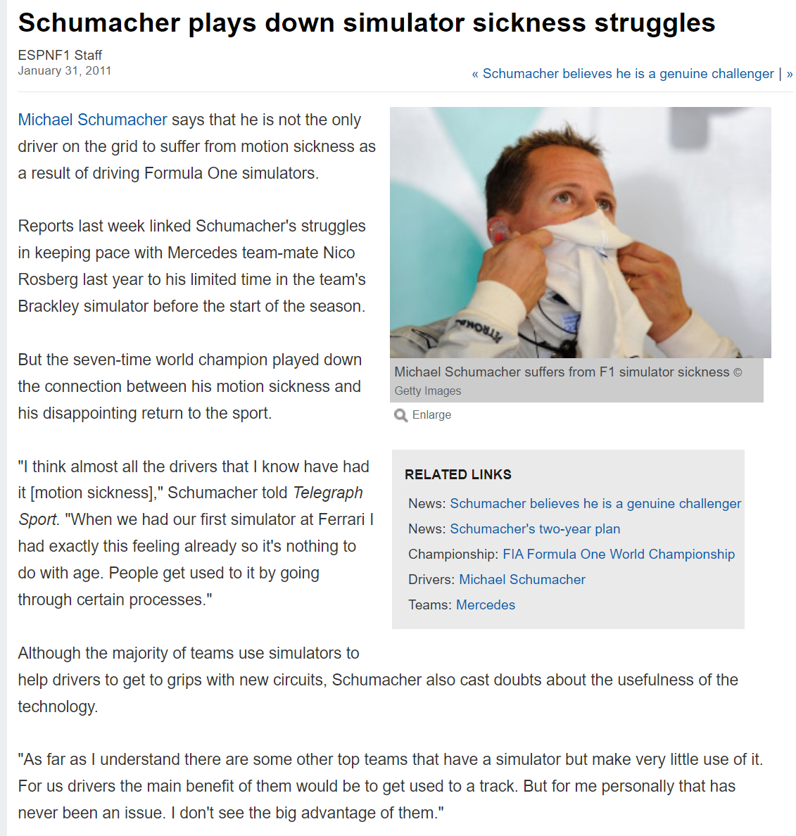
Notes:
Perry

Slide 17
CyS Science
Scientific research findings on factors that affect CyS
Human
Hardware
Content
Interaction
Acronyms
CyS - Cybersickness
Notes:
Claire
Possible useful references:
Cao, Z., Grandi, J., & Kopper, R. (2021). Granulated rest frames outperform field of view restrictors on visual search performance. Frontiers in Virtual Reality, 2, 604889.
Stauffert, J. P., Niebling, F., & Latoschik, M. E. (2020). Latency and cybersickness: Impact, causes, and measures. A review. Frontiers in Virtual Reality, 1, 582204.
Shahnewaz Ferdous, S. M., Chowdhury, T. I., Arafat, I. M., & Quarles, J. (2021). Static rest frame to improve postural stability in virtual and augmented reality. Frontiers in Virtual Reality, 1, 582169.

Slide 18
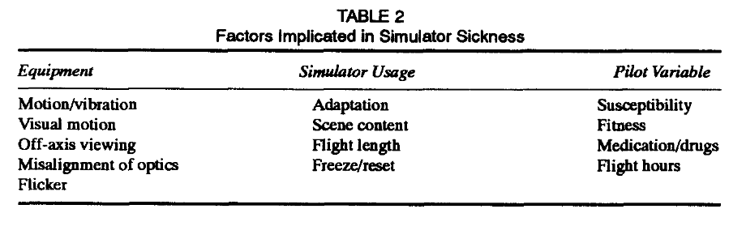
CyS Science
Polysymptomatic & Polygenic
“Therefore, it is possible (and it happens) that some people exhibit all the signs and symptoms in connection with their simulator exposure and others experience only a few. No one symptom predominates in all persons.” (Kennedy & Fowlkes (1992),pg. 25)
Acronyms
CyS - Cybersickness
Notes:
Claire

Slide 19
CyS Science
Learning Objective 1
Describe basic science of causes and mitigating factors of CyS
Sensory Conflict Hypothesis
Evolutionary Hypothesis
Ecological Hypothesis
Multisensory Re-weighting Hypothesis
Acronyms
CyS - Cybersickness
Notes:
Claire

Slide 20
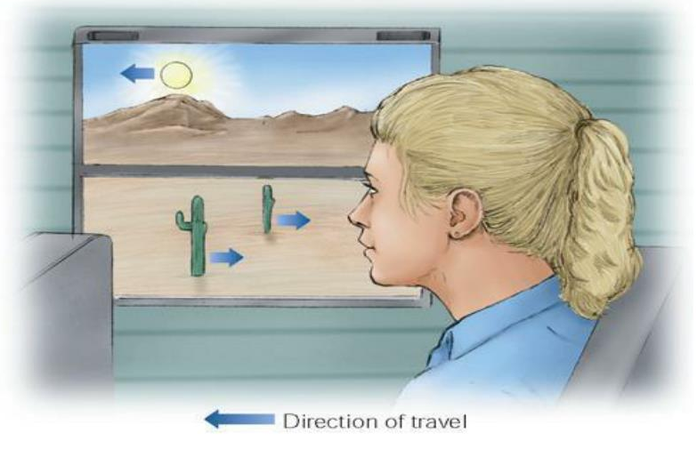
CyS Science
Sensory Conflict Hypothesis (or neural mismatch hypothesis; most cited)
CyS driven by discrepancy between expected and experienced sensory signals (visual, vestibular, proprioceptive)
Viewers can be particularly sensitive to motion parallax cues
Objects closer to you travel at faster speeds and in opposite direction; further objects travel slower and in same direction
Acronyms
CyS - Cybersickness
Notes:
Claire
Sensory Conflict Hypothesis (or neural mismatch hypothesis; most cited)
CyS driven by discrepancy between expected and experienced sensory signals (visual, vestibular, proprioceptive)
Viewers can be particularly sensitive to motion parallax cues
Example: Eyes perceive moving in a virtual world, but body does not feel motion because sitting still
Relevance: High level of individual variability in sensitivity to sensory depth cues varies
Design: Need to determine which sensory cues are particularly sickness-inducing

Slide 21
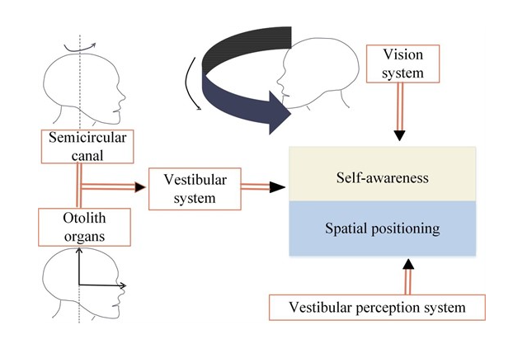
CyS Science
Evolutionary Hypothesis
CyS is seen as an evolutionary response to perceived toxins
Body’s defense mechanism against neurotoxins, causing nausea to expel them
Acronyms
CyS – Cybersickness
XR - eXtended Reality
HWD - Head Work Display
FOV - Field of View
Notes:
Claire
Evolutionary Hypothesis
CyS is seen as an evolutionary response to perceived toxins
Mechanism: Body’s defense mechanism against neurotoxins, causing nausea to expel them
Example: XR effects coordination of visual, vestibular, proprioceptive sensory systems, misinterpreted by body as hallucinations associated with ingestion of noxious substance that trigger emetic response to rid body of poison
Relevance: Sensorineural discordance due to HWD limitations (limited FOV, optical distortions, static projection depth planes, etc.)
Design: Design XR systems to minimize sensorineural discordance to prevent cybersickness and harmful maladaptation
Integrate eye tracking in HWDs to help capture adaptive changes and adjust visual content accordingly
Usage protocols can be used to drive adaptation to XR environments to help avoid sickness; such adaptation can be quick (visual coding) or gradual (end-state results)

Slide 22
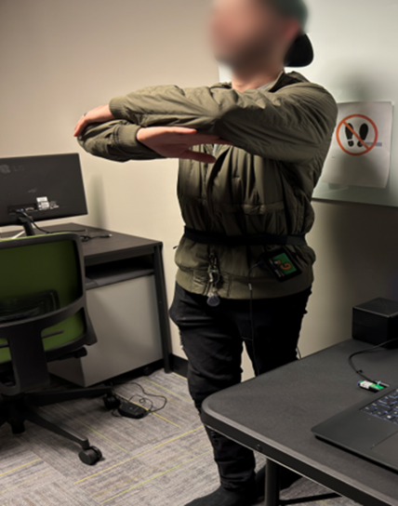
CyS Science
Ecological Hypothesis
CyS arises from prolonged postural instability (inability to maintain balance and posture in XR), focusing on movement control rather than sensory conflict
Acronyms
CyS – Cybersickness
XR – eXtended Reality
Notes:
Claire
Ecological Hypothesis
CyS arises from prolonged postural instability (inability to maintain balance and posture in XR), focusing on movement control rather than sensory conflict
Example: XR exposure can lead to altered specificity (e.g., visual accelerations and rotations unrelated to control of body), thus may use muscular force to resist these virtual motions but these control strategies for gaining postural stability will not work, which creates unintended divergence from a stable position causing postural instability
Relevance: As postural instability increases, motion sickness develops
Design: Design XR environments that promote postural stability by reducing unnecessary motion, providing stable reference points, and giving users control over their movements within the XR environment

Slide 23
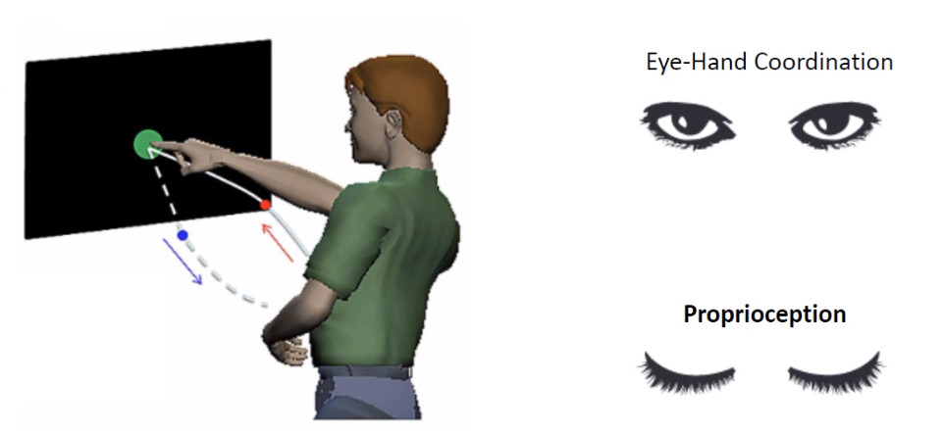
CyS Science
Multisensory Reweighting Hypothesis
Suggests that CNS adjusts importance, or “weight” it assigns to different sensory inputs to maintain balance and orientation during XR exposure
Shift in Felt Limb Position
Acronyms
CyS – Cybersickness
XR - eXtended Reality
CNS - Central Nervous System
Notes:
Claire
Multisensory Reweighting Hypothesis
Suggests that CNS adjusts importance, or “weight” it assigns to different sensory inputs to maintain balance and orientation during XR exposure
Example: Brain re-weights sensory information to adapt to XR environments
Over time, CNS adapts by increasing weight of more reliable sensory inputs (e.g., vision) and decreasing weight of less reliable ones (e.g., vestibular cues) to reduce discomfort
Relevance: Can predict which individuals might be more susceptible to CyS based on their ability to re-weight sensory inputs effectively
Design: Design XR systems to provide most reliable sensory inputs, particularly visual cues, to help CNS prioritize accurate information
Implement adaptive feedback mechanisms that adjust sensory outputs based on real-time user interactions and sensory reliability
Allow users to customize sensory settings to match their individual sensory processing capabilities and preferences

Slide 24
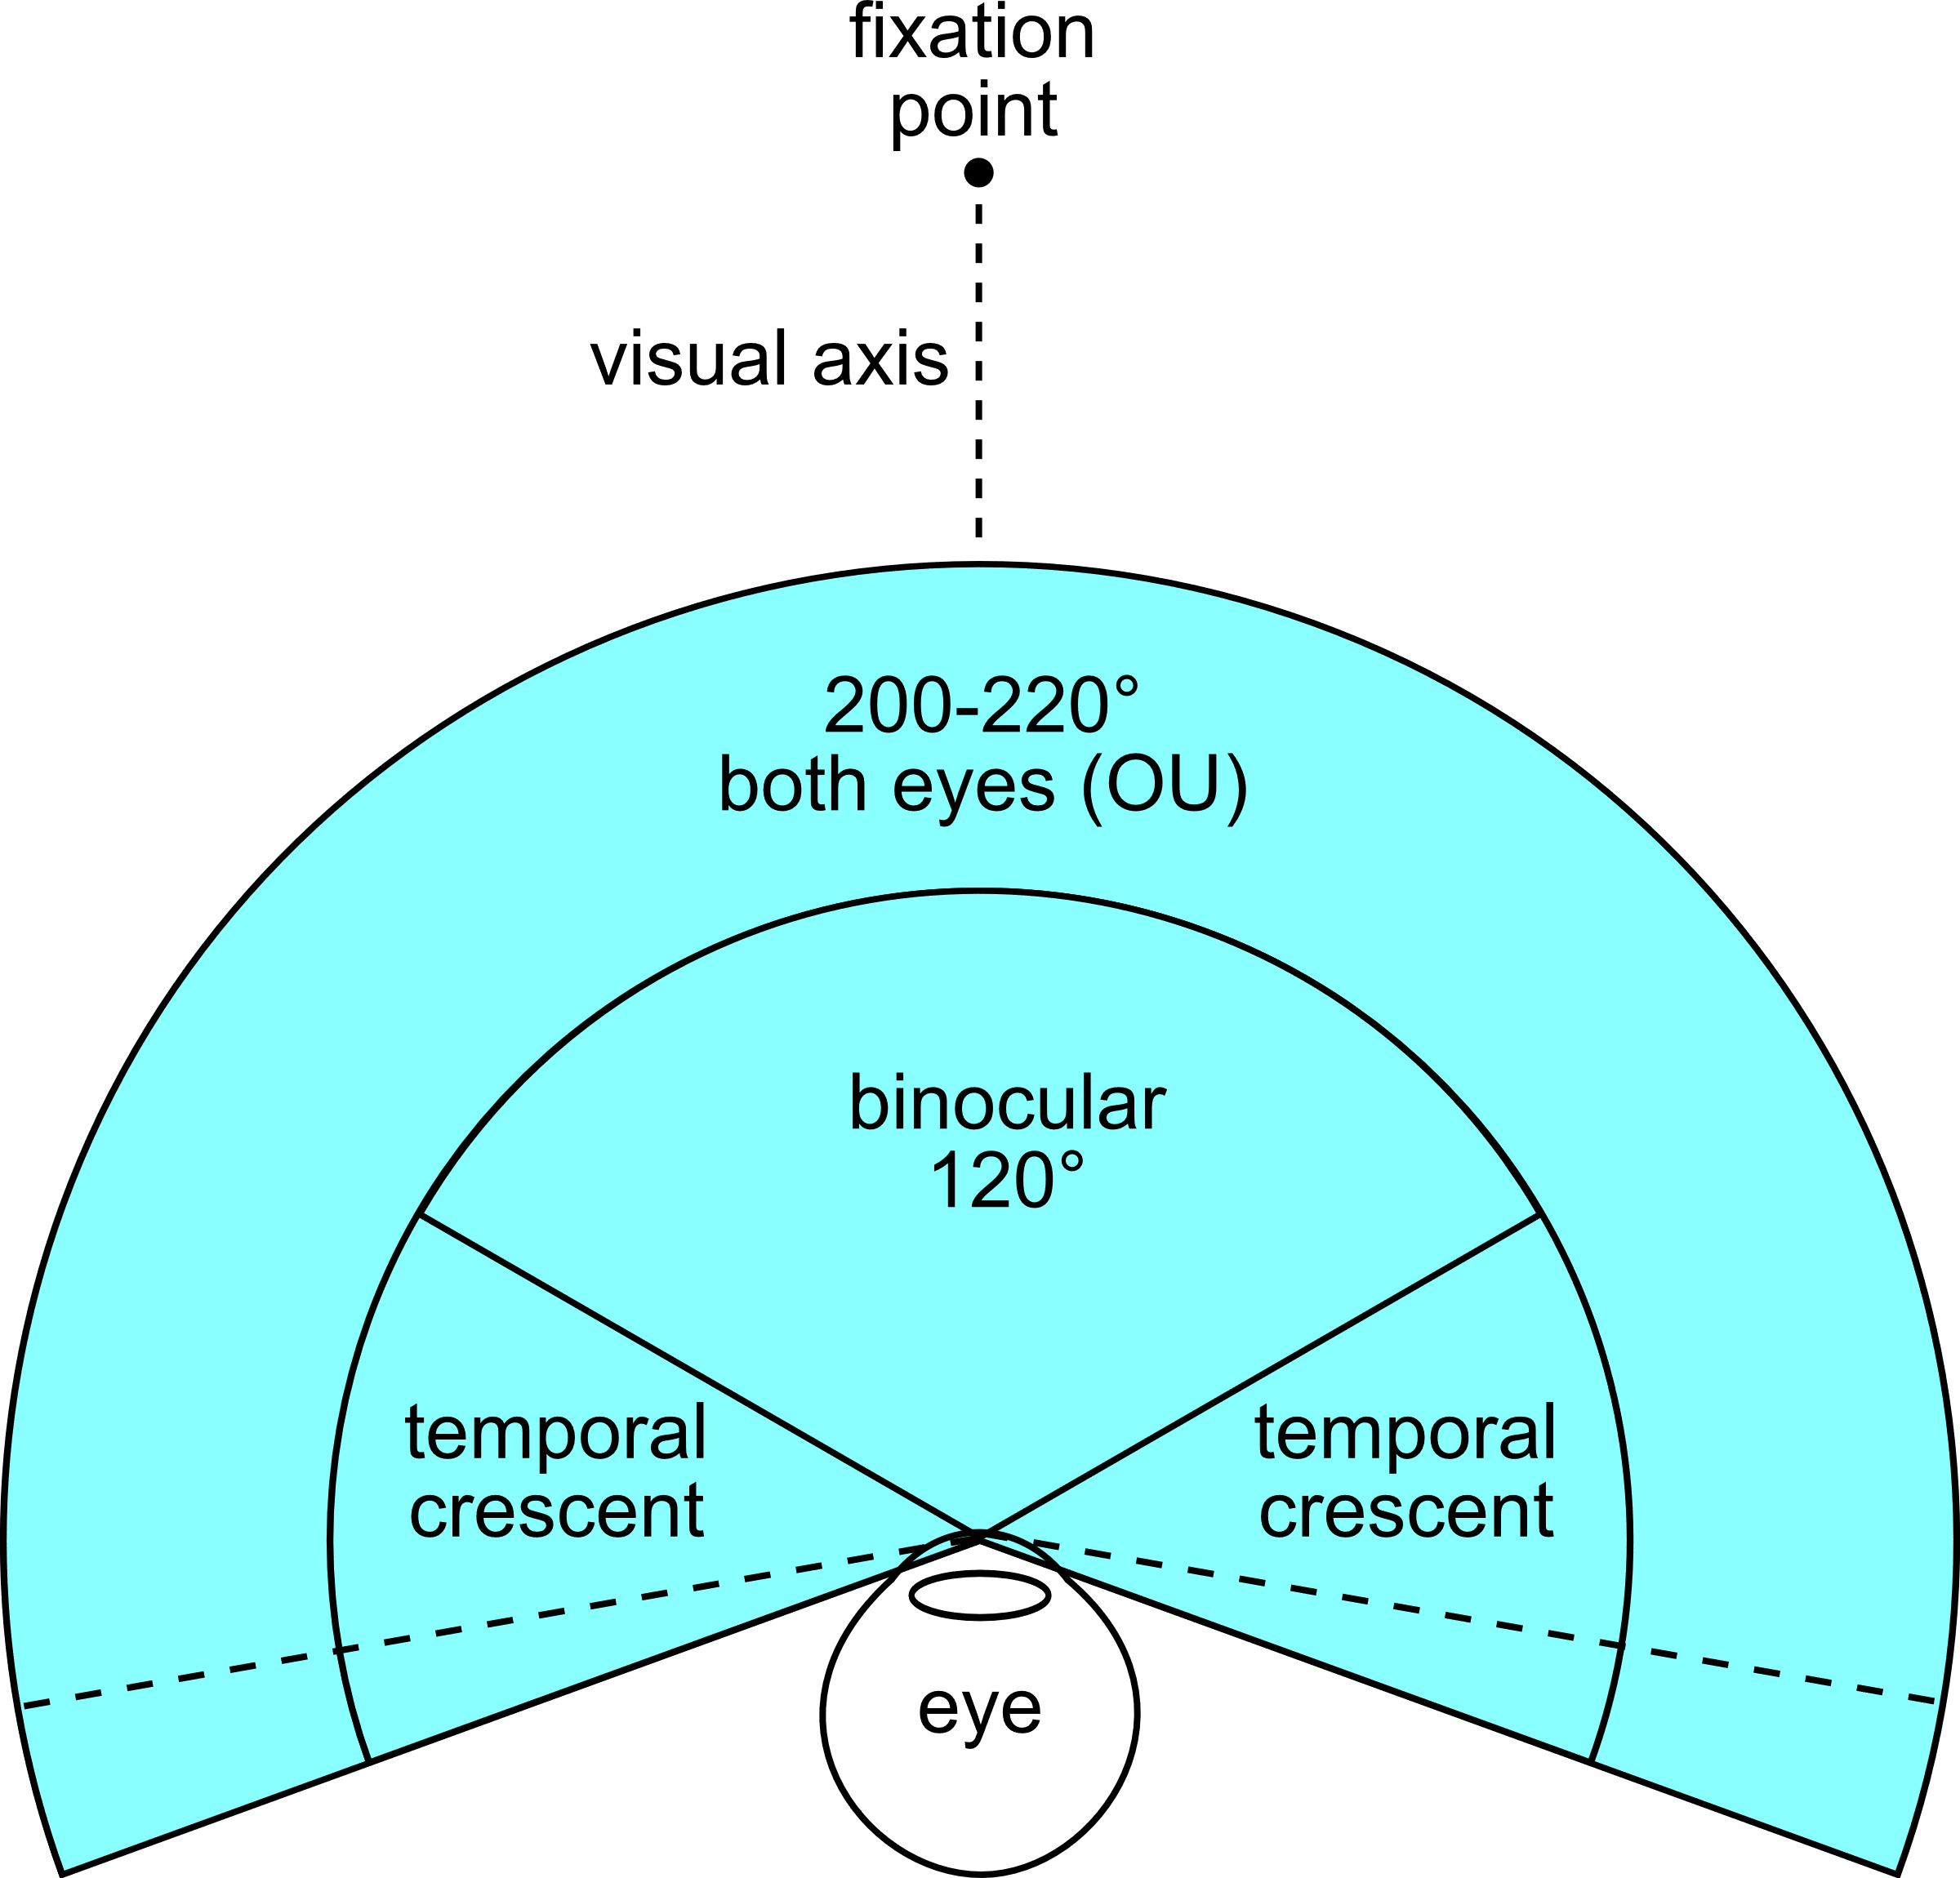
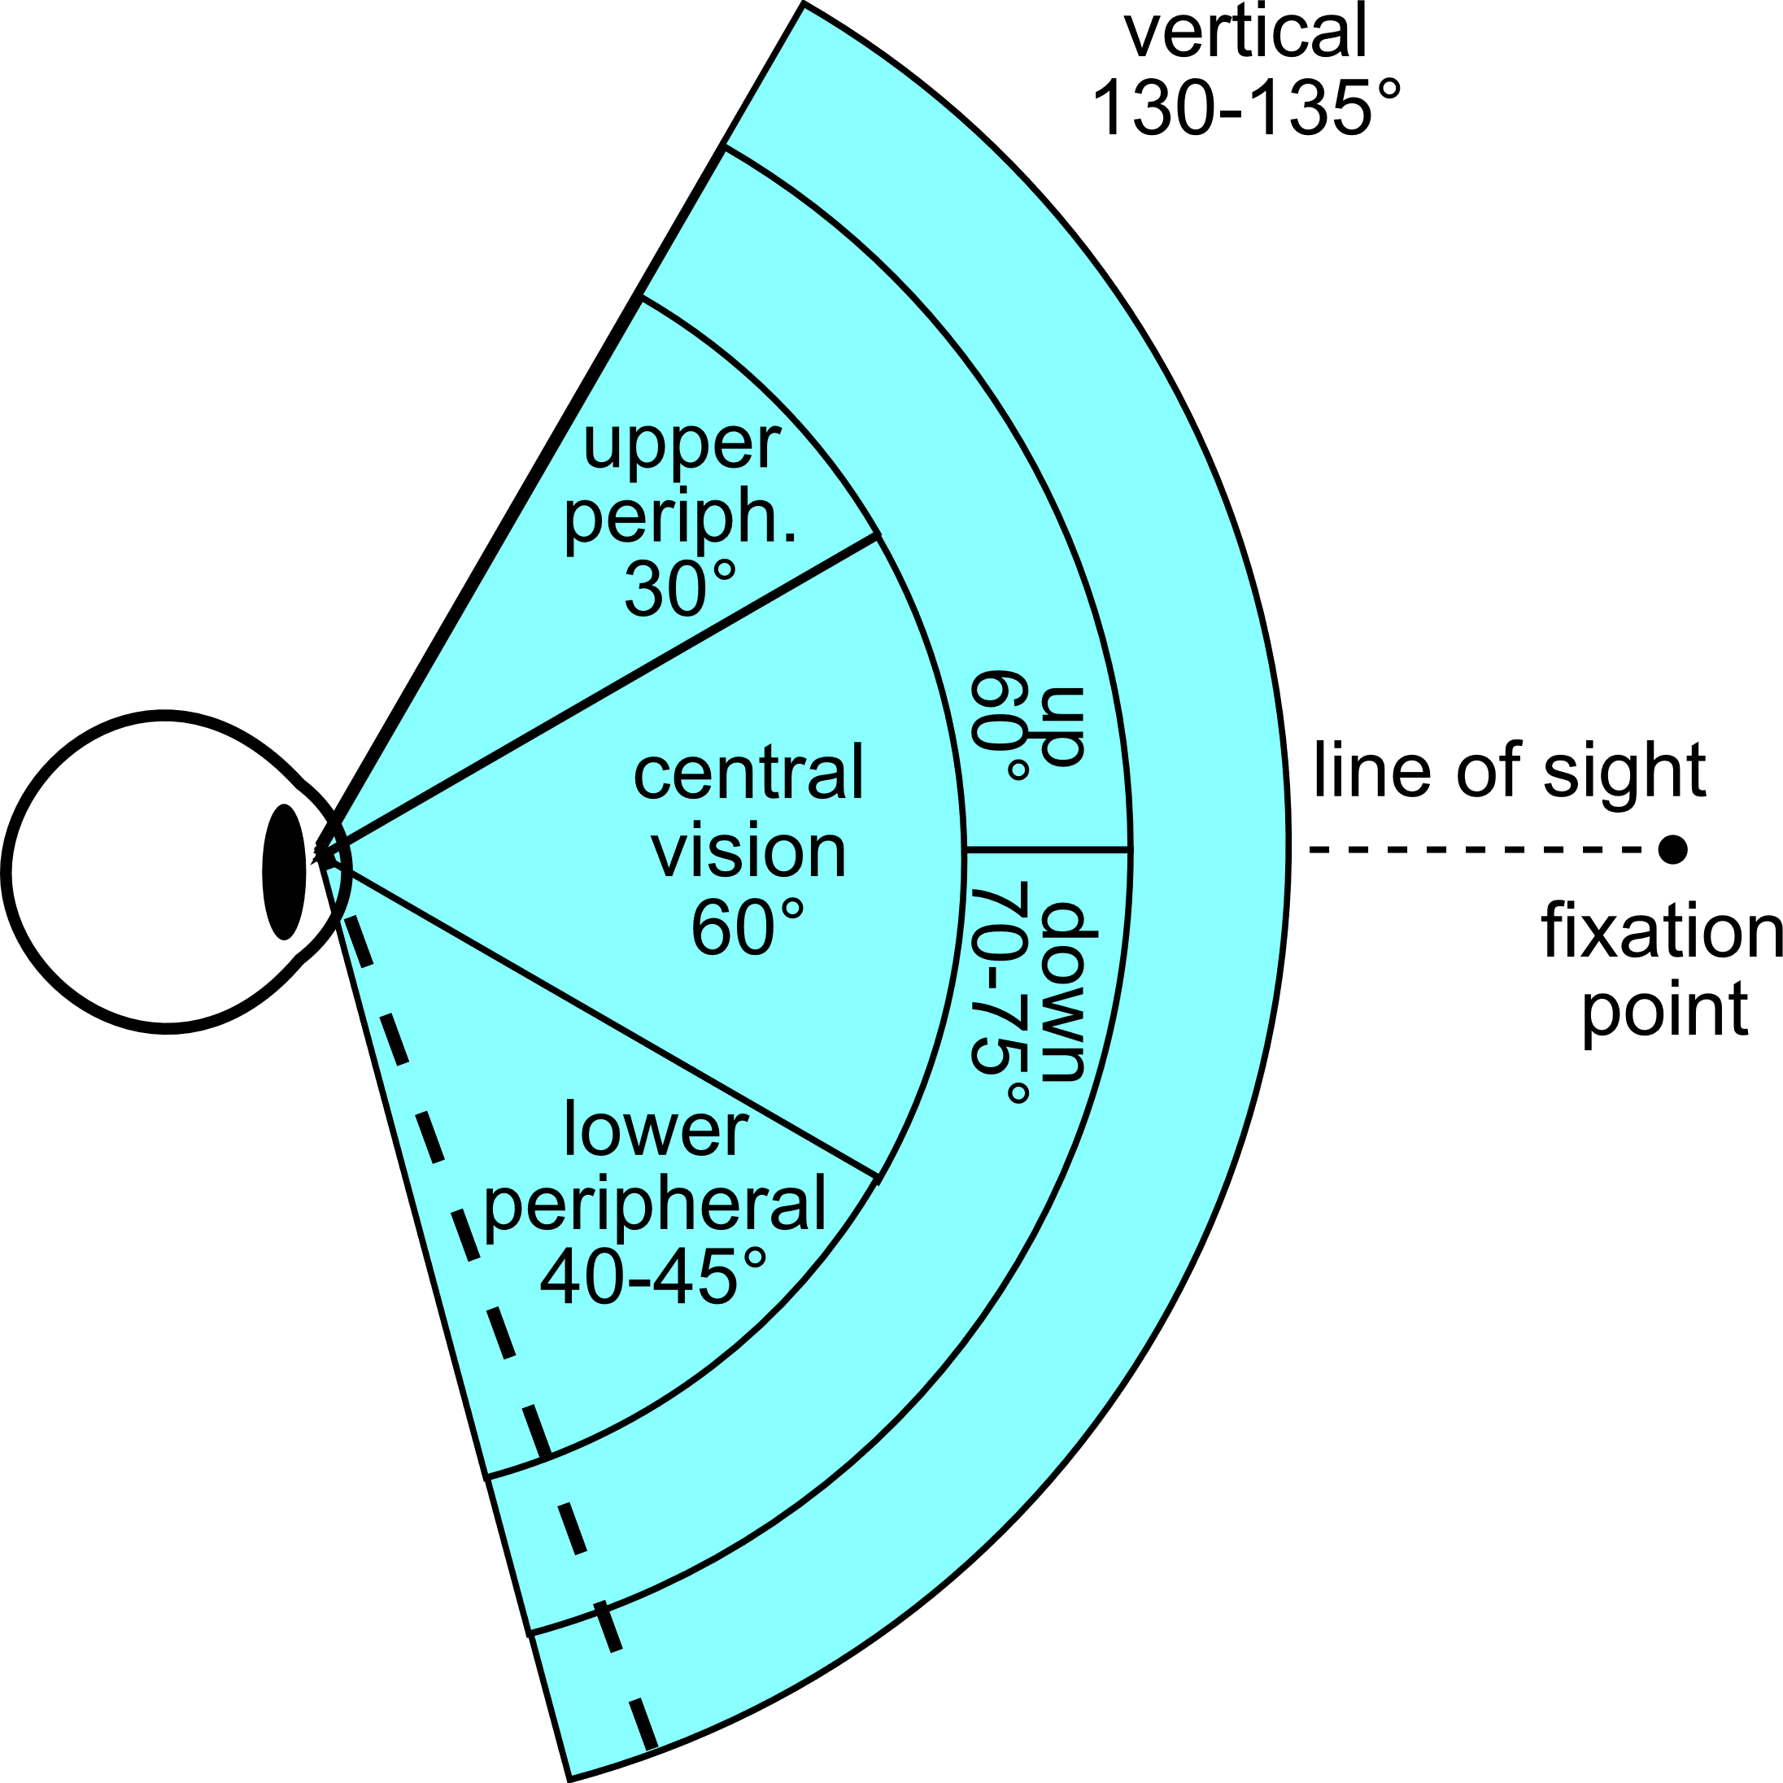
CyS Science – Hardware Factors
Field of View (FOV)
Depth of field
Tracking errors
Latency
Resolution
Acronyms
CyS – Cybersickness
FOV – Field of View

Slide 25
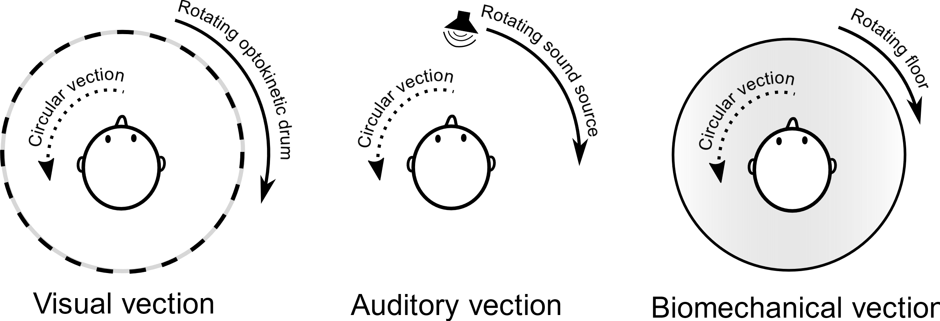
CyS Science – Content Factors
Vection
Optic Flow
Flicker
Visual lag
Rest frames
Visual realism
Acronyms
CyS - Cybersickness
Notes:
Claire
https://en.wikipedia.org/wiki/Illusions_of_self-motion#/media/File:Vection_diagram.svg

Slide 26
Reduce CyS During Design and Development
Learning Objective 2
CyS must be THE key factor in design and development of XRs
If people can’t use it, does it matter how “good” the product is?
Test early/test often
Choice of input devices
Design XR stimulus to minimize CyS and associated adverse effects
Acronyms
CyS – Cybersickness
XR – eXtended Reality
Notes:
Claire
Improvements in technology have reduced or eliminated some of the causes of CyS, but there are causes that are inherent in humans which technology is unlikely to eliminate. This means that everyone involved in the design, development, and implementation of training VEs must understand the causes of CyS, how to mitigate them, and how to create systems that reduce both the likelihood and severity of CyS symptoms. Otherwise, it will be impossible to properly utilize the incredible potential of these technologies.
Developers must test their design early in development process.
Weech, S., Calderon, C. M., & Barnett-Cowan, M. (2020). Sensory down-weighting in visual-postural coupling is linked with lower cybersickness. Frontiers in Virtual Reality, 1, 10.

Slide 27
CyS Mitigation Factors
Sensory Conflict Hypothesis
Upon initial XR exposure, minimize motion parallax cues to acclimate user to XR experience
Gradually step-up motion parallax cues over time, if user begins to feel discomfort, diminish motion parallax cues once again
Include options to minimize amount of head movement/motion parallax required
Use teleportation (but note that this can increase disorientation and hinder spatial awareness)
Add concordant motion (e.g., a motion-base to reduce visual-vestibular conflicts)
Ask observers to actively align head/body to behavior of virtual motion they are experiencing
Limit or slow forward speed and acceleration to reduce visual scene motion
When conflicts persist:
Provide visual cues that match vestibular system, such as by adding inertially stable visual motion cues (fixed-horizon)
Minimize vestibular cues through depth-of-field blur, peripheral blur, or dynamic field of view, latter of which involves modifying FOV based on speed and angular velocity
Acronyms
CyS – Cybersickness
XR - eXtended Reality
FOV - Field of View
Notes:
Claire
Source: Stanney, K., Lawson, B. D., Rokers, B., Dennison, M., Fidopiastis, C., Stoffregen, T., … Fulvio, J. M. (2020). Identifying Causes of and Solutions for Cybersickness in Immersive Technology: Reformulation of a Research and Development Agenda. International Journal of Human–Computer Interaction, 36(19), 1783–1803. https://doi.org/10.1080/10447318.2020.1828535

Slide 28
CyS Mitigation Factors
Evolutionary Hypothesis
Foster sensory adaptation via perceptual recalibration by highlighting visuomotor discordances to engender a sense of body ownership and drive sensorimotor adaptation in XR environments
Foster sensory adaptation via visual-motor skill alterations by using representational feedback that appears to arise from manipulation of XR environment
Acronyms
CyS – Cybersickness
XR – eXtended Reality
Notes:
Source: Stanney, K., Lawson, B. D., Rokers, B., Dennison, M., Fidopiastis, C., Stoffregen, T., … Fulvio, J. M. (2020). Identifying Causes of and Solutions for Cybersickness in Immersive Technology: Reformulation of a Research and Development Agenda. International Journal of Human–Computer Interaction, 36(19), 1783–1803. https://doi.org/10.1080/10447318.2020.1828535

Slide 29
CyS Mitigation Factors
Ecological Hypothesis
XR should be used while seated, and users should be encouraged to use a headrest
Design XR dynamics that support rather than degrade postural stability
Use motion sensor data (from headsets) to identify individuals at risk for cybersickness due to copious head movement not aligned with scene content
Modulate XR dynamics in real time to suppress unstable postural activity
Acronyms
CyS – Cybersickness
XR – eXtended Reality
Notes:
Source: Stanney, K., Lawson, B. D., Rokers, B., Dennison, M., Fidopiastis, C., Stoffregen, T., … Fulvio, J. M. (2020). Identifying Causes of and Solutions for Cybersickness in Immersive Technology: Reformulation of a Research and Development Agenda. International Journal of Human–Computer Interaction, 36(19), 1783–1803. https://doi.org/10.1080/10447318.2020.1828535

Slide 30
CyS Mitigation Factors
Multisensory Reweighting
Promoting rapid re-weighting of multisensory cues may protect against provocative conditions of XR exposure
Facilitating vection might offer protection from cybersickness in XR
“Re-couple” multimodal cues, either by physically moving an observer along with visual self-motion or by stimulating vestibular sense with mild current (GVS) to replicate missing acceleration cues
Use vestibular noise to modulate cybersickness response
Consider using tDCS to reduce severity of cybersickness
Increase presence to lower cybersickness
Use positive smells and pleasant-sounding music to promote user comfort
Acronyms
CyS – Cybersickness
XR - eXtended Reality
GVS - Galvanic Vestibular Stimulation
tDCS - Transcranial Direct Current Stimulation
Notes:
Source: Stanney, K., Lawson, B. D., Rokers, B., Dennison, M., Fidopiastis, C., Stoffregen, T., … Fulvio, J. M. (2020). Identifying Causes of and Solutions for Cybersickness in Immersive Technology: Reformulation of a Research and Development Agenda. International Journal of Human–Computer Interaction, 36(19), 1783–1803. https://doi.org/10.1080/10447318.2020.1828535

Slide 31
Protocols to reduce CyS for Fielded Systems
Learning Objective 3
Quantify XR stimulus intensity
Quantify XR aftereffects of target system
Identify individual capacity of target user population to resist adverse effects of XR exposure
Provide warnings for those with severe susceptibility to issues
Promulgate usage protocols
Acronyms
CyS – Cybersickness
XR – eXtended Reality
Notes:
Nick

Slide 32
Quantify XR Stimulus Intensity
Optical flow
Cumulative optical flow entropy
Horizontal flow, vertical flow, magnitude – contribute differently
Number of optical flow events can vary significantly between VE sequences (movement, elements in environment)
Difference between focused vs peripheral vision
Questionnaires
CyS susceptibility questionnaire (CSSQ)
Simulator sickness questionnaire (SSQ)
Visually induced motion sickness susceptibility questionnaire (VIMSSQ)
Virtual reality neuroscience questionnaire (VNSQ)
Acronyms
CyS – Cybersickness
XR – eXtended Reality
Notes:
Nick
Optical flow is an approximation measure of image motion using projection of a 3D surface on a 2D plane. When analyzed in time sequence structures of the optical flow field can recover 3D motion and motion of the original sensor. Used in many computer vision tasks. It provides insight into motion regularity and complexity.
Using entropy metrics to characterise the signal of optical flow
Tian, N., & Boulic, R. (2024). The Least Increasing Aversion (LIA) Protocol: illustration on identifying individual susceptibility to cybersickness triggers. IEEE Transactions on Visualization and Computer Graphics
Smith, S. P. (2021). Comparing virtual environments for cybersickness using a cumulative optical flow entropy metric. IEEE Access, 9, 68898-68904.
We really need more data here for longer learning type experiences. The data is often focused on short (<15 minute), ride like experiences (rollercoasters) which doesn’t necessarily translate well into an educational setting.
Challenging to compare across systems as well. i.e. how much of the issue is due to limited resolution when comparing say Oculus DK 1 vs a Quest 3 or Varjo?
Does the frame rate that the data was captured at have an impact?
Kourtesis, P., Collina, S., Doumas, L. A., & MacPherson, S. E. (2019). Validation of the virtual reality neuroscience questionnaire: maximum duration of immersive virtual reality sessions without the presence of pertinent adverse symptomatology. Frontiers in human neuroscience, 13, 417.

Slide 33
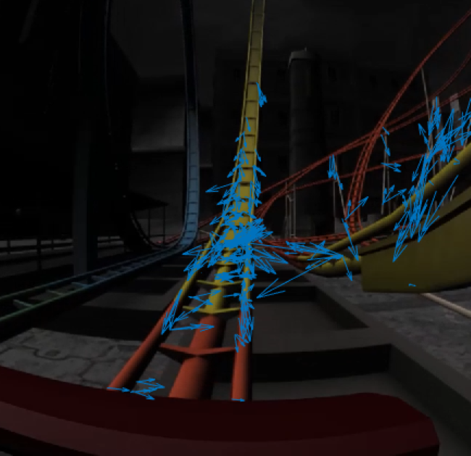
Cumulative Optical Flow Entropy Diagram
Notes:
Nick

Slide 34

Optical Flow - VIDVR

Slide 35
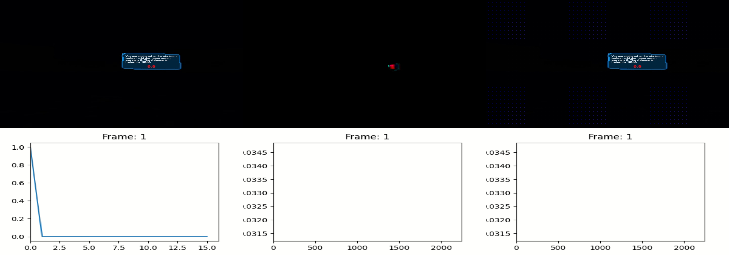
Cumulative Optical Flow Entropy Diagram – VIDVR #1

Slide 36
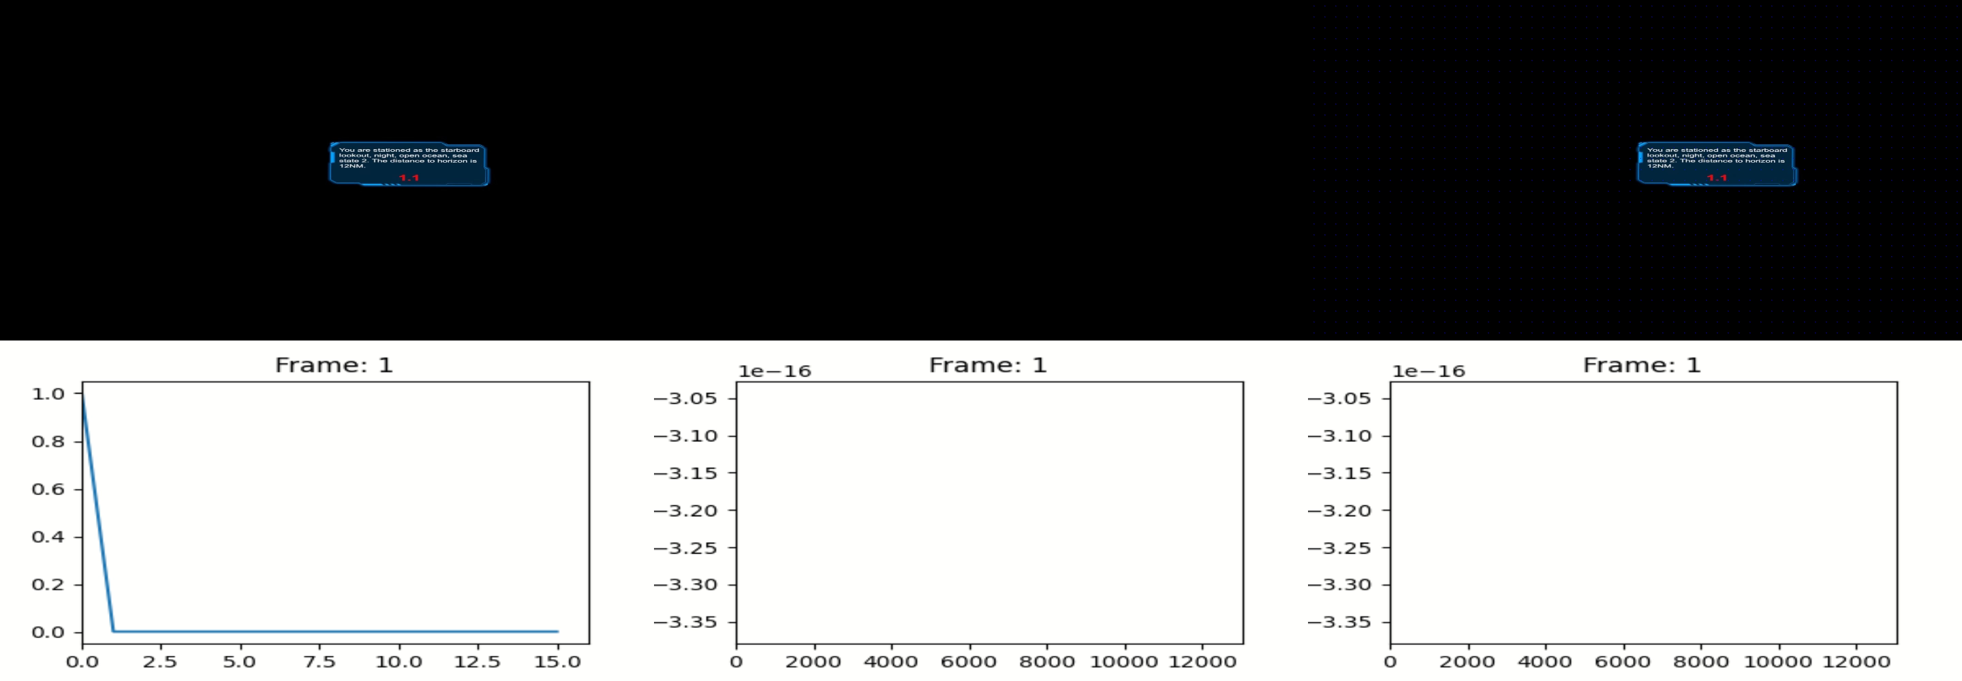
Cumulative Optical Flow Entropy Diagram – VIDVR #2

Slide 37
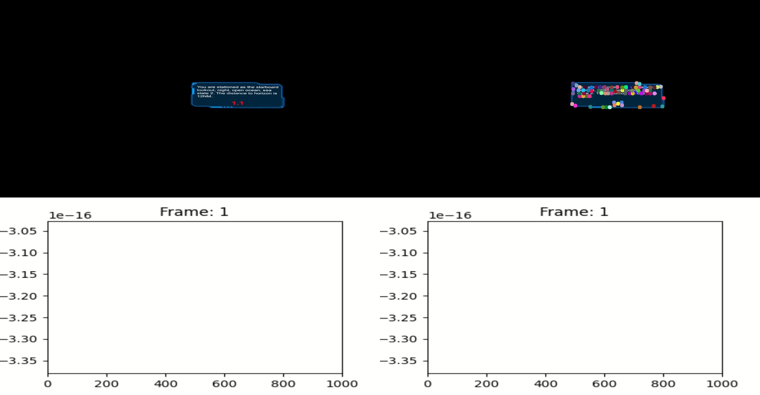
Cumulative Optical Flow Entropy Diagram – VIDVR #1

Slide 38
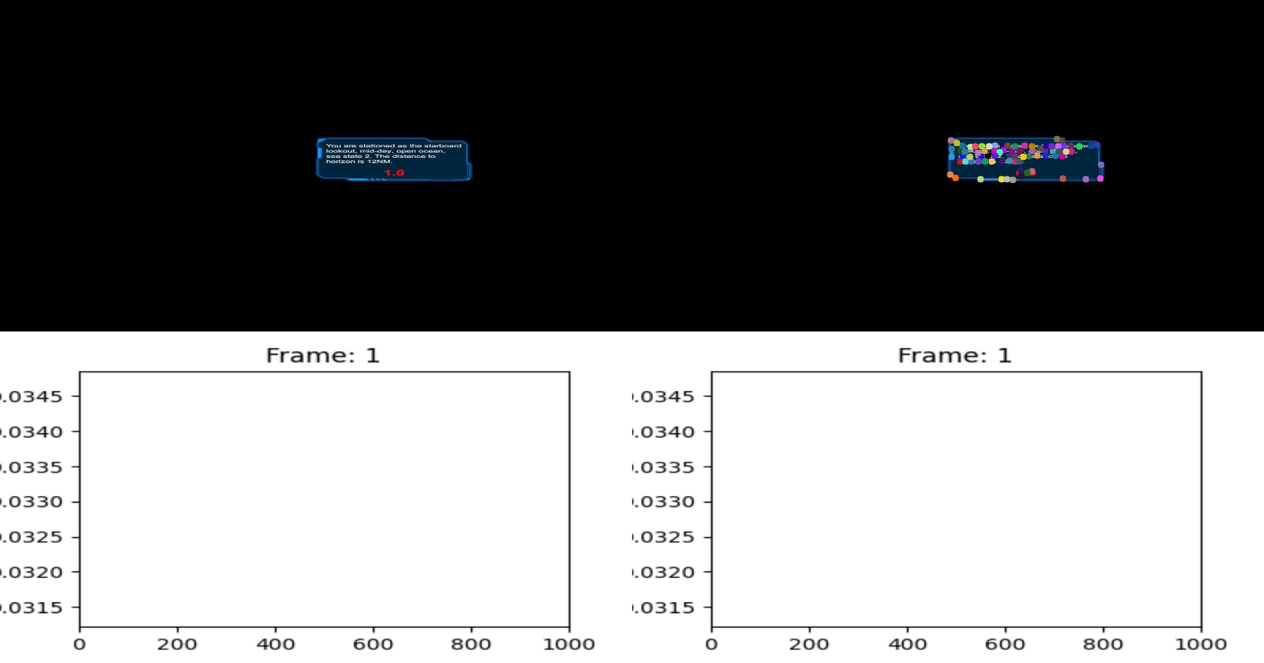
Cumulative Optical Flow Entropy Diagram – VIDVR #2

Slide 39
Guidance from XR Stimulus Quantification
Maximum session length
Cumulative session limits
Susceptibility index
Design of lessons
Acronyms
XR – eXtended Reality
Notes:
Nick

Slide 40
Quantify XR Aftereffects of Target System
Questionnaires
Biometric States
Binocular vision impact
Postural instability
Visual acuity
Refractive error
Pupil size
EEG/ECG
Physiological states
Cognitive performance
Acronyms
EEG – Electrogastrogram
ECG - Electrocardiogram
Notes:
Nick
Smith, S. P. (2021). Comparing virtual environments for cybersickness using a cumulative optical flow entropy metric. IEEE Access, 9, 68898-68904
Long, Y., Shen, Y., Guo, D., Wang, X., & Gu, Y. (2020). The Effects of Consumer-grade Virtual Reality Headsets on Adult Visual Function. Seminars in Ophthalmology, 35(3), 170–173. https://doi.org/10.1080/08820538.2020.1776342
Long term the amplitude of accommodation changed, but visual acuity, pupil size and refractive error remained unaffected
10 minutes, 2x day for 2 weeks – possibly well representative of a learning style activity?
Biases? Subjective measurements?

Slide 41
Guidance from XR Aftereffects Quantification
Post experience limitations
Management protocols for affected users
Training for instructors
Notes:
Nick

Slide 42
Reduce CyS During Curriculum Design
Learning Objective 4
Key actions/methods to design curricula which minimize CyS
Length of XR sessions
Number of sessions
Placement of XR sessions within curricula
Learning outcomes
Individual susceptibility
Adaptation
Acronyms
CyS – Cybersickness
XR – eXtended Reality
Notes:
Perry
Learning Objective 4
Short – trying to fix it at curriculum level is really too late

Slide 43
Identify Individual Capacity of Target User Population
Motion sickness susceptibility questionnaire (MSSQ)
Fast motion sickness scale (FMS)
Significant differences in responses of individuals
Sex
Age
Past experience
VR time
Simulator time
Videogame time
Prior sickness susceptibility
Adaptation
Acronyms
MSSQ - Motion Sickness Susceptibility Questionnaire
FMS - Fast Motion Sickness Scale
VR – Virtual Reality
Notes:
Perry
Tian, N., Lopes, P., & Boulic, R. (2022). A review of cybersickness in head-mounted displays: raising attention to individual susceptibility. Virtual Reality, 26(4), 1409-1441
Golding, J. F., Rafiq, A., & Keshavarz, B. (2021). Predicting individual susceptibility to visually induced motion sickness by questionnaire. frontiers in Virtual Reality, 2, 576871.
Jasper, A., Cone, N., Meusel, C., Curtis, M., Dorneich, M. C., & Gilbert, S. B. (2020). Visually induced motion sickness susceptibility and recovery based on four mitigation techniques. Frontiers in Virtual Reality, 1, 582108.

Slide 44
Other Factors
Design of training for those who cannot use VEs
Does it still achieve the LOs?
Does it fit into the schedule?
Does CyS become a selection criteria?
Acronyms
CyS – Cybersickness
VE – Virtual Environment
LO – Learning Outcome
Notes:
Perry

Slide 45
Discussion
How will you apply the information from this tutorial?
What additional questions does this tutorial raise for you?
What barriers exist to fully implementing best practices to minimize CyS in your virtual content?
Acronyms
CyS – Cybersickness

Slide 46
Conclusions
Early stages of building a XR for training must consider CyS because many mitigation strategies can only be implemented there
Failure to consider CyS throughout the process can render an XR training system ineffective or unusable
Acronyms
CyS – Cybersickness
XR – eXtended Reality

Slide 47
Questions?
Contact Details:
LCDR Nick Adriaanse
nicholas.j.adriaanse.fm@us.navy.mil
C: +1 419 908 9894
W: +1 757 492 8362
Kay Stanney
kay@designinteractive.net
W: +1 407 706 0977 x 223
Claire Hughes
claire.hughes@designinteractive.net
C: +1 386 506 9995
Perry McDowell
mcdowell@nps.edu
C: +1 831 915 8396
W: +1 831 656 7591

Slide 48
Key References
Stanney, K., Lawson, B. D., Rokers, B., Dennison, M., Fidopiastis, C., Stoffregen, T., … Fulvio, J. M. (2020). Identifying Causes of and Solutions for Cybersickness in Immersive Technology: Reformulation of a Research and Development Agenda. International Journal of Human–Computer Interaction, 36(19), 1783–1803. https://doi.org/10.1080/10447318.2020.1828535
Kennedy, R. S., & Fowlkes, J. E. (1992). Simulator sickness is polygenic and polysymptomatic: Implications for research. The International Journal of Aviation Psychology, 2(1), 23–38. https://doi.org/10.1207/s15327108ijap0201_2
Lawson, B. D., & Stanney, K. M. (2021). cybersickness in virtual reality and augmented reality. Frontiers in Virtual Reality, 2, 759682.
LaViola, J. J. (2000). A discussion of cybersickness in virtual environments. ACM Sigchi Bulletin 32(1), 47-56.
Lowood, H. E. (2023, 08 23). Virtual reality (VR) | Definition, Development, Technology, Examples, & Facts. Retrieved from Britannica.com: https://www.britannica.com/technology/virtual-reality
McCauley, M. E., & Sharkey, T. J. (1992). Cybersickness: Perception of Self-Motion in Virtual Environments. Presence: Teleoperators and Virtual Environments, 311-318.
Rebenitsch, L., & Owen, C. (2016). Review on cybersickness in applications and visual displays. Virtual Reality, 101-125.
Notes:
3 -4 key references from paper
Stanney Article
Stanney/Hale Book
La Viola
Lowood

Slide 49
Key References
Stanney, K.M., Graeber, D.A., & Kennedy, R.S. (2021). Virtual environment usage protocols (chapter 29). In W. Karwowski (ed.), Handbook of Standards and Guidelines in Ergonomics and Human Factors. Mahwah, NJ: Lawrence Erlbaum.
Stanney, Kay M., Claire L. Hughes, Peyton Bailey, Ernesto Ruiz, and Cali Fidopiastis. “Cybersickness in Immersive Training Environments.” In Human Factors in Simulation and Training, by Dennis A. Vincenzi, Mustapha Moloua, Peter A Hancock, James A. Pharmer, and James C. Ferraro, 159–80, 2nd ed. Boca Raton: CRC Press, 2023.
Riley, J., Stanney, K., Hughes, C., & Fidopiastis, C. (2022). Examining Technology, Human, and Contextual Factors Impacting AR Utility for Learning. In Interservice/Industry Training, Simulation, and Education Conference (I/ITSEC) November (Vol. 23).
Stanney, K., Kennedy, R., & Hale, K. (2014). Virtual Environment Usage Protocols. In K. S. Hale, & K. M. Stanney, Handbook of virtual environments: Design, implementation, and applications. (pp. 797-809). Boca Raton, FL: CRC Press.
Tian, N., Lopes, P., & Boulic, R. (2022). A review of cybersickness in head-mounted displays: raising attention to individual susceptibility. Virtual Reality, 26(4), 1409-1441
Tian, N., & Boulic, R. (2024). The Least Increasing Aversion (LIA) Protocol: illustration on identifying individual susceptibility to cybersickness triggers. IEEE Transactions on Visualization and Computer Graphics
Notes:
3 -4 key references from paper
Stanney Article
Stanney/Hale Book
La Viola
Lowood

