Slide 1

Harnessing the Power of Simulation-Based Tools to Enhance Warfighter Brain Health
DeAnna Pinnow, PhD, Traumatic Brain Injury Center of Excellence Fort Carson, CO
Jamie Hershaw, PhD, Traumatic Brain Injury Center of Excellence Joint Base San Antonio, TX
Unclassified
Notes:
Hello Everyone, we are happy to have you here this morning for our tutorial on Harnessing the Power of Simulation-Based Tools to Enhance Warfighter Brain Health.

Slide 2
Presenter Information
DeAnna Pinnow, PhD
Research Scientist
Compass Government Solutions
Contractor Support to the Traumatic Brain Injury Center of Excellence
Location: Fort Carson, CO
Jamie Hershaw, PhD
Senior Clinical Research Director
General Dynamic Information Technology
Contractor Support to the Traumatic Brain Injury Center of Excellence
Location: Joint Base San Antonio, Texas
Notes:
Both Dr. Hershaw and I are from the Defense Health Agency’s Traumatic Brain Injury Center of Excellence where we focus on developing and leading state of the art clinical research studies focused on traumatic brain injury (TBI). I am a research scientist at the Fort Carson site and Dr. Hershaw is the Senior Clinical Research Director at the Joint Base San Antonio site.

Slide 3
Disclaimer
The views expressed in this presentation are those of the authors and do not necessarily represent the official policy or position of the Defense Health Agency (DHA), Department of Defense (DoD), or any other U.S. government agency. This work was prepared under Contract HT0014-22-C-0016 with DHA Contracting Office (NM-CD) HT0014 and, therefore, is defined as U.S. Government work under Title 17 U.S.C.§101. Per Title 17 U.S.C.§105, copyright protection is not available for any work of the U.S. Government. Oral presentation at the I/ITSEC Conference, December 2024. For more information, please contact dha.TBICOEinfo@health.mil.
UNCLASSIFIED
Notes:
As a disclaimer

Slide 4
Agenda
Introduction
  Learning Objectives
  What is warfighter brain health?
There’s a Simulation for That Right? – Healthcare and Simulation Worlds Collide
Facilitating Neuroplasticity – Harnessing Simulation Technology for Enhancing Warfighter Brain Health
Scaling Simulations for Healthcare and Training Applications
Tutorial Summary
Q/A
Notes:
Today’s tutorial is going to take you all through brief overviews of topics surrounding healthcare and simulation, data from some studies we have conducted as we discuss some of the outcome metrics that cross over between the newest simulation technology and TBI research, facilitating neuroplasticity and where there are several opportunities to merge simulation and the warfighter brain health initiative, what could be scaled within simulations for healthcare and training applications, and then we will be happy to answer your questions. We will sprinkle in bits of neuroscience and neuroplasticity for you to think about during the conference this week.

Slide 5
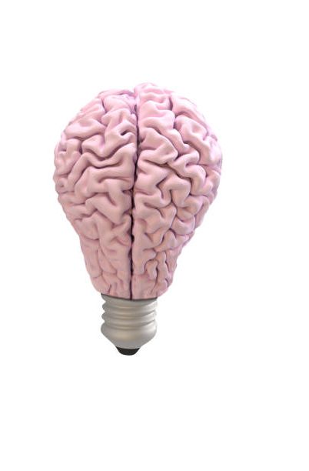
Learning Objectives
By the close of the tutorial attendees will be able to:
Apply knowledge of common TBI symptoms that may influence service members’ cognitive performance in simulation-based environments.
Analyze the potential outcome metrics that can be utilized within simulations for comparative analyses of cognitive performance in active-duty service members with and without a history of TBI.
Evaluate future opportunities for developing simulation-based tools for assessing and enhancing warfighter brain health.
Image Credit: Canva
Notes:
But first after our talk today you all will be able to ……..

Slide 6
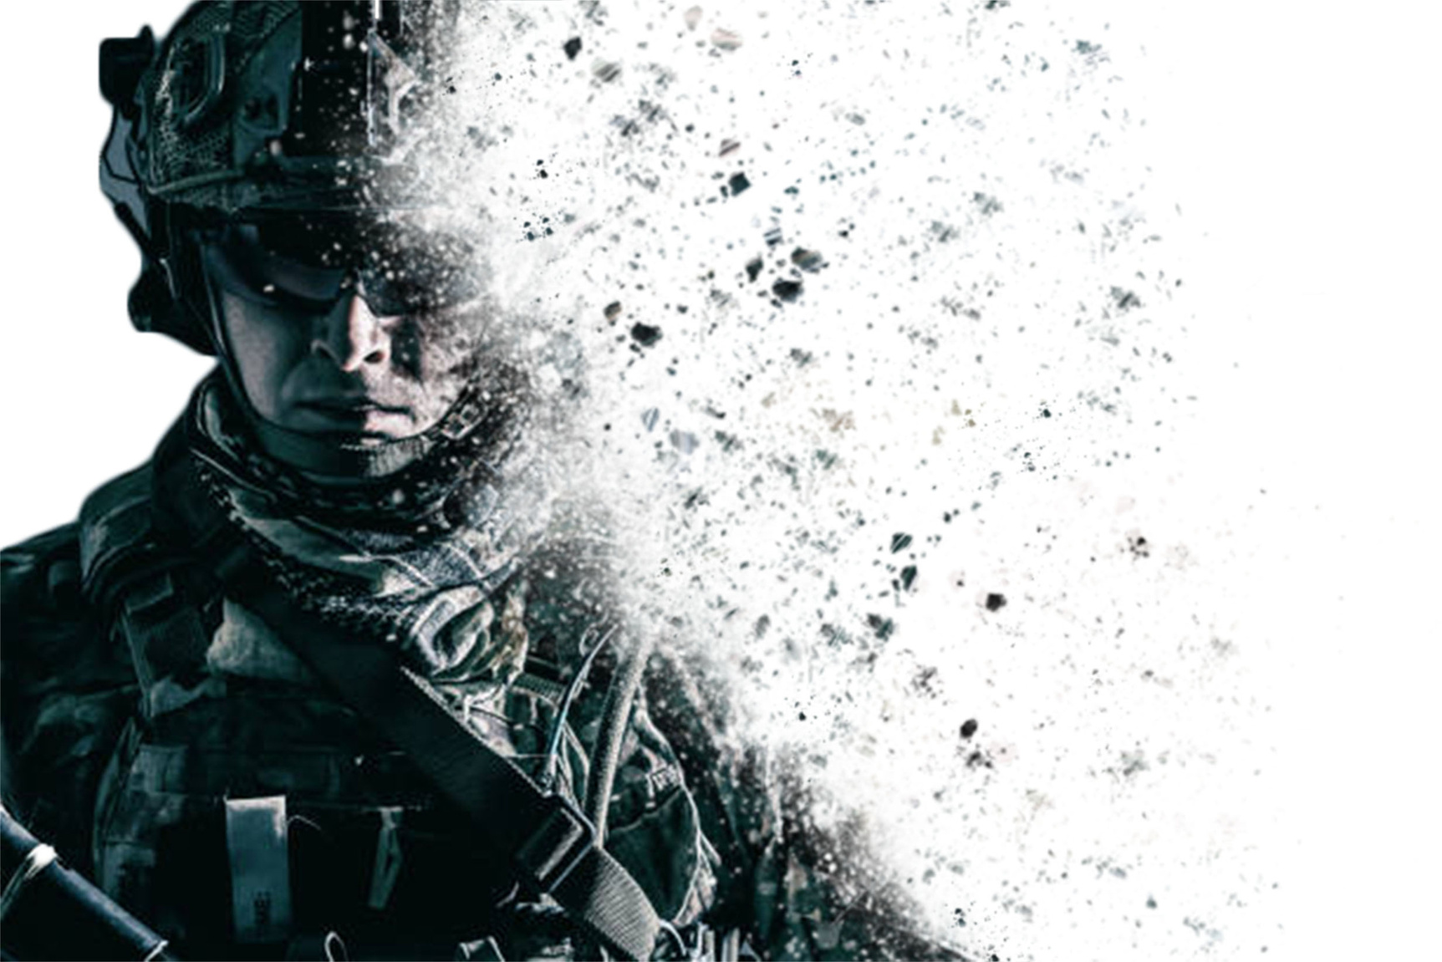
Today’s Demands on the Warfighter
Cognitive
Psychological
Physical
Environmental
Image Credit: Canva
Notes:
The demands on today’s warfighter are constantly increasing and evolving as conflicts become more complex. Oftentimes the warfighter is faced with a multitude of tasks that require optimal cognitive, psychological, and physical fitness to meet the demands of any operational environment.

Slide 7
Demands on the Warfighter After a Traumatic Brain Injury (TBI)
TBI Symptoms
Threats to Warfighter Readiness
Cognition
Threat Detection
Executive Function
Reaction Time
Mental Health
Decision Making
Sleep
Emotional Control
Hearing
Vision
Teamwork
Balance
Situational Awareness
Image Credit: Canva
Notes:
But what happens to those demands after a traumatic brain injury? These demands expand significantly, often putting strain on cognition, executive function, mental health, sleep, hearing, vision, and even balance to name a few. These demands also translate into well documented threats to warfighter readiness which include difficulties adapting to differing environmental demands which result in challenges with threat detection, reaction time, decision making, emotional control, teamwork, and situational awareness.

Slide 8
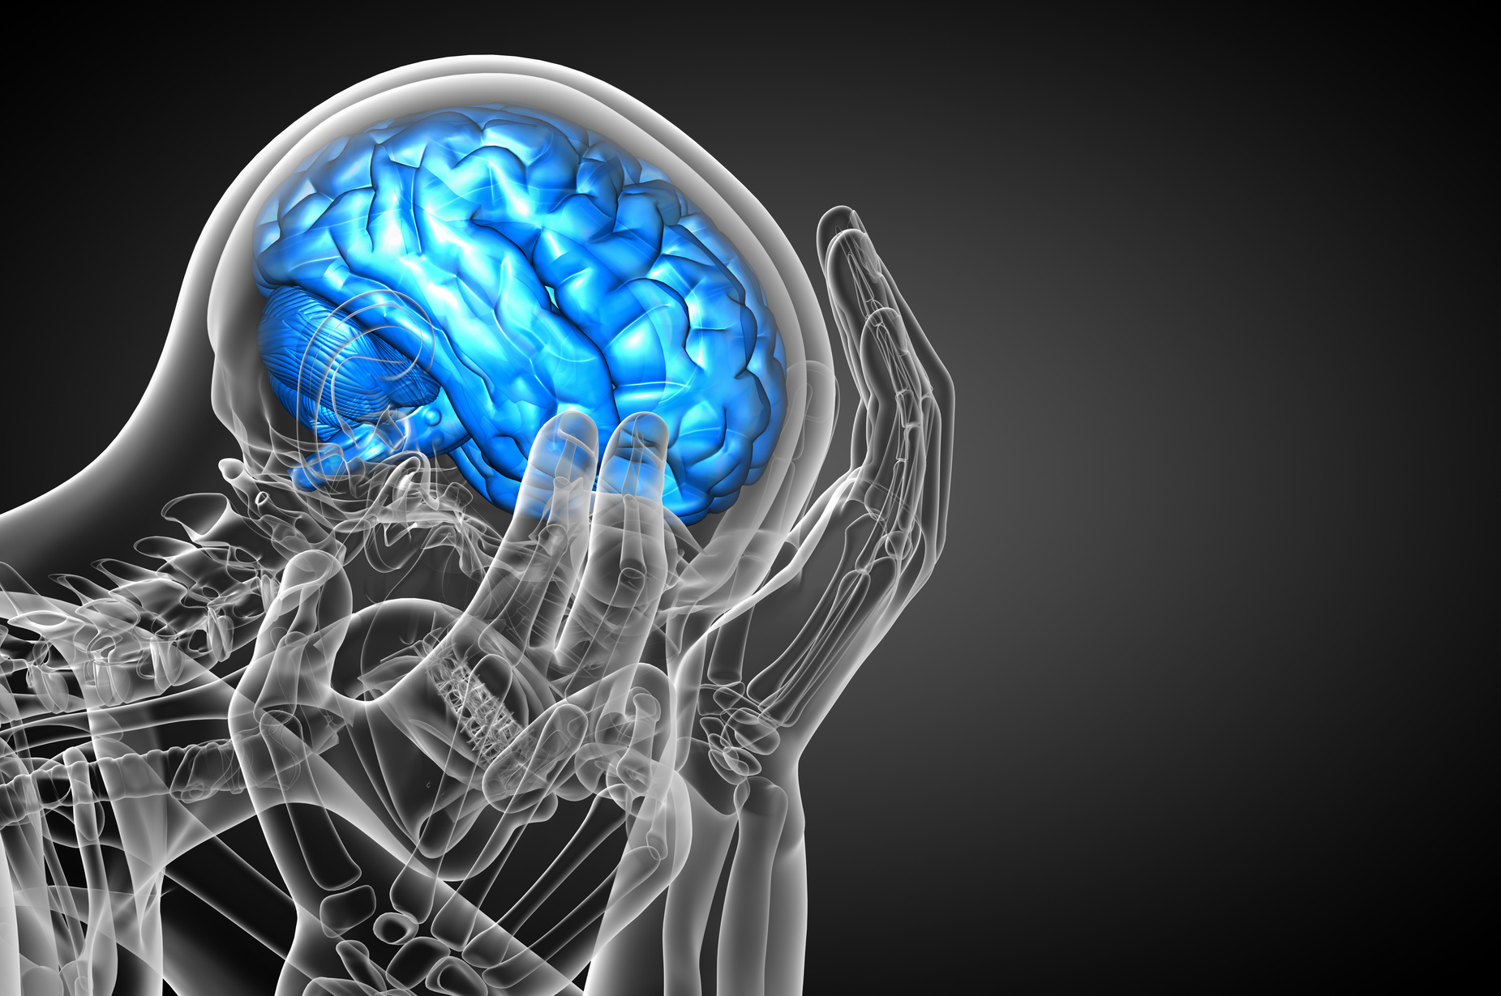
TBI - The Invisible Injury
What is a TBI?
  Structural and/or physiological disruption of brain function from an external force
Prevalence
  499,852 Total Injuries (2023)
  82% Mild TBI (mTBI; Concussion)
Causes
  Blast
  Motor Vehicle Accident
  Airborne Jumps
  Combatives
Image Credit: Canva
Traumatic Brain Injury Center of Excellence, DoD TBI Worldwide Numbers DoD TBI Worldwide Numbers | Health.mil
Notes:
TBI is often referred to as the invisible injury because as compared to a broken arm or leg it is significantly difficult to assess someone’s brain functioning as we will dive deeper into in a bit. But the prevalence of TBI in the military is no secret and TBIs happen both on and off the battlefield with a little less that 500,000 injuries (not accounting for multiple injuries) that happened since 2000 (2023) alone with around 82% of them being mild also referred to as concussions. These yearly totals do not include pre-enlistment TBIs which are also prevalent in active duty service members. To meet the diagnostic criterial of a mTBI one must have had a plausible mechanism of injury, one or more clinical signs such as a loss of consciousness (less than 30 minutes), or two or more acute signs such as feeling dazed or confused and an abnormal clinical or laboratory finding. The causes of these injuries during service can range from blast exposure, motor vehicle accidents, airborne jumps, and combatives just to name a few.

Slide 9
mTBI Assessment & Recovery
Mandatory Assessment (Brain Exposures)
  Involvement in a vehicle blast event, collision, or rollover
  Within 50 meters of a blast
  Direct blow to the head or observed loss of consciousness
  Exposure to more than one blast event
Recovery Time
  1-3 months (~20% with persistent symptoms)
  Prognostic factors
Major Challenges
Exposure Monitoring
Diagnostic Tools
Treatment Tools
Short Term Monitoring
Long Term Monitoring
Warfighter Readiness
Image Credit: Microsoft
(Stein et al., 2016)
Notes:
Sometimes TBI assessment and recovery can seem mysterious. To demystify this process it is best to have a TBI assessment done as quickly as possible to assess severity and get referrals to specialists in the domains of neurology, rehabilitation and behavioral health. However, depending on a variety of factors head injuries or events go unreported which can result in poor long term outcomes for service members. However, there are instances that a mandatory assessment is warranted which include a vehicle blast event, collision, or rollover, if someone is within 50 meters of a blast, if there is a direct blow to the head or an observed loss of consciousness, or an exposure to more than one blast event. Recovery from a mTBI is not a straightforward path unfortunately, in which individuals goes through various improvements and plateaus however recovery time can range from 1-3 months with about 20% of folks experiencing persistent post concussive symptoms. There are a multitude of factors that can contribute to this which include: Prior TBI(s), Pre-deployment psychological stress, Severe deployment stress, Loss of consciousness or Post Traumatic Amnesia.
We have some major challenges in assessing and treating the immediate and chronic symptoms of TBI which center around several areas related to warfighter readiness which include diagnostic/assessment and treatment tools, short term and long term monitoring, as well as monitoring lifetime exposures to head injury events. Trying to tackle these areas can often happen in siloed efforts across resarch, academia, and industry.

Slide 10
What is Warfighter Brain Health and Why is it Important?
Warfighter Brain Health Initiative
  Joining operational and medical communities in a unified approach for optimizing service member brain health and countering TBIs
Problem
  The physical, psychological, and cognitive status that affects a warfighter's capacity to function adaptively in any environment and impacts readiness, operational capability, mission effectiveness, and the goal to achieve overmatch or superior lethality
  (Deputy Secretary of Defense memorandum, “Comprehensive Strategy and Action Plan for Warfighter Brain Health,” dated October 1, 2018 and National Defense Strategy, January 2018)
Identify, Monitor, and Mitigate
Reduce, and Eliminate
Prevent, Recognize, and Minimize
Optimize
Advance
Comprehensive Strategy
Warfighter Brain Health Hub | Health.mil
Notes:
The prevalence and persistent challenges faced by service members with a history of TBI as well as the clinical providers, commanders, line leaders, family members, and communities who try to help sometimes in siloes was recognized by the DOD which led to the launch of the warfighter brain health initiative. But really what is this initiative and why is it important? When we often hear this initiative discussed but lets dig a little deeper. It aims for a more unified approach towards optimizing service members brain health and countering TBIs that centers around both physical and cognitive injuries the can affect a warfighters capacity to function adaptively in any environment, impact readiness, operational capability, mission effectiveness, and. Lethality. It provides a platform for a more unified approach for optimizing brain health through a compressive strategy that spans the spectrum of identification, reduction, prevention, optimization and advancing brain health science. Which allows for a more unified approach to TBI care across medical specialties, academia, and industry partners.
Optimizing cognitive and physical performance
Identifying, monitoring, and mitigating brain exposures
Preventing, recognizing, and minimizing traumatic brain injuries (TBI)
Reducing and eliminating long-term or late effects of traumatic brain injury (TBI)
Advancing warfighter brain health science

Slide 11
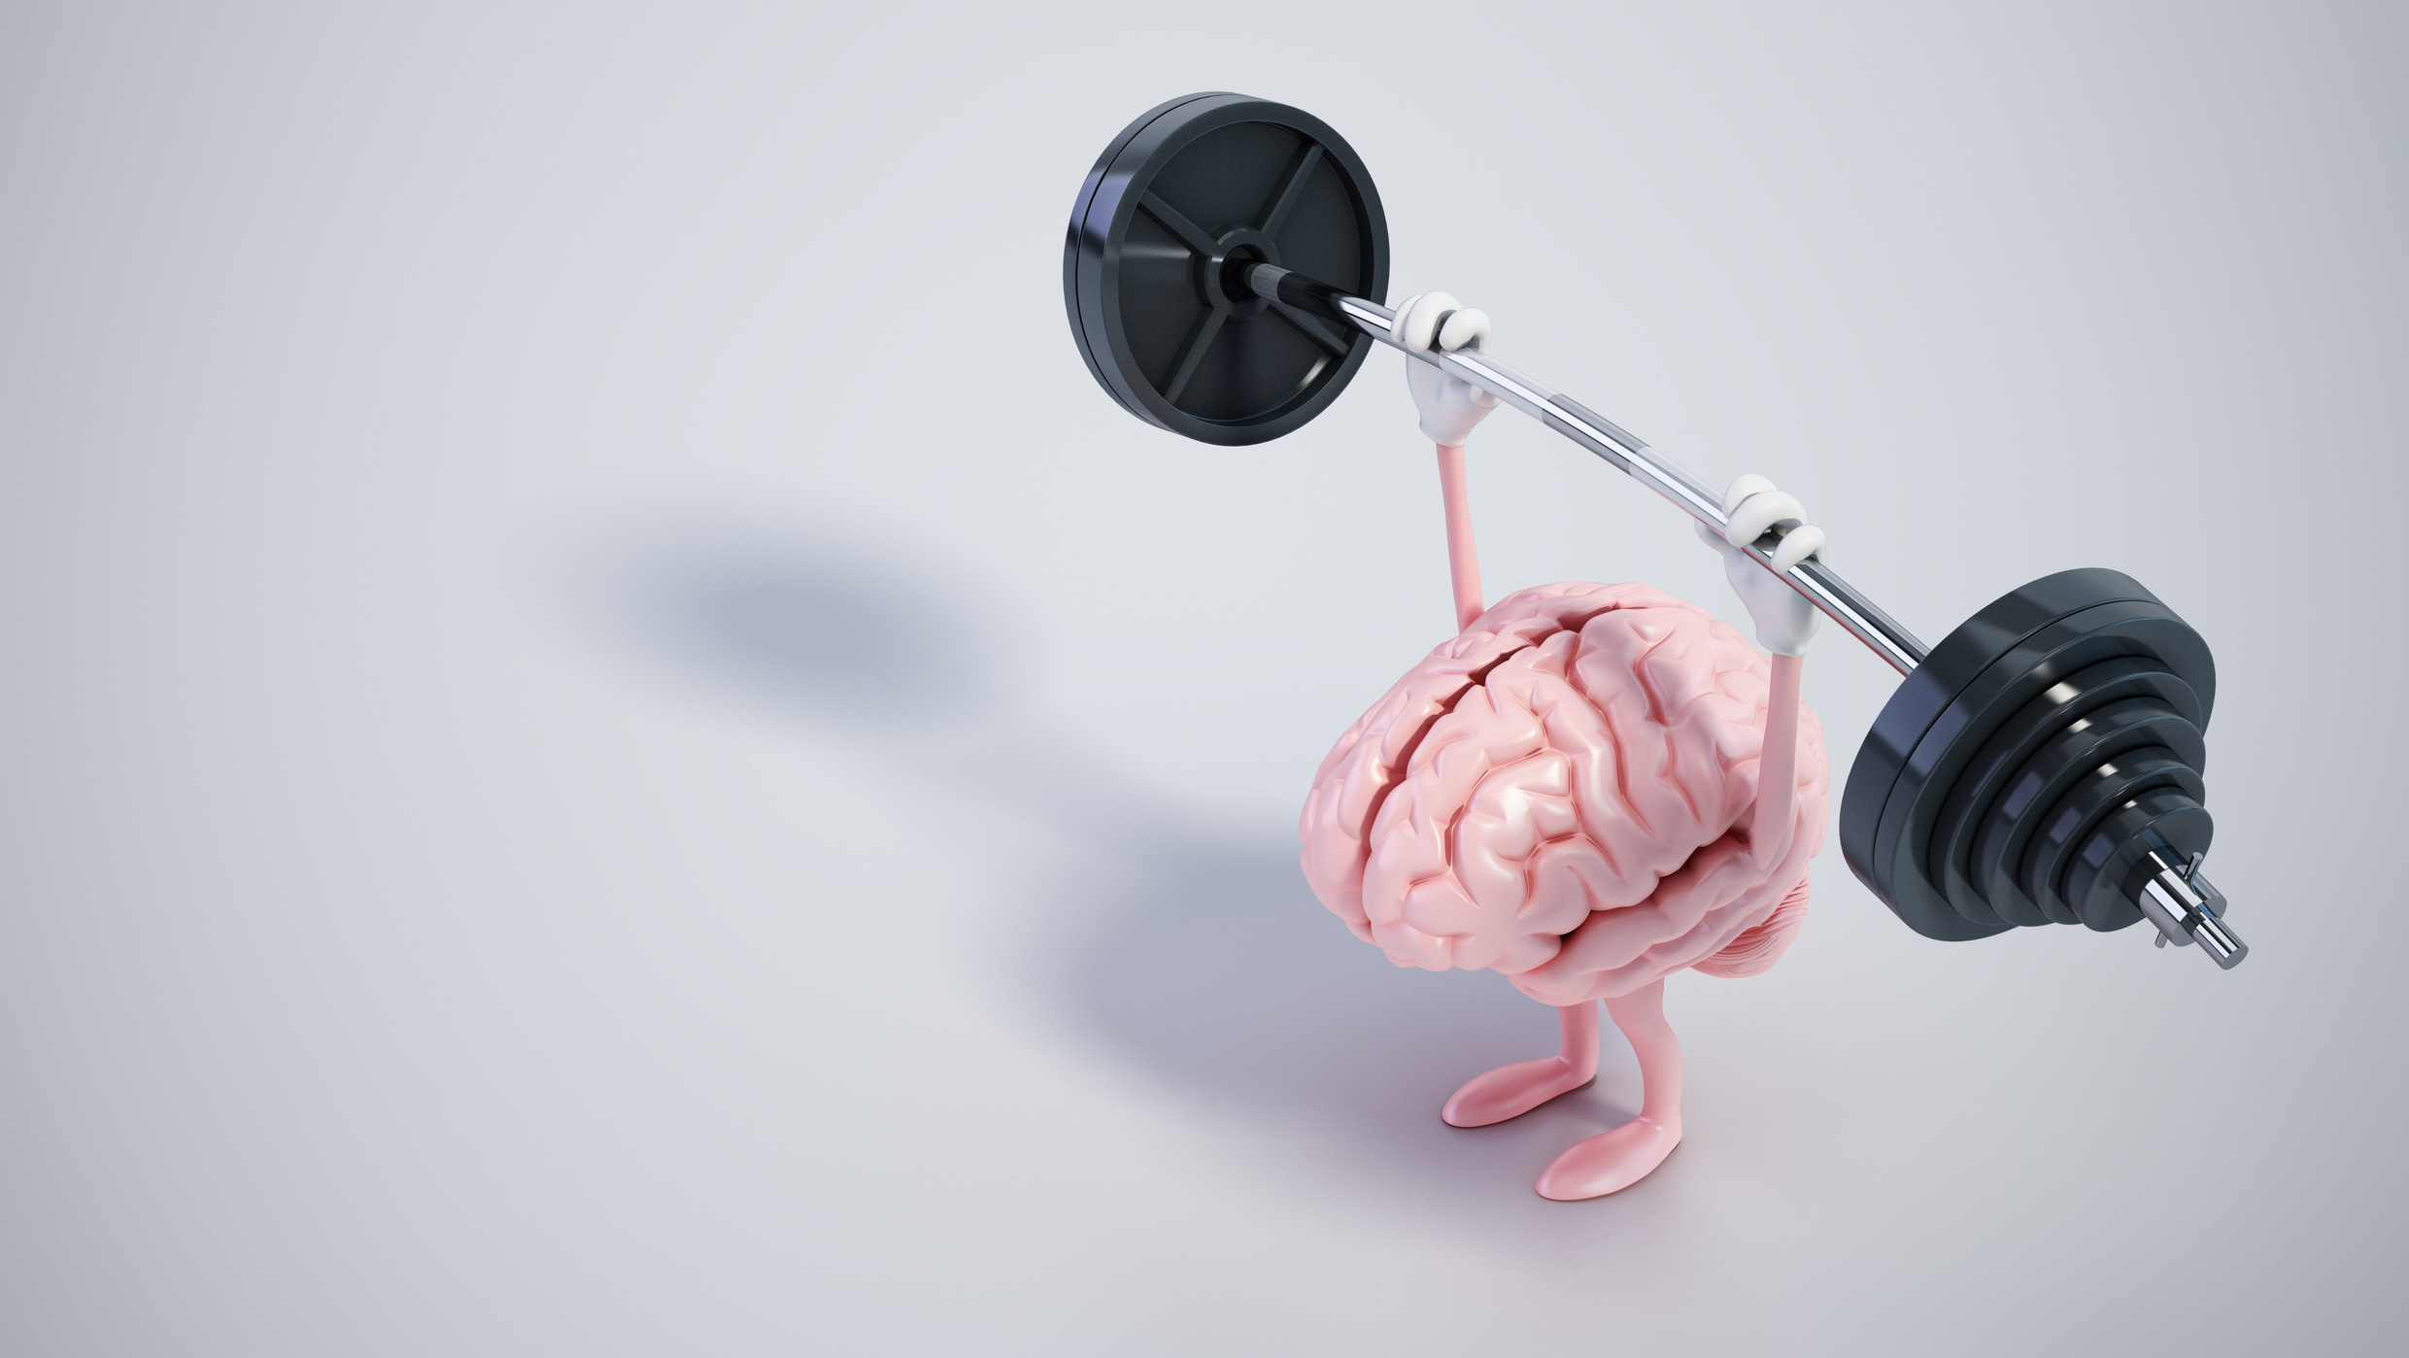
But first…………..
Aren’t there already applications for brain training?
Image Credit: Canva
Notes:
Not to be controversial this Monday morning, but lets address something that comes up quite frequently in TBI assessment and interventions….a common myth is that there are already applications for brain training to help diagnose and mitigate the effects of TBI….the answer is a bit murky….

Slide 12
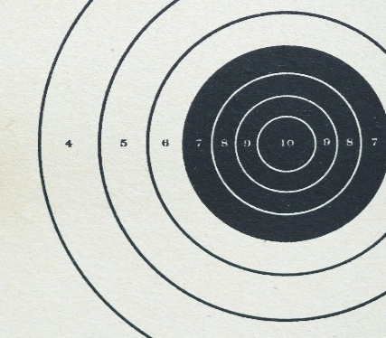
Brain Training vs. Integrated Warfighter Cognitive Performance Training
Brain Training Applications
  Training environment utilizes mobile devices and computers
    Lack of sensory integration – targeted cognitive training (i.e., auditory, visual, tactile)
  Context of tasks is game-based
  (i.e., card sorting, matching)
  TBI is not accounted for
Evidence (Good or bad?)
  Some evidence of efficacy in aging populations
  Little to no evidence of efficacy in TBI populations
Example
═
?
Image Credit: Microsoft
  (Bonnechere et al., 2021; Christopher et al., 2019: Edwards et al., 2017)
Notes:
When we look at the makeup of brain training applications they often utilize mobile devices and computers which innately cut a large amount of environmental sensory integration that is critical for refining cognitive skills. The contexts of the tasks are often game based which are interactive and entertaining but don’t necessarily train to relevant aspects of cognitive skills that match the skills required in everyday life. For example we see a common task of identifying certain shapes or shapes and colors as way to train attention and memory. But how does this task translate to marksmanship? If I did this task over and over would it make my shooting accuracy better? Probably not. When we look at the evidence it is a mixture depending on clinical populations such as aging populations. However, TBI is not accounted for in the development of these tools and if it is, the long term effectiveness of these tools as they translate to the real world is not readily investigated.

Slide 13

Bridging the Gap - Advancing Warfighter Brain Health Science
Opportunities for Brain Health Science
Reduce
Identify
Optimize
Basic
Neuro
Clinical
Train Like You Fight…..Assess Like You Fight…..
Rehabilitate like You Fight
Image Credit: Canva
Notes:
Now here comes the fun part. How can we move beyond app and screen based tools to really help in the Warfighter Brain Health Initiative? There are several opportunities across Brain health science by combining basic, clinical research with the principles of neuroplasticity. If we train like we fight….assess like we fight…why not rehabilitative like we fight? This looks like Innovation – development of novel tools to fit the service member, healthcare provider, and operational needs, Collaboration - community-based participatory, implementation, and translational research approaches, Optimize outcomes – facilitating meaningful brain health changes by merging technology with multiple principles of neuroplasticity

Slide 14
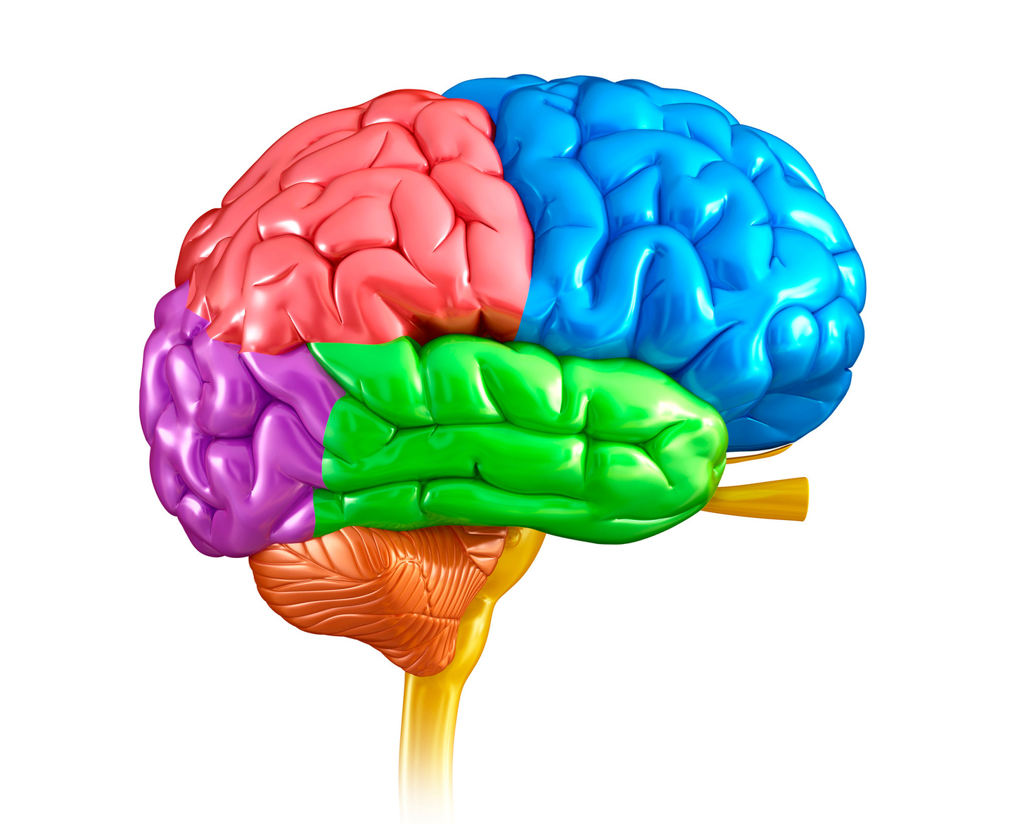
There’s a Simulation for That Right?
Healthcare and Simulation Worlds Collide
What are the Current Gaps in Brain Health Tools?
  Identify: Predictive Capabilities
    Ecological validity
    Military normed tools (contextually relevant)
  Reduce: Treat Subtle mTBI Symptoms
    Clinic vs. operational needs
    Siloed approaches for brain health
  Prevent: Minimize Short and Long-Term Impacts
    Compounding symptoms with multiple TBIs
  Optimize: Feedforward vs. Feedback Approaches
    Minimal opportunities to shape cognitive skills in real time
    Constrained ability to facilitate neuroplasticity across environments
Identify, Monitor, and Mitigate*
Reduce, and Eliminate*
Comprehensive Strategy
Prevent, Recognize, and Minimize*
Optimize*
Advance*
Image Credit: Canva
Notes:
Simulation in healthcare isn’t anything new where the range of simulation can be from standardized patients, to screen or computer based, to VR/AR applications delivered through a variety of modalities. But There should be some for TBI and Brain Health right? Actually No. There have been several calls for the use of simulation-based tools for TBI assessment and intervention but there is a silo effect happening where technology developers don’t necessarily know how to design their tools to make an impact in healthcare, healthcare providers who don’t know how this technology can fill critical gaps in clinical practice, and our patients or end users who are rarely consulted during the design phases of these tools. In addition to that there are a slew of gaps that need addressing including tools that can enhance the predictive capabilities of medical professionals, mTBI deficits are inherently hard to elicit because our tools lack the ecological validity necessary to re-create various environmental demands that exhaust attentional capacity leading to breakdowns in cognition, tools that are normed for active duty service members with contextually relevant scenarios. In order to reduce these very subtle effects of TBI that are difficult to elicit in clinical settings tools can be developed that can merge the world of clinic-based treatments and operational needs. This often is a primary complaint for TBI rehabilitation where cognitive rehabilitation tools are far removed from the context of everyday life and operational needs. On the prevention side tools that can account for the compounding symptoms with multiple TBIs and minimizing short term and long term impact. And Lastly, Optimize outcomes which could be done by developing simulation tools that help medical professionals switch from a feedback approach were we ask people to try different strategies outside of the clinic or session, have them recall and utilize that strategy accurately, and then tell us about it the following week. Whereas in feedback approaches we are making individualized adjustments to strategies and treatment plans by observing performance in real-time and making those adjustments immediately. The feedback approach provides minimal opportunities to shape cognitive skills in real time and constrains our ability to facilitate adaptive neuroplasticity across environments.
So when we look across the warfighter brain health comprehensive strategy there are a vast amount of opportunities across each of the main areas of focus which really spans across the initial point of injury all the way to monitoring long term outcomes.

Slide 15
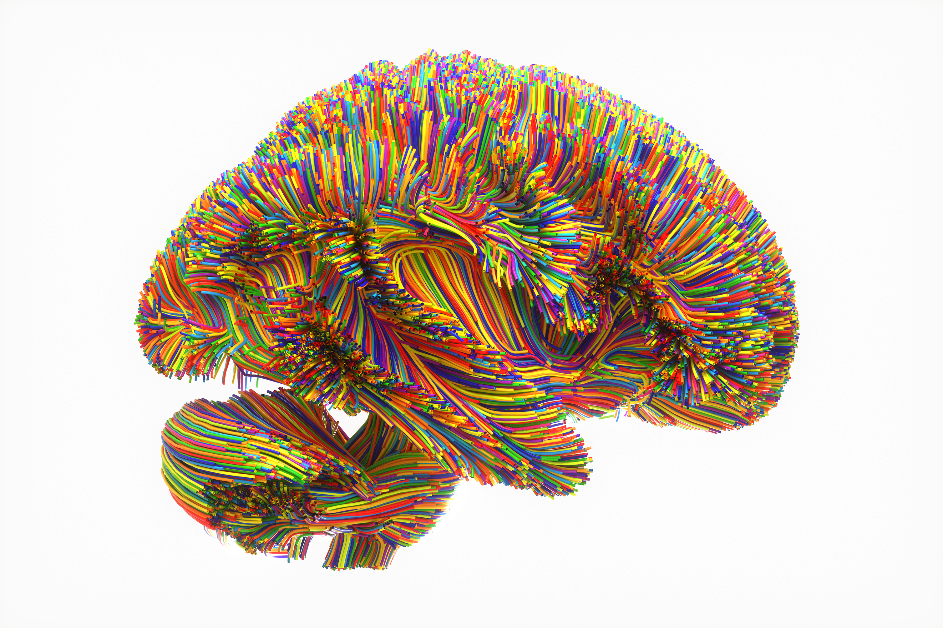
Harnessing simulation technology for enhancing warfighter brain health
It’s all about neuroplasticity, who is on the team, optimal outcome metrics, and translating data.
Image Credit: Microsoft

Slide 16



Neuroplasticity
What is it and how do we facilitate it?
  Changing behavior, perception, and cognitive state
    Learning and Adapting
  Our brain’s ability to reorganize synaptic connections (neuropathways) in response to experiential learning and after an injury
    Developed over time, with feedback, and repetition across environments
  REQUIRES integration of sensation and perception
    Matching skills with environmental demand
    Internal and external factors
    Optimal for post TBI recovery
Crawl
Walk
Run
Notes:
We often talk about neuroplasticity but don’t necessarily examine how it happens. It is our brain’s ability to adapt in response to experience.
(i.e., the nature, anatomy, and function of the Nervous System)
Examples: learning how to walk, ride a bike, use a weapon, fly a plane
Without the inclusion of sensation and perception cognitive skills will remain within the context of the learning environment vs within operational environments

Slide 17
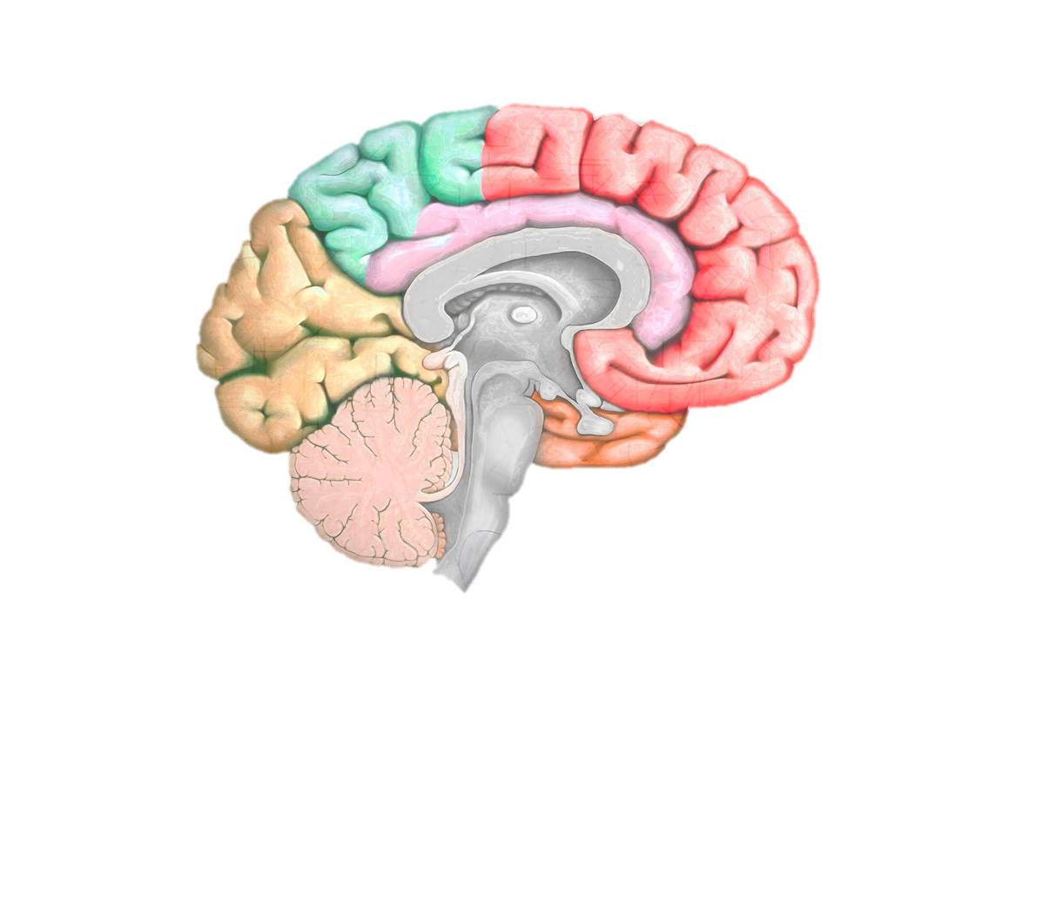
Principles of Neuroplasticity
Age
Time
Salience
Specificity
Intensity
Repetition
Transference
Use It or Lose It
Use It and Improve It
Interference
Image Credit: Canva
Notes:
Age Matters
Time Matters
Salience Matters – Importance to the person learning
Specificity – Training the specific task
Intensity – Increasing the difficulty level incrementally to elicit meaningful changes
Repetition – Practice makes perfect
Transference – Generalizing training to different environments
Use it or lose it – When you don’t practice for an extended period of time the established pathways start to weaken
Use it and Improve it – Practicing over time and improve speed and performance
Interference – Maladaptive plasticity that interferes with progress

Slide 18
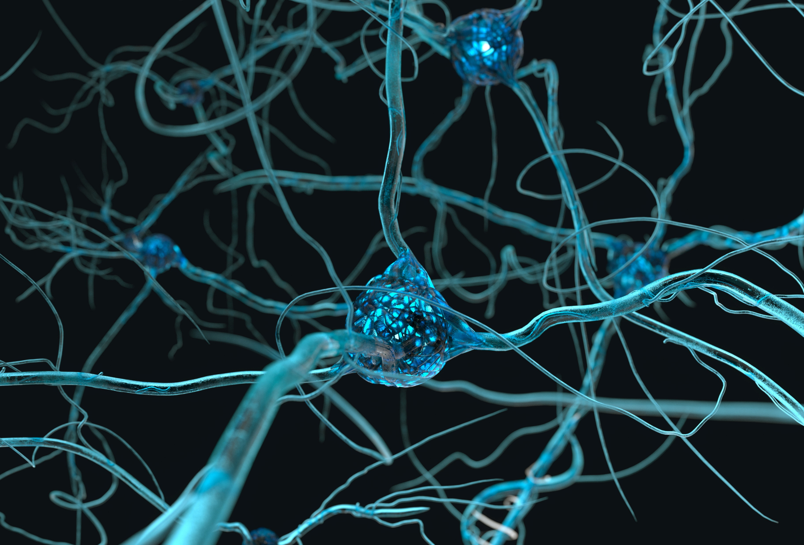
How are Neuropathways Developed and Refined?
Age matters
  Occurs throughout your lifetime
Dependent on experiential learning
  Salience
  Specificity
  Intensity
  Repetition
Inclusion of sensation and perception
  Variability
  Specificity
Task
Environment
Feedback
Skill
Image Credit: Microsoft
Notes:
Neuropathways are developed over time across the lifetime. We are born with too many neurons at birth and through experiential learning. Unused neurons get pruned over time as we gain more experience. This contributes to why children learn quickly because they have many more neurons to work with than you and I. But learning has to be meaningful with specific training at varying intensities over time to become established neuropathways. This includes sensation and perception to connect mind and body skilled movements. At the core of neuropathway development we are compiling all the sensory and perceptual information gained from the specific tasks, done in varying environments, with refined skilled behavior, and feedback to adapt or adjust approaches to the task at hand.

Slide 19
Neuroplasticity after mTBI
Not all plasticity is “good” plasticity
  Maladaptive
    Activation of neuropathways that hinder function
    Post-Traumatic Stress Disorder (PTSD)
    Stuttering
  Adaptive
    Tailored and layered approaches
  Time Matters (injury to intervention)
Tailored and Layered Approach
Stable Plasticity
Predicting Outcomes
Mass Practice
Adaptive Plasticity Changes
Contextual Learning
Environmental Shifting
Variation
Neuronal Competition
Building Perceptions
Multiple Dynamic Systems
Defining Skill
Out Competing Modal Behaviors
Selective Attention
Constraint Induced
Building Patterns
Notes:
When we talk about neuroplasticity we tend to think if it as being a good thing. But not all plasticity is good plasticity, there is also what some coin maladaptive plasticity. This happens when the activation of neuropathways hinder function (i.e., temporal synchrony signals are correlated in time, get matched, and strengthened) examples of maladaptive disorders include PTSD and stuttering. Think it as “I did everything right and still end up wrong” Maladaptive plasticity can still occur even when you have trained two people in the same exact way. We can also think of plasticity as occurring on a continuum instead, some of us can be more capable of being in a plastic state and some of us our not.
This is why incorporating principles of neuroplasticity are essential for building adaptive plasticity which requires tailored and layered approaches. Here we have an example of what the roadmap of a tailored and layered approaches can look like. We take someone who has stable plasticity before intervention and we apply a constraint induced approach by removing artificial supports such as people who may be unintentionally taking away critical opportunities for contextually-relevant skill building opportunities like giving reminders or ignoring errors, we then define the skilled activity we would like them to do, and build in contextually relevant learning meaning we have them do that exact task as they would in the real world during therapeutic intervention, after that task is mastered we can then include environmental shifting to help build adaptive task completion by training selective attention (what to attend to and what no to) through what is called variation which is critical for building adaptative cognitive skills, this variation helps to promote neuronal competition for selection to help in encoding memories to build perceptions. These perceptions then get stored as memories that help to support pattern recognition for predicting outcomes. We then mass practice the task + environment to help softly assemble self-organization (neuronal re-organization) to help outcompete modal behaviors or behaviors that have become established that minimize function.
The tailored and layered approach to facilitating adaptive plasticity is much easier if intervention is done immediately after injury. This is why delayed diagnosis can be a huge problem for facilitating meaningful change because it makes rehabilitation harder for service members.

Slide 20
The Next Frontier – Integration of Neuroplasticity into Brain Health Tools
Why is virtual reality simulation ideal for targeting warfighter brain health initiatives?
  Incorporates all Principles of Neuroplasticity
    Perception and Sensation
  Ecological Validity
  High Levels of Control
    Customized
    New and Refined Learning
  Measure Physiologic, Behavioral, and Perceptual Metrics (i.e., functional outcomes)
  Build Cognitive Skills to Meet Demands of Operational Environments
    Cognitive Flexibility and Endurance
  (Bogdanova et al., 2024; Faria et al., 2023; Sheehan et al., 2024)
Notes:
There is a huge opportunity to advance brain health science with merging the worlds of simulation and healthcare. We do not have the tools necessary to elicit real world performance across the TBI diagnostic and intervention space.

Slide 21

Where Do We Start?
Integrative Approach
  Bridging the gap between healthcare professionals and operational communities
Build Multi-disciplinary Teams
  Healthcare Professionals
  Trainers
  End Users
  Industry and Academic Partners
Benefits
  Real-world feedback
  Healthcare perspective
  Builds trust and common understanding
Image Credit: Microsoft

Slide 22
Incorporate End User Touchpoints
Implementation and Translational Science Approaches
  Community-Based Participatory Approaches
Embedded Mixed Methods
  Context and Content Validation
Simulation Design
  Conceptualizing Environment
  Auditory, Visual, and Haptic Elements
  Define Skills
  Establish Evaluation Criteria
    Psychologic, Behavioral, Perceptual
Knowledge to Action Framework
Monitor
Evaluate
Sustain
Adapt
Assess
Tailor
Knowledge Inquiry
Synthesis
Product Development
Knowledge Creation
(Graham et al., 2006)

Slide 23

What are the best outcome metrics to include?
Our ability to target warfighter brain health is only as good as the assessments and training tools we develop.
Image Credit: Microsoft
Notes:
When we talk about integrating operational training with warfighter brain health, we have to consider what outcome metrics are relevant to brain health and also available from the simulation tools we have. This will allow us to properly assess the desired impact of simulation-based training on warfighter brain health. So what ARE the best outcome metrics to include in simulated training protocols in the context of warfighter brain health?

Slide 24
How to Measure Brain Health? Outcome Metrics
Highly Debated
  Historical Challenges
Screeners
  TBI Screeners
Baseline Measures
  TBI History and Self-Report
  Standardized Measures
Overlapping Outcome Measures
  Eye Tracking
  Electroencephalogram (EEG)
Notes:
In the clinical realm of warfighter brain health, we start with trying to predict outcomes associated with brain injury and from there we identify targets for clinical and/or functional improvement, to which we apply rehabilitation practices. Simulation-based tools can be applied to address these clinical needs. Expanding beyond a purely clinical framework for improving warfighter brain health, we can also use simulation-based technology to respond to a need for cognitive enhancement, including in the context of warfighters with a history of brain injury.
Historically, there is no consensus on what are the best outcome measures for assessing brain function, breath health, and brain injury. Ecological validity has been a longstanding challenge for assessing brain function for decades; however, now that wee have the technology to test brain function in contextually relevant and ecologically valid environments, we can potentially overcome that challenge.
At perhaps the most basic level of assessment, screeners are useful for determining if further assessment of brain function is needed. However, they should not be used for outcomes assessments. More comprehensive assessment of brain function should include a detailed history of brain injury as well as patient-reported outcomes directly related (such as neurobehavioral symptoms) or indirectly related (such as health related quality of life) to brain health. Standardized measures, including objective assessments of cognitive function (such as conventional neuropsychological test batteries or computerized tests of cognition) can also be administered at baseline and other critical timepoints surrounding stimulation-based training. I will describe these outcome measures in more detail in later slides.
There are also many outcomes relevant to measuring brain function and brain health that are native to or frequently embedded into simulation technology. Common examples of outcomes that overlap clinical practice and operational applications of simulation technology include eye tracking and electroencephalography, or EEG. I will provide a thorough overview of these outcome measures in later slides as well.

Slide 25
TBI Screeners
TBI Screeners
  Determine if further assessment is needed
    Imaging and standardized assessment
    Time dependent (< 48 – 72 hours)
  Assessing: altered or loss of consciousness (> 24 hours), posttraumatic amnesia (≤ 24 hours), headache/migraine, depression, anxiety, attention, memory, speech fluency, word finding, grip strength, pupil light response, (observed) smooth pursuits, saccades, convergence, vestibular-ocular reflex, and visual motion sensitivity.
Types of Administered Screeners
  Examples: Glasgow Coma Scale, Military Acute Concussion Evaluation 2, National Institutes of Health Toolbox – Cognition Battery, Rancho Los Amigos Scale
Notes:
TBI screeners are a critical part of assessment of brain injury, as they are the first line of inquiry which indicates whether additional testing is needed to assess brain function. They are designed to be sensitive to brain injury at the expense of specificity; this allows for fewer false negatives and greater false positives, which is a critical feature of screeners.
Screeners can assess clinical signs and symptoms of injury or basic cognitive or physiological function. In general, different screeners are used in different contexts—for example the GCS is comonly used in clinical environments (such as Role 3 and 4 care at MTFs) while the MACE 2 is used at the front line (such as Role 1 and 2 care).
Patients who fail a screener are determined to need more comprehensive and thorough assessment to confirm or rule out brain injury; these assessments may include imaging to rule out brain bleeds, querying patient-reported outcomes, and/or administering standardized testing.

Slide 26
Outcome Metric – Self-Report
Surveys and Questionnaires
  Obtain frequency and intensity of TBI symptoms
  Examples: Neurobehavioral Symptom Inventory (NSI), Rivermead Post Concussion Symptoms Questionnaire, Posttraumatic Stress Disorder Checklist, Pittsburgh Sleep Quality Index, Beck Depression Inventory, Patient Health Questionnaire
Differences in mTBI and Healthy Controls
  TBI groups have higher scores across cognitive, executive function, and mental health symptoms
    Scores can change throughout the day
  TBI symptoms are exacerbated by mental health disorders (PTSD, anxiety, depression)
Notes:
Patient-reported outcomes in the form of surveys and questionnaires are often used to quantify the frequency and intensity of TBI symptoms that are directly or indirectly related to brain injury. Common symptom surveys of symptoms directly relevant to brain injury include the neurobehavioral symptom inventory and the revermead post concussion symptoms questionnaire. Other common surveys or questionnaires assessing brain function or brain health in the context of brain injury include the measures of PTSD, sleep impairment, mood dysregulation, and overall quality of life.
Typically, patients with TBI report higher cognitive, executive function, and mental health symptoms. There are circadian patterns to these symptoms, with TBI patients generally reporting worse symptoms earlier in the day. These symptoms are also known to be exacerbated by mental health disorders. In fact, the presence of PTSD is consistently one of the strongest predictors of more severe neurobehavioral symptoms in service members with TBI.

Slide 27
Self-Report Methods Considerations
TBI History Interview
  Ohio State University Traumatic Brain Injury Identification method
    Standardized Interview for lifetime TBI History
Limitations
  Heavily reliant on accurate perception and recall
  Low predictive capabilities
  Normative Data (time since injury, mechanism of injury, and service demographics)
Data Analysis Approaches
  Symptom reporting validity (Validity-10 validity score, NSI)
  Assess changes across recovery timepoints and in response intervention, training, or exposures (blast)
  Compare across deployment and combat demographics
(Lange et al., 2015; Llop et al., 2023; Sobel et al., 2023)
Notes:
Getting a comprehensive history on patients’ TBI histories is also vital to measuring warfighter brain health. Clinical history taking is typically done through a clinical interview with a provider. In the research domain, there is only one validated tool to offer a standardized interview for lifetime TBI history—the Ohio State University TBI identification method. It is currently the only standardized tool available to us at this time.
Patient-reported symptoms and history is heavily reliant on patients’ perceptions and recall of events. It also does not provide robust capabilities for predicting functional or operational outcomes. Finally, normative data is not always available for widely used assessments, particularly with respect to influential factors such as time since injury, mechanism of injury, or service demographics.
When considering patient-reported data, it is critical to be mindful of symptom reporting validity, as patients may not always accurately report their symptoms; however, there are tools available to identify symptom exaggeration or misreporting, such as embedded symptom validity tests like the Validity-10 on the neurobehavioral symptom inventory. Symptom presentation also changes over the course of recover and may also differ based on responses to interventions, trainings, or various types of exposure. Deployment and combat demographics may also bias or otherwise influence symptom reporting.

Slide 28
Standardized Behavioral Measures
Standardized Measures
  Provide objective measures of cognition and executive function
  Pen and paper or computer-based
  Assessing: attention, memory, processing speed, reaction time, impulsivity, problem solving, organization, mental flexibility, and emotional control
  Common measures: accuracy, reaction time, impulsivity
Types of Administered Standardized Measures
  Automated Neuropsychological Assessment Metrics, Trail Making Test, Stroop Test, Rey Auditory Verbal Learning Test, Mini Mental State Examination, Delis-Kaplan Executive Function System, Conners Continuous Performance Test
(Lee et al., 2024)
Notes:
Standardized measures of cognition and executive function permit objective, valid, and reliable measures of brain function and brain health in the context of brain injury. The outcomes are typically assessed either using conventional pen-and-paper method or computer-based applications.
Nearly every cognitive domain can be assessed using standardized testing, including attention, memory, processing speed, problem solving, mental flexibility, and emotional control. Function in these domains can be measured in various cognitive tasks using accuracy, reaction time, and impulsivity.
Some common standardized tests that you may (or may not) have heard about include the ANAM, Trail Making Test, Stroop Test, and the MMSE—or the mini mental state examination.

Slide 29
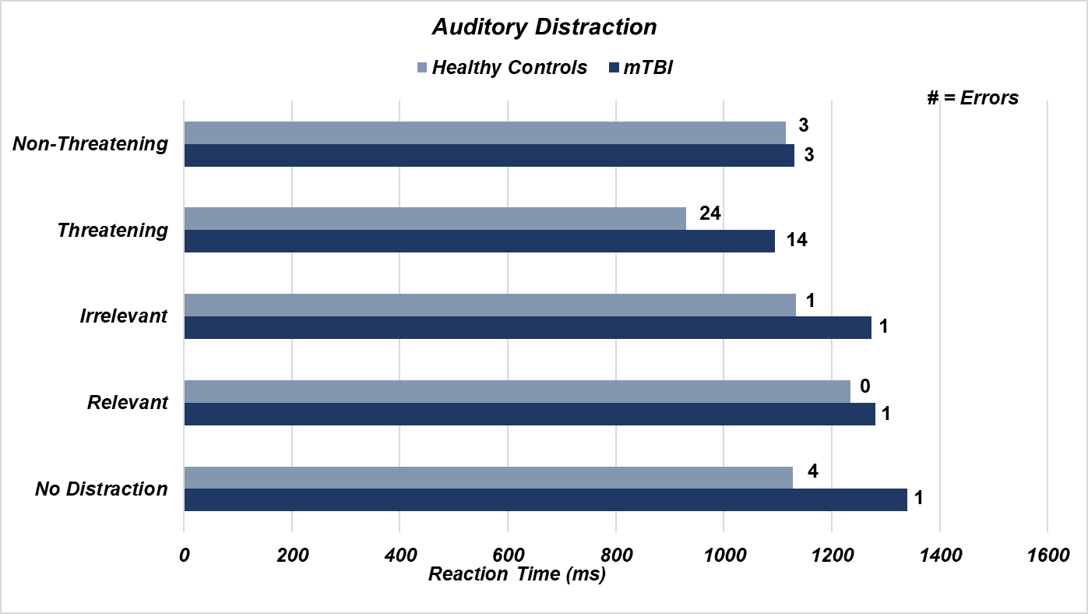
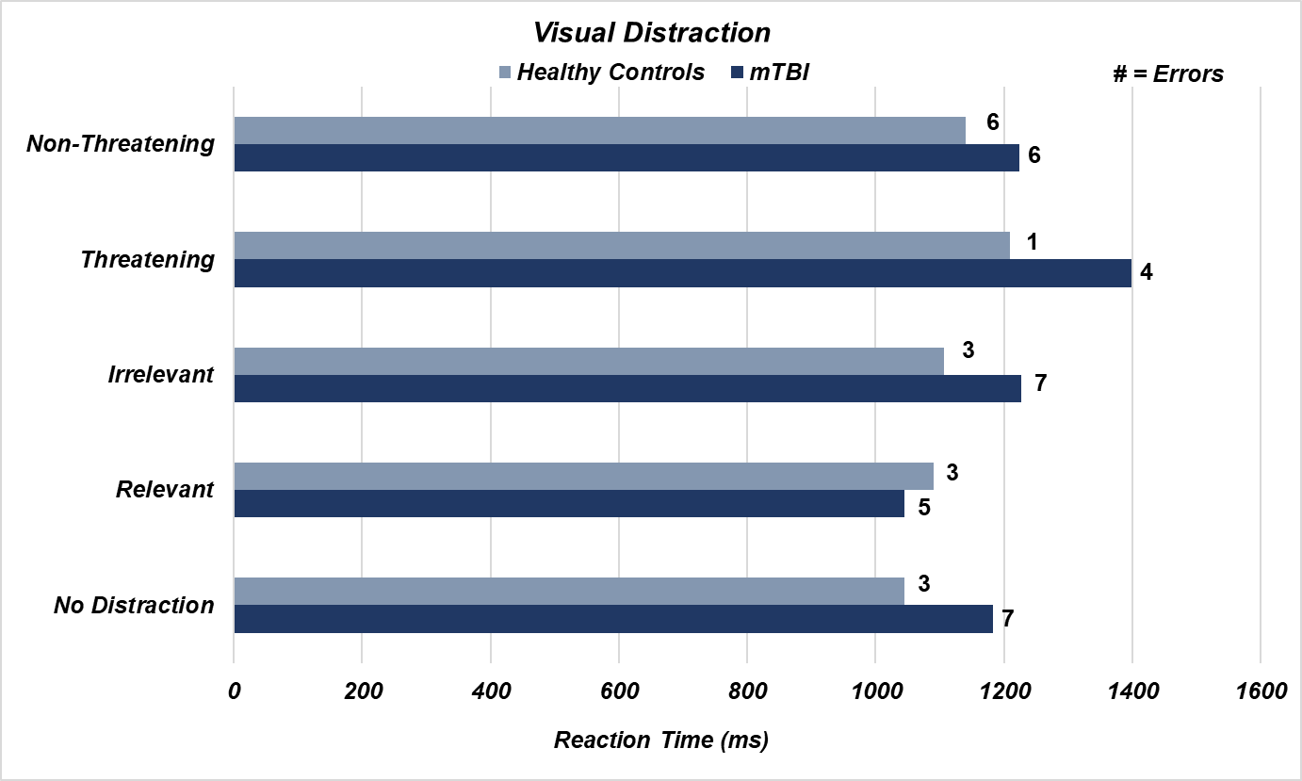
Example
Key Findings
  mTBI participants demonstrated a lack of cognitive strategy development and initiation for “go-no-go” task in response to various environmental distractions
  Faster reaction time did not equate to less errors
    mTBI participants reported inaccurate perceptions of performance
  Changes in accuracy across distraction modalities
(Pinnow et al., 2024 (In Progress))
Notes:
Here are some data comparing performance on a computer-based lexical decision task between 12 patients with mTBI and 18 health controls. In this task, patients performed a go/no-go type task, which measures behavioral inhibition and cognitive flexibility, in the presence of threatening or non-threatening faces and relevant or irrelevant distractions in either an auditory or visual format.
The results show that patients with mTBI had delayed reaction times when presented with threatening and irrelevant auditory distractors with variable improvements in accuracy. In the visual distraction condition, patients with mTBI similarly had longer reaction times, but in this case they were paired with worse accuracy.
These results show the mTBI patients failed to develop a consistent cognitive strategy to optimize cognitive performance in response to various environmental distractions and that faster reaction time in some cases paired with more errors. Therefore, faster reaction time is not necessarily indicative of improved performance. Interestingly, patients with mTBI did not accurately rate their perceived performance.
Importantly, we were able to elicit these subtle deficits in mTBI patients by incorporating environmental distractions, which typically are not included in standard methods and makes the case for using simulation-based technologies to assess and improve warfighter brain health.

Slide 30
Standardized Measures Methods Considerations
Differences in mTBI and Healthy Controls
  Decreased cognitive, executive functions, perception, mental flexibility, and cognitive endurance
  Increases in impulsivity and frustration
Limitations
  Ecological validity
    Low predictive capabilities outside of experimental task
Alterations in set up
  Real-world scenarios and environments
  Re-created stressors
Notes:
This study and others using standardized, objective measures of cognitive performance show that mTBI patients, when compared to controls, have decreased cognitive and executive functions, perception, mental flexibility, and cognitive endurance. Data also indicate that they have higher impulsivity and frustration while completing cognitive tasks.
Limitations of this type of outcome measures include low sensitivity and predictive capability for performance in other environments, including ecologically valid environments. These outcomes are typically measured in sterile clinical environments wherein patients are not fully immersed in a target environment. Relatedly, the context surrounding the tasks is limited; the real-world application of these cognitive functions are not harnessed in standardized computer-based measures of brain function.
However, these type of measures can be integrated into simulation-based technology to address these limitations of ecological validity and task context and relevance. Simulation-based technology can be applied to warfighter brain health by leveraging real-world scenarios and environments to include contextually-relevant and ecologically valid adaptations of these cognitive measures, including relevant stressors or distractions that influence cognitive performance.

Slide 31
Standardized Measures Data Analysis
Data Analysis Approaches
  Triangulate multimodal data
  Include observational data (repeated directives, increased frustration, off task)
Indicators of New Learning
  Increased recall
  Increased prediction
  Cognitive skill initiation
  Decreased need for clarification
  Increased accuracy + decreased reaction time
Notes:
**When adapting standardized measures of cognitive function to simulated environments as I just described, it will be critical to triangulate multimodal data to optimize the robustness and value of the data that would be measurable, as simulated environments can support quantifiable data in various modalities.
Another data source that could add richness to the data and paint a more comprehensive picture of warfighter brain health includes observational data, or what was observed by the person administering the assessment, including how often repeated directives or instructions were needed, increased visible frustration in the patient, and how frequently they go off task.
In the context of cognitive enhancement, it is critical to identify indicators of new learning to evaluate whether simulation-based training tools effectively improve performance. Different indicators of new learning that can be used include increased recall, increased prediction, cognitive skill initiation, decreased need for clarification, and increased accuracy paired with decreased reaction time.

Slide 32
Outcome Metric – Eye Tracking
Objectively Measuring Human Behavior and Brain Function
  Dilation (cognitive load, emotion), fixations, saccades, blinks
    Oculomotor metrics can be more sensitive to mTBI effects than standardized assessments
  Heat maps, areas of interest, fixation sequences, time to first fixation
Types of Eye Tracking
  Head-stabilized, remote, mobile (head-mounted), integrated
    Computer-based, virtual reality headset, glasses
Differences between mTBI and Healthy Controls
  Larger resting Pupil dilation
  Larger dilation in response to sensory stimuli
  Slower saccadic response rate
  Poor coordination between eyes
(Ettenhofer et al., 2016)
Notes:
Eye movements and dynamic pupillary responses while performing tasks within a simulated training environment can be used to objectively measure brain function. Metrics such as pupil dilation can provide information on cognitive load or emotion processing, while eye movement-based metrics like fixations and saccades can be used to infer attention processing and other cognitive functions. Eye tracking, which includes measurement of pupil diameter and movement of the eye/pupil in response to a task, can be done using head-stabilized systems, remote/desktop mounted eye trackers, mobile head mounted eye trackers, or cameras that are integrated into simulation-based technology.
Previous research has demonstrated that pupil diameter at rest and dilation in response to sensory stimuli are larger in mTBI patients than healthy controls; they also tend to have slower saccadic response times and poor coordination between the two eyes.

Slide 33
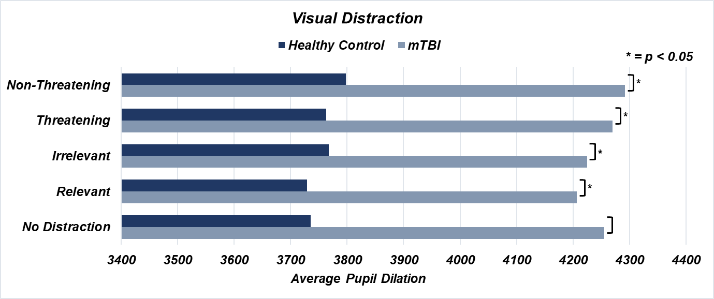
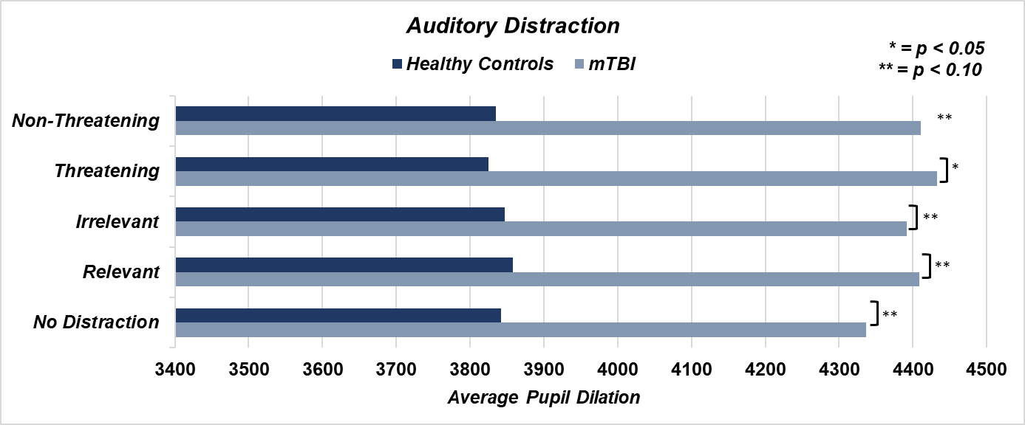
Example
Key Findings
  Significant differences in Pupil dilation at baseline
    mTBI driving significant differences
  No distraction conditions resulted in increase in internal distractions suggesting that “distraction free” conditions do not lower cognitive demand
    Increased irrelevant internal distractions in mTBI group
  Poor perception of facial expressions in mTBI group
*
(Pinnow et al., 2024 (In Progress))
Notes:
In the same lexical decision task described previously, we found that the mTBI group had larger pupil diameter at rest, or baseline, suggesting they are using more neural resources even in an idle state. We also found that cognitive demand did not go down during the no-distraction condition and that the “distraction free” conditions actually resulted in an increase in internal distractions in the mTBI group. Finally, we found that the mTBI group was very bad at perceiving threatening vs non-threatening facial expressions, suggesting they are not efficiently or effectively processing facial expressions.
These results from a computer-based cognitive task indicate that training using simulated environments can be adapted to include stimuli that elicit variability in subtle cognitive demand and efficiency to leverage the ability to measure cognitive processing in warfighters while they perform simulated operational tasks.

Slide 34
Eye Tracking Methods Considerations
Limitations
  No universal methods
  Lack of TBI data across recovery timepoints
    Difficult to establish normative data
  Not an indicator of perception
  Highly Sensitive
    Influenced by substances, fatigue, emotions, internal thoughts, contacts, glasses, eye color
Alterations to Experimental Set-Up
  Environment
  Complimentary measures
    Pre and post simulation measures (fatigue, TBI symptoms)
    Self-reports, semi-structured questions (between action and recollection)
Notes:
Adapting measures of eye tracking and pupillary dynamics into simulated environments to measure brain function and brain health in warfighters may be limited by the inconsistency in published methods, as there is no consensus on what eye tracking and pupillary metrics are most sensitive to brain injury. There is also not enough information on these measures at different recovery timepoints following TBI, such as acute, sub-acute, and chronic stages of injury; this further creates difficulties with establishing normative data. Eye tracking and pupillary dynamics may be able to tell us what a patient is paying attention to and how efficiently they are processing information, it does not indicate what is perceived and exactly what information from a stimuli or a set of stimuli is being processed. Finally, eye tracking and pupillary dynamics are highly sensitive to factors other than brain injury or brain health, including substances, fatigue, emotions, internal thoughts, whether a person is wearing contacts or glasses, and their eye color.
Including these outcome measures in simulation-based environments in the context of warfighter brain health will need some experimental considerations, including lighting condition and random distracting noises, as these may influence eye tracking and pupillary outcomes. Additionally, it may be advisable to get complimentary measures to account for covariates or confounds in the results with measures of influential factors such as fatigue or substance use, or interjecting questions between task performance and recollection of task performance, where there may be incongruence.

Slide 35
Eye Tracking Data Analysis
Data Analysis Approaches
  Pre-Processing
  Automated data organization
  Calculating percent change from baseline
  Compare outlier participant data with health history
Indicators of Effort
  Larger Pupil dilation, increased blinks
Indicators of Learning
  Decreases in pupil dilation, average fixation duration, and number of revisits
    Without increases in fatigue and errors
(Adhanom et al., 2023; Fehringer et al., 2021; Negi et al., 2020)
Notes:
Analyzing eye tracking and pupillary data requires effort for pre-processing the raw time-series data. It may be beneficial to use automated data organization, as raw time series data can be unwieldy. Various calculations using these data may be optimized by calculating changes relative to a within-subject baseline, which necessitates adequately measuring baselines. The rich datasets that are typically generated with eye tracking and pupillary data may include many outlier or extreme data points which may need to be cross-referenced with patients’ health history.
Eye movement and pupillary data, specifically increased blinks and larger pupil dilation, are often indicative of the amount of effort applied to performing or optimizing tasks. Indicators of learning that can be leveraged from data like this include decreases in pupil dilation (i.e., becoming more efficient at processing information with practice), decreased fixation durations, and decreased revisits to visual stimuli, with concurrent stability in fatigue and accuracy.

Slide 36
Outcome Metric - EEG
Objectively Measuring Brain Function
  Quantifies electrical activity of large populations of neurons using differences in voltage
  Measures brain function at various stages of cognitive processes with millisecond precision
  Methods Fundamentals
    Scalp electrodes (at least three, including ground and reference)
    Resting state or stimulus/task based
    Event trigger integration
Types of EEG Metrics
  Time-based analyses: Event-related potentials (ERPs), evoked potentials
  Frequency-based analyses (spectral analysis): relative and absolute power
  Time-frequency based analyses: phase synchrony and coherence, functional connectivity
Notes:
Finally today, we’ll discuss EEG as an outcome metric that can be harnessed from simulation-based technology to understand and improve warfighter brain health. EEG uses scalp-based sensors to quantify electrical activity of large populations of neurons. In doing so, it is capable of measuring brain function at various stages of cognitive processing with millisecond precision. To generate usable EEG data, there need to be at least three electrodes, including a ground and a reference, as well as a resting state recording period or cognitive task; and the system must have the ability to link stimulus information to the data, or event trigger integration.
EEG activity can be measured in the time-domain—or the average activity over time; the frequency domain—such as the relative and absolute power of the recorded EEG activity separated into different frequency bands (like alpha, theta, or beta); or the time-frequency domain—where changes in frequency measures are recorded as a function of time, with metrics such as coherence or functional connectivity.

Slide 37
EEG
Differences between mTBI and Controls
  Decrease in alpha power
  Increase in theta and beta power
  Increase in frontal asymmetry
  Reduced amplitudes and delayed latencies of event related potentials during attention, working memory, and cognitive control tasks
    Limited resource allocation/resource availability and cognitive slowing
Notes:
Historically, we see in mTBI patients a decrease in alpha power; an increase in theta and beta power; increases in frontal asymmetry; and reduced amplitudes and longer latencies of average activity in response to attention, working memory, and cognitive control tasks. These latter effects are indicative of limited resource allocation and cognitive slowing.

Slide 38
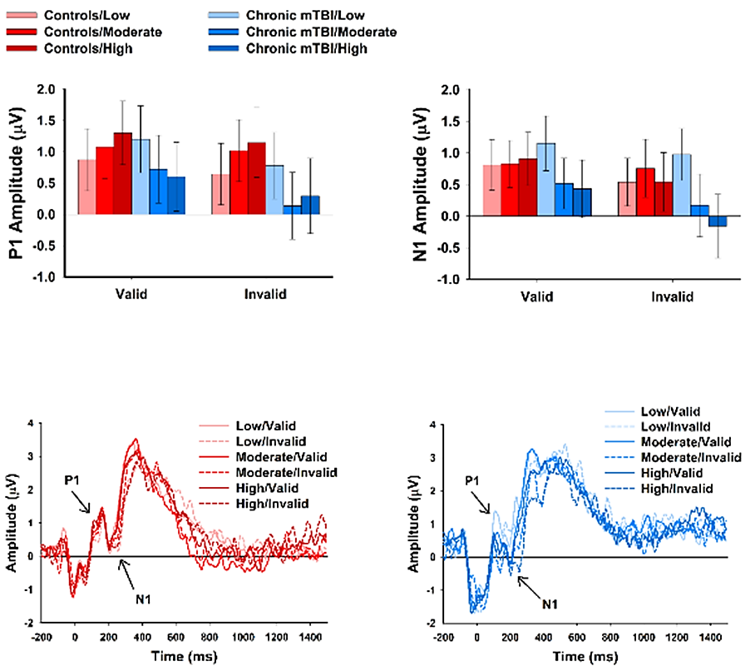
Example
Key Findings
  Patients with remote mTBI do not linearly modulate neural resource allocation in response to higher levels cognitive load
    Asymptotic, all-or-none
  Inhibition of irrelevant stimulus processing and enhancement of relevant stimulus processing
    Exaggerated and plateaued at moderate and high cognitive load levels
    Sustained mental effort needed to maintain normal performance
      Inefficient resource allocation and inability to flexibly modulate neural resources
Notes:
In an EEG study (not in a simulated environment) investigating time-domain activity (or, event related potentials) in response to a working memory task under low, moderate, and high cognitive load conditions, we found the patients with mTBI do not modulate or optimize their neural resource allocation in response to increasing levels of cognitive load, while healthy controls do. Processing irrelevant stimulus was overly inhibited at higher levels of cognitive load while processing of relevant stimuli was enhanced. This shows that the mTBI patients had to sustain much greater mental effort and resource allocation to maintain normal performance during the task. They essentially adopted an all-or-none approach and showed an inability to flexibly modulate their neural resources in response to dynamic cognitive demands.

Slide 39
EEG Methods Considerations
Limitations
  Variability in findings across studies due to differences in study methods and cognitive tasks
  No consensus on data analysis techniques; highly variable and subjective
  Susceptible to artifacts: muscle activation, heart beats, electrical interference, sweat
  Needs multiple trials per condition
Alterations to Experimental Set-Up
  Adhering electrodes (cap or individually attached); wired or wireless
    Consideration of extra cabling if not wireless
  Stimulus presentation software must deliver event triggers to EEG acquisition software/hardware
    Hardwired connection or sensors (e.g., photo diodes)
Notes:
EEG is an incredibly useful methodology that can easily be and sometimes is incorporated into simulation-based technologies. While it can provide very precise information regarding the timing of neural activity in the brain at rest or in response to cognitive tasks, there are limitations to consider regarding its integration into simulation technology. There is a lot of variability in study results across studies, likely due to variability in study methods and cognitive tasks. There also are very few automated or purely objective data analysis techniques. EEG recordings are susceptible to artifacts caused by muscle activation, heat beats, electrical interference from the testing environments, and sweat. It also requires multiple trials per condition to get reliable averages.
To incorporate this technology into simulation-based experimental set ups, it will be critical to optimize how electrodes are placed on the scalp and whether they will be wired or wireless. The software that presents stimuli must also “talk to” the software that records the EEG activity so there can be linking of external events/stimuli to the raw EEG dtata.

Slide 40
EEG Data Analysis
Data Analysis Approaches
  Higher sampling rate = better data
  Signal to noise ratio
    Artifact reduction and removal
Indicators of Effort
  Reduced alpha power and synchronization
Indicators of Learning
  Error-related negativity amplitude (ERP)
  Processing Negativity amplitude (ERP)
  P3 (“P300”) amplitude and latency (ERP)
Notes:
Analyzing EEG data is somewhat of an artform, in some cases. A higher sampling rate will lead to better data, but is more computationally demanding. The signal to noise ratio of the data needs to be increased through careful identification and removal of artifacts.
Effort on cognitive tasks can be relatively easily measured with alpha power and synchronization. There are also robust indicators of learning that can be measured with event related potentials (the time-domain outcome of EEG activity), including amplitudes of ERP components known as error related negative and processing negativity which are commonly observed in response to making errors on tasks, and the P3 or P300 amplitude and latency which is commonly thought of as a component reflective of neural resource allocation and often correlates with pupil diameter.

Slide 41

How can we utilize multimodal data from simulations to enhance clinical and training decision making?
Image Credit: Microsoft

Slide 42
Translation of Raw Data into Actionable Insights
We first have to address current challenges
  Triangulation of data
  Predictive capabilities
    Adaptive assessment and training
    Skills + Environments
    Brain health and TBI forecasting
  Provider friendly automated data scoring and interpretation
  Ability to handle large datasets
Then we must apply tools that can integrate holistic brain health data
TBI History
Notes:
First translating raw data into actionable insights for clinical decision making can be a big challenge due to a whole host of reasons including triangulating both qualitative and quantitative data, developing predictive capabilities such as adaptive assessment and training, scaffolding skills and environments, and even utilizing longitudinal data for brain health and TBI . But medical providers need automated data scoring and interpretation that can pair with simulation technology. Sometimes systems output excel files with raw data that is left to the provider to analyze and interpret independently, this is particularly challenging due to varying patient needs and schedules. Additionally, raw data can be difficult to make clinical inferences from. Expanding simulation programs to handle both qualitative and quantitative data inherently requires large data storage capabilities as well. Then if we can have all of than then we can apply tools to integrate holistic brain health data.

Slide 43
Utilization of Artificial Intelligence and Machine Learning
Medication
Skills Needed
Nutrition
Sleep
Cognition
Mental Health
Individual Goals
Executive Function
Data Analysis & Integration
Predictive Decision Making
Adaptable Assessment & Training
Brain Health Forecasting
Individualized Recommendations
TBI History
Sensor Data
Blast Exposure History
Service Demographics
(Husain et al., 2024)
Notes:
The use of artificial intelligence and machine learning in ever evolving and rapidly growing as we speak. Typically we have siloed sets of data where deciphering it is often left to the service member, however what if we could pull all of this data together form them, analyzed all of it independently and together to build predictive decision making tools, these predictive decision making tools would be extremely helpful for adaptive assessment and training capabilities – which are becoming more popular, but again for healthcare we are still in need of these tools, and lastly oftentimes we want to know what the future holds after and injury which is one of the most challenging questions to answer. However, if we utilize AI and ML we may be better equipped to answer that questions through brain health forecasting and provider individualized recommendations to improve long term outcomes.

Slide 44
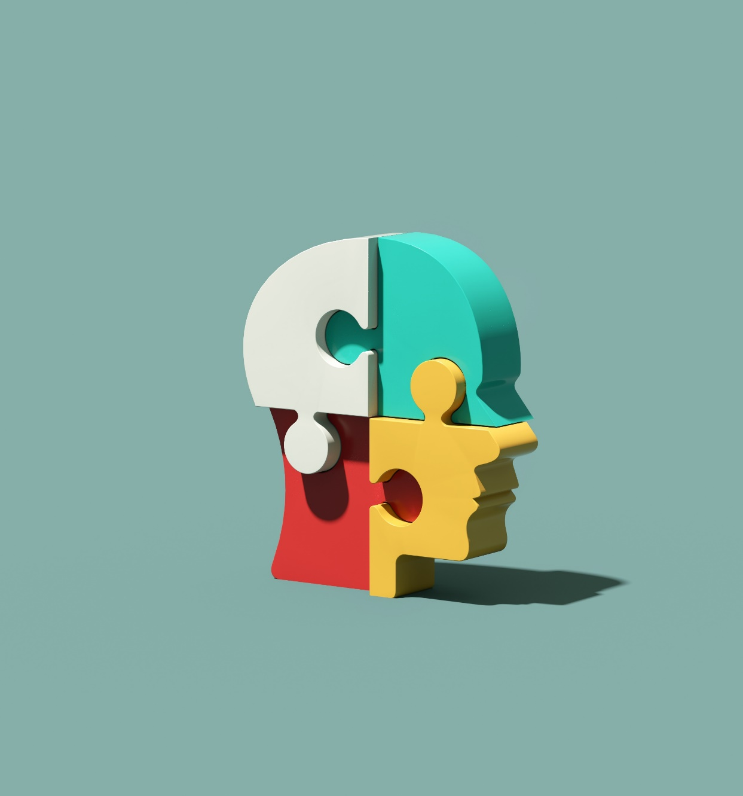
How could simulation applications be scaled for Healthcare and Training Applications?
Image Credit: Microsoft

Slide 45
Putting It All Together
What needs to be integrated for the warfighter and brain health professionals?
End User Input
Defining Skill
Outcome Metrics
Principles of Neuroplasticity
Simulation Variation
Predictive Modeling
Automated Data Processing and Analysis
Image Credit: Microsoft
Notes:
So we have discussed several sections related to healthcare and training applications but how do we scale them and what needs to be integrated for the warfighter and brain health professionals? End user input, defining skills and common outcome metrics for service members, applying principles of neuroplasticity – carefully and specifically, building variation within simulation programs but also building flexible programs so that providers such as rehabilitation professionals can adapt and change the environments, skills, and cognitive stressors/distractions to build adaptive cognitive skills, and leveraging predictive modeling and automated data processing and analysis to make a seamless system that can be utilized long-term.

Slide 46
Spectrum of Brain Health Professionals Who Would Benefit
Healthcare Fields
Psychology
Neuropsychology
Physical Medicine & Rehabilitation
Training
Athletic Training
Strength and Conditioning
Sports Psychology
Rehabilitation
Speech Therapy
Occupational Therapy
Physical Therapy
Specialists
Behavioral Medicine
(Shazhaev et al., 2023)
Notes:
How many brain health professionals would benefit from this technology? There are a wide range of specialists, trainers, and rehabilitation professionals who would significantly benefit from simulation tools that were designed for their area of focus specifically.

Slide 47
Considering The End User
Service Demographics
End User Demographics
Brain Health Symptoms
TBI History
Polytrauma History
Blast Exposure History
Mental Health History
Combat History
Deployment History
Time in Service
Military Occupational Specialty
Notes:
As these specialists work with service members they often look at brain health symptoms across a broad spectrum and service demographics. Considering end user demographics will be critical in designing simulated operational environments. Potential negative outcomes of utilizing simulation-based tools in healthcare include PTSD triggers, emotional distress, and dizziness or motion sickness. There is an emergence of VR and digital health tools to treat these different conditions, however systems should be considerate of the potential negative outcomes and build in tools to mitigate them

Slide 48
Simulation Variability – The Key to Neuroplasticity
Environment
Operational, Training, Garrison, Off-Duty
Tasks
Contextually Relevant (Role Specific)
Interactive
Repetitive Practice
Sensation
Haptic Feedback
Fluctuating Modalities and Intensities
Variation Options
Dynamic Assessment and Training (Individual/Team)
Integration of Weapons, Communication, Adversaries
(Shazhaev et al., 2023)
Notes:
One of they key benefits of simulation technology that is a big pull for brain health is the variation capabilities. The possibilities are endless for integrating cognitive skill training when we think about how adaptable environments, sensations, and tasks are within these programs. With this technology providers will not be stuck guessing what their treatment plans look like outside of the clinic. Building adaptable cognitive skills and brain health requires variation across environments, sensations, and tasks to build perception and store critical memories of how they adapted their skills to be successful in specific tasks to recall later.

Slide 49

The Road Ahead
Future Opportunities
The way forward for integrative brain health tools is based on emerging technologies, healthcare partners, and warfighter needs:
  Virtual, Extended, and Augmented Realities: headsets, glasses, and screen-based that allows for the inclusion of measurable and meaningful variations within simulated environments
    Enable brain health professionals to target all specified areas of the WBHI | “I see what you are seeing”
    Measure responses to interventions (i.e., mental health, behavioral, rehabilitative)
  Haptic Feedback: integrates tactile (sensorimotor) variation to optimize adaptability, pair cognitive skills with all modalities of sensory inputs, and facilitate adaptive plasticity
  AI and ML: enable adaptive assessment and training, automated data analysis and interpretation, identify needed referrals, and forecast recovery outcomes
Image Credit: Microsoft

Slide 50
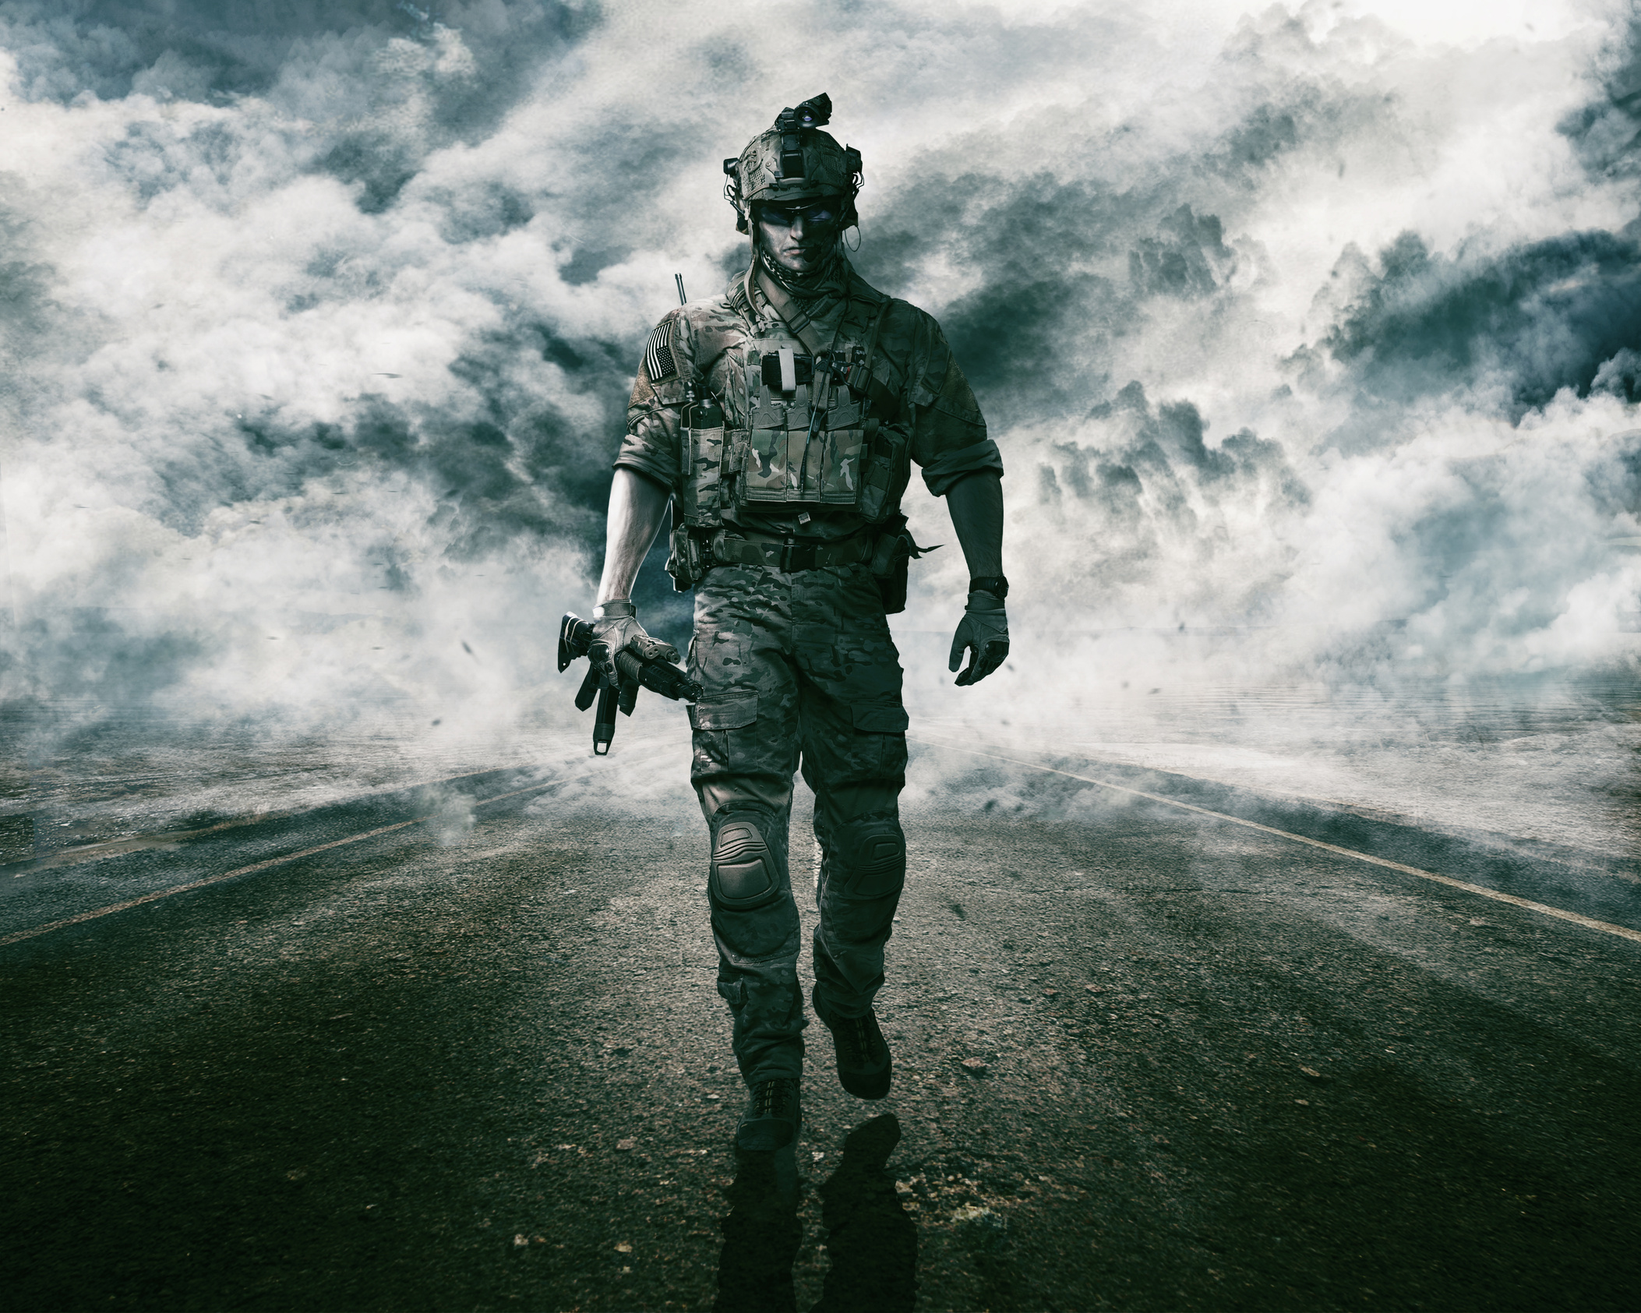
Warfighter Benefits
Holistic and Dynamic Assessment
Integrated Approaches
Individualized Treatment and Training Plans
Enhanced Cognitive Skills
Decreased Recovery Time
Improved Short- and Long-Term Outcomes
Increased Lethality
Career Longevity
Image Credit: Canva

Slide 51
Learning Objectives
By the close of the tutorial attendees will be able to:
Apply knowledge of common TBI symptoms that may influence service members’ cognitive performance in simulation-based environments.
Analyze the potential outcome metrics that can be utilized within simulations for comparative analyses of cognitive performance in active-duty service members with and without a history of TBI.
Evaluate future opportunities for developing simulation-based tools for assessing and enhancing warfighter brain health.
Image Credit: Canva

Slide 52
Contact Information and Q/A
Questions?
deanna.r.pinnow.ctr@health.mil
jamie.n.hershaw.ctr@health.mil

Slide 53
Select References
Adhanom, I.B., MacNeilage, P. & Folmer, E. Eye Tracking in Virtual Reality: a Broad Review of Applications and Challenges. Virtual Reality 27, 1481–1505 (2023). https://doi.org/10.1007/s10055-022-00738-z
Bogdanova, Y., Wethe, J., Sokol, O., Sacks-Zimmerman, A., Schwertfeger, J., Dwyer, B., ... & Bergquist, T. (2024). VR and Computerized Cognitive Rehabilitation for Brain Injury: A Systematic Review. Archives of Physical Medicine and Rehabilitation, 105(4), e149.
Edwards, J. D., Xu, H., Clark, D. O., Guey, L. T., Ross, L. A., & Unverzagt, F. W. (2017). Speed of processing training results in lower risk of dementia. Alzheimer's & Dementia: Translational Research & Clinical Interventions, 3(4), 603-611.
Faria, A. L., Latorre, J., Silva Cameirão, M., Bermúdez i Badia, S., & Llorens, R. (2023). Ecologically valid virtual reality-based technologies for assessment and rehabilitation of acquired brain injury: a systematic review. Frontiers in psychology, 14, 1233346.
Fehringer B. C. O. F. (2021). Optimizing the usage of pupillary based indicators for cognitive workload. Journal of eye movement research, 14(2), 10.16910/jemr.14.2.4. https://doi.org/10.16910/jemr.14.2.4
Graham ID, Logan J, Harrison MB, Straus SE, Tetroe J, Caswell W, et al. Lost in knowledge translation: time for a map? The Journal of continuing education in the health professions [Internet]. 2006. [cited 2019 Apr 7];26(1):13–24. Available from: https://www.ncbi.nlm.nih.gov/pubmed/16557505 doi: 10.1002/chp.4
Jannace, K. C., Pompeii, L., Gimeno Ruiz de Porras, D., Perkison, W. B., Yamal, J. M., Trone, D. W., & Rull, R. P. (2024). Lifetime traumatic brain injury and risk of post-concussive symptoms in the millennium cohort study. Journal of neurotrauma, 41(5-6), 613-622.
Lange, R. T., Brickell, T. A., Lippa, S. M., & French, L. M. (2015). Clinical utility of the Neurobehavioral Symptom Inventory validity scales to screen for symptom exaggeration following traumatic brain injury. Journal of clinical and experimental neuropsychology, 37(8), 853–862. https://doi.org/10.1080/13803395.2015.1064864
Llop, J. Z., Hoover, P. J., Nix, C. A., Lu, L. H., Bowles, A. O., & Caban, J. J. (2023). NSI and PCL-5 Normative Tables for Active Duty Service Members Affected by Traumatic Brain Injury. Military medicine, 188(9-10), 3127–3133. https://doi.org/10.1093/milmed/usac189
Negi, S., & Mitra, R. (2020). Fixation duration and the learning process: an eye tracking study with subtitled videos. Journal of eye movement research, 13(6), 10.16910/jemr.13.6.1. https://doi.org/10.16910/jemr.13.6.1
Section 735(b)(1)(G) of NDAA FY 2023 (Public Law 117–263): “The consideration of the findings and recommendations of the report of the National Academies of Science, Engineering, and Medicine titled “Traumatic Brain Injury: A Roadmap for Accelerating Progress” and published in 2022 (relating to the acceleration of progress in traumatic brain injury research and care), or any successor report, in relation to the activities of the Department relating to brain health, as applicable.”
Shazhaev, I., Mihaylov, D., & Shafeeg, A. (2023). A review of haptic technology applications in healthcare. Open Journal of Applied Sciences, 13(2), 163-174.
Sheehan, R. C., & Vernon, M. (2024). Development of a multidimensional military readiness assessment. Frontiers in Rehabilitation Sciences, 5, 1345505.
Soble, J. R., Silva, M. A., Vanderploeg, R. D., Curtiss, G., Belanger, H. G., Donnell, A. J., & Scott, S. G. (2014). Normative Data for the Neurobehavioral Symptom Inventory (NSI) and post-concussion symptom profiles among TBI, PTSD, and nonclinical samples. The Clinical neuropsychologist, 28(4), 614–632. https://doi.org/10.1080/13854046.2014.894576
Stein, M. B., Ursano, R. J., Campbell-Sills, L., Colpe, L. J., Fullerton, C. S., Heeringa, S. G., Nock, M. K., Sampson, N. A., Schoenbaum, M., Sun, X., Jain, S., & Kessler, R. C. (2016). Prognostic Indicators of Persistent Post-Concussive Symptoms after Deployment-Related Mild Traumatic Brain Injury: A Prospective Longitudinal Study in U.S. Army Soldiers. Journal of neurotrauma, 33(23), 2125–2132. https://doi.org/10.1089/neu.2015.4320

