Slide 1

Harnessing the Power of Simulation-Based Tools to Enhance Warfighter Brain Health
DeAnna Pinnow, PhD, Traumatic Brain Injury Center of Excellence Fort Carson, CO
Jamie Hershaw, PhD, Traumatic Brain Injury Center of Excellence Fort Sam Houston, TX
Unclassified

Slide 2
Presenter Information
DeAnna Pinnow, PhD
Research Scientist
Compass Government Solutions
Contractor Support to the Traumatic Brain Injury Center of Excellence
Location: Fort Carson, CO
Jamie Hershaw, PhD
Senior Clinical Research Director
General Dynamic Information Technology
Contractor Support to the Traumatic Brain Injury Center of Excellence
Location: Joint Base San Antonio, Texas

Slide 3
Disclaimer
The views expressed in this presentation are those of the authors and do not necessarily represent the official policy or position of the Defense Health Agency (DHA), Department of Defense (DoD), or any other U.S. government agency. This work was prepared under Contract HT0014-22-C-0016 with DHA Contracting Office (NM-CD) HT0014 and, therefore, is defined as U.S. Government work under Title 17 U.S.C.§101. Per Title 17 U.S.C.§105, copyright protection is not available for any work of the U.S. Government. Oral presentation at the I/ITSEC Conference, December 2024. For more information, please contact dha.TBICOEinfo@health.mil.
UNCLASSIFIED

Slide 4
Agenda
Introduction
  Learning Objectives
  What is warfighter brain health?
There’s a Simulation for That Right? – Healthcare and Simulation Worlds Collide
Facilitating Neuroplasticity – Harnessing Simulation Technology for Enhancing Warfighter Brain Health
Scaling Simulations for Healthcare and Training Applications
Tutorial Summary
Q/A

Slide 5

Learning Objectives
By the close of the tutorial attendees will be able to:
Apply knowledge of common TBI symptoms that may influence participants’ cognitive performance in simulation-based environments.
Analyze the potential outcome metrics that can be utilized within simulations for comparative analyses of cognitive performance in active-duty service members with and without a history of TBI.
Evaluate future opportunities for developing simulation-based tools for assessing and enhancing warfighter brain health.
Image Credit: Canva

Slide 6
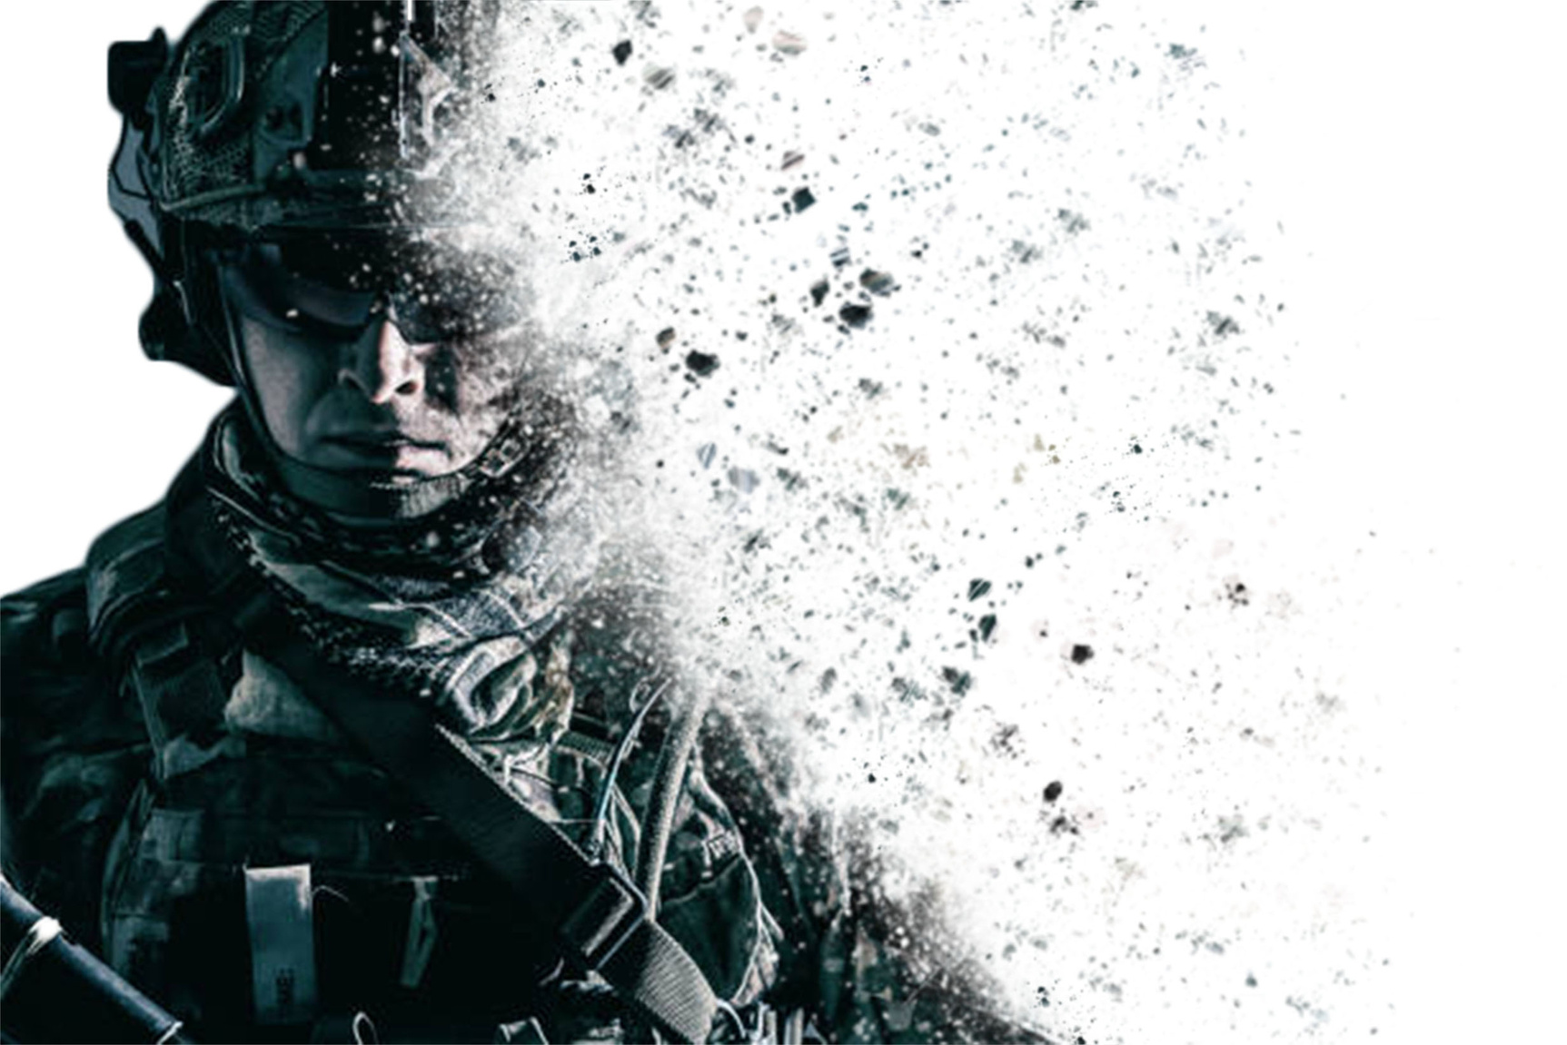
Today’s Demands on the Warfighter
Cognitive
Psychological
Physical
Environmental
Image Credit: Canva

Slide 7
Demands on the Warfighter After a Traumatic Brain Injury (TBI)
TBI Symptoms
Threats to Warfighter Readiness
Cognition
Threat Detection
Executive Function
Reaction Time
Mental Health
Decision Making
Sleep
Emotional Control
Hearing
Vision
Teamwork
Balance
Situational Awareness
Image Credit: Canva

Slide 8

TBI - The Invisible Injury
What is a TBI?
  Structural and/or physiological disruption of brain function from an external force
Prevalence
  499,852 Total Injuries (2023)
  82% Mild TBI (mTBI; Concussion)
Causes
  Blast
  Motor Vehicle Accident
  Airborne Jumps
  Combatives
Image Credit: Canva
Traumatic Brain Injury Center of Excellence, DoD TBI Worldwide Numbers DoD TBI Worldwide Numbers | Health.mil
Notes:
Structural injury or physiologic disruption of brain function by an external force
Significant different between pre-enlistment and service-related mechanisms of injury
Numbers do not account for more than one injury
*high probability there are significantly more service members with a history of TBI due to pre enlistment injuries from sports, MVA,
Causes: Blast , MVA, Combatives, Airborne Jumps
Concussion = Mild TBI Diagnostic Criteria
Loss of Consciousness < 30 minutes
Alteration of Consciousness < 24 hours
Post-traumatic Amnesia 0-1 Day

Slide 9
mTBI Assessment & Recovery
Mandatory Assessment (Brain Exposures)
  Involvement in a vehicle blast event, collision, or rollover
  Within 50 meters of a blast
  Direct blow to the head or observed loss of consciousness
  Exposure to more than one blast event
Recovery Time
  1-3 months (~20% with persistent symptoms)
  Prognostic factors
Major Challenges
Exposure Monitoring
Diagnostic Tools
Treatment Tools
Short Term Monitoring
Long Term Monitoring
Warfighter Readiness
Image Credit: Microsoft
(Stein et al., 2016)
Notes:
Prior TBI(s)
Pre-deployment psychological stress
Severe deployment stress
Loss of consciousness or Post Traumatic Amnesia
Brain Exposures
Direct blow to the head or witnessed loss of consciousness
Vehicle collision, rollover, or blast
Within 50 meters of a blast
Exposure to more than one blast

Slide 10
What is Warfighter Brain Health and Why is it Important?
Definition
  The physical, psychological, and cognitive status that affects a warfighter's capacity to function adaptively in any environment and impacts readiness, operational capability, mission effectiveness, and the goal to achieve overmatch or superior lethality
  (Deputy Secretary of Defense memorandum, “Comprehensive Strategy and Action Plan for Warfighter Brain Health,” dated October 1, 2018 and National Defense Strategy, January 2018)
Warfighter Brain Health Initiative
  Joining operational and medical communities in a unified approach for optimizing service member brain health and countering TBIs
Identify, Monitor, and Mitigate
Reduce, and Eliminate
Prevent, Recognize, and Minimize
Optimize
Advance
Comprehensive Strategy
Warfighter Brain Health Hub | Health.mil
Notes:
Optimizing cognitive and physical performance
Identifying, monitoring, and mitigating brain exposures
Preventing, recognizing, and minimizing traumatic brain injuries (TBI)
Reducing and eliminating long-term or late effects of traumatic brain injury (TBI)
Advancing warfighter brain health science

Slide 11

But first…………..
Aren’t there already applications for brain training?
Image Credit: Canva

Slide 12
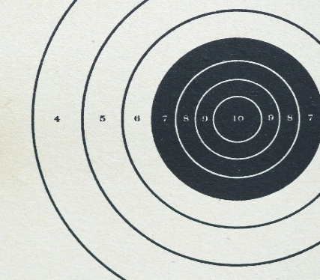
Brain Training vs. Integrated Warfighter Cognitive Performance Training
Brain Training Applications
  Training environment utilizes mobile devices and computers
    Lack of sensory integration – targeted cognitive training (i.e., auditory, visual, tactile)
  Context of tasks is game-based
  (i.e., card sorting, matching)
  TBI is not accounted for
Evidence (Good or bad?)
  Some evidence of efficacy in aging populations
  Little to no evidence of efficacy in TBI populations
Example
═
?
Image Credit: Microsoft
  (Bonnechere et al., 2021; Christopher et al., 2019: Edwards et al., 2017)

Slide 13

Bridging the Gap - Advancing Warfighter Brain Health Science
Opportunities for Brain Health Science
Reduce
Identify
Optimize
Basic
Neuro
Clinical
Train Like You Fight…..Assess Like You Fight…..
Rehabilitate like You Fight
Image Credit: Canva
Notes:
Innovation – development of novel tools to fit the service member, healthcare provider, and operational needs
Collaboration - community-based participatory, implementation, and translational research approaches
Optimize outcomes – facilitating meaningful brain health changes by merging technology with multiple principles of neuroplasticity

Slide 14
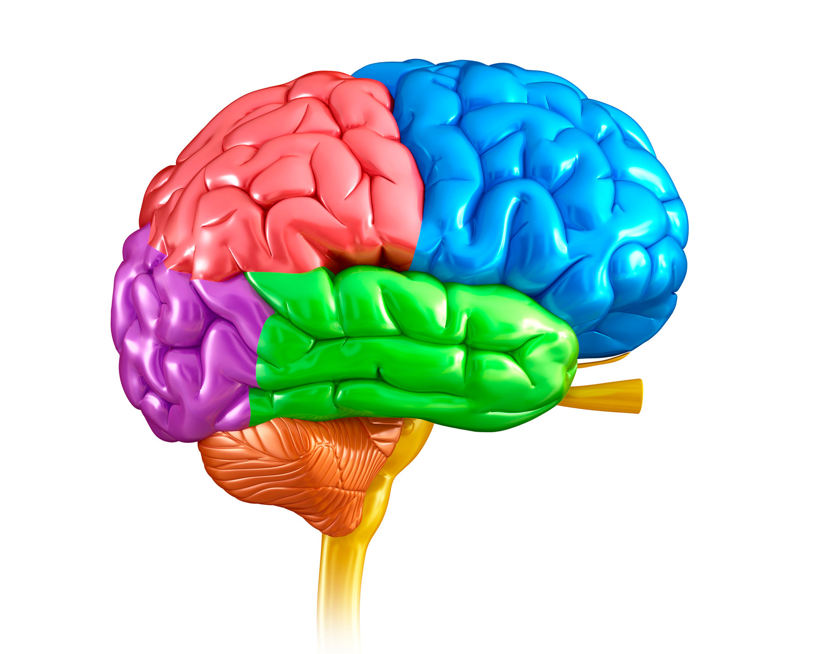
There’s a Simulation for That Right?
Healthcare and Simulation Worlds Collide
What are the Current Gaps in Brain Health Tools?
  Identify: Predictive Capabilities
    Military normed tools (contextually relevant)
    Ecological validity
  Reduce: Treat Subtle mTBI Symptoms
    Clinic vs. operational needs
    Siloed approaches for brain health
  Prevent: Minimize Short and Long-Term Impacts
    Compounding symptoms with multiple TBIs
  Optimize: Feedforward vs. Feedback Approaches
    Minimal opportunities to shape cognitive skills in real time
    Constrained ability to facilitate neuroplasticity across environments
Identify, Monitor, and Mitigate*
Reduce, and Eliminate*
Comprehensive Strategy
Prevent, Recognize, and Minimize*
Optimize*
Advance*
Image Credit: Canva
Notes:
Minimal simulation products/tools available

Slide 15

Harnessing simulation technology for enhancing warfighter brain health
It’s all about neuroplasticity, who is on the team, optimal outcome metrics, and translating data.
Image Credit: Microsoft

Slide 16



Neuroplasticity
What is it and how do we facilitate it?
  Changing behavior, perception, and cognitive state
    Learning and Adapting
  Our brain’s ability to reorganize synaptic connections (neuropathways) in response to experiential learning and after an injury
    Developed over time, with feedback, and repetition across environments
  REQUIRES integration of sensation and perception
    Matching skills with environmental demand
    Internal and external factors
    Optimal for post TBI recovery
Crawl
Walk
Run
Notes:
(i.e., the nature, anatomy, and function of the Nervous System)
Examples: learning how to walk, ride a bike, use a weapon, fly a plane
Without the inclusion of sensation and perception cognitive skills will remain within the context of the learning environment vs within operational environments

Slide 17
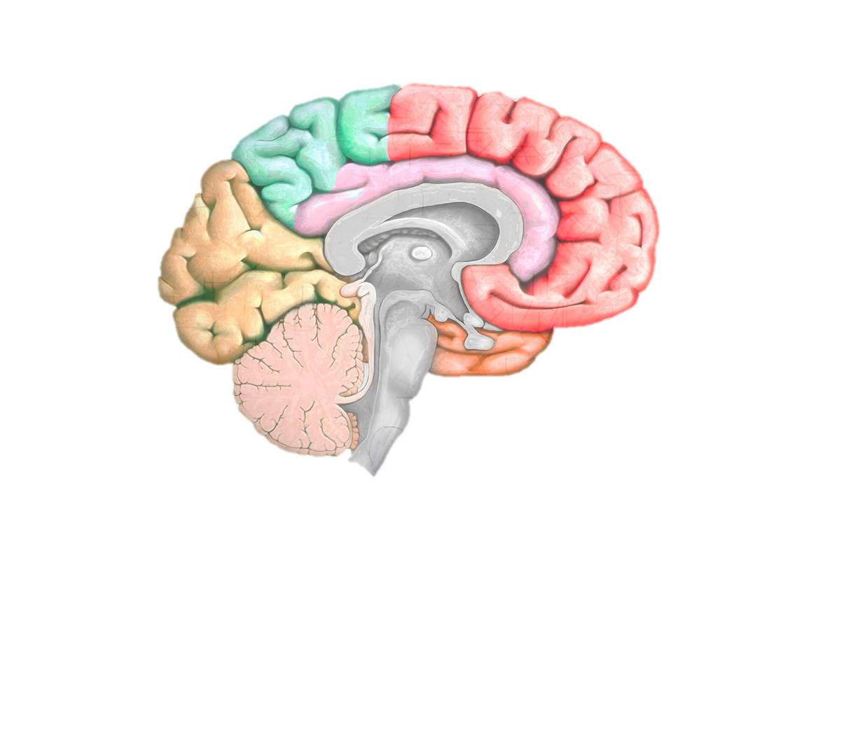
Principles of Neuroplasticity
Age
Time
Salience
Specificity
Intensity
Inference
Variability
Use It or Lose It
Use It and Improve It
Image Credit: Canva

Slide 18

How are Neuropathways Developed and Refined?
Age matters
  Occurs throughout your lifetime
Dependent on experiential learning
  Salience
  Specificity
  Intensity
  Repetition
Inclusion of sensation and perception
  Variability
  Specificity
Task
Environment
Feedback
Skill
Image Credit: Microsoft

Slide 19
Neuroplasticity after mTBI
Not all plasticity is “good” plasticity
  Maladaptive
    Activation of neuropathways that hinder function
    Post-Traumatic Stress Disorder (PTSD)
    Stuttering
  Adaptive
    Tailored and layered approaches
  Time Matters (injury to intervention)
Tailored and Layered Approach
Stable Plasticity
Predicting Outcomes
Mass Practice
Adaptive Plasticity Changes
Contextual Learning
Environmental Shifting
Variation
Neuronal Competition
Building Perceptions
Multiple Dynamic Systems
Defining Skill
Out Competing Modal Behaviors
Selective Attention
Constraint Induced
Building Patterns
Notes:
Stuttering
PTSD

Slide 20
The Next Frontier – Integration of Neuroplasticity into Brain Health Tools
Why is virtual reality simulation ideal for targeting warfighter brain health initiatives?
  Incorporates all Principles of Neuroplasticity
    Perception and Sensation
  Ecological Validity
  High Levels of Control
    Customized
    New and Refined Learning
  Measure Physiologic, Behavioral, and Perceptual Metrics (i.e., functional outcomes)
  Build Cognitive Skills to Meet Demands of Operational Environments
    Cognitive Flexibility and Endurance
  (Bogdanova et al., 2024; Faria et al., 2023; Sheehan et al., 2024)

Slide 21

Where Do We Start?
Integrative Approach
  Bridging the gap between healthcare professionals and operational communities
Build Multi-disciplinary Teams
  Healthcare Professionals
  Trainers
  End users
  Industry and Academic Partners
Benefits
  Real-world feedback
  Healthcare prospective
  Builds trust and common understanding
Image Credit: Microsoft

Slide 22
Incorporate End User Touchpoints
Implementation and Translational Science Approaches
  Community-Based Participatory Approaches
Embedded Mixed Methods
  Context and Content Validation
Simulation Design
  Conceptualizing Environment
  Auditory, Visual, and Haptic Elements
  Define Skills
  Establish Evaluation Criteria
    Psychologic, Behavioral, Perceptual
Knowledge to Action Framework
Monitor
Evaluate
Sustain
Adapt
Assess
Tailor
Knowledge Inquiry
Synthesis
Product Development
Knowledge Creation
(Graham et al., 2006)

Slide 23

What are the best outcome metrics to include?
Our ability to target warfighter brain health is only as good as the assessments and training tools we develop.
Image Credit: Microsoft

Slide 24
How to Measure Brain Health? Outcome Metrics
Highly debated
  Historical Challenges
Screeners
  TBI Screeners
Baseline Measures
  TBI History and Self-Report
  Standardized Measures
Overlapping Outcome Measures
  Eye Tracking
  Electroencephalogram (EEG)

Slide 25
TBI Screeners
TBI Screeners
  Determine if further assessment is needed
    Imaging and standardized assessment
    Time dependent (< 48 – 72 hours)
  Assessing: altered or loss of consciousness (> 24 hours), posttraumatic amnesia (≤ 24 hours), headache/migraine, depression, anxiety, attention, memory, speech fluency, word finding, grip strength, pupil light response, (observed) smooth pursuits, saccades, convergence, vestibular-ocular reflex, and visual motion sensitivity.
Types of Administered Screeners
  Examples: Glasgow Coma Scale, Military Acute Concussion Evaluation 2, National Institutes of Health Toolbox – Cognition Battery, Rancho Los Amigos Scale

Slide 26
Outcome Metric – Self-Report
Surveys and Questionnaires
  Obtain frequency and intensity of TBI symptoms
  Examples: Neurobehavioral Symptom Inventory (NSI), Rivermead Post Concussion Symptoms Questionnaire, Posttraumatic Stress Disorder Checklist, Pittsburgh Sleep Quality Index, Beck Depression Inventory, Patient Health Questionnaire
Differences in mTBI and Healthy Controls
  TBI groups have higher scores across cognitive, executive function, and mental health symptoms
    Scores can change throughout the day
  TBI symptoms are exacerbated by mental health disorders (PTSD, anxiety, depression)

Slide 27
Self-Report Methods Considerations
TBI History Interview
  Ohio State University Traumatic Brain Injury Identification method
    Standardized Interview for lifetime TBI History
Limitations
  Heavily reliant on accurate perception and recall
  Low predictive capabilities
  Normative Data (time since injury, mechanism of injury, and service demographics)
Data Analysis Approaches
  Symptom reporting validity (Validity-10 validity score, NSI)
  Assess changes across recovery timepoints and in response intervention, training, or exposures (blast)
  Compare across deployment and combat demographics
(Lange et al., 2015; Llop et al., 2023; Sobel et al., 2023)

Slide 28
Standardized Behavioral Measures
Standardized Measures
  Provide objective measures of cognition and executive function
  Pen and paper or computer-based
  Assessing: attention, memory, processing speed, reaction time, impulsivity, problem solving, organization, mental flexibility, and emotional control
  Common measures: accuracy, reaction time, impulsivity
Types of Administered Standardized Measures
  Automated Neuropsychological Assessment Metrics, Trail Making Test, Stroop Test, Rey Auditory Verbal Learning Test, Mini Mental State Examination, Delis-Kaplan Executive Function System, Conners Continuous Performance Test
(Lee et al., 2024)

Slide 29
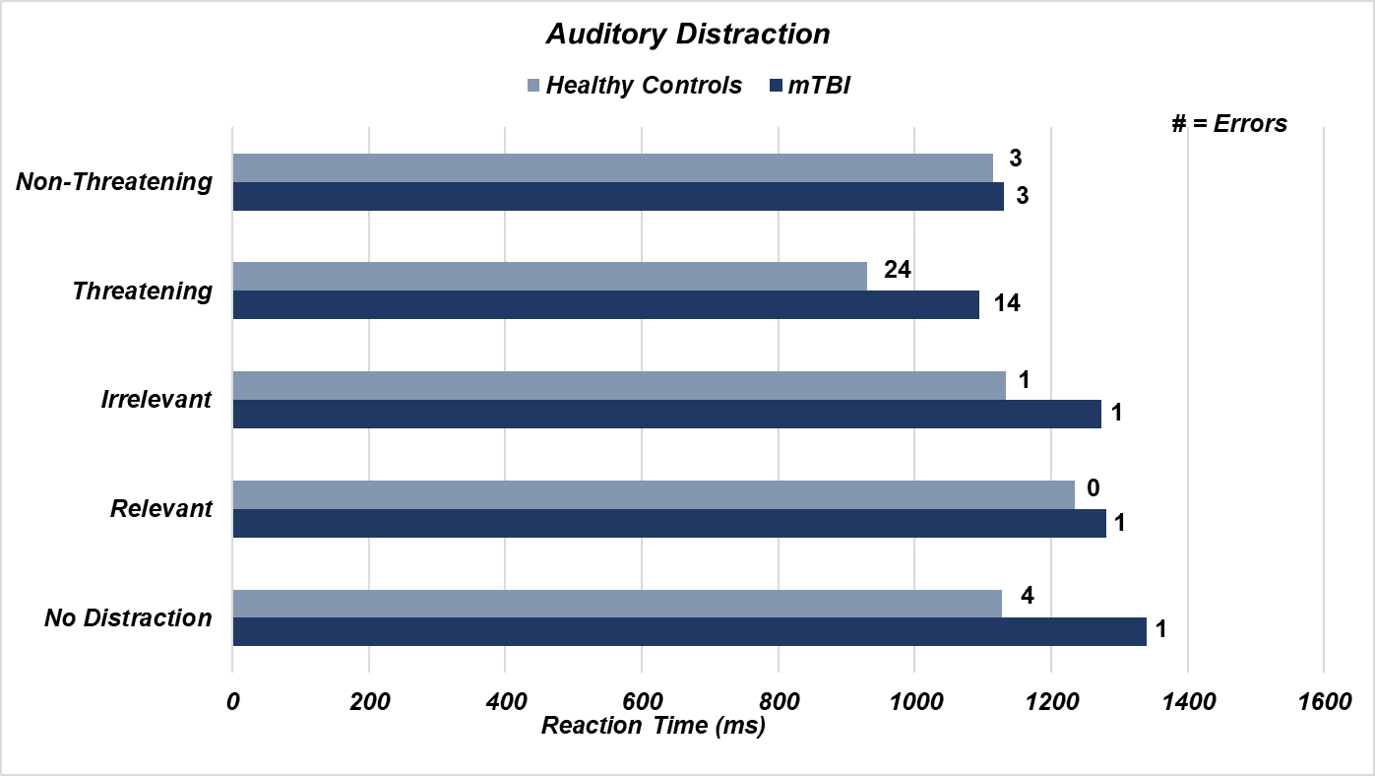
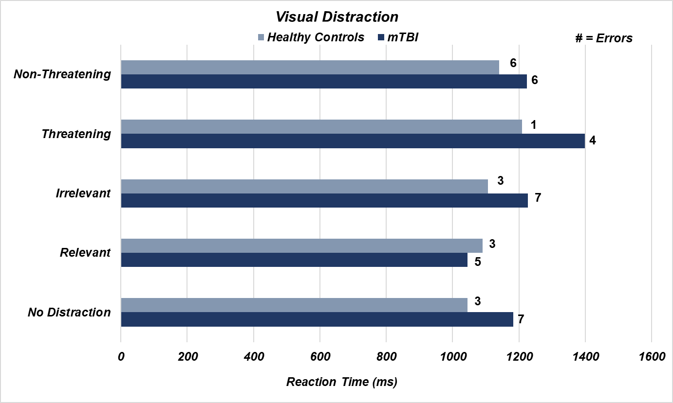
Example
Key Findings
  mTBI participants demonstrated a lack of cognitive strategy development and initiation for “go-no-go” task in response to various environmental distractions
  Faster reaction time did not equate to less errors
    mTBI participants reported inaccurate perceptions of performance
  Changes in accuracy across distraction modalities
(Pinnow et al., 2024 (In Progress))
Notes:
12 mTBI (chronic stage) and 18 healthy controls ages 20 – 54
Computer-based Lexical Decision Task with Distractions

Slide 30
Standardized Measures Methods Considerations
Differences in mTBI and Healthy Controls
  Decreased cognitive, executive functions, perception, mental flexibility, and cognitive endurance
  Increases in impulsivity and frustration
Limitations
  Sensitivity (mTBI)
    Low predictive capabilities
  Ecological validity
  Context of tasks
Alterations in set up
  Real-world scenarios and environments
  Re-created stressors

Slide 31
Standardized Measures Data Analysis
Data Analysis Approaches
  Triangulate multimodal data
  Include observational data (repeated directives, increased frustration, off task)
Indicators of New Learning
  Increased recall
  Increased prediction
  Cognitive skill initiation
  Decreased need for clarification
  Increased accuracy + decreased reaction time

Slide 32
Outcome Metric – Eye Tracking
Objectively Measuring Human Behavior and Brain Function
  Dilation (cognitive load, emotion), fixations, saccades, blinks
    Oculomotor metrics can be more sensitive to mTBI effects than standardized assessments
  Heat maps, areas of interest, fixation sequences, time to first fixation
Types of Eye Tracking
  Head-stabilized, remote, mobile (head-mounted), integrated
    Computer-based, virtual reality headset, glasses
Differences between mTBI and Healthy Controls
  Larger resting Pupil dilation
  Larger dilation in response to sensory stimuli
  Slower saccadic response rate
  Poor coordination between eyes
(Ettenhofer et al., 2016)

Slide 33
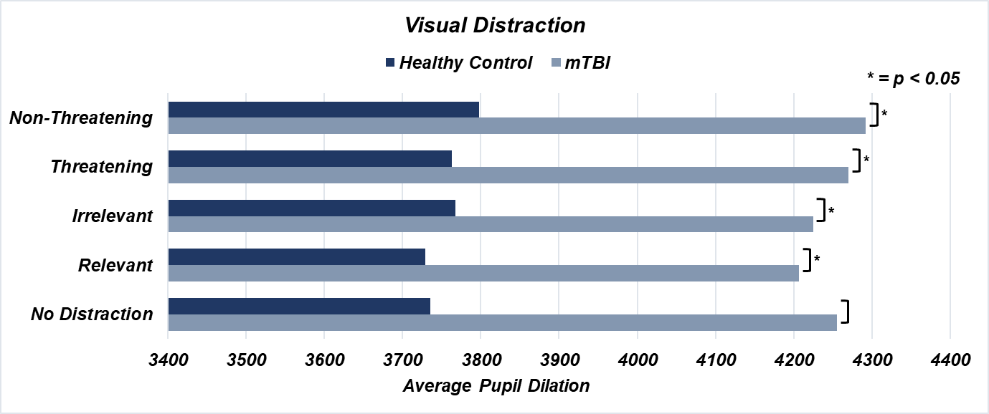
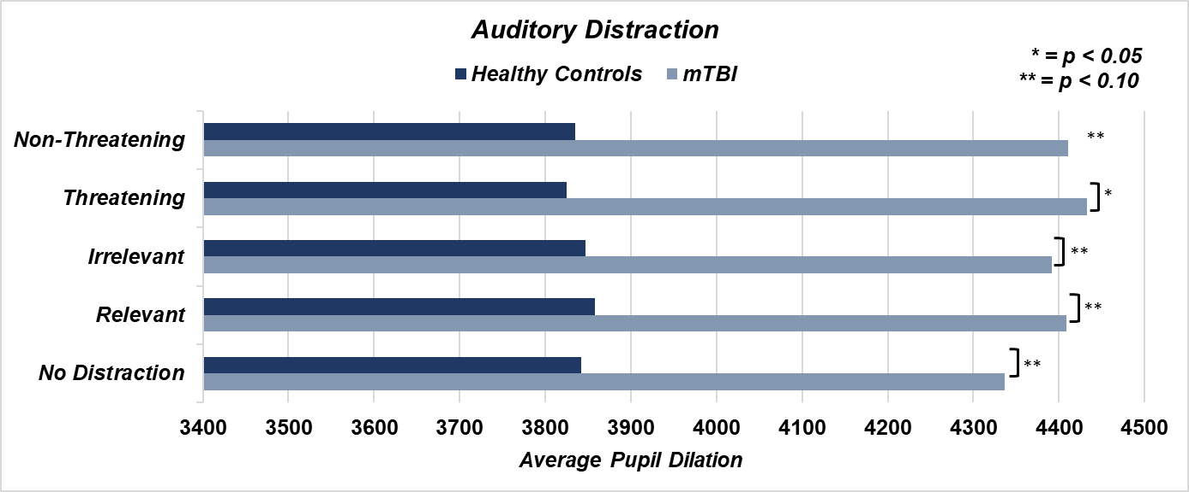
Example
Key Findings
  Significant differences in Pupil dilation at baseline
    mTBI driving significant differences
  No distraction conditions resulted in increase in internal distractions suggesting that “distraction free” conditions do not lower cognitive demand
    Increased irrelevant internal distractions in mTBI group
  Poor perception of facial expressions in mTBI group
*
(Pinnow et al., 2024 (In Progress))

Slide 34
Eye Tracking Methods Considerations
Limitations
  No universal methods
  Lack of TBI data across recovery timepoints
    Difficult to establish normative data
  Not an indicator of perception
  Highly Sensitive
    Influenced by substances, fatigue, emotions, internal thoughts, contacts, glasses, eye color
Alterations to Experimental Set-Up
  Environment
  Complimentary measures
    Pre and post simulation measures (fatigue, TBI symptoms)
    Self-reports, semi-structured questions (between action and recollection)

Slide 35
Eye Tracking Data Analysis
Data Analysis Approaches
  Pre-Processing
  Automated data organization
  Calculating percent change from baseline
  Compare outlier participant data with health history
Indicators of Effort
  Larger Pupil dilation, increased blinks
Indicators of Learning
  Decreases in pupil dilation, average fixation duration, and number of revisits
    Without increases in fatigue and errors
(Adhanom et al., 2023; Fehringer et al., 2021; Negi et al., 2020)
Notes:
Sampling rate 100 – 200 Hz
De-blinking
Binning

Slide 36
Outcome Metric - EEG
Objectively Measuring Brain Function
  Quantifies electrical activity of large populations of neurons using differences in voltage
  Measures brain function at various stages of cognitive processes with millisecond precision
  Methods Fundamentals
    Scalp electrodes (at least three, including ground and reference)
    Resting state or stimulus/task based
    Event trigger integration
Types of EEG Metrics
  Time-based analyses: Event-related potentials (ERPs), evoked potentials
  Frequency-based analyses (spectral analysis): relative and absolute power
  Time-frequency based analyses: phase synchrony and coherence, functional connectivity

Slide 37
EEG
Differences between mTBI and Controls
  Decrease in alpha power
  Increase in theta and beta power
  Increase in frontal asymmetry
  Reduced amplitudes and delayed latencies of event related potentials during attention, working memory, and cognitive control tasks
    Limited resource allocation/resource availability and cognitive slowing

Slide 38
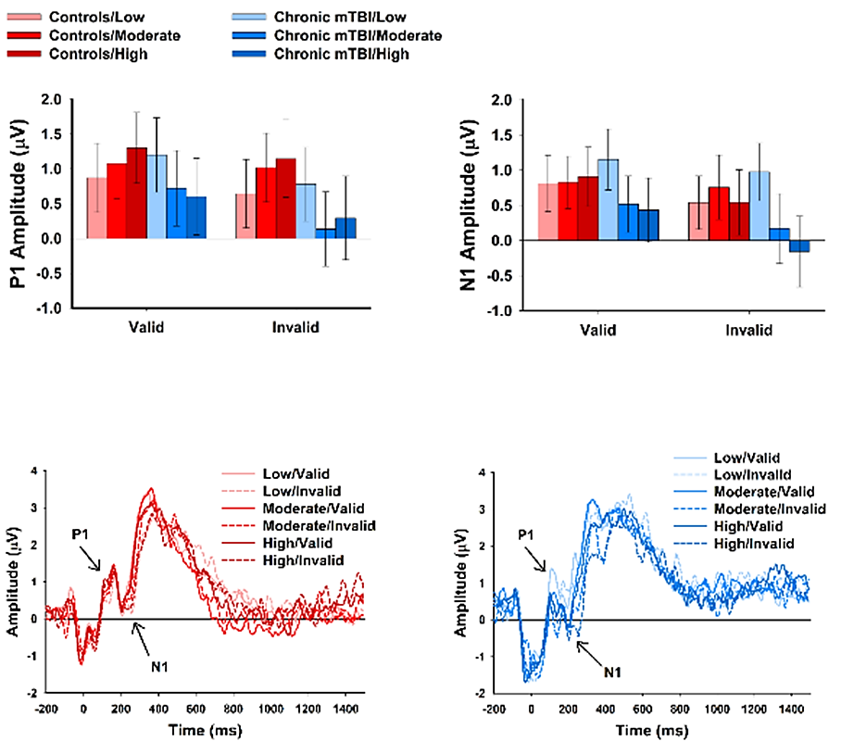
Example
Key Findings
  Patients with remote mTBI do not linearly modulate neural resource allocation in response to higher levels cognitive load
    Asymptotic, all-or-none
  Inhibition of irrelevant stimulus processing and enhancement of relevant stimulus processing
    Exaggerated and plateaued at moderate and high cognitive load levels
    Sustained mental effort needed to maintain normal performance
      Inefficient resource allocation and inability to flexibly modulate neural resources
Notes:
in response to dynamic cognitive demands

Slide 39
EEG Methods Considerations
Limitations
  Variability in findings across studies due to differences in study methods and cognitive tasks
  No consensus on data analysis techniques; highly variable and subjective
  Susceptible to artifacts: muscle activation, heart beats, electrical interference, sweat
  Needs multiple trials per condition
Alterations to Experimental Set-Up
  Adhering electrodes (cap or individually attached); wired or wireless
    Consideration of extra cabling if not wireless
  Stimulus presentation software must deliver event triggers to EEG acquisition software/hardware
    Hardwired connection or sensors (e.g., photo diodes)

Slide 40
EEG Data Analysis
Data Analysis Approaches
  Higher sampling rate = better data
  Signal to noise ratio
    Artifact reduction and removal
Indicators of Effort
  Reduced alpha power and synchronization
Indicators of Learning
  Error-related negativity amplitude (ERP)
  Processing Negativity amplitude (ERP)
  P3 (“P300”) amplitude and latency (ERP)

Slide 41

How can we utilize multimodal data from simulations for enhancing clinical and training decision making?
Image Credit: Microsoft

Slide 42
Translation of Raw Data into Actionable Insights for Clinical Decision Making
We first have to address current challenges
  Triangulation of data
  Predictive capabilities
    Adaptive assessment and training
    Skills + Environments
    Brain health and TBI forecasting
  Provider friendly automated data scoring and interpretation
  Ability to handle large datasets
Then we must apply tools that can integrate holistic brain health data
TBI History

Slide 43
Utilization of Artificial Intelligence and Machine Learning
Medication
Skills Needed
Nutrition
Sleep
Cognition
Mental Health
Individual Goals
Executive Function
Data Analysis & Integration
Predictive Decision Making
Adaptable Assessment & Training
Brain Health Forecasting
Individualized Recommendations
TBI History
Sensor Data
Blast Exposure History
Service Demographics
(Husain et al., 2024)

Slide 44

How could simulation applications be scaled for Healthcare and Training Applications?
Image Credit: Microsoft

Slide 45
Putting It All Together
What needs to be integrated for the warfighter and brain health professionals?
End User Input
Defining Skill
Outcome Metrics
Principles of Neuroplasticity
Simulation Variation
Predictive Modeling
Automated Data Processing and Analysis
Image Credit: Microsoft

Slide 46
Spectrum of Brain Health Professionals Who Would Benefit
Healthcare Fields
Psychology
Neuropsychology
Physical Medicine & Rehabilitation
Training
Athletic Training
Strength and Conditioning
Sports Psychology
Rehabilitation
Speech Therapy
Occupational Therapy
Physical Therapy
Specialists
Behavioral Medicine
(Shazhaev et al., 2023)

Slide 47
End User Demographics
Service Demographics
End User Demographics
Brain Health Symptoms
TBI History
Polytrauma History
Blast Exposure History
Mental Health History
Combat History
Deployment History
Time in Service
Military Occupational Specialty

Slide 48
Simulation Variability – The Key to Neuroplasticity
Environment
Operational, Training, Garrison, Off-Duty
Tasks
Contextually Relevant (Role Specific)
Interactive
Repetitive Practice
Sensation
Haptic Feedback
Fluctuating Modalities and Intensities
Variation Options
Dynamic Assessment and Training (Individual/Team)
Integration of Weapons, Communication, Adversaries
(Shazhaev et al., 2023)

Slide 49

The Road Ahead
Future Opportunities
The way forward for integrative brain health tools is based on emerging technologies, healthcare partners, and warfighter needs:
  Virtual, Extended, and Augmented Realities: headsets, glasses, and screen-based that allows for the inclusion of measurable and meaningful variations within simulated environments
    Enable brain health professionals to target all specified areas of the WBHI | “I see what you are seeing”
    Measure responses to interventions (i.e., mental health, behavioral, rehabilitative)
  Haptic Feedback: integrates tactile (sensorimotor) variation to optimize adaptability, pair cognitive skills with all modalities of sensory inputs, and facilitate adaptive plasticity
  AI and ML: enable adaptive assessment and trailing, automated data analysis and interpretation, identify needed referrals, and forecast recovery outcomes
Image Credit: Microsoft

Slide 50
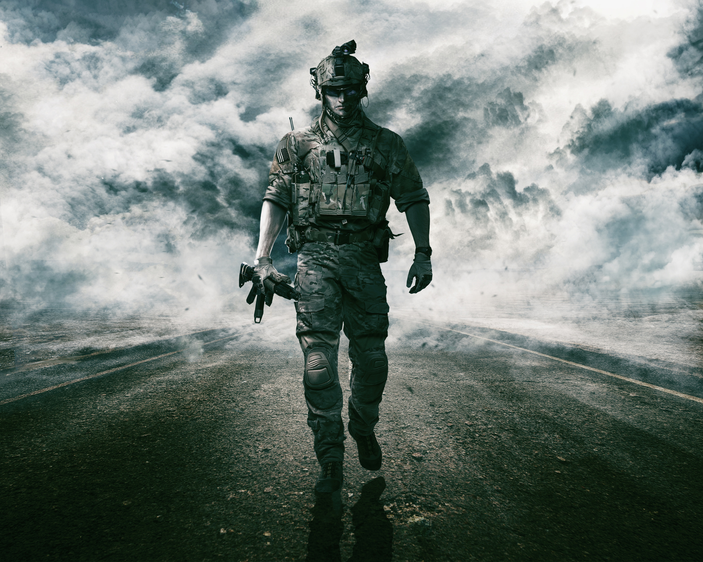
Warfighter Benefits
Holistic and Dynamic Assessment
Integrated Approaches
Individualized Treatment and Training Plans
Enhanced Cognitive Skills
Decreased Recovery Time
Improved Short- and Long-Term Outcomes
Increased Lethality
Career Longevity
Image Credit: Canva

Slide 51
Learning Objectives
By the close of the tutorial attendees will be able to:
Apply knowledge of common TBI symptoms that may influence participants’ cognitive performance in simulation-based environments.
Analyze the potential outcome metrics that can be utilized within simulations for comparative analyses of cognitive performance in active-duty service members with and without a history of TBI.
Evaluate future opportunities for developing simulation-based tools for assessing and enhancing warfighter brain health.
Image Credit: Canva

Slide 52
Contact Information and Q/A
Questions?
deanna.r.pinnow.ctr@health.mil
jamie.n.hershaw.ctr@health.mil

Slide 53
Select References
Adhanom, I.B., MacNeilage, P. & Folmer, E. Eye Tracking in Virtual Reality: a Broad Review of Applications and Challenges. Virtual Reality 27, 1481–1505 (2023). https://doi.org/10.1007/s10055-022-00738-z
Bogdanova, Y., Wethe, J., Sokol, O., Sacks-Zimmerman, A., Schwertfeger, J., Dwyer, B., ... & Bergquist, T. (2024). VR and Computerized Cognitive Rehabilitation for Brain Injury: A Systematic Review. Archives of Physical Medicine and Rehabilitation, 105(4), e149.
Edwards, J. D., Xu, H., Clark, D. O., Guey, L. T., Ross, L. A., & Unverzagt, F. W. (2017). Speed of processing training results in lower risk of dementia. Alzheimer's & Dementia: Translational Research & Clinical Interventions, 3(4), 603-611.
Faria, A. L., Latorre, J., Silva Cameirão, M., Bermúdez i Badia, S., & Llorens, R. (2023). Ecologically valid virtual reality-based technologies for assessment and rehabilitation of acquired brain injury: a systematic review. Frontiers in psychology, 14, 1233346.
Fehringer B. C. O. F. (2021). Optimizing the usage of pupillary based indicators for cognitive workload. Journal of eye movement research, 14(2), 10.16910/jemr.14.2.4. https://doi.org/10.16910/jemr.14.2.4
Graham ID, Logan J, Harrison MB, Straus SE, Tetroe J, Caswell W, et al. Lost in knowledge translation: time for a map? The Journal of continuing education in the health professions [Internet]. 2006. [cited 2019 Apr 7];26(1):13–24. Available from: https://www.ncbi.nlm.nih.gov/pubmed/16557505 doi: 10.1002/chp.4
Jannace, K. C., Pompeii, L., Gimeno Ruiz de Porras, D., Perkison, W. B., Yamal, J. M., Trone, D. W., & Rull, R. P. (2024). Lifetime traumatic brain injury and risk of post-concussive symptoms in the millennium cohort study. Journal of neurotrauma, 41(5-6), 613-622.
Lange, R. T., Brickell, T. A., Lippa, S. M., & French, L. M. (2015). Clinical utility of the Neurobehavioral Symptom Inventory validity scales to screen for symptom exaggeration following traumatic brain injury. Journal of clinical and experimental neuropsychology, 37(8), 853–862. https://doi.org/10.1080/13803395.2015.1064864
Llop, J. Z., Hoover, P. J., Nix, C. A., Lu, L. H., Bowles, A. O., & Caban, J. J. (2023). NSI and PCL-5 Normative Tables for Active Duty Service Members Affected by Traumatic Brain Injury. Military medicine, 188(9-10), 3127–3133. https://doi.org/10.1093/milmed/usac189
Negi, S., & Mitra, R. (2020). Fixation duration and the learning process: an eye tracking study with subtitled videos. Journal of eye movement research, 13(6), 10.16910/jemr.13.6.1. https://doi.org/10.16910/jemr.13.6.1
Section 735(b)(1)(G) of NDAA FY 2023 (Public Law 117–263): “The consideration of the findings and recommendations of the report of the National Academies of Science, Engineering, and Medicine titled “Traumatic Brain Injury: A Roadmap for Accelerating Progress” and published in 2022 (relating to the acceleration of progress in traumatic brain injury research and care), or any successor report, in relation to the activities of the Department relating to brain health, as applicable.”
Shazhaev, I., Mihaylov, D., & Shafeeg, A. (2023). A review of haptic technology applications in healthcare. Open Journal of Applied Sciences, 13(2), 163-174.
Sheehan, R. C., & Vernon, M. (2024). Development of a multidimensional military readiness assessment. Frontiers in Rehabilitation Sciences, 5, 1345505.
Soble, J. R., Silva, M. A., Vanderploeg, R. D., Curtiss, G., Belanger, H. G., Donnell, A. J., & Scott, S. G. (2014). Normative Data for the Neurobehavioral Symptom Inventory (NSI) and post-concussion symptom profiles among TBI, PTSD, and nonclinical samples. The Clinical neuropsychologist, 28(4), 614–632. https://doi.org/10.1080/13854046.2014.894576
Stein, M. B., Ursano, R. J., Campbell-Sills, L., Colpe, L. J., Fullerton, C. S., Heeringa, S. G., Nock, M. K., Sampson, N. A., Schoenbaum, M., Sun, X., Jain, S., & Kessler, R. C. (2016). Prognostic Indicators of Persistent Post-Concussive Symptoms after Deployment-Related Mild Traumatic Brain Injury: A Prospective Longitudinal Study in U.S. Army Soldiers. Journal of neurotrauma, 33(23), 2125–2132. https://doi.org/10.1089/neu.2015.4320

