Slide 1

Mission XRpossible: Navigating Novice-to-Expert Assessment Design in Medical & Military Training
Jeanine A. DeFalco, PhD, University of New Haven
Madeleine Keehner, PhD, Brighter Research

Slide 2
Welcome
In this tutorial, we will:
Explore how XR (immersive, augmented, and mixed reality) can transform high-stakes training programs
Examine effective assessment design for XR training environments
Provide both theoretical knowledge and practical insights
Identify robust assessment strategies for your XR simulations
Who we are:
Dr. DeFalco and Dr. Keehner

Slide 3
Learning Objectives
By the end of this tutorial, you will be able to:
  Identify and use effective assessment design principles for XR
    Know the key components of assessment frameworks
    Understand how to operationalize them in XR training simulations
    Approach XR training and assessment from a Learning Engineering perspective
  Apply data collection methods in XR to infer learner progression
    Specify evidence of proficiency development in medical or military contexts
    Evaluate data about learners derived from different tools and techniques
  Integrate learning and assessment in XR to achieve formative goals
    Use XR-based simulations to provide individualized, actionable feedback
    Produce information that is useful to learners, instructors, and training developers
    Tailor formative XR learning experiences to expedite learner progression

Slide 4
The Assessment Context

Slide 5
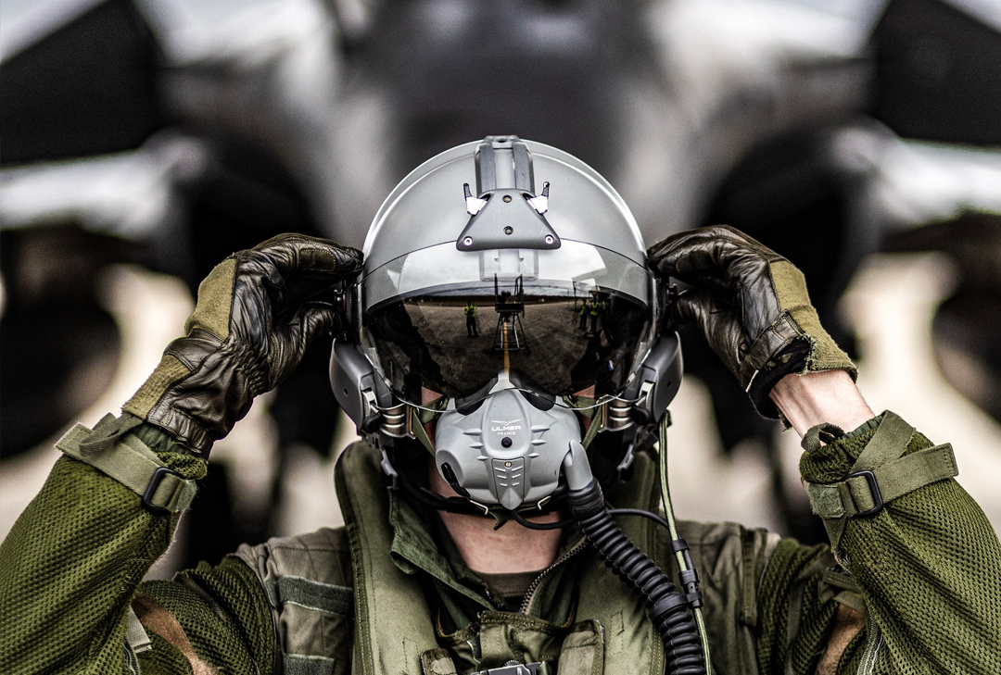
Measuring for Deterrence
Measuring to Ensure Deterrence of Challenges and Success of the Mission
  Considerations for effective measurement in this high-stakes context:
    Assessment of capabilities
    Readiness evaluation
    Strategic alignment
    Performance metrics
    Simulated threats and challenges
    Feedback and improvement
Notes:
Talking points: Effective training is the backbone of mission success and operational readiness.
In high-stakes environments, such as the military, ensuring that personnel are adequately prepared to face challenges is paramount.
Measuring training effectiveness is critical to ensure that deterrence of challenges and mission success are achieved.

Slide 6
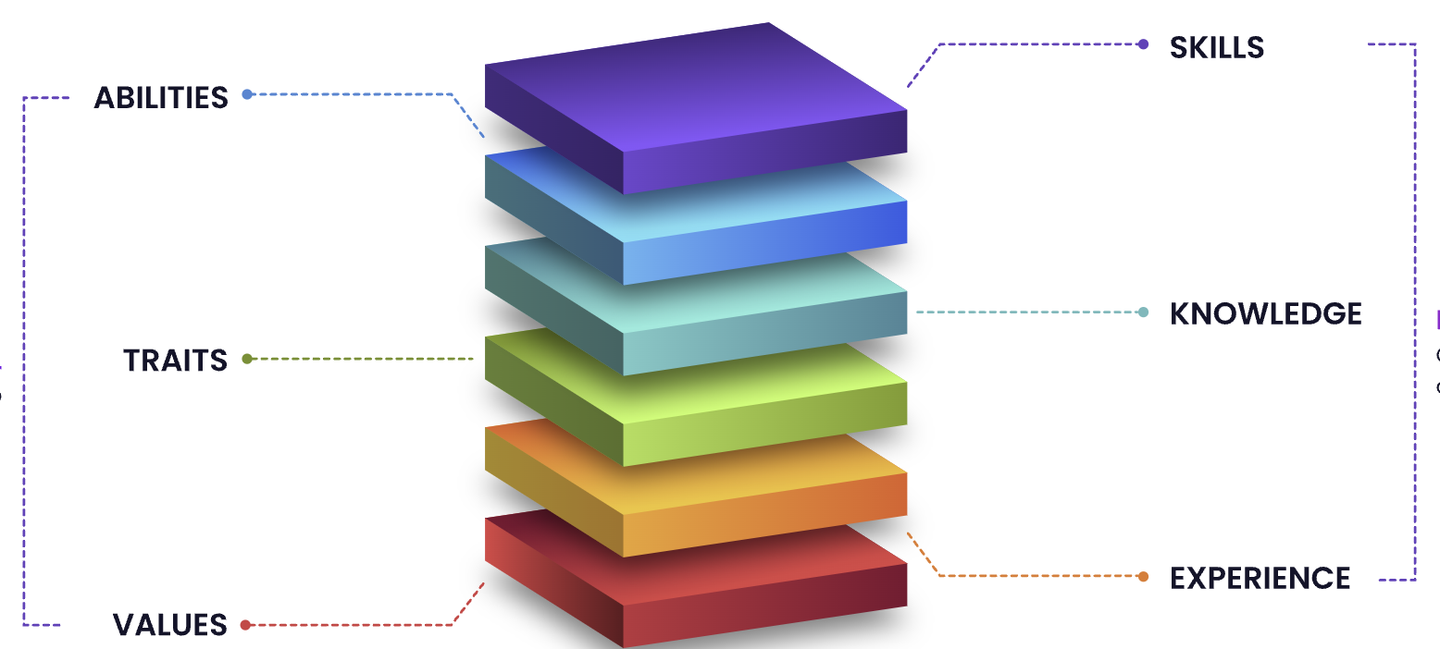
Assessment of Capabilities
The primary goal of training assessments:
  Determine efficacy of training
  Measure learning gains
  Identify gaps
Requires:
  Evaluation of the competencies required for various roles and tasks.
Assessments should be designed to
  Measure both individual and team capabilities,
  Ensure that all personnel are equipped to perform under pressure.

Slide 7

Assessment of Capabilities
Effective capability assessment includes:
  Skill Proficiency Tests: Evaluating technical and tactical skills through standardized tests.
  Scenario-Based Evaluations: Using realistic scenarios to test decision-making and problem-solving abilities.
  Performance Reviews: Regular reviews of performance during training exercises to identify strengths and areas for improvement.

Slide 8

Readiness Evaluation
Readiness evaluation involves:
  Gauging the preparedness of trainees
  Determining ability to be deployed quickly and respond promptly to various situations.
This is particularly critical in the military, where the ability to mobilize swiftly can mean the difference between mission success and failure.

Slide 9
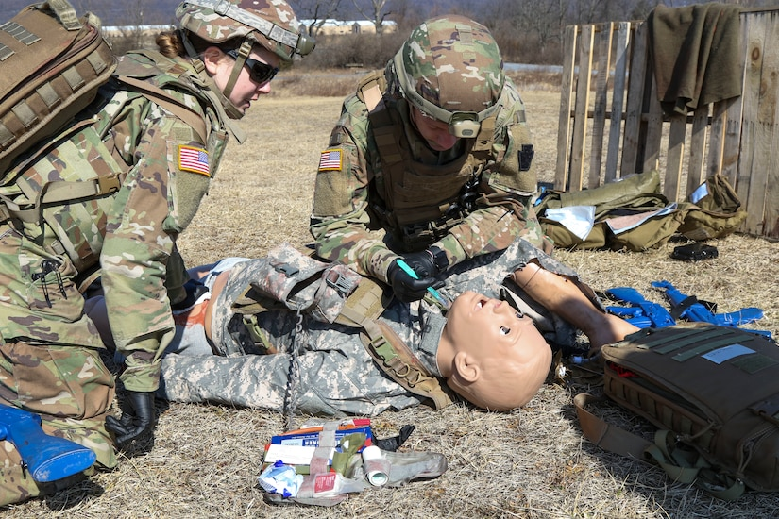
Readiness Evaluation
Key components of readiness evaluation include:
  Deployment Drills: Simulating rapid deployment scenarios to test the speed and efficiency of troop mobilization.
  Crisis Response Exercises: Conducting exercises that mimic real-world crises to evaluate response times and effectiveness.
  Readiness Metrics: Developing metrics to quantify readiness levels, such as response time, accuracy of actions, and resilience under stress.

Slide 10

Strategic Alignment
Training objectives must align with strategic deterrence goals:
  Maintaing a strong, visible presence
  Discouraging adversaries and prevent mission failures
This alignment ensures that training programs are:
  Effective in skill development
  Contribute to broader strategic objectives.

Slide 11
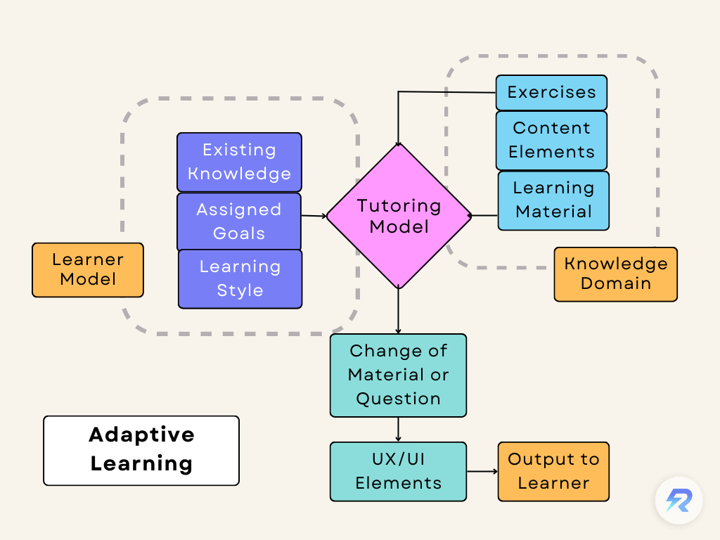
Strategic Alignment
Strategic alignment involves:
  Mission-Focused Training Objectives: Setting training goals that support overall mission objectives and strategic priorities.
  Consistency with Doctrine: Ensuring that training methods and content are consistent with established military doctrines and strategies.
  Adaptive Training: Designing training that can evolve in response to changing strategic needs and emerging threats.

Slide 12

Performance Metrics
To evaluate training outcomes, specific performance metrics are utilized.
These metrics provide quantifiable data on various aspects of training, allowing for objective assessment and continuous improvement.
Important performance metrics include:
  Speed of Response
  Mission Success Rates
  Adaptability (new and unexpected scenarios)

Slide 13

Simulated Threats and Challenges
Incorporating realistic scenarios in training exercises is essential:
  simulating potential threats
  assessing how well military personnel can identify and neutralize them.
Mirrors real-world conditions.
Examples of simulated threats include:
  Combat Scenarios
  Disaster Response

Slide 14
Simulation Modalities
VR, AR, MR – Extended Reality (XR) technologies for learning

Slide 15
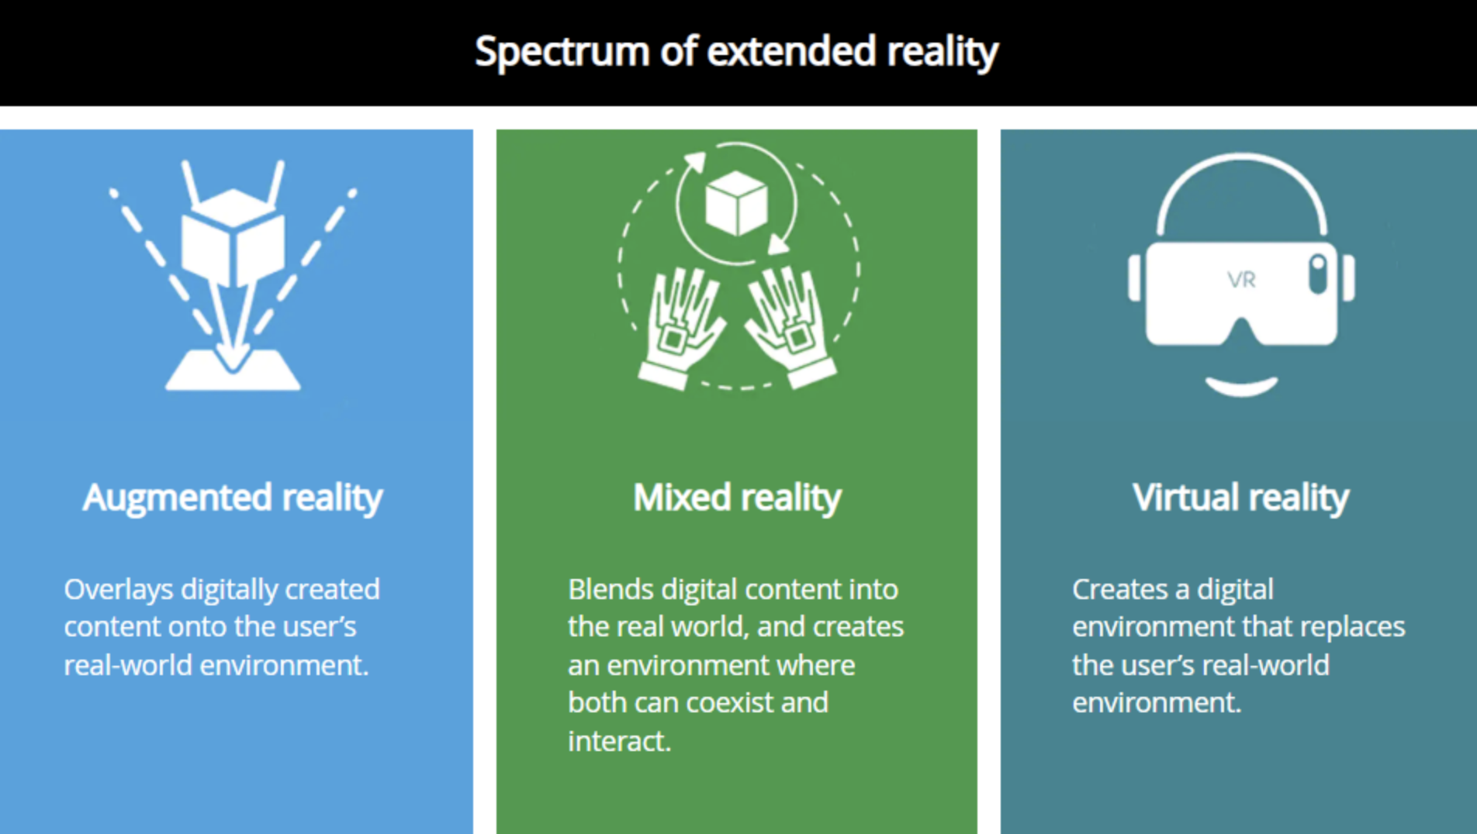
Virtual Reality, Augmented Reality, Mixed Reality
Simulated reality offers numerous advantages for training:
  where realism, safety, and repeatability are critical
Simulated and partially-simulated reality modalities include:
  Immersive Virtual Reality (VR)
  Augmented Reality (AR)
Collectively, these modalities are referred to as Extended Reality (XR)

Slide 16

VR
Immersive Virtual Reality
  VR is a fully virtual environment that completely surrounds the user
  Pros:
    Good for total immersion and isolation from the real world.
    Allows high level of control and standardization of the training. Can simulate complex, dangerous, or rare situations.
    Enables detailed tracking of user movements and interactions with virtual objects.
  Cons:
    Can be expensive to develop and maintain ($15,000 - $300,000 per simulation).
    May cause motion sickness or discomfort in some users.
    Often limited in adaptive functionality.
    Limited transfer of learning to real world environments.

Slide 17
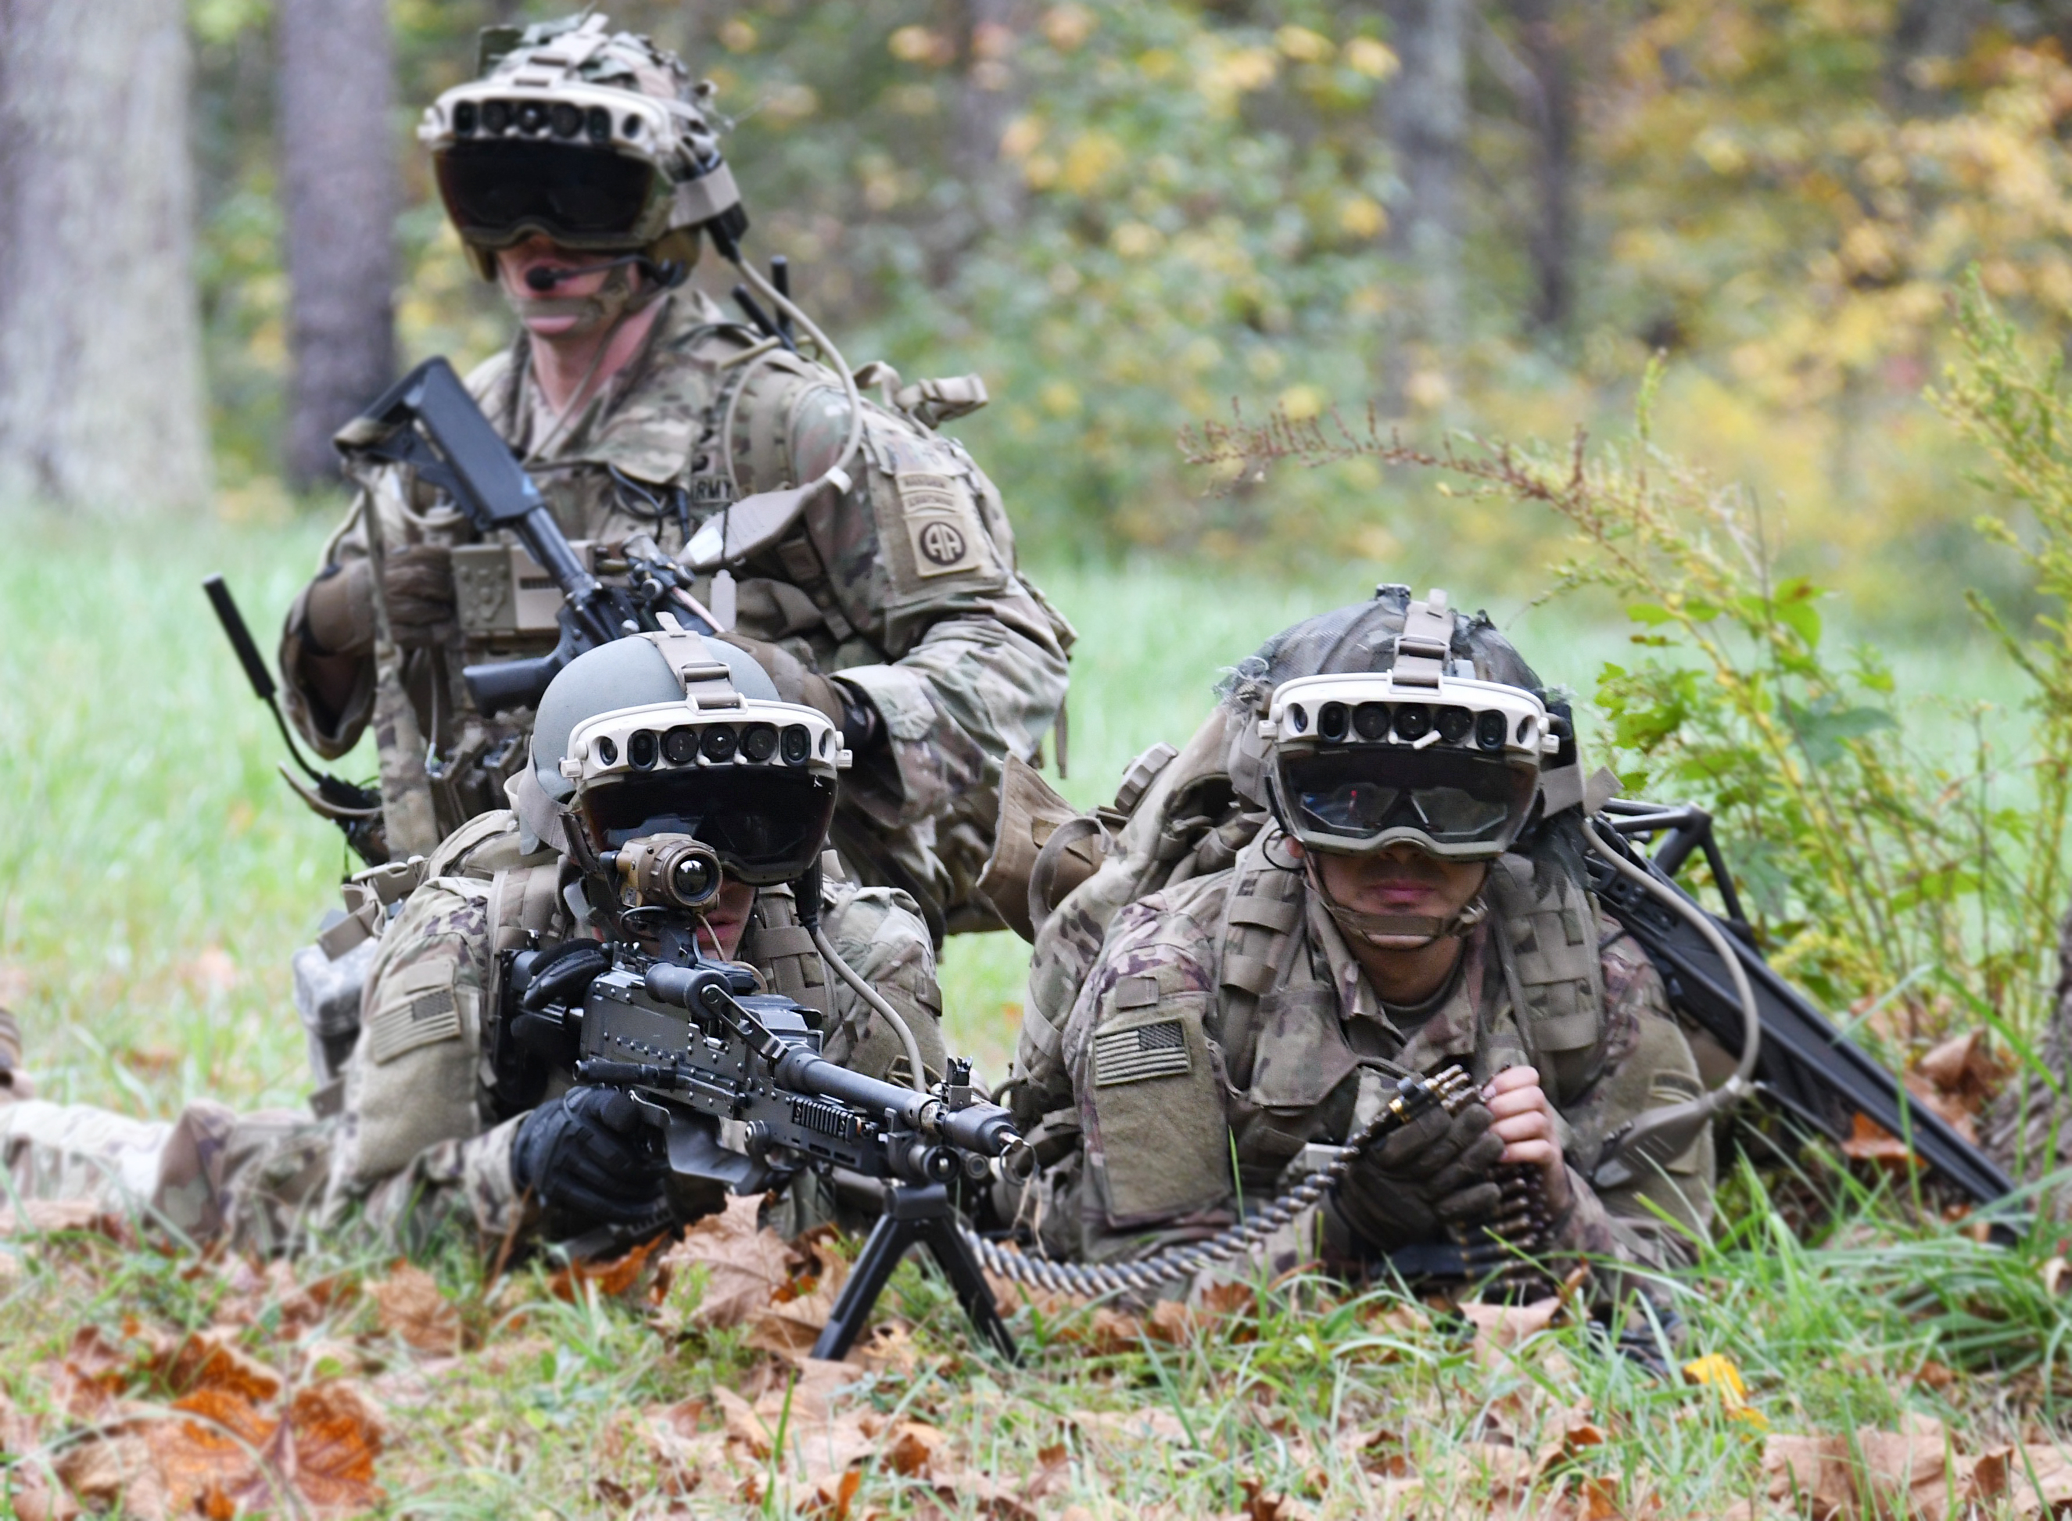
AR
Augmented Reality
AR overlays virtual elements onto the real world
Pros:
  Blends real and virtual elements.
  Enhances perception of, and interaction with, physical environment.
  Bridges the gap between theory and practice in the field.
  Allows for contextual learning and practice in real-world settings.
Cons:
  Limited by the physical environment in which it is used.
  Virtual elements may not always align perfectly with real-world objects.
  Requires robust tracking and calibration systems.
  Costs ($15,000 - $200,000 per simulation).

Slide 18
Learning with XR
Assessments within XR environments are crucial for ensuring that training programs are effective and that learners are acquiring the necessary skills and knowledge.
However, XR assessments come with unique complications, such as:
  Ensuring the fidelity and authenticity of simulations
  Capturing accurate performance data
  Providing meaningful feedback in a virtual context
Overcoming these challenges is essential for leveraging the full potential of DR in training.
  We advocate for adopting the Learning Engineering approach to assessment design for XR.

Slide 19
Learning Engineering
What it is and why this approach is valuable

Slide 20
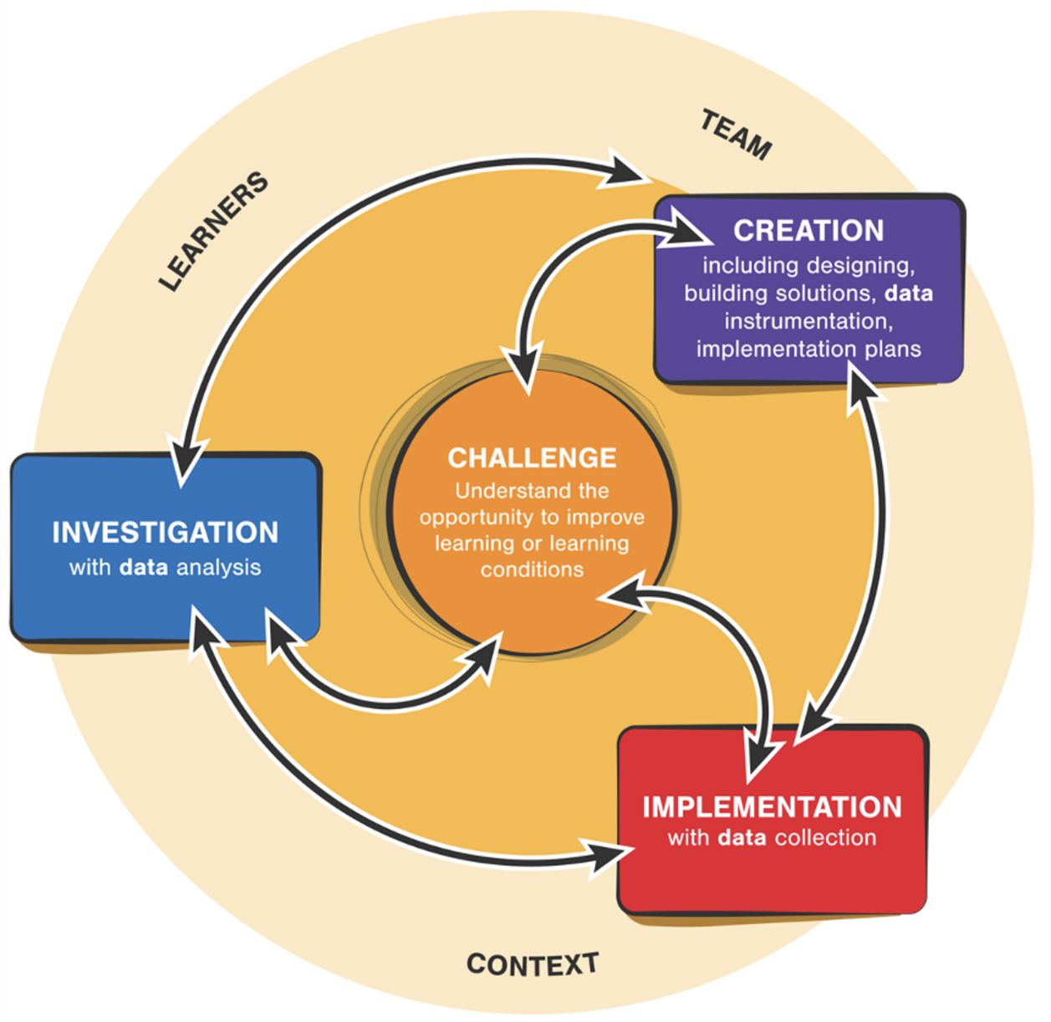
Learning Engineering for VR
Learning Engineering Cycle
Image: Kessler, A. (2022).

Slide 21

Learning Engineering for VR
In implementing the Learning Engineering processes, we begin by identifying the CHALLENGE element of this process as one that requires research and analysis on the competencies necessary to move novice to expert for an inclusive adult learner population.
Initial competency research is aligned with the INVESTIGATION effort of the Learning Engineering process.
This research informs developing a baseline competency assessment to leverage the design of a simulations, that would be the first step in the CREATION cycle.
Image: Kessler, A. (2022).

Slide 22
Learning Engineering for VR
Baseline assessments can then be used an adaptive engine in the VR/AR environment in two ways: as a pre-assessment and as a real-time assessment.
The pre-assessment could be in the form of a dialogue between the learner and the pedagogical agent before the learning activities began in the simulation.
For the real-time assessment, the assessment would be used to identify what performance data is relevant to drive the personalized learning experiences for adult learners in data science training simulations.
This would represent the IMPLEMENTATION part of the Learning Engineering cycle.
Image: Kessler, A. (2022).

Slide 23
Learning Engineering Life Cycle
Implementation and Continuous Improvement in Learning Engineering Life Cycle
Finally, the insights gained from data analysis should be implemented into the XR training program to enhance its effectiveness. This involves:
  Feedback Loops: Providing trainees with actionable feedback based on analysis results.
  Curriculum Adjustments: Updating training scenarios and materials based on identified strengths and weaknesses.
  Continuous Monitoring: Regularly collecting and analyzing data to ensure continuous improvement of the training program.

Slide 24
Validity
How to design assessment tasks to validly measure key competencies

Slide 25
Assessment Types and Uses
Core goals of assessment:
To make valid claims about what a learner knows and can do based on observable evidence
  Knowledge, skills, aptitudes (KSAs)
Different types of assessment
EPA based
Competency based
Performance based
Norm referenced
Different uses of assessment
  Formative or Summative
  High stakes or Low stakes
  Real time or delayed reporting
  Feedback, credentialing/badging
All assessments depend on evidence

Slide 26
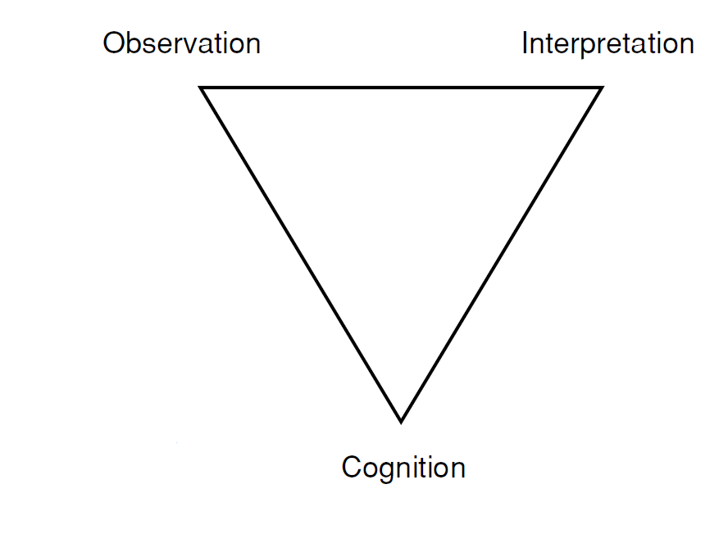
The Assessment Triangle (NRC, 2001)
The observation corner represents the kinds of tasks or situations that will prompt learners to say, do, or create something that demonstrates important knowledge and skills
The interpretation corner expresses how observations derived from the tasks constitute evidence about the knowledge and skills being assessed. This can include analytics and scoring
The cognition corner is a theory, model, or set of beliefs about how learners represent knowledge and develop competence in a domain, which is needed to identify the set of knowledge and skills that are important to measure for the task at hand
Notes:
National Research Council. 2001. Knowing What Students Know: The Science and Design of Educational Assessment. Washington, DC: The National Academies Press. https://doi.org/10.17226/10019.
Connections Between Cognition and Observation. A cognitive theory of
how people develop competence in a domain provides clues about the
types of situations that will elicit evidence about that competence. Conversely,
a well-developed knowledge base about the properties and
affordances of tasks—what does and does not work to reveal what students
know and can do—helps the assessment designer anticipate the types of
knowledge and skills likely to be elicited by tasks with certain features.
When the knowledge derived from both perspectives is combined, relevant
information about student performance is more likely to be collected through
assessment tasks.
Connections Between Cognition and Interpretation. A cognitive theory
of how people develop competence in a domain also provides clues about
the types of interpretation methods that are appropriate for transforming the
data about student performance into assessment results. The cognitive theory
suggests aspects of knowledge and skills by which we want to characterize
students. Conversely, a familiarity with available measurement models provides
a set of experience-tested methods for handling thorny and often subtle
issues of evidence.
Connections Between Observation and Interpretation. Knowing the possibilities
and limitations of various interpretation models helps in designing
a set of observations that is at once effective and efficient for the task at
hand. The interpretation model expresses how the observations from a given
task constitute evidence about the performance being assessed as it bears
on the targeted knowledge. It is only sensible to look for evidence one
knows how to reason from or interpret.

Slide 27

Evidence Centered Design for Assessment
What claims do you want to make?
What evidence types will work?
How can you elicit the evidence?
Competency Model
Evidence Models
Task Models
Stat
Evidence
Scoring and reporting
Mislevy et al. (2012)
model
Rules
Features
1.
xxxxx
2.
xxxxx
3.
xxxxx
XR simulations can be designed to:
Elicit evidence of competencies
Capture evidence automatically
Adapt and respond in real-time
Design XR sims using ECD principles and you can connect evidence to competencies
Keehner, Arslan, & Lindner (2023)
Keehner, Gorin, Feng, & Katz (2016)
Image created with assistance of DALL·E 2
Notes:
Decide what you want to assess and how (formative, summative, integrated learning and assessment, adaptive assessment)
Build a competency model that makes explicit the competencies you’ll be measuring and how performance looks at different levels
Identify observable evidence of competencies at different levels
Design tasks to elicit evidence that you can score and clearly connect to competencies in reporting because you have a competency model
Gather the people you’ll need if you want to do real-time adaptive
Gather validity evidence for your scores by comparing with experts
Iterate with stakeholders on scoring and reporting so they understand and trust the results

Slide 28
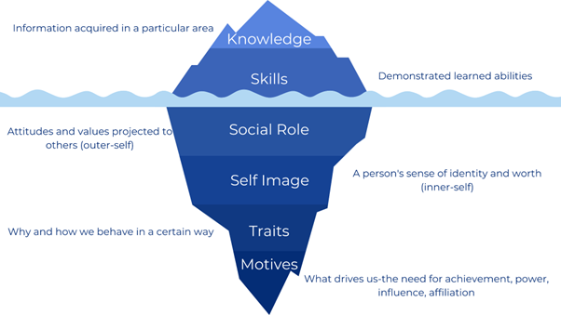
Evidenced Centered Design Principles
Competency Model
  The competency model is a crucial component that defines the skills, knowledge, and abilities that trainees must demonstrate.
  Developing a robust competency model involves several steps and considerations.

Slide 29
Evidence Centered Design Principles
Detailed Development of a Competency Model:
  Industry and Role Analysis:
    Conduct thorough research to identify the core competencies required in the industry or role. For example, in military training, competencies might include strategic thinking, physical endurance, and tactical execution.
  Consultation with Experts:
    Engage with subject matter experts to validate the identified competencies and ensure they are comprehensive and relevant.
  Benchmarking and Standards:
    Compare with industry standards and benchmarks to ensure the competencies align with recognized best practices and regulatory requirements.
  Iterative Review and Refinement:
    Continuously review and refine the competency model based on feedback and emerging industry trends.

Slide 30
Evidenced Centered Design Principles
Application of the Competency Model in XR Assessments:
  Scenario Design:
    Use the competency model to design XR scenarios that require trainees to demonstrate the identified competencies.
    For instance, a competency in tactical execution could be assessed through a complex mission simulation.
  Assessment Criteria:
    Develop specific criteria for each competency, detailing the behaviors and outcomes that indicate proficiency. This ensures assessments are objective and consistent.

Slide 31
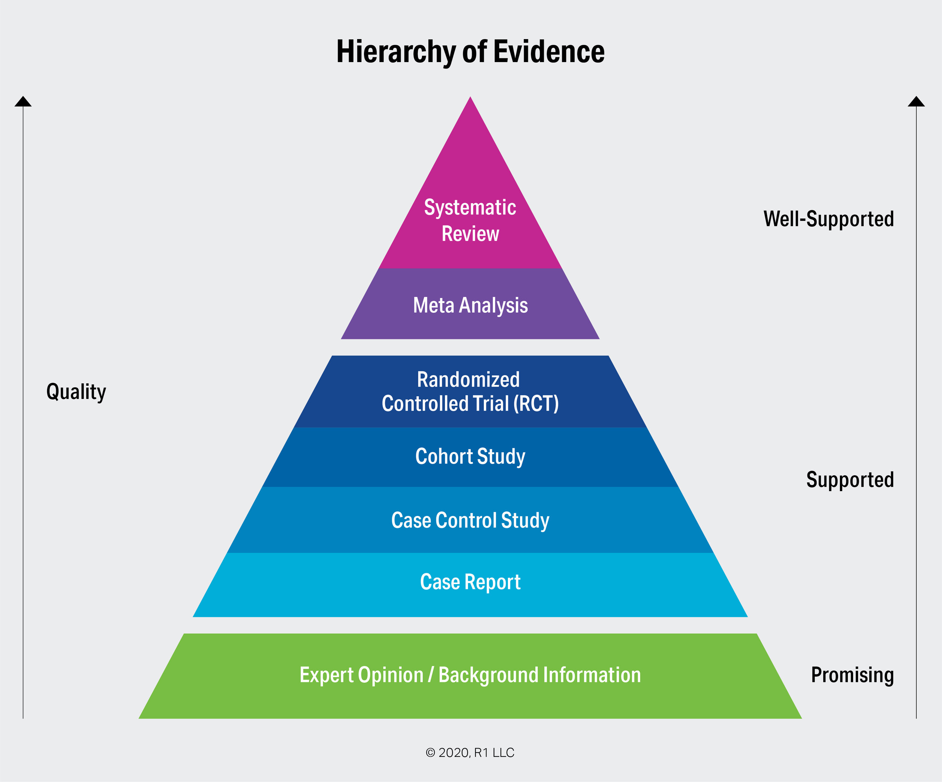
Evidenced Centered Design Principles
Evidence Model
  The evidence model specifies the types of evidence needed to support claims about trainees' competencies.
  Creating an effective evidence model involves identifying relevant evidence and establishing criteria for its evaluation.

Slide 32
Evidenced Centered Design Principles
Detailed Creation of an Evidence Model:
  Identify Evidence Sources:
    Determine the sources of evidence that can provide valid and reliable information about competencies. T
    his could include performance data from VR simulations, observational notes from instructors, and feedback from peers.
  Define Evaluation Criteria:
    Establish clear criteria for evaluating the evidence, ensuring it is comprehensive, relevant, and accurate.
    For example, criteria for evaluating decision-making might include the rationale behind decisions, timeliness, and outcomes.
  Link Evidence to Competencies:
    Map each piece of evidence to specific competencies and proficiency levels,
    ensuring there is a clear and direct connection between the evidence collected and the claims about trainees' abilities.

Slide 33

Evidenced Centered Design Principles
Implementation of the Evidence Model in XR Assessments:
Data Collection:
  Use XR technology to collect detailed data on trainees' performance.
  This could include tracking movements, actions, and decisions within the XR environment.
Analysis and Interpretation:
  Analyze the collected data to evaluate trainees' competencies against the established criteria.
  Use statistical methods and qualitative analysis to interpret the results and provide meaningful insights.

Slide 34
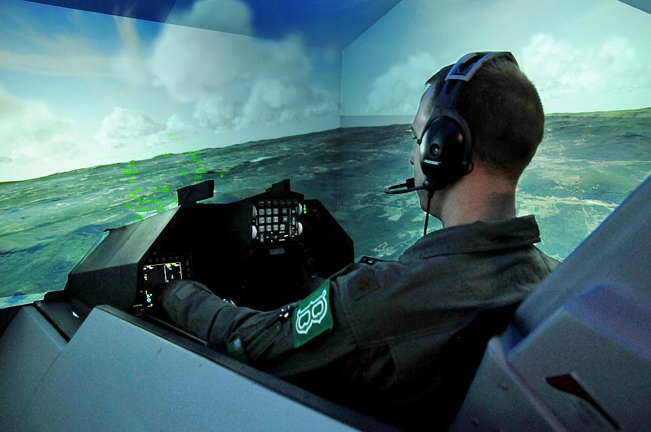
Task Model
Task model:
  Describes the tasks or activities that will elicit the necessary evidence from trainees
  Designed creating realistic, relevant, and challenging tasks
  Aligned with the competency and evidence models.

Slide 35
Evidenced Centered Design Principles
Detailed Design of Task Models:
  Develop Realistic Scenarios:
    For VR, create scenarios that mimic real-world tasks and challenges, ensuring they are relevant to the competencies being assessed.
    For example, a task model for medical training might involve a multi-patient emergency scenario.
  Specify Task Parameters:
    For AR and MR, define the parameters for each task, including duration, complexity, and conditions for performance.
    This ensures consistency and fairness in assessments.
  Include Variability:
    Design tasks that include variability to challenge trainees and test their adaptability.
    For instance, a military training task might involve unexpected changes in the mission environment.

Slide 36
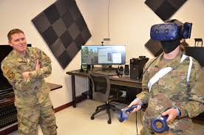
Evidenced Centered Design Principles
Application of Task Models in XR Assessments:
  Scenario Implementation:
    Implement the task models in the XR environment, ensuring they are interactive and engaging.
    For VR technology, create immersive experiences that fully engage trainees.
  Performance Monitoring:
    Continuously monitor trainees' performance during the tasks.
    Collect detailed data on their actions, decisions, and outcomes.

Slide 37
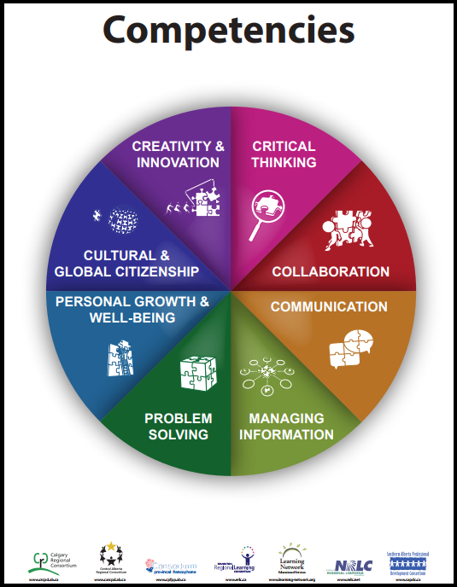
Defining Competencies & Proficiency
Defining competencies and proficiency levels is essential for setting clear expectations and benchmarks for performance.

Slide 38
Defining Competencies
Steps for Defining Competencies:
  Conduct Job Analysis:
    Perform a detailed analysis of the job roles and tasks to identify the key competencies required.
    This involves understanding the skills, knowledge, and abilities needed for successful performance.
  Engage Stakeholders:
    Involve stakeholders, such as industry experts, trainers, and trainees, in the process to ensure the competencies are comprehensive and relevant.
  Use Action-Oriented Language:
    Define competencies using action-oriented language that clearly describes the behaviors and actions expected.
    For example, "demonstrates effective decision-making under pressure" rather than "good decision-maker."
  Ensure Measurability:
    Ensure that each competency is measurable, with clear criteria for evaluating performance.
    This facilitates objective and consistent assessments.

Slide 39
Defining Proficiency
Creating Proficiency Levels:
  Establish Clear Benchmarks:
    Define clear benchmarks for each proficiency level, such as novice, intermediate, advanced, and expert.
    Each level should have specific criteria that describe the expected performance.
  Describe Performance Expectations:
    Outline the specific behaviors, actions, and outcomes expected at each proficiency level.
    For example, an expert level in surgical training might involve performing complex procedures with minimal supervision and high precision.
  Use Consistent Language:
    Use consistent language across all proficiency levels to ensure clarity and comparability.
    This helps trainees understand the progression and what is required to advance.

Slide 40
ASSESSMENT DESIGN
How to apply these principles in the design of XR-based assessment

Slide 41
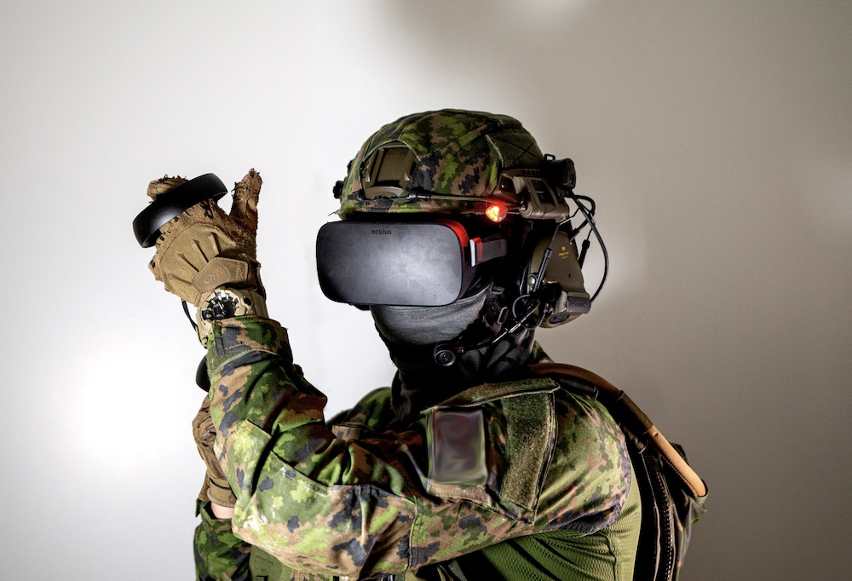
XR Assessment Design
XR assessment design involves creating assessments that leverage the unique capabilities of XR technology.
These assessments should be immersive, interactive, and capable of capturing detailed performance data.

Slide 42

XR Assessment Design
Principles of XR Assessment Design:
  Immersiveness: Create fully immersive environments that simulate real-world scenarios.
    Utilize high-quality graphics, realistic sounds, and interactive elements to enhance the immersive experience.
    For example, in a medical training VR simulation, the environment should include accurate representations of medical equipment, patient anatomy, and hospital settings.

Slide 43
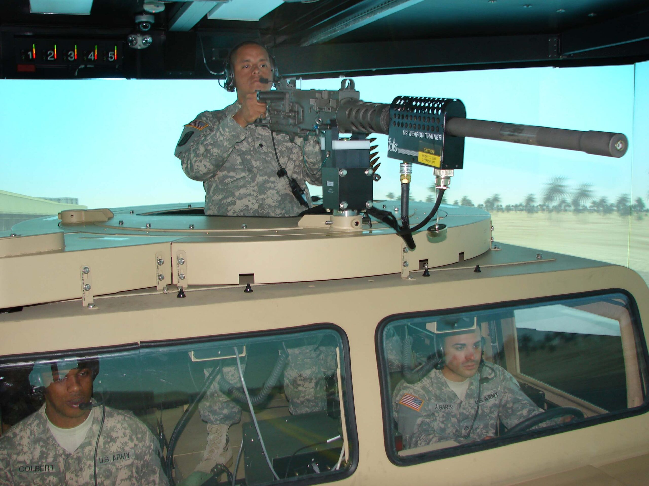
XR Assessment Design
Principles of XR Assessment Design:
Interactivity: Design interactive tasks that require active engagement from trainees.
  This could include hands-on activities, decision-making scenarios, and real-time feedback.
  For instance, a military VR or AR simulation might involve interactive combat scenarios where trainees must make split-second decisions and coordinate with team members.

Slide 44
XR Assessment Design
Principles of XR Assessment Design:
  Data Capture:
    Use XR technology to capture detailed performance data, including movements, actions, and decisions.
  This data can be used to assess competencies such as:
    reaction time
    accuracy
    decision-making skills

Slide 45
Modalities for Data Extraction
  Advanced data capture techniques:
    Eye tracking (attentional focus)
    Galvanized skin response (emotional arousal and stress)
    Motion tracking
    Natural Language/Dialogue and Understanding
      Voice biomarkers (affect and stress detection)

Slide 46

Physiological Responses
Applications of Physiological Data:
  Attention Tracking: Evaluating where trainees focus their attention during simulations to ensure they are observing critical elements.
  Stress and Anxiety Monitoring: Assessing how trainees respond to stressful scenarios and identifying areas where additional support may be needed.
  Engagement Measurement: Measuring physiological indicators of engagement to assess how immersed and involved trainees are in the training.

Slide 47
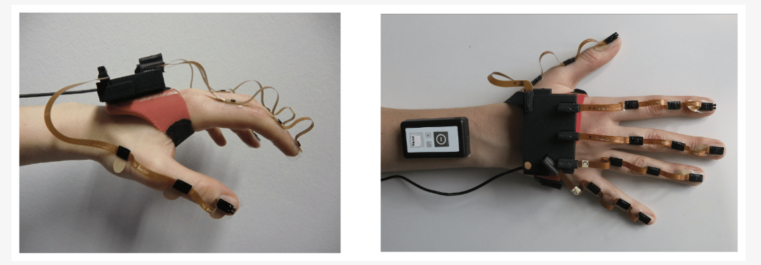
Motion Tracking
Applications of Motion Tracking:
  Analyzing Movement Patterns: Evaluating how trainees move through simulations, including their speed, accuracy, and efficiency.
  Assessing Physical Skills: Tracking specific movements, such as hand-eye coordination or fine motor skills, to assess proficiency
  Identifying Errors: Detecting and analyzing errors in movements or actions to provide targeted feedback.

Slide 48
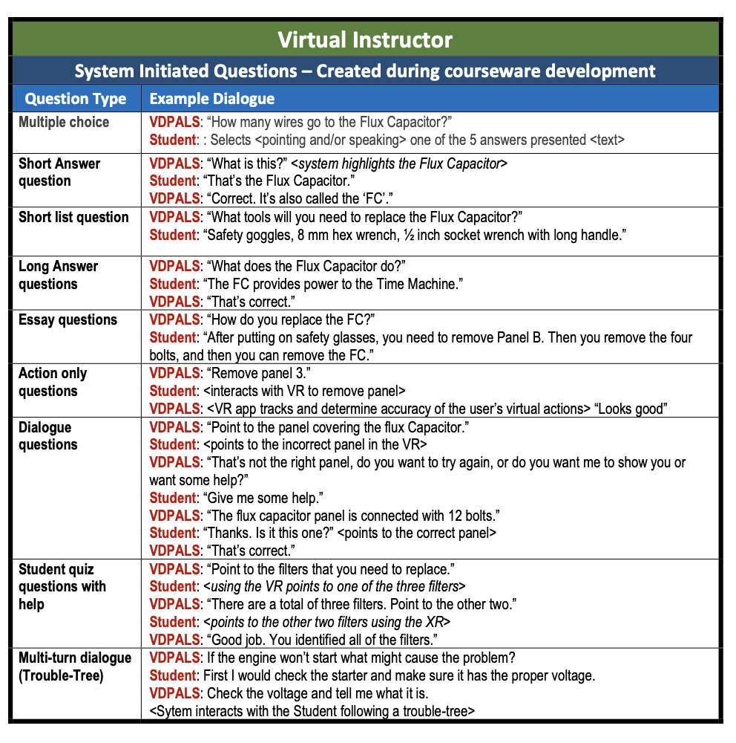

NLP
Natural Language/Dialogue and Understanding
  Voice biomarkers (affect and stress detection)
  Understanding what people said; NLP helps you understand what they meant

Slide 49
Machine Learning Analyses
Data Collection
The first step in analyzing XR training data is to collect comprehensive and high-quality data from the simulations. This includes:
  Performance Metrics: Accuracy, completion times, error rates, etc.
  Motion Tracking Data: Movements, gestures, and postures.
  Physiological Data: Heart rate, skin conductance, and eye tracking.
  Environmental Context: Details about the XR environment and scenarios.
  Interaction Data: User interactions with XR elements and decision-making processes.

Slide 50
Interaction Analysis
Applications of Interaction Analysis:
  Tool Usage:
    In a XR medical simulation, analyzing how trainees handle surgical instruments can highlight their proficiency and areas for improvement in dexterity and technique.
  Interface Navigation:
    Evaluating how efficiently trainees navigate through XR interfaces, such as control panels or medical charts, to ensure they can quickly access and utilize necessary information.
  Avatar Interaction:
    Observing interactions with virtual teammates or patients to assess communication skills, teamwork, and empathy.
    For example, in a military training simulation, analyzing how well trainees coordinate with their virtual squad members.

Slide 51
AI-Driven Scoring and Metrics
Open-ended sims can produce many different behavior patterns – how do we use AI to make sense of these?
Vendlinski & Stevens (2000)
Unsupervised algorithm
Identified clusters of learners with similar patterns of interaction behaviors
Supervised algorithm
Used labeled training data to characterize the ways in which the clusters differed
Inferences
Explainable and actionable inferences about learners
Competency model
Bottom-up data-driven metrics may not have explainability (or construct validity)
A competency and evidence model can provide structure for supervised learning algorithms
Reported scores can then be traced back to constructs and competencies
  Helps stakeholders understand scores and metrics
  Realtime feedback can connect to learning goals
The NBME (National Board of Medical Examiners) have taken a hybrid approach to scoring with AI

Slide 52
DESIGN CONSIDERATIONS
What it is and why this approach is valuable

Slide 53
Unique Considerations
Fidelity
  Fidelity refers to the realism and accuracy of the XR environment.
  High-fidelity simulations closely mimic real-world conditions, enhancing the relevance and impact of training.
Enhancing Fidelity:
  High-Quality Visuals:
    Use photorealistic graphics and detailed textures to create lifelike environments.
  Realistic Soundscapes:
    Incorporate spatial audio and realistic sound effects to enhance immersion.
  Accurate Physics and Dynamics:
    Ensure that the physics and dynamics of the XR environment accurately replicate real-world interactions, such as the weight and movement of objects.

Slide 54

Unique Considerations
Authenticity
  Authenticity ensures that the XR scenarios are relevant and applicable to real-world tasks and challenges.
  Authentic scenarios increase the transfer of learning from the virtual environment to real-life situations.

Slide 55
Unique Considerations
Ensuring Authenticity:
  Contextual Relevance: Design scenarios that reflect the actual context in which trainees will operate.
    For example, a medical VR simulation should replicate the layout and equipment of a real hospital ward.
  Expert Validation: Involve subject matter experts in the design and validation of VR scenarios to ensure they are realistic and relevant.
  Cultural and Environmental Factors: Consider cultural and environmental factors that may influence the scenario.
    For instance, a military AR simulation might be used in a specific terrain and climate conditions relevant to a particular operational area.

Slide 56
NOVICE TO EXPERT
What it is and why this approach is valuable

Slide 57
Measuring Novice-to-Expert Progression
Qualitative Metrics: Qualitative metrics provide descriptive data that offer insights into trainees' decision-making processes, behaviors, and attitudes.
  Decision-Making Analyses:
    Evaluations of how trainees make decisions during simulations, including the rationale behind their choices.
    For example, analyzing the decision-making process of a trainee during a military strategy simulation.
  Observational Data:
    Notes and feedback from instructors or peers on trainees' performance and behaviors.
    This might include observations on communication skills, teamwork, and adherence to protocols.

Slide 58
Measuring Novice-to-Expert Progression
Quantitative Metrics: Provides numerical data that can be analyzed to track trainees' progress and performance.
  Performance Metrics: Measures such as accuracy, completion time, and error rates.
    For example, tracking how quickly and accurately a trainee can complete a medical procedure in an AR simulation.
  Time Metrics: Data on how long it takes trainees to complete tasks or respond to scenarios.
    This can be used to assess efficiency and reaction times.
  Scoring Systems: Numerical scores that reflect overall performance on assessments.
    These can be aggregated to provide a comprehensive view of a trainee's progress.

Slide 59
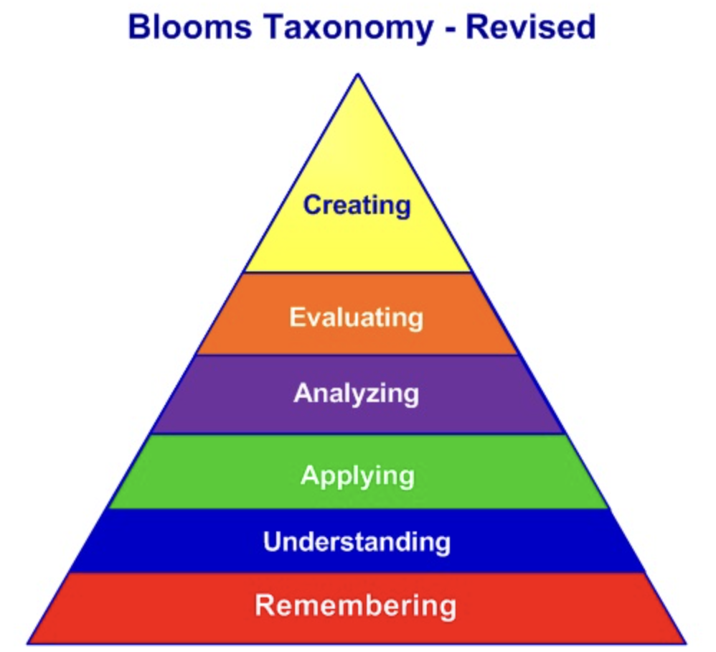
Novice to Expert
Most simulations tend to evaluate on knowledge mastery or skill proficiency.
Another way to map the trajectory of the novice to the expert is along a learning taxonomy, such as Bloom’s Revised Taxonomy.

Slide 60
Novice to Expert
If you are looking to obtain evidence of how a novice moves to an expert, you can design activities that would give evidence of a progression through the taxonomy.
For example, a low level, novice approach to a new domain would be to demonstrate remembering information.
  Identification of a tool or process.
An expert, however, would be able to create an original solution in an ambiguous or novel set of circumstances.
  Application of tool to solve a problem.

Slide 61

Identifying Evidence
  Identifying the right evidence and designing appropriate tasks are crucial for effective assessments.

Slide 62
Identifying Evidence
Guidelines for Identifying Evidence:
  Use Multiple Sources:
    Collect evidence from various sources to ensure a comprehensive assessment.
    This might include performance data from XR simulations, feedback from peers and instructors, and self-assessments.
  Focus on Relevance:
    Ensure all evidence is directly related to the competencies being assessed.
    This ensures that the evidence is meaningful and accurately reflects trainees' abilities.
  Ensure Validity and Reliability:
    Use evidence that is valid and reliable, meaning it accurately measures the competencies and is consistent across different contexts and times.

Slide 63
Designing Tasks
Guidelines for Designing Tasks:
  Ensure Alignment:
    Align tasks with the competencies and evidence models to ensure they are relevant and effective.
    Each task should clearly relate to specific competencies and elicit the necessary evidence.
  Incorporate Realism:
    Use realistic scenarios and conditions to enhance relevance and authenticity.
    This helps trainees apply their skills in practical situations.
  Include Clear Instructions:
    Provide clear, detailed instructions for each task to ensure trainees understand what is expected.
    This reduces confusion and ensures fairness in assessments.

Slide 64
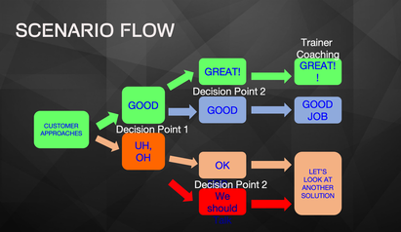
Behavioral Indicators
Behavioral indicators capture data on trainees' interactions, decision-making processes, and overall behavior within the XR environment.
Applications of Behavioral Indicators:
  Decision Pathways:
    Mapping out the decision-making pathways that trainees take during scenarios to identify strengths and weaknesses.
    This could involve analyzing the sequence and timing of decisions in a tactical simulation.

Slide 65
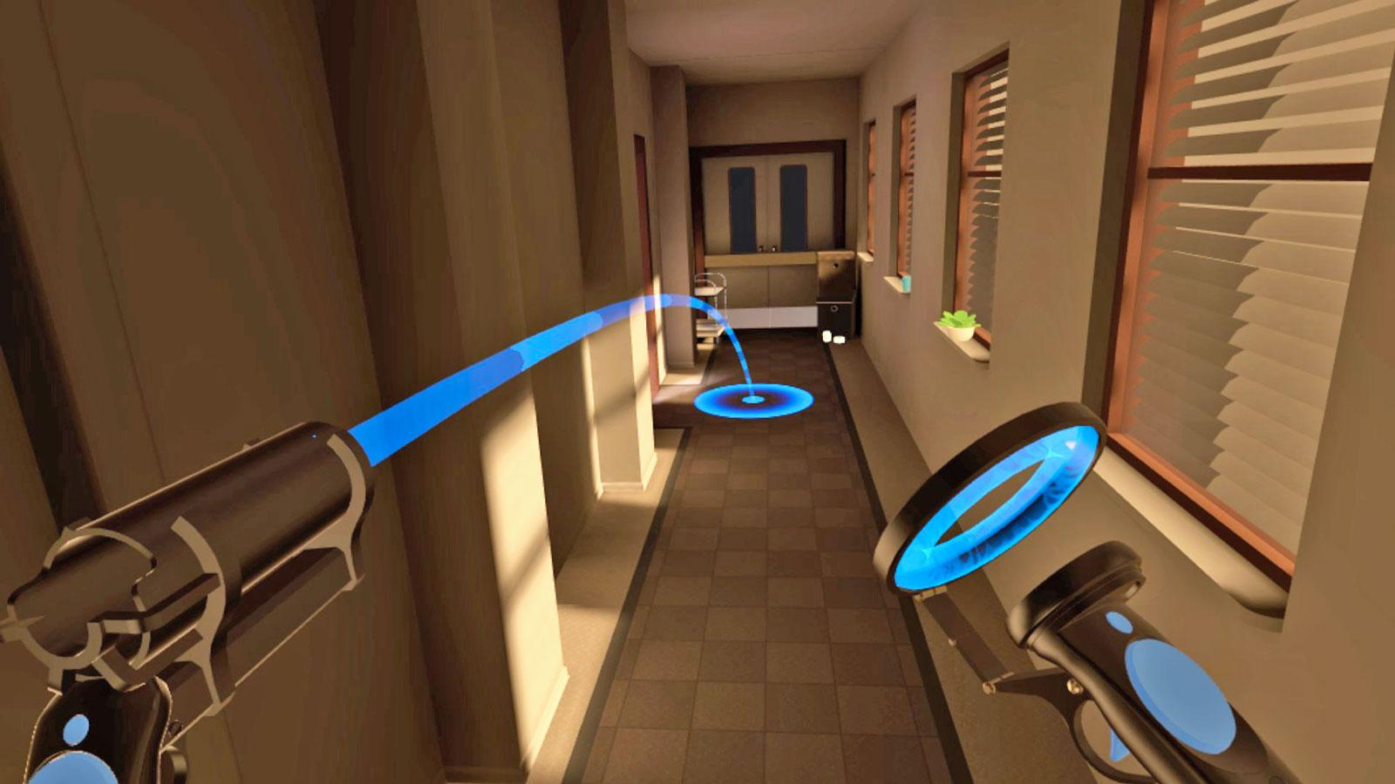
Interaction Analysis
Interaction analysis
  Evaluates how trainees interact with virtual elements, such as tools, interfaces, and other avatars within the XR environment.
This provides valuable insights into their proficiency
  With equipment
  Ability to navigate and utilize the XR system effectively

Slide 66
Concluding Remarks

Slide 67
Summary of Key Points
Key points include:
  The importance of aligning training objectives with strategic goals.
  The unique considerations of XR environments, such as fidelity, authenticity, and adaptability.
  Implementation of assessment theory, including validation, in the design process.
  Operationalized metrics to track performance and progression.
  Designing for novice to expert requires the integration of valid assessments and evidence of learning obtained through knowledge checks, interactions, and points of data extraction that give evidence of learning.

Slide 68
Future Work
Future work can the ongoing development and refinement of assessment strategies in XR training. For example:
  Scoring: Developing robust scoring systems that accurately reflect trainees' performance and proficiency. This might involve creating detailed rubrics, incorporating peer assessments, and using advanced data analytics.
  Reporting: Creating detailed and accessible reports that provide insights into trainees' progress and areas for improvement. This could include interactive dashboards, detailed performance summaries, and individualized progress reports.
  Validating: Ensuring the validity and reliability of assessments through continuous testing and validation processes. This might involve pilot testing new assessments, conducting validation studies, and gathering feedback from stakeholders.

Slide 69
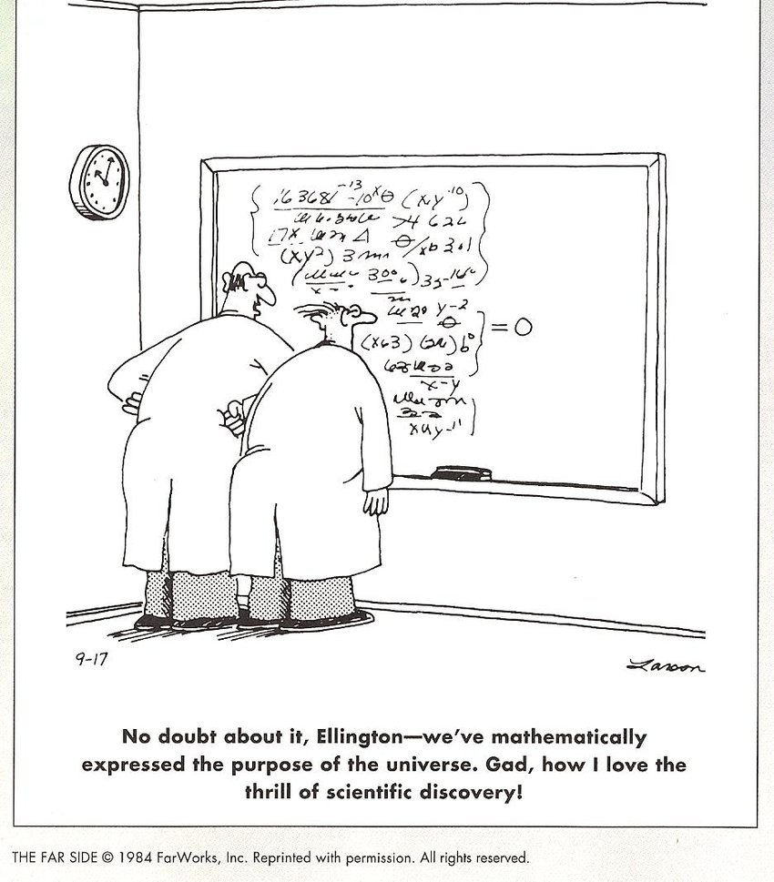
Thank you
Questions? Comments?

Slide 70
References
Gasteiger, N., van der Veer, S. N., Wilson, P., & Dowding, D. (2022). How, for whom, and in which contexts or conditions augmented and virtual reality training works in upskilling health care workers: realist synthesis. JMIR serious games, 10(1), e31644.
Kessler, A. (2022). The Learning Engineering Process. In Goodell & Kolodner (Eds.), Learning Engineering Toolkit: Evidence-based Practices from the Learning Sciences, Instructional Design, and Beyond. (pp. 31) Routledge: New York and London.
Lockyer, J., Carraccio, C., Chan, M. K., Hart, D., Smee, S., Touchie, C., ... & ICBME Collaborators. (2017). Core principles of assessment in competency-based medical education. Medical teacher, 39(6), 609-616.
McGrath, J. L., Taekman, J. M., Dev, P., Danforth, D. R., Mohan, D., Kman, N., ... & Won, K. (2018). Using virtual reality simulation environments to assess competence for emergency medicine learners. Academic Emergency Medicine, 25(2), 186-195.
Owens, K., & Goldberg, B. (2022). COMPETENCY-BASED EXPERIENTIAL-EXPERTISE. Design Recommendations for Intelligent Tutoring Systems, 9, 19-29.

Slide 71
Broad-Based Learning Science Principles for XR
For skills:
  Spacing practice
  Interleaving practice
  Consistent practice for developing automaticity and proficiency
  Deliberate practice, unpredictable conditions for mastery
For knowledge:
  Multimedia design
  Dual coding
  Elaboration
  Concrete examples
  Spacing and interleaving
  Retrieval practice
Model the cognitive processes and the learning objectives
Consider aptitude-treatment interactions
Apply learning engineering, feedback, adaptive learning

Slide 72
Recap of Learning Objectives
LO1: Identify the principles of effective assessment design within virtual reality training simulations.
LO2: Appraise various metrics and data collection methods to track learners' progression from novice to expert levels in medical and military contexts.
LO3: Examine how to develop assessments that provide actionable feedback to learners, instructors, and training developers, including tailoring learning experiences and optimizing training curricula to expedite novice to expert proficiency.

Slide 73
Data Analysis
Data Cleaning and Preparation
Before analyzing data, it is important to clean and prepare it to ensure accuracy and reliability.
  Remove Outliers: Identify and remove any outliers that may skew the analysis. For instance, extremely high or low scores that do not reflect typical performance.
  Check for Missing Data: Address any missing data points to ensure completeness. This might involve imputing missing values or excluding incomplete data sets.
  Normalize Data: Normalize data to ensure consistency and comparability across different data sets. This could involve standardizing scores to a common scale.

Slide 74
Machine Learning Analyses
Data Preprocessing
Once data is collected, it must be preprocessed to ensure it is suitable for analysis. Preprocessing steps include:
  Data Cleaning: Removing duplicates, handling missing values, and correcting errors.
  Normalization: Scaling numerical data to a standard range to ensure consistency.
  Categorization: Converting categorical data into numerical format using techniques like one-hot encoding.
  Segmentation: Dividing continuous data streams into meaningful segments for analysis.

Slide 75
Feature Engineering
Feature engineering involves creating new features or modifying existing ones to improve the performance of machine learning models. Key steps include:
  Feature Extraction: Identifying and extracting relevant features from raw data. For example, extracting specific movement patterns from motion tracking data.
  Feature Selection: Selecting the most important features that contribute to predictive performance. Techniques include correlation analysis and feature importance scores.
  Feature Transformation: Transforming features to enhance model performance. This could include logarithmic transformations, polynomial features, or interaction terms.

Slide 76
Modeling: Supervised Learning
Machine learning models are used to analyze the data and derive insights. Commonly used models include:
a. Supervised Learning
Classification: Used when the output variable is categorical. Examples include:
  Logistic Regression: For binary outcomes (e.g., pass/fail).
  Random Forests and Gradient Boosting Machines: For multi-class classification.
Regression: Used when the output variable is continuous. Examples include:
  Linear Regression: For predicting scores or times.
  Support Vector Regression and Neural Networks: For more complex relationships.

Slide 77
Modeling: Unsupervised Learning
Unsupervised Learning
Clustering: Grouping data points into clusters based on similarity. Techniques include:
  K-Means Clustering: Grouping similar performance patterns.
  Hierarchical Clustering: Creating a hierarchy of clusters.
Dimensionality Reduction: Reducing the number of features while retaining important information. Techniques include:
  Principal Component Analysis (PCA): Simplifying feature sets.
  t-Distributed Stochastic Neighbor Embedding (t-SNE): For visualizing high-dimensional data.

Slide 78
Modeling: Reinforcement Learning
Reinforcement Learning
Policy Learning: Training models to make sequential decisions by maximizing cumulative rewards. This can be used to adapt VR training scenarios dynamically based on trainee performance.

Slide 79
Model Evaluation
Model Evaluation
Evaluating the performance of machine learning models is crucial to ensure their reliability and accuracy. Key metrics and methods include:
  Accuracy, Precision, Recall, and F1-Score: For classification models.
  Mean Absolute Error (MAE) and Root Mean Squared Error (RMSE): For regression models.
  Confusion Matrix: To visualize classification performance.
  Cross-Validation: To assess model performance on different subsets of data.

Slide 80
Interpretation and Insights
Interpretation and Insights
Interpreting the results of machine learning models helps translate data analysis into actionable insights. Key approaches include:
  Feature Importance Analysis: Identifying which features most significantly impact model predictions.
  Model Explainability: Using techniques like SHAP (SHapley Additive exPlanations) to understand how different features contribute to individual predictions.
  Pattern Recognition: Identifying common patterns and trends in the data, such as typical errors or successful strategies.

Slide 81
Example
Practical Example: Analyzing VR Medical Training Data
Let’s consider a practical example where we analyze data from a VR medical training simulation:
Data Collection:
  Performance Metrics: Time to complete procedures, accuracy of diagnoses.
  Motion Tracking: Hand movements during surgery simulations.
  Physiological Data: Heart rate during high-stress scenarios.
  Interaction Data: Choices made during patient interactions.

Slide 82
Example
Data Preprocessing:
Clean and normalize the performance metrics.
Handle missing motion tracking data by interpolation.
Encode interaction choices as numerical features.

Slide 83
Example
Feature Engineering:
Extract features like average hand movement speed and variability.
Select features with high correlation to successful outcomes.
Transform features such as log-transforming the completion times.

Slide 84
Example
Modeling:
Use Random Forest for classification of pass/fail outcomes.
Apply PCA to reduce the dimensionality of motion tracking data.
Implement a reinforcement learning model to adapt training scenarios based on trainee performance.

Slide 85
Example
Model Evaluation:
Evaluate Random Forest using precision, recall, and F1-score.
Assess PCA results by visualizing the variance explained by each principal component.
Monitor the cumulative rewards in the reinforcement learning model to ensure effective learning.

Slide 86
Example
Interpretation and Insights:
Identify key features like hand movement precision as critical for success.
Use SHAP values to explain individual pass/fail predictions.
Recognize patterns such as common errors in diagnosis during specific procedures.

Slide 87
Example
Implementation and Continuous Improvement:
  Provide trainees with detailed feedback on their hand movement efficiency.
  Update training scenarios to focus more on commonly misdiagnosed conditions.
  Continuously collect new data to refine and improve the models and training curriculum.
VR designers can leverage machine learning and data science to gain deep insights into VR training simulation data, ultimately leading to more effective and personalized training programs.

Slide 88
Optional/Hidden Slides
Moved here from the main deck

Slide 89
Different Uses and Types of Assessments: Which is Right for You?
Formative Assessments
  Formative assessments are integral to the learning process as they provide continuous feedback and enable instructors to adjust training in real-time. In VR training, formative assessments can take various forms, each tailored to specific learning goals and contexts.

Slide 90
Formative
Detailed Examples of Formative Assessments in VR:
  Interactive Quizzes: Embedded within the VR environment, quizzes can appear at critical junctures in a training simulation. For instance, in a medical training VR, a quiz might appear after a trainee completes a diagnostic procedure, asking questions about the steps taken and the reasoning behind them.
  Scenario-Based Feedback: In military VR training, after a simulated mission, trainees could receive detailed debriefings highlighting their decision-making process, tactical maneuvers, and areas for improvement. This immediate, context-specific feedback is crucial for learning complex
  Peer Assessments: Trainees can engage in peer reviews within the VR environment. For instance, during a collaborative rescue mission simulation, trainees can observe and provide feedback on each other’s performance, fostering a collaborative learning culture and critical thinking.

Slide 91
Summative
Summative Assessments
Summative assessments evaluate the overall learning outcomes at the end of a training cycle. These assessments are critical for certifying competencies and readiness for real-world application.

Slide 92
Summative
Detailed Examples of Summative Assessments in VR:
  Comprehensive Simulations: In a final evaluation, medical trainees might engage in a complex VR simulation involving multiple patients and various medical emergencies. Their performance would be assessed based on criteria such as accuracy, speed, and adherence to protocols.
  Capstone Projects: Military trainees could undertake a capstone project that involves planning and executing a complex mission in a VR environment. The project would be evaluated on strategic planning, execution, team coordination, and overall mission success.
  Certifications and Badges: Successful completion of summative assessments could result in digital certifications or badges that trainees can add to their professional portfolios, demonstrating their proficiency in specific skills.

Slide 93
Diagnostic
Diagnostic Assessments
Diagnostic assessments help in identifying trainees' existing knowledge and skills before starting the training program, allowing for tailored training interventions.

Slide 94
Diagnostic
Detailed Examples of Diagnostic Assessments in VR:
  Pre-Training Skill Assessments: Before beginning a surgical training program, trainees might complete a VR simulation where they perform basic surgical procedures. Their performance would be assessed to identify areas needing focus.
  Knowledge Inventories: In a VR-based onboarding for cybersecurity training, trainees might undergo a series of scenarios testing their knowledge of network security principles, helping trainers to customize the training content.

Slide 95
Performance-Based
Performance-Based Assessments
Performance-based assessments focus on evaluating practical skills and the ability to perform tasks in realistic scenarios.

Slide 96
Performance-Based
Detailed Examples of Performance-Based Assessments in VR:
  Live Mission Simulations: Military trainees might participate in a live VR mission where they need to execute strategic plans, engage with adversaries, and complete mission objectives. Performance metrics could include decision-making under pressure, teamwork, and mission success rate.
  Practical Skill Demonstrations: In a VR setting, nursing students might be required to perform patient assessments, administer medications, and respond to medical emergencies, with their performance being evaluated on accuracy and adherence to protocols.

