Slide 1
A Practitioner’s Guide to
Human-Machine
Teaming Research
Sandro Scielzo Human Systems Technical Authority CAE USA sandro.scielzo@caemilusa.com

Slide 2
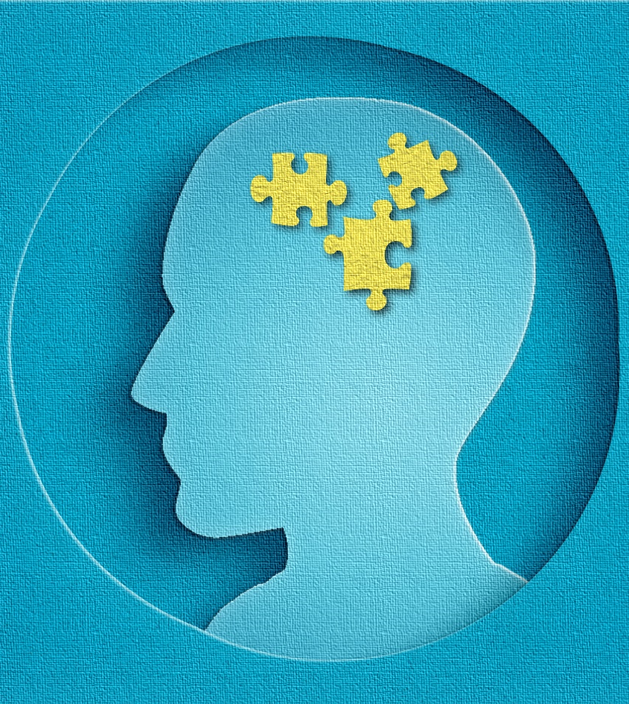
By the end of this tutorial I will be able to…
… Explain “from tools to teammate” paradigm shift
… Compare and contrast traditional automation taxonomies to human-machine teaming taxonomies
… Describe DoD human factors R&D priorities and roadmaps
… Identify Human-Machine Teaming performance enablers

Slide 3


Human-Machine Teaming (HMT)
Certainly! Human-machine teaming refers to the relationship between a human and a machine (typically an autonomous system) that involves the shared pursuit of a common goal.
Human-machine teaming refers to the collaborative interaction between humans and machines (such as robots, artificial intelligence systems, or autonomous systems) to achieve a common goal or task.
Copilot

Slide 4
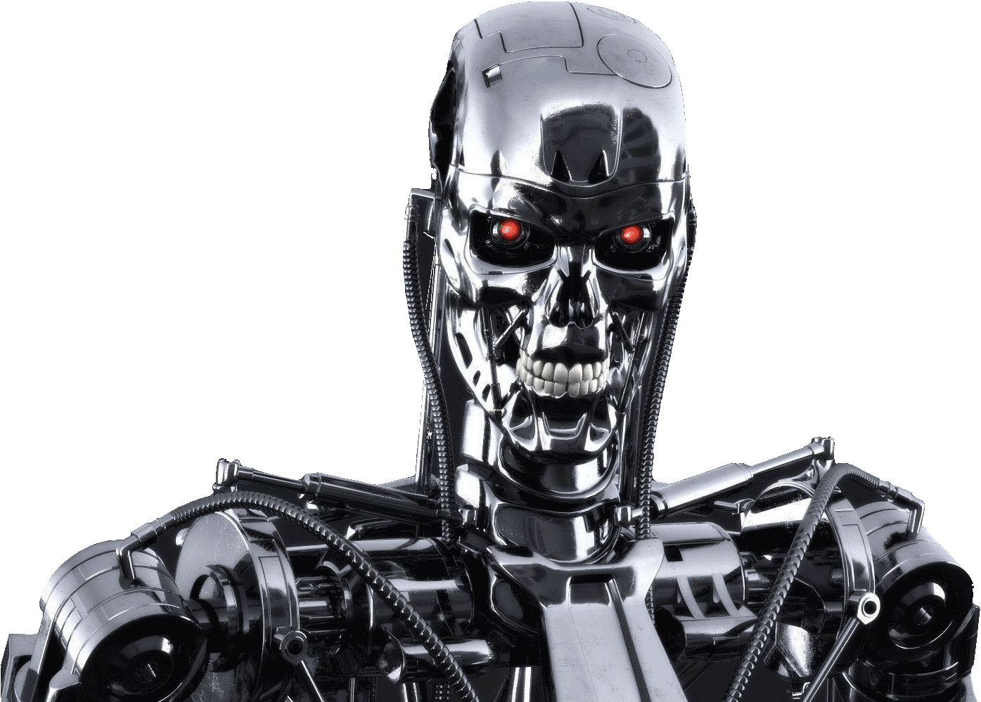
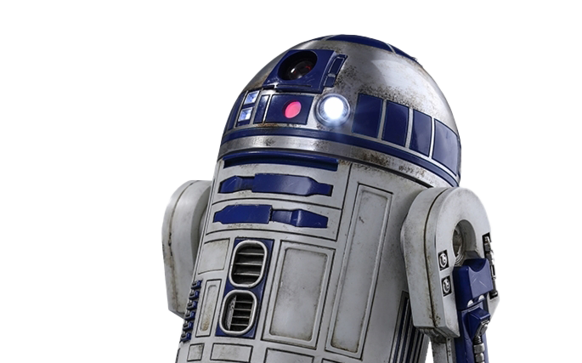
Human-Machine Teaming (HMT)
Certainly! Human-machine teaming refers to the relationship between a human and a machine (typically an autonomous system) that involves the shared pursuit of a common goal.
Human-machine teaming refers to the collaborative interaction between humans and machines (such as robots, artificial intelligence systems, or autonomous systems) to achieve a common goal or task.
Copilot
PICK ME!!
PICK ME!!
Notes:
Section 107 of the Copyright Act of 1986 (17 U.S. Code § 107) states that fair use of copyrighted material "for purposes such as criticism, comment, news reporting, teaching (including multiple copies for classroom use), scholarship, or research, is not an infringement of copyright."

Slide 5
Can we trust machines?!
PICK ME!!
PICK ME!!

Slide 6

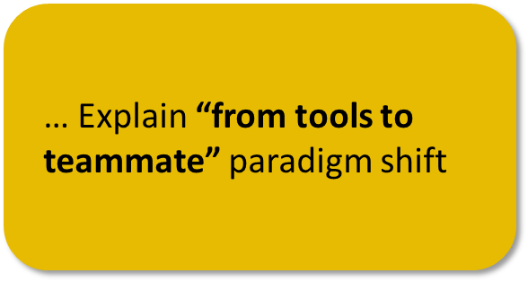

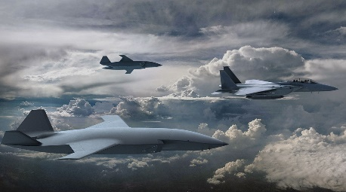
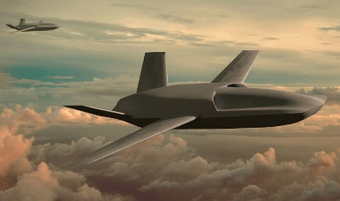
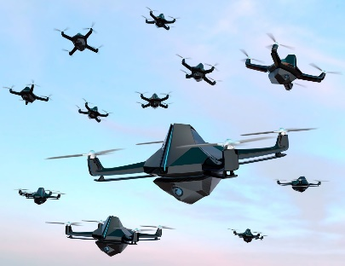
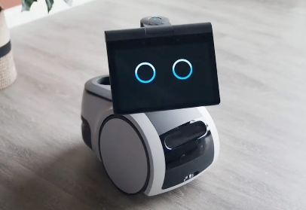
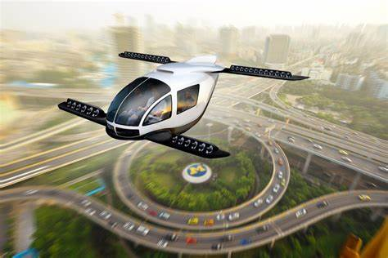
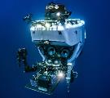
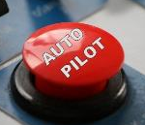
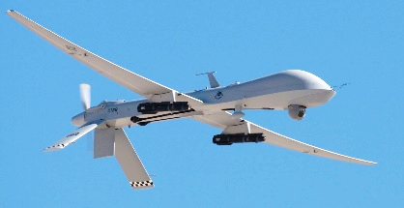
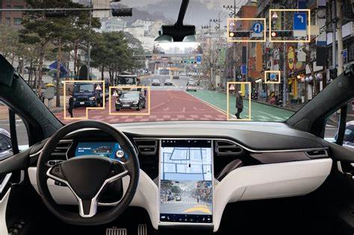
Can we trust machine?
A rapid paradigm shift is underway!
Loyal Wingman
today
Collaborative Combat Aircraft
Cobots - Astro
Swarms
Air taxis
Collaboration
Unmanned Vehicle
Tele-Operations
A/C autopilot
Car autopilot
Time

Slide 7

Can we trust machine?
A rapid paradigm shift is underway!
today
TEAMMATES
Collaboration
TOOLS
Time

Slide 8
What is driving this paradigm shift?
(1) AI Revolution
(2) Future warfare demands
(3) Modern mythology

Slide 9
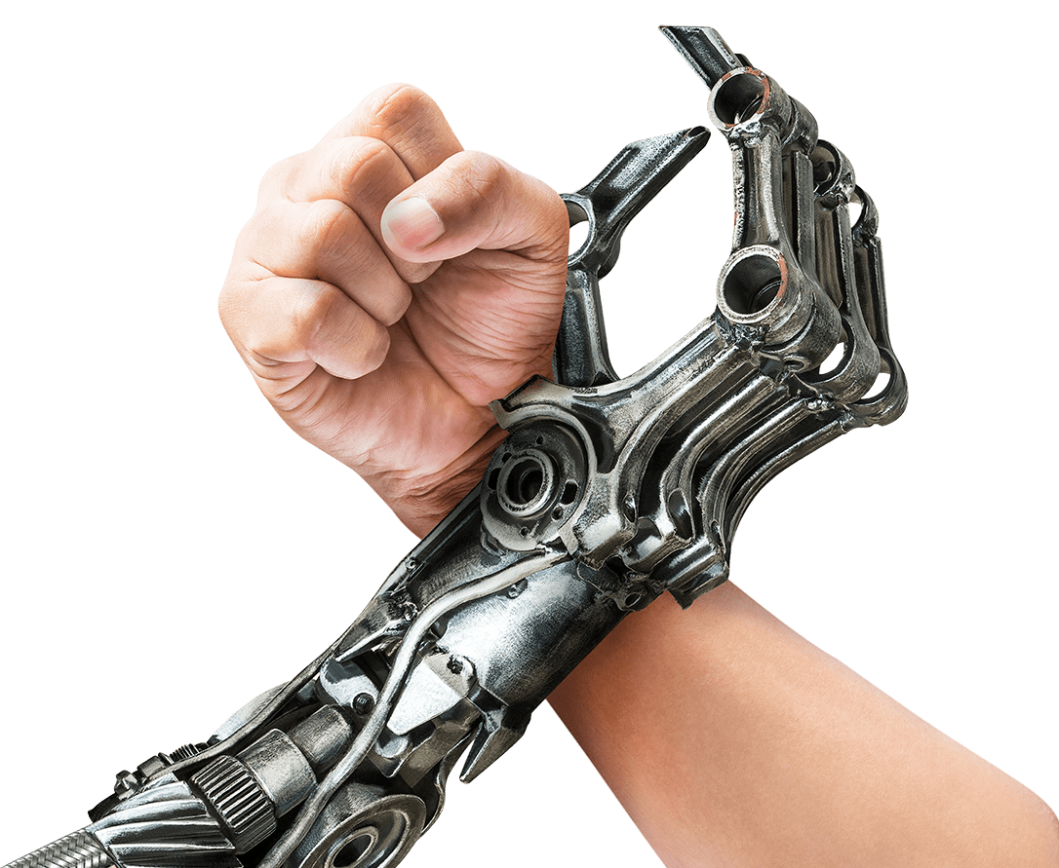
AI Revolution
Machines are…
- Consistent
Humans are…
- Fast
- Flexible
- Accurate
- Creative
- Adaptable
Notes:
Max Roser (2022) - “The brief history of artificial intelligence: the world has changed fast — what might be next?” Published online at OurWorldInData.org. Retrieved from: 'https://ourworldindata.org/brief-history-of-ai' [Online Resource]

Slide 10


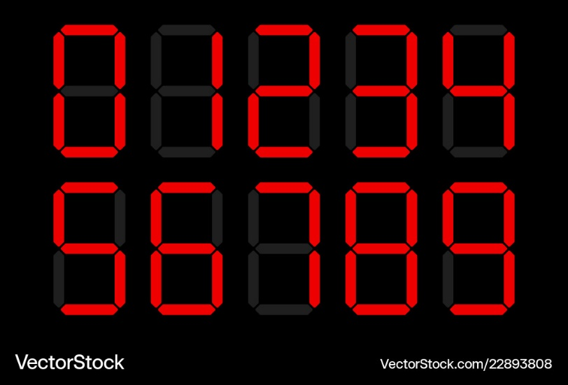
AI Revolution
Precision and repetition
May make errors due to workload, stress, fatigue or lack of focus
HUMANS
MACHINES
Excel at repetitive tasks with high precision consistently without getting tired

Slide 11

AI Revolution
Processing Speed
Analyze complex situations, consider context, and make nuanced decisions
HUMANS
MACHINES
Process vast amounts of data quickly, for analysis, calculations, and sorting

Slide 12
AI Revolution
Learning & Adaptation
Learn from experience, and exposure. We adapt to new situations and contexts
HUMANS
MACHINES
Can learn from data (machine learning) and adapt algorithms over time

Slide 13

AI Revolution
Creativity & Innovation
Innovate, create art, and think outside the box
HUMANS
MACHINES
Can generate patterns based on existing data

Slide 14
AI Revolution
Strength & Endurance
Possess limited physical strength, agility, and endurance
HUMANS
MACHINES
Can perform physically demanding tasks without fatigue

Slide 15

AI Revolution
Ethical Judgment
Consider ethics, values, and consequences when making decisions
HUMANS
MACHINES
Follow predefined rules; lack moral judgment

Slide 16
AI Revolution
Humans win!
Not so quick!
HUMANS
MACHINES

Slide 17

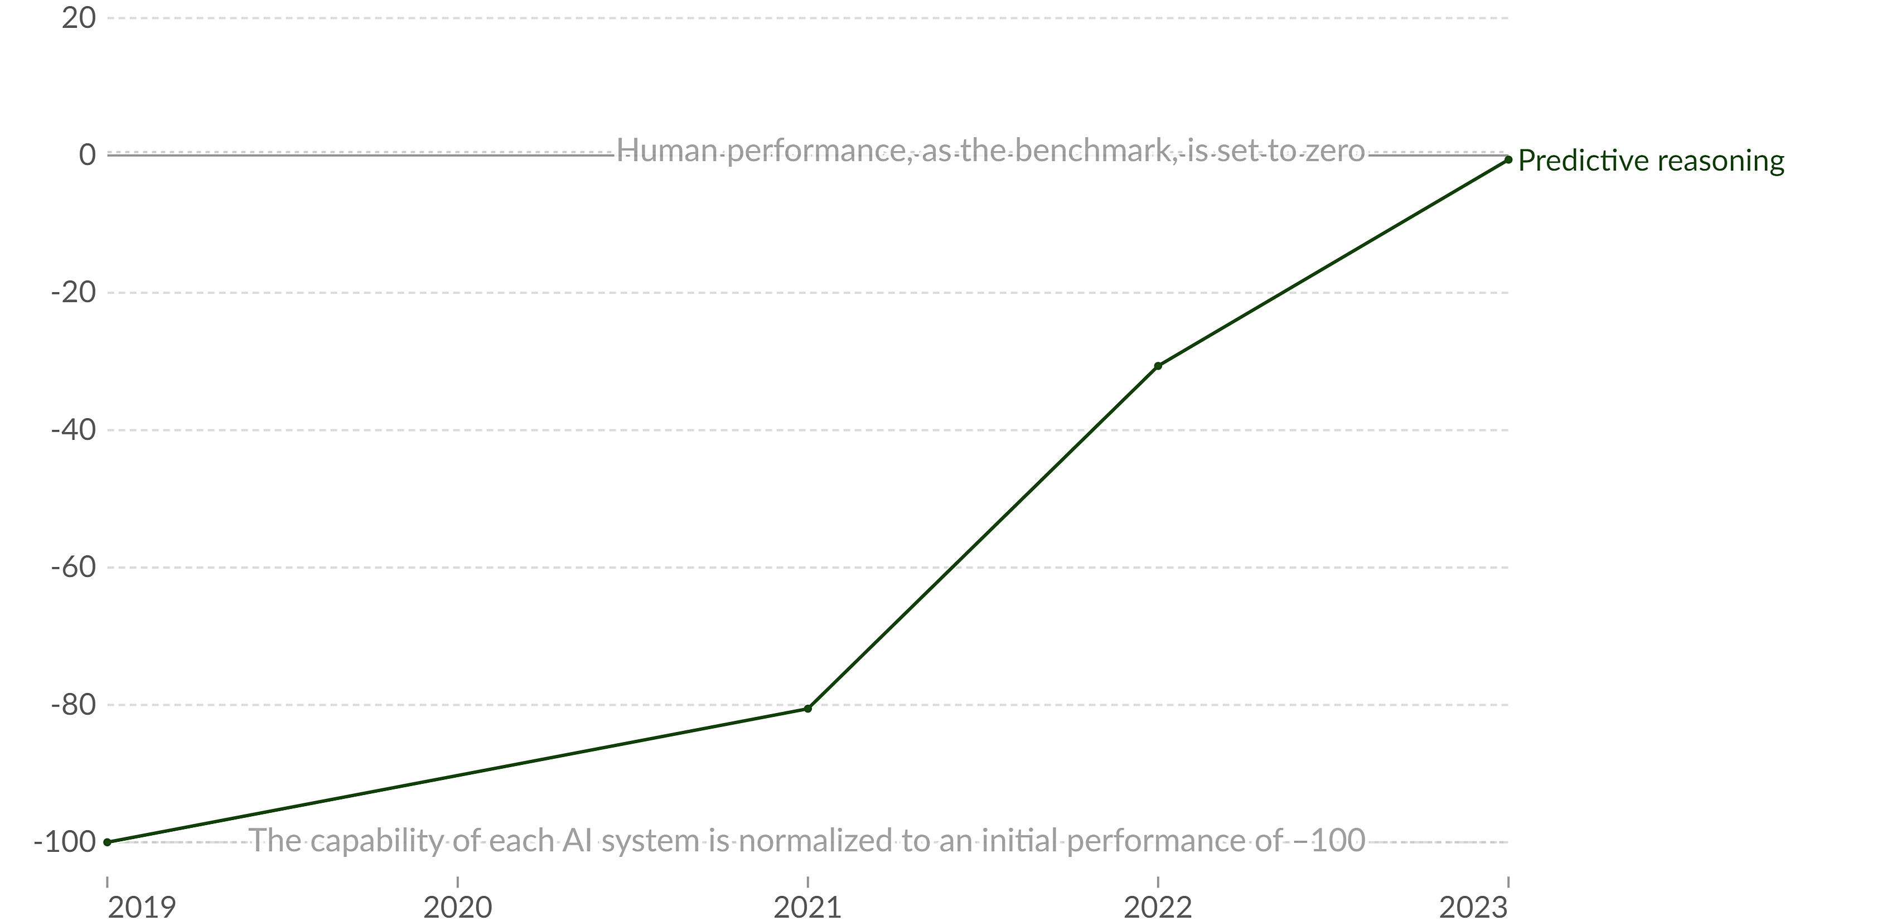

AI Revolution
Human performance, as the benchmark, is set to zero
The capability of each AI system is normalized to an initial performance of -100
Notes:
Max Roser (2022) - “The brief history of artificial intelligence: the world has changed fast — what might be next?” Published online at OurWorldInData.org. Retrieved from: 'https://ourworldindata.org/brief-history-of-ai' [Online Resource]

Slide 18
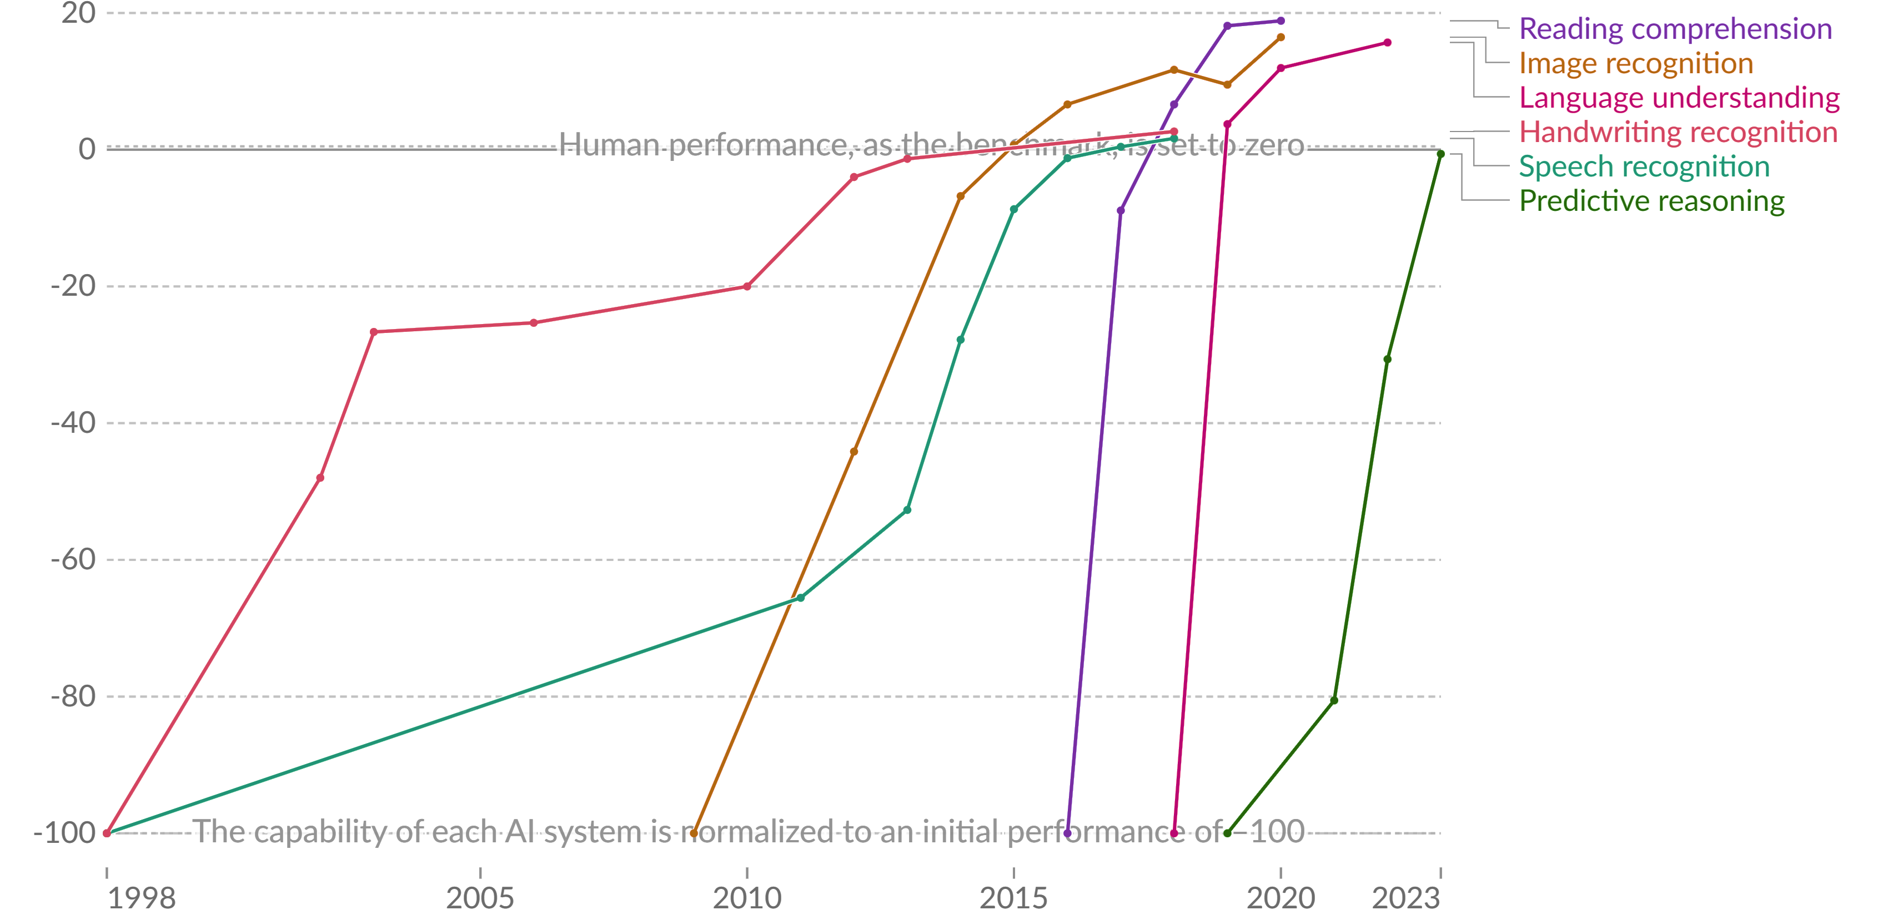
AI Revolution
Notes:
Max Roser (2022) - “The brief history of artificial intelligence: the world has changed fast — what might be next?” Published online at OurWorldInData.org. Retrieved from: 'https://ourworldindata.org/brief-history-of-ai' [Online Resource]

Slide 19
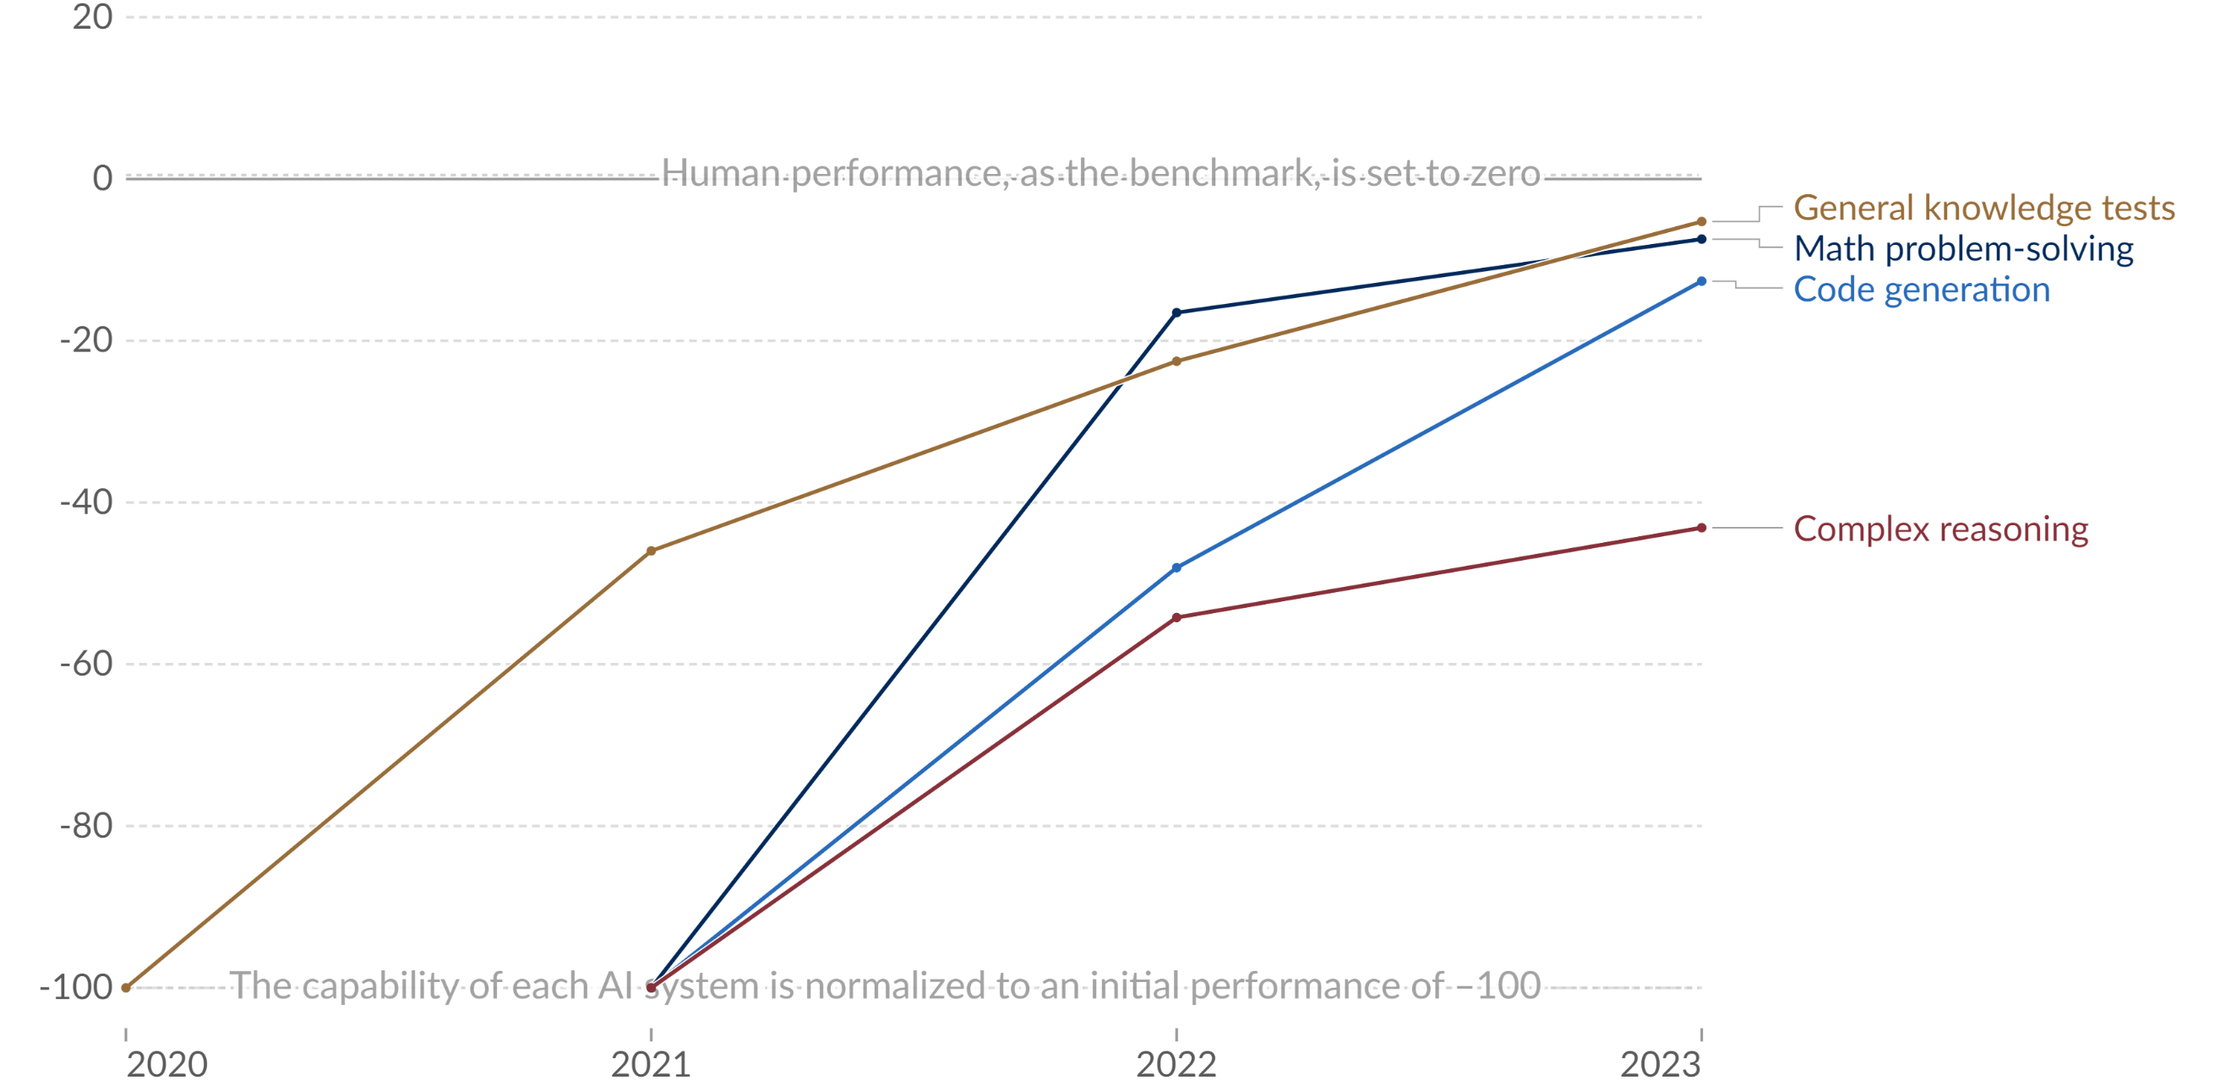
AI Revolution
Notes:
Max Roser (2022) - “The brief history of artificial intelligence: the world has changed fast — what might be next?” Published online at OurWorldInData.org. Retrieved from: 'https://ourworldindata.org/brief-history-of-ai' [Online Resource]

Slide 20
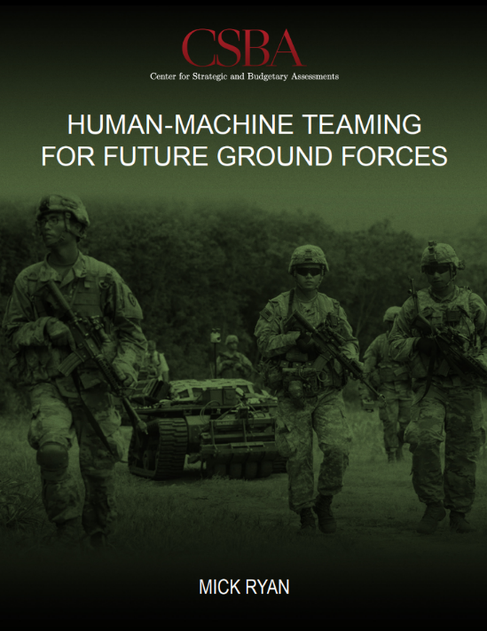

Future Warfare Demands
Boost national military power
“A foundation for analyzing the personnel, equipment, training, education, doctrine, sustainment, and infrastructure required by allied forces to build a future human-machine force”
Improve individual and team performance while reducing threats to humans
Enable new operating concepts
Employ robots on future military operations as an ethical preference
Future adversaries will use these technologies
Improve all institutional and support functions of ground forces
Notes:
“Human-Machine Teaming for Future Ground Forces” provides an intellectual foundation for analyzing the personnel, equipment, training, education, doctrine, sustainment, and infrastructure required by allied forces to build a future human-machine force. The study outlines activities for the U.S. Army and emphasizes that ground forces of U.S. allies and partners can also benefit from enhanced human-machine teaming in the future

Slide 21
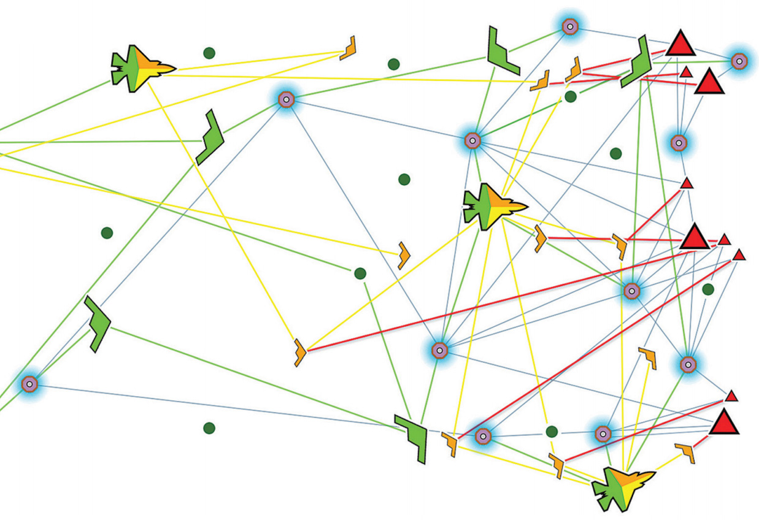



Future Warfare Demands
Mosaic Warfare
“Rapidly reconfigurable kill-webs based of human-operated and automated platforms”
Notes:
Mosaic warfare is a concept developed by DARPA to create more resilient and adaptable warfighting capabilities by linking together manned and unmanned systems from different domains. These systems can be rapidly composed and recomposed to address changing threats and reduce vulnerabilities. Mosaic warfare relies on advances in computing, artificial intelligence, and networking to disaggregate the functions of finding, fixing, targeting, tracking, engaging, and assessing the enemy across multiple platforms and sensors

Slide 22
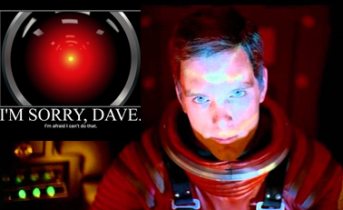
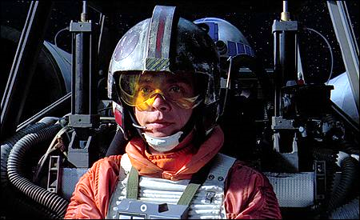
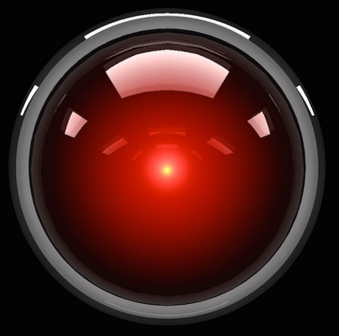
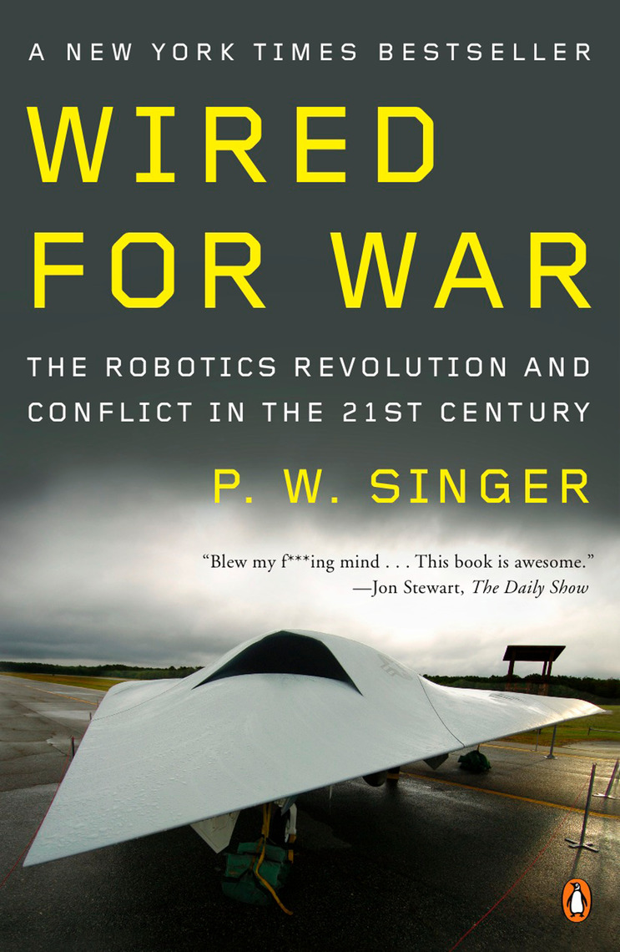
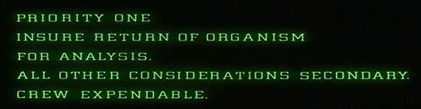

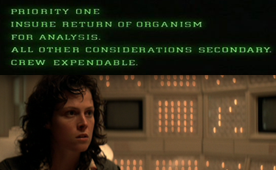
Modern Mythology
“Explores how science fiction has started to play out on modern day battlefields, with robots used more and more in war. ”
I’M SORRY DAVE.
I’m afraid I can’t do that
Notes:
Wired for War is a best-selling book by Peter Warren Singer. It explores how science fiction has started to play out on modern day battlefields, with robots used more and more in war. The book reads like science fiction but is instead a brilliant piece of reporting on the future of warfare, a future already unfolding in the skies over Iraq, Afghanistan and Pakistan, where unmanned drones scan the ground below and blow up people as determined by “pilots” thousands of miles away

Slide 23
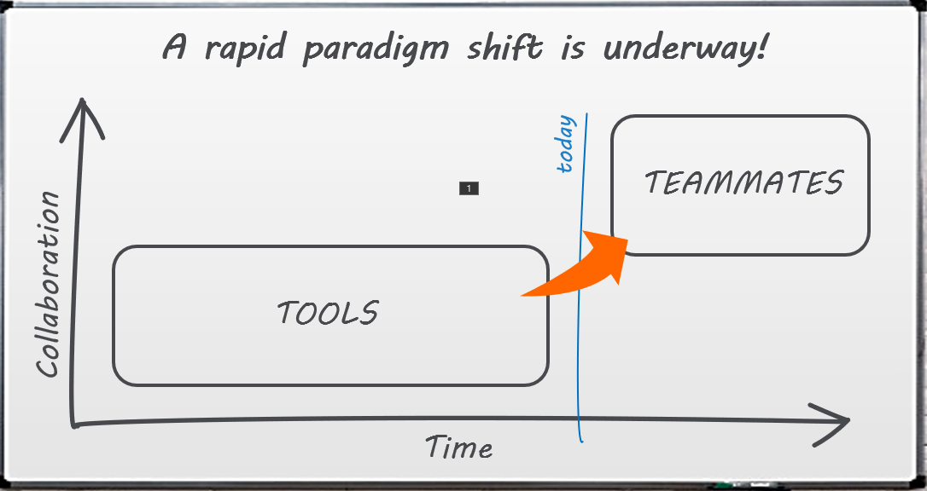

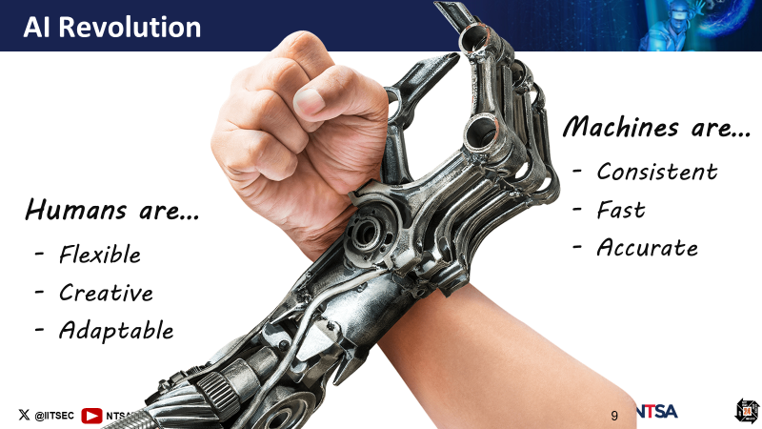
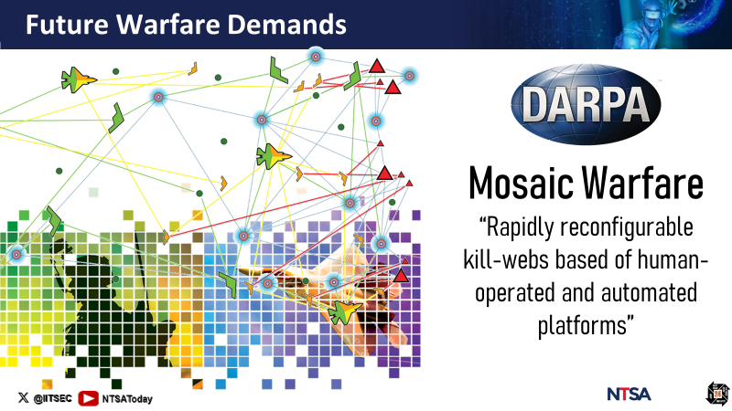
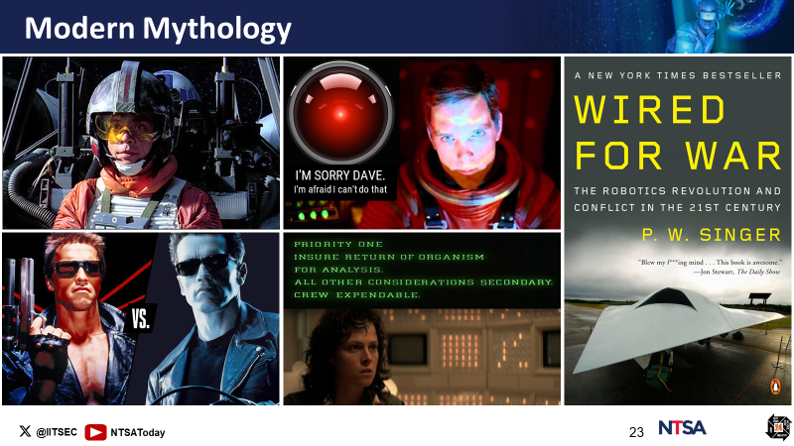
From Tools to Teammates: A Recap!

Slide 24
How is this paradigm shift affecting
Level of Automation (LOA) taxonomies?
(1) Machines & LOA
(2) Gold-standard LOA taxonomies
(3) A need for novel taxonomies

Slide 25
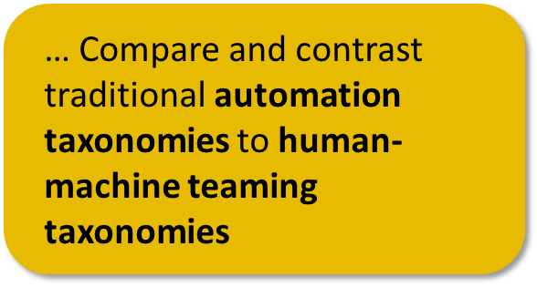
Machines & LOA
Level of Automation: Degree to which a task is automated, reflecting the balance between human control and machine control

Slide 26
Can we trust machine?
What are the goals of automation anyway?
Goals
Benefits
Task delegation
Workload reduction
Task management
Efficient task allocation
Task accuracy
Minimizing human error
Timeliness
Maximizing safety
Decision support
Supporting mission goals

Slide 27
Can we trust machine?
Get the balance right with LOAs
Full Manual
Human-In-The-Loop
Human Does
Full Automation
Human-On-The-Loop
Machine Does

Slide 28
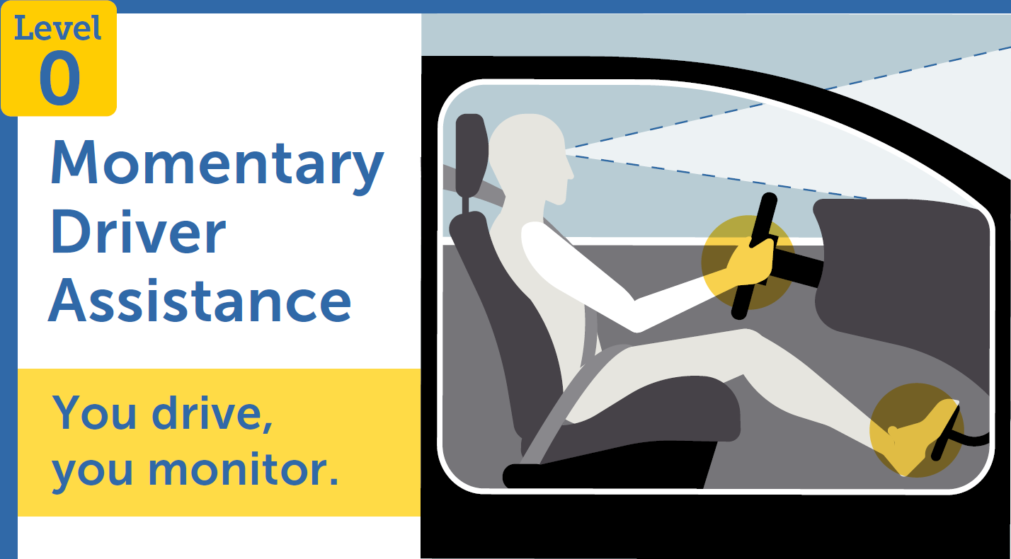
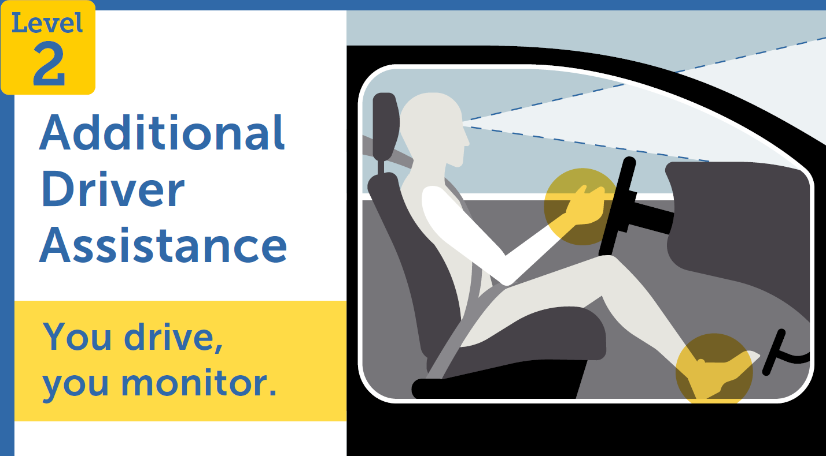
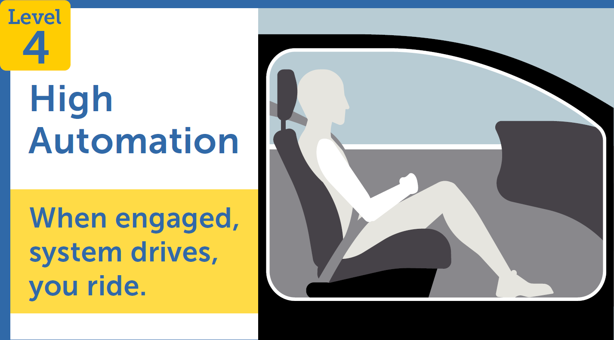

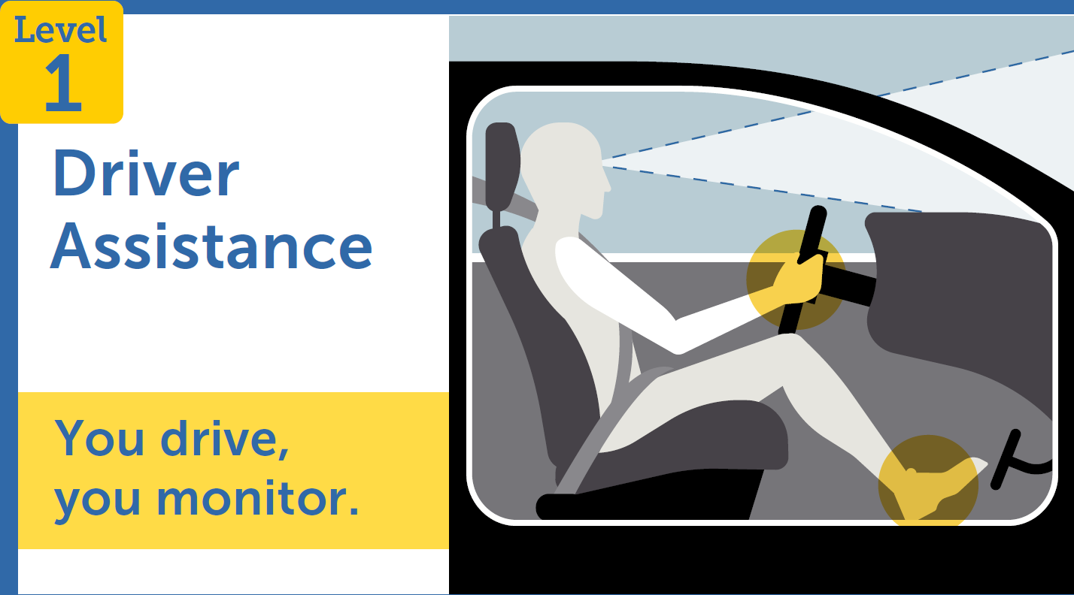
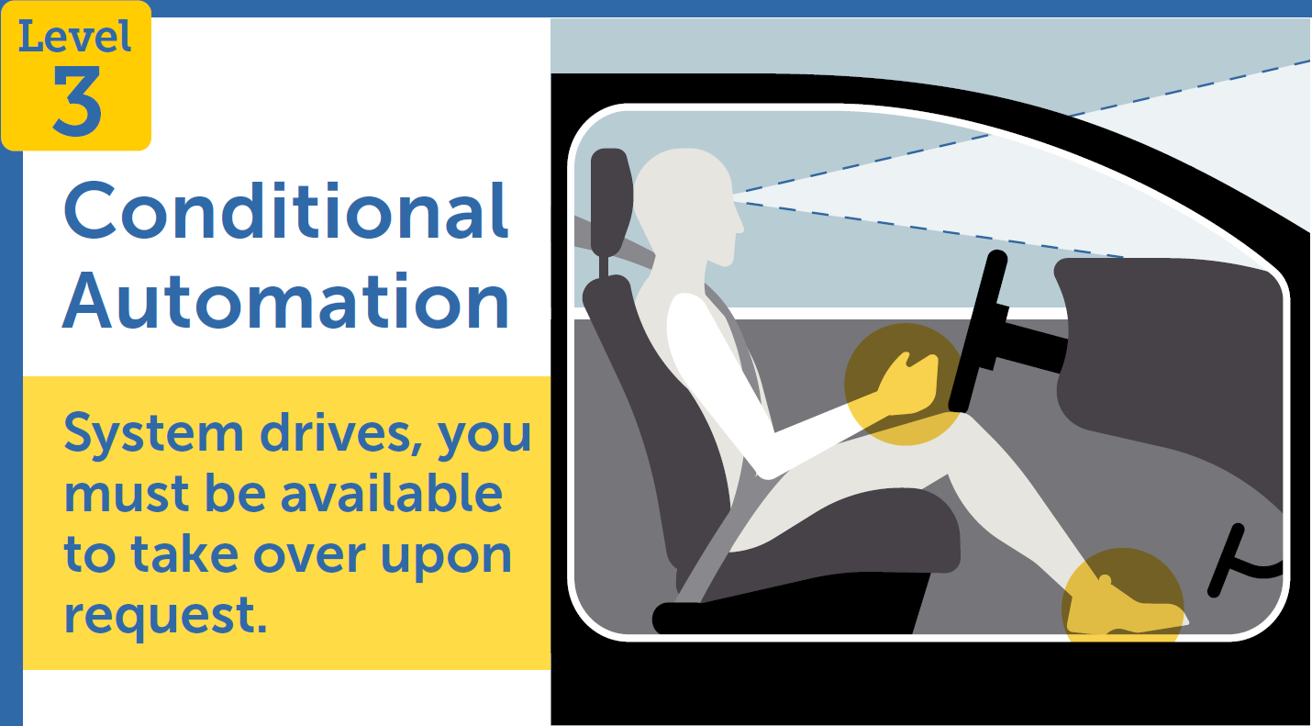
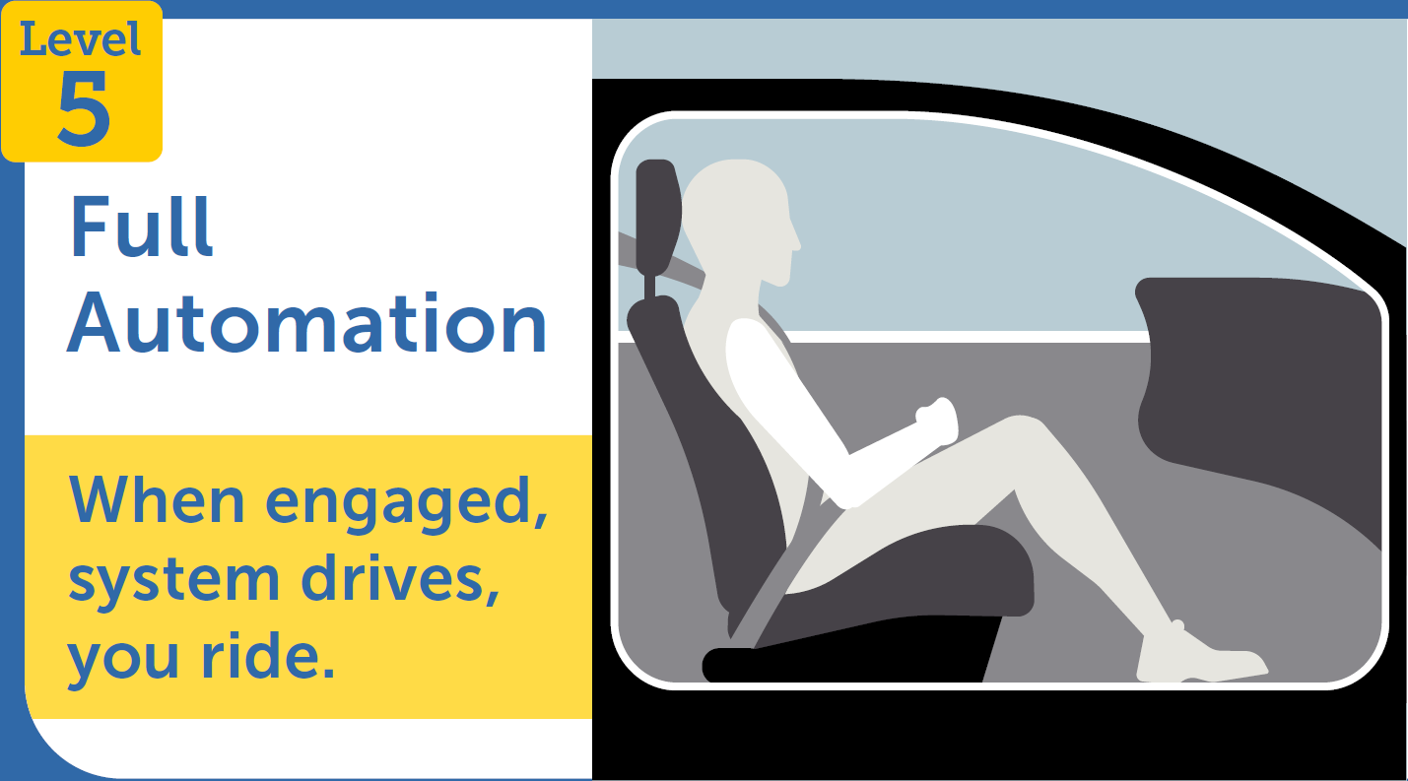

An example from the automotive industry…
6 Levels of Automation
Notes:
The National Highway Traffic Safety Administration is an agency of the U.S. federal government, part of the Department of Transportation, focused on transportation safety in the United States

Slide 29
Can we trust machine?
Get the balance right with LOAs
D&S Applicable
Full Manual
Collaborative
Decision-Making
Human-In-The-Loop
Hybrid Decision-Making
Human Does
The point of LOA
taxonomies is to inform
Full Automation
system design!
Human-On-The-Loop
Machine Does

Slide 30
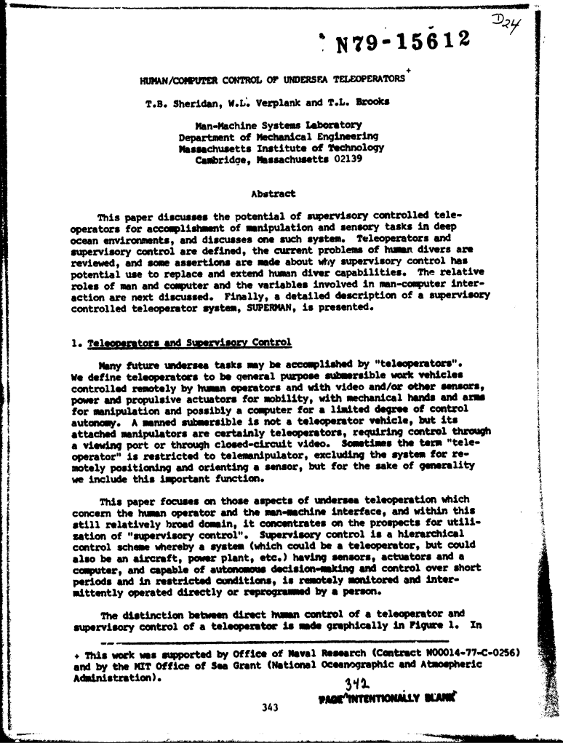

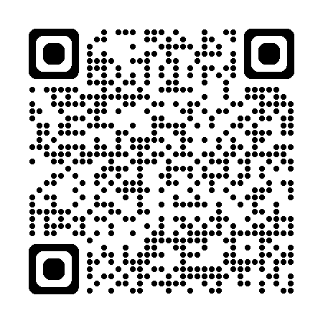
Sheridan & Verplank LOA Taxonomy (1978)

Slide 31
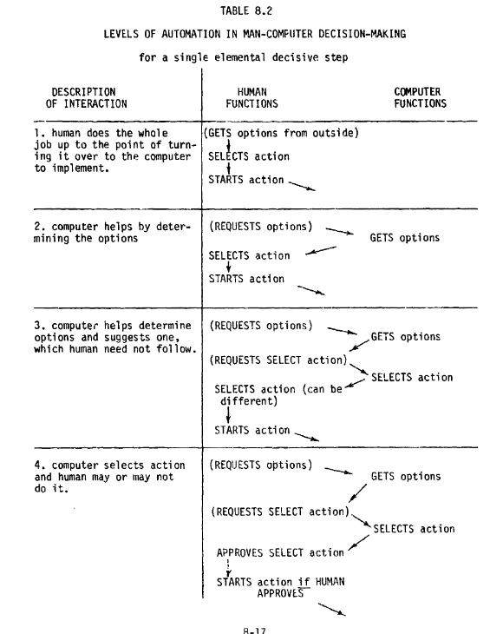
Sheridan & Verplank LOA Taxonomy (1978)
Provides 10 levels of automation that focus on the interaction of the human and the machine
Interaction
Human does
Machine does

Slide 32
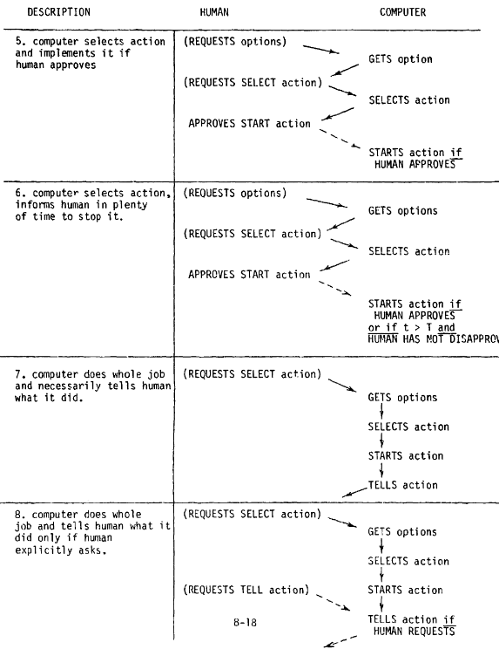
Sheridan & Verplank LOA Taxonomy (1978)
Provides 10 levels of automation that focus on the interaction of the human and the machine
Interaction
Human does
Machine does

Slide 33
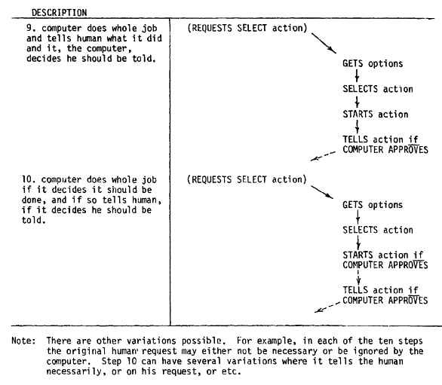
Sheridan & Verplank LOA Taxonomy (1978)
Provides 10 levels of automation that focus on the interaction of the human and the machine
Interaction
Human does
Machine does
I approve this option!

Slide 34
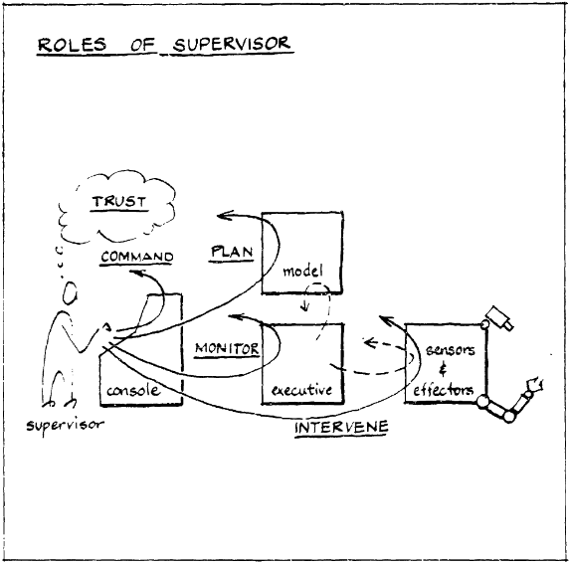
Sheridan & Verplank LOA Taxonomy (1978)
TRUST

Slide 35
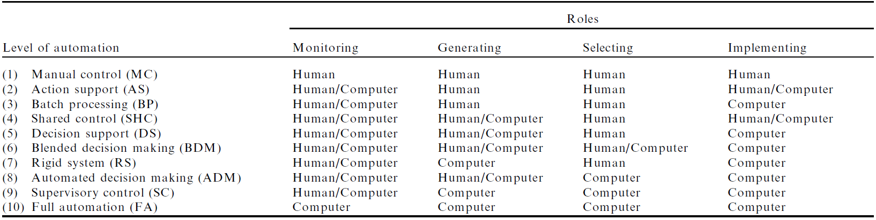
Endsley & Kaber LOA Taxonomy (1999)
Expands Sheridan’s 10 levels of automation by mapping LOAs across four human-machine decision-making categories
OODA Loop:
Observe
Orient
Decide
Act

Slide 36
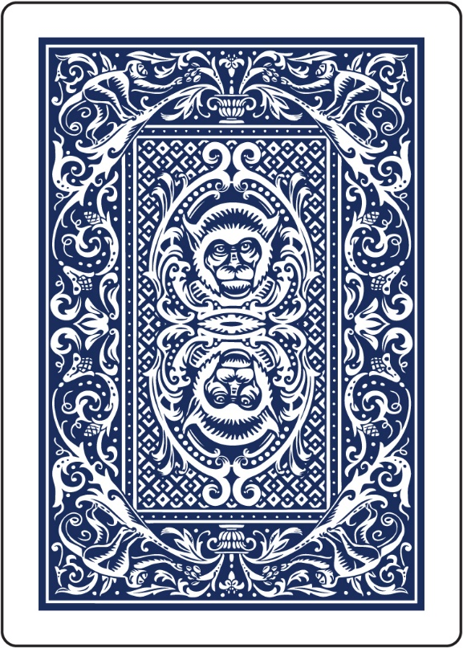
Future LOA Taxonomies
Build on existing taxonomies to provide specific design guidance for complex Human Machine Interfaces based on:
LOA Selection Rationale
Operator Goal
Operator Behavior
Machine Behavior
HMI Requirements
Answers “why” a particular LOA is appropriate
Maps LOA to human-centered goal structure
Describes expected human behavior based on goal and LOA
Describes expected machine behavior based on human goal and LOA
Defines “user stories” based on data in previous four cards

Slide 37
… an example: levels of swarm autonomy
Proposed Levels of Swarm Autonomy (LOSA) for Enhanced HMT Decision-Making
Level Of Automation | LOA Selection Rationale | Operator Goal | Goal Description | Human Operator Behavior | Unified Synthetic Agent Controller Behavior | Swarm Element Behavior | Human Interface Requirement
Level 1: Full Human Operator Control (all automation disabled or non-functional) | Only desirable to address automation limitations or system malfunctions | Command | To select a series of hive sensing, mobility, or operations and commit these to action | Operator selects commands from comprehensive option list with no assistance | Agent executes Operator commands with no intervention or deviation | Swarm element obeys agent commands with no feedback to the operator | The interface shall provide to the user all available command options
 |  | Plan | To consider and evaluate various alternative future commands | Operator selects plan from option list with no assistance | Agent executes Operator plan with no intervention or deviation | Swarm element obeys agent plan with no feedback to the operator
 |  | Monitor | Observe Hive state, mission parameters, and system diagnostics | All information shown to operator | N/A | N/A
 |  | Intervene | To take control, override, or abort an automated process | N/A | N/A | N/A
 |  | Trust | To acquire a basis for believing that the Swarm (or operator) will behave as intended | Operator observes Agent and Swarm Element perform exactly as directed | Agent observes Swarm Element perform exactly as directed | Hive understands its limitations and allows operator full control | The interface shall allow full operator control when human trust in automation is lost
Why?
Human does
Swarm does
HMI Shows
“Quarterback” does
OODA Loop

Slide 38
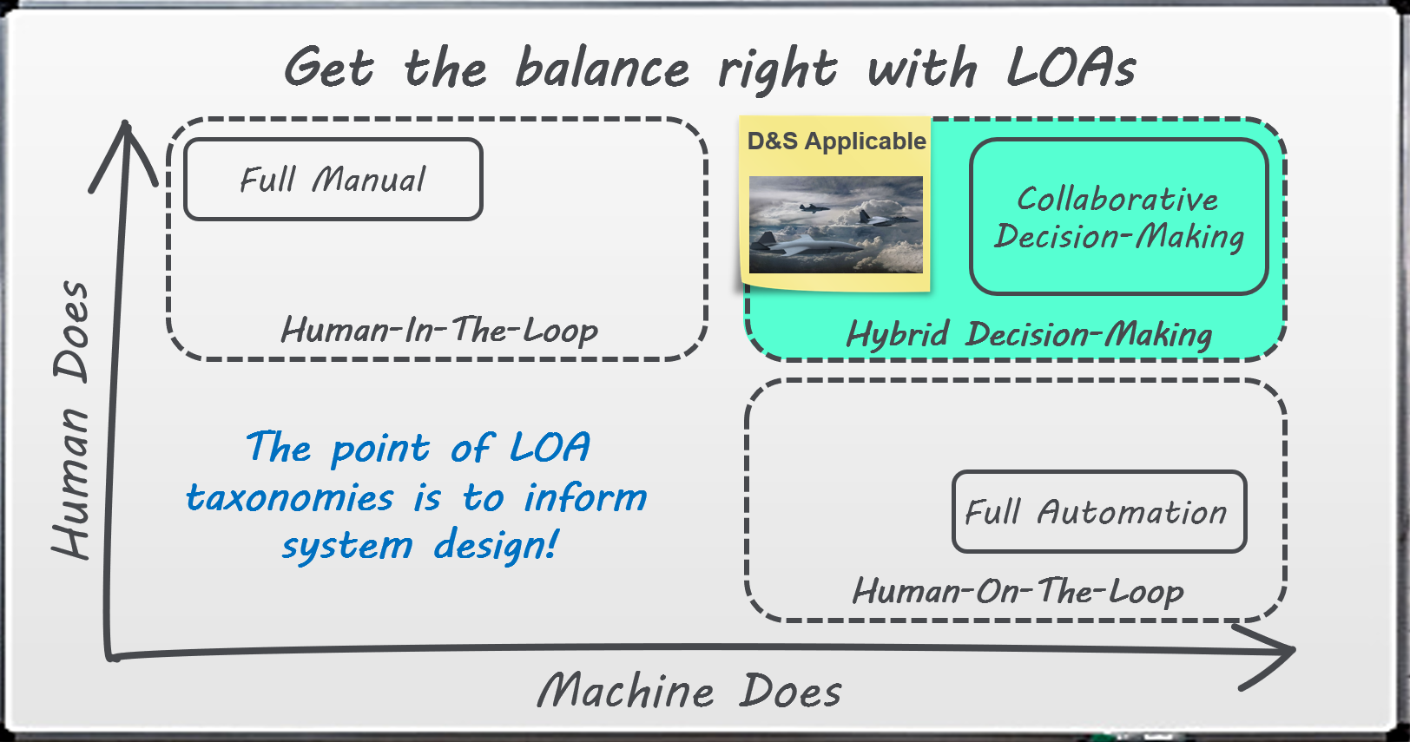
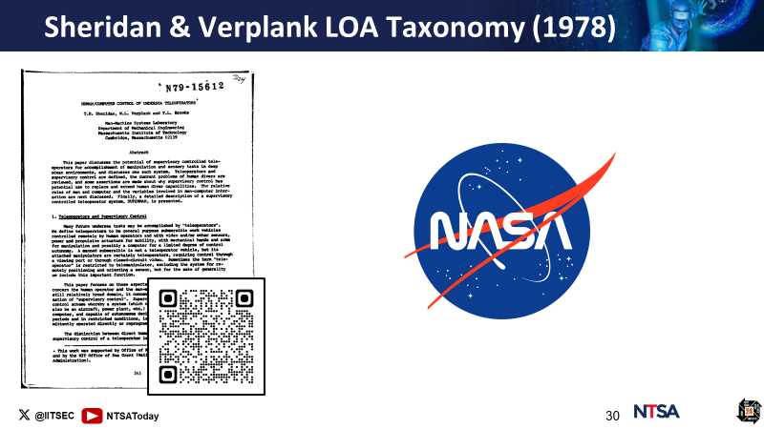
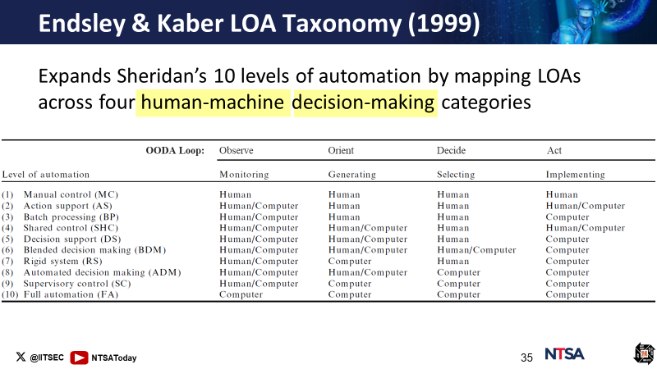
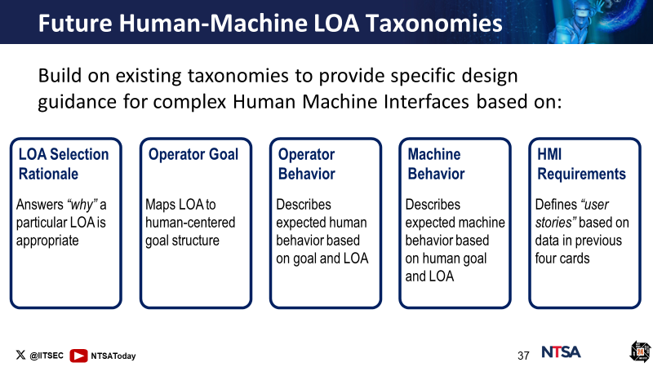
Machines & Level of Automation: A Recap!

Slide 39
LOAs are a good starting point, but
how can I ensure my R&D efforts are
consistent with DoD priorities ?
(1) DoD Communities of Interest
(2) Research gaps and roadmaps
(3) Risk management & Responsible AI

Slide 40
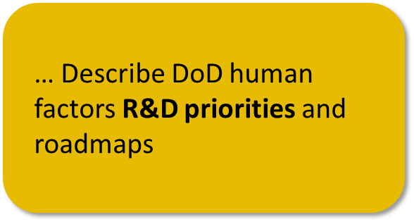






HMT R&D Priorities

Slide 41
DoD Communities of Interest (CoI)
Closely examines the DoD’s S&T investments in the enabling of autonomous systems, to include the strategic assessment of the challenges, gaps, and opportunities.

Slide 42



DoD Communities of Interest (CoI)
Scope/Trust Areas
Focus Going Forward
Outcomes

Slide 43
Research Gaps and Roadmaps
Consensus study report from the National Academies Press examining how to design and implement Human-AI systems. It presents a comprehensive list of research gaps, prioritized against a 15-year roadmap.

Slide 44
Research Gaps and Roadmaps
Human-AI Teaming Methods And Models
Trusting AI Teammates
Human-AI Teaming Processes And Effectiveness
Identification and Mitigation of Bias in Human-AI Teams
Situation Awareness In Human-AI Teams
Training Human-AI Teams
AI Transparency And Explainability
HSI Processes and Measures of Human-AI Team Collaboration And Performance
Human-AI Team Interaction

Slide 45
Research Gaps and Roadmaps
Research Gap Roadmap: Training Human-AI Teams
Near-Term (1-5 years) | Mid-Term (6-10) years | Far-Term (11-15 years)
Developing Human-Centered Human-AI Team-Training Content
Validating Traditional Team Training Methods to Inform New Methods | Training to Calibrate Human-Machine Expectations
Designing Platforms for Human-AI Team Training
 | Adaptive Training Materials Based on Differing Team Compositions and Sizes
 | Training Trust in Human-AI Teaming

Slide 46
Risk Management & Responsible AI
The National Institute of Standards and Technology AI Risk Management Framework is a voluntary guidance designed to manage risks associated with AI. It incorporates trustworthiness considerations into the design, development, use, and evaluation of AI technologies around 5 key steps.

Slide 47
Risk Management & Responsible AI
Scoping and Context Establishment: Define the scope of AI systems, including their intended use, stakeholders, and boundaries
Risk Assessment: Identify and assess risks related to AI, considering factors like data quality, model robustness, and fairness
Risk Mitigation Strategy: Develop strategies to mitigate identified risks, such as improving data quality, enhancing model explainability, and addressing bias
Implementation and Operation: Implement risk mitigation measures, monitor AI systems, and adapt as needed
Evaluation and Feedback: Continuously evaluate AI system performance, collect feedback, and refine risk management strategies

Slide 48


Risk Management & Responsible AI
The DoD issued a memorandum to promote responsible use of AI. The memo provides a governance structure, oversight approaches, and warfighter trust-building efforts to implement responsible AI across 5 DoD AI ethical principles.

Slide 49
Risk Management & Responsible AI
Responsible: exercise appropriate levels of judgment while remaining responsible for the development, deployment, and use of AI capabilities
Equitable: take deliberate steps to minimize unintended bias in AI capabilities
Traceable: develop and deploy AI using transparent and auditable methodologies, data sources, and design procedure and documentation
Reliable: ensure AI capabilities will be subject to testing and assurance across its entire life-cycle
Governable: engineer AI capabilities with the ability to disengage or deactivate deployed systems that demonstrate unintended behavior

Slide 50




HMT Research Priorities: A Recap!

Slide 51
So many factors to consider…
This is a bit overwhelming!
Humans are so limited…

Slide 52


So many factors to consider…
This is a bit overwhelming!
HMT Performance
HMT Performance
AI as teammates
Roadmap priorities
LOAs
Responsible AI
Explainability
Risk framework
R&D
Trust
Research Gaps
Training
Transparency
Situational
Awareness
Biases
Interaction
Methods
Robustness
Reliability
Notes:
– As engineers our eternal goal is to make that perfect tool. That tool capable of doing everything perfectly. Adding a human dimension has changed the game. When it comes to Human Machine Teaming, we have learned that the task is an uphill journey built on an endless supply of unknowns.
Sisyphus by thechewu on DeviantArt
Sisyphus by thechewu on DeviantArt | Cellphone background, Art inspiration, Art (pinterest.com)

Slide 53

Philosophy precept: Apply knowledge of what makes great human-human teams work to human-machine teams!

Slide 54
Ok… so where do I start to enable
warfighters to perform in HMTs?
(1) Calibrate HMT trust
(2) Promote HMT Situation Awareness (SA)
(3) Enable trust and SA via adaptive
Human-Machine Interfaces (HMI)

Slide 55





HMT Performance Enablers
Team Trust
Team SA
Adaptive HMIs

Slide 56

Trust is a willingness to depend on someone else and meet each other’s expectations
Trust is a willingness to depend on someone else and meet each other’s expectations
Trust Calibration
Overtrust
Distrust
Disposi-tional Trust
Situational Trust
Learned Trust
How?
Need to calibrate
Operationalize trust
human trust
Leverage bio-behavioral markers
in real time!
Model real-time trust
Develop trust calibration methods for HMIs

Slide 57

Team SA focuses on group awareness and the capacity to accurately project events in-sync, enabling well-informed decisions
Team SA focuses on group awareness and the capacity to accurately project events in-sync, enabling well-informed decisions
You guessed it,
we need to assess
Same steps
SA in real time!
Operationalize SA & Team SA
Leverage bio-behavioral markers
Model real-time SA
Develop Team SA methods for HMIs

Slide 58

HMT Situation Awareness
Adaptive HMIs need to dynamically present information across LOAs to maximize Team SA and maintain calibrated trust for HMTs
Adaptive HMIs need to dynamically present information across LOAs to maximize Team SA and maintain calibrated trust for HMTs

Slide 59

HMT Situation Awareness
a notional example of an adaptive HMI
dynamic
With an AI Weapons Systems Officer
components
1. AI agent status
2. Dynamic WEZ
3. Live target timeline
4. Dynamic threat list
5. Critical task status
6. Shared situation status
7. Human-machine chat

Slide 60




HMT Performance Enablers: A Recap!

Slide 61
SUMMARY

Slide 62





From Tools to Teammates
HMT Research Priorities
AI Revolution
DoD Communities of Interest
Future Warfare Demands
Research Gaps & Roadmaps
Get the Balance Right
HMT Trust
Modern Mythology
Risk Management and Responsible AI
HMT Situation Awareness
Traditional LOAs
Need for HMT LOAs
Adaptive HMIs
Level of Automation
Performance Enablers

Slide 63






Tutorial References
The Brief History of AI: the World Has Changed Fast – What Might Be Next?
By Max Roser
Human-Machine Teaming for Future Ground Forces
By Mick Ryan
Wired for War
By P. W. Singer
Level of Automation
By National Highway Traffic Safety Administration
Human/Computer Control of Undersea Teleoperations
By T.B. Sheridan &
W. L. Verplank

Slide 64






Tutorial References
Level of Automation Effects on Performance
By M. R. Endsley &
D. B. Kaber
Reliance 21 – DoD Communities of Interest: Autonomy
By DoD CoI
Human-AI Teaming State-of-the-Art and Research Needs
Consensus Study Report from the National Academies Press
Artificial Intelligence Risk Management Framework
By National Institute of Standards and Technology
DoD Memorandum: Implementing Responsible AI
By the Deputy Secretary of Defense

Slide 65
Quiz time!
False: the trend using machines as teammates is accelerating
False: LOA taxonomies need to better describe complex HMT behaviors
True of False: the trend using machines as teammates is slowing down
True of False: human-machine LOA taxonomies are well-defined
… Explain “from tools to teammate” paradigm shift
… Compare and contrast traditional automation taxonomies to human-machine teaming taxonomies
True: DoD HMT R&D priorities and roadmaps are well-defined
True: adaptive HMIs driven by HMT trust and SA are team performance enablers
True of False: human-machine teaming R&D priorities are well-defined
True of False: adaptive human-machine interfaces can enable team performance
… Describe DoD human factors R&D priorities and roadmaps
… Identify Human-Machine Teaming performance enablers

Slide 66

That’s all Folks!
Sandro Scielzo Human Systems Technical Authority CAE USA sandro.scielzo@caemilusa.com

