Slide 1

Motion Sickness in Virtual Environments:
Theory and Practical Considerations
Dr. Behrang Keshavarz, KITE Research Institute – University Health Network
Dr. Bruce Haycock, KITE Research Institute – University Health Network

Slide 2

Why is it important?
Motion sickness affects everyone
1 in 3 people are considered highly susceptible
Two mega-trends make motion sickness highly relevant today:
Relevance
Photo by Pixabay from Pexels
Notes:
MS affects everyone, only those with a complete bilateral vestibular loss cannot get MS (even blind people can)
35% highly susceptible to MS!
MS is an old phenomenon – even ancient Greek knew MS; Still, MS is highly modern concern for two reasons (switch to next slide)

Slide 3
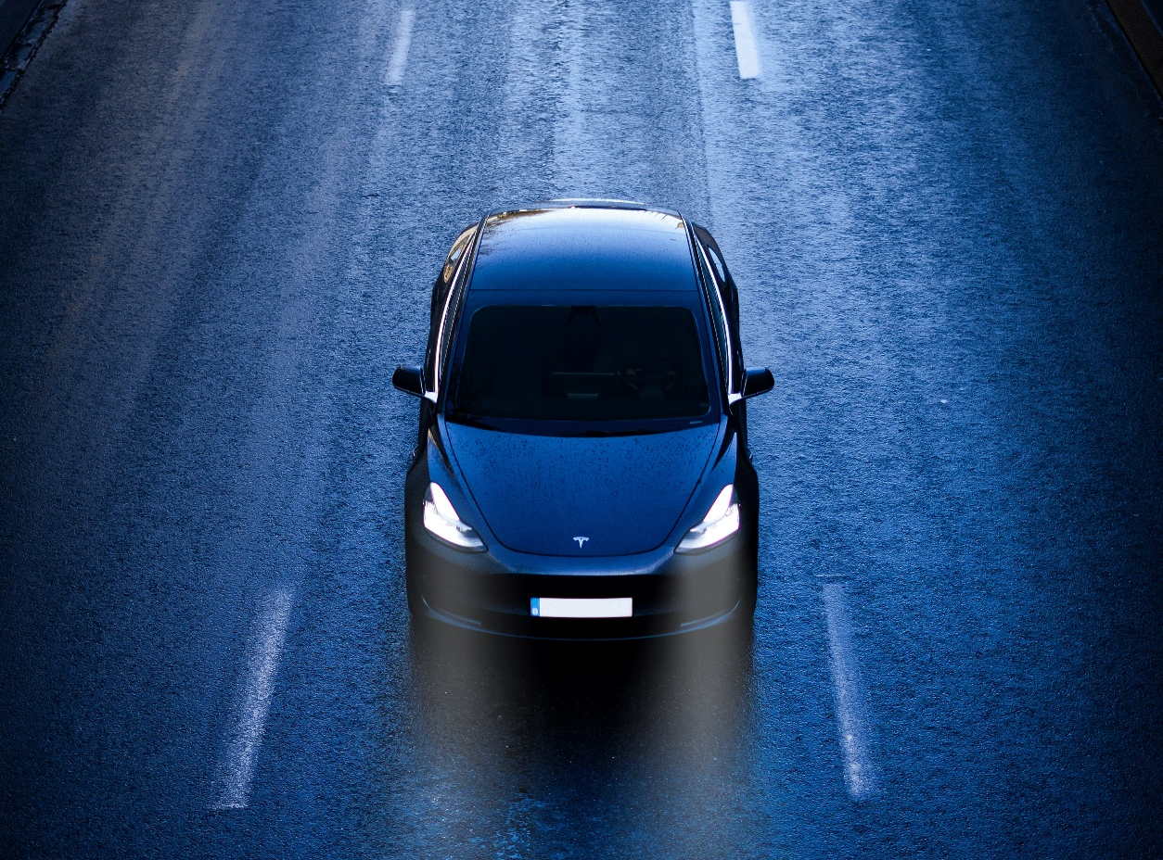
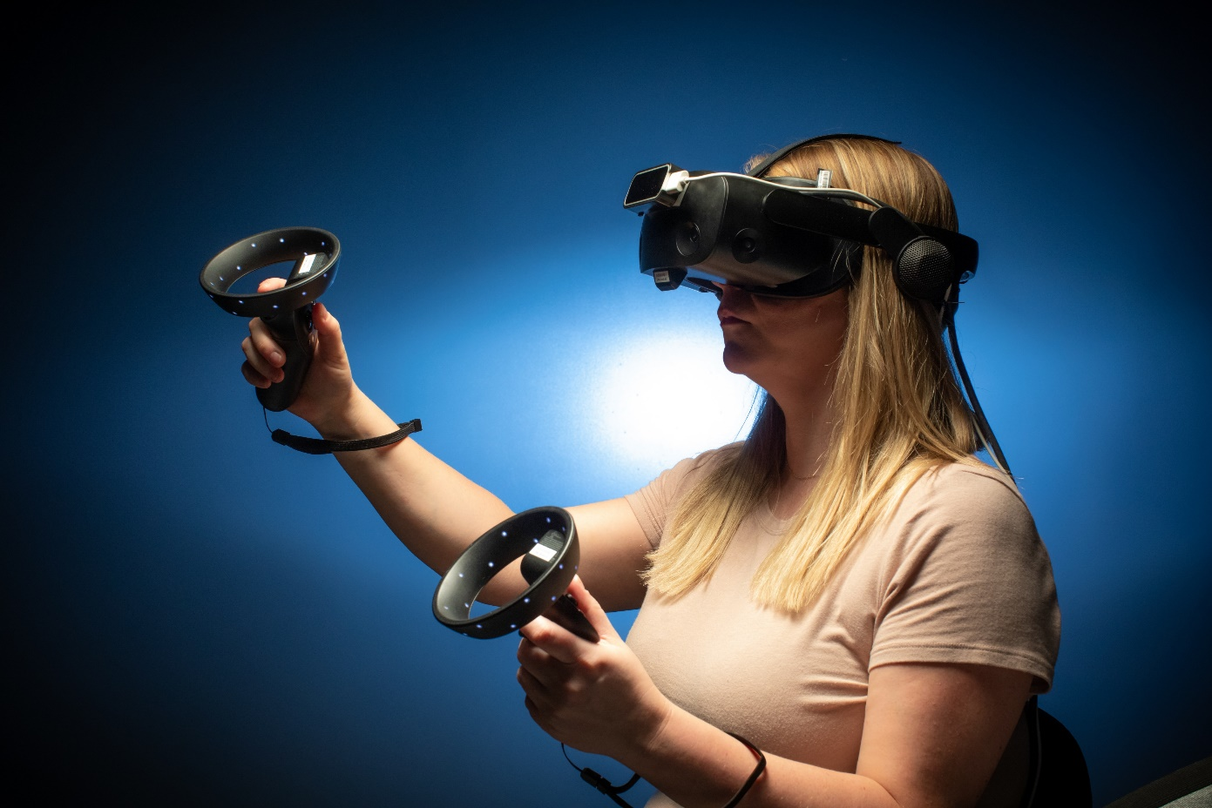
Current challenges
Automated vehicles
VR applications
Reducing current collision costs at $37B CAD and saving thousands
of lives
Million of users worldwide with an estimated market value of
$14.8B USD
Notes:
Automated vehicles: promise to increase safety and make use of your time more efficiently (working, reading etc.) → all those activities increase the risk of MS!
VR: mainstream in many domains, increasing application in various contexts such as health care, rehab, entertainment… market is supposed to grow dramatically and MS is a key limitation of VR success

Slide 4
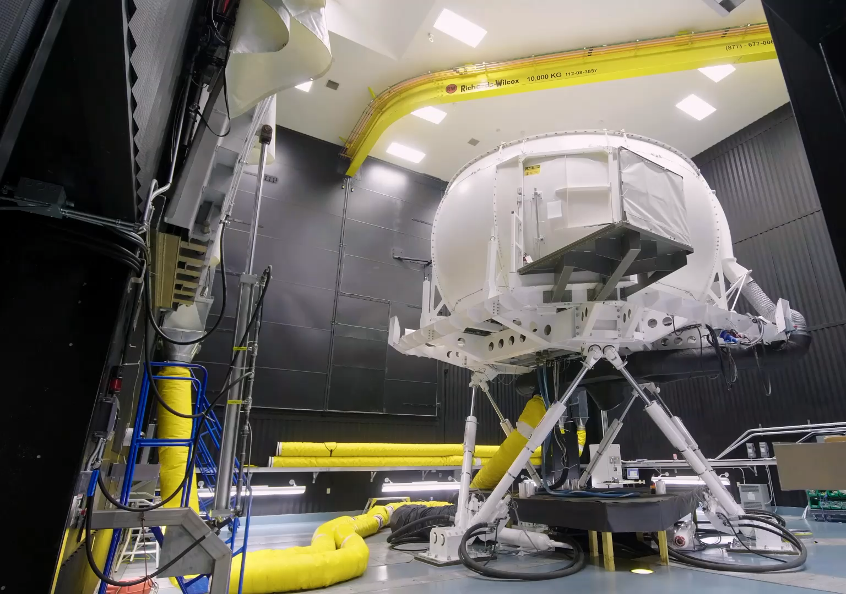
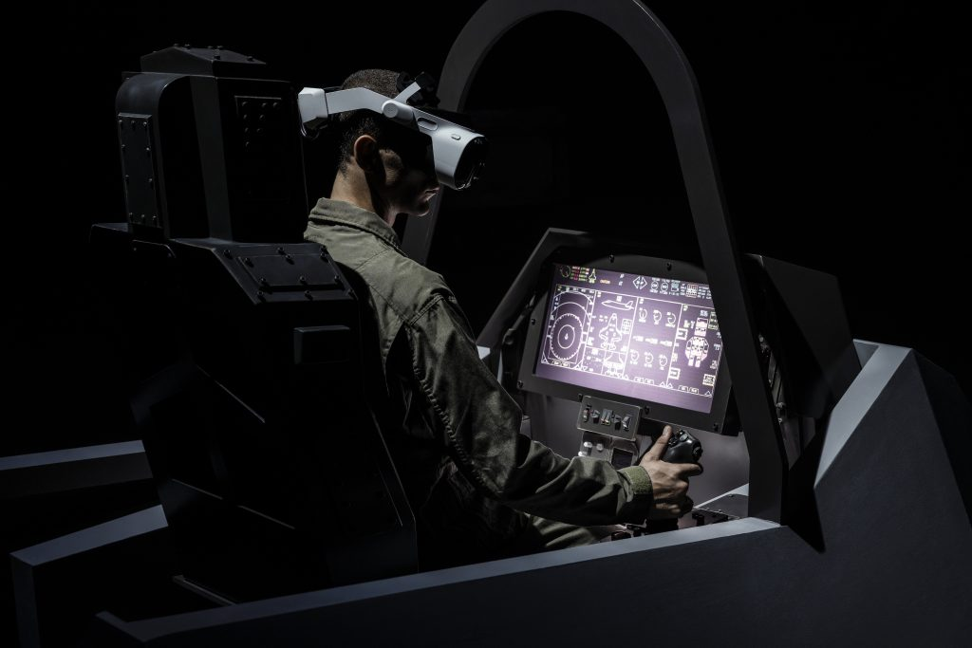
Current challenges
“Traditional” Motion Simulators
VR/MR/XR Simulators
Notes:
More importantly for the IITSEC audience, military training makes extensive use of simulators large and small, as evidenced by exhibit hall,
Including “traditional” simulators and training devices as well as increasing use of VR/MR/XR,
problem of MS remains (the same).

Slide 5


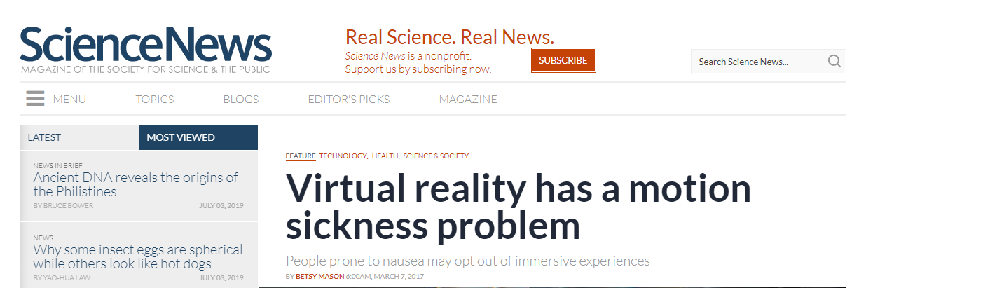
In the media
News
Photo by Pixabay from Pexels
Notes:
- Quotes showing the public awareness of the problem of MS in VR

Slide 6
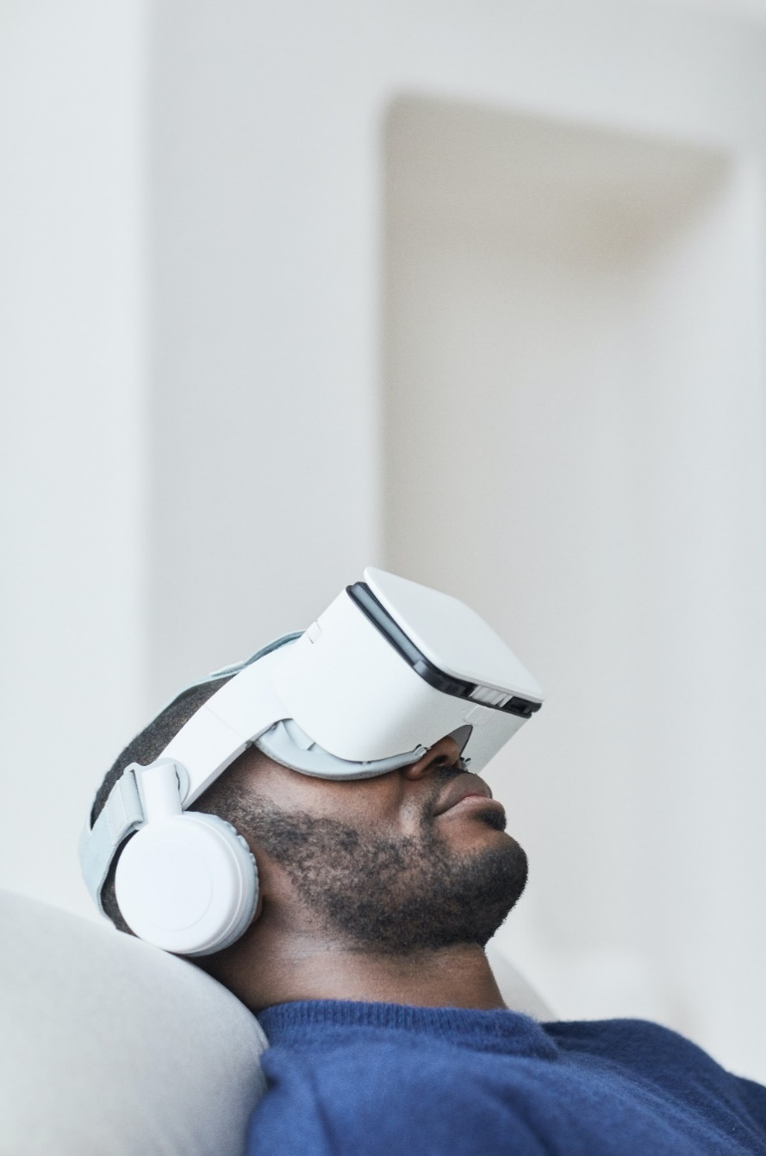
Let’s look at some stats...
1
15
31
15,000
364,000
9,600,000
171,000,000
105,890,000,000
1,710,000
– % of people experiencing motion sickness in Virtual Environments
– number of minutes until Oculus Rift V2 sold out
– % of users who use VR at least once a month
VR sickness
– number of HTC Vive headsets sold in first 10 minutes
– number of google hits for “VR sickness” OR “cyber sickness”
– number of non-mobile VR/AR headsets sold in 2022
– number of VR users worldwide in 2022
– Projected VR market value in 2030 (USD)
– number of VR users who are at risk of experiencing
motion sickness
Photo by August de Richelieu from Pexels
Notes:
- Little intro with numbers: 1% highly underestimating the actual number of VR sickness (70%), but the lowest number that can be found in the literature. Taking this conservative number to get to the last number (1.7 mil) to show that even with this low number MS in VR is a huge issue

Slide 7
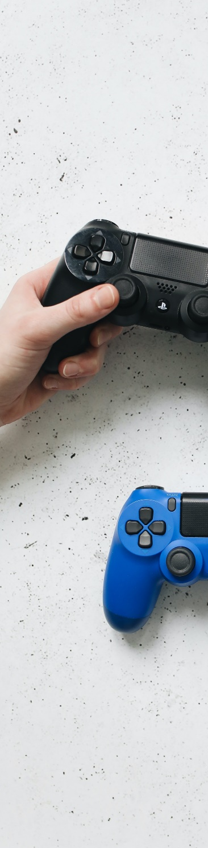
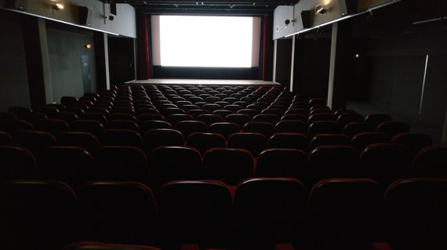
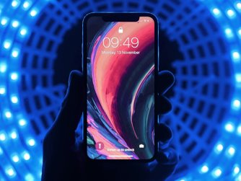
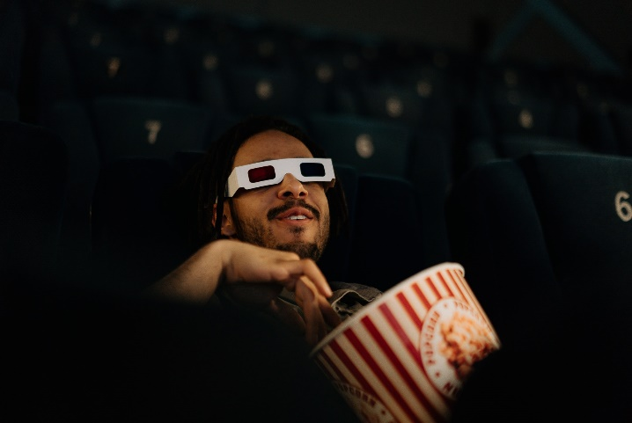
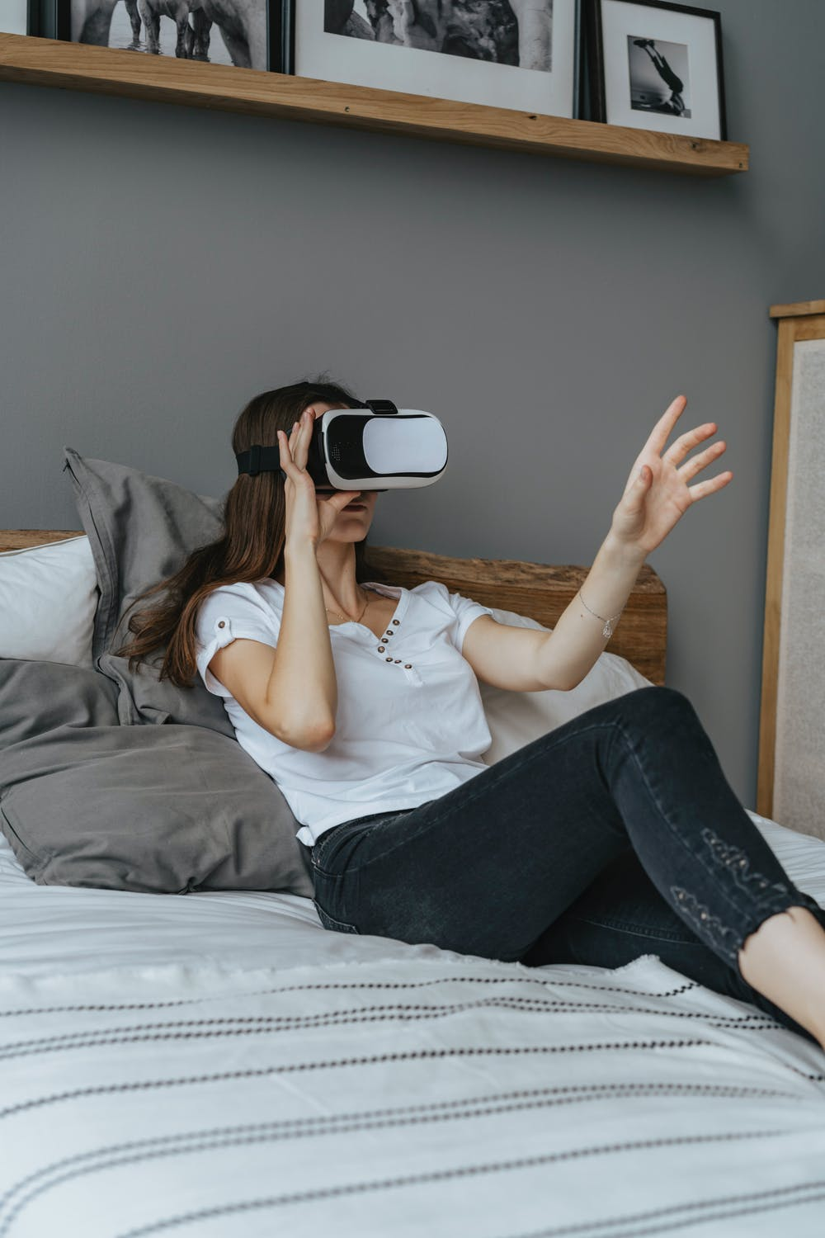
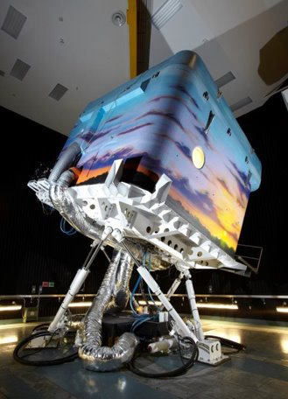

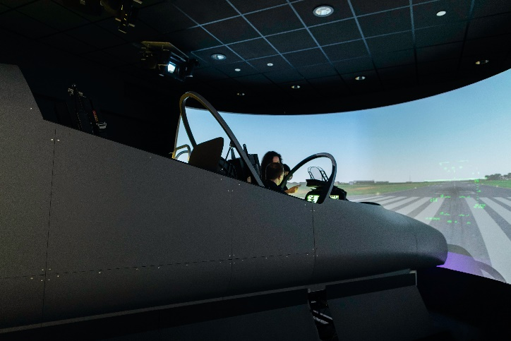
Notes:
Examples of different visual displays where people can get sick (it’s not only VR!)

Slide 8

Goals and Learning Objectives
The main goals of this tutorial are:
  Provide an overview of motion sickness in Virtual Environments
  Provide practical considerations when using or designing VEs
An overview of motion sickness
focusing on four components:
The learning objectives are:
Understand the theoretical underpinnings of VIMS.
Identify and measure VIMS experienced by users in a training device/scenario.
Estimate the relative likelihood of users encountering VIMS in a particular simulator or VR device and associated presented content.
Identify and select possible ways to reduce VIMS experienced by users when setting up their own applications.
Focus

Slide 9





Goals and Learning Objectives
5 Segments:
1. Foundation
Terminology, Theories, Symptomatology
2. Susceptibility
Personal factors, hardware factors, content factors
Focus
3. Measurement
Questionnaires, rating scales, physiological measures
4. Solutions
Pharmacological vs. non-pharmacological (behavioural, situational, technological)
5. Future
Identifying gaps in knowledge
Notes:
- Giving an overview of the presentation’s agenda with some main topics that will be discussed/explained

Slide 10

Theoretical Foundation
of Visually Induced
Motion Sickness (VIMS)
Background
Photo by Mikhail Nilov from Pexels

Slide 11









Terminology
Theoretical Foundation of VIMS
Motion Sickness
Visually Induced²
Traditional¹
cinerama sickness
car sickness
gaming sickness
air sickness
VR/cybersickness³
sea sickness
simulator sickness⁴
space sickness
camel sickness
¹Keshavarz, B., & Golding, J. F. (2022). Motion sickness: current concepts and management. Current Opinion in Neurology, 35(1), 107–112.
²Keshavarz, B., Hecht, H., & Lawson, B. D. (2014). Visually induced motion sickness: Characteristics, causes, and countermeasures. In K. S. Hale & K. M. Stanney (Eds.), Handbook of Virtual Environments: Design, Implementation, and Applications (2nd ed., pp. 648–697). CRC Press.
³Rebenitsch, L., & Owen, C. (2016). Review on Cybersickness in Applications and Visual Displays. Virtual Real., 20(2), 101–125.
⁴Kennedy, R. S., Hettinger, L. J., & Lilienthal, M. G. (1990). Simulator sickness. In G. H. Crampton (Ed.), Motion and Space Sickness.

Slide 12
Symptoms
Theoretical Foundation of VIMS
Gastrointestinal
Nausea
Vomiting
Stomach awareness
Burping
General discomfort
Thermoregulation
Pallor
Sweating
VIMS^{1,2}
Arousal
Fatigue
Drowsiness
Difficulty concentrating
Orientation
Dizziness
Vertigo
Disorientation
Eyestrain
Blurred vision
Headache
Difficulty focusing
Head fullness
Oculomotor
¹Lackner, J. R. (2014). Motion sickness: More than nausea and vomiting. Experimental Brain Research, 232(8), 2493–2510.
²Lawson, B. D. (2014). Motion sickness symptomatology and origins. In K. S. Hale & K. M. Stanney (Eds.), Handbook of Virtual Environments: Design, Implementation, and Applications (2nd ed., pp. 531–599). CRC Press.

Slide 13
Theoretical Foundation of VIMS
Diagnostic criteria
Acute episode of MS/VIMS¹
At least one of the following:
  Nausea/gastrointestinal disturbance
  Thermoregulatory disruption
  Alterations in arousal
  Dizziness and/or vertigo
  Headache and/or ocular strain
Symptoms appear during real/visual motion exposure
Symptoms stop after cessation of real/visual motion
Symptoms are not better accounted for by another disease or disorder
IMPORTANT
MS/VIMS are natural responses and no disease or illness.
Every healthy individual can get motion sick; patients with complete bilateral vestibular loss are immune to motion sickness.
¹Cha, Y.-H., Golding, J., Keshavarz, B., Furman, J., Kim, J.-S., Lopez-Escamez, J. A., Magnusson, M., Yates, B. J., Lawson, B. D., Staab, J., & Bisdorff, A. (2021). Motion sickness diagnostic criteria: Consensus document of the classification committee of the Bárány society. Journal of Vestibular Research: Equilibrium & Orientation.

Slide 14





Theories
Theoretical Foundation of VIMS
Sensory conflict
Postural instability
Eye movements¹
DVP ²
(diff in virtual and physical head pose)
Evolutionary Hypothesis³
¹Ebenholtz, S. M., Cohen, M. M., & Linder, B. J. (1994). The possible role of nystagmus in motion sickness: A hypothesis. Aviation, Space, and Environmental Medicine, 65(11), 1032–1035.
²Palmisano, S., Allison, R. S., & Kim, J. (2020). Cybersickness in Head-Mounted Displays Is Caused by Differences in the User’s Virtual and Physical Head Pose. Frontiers in Virtual Reality, 1.
³Treisman, M. (1977). Motion sickness: An evolutionary hypothesis. Science, 197(4302), 493–495.
Notes:
- will talk more about the first two theories in the next slides, as these are the most popular ones
Eye movements: limiting eye movements can reduce MS; fixation cross often used to reduce MS (can work to some extent)
DVP: very new theory, suggesting that the lag causing differences in the virtual and physical head pose is the main cause of VR sickness
Evolutionary hypothesis: not a theory explaining how you get sick, but rather tries to explain why you show the specific symptoms (nausea, vomiting)

Slide 15





Sensory Conflict^{1,2}
Theoretical Foundation of VIMS
Visual-vestibular conflict (Type II): reading in a car
Visual-vestibular conflict (Type III):
driving simulator
¹Reason, J. T., & Brand, J. J. (1975). Motion sickness. Academic Press.
²Bles, W., Bos, J. E., de Graaf, B., Groen, E., & Wertheim, A. H. (1998). Motion sickness: Only one provocative conflict? Brain Research Bulletin, 47(5), 481–487.

Slide 16
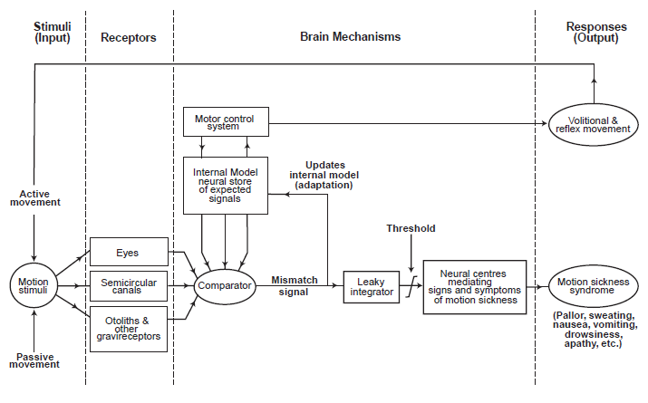
Theoretical Foundation of VIMS
Sensory Conflict^{1,2}
Picture taken from A. Benson
¹Reason, J. T. (1978). Motion sickness adaptation: A neural mismatch model. Journal of the Royal Society of Medicine, 71(11), 819–829.
²Oman, C. M. (1990). Motion sickness: A synthesis and evaluation of the sensory conflict theory. Canadian Journal of Physiology and Pharmacology, 68(2), 294–303.
Notes:
Crucial aspect: neural store – storage that includes all sensory patterns of past motion (visual, vestibular, proprioceptive).
When adequate model found from the neural store matching the current actual sensation, no MS will occur
ONLY if the sensory conflict pattern is unique (i.e., no adequate expectation formed), then MS will occur (not conflict alone!)

Slide 17

Postural Instability^{1,2}
Theoretical Foundation of VIMS
Gastrointestinal
Thermoregulation
Arousal
Orientation
Oculomotor
Input
real/apparent motion
Output
motion sickness symptoms
increased/reduced postural sway
¹Riccio, G. E., & Stoffregen, T. A. (1991). An ecological Theory of Motion Sickness and Postural Instability. Ecological Psychology, 3(3), 195–240. https://doi.org/10.1207/s15326969eco0303_2
²Smart, L. J., Jr, Stoffregen, T. A., & Bardy, B. G. (2002). Visually induced motion sickness predicted by postural instability. Human Factors, 44(3), 451–465.
Notes:
Changes in postural control (more or less sway) PRECEDES the onset of MS.
Postural sway not a byproduct, but the main cause of MS.
Mixed findings in the literature

Slide 18

Factors determining the susceptibility to motion sickness
Prediction
Photo by Tim Mossholder from Pexels

Slide 19


Factors Determining Susceptibility to VIMS
Personal Factors
Sex/Gender¹
Age²
Ethnicity³
Women more susceptible than men?
East Asians potentially more susceptible to VIMS?
Peak 8-10 yrs. for traditional MS. Older adults more susceptible to VIMS?
¹Flanagan, M. B., May, J. G., & Dobie, T. G. (2005). Sex differences in tolerance to visually-induced motion sickness. Aviation, Space, and Environmental Medicine, 76(7), 642–646.
²Keshavarz, B., Ramkhalawansingh, R., Haycock, B., Shahab, S., & Campos, J. L. (2018). Comparing simulator sickness in younger and older adults during simulated driving under different multisensory conditions. Transportation Research Part F: Traffic Psychology and Behaviour, 54, 47–62.
³Klosterhalfen, S., Pan, F., Kellermann, S., & Enck, P. (2006). Gender and race as determinants of nausea induced by circular vection. Gender Medicine, 3(3), 236–242.
Notes:
Sex: many studies suggest that women are more susceptible than men, but only in 50% of studies this was found. Potential explanation: hormonal differences or openness to report symptoms (gender effect)
Age: babies immune to MS, peak susceptibility between 8-10 years, then decline in susceptibility. BUT: In VR there might be second peak in older adults (65+), although mixed findings have been reported. VR sickness in adolescents only sparsely tested, but the few studies suggested that kids are not prone to VR sickness
Ethnicity: east Asians potentially hyper-susceptible, but weak evidence in the literature

Slide 20
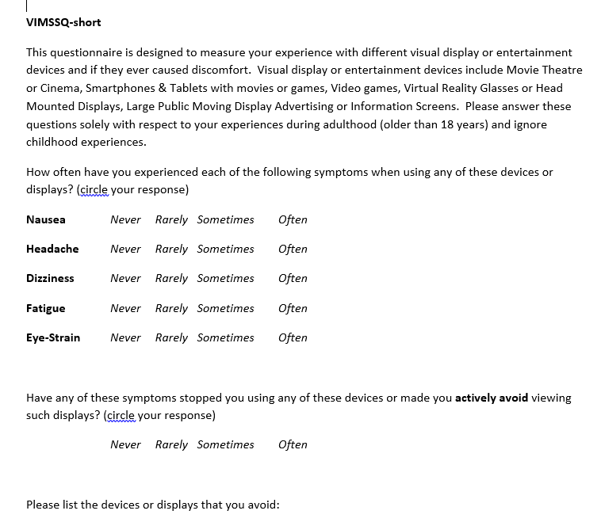
History^{1,2,3}
Factors Determining Susceptibility to VIMS
¹Keshavarz, B., Murovec, B., Mohanathas, N., & Golding, J. F. (2023).
The Visually Induced Motion Sickness Susceptibility Questionnaire (VIMSSQ):
Estimating Individual Susceptibility to Motion Sickness-Like Symptoms When Using Visual Devices. Human Factors, 65(1), 107–124.
²Keshavarz, B., Saryazdi, R., Campos, J. L., & Golding, J. F. (2019). Introducing the VIMSSQ: Measuring susceptibility to visually induced motion sickness.
Proceedings of the Human Factors and Ergonomics Society Annual Meeting, 63(1), 2267–2271.
³Golding, J. F., Rafiq, A., & Keshavarz, B. (2021). Predicting Individual Susceptibility to Visually Induced Motion Sickness by Questionnaire. Frontiers in Virtual Reality, 2
Notes:
The Visually Induced Motion Sickness Susceptibility Questionnaire (VIMSSQ)
- Using past experiences of VIMS to predict future susceptibility – describing the VIMSSQ in more detail as a useful novel tool to predict VIMS (not MS)

Slide 21
Factors Determining Susceptibility to VIMS
History
Online Study: Occurrence of (traditional) motion sickness¹
¹Umatheva, N., Russo, F. A., & Keshavarz, B. (2024). The role of lifestyle factors, biological sex, and racial identity for (visually induced) motion sickness susceptibility: Insights from an online survey. Displays, 82, 102666.
Notes:
Results from an online survey supporting the idea that MS is still a problem in adults (more than 35% sometimes get sick as car passenger
Methods: using the MSSQ capturing past experiences of traditional motion sickness (car, bus etc.)

Slide 22
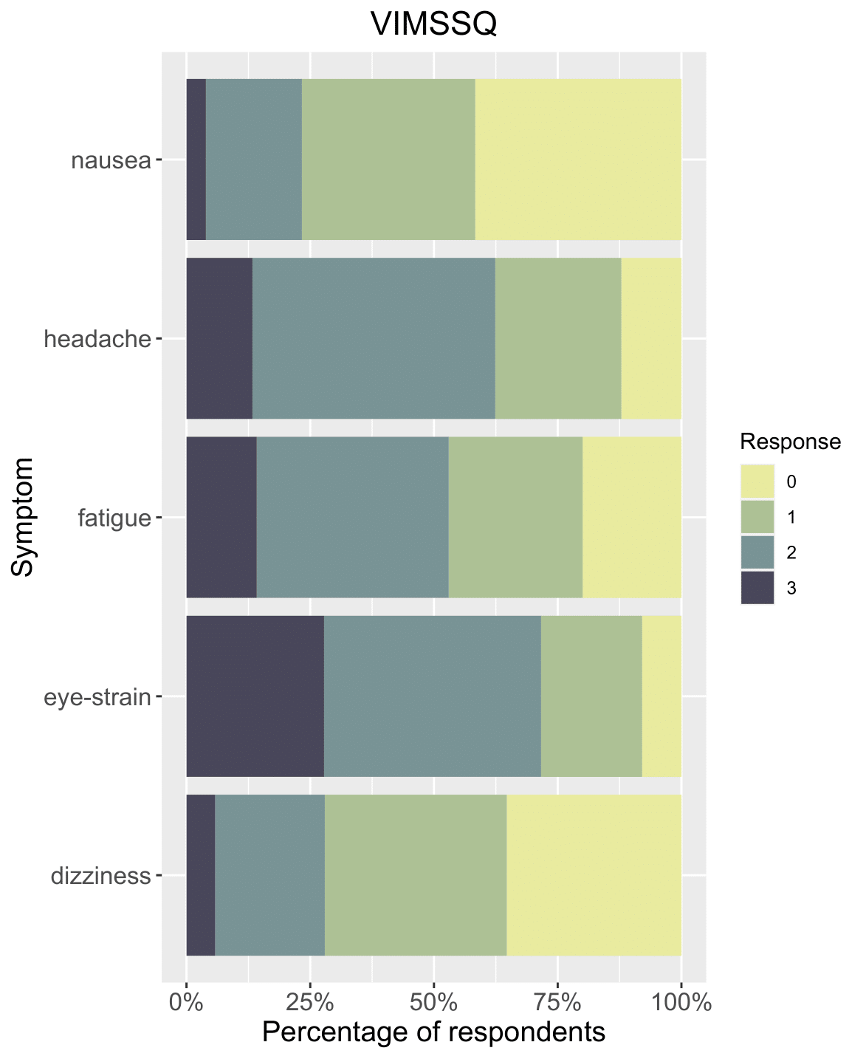
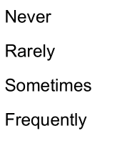
Factors Determining Susceptibility to VIMS
History
Occurrence of visually induced motion sickness¹
Sex-related difference
Female participants reported significantly higher VIMSSQ and MSSQ scores than male participants.
¹Umatheva, N., Russo, F. A., & Keshavarz, B. (2024). The role of lifestyle factors, biological sex, and racial identity for (visually induced) motion sickness susceptibility: Insights from an online survey. Displays, 82, 102666.
Notes:
- Data from online survey showing prevalence of different symptoms when using any type of visual display (including simulators, TV, VR etc)

Slide 23
Factors Determining Susceptibility to VIMS
History
Main finding¹: VIMSSQ is a good predictors of VIMS (R² = .034)
Combination of
VIMSSQ
MSSQ-pcn
Migraine
Syncope
Dizziness
Explained 56% of the variance
¹Golding, J. F., Rafiq, A., & Keshavarz, B. (2021). Predicting Individual Susceptibility to Visually Induced Motion Sickness by Questionnaire. Frontiers in Virtual Reality, 2.
Notes:
- Demonstrating the usefulness of the VIMSSQ-short to predict VIMS severity as measured in an experimental study

Slide 24



Factors Determining Susceptibility to VIMS
Hardware Factors
Field of view¹
Visual Setup²
Motion System
Larger FOV often increases VIMS
Screen resolution, refresh rate, time lag
Motion DOFs, scale, smoothness
¹Bos, J. E., de Vries, S. C., van Emmerik, M. L., & Groen, E. L. (2010). The effect of internal and external fields of view on visually induced motion sickness. Applied Ergonomics, 41(4), 516–521.
²Saredakis, D., Szpak, A., Birckhead, B., Keage, H. A. D., Rizzo, A., & Loetscher, T. (2020). Factors Associated With Virtual Reality Sickness in Head-Mounted Displays: A Systematic Review and Meta-Analysis. Frontiers in Human Neuroscience, 14.
Notes:
Field of view: larger -> stronger vection -> more likely to experience VIMS
Visual setup: time lag, FOV, resolution, refresh rate / frame rate (often locked) all may contribute to the occurrence of VIMS
Motion system: fixed-base vs. small/reduced DOF vs large motion systems, smoothness of motion (artifacts)

Slide 25

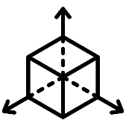
Factors Determining Susceptibility to VIMS
Content Factors
Optical Flow¹
Visual Rotations²
Motion Cueing³
Scene characteristics (density, retinal speed), navigation methods
Single vs. combined axes, angular rates
Appropriate motion cues may reduce VIMS
¹Keshavarz, B., Philipp-Muller, A. E., Hemmerich, W., Riecke, B. E., & Campos, J. L. (2019). The effect of visual motion stimulus characteristics on vection and visually induced motion sickness. Displays, 58, 71–81.
²Keshavarz, B., & Hecht, H. (2011). Axis Rotation and Visually Induced Motion Sickness: The Role of Combined Roll, Pitch, and Yaw Motion. Aviation, Space, and Environmental Medicine, 82(11), 1023–1029.
³Keshavarz, B., Ramkhalawansingh, R., Haycock, B., Shahab, S., & Campos, J. L. (2018). Comparing simulator sickness in younger and older adults during simulated driving under different multisensory conditions. Transportation Research Part F: Traffic Psychology and Behaviour, 54, 47–62.
Notes:
Optical flow: directly impact the level of self-motion perception (vection) and have also been shown to impact VIMS – speed, density etc.,
as well as navigation type (hyperjump, teleport etc. to potentially avoid flow altogether)
Visual rotations: combined axis rotations are quite bad for VIMS, yaw axis not as bad as pitch and roll in some instances.
Motion cues: “no motion is better than bad motion”. Proper + reliable cueing can help reduce VIMS. False cues and artifacts (hard limits!) can quickly reverse that benefit

Slide 26

Measuring
motion sickness
Measures
Photo by Timur Weber from Pexels

Slide 27

Measures
Measuring VIMS
Simulator Sickness Questionnaire¹ (SSQ) – 16 items
Nausea Profile² (NP) – 0-100% overall, 3 subscales
Misery Scale³ (MISC) – 0-9 scale
Questionnaires
¹Kennedy, R. S., Lane, N. E., Berbaum, K. S., & Lilienthal, M. G. (1993). Simulator Sickness Questionnaire: An Enhanced Method for Quantifying Simulator Sickness. The International Journal of Aviation Psychology, 3(3), 203–220.
²Muth, E. R., Stern, R. M., Thayer, J. F., & Koch, K. L. (1996). Assessment of the multiple dimensions of nausea: the Nausea Profile (NP). Journal of psychosomatic research, 40(5), 511–520.
³Bos, J. E., MacKinnon, S. N., & Patterson, A. (2005). Motion sickness symptoms in a ship motion simulator: effects of inside, outside, and no view. Aviation,
Space, and Environmental Medicine, 76(12), 1111–1118.
Notes:
Many different questionnaires exist – SSQ the most prominent one (several adaptations for VR have been proposed), but SSQ still the most used one. Adaptation of the MSAQ/MSQ
Misery scale: measures different symptoms in a single score, with different scores representing different severities. Simple, yet needs some training to be able to accurately use.

Slide 28
Measuring VIMS
Measures
Fast Motion Sickness Scale (FMS)¹
¹Keshavarz, B., & Hecht, H. (2011). Validating an Efficient Method to Quantify Motion Sickness. Human Factors: The Journal of the Human Factors and Ergonomics Society, 53(4), 415–426.
Notes:
- FMS: Simple and effective tool; 20 point scale; established as one of the most often used single-rating scales for the nausea aspect of motion sickness

Slide 29

Measuring VIMS
Measures
Gastric activity (EGG)
Heart Rate & HR variability (ECG)
Sweating response (EDA)
Breathing rate
Body temperature
Physiology^{1,2,3}
¹Tauscher, J.-P., Witt, A., Bosse, S., Schottky, F. W., Grogorick, S., Castillo, S., & Magnor, M. (2020). Exploring neural and peripheral physiological correlates of simulator sickness. Computer Animation and Virtual Worlds, 31(4–5), e1953.
²Dennison, M. S., Wisti, A. Z., & D’Zmura, M. (2016). Use of physiological signals to predict cybersickness. Displays, 44, 42–52.
³Hu, S., Grant, W. F., Stern, R. M., & Koch, K. L. (1991). Motion sickness severity and physiological correlates during repeated exposures to a rotating optokinetic drum. Aviation, Space, and Environmental Medicine, 62(4), 308–314.
Notes:
MANY studies looked into physiological correlates. Very mixed findings.
Some interesting correlations, but nothing robust that could be used as an objective measure of MS
Electrogastrography (EGG) showed good results, but a signal that is extremely prone to movement artifacts, making it de facto impractical.

Slide 30
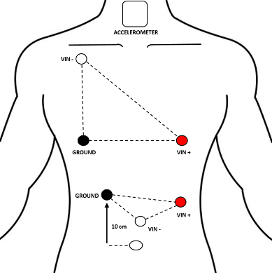
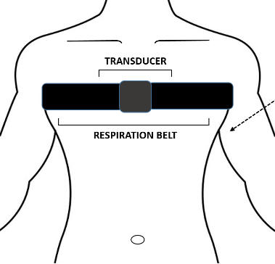
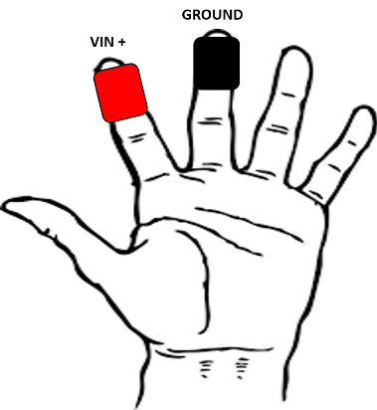
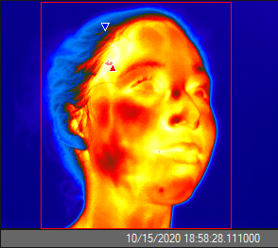
Measuring VIMS
Measures
Physiological measures in combination with machine learning technique¹
43 participants (25 females), mean age 27 years
Visual scene (bicycle video)
FMS and SSQ as dependent variables
¹Keshavarz, B., Peck, K., Rezaei, S., & Taati, B. (2022). Detecting and predicting visually induced motion sickness with physiological measures in combination with machine learning techniques. International Journal of Psychophysiology: Official Journal of the International Organization of Psychophysiology, 176, 14–26.
Notes:
Recent approach: combining physiological measures with machine learning to identify patterns across different signals that may predict MS.
Study from our lab

Slide 31
Measuring VIMS
Measures
Notes:
Results: showing difference between sick and non-sick participant across many different measures. Highlighting the most relevant findings here.

Slide 32
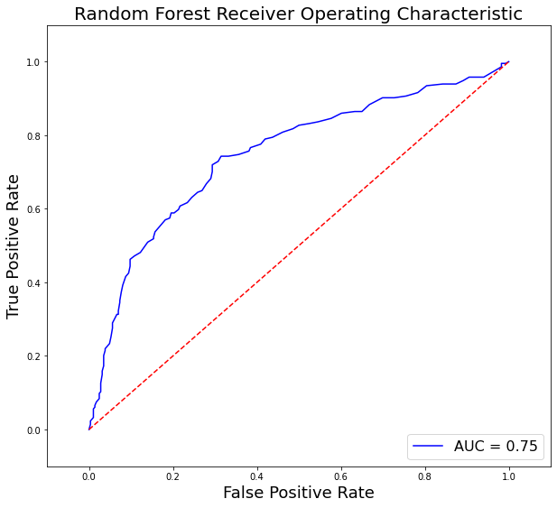
Measuring VIMS
Measures
Top 5 features
Mean heartbeat interval
Mean respiration rate
Mean facial temperature
Body temperature trend
Skin conductance trend
Pearson correlation = .41
Area Under the Curve = 0.75
Random forest models
Promising results, but physiological measures alone do not seem to be sufficient to reliably detect motion sickness
Notes:
Overall: promising results (also when predicting 2 minutes in advance – slightly worse scores, but similar)
BUT: not robust enough, and more research needed to look into this further. Good first start, though.

Slide 33
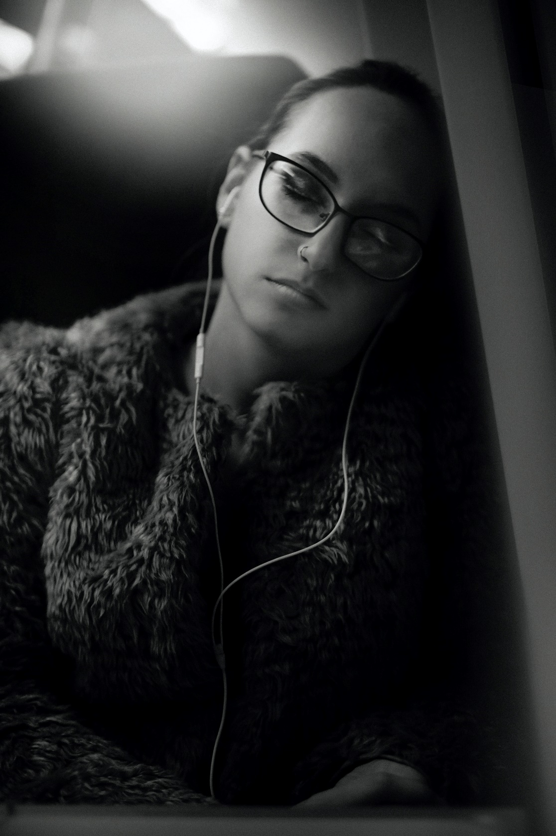
Countermeasures against motion sickness
Solutions
Photo by Zoltan Tasi on Unsplash

Slide 34
Counter-measures
VIMS Countermeasures
Method
Pharmacological
Non-pharmacological
behavioural
situational
technological

Slide 35

Pharmacological Treatments^{1,2,3}
VIMS Countermeasures
Cholinergic
Histaminergic
Antipsychotics
Benzodiazepines
Neurokinin-1 antagonists
Barbiturates
¹Schmäl, F. (2013). Neuronal mechanisms and the treatment of motion sickness. Pharmacology, 91(3–4), 229–241. https://doi.org/10.1159/000350185
²Stankovic, A. S., Alvarenga, D. L., Coleman Daniels, V. R., Simmons, R. G., Buckey, J. C., & Putcha, L. (2019). Intranasal Scopolamine for Motion Sickness. Aerospace Medicine and Human Performance, 90(11), 917–924. https://doi.org/10.3357/AMHP.5456.2019
³Golding, J. F., & Gresty, M. A. (2015). Pathophysiology and treatment of motion sickness: Current Opinion in Neurology, 28(1), 83–88. https://doi.org/10.1097/WCO.0000000000000163
Notes:
Overview of the many pharmacological solutions that exist
PRO: they do work for most people, inexpensive, easily accessible
CON: side effects (drowsy, temporary mild cognitive impairment etc.) – not useful for testing performance or attention in simulation studies. Need to find non-pharmacological solutions

Slide 36




VIMS Countermeasures
Behavioural
Postural support¹
Breathing²
Exposure³
Habituation⁴
Resticting body movements may reduce MS
Controlled breathing has shown promising results
Stepwise exposure is helpful
Best method, but has some disadvantages
¹Keshavarz, B., Novak, A. C., Hettinger, L. J., Stoffregen, T. A., & Campos, J. L. (2017). Passive restraint reduces visually induced motion sickness in older adults. Journal of Experimental Psychology: Applied, 23(1), 85–99.
²Yen Pik Sang, F. D., Billar, J. P., Golding, J. F., & Gresty, M. A. (2003). Behavioral methods of alleviating motion sickness: Effectiveness of controlled breathing and a music audiotape. Journal of Travel Medicine, 10(2), 108–111.
³Domeyer, J. E., Cassavaugh, N. D., & Backs, R. W. (2013). The use of adaptation to reduce simulator sickness in driving assessment and research. Accident Analysis & Prevention, 53, 127–132.
⁴Stanney, K. M., Kennedy, R. S., Drexler, J. M., & Harm, D. L. (1999). Motion sickness and proprioceptive aftereffects following virtual environment exposure.
Applied Ergonomics, 30(1), 27–38.
Notes:
Postural support: going back to the theory, providing support of the body (i.e., restricting motion) can indeed reduce MS, but not fully eliminate. Also mixed findings in the literature
Breathing: controlled breathing has been shown across few studies to reduced MS significantly
Exposure: stepwise adaptation to the simulator can be very useful in reducing the occurrence and severity of MS
Habituation: best non-pharma treatment available. BUT: very time consuming, not pleasant for the user, expensive – not always feasible.

Slide 37



VIMS Countermeasures
Situational
Music¹
Smells²
Airflow³
Music perceived as “pleasant”
Odors perceived as “pleasant“
Constant airflow to the face
¹Peck, K., Russo, F., Campos, J. L., & Keshavarz, B. (2020). Examining potential effects of arousal, valence, and likability of music on visually induced motion sickness. Experimental Brain Research.
²Keshavarz, B., Stelzmann, D., Paillard, A., & Hecht, H. (2015). Visually induced motion sickness can be alleviated by pleasant odors. Experimental Brain Research, 233(5), 1353–1364.
³D’Amour, S., Bos, J. E., & Keshavarz, B. (2017). The efficacy of airflow and seat vibration on reducing visually induced motion sickness. Experimental Brain Research, 235(9), 2811–2820.
Notes:
Results from our own research: investigated many situational factors and found that three were quite promising in reducing MS:
Music that was, odors, airflow

Slide 38
VIMS Countermeasures
Situational
Three independent, experimental studies
Exposed to VIMS-inducing video (bicycle ride)
Recorded VIMS via SSQ and FMS
Manipulated different countermeasures:
  Music¹ (Peck, Russo, Campos & Keshavarz, 2020)
  Smells² (Keshavarz, Stelzmann, Paillard & Hecht, 2015)
  Airflow³ (D’Amour, Bos & Keshavarz, 2017)
¹Peck, K., Russo, F., Campos, J. L., & Keshavarz, B. (2020). Examining potential effects of arousal, valence, and likability of music on visually induced motion sickness. Experimental Brain Research.
²Keshavarz, B., Stelzmann, D., Paillard, A., & Hecht, H. (2015). Visually induced motion sickness can be alleviated by pleasant odors. Experimental Brain Research, 233(5), 1353–1364.
³D’Amour, S., Bos, J. E., & Keshavarz, B. (2017). The efficacy of airflow and seat vibration on reducing visually induced motion sickness. Experimental Brain Research, 235(9), 2811–2820.
Notes:
Summary of the methodology

Slide 39




VIMS Countermeasures
Situational
Notes:
Summary of the results: all countermeasures reduced MS severity by almost 50%. Great result for simple and easy-to-apply methods, but cannot fully prevent MS.

Slide 40



VIMS Countermeasures
Technological
Time Lag¹
Reference Frame²
Motion Cues³
Higher update rates and minimal buffering
Provide stable visual reference or horizon
Accurate motion cueing to reduce sensory conflict
¹Moss, J. D., & Muth, E. R. (2011). Characteristics of Head-Mounted Displays and Their Effects on Simulator Sickness. Human Factors: The Journal of the Human Factors and Ergonomics Society, 53(3), 308–319.
²Prothero, J. D., Draper, M. H., Furness, T. A., 3rd, Parker, D. E., & Wells, M. J. (1999). The use of an independent visual background to reduce simulator side-effects. Aviation, Space, and Environmental Medicine, 70(3 Pt 1), 277–283.
³Klüver, M., Herrigel, C., Heinrich, C., Schöner, H.-P., & Hecht, H. (2016). The behavioral validity of dual-task driving performance in fixed and moving base driving simulators. Transportation Research Part F: Traffic Psychology and Behaviour, 37, 78–96.

Slide 41

Where do we go
from here?
Future Directions
Photo by Mark Neal from Pexels
Notes:
Still much that is not known around the topic.
An overview of future research we and others will be performing

Slide 42
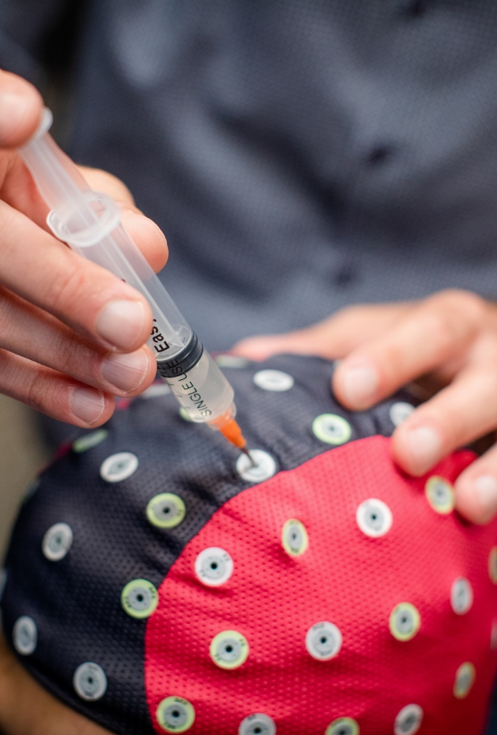


Future Directions
Physiology
What are the underlying (neuro)physiological processes of motion sickness in real and virtual environments?
Understand
Susceptibility
How can we accurately estimate the risk of motion sickness using different measures?

Slide 43
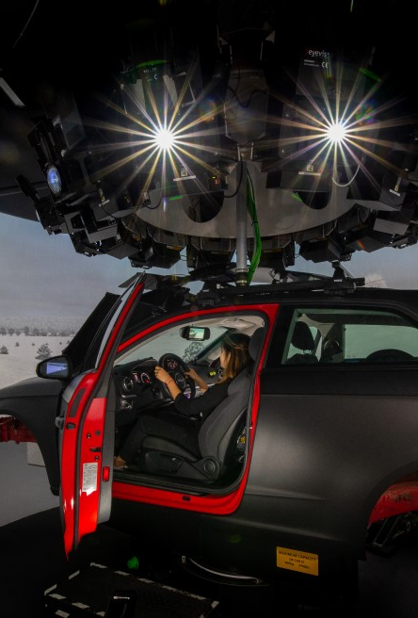


Future Directions
Performance
How does motion sickness affect perception and performance in simulators and in the real world?
Impact
Other concepts
What is the nature of the relationship between motion sickness and other phenomena such as vection and presence?

Slide 44
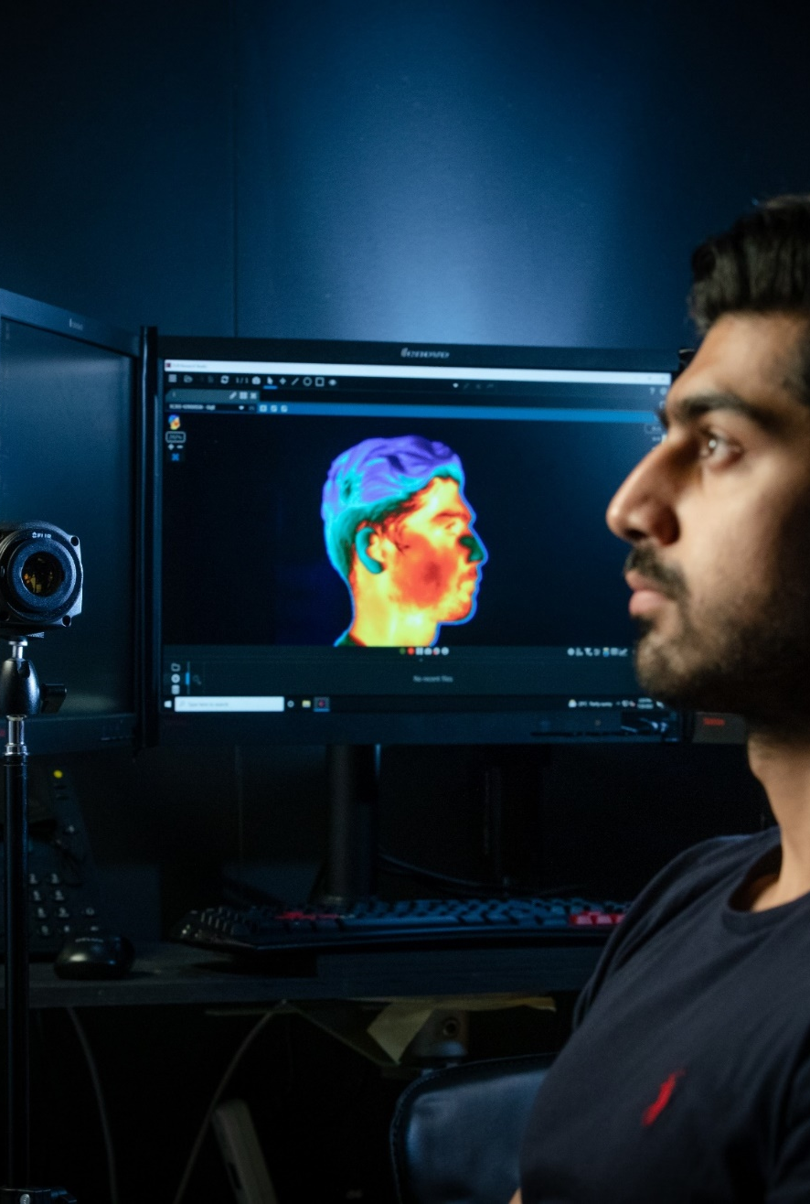


Future Directions
Multisensory
Can the stimulation of multiple senses (tactile, auditory, olfactory) reduce motion sickness?
Prevention
Temperature
Can changes in room/body temperature reduce motion sickness?

Slide 45

Summary
  Key recommendations as related to points given:
  Choose users with care depending on the research question (use questionnaires to assess susceptibility).
  Design your stimulus with regards to the research question: Avoid unnecessary elements causing visual clutter/optical flow.
  Minimize excessive or abrupt visual motion.
  Provide a multisensory simulation (vision, hearing, touch, vestibular etc.). BUT: No motion is better than bad motion!
  Provide a pleasant ambience for the user (music, airflow, stress reduction etc.).
  Let users slowly familiarize themselves with the VE.
  Monitor signs of VIMS closely and use appropriate measures.
  Always record VIMS data to ensure integrity of performance data.
Take home message

Slide 46
Summary
Learning Objectives Recap
Understand the theoretical underpinnings of VIMS.
Identify and measure VIMS experienced by users in a training device/scenario.
Evaluate the likelihood of users encountering VIMS in a particular simulator or VR device and associated content.
Identify and select possible ways to reduce VIMS experienced by users in their own applications.
✓
An overview of motion sickness
focusing on four components:
✓
Take home message
✓
✓

Slide 47
Summary
  Motion sickness is a key limitation of modern technologies that needs to be addressed to allow the full potential of the technology to unfold.
  Various factors affect the susceptibility to motion sickness, making accurate predictions challenging.
  Objective measurements for motion sickness do not currently exist, but physiological signs in combination with other measures could be useful.
  Non-pharmacological treatments exist, but they cannot fully prevent motion sickness.
Take home message

Slide 48
Bibliography
Bles, W., Bos, J. E., de Graaf, B., Groen, E., & Wertheim, A. H. (1998). Motion sickness: Only one provocative conflict? Brain Research Bulletin, 47(5), 481–487.
Bos, J. E., de Vries, S. C., van Emmerik, M. L., & Groen, E. L. (2010). The effect of internal and external fields of view on visually induced motion sickness. Applied Ergonomics, 41(4), 516–521. https://doi.org/10.1016/j.apergo.2009.11.007
Bos, J. E., MacKinnon, S. N., & Patterson, A. (2005). Motion sickness symptoms in a ship motion simulator: Effects of inside, outside, and no view. Aviation, Space, and Environmental Medicine, 76(12), 1111–1118.
Cha, Y.-H., Golding, J. F., Keshavarz, B., Furman, J., Kim, J.-S., Lopez-Escamez, J. A., Magnusson, M., Yates, B. J., Lawson, B. D., & Advisors: (2021). Motion sickness diagnostic criteria: Consensus Document of the Classification Committee of the Bárány Society. Journal of Vestibular Research: Equilibrium & Orientation, 31(5), 327–344. https://doi.org/10.3233/VES-200005
D’Amour, S., Bos, J. E., & Keshavarz, B. (2017). The efficacy of airflow and seat vibration on reducing visually induced motion sickness. Experimental Brain Research, 235(9), 2811–2820. https://doi.org/10.1007/s00221-017-5009-1
Dennison, M. S., Wisti, A. Z., & D’Zmura, M. (2016). Use of physiological signals to predict cybersickness. Displays, 44, 42–52. https://doi.org/10.1016/j.displa.2016.07.002
Domeyer, J. E., Cassavaugh, N. D., & Backs, R. W. (2013). The use of adaptation to reduce simulator sickness in driving assessment and research. Accident Analysis & Prevention, 53, 127–132. https://doi.org/10.1016/j.aap.2012.12.039
Ebenholtz, S. M., Cohen, M. M., & Linder, B. J. (1994). The possible role of nystagmus in motion sickness: A hypothesis. Aviation, Space, and Environmental Medicine, 65(11), 1032–1035.
Flanagan, M. B., May, J. G., & Dobie, T. G. (2005). Sex differences in tolerance to visually-induced motion sickness. Aviation, Space, and Environmental Medicine, 76(7), 642–646.
Golding, J. F., & Gresty, M. A. (2015). Pathophysiology and treatment of motion sickness: Current Opinion in Neurology, 28(1), 83–88. https://doi.org/10.1097/WCO.0000000000000163
Golding, J. F., Rafiq, A., & Keshavarz, B. (2021). Predicting Individual Susceptibility to Visually Induced Motion Sickness by Questionnaire. Frontiers in Virtual Reality, 2. https://doi.org/10.3389/frvir.2021.576871
Hu, S., Grant, W. F., Stern, R. M., & Koch, K. L. (1991). Motion sickness severity and physiological correlates during repeated exposures to a rotating optokinetic drum. Aviation, Space, and Environmental Medicine, 62(4), 308–314.
Kennedy, R. S., Hettinger, L. J., & Lilienthal, M. G. (1990). Simulator sickness. In G. H. Crampton (Ed.), Motion and Space Sickness.
Kennedy, R. S., Lane, N. E., Berbaum, K. S., & Lilienthal, M. G. (1993). Simulator Sickness Questionnaire: An Enhanced Method for Quantifying Simulator Sickness. The International Journal of Aviation Psychology, 3(3), 203–220. https://doi.org/10.1207/s15327108ijap0303_3
Keshavarz, B., & Golding, J. F. (2022). Motion sickness: Current concepts and management. Current Opinion in Neurology, 35(1), 107–112. https://doi.org/10.1097/WCO.0000000000001018
Keshavarz, B., & Hecht, H. (2011a). Axis Rotation and Visually Induced Motion Sickness: The Role of Combined Roll, Pitch, and Yaw Motion. Aviation, Space, and Environmental Medicine, 82(11), 1023–1029. https://doi.org/10.3357/ASEM.3078.2011
Keshavarz, B., & Hecht, H. (2011b). Validating an Efficient Method to Quantify Motion Sickness. Human Factors: The Journal of the Human Factors and Ergonomics Society, 53(4), 415–426. https://doi.org/10.1177/0018720811403736
Keshavarz, B., Hecht, H., & Lawson, B. D. (2014). Visually induced motion sickness: Characteristics, causes, and countermeasures. In K. S. Hale & K. M. Stanney (Eds.), Handbook of Virtual Environments: Design, Implementation, and Applications (2nd ed., pp. 648–697). CRC Press.
Keshavarz, B., Murovec, B., Mohanathas, N., & Golding, J. F. (2023). The Visually Induced Motion Sickness Susceptibility Questionnaire (VIMSSQ): Estimating Individual Susceptibility to Motion Sickness-Like Symptoms When Using Visual Devices. Human Factors, 65(1), 107–124. https://doi.org/10.1177/00187208211008687
Keshavarz, B., Novak, A. C., Hettinger, L. J., Stoffregen, T. A., & Campos, J. L. (2017). Passive restraint reduces visually induced motion sickness in older adults. Journal of Experimental Psychology: Applied, 23(1), 85–99. https://doi.org/10.1037/xap0000107
Keshavarz, B., Peck, K., Rezaei, S., & Taati, B. (2022). Detecting and predicting visually induced motion sickness with physiological measures in combination with machine learning techniques. International Journal of Psychophysiology: Official Journal of the International Organization of Psychophysiology, 176, 14–26. https://doi.org/10.1016/j.ijpsycho.2022.03.006
Keshavarz, B., Philipp-Muller, A. E., Hemmerich, W., Riecke, B. E., & Campos, J. L. (2019). The effect of visual motion stimulus characteristics on vection and visually induced motion sickness. Displays, 58, 71–81. https://doi.org/10.1016/j.displa.2018.07.005
Keshavarz, B., Ramkhalawansingh, R., Haycock, B., Shahab, S., & Campos, J. L. (2018). Comparing simulator sickness in younger and older adults during simulated driving under different multisensory conditions. Transportation Research Part F: Traffic Psychology and Behaviour, 54, 47–62. https://doi.org/10.1016/j.trf.2018.01.007

Slide 49
Bibliography
Keshavarz, B., Saryazdi, R., Campos, J. L., & Golding, J. F. (2019). Introducing the VIMSSQ: Measuring susceptibility to visually induced motion sickness. Proceedings of the Human Factors and Ergonomics Society Annual Meeting, 63(1), 2267–2271. https://doi.org/10.1177/1071181319631216
Keshavarz, B., Stelzmann, D., Paillard, A., & Hecht, H. (2015). Visually induced motion sickness can be alleviated by pleasant odors. Experimental Brain Research, 233(5), 1353–1364. https://doi.org/10.1007/s00221-015-4209-9
Klosterhalfen, S., Pan, F., Kellermann, S., & Enck, P. (2006). Gender and race as determinants of nausea induced by circular vection. Gender Medicine, 3(3), 236–242.
Klüver, M., Herrigel, C., Preuss, S., & Hecht, H. (2015). Comparing the Incidence of Simulator Sickness in Five Different Driving Simulators. Proceedings of the Driving Simulation Conference Europe 2015, 87–94.
Lackner, J. R. (2014). Motion sickness: More than nausea and vomiting. Experimental Brain Research, 232(8), 2493–2510. https://doi.org/10.1007/s00221-014-4008-8
Lawson, B. D. (2014). Motion sickness symptomatology and origins. In K. S. Hale & K. M. Stanney (Eds.), Handbook of Virtual Environments: Design, Implementation, and Applications (2nd ed., pp. 531–599). CRC Press.
Moss, J. D., & Muth, E. R. (2011). Characteristics of Head-Mounted Displays and Their Effects on Simulator Sickness. Human Factors: The Journal of the Human Factors and Ergonomics Society, 53(3), 308–319. https://doi.org/10.1177/0018720811405196
Muth, E. R., Stern, R. M., Thayer, J. F., & Koch, K. L. (1996). Assessment of the multiple dimensions of nausea: The Nausea Profile (NP). Journal of Psychosomatic Research, 40(5), 511–520.
Oman, C. M. (1990). Motion sickness: A synthesis and evaluation of the sensory conflict theory. Canadian Journal of Physiology and Pharmacology, 68(2), 294–303.
Palmisano, S., Allison, R. S., & Kim, J. (2020). Cybersickness in Head-Mounted Displays Is Caused by Differences in the User’s Virtual and Physical Head Pose. Frontiers in Virtual Reality, 1. https://doi.org/10.3389/frvir.2020.587698
Peck, K., Russo, F., Campos, J. L., & Keshavarz, B. (2020). Examining potential effects of arousal, valence, and likability of music on visually induced motion sickness. Experimental Brain Research, 238(10), 2347–2358. https://doi.org/10.1007/s00221-020-05871-2
Prothero, J. D., Draper, M. H., Furness, T. A., 3rd, Parker, D. E., & Wells, M. J. (1999). The use of an independent visual background to reduce simulator side-effects. Aviation, Space, and Environmental Medicine, 70(3 Pt 1), 277–283.
Reason, J. T. (1978). Motion sickness adaptation: A neural mismatch model. Journal of the Royal Society of Medicine, 71(11), 819–829.
Reason, J. T., & Brand, J. J. (1975). Motion sickness. Academic Press.
Rebenitsch, L., & Owen, C. (2016). Review on Cybersickness in Applications and Visual Displays. Virtual Real., 20(2), 101–125. https://doi.org/10.1007/s10055-016-0285-9
Riccio, G. E., & Stoffregen, T. A. (1991). An ecological Theory of Motion Sickness and Postural Instability. Ecological Psychology, 3(3), 195–240. https://doi.org/10.1207/s15326969eco0303_2
Saredakis, D., Szpak, A., Birckhead, B., Keage, H. A. D., Rizzo, A., & Loetscher, T. (2020). Factors Associated With Virtual Reality Sickness in Head-Mounted Displays: A Systematic Review and Meta-Analysis. Frontiers in Human Neuroscience, 14. https://doi.org/10.3389/fnhum.2020.00096
Schmäl, F. (2013). Neuronal mechanisms and the treatment of motion sickness. Pharmacology, 91(3–4), 229–241. https://doi.org/10.1159/000350185
Smart, L. J., Jr, Stoffregen, T. A., & Bardy, B. G. (2002). Visually induced motion sickness predicted by postural instability. Human Factors, 44(3), 451–465.
Stankovic, A. S., Alvarenga, D. L., Coleman Daniels, V. R., Simmons, R. G., Buckey, J. C., & Putcha, L. (2019). Intranasal Scopolamine for Motion Sickness. Aerospace Medicine and Human Performance, 90(11), 917–924. https://doi.org/10.3357/AMHP.5456.2019
Stanney, K. M., Kennedy, R. S., Drexler, J. M., & Harm, D. L. (1999). Motion sickness and proprioceptive aftereffects following virtual environment exposure. Applied Ergonomics, 30(1), 27–38.
Tauscher, J.-P., Witt, A., Bosse, S., Schottky, F. W., Grogorick, S., Castillo, S., & Magnor, M. (2020). Exploring neural and peripheral physiological correlates of simulator sickness. Computer Animation and Virtual Worlds, 31(4–5), e1953. https://doi.org/10.1002/cav.1953
Treisman, M. (1977). Motion sickness: An evolutionary hypothesis. Science, 197(4302), 493–495. https://doi.org/10.1126/science.301659
Umatheva, N., Russo, F. A., & Keshavarz, B. (2024). The role of lifestyle factors, biological sex, and racial identity for (visually induced) motion sickness susceptibility: Insights from an online survey. Displays, 82, 102666. https://doi.org/10.1016/j.displa.2024.102666
Yen Pik Sang, F. D., Billar, J. P., Golding, J. F., & Gresty, M. A. (2003). Behavioral methods of alleviating motion sickness: Effectiveness of controlled breathing and a music audiotape. Journal of Travel Medicine, 10(2), 108–111.

Slide 50
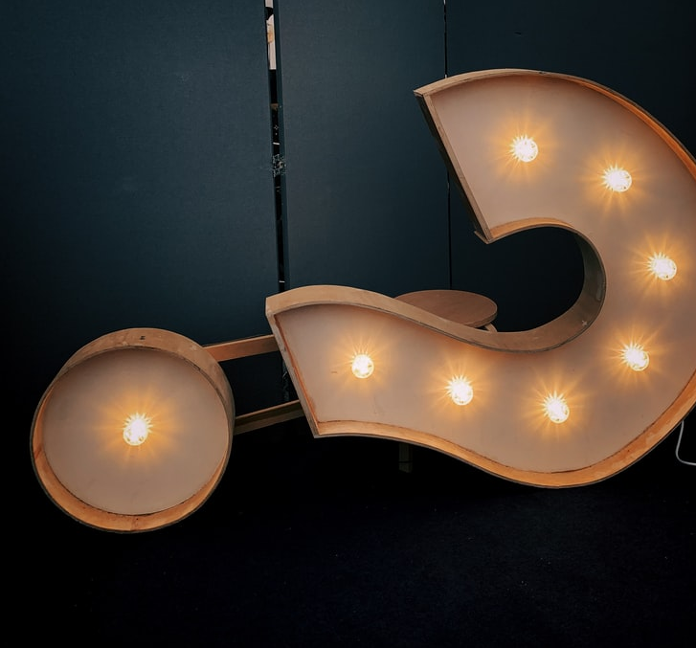




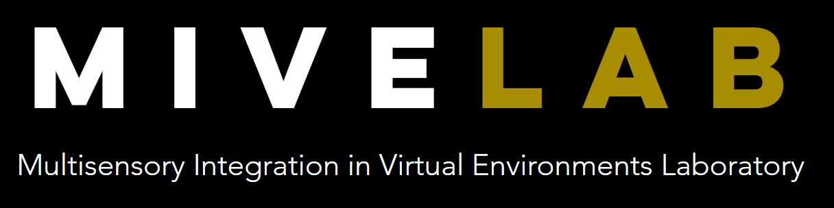
Thank you
Contact:
behrang.keshavarz@uhn.ca
bruce.haycock@uhn.ca
Web:
www.kite-uhn.com
www.mive.ca

