Slide 1

24T22: The Development of a Resilient ADL Capacity Through Long Term Nordic Military Partnership
Cdr. Geir Belgen Isaksen, Norwegian Defence University College
Major Ville Kostian, The Finnish Defence Forces, Shared Services Centre
Major Tohmas Ax, Swedish Military Academy
Major Niclas Ljung, Swedish Military Academy
Major Steffen Waedeled-Moeller, Royal Danish Defence College
Major (r) Michael Thorsen, Royal Danish Defence College

Slide 2
Learning Outcomes
Learning Objective 1:
Recognize how the Nordic countries have structured their Advanced Distributed Learning (ADL) cooperation for more than 10 years
Learning Objective 2:
Describe how to foster real interoperability between military partners
Learning Objective 3:
Describe how a joint ADL conference have benefitted four different countries in their effort to build a resilient ADL capability
Learning Objective 4:
Describe joint R&D projects looking at emerging technologies and how they have collectively
increased knowledge and lesson learned in all 4 countries
Notes:
Learning Objective 1: Be familiar with how the Nordic countries have structured their ADL cooperation for more than 10 years
Key Points:
Overview of the Nordic cooperation model in ADL (Advanced Distributed Learning).
Highlight the importance of long-term cooperation in defense education and training.
How have we built sustainable frameworks for collaboration across borders?
The challenges of different governance structures, standardized processes in each nations, and how we have overcome the challenges of sharing resources.
Lessons learned from over a decade of collective ADL development and its impact on operational readiness.
Takeaway: Participants should understand the framework and strategies that have allowed Nordic countries to maintain and advance ADL cooperation over the past decade.
Learning Objective 2: Gain insight on how to foster real interoperability between military partners
Key Points:
Define "interoperability" in the military context and the importance of ADL in achieving it.
How common ADL platforms and shared training initiatives can break down silos between military forces.
The role of cross-national exercises and simulations in fostering seamless cooperation.
Case studies or examples of successful interoperability initiatives.
Challenges and solutions in synchronizing ADL efforts to enable cohesive military operations.
Takeaway: Understanding the steps and requirements to create interoperability in military training and operations through ADL.
Learning Objective 3: Learn how a joint ADL conference has benefited four countries in their efforts to build a resilient ADL capability
Key Points:
The significance of collaboration through joint conferences.
How the ADL conference acted as a platform for knowledge exchange and the development of best practices.
Examples of successful outcomes from past conferences, such as new joint projects or innovations in ADL.
How the conference strengthened networking and communication channels between countries.
Role in building resilience by addressing common challenges collectively.
Takeaway: The participants should see how joint conferences are a powerful tool for enhancing shared capabilities and fostering resilience across nations.
Learning Objective 4: Learn about joint R&D projects looking at emerging technologies and how they have collectively increased knowledge and lessons learned in all 4 countries
Key Points:
Overview of key R&D projects focused on emerging technologies such as AI, VR/AR, and simulation.
How joint research initiatives promote innovation and adaptability in military training.
Success stories of technology adoption and shared insights from those projects.
Examples of how R&D has led to the development of cutting-edge ADL solutions.
Broader implications of technological advancements for the future of military training.
Takeaway: Participants should gain an understanding of the importance of joint R&D in adopting emerging technologies and how it benefits all countries involved.

Slide 3
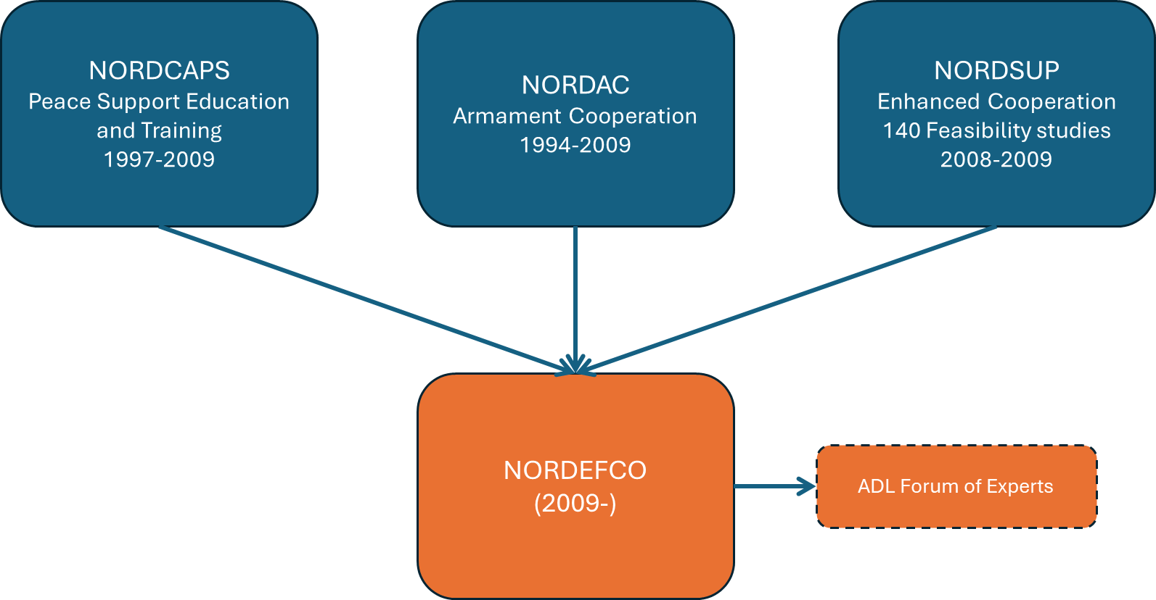
Initial Collaboration Begins Among Nordic Countries
Notes:
First some short historical background
NORDCAPS: Peace Support Operations Education & Training programme was an excellent example of how the Nordic nations can cooperate. By dividing the responsibility for the different types of courses, it was possible to reach international top-level. This had not have been possible if the nations would have attempted to set-up the courses individually.
NORDAC: closer cooperation on acquisition of materiel was established, based on the principle of mutual exchange of national procurement plans, in order to find opportunities for common development, procurement and maintenance related to defence materiel. During its fifteen years of existence the NORDAC has saved an estimated € 100 million.
NORDSUP: An initiative from the Chiefs of Defense of Finland, Norway and Sweden in 2008 laid the foundation for a wider approach through the NORDSUP, starting with a feasibility study naming more than 140 areas where cooperation either is possible or even necessary to retain defense capabilities. The areas ranged over the entire military spectrum and about a third of the potential areas were assessed to be possible to realize within the following years.

Slide 4
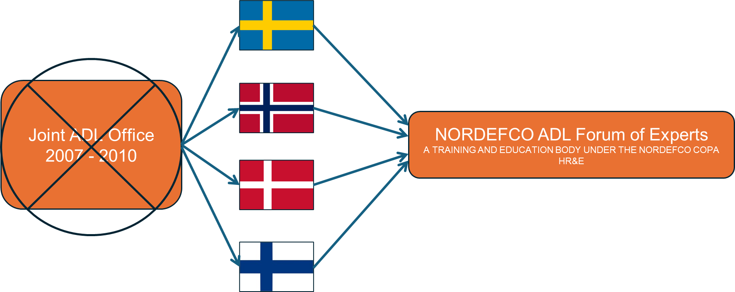
ADL Forum of Experts (Historic Development)
Sweden
Norway
Denmark
Finland
Notes:
As early as 2007, the then FMADLE (Swedish Armed Forces Unit for Advanced Distributed Learning) was tasked within the framework of NORDSUP to explore the possibilities of a joint unit for the Nordic countries. Subsequently, at least two additional feasibility studies with the same goal were conducted. Each investigation was discontinued for various reasons, and the ideas were never realized, even though all reports indicated clear benefits from a consolidated Nordic unit.
In the vacuum that arose after the latest report, the different nations developed in slightly different directions. However, there remained a clear willingness to cooperate across borders. Initially sporadic, this cooperation gradually became more frequent, creating the need for some form of formalization. Within NORDEFCO, there was the possibility to establish more permanent groups, known as "forums of experts." Therefore, a proposal was submitted to NORDEFCO (MCC/CS/COPA HR&E) to form the NORDEFCO ADL forum of experts. This was approved, and the group received its own terms of reference and a task list.
The countries had different approaches to course development. While Denmark had the capacity to develop courses in-house, the other Nordic countries did not and instead purchased the service from private companies.
The Danish ADL (Advanced Distributed Learning) section was also significantly larger than the others.

Slide 5
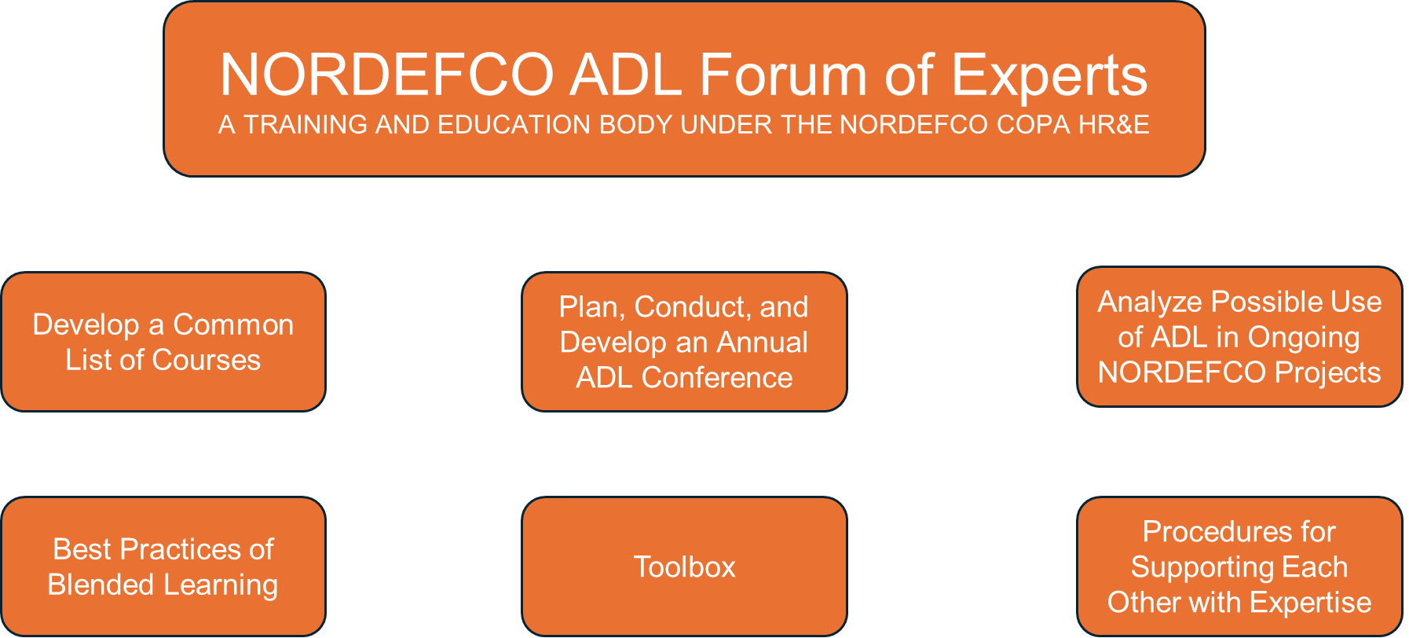
ADL Forum of Experts - Main Tasks
Notes:
NORDEFCO ADL Forum of Experts, works with matters concerning education in general and online learning in particular. The group holds the status of a "forum of experts," which is unique in that it is a permanent part of the NORDEFCO organization (MCC/CS/COPA HR&E), which normally does not have its own units but delegates tasks to the line organizations in the participating countries. The group meets physically two to four times a year, in addition to meeting about two to three times via video conference.
Tasks:
Further Develop a Common List of Courses,
•This work is ongoing, and there is a list of several courses available for everyone to use
Continue to Plan, Conduct, and Further Develop an Annual ADL Conference
•This task requires the most time and energy. The conference has good attendance with 130-170 participants from 20 different nations.
Look Into and Define Areas Where It Is Possible to Use ADL in Ongoing NORDEFCO Projects
•This task initially involved an inventory of the Nordic countries' international education and training centers regarding their use of online learning and online methods.
Analyze a Selection of Blended Learning Courses Run by Different Nordic Units to Come Up with Recommendations for Best Practices in Development and Use
•Data is continuously collected and then forms the basis for national recommendations for the use of education in mixed learning environments.
Look Into Existing ADL Tools for the Development and Distribution of Learning Content/Objects
•There is a high demand for simple and user-friendly tools for creating online courses. After a simple survey, the group concluded that: It is not feasible to create a standardized toolbox as it would become outdated very quickly. Moreover, there are many individual preferences regarding which tools are good.
Recommend Possible Procedures for Supporting Each Other with Expertise if One or More Nations Have Special Competence Needed by Another Nation
•To solve several of the above tasks, the group has developed a website, www.nordicadl.com, where all information about ongoing projects is available.
Each country has its own platform solution, which does not pose practical problems as all modern platforms can upload courses manufactured in the standardized SCORM format. Other resources in the form of text, audio, and image (docx, xlsx, pdf, mp4, etc.) can easily be shared between platforms. Our assessment is that there is no immediate need for a common platform within NORDEFCO. Our suggestion is that each country hosting NORDEFCO-related courses does so on its own learning platforms.

Slide 6

Organzation of Nordic ADL Units
Royal Danish Defence Center Educational Center
Head of Center
Commander
Denmark
Team Leader L&D
Major
Team Leader ADL
Major
Learning Consultant
Civilian
Learning Consultant
Civilian
Learning Consultant
Civilian
Learning Consultant
Civilian
Learning Consultant
Civilian
ADL Developer
OR 9
Learning Consultant
Civilian
ADL DEveloper
OR 8
Learning Consultant
OF 2
ADL Developer
Civilian
Learning Consultant
OR 8
Multimedia Designer
Civilian
Multimedia Designer
OR 3
Notes:
The Danish Defence Forces has used Distributed Learning since 1952. In the beginning using letters and vinyl records. In the mid 90es we implemented our first LMS.
The organization has changed a lot over the years, but the current Educational Center at Royal Danish Defence College responsible for all pedagogical development under the MOD has been established in 2020.
It consist of two teams. One team dealing mainly with traditional pedagogy and one team dealing mainly with ADL. The ADL team also runs the Danish LMS (Moodle).
The Center conducts pedagogical courses for all teachers under the MOD both courses related to traditional pedagogyen but also courses related to building e-learning, cause the concept in the Danish Armed forces is to build our own courses.
Main Challenges.
The role of the Education Center has changed over time. The first LMS platform (Atutor) was relatively difficult to develop learning content in, and at that time, the benefits of e-learning had not yet been fully recognized. The Education Center were experts in developing courses as e-learning and therefore offered to develop courses that large parts of the armed forces were required to take. This also meant that the Education Center became responsible for maintaining the courses, as the subject matter experts often moved to new positions, retired, or took on other tasks. As a result, the courses were not updated in accordance with new knowledge or pedagogical and didactic principles.
The advantage of this arrangement was that the courses developed were of good quality and e-didactics had been carefully considered. When the old LMS platform was shut down, the Education Center was responsible for over 200 courses. With the transition to Moodle as the LMS platform, it is now a requirement that a subject matter expert is appointed for each course. The Education Center still develops courses that must be taken by everyone in the armed forces, but the scope has been significantly reduced.
The primary task of the Education Center is to train instructors or SME's to develop their own courses. One of the prerequisites is that the LMS platform we use is easy to operate. These qualities are found in Moodle. Unfortunately, we are seeing too many courses where e-didactics and visual design have not been adequately considered.
We are trying to address this, but the number of courses developed by the instructors themselves has exploded since COVID, as many have recognized the advantages of distance learning, along with a general desire of reducing cost.
Distance learning proved its worth during COVID, but many of the courses were essentially just a powered-up PowerPoint presentation. As a result, many soldiers' experience of distance learning comes from the courses they completed during COVID – which wasn’t always very good. This is why many of our students prefer to receive instruction in a classroom setting, where there is interaction between the instructor and the students.
The allocated resources have not kept up with the need for developing modern courses. This is evident, among other things, in the reduction of personnel in the training centers and the funds allocated to the center for the development of the LMS platform.
Another challenge is that the military is unable to attract skilled developers due to lower salaries, and it does not encourage soldiers to pursue this career path.
need to cut costs associated with physical courses.

Slide 7

Organization of Nordic ADL Units
The FDF’s Shared Services Center, Learning (ADL) and Image Services Unit
Security Team
Civilians x2
Commanding Officer
Major
Finland
Situation & Planning Team
Production Team
Head of Administration and Development of eLearning Platform
Civilian
Head of Production
Civilian
Administrator of the FDF Moodle (LMS)
Civilian
Learning Designer
Civilian
Administrator of the Media Library
Civilian
Content production designer
Civilian
Producer and video archive manager
Civilian
Director
Captain
Documentary production and printing specialist
Civilian
Video-/photographer editor 1-3
Civilians
Photography planner and portrait archive manager
Civilian
Graphic artist 1-4
Civilians
Unit secretary and photo archive manager
Civilian
Apprentice 1-3
Civilian + Conscripts
LMS Online support 1-4
Conscripts
Notes:
The Finnish Defence Forces Shared Services Center provides and coordinates support services within the Defence Forces.
Its aim is to create shared procedures and streamline administration. Here are some of the services it offers:
Personnel services: Including centralized recruitment services for civilians, non-commissioned officers, and special officers.
Financial and travel services: Handling bookkeeping, travel, expense, and purchase invoices.
Information management services: Developing and maintaining information systems, analytics, and automation.
Learning (ADL) and image services: Providing learning material packages and eLearning Courses, maintaining virtual learning environments (FDF's LMS), and offering course services.

Slide 8


Organization of Nordic ADL Units
Norwegian Defence University College - ADL Unit
Commanding Officer
Commander
Norway
ADL staff officer
Major
Sen. Faculty administrator
Civilian
Sen. Quality adviser
Civilian
ICT Pedagogue
Civilian
Faculty administrator
Civilian
Quality adviser
Civilian
Video producer
Civilian
Faculty administrator
Civilian
Sen. Legal adviser
Civilian
Data security LMS Admin
Civilian
Course coordinator
Civilian
OR education adviser
Major
Apprentice 1
Conscript
ICT System coordinator
Civilian
Apprentice 2
OR 1
Admission coordinator
Civilian
Notes:
In 2002 this unit still deployed letter-courses by post and had a staff of 15.
In the late 2002 the Norwegian Armed forces got their first IBM LMS and things started to change.
The size of the unit responsible for online learning have changed over the years and the chart you see on the screen is the section at the Norwegian Defence University College responsible for not only ADL , but also other key functions for supporting the faculty in all aspect of teaching, doing assessments, exercises, always looking to benefit from the using technology, digital tools and digital learning methods.

Slide 9



Organization of Nordic ADL Units
Military Academy Halmstad
SWAF Development Unit for Leadership & Pedagogy
Head of Unit
LtCol
Sweden
Head of Leadership
OR 8
Head of ADL
OF 3
Project Manager
OR 8
Project Manager
Civ (PhD)
Project Manager
OF 3
Project manager
OR 7
Project Manager
Civ
Project Manager
Civ
Project Manager
Civ
Project Manager
Civ
Project Manager
Civ
Notes:
The Swedish Development unit for leadership and pedagogy is a part of the Military Academy located in Halmstad, Sweden.
Mission
The Swedish Partnership Center’s main focus is to lead the development of net-based learning (ADL) within the Swedish Armed Forces and to do it in the spirit of the supreme commander’s vision:
“A stronger defense – responding to every threat, facing every challenge.”
Striving towards the vision means that the Center needs to work on continuous development of a higher degree of professionalism, leading to a well-developed military profession.
This boils down to five main efforts:
Development of leadership and pedagogy
Development of the ADL learning
Coordination of digital course production
Implementing ADL in multinational exercises
Cooperation on an international level

Slide 10
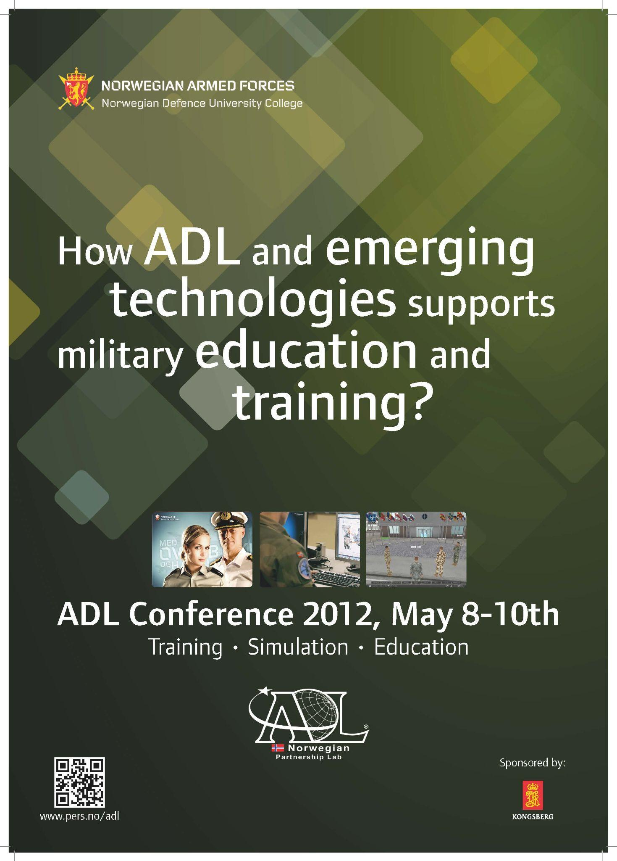
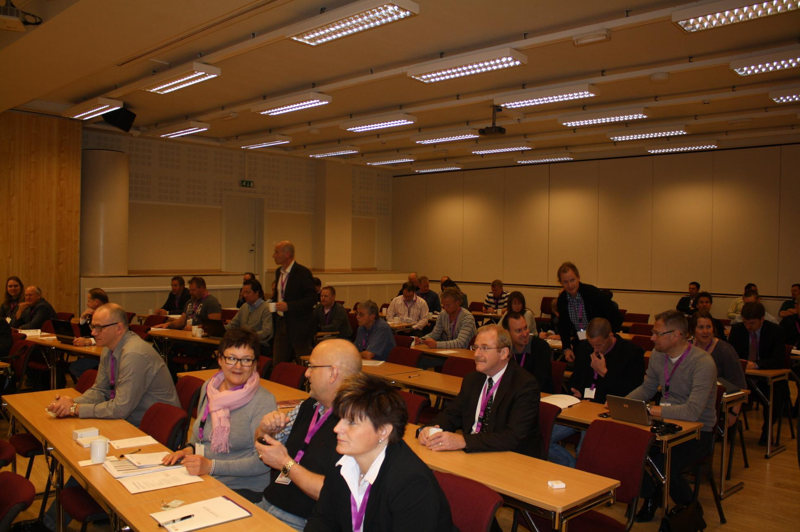
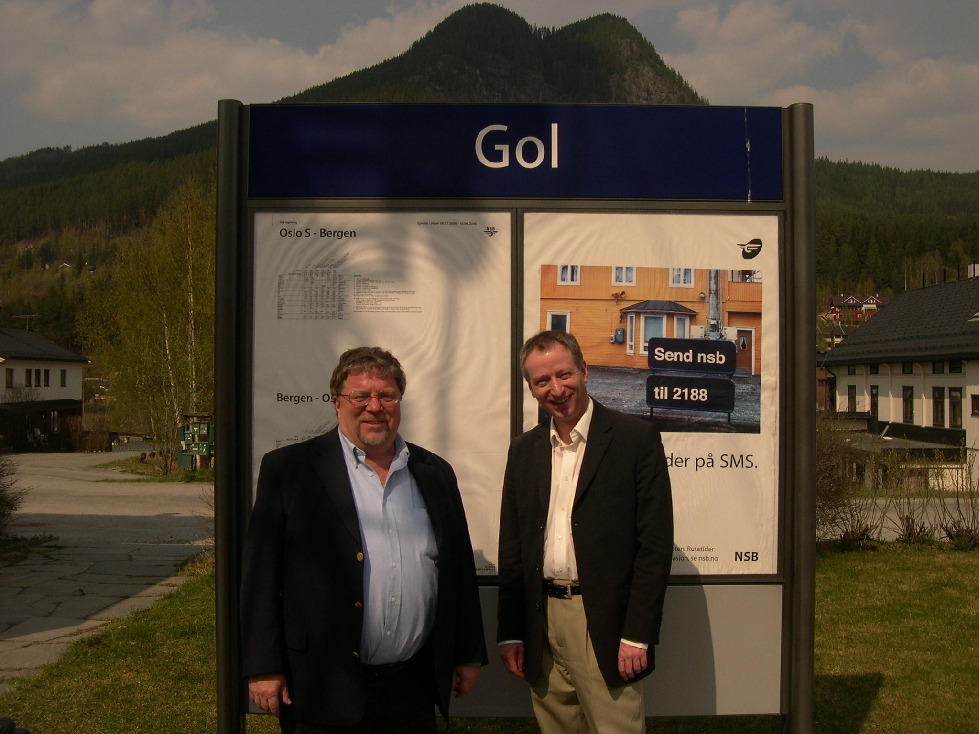
The Story About the NORDEFCO ADL Conference
First conference held in 2005:
The first national ADL conference in Gol, Norway:
To foster the development, implementation and use of digital learning methods, assets and tools in the Norwegian Armed forces
Notes:
In 2005 the Norwegian Defence University College started a national ADL conference hosted in Gol, Norway.
It was a challenge early on to get the buying to use resources on an annual conference,
but by showing real examples to the leadership on how the conference laid the ground for reuse of courses (free) internaly and internasionally and also helped educate the community about technical standards (saving money) convinced the leadership.
I think we started with about 30-40 participants from the Norwegian armed forces.
The goal was to gather the people using technology or digital learning in their courses.
Create a community of interest and a network who shared lesson learned and got insight from experts.
It remained as a national conference until 2012, slowly growing. Early on it became a conference open for our international and Nordic partners.

Slide 11
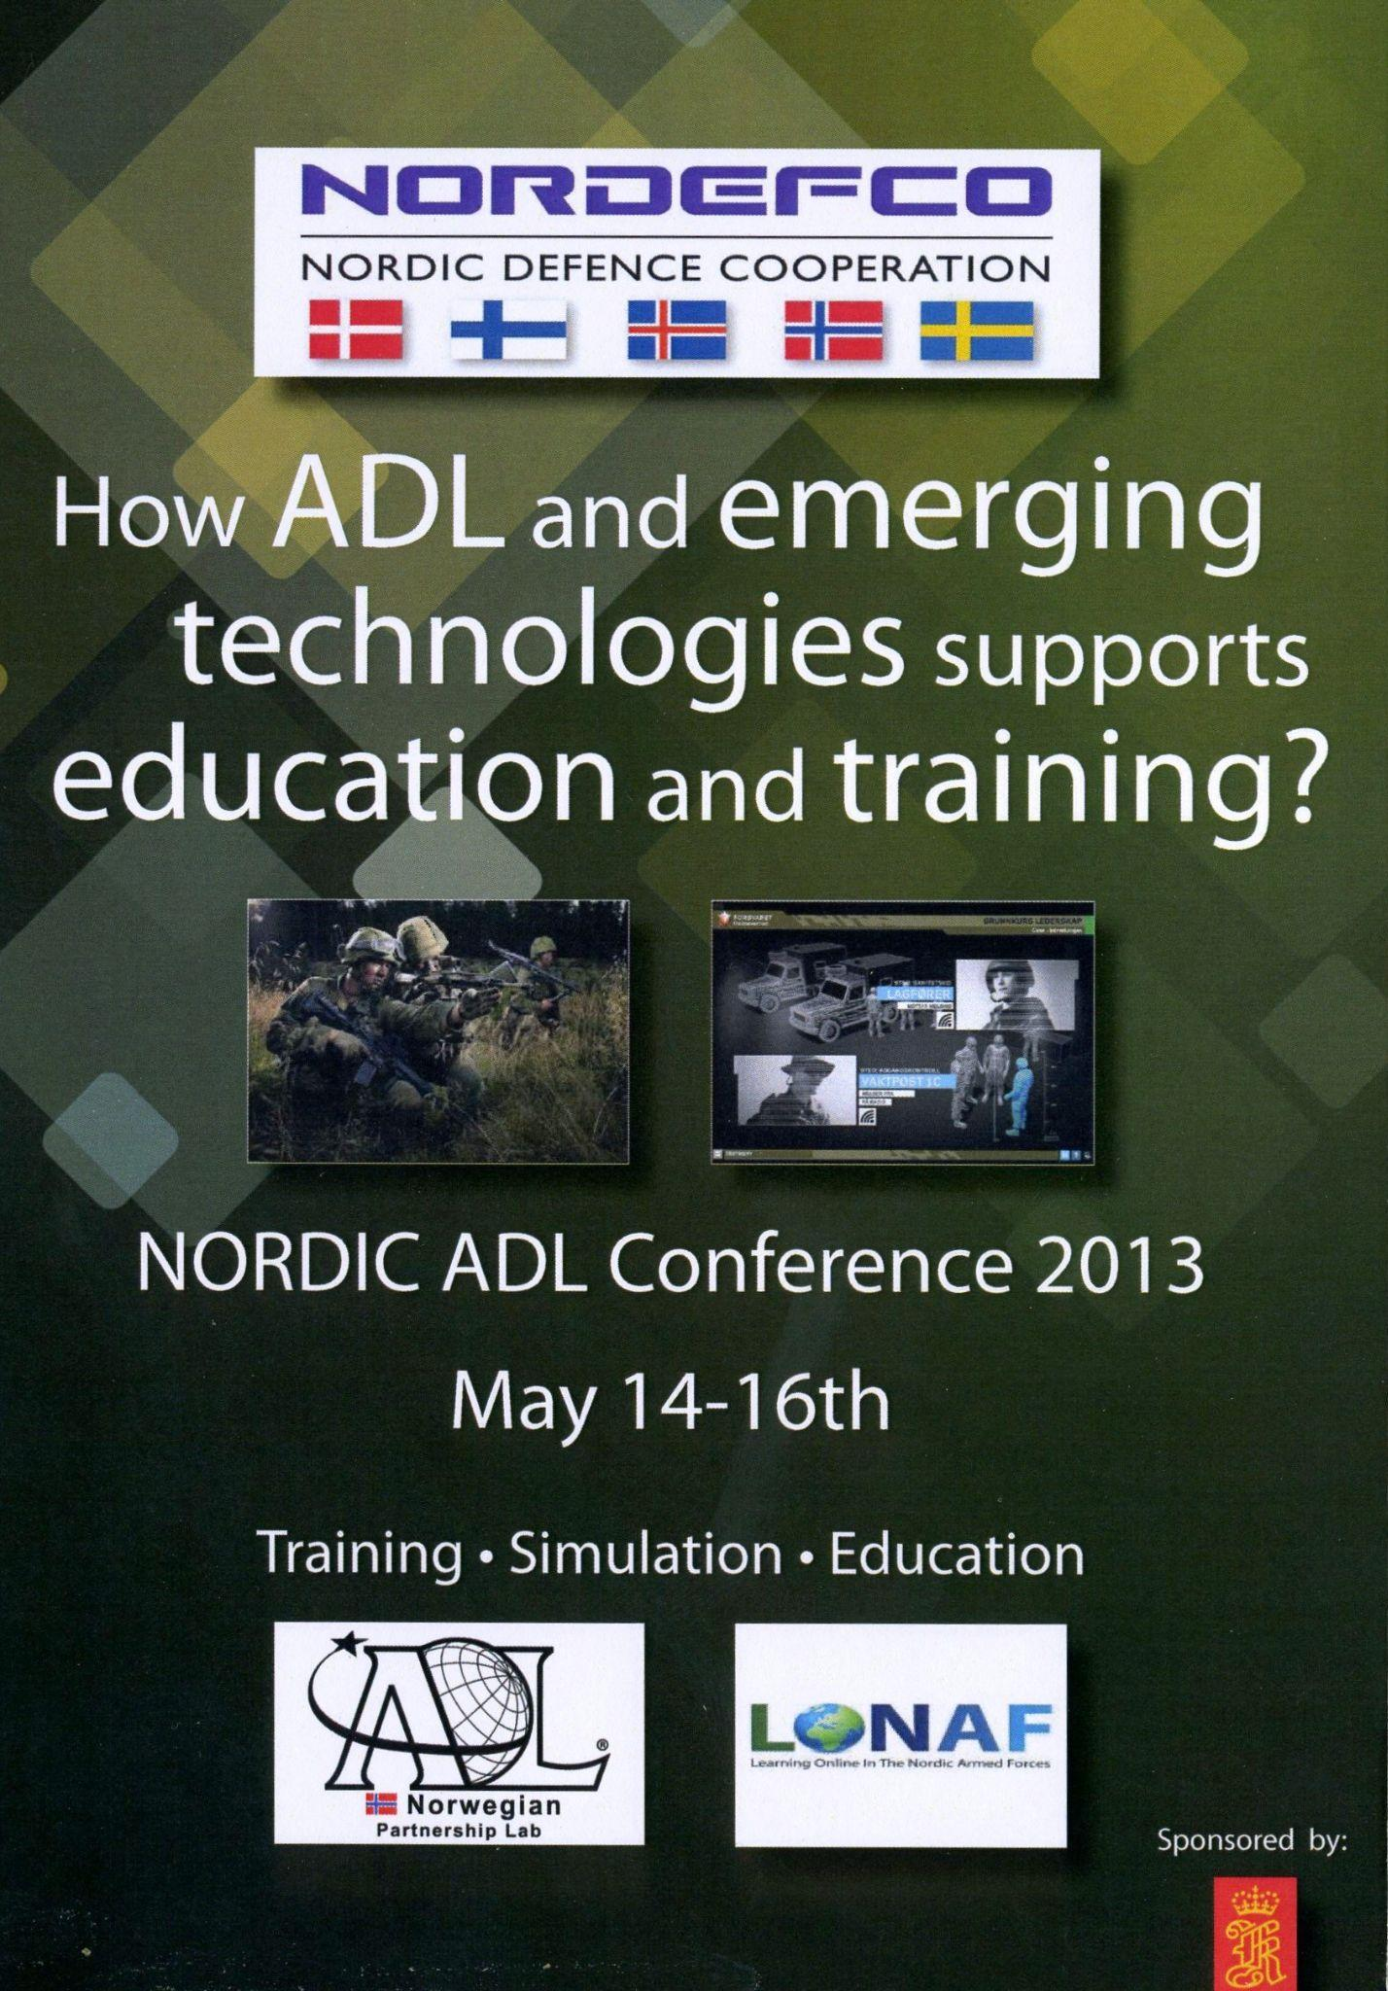

The Story About the NORDEFCO ADL Conference
Became a joint Nordic event in 2013
Aimed for a regular event to share best practices, collaborate on projects, and discuss future developments
Networking and Exchange:
Facilitating interactions amongst experts for knowledge sharing and building collaborations
Gol, Norway
Tyløsand, Sweden
Vingstedt, Denmark
Gustavelund, Finland
Notes:
Together with our Nordic partner we decided to make the Norwegian ADL conference a joint Nordic conference in 2013,
and since we have conducted the annual NORDEFCO ADL conference.
It is probably the biggest ADL event outside the USA with a regular number of attendees over 160 participants.
The four countries alternates hosting the event and his year we had over 20 people on the waiting list. For the last five years we have had participants and speakers from all over the world. Even as far as New Zealand.
One of the challenges in hosting the NORDEFCO ADL conference is that it is the responsibility of the host country to find funding for the event. Additionally, the importance of such a conference is viewed differently, as it does not formally stem from NATO cooperation. The Nordic countries collaborate across borders, but ADL has never been highly prioritized compared to, for example, training and exercises.

Slide 12
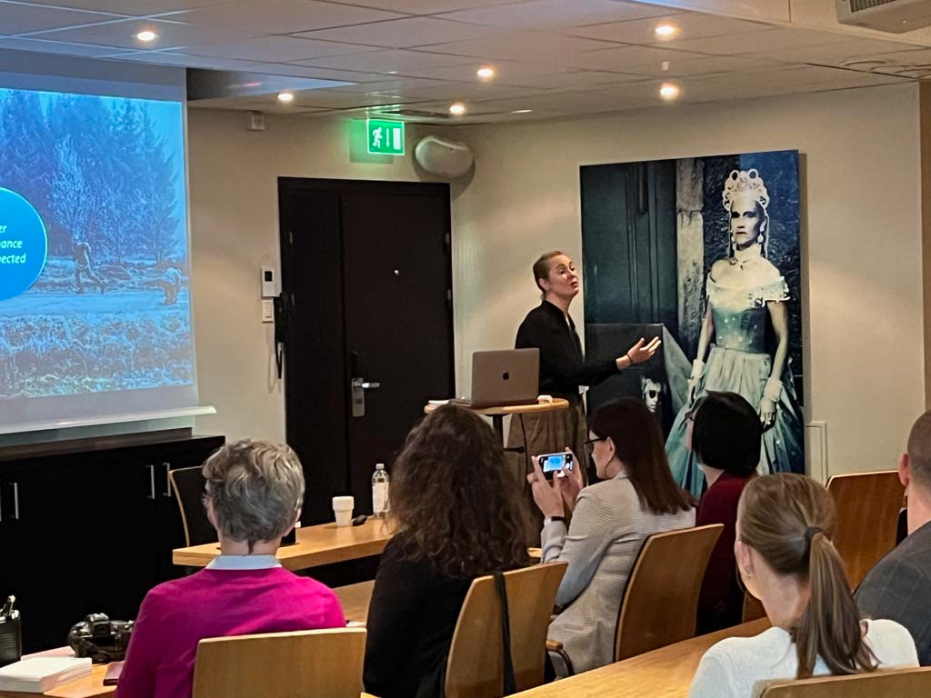
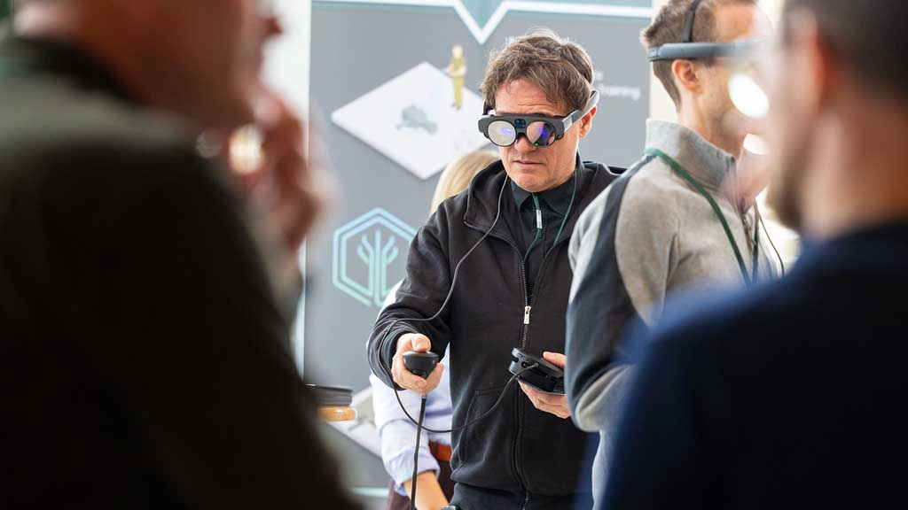
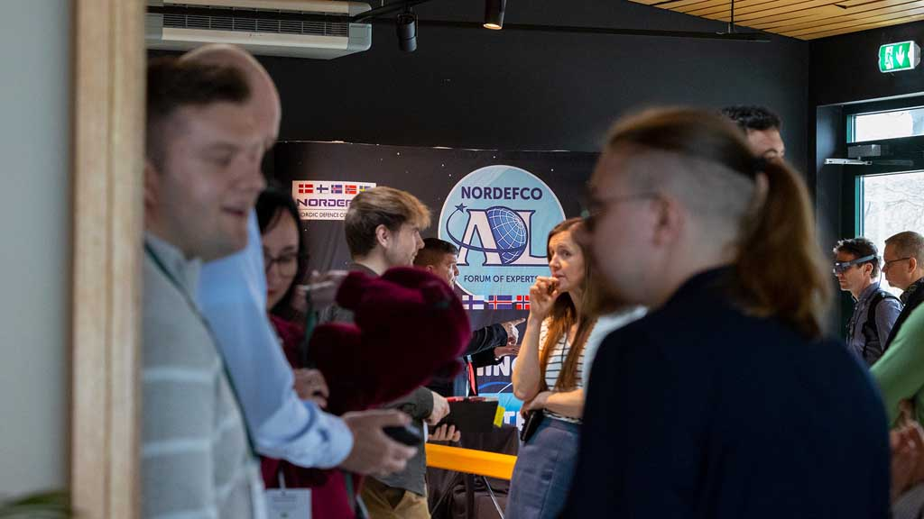
The Story About the NORDEFCO ADL Conference
Concept of Success
The use of plenary presentations, exhibitions and parallel sessions (workshops):
Members learn from each other's experiences and explore new ADL concepts and solutions.
How and why participants always are invited to be an active part of the conference.
Notes:
When we first made it a joint Nordic event, some key elements was established.
The feedback over the years have pointed at the combination of plenary sessions and more practical orientated workshops as a success factor. Also make sure that we use remote locations outside the big cities ensures a vivid and network an d community of interest.
The key take away have for the last 10 years been that the participants have stated that by establishing a community like this, NORDEFCO have heavily contributed to nations and units ability to produce and use online learning.
We have noticed that many speakers, including those from the USA, have participated. There's nothing wrong with that, but often their reality is far removed from the reality in which the Nordic countries operate, making it difficult to apply their presentations to our context. At the last conference, we had a professor from a university give a presentation on how he uses AI in his teaching. It was very inspiring, but since the armed forces in the Nordic countries operate on closed networks, we cannot install a GAI (Generative AI) and therefore cannot incorporate it into our teaching.
We have therefore discussed whether the conference should focus more on attracting speakers from our own nations. However, the downside of this is that we may miss out on external inspiration.

Slide 13
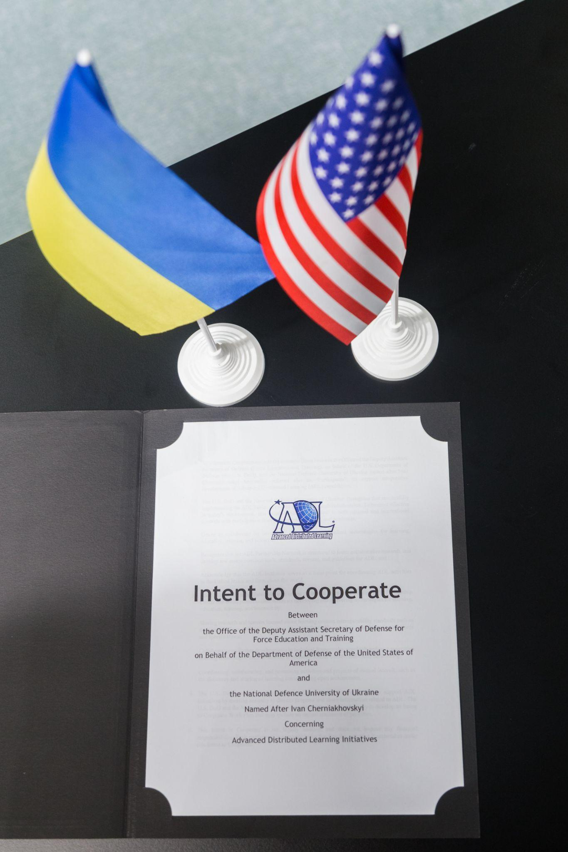

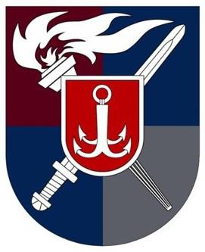

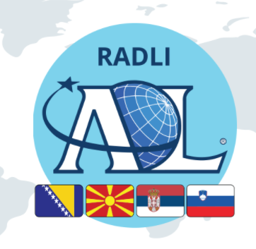
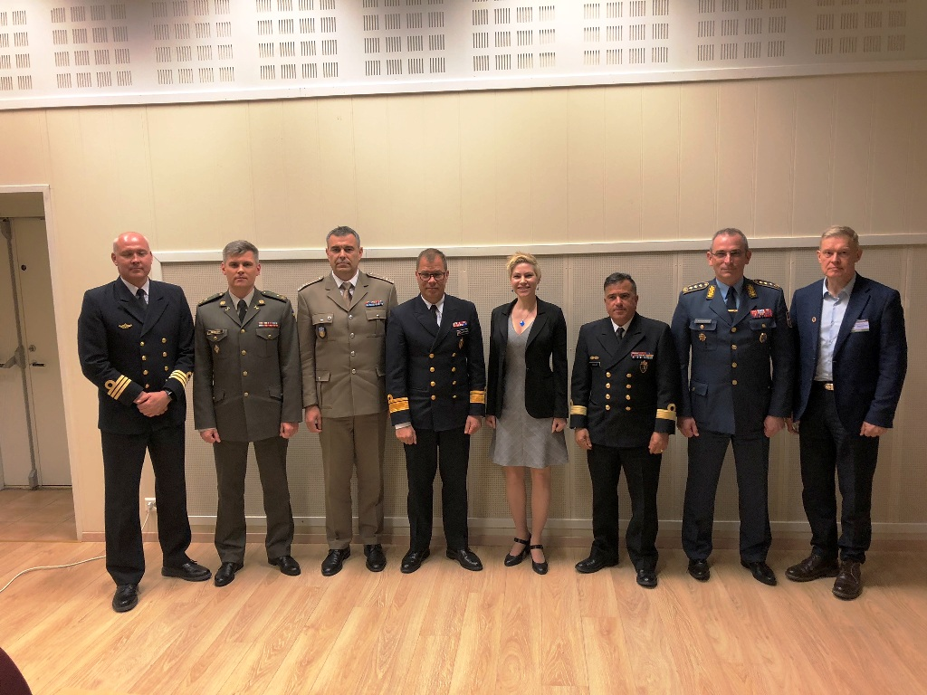
The Story About the NORDEFCO ADL Conference
How the conference also have been used to help other nations
Notes:
Over the years the Nordic countries have used the NORDEFCO ADL conference to "help" partner nations to kickstart their ADL journey.
Countries like Bosnia & Herzegovina, North Macedonia, Serbia, Georgia and Ukraine have early on participated at the event.
This have contributed to the establishment of ADL communities like the RADL on the Balkans and paved the way for Ukraine, and Serbia to become certified ADL partners by the US DoD.
Key elements used to build an ADL capacity in other nations has been donation of needed ICT equipment, training and access to courses.
And it's actually help to ourselves, because now these partner nations support us in course sharing, course production and lesson learened.
This especially relevant for the situation in Ukraine.

Slide 14
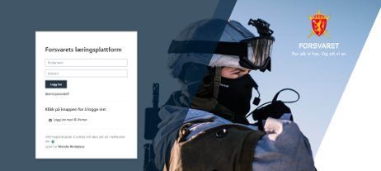
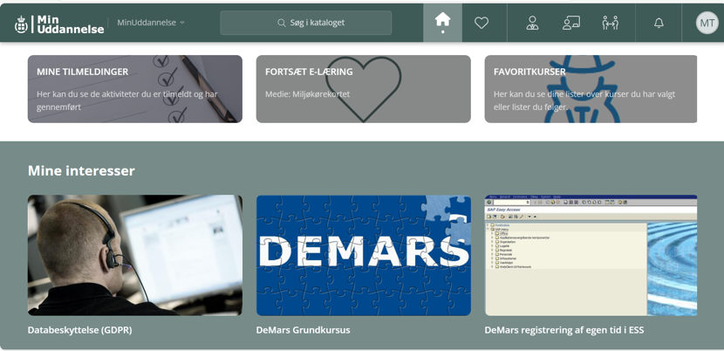
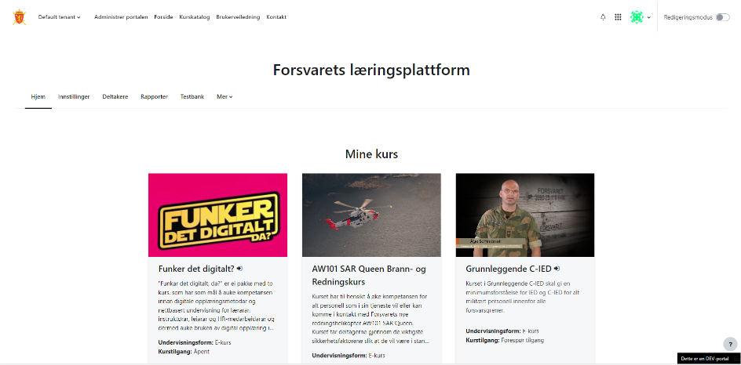
Ongoing Collaboration in the NORDEFCO Community
Notes:
In 2021, Denmark launched the course administration site "My Education", where all employees, reservists and volunteers under the Ministry of Defense can register for courses. The site has direct connectivity to other systems, such as Moodle.
When Norway decided to implement a similar site, there has been a close collaboration where experiences from the Danish development have been handed over
A challenge with sharing courses is that each country develops them in its own language, and there are many small procedural differences that would need to be adjusted. Additionally, we often find that students focus on whether the soldier in the course is wearing a Danish or Finnish uniform, even when the course is, for example, about operating a weapon system that is the same for both countries.

Slide 15

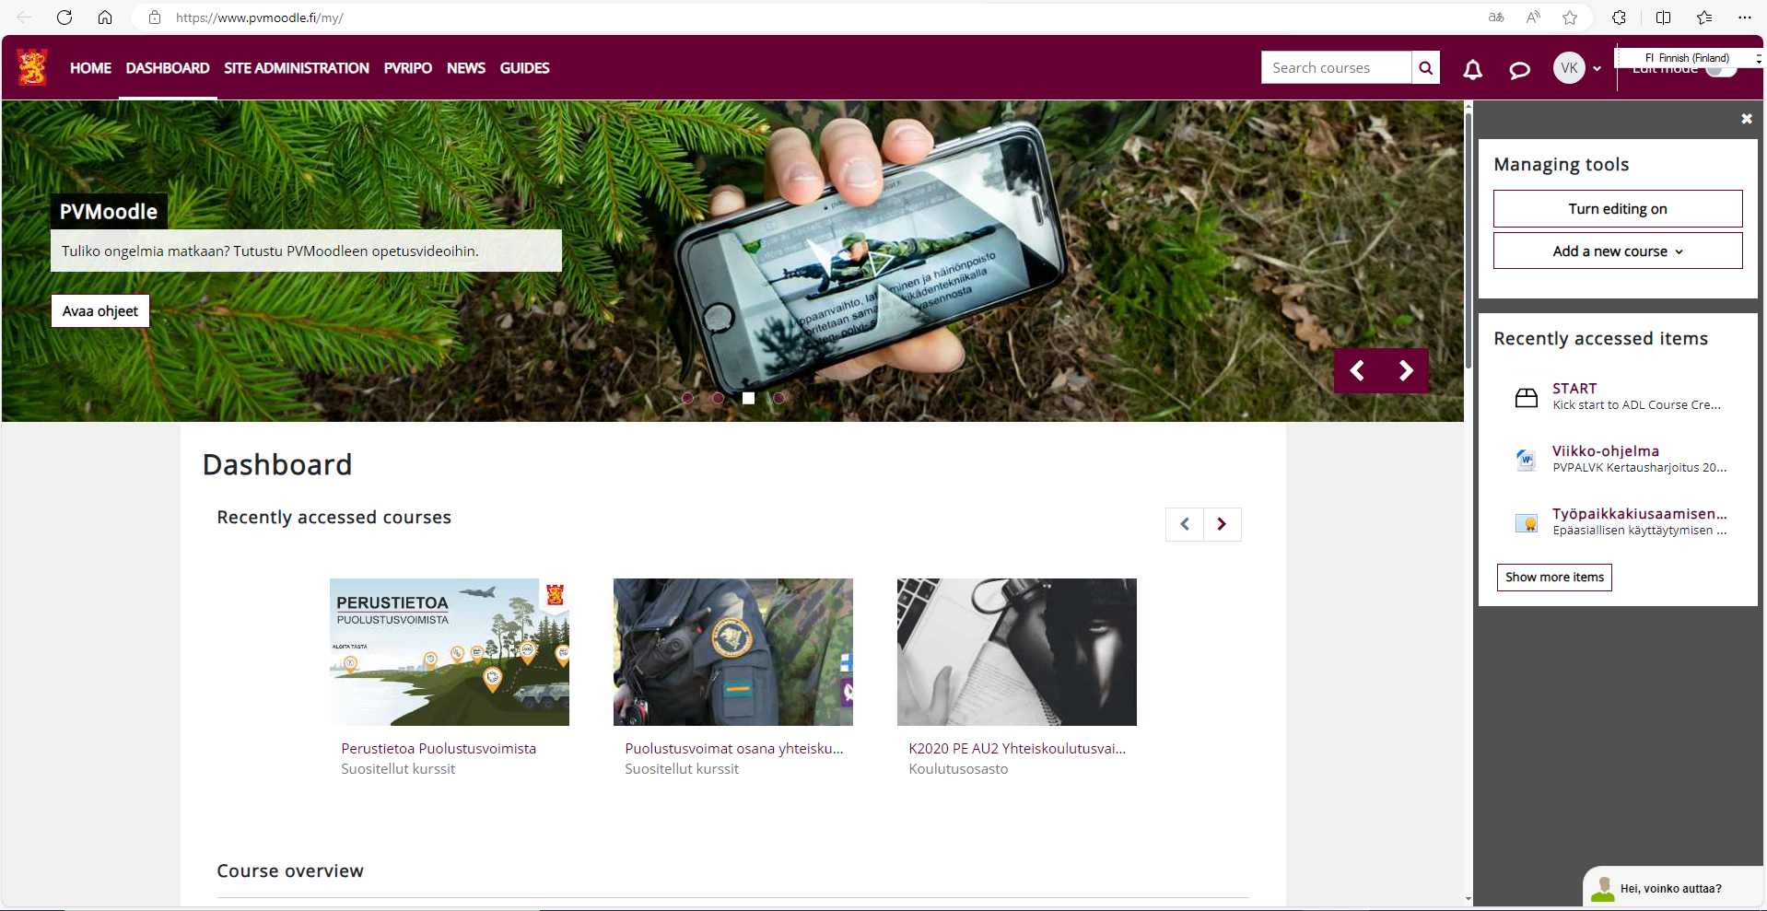
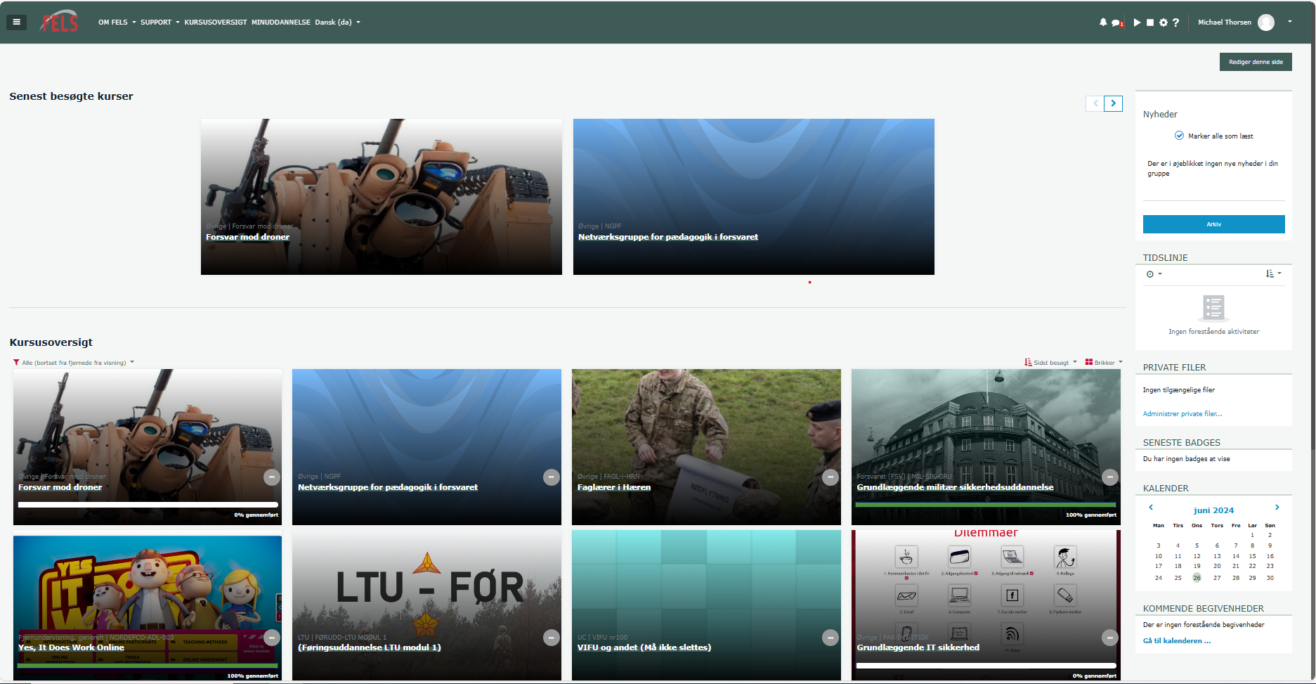
Ongoing Collaboration
Notes:
Finland is the member state that has been using Moodle the longest.
When Denmark decided to move to using Moodle as the common digital learning platform both on the web and intranet, Denmark contacted Finland to hear about their experiences of implementing and developing Moodle as a learning platform.
Especially integration to other systems and between the web and the classified network. A collaboration Denmark has benefited greatly from.
Norway and Sweden will move to Moodle in the coming years and will get support and training from Denmark and Sweden.
It's always challenging to implement a new LMS, so it's very beneficial to have a Nordic community of interest with a lot of experience of using Moodle.

Slide 16
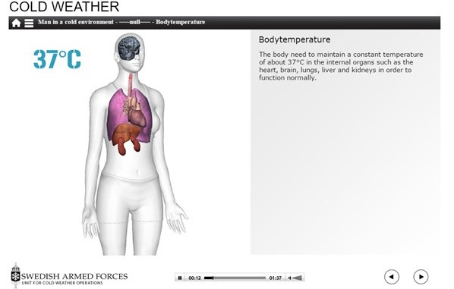
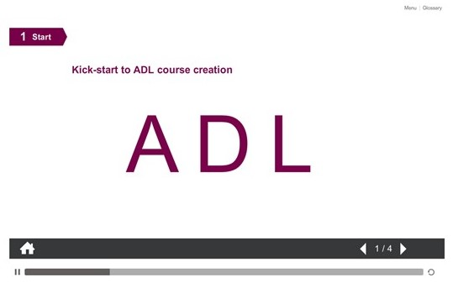
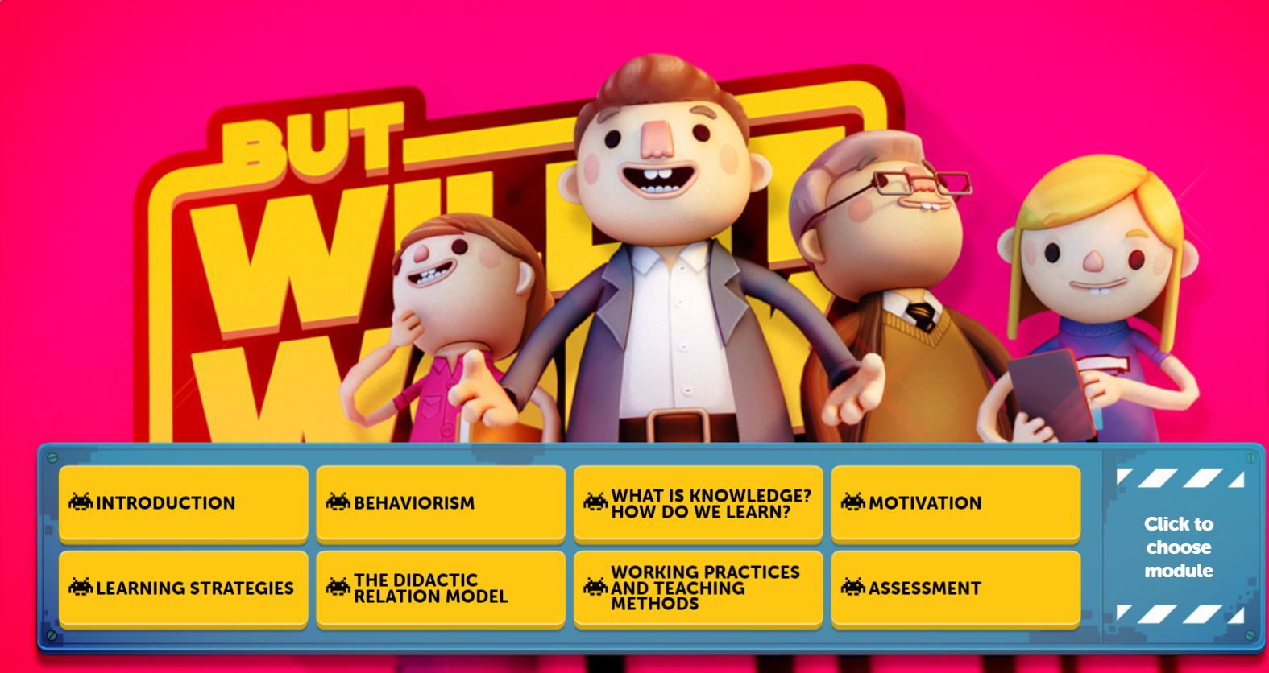
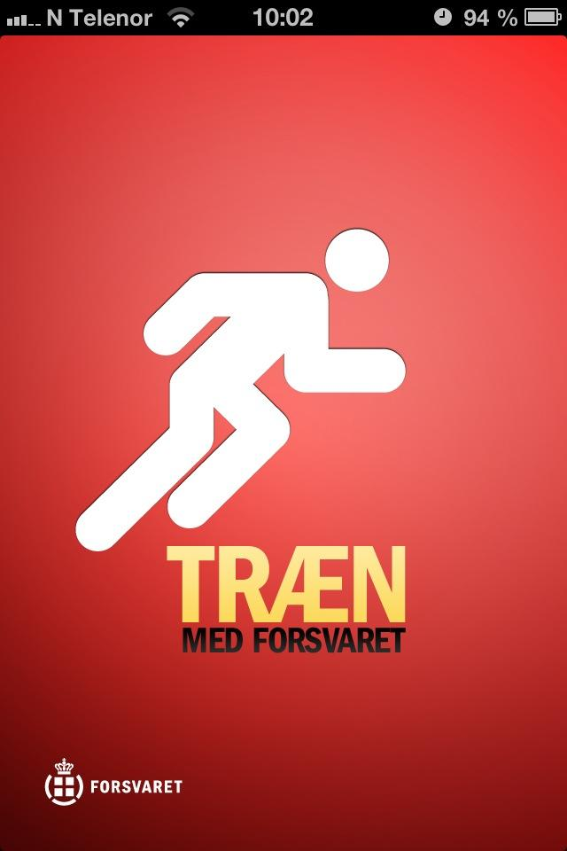
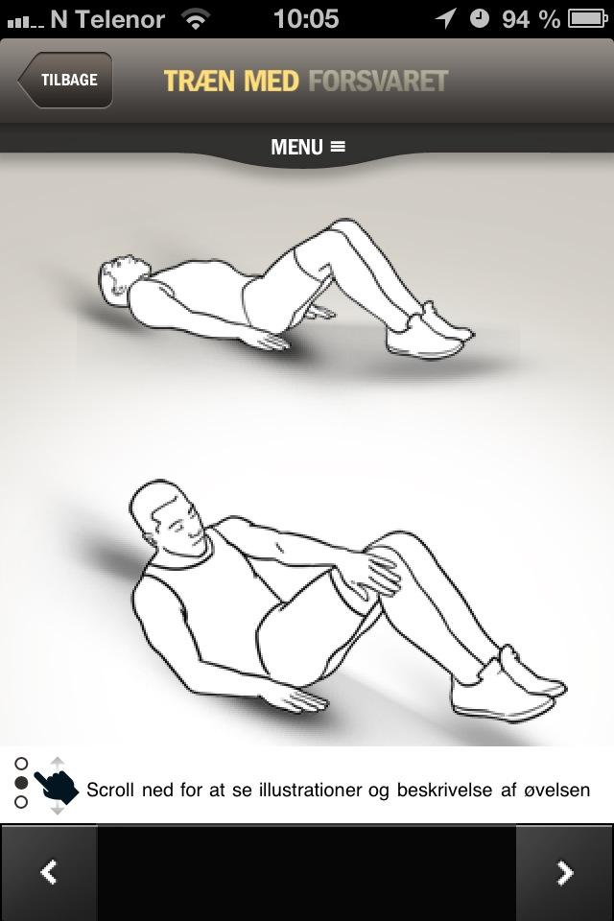


Nordic Countries Directly Collaborate on Joint ADL Projects
Sweden
Finland
Norway
Denmark
Notes:
One of the big collaboration topics has always been sharing of courses and over the years all four countries have produced e-learning courses,
Technical standards, legal rights has always been and still is a bit of challenge. But by frequently sharing information and choosing the same standards, course sharing continues to be one of the great benefits.
APPs of other learning resources and shared them within the community. You see 4 examples on the screen now. All facilitated of course by technical interoperability and contract enabling course sharing. Saving cost for all the nations

Slide 17
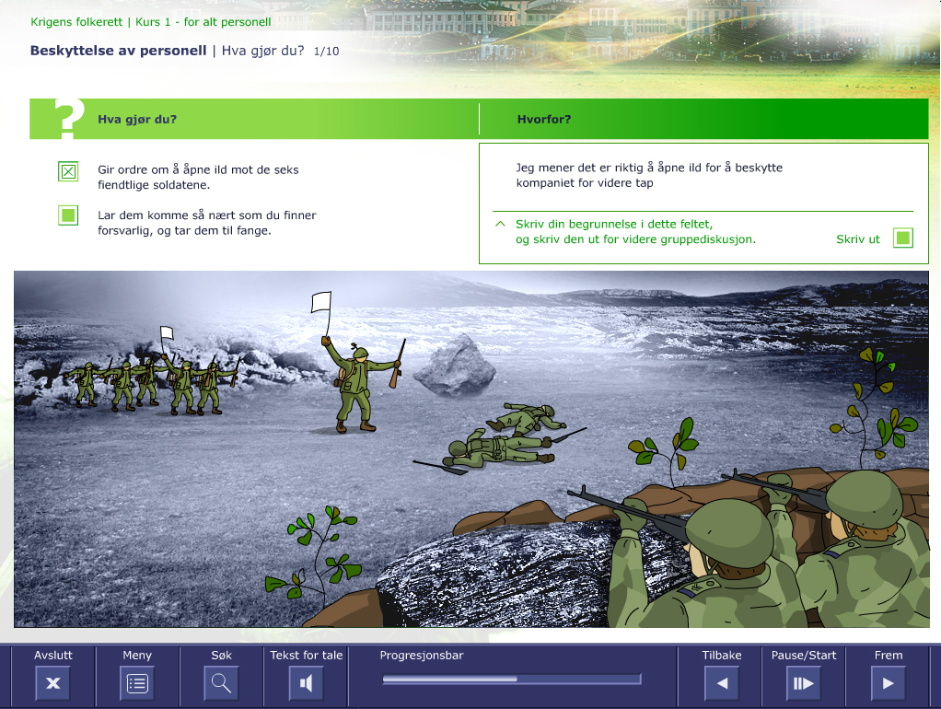
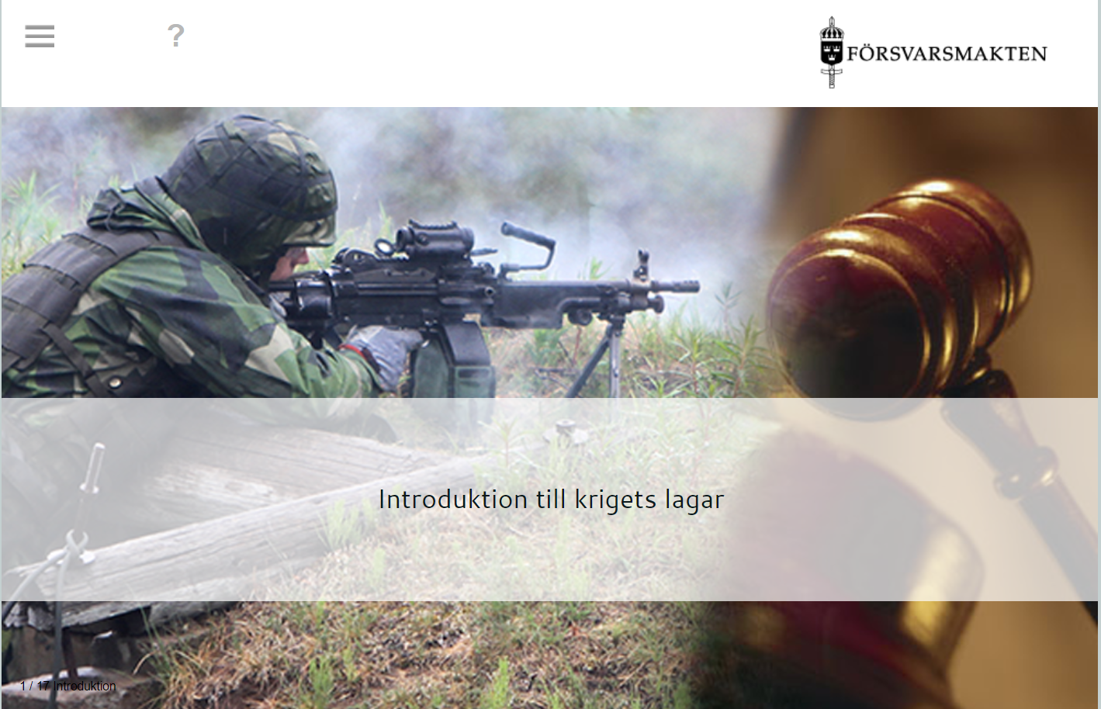
Technical Update and Life-Extending of Courses
Norway
Sweden
2006 - Step 1 - eLearning -
Laws of Armed Conflict - Flash based
2017 - Step 2 - eLearning -
Laws of Armed Conflict - HTML5 based
Notes:
Another great example is the journey of the Laws of Armed conflict e-learning course produced by Norway in 2006, in both Norwegian and English.
It was state of the art at the time with SCORM and flash as key elements.
We all know the story about flash and after some years the course needed a technical update.
Sweden then took it upon themselves to rebuild the course using HTML 5 and again making it available for the community and international partners. Saving time and costs for everybody.
This was possible because the legal rights of sharing with partners was already cleared from the Norwegian side. A big learning point
The reason Denmark is not part of this project is that the legal advisors said no. In Denmark, there are certain additions that would only apply to Danish personnel. The course was developed in 2026, which made it impossible for Denmark to add a supplement to the course. One key takeaway is that there should be an agreement allowing all parties to edit, delete, and make additions to courses – something we can now do by using the same LMS platform.

Slide 18

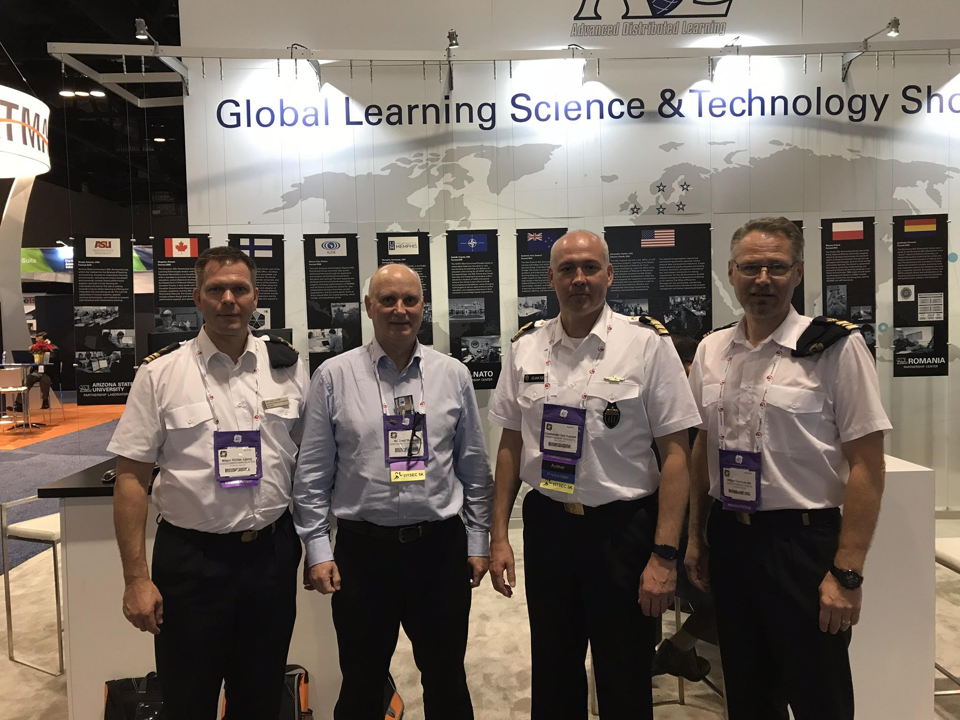
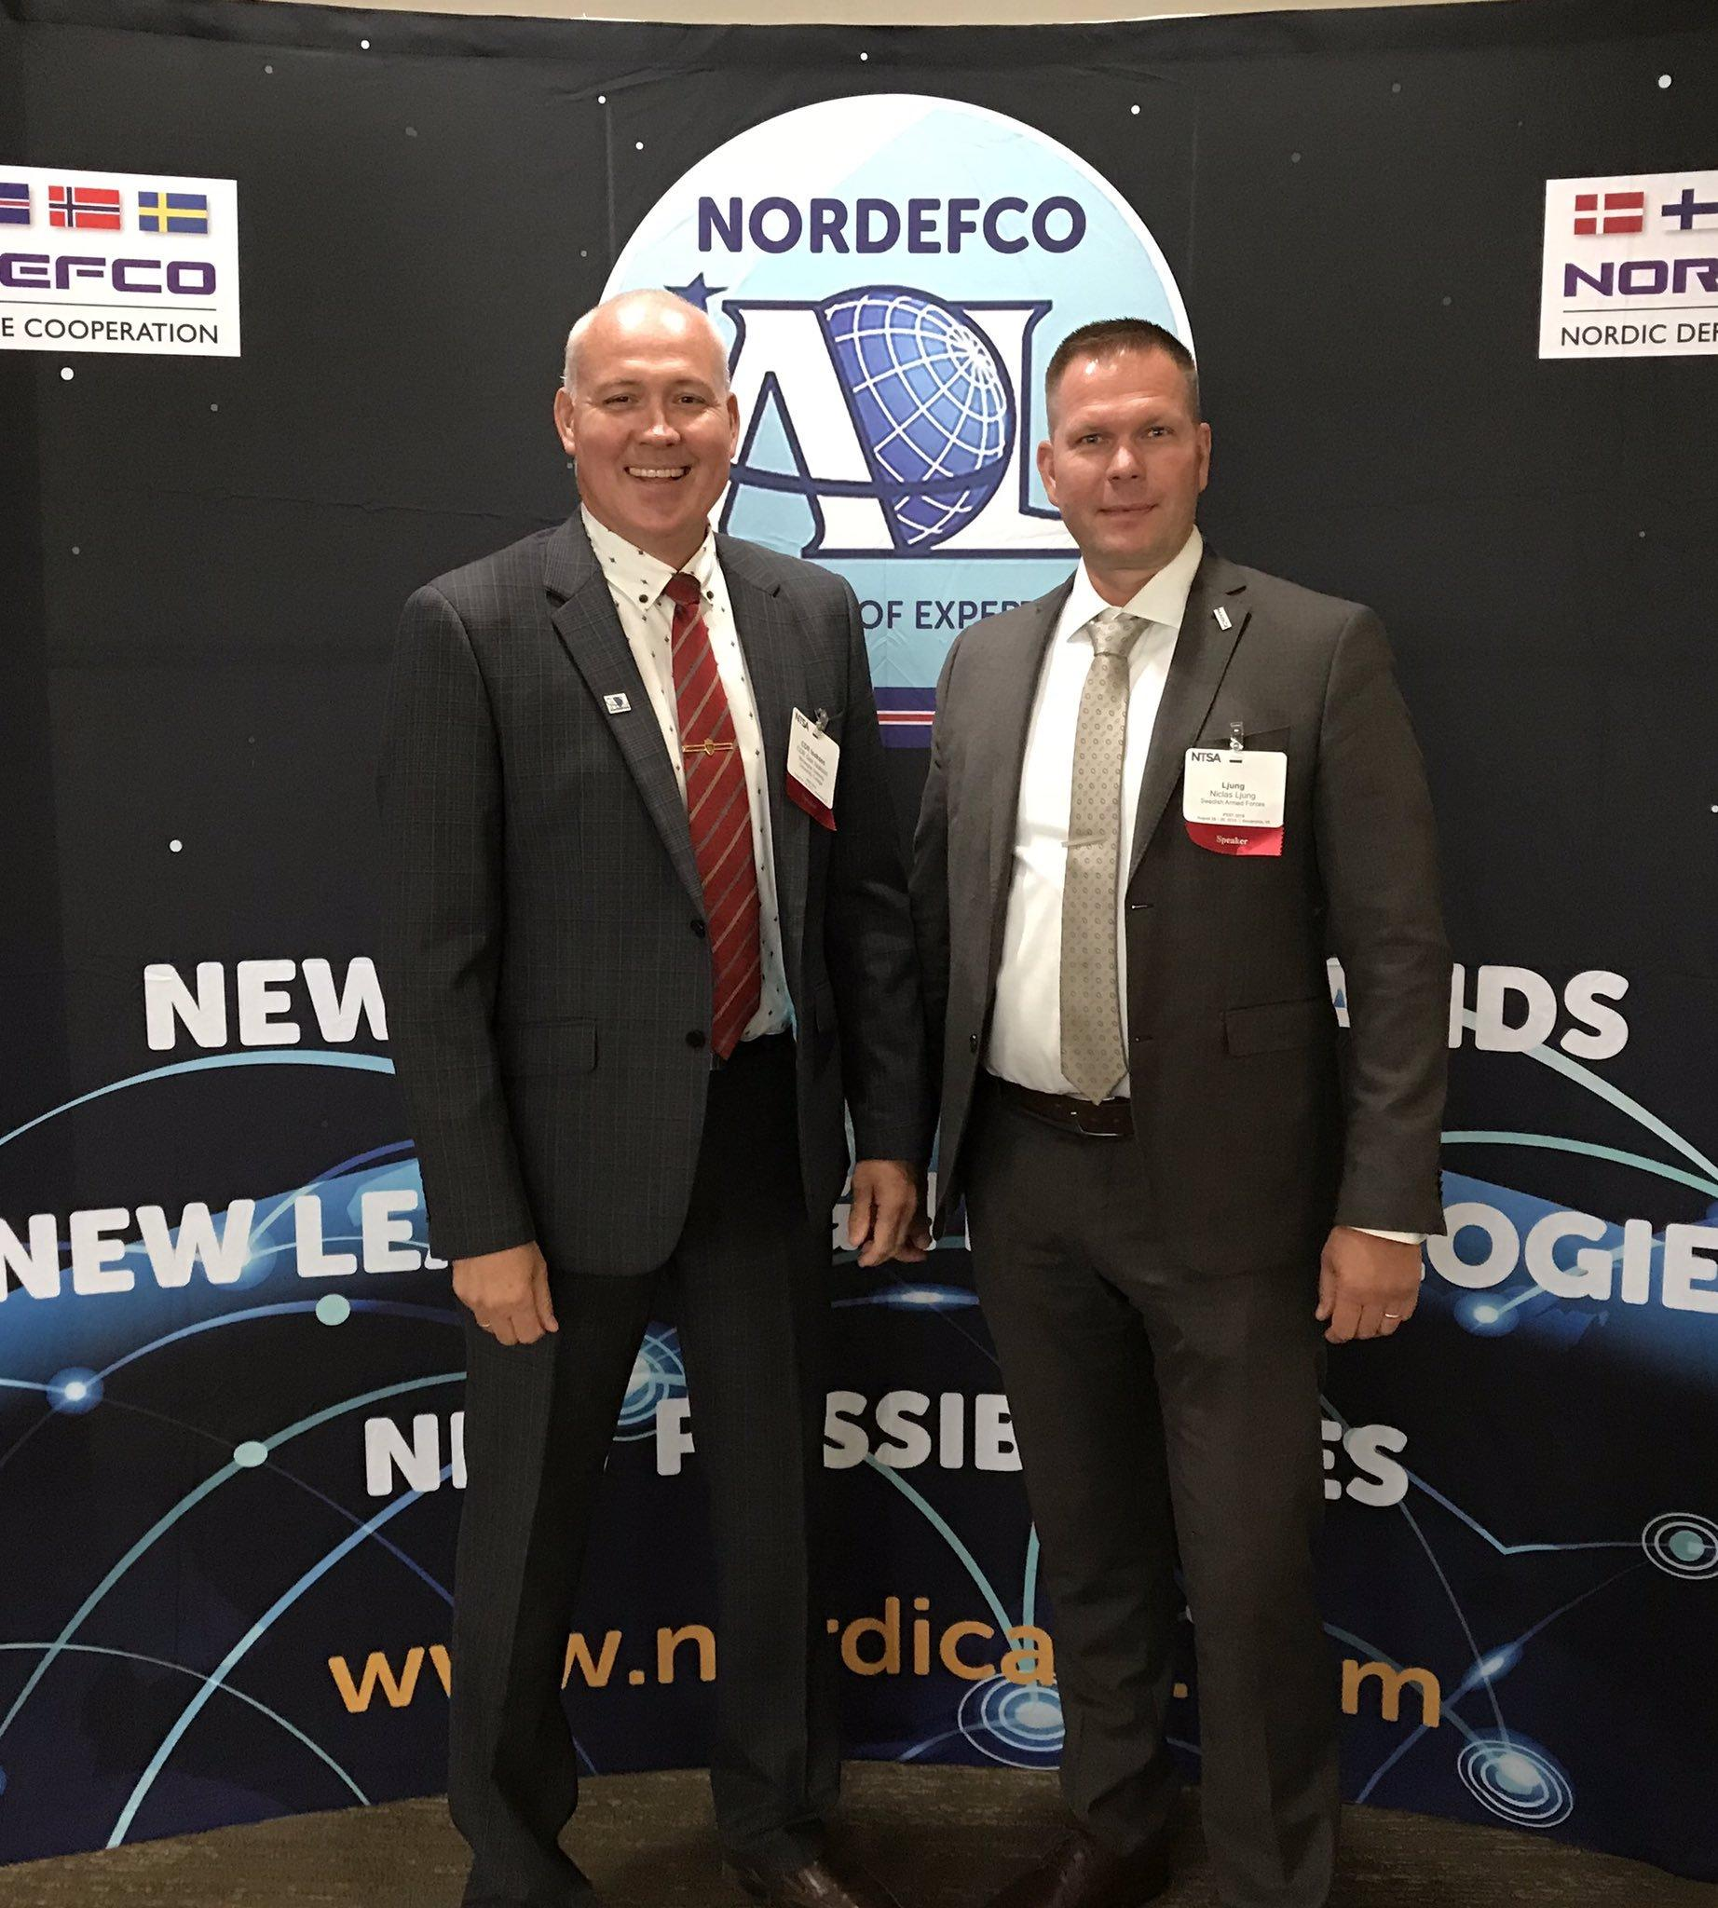
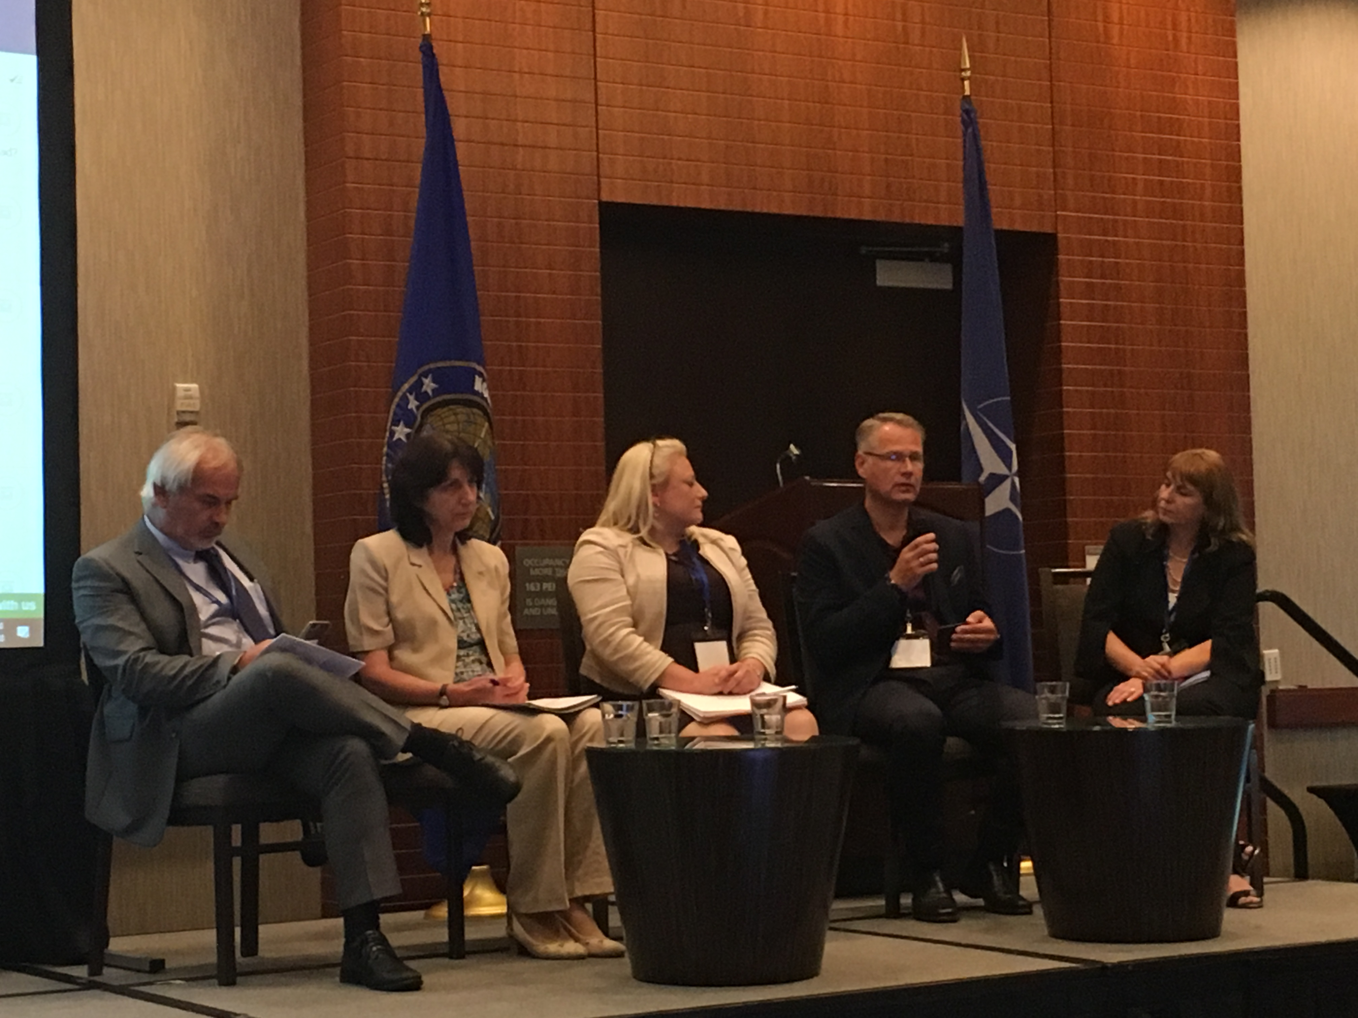
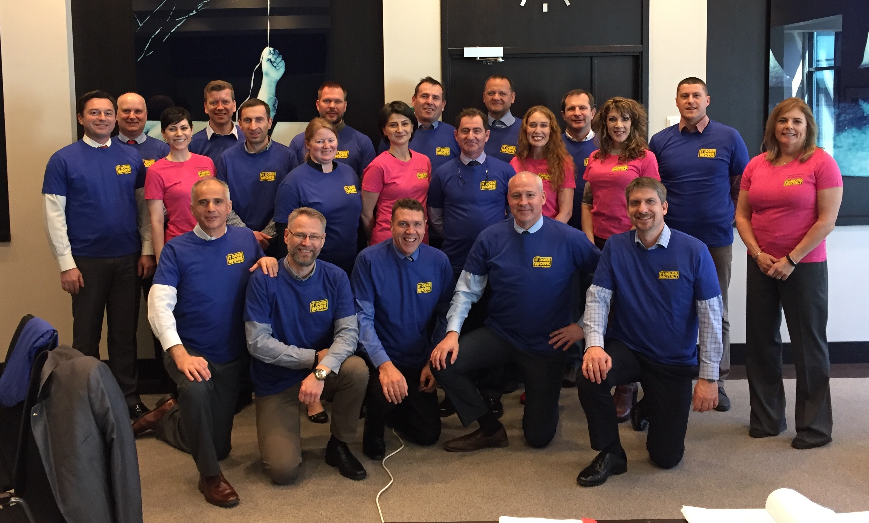
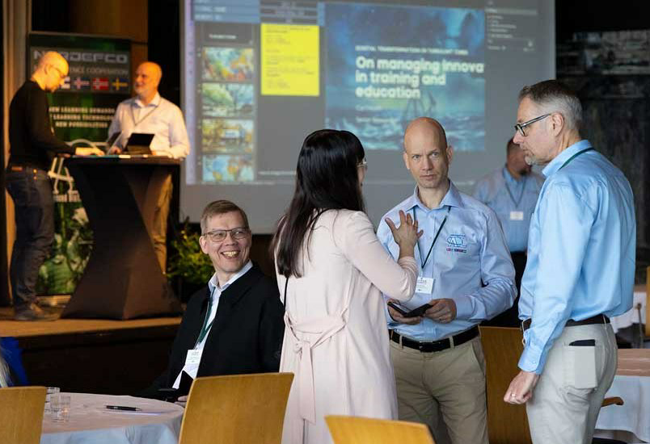
Contributing to International Learning Events
Notes:
The Nordic community have also contributed to national and international learning events. Often together, sharing our experiences and insights
By having the willingness to share we have strengthening the NORDEFCO groups reputation as thus get more nations and people to share with us.

Slide 19
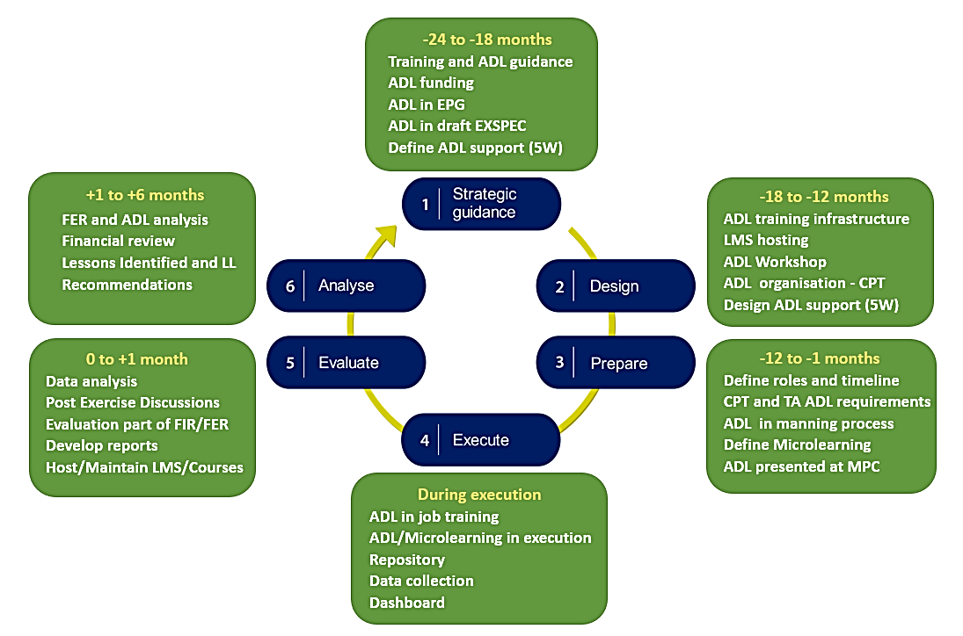

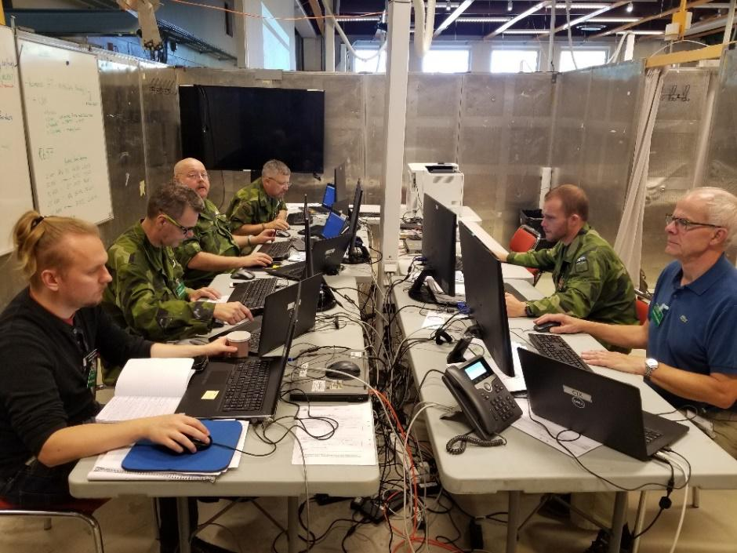
ADL in Exercises
ADL IN EXERCISES Annex to NATO ADL Handbook
Notes:
This Annex provides pragmatic guidance on developing and integrating Advanced Distributed Learning (ADL) into all types and levels of training exercises and similar events, such as test experimentation, mission rehearsal, and war gaming.
Purpose
The purpose of this Annex is to enhance military training and education by synthesizing the best practices of integrating ADL capabilities into joint and coalition training exercises. This use of ADL resources can yield concrete benefits: improved learning outcomes; increased learning efficiency by easing access to instructional materials and making them more convenient to use; and expanded readiness reporting through learning analytics and their associated visualizations.
Scope
This Annex is intended to serve as a practical, usable set of guidelines that both ADL and exercise communities can relate to and act upon. It covers event planning, execution, and evaluation; and it offers insights and topics for consideration when implementing and maturing ADL in support of a training exercise.
All the Nordic countries have been involved in developing this annex.

Slide 20
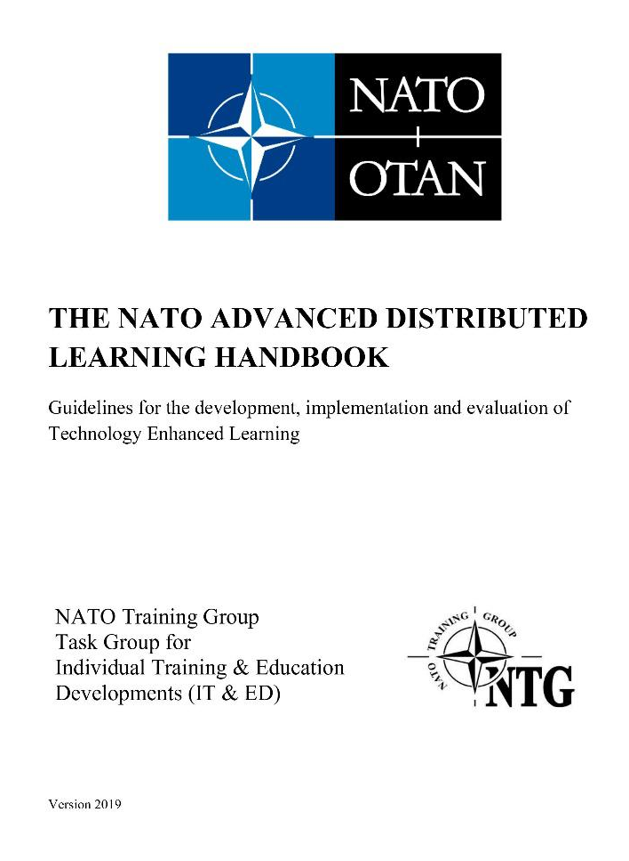

Best Practice for ADL in Exercises
ADVANCED DISTRIBUTED LEARNING IN EXERCISES Annex to NATO ADL Handbook
Notes:
The Nordic countries have been instrumental in producing the NATO ADL handbook and the annex about ADL in exercises
This is open for resue by others

Slide 21
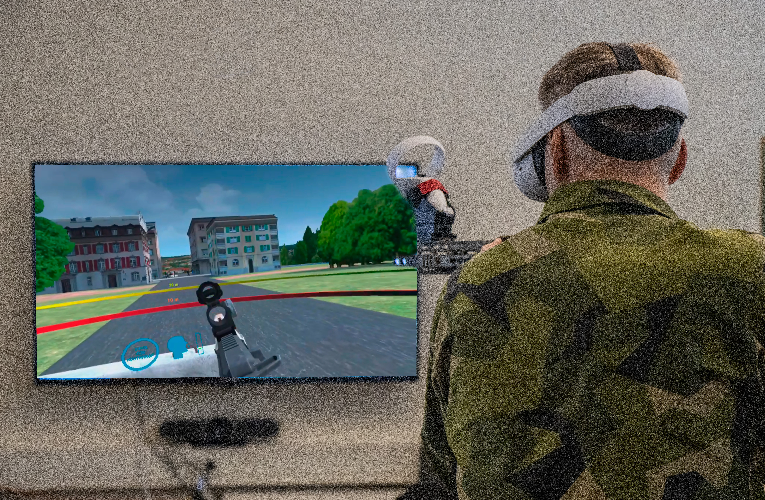
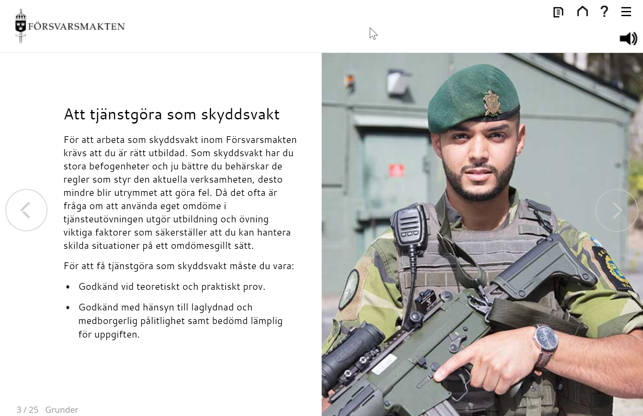
Nordic VR Collaboration Going Forward
Notes:
This project aims to test the effect of creating a digital learning resource to train and examine decision-making and actions with the support of VR (Virtual Reality), a proof of concept to see if VR as an educational tool is a viable path.
The question posed was whether our participants/students/soldiers become better and more confident in their role as decision-makers under stressful situations when they can train as much as they want, regardless of time and resources.
Furthermore, it is also necessary to study the requirements that the Armed Forces should place on learning resources and the benefits and advantages that are realized when there is no longer a need to consider resources and facilities.
This project has evolved from a Swedish initiative into a cooperation between Sweden and Denmark.

Slide 22

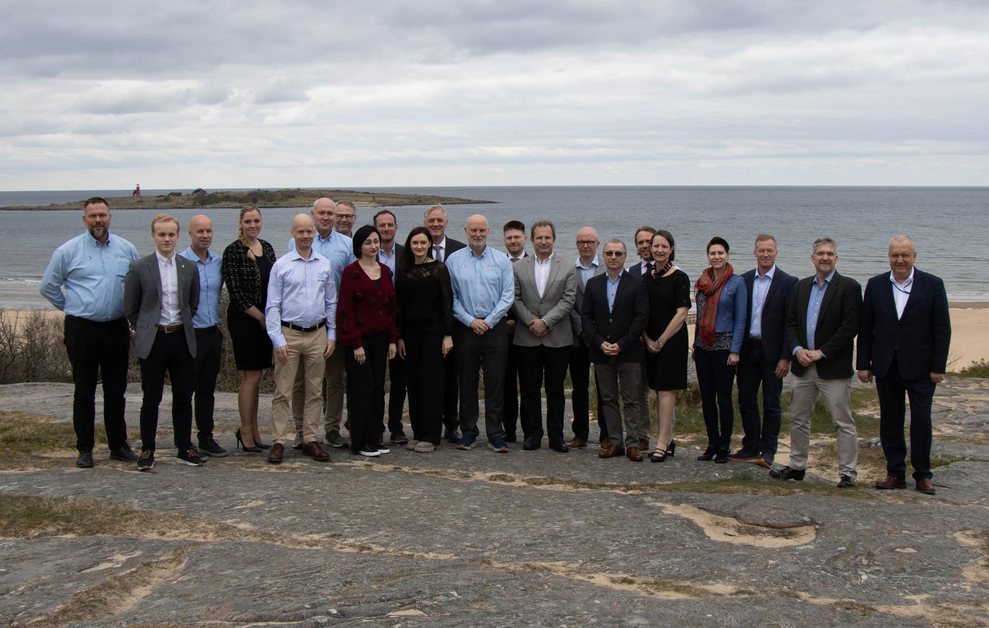
Participation and Influencing Other International ADL Arenas
Learning Technology
Global Partnership Network
20 members, defense agencies and universities
Chaired by the DASD FE&T
Meets twice a year
Autumn in the US (I/ITSEC)
Spring in Europe (Nordic ADL Conference)
Notes:
Formerly ADL Global Partnership Network
Chaired by the DASD FE&T: as the representative for the Under secretary of defence for personnel and readiness, the secretary of defence principal staff assistant for military training
Scope:
Focus on joint combined training and education and the learning technology that support it
Advocate for modernizing training capabilities across allied and partner nations
Provide a forum for allied and and partner nations to identify and examine training challenges and gaps and consider solutions

Slide 23
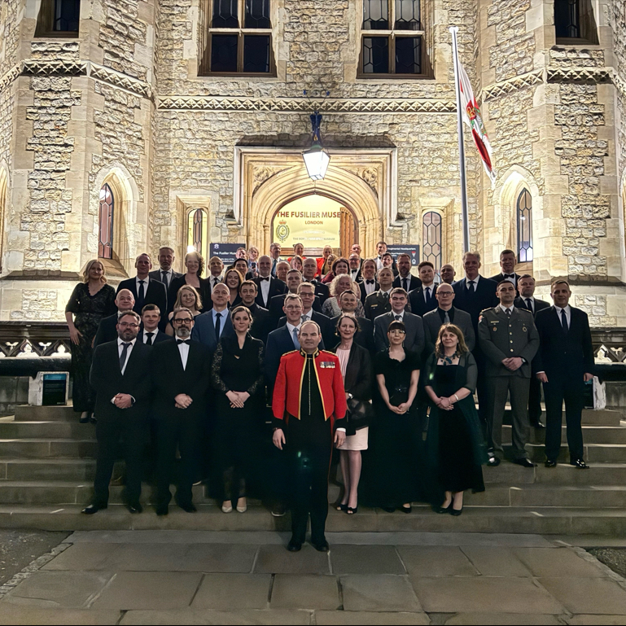
Participation and Influencing Other International ADL Arenas
NATO Learning
Technology Interoperability Group
Long standing group (+ 50 years), meets twice a year
In transition from NATO Training Group Individual Training & Education Developments to the NATO Learning Technology Interoperability Group
Chaired by NATO ACT
Notes:
Handbook Michael
Primary Objectives:
To provide training technology related input to relevant NATO policies and education and training directives.
To manage the Advanced Distributed Learning STANAG 2591 and its accompanying handbook, on behalf of HQ SACT DCOS JFD.
Enhance interoperability by implementing common training, training technology, and common standards for both training and technology.

Slide 24
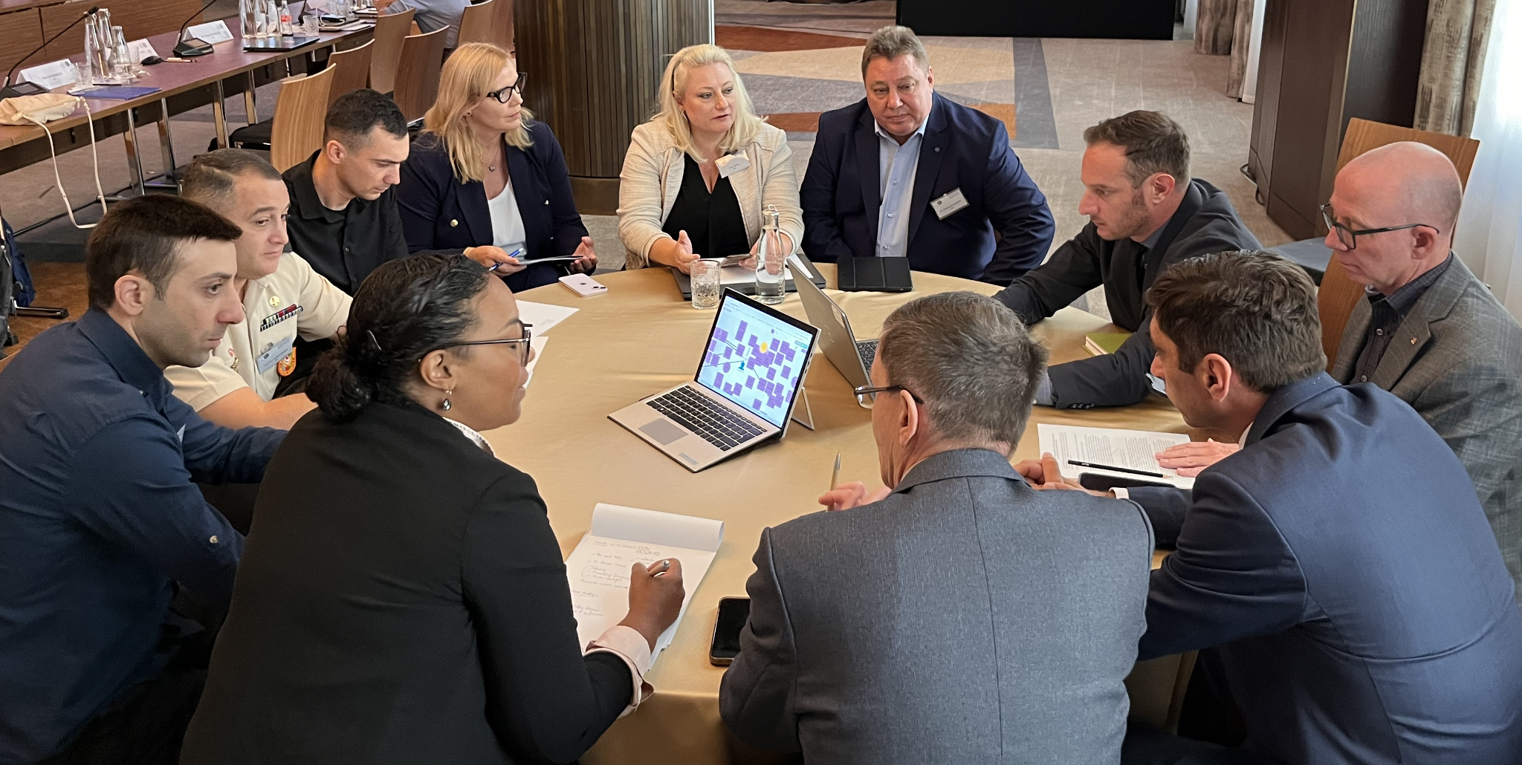
Participation and Influencing Other International ADL Arenas
PfP Consortium ADL Working Group
The mission is to strengthen defense, military, and security policy education and training through technology-enhanced learning.
The ADL WG fosters cooperation and coordination between Euro-Atlantic Partnership Council countries, and it aims to support the transformation of readiness preparation in NATO and Partner defense and academic institutions with interoperable, reliable, resilient eLearning solutions.
The ADL WG emphasizes learning solutions that address related security activities such as peace support operations, combating human trafficking, language training, and security policy education.
Notes:
The PfPC ADL WG is a true working group that gives hands on support to many different nations and institutions. The WG has also produced several white-papers and info-papers on for example lessons learned from Ukraine. The Nordic countries are working together with this group in various projects, such as ADL in Exercises.

Slide 25
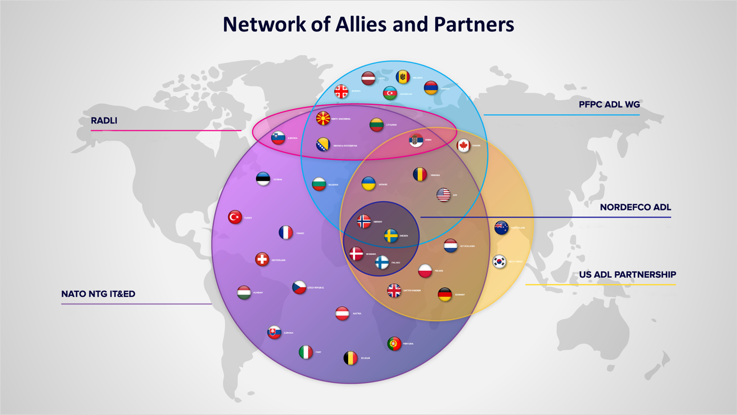
Stronger Together
Notes:
This is a picture of the network NORDEFCO FoE are participating in.
As you can see NORDEFCO FoE are placed in the middle of this. Meaning one or more of the group are participating in the major groups dealing with ADL amongst Allied and Partners.
This gives a great opportunity to work together on matters discussed in the different groups. For example, have we worked together on changes to the NATO ADL Handbook in between the meetings in the NATO Group.

Slide 26
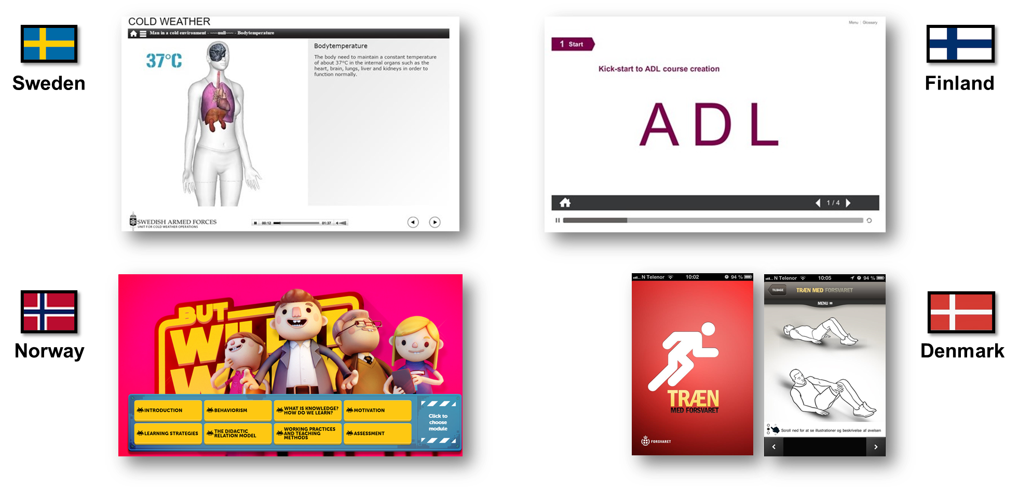
Benefits of This Long Ongoing Collaboration – Examples
Shared Expertise: Countries collaborate to develop effective training and education solutions.
Cost Efficiency: By sharing resources, we reduce duplication and optimize costs.
Notes:
The long-standing collaboration among the Nordic countries (Denmark, Finland, Norway, and Sweden) within the NORDEFCO Advanced Distributed Learning Forum of Experts offers several benefits:
Shared Expertise: By pooling our knowledge and experience our countries can develop more effective training and education solutions. We can learn from each other’s successes and challenges.
Cost Efficiency: Collaborating on technology-based learning concepts allows us to share resources, reduce duplication, and optimize costs.

Slide 27




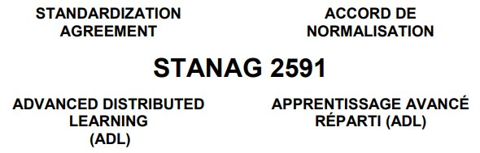

Benefits of This Long Ongoing Collaboration – Examples Continued
3. Innovation: Joint efforts foster new approaches and technologies
4. Interoperability: Aligning learning systems ensures seamless access to shared content
5. Standardization: Common standards enhance efficiency.
Notes:
3. Innovation: Joint efforts foster innovation. By working together, we can explore and choose together new approaches, technologies, and methodologies for training and education. For example how to utilize AI and technologies such as xAPI and LTI, and how to ratify NATO ADL STANAG.
4. Interoperability: Aligning our learning systems ensures better interoperability. This means that personnel from different Nordic countries can seamlessly access and benefit from shared learning content. For example by using the same LMS and producing tools, SCORM or LTI. We can also utilize our NORDEFCO ADL webpage and NATO JADL.
5. Standardization: The collaboration promotes the adoption of common standards and best practices. This consistency enhances efficiency and effectiveness.

Slide 28
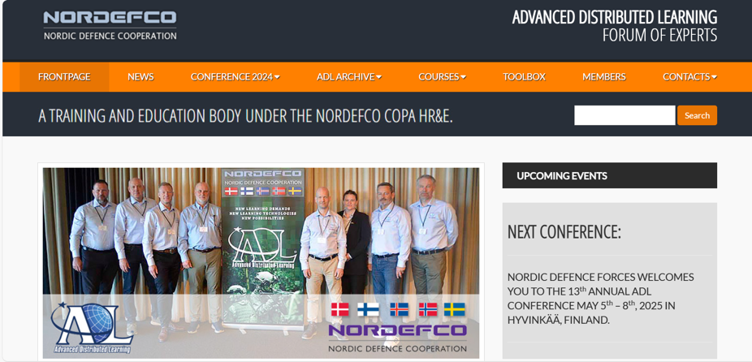
Benefits of This Long Ongoing Collaboration – Examples Continued
Networking: Regular forums strengthen professional relationships.
Notes:
6. Networking and Relationships: Regular forums and conferences provide opportunities for networking, building relationships, and strengthening bonds among professionals in the field.
Overall, this ongoing collaboration enhances the quality of training, supports defense readiness, and contributes to the collective security of the Nordic region.
We also do bi- and trilateral cooperation for example how we utilize and develop Moodle or how we use ADL in exercises.

Slide 29
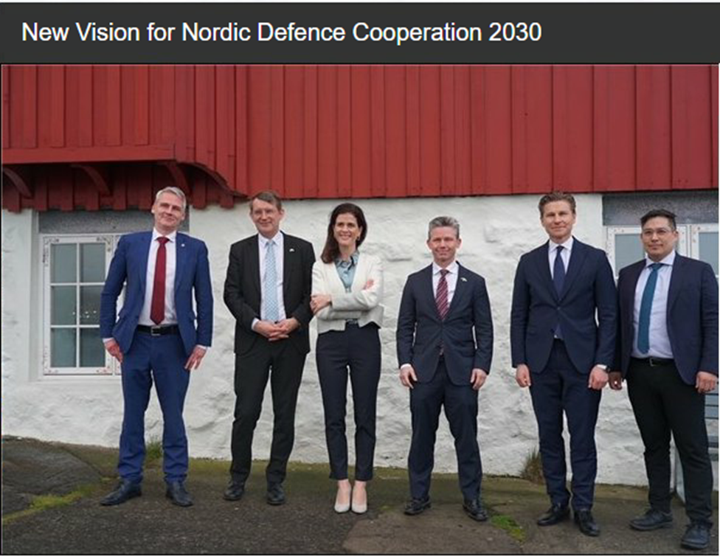
The Way Forward
The New Vision for Nordic Defence Cooperation 2030 was signed on April 30th 2024
This vision marks a new era for Nordic Defence cooperation, reflecting the strategic reality of war in Europe and the accession of Finland and Sweden to NATO.
The New Vision for Nordic Defence Cooperation 2030 focuses on improving interoperability among the Nordic countries.
Specific details regarding Advanced Distributed Learning (ADL) are not explicitly mentioned.
Notes:
The New Vision for Nordic Defence Cooperation 2030 was signed by the Nordic Ministers of Defence on April 30th, 2024, during a Ministerial meeting in Tórshavn, Faroe Islands. This vision marks a new era for Nordic Defence cooperation, reflecting the strategic reality of war in Europe and the accession of Finland and Sweden to NATO. It lays out an ambitious plan to strengthen the ability to prepare and conduct combined joint military operations, contributing to the allied security in the Nordic region and the Euro-Atlantic Area.
The New Vision for Nordic Defence Cooperation 2030 focuses on improving interoperability among the Nordic countries. It also includes cooperation on capabilities, defense materials, military mobility, logistics, and security of supply.
The New Vision for Nordic Defence Cooperation 2030 emphasizes several areas of collaboration, but specific details regarding Advanced Distributed Learning (ADL) are not explicitly mentioned. However, the broader focus on interoperability and cooperation includes aspects related to ADL. While ADL is not explicitly singled out, these efforts contribute to overall defense readiness and cooperation within the Nordic region and NATO.

Slide 30
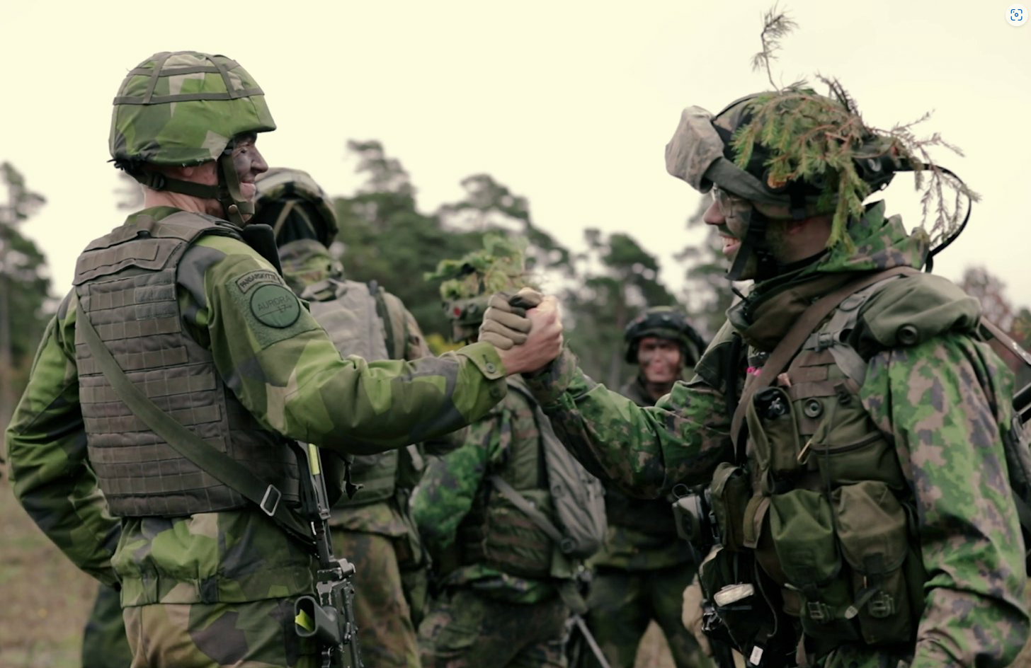
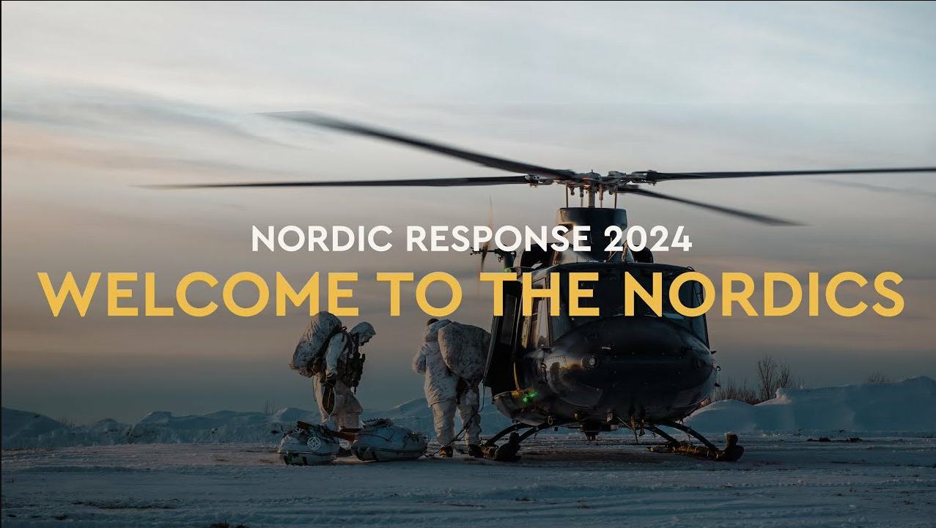
The Way Forward/ Key Issues
How can we support the new NORDEFCO vision by means of ADL?
”ADL in exercises” and “ADL in warfare”?
More cooperation with the NORDEFCO COPA TEX?
LI/LL from the Russia-Ukraine war?
Notes:
How can we support the new NORDEFCO vision by means of ADL?
•How can we use the ADL to support exercises as well as the troops and soldiers involved in military operations? What are the Lessons Learned from the Russia-Ukraine war?
•How to strengthen the ability to prepare and conduct combined joint military operations in the Nordic region and the Euro-Atlantic Area?
•How to improve interoperability among the Nordic countries? Should we support for example Combat Enhancement Training/ Force Integration Training (CET-FIT) and make eLearning materials for that together? Should we have a common platform (LMS) for that?

Slide 31
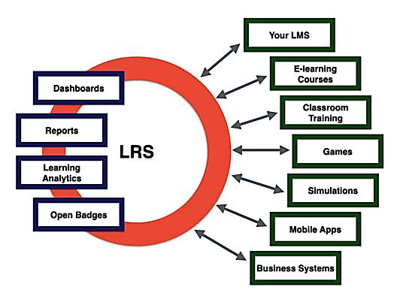
The Way Forward/ Key Issues
2. Can the Nordic countries develop our ADL ecosystems together
and save time and money?
R&D
Total Learning Architecture (TLA)​
Data, Learning Analytics & AI
Support from our allies and partners?
Information Security & Data protection
Different national legislations/ standards?
Notes:
Cost Efficiency: Can we work together and share resources, reduce duplication and optimize costs while developing our ADL-ecosystems? To Use joint efforts foster new approaches and technologies?
Common standards should enhance efficiency. Will there be challenges because of different national legislations and standards?

Slide 32


The Way Forward/ Key Issues
3. How we should produce eLearning material/courses, and how can we share them with each other and with our allies and partners?
NATO ADL STANAG – UPDATE? Still SCORM?
Common LMS-platform(s)? LTI?
Same Creator Tools?
Using Generative AI?
Translations?
Copyrights?
How about the restricted materials?
​
Vice versa: Could we ourselves receive eLearning materials from other countries if our own country would be attacked?​​
Notes:
How can we solve together all the difficulties with sharing our eLearning Courses and materials with each other and for example with Ukraine?
Is SCORM still "the Thing"?.
Will there be updated version of the NATO ADL STANAG that gives us all the answers?
Should we use common (not similiar) LMS-platform(s)? Or should we use Learning Tools Interoperability (LTI) to connect our LMS-platforms?
Should we use same creator/producing tools? Should we use similar eLEarning Course templates?
How should we utilize the generative AI?
What are the best ways to translate our products?
What about the Copywrights?
How about the restricted materials? How should and could we share them?
Or vice versa: Could we even ourselves receive eLearning materials from other countries if our own country would be attacked?

Slide 33



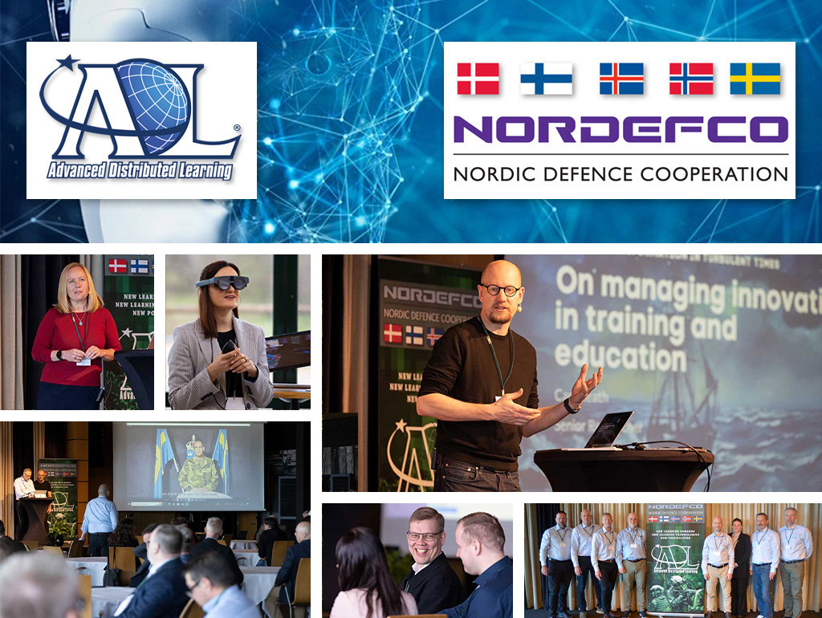

Summary - Learning Objective 1
How the Nordic countries structures their ADL cooperation
(2) F2F meetings spring and fall
Online meetings on the fly
Joint collaboration on NATO tasks
Annual NORDEFCO ADL conference

Slide 34

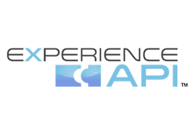

Summary - Learning Objective 2
Get insight on how to foster real interoperability between military partners.
Joint acquisition and production of learning content
Same LMS

Slide 35


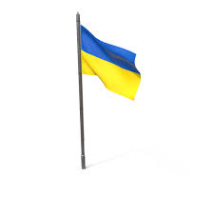
Summary - Learning Objective 3
How a joint ADL conference have benefitted four different countries in building a ​resilient ADL capability
Optimizing the use of LMS functions
Increasing in-house production capabillities
Shared resouces
Lessons learned
Emerging technology

Slide 36





Summary - Learning Objective 4
Joint R&D projects increasing knowledge and lesson learned in all 4 countries
Notes:
Elaborate about the different ongoing VR projects

Slide 37



The Way Forward
Possible new joint NORDEFCO projects
LMS
LMS
LMS
LMS
Notes:
Going forward the NORDEFCO community aims at develop a joint content repository and a Nordic LRS

Slide 38

NORDEFCO ADL Forum of Experts
Thank you for participating
www.nordicadl.com

