Slide 1

Introduction to Cognitive Systems for Modeling and Simulation
Randolph M. Jones, PhD, SoarTech, rjones@soartech.com
Dylan Schmorrow, PhD, SoarTech, dylan.schmorrow@soartech.com

Slide 2







Learning Objectives
1
2
3
Describe Cognitive Systems
Examine Benefits and Distinguishing Features
Compare to Other Software Systems
4
5
6
7
Explain “Least Commitment”
Understand Supporting Examples
Evaluate When to Use Cognitive Systems
Analyze Thinking vs. Learning
Notes:
Identify the benefits of cognitive simulation/application
Identify key differences between cognitive systems and traditional software systems
Describe the least-commitment approach inherent to knowledge-rich cognitive systems
Provide examples that motivate cognitive, least-commitment strategies over traditional state-based engineering strategies
Characterize applications where cognitive systems solutions are appropriate

Slide 3

Why Cognitive Systems?
1
To “Assure deterrence through integrated
training and readiness” we must…
“Raise the bar” of automation
Bring judgment and awareness to models and tools
Enable and embrace
human-system teams
Use automation as a
cognitive multiplier
Anticipate and exploit the cognitive constraints and
tendencies of adversaries
Build trust with systems that can explain themselves
Notes:
“A cognitive system is a one that performs the cognitive work of knowing, understanding, planning, deciding, problem solving, analyzing, synthesizing, assessing, and judging as they are fully integrated with perceiving and acting. …an entity that does cognitive work.” from http://mac9.org/w/what-is-a-cognitive-system-cognitive-systems-design-w216/

Slide 4
1
What is a Cognitive System?
Judging
Analyzing
Assessing
Problem Solving
Synthesizing
Deciding
Understanding
Knowing
Notes:
“A cognitive system is a one that performs the cognitive work of knowing, understanding, planning, deciding, problem solving, analyzing, synthesizing, assessing, and judging as they are fully integrated with perceiving and acting. …an entity that does cognitive work.” from http://mac9.org/w/what-is-a-cognitive-system-cognitive-systems-design-w216/

Slide 5


What is a Cognitive System?
1
Judging
Analyzing
Assessing
Problem Solving
Synthesizing
Deciding
Understanding
Knowing
Notes:
Recreate a person’s cognition in a model, in order to help people

Slide 6
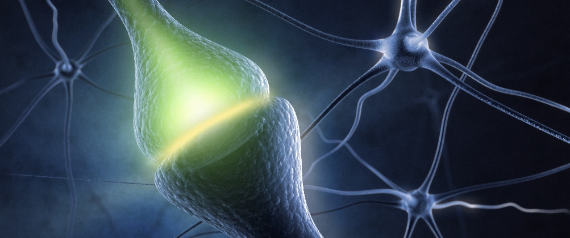
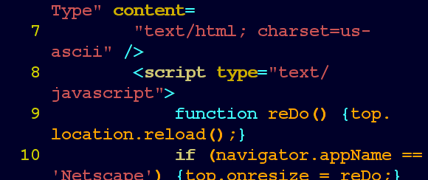
2
Benefits of human-like cognition?
Human-Like Cognition
Traditional Artificial Intelligence
Satisficing: Best quick decision
Emergent, purposeful, adaptive
(Re-)consider interpretations of the situation, goals, and plan
  Computation-intensive
  “Traditional” expert systems
  “Reactive” systems with no internal state
Notes:
Humans, and other cognitive systems, use least-commitment reasoning (which we will describe in detail later)
Make the best manageable decision in a very short amount of time
Rapidly consider and reconsider interpretations of the situation, goals to achieve, how to achieve them
Compose emergent, purposeful (but also adaptive) behavior from individual least-commitment choices
Contrast:
Search- and computation-intensive planning approaches to AI
“Traditional” expert systems
“Reactive” systems with no internal state

Slide 7
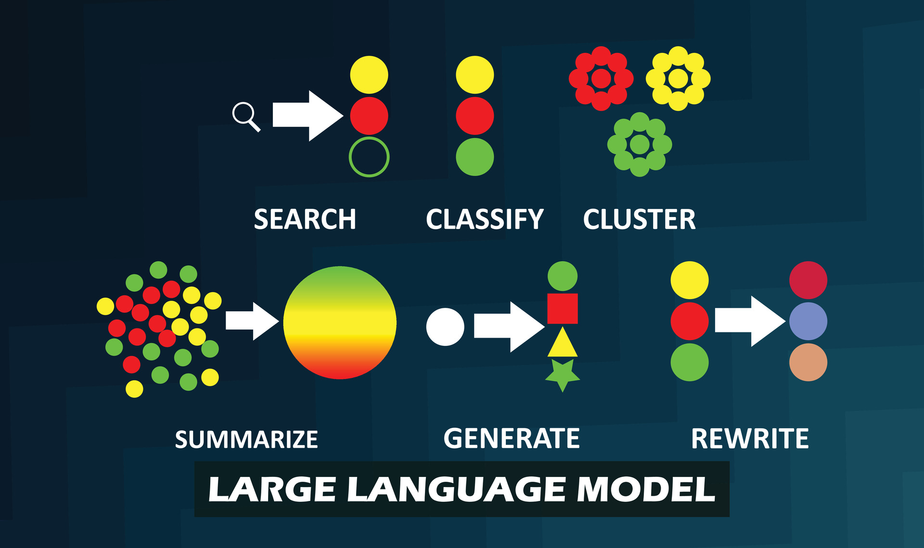
2
Benefits of human-like cognition?
Human-Like Cognition
Modern Machine Learning
Satisficing: Best quick decision
Emergent, purposeful, adaptive
(Re-)consider interpretations of the situation, goals, and plan
  Computation-intensive
  “Reactive” systems with no internal state (albeit large context)
  Statistical, both for training and execution
  Language vs. thought

Slide 8
2
What is unique about cognitive systems software?
Significant amounts of knowledge
Significant breadth of behavior
Dynamic and robust interruptibility and opportunism
Flexible adaptation to perturbations in environment
Emotional/social factors
Learning (in many forms)
Adaptive, “least-commitment” reasoning
Explicit representation of situational understanding
  Encoding of reasoning/justifications behind actions
  Traceable/inspectable decision making
Train as we fight –
Realistic simulation of opponents and teammates
Cognitive systems understand why they are doing what they are doing.

Slide 9

Challenges in Engineering Cognitive Systems
2
Requirements
Step 1
“Always do the smart thing”
“Make the same mistakes people do”
Don’t be predictable or boring
There is always room for more intelligence
Notes:
Introduction to “how to build them”
The first part is saying “requirements are usually bad/problem”
The second part is the solution
Requirements definitions are vague and general
“Always do the smart thing”
“Make the same mistakes people do”
Don’t be predictable or boring
There is always room for more intelligence

Slide 10
Challenges in Engineering Cognitive Systems
2
Requirements
Scenario Set
Step 1
Step 2
Notes:
Introduction to “how to build them”
The first part is saying “requirements are usually bad/problem”
The second part is the solution
Requirements definitions are vague and general
“Always do the smart thing”
“Make the same mistakes people do”
Don’t be predictable or boring
There is always room for more intelligence
Demands a spiral design process
Start with small set of generalized scenarios
Get at principles and understanding behind decision making
Focus on situational awareness and representation
Iterate design on areas of emphasis
Prototype-test-evaluate-refine

Slide 11
Challenges in Engineering Cognitive Systems
2
Requirements
Scenario Set
Decision-making principles
Step 1
Step 3
Step 2
Situation Awareness
Representation
Notes:
Introduction to “how to build them”
The first part is saying “requirements are usually bad/problem”
The second part is the solution
Requirements definitions are vague and general
“Always do the smart thing”
“Make the same mistakes people do”
Don’t be predictable or boring
There is always room for more intelligence
Demands a spiral design process
Start with small set of generalized scenarios
Get at principles and understanding behind decision making
Focus on situational awareness and representation
Iterate design on areas of emphasis
Prototype-test-evaluate-refine

Slide 12
Challenges in Engineering Cognitive Systems
2
Scenario Set
Decision-making principles
Emphasis Areas
Prototype/Test
Step 2
Step 4
Step 3
Step 5
Situation Awareness
Representation
Notes:
Introduction to “how to build them”
The first part is saying “requirements are usually bad/problem”
The second part is the solution
Requirements definitions are vague and general
“Always do the smart thing”
“Make the same mistakes people do”
Don’t be predictable or boring
There is always room for more intelligence
Demands a spiral design process
Start with small set of generalized scenarios
Get at principles and understanding behind decision making
Focus on situational awareness and representation
Iterate design on areas of emphasis
Prototype-test-evaluate-refine

Slide 13
Challenges in Engineering Cognitive Systems
2
Requirements
Scenario Set
Decision-making principles
Emphasis Areas
Prototype/Test
Step 1
Step 2
Step 3
Step 4
Step 5
Notes:
Introduction to “how to build them”
The first part is saying “requirements are usually bad/problem”
The second part is the solution
Requirements definitions are vague and general
“Always do the smart thing”
“Make the same mistakes people do”
Don’t be predictable or boring
There is always room for more intelligence
Demands a spiral design process
Start with small set of generalized scenarios
Get at principles and understanding behind decision making
Focus on situational awareness and representation
Iterate design on areas of emphasis
Prototype-test-evaluate-refine

Slide 14
Simple Approach: Finite State Machines
3
S₁
Engineered Behavior
S₃
S₂
S₅
  Rigid contexts for plans
  Allows limited contextual action
  Procedural programming
  Convenient and familiar idioms
S₄
S₆
Notes:
Ok, let’s say you have the requirements, then how are you going to build a system to meet them?
FSM is the strawman
A lot of SAF systems use this
Quick overview of how they work + advantages and disadvantages
Rigid contexts for plans of action
“In situation A, follow plan X.”
Like rule-based systems, without the search
Allows limited contextual action
Exploits strengths of procedural programming
Convenient and familiar idioms, point of view

Slide 15


Finite State Machine Tradeoffs
3
Future learning capabilities depend on careful, integrated knowledge representations
Organizational assumptions and strengths will not scale with complexity
  Familiar to software engineers
  Traditional linear flow of control; States are the antithesis of satisficing
Finite State Machines do not know why they are doing what they are doing!
Efficient implementation and organization in traditional computer languages
Difficult to handle task switching, interruption, and opportunism
Representations of awareness built from ad-hoc data structures
The simplifying constructs that make finite state machines attractive do not scale to complex, adaptive, knowledge-rich systems
Notes:
Advantages
Familiar to software engineers
Efficient implementation and organization in traditional computer languages
Disadvantages
Traditional linear flow of control; States are the antithesis of least-commitment
Difficult to handle task switching, interruption, and opportunism
Representations of awareness built from ad-hoc data structures
Organizational assumptions and strengths will not scale with complexity
Future learning capabilities depend on careful, integrated knowledge representations

Slide 16




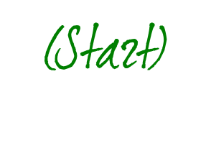
Intelligent Behavior as Search (Simple Version)
3
B
Stack(B,C)
Stack(A,B)
A
B
C
A
C
A
C
B
Stack(C,A)
Stack(A,Table)
A
A
C
B
B
C
Stack(A,Table)
Stack(C,Table)
Stack(A,C)
B
A
Stack(B,A)
A
B
C
C
Stack(B,Table)
Notes:
A cognitive system is always in some state
Transitions from one state to another are accomplished by operators
A cognitive system repeatedly applies operators in an attempt to achieve some goal
Intelligence involves making smart choices about which operator to apply next
Each picture is a state; each arrow is an operator
The ABC is the goal state
The start state is the first one
Applying an operator means executing it
…There are alternative paths
…This is the whole state space

Slide 17
Finite State Machine Tradeoffs
3
Future learning capabilities depend on careful, integrated knowledge representations
Organizational assumptions and strengths will not scale with complexity
  Familiar to software engineers
  Traditional linear flow of control; States are the antithesis of satisficing
Efficient implementation and organization in traditional computer languages
Difficult to handle task switching, interruption, and opportunism
  Traditional linear flow of control; States are the antithesis of satisficing
Representations of awareness built from ad-hoc data structures
Intelligent behavior as search mitigates (or partially mitigates) some problems with Finite State Machines
Notes:
Intelligent behavior as search mitigates (1) linear flow of control and (2) somewhat mitigates task switching and (3) somewhat mitigates representations of awareness and (4) somewhat mitigates future learning
But it doesn’t address scaling with complexity ← it breaks down with that

Slide 18

Example Applied Scenario
3
TASK: Provide autonomous synthetic aircraft to fly close-air support missions
  On the surface, neatly divisible mission phases
  Mission phases may work with a state-machine approach
  But increasing requirements for flexibility, autonomy, and intelligence stress the FSM approach…
Notes:
Provide autonomous synthetic aircraft to fly close-air support missions
On the surface, neatly divisible mission phases
Take-off, Enter-AOA, Check-in, Hold, Ingress, Attack, Egress, Leave-AOA, Land
Mission phases may lend themselves to a state-machine approach
But increasing requirements for flexibility, autonomy, and “intelligence” stress the FSM approach
A SME might describe it in nice, linear mission phases
So meeting with a SME might generate a state diagram like this…

Slide 19
Example Applied Scenario
3
Take-Off
Close-Air Support “State Space”
Enter-AOA
Attack
Check-in
Ingress
Egress
Leave-AOA
Hold
Land

Slide 20
Example Applied Scenario
3
Take-Off
Close-Air Support “State Space”
Enter-AOA
Enter-AOA
Attack
Attack
Check-in
Ingress
Leave-AOA
Check-in
Ingress
Egress
Leave-AOA
Egress
Hold
Hold
Land
Notes:
Can’t be done for realistic/complex tasks
Narrows the system’s areas of applicability (i.e., less adaptive)
For realistic tasks, the system’s environment is large and complex, and part of being intelligent involves filtering out and attending to relevant information
But when you talk to the SME again it’s not so neat and linear
Sometimes I don’t have to do the check in or I start it early or I start flying to target before check-in
The state space starts to break
Just pictorial
Might be in a combination of states
Temptation to include only the relevant elements in a given state, but that’s not practical because you don’t know what’s going to be relevant or not
So you end up with a combinatorial explosion of states

Slide 21

Example Applied Scenario
3
Avoid air threat
“Cognitive”
Close-Air Support
Counter-measures
Survive
Avoid ground
threat
Speed
Evade
Heading
Beliefs
SAM sites
Air threats
Call sign
Group info
Current contact
Authentication
Target location
Target description
Aircraft status
Waypoints
…
Maneuver
Authentication
Communicate
Tactical control
Altitude
GOALS
Command-group
Fly to point
Air control
Detour
Wheel
Flight-Plan
Attack
brief
Check in
Close-Air
Support
Attack
maneuvers
Attack
Tactics
Hold at point
BDA
Manage ordnance
Racetrack
Clearance
Notes:
Add arrows to show interdependency / complicated

Slide 22
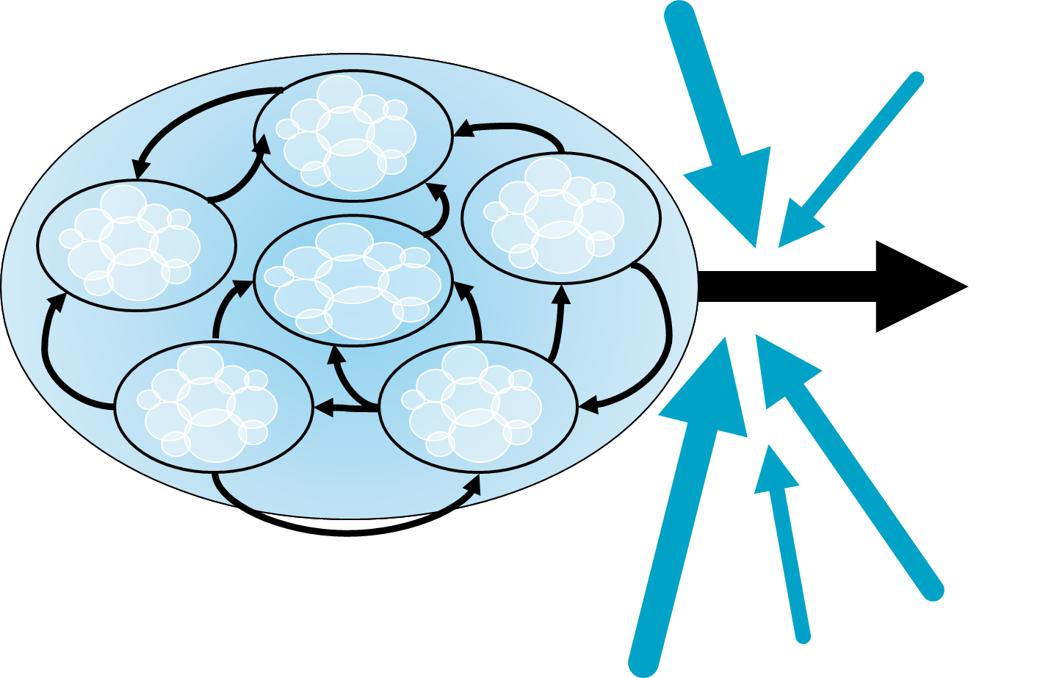
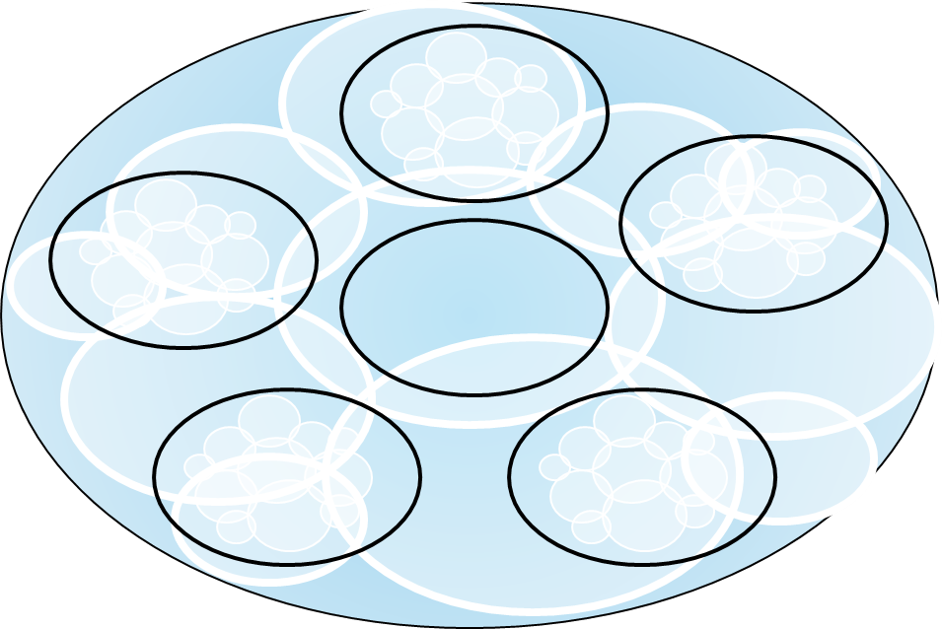
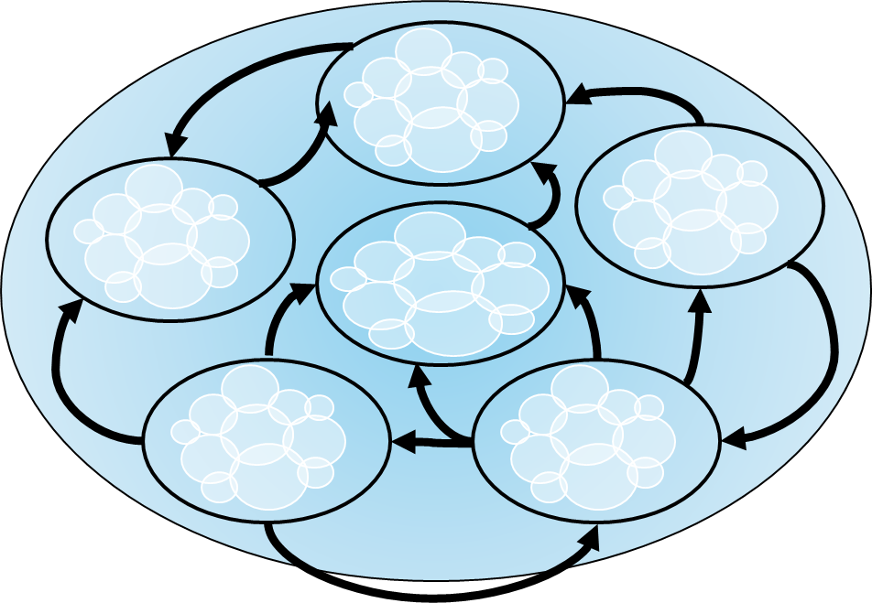
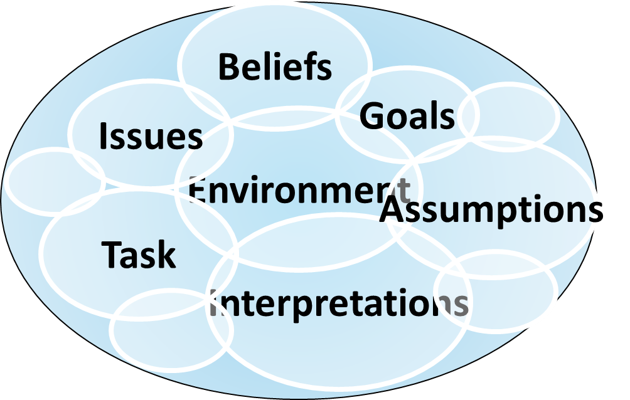
Complexity
3
States contain multiple layers and types of information
“States” consist of many states
States and associated tasks are codependent
States change for many reasons
  Few simple transitions that are under agent control
Notes:
ORIGINAL: Complexity: States Include (Internal) Mental
For a cognitive system, the state does not just include a representation of the task or the external environment
Cognitive systems create goals, hypotheses, inferences, interpretations, expectations, decisions, intentions…
All of these contribute to the mental “state” of the system
Here’s why it doesn’t scale
States are much more complicated than the diagrams we’ve looked at so far; they don’t just include a representation, they
it’s not just a snapshot of the current state of the world that’s important; it also needs to include your beliefs and interpretations – it’s more complicated than just it’s current task/rep

Slide 23

Cognitive Systems = Coping with Complexity
3
Maintain the notion of search, states, and operators
  Reasoning is deliberative action on a knowledge representation
Operators employed via associative pattern matches
  Reasoning is recognition based
Operators initiate interleaved mental and external actions
Least-commitment reasoning
Notes:
How can we generalize the state approach even further to make it useful?
We want to keep the state-based concept, but we can’t scale it because of the complexity and interdependency
How do we represent states & operators without the problems?
Maintain the notion of search, states, and operators
Operators are considered, compared, and selected via associative pattern matches to portions of the current state
Operators initiate interleaved mental and external actions
Least-commitment reasoning
A: We add least-commitment reasoning
The least commitment approach moves everything over to the green side

Slide 24



Least-commitment reasoning
4
Satisficing
Iterative
Emergent
Make the best manageable decision in a very short amount of time
Rapidly consider and reconsider interpretations of the situation, goals to achieve, how to achieve them
Compose emergent, purposeful (but also adaptive) behavior from individual least-commitment choices
These are supported by modern cognitive architectures
Notes:
These are supported by modern cognitive architectures
Make the best manageable decision in a very short amount of time
Rapidly consider and reconsider interpretations of the situation, goals to achieve, how to achieve them
Compose emergent, purposeful (but also adaptive) behavior from individual least-commitment choices

Slide 25

Cognitive Systems are Not “Rule Based”
4
PHOTO: JON EBEN FIELD
Cognitive System
Hey! Haven’t we already tried these “rule-based systems”?
Parallel, associative, relational memory
Belief maintenance and understanding
Situation appraisal and preferences
Flexible problem decomposition
Adaptation via experience
Rigid
Brittle
Expensive
Notes:
Photo from
http://commons.wikimedia.org/wiki/File:Summer_2007-101_(871613008).jpg
DescriptionOmer's patented scowl.
Date14 July 2007, 07:55SourceSummer_2007-101Uploaded by MTHarden
AuthorJon Eben Field from St. Catharines, Ontario, Canada
you are free:to share – to copy, distribute and transmit the work
to remix – to adapt the work
Under the following conditions:attribution – You must attribute the work in the manner specified by the author or licensor (but not in any way that suggests that they endorse you or your use of the work).
A “rule based system” generally performs an exhaustive (expensive) search through a fairly rigid set of “rules,” trying to find the “best” for each situation
In contrast, cognitive systems model the fluid, least commitment approach that emulates how humans think and behave
Parallel, associative, relational memory
Belief maintenance and understanding
Deliberation based on situation appraisal and preferences
Flexible problem decomposition
Adaptation via experience
FIRST HALF OF SLIDE
There’s a notion that rule-based systems are brittle
… how do we get to cognitive systems as not brittle?
Trying to define the terms
A “rule based system” generally performs an exhaustive (expensive) search through a fairly rigid set of “rules,” trying to find the “best” for each situation
When people tried to traditionally define rule-based systems, then search through the set of rules, pick one and follow it without changing
…it’s so expensive to find out what the best set of rules is, so then you don’t want to abandon that set of rules (expensive decisions)
…it is also cheap to change your mind, then you’re less brittle
Maybe move this slide?
SECOND HALF OF SLIDE
Some of the patterns that humans use to implement the fluid approach
Redundant?

Slide 26
High Commitment vs. Least Commitment
4
I have a script, but I’ve
lost my place.
What happens next?
I have no script, but
I understand and
recognize what to
do next!
High Commitment
Least Commitment

Slide 27

Pasta and Cheese Sauce: High Commitment
5
Fill pot1 with water
Heat pot1 until water boils
Add pasta to pot1
Stir pasta until pasta is soft
Drain pasta
Put butter in pot2
Heat pot2 until butter melts
Add flour to pot2
Stir flour until absorbed in butter
Add milk to pot2
Stir milk until it is thick
Add cheese to pot2
Stir milk and cheese until melted and smooth
Pour pasta into bowl
Pour sauce onto pasta
Notes:
This works great as long as all of your assumptions hold… but if anything goes wrong, then you’re lost
You lose your pasta

Slide 28
Pasta and Cheese Sauce: Least Commitment
5
If pot1 is empty and pasta is uncooked, fill pot1 with water
If pot1 contains water and pasta is uncooked, heat pot1
If pot1 contains water and pasta is uncooked and pasta is not in pot1 and water is boiling, add pasta to pot1
If pasta is in pot1 and pasta is not soft, stir pasta
If pasta is in pot1 and pasta is soft, drain pasta
If pot2 is empty and sauce is not done, put butter in pot2
If pot2 is not empty, heat pot2
If butter is melted and flour is not in pot2, add flour to pot2
If butter and flour are in pot2 and flour is not absorbed into butter, stir pot2
If butter and flour are in pot2 and flour is absorbed into butter and milk is not in pot2, add milk to pot2
If milk is in pot2 and milk is not thick, stir milk
If milk is in pot2 and milk is thick and cheese is not in pot2, add cheese to pot2
If milk and cheese are in pot2 and sauce is not smooth, stir milk and cheese
If pasta is soft and drained, pour pasta into bowl
If sauce is smooth and pasta is in bowl, pour sauce onto pasta
Notes:
All of the numbers are gone
Everything is conditional (if/then)
There’s still an implied sequence, but it’s based upon how the world is actually behaving, not just rules

Slide 29
Pasta and Cheese Sauce: Goals
5
If goal(pasta-and-cheese-sauce), subgoal (cooked-pasta) subgoal(cheese-sauce)
If goal(cooked-pasta), subgoal (pot-filled-with-hot-water)
If goal(pot-filled-with-hot-water), subgoal (pot-filled-with-water)
If goal(pot-filled-with-water) and pot1 is available, fill pot1 withwater
If goal(pot-filled-with-hot-water) and pot1 is filled with water, heat pot1
If goal(cooked-pasta) and pot1 is filled with hot water, add pasta to pot1
…
Notes:
In a real cognitive system, we don’t just have tasks… we also have goals

Slide 30


Advantages to Least-Commitment Design
5
Any or all actions can be executed or omitted depending on the situation
Model will smoothly handle interruption, task switching, serendipitous (or team-driven) achievement of goals, unexpected world changes
Parallelism is constrained only by knowledge dependencies, not idiosyncrasies of the execution paradigm
Underlying cognitive architecture provides the machinery to manage all this, without requiring ad hoc solutions from the software engineer
Notes:
Benefits
Can do two things at the same time
Can take advantage of opportunities
Can recover from errors
…introduce the idea of the cognitive architecture = A software system that supports these advantages

Slide 31
Cognitive Least-Commitment Organization
5
Sense Environment
Environment
Revise Beliefs
Revise Desires
Revise Active Goals
Select or Reconsider Plan
Execute Planned Action
Issue Motor Commands
Notes:
Basic decision-cycle in a least commitment design
All cognitive architectures have a decision cycle that is pretty close to this
Make this into a linear/slide
Desire = Things the agent would like to be true
Goal = subset of desires that the agent will commit resources to achieve (especially good for teamwork)
Execute planned action = may be external (motor cmd) or an internal thing (e.g. mark a goal as achieved, mark a belief as false)
Issue motor commands = maybe combined with execute

Slide 32

Cognitive Least-Commitment Organization
5
Sense Environment
entailment
Environment
Revise Beliefs
assumption
Revise Desires
association
Revise Active Goals
Select or Reconsider Plan
Distinguishing feature of cognitive architectures vs traditional software systems
Execute Planned Action
Issue Motor Commands
Notes:
Beliefs
This slide is expanding upon the diagram slide
Usually does an example with a pen, held in the air = if visual it’s an entailment, once behind back, it’s an assumption (that might not be true)
Association = neither logical nor an assumption
Distinguishing feature between cognitive architectures and traditional software systems

Slide 33
Cognitive Least-Commitment Organization
5
Sense Environment
Why?!
Environment
purposeful action
Revise Beliefs
Revise Desires
What?!
separate from
achievement
Revise Active Goals
Select or Reconsider Plan
Execute Planned Action
(Analog to “states”)
Issue Motor Commands
Notes:
Desires/Goals
Explicit representation of purposeful action
Goals can be represented separately from how to achieve them
Provide rational organization of knowledge
Explicitly representing goals = engineering / behavior advantages
Organize decision making and behavior
Analog to “states” or “modules” in traditional programming
There are some systems that don’t make goals explicit (but they’re less flexible)

Slide 34
Different Example Implementation
5
Sense Environment
Environment
Revise Beliefs
Revise Desires
Revise Active Goals
Select or Reconsider Plan
Execute Planned Action
Issue Motor Commands
Notes:
Point of this slide is to say that different cognitive architectures implement least commitment in different ways

Slide 35

5
Situational Understanding
Notes:
So here’s a case study. A simple air engagement. The blue guy’s a good guy the red guy’s a bad guy. Blue has approached the target.
Fired a missile. And then…
Makes a slight turn to the right. Okay.
So the question is for this case here why did the aircraft turn right? Okay. Now. So. One way to have approached building the entire intercept behavior would be to build that very procedurally right? I mean there are a number of steps you have to go through to intercept a target. You fly towards the target. When you get close enough you shoot the missile. And then for some reason, maybe you don’t know yet, you turn right. Okay. We could script that, but that’s not what we did in TacAir-Soar. And by watching this behavior you wouldn’t be able to tell if this thing has understanding of its environment or not. Maybe if you watched it on hundreds of different kinds of scenarios and saw gee it’s always doing the right thing in different situations you’d become convinced wow it really does understand what it’s doing. But we’re gonna look directly at the internal representations that are supporting this decision to try, for me to try to convince you that it’s doing this for the right reasons, because it understands what’s going on.
Okay, so why did the aircraft turn right? Well it turns out if you look into the set of rules in TacAir-Soar, I kind of made a stylized graphical representation here. It’s outputting a desired heading. And a new desired heading of the aircraft implements the turn of the aircraft in this simulation. And because there’s a rule that says if my goal is to do what’s called an f-pole maneuver. F-pole tactic. And there’s an agent out there who, uh, is in a particular direction from me that I wanna do this f-pole maneuver in. And the f-pole maneuver is annotated with a maintain-heading attribute. Well then that’s what I’m gonna do. You say well that’s pretty scripted, right? So we need to know where that goal came from.
Here’s that Soar rule. If I have an operator named f-pole annotated with a maintain-heading then I’m gonna change the value of the desired-heading attribute to be that heading.
Okay, so why that particular heading? Okay there’s another rule that computes that maintain-heading attribute of the f-pole goal. Well it turns out now we’re gonna do the reasons why this behavior’s happening. Okay it turns out that this particular kind of missile that we shot is a radar-guided missile. But it’s not guided by a radar on the missile, it’s guided by the radar on the aircraft. Okay so after you shot the missile you have to keep your radar locked onto that target until the missile hits. What you’d really like to do after you shoot the missile is run away so he can’t shoot you, right? But you can’t do that. If you do that you lose the radar lock and the missile won’t hit the target because it doesn’t know where to go. So that’s…different kinds of missiles have different guidance systems and in this case this is that kind of missile. But at the same time the closer you get to that target the more likely it is he’s gonna be able to shoot you. And what you’d really like is for him not to shoot you, or if he does shoot at you that your missile hits him before his missile hits you. Because if you can destroy him before his missile hits you, his radar lock will go away and his missile won’t hit you. Okay, that’s a little game of chicken. So how do you do that? Well I have to turn far enough, only so far that the guy’s still on my radar because the radar on my aircraft is on the nose of my plane so I have a cone in front of me. But I want to slow down how quickly I’m approach him so I’m gonna turn. That’s what the f-pole maneuver is. So the heading I turn to in this goal depends on information about the agent I just shot and information about my radar. What are the safe limits of my radar that I can turn to and still maintain contact?
There’s the rule for that. So this. If I have an operator named f-pole and I’m turning to the right and there’s a magnetic bearing for the target I know the radar safe angle off limit of my radar, then I can compute which angle I should turn to. Okay, this kind of rule will constantly recompute. As…if that aircraft’s magnetic bearing changes then I’m gonna recompute a new heading that I need to come to. So I can maintain the proper heading as the geometry changes.

Slide 36
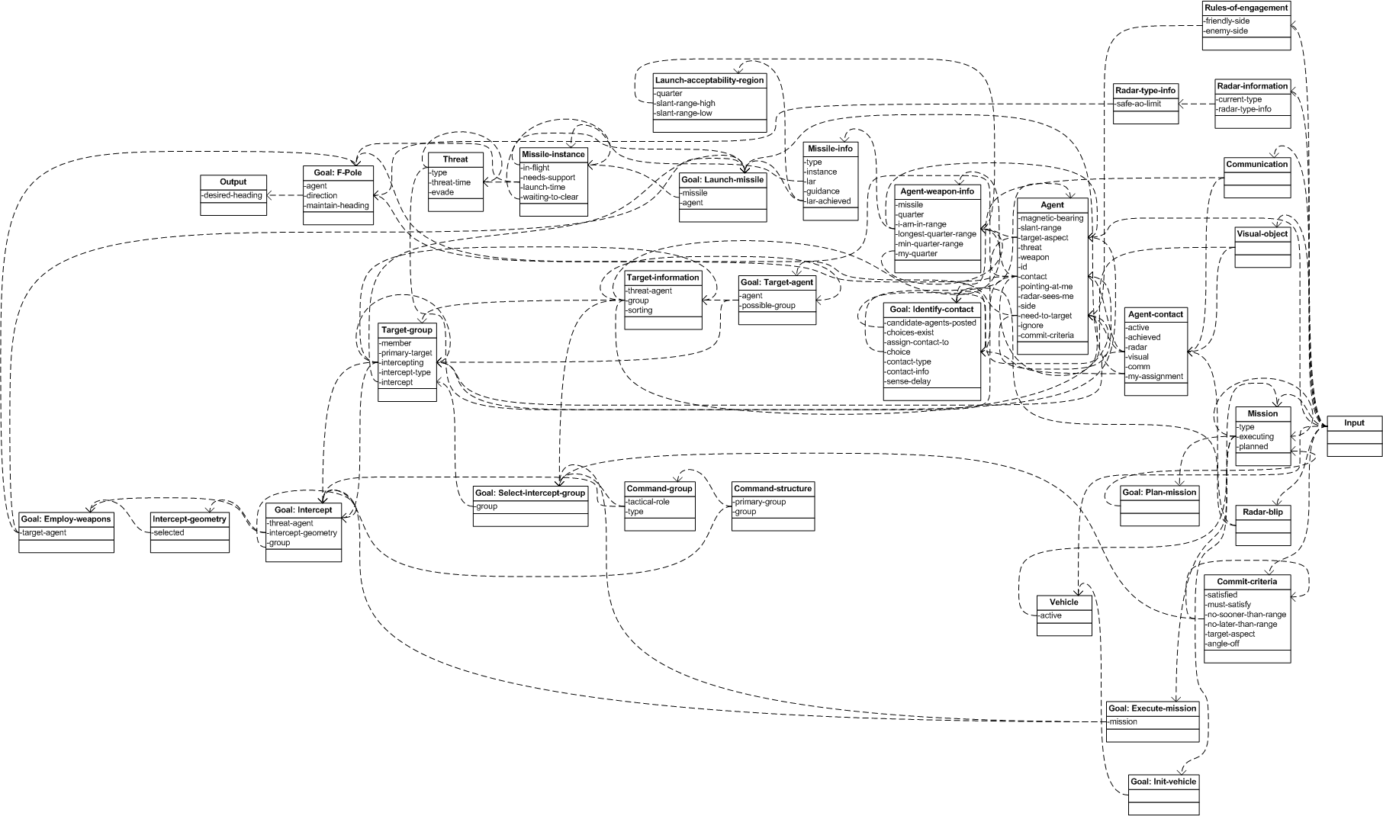
Notes:
THIS SLIDE ISN’T SUPPOSED TO BE READABLE; IT’S JUST SHOWING COMPLEXITY

Slide 37
Where is the sweet spot for Cognitive Systems?
6
Does the application require attention to parallel tasks that are sensitive to each other?
Does the application require handling large numbers of special cases and exceptions?
Does the application require quick, dynamic, and robust adaptation to changing situations?
Dependent on common understanding
Difficult to code a simple, general algorithm
Pattern recognition is a must
Notes:
Must analyze requirements on entity behaviors within the application
Does the application require attention to parallel tasks that are sensitive to each other?
Dependent on common understanding.
Does the application require handling large numbers of special cases and exceptions?
Difficult to code a simple, general algorithm.
Does the application require quick, dynamic, and robust adaptation to changing situations?
Pattern recognition a must.
Does the application require flexible interruptibility and opportunism
Least-commitment approach dictates programming model.
Does the application require natural collaboration with human users?
Especially including modeling users’ understanding and intentions.
REMOVE BUMPER STICKERS

Slide 38
Where is the sweet spot for Cognitive Systems?
6
Does the application require attention to parallel tasks that are sensitive to each other?
Does the application require handling large numbers of special cases and exceptions?
Does the application require flexible interruptibility and opportunism
Does the application require natural collaboration with human users?
Does the application require quick, dynamic, and robust adaptation to changing situations?
Dependent on common understanding
Difficult to code a simple, general algorithm
Pattern recognition is a must
Least-commitment approach dictates programming model
The system’s knowledge is relatable to the users’ understanding and intentions
Notes:
Must analyze requirements on entity behaviors within the application
Does the application require attention to parallel tasks that are sensitive to each other?
Dependent on common understanding.
Does the application require handling large numbers of special cases and exceptions?
Difficult to code a simple, general algorithm.
Does the application require quick, dynamic, and robust adaptation to changing situations?
Pattern recognition a must.
Does the application require flexible interruptibility and opportunism
Least-commitment approach dictates programming model.
Does the application require natural collaboration with human users?
Especially including modeling users’ understanding and intentions.

Slide 39
Notes on Learning and Cognition
7
Machine Learning could be (and is!) an entire additional tutorial (or several!)
  We understand some forms of learning extremely well
Building a cognitive system can be expensive.
  Knowledge representation, algorithm tuning, data collection, training regimen, amount of training
  Why can human learn some things machine-learning systems still cannot?
    Humans bring knowledge to the table. How can prior knowledge and learning work together?
Similar questions to ask:
  What, why, and when should my application learn?
Aim learning at improving the processes and representations of the (cognitive) system:
  Turn perceptions into beliefs
  Extract desires from beliefs
  Select and prioritize goals from desired and beliefs
  Formulate plans in response to goals and beliefs
  Select actions relevant to plans and beliefs
  Respond, reconsider, adapt at each stage
Cognitive architectures integrate numerous forms of learning
  Empirical, analytic, reinforcement, semantic, episodic, associative, deep, perceptual, …
So is learning!

Slide 40
Learning and Cognition: A Path Forward
7
The best learning algorithms are flexible, fluid, and noise tolerant
  “Subsymbolic” representation languages
  Graded and continuous optimization and learning functions
  OPAQUE
  BUT: Dogs are very good learners, too…we want learners that understand
    Do learning systems understand WHY they are doing WHAT they are doing? (Maybe!)
In addition to being good learners, humans can…
  Communicate what they know
  Explain their choices
  Collaborate in teams
  Accelerate learning with prior knowledge and reasoning
  Discover and create new knowledge
The most robust future learning systems will ALSO be cognitive systems
The best future cognitive systems will ALSO be learning systems
The problems of each research area will not be solved without the other
Integrated systems will learn what to do and why!

Slide 41
Cognitive Systems and Large Language Models
7
Large language models provide some exciting opportunities for enhancing cognitive systems
  A challenge has been integrating the (mostly) symbolic knowledge representations in cognitive systems with the (mostly) non-symbolic knowledge representations in machine-learning systems
  Although LLMs are non-symbolic “under the hood”, they EXPRESS themselves in symbolic language
    (Like humans do!)
Potential synergy
  Cognitive systems run into situations where they have knowledge gaps
  LLMs have immense amount of knowledge but not always structured in the ways cognitive systems assume
  Could LLMs serve as “advice givers” to cognitive systems?
  Can we also go “in the other direction”?

Slide 42

Take-Home Messages
raise the bar of automation!
You need cognitive systems
Many varieties of cognitive systems exist
Good ones have adaptive, complex behavior that understand why they are doing what they are doing
Methods can help you decide which approaches to use
Notes:
Cognitive systems are not optional
There are identified needs to build systems that model and collaborate with humans
There are current technologies available to build a variety of types of cognitive systems
Knowledge-rich cognitive systems incorporate specific capabilities to support adaptive, complex behavior
There are good methods for deciding which approaches best suit your requirements

Slide 43
Learning Objectives (Recap)
1
2
3
Describe Cognitive Systems
Examine Benefits and Distinguishing Features
Compare to Other Software Systems
4
5
6
7
Explain “Least Commitment”
Understand Supporting Examples
Evaluate When to Use Cognitive Systems
Analyze Thinking vs. Learning
Notes:
Identify the benefits of cognitive simulation/application
Identify key differences between cognitive systems and traditional software systems
Describe the least-commitment approach inherent to knowledge-rich cognitive systems
Provide examples that motivate cognitive, least-commitment strategies over traditional state-based engineering strategies
Characterize applications where cognitive systems solutions are appropriate

Slide 44
Questions?
Randolph M. Jones, Ph.D. rjones@soartech.com | Dylan Schmorrow, Ph.D. dylan.schmorrow@soartech.com

