Slide 1

Machine Learning: An Introduction for Humans
Randolph M. Jones, PhD, SoarTech, rjones@soartech.com

Slide 2
Learning Objectives
Contrast what machine learning is and what it is not
Identify opportunities to use ML in training, simulation, and education
Compare the different types of functionality current machine learning algorithms can provide
Apply “the basic idea” of how machine learning works and what makes it challenging
Analyze the mechanics of how to make an algorithm learn effectively and where it might fail
Evaluate the types of human learning that are still a challenge for machines

Slide 3
Caveat
This is intended to be a high-level tutorial that stays out of the detailed weeds
This necessarily means things will be simplified, and sometimes over-simplified
I will try to call out areas where things are being over-simplified in a potentially confusing way
!

Slide 4

Animal vs. Human vs. Machine Learning
Classical conditioning
  Learning to associate two external stimuli
Operant conditioning
  Learning to associate an internally generated action with an external stimulus (action-consequence)
Observational learning
  Learning to generate an internal action by mimicking an external observation

Slide 5
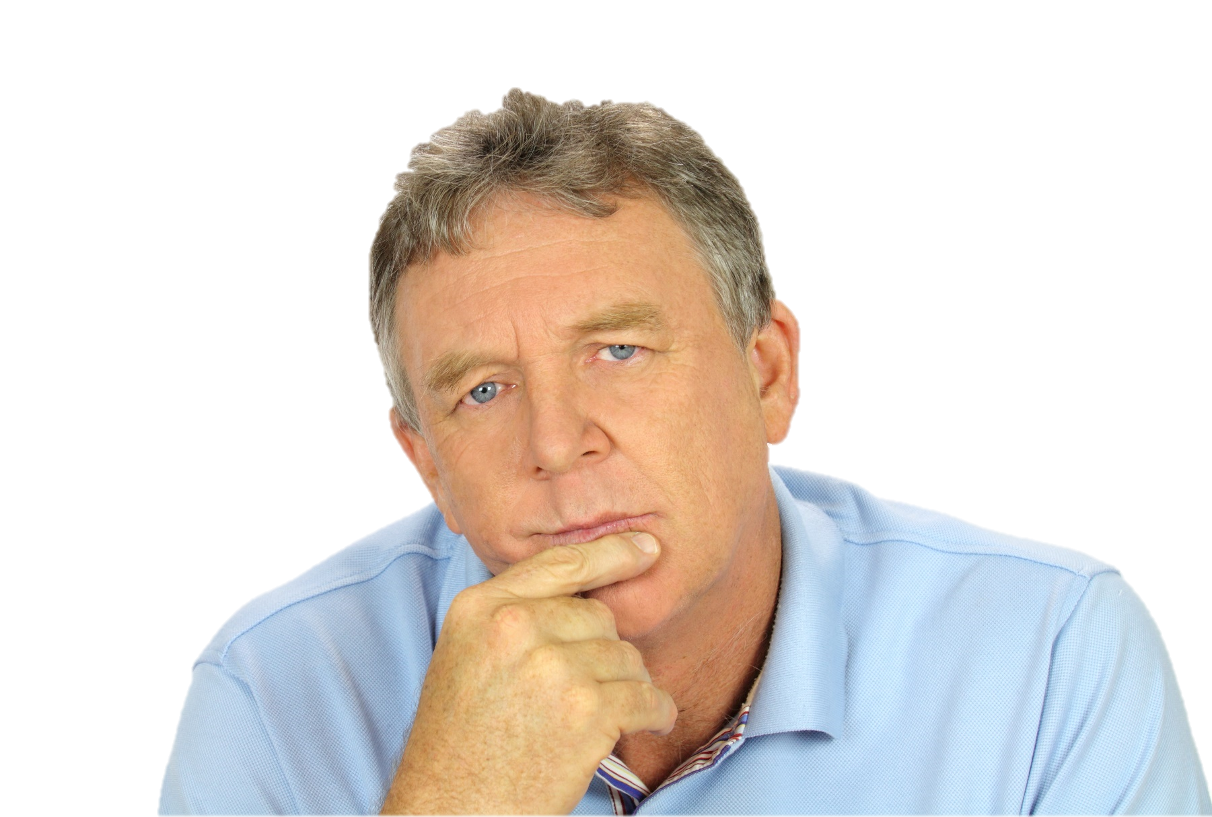
Animal vs. Human vs. Machine Learning
Generalizing (and over-generalizing)
  Learning by extending experiential knowledge to new stimuli and situations
Symbolic learning
  Adding language and other symbol manipulation to the set of actions, stimuli, and consequences, not just experiences
Deductive learning
  Learning by reasoning about stimuli, rather than experiencing them

Slide 6

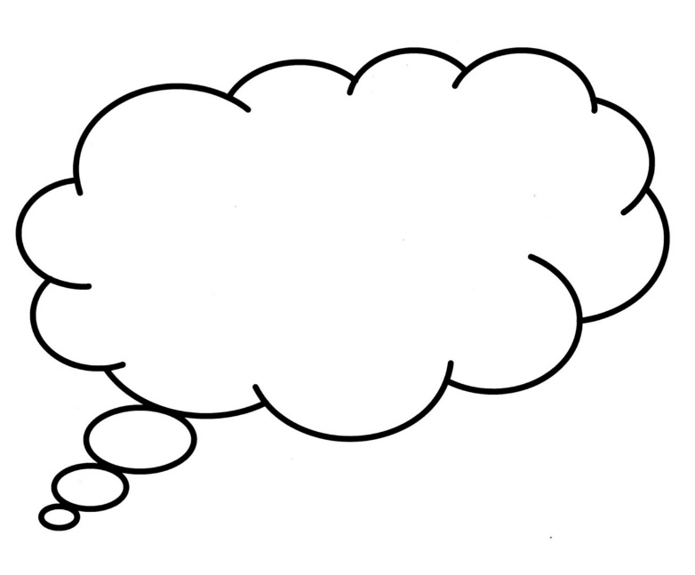
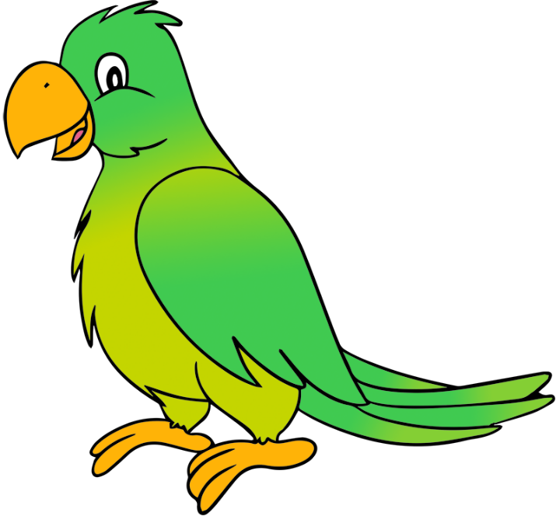
Animal vs. Human vs. Machine Learning
Strongest current area for machines is associative learning
  Classical and operant
BUT, with the twist of adding language
!
Polly want a large language model!!

Slide 7
Different Types of Adaptivity
Reacting
  A system that changes its behavior in response to environmental stimuli
  Changes in action
Generalizing
  A system that is able to generalize its behavior to a variety of situations and environments
  Changes in decision making
Learning
  A system that is able to improve its behaviors by encoding and integrating past experience
  Changes in knowledge
Evolving
  A system that undergoes long-term structural changes adapted to environmental feedback
  Changes in structure
Notes:
I want to make the point that there are different ways a system can change its behavior, and we don’t call them all “learning”. Some systems already have the knowledge to do things differently when a situation changes…that is not learning. Humans and animals evolve, which shapes the behavior of individuals by changing their actual “machinery”…that is also not learning. Learning falls in between. Changes to the knowledge being processed by the machinery, but not changes to the machinery itself.

Slide 8
Different Types of Adaptivity
A Definition for Machine Learning
Reacting
  A system that changes its behavior in response to environmental stimuli
  Changes in action
Generalizing
  A system that is able to generalize its behavior to a variety of situations and environments
  Changes in decision making
Learning
  A system that is able to improve its behaviors by encoding and integrating past experience
  Changes in knowledge
Evolving
  A system that undergoes long-term structural changes adapted to environmental feedback
  Changes in structure
!

Slide 9
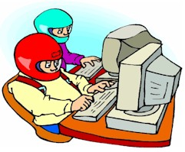
Learning in Training, Simulation, and Education
Now
  Inferring student proficiency level and recommending new content
  Learning to identify tactical and operational patterns from simulation data streams to use for trainee assessment
  Learning to identify human performance states, such as workload, stress, fatigue, trust
  Generative AI to create new “levels” in serious games for training

Slide 10
Learning in Training, Simulation, and Education
Now
  Inferring student proficiency level and recommending new content
  Learning to identify tactical and operational patterns from simulation data streams to use for trainee assessment
  Learning to identify human performance states, such as workload, stress, fatigue, trust
  Generative AI to create new “levels” in serious games for training
Soon
  Automatic generation of full courses of instruction (COI) based on individualized student needs
  Behavior cloning: learning realistic models of human behavior for simulation
  Learning to use training and performance data to predict future human performance in context
  Adaptation of simulation-based training scenarios in real time

Slide 11
Learning in Training, Simulation, and Education
Soon
  Automatic generation of full courses of instruction (COI) based on individualized student needs
  Behavior cloning: learning realistic models of human behavior for simulation
  Learning to use training and performance data to predict future human performance in context
  Adaptation of simulation-based training scenarios in real time
Further in the future
  Large language models (LLMs) that operate like responsive and insightful teachers in real time
  Instructor assessment models that can identify individual learning and knowledge differences to adapt instructional content and delivery styles

Slide 12
Approaches to Machine Learning
Analytical learning
  Formal extraction of knowledge from a set of training examples
  Emphasis on logical consistency between the extracted representation and the examples
  Example: “The top is flat” is the feature that determines whether an object can support another object
  (Think “scientific method”, ruling out hypotheses with experimentation)
Notes:
Analytical learning is not the hot topic these days, but it is still used. Basically it uses logical/symbolic descriptions of concepts, and it adjusts those symbolic descriptions to fit the data. It uses “logic” to generalize the data into more abstract definitions. Common approaches include “learning by generalization”, “learning by discrimination”, and “version spaces, which does both generalization and discrimination”
The basic distinction here is that “analytical learning” uses a set of logical patterns or rules to attempt to extract information from examples. Analytical learning can be good because it can often learn from just a few examples, but it is brittle and has difficult handling “outliers”. “Empirical learning”, in contrast, is statistical. It depends on having lots and lots of examples that we try to identify statistical patterns in. It takes many more examples to train a system using empirical learning, but the results are generally much better than with empirical learning. The most successful models in general are currently empirical, not analytical, but there are places where analytical models are the most appropriate.
Empirical learning is far more common these days. The basic idea here is to use statistics instead of logic to learn concepts. The “best description” of a concept is the one that does the best job of fitting the data in a statistical sense. But there is not always a single definition of what counts as “best”.

Slide 13
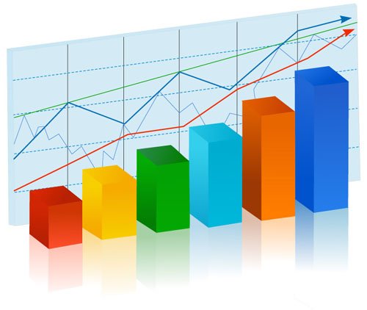
Approaches to Machine Learning
Empirical learning
  Statistical combinations of examples to create abstractions
  Can be symbolic and/or numeric
  Better at handling fuzziness or “noise”
  The dominant paradigm in modern machine learning
Analytical learning
  Formal extraction of knowledge from a set of training examples
  Emphasis on logical consistency between the extracted representation and the examples
  Usually symbolic
  Often difficult to handle fuzziness or “noise”
  Example: “The top is flat” is the feature that determines whether an object can support another object

Slide 14
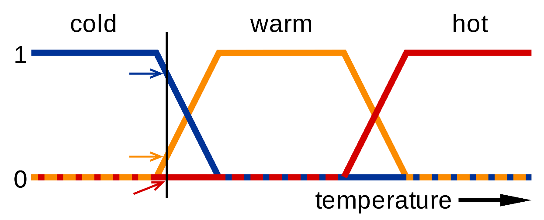
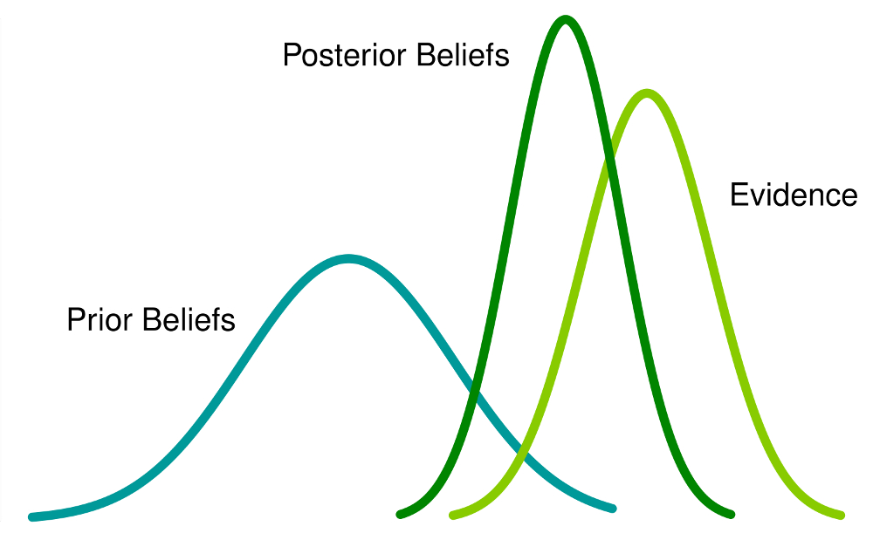
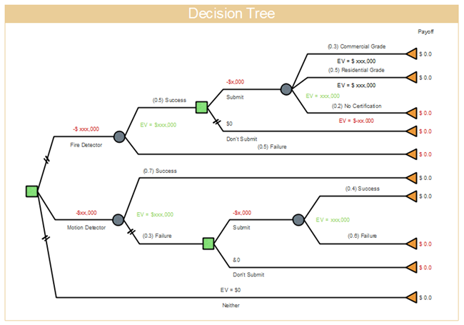
Approaches to Machine Learning
Hybrid approaches
  Fuzzy logic
  Bayesian reasoning
  Decision trees

Slide 15









Types of Empirical Learning
Supervised
  Training set is a set of labeled examples
    A description of something, plus a categorization of the thing
    In simple cases, the label is simply “positive” or “negative” for a single category
  Learned capability is to take as input a new description and output the correct label
“Cat”
“Not Cat”
!

Slide 16
What Does a “Training Example” Look Like?
An “example” is a vector of feature values
Example (symbolic):
  Furry: true
  Fur-texture: soft
  Ear-shape: Triangular
  Number-of-legs: 4
  Purrs: True
  Meows: True
  Barks: False
  Claw-type: Retractable

Slide 17
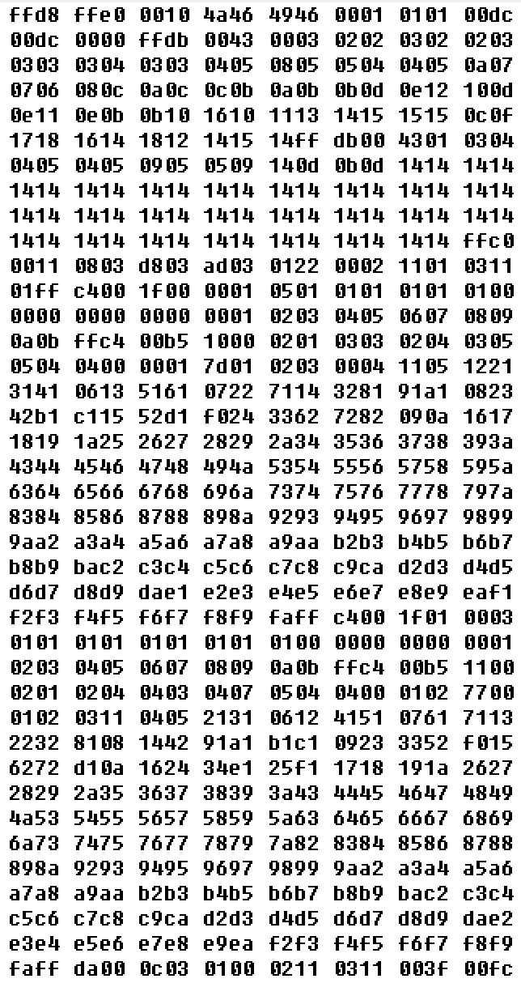
What Does a “Training Example” Look Like?
An “example” is a vector of feature values
Example (“subsymbolic”):
  Furry: true
  Fur-texture: soft
  Ear-shape: Triangular
  Number-of-legs: 4
  Purrs: True
  Meows: True
  Barks: False
  Claw-type: Retractable

Slide 18
Types of Empirical Learning
Supervised
  Training set is a set of labeled examples
    A description of something, plus a categorization of the thing
    In simple cases, the label is simply “positive” or “negative” for a single category
  Learned capability is to take as input a new description and output the correct label
“Cat”
“Not Cat”
!

Slide 19




Types of Empirical Learning
Unsupervised
  Training set is a set of unlabeled examples
  It is up to the system to learn how the examples should most usefully be organized into categories
  Learned capability is to take as input a new description and output a useful label
Supervised
  Training set is a set of labeled examples
    A description of something, plus a categorization of the thing
    In simple cases, the label is simply “positive” or “negative” for a single category
  Learned capability is to take as input a new description and output the correct label
Pick the
Categories
for me
Okay

Slide 20
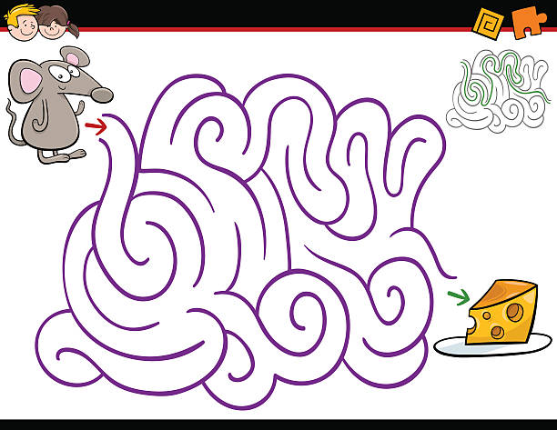
Types of Empirical Learning
Unsupervised
  Training set is a set of unlabeled examples
  It is up to the system to learn how the examples should most usefully be organized into categories
  Learned capability is to take as input a new description and output a useful label
Reinforcement
  Training set is a series of situation descriptions, transition actions, and situation evaluations
  Learned capability is to iteratively take as input situation descriptions and output the most valuable next action in each situation

Slide 21
A Generalized Framework For Machine Learning
Input representation space
Output representation space
Condition-action patterns
Reward/punishment signals
Allocation of credit/blame
A language defining the set of possible inputs to the system
A language defining the set of possible actions/responses from the system
An internal data structure mapping sets of inputs to outputs
A regime for evaluating system outputs and providing feedback
An algorithm to allocate feedback as specific adjustments the condition-action data structure
Learning!!!
Notes:
This is my attempt to frame each of the “types” of machine learning in a single framework. The basics are:
* An input representation, which is the language we use to represent each “example”
* An output representation, which is the set of “labels” or “actions” the system is expected to learn to generate.
Condition-action patterns are essentially what the system is being asked to learn. “Which output should be generated for each possible set of inputs?”
* The “reward signal” is what we use to reward or punish the system for making good or bad decisions. In supervised learning, the “reward signal” is based simply on whether the generated label was correct.
* Credit/blame assignment is the need for the ML algorithm to decide what it needs to change in its condition-action patterns, based on the reward signal
The basic “training cycle” is this:
* Receive an input
* use existing condition-action patterns to generate an action
* Receive a reward signal depending on how desirable the generated action was
* Decide how to allocate the reward signal to the condition-action patterns, so that the next time we see the same example, we will get a better reward

Slide 22
A Generalized Framework For Machine Learning
Evaluate response
Present reward (punishment) signal
Generate a response
Assign credit and blame
Present an input
Adjust condition-response data structures

Slide 23
A Generalized Framework For Machine Learning
Evaluate response
Present reward (punishment) signal
Generate a response
Hard (manual) work happens here
Assign credit and blame
Present an input
Adjust condition-response data structures

Slide 24
A Generalized Framework For Machine Learning
Evaluate response
Present reward (punishment) signal
“Magic” (learning) happens here
Generate a response
Hard (manual) work happens here
Assign credit and blame
Present an input
Adjust condition-response data structures

Slide 25
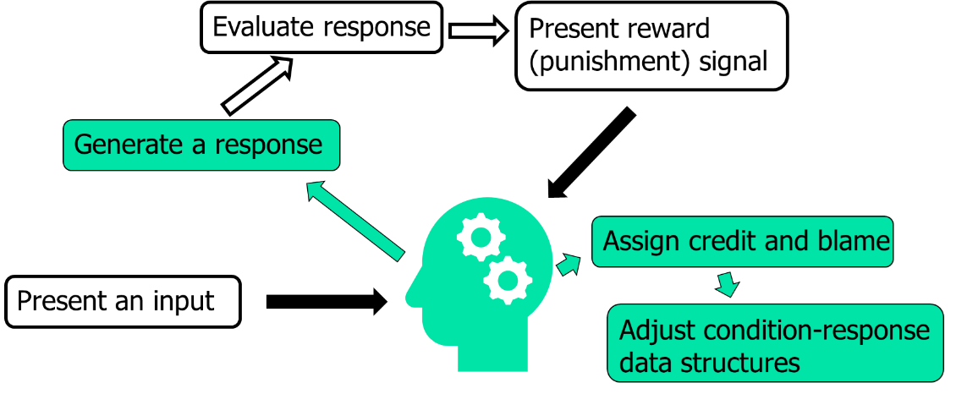

Understanding Learning as a Form of Search
The goal is to find a “good” set of condition-action patterns
Search process
  Start with an initial definition of the conditions under which to generate each action
  Repeat
  Until some measure of quality has been achieved
Search through the space of possible condition-action pairings
Notes:
Learning can usefully be viewed as a form of search. The world defines a huge space of inputs and a huge space of outputs. ML involves figuring out the mappings of some of those inputs to some of those outputs that maximize whatever the “reward” is. The more complicated the patterns are “in the real world”, the bigger the search space of possibilities is. The bigger the space is, the more training you need to cover all the bases. One approach is to simplify things so the search space is smaller. This can allow you to learn faster, but it risks making it impossible to learn “exactly” the right concepts.
Example: If you want to learn how best to fly an airplane, you probably don’t need to include “What did I have for breakfast?” in your input representation. But if it turns out that what you had for breakfast is relevant, then you will never be able to learn that (unless you expand your search).

Slide 26
Supervised Concept Learning: A Simple Example
Assume we are learning a concept that has only two descriptive features
  The input language consists of X and Y coordinates in a coordinate system
The “target concept” is some shape
  Output language is “positive” or “negative”
    Positive examples are inside the shape
    Negative examples are outside the shape
Based on input examples, can we learn what the “correct” shape is?

Slide 27
First Set of Training Examples
_
_
_
_
_
_
_
_
+
+
+
_
+
+
_
+
+
+
_
_
+
+
+
+
+
What is the target shape?
_
_
_
_
_
_
_
_
_
_
_
_
Notes:
First we show a few “positive” and “negative” examples. We ask the question “What is the ‘best’ shape that encloses the positive examples but excludes the negative examples? We add more pluses and minuses, hinting that the correct shape is a square.

Slide 28
Candidate Learning Target
_
_
_
_
_
_
_
_
+
+
+
_
+
+
_
+
!
+
+
_
_
+
+
+
+
+
_
_
_
_
_
_
_
_
_
_
_
_

Slide 29
Next Set of Training Examples
_
_
_
_
_
_
_
_
_
_
_
_
+
+
+
_
+
+
_
_
+
+
+
_
_
+
+
+
+
_
+
_
_
So far so good
_
_
_
_
_
_
_
_
_
_
_
Notes:
Now we show that we get more examples that are consistent with our guess that the correct shape is a square.

Slide 30
One More Training Example
_
_
_
_
_
_
_
_
_
_
_
_
+
+
+
_
+
+
_
_
+
+
+
_
_
+
+
+
+
_
+
_
+
_
Oops!
_
_
_
_
_
_
_
_
_
_
_
Notes:
Now we get some new examples that violate our guess that the best shape was a square. What should we do?

Slide 31
More Exceptions
_
+
_
_
_
_
_
_
_
_
_
_
_
+
+
+
+
_
+
+
_
_
+
+
+
_
_
+
+
+
+
_
+
_
+
_
_
_
_
_
_
_
_
_
_
_
_

Slide 32
More Exceptions
_
+
_
_
_
_
_
_
_
_
_
_
_
+
+
+
+
_
+
+
_
_
_
+
+
+
_
_
_
+
+
_
+
+
_
_
_
_
+
_
+
_
_
_
More oops!
_
_
_
_
_
_
_
_
_
_
_

Slide 33
Time To Reconsider
_
+
_
_
_
_
_
_
_
_
_
_
_
+
+
+
+
_
+
+
_
_
_
+
+
+
_
_
_
+
+
_
+
+
_
_
_
_
+
_
+
_
_
_
_
_
_
_
_
_
_
_
_
_
_
Notes:
We need to abandon the idea that the “target concept” is a square, because it’s clearly not working well any more. Can we find a different shape that would work better?

Slide 34
Another Candidate Learning Target
_
+
_
_
_
_
_
_
_
_
_
_
_
+
+
+
+
_
+
+
_
_
_
+
+
+
_
_
_
+
+
_
+
+
_
_
_
_
+
_
+
_
_
_
_
_
_
_
_
_
_
_
_
_
_
Notes:
This star shape fits the data we have receive so far. So maybe we should revise our “guess” from a square to a star. This is the basic process a supervised learning algorithm goes through.

Slide 35
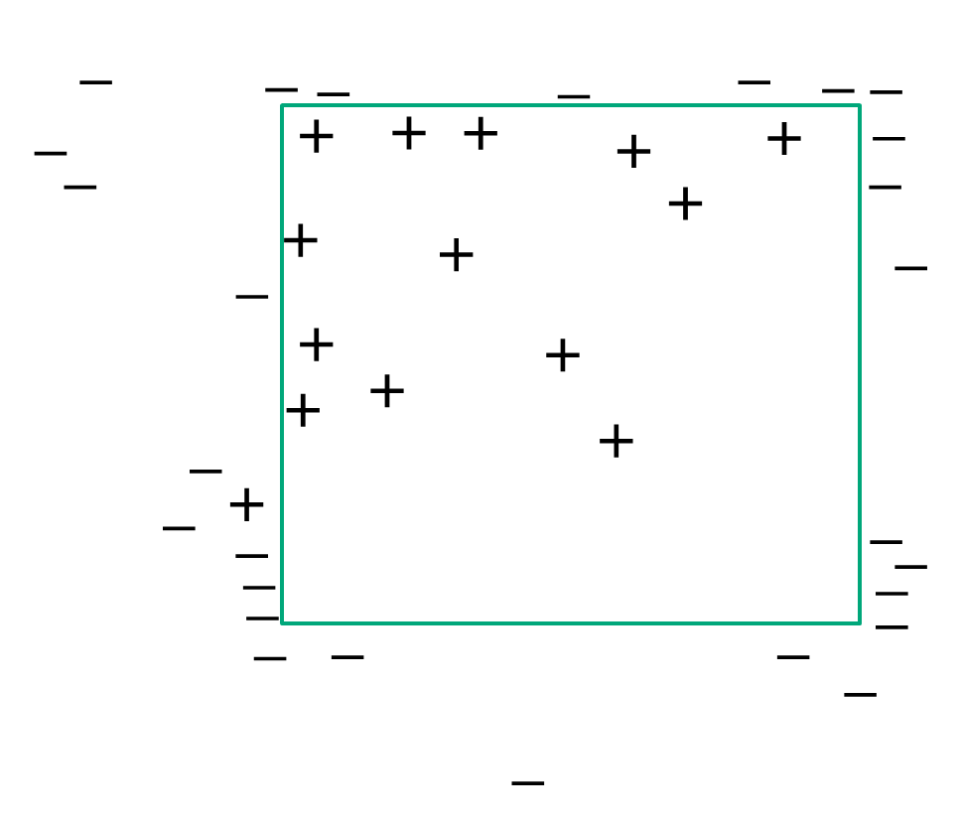
Complications: The Problem of Noise
Is our current concept wrong or is the data wrong?
Potential sources of noise
  Inaccurate sensors
  Imperfect knowledge
  Incomplete representation language
  Adversarial action (lying!)
Notes:
One issue is “Noise”. That is, what do we do when a new example doesn’t fit our current concept? Is the problem that our concept is wrong? Or is the problem that the new example is mislabeled? In the real world, there are many potential sources of “noise” and a good machine learning algorithm has to be able to decide, based on the evidence seen so far, whether new examples represent “noise” or whether the represent incorrect knowledge. The way this problem gets solved is to gather more and more examples, so we can make a statistical decision.

Slide 36
How Do We Deal With Noise?
Gather more data!
  Treat learning as an evidence problem
    Do I have enough evidence to decide my current conception is wrong?
    This is a brittle decision in analytical learning
    It is much more fluid in empirical learning
Notes:
The “Noise” in these pictures are the plus signs that are outside the square and the minus signs that are inside the square. The point of the two pictures here is to show that the picture on the left only has one “noisy” example, so maybe we tolerate that and assume the square is still the best description of the concept. But the diagram on the right has much more noise, which could exceed our level of tolerance and indicate that we need to change things.

Slide 37
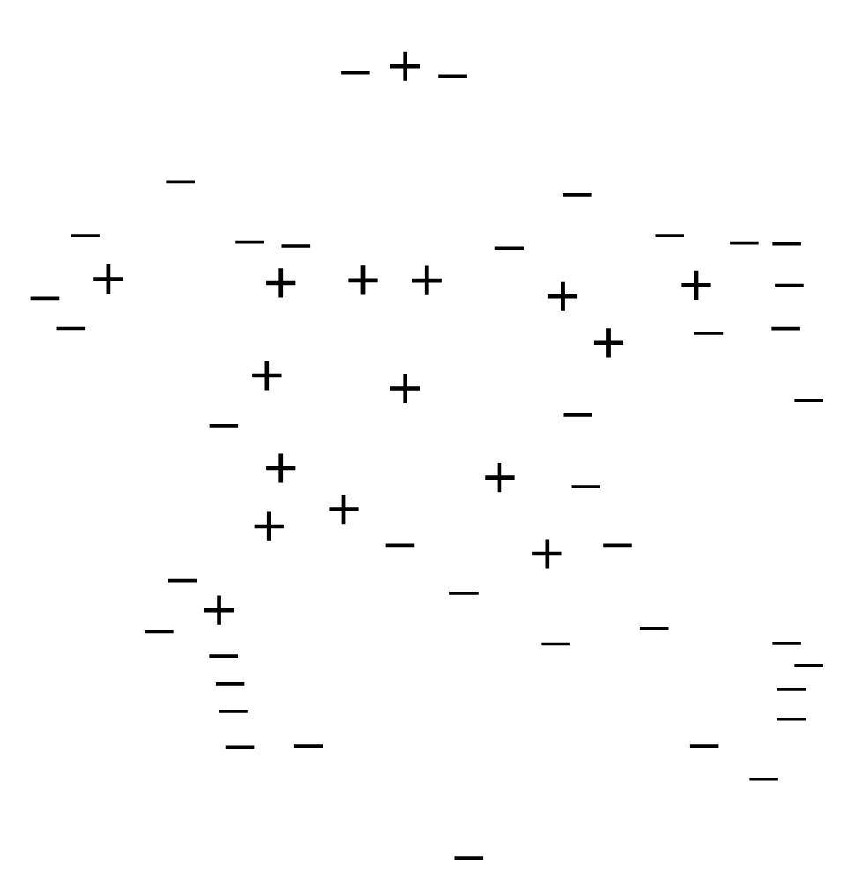
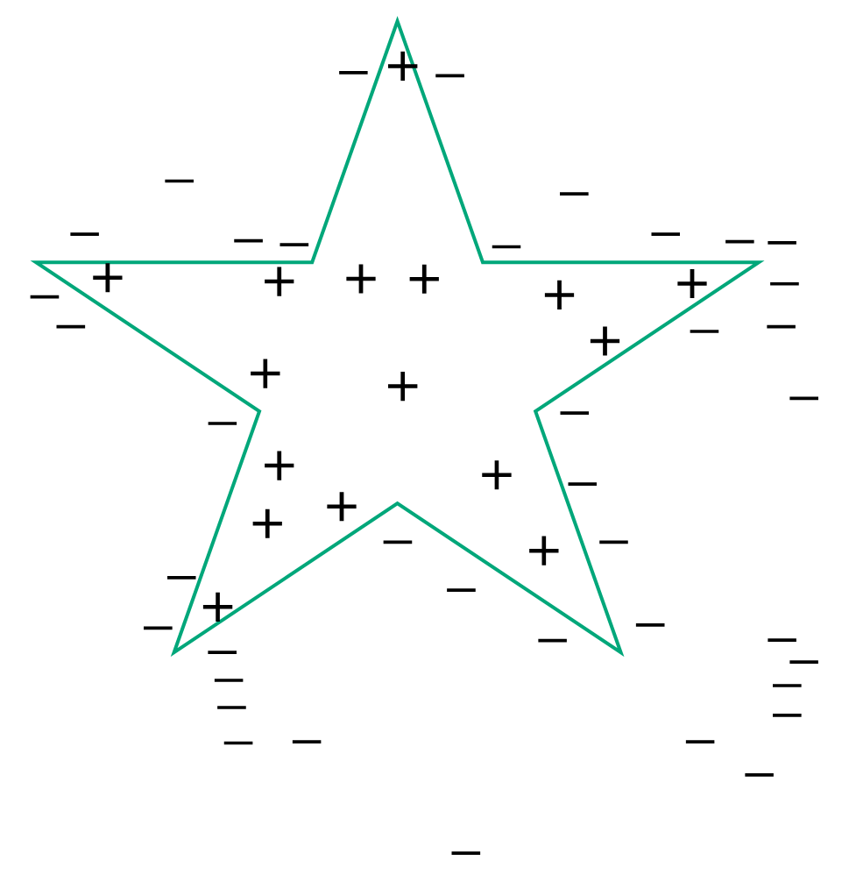
Beyond Rote Memorization: Learning Bias
Another way to handle noise is to incorporate bias
  Do we require our target concept to be a single polygon, or do we allow multiple?
  Do we require it to be a convex polygon?
  If we know there is no noise in the data, we might try to fit it “perfectly”
  But if we know there is noise, this leads to overfitting
!
Notes:
Here we ask the question “So how does your algorithm decide what an acceptable level of noise is? How does it decide what is noisy and what is not?”
the point is that, for your algorithm to do more than just “memorize”, you HAVE to introduce some kind of bias into it. It has to have some way to decide what is noise and what is not. Then we will get into the “No free lunch” theorem, which state that no matter WHAT bias you build into your algorithm, I can construct an artificial dataset that causes your algorithm to fail miserably. So you have to have a bias, but how can you know whether your bias is actually a good one for whatever concept you are trying to learn? You have to base it on what you know about how the world is actually structured. For example, if we knew we were operating in a world that only has horizontal and vertical lines (no diagonals), then we would know that a “star-shaped concept” is impossible, and we could bias our system not to even consider the possibility. But if we are wrong in our assumptions, our biases will fail.
The main point of this slide is that there is no “perfect” learning algorithm. It’s always possible that the examples we are going to see in the future do not fit well with the examples we have seen in the past. So every learning algorithm has to make some kind of assumptions, and the best algorithms will be the ones that end up making the “right” assumptions for a particular learning problem.

Slide 38
Bias is a Doubled-Edged-Sword
An all-knowing adversary can always defeat your bias.
  The “No free lunch” theorem:
  No matter where you draw your boundaries,
  I can create an example that will violate them
  This also introduces a possibility to “hack” learning
  algorithms
Part of the “art” of machine learning is incorporating the biases that are best suited to the learning task and environment
  But this sometimes has to be determined by trial and error

Slide 39
Complications: The Importance of Context
The predictive text on your phone is a “small” language model
  Essentially keep a history of text input and count the frequency of each word pair.
!
the
?
?
?
?
quick
brown
fox
jumps
over
the
quick
brown
Notes:
Sentences are sequences of words. For “predictive text” the system learns the “best” next word based ONLY on looking at the single previous word in the sentence. But the new wave of language models (like ChatGPT and Bard) use the ENTIRE conversation so far to predict the best next word, and that’s why they are so good. This is a pretty obvious idea, so why didn’t anybody do it before? Because it requires MASSIVE amounts of data (basically these systems have been trained on the entire world-wide web) and its MASSIVELY expensive both to train the system AND to run the system. This is because the “search space” is enormous when you allow the next word to depend on the entire history of your conversation. If the next word only depends on the previous word, the “search space” is much smaller, and the processing is much cheaper, but you will not get very good results.

Slide 40
Context in Large Language Models
How is a “large” language model different?
  Ingest a much MUCH larger body of text inputs
  Keep track of frequencies of multiple word relationships
  Essentially use the entire conversation’s history as context to predict the next word
  Enormous search space → massive amounts of training data required
  Enormous and complex input space → massive amounts of computation necessary during language generation
the
?
?
?
dog
quick
brown
fox
jumps
over
the
lazy

Slide 41
Complications: Scaling Up in Complexity
We started with an initial, simple, two-dimensional example to make it easier to visualize what the learning algorithm’s task is

Slide 42
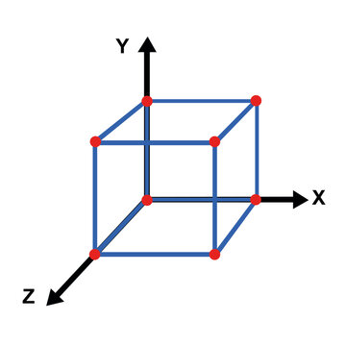
Scaling Up in Complexity
We started with an initial, simple, two-dimensional example to make it easier visualize what the learning algorithm’s task is
We can still visualize the learning task if we move
to three dimensions

Slide 43
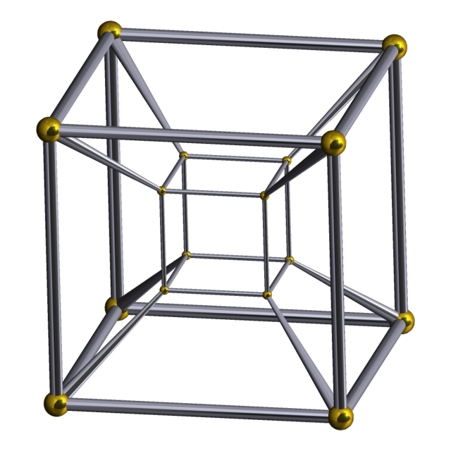
Scaling Up in Complexity
We started with an initial, simple, two-dimensional example to make it easier visualize what the learning algorithm’s task is
We can still visualize the learning task if we move
to three dimensions
The more inputs we add to describe each example,
the more dimensions we have

Slide 44
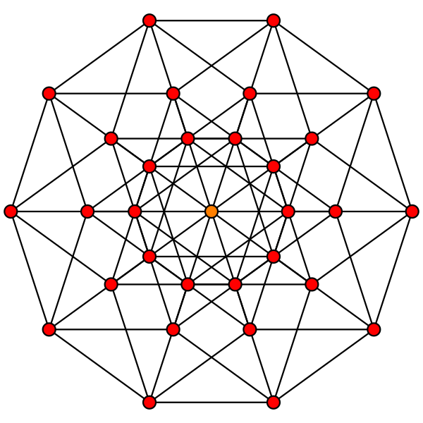
Scaling Up in Complexity
We started with an initial, simple, two-dimensional example to make it easier visualize what the learning algorithm’s task is
We can still visualize the learning task if we move
to three dimensions
The more inputs we add to describe each example,
the more dimensions we have

Slide 45
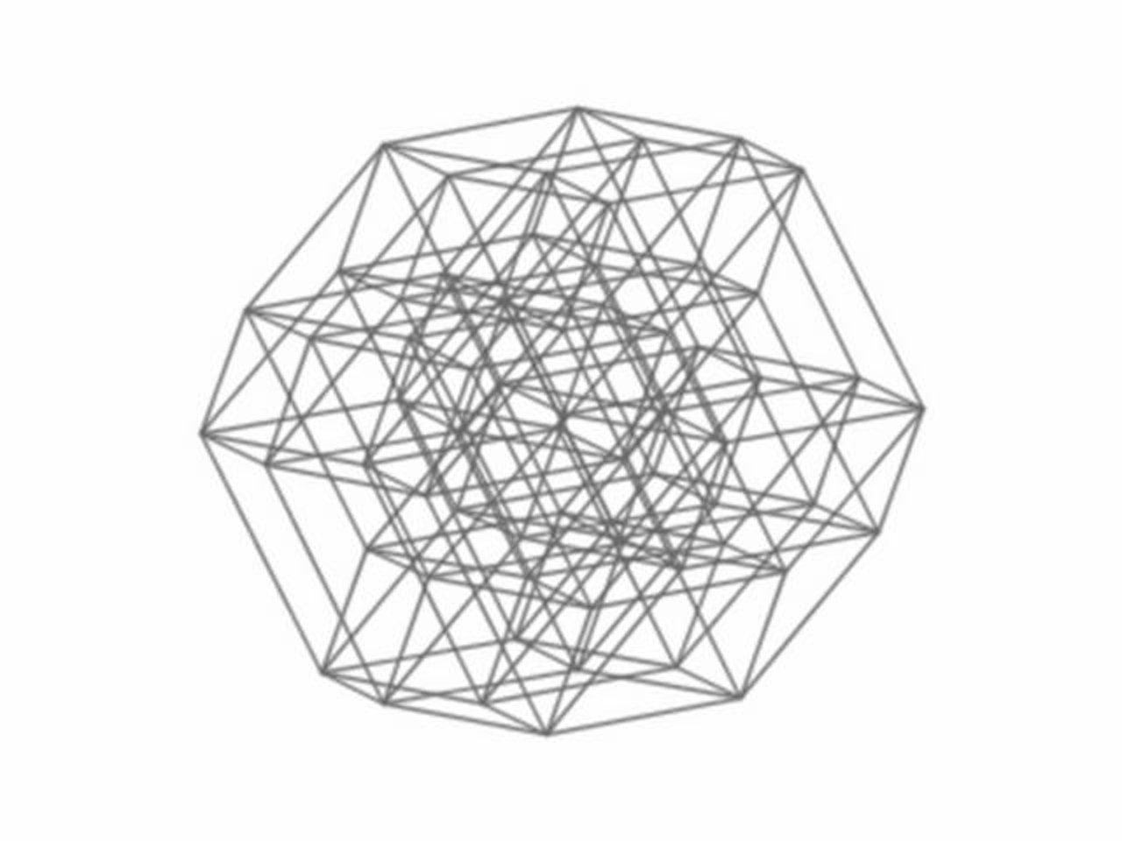
Scaling Up in Complexity
We started with an initial, simple, two-dimensional example to make it easier visualize what the learning algorithm’s task is
We can still visualize the learning task if we move
to three dimensions
The more inputs we add to describe each example,
the more dimensions we have

Slide 46
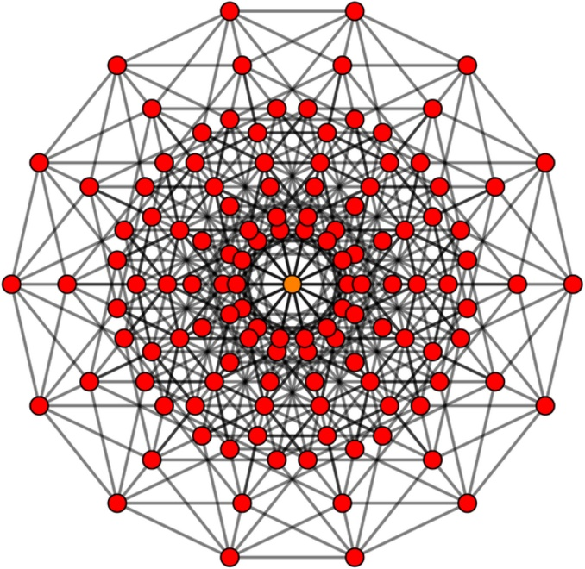
Scaling Up in Complexity
We started with an initial, simple, two-dimensional example to make it easier visualize what the learning algorithm’s task is
We can still visualize the learning task if we move
to three dimensions
The more inputs we add to describe each example,
the more dimensions we have

Slide 47


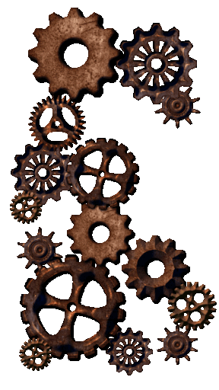
Scaling up in Complexity
Every increase in complexity:
  Requires more data and training time to arrive at an acceptable level of performance
  May require more resources to execute when the learned system is deployed

Slide 48
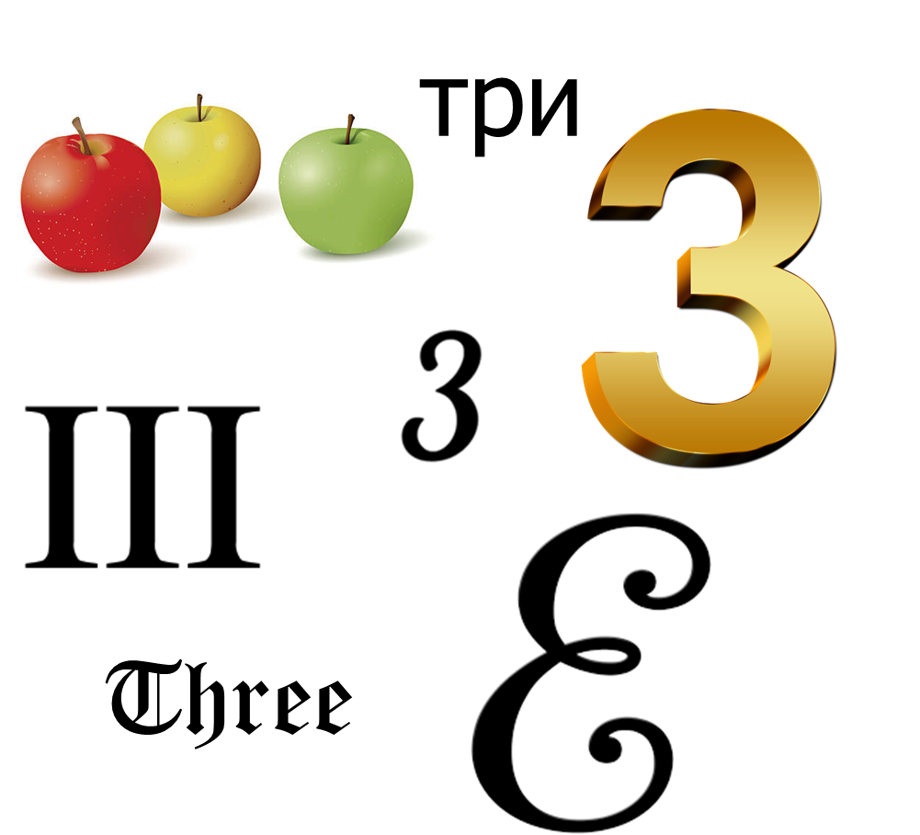
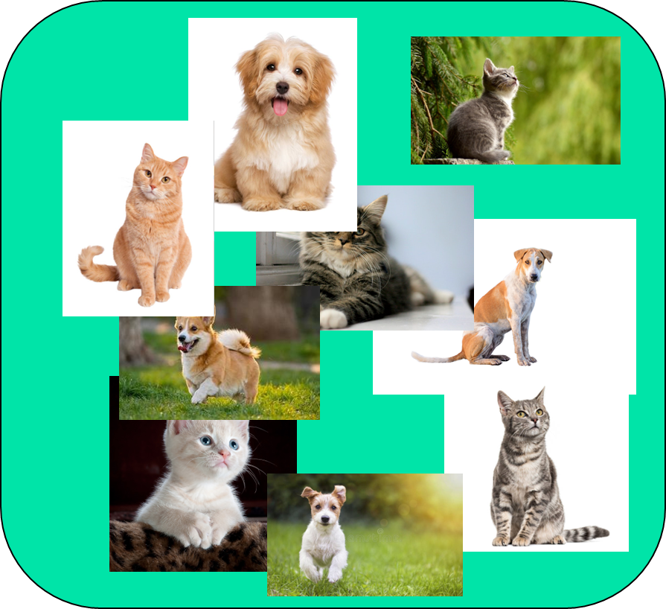

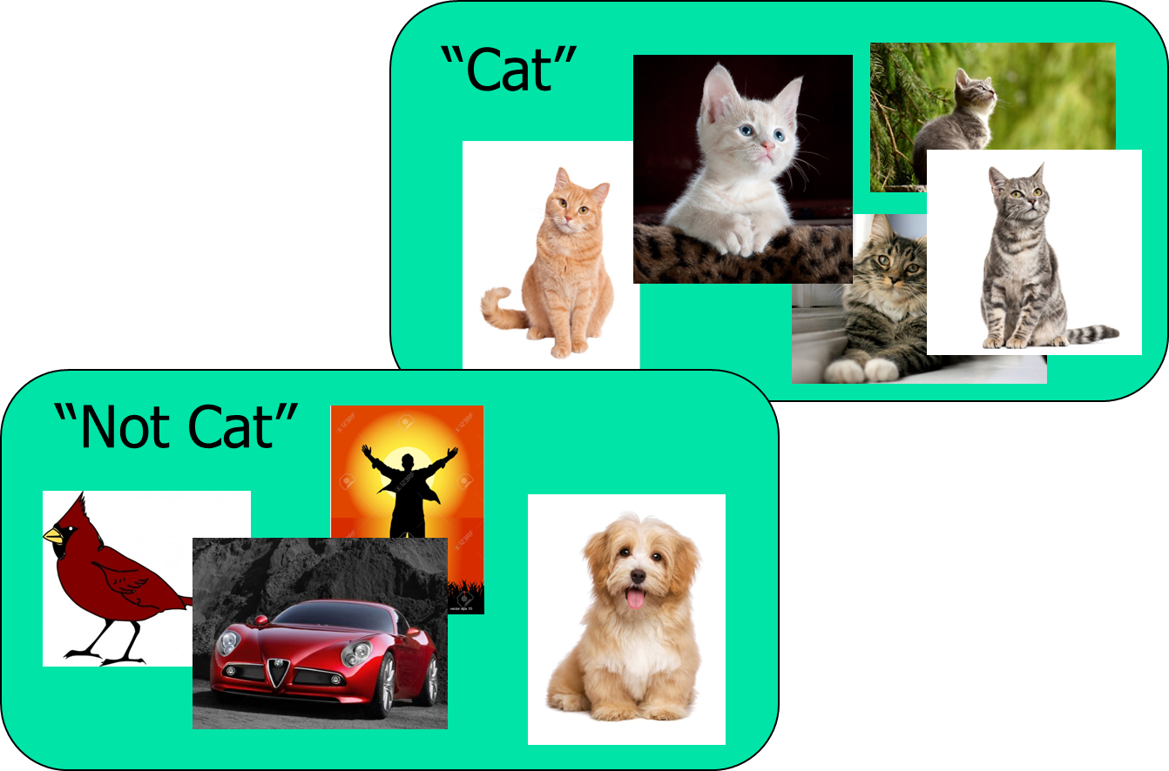


Beyond Supervised Classification
What if the training examples are not labeled?
What if the “target hyper-shape” is ridiculously complicated?
What if we are learning sequences of decisions that affect each other?
What if we want to learn to create things rather than learn to understand things?

Slide 49
Unsupervised Learning
Similar to supervised learning, but the reward signal is self-generated
Evaluate response
Present reward (punishment) signal
Generate a response
Assign credit and blame
Present an input
Adjust condition-response data structures
Notes:
In supervised learning, nobody tells the system whether its actions are “right” or “wrong”. There is no external reward signal.
Examples of unsupervised learning can include creating biological taxonomies. Depending on how you describe things, you might end up with different groupings. For example, is a tomato a fruit (based on its biological properties) or a vegetable (based on how it is used in cooking)?
However, there must be SOME way for the system to give itself reward or punishment.
Here we will go back to a 2-dimensional example. This one will have two separate clusters of + symbols plus a bunch of – symbols scattered around. The question will be “Is this just one category of things, or is it two?” The system needs to have some built-in way to decide why categorization is better. For example, maybe it analyzes every combination of + symbols, computers the centroid of each grouping, and only separates groups when they exceed some fixed distance.

Slide 50
Unsupervised Learning
Similar to supervised learning, but the reward signal is self-generated
Evaluate response
Compute reward (punishment) signal
Generate a response
Assign credit and blame
Present an input
Adjust condition-response data structures

Slide 51
Unsupervised Learning
No manual labeling of data required
However, the mechanism for self-generating a reward signal must be manually supplied
Evaluate response
Compute reward (punishment) signal
Algorithm/Criteria for evaluating categories and examples
Generate a response
Assign credit and blame
Present an input
Adjust condition-response data structures

Slide 52

Unsupervised Learning
Unsupervised learning depends heavily on the input representation and the evaluation criteria
Study of evolution provides a classic example
  Evolutionary trees based on morphology gradually changed to incorporate genetics
  New categories and arrangements of categories are considered as new examples are encountered
Birds are animals
Birds are reptiles
Birds are dinosaurs

Slide 53
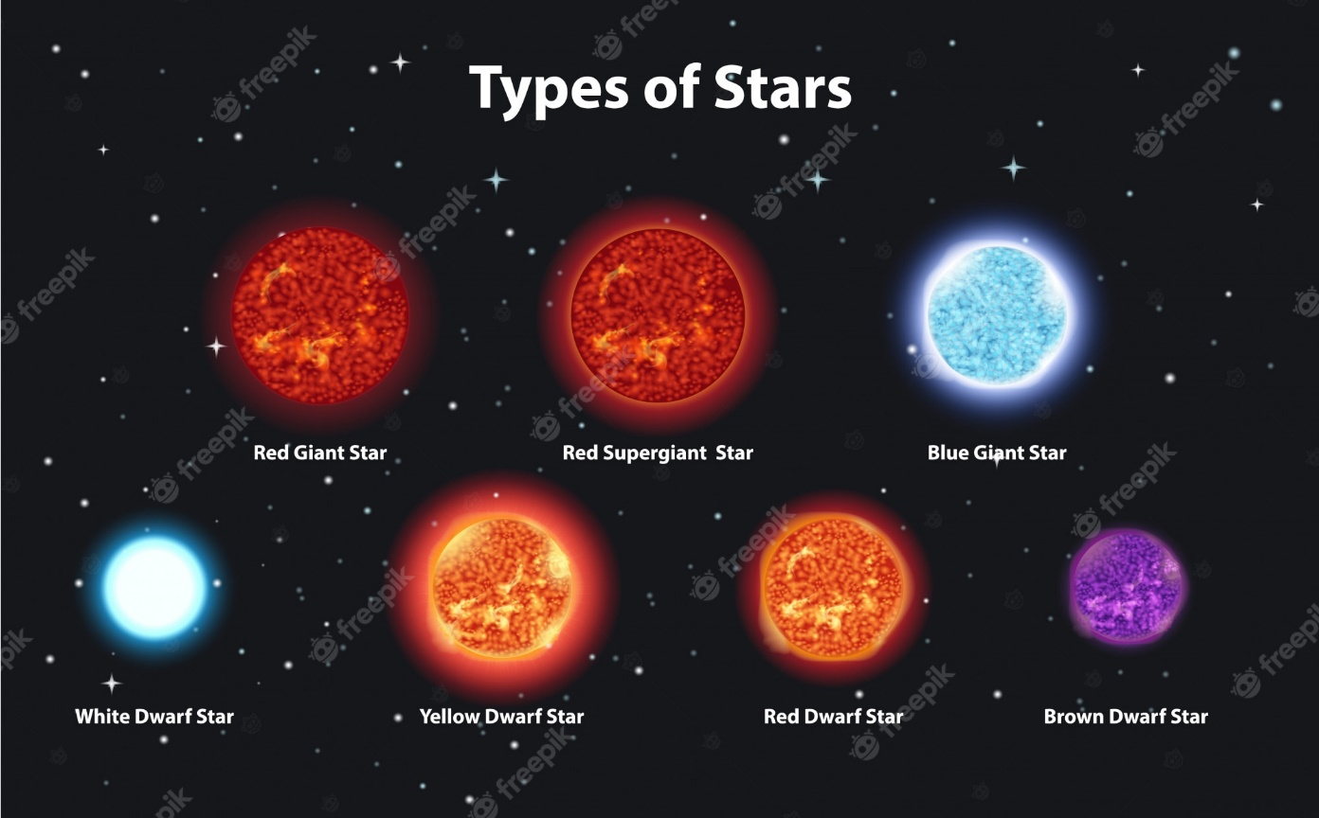
Unsupervised Learning
Sometimes unsupervised learning is an end in itself
Often, unsupervised learning is done to support supervised learning
Dog
Cat
Cat
I will label the images, but you have to figure out how to distinguish them
Cat
Dog
I see some patterns in the image data that appear to be diagnostic
Dog
Cat
Cat
Dog

Slide 54
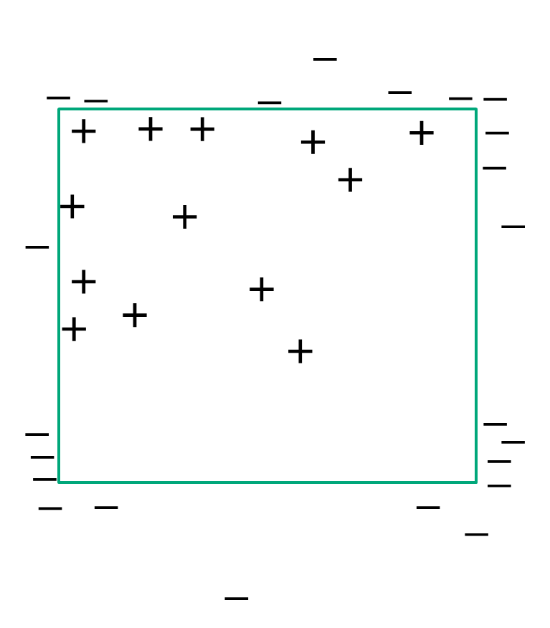
Which Brings Us To “Deep” Learning
Start simple: What is a “neural network”?
X
Math
Math
+
Learning allocates credit and blame to the parameters of the equations doing the math
Y
Math
Math
-
Notes:
Start simple by showing a two-layer neural network (just two inputs and one output) and talk about how it would (potentially) learn the “square” concept that we used at the beginning of the tutorial. Basically, it has an x input and a y input, and it has to learn that both x and y need to be within particular bounds to have a positive example “inside the square”. You can do this, as long as the math that translates the inputs to the outputs does the kinds of computation you need. (I.e., in this case, the math formulas you use plus the inputs you decide to use determine how big the “search space” is going to be, which in turn determines how much training you need to do to learn effectively)
But we want to make the point that, with any “reasonable choice” for the math formulas, a 2-layer network is not going to learn much of interest, regardless of how many inputs it has and how much training you can do. We can also mention the example of a “perceptron” being proven not to be able to learn an “exclusive or” relationship

Slide 55
Deep Learning
What is deep learning, and how did it change things?
More nodes and layers in the network
Also better algorithms for
allocation of credit/blame,
especially BETWEEN layers
Math
Math
X
Math
Math
+
Math
Math
Y
Math
Math
-
Math
Math

Slide 56
How Do These Circles and Arrows Benefit Us?
Deep Learning systems simultaneously do supervised learning and unsupervised learning
  The math in each layer computes internal reward signals for the previous layer
  Having multiple nodes in a single layer allows each node to learn a different relationship between nodes in the previous layer
  With increasing data, the “inner” (unsupervised) layers organize themselves in ways that make the “outer” (supervised) layer learn more effectively
  Deep Learning is especially good at organizing very low-level data (e.g., image data) that has not already been converted into higher-level symbolic features (e.g., “has whiskers”, “has long tail”, “has retractable claws”)

Slide 57
Contrived Example
Note these “internal” classifications will only be learned if they are useful!
X<10?
!
X
+
X>Y?
Y
-
X+Y<3?

Slide 58

Reinforcement Learning
What happens when we move beyond making one decision at a time?
More problems with credit/blame assignment
Some decisions do not deserve any punishment OR reward!
Notes:
The basic idea is that different series of decisions from a starting state lead to different levels of reward. The hard part is figuring out which of the decisions were really most responsible for the reward. We achieve this by exposing the system to lots of different situations with lots of different rewards and the ones that really deserve the credit should eventually “rise to the top” (for the situations in which they are the best choice…there will be different “best choices” in different situations).
We allocate portions of that reward to different decisions in the series. With multiple rewards, we eventually learn which decisions in the series are important and which are not.
Another example is a dog getting a treat every time a bell has been rung. This is one of the classical examples of reinforcement learning in animals.

Slide 59
Reinforcement Learning
The basic idea:
  Every state we can be in has a value
    Value includes expectation of future value
  The model maintains predictions of:
    The estimated value of each state
    The estimated value of an action
  After receiving a reward or punishment,
  the model compares the actual outcome
  to its predictions
  Credit/blame assignment revises the
  estimates
30
85
100
10
0

Slide 60
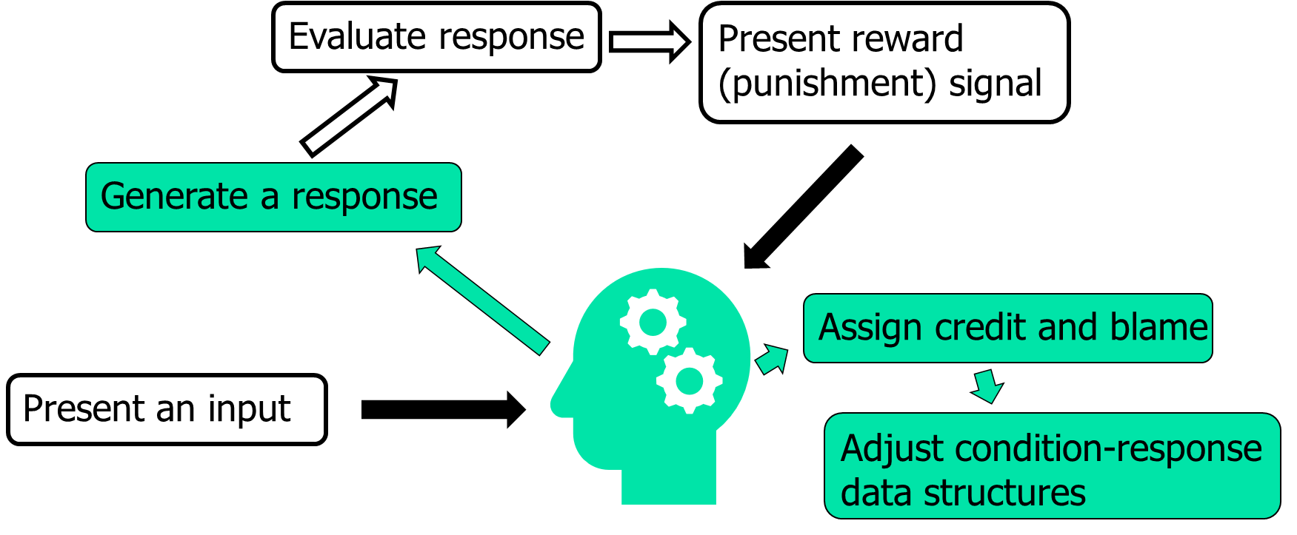
Does This All Sound Familiar?
The primary difference is that we are allocating credit and blame across sequences of decisions, rather than a single decision

Slide 61
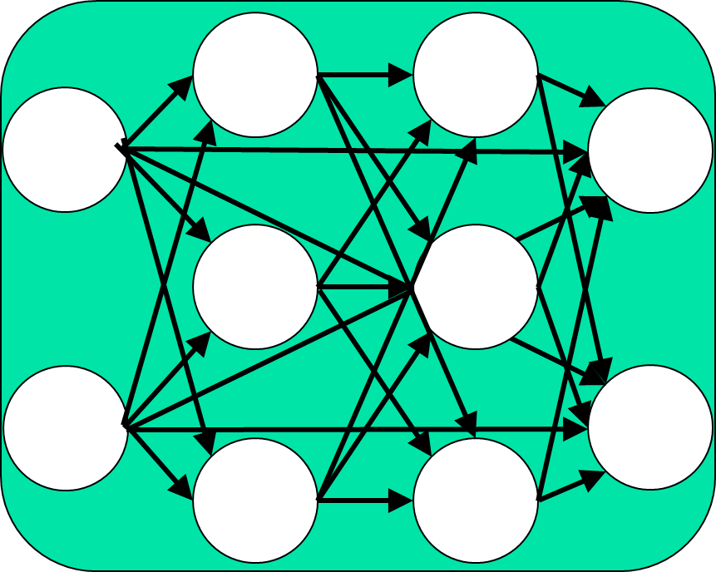
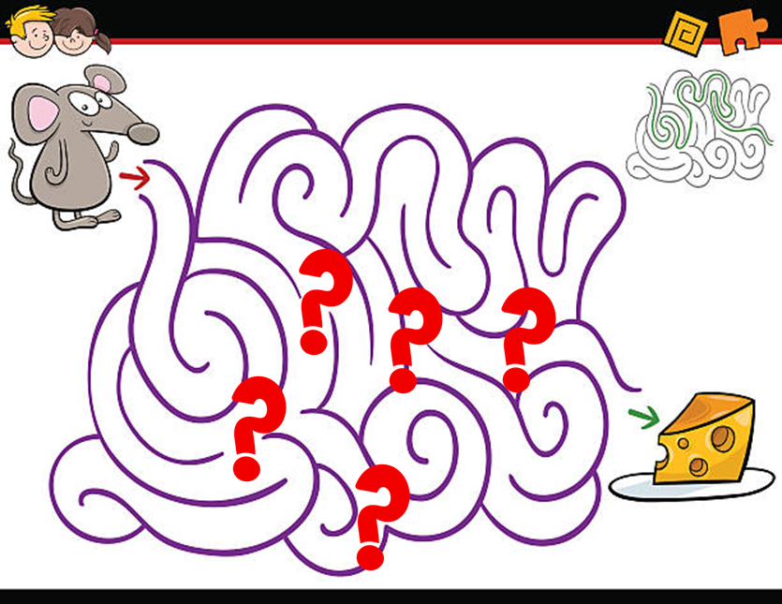
Deep Reinforcement Learning
Replaces the state and action value estimation functions with deep neural networks
Allows the system to learn how individual features of the state and actions contribute to value in different contexts
  As with everything else, learning more complex value estimations requires more training data

Slide 62
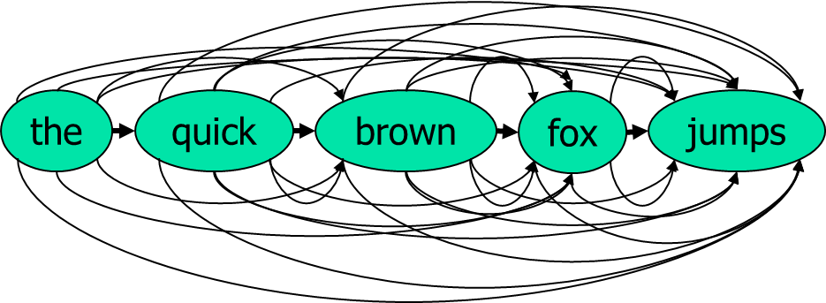
Generative Learning
Learning to predict and generate, rather than to identify, label, and categorize
Example: Large Language Models
  Use many different deep neural networks for different functions
    Input a word and output semantic, syntactic, and grammatical features
    Transform multiple word relationships into higher-level abstractions (“concepts”)
    Encode relationships between input prompts
    Focus attention on the most salient parts of the input
Many networks
Many nodes
Many inputs
Billions of parameters
Learning to predict and generate, rather than to identify, label, and categorize
Example: Large Language Models
  Use many different deep neural networks for different functions
    Input a word and output semantic, syntactic ,and grammatical features
    Transform multiple word relationships into higher-level abstractions (“concepts”)
    Encode relationships between input prompts
    Focus attention on the most salient parts of the input
Massive amounts of training
Very expensive to run
Incredibly impressive capability

Slide 63
Data Engineering: Making Machine Learning Work in Practice
Machine learning systems do not (yet) “just work”
Multiple tasks to create successful learned systems
  Finding or generating training data
  Identifying what we want the system to learn
  Configuring the knowledge representation
  Getting the labels and rewards right
  Shaping rewards for faster learning
  Trading off training time for biases built into the algorithm
  Finding the right settings for algorithm parameters
For simple problems, these processes are becoming straightforward
For complex problems, this often involves iterative trial and error
Notes:
Machine learning algorithms are doing really impressive things these days, but they don’t just work “out of the box”. There are lots of different things a “machine learning practitioner” needs to experiment with to make an ML algorithm work effectively for a particular problem.

Slide 64
State of the Art Assessment
Current strengths of Machine Learning
  Does not bring preconceived notions to learning (except for bias)
  Goes where the data takes it, without resistance
  Capable of learning extremely complex functions in extremely large representation spaces
  Can discover patterns and relationships experts might not have anticipated

Slide 65
State of the Art Assessment
Current weaknesses of Machine Learning
  Impenetrable and opaque
  Difficult to “correct” or “instruct”
  Difficult to exploit “knowledge” beyond the data
  The bigger the search space is, the longer it takes to achieve the learning goals
    But reducing the search space risks missing some learning opportunities
  The most sophisticated learning systems are also expensive to run after learning

Slide 66
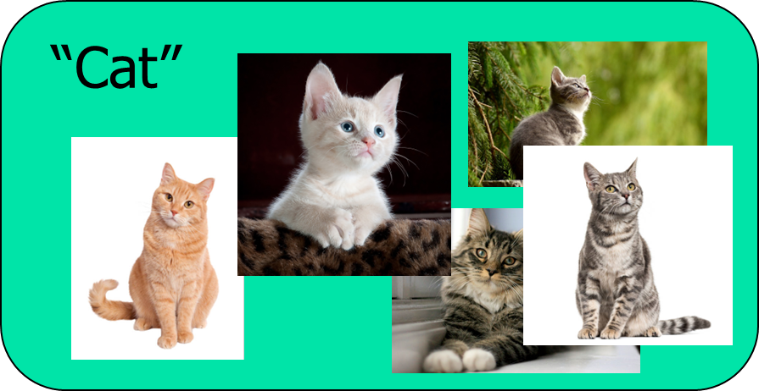
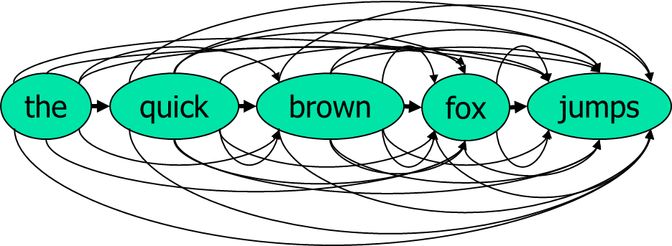
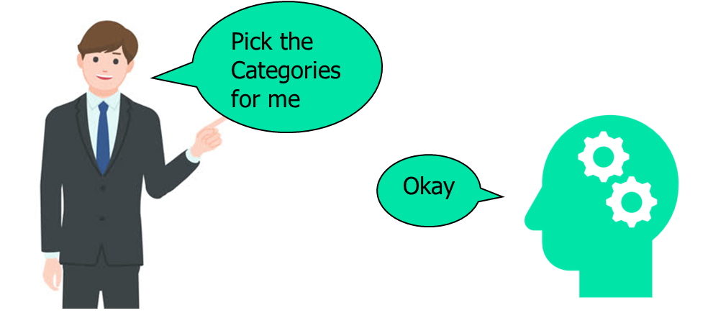
Learning in Training, Simulation, and Education
Now
  Inferring student proficiency level and recommending new content
  Learning to identify tactical and operational patterns from simulation data streams to use for trainee assessment
  Learning to identify human performance states, such as workload, stress, fatigue, trust
  Generative AI to create new “levels” in serious games for training
Supervised learning
Mixture of supervised and unsupervised learning
Generative Learning

Slide 67
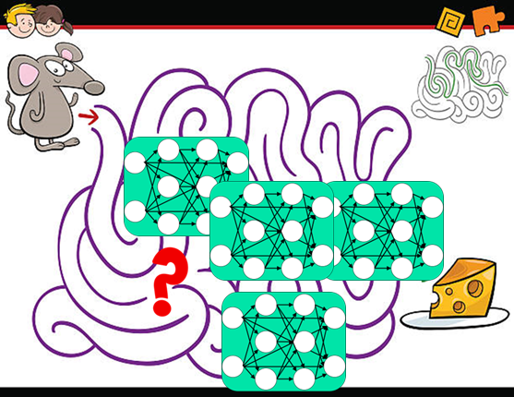
Learning in Training, Simulation, and Education
Soon
  Automatic generation of full courses of instruction (COI) based on individualized student needs
  Behavior cloning: learning realistic models of human behavior for simulation
  Learning to use training and performance data to predict future human performance in context
  Adaptation of simulation-based training scenarios in real time
Deep reinforcement, generative, and supervised learning
Deep reinforcement learning
Mixture of supervised and generative learning
Deep reinforcement and supervised learning

Slide 68
Learning in Training, Simulation, and Education
Further in the future
  Large language models (LLMs) that operate like responsive and insightful teachers in real time
  Instructor assessment models that can identify individual learning and knowledge differences to adapt instructional content and delivery styles
+ knowledge and trust integration

Slide 69
What is Still Difficult?
Transfer learning
  Generalizing beyond the data
  Using training in one area to improve performance and/or training in another area
Analytical types of learning
  Scientific reasoning
  Deductive inference
  Symbolic procedural learning (e.g., arithmetic)
Learning by integrating sparse data with knowledge
  (Over-)generalizing from one or two examples
Case-based learning (e.g., legal reasoning), analogical learning
Learning from reading or verbal instruction
Reflective problem solving
  Reasoning about when, how, and whether to learn
!
Notes:
Transfer learning is the ability to learning from one set of inputs and use the learning effectively for a different, but analogous set of inputs. Basically, the theory is that the middle layer of a deep learning network should be able to transfer to a similar task, but SOMETHING has to translate the inputs of the new task into a form that the middle layer can use. So possibly this could still involve some training, but less training than the initial training required. Possibly the translator could be “somehow” hand coded, to translate “new” inputs into “old” inputs by exploiting similarities between the two problems.
Analytical learning is the ability to logically analyze something and realize that there is an implication of it the MUST be true. Statistical learning methods can’t really do this…they are just statistical. They have no notion of logical inference.
“Low shot” learning is the ability to learn from small numbers of examples. As we have discussed before, this involves making the “learning search space” smaller by introducing some kinds of bias (which could be an analytical bias) to allow the system to learn from many, many fewer examples. As before, the tradeoff of doing this is you risk your bias screwing things up and learning incorrectly, either over-generalizing our under-generalizing. (Mention how horrible people are about over-generalizing.)
Case-based reasoning and analogical learning are similar to a combination of transfer learning and analytical learning. The idea is to say “If we have learned things in one situation, which of those things we have learned should logically also apply to a new situation.” This depends on identifying which “similarities” between the old and new situations are relevant and which are not. This is often an analytical or value-based choice, rather than a statistical choice.
For reading and verbal instruction there is some nuance. Because deep learning can learn to read and can learn to remember things that are expressed verbally. But what they struggle with is incorporating those verbal instructions into their knowledge base. Teaching a deep neural net how to perform a procedure would mean we would have to repeat the instructions a million times. But people are able to do some form of analytical or low-shot learning from verbal instructions (although it often sees lots of improvement if combined with statistical practice).

Slide 70
Tradeoffs of ML vs. Non-Learning AI
If a system is going to be intelligent, the knowledge has to come from somewhere
A learning system creates the knowledge from examples/experience
A non-learning system needs manual creation of knowledge
Supervised learning systems need manual creation/curation of the examples/experience
All types of systems currently require different types of additional manual labor
  Crafting the representation spaces
  Crafting the reward signals
  Finding the optimal parameter settings for numerous algorithmic parameters
    But this can also be posed as a search/learning problem!
Transparency and trust
  When is transparency irrelevant?
  When is transparency critical?

Slide 71
Summary and Lessons Learned
What is machine learning, and what is it not?
  “A system that is able to improve its behaviors by encoding and integrating past experience”
What kinds of functionality can learning give us?
  Learning to categorize inputs
  Learning what the categories should be
  Learning sequences of actions
  Learning to generate by imitation
  Future capabilities…
What is the basic idea? How does it all work?
Where can problems arise in learning, and how do we get around them?
  Much effort is still required to create effective learning systems
  Some of that effort is being reduced with additional learning systems
  Some will require continued integration of existing learning strengths with additional cognitive capabilities

Slide 72
Where do we go from here?
Some of the current wave of learning systems are impressively human-like
  Are we learning to make machines be more like humans, or are we learning that humans are more like machines than we thought?
  Even these systems have glitches that are relatively easily exposed
Other current systems have even more glitches
  (My car still sometimes misreads speed limit signs)
There is much talk about Artificial General Intelligence
  But there are still many things the best learning systems cannot do
Some forms of human learning “seem” not to be purely data-driven
  Will we discover that we are wrong about that?
  Multiple research thrusts will eventually provide the answer
Current successes were driven to a large degree by massive increases in computational power, memory, and available data
  How does this enhance or constrain where we will have success in the future?

Slide 73
Where do we go from here?
“Before 2030, we will have machines proclaiming Descartes's dictum. And it won't seem like a programmed response. The machines will be earnest and convincing. Should we believe them when they claim to be conscious entities with their own volition?” – Ray Kurzweil, 1999

Slide 74
Learning Objectives Revisited
Contrast what machine learning is and what it is not
Identify opportunities to use ML in training, simulation, and education
Compare the different types of functionality current machine learning algorithms can provide
Apply “the basic idea” of how machine learning works and what makes it challenging
Analyze the mechanics of how to make an algorithm learn effectively and where it might fail
Evaluate the types of human learning that are still a challenge for machines

Slide 75
Questions?
Randolph M. Jones, PhD
rjones@soartech.com

