Slide 1
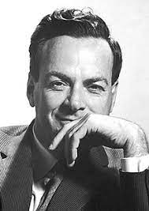
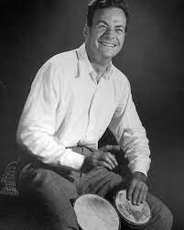
Introduction to Quantum Computing
(It’ll be “Fine Man”)
Dr. Randal Allen
Chief Scientist
Lone Star Analysis
2 December 2024

Slide 2
Learning Objectives
Identify the three aspects of quantum information science
Describe the difference between a quantum bit (qubit) and a classical (0/1) bit
Explain how superposition facilitates quantum cryptography and makes quantum computing relevant today
Explain how entanglement facilitates quantum teleportation and makes quantum computing relevant today
Tell the truths about quantum computing myths
Identify different computational models for quantum optimization and their applications
Describe the four families of quantum machine learning and variations of quantum neural networks

Slide 3
Outline
Introduction
  Why should I care, quantum info science, physical implementations and challenges, software interfaces, concepts from quantum mechanics and important properties, various computational models, and myths
Single Qubits and Cryptography
  The qubit and the Bloch sphere, the property of superposition, operators for gate-based QC, cryptography application
Multiple Qubits and Teleportation
  Multiple qubits, the property of entanglement, more operators for gate-based QC, teleportation application
Quantum Optimization
  Quantum Unconstrained Binary Optimization (QUBO) and the Ising model, adiabatic QC and gate-based quantum annealing, Quantum Approximate Optimization Algorithm (QAOA), Variational Quantum Eigensolver (VQE), and Grover’s adaptive search
Quantum Machine Learning
  Quantum Neural Networks (QNN)
Closing
  More Information and references

Slide 4
Introduction
Concepts from Quantum Mechanics
Quantum Computing: Who Cares?
Quantum Information Science
Physical Implementations/Challenges
Software Interfaces
Computational Models
Myths
Introduction
Single Qubit
Multiple Qubits
Quantum Optimization
Quantum Machine Learning
Closing

Slide 5
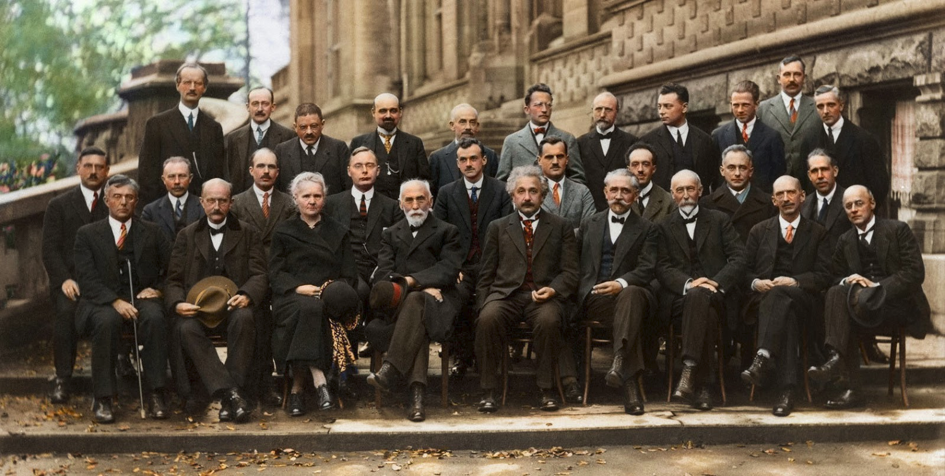

Schrodinger
Pauli
Heisenberg
Ehrenfest
Debye
<Di|rac>
Compton
de Broglie
Born
Bohr
Planck
Curie
Lorentz
Einstein
1927 Solvay Conference on Quantum Mechanics
5

Slide 6
Concepts from Quantum Mechanics
Quantization of Matter – Max Planck (photon), Albert Einstein (photoelectric effect)
  Quantum bits (qubits) operate using the properties of subatomic particles
Wave Function Collapse – The Copenhagen Interpretation of Neils Bohr and Max Born
  A qubit may be in a superposed state, but when a qubit is measured, the result is always either 0 or 1
Eigenstates and Eigenvalues – Linear Algebra
  Used to determine if an operator is Unitary (reversible gate) and/or Hermitian (irreversible measurement)
Exclusion Principle – Wolfgang Pauli
  The Pauli Exclusion Principle defines the conduct of qubits; X, Y, and Z operators (gates) are the Pauli matrices
Quantum Superposition and Entanglement - Spooky action at a distance (Einstein)
  Superposition: qubits exist in multiple states simultaneously, offering an exponential increase in computational power
  Entanglement: qubits linked in such a way that the state of one (no matter the distance) instantly influences its partner, enabling unparalleled data synchronization
  Interference uses the probability nature of quantum mechanics to reinforce or cancel out pathways, guiding algorithms towards the correct solution
“If you think you understand quantum mechanics, you don’t understand quantum mechanics.” – Feynman
6

Slide 7
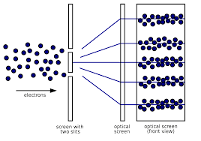
Quantum Properties
P(0)=15%
P(1)=85%
P(0)=70%
P(1)=30%
P(0)=50%
P(1)=50%
Superposition without entanglement
Classical computers can be in any state, but they can only be in one state at a given time
Quantum computers are in a superposition of all states at a given time
Individual wavefunctions constructively/destructively interfere
Quantum Algorithm
Create superposition
Entangle qubits
Apply interference
Measure result
000
001
010
011
100
101
110
111
Entangled probabilities - If you change the state of one qubit, the probability of all other states changes

Slide 8
Quantum Computing: Who Cares?
Recent quantum technological breakthroughs not achievable by classical (digital) computing
  Quantum cryptography (implemented/fielded)
  Quantum teleportation
Department of Energy (DOE) exploring applications of quantum simulation (energetics)
Modeling, Simulation, and Training
  Optimization applications to MS&T (e.g., training and human performance optimization)
  I/ITSEC Knowledge Repository returned 1618 papers with keyword “machine learning”
  Quantum optimization leads to quantum machine learning
“For the intelligence community, some areas “where you might be able to take advantage of quantum computing” include operations research, decision-making and optimization, …”
- Algorithmic Warfare by Josh Luckenbaugh, National Defense Magazine 2024
8

Slide 9
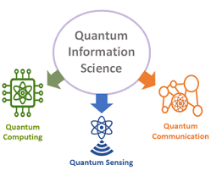
Quantum Information Science
“Military confrontation capabilities have been upgraded to basic research related to synthetic biology, quantum information science, cognitive neuroscience, human behavior modeling, and new engineering materials.” – Integrated Human-Machine Intelligence: Beyond Artificial Intelligence, Wei Liu 2023
Quantum Sensing
  Quantum devices for PNT
  For use in GPS-denied environments
  Also, electromagnetic and gravitational field sensing
Quantum Communication (Networking)
  Cryptography
  Teleportation
Quantum Computation
The focus of this presentation will be quantum computing, with networking examples of quantum cryptography and quantum teleportation
9

Slide 10
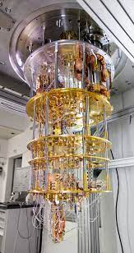
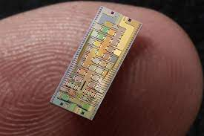
Physical Implementations
Company | Technology | Encoding | State
Xanadu PsiQuantum | Nanophotonics | Polarization | Polarization filters
Honywell IonQ | Trapped Ions | Energy Levels | Spin (up/down)
IBM Intel Google D-Wave | Superconducting Josephson Junction | Charge Current | Charged/uncharged Current (CW/CCW) Ground state/first excited state
Microsoft | Hypothetical | quasi-particle (anyon) | No hardware at this time
Xanadu’s nanophotonic chip powered by laser pulses

Slide 11
Quantum Computers - Challenges
Noise – In the sense of error (not audio or signal-to-noise ratio)
Noise and Decoherence
  At the subatomic level, electromagnetic field fluctuations and radiation result in environmental changes
  Most of today’s quantum computers are Noisy Intermediate-Scale Quantum (NISQ) computers
  Quantum cryptography can be performed with single qubits, which is why there are commercial applications
Quantum Error Correction
  Because of the fragility (incoherence) of qubits, ~100 physical qubits make up one logical qubit
  Physical qubits are necessary for error checking and error correction (checksum)
  IBM announced Condor, with 1121 physical qubits, the world’s largest quantum chip (Jan 2024)
  Compare with the bits in an average laptop (8 core) numbering about 24,576
  We’re sort of at the equivalent of the Babbage stage when it comes to quantum computers
Notional Example
3 physical qubits for 1 logical qubit
PQ LQ
000 → 0
001 → 0
010 → 0
011 → 1
100 → 0
101 → 1
110 → 1
111 → 1
11

Slide 12
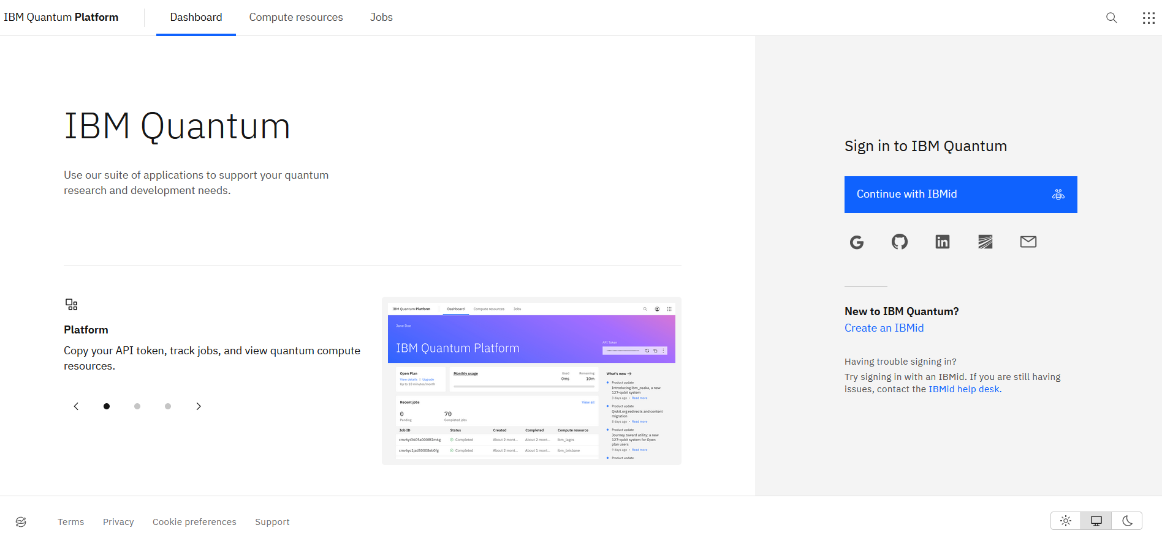
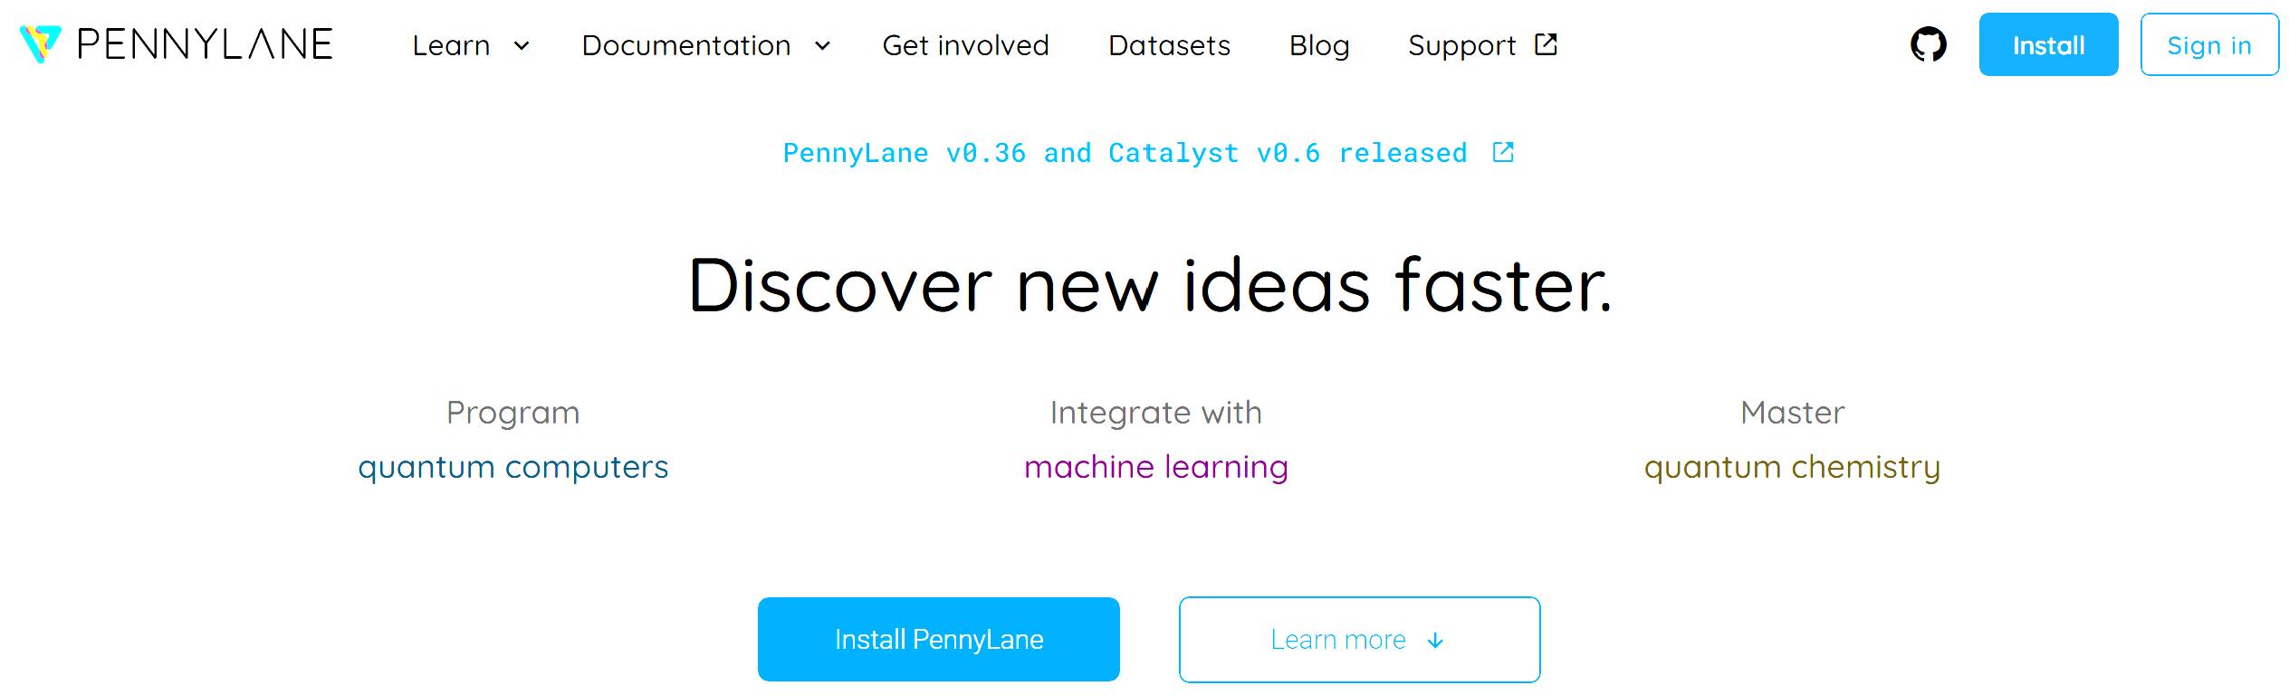
Software Interfaces
Software
  QDK/Q# (Microsoft)
  Cirq/Python (Google)
  Qiskit/Python (IBM)
  PennyLane/Python (Xanadu)
  Ocean/Python (D-Wave)
Personal Experience
  Qiskit for Quantum Optimization
  PennyLane for Quantum ML
  Python can be problematic: deprecations because the technology is moving so fast!
12

Slide 13
Computational Models
Quantum Circuit Model (Quantum Cryptography & Quantum Teleportation)
  Application of quantum gates (universal quantum computing)
Adiabatic Quantum Computing (Quantum Optimization and Quantum Machine Learning)
  Adiabatic evolution: begin in ground state, not enough energy added to jump to excited state
  Implemented as quantum annealing, it’s restricted, therefore not universal quantum computing
Other
  Quantum Turing Machines
  Measurement-Based Quantum Computing (One-Way Quantum Computing)
  MBQC has given way to Fusion-Based QC, as pursued by PsiQuantum
13

Slide 14
Debunking Myths
Myth: Quantum computers will render classical computers obsolete
  Truth: For most tasks running on your personal computer, a quantum computer performs no better
  Only very specific classes of algorithms are currently known to benefit from quantum computing
From a programmer’s perspective, a quantum computer is but a co-processor
  Classical computers handle input and output and call the “QPU” for specific tasks
Quantum computers excel at optimization problems and since AI/ML is nothing more than fancy curve-fitting (Judea Pearl), quantum computing may play a significant role in AI/ML
CPU
Input
Quantum Processing Unit
Control
Control
Parameters
I/O
ALU
Quantum
Circuit
Solutions
Memory
Today, all quantum computing (hardware) is hybrid, i.e., quantum computers receive input from classical computers and provide output to classical computers; plus, some software applications are hybrid too (classical/quantum algorithms)
14

Slide 15
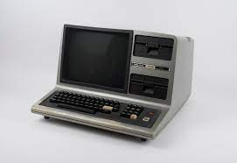
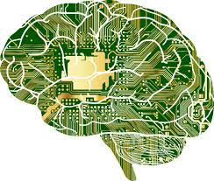
Debunking Myths
Myth: There is no practical use for quantum computers
  Truth: Even with NISQ QCs, there are already applications (as will be shown)
  Think of Radio Shack’s TRS-80 (Z-80, 2 MHz processor with 4K RAM), we did a lot with it!
  However, practical advantages? Not really.
Myth: Quantum computers will develop their own minds
  Truth: We’ve heard this (for a while now) about AI/ML
  For quantum computing (and AI/ML for that matter), how can this be if humans do not fully understand how consciousness works?
  For that matter, can AI reflect on a decision it has made?

Slide 16
Single Qubits
Qubits
Superposition
Bloch Sphere
Operators/Gates
Application: Cryptography
Introduction
Single Qubit
Multiple Qubits
Quantum Optimization
Quantum Machine Learning
Closing

Slide 17
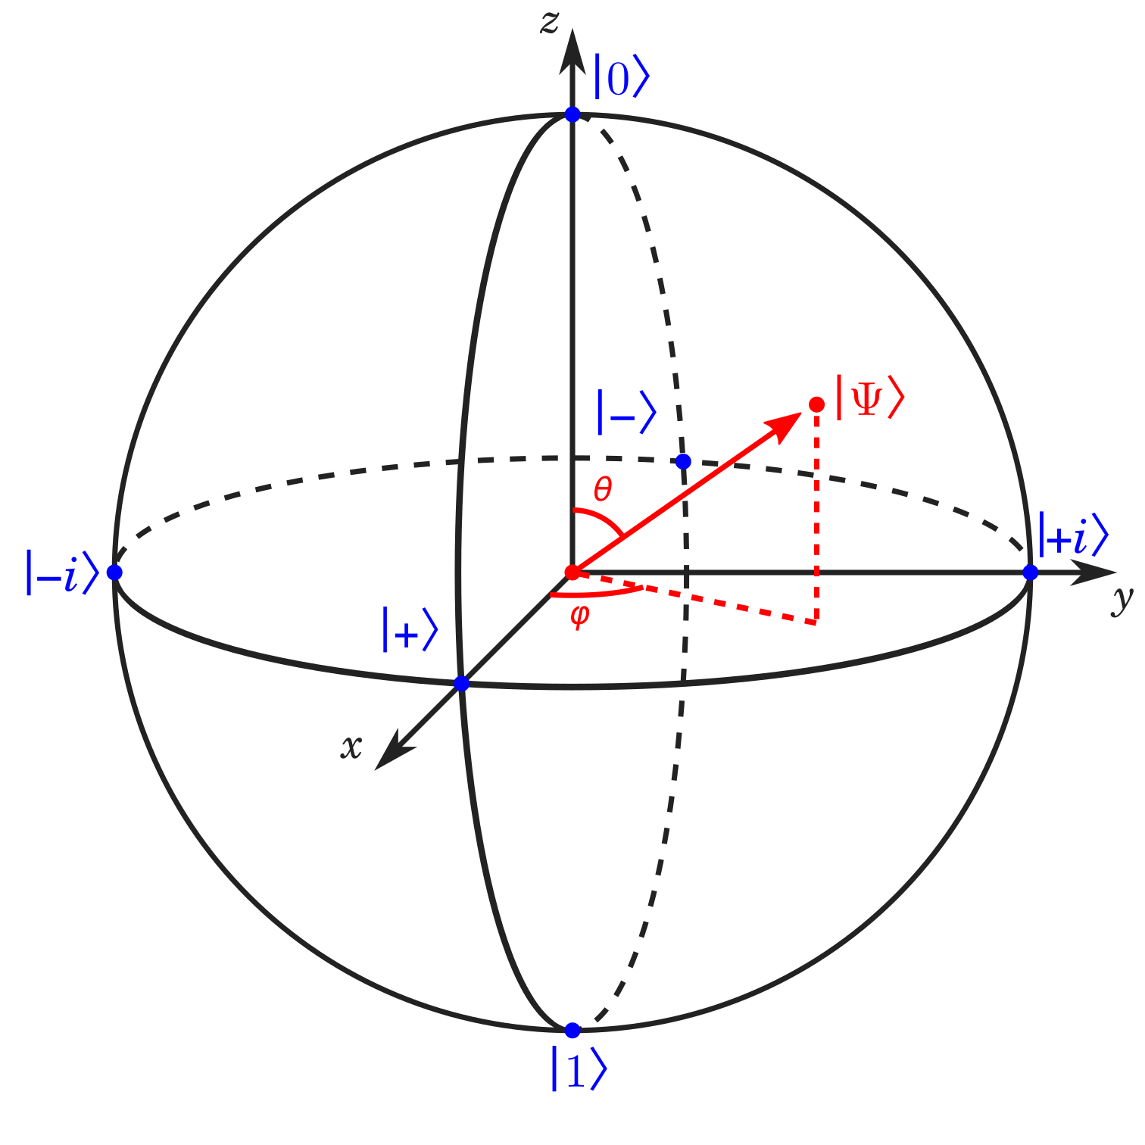
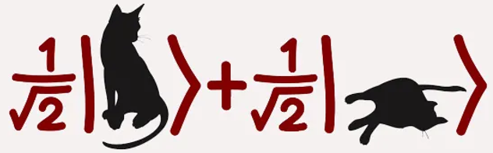
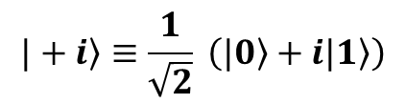

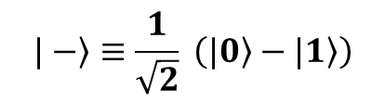
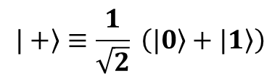

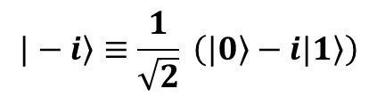
Single Qubits
Classical Bit
  Either 0 or 1
Quantum Bit (Qubit)
  Superposition of pure states 0 and 1
  Dirac’s notation
  Some qubits could be an equal superposition of 0 and 1
  These states are on the “equator” of the Bloch sphere
  While the superpositions are equal in magnitude, in some cases, their phase differs
$$\left.|0\right\rangle ≡\left[\begin{matrix}1 \\ 0\end{matrix}\right]$$
$$\left.|1\right\rangle ≡\left[\begin{matrix}0 \\ 1\end{matrix}\right]$$
← Standard (Computational) Basis
Bloch Sphere
$$\left.|+\right\rangle ≡\frac{1}{\sqrt{2}} \left(\left.|0\right\rangle +|\left.1\right\rangle \right)$$
$$\left.|−\right\rangle ≡\frac{1}{\sqrt{2}} \left(\left.|0\right\rangle −|\left.1\right\rangle \right)$$
$$\left.|+i\right\rangle ≡\frac{1}{\sqrt{2}} \left(\left.|0\right\rangle +i|\left.1\right\rangle \right)$$
$$\left.|−i\right\rangle ≡\frac{1}{\sqrt{2}} \left(\left.|0\right\rangle −i|\left.1\right\rangle \right)$$

Slide 18
Single Qubits
Light polarization
  Sunlight has no preferred polarization, however a filter can set the preferred polarization
  Let vertical polarization be represented by and horizontal polarization be represented by
  Then the state of sunlight may be represented by
Vertical polarization
  If sunlight is vertically polarized, what happens if we introduce a second perpendicular (horizontal) filter?
  If sunlight is vertically polarized, what happens if we introduce a second filter at 45 degrees?
  Vertical polarization is a superposition of +45° diagonal and -45° diagonal filtering
  Since the state is only one term in the superposition, half of the light gets through to the screen
Filter
Filter
Screen
Filter
Filter
Screen

Slide 19

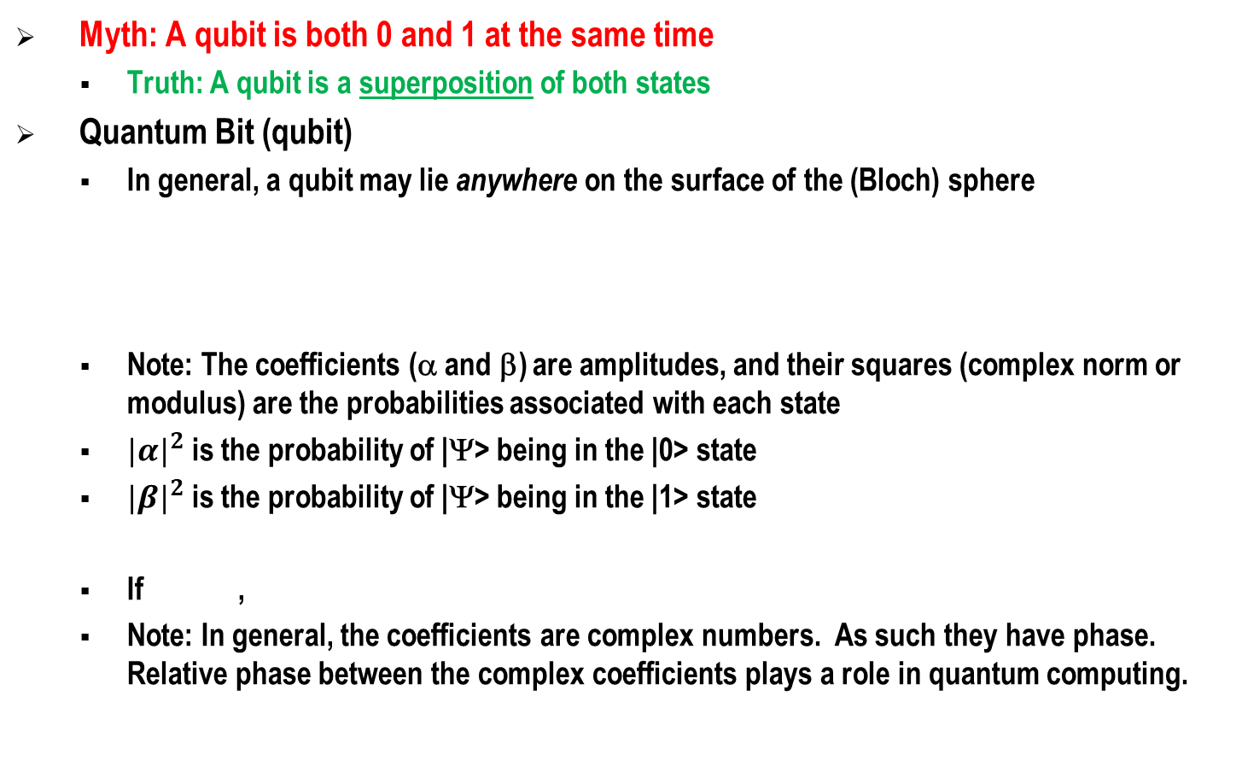

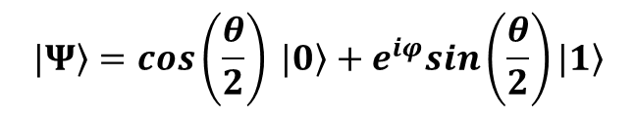
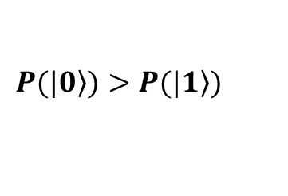

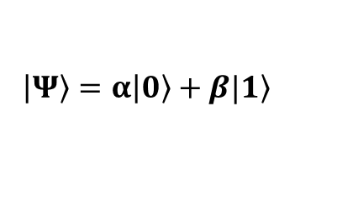

Single Qubits
Myth: A qubit is both 0 and 1 at the same time
  Truth: A qubit is a superposition of both states
Quantum Bit (qubit)
  In general, a qubit may lie anywhere on the surface of the (Bloch) sphere
  Note: The coefficients (α and β) are amplitudes, and their squares (complex norm or modulus) are the probabilities associated with each state
  ${|α|}^{2}$ is the probability of |Ψ> being in the |0> state
  ${|β|}^{2}$ is the probability of |Ψ> being in the |1> state
  If ,
  Note: In general, the coefficients are complex numbers. As such they have phase. Relative phase between the complex coefficients plays a role in quantum computing.
$$\left.|Ψ\right\rangle =cos\left(\frac{θ}{2}\right) \left.|0\right\rangle +e^{iφ}sin\left(\frac{θ}{2}\right)\left.|1\right\rangle$$
$$0≤θ≤π$$
$$0≤φ<2π$$
$$\left|\left.Ψ\right\rangle =α\right|\left.0\right\rangle +β|\left.1\right\rangle$$
Bloch Sphere
${|α|}^{2}+$ ${|β|}^{2}=1$
$$α>β$$
$$P(|\left.0\right\rangle )>P(|\left.1\right\rangle )$$

Slide 20
Quantum Gates
Digital computers have finite logic gates (AND, OR, etc.)
The situation is similar with quantum computing
There are different operations applied to qubits
  When initializing a qubit, the process is irreversible (Hermitian)
  When performing quantum computations, the process is reversible (Unitary)
  When measuring qubits, the process is irreversible (Hermitian)
Because the systems are linear, the operators are matrix multiplications
20

Slide 21
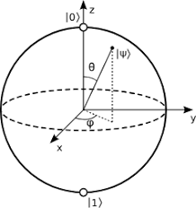
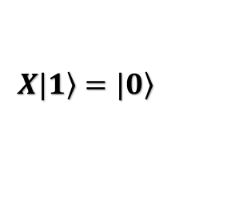


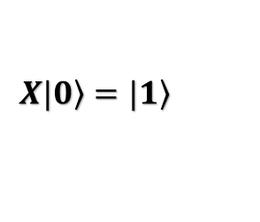
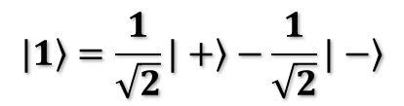
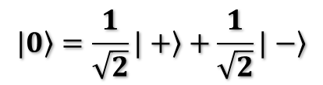
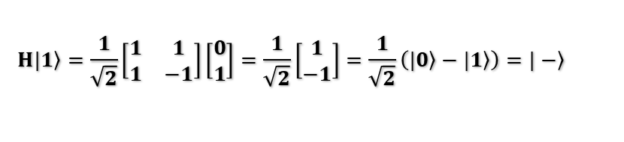
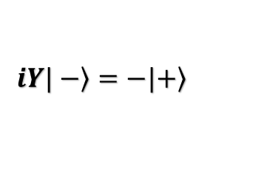
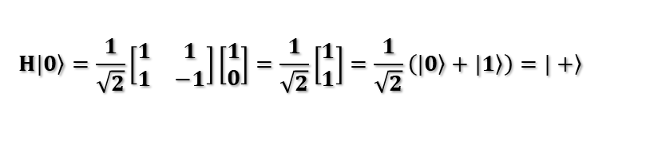
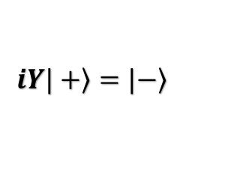

Quantum Gates
$\left[\begin{matrix}1 \\ 1\end{matrix}\right]=\left[\begin{matrix}1 \\ 0\end{matrix}\right]$+ $\left[\begin{matrix}0 \\ 1\end{matrix}\right]$
Hadamard Gate (Unitary)
  Used to create a superposed state
  When applied to |0>, the result is |+>
  When applied to |1>, the result is |->
  |+> and |-> comprise the Hadamard Basis
X, Y, and Z (Pauli) Gates (Unitary)
  X is referred to as the “not” gate
  Z is referred to as the phase shift gate
  It’s a rotation about Z of the Bloch sphere, i.e., ϕ
  Y completes the trio
$$H=\frac{1}{\sqrt{2}}\left[\begin{matrix}1 & 1 \\ 1 & −1\end{matrix}\right]$$
$$H\left.|0\right\rangle =\frac{1}{\sqrt{2}}\left[\begin{matrix}1 & 1 \\ 1 & −1\end{matrix}\right]\left[\begin{matrix}1 \\ 0\end{matrix}\right]=\frac{1}{\sqrt{2}}\left[\begin{matrix}1 \\ 1\end{matrix}\right]=\frac{1}{\sqrt{2}}\left(\left.|0\right\rangle +\left.|1\right\rangle \right)=\left.|+\right\rangle$$
$$H\left.|1\right\rangle =\frac{1}{\sqrt{2}}\left[\begin{matrix}1 & 1 \\ 1 & −1\end{matrix}\right]\left[\begin{matrix}0 \\ 1\end{matrix}\right]=\frac{1}{\sqrt{2}}\left[\begin{matrix}1 \\ −1\end{matrix}\right]=\frac{1}{\sqrt{2}}\left(\left.|0\right\rangle −\left.|1\right\rangle \right)=\left.|−\right\rangle$$
$$\left.|0\right\rangle =\frac{1}{\sqrt{2}}\left.|+\right\rangle +\frac{1}{\sqrt{2}}\left.|−\right\rangle$$
$$\left.|1\right\rangle =\frac{1}{\sqrt{2}}\left.|+\right\rangle −\frac{1}{\sqrt{2}}\left.|−\right\rangle$$
$$\left.X|0\right\rangle =|\left.1\right\rangle$$
$$\left.X|1\right\rangle =|\left.0\right\rangle$$
$$X=\left[\begin{matrix}0 & 1 \\ 1 & 0\end{matrix}\right]$$
$$Z=\left[\begin{matrix}1 & 0 \\ 0 & −1\end{matrix}\right]$$
$$Y=\left[\begin{matrix}0 & −i \\ i & 0\end{matrix}\right]$$
$$\left.iY|+\right\rangle =|\left.−\right\rangle$$
$$\left.iY|−\right\rangle =−|\left.+\right\rangle$$
21

Slide 22
Quantum Gates
X, Y, and Z (Pauli) Gates (Unitary)
  X, Y, and Z are all rotations of π radians (180 deg)
Generalized Rotations
≡ denotes equivalent action up to a global phase
22

Slide 23
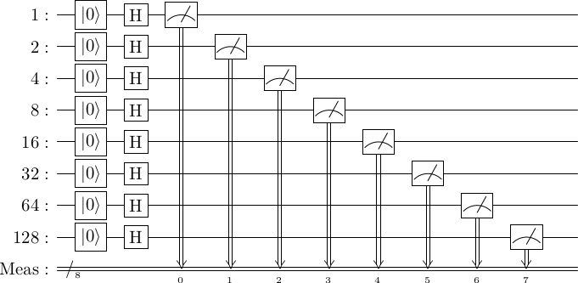
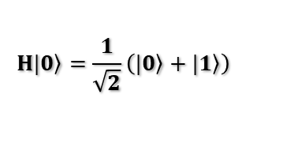
True Random Number Generator
Random Byte (no need for pseudo-random number generators)
  H|0> produces a superposition, with a 50/50 chance of resulting in a 0 or a 1
  1*Meas0 + 2*Meas1 + 4*Meas2 + 8*Meas3 + 16*Meas4 + 32*Meas5 + 64*Meas6 + 128*Meas7
$$H\left.|0\right\rangle =\frac{1}{\sqrt{2}}\left(\left.|0\right\rangle +\left.|1\right\rangle \right)$$
from qiskit import QuantumCircuit, QuantumRegister, ClassicalRegister, Aer
from qiskit.tools.visualization import circuit_drawer
from qiskit.visualization import plot_histogram
qr1 = QuantumRegister(1, 'qr1’), qr2 = QuantumRegister(1, 'qr2’)
qr3 = QuantumRegister(1, 'qr3’),qr4 = QuantumRegister(1, 'qr4')
qr5 = QuantumRegister(1, 'qr5’),qr6 = QuantumRegister(1, 'qr6’)
qr7 = QuantumRegister(1, 'qr7’),qr8 = QuantumRegister(1, 'qr8')
cr = ClassicalRegister(8, 'cr')
qc = QuantumCircuit(qr1,qr2,qr3,qr4,qr5,qr6,qr7,qr8,cr)
qc.reset(0),qc.reset(1),qc.reset(2),qc.reset(3)
qc.reset(4),qc.reset(5),qc.reset(6),qc.reset(7)
qc.h(0),qc.h(1),qc.h(2),qc.h(3)
qc.h(4),qc.h(5),qc.h(6),qc.h(7)
qc.measure(0, 0),qc.measure(1, 1),qc.measure(2, 2),qc.measure(3, 3)
qc.measure(4, 4),qc.measure(5, 5),qc.measure(6, 6),qc.measure(7, 7)
circuit_drawer(qc, output='latex', style={'backgroundcolor': '#EEEEEE'})
NIST’s New Quantum Method Generates Really Random Numbers - 2018
23

Slide 24
Qubit Summary
Qubits are a superposition of both states simultaneously
Because of superposition, there is a relative phase (quantum interference) between α and β
  This has implications for Deutch’s algorithm and Grover’s algorithm
Entanglement (to be discussed) is a property of multiple qubits
Because of these properties, qubits are more powerful than classical bits
https://javafxpert.github.io/grok-bloch/
One drawback is the “No Cloning Theorem” which states that a qubit cannot be copied
  This has implications for cryptography which we will explore next…
24

Slide 25
Application: Quantum Cryptography
A quantum computer with several thousand qubits can solve a strategic problem (encryption and decryption) that classical computers have no hope of solving
  This is one of those “special applications” where quantum computing outperforms classical computers
  Peter Shor’s algorithm cracks the widely used RSA encryption scheme
  But quantum computing also has some clever ways to solve this problem with single qubits…
Cryptography aims to hide the meaning of a message through encryption
  BB84 was developed by Charles Bennett and Gilles Brassard in 1984
  Goal: to share symmetric keys, securely
  The qubits themselves are not used to send messages
25

Slide 26
Application: Quantum Cryptography
Alice and Bob want to share a secret
  Alice generates 20 qubits and sends them to Bob
  Eavesdropper (Eve) listens-in, makes note of the qubits, and forwards them to Bob
  The secret has been compromised, hmmm…
But Alice and Bob know about quantum computing
  Alice applies the Hadamard gate before sending her qubits
  Since the Hadamard gate is its own inverse, Bob can recover each qubit
Unfortunately, Eve knows about quantum computing too
  Eve applies the Hadamard gate twice, once to recover the qubits and again before forwarding them to Bob
  Alas, Hadamard gates alone don’t help, hmmm…
Unfortunately, just as Eve can’t figure out what Alice meant to send, neither can Bob
  If Alice tells Bob which qubits had been Hadamarded, Eve could intercept that message, hmmm…
26

Slide 27
Application: Quantum Cryptography
BB84
  Both Alice and Bob decide to randomly apply the Hadamard gate with two possible outcomes:
    They both applied the Hadamard gate, or neither applied the Hadamard gate
    One applied the Hadamard gate, and the other didn’t
  Bob publicly announces which qubits he applied the Hadamard gate to
    If Eve is listening-in, the information Bob provides is or no use to her
  Alice publicly announces which of her choices agrees with Bob
    If Eve is listening-in, the information Alice provides is or no use to her
  Bob publicly announces the results of the first-half of their agreement as “test qubits”
    If Eve is listening-in, there is little chance that all “test qubits” match
  The second-half of the results form the “shared secret”
27

Slide 28

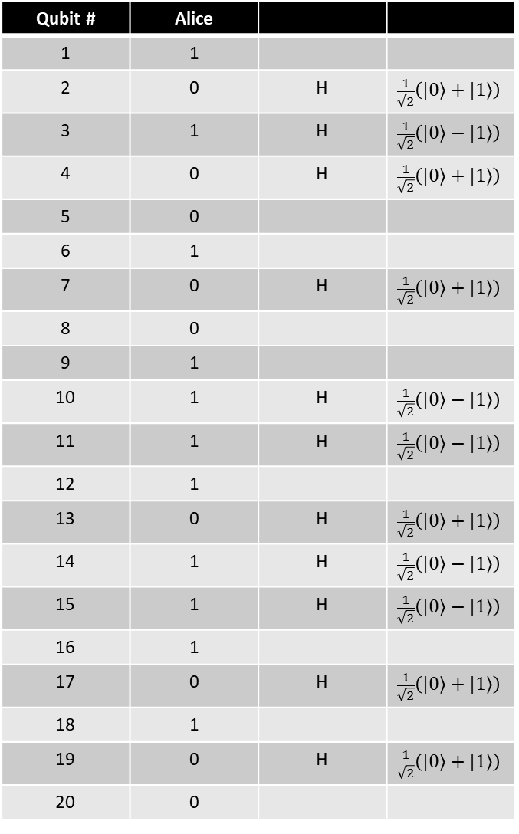
Qubit # | Alice
1 | 1
2 | 0 | H | $$\frac{1}{\sqrt{2}}\left(\left.|0\right\rangle +\left.|1\right\rangle \right)$$
3 | 1 | H | $$\frac{1}{\sqrt{2}}\left(\left.|0\right\rangle −\left.|1\right\rangle \right)$$
4 | 0 | H | $$\frac{1}{\sqrt{2}}\left(\left.|0\right\rangle +\left.|1\right\rangle \right)$$
5 | 0
6 | 1
7 | 0 | H | $$\frac{1}{\sqrt{2}}\left(\left.|0\right\rangle +\left.|1\right\rangle \right)$$
8 | 0
9 | 1
10 | 1 | H | $$\frac{1}{\sqrt{2}}\left(\left.|0\right\rangle −\left.|1\right\rangle \right)$$
11 | 1 | H | $$\frac{1}{\sqrt{2}}\left(\left.|0\right\rangle −\left.|1\right\rangle \right)$$
12 | 1
13 | 0 | H | $$\frac{1}{\sqrt{2}}\left(\left.|0\right\rangle +\left.|1\right\rangle \right)$$
14 | 1 | H | $$\frac{1}{\sqrt{2}}\left(\left.|0\right\rangle −\left.|1\right\rangle \right)$$
15 | 1 | H | $$\frac{1}{\sqrt{2}}\left(\left.|0\right\rangle −\left.|1\right\rangle \right)$$
16 | 1
17 | 0 | H | $$\frac{1}{\sqrt{2}}\left(\left.|0\right\rangle +\left.|1\right\rangle \right)$$
18 | 1
19 | 0 | H | $$\frac{1}{\sqrt{2}}\left(\left.|0\right\rangle +\left.|1\right\rangle \right)$$
20 | 0
Qubit # | Bob
1 | H | ?
2 |  | ?
3 |  | ?
4 | H | 0
5 |  | 0
6 |  | 1
7 | H | 0
8 | H | ?
9 |  | 1
10 |  | ?
11 |  | ?
12 |  | 1
13 | H | 0
14 | H | 1
15 |  | ?
16 | H | ?
17 |  | ?
18 | H | ?
19 | H | 0
20 |  | 0
Bob publishes all 20 of his decisions
Alice publishes when she agrees, namely qubits 4, 5, 6, 7, 9, 12, 13, 14, 19, 20
Bob publishes results of the first-half, namely [0, 0, 1, 0, 1] as “test qubits”
The second-half, namely [1, 0, 1, 0, 0] form the “shared secret”

Slide 29
Application: Quantum Cryptography
Suppose we want to encrypt the message, “LSA”
  In ASCII L=1001100, S=1010011, A=1000001
  The bit stream is 1001100 1010011 1000001
  Alice repeatedly applies the XOR “shared secret” 10100 (key)
  Then she sends the encrypted message to Bob
  Upon receipt, Bob repeatedly applies the XOR “shared secret” and recovers the message
Message | 1 | 0 | 0 | 1 | 1 | 0 | 0 |  | 1 | 0 | 1 | 0 | 0 | 1 | 1 |  | 1 | 0 | 0 | 0 | 0 | 0 | 1
Key | 1 | 0 | 1 | 0 | 0 | 1 | 0 |  | 1 | 0 | 0 | 1 | 0 | 1 | 0 |  | 0 | 1 | 0 | 1 | 0 | 0 | 1
Encrypted | 0 | 0 | 1 | 1 | 1 | 1 | 0 |  | 0 | 0 | 1 | 1 | 0 | 0 | 1 |  | 1 | 1 | 0 | 1 | 0 | 0 | 0
Encrypted | 0 | 0 | 1 | 1 | 1 | 1 | 0 |  | 0 | 0 | 1 | 1 | 0 | 0 | 1 |  | 1 | 1 | 0 | 1 | 0 | 0 | 0
Key | 1 | 0 | 1 | 0 | 0 | 1 | 0 |  | 1 | 0 | 0 | 1 | 0 | 1 | 0 |  | 0 | 1 | 0 | 1 | 0 | 0 | 1
Message | 1 | 0 | 0 | 1 | 1 | 0 | 0 |  | 1 | 0 | 1 | 0 | 0 | 1 | 1 |  | 1 | 0 | 0 | 0 | 0 | 0 | 1
“L”
“S”
“A”
29

Slide 30
Application: Quantum Cryptography
Myth: Quantum computers will put cybersecurity at risk
  Truth: While the power and speed of quantum computers could crack RSA public key encryption (Shor’s algorithm), there are already quantum-resistant cryptography algorithms
We just showed a simple (BB84) example using only single qubits and the Hadamard gate for superposition to establish a post-quantum encryption algorithm
  Perhaps this could be extended for secure distributed simulation
What is Post-Quantum Cryptography (PQC)?
  The development of novel classical cryptographic schemes, believed to be resistant to future quantum computers employing Shor's algorithm
  The NSA is taking this seriously to safeguard data against future hackers
  Efforts are already underway to incorporate these new schemes (some of which have already been hacked)
  Note: Encrypted data is being collected now for future decryption (What is the “shelf-life” of your data?)
NIST SP 1800-38B, Migration to Post-Quantum Cryptography Quantum Readiness: Cryptographic Discovery
NIST SP 1800-38C, Migration to Post-Quantum Cryptography Quantum Readiness: Testing Draft Standards for Interoperability and Performance
30

Slide 31
Multiple Qubits
Introduction
Multi-Qubit Operators/Gates
Entanglement
Application: Teleportation
Single Qubit
Multiple Qubits
Quantum Optimization
Quantum Machine Learning
Closing

Slide 32



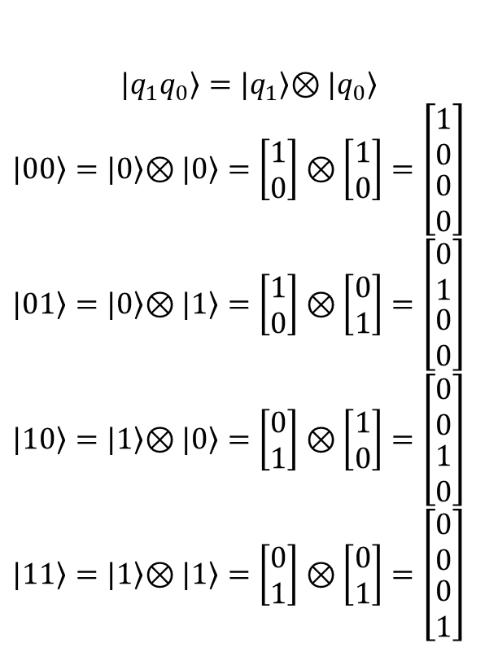

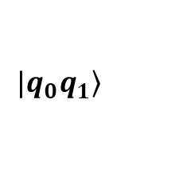
Multiple Qubits
Label
Math
The Hadamard and Pauli gates operate on a singe qubit
Some gates operate on multiple qubits in parallel
Qubits are combined according to the tensor product
Caution! Some literature uses different ordering
Controlled NOT (CNOT)
  If the control qubit is 0, do nothing
  If the control qubit is 1, flip the other (target) qubit
  Assume: left qubit |x> is Control, right qubit |y> is Target
  Caution! Sometimes the control/target qubits are opposite
$$\left.|q_{0}q_{1}\right\rangle$$
$$\left.|q_{1}q_{0}\right\rangle =|\left.q_{1}\right\rangle \left.⊗|q_{0}\right\rangle$$
$\left.|00\right\rangle =|\left.0\right\rangle \left.⊗|0\right\rangle =$ $\left[\begin{matrix}1 \\ 0\end{matrix}\right]⊗\left[\begin{matrix}1 \\ 0\end{matrix}\right]=\left[\begin{matrix}\begin{matrix}1 \\ 0\end{matrix} \\ \begin{matrix}0 \\ 0\end{matrix}\end{matrix}\right]$
$\left.|01\right\rangle =|\left.0\right\rangle \left.⊗|1\right\rangle =$ $\left[\begin{matrix}1 \\ 0\end{matrix}\right]⊗\left[\begin{matrix}0 \\ 1\end{matrix}\right]=\left[\begin{matrix}\begin{matrix}0 \\ 1\end{matrix} \\ \begin{matrix}0 \\ 0\end{matrix}\end{matrix}\right]$
$\left.|10\right\rangle =|\left.1\right\rangle \left.⊗|0\right\rangle =$ $\left[\begin{matrix}0 \\ 1\end{matrix}\right]⊗\left[\begin{matrix}1 \\ 0\end{matrix}\right]=\left[\begin{matrix}\begin{matrix}0 \\ 0\end{matrix} \\ \begin{matrix}1 \\ 0\end{matrix}\end{matrix}\right]$
$\left.|11\right\rangle =|\left.1\right\rangle \left.⊗|1\right\rangle =$ $\left[\begin{matrix}0 \\ 1\end{matrix}\right]⊗\left[\begin{matrix}0 \\ 1\end{matrix}\right]=\left[\begin{matrix}\begin{matrix}0 \\ 0\end{matrix} \\ \begin{matrix}0 \\ 1\end{matrix}\end{matrix}\right]$
$$\left[\begin{matrix}\begin{matrix}1 & 0 \\ 0 & 1\end{matrix} & \begin{matrix}0 & 0 \\ 0 & 0\end{matrix} \\ \begin{matrix}0 & 0 \\ 0 & 0\end{matrix} & \begin{matrix}0 & 1 \\ 1 & 0\end{matrix}\end{matrix}\right]\left[\begin{matrix}\begin{matrix}\left.|00\right\rangle \\ \left.|01\right\rangle \end{matrix} \\ \begin{matrix}\left.|10\right\rangle \\ \left.|11\right\rangle \end{matrix}\end{matrix}\right]=\left[\begin{matrix}\begin{matrix}\left.|00\right\rangle \\ \left.|01\right\rangle \end{matrix} \\ \begin{matrix}\left.|11\right\rangle \\ \left.|10\right\rangle \end{matrix}\end{matrix}\right]$$
$$\left[\begin{matrix}\begin{matrix}1 & 0 \\ 0 & 1\end{matrix} & \begin{matrix}0 & 0 \\ 0 & 0\end{matrix} \\ \begin{matrix}0 & 0 \\ 0 & 1\end{matrix} & \begin{matrix}1 & 0 \\ 0 & 0\end{matrix}\end{matrix}\right]\left[\begin{matrix}\begin{matrix}\left.|00\right\rangle \\ \left.|01\right\rangle \end{matrix} \\ \begin{matrix}\left.|10\right\rangle \\ \left.|11\right\rangle \end{matrix}\end{matrix}\right]=\left[\begin{matrix}\begin{matrix}\left.|00\right\rangle \\ \left.|01\right\rangle \end{matrix} \\ \begin{matrix}\left.|11\right\rangle \\ \left.|10\right\rangle \end{matrix}\end{matrix}\right]$$
32

Slide 33
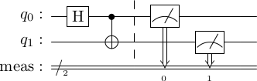
Gate-Based/Universal Quantum Computing
Create wires and associate qubits with them
Gates interact with the qubits to perform calculations
  The Hadamard gate interact with a single qubit
  The CNOT gate interacts with multiple qubits
In the end, measurements are made
  Remember: The result is either a 0 or a 1
Example in Qiskit
  from qiskit import QuantumCircuit
  circuit = QuantumCircuit(2)
  circuit.h(0)
  circuit.cnot(0,1)
  circuit.measure_all()
  display(circuit.draw('latex'))
  Import the library
  Create a quantum circuit with two qubits, q0 and q1
  Apply the Hadamard operator to qubit 0
  Apply the CNOT operator q0(C), q1(T)
  Measure both qubits
  Draw the circuit
33

Slide 34
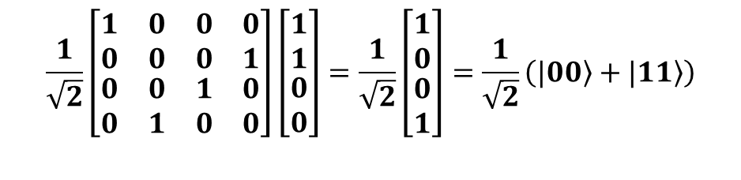
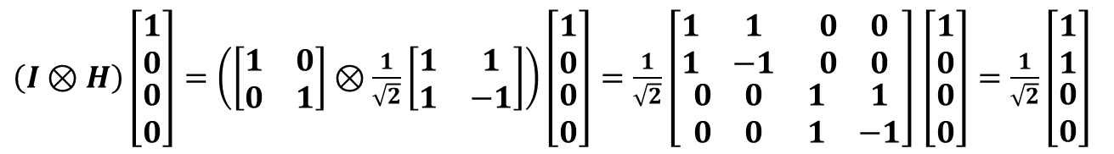
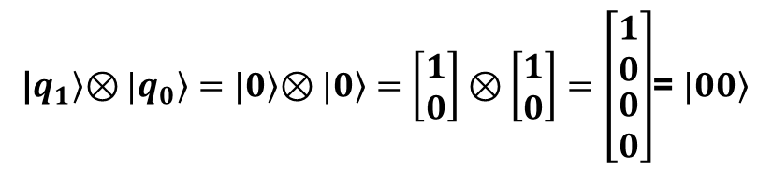
Circuitry and Mathematics
What is the result of the previous example?
Let’s “do the math…”
  Assume each qubit is in the initial pure state |0>
  We want to apply to Hadamard operator to q0 while maintaining q1 in parallel
  Next, we apply the CNOT operator
|$\left.q_{1}\right\rangle \left.⊗|q_{0}\right\rangle =|\left.0\right\rangle \left.⊗|0\right\rangle =$ $\left[\begin{matrix}1 \\ 0\end{matrix}\right]⊗\left[\begin{matrix}1 \\ 0\end{matrix}\right]=\left[\begin{matrix}\begin{matrix}1 \\ 0\end{matrix} \\ \begin{matrix}0 \\ 0\end{matrix}\end{matrix}\right]$= $\left.|00\right\rangle$
Math
Label
$\left(I⊗H\right)\left[\begin{matrix}\begin{matrix}1 \\ 0\end{matrix} \\ \begin{matrix}0 \\ 0\end{matrix}\end{matrix}\right]=\left(\left[\begin{matrix}1 & 0 \\ 0 & 1\end{matrix}\right]⊗\frac{1}{\sqrt{2}}\left[\begin{matrix}1 & 1 \\ 1 & −1\end{matrix}\right]\right)\left[\begin{matrix}\begin{matrix}1 \\ 0\end{matrix} \\ \begin{matrix}0 \\ 0\end{matrix}\end{matrix}\right]=\frac{1}{\sqrt{2}}\left[\begin{matrix}\begin{matrix}1 & 1 \\ 1 & −1\end{matrix} & \begin{matrix}0 & 0 \\ 0 & 0\end{matrix} \\ \begin{matrix}0 & 0 \\ 0 & 0\end{matrix} & \begin{matrix}1 & 1 \\ 1 & −1\end{matrix}\end{matrix}\right]$ $\left[\begin{matrix}\begin{matrix}1 \\ 0\end{matrix} \\ \begin{matrix}0 \\ 0\end{matrix}\end{matrix}\right]=\frac{1}{\sqrt{2}}\left[\begin{matrix}\begin{matrix}1 \\ 1\end{matrix} \\ \begin{matrix}0 \\ 0\end{matrix}\end{matrix}\right]$
Note: You could begin by applying the Hadamard operator to q0, perform the tensor multiplication, then apply the CNOT operator
$$\frac{1}{\sqrt{2}}\left[\begin{matrix}\begin{matrix}1 & 0 \\ 0 & 0\end{matrix} & \begin{matrix}0 & 0 \\ 0 & 1\end{matrix} \\ \begin{matrix}0 & 0 \\ 0 & 1\end{matrix} & \begin{matrix}1 & 0 \\ 0 & 0\end{matrix}\end{matrix}\right]\left[\begin{matrix}\begin{matrix}1 \\ 1\end{matrix} \\ \begin{matrix}0 \\ 0\end{matrix}\end{matrix}\right]=\frac{1}{\sqrt{2}}\left[\begin{matrix}\begin{matrix}1 \\ 0\end{matrix} \\ \begin{matrix}0 \\ 1\end{matrix}\end{matrix}\right]=\frac{1}{\sqrt{2}}\left(\left.|00\right\rangle +\left.|11\right\rangle \right)$$
Math
Label
34

Slide 35




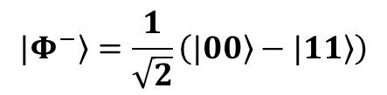
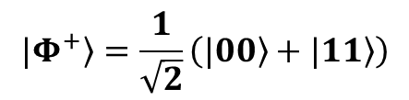
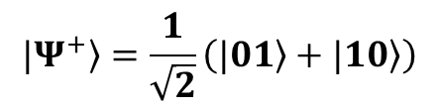
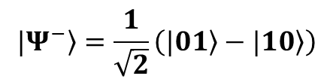
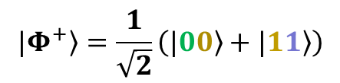
Circuitry and Mathematics
At this point, the qubits are equally likely (50/50) to be in either the |00> or the |11> state
If q0 is measured to be 0, then q1 must be 0; likewise, if q0 is measured to be 1, q1 must be 1
The qubits are known to be entangled
Similarly…
…these are known as EPR* pairs or Bell states (after John Bell who proved the EPR paradox)
$$\left.{|Φ}^{+}\right\rangle =\frac{1}{\sqrt{2}}\left(\left.|00\right\rangle +\left.|11\right\rangle \right)$$
$$\left.{|Φ}^{+}\right\rangle =\frac{1}{\sqrt{2}}\left(\left.|00\right\rangle +\left.|11\right\rangle \right)$$
$$\left.{|Ψ}^{+}\right\rangle =\frac{1}{\sqrt{2}}\left(\left.|01\right\rangle +\left.|10\right\rangle \right)$$
$$\left.{|Φ}^{−}\right\rangle =\frac{1}{\sqrt{2}}\left(\left.|00\right\rangle −\left.|11\right\rangle \right)$$
$$\left.{|Ψ}^{−}\right\rangle =\frac{1}{\sqrt{2}}\left(\left.|01\right\rangle −\left.|10\right\rangle \right)$$
*EPR refers to a paper written by Einstein, Podolsky, and Rosen challenging the concept of entanglement (hidden variables)
35

Slide 36
Quantum Properties
P(0)=15%
P(1)=85%
P(0)=70%
P(1)=30%
P(0)=50%
P(1)=50%
Superposition without entanglement
Classical computers can be in any state, but they can only be in one state at a given time
Quantum computers are in a superposition of all states at a given time
Individual wavefunctions constructively/destructively interfere
Quantum Algorithm
Create superposition
Entangle qubits
Apply interference
Measure result
000
001
010
011
100
101
110
111
Entangled probabilities - If you change the state of one qubit, the probability of all other states changes

Slide 37
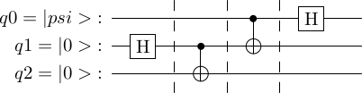
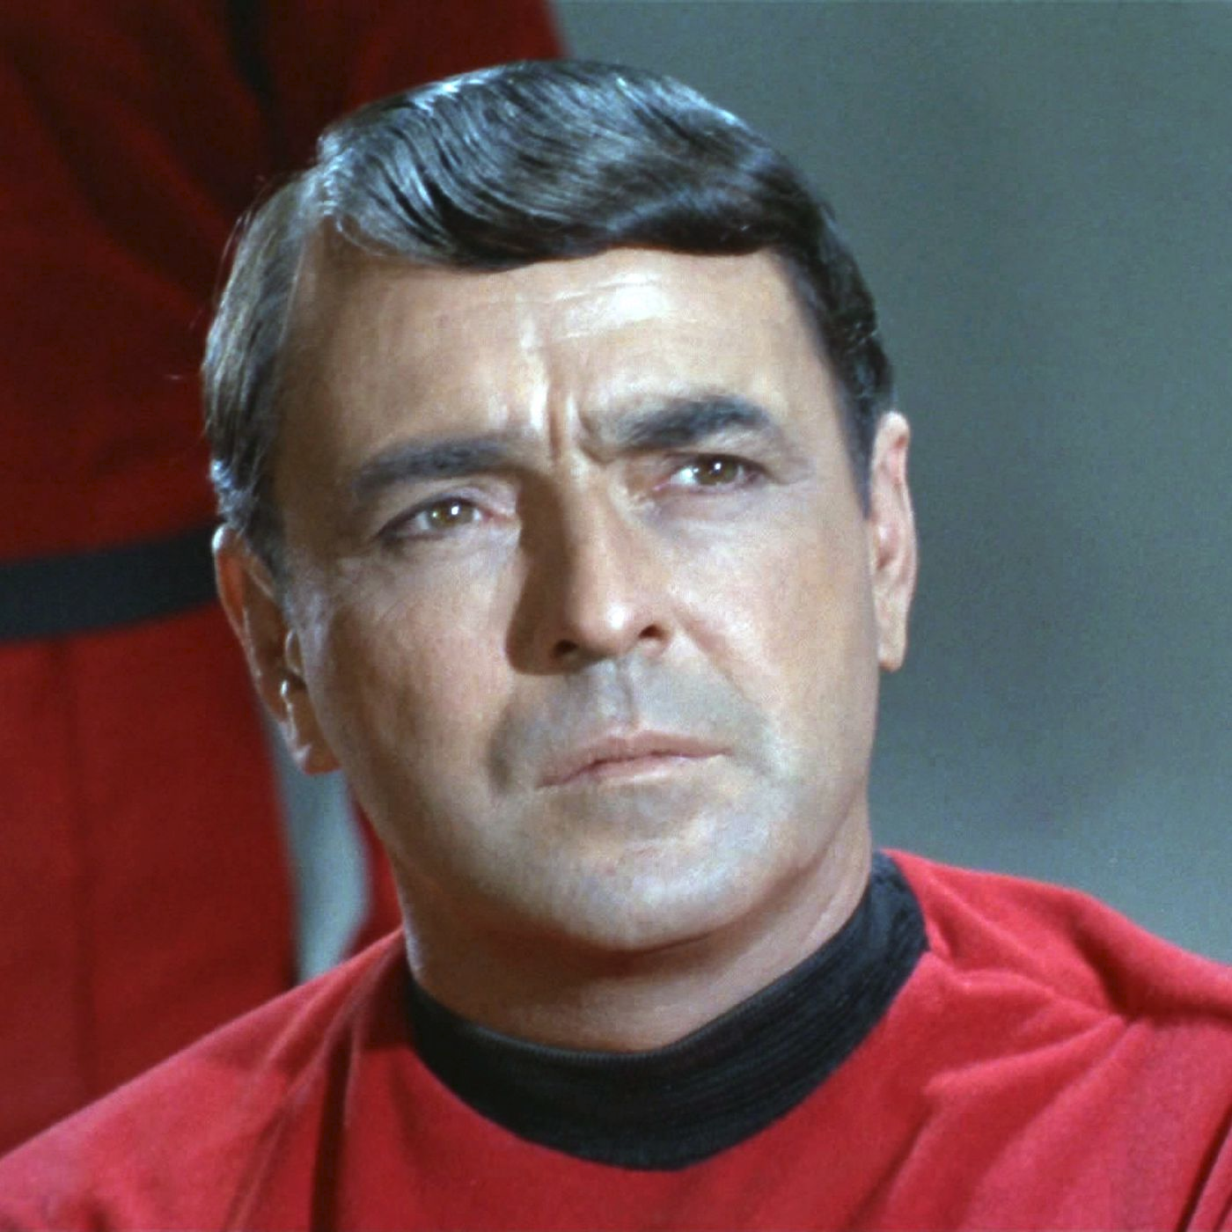
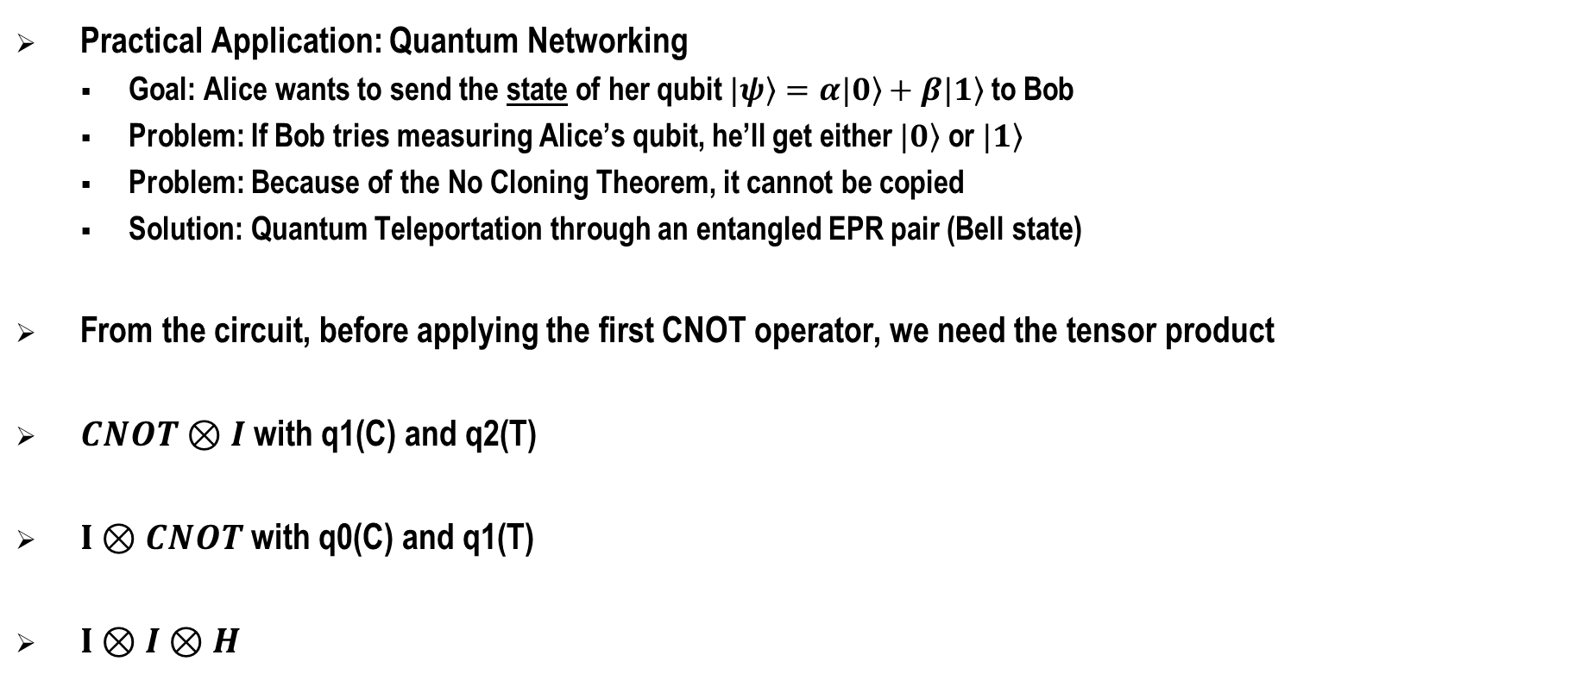
Application: Quantum Teleportation
Practical Application: Quantum Networking
  Goal: Alice wants to send the state of her qubit $\left.|ψ\right\rangle =α\left.|0\right\rangle +β|\left.1\right\rangle$ to Bob
  Problem: If Bob tries measuring Alice’s qubit, he’ll get either $\left.|0\right\rangle$ or $\left.|1\right\rangle$
  Problem: Because of the No Cloning Theorem, it cannot be copied
  Solution: Quantum Teleportation through an entangled EPR pair (Bell state)
From the circuit, before applying the first CNOT operator, we need the tensor product
$CNOT⊗I$ with q1(C) and q2(T)
$I⊗CNOT$ with q0(C) and q1(T)
$I⊗I⊗H$
While the term “teleportation” is used, matter is not being displaced. There’s no need to call Scotty.
37

Slide 38





Application: Quantum Teleportation
Recall the qubit order is $\left.|q_{2}q_{1}q_{0}\right\rangle$
If Alice measures$\left.|q_{2}00\right\rangle$, the state is $α\left.|0\right\rangle +β\left.|1\right\rangle =\left.|ψ\right\rangle$
If Alice measures $\left.|q_{2}01\right\rangle$, the state is $α\left.|0\right\rangle −β\left.|1\right\rangle$, Bob just needs to apply the Z gate
If Alice measures $\left.|q_{2}10\right\rangle$, the state is $β\left.|0\right\rangle +α\left.|1\right\rangle$, Bob needs to apply the X gate
If Alice measures $\left.|q_{2}11\right\rangle$, the state is $−β\left.|0\right\rangle +α\left.|1\right\rangle$, Bob needs to apply the X gate, then the Z gate
$$\left[\begin{matrix}\begin{matrix}\begin{matrix}α \\ α\end{matrix} \\ \begin{matrix}β \\ −β\end{matrix}\end{matrix} \\ \begin{matrix}\begin{matrix}β \\ −β\end{matrix} \\ \begin{matrix}α \\ α\end{matrix}\end{matrix}\end{matrix}\right]$$
$$\left[\begin{matrix}\begin{matrix}\begin{matrix}\left.000\right\rangle \\ \left.001\right\rangle \end{matrix} \\ \begin{matrix}\left.010\right\rangle \\ \left.011\right\rangle \end{matrix}\end{matrix} \\ \begin{matrix}\begin{matrix}\left.100\right\rangle \\ \left.101\right\rangle \end{matrix} \\ \begin{matrix}\left.110\right\rangle \\ \left.111\right\rangle \end{matrix}\end{matrix}\end{matrix}\right]$$
$\left.|ψ\right\rangle$ is the original state Alice wanted to send to Bob!
It has been quantum teleported through entanglement.
Alice | Bob
$$\left.|00\right\rangle$$ | $$\left.|ψ\right\rangle =\left.I|q_{2}\right\rangle$$
$$\left.|01\right\rangle$$ | $$\left.\left.|ψ\right\rangle =Z|q_{2}\right\rangle$$
$$\left.|10\right\rangle$$ | $$\left.\left.|ψ\right\rangle =X|q_{2}\right\rangle$$
$$\left.|11\right\rangle$$ | $$\left.\left.|ψ\right\rangle =ZX|q_{2}\right\rangle$$
Re: Spooky Action at a Distance, an entangled system may be separated by great distance e.g., part of the system may be in orbit and the other part may be ground-based.
Since there is no communication network, there is nothing to be hacked.
This is certainly an advantage over classical computing!
38

Slide 39
Quantum Optimization
Introduction
Quantum Unconstrained Binary Optimization
Adiabatic Quantum Computing/Quantum Annealing
Quantum Approximate Optimization Algorithm
Variational Quantum Eigensolver
Grover Adaptive Search
Single Qubit
Multiple Qubits
Quantum Optimization
Quantum Machine Learning
Closing

Slide 40
Quantum Unconstrained Binary Optimization
Quadratic Objective Function with Linear Equality/Inequality Constraints
  Begin with Quantum Unconstrained Binary Optimization (QUBO)
  Convert any Inequality Constraints to Equality Constraints via Slack Variables
  Append Equality Constraints to the Objective Function (typical Lagrangian approach)
  Change variables , to produce the Ising model
  Objective function → Hamiltonian (energy) and minimization determines the ground state energy
  Evaluation of the Objective Function (Hamiltonian) is the Expectation Value …
  …where is the state of the Ising model
Note: when applying constraints via slack variables, a suboptimal solution may give "impossible" results that don't satisfy the constraints
Hamiltonians are sums of tensor products of 𝑍 matrices
This is mostly just recasting an optimization problem into something that resonates with physicists
40

Slide 41
QUBO Application
Example…
  min
  subject to
  Substitute
  min
  subject to
  Ising Hamiltonian
  There are three variables, therefore three qubits are needed
  Expectation Values based on
Diagonal tensor product of Z gates
Orthogonality note:
⟨𝑥| 𝑍_{𝑗} |𝑥⟩ = 1 if the 𝑗^{th} bit of 𝑥 is 0 and that ⟨𝑥| 𝑍_{𝑗} |𝑥⟩ = −1 otherwise
⟨𝑥| 𝑍_{𝑗} 𝑍_{𝑘} |𝑥⟩ = 1 if the 𝑗^{th} and k^{th} bits of 𝑥 are equal and ⟨𝑥| 𝑍_{𝑗} 𝑍_{𝑘} |𝑥⟩ = −1 otherwise
41

Slide 42
Adiabatic QC and Quantum Annealing
Adiabatic quantum computing uses a quantum device called a quantum annealer
  Think of simulated annealing, where the temperature is varied
  A simple Hamiltonian adiabatically evolves to the desired complicated Hamiltonian
  But don’t add more energy than ΔE
Quantum Annealing
  Adiabatic evolution can take too long for the process to lead to a feasible/optimal solution
  System evolves from its initial state to the Ising model’s ground state
  Physical quantum devices based on quantum annealing are simpler to construct
  It’s possible to scale the size of these quantum annealers up to hundreds or even thousands of qubits
There is no known computational advantage to quantum annealing
Also, scaling will be limited by the connectivity between qubits
42

Slide 43

Quantum Approximate Optimization Algorithm
Quantum Approximate Optimization Algorithm (QAOA)
  For use with gate-based quantum circuit computers, as an alternative to quantum annealers
  …such that
  Let
  If is a computational basis state in which j and k have the same value, then
  If j and k have different values, then
43

Slide 44

Quantum Approximate Optimization Algorithm
Quantum Approximate Optimization Algorithm (QAOA)
  Example: Let
  The quantum circuit implementation (for p=1) is
  As seen with QUBO, ⟨𝑥|𝑍_{𝑗}|𝑥⟩ = 1 if the 𝑗th bit of 𝑥 is 0 and that ⟨𝑥|𝑍_{𝑗}|𝑥⟩ = −1 otherwise
  ⟨𝑥|𝑍_{𝑗}𝑍_{𝑘}|𝑥⟩ = 1 if the 𝑗th and kth bits of 𝑥 are equal and ⟨𝑥|𝑍_{𝑗}𝑍_{𝑘}|𝑥⟩ = −1 otherwise
There is no known computational advantage to QAOA
44

Slide 45
Variational Quantum Eigensolver
Measurements in quantum mechanics are represented by Hermitian operators (observables), e.g., Z matrix
The expectation value of any Hermitian operator (observable) A is given by
An observable can be expressed as a linear combination of tensor products of Pauli matrices, I, X, Y, Z
  Example
    The eigenvectors of Z are with eigenvalue 1 and with eigenvalue −1
    The eigenvectors of X are with eigenvalue 1 and with eigenvalue −1
    The eigenvectors of Y are with eigenvalue 1 and with eigenvalue −1
    Any (non-null) state is an eigenvector of I with eigenvalue 1
ZIX | Eigenvalue
|0>|0>|+> | 1
|0>|0>|-> | -1
|0>|1>|+> | -1
|0>|1>|-> | 1
|1>|0>|+> | -1
|1>|0>|-> | 1
|1>|1>|+> | 1
|1>|1>|-> | -1
IYY | Eigenvalue
|0>|i>|i> | 1
|0>|i>|-i> | -1
|0>|-i>|i> | -1
|0>|-i>|-i> | 1
|1>|i>|i> | -1
|1>|i>|-i> | 1
|1>|-i>|i> | 1
|1>|-i>|-i> | -1
ZXZ | Eigenvalue
|0>|+>|0> | 1
|0>|+>|1> | -1
|0>|->|0> | -1
|0>|->|1> | 1
|1>|+>|0> | -1
|1>|+>|1> | 1
|1>|->|0> | 1
|1>|->|1> | -1
45

Slide 46
Variational Quantum Eigensolver
  Example (continued)
    Recall and such that and
    Also, and such that and
    Therefore…
    H takes the eigenvectors of X to the standard/computational basis
    SH takes the eigenvectors of Y to the standard/computational basis
    I takes the eigenvectors of Z to the standard/computational basis
    Bottom line: For any Hermitian operator A, there is always a unitary transformation that takes any basis of eigenvectors of A to the computational basis, and vice versa
Note: Everything we have done, so far, is to find the ground state (minimum) of the Hamiltonian
However, the Hamiltonian may be augmented to find excited states with Physical Chemistry applications
There is no known computational advantage to VQE
46

Slide 47


Grover’s Algorithm
Grover’s algorithm is $O\left(\sqrt{n}\right)$
Caveats:
  It provides only a quadratic speedup
  You need to know the number of solutions (or be patient in guessing)
  It can be adapted to optimization via a binary search of cost function values
  Classical algorithms, such as Schoening's algorithm, offer a better speedup for satisfiability problems
  A quantum version may offer further enhancement
Hacking a 13-character (alpha only) password
${26}^{13}=2.5×{10}^{18}$ combinations
At one guess/nanosecond, that’s $2.5×{10}^{9}$ sec (~80 years)
Grover solves it in $\sqrt{n}=\sqrt{2.5×{10}^{9}}=$ 50,000 sec
If QC advances like today’s Intel chips, i.e., at 50,000X…
…then the password will be hacked in 1 sec
47

Slide 48
Quantum Machine Learning
Introduction
Single Qubit
Quantum Machine Learning
Application: Quantum Neural Networks
Multiple Qubits
Quantum Optimization
Quantum Machine Learning
Closing
Many machine learning problems can be reduced to the minimization of a loss function through some optimization algorithm on a suitable model

Slide 49

Quantum Machine Learning (QML)
Quantum Machine Learning
  Use a quantum computer in some part a model that you wish to train
  Use data generated by some quantum process
  Use a quantum computer to process quantum-generated data
Four families of QML
  CQ – classical data training a quantum algorithm
  QQ – quantum technologies still immature
Quantum algorithms
  Quantum model and quantum optimization (hardware not currently ready)
  Quantum model and classical optimization (available on NISQ devices)
Models
  Quantum Support Vector Machines (SVM): quantum computers mapping data to quantum states
  Quantum Neural Networks: a full quantum model running on a quantum computer
 | Classical Algorithm | Quantum Algorithm
Classical Data | CC | CQ
Quantum Data | QC | QQ

Slide 50
Quantum Neural Networks
CQ – Classical data training a quantum algorithm
  Classical computing for the preparation of circuits and the statistical analysis of measurements
  Quantum neural networks are “purely quantum” models
Data input: Input nodes
  Classical inputs mapped to quantum states through a feature map
Data processing: Network
  Architecture is a variational circuit dependent on optimizable parameters
Data output: Output nodes
  Output is the result of a measurement operation on the final state
50

Slide 51



Quantum Neural Networks
Variational forms
Two-local Variational Form
Strongly Entangling Layers
Tree Tensor Variational Form
These variational circuits have the same “black box” explainability challenges as classical neural nets
51

Slide 52
Quantum Neural Networks
Measurements (classification problems)
  The M operator associates the eigenvalues 1 and 0 to the qubit’s value being 0 and 1
  The Z operator associates the eigenvalues 1 and −1 to the qubit’s value being 0 and 1
Training/Optimization (Adam algorithm)
  Numerical approximation
  Automatic differentiation
  Parameter shift rule
Tips
  Feature map → variational form → measurement operation
  Variational form: too many optimizable parameters → overfitting, too few → underfitting
  Small learning rate → accurate/slower, higher batch size → effective optimization/slower
  Normalize the data and consider dimensionality reduction techniques
QML provides a larger state space with the potential benefit of requiring less data
52

Slide 53
Closing
Introduction
Recap
Learning Objectives
More Information
References
Single Qubit
Multiple Qubits
Quantum Optimization
Quantum Machine Learning
Closing

Slide 54
Learning Objectives
Identify the three aspects of quantum information science
Describe the difference between a quantum bit (qubit) and a classical (0/1) bit
Explain how superposition facilitates quantum cryptography and makes quantum computing relevant today
Explain how entanglement facilitates quantum teleportation and makes quantum computing relevant today
Tell the truths about quantum computing myths
Identify different computational models for quantum optimization and their applications
Describe the four families of quantum machine learning and variations of quantum neural networks
54

Slide 55
For More Information on…
…the algorithms
  Linear algebra (almost any college text will suffice)
…the science underlying quantum computing
  Quantum mechanics (Griffiths’ Intro to QM, Weinberg’s Lectures on QM)
…the engineering challenges
  Noise and decoherence, error detection, and error correction (Mike & Ike)
…practicing quantum computing code
  Qiskit, Penny Lane, and D-Wave documentation pages
  OpenQASM, Q#, Cirq, Bracket
  Qirk (web-based simulator)
  Virtual Quantum Optics Lab (quantum objects experiments) vqol.org
55

Slide 56
Quantum Computing References
Textbooks
  Quantum Computation and Quantum Information (Michael Nielsen & Isaac Chuang aka “Mike & Ike”)
  Quantum Computing: An Applied Approach (Hidary), complementary to Mike & Ike
  Quantum Computer Science (Mermin)
  Quantum Computing Algorithms (Burd)
  A Practical Guide to Quantum Machine Learning and Quantum Optimization (Combarro & Gonzalez-Castillo)
  Programming Quantum Computers (Johnston, Harrigan, Gimeno-Segovina)
  E-book https://www.thomaswong.net (Thomas Wong)
Udemy
  Quantum Computing Made Simple
  QC101 Quantum Computing and Intro to Quantum Machine Learning
  QC201 Advanced Math for Quantum Computing
56

Slide 57
Acknowledgements
Roy Scrudder
Program Manager
Modeling and Simulation Engineering
Applied Research Laboratories
The University of Texas at Austin
Brian La Cour, Ph.D.
Senior Research Scientist
Center for Quantum Research
Applied Research Laboratories
The University of Texas at Austin
57

Slide 58
Q&A
Where are the quantum computers? Can I order one from Dell or pick one up at Best Buy?
  Research institutions, NSA, etc.
What do the experts think? Progress, roadblocks, etc.
  10, 20, 50 years? Nobody knows at this time. An over-night breakthrough may occur.
What are the implications for managers?
  Workforce development
  Quantum education
  Quantum programming jobs
My question to you…
  This material has been essentially at the “101” level
  Would you like another tutorial at the “201” level?
  Would you like an I/ITSEC Workshop with hands-on quantum computing?
Your questions…?

