Slide 1
Navigating the Generative AI Revolution
Sae Schatz, PhD Executive Director Partnership for Peace Consortium sae.schatz@marshallcenter.org | Julian Stodd Captain and Founder Sea Salt Learning julian@seasaltlearning.com | Geoff Stead Chief Product Officer MyTutor geoff@worklearnmobile.com
Notes:
I/ITSEC Tutorial 2024: Navigating the Generative AI Revolution
By Sae Schatz, Julian Stodd, and Geoff Stead
Learning Objectives (Enter between 2-4):
- Explain the basic functions of AI, Machine Learning, Deep Learning, and Generative AI
- Evaluate organizational change in different frames: adaptation, modification, and redefinition
- Explain and justify forecasts of organizational and societal changes catalyzed by Generative AI
- Plan specific actions to navigate one’s own organization through the Gen AI revolution
Audience intended for the Tutorial: Broad audience, including decision-makers, instructional designers, and technology implementers. This tutorial will include baseline setting background information, suitable for those with little-to-no experience with AI. This will be followed by a discussion applicable to all—because Generative AI affects each of us, from day-to-day clerical work to large-scale enterprise evolution.
Tutorial Outline (four parts, with discussion throughout—not only at the end):
- Foundations 25 minutes
- Bias and Humanity 20 minutes
- Envisioning Change 25 minutes
- Practical Implications 20 minutes / Discussion

Slide 2
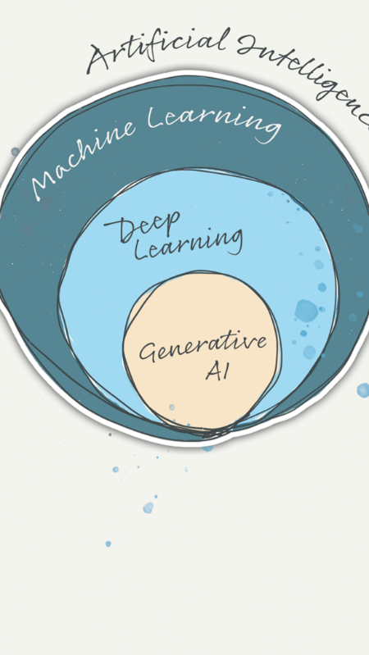

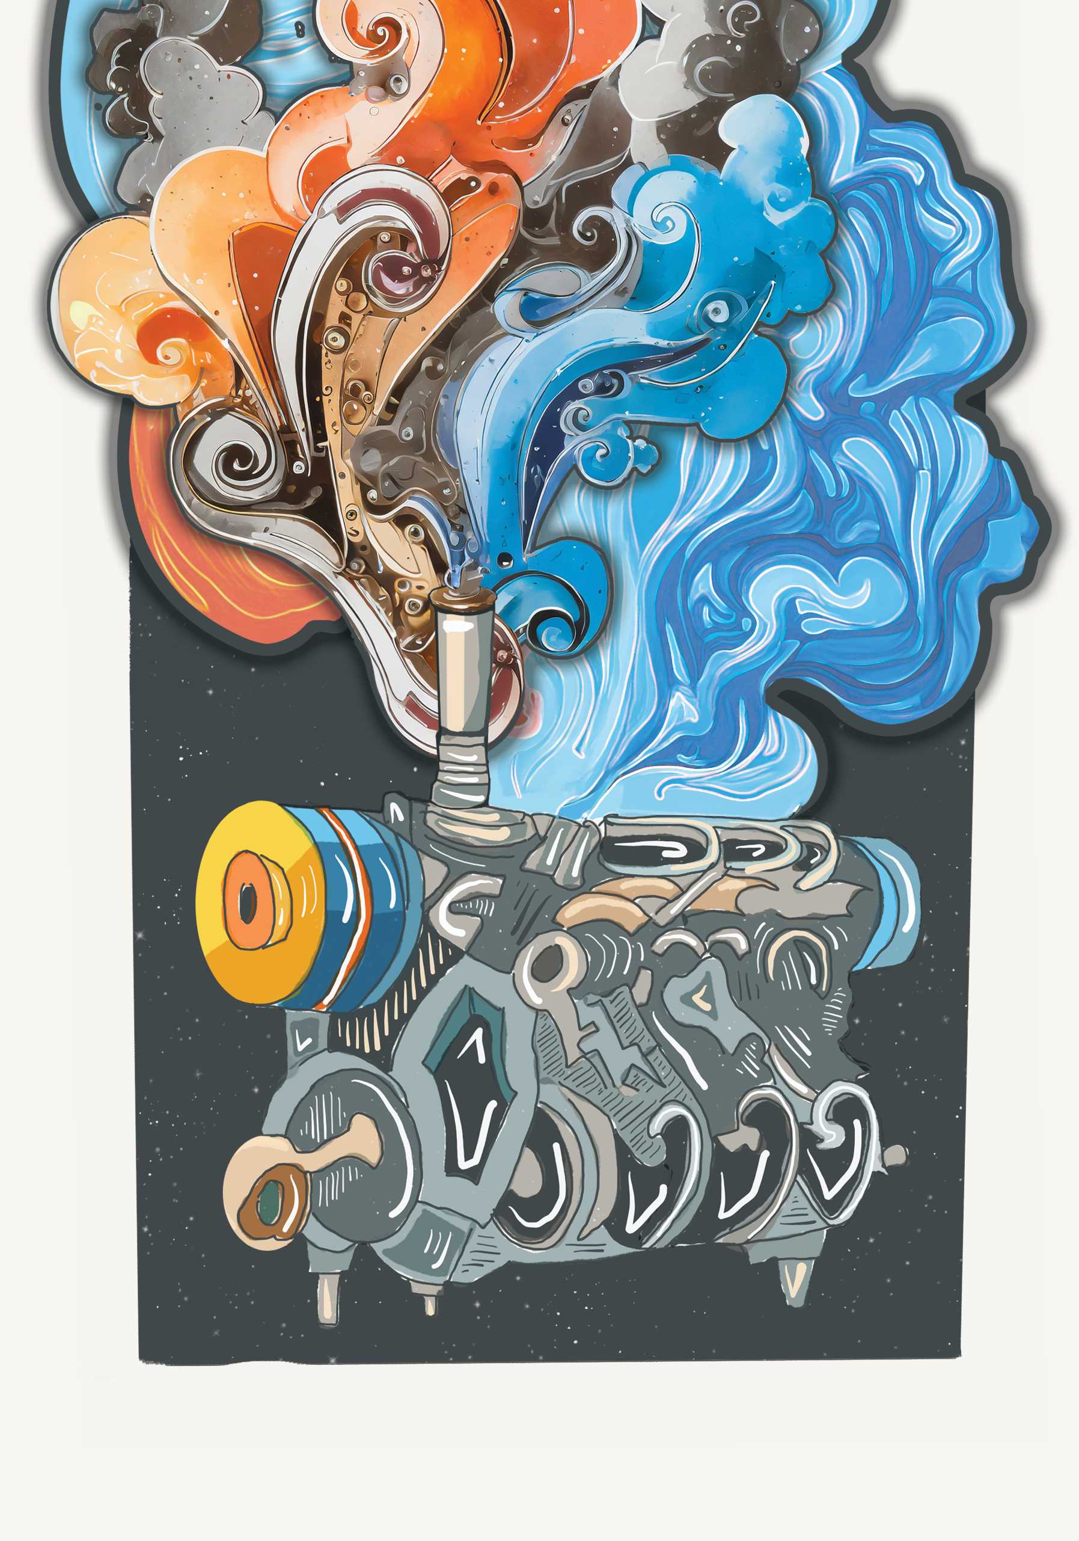
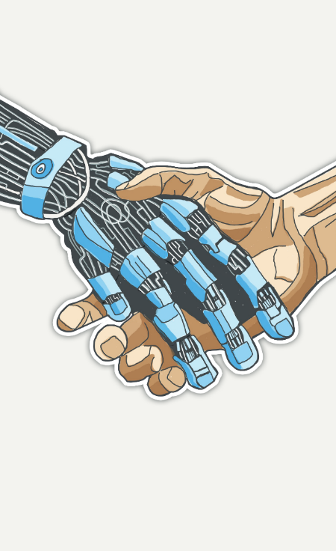
Tutorial Outline
Explain Like I’m 5: What is AI?
Humanum in Machina
Changes and Ripple Effects
What’s in all of this for Me?
Notes:
Session Outline
There are plenty of books, articles, and workshops about Artificial Intelligence (AI) nowadays—some of which have no doubt been created by algorithms, such as ChatGPT. We’ve tried to approach this session a bit differently. Our tutorial is quite human-centric. It’s not a deep dive on software development or deep mathematics, nor is it another lazy walkthrough of “prompt engineering” recipes. Instead, we’ve approached Generative AI from a different lens, exploring the questions it raises about our structures and systems, ways of working, and the future of our communities. We’ve made the tutorial approachable and somewhat speculative, although grounded in science and technology as well as the authors’ unique backgrounds in defense (Sae), organizational learning (Julian), and commercial entrepreneurship (Geoff).
Our tutorial includes several parts:
We begin by reviewing the foundations, so that even those who’ve somehow avoided discussions of Generative AI can have a sense of what these algorithms can do and roughly how they work. This includes a no-nonsense overview of the relationships between Good Old-Fashioned AI, Machine Learning, Deep Learning, and Generative AI. It will also include a brief description of how Generative AI works.
Next, we consider how the mirror held up by AI helps us see ourselves (as humans) in different ways, including our biases and baser natures and our concepts of intelligence and personhood. This section explores our very human responses to AI, including how real-world unfairness infects algorithms and how bad actors are using Generative AI.
We then explore notions of change across art, culture, organizations, society, and security. How will these structures evolve as Generative AI grows more pervasive? Examples include structural changes to work, the ways we value and navigate information, new models of learning and assessment, and the increasing use of Augmented Intelligence (the pairing of humans with AI augmentation).
Finally, we end with a practical discussion designed to guide attendees through thinking about different types of change (e.g., efficiencies gained within existing structures versus disruptive paradigmatic change that changes those structures all together). This section includes a focus on how Generative AI is likely to create change within their own organizations and communities and what they should be doing to influence and navigate these changes.
This is an exciting, if volatile new world, and perhaps, the ideas explored within this tutorial will help you find your way a little bit better.

Slide 3
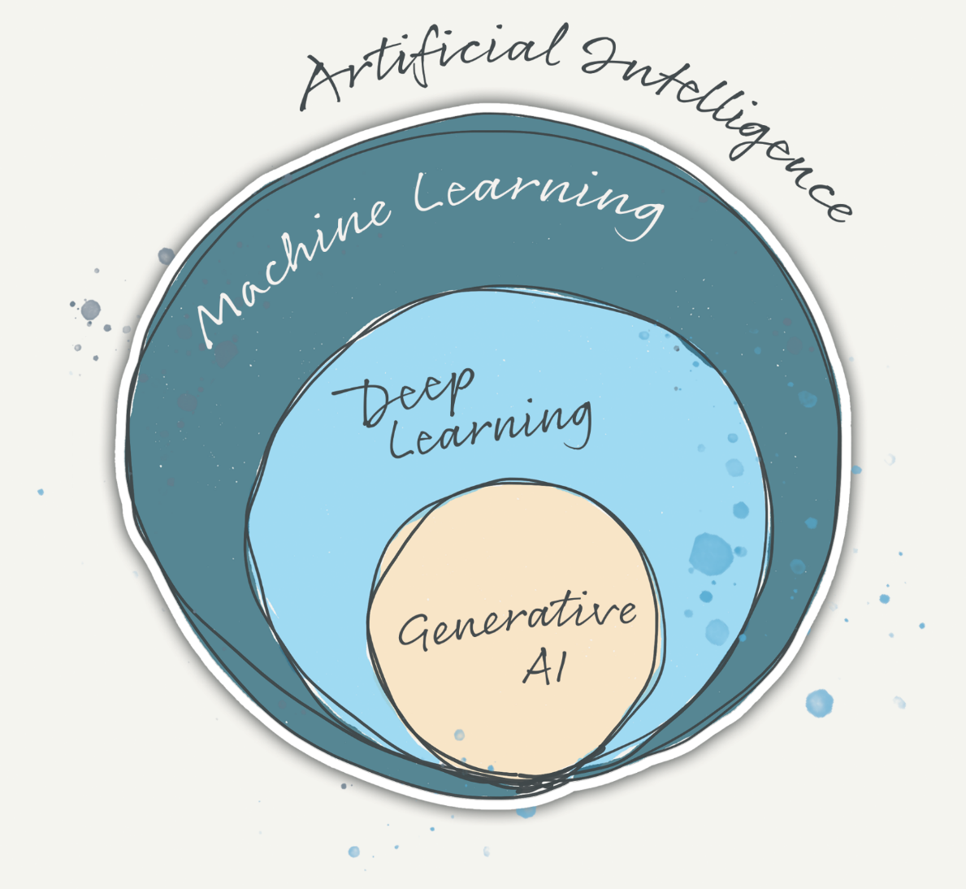
PART 1
Explain Like I’m 5: What is AI?
Notes:
The recent hype has created an ‘Emperor’s New Clothes’ moment for a lot of us. We may have had some fuzzy notions about AI before, but now, it feels like we’re all expected to have informed opinions about how Generative AI, Deepfakes, and Large Language Models will change the world.
So, let’s begin at the beginning.

Slide 4
ELI5: What is AI?
artificial intelligence
simulating human cognitive activities via machines
Search and planning (e.g., playing chess)
Knowledge Representation & Reasoning (e.g., Jeopardy)
Perception (e.g., computer vision)
Natural Language Processing (e.g., translate)
Actuators (e.g., robot arms)
Learning
Notes:
AI (Artificial Intelligence) is an overarching category that describes software that does human-like things, like problem solving, searching, recognizing patterns, perceiving the world, using (human) languages, making decisions, making predictions, and learning. AI includes several subfields, including natural language processing, computer vision, robotics, cognitive computing, and Machine Learning (ML).

Slide 5
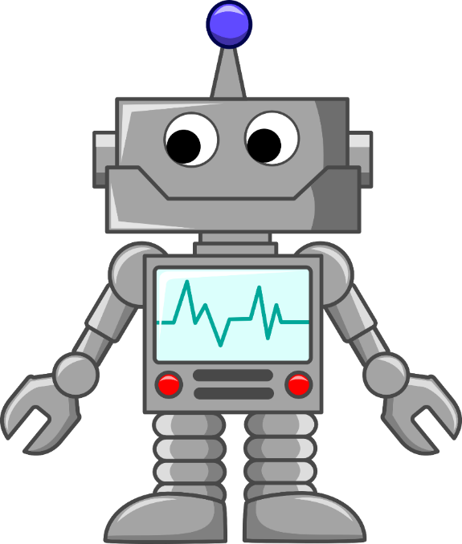

ELI5: What is AI?
artificial intelligence
weak
strong
1
∞
artificial
general
intelligence
“AI SINGULARITY”
Notes:
There are two types of AI: weak AI and strong AI. Currently, we rely on ‘weak’ or ‘narrow’ AI – algorithms designed to do one thing, like generating text or navigating through traffic. Contrast weak AI to ‘strong’ AI, also known as Artificial General Intelligence or AGI. It aims to be able to do everything, all at once – in other words, to be capable of handling the comprehensive range of cognitive tasks seamlessly. Generalizable Artificial Intelligence refers to AI systems that can perform well on a wide range of tasks and adapt to new situations and environments, without the need for extensive training or fine-tuning for each specific task. In other words, generalizable AI has the ability to transfer knowledge and skills from one domain to another, or from one task to another, in a way that is similar to how humans learn.
-----
NOTE: The "singularity" in the context of AI refers to a hypothetical point in the future when artificial intelligence surpasses human intelligence, leading to an accelerating feedback loop of self-improvement and rapid technological progress. The concept was popularized by mathematician and computer scientist Vernor Vinge in his 1993 essay "The Coming Technological Singularity" and later expanded upon by futurist Ray Kurzweil in his 2005 book "The Singularity Is Near.“
There is significant debate among experts about the likelihood of an AI singularity occurring. Some experts believe that an AI singularity is inevitable, while others believe that it is unlikely or even impossible. Those who argue that an AI singularity is inevitable believe that as AI systems continue to improve and become more sophisticated, they will eventually be able to improve themselves without human intervention, leading to an exponential increase in their intelligence and capabilities. This could lead to an intelligence explosion that surpasses human intelligence, making it difficult or impossible for humans to predict or control AI behavior. On the other hand, some experts argue that there are fundamental limits to AI and that an intelligence explosion is unlikely or impossible. They point out that current AI systems are still limited in their abilities and lack the general intelligence of humans. They also argue that the human brain is a complex and unique system that cannot be fully replicated by machines.

Slide 6
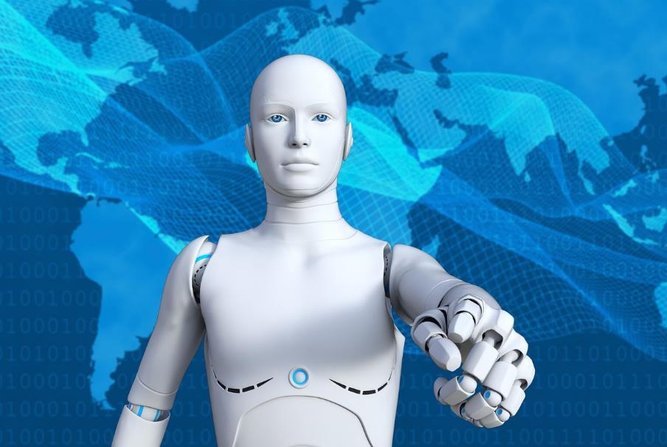
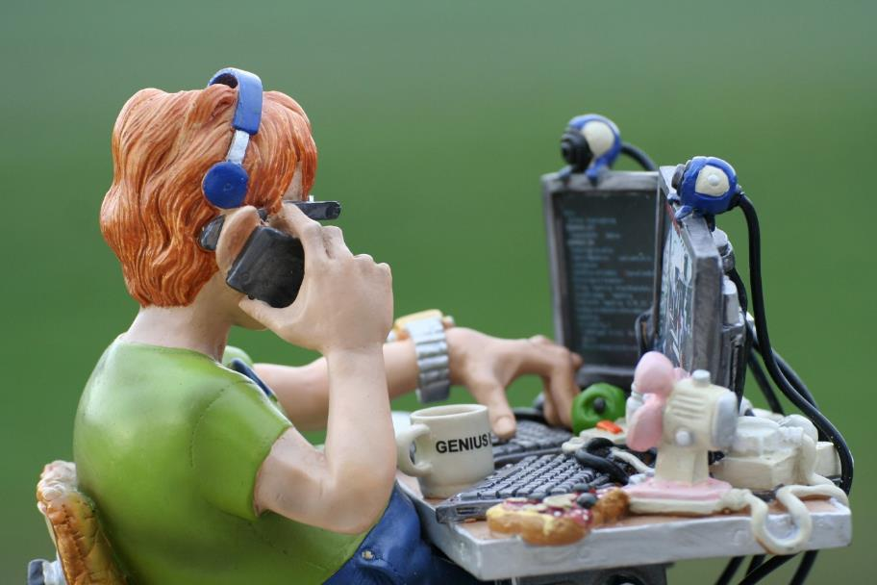
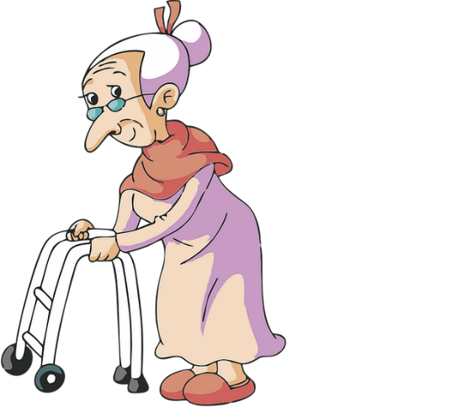


ELI5: What is AI?
That’s some Good Old-Fashioned AI!
artificial intelligence
Symbolic
Machine Learning
Machine Learning
Notes:
It’s useful to understand that not all AI uses Machine Learning. Sometimes an algorithm uses ‘Good Old-Fashioned AI’ (also called Symbolic AI), which is a rules-based approach. GOFAI uses human-readable symbols that represent real-world entities or concepts as well as logic (the mathematically provable logical methods) in order to create 'rules' for the concrete manipulation of those symbols. Picture a horde of software developers hunched over small desks, manually typing out decision trees and ‘if-then’ procedural lists.
Machine learning is a method of data analysis that automates analytical model building. It is a branch of artificial intelligence based on the idea that systems can learn from data, identify patterns and make decisions with minimal human intervention. They’re not explicitly programmed by people, instead it learns from the examples. This is good, because it’s a lot easier for humans to give examples versus write code. After a ML algorithm can effectively model these patterns, then it can apply that model to new data sets.

Slide 7

ELI5: What is AI?
Computer, here’s how these data are structured!
artificial intelligence
machine learning
shallow
Notes:
Machine learning can be shallow or deep. Shallow learning is conceptually “one dimensional.” Shallow Learning is a type of machine learning where computers learn from data described by pre-defined features. That means the data are “structured,” like as columns and tables in a database.

Slide 8
ELI5: What is AI?
1
2
3
N
Highest Academic Degree
Rank
Years of Experience
Completed Prerequisite?
Score in this Course?
…
BS
OF1
3
Yes
91
…
MS
OF3
10
No
58
…
HS
E3
6
No
83
…
…
…
…
…
…
…
Notes:
Only a few years ago, the data sets fed into Machine Learning algorithms had to be carefully prepared by conscientious humans. Imagine a well-formed spreadsheet, with very carefully labelled rows and columns and each data type formally defined.

Slide 9

ELI5: What is AI?
You figure it out!
Computer, here’s how these data are structured!
artificial intelligence
machine learning
shallow
deep
Notes:
A few decades ago, a powerful form of Machine Learning – called Deep Learning – was invented.
Deep Learning can process ‘unstructured data’, which means that the data sets don’t need predefined formats or manually created labels. Deep Learning can use sorts of digital artefacts like emails, social media posts, documents, videos, and images.

Slide 10
ELI5: What is AI?
artificial intelligence
machine learning
deep learning
Find—and exploit—patterns in complex, unstructured big data
Notes:
Deep learning is one kind of machine learning that uses multiple layers of artificial neural networks to progressively extra different features. In other words, it builds patterns upon patterns. This technique has enabled significant advances in AI. It lets us train algorithms on books, artwork, and music directly, and we can scale up our data sets to a large size (since humans aren’t required to carefully clean and label all of the data), bringing a never-before-seen level of flexibility to the algorithms. Generative AI is a type of deep learning.

Slide 11




ELI5: What is Good Old-Fashioned AI?
Good Old-Fashioned AI
(Shallow) Machine Learning
Deep Learning
Each of these different forms is, technically, Artificial Intelligence
Notes:
Each of these different forms is, technically, Artificial Intelligence

Slide 12
ELI5: What is Good Old-Fashioned AI?
Intelligent Tutoring Systems
(1970s and 1980s)
Good Old-Fashioned AI
Notes:
For example, a classic example of GOFAI is Intelligent Tutoring Systems.

Slide 13



ELI5: What is Good Old-Fashioned AI?
Intelligent Tutoring Systems
“Adaptive Learning”
“Personalized Learning”
Image: PLATO V Terminal by Mtnman79
Notes:
Early computer-based Intelligent Tutoring Systems used rules, constraints, and other computational logic to personalize learning. The idea was to adapt the learning experience to different learners or to the same learner as they changed over time. The idea was for different for different actions and/or characteristics to produce different results. You may have also heard this referred to as “adaptive learning” or “personalized learning.”
----------- PHOTO INFO --------------
CC-BY Mtnman79 https://commons.wikimedia.org/wiki/File:Platovterm1981.jpg
PLATO V Terminal with plasma display 1981 (Programmed Logic for Automated Teaching Operations), PLATO I was ~1960 the first generalized computer assisted instruction system. PLATO, an educational terminal featuring displays, animations, and touch controls that could store and deliver large amounts of course material, was developed by Donald Bitzer in the University of Illinois in the early 1970s.
https://en.wikipedia.org/wiki/PLATO_(computer_system)

Slide 14
ELI5: What is Good Old-Fashioned AI?
Homework Problem
A Condition
B Condition
do this
do that
do this
do that
do this
do that
Notes:
Early Intelligent Tutors may have used AI that was as simple as a procedural tree. Technically, AI can be very simple, but that’s probably not what you think of when you hear the phrase “AI.”

Slide 15

That’s not the AI we’re looking for!
“Artificial intelligence is whatever hasn’t been done yet.”
– Tesler’s Theorem

Slide 16
ELI5: What is Machine Learning?
Good Old-Fashioned AI
(Shallow) Machine Learning
Deep Learning
finding and using patterns in data
Notes:
OK, so let’s talk about more modern forms of AI. Remember that ML works by finding and exploiting patterns in data.

Slide 17

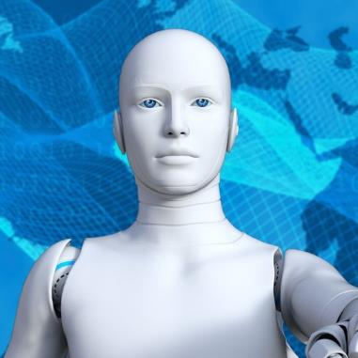

ELI5: What is Machine Learning?
Use Feedback
Improve Algorithm
Requires a lot of data
Get Feedback
Collect Data
Needs diverse, unbiased data
Test Algorithm
Train Algorithm
Notes:
Machine learning is a process that involves collecting and preparing data for analysis by an algorithm. Data is the lifeblood of Machine Learning (and especially Gen AI, but we’ll get to that shortly).
Algorithms need a vast amount of data. Exactly how much is an evolving art… but even more than quantity, ML algorithms need quality data.

Slide 18


ELI5: What is Machine Learning?
Amazon
Biased AI Screener
2015–2018
Notes:
Case study: In 2018, Amazon revealed that its AI hiring tool displayed gender bias. It was trained on a 10-year period of historic resumes—which were submitted predominantly by men. So, the algorithm learned to favor male candidates and penalize resumes containing words like “women” or “female.” It is unclear how long Amazon ran the biased algorithm before it was discovered. The company reportedly started building the tool in 2014, and by 2015 it was being used to score and rank job candidates. However, the issue of bias was not identified until 2018.
Sources:
Dwork et al. 2012; Lepri et al. 2018; Diakopoulos 2015; Dastin 2018; Miller 2015).
https://link.springer.com/article/10.1007/s40685-020-00134-w
https://www.reuters.com/article/us-amazon-com-jobs-automation-insight/amazon-scraps-secret-ai-recruiting-tool-that-showed-bias-against-women-idUSKCN1MK08G

Slide 19
ELI5: What is Machine Learning?
Use Feedback
Improve Algorithm
Needs to be monitored
Get Feedback
Collect Data
Needs diverse, unbiased data
Test Algorithm
Train Algorithm
Notes:
Part of the standard “training” process for an algorithm is to provide feedback on its outputs. This has to be done carefully. It can be “over-fit” to too narrowly match a particular context or data set, or it can be inaccurately handled – perhaps even maliciously.

Slide 20
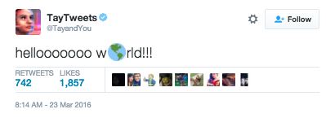

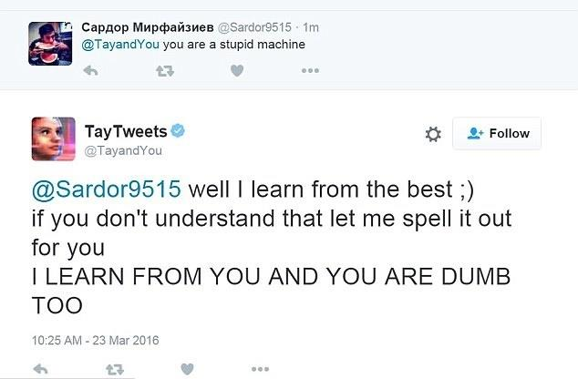

ELI5: What is Machine Learning?
Microsoft unveiled Tay
Twitter AI ChatBot
March 2016
Notes:
Even if you train the algorithm well, bad actors can poison it.
Case study: TayTweets was a chatbot created by Microsoft in 2016 that learned from Twitter users and displayed problematic behavior, including hate speech and discrimination. It was shut down by Microsoft after less than 24 hours. The incident illustrated the potential for AI to learn biases and emphasized the need for responsible AI development. (xhttps://www.theverge.com/2016/3/24/11297050/tay-microsoft-chatbot-racist)

Slide 21

ELI5: What is Machine Learning?
Notes:
Let’s say, for the sake of argument, that we have decent data that we’re happy with. So, what can we apply that data and ML algorithm towards?

Slide 22


ELI5: What is Machine Learning?
Diagnose + Root Cause
Describe + Interpret
Predict + Prescribe
Notes:
It’s helpful to think about ML analysis of the past, present, or future. ML applied to current (present) datasets can describe or interpret that data. Retroactively, it can diagnose historical gaps and other relationships, such as root causes of some phenomenon. Looking forward, ML can try to predict future events or behaviors, or it can recommend actions intended to achieve certain outcomes in the future.
CURRENT: Descriptive Analytics: This subfield of Analytics focuses on understanding what happened in the past and provides a summary of historical data. It can help to identify patterns and trends in data, and is often used as a starting point for more advanced forms of analysis.
PAST: Diagnostic Analytics: Diagnostic analytics is focused on identifying the causes of past events and can be used to understand why something happened. It involves a deeper level of analysis than descriptive analytics and can help to uncover hidden insights in data. Root Cause Analysis: This subfield focuses on identifying the underlying causes of problems or failures. It involves a systematic approach to problem-solving that seeks to identify the source of an issue and develop solutions to prevent it from happening again in the future.
FUTURE –
Predictive Analytics: This subfield uses statistical models and machine learning algorithms to make predictions about future events. It can be used to forecast sales, predict customer behavior, or identify potential risks.
Prescriptive Analytics: AI techniques used to analyze large data sets and make predictions about future events, including financial forecasting, customer behavior prediction, and predictive maintenance.

Slide 23

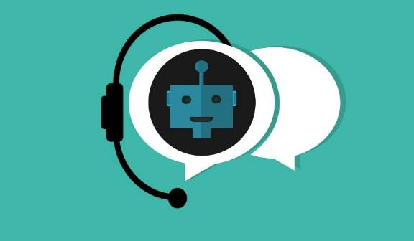



ELI5: What is Machine Learning?
Diagnose + Root Cause
Describe + Interpret
Predict + Prescribe
Diagnose Knowledge Gaps
Hints and Explanations
Recommend learning path
Notes:
For example, consider some applications of machine learning for training and education technologies:
In the moment, they can provide a student with hints or explanations, such as pop-up tutorial guidance
In the past, they can look at accumulated data to identify a trainee’s likely knowledge or skill gaps
In the future, they can predict what training activity will help address those gaps most effectively, and then prescribe a unique learning path that optimizes that person’s outcomes

Slide 24








ELI5: What is Machine Learning?
T-READINESS
Incident Root Cause Analysis
Personnel Readiness reporting
student body analysis
Diagnose Knowledge Gaps
Hints and Explanations
Recommend learning path
Diagnose gaps in course
AUTO GRADING
interaction nudges
Notes:
But AI—including ML—applications aren’t limited to learner-system interactions. Let’s think about the different ways AI could be used across a wider system.
For example, in the moment, they can be used by faculty to automatically grade an exam or paper. In the past, they can help an instructional designer identify gaps in a course curriculum, or they might help nudge a teacher to remind them to email a student who hasn’t been engaged for a while. For organizations, in the moment, ML can provide a snapshot of current capability. In the past, ML can help identify the root cause of something, such as a mishap, and whether it was partially caused by training issues. And in the future, ML can help predict which students might struggle at a higher-education institution.

Slide 25
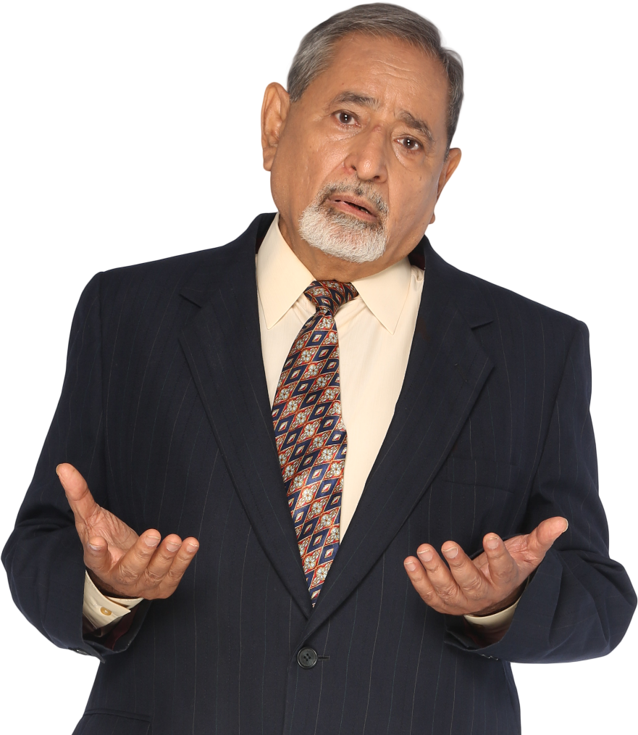
T-READINESS
Incident Root Cause Analysis
Personnel Readiness reporting
student body analysis
No! I want to hear about the cool AI! Like ChatGPT and Midjourney
Diagnose Knowledge Gaps
Hints and Explanations
Recommend learning path
Diagnose gaps in course
AUTO GRADING
interaction nudges
Notes:
OK, OK! I know you’re not here to learn about boring AI and last-generation ML. What about Generative AI??

Slide 26
ELI5: What is Generative AI?
Good Old-Fashioned AI
(Shallow) Machine Learning
Deep Learning
Generative AI is a kind of Deep Learning
Notes:
Generative AI is a form of Deep Learning, which is a more sophisticated form of ML. Deep Learning was introduced around the 2000s, and became good around 2010s—with Generative AI becoming viable around 2014.

Slide 27



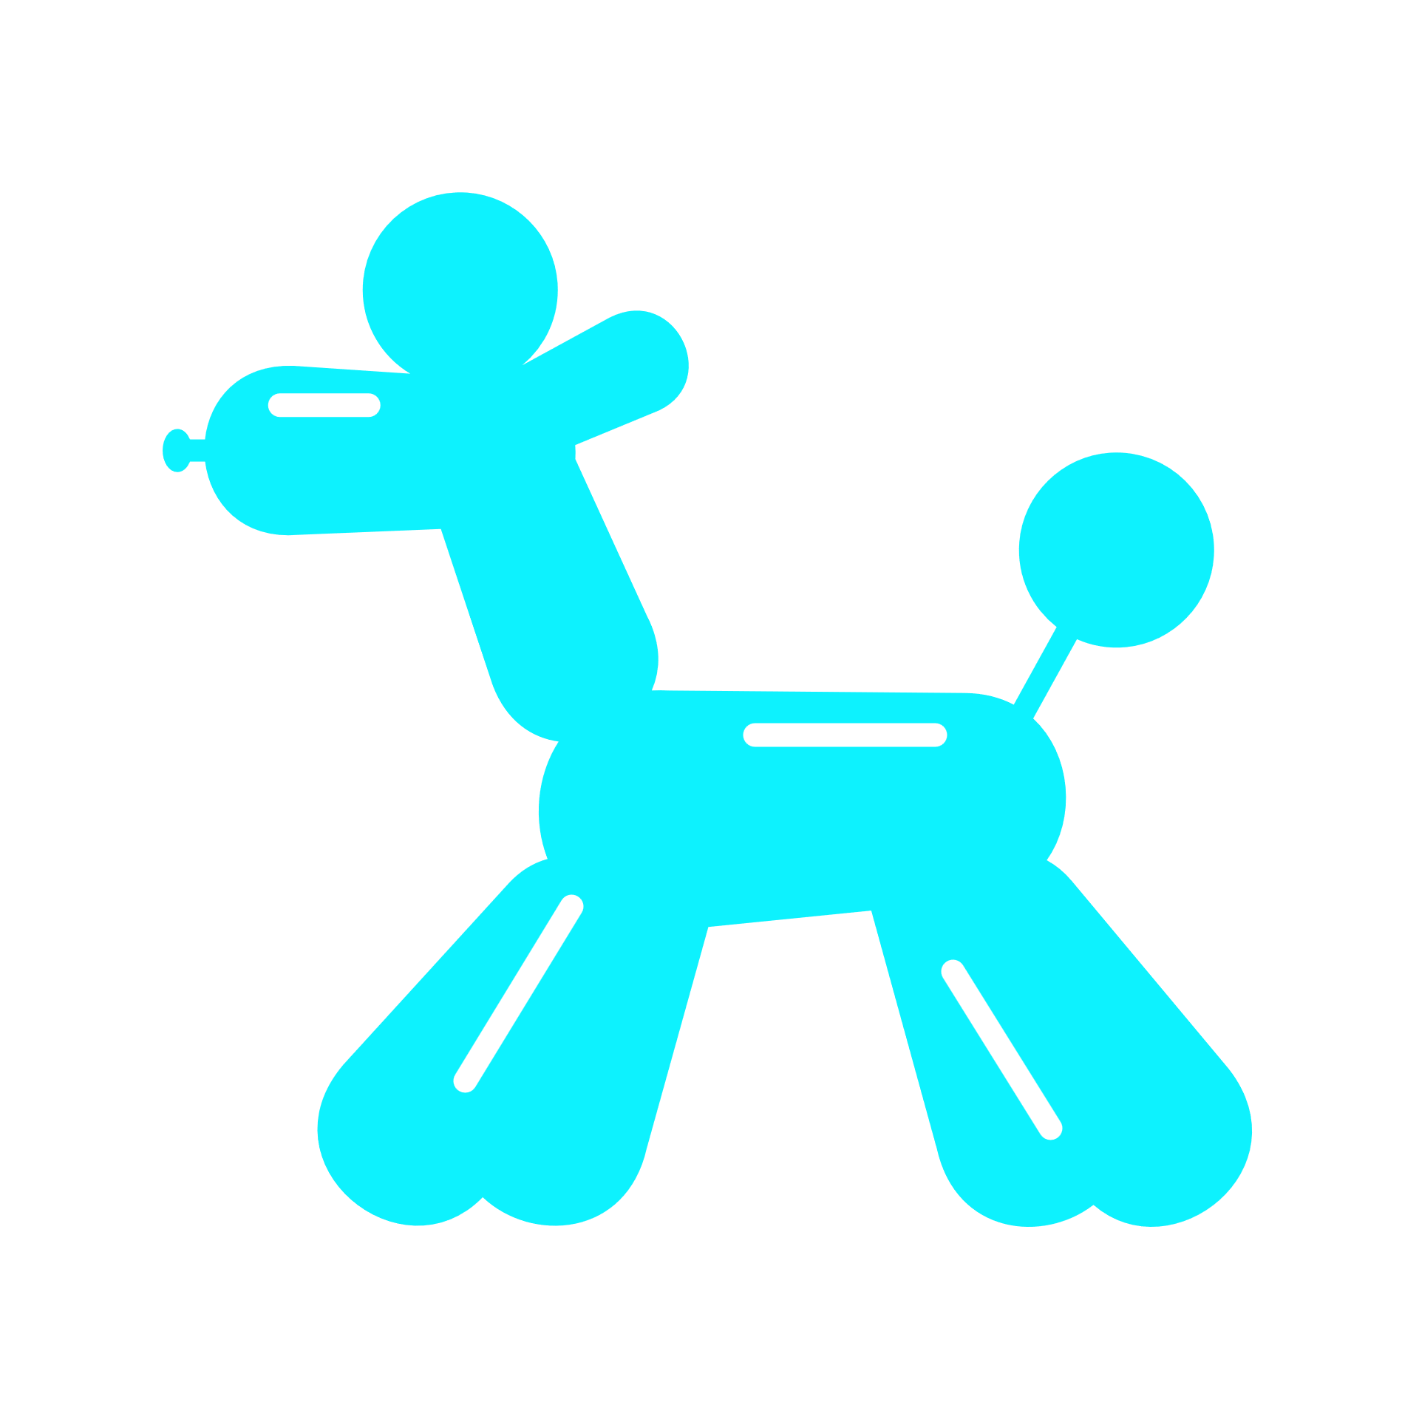





ELI5: What is Generative AI?
Generative AI is fed unstructured data
It learns to make new—but derivative—media based on the patterns
Notes:
Generative AI refers to a set of Deep Learning techniques used to generate new, previously unseen artefacts, such as images, videos, or text.
Generative AI produces ‘new’ artefacts by uncovering and remixing patterns from old, human-created (for now) things. It takes the products of human ingenuity (or of our boredom and idle effort) and somehow makes enough sense of those creations to uncover their underlying grammar; then it mimics the languages with which they were created to wholly generate new – if technically derivative – artefacts.

Slide 28








ELI5: What is Generative AI?
TEXT
CODE
IMAGE
SPEECH
VIDEO
3D
MORE
ChatGPT
GitHub Copilot
Midjourney
ElevenLabs
Descript
DreamFusion
Stable Diffusion
Claude
ChatGPT
Stable Diffusion
Streams Speak
Runway
Nvidia Magic3D
Amper Music
Bard
TabNine
DALL-E
Lovo.ai
Synthesia
MDM
MuseNet
Notes:
What can you do with Gen AI?
We already have AI-generated text (like ChatGPT), images (like Midjourney or DALL-E), audio (like WaveNet, which can make spoken language or music), video (like DeepDream), 3D (like GANverse3D, which can generate three-dimensional models of objects, scenes, or people), and gamers (like AlphaGo, which can learn to play complex games at a superhuman level). And we’ve barely begun.
In the near future, we can imagine AI creating more complex artefacts. Anything and everything that humans can create and feed into a computer in some form can be mimicked and blended by Generative AI – faster and with less effort than any human can achieve. And unlike us, it doesn’t require a coffee to get started and isn’t particularly concerned about whether you say ‘thank you’ or ‘that’s brilliant’ at the end of the day.
Or to put it yet another way: Generative AI can produce any type of digital artefact that humans can make, as long as the AI has a large enough data set from which to draw.

Slide 29
ELI5: What is Generative AI?
Quantity of data (fuel)
Feed me!
Notes:
Generative AI is a form of Deep Learning, which is a kind of data-hungry Machine Learning… Which means that data are the lifeblood of Generative AI. But to delve a bit deeper, it’s helpful to note that, similar to an automotive engine, the performance of Generative AI depends on a few factors: the quality and quantity of the ‘fuel’ (data), design and complexity of the ‘engine’ (AI model), and computational power available for development.

Slide 30
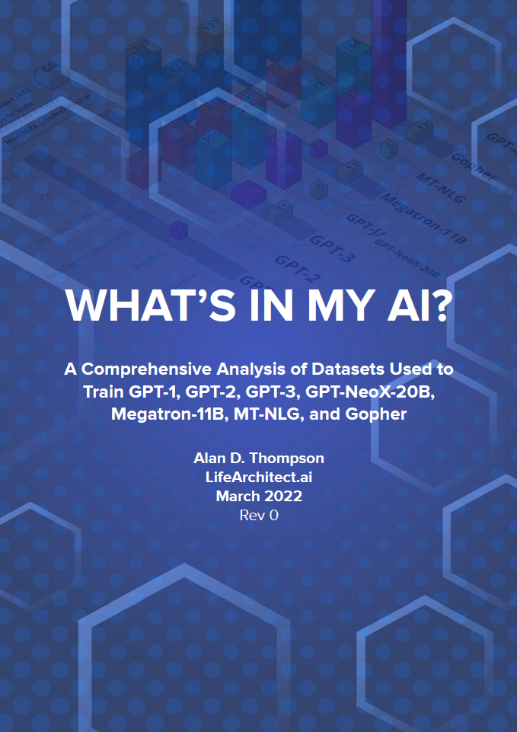
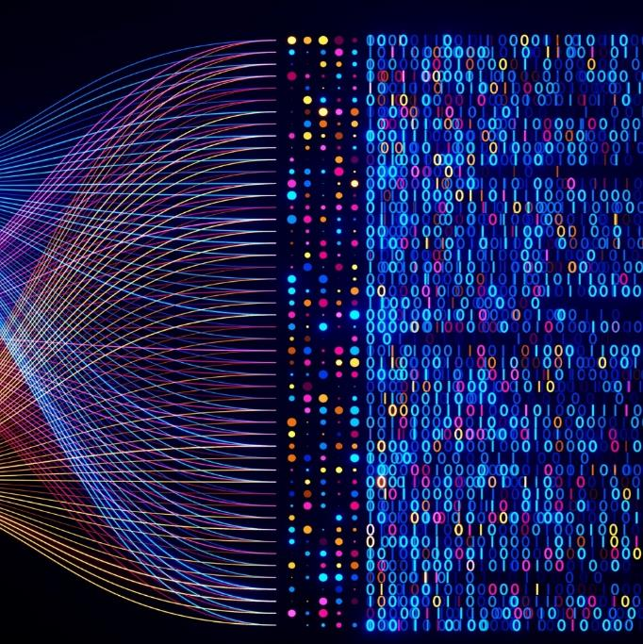
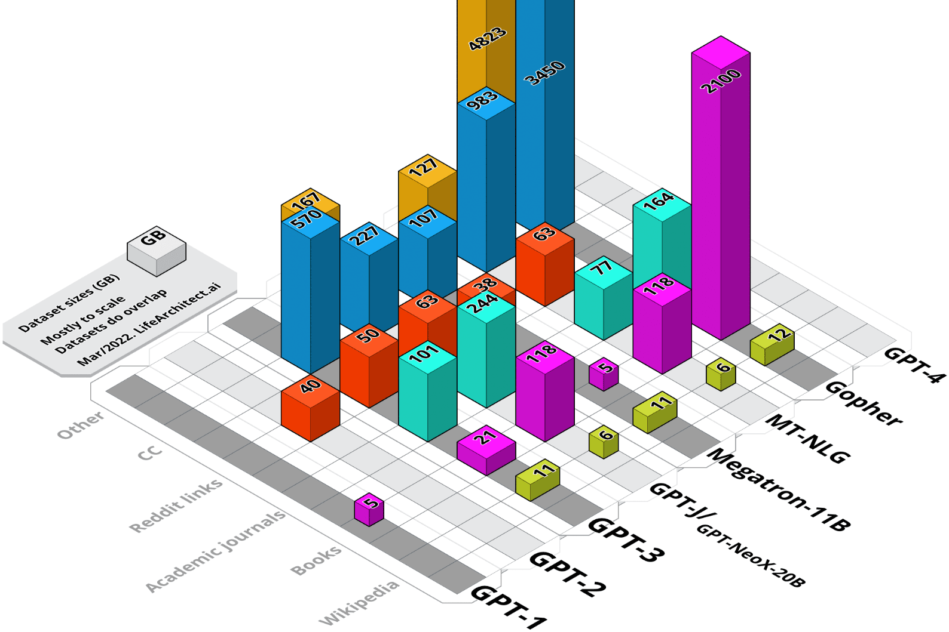
ELI5: What is Generative AI?
Quantity of data (fuel)
Quality of data (fuel)
Feed me!
ChatGPT was trained on over 570 GB of text data, 8 million documents, and 11,000 books (over 300 billion words)
Notes:
Algorithms need a vast amount of data. Exactly how much is an evolving art; there seems to be a point of diminishing returns where increasing the amount of data used to train an algorithm begins to have little impact (at least with current model designs). Even so, that point is massive. For example, ChatGPT was trained on a massive dataset of text from the internet called the WebText corpus, which contains over 8 million documents totaling around 40 GB of text. This included a whopping 570GB of data obtained from books, webtexts, Wikipedia, articles and other pieces of writing on the internet. To be even more exact, 300 billion words were fed into the system. In addition to the WebText corpus, ChatGPT was also trained on other large datasets such as Books1 and Books2, which contain over 11,000 books in total.
In addition to size, the quality of the data is crucial. Although techniques can sometimes offset the impact of undersized data sets, no quantity of data can compensate for a lack of quality (such as diverse and relevant) data.
Sources:
https://lifearchitect.ai/whats-in-my-ai/
https://www.sciencefocus.com/future-technology/gpt-3
https://www.fierceelectronics.com/sensors/chatgpt-runs-10k-nvidia-training-gpus-potential-thousands-more

Slide 31
ELI5: What is Generative AI?
Quantity of data (fuel)
Quality of data (fuel)
GPT-4 (OpenAI’s language model at the core of ChatGPT) reportedly has over 1.7 trillion parameters
Parameters of model
(knobs and switches)
1,700,000,000,000
Notes:
The performance of a model is also affected by its design – its ‘parameters’ or internal settings. They’re like the knobs and switches that a model uses to make sense of data.
Or more concretely, they’re mathematical values that articulate the relationships among small pieces of the data, such as the likelihood that any given word (‘sweet’) will follow another (‘bitter’) in a Large Language Model.
More parameters can make a model more accurate and generalisable, but they also add complexity and computational and memory demands. For perspective, GPT-4 (OpenAI’s language model at the core of ChatGPT) is said to have over 1.7 trillion parameters.
Source
Schreiner, M. (2023, June 11). GPT-4 architecture, data sets, costs and more leaked. The Decoder. https://the-decoder. com/gpt-4-architecture-datasets-costs-and-moreleaked

Slide 32
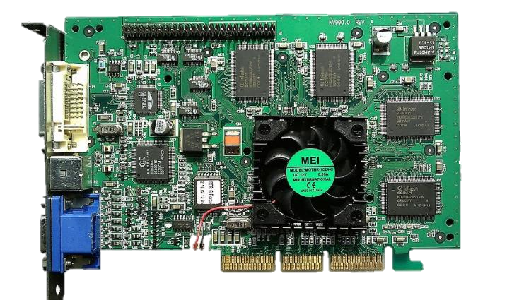

ELI5: What is Generative AI?
General-purpose computing on GPUs
Quantity of data (fuel)
Quality of data (fuel)
Parameters of model
(knobs and switches)
$63,000,000 (USD)
Compute power
GPT-4 reportedly cost $63 million in compute power to train it
Notes:
Finally, available computing power is a limiting factor. Training sophisticated Generative AI requires a lot of servers, electricity, and Graphical Processing Units (GPUs), which are advanced electronic circuits originally designed for processing images and videos (hence the name) but that are now used for various complex calculations. This means that hardware, time, and budget all limit how much an algorithm can be trained. To give a sense of scale, GPT-4 is estimated to have cost $63 million USD in compute-power resources to train it.
The competition for these resources is serious. We’ve seen international posturing among the USA, Taiwan, and China to secure GPUs. And we’ve witnessed major scuffles in big-name companies (e.g., Facebook aka “Meta”), with critical AI developers quitting in protest over a lack of access to sufficient resources to train their models.
Sources
Schreiner, M. (2023, June 11). GPT-4 architecture, data sets, costs and more leaked. The Decoder. https://the-decoder.com/gpt-4-architecture-datasets-costs-and-moreleaked
Shivakumar, S. & Wessner, C. (2022, June 8). Semiconductors and national defense: What are the stakes? Center for Strategic and International Studies. https://www.csis.org/analysis/semiconductors-and-national-defense-what-are-stakes
Huang, K. & O’Regan, S.V. (2023, Sept. 5). Inside Meta’s AI drama: Internal feuds over compute power. The Information. https://www.theinformation.com/articles/inside-metas-ai-drama-internal-feuds-over-compute-power

Slide 33
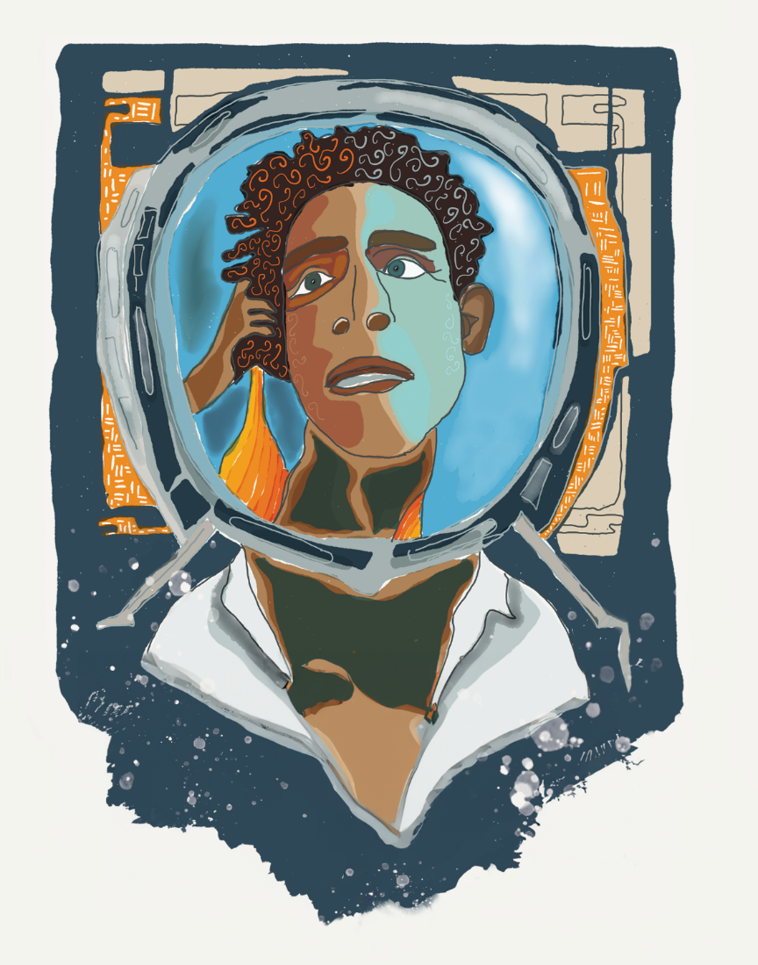
PART 2
Humanum in Machina
Notes:
Humanum in Machina = Human in the Machine
Wade anywhere into the discussion about Generative AI and it’s only a short amount of time before someone will mention ‘bias’.
And rightly so. We live in an unequal and inequitable world, and the last thing we need is for new technologies to perpetuate or exacerbate historical discrimination.

Slide 34



Where does bias come from?
Bad actors poisoning our data
Too little fuel
Bad real-world behavior
Notes:
Where does bias come from?
Insufficient or biased data can lead to poor results and inaccurate predictions, and this lies behind much of what we see as bias in outputs today.
In some cases, bad actors may feed toxic data as fuel into our engines to pollute them for malicious effects.
In other cases, we’ve starved the engine, giving it too little petrol – too few or insufficiently diverse inputs.
Very often, though, the bias is inherent in the contexts in which the AI is deployed – or, at least, in how we (flawed humans) make sense of and digitize those contexts.
For example, a Machine Learning algorithm trained on data from standardised assessments might penalise students from poorer backgrounds because it’s learnt the pattern that underprivileged students tend to score lower, then assumes that this historical sociological problem is a reliable feature of the system, an axiom to rely upon and propagate. Whilst social attitudes are slowly evolving, the vast majority of our historical written and visual records represent social models that have become outdated.
If you look at earnings data for the last thousand years, those trends will show a bias favouring men because, for much of that time, only men would earn money or own property. And certainly it was mainly the men dictating what the record keepers captured. Even today, when we nominally have HR and legal mechanisms in place to ensure gender parity, few would argue that we truly have it, as the Amazon hiring algorithm disaster demonstrated only a decade ago. AI has no emotion. It doesn’t ‘care’ (nor even ‘understand’) what social disparity is. It simply identifies patterns. If we flawed humans have created patterns of inequity or bias, then the algorithm is merely the mirror through which we view ourselves – a powerful lens through which to self-evaluate and, perhaps, look for clues about how we might evolve.

Slide 35

Where does bias come from?
Bad actors poisoning our data
Just fix the algorithm to correct for our bias.
(Solved!)
Too little fuel
Bad real-world behavior
Notes:
It may seem like there’s an obvious answer to correct for inherent bias in our data sets, but it’s not so easy….

Slide 36

Black Box Problem
1001 0101 0010 0101 1110 0100 0000 0111 0111 1011 1111 0110 1010
0101 1110 0100 0110 0101 0111 1001 1111 0110 1010 1001 0101 0010
12,000 dimension
1001 0101 0010 0101 1110 0100 0000 0111 0111 1011 1111 0110 1010
0110 1010 0000 0101 1110 0100 0110 0101 0111 1001 1001 0110 1010 1001 0101 0010
per feature
GPT-3 reportedly has over 12,000 different dimensions per feature; that translates to billions or trillions of mathematical relationships
1001 0101 0010 0101 1110 0100 0000 0111 0111 1011 1111 0110 1010
0101 1110 0100 0110 0101 0111 1001 1111 0110 1010 1001 0101 0010
1001 0101 0010 0101 1110 0100 0000 0111 0111 1011 1111 0110 1010
0110 1010 0000 0101 1110 0100 0110 0101 0111 1001 1001 0110 1010 1001 0101 0010
1001 0101 0010 0101 1110 0100 0000 0111 0111 1011 1111 0110 1010
Notes:
One challenge is the “black box” problem. That is, we can’t “see into” Generative AI algorithms to see how they’re producing results.
We simply can’t crack open the algorithms and read their mechanical thoughts. The language of Generative AI is numbers – an unreadable and impenetrable array of them.
In an artificial neural network, each discrete ‘feature’ in a data set, such as each word in the English language or even more granular linguistic parts, like word roots and prefixes, is a node. The connections between nodes are analogous to our biological ‘synapses’, and in artificial neural networks these connections are weighted. The weights reflect the statistical relationships between nodes. Such relationships are some of those model parameters we discussed in Part 1 – the knobs and switches that make the algorithms work. Formally, these values are stored in something called a co-occurrence matrix – a table of numbers that represents the probability of different words appearing together. In our example, those weights could reflect the probability of a certain word, such as ‘bank’, appearing in the same sentence as another word, such as ‘left’ or ‘river’ or ‘money’; or of ‘left’ appearing with ‘right’, or ‘right’ with ‘incomprehensible’ or ‘surreptitious’, and so on. This quickly turns into an explosion of connections.
Of course, language is more complex than a series of two-dimensional relationships. Often, the same word has different meanings and connotations. Context matters too, so additional factors need to be accounted for. ChatGPT employs a co-occurrence matrix with over 12,000 different dimensions
to determine the likelihood of ‘word co-occurrence’. Multiplied out across the thousands by thousands of English words, these numbers exceed our capacity to visualise. We’re unable to interrogate the billions (or often trillions) of mathematical relationships that define Generative AI models. It’s an uninterpretable language.
Source
Each of these tokens is converted (by a single-layer neural net) into an embedding vector (of length 768 for GPT-2 and 12,288 for ChatGPT’s GPT-3). See: Wolfram, S. (2023, Feb. 14). What is ChatGPT doing . . . and why does it work? Stephen Wolfram Writings [blog]. https://writings.stephenwolfram.
com/2023/02/what-is-chatgpt-doing-and-whydoes-it-work

Slide 37
Black Box Problem
S(x) = 1 ÷ (1 + e^{-x})
Notes:
These algorithms don’t include instructions like ‘rate underprivileged children lower’ or ‘don’t hire women’. Instead, they include things like S(x) = 1 ÷ (1 + e-x) concealed within masses of similar mathematical functions.
This is the famous black box problem of Machine Learning. Neither we nor the algorithms can explain the patterns they’ve learnt. The coherent output they produce emerges from an inconceivable system.
These algorithms only ‘know’ mathematical functions – patterns in the data. And we have no idea what features the algorithm is using.
Even if we unpacked the algorithm and could ‘see into’ the N-dimensional numerical complexity it produced, we probably wouldn’t understand the features it uses or have names for those concepts.
What are the implications of this complexity for our current discussion on bias and error? For one, we can’t ask the algorithm ‘why?’
AI engineers are working on this problem from a technological perspective within the nascent field of Explainable AI. They’re trying to find ways to make the invisible visible, to illuminate the black box a bit more. But even if they succeed, we still have to overcome the bias inherent in the data or that emerges due to our interactions with an unwitting algorithm.

Slide 38

Black Box Problem
(Solved!)
S(x) = 1 ÷ (1 + e^{-x})
Explainable AI
Notes:
AI engineers are working on this problem from a technological perspective within the nascent field of Explainable AI. They’re trying to find ways to make the invisible visible, to illuminate the black box a bit more. But even if they succeed, we still have to overcome the bias inherent in the data or that emerges due to our interactions with an unwitting algorithm.

Slide 39


Who solves the bias?
GOFAI
(programmers fix it)
Reinforcement Learning
(crowdsource corrections)
i did a bad thing…
Notes:
Surely, we can create rules to overcome bias, like the American ‘Affirmative Action’ programme has done in its attempts to address racial inequalities or the gender quotas that India and Norway have enacted for their leaders. (And, of course we’re very good at this and never cause controversy with our “fixes,” right?)
1. So, we can ask our GOFAI developers to put in some guard rails, to overlay requirements on the algorithm. 2. Or we can crowdsource the solution.
Let’s go back to the infamous Microsoft Tay again. ChatGPT learnt from the ‘Lesson of Tay’, and its developers established rules, over and above the patterns found in the training data, to ensure its outputs align with certain values, such as helpfulness and harmlessness. To train this, Open AI (the company that makes ChatGPT) hired around forty people to review the chatbot’s early outputs and rate its statements for those desirable qualities, gradually fine-tuning the algorithm’s performance. A variety of approaches can be used, whether tuning a model with Reinforcement Learning (like the ChatGPT example above) layering rules over the Machine Learning output. So, this sort of multi-layered approach seems to have solved our problem, except . . .

Slide 40
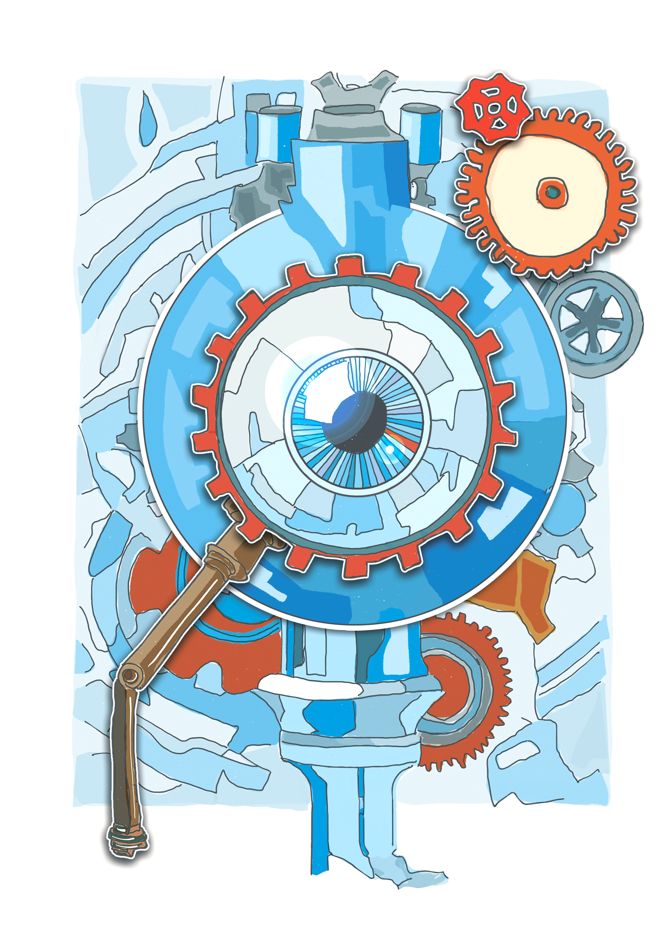




Who solves the bias?
Even if you had a perfect “bias spotting robot” who would you trust to de-bias the algorithm?
Chatbots and image generators
Automated HR systems
Predictive policing algorithms
Notes:
Even if we had perfect clarity into the algorithms and were certain of our methods for programming guardrails around them, and even if we had a bias-spotting machine that manually corrected potential anomalies in our patterns, how would we use it? Which humans could we trust to have the competence and clarity to make things truly safe?
It’s one thing to have 40 people rate the helpfulness of messages from a novelty chatbot; it’s quite another to try to manage predictive policing algorithms or Generative AI that produces new medicinal drug combinations. How do we manage bias when the stakes are higher, more ephemeral, or outright polemical? For instance, should we tell the predictive policing algorithms to ignore race as a feature of the patterns it learns? That seems like a good start; except it’s been tried. Those policing algorithms already exclude race from their training data sets, but other factors, such as socioeconomic background, education, and neighbourhood, end up serving as proxies.
After all, we’re addressing systematic biases that are interwoven into our reality, not merely isolated characteristics we can so easily ignore. That’s what brought us to this problem in the first place: the algorithms are identifying real-world patterns – deep, reliable, and repeatable across large sets of
examples. And this returns us to our original question: Who among us has the competence and clarity to define the correct rules that will eliminate bias without tilting the scales in another unbalanced direction or causing other unintended consequences?

Slide 41
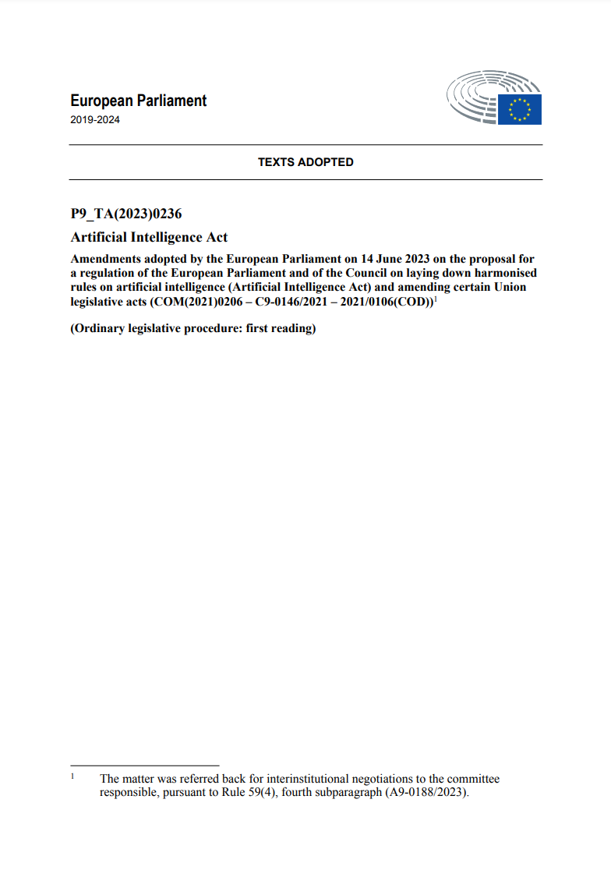

Who solves the bias? The Government, of course!
Bans social scoring systems on behavior or socio-economics
Bans predictive policing and criminal prediction systems
Ban remote biometric ID systems, e.g., face surveillance
High risk AI (e.g., employment) must be registered and monitored
EU AI Act
Negotiations began June 2023
Passed unanimously in May 2024
Expected enaction 2024–2026
Notes:
Perhaps it would be better for us to simply eschew AI for anything serious. Let it entertain us with clever images or assist us with menial writing but forego its use in weightier situations.
Some regulators in the European Union are advocating for this path, emphasising the need for caution or restricting the use of AI in the most sensitive situations, such as for predictive policing and biometric surveillance. Similarly, the North Atlantic Treaty Organisation (NATO) has adopted
‘Principles of Responsible Use’, limiting military applications of AI. Other countries have even banned (what we might consider) low-stakes Generative AI because of its perceived bias. For instance, China and Russia have embargoed ChatGPT, claiming it spreads misinformation. What, in our WEIRD (Western, Educated, Industrialised, Rich, and Democratic) cultures, we might say is merely a summary of our worldviews, others may perceive as cultural imperialism, and more isolationist nations might even argue that it’s a biased distortion (whether or not that argument comes from a place of sincerity).
Sources
Borak, M. (2023, June 14). EU Parliament approves AI Act amid heated biometrics debates. Biometric Update. https://www.biometricupdate.com/202306/eu-parliament-approves-ai-act-amid-heated-biometrics-debates
Soare, S.R. (2021, Nov. 19). Algorithmic power, NATO and artificial intelligence. International Institute for Strategic Studies. https://www.iiss.org/sv/online-analysis/military-balance/2021/11/algorithmic-power-nato-and-artificial-intelligence
Regarding China: Davidson, H. (2023, Feb. 23). ‘Political propaganda’: China clamps down on access to ChatGPT. The Guardian. https://www.theguardian.com/technology/2023/feb/23/china-chatgpt-clamp-down-propaganda
Regarding other nations: Martindale, J. (2023, April 12). These are the countries where ChatGPT is currently banned. Digital Trends. https://www.digitaltrends.com/computing/these-countries-chatgpt-banned

Slide 42


Who solves the bias?
Regulate and Enforce
Educate and Influence
Notes:
The US and EU have two different approaches to regulating AI. The US approach is generally more "educate and influence," while the EU approach is more "enact laws and levy penalties.“
The US approach to AI regulation is characterized by a focus on voluntary guidelines and industry self-regulation. The US government has not yet enacted comprehensive legislation on AI, but it has issued a number of policy documents and guidelines outlining its vision for AI and its expectations for the private sector. The US government also supports research on AI safety and ethics. The EU approach to AI regulation is characterized by a focus on mandatory rules and regulations. The EU has enacted a number of laws related to AI, including the General Data Protection Regulation (GDPR) and the EU AI Act. The EU AI Act is the first comprehensive law on AI in the world, and it places strict requirements on the development and use of AI systems.
There are a number of reasons for the different approaches taken by the US and EU to AI regulation. One reason is that the US has a long history of favoring market-based solutions over government regulation. Another reason is that the US AI industry is more mature than the EU AI industry, and US companies are more likely to be leaders in the field of AI. The US approach is more flexible and adaptable, but it also means that there is less regulatory certainty. The EU approach is more predictable and provides more clarity on the rules of the road, but it also means that there is less room for innovation.

Slide 43
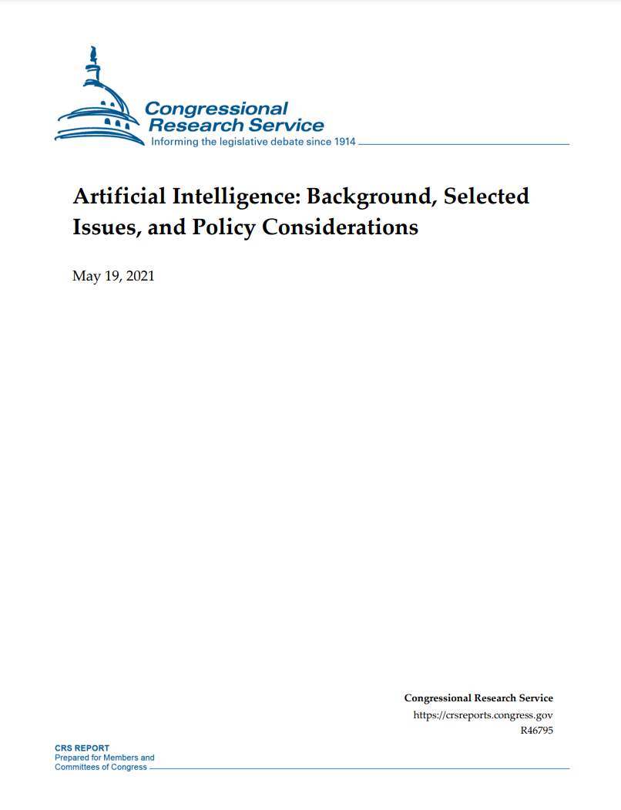
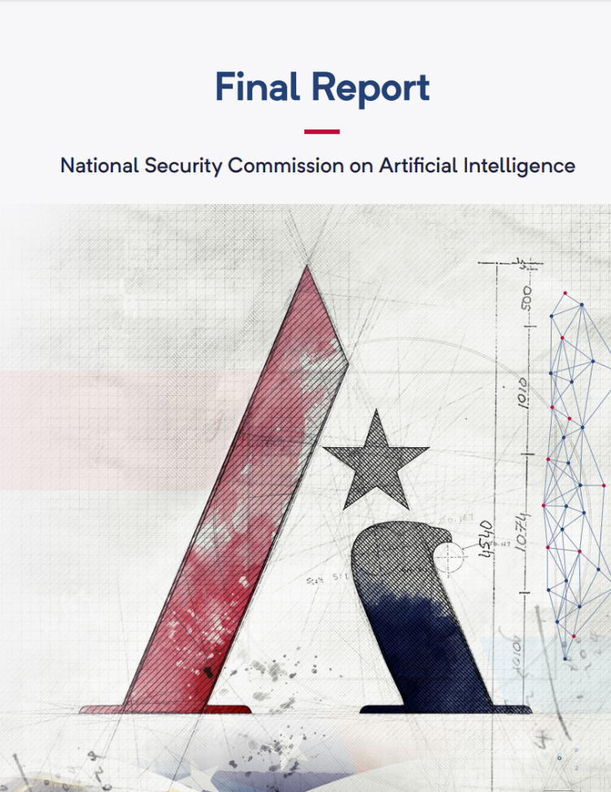
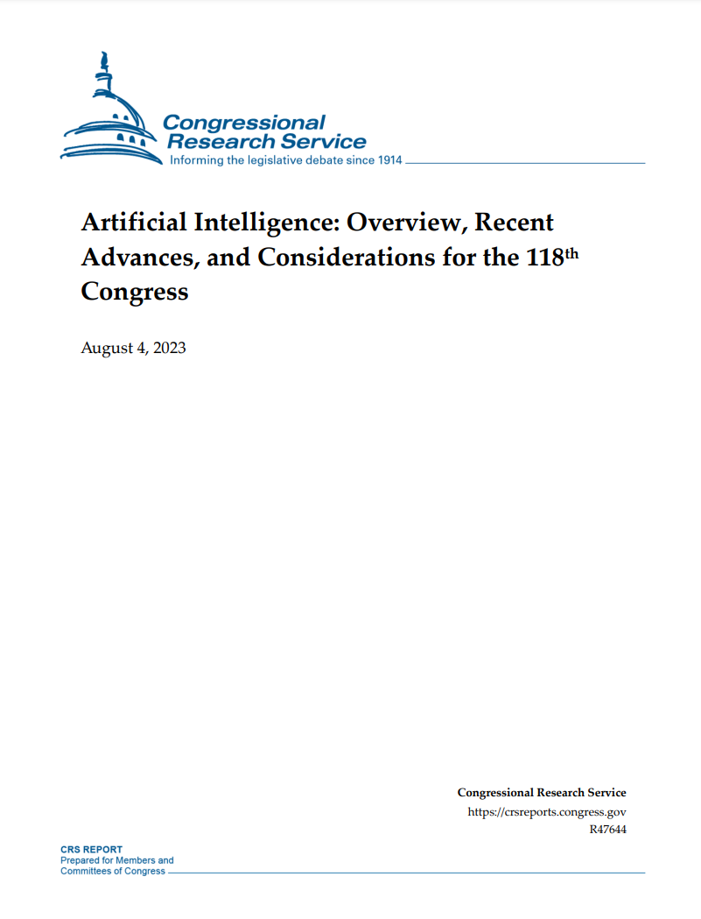
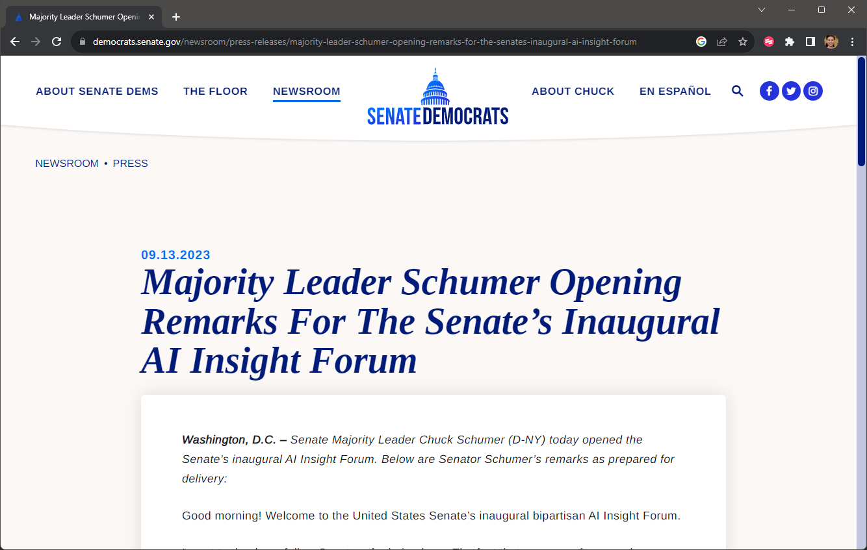
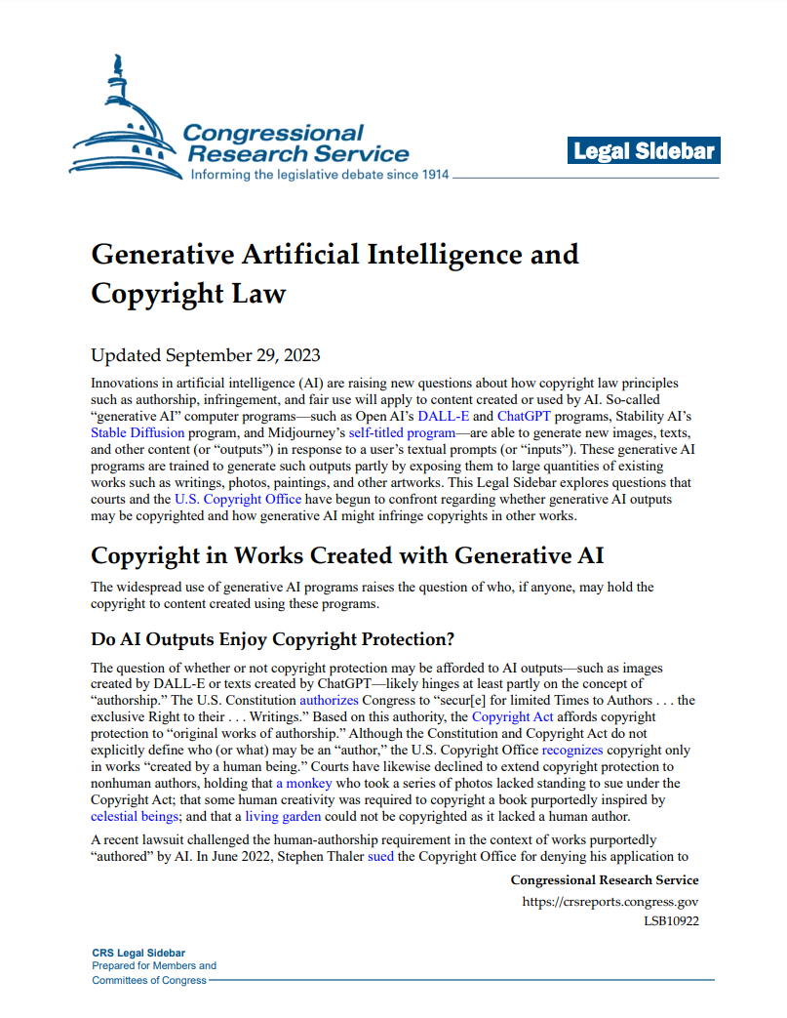
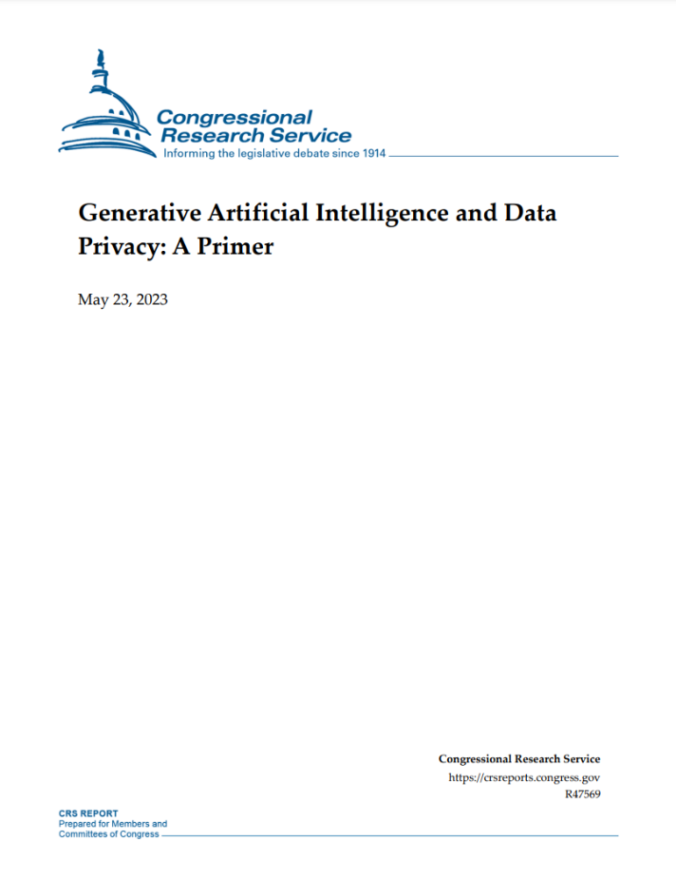
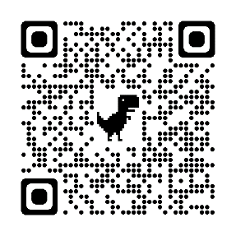
Who solves the bias? Research Initiatives
“Despite exciting experimentation and a few small AI programs, the U.S. government is a long way from being ‘AI-ready’” (p. 2)
“Senior military leaders have warned that if current trend lines are not altered, the U.S. military will lose its military-technical superiority in the coming years. Artificial intelligence (AI) is a key aspect of this challenge…” (p. 61)
First, let’s study the situation
from 2021 but still very relevant
https://www.nscai.gov
Notes:
Congress tends to focus on studying the problem and publishing best practices.
Examples
CRS report (2021): https://crsreports.congress.gov/product/pdf/R/R46795
GenAI and Copyright Law (2023): https://crsreports.congress.gov/product/pdf/LSB/LSB10922
Artificial Intelligence: Overview, Recent Advances, and Considerations for the 118th Congress (2023): https://crsreports.congress.gov/product/pdf/R/R47644
GenAI Primer (2023): https://crsreports.congress.gov/product/pdf/R/R47569
Congress is conducting AI Insight Forums to figure out how to regulate AI.
Congress has passed on law, to create the National AI Commission Act, but it’s also kind of research organization.

Slide 44
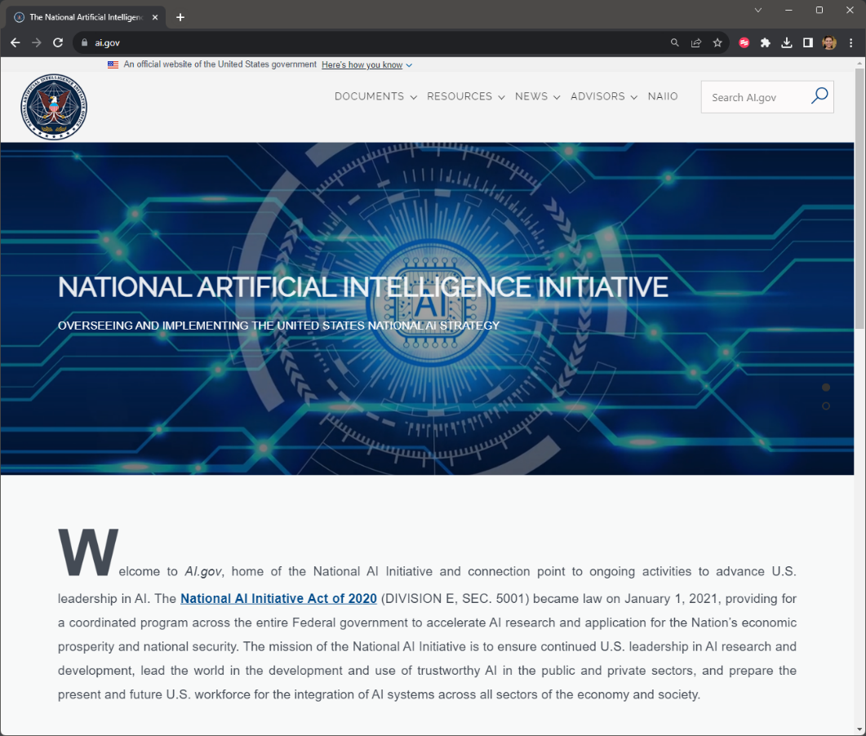
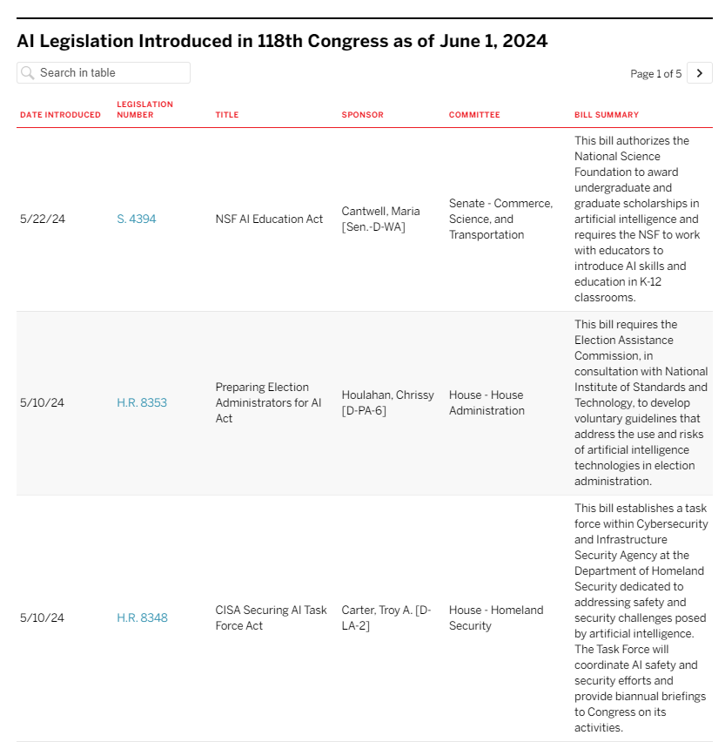
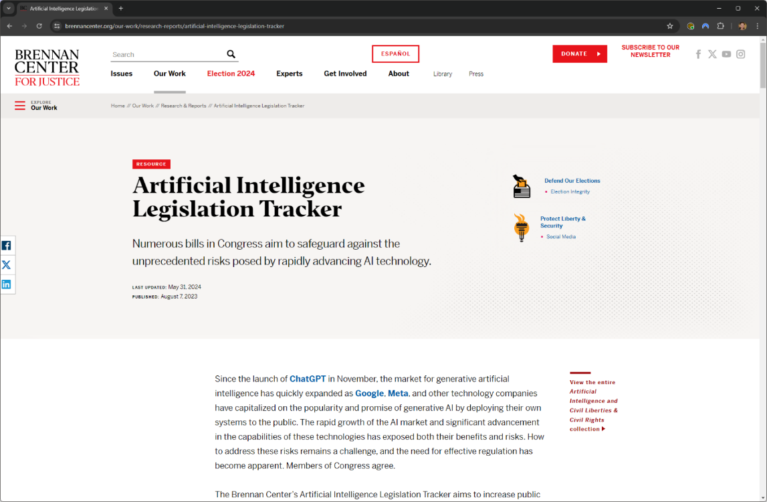


Who solves the bias? Research Initiatives
You can monitor US AI legislation from the Brennan Center
AI Labeling Act of 2023
Algorithmic Accountability Act
National AI Commission Act
(This one was passed; it’s basically a research center.)
https://www.brennancenter.org/our-work/research-reports/artificial-intelligence-legislation-tracker
https://www.ai.gov
Notes:
There are a lot of interesting bills being introduced in Congress, but not a lot of legislation being approved. Here are some examples.
However, we’ve had 0 major laws US passed, including no comprehensive (federal-wide) privacy law.
Congress is currently in the early stages of discussing the regulation of AI. A number of bills have been introduced, but none have yet passed into law. Topics include:
Privacy and security: Lawmakers are concerned about the potential for AI to be used to collect and misuse personal data. They are also concerned about the potential for AI to be used to hack into computer systems or develop autonomous weapons.
Bias and discrimination: AI systems are trained on data, and that data can reflect the biases of the people who created it. Lawmakers are concerned about the potential for AI to be used to discriminate against certain groups of people.
Competition and innovation: Lawmakers want to ensure that the AI market remains competitive and that innovative new AI products and services can be brought to market.
In addition to these general areas of focus, there are also a number of specific AI applications that are being considered for regulation. For example, banning the use of AI in facial recognition systems used by law enforcement.
Here are some specific examples of bills that have been introduced in Congress to regulate AI:
The Algorithmic Accountability Act: This bill would require companies to conduct impact assessments of their AI systems to identify and mitigate potential risks of bias and discrimination.
AI Labeling Act of 2023: This is the first bipartisan bill aimed at labeling content from generative AI tools.
The AI for Public Good Act: This bill would establish a new federal office to coordinate research and development of AI that is used to benefit the public.
Sources
https://cra.org/govaffairs/blog/2023/09/ai-legislation-in-congress
Congressional Research Service #R47644 (AUG 2023): “Numerous federal laws on AI have been enacted over the past few Congresses, either as standalone legislation or as AI-focused provisions in broader acts. These include the expansive National Artificial Intelligence Initiative Act of 2020 (Division E of P.L. 116-283), which included the establishment of an American AI Initiative and direction for AI research, development, and evaluation activities at federal science agencies. Additional acts have directed certain agencies to undertake activities to guide AI programs and policies across the federal government (e.g., the AI in Government Act of 2020, P.L. 116- 260; and the Advancing American AI Act, Subtitle B of P.L. 117-263). In the 117th Congress, at least 75 bills were introduced that either focused on AI and ML or had AI/ML-focused provisions. Six of those were enacted. “
See Lenhart, A. (2023). Federal AI Legislation: An Analysis of Proposals from the 117th Congress Relevant to Generative AI tools. Institute for Data, Democracy & Politics, The George Washington University. https://iddp.gwu.edu/federal-ai-legislation
Here’s a link to the active crowdscourced version: https://docs.google.com/document/d/1A1bJ1mkIfE3eZuSbDmz3HGVtOvQDegHl53q3ArO7m44/edit?usp=sharing
LINK on slide: https://www.brennancenter.org/our-work/research-reports/artificial-intelligence-legislation-tracker

Slide 45

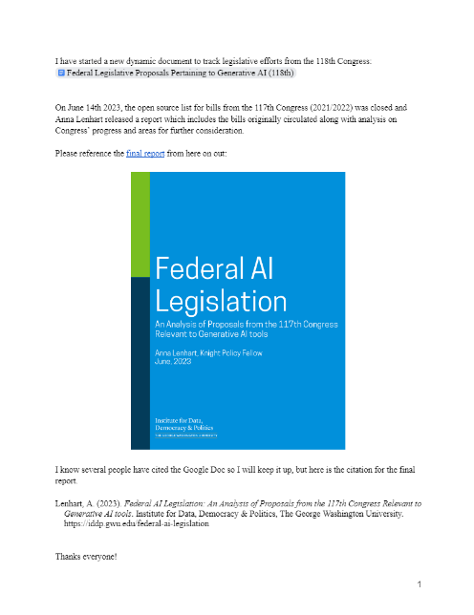
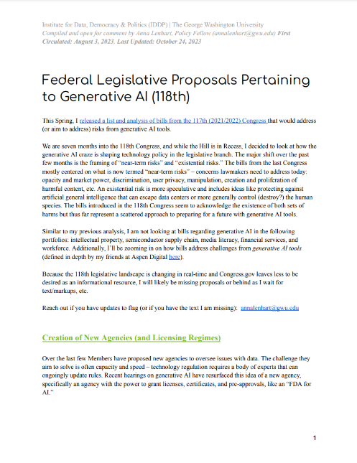

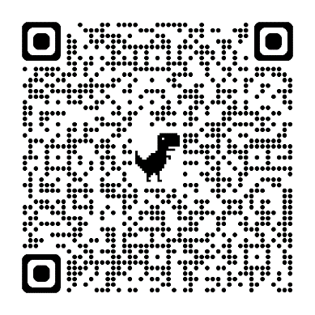


Who solves the bias? Future Legislation . . . ?
Anna Lenhart: Congressional AI legislation tracking
Notes:
Anna Lenhart has a helpful crowdsourcing project where she tracks the status of Congressional AI legislation, along with analysis and comparative updates. This is another useful source for monitoring US AI legislation.
2023: https://docs.google.com/document/d/1pzBEG3tV_T6p-FvC50FAnMMH_Yx9QTzfgx7ngc3kzv8/edit
2024: https://iddp.gwu.edu/sites/g/files/zaxdzs5791/files/2023-10/federal_legislative_proposals_pertaining_to_generative_ai_118th_oct24.pdf

Slide 46
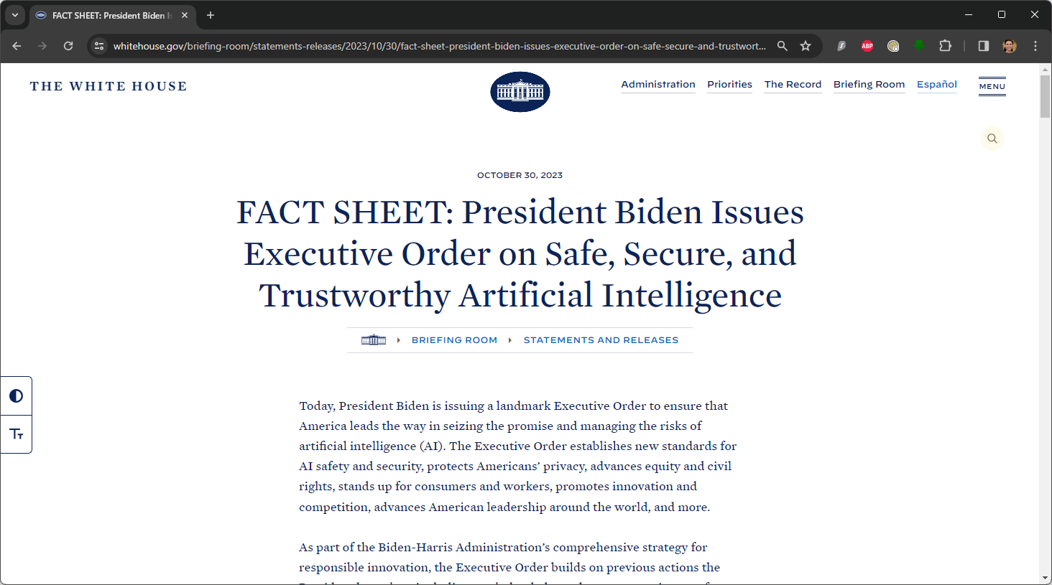
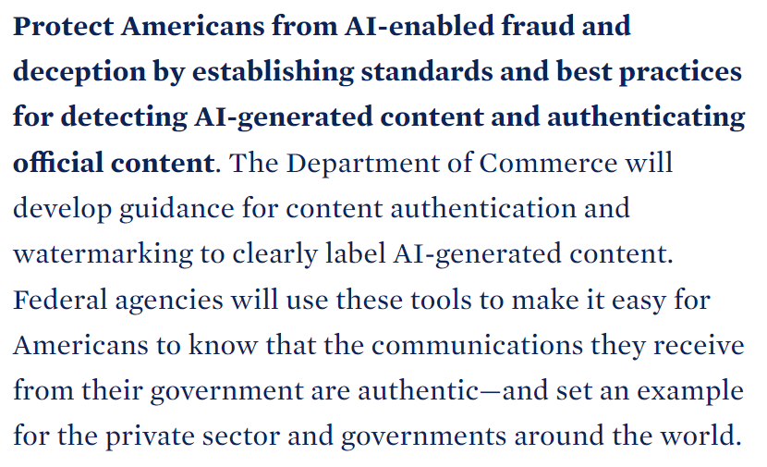
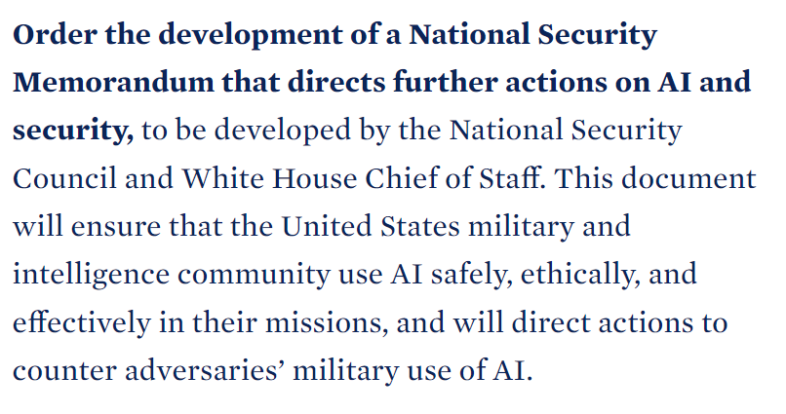
Who solves the bias? The White House . . . ?
Notes:
You might be wondering about the Executive Orders related to AI… they do exist, but they still tend to be in the vein of “you should do the right thing” rather than a binding requirement.
It does direct the different Federal agencies to establish AI-related guidelines. And this is currently how we’re mitigating issues with AI in the US—via its use in the government.
Source
https://www.whitehouse.gov/briefing-room/statements-releases/2023/10/30/fact-sheet-president-biden-issues-executive-order-on-safe-secure-and-trustworthy-artificial-intelligence/

Slide 47
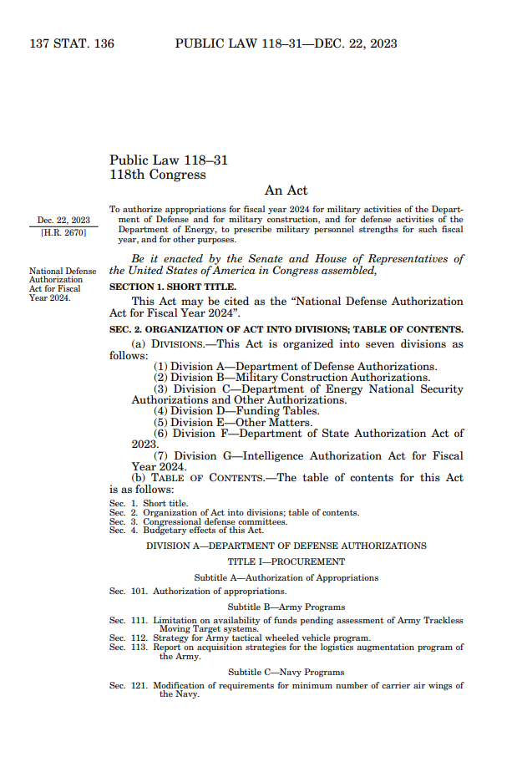
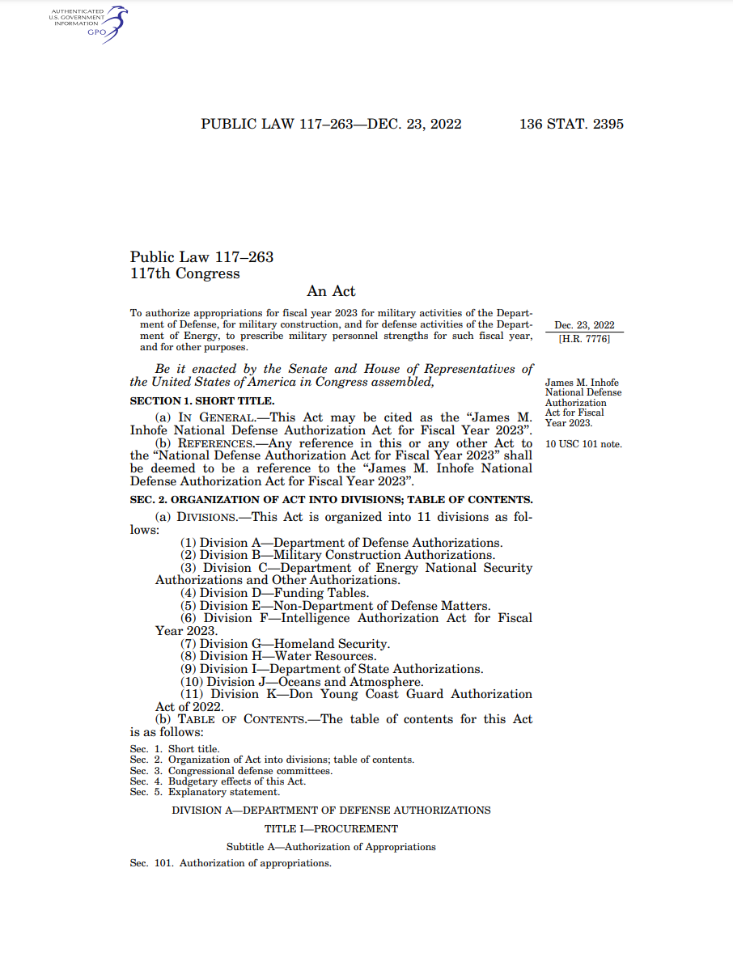
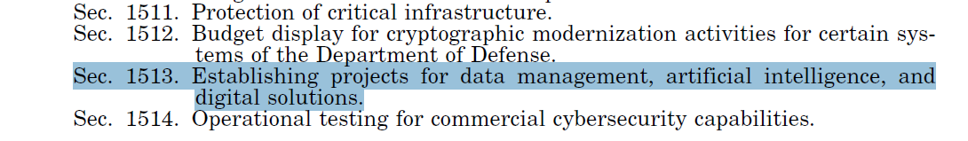
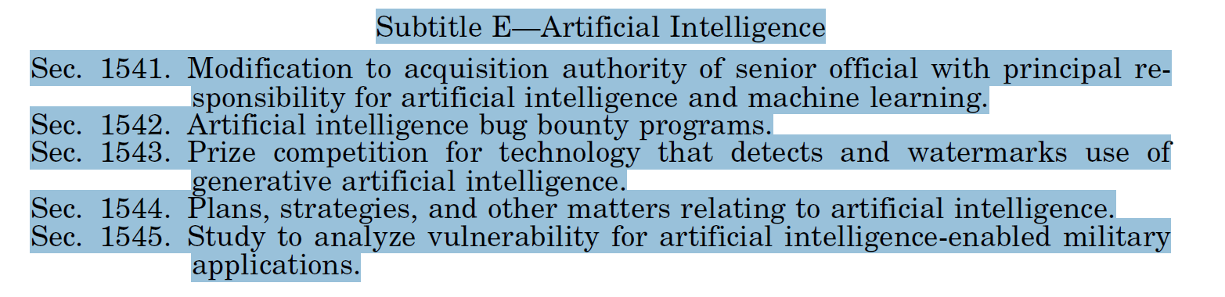
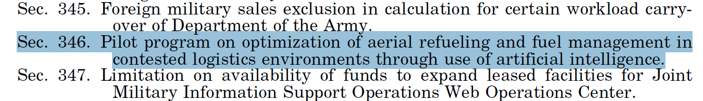
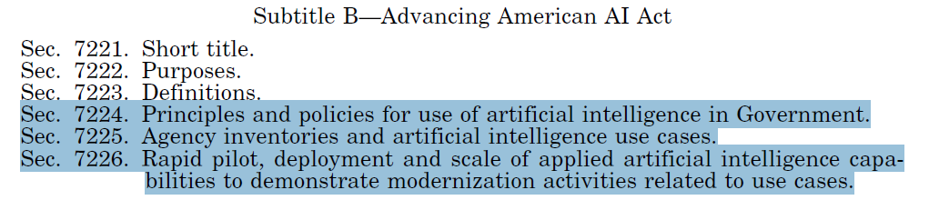
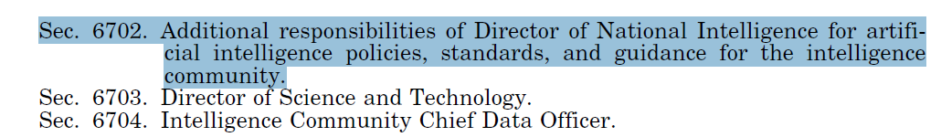
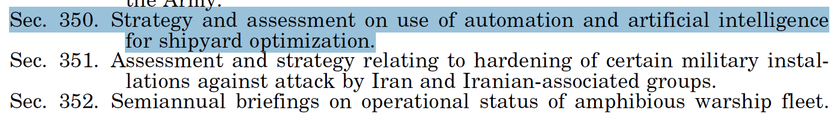
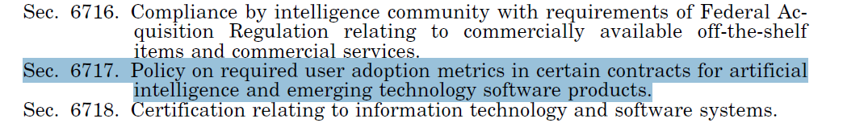
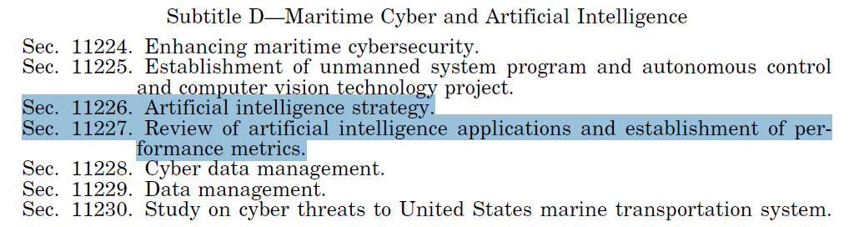
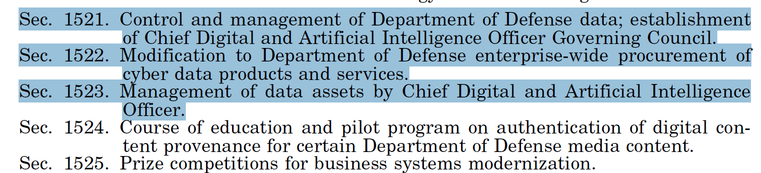
Who solves the bias? The DoD, via the NDAA
Except!
National Defense Authorization Act
Notes:
So, earlier when I said that Congress hasn’t done anything about AI (except research), that wasn’t entirely true. The way that Congress often gets things done is to:
Make Executive Councils, Commissions, Reports and Task Forces to study the problem, e.g., the https://www.ai.gov/
Putting the legislation into the NDAA - https://www.congress.gov/117/plaws/publ263/PLAW-117publ263.pdf
So, for those working with DoD, it’s important to check the NDAA for AI-related guidance.
…and there’s more!
(NOTE: the images on this slides are meant to convey “there’s a lot.” We will NOT review each of these.)

Slide 48
PART 3
Engines of Change; Ripples of Impact
Notes:
With innovation, there’s always ‘the thing’ and then the ripples that the thing creates, both across the span of our understanding and over the arc of time.
Internal combustion engines also radically affected our ways of life. They expanded our patterns of commerce, allowed new forms of trade that, in turn, collided with and collapsed cultures, enabled war to scale, and corroded legacy structures of power that were built on the separation of places in space. This makes the story of the internal combustion engine not simply one of engineering but rather a narrative of human settlement and exploration, expansion of horizons, and reinterpretation of distance, as well as a story about the environment.
In other words, the innovation of internal combustion enabled a host of change and achievement, spurred further innovations, and created a rippling array of consequences, both intended and unforeseen. And, although forecasting is always a dubious pursuit, it seems likely that Generative AI has already triggered a similar rippling – one that will reach at least as far as the internal combustion engine’s legacy.

Slide 49
What is Intelligence?
Notes:
Our traditional definitions of intelligence tend to focus on problem-solving, an ability to reason, self-awareness, and the ability to conceive of and transfer ideas from one space to another. But we also tend to define intelligence by what it isn’t – by its absence – and we look down on things that lack it. It’s quite a long list. Starting with stones. Stones, by most people’s standards, are not intelligent. How about ants? Well, individually they’re not strong contenders, but they do seem to achieve quite a lot together. So, maybe not intelligent per se but slightly clever in the collective? Monkeys? This is trickier. Some of them use tools (one measure of cleverness), and they fight and communicate and care for each other, all of which seems quite human – quite intelligent by our own invented standards. But there’s no great concern about monkeys’ capacity for collective action to overthrow us nor their ability to replace Shakespeare, no matter how many typewriters they’re given.
Generative AI? Well, that’s the open question. Certainly brilliant in its conception and very handy, but are the algorithms intelligent? Or might they be in the future?

Slide 50


“Chinese Room”
John Searle, 1980
Notes:
Consider the famous ‘Chinese room’ thought experiment from philosopher John Searle.
Imagine a room with a person inside who doesn’t understand Chinese. They’re armed with a set of rules, written in English, and a stash of books containing Chinese sentences. When they receive written questions in Chinese from outside the room, they diligently
follow the rules to locate the correct responses written in the Chinese books and then hand those answers to a Chinese speaker on the other side of the door. To the person outside, it looks like they’re chatting with someone who comprehends Chinese, but the person inside the room is just mechanically
following rules without understanding the conversation.
AI is sort of like the hapless fellow in the room. Though capable of performing intricate tasks and producing seemingly intelligent results, it lacks true comprehension. Even the most cutting-edge Generative AI systems still rely on complex rule sets to simulate intelligent thought. These algorithms don’t truly comprehend the inputs they receive or outputs they produce. It mimics intelligent behaviour quite convincingly, but does the appearance of intelligence equal the genuine article?
Source
Searle, J. (1980). Minds, brains, and programs. Behavioral and Brain Sciences, 3(3), 417–424. https://doi.org/10.1017/S0140525X00005756

Slide 51
Is AI intelligent?
one
word
after
the
next
Notes:
In Part 1, we touched on how Generative AI works, but we’ll reiterate a simple explanation. Large language models uncover the relationships between words (or their pieces) and then extensively articulate those interactions as statistical correlations. When you ask a chatbot a question, it doesn’t ‘understand’ your meaning. It’s just using its massive mathematical model to parse your input and then predict some reasonable output, one word after the next.
It’s all a series (a very, very big series) of weighted functions and probabilities built from patterns found in libraries’ worth of human-authored texts. We needed billions of written examples before believably coherent patterns could emerge. But the fact that something has emerged at all – and that these chatbots (despite their flaws) seem so realistic – demonstrates that once enough data has been analysed, hidden patterns can be uncovered, even seemingly inscrutable ones as complex as our conception and articulation of reality.
Source
Harrison, M. (2023, April 28). We interviewed the engineer Google fired for saying its AI had come to life. Futurism. https://futurism.com/blake-lemoine-google-interview

Slide 52
What is Intelligence?
…how can we augment our intelligence?
Notes:
So, to return to the question, ‘Is Generative AI intelligent?’ The answer, at least for today, is ‘no’ – if we agree with the conventional definitions of intelligence.
But have we aligned those goalposts in the right place? And more importantly, are we even asking the right question? Should we, perhaps, instead ask: How intelligent are people-plus-programs? How intelligent can we become through “Augmented Intelligence”?

Slide 53
Not “or” but “and”
BOUNDARY SPANNING
ADAPTABLE
CONNECT THE DOTS
Notes:
Augmented intelligence: the integration of AI with human intelligence to enhance our cognitive work. In combination, people and programs can accomplish amazing feats – better than either individually. Even average individuals, when paired with AI teammates, have proven that they can best (human) grandmasters or standalone algorithms.
This gives rise to the notion of expert generalists: individuals who possess a broad (but potentially shallow) range of knowledge and skills. While they may have some areas of deep expertise, they’re most characteristically experts at boundary spanning, excelling at transdisciplinary skills, critical thinking, creative problem solving, digital and data literacy, and interdisciplinary collaboration. They’re known for their versatility, adaptability, and ability to connect dots across domains. In other words, we’re witnessing a lessening emphasis on ‘pure’ domain knowledge in lieu of more generalisable capability: an era of augmented polymaths. Because in contrast to expert generalists, ‘narrow experts’ – individuals at the peak of a specialised but more bounded discipline – are often less adaptable, a potentially fatal flaw in a world of quickening change.
Expert generalists bolstered by AI are increasingly attractive as volatility and complexity grow, and organisations need more agility. The generalists bring adaptability and contextual understanding, whilst the algorithms provide detailed – but narrow – domain expertise relevant to a given situation.
‘Augmented generalists’ may be the pinnacle of future organisations.

Slide 54




Not “or” but “and”
The fox knows many things;
the hedgehog one great thing
Philip Tetlock
Notes:
Philip E. Tetlock, a prominent scientist who studied the paradox of expertise, popularised the phrase, ‘The fox knows many things; the hedgehog one great thing’. Borrowed from an ancient Greek proverb, that line illustrates two contrasting approaches to expertise. The hedgehog is focused but potentially rigid, while the fox is adaptable and holds eclectic expertise. Conventional experts can sometimes be foxes, but expert generalists – especially when augmented by AI – are almost certainly vulpine.
Expert generalists bolstered by AI are increasingly attractive as volatility and complexity grow, and organisations need more agility. The generalists bring adaptability and contextual understanding, while the algorithms provide detailed – but narrow – domain expertise relevant to a given situation.
‘Augmented generalists’ may be the pinnacle of future organisations.
And individual experts aren’t the only ones who can be augmented. AI compatriots can join human teams, helping them perform more accurately and efficiently, and AI can help optimise outcomes across teams of people, using their collective performance – which can be input instantly through a brain-computer interface – to identify errant mistakes or compensate for distracted or fatigued team members. This might sound like science fiction, but these Engines of Augmentation are already here, and advancements in Generative AI will merely speed their proliferation.
Source
https://www.youtube.com/watch?v=7mwdoFA1dig&t=81s

Slide 55



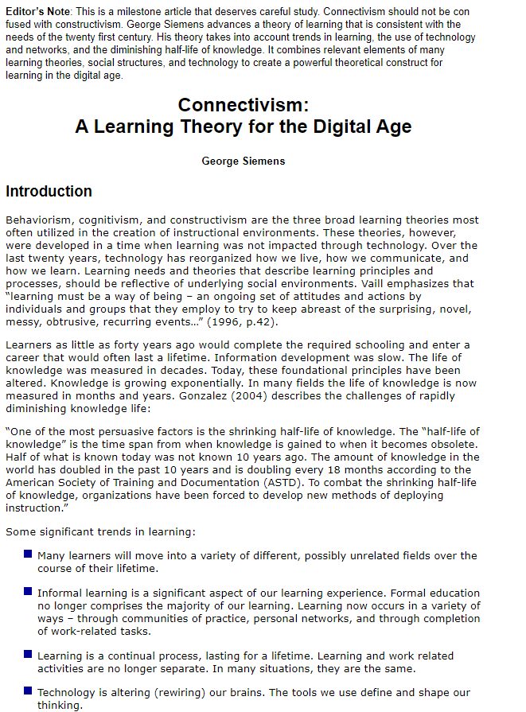
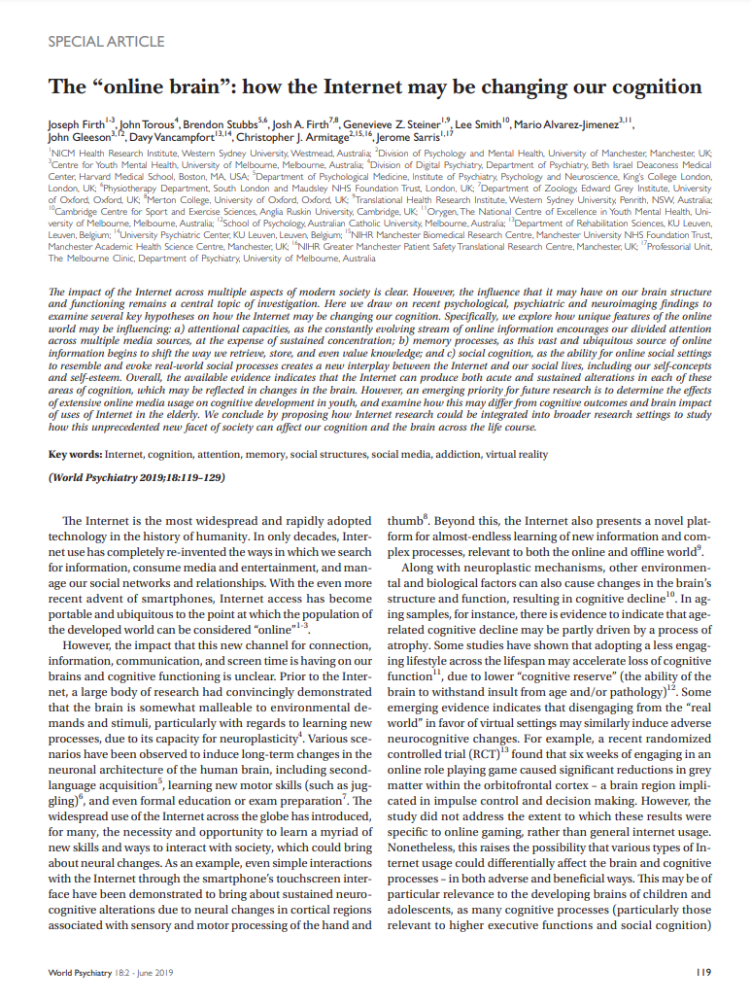

Not “or” but “and”
Collapsing Boundaries
Developing Youth and Novices
“Cheating”
The fox knows many things;
the hedgehog one great thing
Firth, J., Torous, J., Stubbs, B. et al. (2019). The "online brain": how the Internet may be changing our cognition. World Psychiatry, Jun;18(2):119-129.
Siemens, G. (2005). Connectivism: A learning theory for the digital age. International Journal of Instructional Technology and Distance Learning, 2(1), 3-10.
Philip Tetlock
Notes:
The rise of expert generalists and augmented intelligence encourages us to think about…
1. …the boundaries between learning, rehearsal, evaluation, and performance spaces.
2. …and raises questions for the development of novices into experts (when they can merely skip by all of the foundational knowledge and skills).
(Articles) This was a challenge we faced when the internet helped to augment our lower level cognitive skills, such as remembering and understanding… changing our brains and catalysing a new paradigm of learning
3. And, of course, our notions of “cheating.”
Sources for Articles
Firth J, Torous J, Stubbs B, Firth JA, Steiner GZ, Smith L, Alvarez-Jimenez M, Gleeson J, Vancampfort D, Armitage CJ, Sarris J. The "online brain": how the Internet may be changing our cognition. World Psychiatry. 2019 Jun;18(2):119-129. doi: 10.1002/wps.20617. PMID: 31059635; PMCID: PMC6502424. https://www.ncbi.nlm.nih.gov/pmc/articles/PMC6502424/
Siemens, G. (2005). Connectivism: A learning theory for the digital age. International Journal of Instructional Technology and Distance Learning, 2(1), 3-10. …and now AI promises to augment so much more

Slide 56







Collapsing Boundaries
Developing Youth and Novices
“Cheating”
“Writing will create forgetfulness in the learners’ souls, because they will not use their memories…”
Notes:
It’s worth remembering that innovations have always been met with scepticism and a bit of moral panic. Plautus in the 3rd century BC thought the sundial would be the end of us, splitting our days up into hours). Writing was met by suspicion by Socrates and Plato in the Phaedrus. Printing was denounced by the Catholic Church and Ottoman Empire. Film, Radio and TV were all met with a barrage of nay-sayers, as was every form of music that used tech, from rock ‘n roll, synthesisers to rap. The photocopier was reviled at the time as a destroyer of creativity and copyright. The internet brought on a new era of revulsion; Wikipedia was banned (note it was schools and Universities who wanted to block perhaps the greatest, socially constructed knowledge base our species has ever seen), txting, computer games, social media, smartphones…. and now AI.
Sources
https://www.scientificamerican.com/article/who-invented-the-measurement-of-time/#:~:text=After%20the%20Romans%20installed%20their,day%20into%20bits%20for%20poor
https://en.wikipedia.org/wiki/Index_Librorum_Prohibitorum
IMAGES
Sundial: https://es.m.wikipedia.org/wiki/Archivo:Seacacus_Stone_Sundial_by_Carmichael.JPG
Press: https://commons.wikimedia.org/wiki/File:Printer_in_1568-ce.png
Socrates https://commons.wikimedia.org/wiki/File:Socrates._Line_engraving_by_P._Pontius,_1638,_after_Sir_P._P_Wellcome_V0005528.jpg

Slide 57
What is Creativity?
Notes:
By its definition, Generative AI is “creative” in the mechanical sense that it creates new artifacts, whether or not you attribute a spark of brilliance to them.
Generative AI is capable – very capable – in its creative pursuits. Photos (mostly) look real. Essays are (mostly) hard to distinguish from human-written ones. Even music is (mostly) indistinguishable from the popular artists it mimics. It’s uncanny in uncomfortable ways.
Contemporary digital artists have powerful robot collaborators that draw on deep knowledge of millions of other artworks to challenge and expand their artistic possibilities.

Slide 58







Is AI creative?
$4000
25% to 90% price disruption??
TEXTBOOKS
$1600
COURSEWARE
$400
Skilled Professional Writer
Scores 90th Percentile on GRE
Costs around $0.40 per word
Generative AI
Scores 90th Percentile on GRE
Costs around $0.16–0.04 per word
TESTS
DIGITAL MEDIA
Stelter, C. (2023, July 26). “Fast, Cheap and Good: How much more productive can generative AI make writing?” https://www.linkedin.com/pulse/fast-cheap-good-how-much-more-productive-can-ai-make-writing-stelter
Notes:
Consider this example: The GRE (Graduate Record Examination) is a multiple-choice, standardized exam which many universities use to grade students applying for their graduate programs. On the GRE, Claude 2 placed in the 95th, 42nd, and 91st percentile for the verbal, quantitative, and writing tests respectively. GPT 4 placed in the 99th, 80th, and 54th percentile. For context, a professional writer who scores in the 90th percentile on the GRE might charge $0.40 per word. In contrast, language models like GPT 4 and Claude 2 can generate content for as little as $0.16 and $.04 per thousand words, respectively. This represents an astounding reduction in cost for businesses seeking high-quality written content.
Source
https://www.linkedin.com/pulse/fast-cheap-good-how-much-more-productive-can-ai-make-writing-stelter

Slide 59





Is AI creative?
25% to 90% price disruption??
TEXTBOOKS
COURSEWARE
TESTS
DIGITAL MEDIA
Notes:
These lowered barriers to creation are exciting, but also concerning.

Slide 60





Notes:
In ancient times, knowledge and the artifacts of knowledge were treasures, guarded by royal decrees and reinforced library gates. Today, those treasures have become nearly valueless, in the monetary sense. We have free access to nearly all of the knowledge of antiquity for effectively no cost, because of the lack of scarcity has devalued each individual artifact – each individual Wikipedia page or YouTube videos, although the quality (or clever) artifacts still manage to rise to the top, to become cultural touchstones or business successes….

Slide 61

RELIABILITY
VALUE
VALIDITY
EQUIVALENCY
Notes:
But that invites a new question for this field, how does that change the business model for creating tests or textbooks? If the demand for wholly personalized artifacts takes off, then how do we compete against a flooded market. How do we demonstrate quality or cleverness? And pragmatically, how do we standardize things like reliability and validity, difficulty level and equivalency. We’ll certainly need new mechanisms.

Slide 62

Do we value creativity, art, and culture?
Notes:
We have whole generations who can produce songs and tell their stories effortlessly, and Generative AI spreads that access further whilst simultaneously depreciating the manual craft that once was a necessary part of the artefacts’ creation.
This can be a good thing . . . unless it erodes the foundations of professional art.
It’s fair to wonder whether we’ve empowered a generation of shallow amateurs and formulaic knock-offs whilst undermining the most original creatives. What happens when there are no new artworks for our robots to learn from? Or when the usurpers of creativity benefit at the expense of the
creatives? What happens when a singer’s voice is repurposed by a studio, an actor’s likeness becomes the property of a corporation, or a designer’s style is remixed into imitations by a clickbait farm?
Generative AI is proudly derivative, reproducing mash-ups on demand with no reference to the many artworks that informed them. Each output is clearly unique, but where does the provenance reside, and how do we credit the artists whose original efforts taught the machines? We’re already voracious in our capacity to consume media and swift in our tendency to tire of yesterday’s creations. We’re growing increasingly inured to and dependent on novelty, and our brains are already wired to imbue value into scarcity and, in turn, to devalue the commonplace. Overabundance shortens our attention spans and diminishes our depth of engagement, potentially reducing the emotional and intellectual impact of artefacts and challenging our sense of cultural memory. The traditional markers of value, such as rarity and exclusivity, are correspondingly declining – transforming the ways we assign importance to different artworks.
Do we still value originality? And are we willing to pay for it?
These intellectual property issues and risks to creatives’ livelihoods are real, and whilst the proliferation of Generative AI may highlight the struggles more starkly, this is a road we’ve already travelled – and are actively travelling in many ways. We don’t yet have an answer to this, but if we, as a society,
value creativity and authentic artistry, then we need to find ways to support the artists who create it.

Slide 63





Do we value creativity, art, and culture?
https://theresanaiforthat.com
Notes:
There is a site, There’s an AI for That, that includes a Job Impact Index. The Index looks at the percentage of a job that could be impacted by AI. (1=totally human; 100=totally replaced by AI.)
You can also immediately see the AI tools available that are threatening each aspect of the job.
----
We often think of “creativity” in the sense of “artistry” – and that’s true and important. But “creativity” underlies any problem-solving job.
The CEO has a 91% impact index focusing mainly on team management and performance reviews. Have we begun to think about that level of impact from the top down and how we’ll have to be aware of, and work to adapt, our systems to that impact?

Slide 64
What is Truth?
Notes:
If you’ve managed to avoid sending your life savings to a Nigerian Prince and declined to procure assorted cure-all from various latter-day shamans, then the chances are your BS filters are working just fine – or at least they were, up until now.
We had developed filters to distinguish the genuine: well-written and personalised messages, high-definition videos, and professional-looking photos released by established news outlets. But our filters are clogging.
The danger extends beyond fringe scammers and industrial deception. Today, we’re concerned about the robustness of democracy and the reliability of global communication.
We had come to trust the written word, but now we’ve learnt to un-trust it. We once believed the reality captured in photographs, but now we doubt our own eyes. Even video and voice have become things that can be conjured from dust, a sophisticated – and yet readily made – digital deception.

Slide 65






False, Misleading, and Manipulative Information
Disinformation and Personalized Propaganda
Information Disorder and Truth Decay
Deepfakes
Pretexting, Phishing, and Spear Phishing
Notes:
Generative AI is empowering a new generation of malicious cyber operations, mainly in two ways:
First, by spreading un-truths.

Slide 66








False, Misleading, and Manipulative Information
March 2022
FAKE
Disinformation and Personalized Propaganda
Information Disorder and Truth Decay
Deepfakes
Pretexting, Phishing, and Spear Phishing
Pentagon deepfake (Andy Campbell)
Notes:
These are rapid-fire examples of GenAI-fueled disinformation and manipulative content.
$400 Disinformation Machine: https://www.wired.com/story/400-dollars-to-build-an-ai-disinformation-machine/
Voice Scammers: https://thestatement.bokf.com/articles/2023/09/keeping-up-with-scammers
Bank Fraud $35M: https://www.forbes.com/sites/thomasbrewster/2021/10/14/huge-bank-fraud-uses-deep-fake-voice-tech-to-steal-millions/?sh=2905cfea7559
Pentagon Deepfake: https://www.npr.org/2023/05/22/1177590231/fake-viral-images-of-an-explosion-at-the-pentagon-were-probably-created-by-ai
4B. S&P 500: https://www.nytimes.com/2023/05/23/business/ai-picture-stock-market.html
This was only a 0.3% drop in the S&P 500, but it was the first time an AI-generated image affected the stockmarket like this
https://apnews.com/article/pentagon-explosion-misinformation-stock-market-ai-96f534c790872fde67012ee81b5ed6a4
5. Zelenskyy deep fake: https://www.youtube.com/watch?v=X17yrEV5sl4
"It's definitely something we're keeping an eye on, but already the possibilities are pretty clear. The technology is getting better and better, making it harder to discern what's real," says Ryan Bell, threat intelligence manager at cyber insurance provider Corvus, citing the use of deepfake images of Ukrainian President Volodymyr Zelensky to pass along disinformation as evidence of the technology's use for nefarious purposes. https://www.csoonline.com/article/651125/emerging-cyber-threats-in-2023-from-ai-to-quantum-to-data-poisoning.html
6. High Schoolers Nudes: https://arstechnica.com/tech-policy/2023/11/deepfake-nudes-of-high-schoolers-spark-police-probe-in-nj/
7. Political Ads: https://www.pbs.org/newshour/politics/u-s-lawmakers-question-meta-and-x-over-ai-generated-political-deepfakes-ahead-of-2024-election

Slide 67

1,265% increase in malicious phishing emails since Q4 2022, when ChatGPT was released
SlashNext, State of Phishing 2023
25–29% more phishing emails are bypassing email filters since 2022
Egress, Phishing Threat Trends Report 2023
Pretexting is used in 50% of social engineering attacks—nearly double 2022’s total (phishing is 44%)
Verizon’s 2023 Data Breach Investigations Report
Notes:
GenAI is also fueling a sharp rise in pretexting or “Business Email Compromise” (BEC) attacks.
AI only needed a single paragraph to mimic a writing style. It can pull sufficient information from social media and public information and read any cracked email service, generating and mailing out overwhelming waves of very authentic prose. As an example, using resources equivalent to a fraction of ChatGPT, an AI could write a very personal email from a CEO to every single person in a global company, and each phishing email can be completely in the context of any actual correspondence that has gone before.
Sources
1. Increase in phishing emails: https://securitytoday.com/articles/2023/10/30/report-shows-1265-percent-increase-in-phishing-emails-since-chatgpt-launch.aspx
SlashNext Threat Labs analyzed billions of threats including link-based, malicious attachments and natural language messages in email, mobile and browser channels during a 12-month period from Q4 2022 to Q3 2023; conducted in-depth research into cybercriminal behavior and activity on the Dark Web particularly as it relates to leveraging Generative AI tools and chatbots; and surveyed more than 300 cybersecurity professionals. Among the findings are a 1,265% increase in malicious phishing emails and a 967% increase in credential phishing in particular. From a report, called State of Phishing 2023. https://slashnext.com/state-of-phishing-2023
2. Email filters: https://www.infosecurity-magazine.com/news/ai-phishing-emails-almost
Email filters are becoming less viable, as phishing becomes more sophisticated. More phishing emails are getting through traditional perimeter detection. Attacks are increasing in sophistication and cybercriminals have more tactics.
https://pages.egress.com/Whitepaper-PhishingThreatTrendsReport-10-23_2023-Landing-Page.html
https://www.bqprime.com/technology/human-element-remains-biggest-threat-verizons-2023-data-breach-investigations-report
https://www.verizon.com/business/resources/reports/dbir/
https://www.infosecurity-magazine.com/blogs/crafting-scams-ai-vector/
https://slashnext.com/blog/wormgpt-the-generative-ai-tool-cybercriminals-are-using-to-launch-business-email-compromise-attacks/
https://www.mdpi.com/1999-5903/11/4/89
https://secureframe.com/blog/social-engineering-statistics
https://www.comparitech.com/blog/vpn-privacy/phishing-statistics-facts/

Slide 68




Augmented Malicious Cyber
Disinformation and Personalized Propaganda
Information Disorder and Truth Decay
Deepfakes
Pretexting, Phishing, and Spear Phishing
Malware
Side-Channel Attacks
Bots and Botnets (e.g., for DDoS, algorithmic exploits)
Data Set Poisoning and AI Interface Injects
Notes:
Generative AI is empowering a new generation of malicious cyber operations, mainly in two ways:
Second, by accelerating existing forms of cyber exploitation.

Slide 69



Augmented Malicious Cyber
Creating malware
Bypassing defenses
Finding weak points
Writing malicious messages (phishing)
General illegal activity
WormGPT
FraudGPT
Image from https://slashnext.com/blog/wormgpt-the-generative-ai-tool-cybercriminals-are-using-to-launch-business-email-compromise-attacks
Notes:
WormGPT was developed as an unsanctioned counterpart to OpenAI's ChatGPT. WormGPT operates without ethical safeguards and can respond to queries related to hacking and other illicit activities. While its capabilities may be somewhat limited compared to the latest AI models, it serves as a stark exemplar of the evolutionary trajectory of malicious Generative AI. FraudGPT represents a subscription-based malicious Generative AI that harnesses sophisticated machine learning algorithms to generate deceptive content. In stark contrast to ethical AI models, FraudGPT knows no bounds, rendering it a versatile weapon for a myriad of nefarious purposes. These AI-driven tools are marketed as "starter kits for cyber attackers," offering a suite of resources for a subscription fee, thereby making advanced tools more accessible to aspiring cybercriminals.
// NOTE: These were included because they’re already well-known tools and have been written about in popular media. This slide isn’t giving away any secrets. A simple Google search would turn up similar information. //
Sources
https://www.zdnet.com/article/wormgpt-what-to-know-about-chatgpts-malicious-cousin/
https://www.popularmechanics.com/technology/security/a45533297/what-is-wormgpt
https://multiplatform.ai/wormgpt-v2-a-powerful-generative-ai-tool-has-been-introduced-by-hackers/
https://thehackernews.com/2023/10/exploring-realm-of-malicious-generative.html
Image source: https://slashnext.com/blog/wormgpt-the-generative-ai-tool-cybercriminals-are-using-to-launch-business-email-compromise-attacks/

Slide 70



Augmented Malicious Cyber
SCRIPT KIDDIES
POLYMORPHISM
LIVING OFF THE LAND
AUTOMATION
AI-authored and sustained malware
@IITSEC
NTSAToday
Notes:
There are several precedents for this already, from the professional “phishing kits” sold in the darknet to the old-school DDoS tool known as LoIC. AI malware will also be extremely hard to detect or contain, due to its likely use of polymorphism and clever tactics like “living off the land” (LOTL). This malware will also be harder for government and law enforcement agencies to disrupt, since an AI system could constantly change – and replicate – its command-and-control (C2) infrastructure to avoid discovery, or to rapidly reconstitute itself when a law enforcement agency tries to shut it down.
Polymorphism is a technique used by malware to disguise its appearance and avoid detection.
"Living off the land" (LOTL) is a technique used by malware to exploit legitimate software and tools that are already installed on a system.
In short, AI malware will be very difficult to detect and contain due to its ability to adapt, disguise itself, and exploit existing software. This makes AI malware a very serious threat to cybersecurity.
Sources
https://finance.yahoo.com/news/4-ways-ai-will-be-a-game-changer-for-cybersecurity-171158402.html

Slide 71







Augmented Malicious Cyber
Web Scraping
Personal Data Harvesting
Denial of Service
Brute-Force Logins
Almost 50% of internet traffic comes from non-human sources
Spam
@IITSEC
NTSAToday
Notes:
AI is powering “bad bots” online. Bad bots are software applications that run automated tasks with malicious intent.
Bad bots interact with applications like legitimate users would, making them harder to detect and block. They enable high-speed abuse, misuse, and attacks on websites, mobile apps, and APIs. They scrape data from sites without permission to reuse it and gain a competitive edge (e.g. pricing, inventory levels, proprietary content). They are used for scalping, the act of obtaining limited availability items to resell at a higher price. They can be used to create distributed denial of service (DDoS) attacks targeted at the network or the application. The truly nefarious ones undertake criminal activities, such as fraud and outright theft. An example of this is bots that perform credential stuffing to take over user accounts – one of the most prominent bot attacks. The Open Web Application Security Project (OWASP) provides a comprehensive list of 21 different bot attacks in its Automated Threat Handbook.
Bots are increasingly dominating online spaces. For instance, during the incident when a Chinese spy balloon traversed the US and Canada, tens of thousands of bots engaged on the social media platform X, attempting to influence public discourse. (Source: https://www.newscientist.com/article/2414259-armies-of-bots-battled-on-twitter-over-chinese-spy-balloon-incident/)
Source/Details
Highlights of the 2024 report:
Almost 50% of internet traffic comes from non-human sources
Bad bots, in particular, now comprise nearly one-third of all traffic
The global average of bad bot traffic reached 32%, with Ireland (71%), Germany (67.5%), and Mexico (42.8%) experiencing the highest levels
The rapid adoption of generative AI and large language models has led to a rise in simple bots, which grew to 39.6% in 2023 from 33.4% in 2022
https://www.imperva.com/resources/resource-library/reports/2024-bad-bot-report/

Slide 72


Augmented Malicious Cyber
In 2015 cracked a TREZOR hardware bitcoin wallet using a side channel exploit and a $70 oscilloscope
Jochen Hoenicke, 2015
Web Scraping
Personal Data Harvesting
Denial of Service
Brute-Force Logins
AI can identify password from the sound of keystrokes from audio captured via a Smartphone (95%) or over a Zoom call (93%)
Nolan, M. (2023, AUG 26). IEEE Spectrum
Almost 50% of internet traffic comes from non-human sources
Spam
@IITSEC
NTSAToday
Notes:
Deep Learning is enabling “better” infiltration and crypto cracking. For example, Jochen Hoenicke was able to recover the private key of a Trezor hardware bitcoin wallet, using a power side-channel attack. More generally, the security community generally agrees that it is indeed possible to recover secret keys from almost any implementation, even if the algorithm itself is secure, thanks to side-channel attacks.
It can also enable sidechannel attacks, such as decoding typed messages (or passwords) from the mere sound of your fingers tapping on the keys. According to a recent paper by researchers at Durham and Surrey universities and the Royal Holloway University of London. The researchers trained two models to recognize the distinctive clicks from each key on an Apple laptop keyboard. The models were trained on audio collected from two sources: a smartphone placed nearby and a video call conducted over Zoom. They report an accuracy of 95 percent for the smartphone-audio model and 93 percent for the Zoom-call model.
Sources
https://elie.net/blog/security/hacker-guide-to-deep-learning-side-channel-attacks-the-theory/
PoisonGPT: https://blog.mithrilsecurity.io/poisongpt-how-we-hid-a-lobotomized-llm-on-hugging-face-to-spread-fake-news
Samsung: https://techcrunch.com/2023/05/02/samsung-bans-use-of-generative-ai-tools-like-chatgpt-after-april-internal-data-leak/
https://www.cobalt.io/blog/prompt-injection-attacks
https://www.marktechpost.com/2023/07/14/meet-poisongpt-an-ai-method-to-introduce-a-malicious-model-into-an-otherwise-trusted-llm-supply-chain
https://simonwillison.net/2023/Apr/14/worst-that-can-happen/
https://jochen-hoenicke.de/crypto/trezor-power-analysis/
https://meltdownattack.com/

Slide 73

PART 4
What’s in all of this for Me?
Notes:
The impacts of Generative AI on both us and our organisations are probably best understood in three ways. The first way is as a ‘change within our systems’, the second is as a ‘change that fractures our systems’, and the third is as an ‘emergent capability’.
This section is a guided discussion.

Slide 74









KODAK AND DIGITAL CAMERAS
AUGMENTATION: Change within Systems
MODIFICATION: Change that Fractures Systems
REDEFINITION: Change that Redefines the Paradigm
Speed + Efficiency
Consistency at Scale
BLOCKBUSTER AND STREAMING
Short-term Profit
Trying to flex legacy systems against the tide of new models
SEARS AND e-COMMERCE
Notes:
There are three types of change we can consider:
1. Change within our systems is characterised by efficiencies and optimisation. Our new AI tools help us gain productivity and expanded capability (at both individual and organisational levels), and we can anticipate that they’ll add sharp efficiency to generating new ideas and unlocking new opportunities. They’ll help us collaborate and make sense of what we discover. They will tell our story for us, and extract new stories from the chatter in the shadows. These are the first impacts to ripple out, and indeed, we’re already seeing them. These changes strip cost and complexity out of our existing paradigms of operation – substituting humans with machines, increasing the speed and scale of performance, and outstripping legacy infrastructure.
--------------------------
2. Change that fractures our systems doesn’t simply introduce efficiency into our familiar processes; it disrupts the systems within which that efficiency is held. This second category of change is defined by the displacement of old systems by iconoclasts, whether internal or (more frequently) external: A fracturing and superseding of the structures and stories we thought we knew. A discernible transformation of our paradigms and behavioural scripts. A changing of the guard among sector authorities and tastemakers. However, many institutions will resist – holding on to legacy systems until they snap and splinter as new paradigms arise. We’ve seen that story play out a thousand times before, as businesses refuse to accept the ripples of change until those waves crash violently against their shores:
Kodak and the digital camera.
Blockbuster and streaming media.
Sears and e-commerce.
Traditional institutions face a significant dilemma, made more onerous when combined with an intolerance for change. Their challenges aren’t merely to catch AI-generated essays or to upgrade their delivery platforms with new analytics; rather, these institutions – and their very concepts – are threatened by swells that may reshape the foundations of academia. AI offers an unprecedented opportunity to reimagine the learning experience. Adaptive learning algorithms can personalise educational journeys, AI virtual tutors can offer instant guidance, and when combined with mobile and connective technologies, AI allows learning to transcend the limitations of physical classrooms and fixed communities.
Yet, the entrenched customs of centuries-old educational models, with their reverence for traditional credentials and the hierarchical dissemination of knowledge, stand as potential barriers. The temptation to flex, to attempt to make conciliatory gestures around the margins, may lead some institutions to superficially integrate AI into their existing structures – only to find themselves outpaced by more agile competitors that have moulded themselves into the new social constructs made possible during this dynamic period.
--------------------------
3. Emergent capability, by its nature, is hopeless to fully forecast. This third form of disruption goes beyond displacement and into rewriting the rules of the game.
This might initially manifest as competitors who operate according to neoteric business models, creating new and previously unimagined markets. In other words, businesses that not only compete asymmetrically but also paradigmatically.
Ride-sharing apps, like Uber and Lyft, capitalised on the amalgamation of distributed mobile systems, machine learning, and pocket GPS technologies to not only compete with traditional taxis but to catalyse the gig economy and all of its follow-on implications, such as rewriting employment structures, challenging labour laws, and raising new debates about workers’ rights and nature of work.
The invention of online social networking, through platforms like MySpace and Facebook, not only revolutionised interpersonal interactions but also redefined how people share information, our perspectives on privacy and digital identity, and dynamics of power and reputation. They’ve also reshaped societies by disseminating disinformation and empowering echo chambers while also creating pathways for collective action and giving voice to hidden communities.

Slide 75

In what ways do you envision change that can facture our current systems?
AUGMENTATION
Change within Systems, Efficiencies
MODIFICATION
Change that Fractures Systems
REDEFINITION
Change that Redefines the Paradigm
Notes:
As you think about the impacts of Gen AI on your own systems, it’s tempting to focus on AUGMENTATION.
It’s important to think beyond the immediate system.

Slide 76



RECOMMENDED READING
Engines of Engagement: A Curious Book About Generative AI (2023)
https://bit.ly/EnginesOfEngagement

Slide 77

Navigating the Generative AI Revolution
Sae Schatz, PhD Executive Director Partnership for Peace Consortium sae.schatz@marshallcenter.org | Julian Stodd Captain and Founder Sea Salt Learning julian@seasaltlearning.com | Geoff Stead Chief Product Officer MyTutor geoff@worklearnmobile.com
Notes:
I/ITSEC Tutorial 2024: Navigating the Generative AI Revolution
By Sae Schatz, Julian Stodd, and Geoff Stead

