Slide 1
Introduction to Defense Modeling and Simulation
John Daly, Booz Allen Hamilton
Dr. James Coolahan, Coolahan Associates
December 2024
Note: DoD related slide material was cleared by the Defense Office of Prepublication and Security review (DOPSR) for public release (Distribution A) (Case No. 21-S-0134), or obtained from public websites/references cited
Notes:
Author: J.J. Daly June2022

Slide 2
Learning Objectives
  Explain the scope and the fundamental terms and concepts associated with Defense Modeling and Simulation
  Identify key policies and procedures for U.S. DoD Modeling and Simulation
  Summarize key Defense Activities enabled by Modeling and Simulation
  Discover Defense Modeling and Simulation information resources
Notes:
The Defense Office of Prepublication and Security Review (DOPSR) has cleared this slide for public release (Distribution A) (Case No. 21-S-0134)

Slide 3
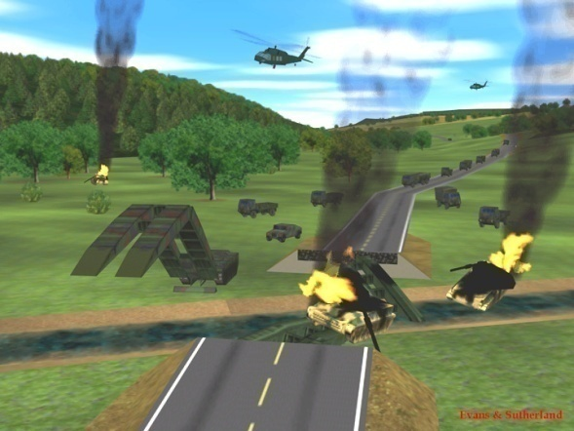

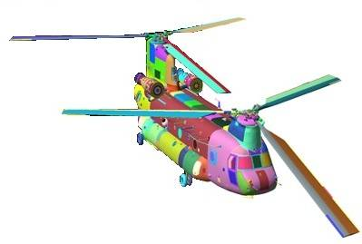
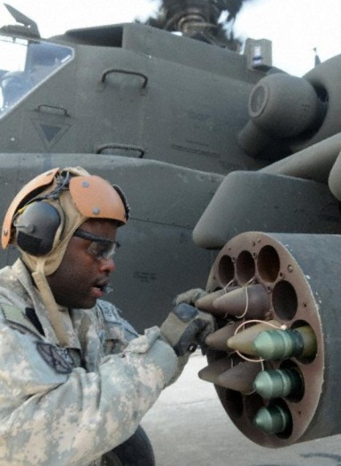

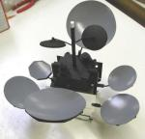
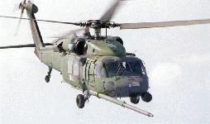
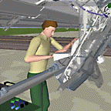
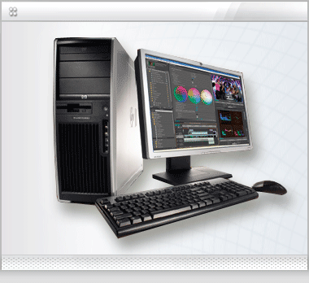
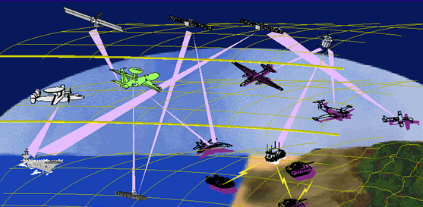
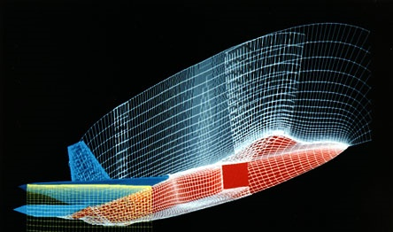
What is Modeling and Simulation (M&S)?
A representation
of real world:
    Equipment
    People
    Activities
    Processes
    Environments
Notes:
The Defense Office of Prepublication and Security Review (DOPSR) has cleared this document for public release (Distribution A) (Case No. 21-S-0134)

Slide 4
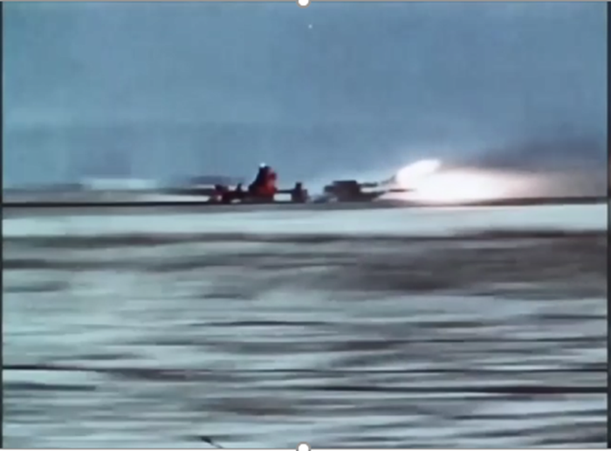
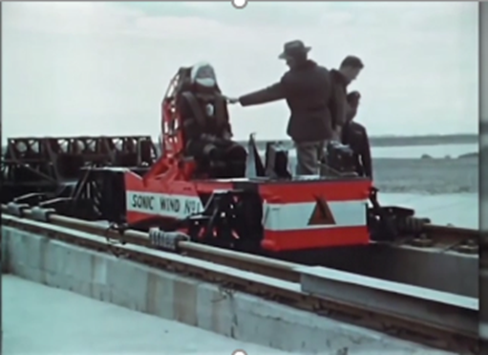
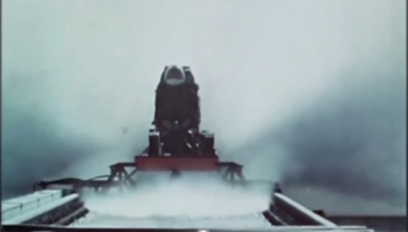
Example of a Famous Simulation
Murphy’s Law
Lt. Edward Murphy
“Whatever can go wrong,
will go wrong”
Ref: https://www.youtube.com/watch?v=-XT8Gim_kIo (DoD YouTube Channel)
4
Notes:
The Defense Office of Prepublication and Security Review (DOPSR) has cleared this document for public release (Distribution A) (Case No. 21-S-0134)

Slide 5
Agenda
PART 1
Basic Modeling and Simulation Concepts
Why model or simulate?
Modeling and Simulation (M&S) definitions and explanations
Types of models and simulations in military use
Key Enabling Concepts
PART 2
Key Defense Activities Enabled by M&S:
    Systems Engineering
    Analysis
    Experimentation and Technology
    Intelligence
    Medical
    Planning
    Test and Evaluation
    Training
Supporting US DoD Organizations and other M&S Resources
Notes:
The Defense Office of Prepublication and Security Review (DOPSR) has cleared this document for public release (Distribution A) (Case No. 21-S-0134)

Slide 6
Why Model Or Simulate?
Affordability: Simulating operations and processes allows us to determine the most cost-effective options. For example, test firing a $1M missile to determine its dynamic characteristics in flight or simulating it in a virtual testbed - avoiding the $1M cost.
Feasibility & Safety: With a simulation, you can access hazardous or denied areas and operating ranges, speed up the passage of time and pause it, and determine how to safely operate our equipment in performing a task and what the safe limits of a process or capability are. For example, we routinely train air, shipboard and vehicle crews on safe operation of their platform using simulation.
Notes:
The Defense Office of Prepublication and Security Review (DOPSR) has cleared this document for public release (Distribution A) (Case No. 21-S-0134)

Slide 7
Why Model Or Simulate?
Research and Development: For problems with no simple solution, simulations allow human reasoning and mathematical analysis to complement each other, creating problem solving synergy. Modeling and simulation allow us to explore and develop new technologies and their application to military missions; before we build. For example, Hypersonic flight.
Prediction: Modeling and simulation enable us to look into the “future” by creating a simulation of it, based on our best information from the present and physics/insight. An example is the common weather forecast, predicting storm paths and danger zones.
Insight: Modeling and simulation allow us to analyze and understand complex systems that we may not even be able to demonstrate/test physically. For example, Electronic Warfare systems – these are designed and even tested using simulation.
Notes:
The Defense Office of Prepublication and Security Review (DOPSR) has cleared this document for public release (Distribution A) (Case No. 21-S-0134)

Slide 8
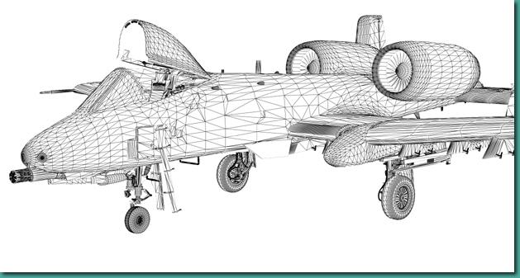
Key Modeling and Simulation Definitions
There are a number of definitions of models, simulations, and Modeling and Simulation (M&S). For the purposes of this tutorial, we will adopt the definitions published by the U.S. Department of Defense (DoD), below.
Mathematical Model
Model: A physical, mathematical, or otherwise logical representation of a system, entity, phenomenon, or process.
Simulation: A method for implementing a model over time.
Modeling and Simulation: The discipline that comprises the development and/or use of models and simulations.
Wire Frame Model
Ref: Department of Defense Modeling and Simulation (M&S) Glossary, July 1, 2013, included in the DoD Digital Engineering Body of Knowledge. Available at: https://www.de-bok.org/glossary
Notes:
The Defense Office of Prepublication and Security Review (DOPSR) has cleared this document for public release (Distribution A) (Case No. 21-S-0134)

Slide 9

Physical Model
Physical Model. A model whose physical characteristics resemble the physical characteristics of the system being modeled - a “mock-up”. DoD M&S Glossary
Notes:
The Defense Office of Prepublication and Security Review (DOPSR) has cleared this document for public release (Distribution A) (Case No. 21-S-0134)

Slide 10

Mathematical Model
In case of a car with uniform acceleration, there are three equations of motion which are also known as the laws of constant acceleration.
v = u + at
v² = u² + 2as
s = ut + ½at²
Where: s = displacement; u = initial velocity; v = final velocity; a = acceleration; t = time of motion
Mathematical Model. A symbolic model whose properties are expressed in mathematical symbols and relationships. DoD M&S Glossary
Notes:
The Defense Office of Prepublication and Security Review (DOPSR) has cleared this document for public release (Distribution A) (Case No. 21-S-0134)

Slide 11
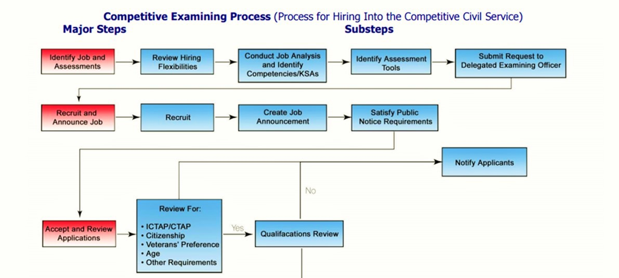
Process Model
Process Model. Model that defines the functional decomposition and the flow of inputs and outputs for a system. DoD M&S Glossary
Notes:
The Defense Office of Prepublication and Security Review (DOPSR) has cleared this document for public release (Distribution A) (Case No. 21-S-0134)

Slide 12
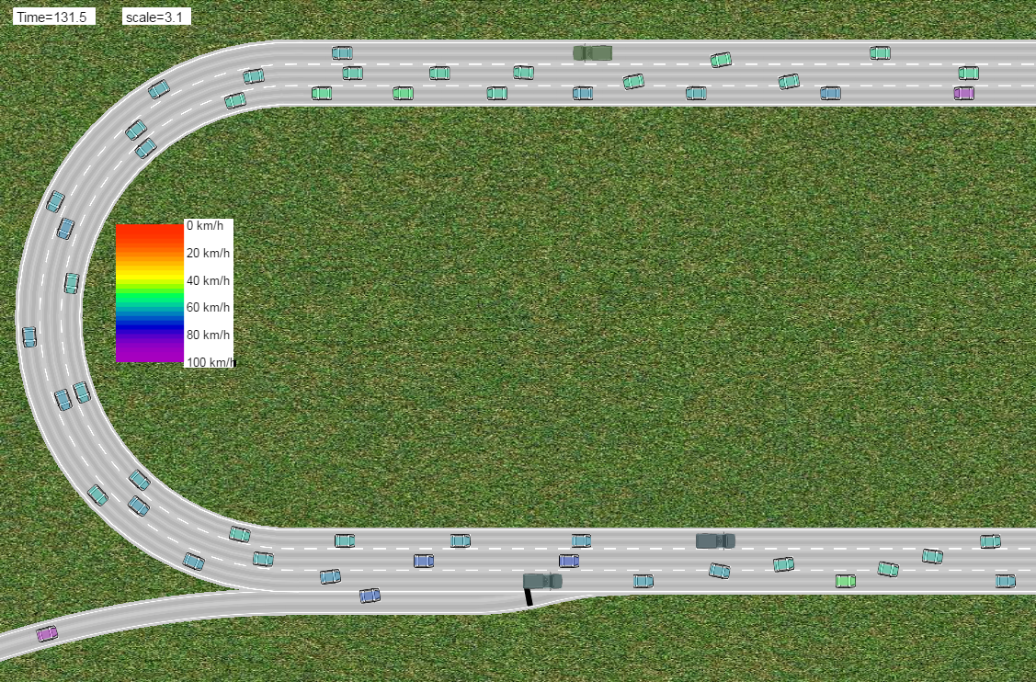
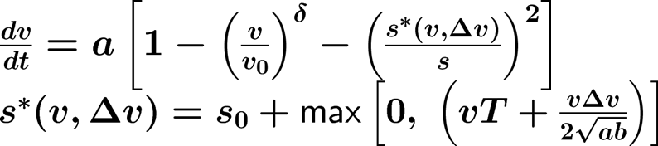
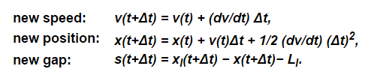
Example of a Mathematical Traffic Simulation
Mathematical Model
Simulating Auto Traffic on Limited Access Highway
an On-ramp situation
Ref: http://www.traffic-simulation.de/onramp.html
Notes:
The Defense Office of Prepublication and Security Review (DOPSR) has cleared this document for public release (Distribution A) (Case No. 21-S-0134)

Slide 13
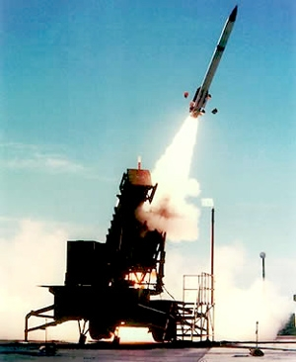
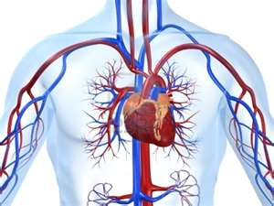
Modeling/Simulation “Pyramids”
Most M&S application areas have a hierarchical means of categorizing models and simulations in that area, by resolution level
Military Simulation Pyramid
Human Body M&S Pyramid
PATRIOT-centric example
Cardiac-centric example
More aggregation
Mission Simulation
Domain
Shorter run time
Gulf War
Campaign
Human
Whole body
Air defense
System
Cardio-vascular
Mission
Missile intercept
Less aggregation
Organ
Heart
Engagement
Longer run time
Cell
Myocyte
Terminal guidance
Engineering
Molecule
Ca++
Engineering Modeling
Domain
13
Notes:
The Defense Office of Prepublication and Security Review (DOPSR) has cleared this document for public release (Distribution A) (Case No. 21-S-0134)

Slide 14
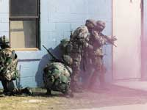
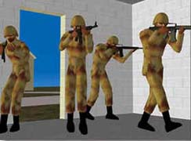
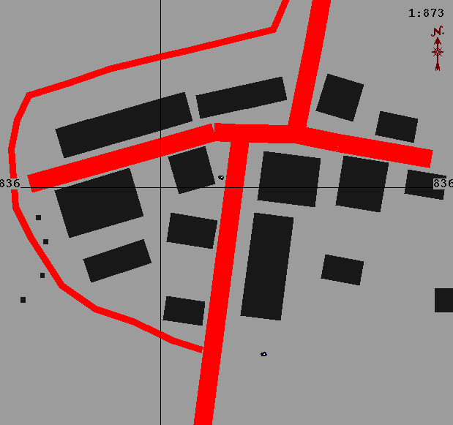
Categorizing Simulations by Human-System Interaction
Live simulation: A simulation involving real people operating real systems
  Examples: exercises, operational tests
Virtual simulation: A simulation involving real people operating simulated systems
  Examples: cockpit simulator, driving simulator
Constructive simulation: A simulation involving simulated people (or no people) operating simulated systems
  Examples: military campaign simulation, missile 6-degree-of-freedom simulation
People
Real Simulated
Live
?
Systems
Simulated Real
Virtual
Constructive
Notes:
The Defense Office of Prepublication and Security Review (DOPSR) has cleared this document for public release (Distribution A) (Case No. 21-S-0134)

Slide 15
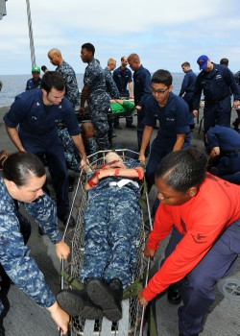
Example of a Live Simulation
Characteristics:
Physical models
Real people
Real Time
Real Systems
An example could be a mass casualty drill with people, simulated injuries, emergency equipment, vehicles, and operations
Notes:
The Defense Office of Prepublication and Security Review (DOPSR) has cleared this document for public release (Distribution A) (Case No. 21-S-0134)

Slide 16
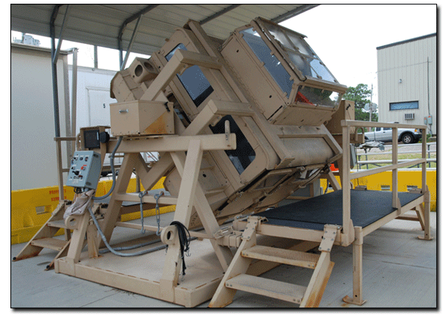
Example of a Virtual Simulation
HMMWV Egress Assistance Trainer (HEAT)
Other examples could be a flight simulator or a combat command center team trainer
Notes:
The Defense Office of Prepublication and Security Review (DOPSR) has cleared this document for public release (Distribution A) (Case No. 21-S-0134)

Slide 17
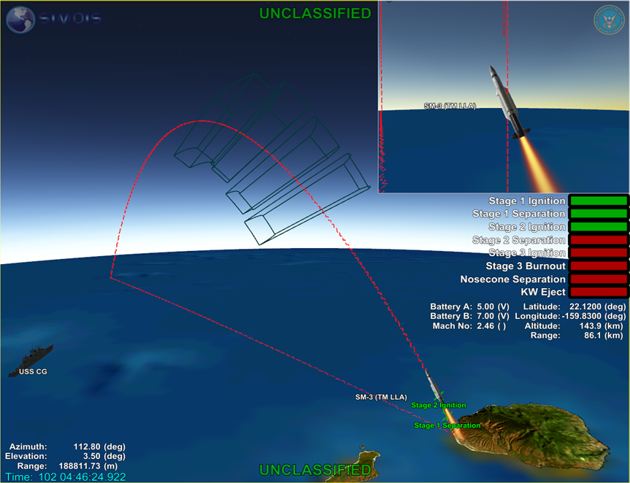
Example of a Constructive Simulation
Constructive simulations are robust computer-generated simulations that offer the ability to:
  analyze concepts
  predict possible outcomes
  support decision-making
  stress large organizations
  make measurements
  generate statistics
  perform analyses
An example is the complex aerodynamic and RF physics, and crew dynamics simulated in a missile intercept scenario.
Notes:
The Defense Office of Prepublication and Security Review (DOPSR) has cleared this document for public release (Distribution A) (Case No. 21-S-0134)

Slide 18
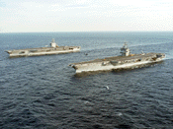
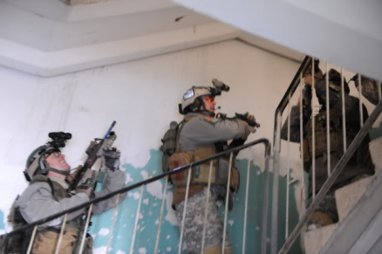

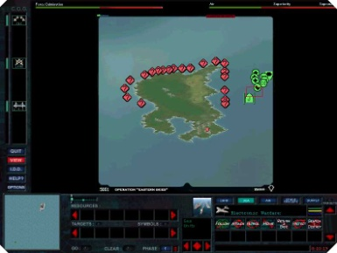
Distributed Simulations
Live
Characterized by the distributed nodes where interactions with the simulation occur
Live
Constructive
World -wide
Locally
OR
Virtual
Virtual
Constructive
LVC= Live + Virtual + Constructive
An example could be a Navy ship pier-side in Norfolk, Va., directing an exercise air strike mission flown by pilots in aircraft simulators located in San Diego, Ca, and Whidbey Island, WA.
Notes:
The Defense Office of Prepublication and Security Review (DOPSR) has cleared this document for public release (Distribution A) (Case No. 21-S-0134)

Slide 19
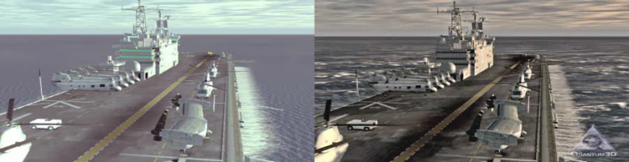
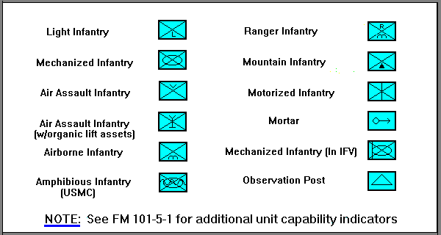
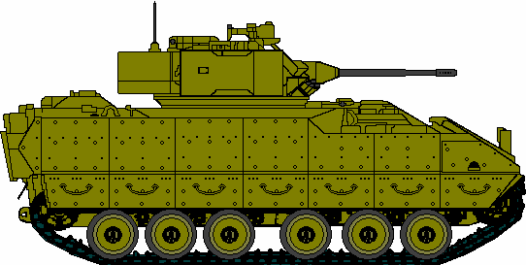
Resolution, Aggregation, and Fidelity
Resolution: The degree of detail and precision used in the representation of an item or the real world aspects in a model or simulation
Models and simulations at lower levels of M&S “pyramid” tend to exhibit more resolution; this does not necessarily imply more accuracy
Aggregation: The ability to group entities while preserving the salient effects of entity behavior and interaction while grouped
  “Campaign-level” simulations often aggregate military entities into larger groups (e.g., brigades vs. battalions)
Entity
Count
1
Entity
Count
3
Entity
Count
12
Fidelity: The accuracy of the representation when compared to the real world ^{[2]}
  Greater fidelity does not imply greater resolution
Refs: [1] DoD Modeling and Simulation (M&S) Glossary, July 1, 2013
[2] DoD Directive 5000.59-P, DoD Modeling and Simulation (M&S) Master Plan, 1995
Notes:
The Defense Office of Prepublication and Security Review (DOPSR) has cleared this document for public release (Distribution A) (Case No. 21-S-0134)

Slide 20
Agenda
PART 1
Basic Basic Modeling and Simulation Concepts
Key Enabling Concepts
Architectures and Standards
Interoperability
Simulation Development Process
Verification, Validation, and Accreditation (VV&A) Process
PART 2
Key Defense Activities Enabled by M&S:
    Systems Engineering
    Analysis
    Experimentation and Technology
    Intelligence
    Medical
    Planning
    Test and Evaluation
    Training
Supporting US DoD Organizations and other M&S Resources
Notes:
The Defense Office of Prepublication and Security Review (DOPSR) has cleared this document for public release (Distribution A) (Case No. 21-S-0134)

Slide 21
Simulation Architectures
Large problems are addressed by:
  Breaking the problem into manageable/functional pieces
  Solving individual pieces in functional areas
  Re-assembling all the required pieces to create the solution for the overall problem
Simulation Federations are often built in much the same way:
  Individual Simulations are built by the experts for a specific purpose
  Simulation “Federations” are integrated together for a larger functional purpose by distributed simulation architectures
US DoD has 3 primary distributed simulation architectures: DIS, HLA, TENA
  Often, larger distributed exercises combine these different architectures to link together many simulations of various domain aspects and beyond basic warfighting (e.g.: Cyber, C2, WMD)
  Gateways (software modules) translate from one architecture to another
Gaming architectures and simulation frameworks/digital ecosystems are now becoming more widely used. These leverage application cloud capabilities to distribute simulation content and interactivity with participants, and offer data commonality internally to that framework
Notes:
The Defense Office of Prepublication and Security Review (DOPSR) has cleared this document for public release (Distribution A) (Case No. 21-S-0134)

Slide 22
US DoD Distributed Simulation Architectures
DIS: Distributed Interactive Simulation (earliest)
  IEEE 1278 – DIS is a standard
  The standard specifies that data is passed using a protocol data unit or PDU
  DIS is widely used in simulators and will be used for the lifetime of those simulators
HLA: High Level Architecture (IEEE 1516)
  Interface specification document defines how HLA-compliant simulations interact with the Run-Time Infrastructure (RTI).
  Object Model Template (OMT) specifies what information is communicated between simulations and how it is documented.
  HLA Rules that simulations must obey to be compliant with the standard
TENA: Test and Training Enabling Architecture
  Enables interoperability among range systems, facilities, simulations, and C4ISR systems in a quick, cost-efficient manner
  Based on same foundation as HLA but specialized for needs of test ranges
Notes:
The Defense Office of Prepublication and Security Review (DOPSR) has cleared this document for public release (Distribution A) (Case No. 21-S-0134)

Slide 23
Standards
Standards provide essential functionality
  Communication: ability to move data and link execution across different machines and sometimes across large distances
  Interoperability: ability to exchange data and the ability to interpret it consistently (common context via standards – and design to a common set of standard interfaces)
  Reusability: ability to adapt components (e.g., ideas, whole simulations, modules) for new simulation applications - with interfaces documented in a standard
  Cost Savings:
    Avoids expenses of moving people and equipment – allow use of unique resources
    Seek to build once and use many times (modular)
Notes:
The Defense Office of Prepublication and Security Review (DOPSR) has cleared this document for public release (Distribution A) (Case No. 21-S-0134)

Slide 24
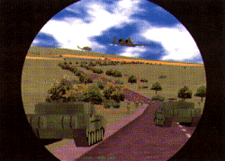
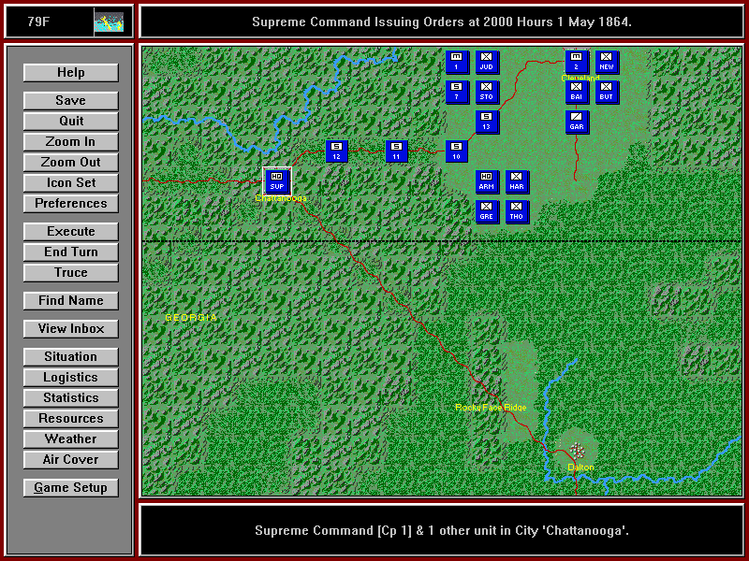
Interoperability in M&S
Virtual Simulation
Constructive Simulation
M&S Interoperability. Is the ability of a model or simulation to provide services to and accept services from other models and simulations, and to use these exchanged services to operate effectively together.
DoD M&S Glossary
Linking these two simulations together in real time execution is Interoperability
A key interoperability challenge is “Unintended Use”
Notes:
The Defense Office of Prepublication and Security Review (DOPSR) has cleared this document for public release (Distribution A) (Case No. 21-S-0134)

Slide 25
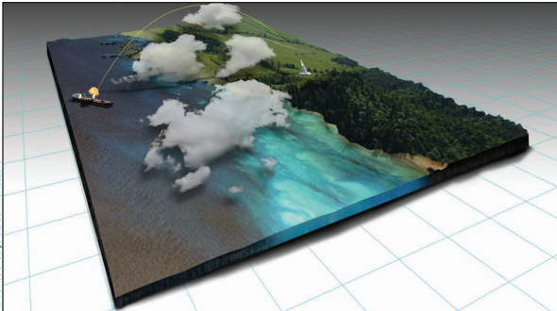
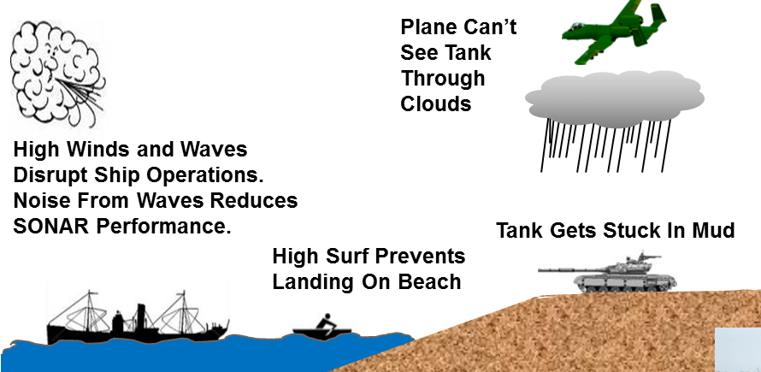
Environment in Simulation
Simulations require specific environment phenomena and their resulting impacts at varying degrees of fidelity
Example: NGA Geospatial 3-D Terrain
3D Simulation model data that Incorporates
elevation, time, and motion
National Geospatial Agency GEOINT Basic Doctrine Publication 1.0;
https://www.nga.mil/resources/GEOINT_Basic_Doctrine_Publication_10_.html
Notes:
The Defense Office of Prepublication and Security Review (DOPSR) has cleared this document for public release (Distribution A) (Case No. 21-S-0134)

Slide 26
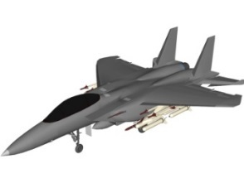
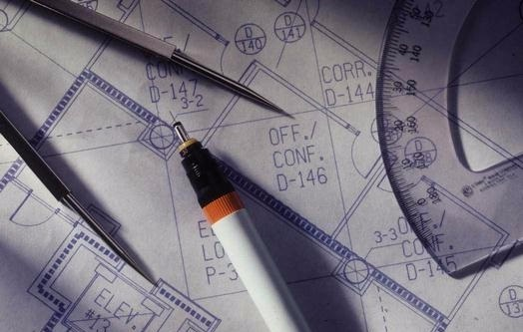

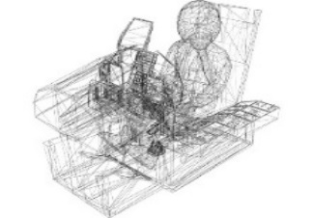
Verification, Validation, and Accreditation (VV&A) Process
Verification
Verification. The process of determining that a model or simulation implementation and its associated data accurately represent the developer’s conceptual description and specifications. DoD M&S Glossary
“Did I build it right?”
Ref: DoD Instruction (DoDI) 5000.61 DoD Modeling and Simulation (M&S) Verification, Validation, and Accreditation (VV&A), October 15, 2018; https://www.esd.whs.mil/Portals/54/Documents/DD/issuances/dodi/500061p.pdf
Notes:
The Defense Office of Prepublication and Security Review (DOPSR) has cleared this document for public release (Distribution A) (Case No. 21-S-0134)

Slide 27

Verification, Validation, and Accreditation (VV&A) Process
Validation
Validation. The process of determining the degree to which a model or simulation and its associated data are an accurate representation of the real world from the perspective of the intended uses of the model. DoD M&S Glossary
“Did I build the right thing?”
Ref: DoD Instruction (DoDI) 5000.61 DoD Modeling and Simulation (M&S) Verification, Validation, and Accreditation (VV&A), October 15, 2018; https://www.esd.whs.mil/Portals/54/Documents/DD/issuances/dodi/500061p.pdf
Notes:
The Defense Office of Prepublication and Security Review (DOPSR) has cleared this document for public release (Distribution A) (Case No. 21-S-0134)

Slide 28
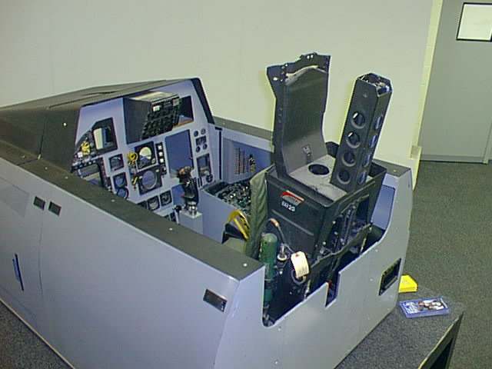
Verification, Validation, and Accreditation (VV&A) Process
Accreditation
Accreditation. The official certification that a model or simulation and its associated data are acceptable for use for a specific purpose. DoD M&S Glossary
“It meets my specific needs for…….”
Ref: DoD Instruction (DoDI) 5000.61 DoD Modeling and Simulation (M&S) Verification, Validation, and Accreditation (VV&A), October 15, 2018; https://www.esd.whs.mil/Portals/54/Documents/DD/issuances/dodi/500061p.pdf
Notes:
The Defense Office of Prepublication and Security Review (DOPSR) has cleared this document for public release (Distribution A) (Case No. 21-S-0134)

Slide 29
Verification, Validation, and Accreditation (VV&A) Process
Example
Artificial intelligence/Machine Learning (AI/ML)
AI/ML capabilities are a special case of M&S as AI/ML software applications are models and simulations that use heuristic algorithms that gain inference or “learn” from input data
The AI/ML model or simulation’s performance and output are dependent on the data sets the AI/ML capability used to gain that inference or was “trained” on
The use, and validity for use of an AI/ML capability requires knowledge of the “training” data set used to “train” the AI/ML algorithms, as well as the functional and data domain that it was designed to be used in - and was tested, verified, validated, and accredited in initially
29

Slide 30
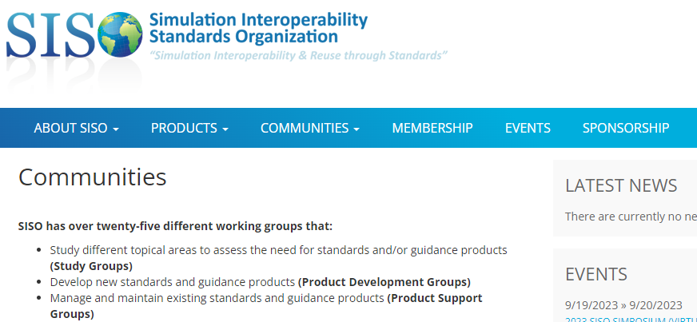
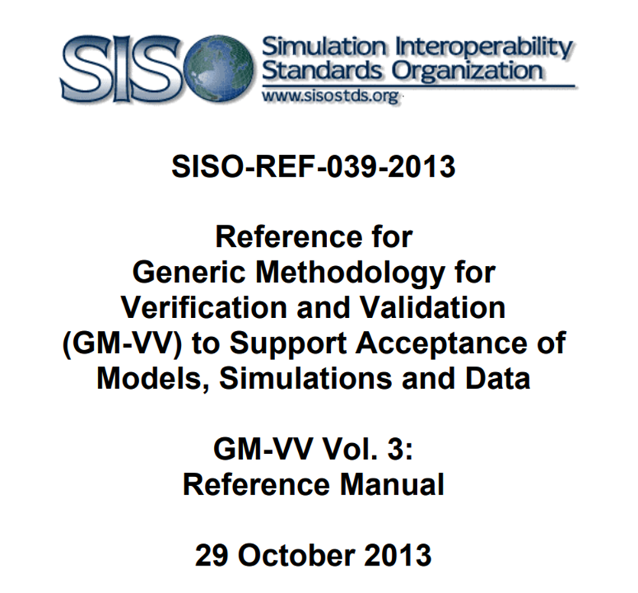
Resources for VV&A
SISO Hosts Simulation development, interoperability, and VV&A resources, standards, and community support groups
SISO has working groups that: Study different topical areas to assess the need for standards and/or guidance products (Study Groups) Develop new standards and guidance products (Product Development Groups) Manage and maintain existing standards and guidance products (Product Support Groups) Includes VV&A guidance/resources and a VV&A Product Support Group!
https://www.sisostandards.org/page/GuidanceProducts
Notes:
Ref: https://vva.msco.mil/
Retrieved from: https://vva.msco.mil/
DIST A public DoD website
June 14, 2022

Slide 31
Agenda
PART 1
Basic M&S Concepts
Key Enabling Concepts
PART 2
Key Defense Activities Enabled by M&S:
    Systems Engineering
    Analysis
    Experimentation and Technology
    Intelligence
    Medical
    Planning
    Test and Evaluation
    Training
Supporting US DoD Organizations and Other M&S Resources
Notes:
The Defense Office of Prepublication and Security Review (DOPSR) has cleared this document for public release (Distribution A) (Case No. 21-S-0134)

Slide 32
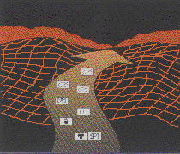
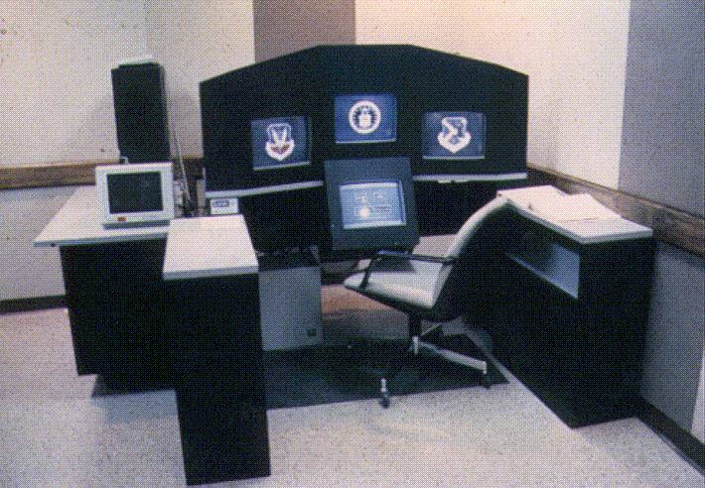

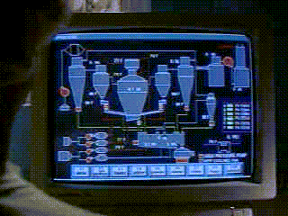



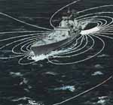

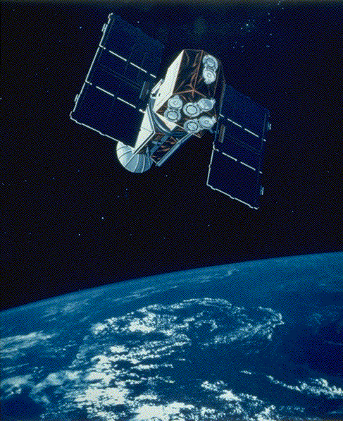
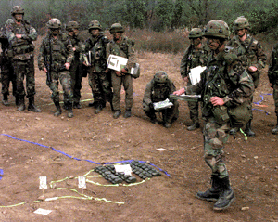
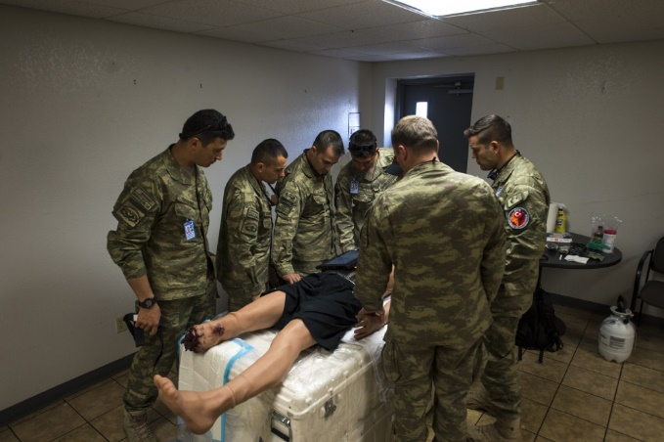
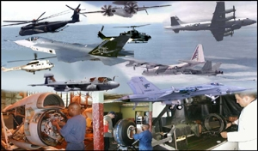
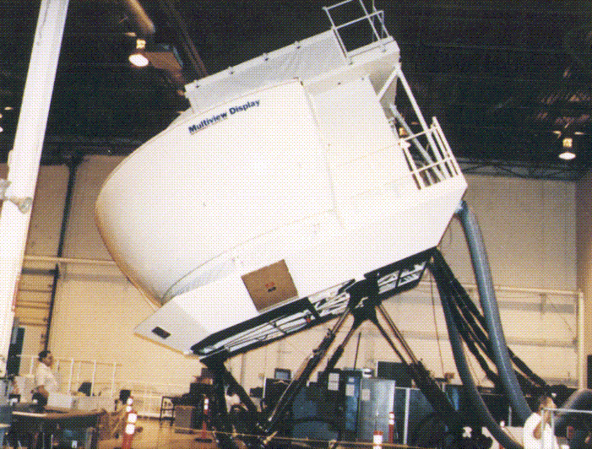



Some Key Defense M&S Users
Experimentation and Technology
Analysis
Systems Engineering
Medical
Intelligence
Planning
Test & Evaluation
Training
Notes:
The Defense Office of Prepublication and Security Review (DOPSR) has cleared this document for public release (Distribution A) (Case No. 21-S-0134)

Slide 33

M&S use in Systems Engineering: Digital Engineering
Figure 6 provides examples of models, simulations and analyses throughout the life cycle.
“An integrated digital approach that uses authoritative sources of systems’ data and models as a continuum across disciplines to support life cycle activities from concept through disposal”
The U.S. DoD has established the formal planning,
development and use of models as an integral part of performing engineering activities as a continuum across the lifecycle – resulting in a continuous
end-to-end digital representation of the system
Relies on M&S for engineering design and analysis, systems engineering processes (Cost, Schedule, Performance), and other acquisition processes
Ref: (1) DoD Digital Engineering Strategy June 2018
https://www.cto.mil/news/digital-engineering-practice/
(2) DoDI 5000.97 Digital Engineering
https://www.esd.whs.mil/Directives/issuances/dodi/
Notes:
Ref: DoD Digital Engineering Strategy June 2018
https://ac.cto.mil/digital_engineering/ DIST A
Retrieved from:
https://ac.cto.mil/wp-content/uploads/2019/06/2018-Digital-Engineering-Strategy_Approved_PrintVersion.pdf
DIST A public DoD Website
6/14/2022

Slide 34

M&S use in Systems Engineering: Mission Engineering
Figure 6 provides examples of models, simulations and analyses throughout the life cycle.
“The deliberate planning, analyzing, organizing, and integrating of current and emerging operational and system capabilities to achieve desired warfighting mission effects… Systems and SoS in an operational mission context. “
Mission‐focused analysis to evaluate solutions, advise on development of requirements and inform technology investment decisions
Feedback from Mission space back to individual System
Relies on M&S to determine System and System of Systems Mission Performance
Ref: DoD Mission Engineering Guide October 2023
https://ac.cto.mil/wp-content/uploads/2023/11/MEG_2_Oct2023.pdf
Notes:
Ref: DoD Mission Engineering Guide November 2020 (Dist A)
Retrieved from: https://ac.cto.mil/wp-content/uploads/2020/12/MEG-v40_20201130_shm.pdf
DIST A public DoD Website
6/14/2022

Slide 35

M&S use in Systems Engineering: Model-Based SE
Figure 6 provides examples of models, simulations and analyses throughout the life cycle.
“Model-Based Systems Engineering (MBSE) is the formalized application of
modeling to support system requirements, design, analysis, verification and
validation activities beginning in the conceptual design phase and continuing
throughout development and later life cycle phases.”
MBSE is part of a long-term trend toward model-centric approaches adopted by other engineering disciplines, including mechanical, electrical and software
Formalizes the practice of Systems Engineering (SE) and systems development through modeling
Broad in scope; Includes multiple modeling domains across life cycle from SOS to component
Results in more quality/productivity & lower risk
Relies on M&S to perform Systems Engineering with the System/SoS Perspective and to provide a digital modeling continuum of all SE processes across the entire lifecycle
Ref: INCOSE SE Vision 2020 (INCOSE-TP-2004-004-02, Sep 2007)
https://sdincose.org/wp-content/uploads/2011/12/SEVision2020_20071003_v2_03.pdf
Notes:
Ref: INCOSE SE Vision 2020 (INCOSE-TP-2004-004-02, ver 2.03, Sep 2007)
Retrieved from: https://sdincose.org/wp-content/uploads/2011/12/SEVision2020_20071003_v2_03.pdf
June 14, 2022

Slide 36

M&S use in Analysis
US DoD analysts use models and simulations to conduct studies and assessments of:
- Strategy
- Resource Allocation
- Operations
- Doctrinal Concepts
- Tactics
- Program Evaluation
- Logistics/Supply Chain analysis
Example: C4I Network Simulation
and Analysis:
Dynamic modeling of Networks in mission scenarios
Cyber vulnerabilities identification
Analysis of mission capability
Cost analysis in network design/procurement
Future Conflicts
Relies on M&S to conduct analysis on complex systems/SoS
Notes:
The Defense Office of Prepublication and Security Review (DOPSR) has cleared this document for public release (Distribution A) (Case No. 21-S-0134)

Slide 37

M&S use in Experimentation and Technology
Explore new concepts, tactics, processes
Investigate cause-and-effect relationships underlying capability development
Investigate futuristic scenarios without risking harm to humans and/or infrastructure
Integrate experiments into training and/or operational tests
Prototyping capabilities in realistic conditions
Mitigate risk for technical advancements
Example: Performance Modeling
Virtual Hypersonic vehicle:
Mission success evaluation
System degradation effects
Dynamic simulation in regions beyond
Wind tunnel capability/practicability
Relies on M&S for insight
and engineering analysis
Notes:
The Defense Office of Prepublication and Security Review (DOPSR) has cleared this document for public release (Distribution A) (Case No. 21-S-0134)

Slide 38


M&S use in Intelligence
Foreign Force Modeling
• Threat representation
• Foreign capabilities
• Authoritative data
Forecast Analysis
• Adversary intent
Example: “Red Force” Capability Simulation:
Accurate models (“twins”) of Red Capabilities
Counter mission success evaluation
Analysis of physical and virtual capabilities (e.g. AI)
Forecasting trends
Can include human, socioeconomic, manufacturing
and technology considerations
Leveraged for use in “Blue” acquisition
Relies on M&S for technical analysis and integration of multiple sources - prediction
Notes:
The Defense Office of Prepublication and Security Review (DOPSR) has cleared this document for public release (Distribution A) (Case No. 21-S-0134)

Slide 39



M&S use in Test & Evaluation
Expands test scenario possibilities
Assists in testing complex systems
Helps guide selection of test conditions
Supports analysis of test and evaluation results
Virtual testing of complex and non-physical systems
Testing AI and AI use in testing
Example: Virtual Cyber Range:
Virtual range for virtual capabilities
Rapidly and realistically represent operational
environments at different levels of security,
fidelity, and/or scale
Precise control of the test environment
Relies on M&S for Testing without physical infrastructure, testing beyond safe or operational ranges, and complex testing beyond traditional techniques
Notes:
The Defense Office of Prepublication and Security Review (DOPSR) has cleared this document for public release (Distribution A) (Case No. 21-S-0134)

Slide 40

M&S use in Medical
US DoD Medical uses:
Education & training
  Exposure to high-risk emergencies
  Doctor to Corpsman
  Mass casualty/Disaster relief
  Sustainment training
Capabilities
  Task trainers/skill training
  Physical/virtual mannequins
  Virtual trainers with haptic feedback
Example: Anesthesiologist virtual interactive training
Relies on M&S for a virtual environment where we can learn and practice medical techniques without risk to patients
Ref: American Society of Anesthesiologists (ASA)
https://www.asahq.org
40
Notes:
The Defense Office of Prepublication and Security Review (DOPSR) has cleared this document for public release (Distribution A) (Case No. 21-S-0134)

Slide 41



M&S use in Operational Planning
Operational planning
Force structure analysis
Operational concept development
Logistics Planning
Time-Phased Force & Deployment Data (TPFDD) projections
Example: Naval Operational Supply System:
Near real-time/accurate logistics readiness picture
Distance support solutions
Enterprise decision making/execution,
Cost savings and increased readiness
Supply Chain planning and pre-positioning
Relies on M&S for a virtual planning process where we can optimize with all actors in play
Notes:
The Defense Office of Prepublication and Security Review (DOPSR) has cleared this document for public release (Distribution A) (Case No. 21-S-0134)

Slide 42




M&S use in Training
Trainers use M&S to:
Train commanders, staffs, units,
and operators
Practice new processes and
tactics
Refine standard procedures
Exercise new equipment and
technologies
Example: Training Displays at I/ITSEC
Look anywhere on the floor!!
Notes:
The Defense Office of Prepublication and Security Review (DOPSR) has cleared this document for public release (Distribution A) (Case No. 21-S-0134)

Slide 43
Agenda
PART 1
Basic M&S Concepts
Key Enabling Concepts
PART 2
Key Defense Activities Enabled by M&S
Supporting US DoD M&S Organizations and other M&S Resources
Notes:
The Defense Office of Prepublication and Security Review (DOPSR) has cleared this document for public release (Distribution A) (Case No. 21-S-0134)

Slide 44
Supporting US DoD M&S Organizations and other M&S Resources
Some key DoD organizations supporting Defense M&S:
  a screen capture of their home Web presence and internet addresses
  Short discussion of their function/purpose
Some key non-DoD organizations supporting Defense M&S:
  a screen capture of their home Web presence and internet addresses
  Short discussion of their function/purpose
44
Notes:
Author: J.J. Daly June 2022

Slide 45

Modeling and Simulation in the US DoD: OSD
https://www.cto.mil/sea/dems/
Provides access to:
DoD Digital Engineering, Modeling and Simulation information and the
Digital Engineering Body of Knowledge (DEBoK) and Glossary (https://www.de-bok.org/glossary)
Verification, Validation, and Accreditation Recommended Practices Guide
Notes:
Ref: https://www.msco.mil
Retrieved from: https://www.msco.mil
DIST A public DoD website
September 28, 2022

Slide 46

Modeling and Simulation in the US DoD: ARMY
AMSO's Mission
The Army Modeling Simulation Office serves as HQDA’s lead activity to:
Develop the strategy and policy for Army Modeling and Simulation Enterprise
Execute effective governance and resource management through leadership and synchronization
Lead coordination of the Army modeling and simulation enterprise and cross-community areas including Joint, Intergovernment, Interagency, and Multinational environments
Train, Educate and Manage the Army Analysis, Modeling & Simulation M&S Workforce (Military and Civilian)
https://www.ms.army.mil/
Notes:
Ref: https://www.ms.army.mil/
Retrieved from: https://www.ms.army.mil/
DIST A public DoD website
June 14, 2022

Slide 47

Modeling and Simulation in the US DoD: Air Force
AIR FORCE M&S VISION
Modeling and simulation capabilities enabling the United States Air Force to organize, train, educate, equip, and employ current and future air, space, and cyberspace forces for the full range of operations.
https://www.afams.af.mil/
Notes:
Ref: https://www.afams.af.mil/
Retrieved from: https://www.afams.af.mil/
DIST A public DoD website
June 14, 2022

Slide 48

Modeling and Simulation in the US DoD: Marines
MCMSO serves as the Marine Corps single point of contact on all Marine Corps modeling and simulation matters, and for coordination with the other Services, DoD, Joint Staff, and other agencies' M&S organizations. MCMSO supports its mission through leading the USMC M&S Integrated Process Team (IPT), individual coordination with Marine Corps activities utilizing
M&S and representing the Marine Corps in DoD.
https://www.cdi.marines.mil/Units/OAD/MCMSO/
Notes:
Ref: https://www.mccdc.marines.mil/Units/OAD/MCMSO.aspx
Retrieved from: https://www.mccdc.marines.mil/Units/OAD/MCMSO.aspx
DIST A public DoD website
June 14, 2022

Slide 49


Modeling and Simulation in the US DoD: Navy
WELCOME TO THE NAVY MODELING & SIMULATION OFFICE
The Navy Modeling and Simulation Office (NMSO) is chartered to promote the discovery and reuse of modeling and simulation (M&S) resources, provide information on policy, data, and services, and to serve as the "action arm" of the Navy Modeling and Simulation Governance Board. As such, NMSO provides administrative support for the Navy Community Leads as well as the M&S community of users. Additionally, NMSO provides core services and products to improve M&S within, between, and across organizations. Finally, NMSO provides assistance to promote and implement cross-cutting M&S projects that improve Navy M&S capabilities. NMSO is part of the Deputy Assistant Secretary of the Navy Research, Development, Test and Evaluation (DASN(RDT&E)) organization
https://www.cdi.marines.mil/Units/OAD/MCMSO/NMSO/
Notes:
Ref: https://www.mccdc.marines.mil/Units/OAD/MCMSO/NMSO//
Retrieved from: https://www.mccdc.marines.mil/Units/OAD/MCMSO/NMSO//
DIST A public DoD website
June 14, 2022

Slide 50

Simulation Interoperability Standards Organization (SISO)
SISO has over twenty-five different working groups that: Study different topical areas to assess the need for standards and/or guidance products (Study Groups) Develop new standards and guidance products (Product Development Groups) Manage and maintain existing standards and guidance products (Product Support Groups)
The Simulation Interoperability Standards Organization (SISO) is an international organization dedicated to the promotion of modeling and simulation interoperability and reuse for the benefit of a broad range of M&S communities.
https://www.sisostandards.org/
50
Notes:
Ref: https://www.sisostds.org
Retrieved from: https://www.sisostds.org
6/15/2022
A Public Website

Slide 51

NATIONAL TRAINING & SIMULATION ASSOCIATION (NTSA)
https://www.ntsa.org/
51
Notes:
Ref: https://www.ntsa.org/#
Retrieved from: https://www.ntsa.org/#
6/15/2022
A Public Website

Slide 52

National Defense Industrial Association (NDIA)
System Engineering Division (M&S Committee)
https://www.ndia.org/divisions/systems-engineering/committees/modeling-simulation-committee
52
Notes:
Ref: https://www.ntsa.org/#
Retrieved from: https://www.ntsa.org/#
6/15/2022
A Public Website

Slide 53
Summary and Questions
Learning Objectives:
  Explain the scope and the fundamental terms and concepts associated with Defense Modeling and Simulation
  Identify key policies and procedures for U.S. DoD Modeling and Simulation
  Summarize key Defense Activities enabled by Modeling and Simulation
  Discover Defense Modeling and Simulation information resources
Questions?
Notes:
The Defense Office of Prepublication and Security Review (DOPSR) has cleared this document for public release (Distribution A) (Case No. 21-S-0134)

