Slide 1
Simulation Conceptual Modeling
Theory and Application
Mr. Jack “Jake” Borah
jborah@sprynet.com
(407) 929-9370

Slide 2
Learning Objectives
After this tutorial, the attendees should be able to
  List five purposes for simulation use
  Define simulation conceptual modeling (SCM) terminology
  Describe SCM development phases
  Explain differences between informal and formal SCMs
  Describe how to use tools for conceptual modeling

Slide 3
Tutorial Outline
Conceptual Modeling Background
  Simulation Conceptual Model (SCM) Basics
  SCM Purposes
Modeling and Simulation (M&S) Development
  Simulation Development Process
  SCM Formats
SCM Construction
  SCM Constructs
  SCM Example
SCM Best Practices Guidance
  Use Cases 1 and 2
  NATO M&S Group 058 Report

Slide 4
Why have this tutorial?
“Conceptual Models” and “Conceptual Modeling” are nebulous terms for most simulation developers
Work by Haddix (2001) and Lacy (2001) have highlighted the need to reconcile multiple views of conceptual modeling
A critical shortcoming is that the purpose and impact of conceptual models has not been clearly understood in the community

Slide 5
What Could Go Wrong?
Adverse impacts on the simulation event objectives
Wastage time and resources of sponsor, resources and participants
Discredited simulation output
Frenzied simulation troubleshooting
On-the-fly creation of manual work-arounds

Slide 6
Modeling and Simulation (M&S) Basics
Terminology
  Model (noun): “a pattern of something to be made”
  Model (verb): “to produce a representation of or simulation of”
  Simulation: “the imitative representation of the functioning of one system or process by means of the functioning of another”
  The terms Model and Simulation are often incorrectly used
    The subtle but very important difference is that simulation is a model implemented over time
    This implies that models are static while simulations are dynamic

Slide 7
The Reason for Simulation
The military definition of a model being “a physical, mathematical, or otherwise logical representation of a system, entity, phenomenon, or process” is a good starting point, however, a major part is missing
The definition of a “model” from simulation experts supplies the missing part: the motivation for building the model and subsequently the simulation
  A representation of a system for the purpose of studying the system. (Banks, 1996)
  A set of assumptions about how a system works in the form of mathematical or logical relationships which is used to try to gain some understanding of how the corresponding system behaves. (Law, 2000)

Slide 8
The Benefit of Simulation
Or in other words:
“… cost-effective use of something in place of something else for some purpose.” (Rothenburg, 1991)
In simulation, humans can:
  Simplify complex parts of the real world
  Abstract items or events of interest
  Synthesize simplified, or abstracted elements into an alternate arrangement

Slide 9
Simulation Purposes
Five purposes have been generally established for simulation
  An aid for thought
  An aid to communication
  An aid for training and instruction
  An aid to experimentation
  A tool of prediction
But before starting simulation development a SCM should be constructed
  To help the simulation stakeholders understand what is going to be built

Slide 10
SCM Features
An abstraction from either the existing or a notional physical world that serves as a frame of reference
Documents simulation-independent views of important entities and their key actions and interactions
Describes what the simulation will represent, the assumptions limiting those representations, and other capabilities needed to satisfy the stakeholder’s requirements
Bridges between these requirements and simulation design

Slide 11
SCM Considerations
Perhaps most complex task of M&S engineering
Method to transform human ideas into executable hardware and software components
An evolutionary simulation artifact
Simulation development begins with sponsor/user interaction
Proceeds through several diverse working groups prior to delivery in final form
  Core engineering team
  Simulation designers
  Systems and network administrators
  Software engineers
  Verification and validation team

Slide 12
Simulation Development Steps
Problem Formulation / System Definition
Data Collection
Model Conceptualization
Model Validation
Model Translation
Model Verification
Model Production
Model Acceptance Testing
Model Delivery
Model Support / Maintenance
Notes:
SIMULATION USERS FREQUENTLY HAVE MULTIPLE PERSPECTIVES AS WELL

Slide 13
Simulation Development Process Flow
Real World
Start
Yes
Establish Purpose & Scope
Done?
Refine & Optimize Model
Analyze Output
No
0
0
0
0
Model
Development
Model
Application
Execute Simulation
Formulate Conceptual Model
Acquire & Analyze Data
Design Detailed Model
Verify & Validate Model
Design Experiments
Fig. 1: The Simulation Modeling Process

Slide 14
Mistakes Made During M&S Development
Failure to have a well-defined set of objectives at the beginning
Failure to communicate with sponsors on a regular basis
Inappropriate level of model detail
Inconsistent level of model detail
Treating using simulation as if it were primarily a complicated exercise in computer programming
Failure to test simulation incrementally during construction

Slide 15
Simulation Development Elements
Simulation Conceptual Model - a Communications Bridge
Model
Modeling
Simulation
“A Bridge”
Real System
Computer

Slide 16
Communicating Through SCMs
Conceptual modeling supports communication
  “The long term contribution of any modeling effort lies in the benefits it affords, either by direct use or by guidance for further development, to science and industry” (Zeigler, 1976)
Communication is achieved through:
  Informal description of the model
  Formal description of the model structure

Slide 17
SCM Construction
Informal and formal models are built during the simulation development process for differing audiences
A transformation process underlies simulation development
  The real world is too complex to be understood much less modeled by humans
  Most practical approach is to abstract key elements forming reasonable approximation of real world

Slide 18
SCM Transformations
Simplification: an analytical technique in which unimportant details are removed in order to define simpler relationships
  A problem solving technique to produce useful approximations of complex problems that yield usable results
Abstraction: an intuitive technique transforming the essential features of a real system into a different form
  A model demonstrating the qualities and behaviors of the real system without being a direct emulation of the system

Slide 19
The Resultant Model
It represents an idealized approximation of the original complex real world system
Result of the “Art of Modeling” or the process of analysis, abstraction, simplification, and synthesis within a simulation development project
  Synthesized combination of simplified and abstracted parts of real world
Part of Rothenburg’s cost-effective model constructed for a cognitive purpose
Embodiment of the communications of Zeigler’s modeling process

Slide 20
Formal and Informal SCMs
Conceptual Model
Informal
Formal
Modeling
Simulation
Real System
Computer

Slide 21
Informal SCM
1.
1.
2.
2.
1.
3
3
2.
3
1.
1.
2.
2.
1.
Domain Experts
2.
Publications
Regulations
Structured, Synthesized
Legacy Systems
Information
Domain Analysis

Slide 22
The Informal SCM
Written using natural language and contains assumptions made during its construction
Plays fundamental role during the period of activity when the modeler conceives, programs, debugs, and tests models
Helps users and colleagues comprehend basic outline of the model from their perspective on how the real world operates

Slide 23
Informal SCM Representations
Natural Language Requirement
Shortcomings of specialized syntax and semantics tools
  Unfamiliarity
  Complexity
  Cost
General purpose office suite
  Word processor
  Graphics or Drawing application
  Spreadsheet

Slide 24
Informal SCM
(Model Description Report Example I)
Chapter | Purpose | Sections | Subsections
Model Recognition | To produce a set of requirements that will drive Model design activities and provide criteria by with the success of the Model development will be judged. | Introduction
 |  | Intended Use
 |  | Modeling and Simulation Application
Model Definition | To produce an implementation-independent conceptual depiction of the real-world that must be represented in the Model application. | Assumptions
 |  | Limitations
 |  | Capabilities
 |  | Requirements
 |  | Risk and Impacts
 |  | Interfaces | Data Import
 |  |  | Data Fetch
 |  |  | Data Export
 |  | Referent Data Identification
Model Design | To translate the Model Definition data into a Model capable of implementing as a simulation. | Behavioral Diagrams and Algorithms
 |  | Data Structures
 |  | Model Integration Updates

Slide 25
Informal SCM
(Model Description Report Example II)
Chapter | Purpose | Sections | Subsections
Model Implementation | To monitor and document Model development activity. | Model Development
Verification | To ensure all features, functions, behaviors, and interactions defined in Model Design can be traced to requirements expressed in Model Definition and have been articulated in the simulation. | Test Plan
 |  | Test Descriptions
 |  | Test Results
Integration and Test | To verify all requirements expressed in the Model's Intended Use (Model Recognition) have been implemented by testing the Model in a representative simulation domain. | Test Descriptions | Non-functional Tests
 |  |  | Closed-Loop Tests
 |  |  | Functional Tests
 |  | Integration and Test Results | Non-functional Tests
 |  |  | Closed-Loop Tests
 |  |  | Functional Tests

Slide 26
Informal SCM
(Model Description Report Example III)
Chapter | Purpose | Sections | Subsections
Validation Plans | To document validation requirements, expected data, validation tools, and processes.
Validation Results | To evaluate the resultant data, performance of the validation tools, and the processes.
Maintenance | To document Model notes, information and maintenance plans.
Appendices |  | Acronyms
 |  | Bibliography | Government Documents
 |  |  | Non-government Documents
 |  | To Be Determined/ To Be Resolved Resolution Issue Tables

Slide 27
Informal SCM
(Example in a Document Format I)

Slide 28
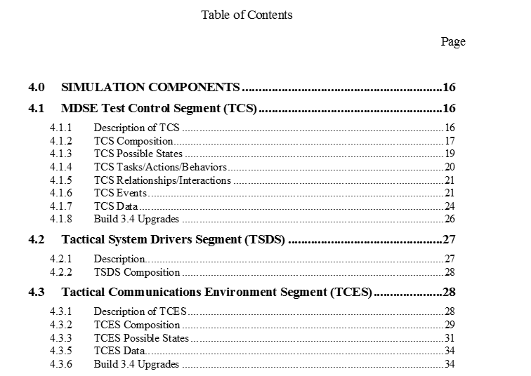
Informal SCM
(Example in a Document Format II)

Slide 29
Informal SCM
(Mind Map Format Example)
The informal SCM is first component of full and complete SCM
Freemind Mind (freeware) mapping software was used to frame this informal SCM

Slide 30
Mind Mapping Software
General purpose office suite shortcoming
  “Expressive Power”
Mind mapping software
  Organizing tool for disorganized mind
  A diagram used to represent words, ideas, tasks or other items linked to and arranged radially around a central key word or idea. … It is an image-centered diagram that represents semantic or other connections between portions of information
  Expressive
  Transportable
  Inexpensive

Slide 31
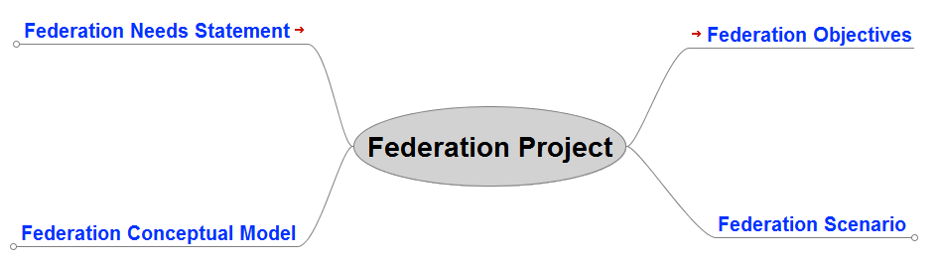
Mind Mapping Informal SCM (Overview)

Slide 32
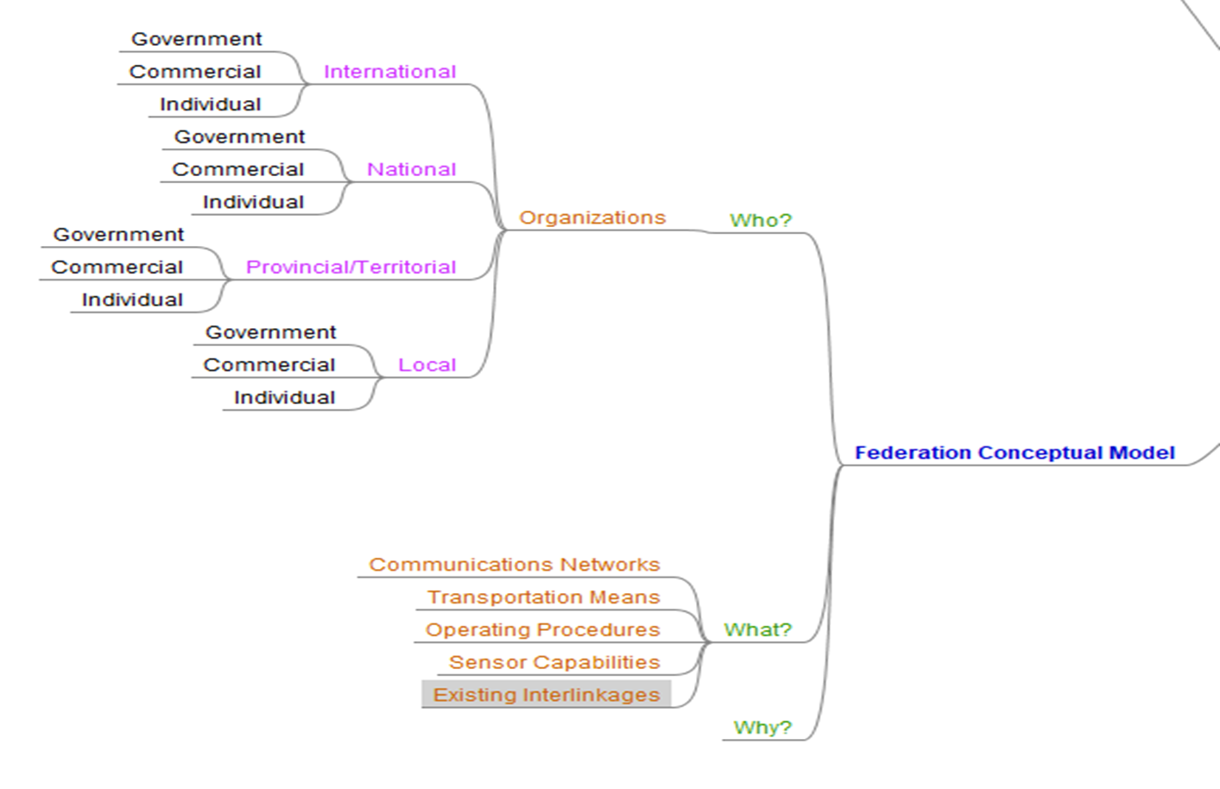
Mind Mapping Informal SCM (CM Expanded)

Slide 33
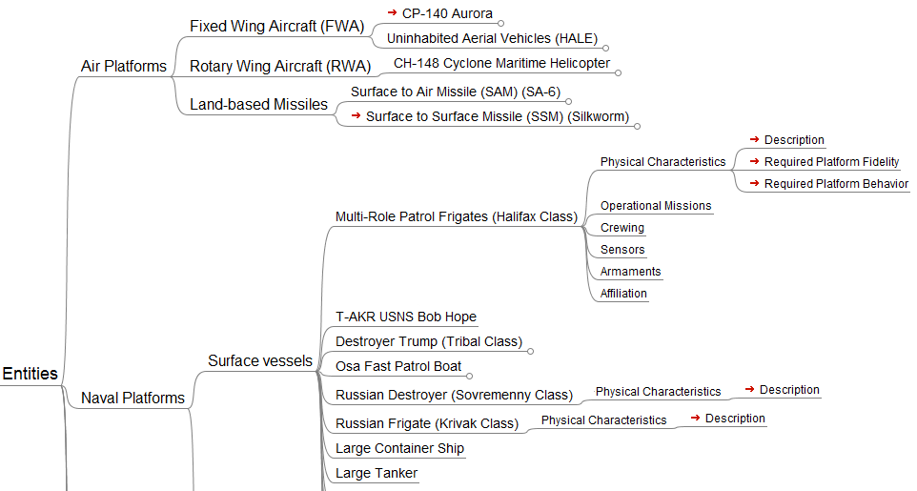
Mind Mapping Informal SCM (Scenario Expanded)

Slide 34
Formal Simulation Conceptual Modeling
“IS-A”
“HAS-A”
Associations
Problem
Domain
Static Structure Diagrams
Use Case
Sequence
Collaboration
Dynamic Structure Diagrams
Domain Analysis
Domain Modeling

Slide 35
The Formal SCM
Unambiguous description of model structure separated from software implementation
Useful once users and colleagues understand informal model and want more detail
Used as an aid to detect omissions and inconsistencies and resolve ambiguities inherent in informal models

Slide 36
Formal Conceptual Model as UML Diagram

Slide 37
Other Formal Conceptual Model Formats
Structured Analysis
Data Flow Modeling
Entity Relationship Modeling
Petri Nets
State Transition Modeling
Object Role Modeling
Unified Modeling Language
Department of Defense Architecture Framework (DoDAF)

Slide 38
Conceptual Modeling and the DSEEP
IEEE Recommended Practice for Distributed Simulation Engineering and Execution Process (DSEEP)
  IEEE Std 1730TM-2022
Step 2 “Perform Conceptual Analysis”
  Develop an appropriate representation of the real-world domain that applies to the defined problem space
Activity 2.2 “Develop Conceptual Model”
  Implementation-independent representation
  Vehicle for transforming objectives into functional and behavioral descriptions
  Crucial traceability link between objectives and design implementation

Slide 39
DSEEP Activity 2.2 Recommended Tasks
Choose conceptual modeling technique and model format
Identify and describe all relevant entities
Define static and dynamic relationships between entities
Identify events of interest
Capture concept of operations
Document the conceptual model and modeling decisions
Have stakeholders verify conceptual model contents

Slide 40
Conceptual Models / Conceptual Scenarios
Guideline on Scenario Development for Simulation Environments
  SISO-GUIDE-006-2018
  DSEEP Step 2 Activity 2.1 “Develop Scenario”
Conceptual model describes entities and their interrelationships
Conceptual scenario is detailed description of a part of the real world chosen for simulation
Conceptual models and conceptual scenarios must be aligned for completeness and consistency

Slide 41
Precepts of Simulation Conceptual Modeling I
A SCM should be malleable and adopt a coherent form located within one model appropriate for each particular simulation development phase
Highly unstructured, informal models are sufficient during early simulation definition
Structured and enhanced formal models appropriate during simulation development

Slide 42
Precepts of Simulation Conceptual Modeling II
No single conceptual model due to the essence of the “Art of Modeling”
Multiple iterations of a SCM which evolve as required in simulation development
A “living” document that grows from an informal description to a formal description to communicate between the diverse groups (sponsors/users, modelers, systems engineers, and software developers) participating in a simulation development
A “roadmap” to guide the current development team and to educate / orient new teammates

Slide 43
Well-formed SCM Characteristics
Simple to understand by the user
Goal or purpose oriented
Robust, in that it does not give absurd answers
Easy for the user to control and use
Complete on important issues
Adaptable (in a maintenance sense)
Malleable (grow in sophistication over time)

Slide 44
SCMs Observations
A simulation developer’s method of translating modeling requirements into a detailed design framework (Pace, 2003)
Result of the “Art of Modeling” or the process of analysis, abstraction, simplification, and synthesis within a simulation development project
A role of the SCM is to document all requirements of the system and subsequent requirements and analysis of the models/federations
  Enables an orderly systems engineering flow during the simulation development

Slide 45
Simulation Conceptual Modeling Problems
No hard and fast rules concerning model formulation (Uncertainty for both the developer and user)
  What does a Conceptual Model look like?
No magic formulas governing what should be included in a model in the form of variables and parameters, descriptive relationships and constraints, or criterion for judgment of effectiveness (Lack of Standardized Processes)
  What should a Conceptual Model contain?
Nobody solves the problem, rather everybody solves the model that they have constructed of the problem (Diversity and Inherent Incompatibility)
  What technique to use? UML, DoDAF, IDEF0,….

Slide 46
Example SCM- Problem Definition
Air to Air Missile Simulation
  A tool to support development of future air-to-air missiles
  The simulation will provide credible representations of offensive and defensive air forces to assist the development of an operational air-to-air missile
  The simulation will be used as an aid for experimentation
  The simulation will be used as a tool for prediction

Slide 47
Example SCM - Purpose Definition
  Should the simulation be stochastic or deterministic?
    Stochastic would produce variable outcomes based upon random variables in probabilistic algorithms
    Deterministic would produce consistent outcomes based upon nonrandom variables in ordered algorithms
  A simulation used for training should generate consistent outcomes
    Instructors will want a simulation that produces predictable outcomes so that training objectives will be met
  A simulation used for analysis should generate variable outcomes
    Analysts will want to approximate the characteristics of a study population
  The purpose of the simulation will have an impact during the implementation phase of the simulation

Slide 48
Example SCM- Simulation Conceptualization
How to provide credible representations of offensive and defensive air forces?
First Step
  Document the key entities which should be represented in the training environment
Second Step
  Document the behaviors of the key entities which should be represented in the training environment
  Important to remember this is a simulation not an emulation of the real world
  Just because it exists in the real world is not automatic justification to include it in a simulation

Slide 49
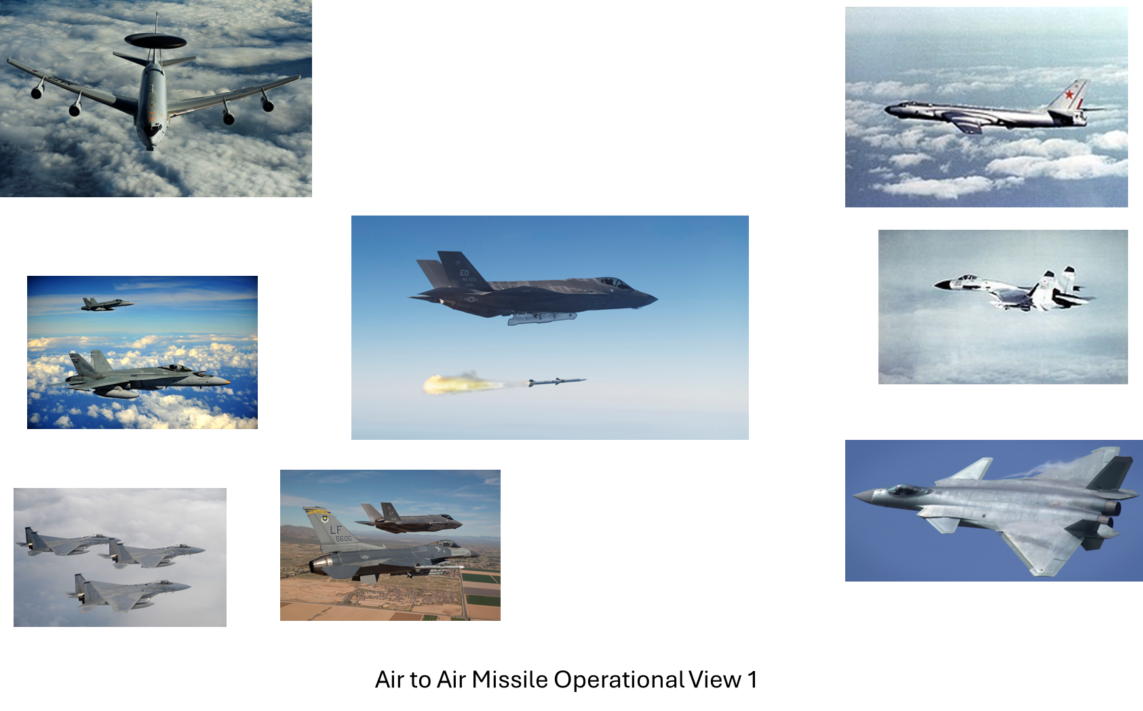
Simulation Conceptualization- Entities View

Slide 50
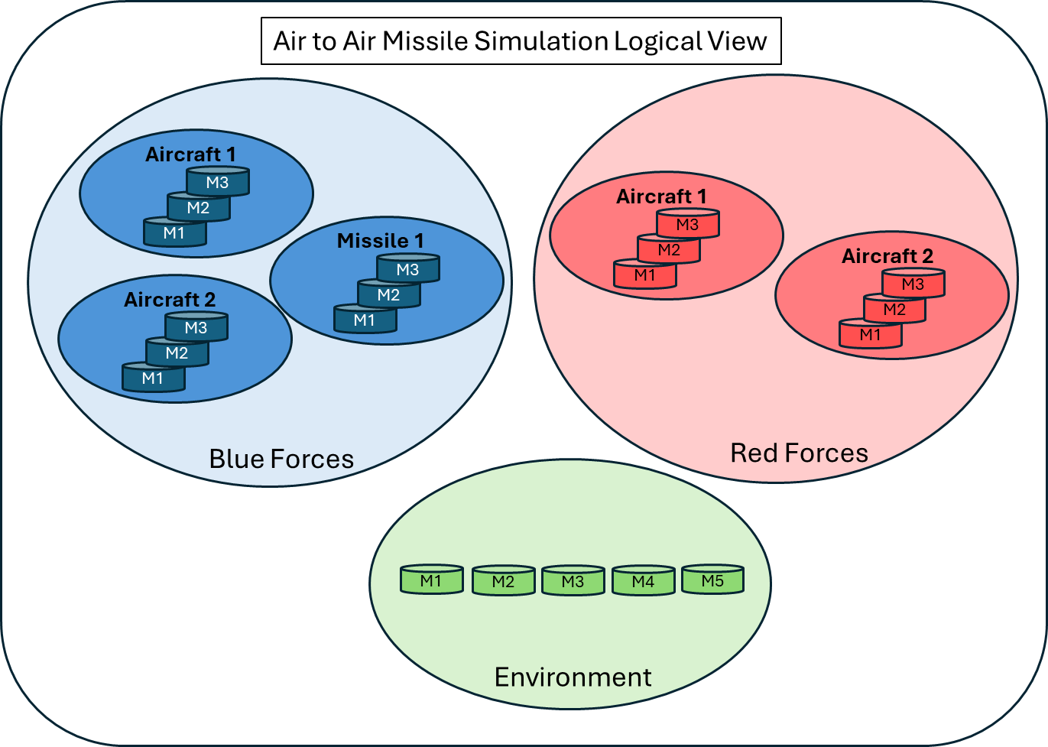
Simulation Conceptualization- Logical View

Slide 51
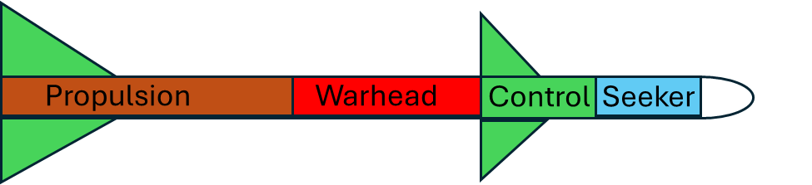
Model Conceptualization- Missile Model View
M4
Missile
M3
M2
M1
Model Description Reports (MDRs)

Slide 52
Simulation Conceptualization- Model Maturity View
Model Description Reports (MDRs)
Conception
Verification
Validation
MDI
Color
Phase
Level
Description
Concept
Geometry
Reliability &
Suitability &
Repeatability
Referent
Accuracy
Precision
Model
Stability
Maintainability
(Fidelity)
(Uncertainty)
1
Black
Concept Phase
ü
ü
ü
2
Crimson
ü
ü
ü
3
Red
Verification
ü
ü
ü
ü
ü
ü
4
Orange
Phase
ü
ü
ü
ü
ü
ü
ü
ü
ü
5
Yellow
ü
ü
ü
ü
ü
ü
6
Green
Validation
ü
ü
ü
ü
ü
ü
7
Aqua
Phase
ü
ü
ü
8
Blue
ü
ü
Ops &
9
Purple
Accreditation
ü
Phase
Note: The overall maturity level is equal to the lowest individual criterion rating.

Slide 53
Use Case 1 – Lack of Attention to Detail
How to represent global flight paths?
Several coordinate systems describe the Earth
  Latitude and Longitude
  Universal Transverse Mercator (UTM)
  Universal Polar Stereographic (UPS)
  Geodetic Height
  Cartesian Coordinates
The one chosen for simulation implementation:
  Latitude and Longitude

Slide 54
Use Case 1 – Lack of Attention to Detail
If using latitude and longitude, then global flight path becomes an algorithm calculating latitude and longitude coordinates
Simple solution for modeling in the most of the world
Except for the coordinate system boundaries

Slide 55
Use Case 1 – Coordinate Boundaries
Latitude / Longitude coordinate system boundaries
  The Equator
  The North and South Poles
  The Greenwich Meridian
  The Anti-Meridian
N
N
Equator
Greenwich
S
S

Slide 56
Use Case 1 – Coordinates-Easy to Use?
Why are these boundaries a problem?
  First, boundary needs to be recognized
  Second, calculation algorithm needs to transpose coordinates
Simple solution to implement
  Unless the developer does not know the boundary definitions and/or the correct methods to transpose coordinates when crossing boundaries

Slide 57
Use Case 1 – Latitude Basic Considerations
The Equator:
  0 degrees Latitude: Direction reverses N > S, S > N
The North and South Poles:
  90 degrees Latitude: Value increases toward pole, decreases away from pole
N 90º
N 60º
N 30º
Equator
0º
S 30º
S 60º
S 90º

Slide 58
Use Case 1 – Longitude Basic Considerations
The Greenwich Meridian:
  0 degrees Longitude: Value decreases approaching meridian, increases away from meridian, Direction reverses E > W, W > E
The Anti-Meridian
  180 degrees Longitude: Value increases approaching meridian, decreases away from meridian, Direction reverses E > W, W > E
N
180º
W 135º
E 135º
Anti-Meridian
Greenwich
W 090º
N
E 090º
Greenwich
W 045º
E 045º
S
0º

Slide 59
Use Case 1 – When the Problem Appears
  Simulation A is used to support an intelligence training scenario
    Multiple logistics aircraft flights are scripted to indicate activity
    One aircraft given a flight path which parallels a longitude meridian to the North Pole
  Simulation B crashes in the middle of the night during scenario flight out
    Developer doesn’t find a reason for crash

Slide 60
Use Case 1 – Lost Aircraft Flight Path
  Simulation B crashes second time during repetition scenario
    Developer discovers Simulation B receives “unallowable” flight position coordinates from Simulation A
    “Unallowable” coordinate is a 3 digit Latitude value in excess of 90 degrees
    Post-event a Change Request is written to remedy this miscalculation
N 90º
Equator
0º

Slide 61
Use Case 1 – How the Problem Propagates
  Simulation A developer writes new software for Change Request
    Asks Change Request Submitter to review new software
    Submitter discovers the developer doesn’t understand physics of problem
    Developer correctly limits latitude maximum value to 90 degrees
    Developer correctly calculates the latitude increases toward the North Pole, decreases away from North Pole
    Developer incorrectly calculates the longitude coordinates once aircraft “flies” over the North Pole

Slide 62
Use Case 1 – Lost Aircraft Lost Again
  Developer did not understand the difference between latitude and longitude calculations
    Developer incorrectly assumed that longitude would only require change of direction
    Correct solution would also require transposition of longitude value from “X” to “180-X” in addition to change of direction
180º
E 150º
W 135º
E 135º
W 090º
N
E 090º
W 045º
E 045º
W 030º
E 030º

Slide 63
Use Case 1 – Problem Impacts
Primary effects
  Initial problem occurrence disrupts training event operations
    Simulation A generates incredible simulation results
    Simulation A causes Simulation B to crash
  Waste of Time and Resources
    Simulation B Developer spends time investigating Simulation B crash
Secondary effects
  Additional waste of Time and Resources
    Simulation A Analyst spends time investigating Simulation A behavior
    Simulation A Developer develops initial solution for problem
    Simulation A Analyst identifies error in solution
    Simulation A Developer revises problem solution

Slide 64
Use Case 2 - Simulation Implementation
How to represent air-to-ground and ground-to-air interactions?
First Method
  Designate target
  Employ Munitions
  Calculate Munitions Time of Flight
  Calculate Munitions Effect based upon Cumulative Probabilities
Second Method
  Designate target
  Employ Munitions
  Calculate Munitions Effect using Probability of Destruction Random Number table

Slide 65
Use Case 2 - Model Conflict
Either Method could provide realistic results
But… What happens when there are 2 developers working independently on different parts of the simulation?
And... Developer 1 simulates offensive operations uses the First Method while Developer 2 simulates defensive operations uses the Second Method?

Slide 66
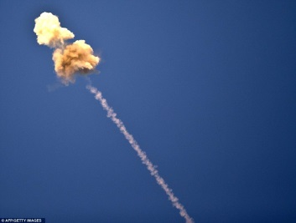
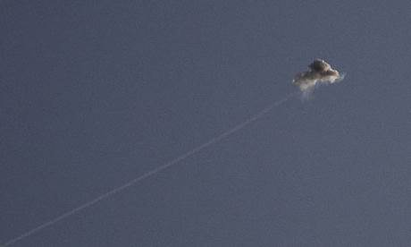
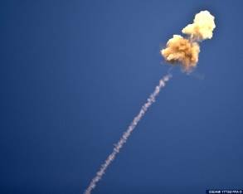
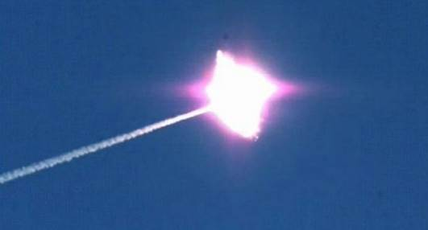
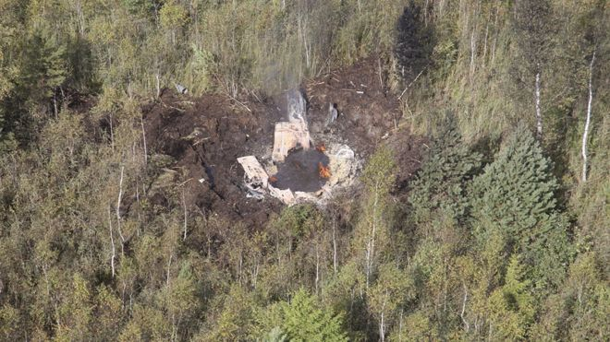
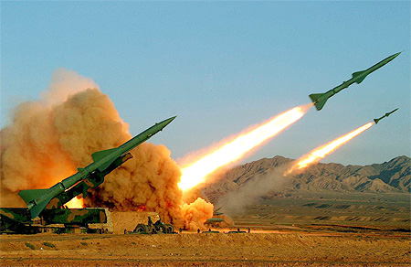
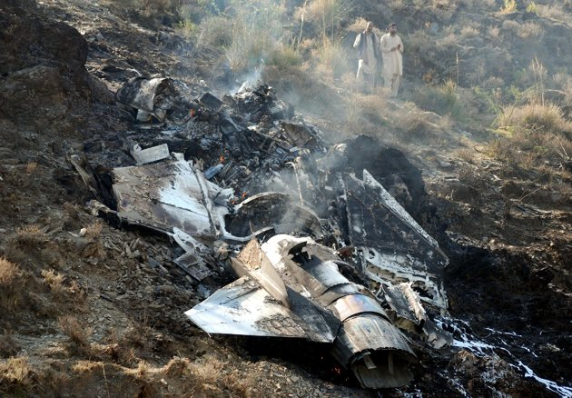
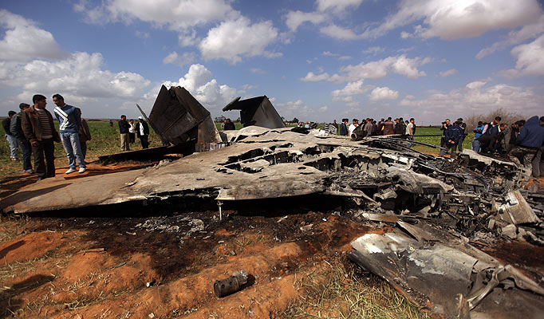
Use Case 2 - Simulation Provides Incredible Results
In 1 game turn, 1 obsolete SAM system shoots down 4 Fighters and 16 air-to-ground missiles

Slide 67
Use Case 2 – The Cause
  Lack of an Overarching SCM
    Allowed the developers to employ two credible simulation methods in a conflicting manner
    Masked a ground-based SAM system self defense behavior that took precedence over other simulation activities
    Hid a simulation interdependency which was that the reload rate for a missile site was based upon the simulation visual display refresh rate

Slide 68
Use Case 2 – The Impacts
  The Impacts
    Immediate: Exercise cadre forced to perform immediate triage to prevent incredible results from reaching the training audience
    Immediate and Long Term: Exercise director mandates manual control of air defense engagements to maintain desired attrition rates
    Long Term: Unplanned work to troubleshoot the scenario then develop and test simulation software

Slide 69
Benefits of Building a SCM
A Well-Formed SCM should provide:
  Assumptions and limitations for model
  Interconnections and dependencies within a model
  A method to detect internal model conflicts
  A preview of possible model output
  A means to discover missing parts
Early detection of problems prevents wasteful expenditure of limited resources

Slide 70
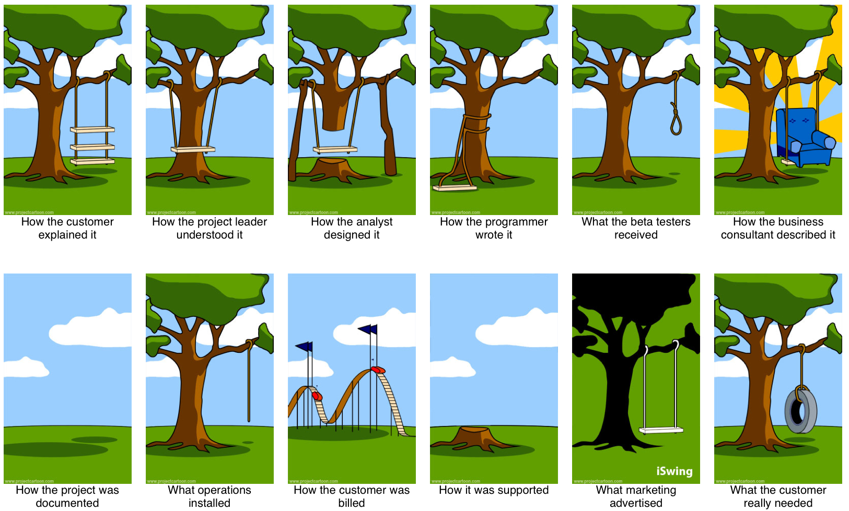
Building Versus Using a SCM
Facilitates
Communication
Between
the Developer
and the End User

Slide 71
Where To Go For Guidance?
  Limited Authoritative Reference Material on how to do Conceptual Modeling as a part of Simulation Development Process
  “Conceptual Modeling” is not a term discussed in modeling and simulation textbooks
  Web searches on “Conceptual Modeling” have led to a diverse set of web sites that contributed little if anything the body of knowledge
    Most often “Conceptual Modeling” was in relation to Database Modeling

Slide 72
One Helpful Resource
Final Report of MSG 058
RTO-TR-MSG-058 - Conceptual Modeling (CM) for Military Modeling and Simulation (M&S) Modélisation conceptuelle (MC) pour la modélisation et la simulation (M&S) militaires
ISBN 978-92-837-0150-7
https://apps.dtic.mil/sti/citations/tr/ADA569241

Slide 73
MSG-058 Report - CM Development Process Phases (PP)
PP 1
INITIATE
CM Development
PP 2
DEFINE
CM Requirements
PP 3
ACQUIRE
CM Knowledge
PP 4
DESIGN
Conceptual Model
PP 5
BUILD
Conceptual Model

Slide 74
MSG-058 Report - INITIATE CM Development Process Activities (PA)
PA 1.1
Identify and Map Stakeholder Responsibilities
PA 1.3
Identify Constraints on
the Modeling and Simulation Effort
PA 1.2
Define Purpose and Intended Use
of Modeling and Simulation Effort
PA 1.4
Impose Mandatory Enterprise Policies

Slide 75
MSG-058 Report - DEFINE CM Requirements Process Activities (PA)
PA 2.1
Identify, Analyse and Record CM,
Mission and Simulation Space Requirements
PA 2.3
Synergize CM, Mission
and Simulation Space Requirements
PA 2.2
Verify Requirements with respect to
Needs, Constraints and Policies
PA 2.4
Derive Mission and
Simulation Space Knowledge Needs

Slide 76
MSG-058 Report - ACQUIRE CM Knowledge Process Activities (PA)
PA 3.1
Identify Authoritative Knowledge Sources
PA 3.4
Gather, Structure and Document Knowledge
PA 3.2
Search for Re-usable Knowledge
PA 3.5
Generate/Extend a Domain Ontology
PA 3.3
Identify Knowledge Gaps and Bounds
PA 3.6
Review Validity of Knowledge wrt
Authoritative Knowledge Sources

Slide 77
MSG-058 Report - DESIGN CM Process Activities (PA)
PA 4.1
Search for Existing CMs that may be Partially
or Fully Re-used to Support CM Development
PA 4.4
Select Views to Support Stakeholders
PA 4.2
Identify and Select Conceptual Primitives and
Model Kinds to Represent Acquired Knowledge
PA 4.5
Select a Notation Suitable
to Express the Chosen Formalism
PA 4.3
Select Formalism(s) for CM Specification
PA 4.6
Evaluate Design for Adequacy/Relevance
With respect to Requirements

Slide 78
MSG-058 Report - BUILD CM Process Activities (PA)
PA 5.1
Populate the CM Using the Chosen Primitives,
Model Kinds, Formalism and Notation
PA 5.4
Validate CM Consistency with respect to
Mission Space and Simulation Space Knowledge
PA 5.2
Create the Specified Views
PA 5.5
Ensure Acceptance of CM
by Authorized Stakeholder
PA 5.3
Verify CM Consistency with respect to CM Design

Slide 79
MSG-058 Report - Phase Diagrams
act PP1 Activity Diagram: Initiate CM Development
Start PP1
PA1.2 Define Purpose and
P1.2 Need
Intended Use of M&S Effort
Statement
PA1.1 Identify and Map
P1.1 Stakeholder
Stakeholder
Description
Responsibilities
PA1.3 Identify Constraints
on the M&S Effort
PA1.4 Impose Mandatory
P1.3 Constraints
Enterprise Policies
and Policies
End PP1

Slide 80
MSG-058 Report - CM Development Products
P 1.4 Conceptual Model Metadata
PP 1
INITIATE
CM Development
PP 2
DEFINE
CM Requirements
PP 3
ACQUIRE
CM Knowledge
PP 4
DESIGN
Conceptual Model
PP 5
BUILD
Conceptual Model
P 1.1
Stakeholder
Description
P 2.1
CM
Requirements
Specification
P 3.1
Validated
Knowledge
P 4.1
Conceptual Model
Design
P 5.1
Conceptual Model
P 1.2
Need
Statement
P 2.2
CM Knowledge
Acquisition
Needs
P 1.3
Constraints and
Policies

Slide 81
References I
Slide | Reference Data
4 | Haddix, Furman, “Conceptual Modeling Revisited: A Developmental Model Approach for Modeling & Simulation” Paper 01F-SIW-098, Proceedings of the Fall 2001 Simulation Interoperability Workshop, September 9-14, 2001, Orlando, FL.
4 | Lacy, Lee, Youngblood, S., and Might, R., “Developing a Consensus Perspective on Conceptual Models for Simulation Systems”, Paper 01S-SIW-074, Proceedings of the Spring 2001 Simulation Interoperability Workshop, March 26-30, 2001, Orlando, FL
5 | Merriam-Webster Unabridged. Retrieved from http://unabridged.merriam-webster.com
6 | Banks, J., J.S. Carson, and B.L. Nelson, Discrete Event Simulation, 2nd ed., Prentice Hall, New Jersey, 1996.
6 | Law, Averril M., Simulation Modeling & Analysis, 3rd ed., McGraw-Hill, New York, 2000.
7 | Rothenburg, Jeff, “Knowledge-Based Simulation at the RAND Corporation”, Knowledge-Based Simulation: Methodology and Application, Fishwick and Modjeski (eds.), Springer-Verlag, 1991.

Slide 82
References II
Slide(s) | Reference Data
12 | Benjamin, P., Patki, M, and Mayer, R., “Using Ontologies for Simulation Modeling”, Proceedings of the Winter Simulation Conference, 2006.
15 | Zeigler, Bernard P., Theory of Modeling and Simulation, Wiley, New York, 1976.
36 | Strickland, Jeffery, Simulation Conceptual Modeling, Lulu.com, 2011.
44 | Pace, Dale K., “Thoughts About the Simulation Conceptual Model”, Paper 03S-SIW-009, Proceedings of the Spring 2003 Simulation Interoperability Workshop, March 30-April 4, Orlando, FL.
52 | McAllister, Branford, Simulation-Based Performance Assessment, Independently Published, 2023
70 | Gushue, John, “What the Customer Really Wanted, Revisited”, Retrieved from http:/johngushue.typepad.com/bolg/2009/08/what-the-customer-really-wanted-revisited.html
70-78 | Final Report of MSG 058. Retrieved from https://apps.dtic.mil/sti/citations/tr/ADA569241

Slide 83
References III
Additional References
Crews, E., “Conceptual Modeling Techniques for Use Within the DoD Acquisition Community”, Retrieved from https://apps.dtic.mil/sti/tr/pdf/AD1018818.pdf
Olivé, A., Conceptual Modeling of Information Systems, Springer-Verlag, New York, 2007.
Roca, Ric, Pace, D., Robinson, S., Tolk, A., and Yilmaz, L., “Paradigms for Conceptual Modeling”, Proceedings of the 48th Annual Simulation Symposium, 2015.
Pace, Dale K., “Ideas About Simulation Conceptual Model Development”, Retrieved from https://pdfs.semanticscholar.org/7100/0df6164dce9f4e948e48688378291fa34528.pdf
Pace, Dale K., “Conceptual Model Development for C4ISR Simulations”, Retrieved from http://citeseerx.ist.psu.edu/viewdoc/download?doi=10.1.1.536.1247&rep=rep1&type=pdf
Parsons, Jeffery, and Cole, L., “What do the pictures mean? Guidelines for experimental evaluation of representation fidelity in diagrammatical conceptual modeling techniques”, Data & Knowledge Engineering, 55: 327-342; doi: 10.1016/j.datak.2004.12.008, 2005.
Wand, Yair, and Weber, R., “Research Commentary: Information Systems and Conceptual Modeling—A Research Agenda”, Information Systems Research, 13 (4): 363-376; doi: 10.1287/isre.13.4.363.69, 2002.

Slide 84
Learning Objectives
Now, the attendees should be able to
  List five purposes for simulation use
  Define simulation conceptual modeling (SCM) terminology
  Describe SCM development phases
  Explain differences between informal and formal SCMs
  Describe how to use tools for conceptual modeling

Slide 85
Conclusion
Questions / Comments?
Contact Information
  Mr. Jack “Jake” Borah
  Phone: (407) 929-9370
  E-mail: jborah@sprynet.com

