Slide 1

Digital Engineering Tutorial
Basic Principles
Jeff Nartatez, OUSD R&E
Keith Henry, OUSD R&E
In support of
Daniel Hettema, OUSD R&E
Director, Digital Engineering, Modeling and Simulation.

Slide 2
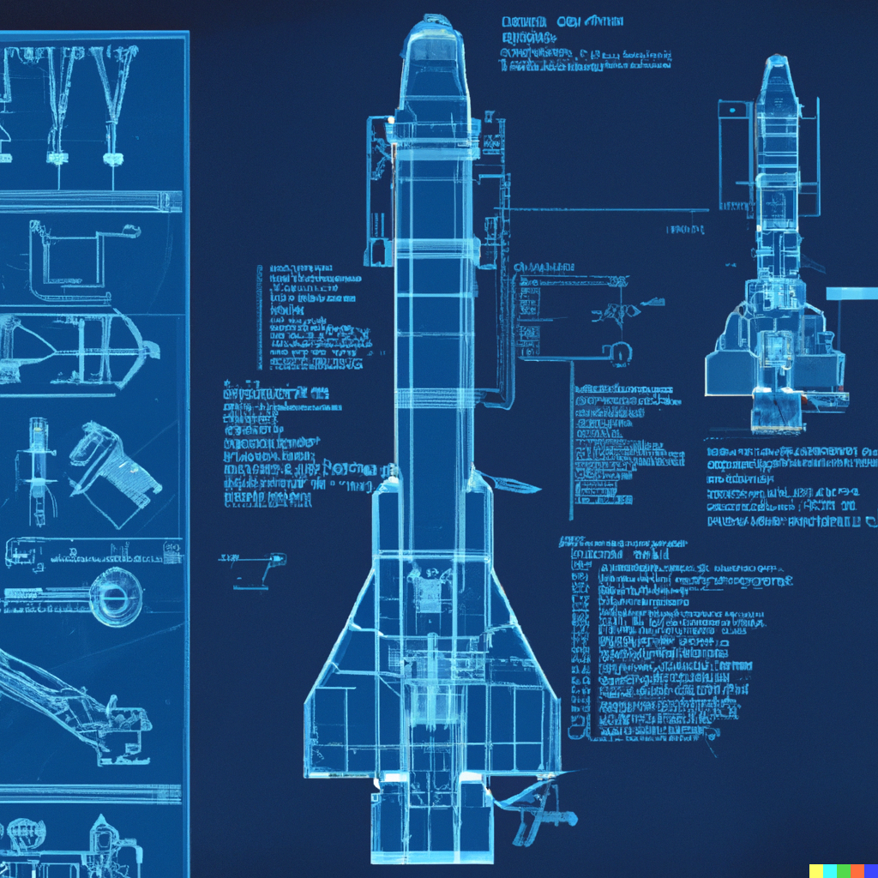
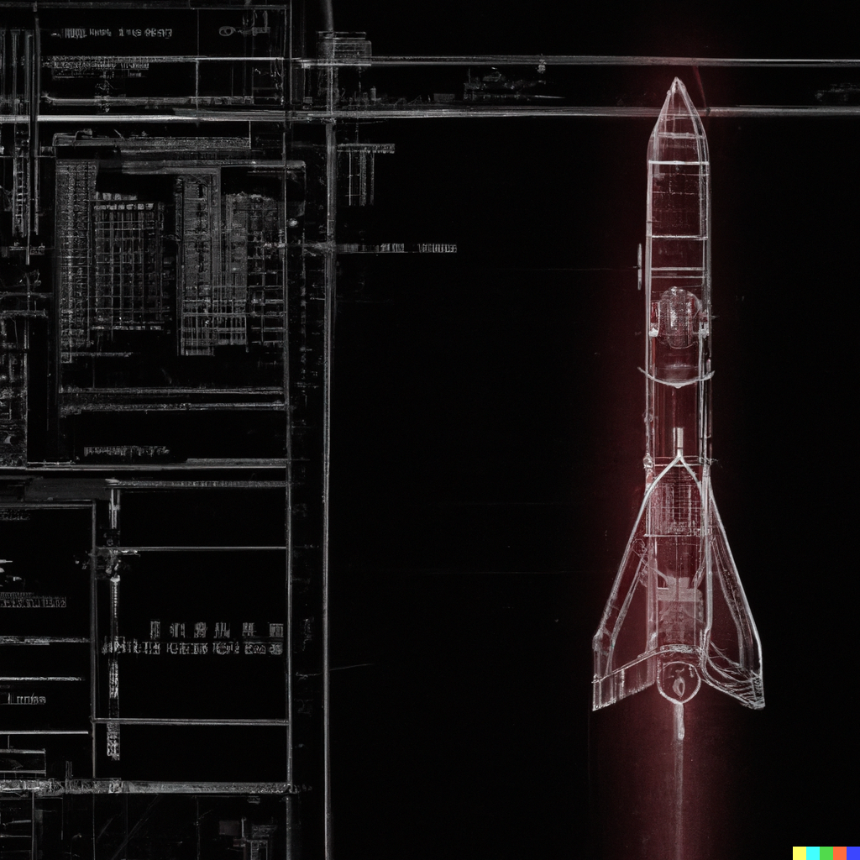
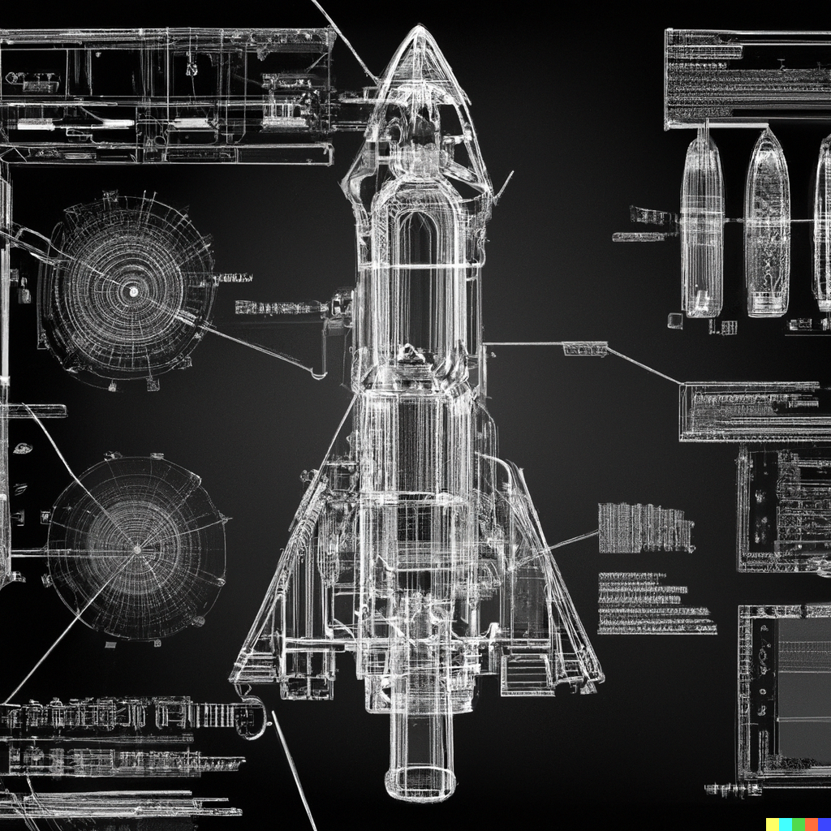
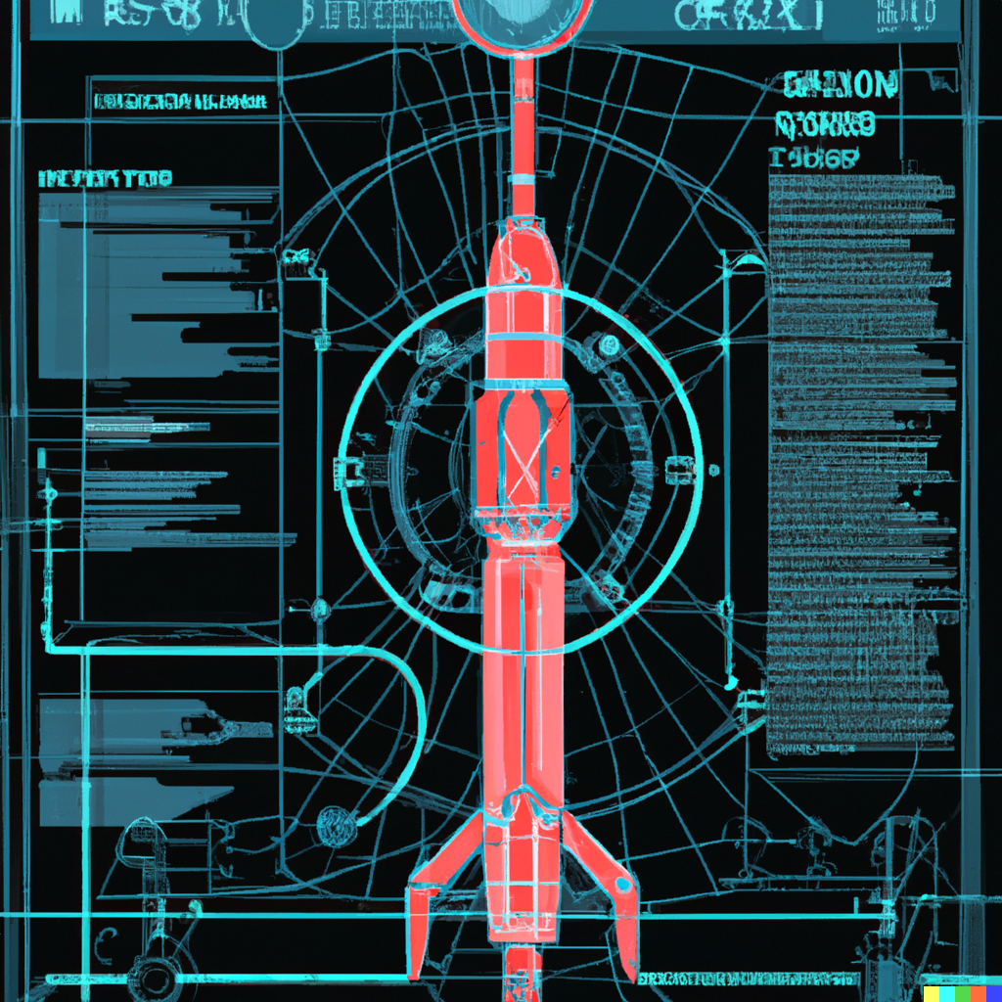
The “New” Authority on Digital Engineering
Feb 2023-
“Digital engineering is the use of digital technologies, such as computer-aided design (CAD) and building information modeling (BIM), to design and manage the construction of buildings and infrastructure projects. It involves the integration of data, processes, and systems to improve collaboration and decision-making throughout the lifecycle of a project. The goal of digital engineering is to create more efficient, sustainable, and cost-effective built environments.”
May 2024-
“Digital engineering is a methodology that uses digital tools and technologies to design, simulate, analyze, and manage engineering processes and systems throughout their lifecycle. It involves the integration of various disciplines, such as computer-aided design (CAD), simulation, data analytics, and virtual reality, to optimize the design, development, and maintenance of complex systems and products.”
- ChatGPT
Images generated using DALL-E – prompt "missile, digital engineering schematics, sci-fi"
Distribution Statement A. Approved for public release. Distribution is unlimited. Case # 23-S-1171
Notes:
From Technology driven to methodology/processes driven
Do we ask Microsoft co-pilot- Microsoft takes over the world

Slide 3
Learning Objectives
Distribution Statement A. Approved for public release. Distribution is unlimited. Case # 23-S-1171
Identify Digital Engineering Authorities
Identify Digital Engineering key terms and concepts
Describe Digital Engineering technology, development, and applications
Summarize Digital Engineering uses and associated challenges
Identify Digital Engineering information resources
Distribution Statement A. Approved for public release. Distribution is unlimited. Case # 23-S-1171
3
Notes:
Frank; Time Hack: 1 min
Review objectives

Slide 4
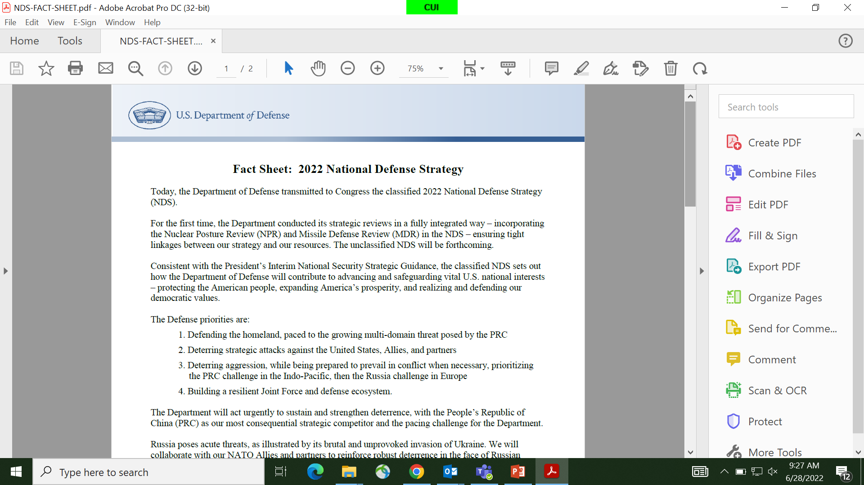
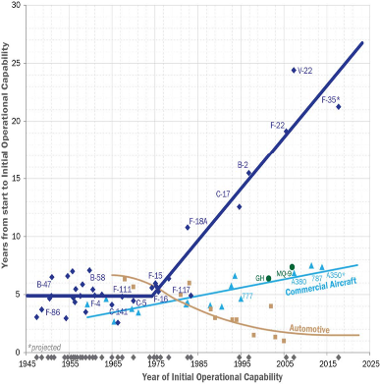
The Need For Change
Fact Sheet: 2022 National Defense Strategy
The Defense priorities are:
Defending the homeland, paced to the growing multi-domain threat posed by the PRC
Deterring strategic attacks against the United States, Allies, and partners
Deterring aggression, while being prepared to prevail in conflict when necessary, prioritizing the PRC challenge in the Indo-Pacific, then the Russia challenge in Europe
Building a resilient Joint Force and defense ecosystem.
Source: Dan Patt, Time-to-Market: A DARPA study on Capability Fielding 2013
Distribution Statement A. Approved for public release. Distribution is unlimited. Case # 23-S-1171
3
Notes:
Frank; Time hack 5 min
We are in a great Power Competition against Russia and China. DoD recognizes this competition as a significant challenge to its national security and has formulated strategies to address it.
The DoD's approach to Great Power Competition involves a comprehensive set of policies and actions aimed at maintaining U.S. military superiority, protecting American interests, and promoting stability and security in key regions around the world. The main focus of the DoD's GPC strategy is on countering the growing influence and assertiveness of China and Russia.
In the case of China, the DoD acknowledges the country's rapid economic growth, military modernization efforts, and its expanding global influence. The DoD's strategy seeks to deter China from challenging the established rules-based international order and safeguarding American interests and those of its allies and partners in the Indo-Pacific region. This includes strengthening alliances, partnerships, and security cooperation with regional countries, enhancing military capabilities, and increasing investments in advanced technologies.
Regarding Russia, the DoD recognizes its aggressive behavior, revisionist tendencies, and efforts to undermine U.S. and Western interests. The DoD's approach involves deterring Russian aggression, defending NATO allies and partners, and ensuring strategic stability. This includes maintaining a credible deterrent posture, enhancing NATO's defense and deterrence capabilities, and countering Russian malign activities such as cyberattacks and disinformation campaigns.
The DoD's Great Power Competition strategy also emphasizes the importance of innovation and technological superiority. It aims to harness advanced technologies, such as artificial intelligence, autonomous systems, and space capabilities, to enhance military readiness, improve decision-making processes, and maintain an edge over potential adversaries.
Highlight Navy background; with the Russia demise, many considered US peerless; not so anymore
Takes us too long to get tech into the hands of the warfighter
Discuss the chart
The study recognized that transitioning innovative technologies from the research and development phase to actual deployment and utilization in the field is a complex process. It highlighted the need for a better understanding of the factors that influence the successful adoption and integration of DARPA-developed capabilities into military and commercial markets.

Slide 5
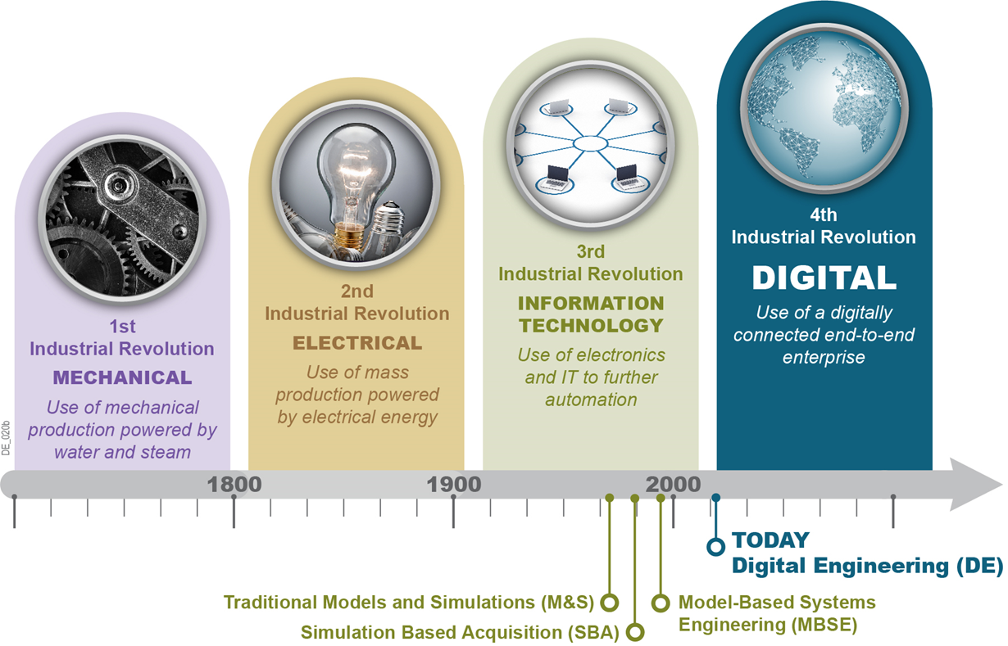

Industrial Revolutions and Transformation Initiatives Leading to Digital Engineering
5th
Industrial Revolution
Artificial Intelligence
Personalization, Deep multi-level cooperation between people and machines
2025
2100
Today
8
Notes:
Frank – Time Hack (3 min)
DE didn't happen over night
It has been evolving for decades
We released the DE Strategy – 4th Industrial Revolution
Describe 4IR
The Fourth Industrial Revolution refers to the ongoing technological transformation of various industries and societies through the integration of advanced technologies. It builds upon the advancements made during the Third Industrial Revolution, which involved the widespread use of computers and the internet. The 4IR is characterized by the convergence of digital, physical, and biological systems, leading to unprecedented levels of automation, connectivity, and data-driven decision-making.
5th IR
The Fifth Industrial Revolution (5IR) refers to the ongoing transformation of industries and society through the integration of advanced technologies, such as artificial intelligence (AI), robotics, blockchain, the Internet of Things (IoT), and other emerging technologies. It builds upon the previous industrial revolutions but emphasizes the convergence of digital and physical systems. The 5IR aims to create a highly interconnected and intelligent world, where smart devices, machines, and systems communicate and collaborate seamlessly. It envisions a future characterized by increased automation, data-driven decision-making, and enhanced connectivity across industries, governments, and individuals.

Slide 6
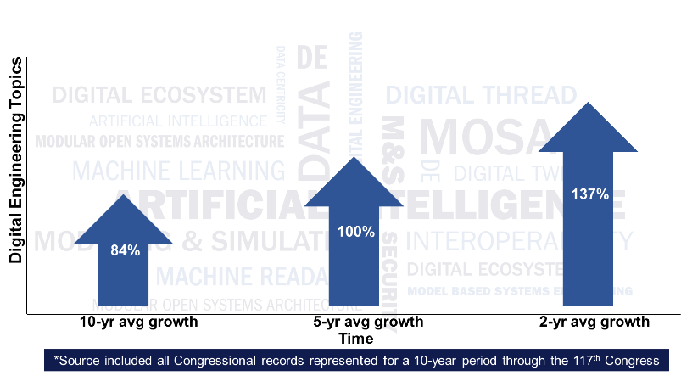
Imagine if…………….
DE Center of Excellence (CoE): inputs provided by the Military Departments understands efficiencies can be realized thru improved coordination of DE with an established DE COE
Multilevel Security: illustrated how digital transformation was being pursued and how digital transformation capabilities enable work across security networks and classification levels.
Tradeoff Analysis: tradeoff analysis at the program level to better address and identify capabilities that would have value across the full spectrum of DOD activities.
DBB: reject or accept each recommendation and provide a high-level implementation plan for accepted recommendations key milestones, reporting mechanism, and governance structure.
GAO: discuss a federated approach to an overarching plan to enable the adoption of modern engineering tools and solicit the status of current plans for their adaptation.
DSB: investigating the current state of, and future potential for, DE within the DOD focused on seven recommendations for OSD to address.
Distribution Statement A. Approved for public release. Distribution is unlimited. Case # 23-S-1171
7
Notes:
Frank; Time hack 3 min

Slide 7
Under Secretary of Defense for Research and Engineering (USD(R&E)) – Technology Vision
Innovation in an era of competition – strategic competition demands collective cooperation between the Government, Industry, academia, international partners, and Research and Development Centers
Technology Strategy Pillars
  Mission Focus - Leverage technology innovation to solve tough operational problems
  Foundation Building – Recruit the workforce, modernize laboratories, create standards, develop tools, and build test facilities
  Succeed through Teamwork - Maximize our nation’s asymmetrical advantages by partnering with the private sector, universities, FFRDCs, UARCs, small businesses, and our international partners
Critical Technology Areas: work closely with the Military Services, Combatant Commands, industry, academia, and other stakeholders to ensure that the Department's science and technology strategy addresses the key national security challenges
Bridge to the Future: develop critical technologies, rapidly prototype them, and conduct continuous campaigns of joint experimentation to improve on those technologies and deliver capabilities.
5
Notes:
Frank – time hack 3 min
See notes on previous slide and highlight bullets- Base document is Memorandum USD(R&E) Technology Vision for an Era of Competition- Dated February 2022
The mission of the Office of the Secretary of Defense Research and Engineering (OSD R&E) is to provide technological and scientific expertise to support the Department of Defense (DoD) in its mission to protect and defend the United States. OSD R&E plays a critical role in advancing state-of-the-art capabilities and ensuring the technological superiority of the U.S. military.
In summary
Research and Development (R&D): OSD R&E is responsible for managing and overseeing a wide range of research and development programs aimed at developing cutting-edge technologies for the military. This includes areas such as advanced materials, artificial intelligence, cybersecurity, directed energy weapons, autonomous systems, and more.
Technology Assessment: OSD R&E conducts technology assessments to evaluate emerging technologies and their potential impact on national security. This involves analyzing the capabilities and vulnerabilities of potential adversaries, assessing the feasibility and effectiveness of new technologies, and providing recommendations for their integration into military systems.
Acquisition and Sustainment Support: OSD R&E assists in the acquisition and sustainment of major defense systems by providing technical expertise and guidance. This includes ensuring that new systems meet performance requirements, assessing technological risks, and supporting the development of acquisition strategies.
Test and Evaluation: OSD R&E oversees the testing and evaluation of defense systems to ensure their reliability, effectiveness, and safety. This involves conducting rigorous testing, collecting and analyzing data, and providing recommendations for system improvements or modifications.
Defense Innovation Initiatives: OSD R&E leads and supports various defense innovation initiatives aimed at fostering collaboration between the DoD, industry, academia, and other stakeholders. This includes initiatives such as the Defense Innovation Unit (DIU), Defense Advanced Research Projects Agency (DARPA), and other innovation programs.
Overall, OSD R&E's mission is to drive innovation, leverage emerging technologies, and provide critical scientific and technical expertise to support the defense and security of the United States.

Slide 8
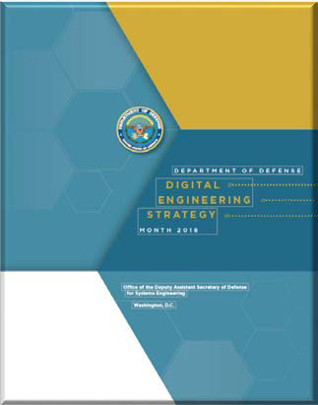

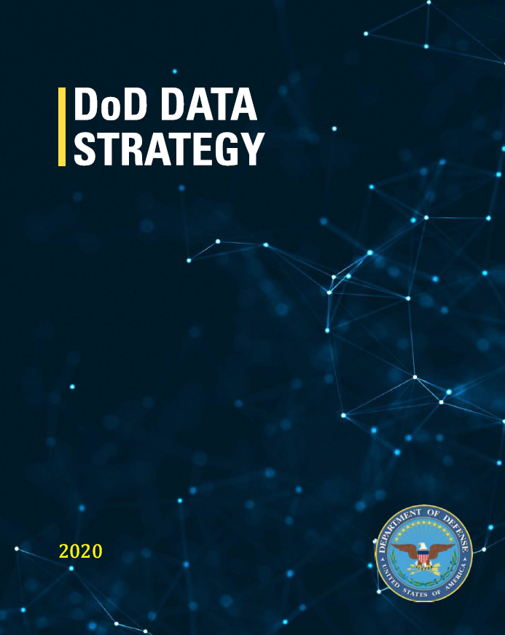
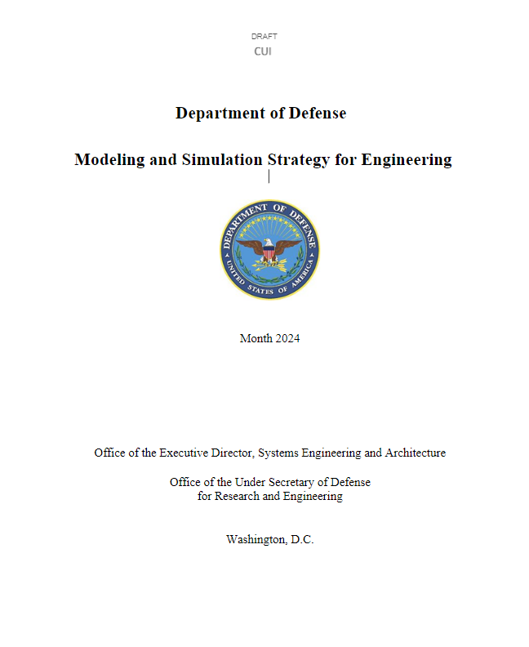
National Defense Strategy & Digital Engineering Strategy
Transform the Foundation of the Future Force: Building the future Joint Force that we need requires overhauling the Department's force development, design, and life-cycle management systems.
Objective: Guide the planning, development, and implementation of digital engineering across the services and agencies
Expected Impact:
  Increased technical cohesion and awareness of system in lifecycle activities
  Reform the Department’s business practices for greater performance and agility
Our Response: Prioritize speed of delivery, continuous adaptation, and frequent modular upgrades
https://www.defense.gov/Spotlights/National-Defense-Strategy/
https://ac.cto.mil/digital_engineering/
Supports: National Defense Strategy and Digital Modernization
Provides an overarching vision, focus areas, guiding principles, essential capabilities, and goals
Transform DoD into a data-centric enterprise that treat data as a weapon system and manage, secure, and use data for operational effect
This Modeling and Simulation Strategy for Engineering lays out the vision and goals for the integration of Models, Simulations, Data, Analysis, and their management throughout the acquisition lifecycle
DRAFT
These Modeling and Simulation engineering-level capabilities must both provide calibration to, and receive scope from, higher-level Models and Simulations
This strategy specifically addresses the very foundation of the DoD model hierarchy
https://ac.cto.mil/digital_engineering/
8
Notes:
Frank – Time Hack 5 min
National Defense Strategy (NDS) priorities: 1. Defending the homeland, paced to the growing multi-domain threat posed by the PRC. 2. Deterring strategic attacks against the United States, Allies, and partners. 3. Deterring aggression, while being prepared to prevail in conflict when necessary, prioritizing the PRC challenge in the Indo-Pacific, then the Russia challenge in Europe. 4. Building a resilient Joint Force and defense ecosystem. (Source: NDS Fact Sheet)
Digital Engineering Strategy (DES): As the Department of Defense continues to relentless implement the NDS, the DES sets a vision for the way the department conceives, builds, tests, fields, and sustains our national defense systems. So essentially, the strategy defines the "what," and the Services are developing implementation plans defining the "how."
There are other complimentary strategies like the Data Strategy, AI strategy, Back to basics for workforce development, and zero trust.

Slide 9
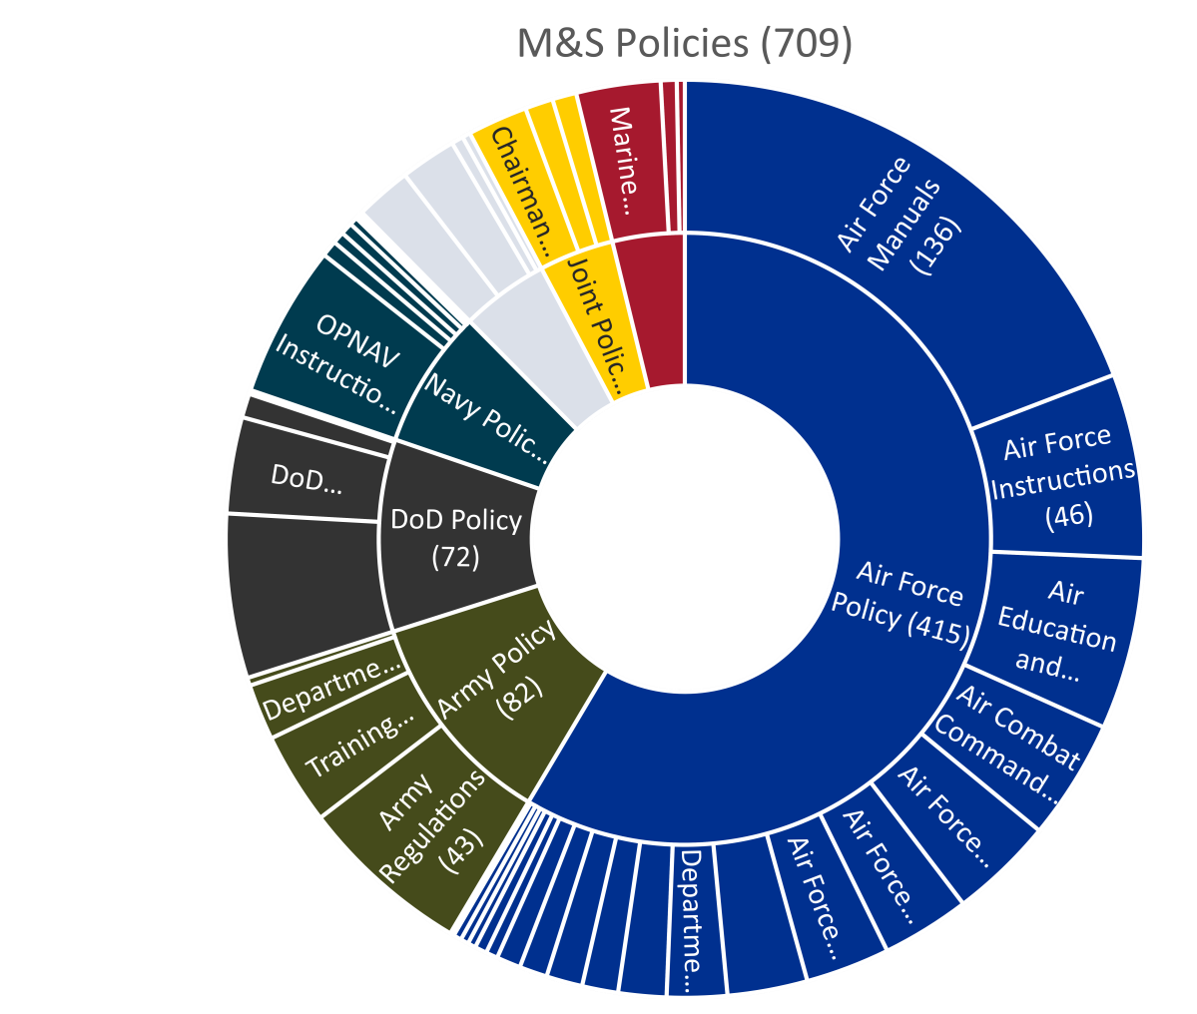
Modeling & Simulation Policy Challenges
Distribution Statement A. Approved for public release. Distribution is unlimited. DOPSR Case # 24-T-0964
Policies are broad and do not solve every issue.
Policy development is a slow process.
  Empower the practitioner
  Focus on interfaces / boundaries
  Update / Improve Standards
  Educate on right sizing
There is no policy that stops digital engineering.
Policy isn’t a life vest.
Connect policy to guidance.
Distribution Statement A. Approved for public release. Distribution is unlimited. DOPSR Case # 24-T-0964

Slide 10
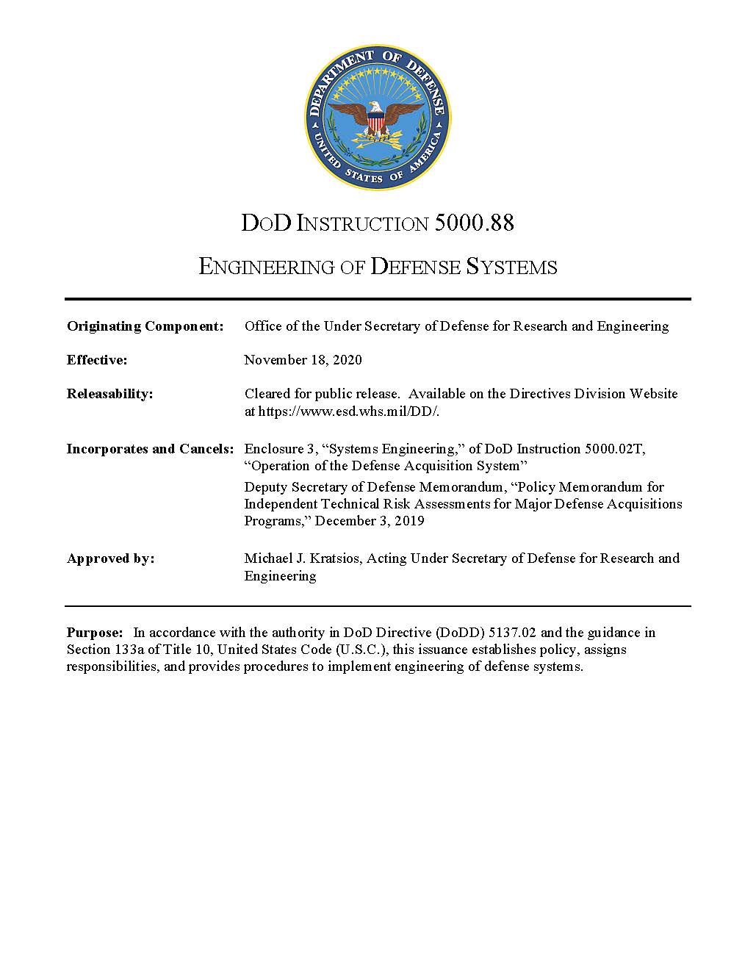
DoDI 5000.88 Engineering of Defense Systems
For MDAPs, ACAT II, and ACAT III programs, the SEP will contain these elements, unless waived by the SEP approval authority:
(m) The digital engineering implementation plan to include model elements, element relationship diagrams, activity diagrams, block definition diagrams, and use case diagrams. The plan must include the evolution of a continuous end-to-end digital representation, or integrated set of digital representations, of the system being produced and the establishment of a digital authoritative source of truth (i.e., configuration controlled digital baseline). The PM will make the relevant digital model(s) accessible to OSD, Joint Staff stakeholders, and interdependent programs, throughout the life of the program and will maintain CM.
…
The PM will implement and describe in the SEP a technical baseline management process as a mechanism to manage technical maturity, to include a mission, concept, functional, allocated, and product baseline. If practicable, the PM will establish and manage the technical baseline as a digital authoritative source of truth.
Distribution Statement A. Approved for public release. Distribution is unlimited. Case # 23-S-1171

Slide 11
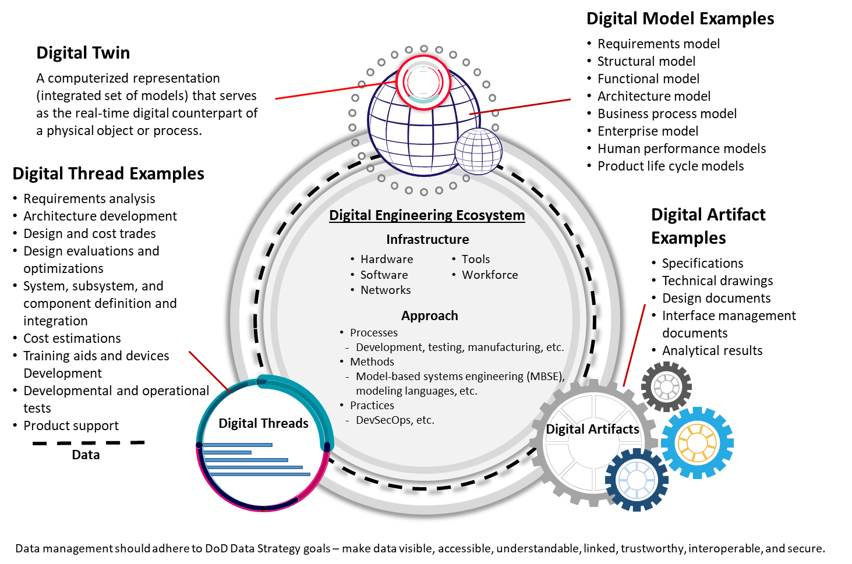

Distribution Statement A. Approved for public release. Distribution is unlimited. DOPSR Case # 24-T-0964
DODI 5000.97, “Digital Engineering”
Purpose: The Department of Defense is transforming its engineering practices to incorporate digital technology and innovations into an integrated, digital, model-based approach. This instruction establishes policy, assigns responsibilities, and provides procedures for implementing and using digital engineering in the development and sustainment of systems.
This policy directs:
Programs started after the date of the policy will incorporate digital engineering during development unless the program’s decision authority provides an exception.
Programs started before the date of the policy should incorporate digital engineering, to the maximum extent possible, when it is practical, beneficial, and affordable.
Digital engineering should be addressed in the Acquisition Strategy and in the Systems Engineering Plan.
Digital engineering methodologies, technologies, and practices support a comprehensive engineering program for defense systems.
Digital engineering transforms DoD systems engineering practice.
Distribution Statement A. Approved for public release. Distribution is unlimited. DOPSR Case # 24-T-0964

Slide 12
DoD Digital Engineering Core Concepts
12
Notes:
Frank – Time Hack Less than 1 min

Slide 13
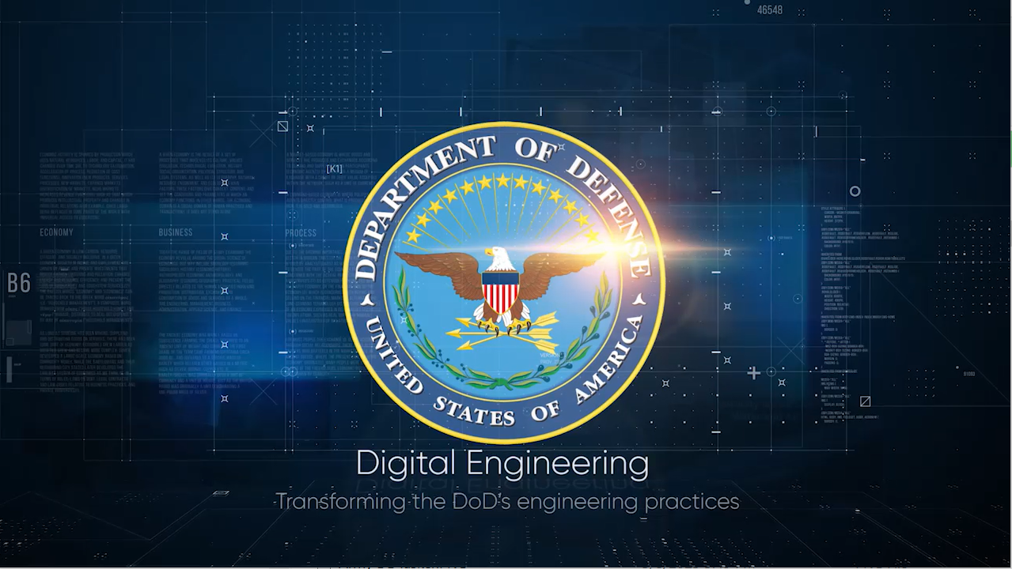
DoD Digital Engineering Overview
13
Notes:
Frank intro video – Time hack - 4 minutes including video

Slide 14
Key Terms* (1 of 2)
Model - A physical, mathematical, or otherwise logical representation of a system, entity, phenomenon, or process.
Authoritative Source of Truth (ASOT) - captures the current state and the history of the technical baseline. It serves as the central reference point for models and data across the lifecycle. The authoritative source of truth will provide traceability as the system of interest evolves, capturing historical knowledge, and connecting authoritative versions of the models and data.
Digital Artifact - An artifact produced within, or generated from, the digital engineering ecosystem. These artifacts provide data for alternative views to visualize, communicate, and deliver data, information, and knowledge to stakeholders.
*Source: DAU Glossary- https://www.dau.edu/glossary/Pages/Glossary.aspx
Distribution Statement A. Approved for public release. Distribution is unlimited. DOPSR Case # 24-T-0964​
14
Notes:
Frank – Time Hack 3 min
Frank…intro terms and very high-level discussion
Terms are important and there needs to be congruence.
The community is settling in on these terms
The language is important to be able to translate and interpret between enterprises.
Having definition of terms helps with communicating with and across domains and enterprises.
It is a way to mitigate talking past one another
We don’t have to be in agreement with every single word but we do need to be aligned.
CAUTION: Be careful of trying to please everyone.....it isn't going to happen.

Slide 15
Key Terms* (2 of 2)
Digital Thread - An extensible, configurable and component enterprise-level analytical framework that seamlessly expedites the controlled interplay of authoritative technical data, software, information, and knowledge in the enterprise data-information-knowledge systems, based on the Digital System Model template, to inform decision makers throughout a system's life cycle by providing the capability to access, integrate and transform disparate data into actionable information.
Digital Twin - An integrated multi physics, multiscale, probabilistic simulation of an as-built system, enabled by Digital Thread, that uses the best available models, sensor information, and input data to mirror and predict activities/performance over the life of its corresponding physical twin.
Digital Engineering Ecosystem - The interconnected infrastructure, environment, and methodology (process, methods, and tools) used to store, access, analyze, and visualize evolving systems' data and models to address the needs of the stakeholders.
There are other definition besides these from DAU.
*Source: DAU Glossary- https://www.dau.edu/glossary/Pages/Glossary.aspx
Distribution Statement A. Approved for public release. Distribution is unlimited. DOPSR Case # 24-T-0964​
15
Notes:
Frank – Time Hack 3 min

Slide 16
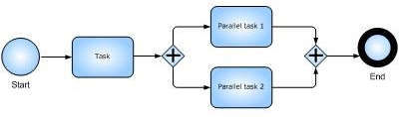
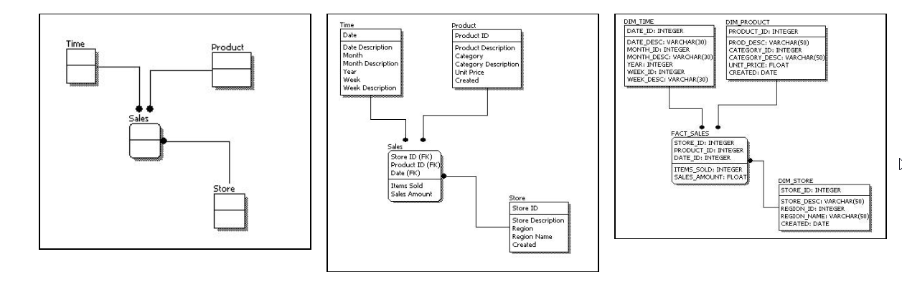
Model
There are three basic types of computer models:
Algorithm or Math Model: A symbolic model whose properties are expressed in mathematical symbols and relationships
Process Model: depicts processes performed by a system or people. Process flow, Functional Flow, Data Flow, Workflow, GANTT, Activity, Sequence,
Data Model: organizes elements of data and standardizes how they relate to one another and to properties of the real world
Math Model: d = V*D/(v1+v2)
Process Model
Data Model
Conceptual Data Model
Logical Data Model
Physical Data Model
What type of model is a Systems model?
What type of model is a CAD model?
Distribution Statement A. Approved for public release: distribution is unlimited.​
16
Notes:
Frank – Time Hack 3 min
Model - A physical, mathematical, or otherwise logical representation of a system, entity, phenomenon, or process.

Slide 17
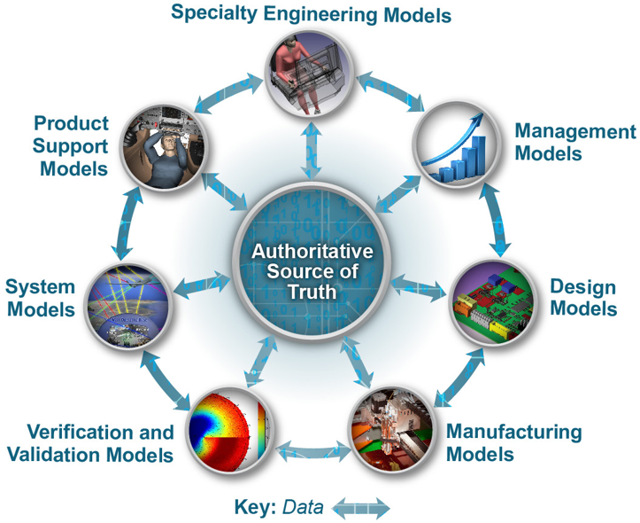
Authoritative Source of Truth
Some motivations to shift from a document-based approach to a DE approach include:
Providing models, simulations and data as artifacts to include in, or substitute for, official documentation
A single accurate, accessible, and automatically updatable models and data with an audit trail
Better collaboration between stakeholders
Ability to make quicker and more reliable decisions
Implementing DE does not promise accurate and complete data, but it does provide an authoritative source of truth that is shared across all Integrated Product Team ( IPT) members.
Successful programs need accurate, complete, timely, and quality information.
Distribution Statement A. Approved for public release: distribution is unlimited.​
17
Notes:
Frank – Time Hack 3 min
Authoritative Source of Truth (ASOT) - captures the current state and the history of the technical baseline. It serves as the central reference point for models and data across the lifecycle. The authoritative source of truth will provide traceability as the system of interest evolves, capturing historical knowledge, and connecting authoritative versions of the models and data.

Slide 18
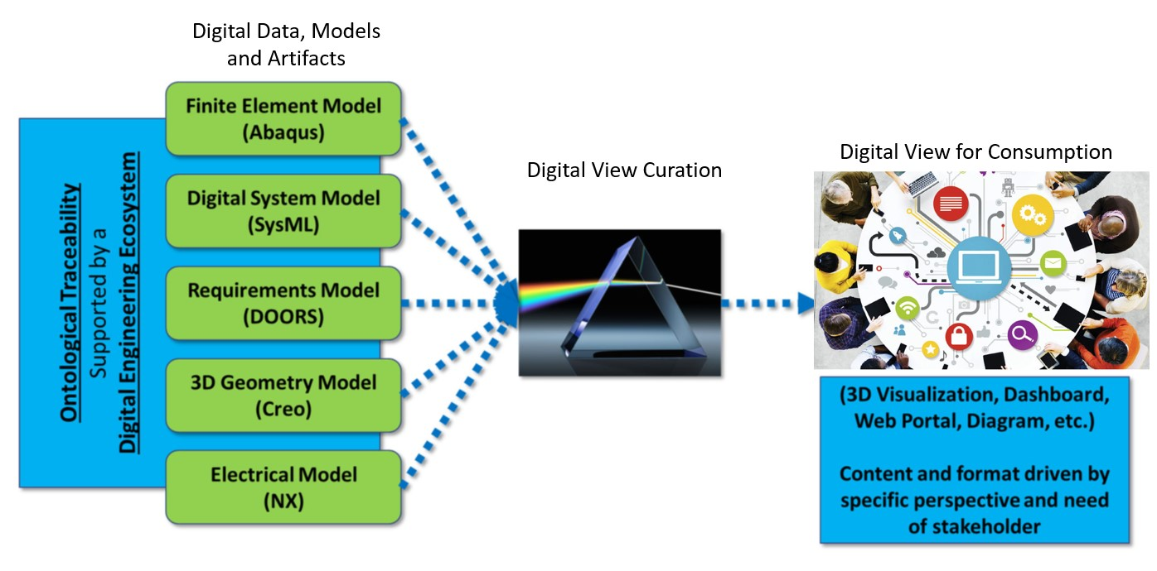
Digital Artifact
Each stakeholder's model is a digital artifact.
Digital artifacts include reports, diagrams, lists, views, etc.
Model
Controller
View
Digital artifacts provide need to be managed and controlled like data!
Distribution Statement A. Approved for public release: distribution is unlimited.​
18
Notes:
Frank – Time Hack 3 min
Digital Artifact - An artifact produced within, or generated from, the digital engineering ecosystem. These artifacts provide data for alternative views to visualize, communicate, and deliver data, information, and knowledge to stakeholders.

Slide 19
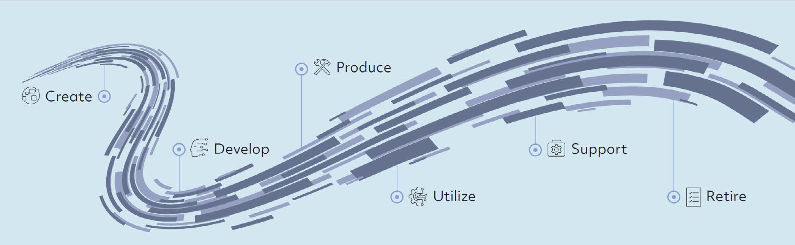
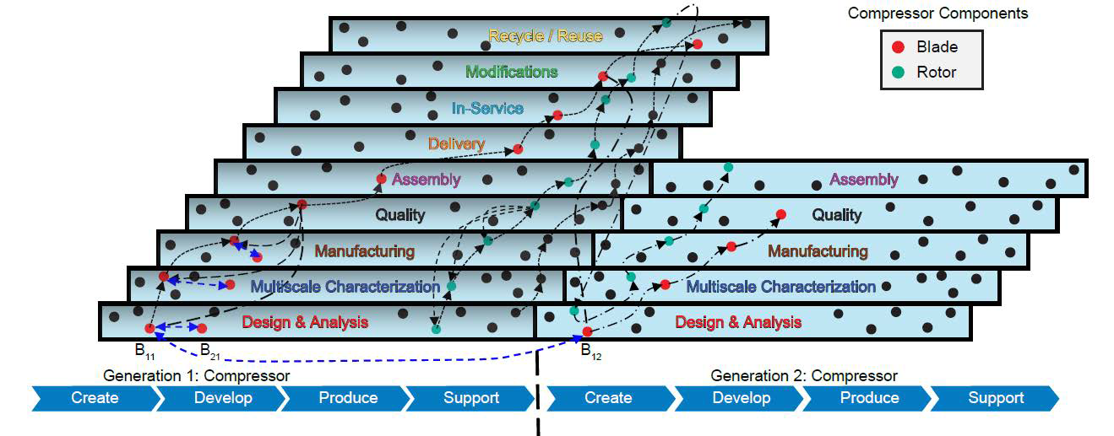
Digital Thread
Think of the Digital Thread as representing the flow of data amongst data sets, between activities, across models.
  They are typically captured as workflows, and relationships between data objects.
  They can be computational procedures that are used to transform data.
  They often are used as the backbone for performing impact assessments.
  They can be used to facilitate data flow amongst integrated models.
Source: Digital Thread: Definition, Value, and Reference Model, June 2023
"The Digital Thread is an engineered digital system"
Source: Digital Thread: Definition, Value, and Reference Model, June 2023
19
Distribution Statement A. Approved for public release: distribution is unlimited.​
Notes:
Frank – Time Hack 3 min
Digital Thread - An extensible, configurable and component enterprise-level analytical framework that seamlessly expedites the controlled interplay of authoritative technical data, software, information, and knowledge in the enterprise data-information-knowledge systems, based on the Digital System Model template, to inform decision makers throughout a system's life cycle by providing the capability to access, integrate and transform disparate data into actionable information.

Slide 20
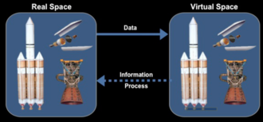
Digital Twin
Models, data, and the product design are baselined through the acquisition life cycle to yield both the product and the Digital Twin.
Think of the Digital Twin as a virtual surrogate for the product at any point along the acquisition life cycle.
One challenge of using a Digital Twin is keeping it and the environment it operates in as accurate as possible as the system design evolves over time.
Source: Wikipedia, https://en.wikipedia.org/wiki/Digital_twin
A Digital Twin is not a:
  Digital tool for configuration management
  Geometric model of an as-built system
  Model-based definition of an as-built system
Distribution Statement A. Approved for public release: distribution is unlimited.​
20
Notes:
Frank – Time Hack 3 min
Digital Twin - An integrated multi physics, multiscale, probabilistic simulation of an as-built system, enabled by Digital Thread, that uses the best available models, sensor information, and input data to mirror and predict activities/performance over the life of its corresponding physical twin.
This is an important product since it combines data, models, and digital artifacts together with the analytical framework of the Digital Thread and maintains it as a collection that can be used as part of the technical baseline to be placed on a contract.
The next page contains a video explaining more about Digital Twin: Digital Industrial Dose: The Digital
Twin. Source: Digital Industrial Dose: The Digital Twin, YouTube video, GE, 2016.
Look at the BF Goodrich story for each definition.

Slide 21
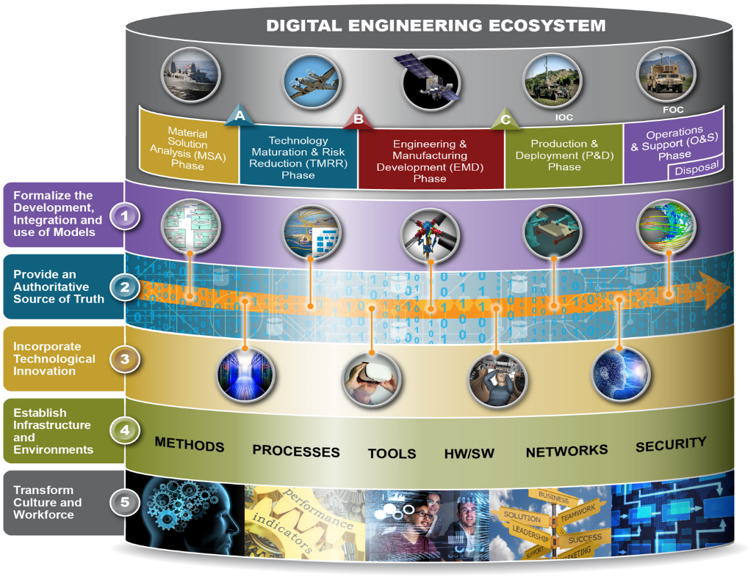
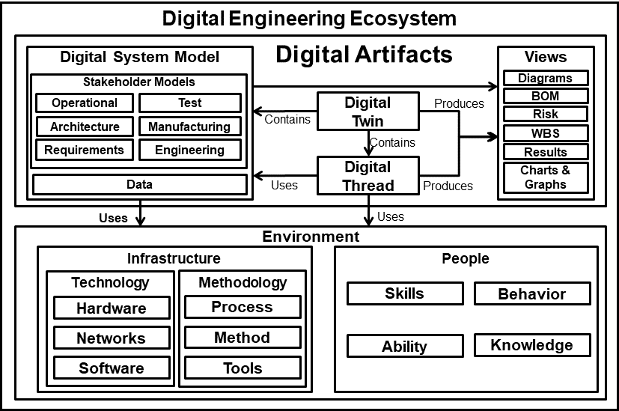
Digital Engineering Ecosystem
The Digital Engineering Ecosystem System is made up of several elements that are integrated, each providing data and information that impacts the other.
The DE Ecosystem is a system. Treat it like one. Architect it, Scope it, Design it to be modular, build it, test it, use it, incrementally improve it to realize the capabilities needed.
Distribution Statement A. Approved for public release: distribution is unlimited.​
21
Notes:
Frank – Time Hack 3 min
Digital Engineering Ecosystem - The interconnected infrastructure, environment, and methodology (process, methods, and tools) used to store, access, analyze, and visualize evolving systems' data and models to address the needs of the stakeholders.
The Digital System Model consists of various stakeholder models: operational, architecture, requirements, test, manufacturing, and engineering. It also consists of data.
The Digital System Model feeds into Views such as diagrams, Bill of Materials (BOM), risk, Work Breakdown Structure (WBS), results, and charts and graphs. The data from the Digital System Model is used by Infrastructure, which is made up of technology (including hardware, networks, and software) and methodology (including process, method, and tools ). Infrastructure also provides information for the Digital Thread, which is composed of trade studies,
tech assessment, and performance analysis. The Digital Thread also produces the views mentioned
above, and uses data from the Digital System Model.
At the center of all this is the Digital Twin, which contains the Digital System Model, produces views (mentioned before), and contains the Digital Thread.
Taken as a whole, the Digital System Model, Digital Twin, and Views produce digital artifacts.

Slide 22
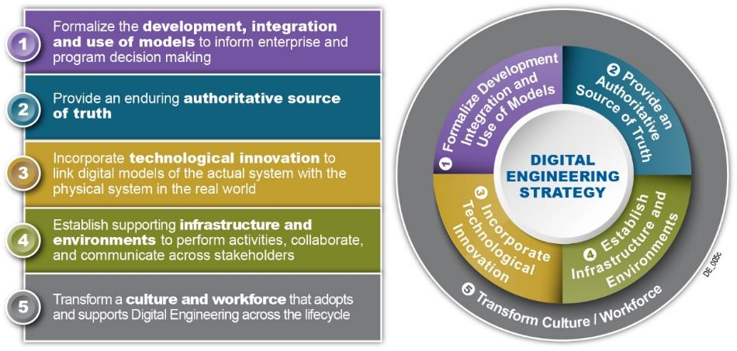
Digital Engineering Strategy: What, not How
Digital Engineering:
Describes an integrated digital approach that uses authoritative sources of systems’ data and models as a continuum across disciplines to support life cycle activities from concept through disposal
Layman’s terms: combine standard representations of ‘system’, with computers, additional computational techniques as a continuous, complete and evolving ecosystem to provide data for data-informed decisions and interactive visualizations to a continuum of questions.
Distribution Statement A. Approved for public release: distribution is unlimited.​
22
Notes:
Frank – Time Hack 2 min
Digital Engineering is a model-based approach incorporates digital practices and computing infrastructure to enable delivery of high pay off solutions to the warfighter at the speed of relevance. It extends beyond traditional model-based approaches that typically focus on a particular discipline or aspect to encompass the broad spectrum of models as a continuum across the lifecycle.
And essentially connects people, processes, data, and capabilities which is essential to enable all stakeholders the ability to solve problems faster and in new ways.
The strategy was developed around 5 strategic goals, to define the vision for what the Department wants to achieve.
The first two goals stems from the model-based community.
The third goal incorporates technological innovations
The fourth goal establishes the supporting infrastructure
The fifth goal is often overlooked in the technical community, but we as system engineers need to highlights the importance of culture in transformation efforts

Slide 23
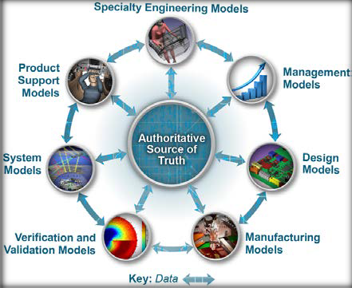

  Formalize Development, Integration and Use of Models
1
Formalize the development, integration, and use of models to inform enterprise decision making
Key Implementation Updates
  Infusion in Policy & Guidance
  DoDI 5000.02, Enclosure 3, Section 9: Modeling and Simulation
  Model Based FMECA DID
  DoDI 5000.61, DoD M&S VV&A
  Other Efforts
  INCOSE Digital Engineering Information Exchange Working group (DEIXWG)
  USN Common Modeling Approach
Formalize the planning for models to support engineering activities and decision making across the lifecycle
Formally develop, integrate, and curate models
Use models to support engineering activities and decision making across the lifecycle
Distribution Statement A. Approved for public release: distribution is unlimited.​
23
Notes:
Frank; Time hack 3 Min
Model development efforts are now considering use and reuse of their modeling efforts. This is driving modeling practice improving consistency with an aim towards achieving a fully realized digital twin of the final product.
List below are relevant efforts across the Department:
Released SEP 4.0. Includes planning guidance for modeling, simulation and digital engineering.
Released: Engineering of Defense Systems Guidebook
Released: Systems Engineering Guidebook
In Process of Development: DODI 5000.DE addressing the use of models to make informed decisions
Updating VV&A policy and model practice guidance to address DE i.e. credibility, curation, quality, consistency
FMECA DID and Model Profile
Other efforts include Services and Industry developing and maturing model development standards
INCOSE DEIXWG are establishing standard modeling methods
The INCOSE Digital Engineering Information Exchange Working Group (DEIXWG) grew out of the need to define a list of Digital Artifacts that could be used in place of the documentation that is asked for today. This need came out of the OUSD R&E ETE team. The team ran a workshop at the INCOSE International Workshop (IW) with the USAF in 2019 and realized it wasn't as simple as creating a list. As a result OUSD R&E ETE worked with INCOSE and NDIA to establish the DEIXWG to address this need. The DEIXWG has regular meetings and will soon be releasing products like the Digital View Model (DVM) and the DEIX Standards Framework. These products would be used to aid in specifying Digital Artifacts based on Use Cases.
The USN Common Modeling Approach:
This approach has grown out of the Navy's Digital Systems Engineering Transformation (D-SET ) efforts that have been going on since before the release of the DE Strategy. This approach was initiated by NAVAIR and has now propagated across all of the Navy Centers. The Common Modeling Approach includes a widely available Integrated Modeling Environment (IME) as well as the Naval Digital Engineering Body of Knowledge (N-DEBoK). These environments are accessible by anyone across the DoD. All you need to access the environment is a CAC and an account. This will allow you access to the modeling tools, model templates, model libraries, modeling policy, procedures, guidance, and model examples. In addition the Navy has established levels of training around this approach. The approach is growing to include specialty and other engineering domains. Although this Common Modeling Approach is mentioned for Goal 1 it spans across all of the goals. The D-SET has regular meetings that open to anyone that wants to attend.
Similarly, the Air Force has their Digital Campaign effort to implement Digital Engineering. The Army ASA/ALT and AFC have just recently started a Digital Engineering effort that will span across of there many centers which have all been doing great work. This, like the Navy effort will drive towards commonality and ultimately will drive more consistency and quality into engineering practice with the goal of better support to the warfighter.

Slide 24
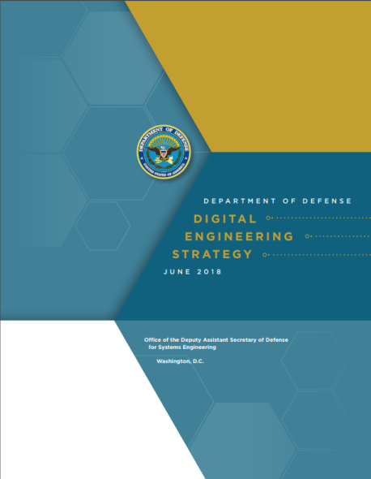
DE Contrasted with MBSE
1
1. Model and integrate data across full enterprise lifecycle
Although critical, Model-Based Systems Engineering (MBSE) is not a full Digital Engineering (DE) solution
DE integrates models and data across the lifecycle and across domains making them digitally navigable
MBSE covers the full systems engineering lifecycle, including requirements, architecture, integration, verification, and validation
2. At each point within the lifecycle, model and integrate data across all engineering and management domains
It is important to establish what the scope for MBSE is
Distribution Statement A. Approved for public release: distribution is unlimited.​
24

Slide 25
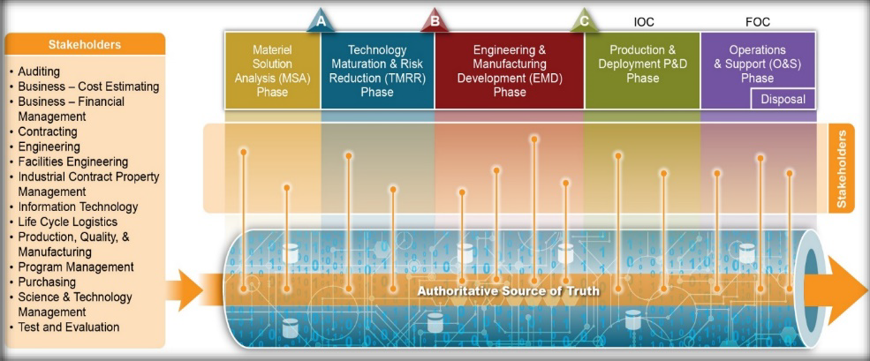
  Provide an enduring Authoritative Source of Truth (ASOT)
2
Provide an enduring authoritative source of truth
Key Implementation Updates
  Infusion in Policy and Guidance
  INCOSE Digital Engineering Information Exchange Working Group (DEIXWG)
  OSD and Service Government Reference Architecture (GRA) and Mission Thread coordination and development
  Service Digital Models and Digital Twin Efforts
Plan and develop the authoritative source of truth
Govern the authoritative source of truth
Use the authoritative source of truth across the lifecycle
Distribution Statement A. Approved for public release: distribution is unlimited.​
25
Notes:
Frank; Time hack 3 Min
In order to provide an enduring authoritative source of truth, there must exist solid data management practices that include data from across all engineering domains to include traceability and to realize the digital thread.
INCOSE DEIXWG: The primary goal is to support an enduring authoritative source of truth and establish a finite set of digital artifacts that acquiring organizations and their global supply chains should use to request an exchange with each other as well as internally between teams/organizational elements.
OSD and Service GRA and Mission Thread example: OSDR R&E Mission Engineering Process - Provides an analytical, data-driven approach to decompose mission elements; collect and analyze trustworthy data for the development of accurate models; develop realistic mission threads and mission engineering threads; and deliver recommendations and artifacts that help inform investment decisions. Key outputs include Government Reference Architectures and Mission Threads that can be flowed down to stakeholders of interest.
Examples of Service Digital Models and Digital Twins Providing an Enduring Authoritative Source of Truth:
The Army has pilot efforts and initiatives to create digital system models and digital twins at different phases of the lifecycle. A few examples are the Digital Twin for Small Caliber (DT2SC), Echelon for evaluating sensors, and the UH-60 Black Hawk Helicopter Digital Twin. DT2SC is enabling complete analysis and optimization of small caliber ammunition to expedite transition from low-rate initial production to full rate production. Echelon is looking earlier in the lifecycle to define a digital system model that’s not tied to a current radar system but rather can be used as a reference for requirements development, analysis, and evaluation of a future radar systems and technologies. The Army’s largest Digital Twin effort is focused on the UH-60 Black Hawk to improve readiness.
The US Army DEVCOM CCDC AC integrated Model Based Engineering environment (iMBE) effort established a prototype environment to integrate tools and data such that a Digital Thread can be established across engineering domains. This environment was designed so that a digital thread can be created for all programs the organization supports.
The US Navy CVN-78 Gerald Ford has developed what you might call a "limited" Digital Twin to be used to largely support manufacturing, assembly, and maintenance activities. The Navy is also making investments in technologies to best understand their application for Naval Digital Twins (NDT) that could be used to support Prognostic Health Management (PHM) and Hull, Mechanical and Electrical (HM&E) degradation, remaining useful life, impending casualty and/or stealth implications.
The Air Force is working with Wichita State to scan and generate 3D models and Finite Element Models (FEM) of the F-16 and B-1 and will use flight test data to validate the FEM's. The B-52 Commercial Engine Replacement Program (CERP)leveraged digital twins of the proposed engine designs in a “digital fly-off” to aid decision making early in the program. The Air Force is also pursuing efforts to develop digital twins of an entire installation to help make base improvement decisions.
Digital Twin Concept:
The Digital Twin concept is being matured by the services,. It isn't clear that there are any examples a full system realization of a Digital Twin. It is fair to say that most programs today have a geometric equivalent "Digital Twin" of the physical product. They also tend to have functional models and simulations used to estimate performance. That said there are many complex subsystems that will have full digital twins such as aircraft and ground vehicle engines. In some cases the engines are instrumented and can provide operational data that is used in the Digital Twin to predict performance, and maintenance activities. In fact, most satellites have on board diagnostics that are feed back to monitor health and to predict how best to maneuver them so that they maintain an optimal orbit. We know that there are some systems like the A-10, which is in sustainment, that is now starting to realize a digital twin. As changes are made to this legacy system the twin is establish for the parts of the system that are undergoing upgrades.

Slide 26
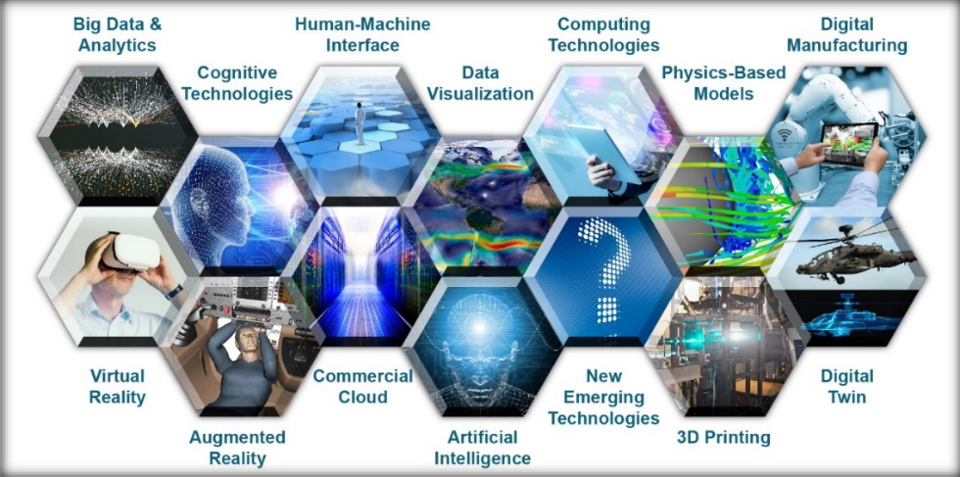
Incorporate Technological Innovation
3
Incorporate technological innovation to improve the engineering practice
Key Implementation Updates
  USAF Digital Campaign
  USN Digital Transformation
  Army Digital Transformation
  Cutting-Edge Digital Engineering Tools Across the Workforce (ex. PLM tools, ADVANA, CAMEO, Satellite Tool Kit (STK), ModelCenter)
Establish an end-to-end digital engineering enterprise
Use technological innovations to improve the digital engineering practice
Distribution Statement A. Approved for public release: distribution is unlimited.​
26
Notes:
Frank; Time hack 3 Min
We are focusing on leveraging high performance computing, cloud networks, open standards. Organizations have vibrant research efforts going on to explore opportunities to use Data Analytics, AI/ML, IOT, Improved Human Machine integration virtual reality, augmented reality.
Key Implementation Updates on Incorporating Technological Innovation:
USAF Digital Campaign. The Department of the Air Force Vision is, "A digitally-empowered Air Force equipped with an agile workforce, state-of-the-art technologies, and intuitive processes that drive model-based enterprise decision-making, enable automation, institutionalize open architectures, and leverage authoritative models and data to ensure seamless stakeholder collaboration across the acquisition lifecycle." The Campaign is a coordinated effort to move the activities of the enterprise, government and industry to modern digital capabilities and processes. The desired end state is a collaborative, integrated digital environment that guides, orchestrates, and delivers the means for each individual across the enterprise to access the data, functions and elements needed to do a his or her job in a purely digital manner. This includes all functions, from acquisition to sustainment and beyond, not just engineering.
USN Digital Transformation. This US Navy and Marine Corps Digital Systems Engineering Transformation Strategy is intended to transform systems engineering capabilities by using common, composable, interactive, model-based systems to store and exchange data, models, and information within and across programs. Digital Engineering uses models and authoritative data to coordinate and integrate all disciplines and phases of work for the life cycle of a platform or system. Digital Engineering allows engineers and leaders to better understand and assess complex choices, automates requirements traceability to achieve design satisfaction, and supports timely decision making through integration, automation, visualization, and high performance computing.
The Army Digital Transformation Strategy (ADTS) is the Army’s strategy to achieve digital transformation across Army technologies, processes and people. The strategy provides an overarching framework to achieve a digital Army of 2028 empowered to deliver overmatch through joint multi-domain operations (MDO). The ADTS will drive digital transformation, innovation, and reform through strategy, policy, governance, oversight and rapid capabilities to establish an operational MDO force. Elements of the strategy include: Software Factory: The Army trains the workforce to create software and prepare for highly technical battlespaces that are ambiguous, fast-paced and data/software-driven. Software Engineering Center: Addresses the challenge of software assurance (SwA) by publishing a new Department of the Army Pamphlet 25-2-5. The pamphlet provides clear guidance for improving security for future government off-the-shelf (GOTS) and commercial off-the-shelf (COTS) software fielded within the Army. Army Cloud Plan: Establishes both unclassified and classified cloud environments called cArmy to enhance and streamline access to data. cArmy enables faster data access, allowing the Army to operate in an agile landscape, monitor permissions and access, and deploy digital products quicker than ever before.
Cutting edge DE tools used by the government, contractor and academia workforce:
PLM: Product lifecycle management (PLM) is an information management system that integrates data, processes, business systems, and, people in an extended enterprise. PLM software allows to manage this information throughout the entire product lifecycle efficiently and cost-effectively: from ideation, design, and manufacture to service and disposal.
ADVANA: A modern data platform that pulls data from hundreds of business systems to make data discoverable, understandable, and usable for advanced analytics aligned to the National Defense Strategy. From finance and contracts to logistics and readiness, this system drives informed decision making across the organization through common data models, natural language discovery, and self-service analytics.
CAMEO - Cameo Systems Modeler ™ is an industry leading cross-platform collaborative Model-Based Systems Engineering (MBSE) environment, which provides smart, robust, and intuitive tools to define, track, and visualize all aspects of systems in the most standard-compliant SysML models and diagrams.
Satellite Tool Kit - Systems Tool Kit (STK) is an indispensable digital mission engineering application for the aerospace, defense, telecommunications, and other industries. It features an accurate, physics-based modeling environment to analyze platforms and payloads in a realistic mission context.
Model Center - Phoenix Integration’s ModelCenter is a vendor-neutral software platform that empowers engineers to create and automate multi-tool workflows, providing increased flexibility to solve challenging engineering problems, and ultimately delivering on the promise of MBE. ModelCenter MBSE bridges the gap between engineering analysis and the systems model, ensuring that the product requirement is met and in sync with the engineering analysis conducted throughout the product development process.

Slide 27
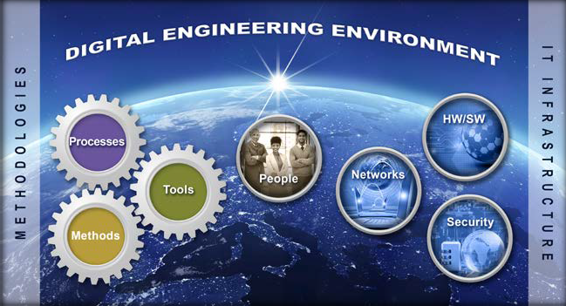
Establish Infrastructure and Environments
4
Establish a supporting infrastructure and environments to perform activities, collaborate, and communicate across stakeholders
Key Implementation Updates
  USAF Digital Campaign
  USN Digital Transformation
  Army Digital Transformation and “Cloud Smart” approach
  Cloud Hosting Services and Platforms (ex. Cloud One, High Performance Computing Modernization Program (HPCMP), AF Digital Engineering Environment Sandbox, Navy Integrated Modeling Environment)
Topic
Develop, mature and use digital engineering IT infrastructures
Develop, mature, and use digital engineering methodologies
Secure IT infrastructure and protect intellectual property
Distribution Statement A. Approved for public release: distribution is unlimited.​
27
Notes:
Frank; Time hack 3 Min
All services and industries have increased their enterprise infrastructure investments to include efforts around improving data protection and data access. The infrastructure is an important part of this. Also all the services are driving towards a cloud-based network architecture approach.
Key Implementation Updates on Establishing a Supporting Infrastructure:
USAF Digital Campaign. USAF is working towards developing an Integrated Environment. They are providing overarching guidance to influence corporate IT improvement investments to enable a robust, secure infrastructure for the enterprise-wide Digital Campaign. Efforts include providing an Integrated Digital Environment (IDE) of models and tools for collaboration, analysis, and visualization across the functional domains of Air Force users
USN Digital Transformation. The Navy is developing a comprehensive, enterprise-wide capability that provides tools, infrastructure, and support for Naval Model-Based Systems Engineering (MBSE) efforts. Covers a wide range of areas from shared licenses and server-based repositories to knowledge and data management.
Army Digital Transformation and “Cloud Smart” approach: The Army will adopt a “cloud smart” approach that supports the migration of enduring applications in existing Army Enterprise Data Centers (AEDC) and Installation Processing Nodes (IPN) to Army’s cloud to achieve cost savings, interoperability, and information sharing across applications.
Cloud Hosting Services and platforms. Examples - Cloud One, High Performance Computing Modernization Program (HPCMP), AF Digital Engineering Environment Sandbox, Navy Integrated Modeling Environment)
Other Efforts Supporting Infrastructure Development:
Congress is now onboard with new laws being put in place, i.e. section 231 that makes it law to have an infrastructure and environment for SW development efforts that supports automated test and evaluation of SW solutions. The department has responded with a number of recommendations along with changes that are being incorporated across many policies and guidance that are being updated. As an example DOD 5000.DE is including such language. In addition the SEP template was recently updated and it has been heavily modified to consider planning for Digital Engineering activities to include the Development, Operation, and training needed for realizing a Digital Engineering Ecosystem. In fact, there are other efforts such as TRMC which provides for a modern day test support environment that can be used for joint test and evaluation efforts along with MEDE that was stood up to support Mission Engineering join mission analyses efforts. In fact, the global pandemic stressed the Infrastructure and Environment and forced many changes to accommodate a 100% remote workforce. Essential to achieving Digital Engineering is the establishment of and change to this part of our government enterprises.
In addition there are enterprise efforts to drive towards bodies of knowledge and to improve on how information is collected and shared across organizational boundaries.

Slide 28
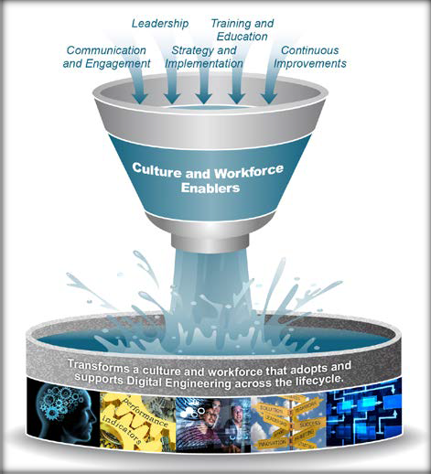

Transform Culture and Workforce
5
Transform the culture and workforce to adopt and support digital engineering across the lifecycle
Key Implementation Updates
  Digital Engineering Body of Knowledge (DEBoK) Vision
  USAF Digital Guide
  USN MBSE Guidebook
  Service Workforce Training
Topic
Short Description
Improve the digital engineering knowledge base
Lead and support digital engineering transformation efforts
Build and prepare the workforce
Distribution Statement A. Approved for public release: distribution is unlimited.​
28
Notes:
Frank; Time hack 3 Min
Leadership is stepping up, setting goals and advocating for change. They are working to change the culture, encourage sharing and are marketing and advertising new capabilities. It is in requests for proposals, as well as in the responses.
Training curriculum is changing due to demand and difficulty in finding the workforce talent needed to work efficiently and comfortably in a digitalized world.
Key Implementation Updates on Transforming the Culture and Workforce:
DEBOK - The Digital Engineering Body of Knowledge (DEBoK) serves as a reference for the DoD engineering community to use in implementing digital engineering practices; starting with systems engineering and expanding to specific disciplines, engineering domains and specialty areas. The BoK stores collective data, information and knowledge on digital engineering. Members of the government, industry and academia working within this space will be able to contribute to the DEBoK and build their digital engineering solutions based on collective knowledge.
USAF Digital Campaign Guide. An information strongbox for transformation efforts. The repository is a focal point for policy, training information, best practices, new, and resources relating to the digital transformation. “The Air Force Digital Guide is the authoritative source of information about products being worked for the Department of the Air Force Digital Campaign.
USN MBSE Guidebook. Similar to USAF Digital Guide. Provides guidance to USN on MBSE best practices
Other:
SERC research DE competency framework is influencing changes into DAU training to include greater emphasis on Digital Literacy.
DAU has a DE Credential which they will continuously improve.
Universities are offering Digital Engineering programs and are changing their curriculums to assure students work in a digitalized engineering environment.

Slide 29

Digital Engineering Tool Examples and Considerations
Example DE tools used in various fields
Computer-Aided Design (CAD) Software
Building Information Modeling (BIM) Software
Finite Element Analysis (FEA) Software
Computational Fluid Dynamics (CFD) Software
Simulation and Modeling Software
Product Lifecycle Management
Project Management
3-D Printing
Virtual Reality
Tradespace Analysis Tools
Others
Key Considerations: Purpose, Scalability, Collaboration, Ease of Use, Compatibility, Performance, Security, Cost, Licensing
29
Notes:
Time Hack:
Needs to be a concerted effort to select tools that support the de ecosystem.
Focus on capability as opposed to specific tools. categories from DETECT

Slide 30









Making the Case
Multiple Demand Signals for Tools Guidance
DODI 5000.97:
(2.1.e) “Establishes digital engineering guidance”
(3.4) “Implementation of Digital Engineering”
(3.2.b) “Digital engineering capability elements”
GAO Report GAO-23-105867 Recommendation #3:
OUSD R&E should establish an overarching plan which identifies associated resources to enable adoption of modern engineering tools, across all programs.
HASC 118-125 NDAA FY2024 Report on a DoD DE COE:
Advisability and feasibility of establishing a digital engineering (DE) center of excellence (COE)
Community Feedback, Industry is looking for (Surveys, Conferences):
Exemplar Reference Implementation for a Digital Engineering Ecosystem
Reference Architecture patterns
Tailoring Digital Engineering based on program features
GAO
Reco’s.
HASC
Rpt.
DE COE
Community
Feedback
DoDI
Policy
DE Tool Guidance
Criteria
List of Tools
"T" Shirt Size
Distribution Statement A. Approved for public release: distribution is unlimited.​

Slide 31
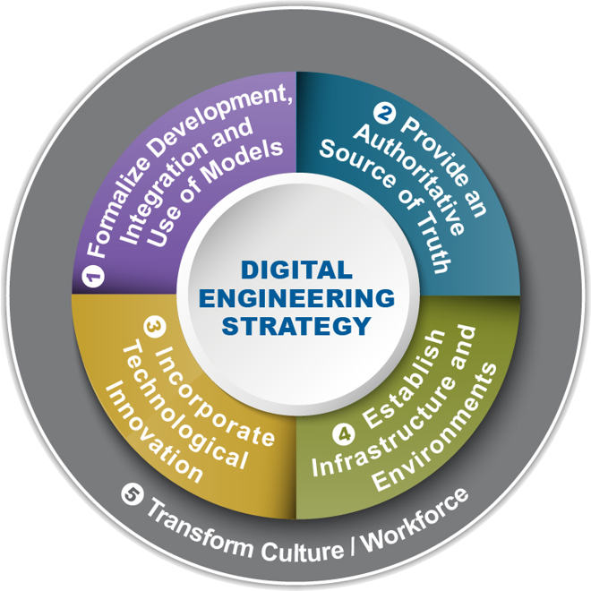
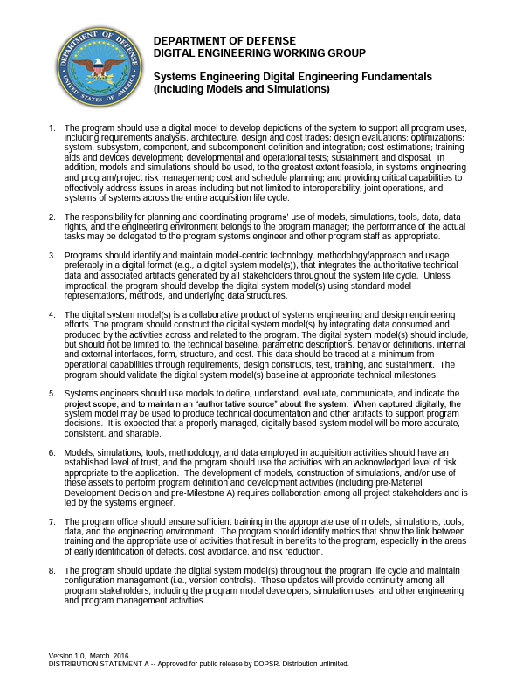
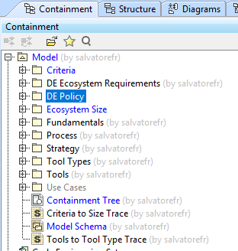
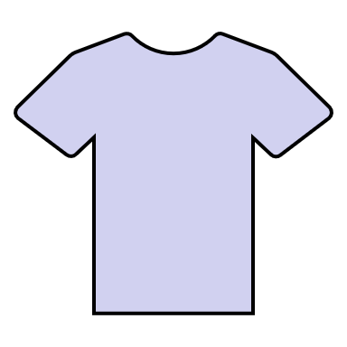

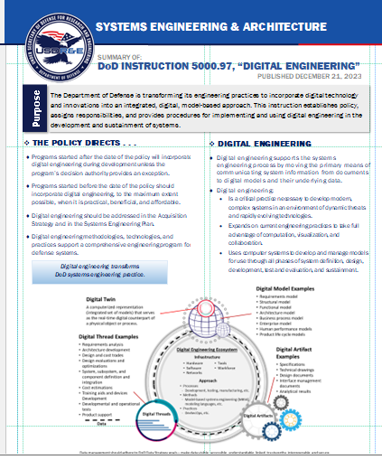
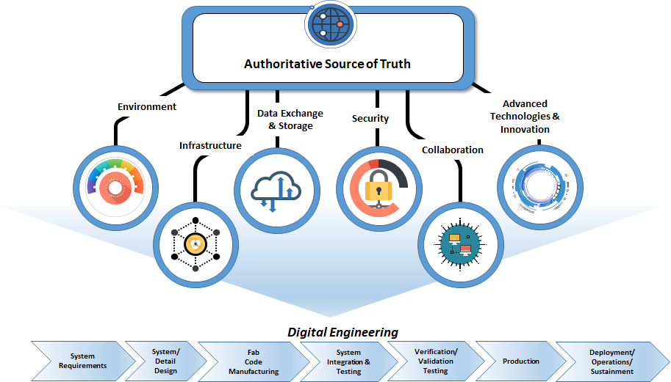

Ecosystem Scoping ,Tracing & Criteria Modeling (in CAMEO)
DETECT Underlying ASOT for our Data Schema
DETECT Reference Model
Less
More
OUSD R&E DE Fundamentals
Computing Capacity $$$$$$$$
Users
S
M
L
Baseline Sizing parameters
Generic DE Tools Selection Criteria
OUSD R&E
DE Ecosystem
Generic Requirements
DE Policy
DODI 5000.97
Distribution Statement A. Approved for public release: distribution is unlimited.​

Slide 32
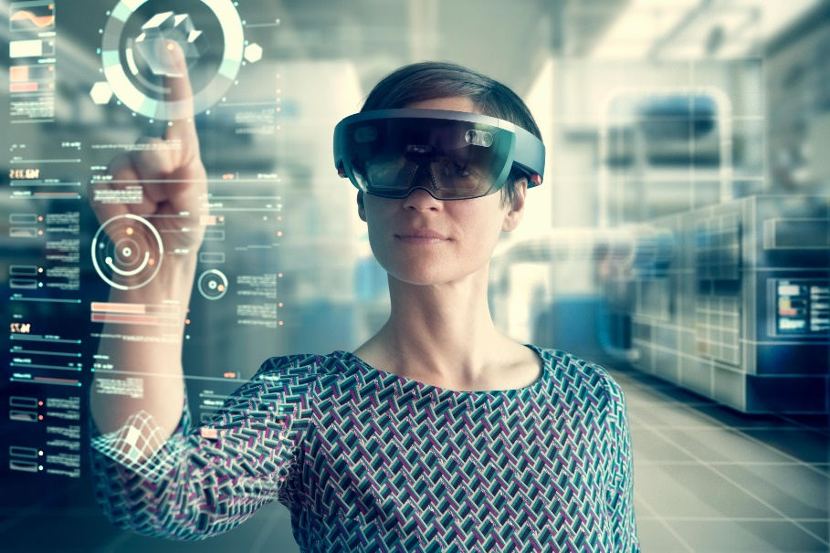

Digital Engineering Technology considerations for Training and Maintenance
Training
  Simulation and Virtual Reality: Creating realistic simulations and virtual environments to train personnel in a safe and controlled setting providing hands-on training without the need for physical equipment.
  Data-Driven Learning: Utilizing data analytics to track and assess trainee performance, providing customized feedback and optimizing training programs in real-time.
  Remote Learning: Facilitating remote and asynchronous training through online platforms, enabling continuous learning and reducing geographical constraints.
  Interactive Manuals: Replacing traditional paper manuals with digital, interactive guides that are more accessible, searchable, and adaptable to different skill levels.
Maintenance
  Predictive Maintenance: Using data analytics, sensors, and machine learning to predict equipment failures and schedule maintenance proactively, reducing downtime and costs.
  Digital Twins: Creating digital replicas (digital twins) of physical assets or systems to monitor their real-time performance, enabling more effective maintenance strategies.
  Augmented Reality (AR): Providing maintenance personnel with AR-based tools and information overlays, enhancing their ability to diagnose and repair equipment on-site.
  Documentation and Records: Digitizing maintenance records, service manuals, and asset histories for easier access and analysis, aiding in decision-making and compliance.
Advanced digital technologies and methodologies to revolutionize how training and maintenance tasks are carried out.
32
Notes:
Time Hack:
Needs to be a concerted effort to select tools that support the de ecosystem.
When do you start considering these capabilities early on in the design solution.
M&S as a continuum? Connect the dots initiative.

Slide 33
Digital Engineering Fundamentals (slide 1 of 3)
Organizations should establish and follow formalized plans, methodologies, and accepted standards for the development and use of models as a continuum throughout the life cycle, including interaction across other models.
Organizations should define and establish Authoritative Sources of Truth (ASOT) for the intended engineering and stakeholder activities.
Organizations should establish a governance methodology for the ASOT across all engineering domains and stakeholder roles and responsibilities to include but not be limited to data protection, access control rules, data traceability, data quality, and acceptance criteria to establish data trust and model credibility.
33
Notes:
Frank; Time hack 3 min
Organizations should establish and follow formalized plans, methodologies, and accepted standards for the development and use of models as a continuum throughout the life cycle, including interaction across other models. Organizations should integrate these activities into the programs’ plans and schedules. Models and all digital representations, including simulations, should mature as the knowledge of the missions and/or systems evolves.
Organizations should define and establish Authoritative Sources of Truth (ASOT) for the intended engineering and stakeholder activities. Definitions should include but not be limited to location, format, organization, traceability, pedigree, provenance, data rights, and acceptable uses. The ASOT should be used to access, share, and exchange models and data so they may be used in support of engineering activities and to form digital artifacts.
Organizations should establish a governance methodology for the ASOT across all engineering domains and stakeholder roles and responsibilities to include but not be limited to data protection, access control rules, data traceability, data quality, and acceptance criteria to establish data trust and model credibility.
Note: Please prepare antidotes for each of these: Not just DoD; talk about Tesla, Ford, Goodyear, others… i.e Tell a story and not just read the fundamentals

Slide 34
Digital Engineering Fundamentals (slide 2 of 3)
Organizations should establish and sustain a Digital Engineering Ecosystem (DEE) that interconnects the infrastructure, environment, and methodology (process, methods, and tools).
Organizations should develop and/or leverage existing enterprise-level resources to establish and sustain a secure DEE.
Organizations should foster an environment that supports innovation and should establish a systematic DE maturation approach to drive continuous improvements in the establishment and use of the DEE in practice and promotes continuous prototyping and experimentation.
34
Notes:
Frank; Time hack 3 min
Organizations should establish and sustain a Digital Engineering Ecosystem (DEE) that interconnects the infrastructure, environment, and methodology (process, methods, and tools). The DEE should enhance the capability to collaborate across organizations, engineering disciplines, and physical locations.
Organizations should develop and/or leverage existing enterprise-level resources to establish and sustain a secure DEE. This includes adequate computing and IT infrastructure, model, data, and simulation interoperability; and the configuration and security management of data using digital engineering processes and methods that help solve the Department’s hardest analytical problems.
Organizations should foster an environment that supports innovation and should establish a systematic DE maturation approach to drive continuous improvements in the establishment and use of the DEE in practice and promotes continuous prototyping and experimentation.
Note: Please prepare antidotes for each of these: Not just DoD; talk about Tesla, Ford, Goodyear, others… i.e Tell a story and not just read the fundamentals

Slide 35
Digital Engineering Fundamentals (slide 3 of 3)
Organizations should understand the digital engineering knowledge, skills, and abilities needed for each occupational discipline. Organizations should train or acquire their personnel appropriately to address the knowledge gaps and expertise needed.
Organizations should identify digital engineering knowledge transfer and personnel exchange opportunities (e.g., mentoring, apprenticeships, industry sharing forums, best practices, success stories, etc.) to mature the workforces’ digital engineering knowledge, and accelerate digital transformation within the enterprise.
Organizations should build leadership advocacy for Digital Engineering initiatives, set organizational goals, establish quality expectations for the workforce, and quantitatively assess the digital engineering value being realized.
35
Notes:
Frank; Time hack 3 min
Organizations should understand the digital engineering knowledge, skills, and abilities needed for each occupational discipline. Organizations should train or acquire their personnel appropriately to address the knowledge gaps and expertise needed.
Organizations should identify digital engineering knowledge transfer and personnel exchange opportunities (e.g., mentoring, apprenticeships, industry sharing forums, best practices, success stories, etc.) to mature the workforces’ digital engineering knowledge, and accelerate digital transformation within the enterprise.
Organizations should build leadership advocacy for Digital Engineering initiatives, set organizational goals, establish quality expectations for the workforce, and quantitatively assess the digital engineering value being realized.
Note: Please prepare antidotes for each of these: Not just DoD; talk about Tesla, Ford, Goodyear, others… i.e Tell a story and not just read the fundamentals

Slide 36
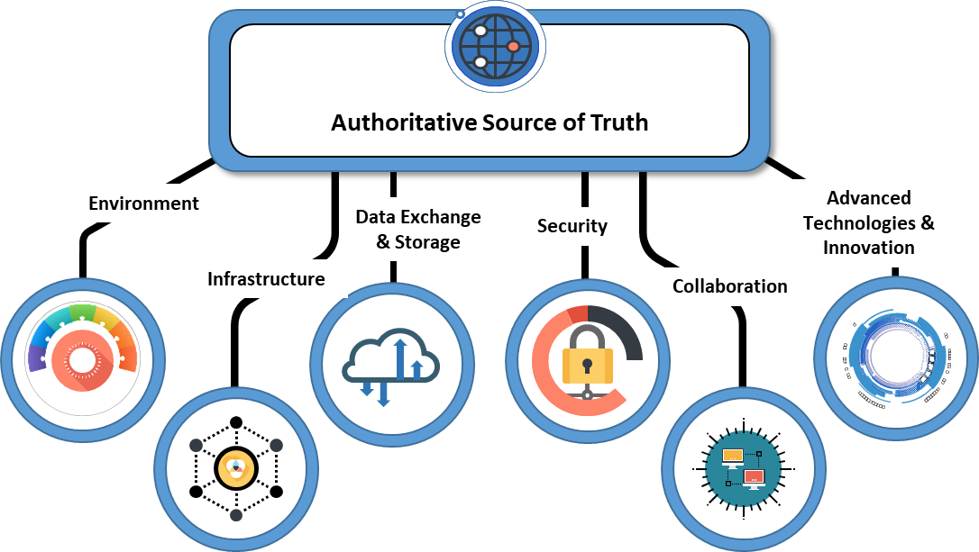
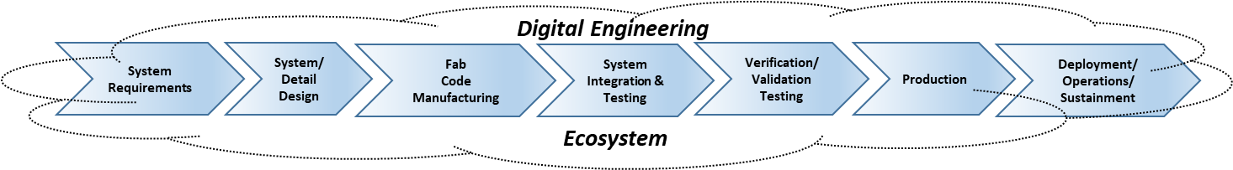
DE Requirements Key Attributes
Distribution Statement A. Approved for public release: distribution is unlimted.​
36
Notes:
Environment
Implements Integrated model-centric workflows for all engineering disciplines, while maximizing automation of engineering methods & processes throughout all program life-cycles. Encompasses a flexible ecosystem that is operated & sustained to support autonomous engineering & program artifact generation.
Infrastructure
Inclusive of all IT hardware equipment computing power, IT software backbones/backends and tool applications. This includes IT network topologies that provide flexible connectivity, extensibility, expansion and seamless multi-user and organizational Interoperability.
Data Exchange and Storage
Management, curation, storing and sharing of information inclusive of models, applications data and artifacts. Implemented within an infrastructure of high speed throughput, data broker and translation handoff between engineering tools, to promote a contiguous exchange and storing of all data.
Security
Encompasses all access control, information assurance and cyber-security aspects regarding multi-classification environments at all appropriate classifications.
Collaboration
Collaborative tools and initiatives across users, stakeholders, services, engineering disciplines, enterprises throughout all development, production, deployment and sustainment lifecycle phases.
Advanced Technologies and Innovations
Intelligent applications that enable rigorous development of new and future innovative approaches to DEVOPs, prototyping, automated testing, and cross domain traceability.

Slide 37
Current State of Practice
37
Notes:
Frank; Time hack 3 min
The U.S. Department of Defense (DoD) has been actively working to implement a digital engineering strategy across its various branches and agencies. The goal of this strategy is to leverage advanced digital technologies and methodologies to enhance the efficiency, effectiveness, and speed of the defense acquisition process, from concept development to sustainment.
Here are some key aspects of the DoD's efforts in implementing the digital engineering strategy:
Digital Model-Based Engineering (MBE): The DoD is promoting the adoption of digital MBE practices, which involve creating and managing a digital representation of a system throughout its lifecycle. This includes capturing requirements, design information, simulation models, and other relevant data in a digital format, allowing for better communication and understanding among stakeholders.
Modeling and Simulation: The DoD is investing in advanced modeling and simulation capabilities to support the digital engineering strategy. This includes the development of high-fidelity virtual environments and virtual prototypes that enable testing and evaluation of systems before physical prototypes are built. These simulations help identify and address potential issues early in the acquisition process, saving time and resources.
Data-Driven Decision-Making: The DoD recognizes the value of data in driving decision-making processes. Efforts are underway to improve data collection, management, and analysis, enabling more informed decision-making at all levels. This includes leveraging artificial intelligence (AI) and machine learning (ML) techniques to derive insights from vast amounts of data and support predictive analytics.
Interoperability and Open Standards: To facilitate collaboration and data exchange across different defense organizations, the DoD is working to establish common data standards and interoperability frameworks. This allows for seamless integration of digital models and information between different stakeholders, ensuring a unified and consistent approach to digital engineering.
Training and Workforce Development: The DoD recognizes the need to develop a skilled workforce capable of leveraging digital engineering tools and methodologies. Efforts are being made to provide training and education programs to defense personnel, equipping them with the necessary skills to effectively implement digital engineering practices.
Partnerships and Industry Engagement: The DoD is actively engaging with industry partners and academia to foster innovation and advance digital engineering capabilities. Collaboration with industry leaders allows the DoD to leverage commercial best practices and cutting-edge technologies, accelerating the implementation of digital engineering across the defense acquisition enterprise.
These efforts by the DoD highlight its commitment to modernizing defense acquisition processes through digital engineering. By leveraging advanced technologies and methodologies, the DoD aims to enhance system performance, reduce costs, and accelerate the delivery of capabilities to the warfighter.

Slide 38
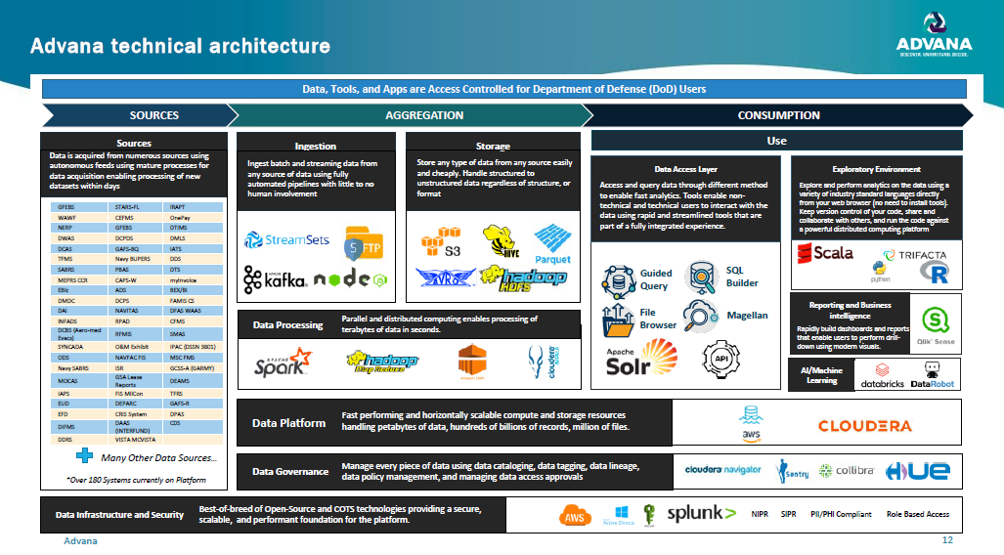
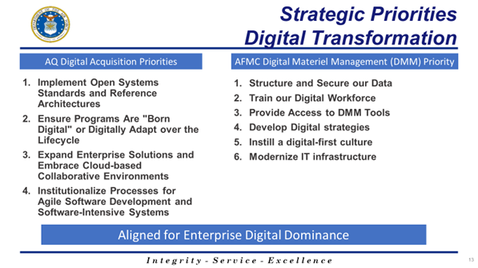
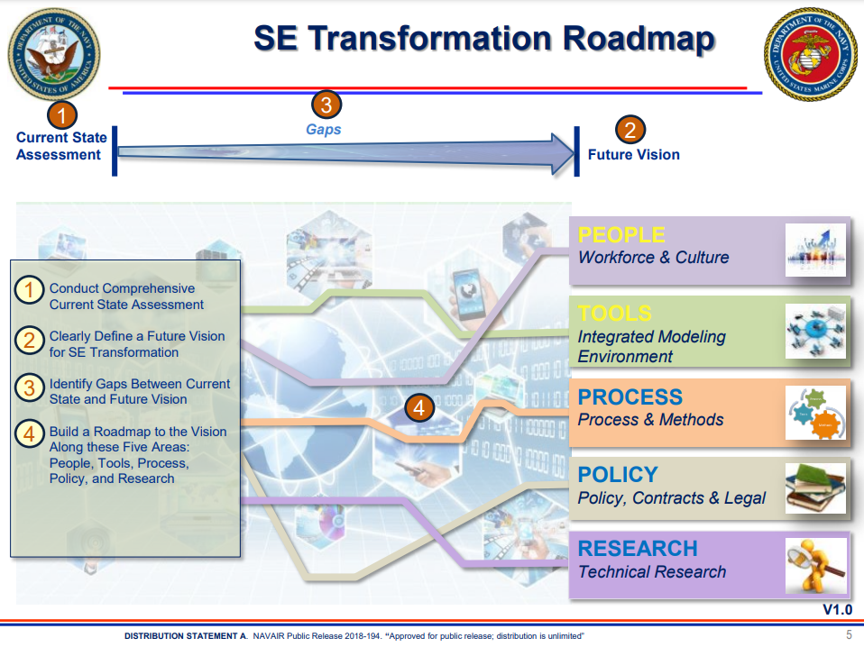
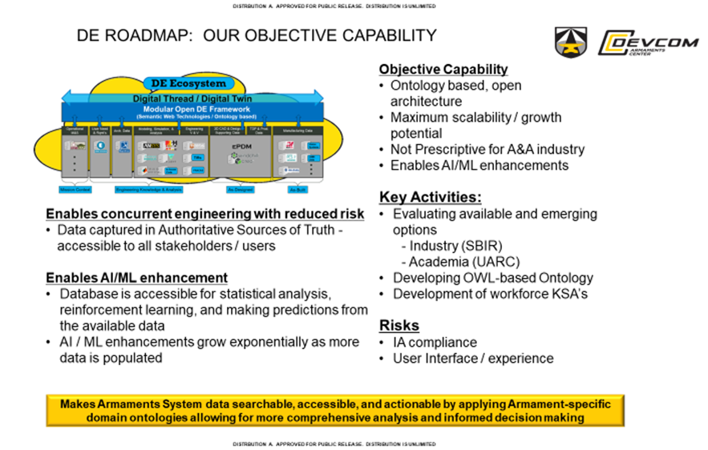
Example DE Efforts in DoD
CDAO
AIR FORCE
NAVY
ARMY
Notes:
Graphic airplanes – Baldwin saving money

Slide 39
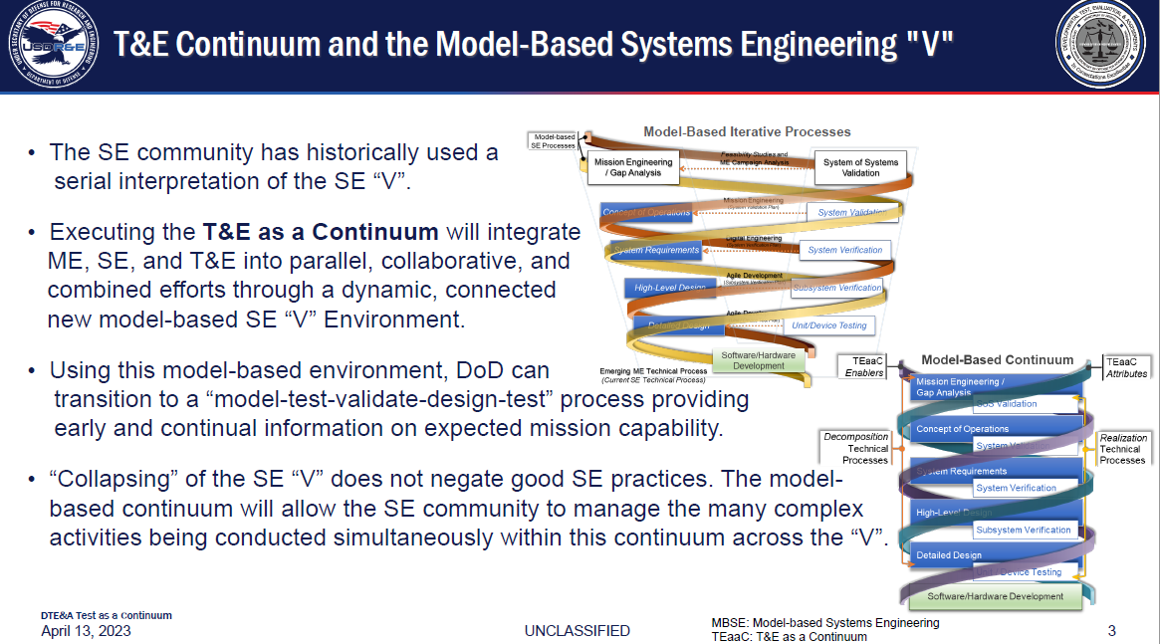
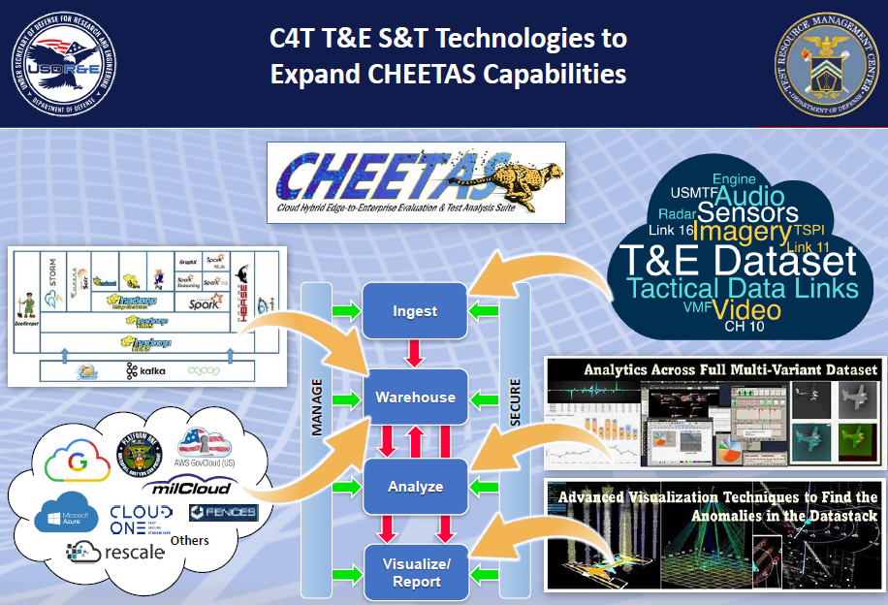
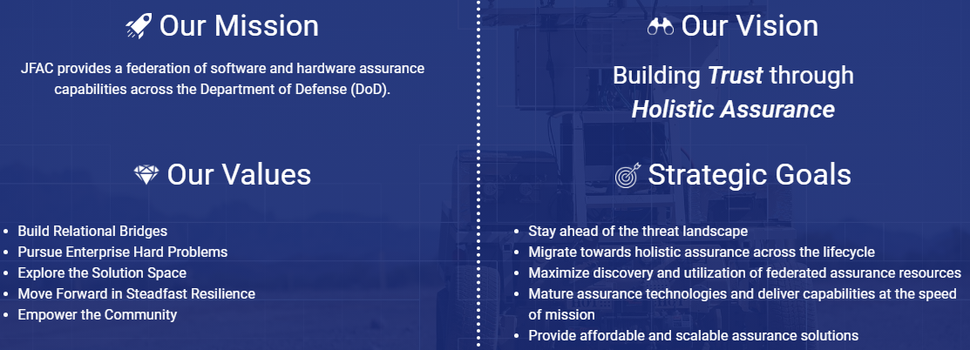
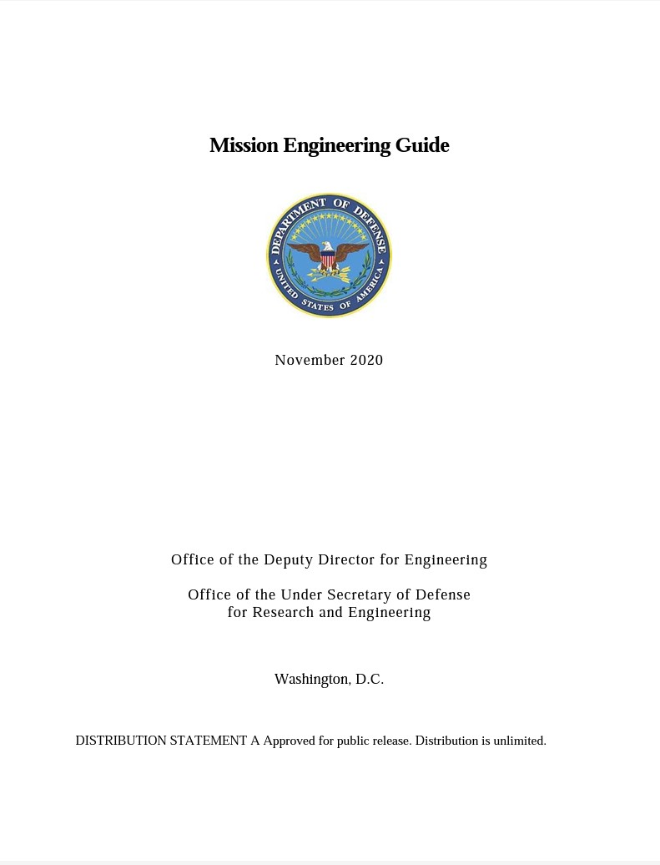
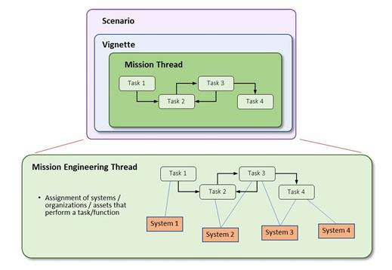
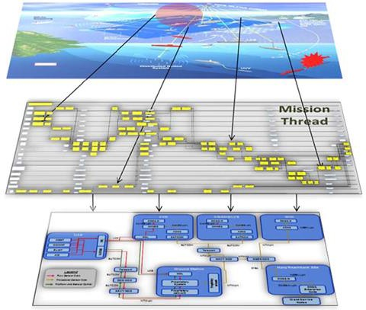

Example DE Efforts in R&E
DEVELOPMENTAL TEST, EVALUATION & ASSESSMENT
TEST RESOURCE MANAGEMENT CENTER
JOINT FEDERATION ASSURANCE CENTER
MISSION ENGINEERING GUIDEBOOK
Notes:
Daniel Content Here JFAC TRMC DTE&A stuff
Mission engineering guidebook – NDIA SE conference 2023 aligning m&s at OSD
Testing as a continuum graphic
Trmc and jfac in chat with daniel

Slide 40




Example DE Efforts in the Industrial Base
NASA
IDAHO NATIONAL LAB
Open-source data warehouse focused on enabling complex projects to embrace digital engineering. It accomplishes bringing digital thread and digital twins to these projects with integrations to a large collection of software systems across a project's lifecycle.
WICHITA STATE
UNIVERSITY OF ARIZONA
Notes:
Quad chart steal from Univ. of AZ (ask Dan)
-
NASA (Ask Dan)
- digi impl and DE
SERC
- Emily has slide
NIAR - witchita state digital twins 3d scanning
-Celia Tseng DS

Slide 41










Federal Digital Engineering Forum
Distribution Statement A. Approved for public release. Distribution is unlimited. DOPSR Case # 24-T-0964
HIGHLIGHTS FROM FED DEF
200
Attendees
26
Overviews
10
Working Groups
MAIN GOALS OF FED DEF
Advance DE practices
Share best practices, success stories, and failures
Promote sharing of models and data
Encourage model reuse
List an prioritize common challenges
SAVE THE DATE
FED DEF SPRING 2025
Visit us at ​
fed-def.org​
Distribution Statement A. Approved for public release. Distribution is unlimited. DOPSR Case # 24-T-0964
Notes:
Graphic support to polish this up- change this graphic with stock photography with similar subject matter
Brian Rismiller graphic designer, helped us prev. on graphics for the DEBoK with this type of DOD-imagry / photography - so it might be that he / or there might be photography avail to designers for use on slide 22.

Slide 42
Celebrate the small wins
Driving Change

Slide 43
5 Foundational Principles for change
1
2
3
Doing Over Planning
Leveraging
Data over Existing Process
Upskilling Over Future Hires
4
5
Interoperability
Over Tool
Verticals
Information
Sharing Over Organizational Silos
43
Distribution Statement A. Approved for public release: distribution is unlimited.​

Slide 44
DEM&S Efforts to Drive Change
Distribution Statement A. Approved for public release. Distribution is unlimited. DOPSR Case # 24-T-0964
STANDARDS
POLICIES
MEASURES OF SUCCESS
ISO
JESC
ReqIF
HLA
FMECA
SISO
OMG
Digital Twin
IEEE
ASME
M&S Strategy
DoDI 5000.97
DoDI 5000.61
JCIDS Manual
DoDI 5000.70
Congress Tasks
DSB & DBB Reports
RAND
DE Measurement Framework
TECHNICAL GUIDANCE
SysML v2
UAF 2.0
5000.61 RPG
MIL HDBK 539
VIPRE
API Guidance
ECOSYSTEMS
Tool Catalog
DETECT
Mission Eng. Ecosystem
JESC
WORKFORCE & CULTURE
INCOSE
AIAA
SERC/AIRC
National Academies
DEM&S CoP
FED DEF
DEBoK
NDIA
ETM & DAU
Distribution Statement A. Approved for public release. Distribution is unlimited. DOPSR Case # 24-T-0964
Notes:
Eating healthy does not stop world hunger

Slide 45


The DoD Doesn’t Make Big Moves
Distribution Statement A. Approved for public release. Distribution is unlimited. DOPSR Case # 24-T-0964
WHERE WE ARE
EXPLORING
Leverage traditional technologies to automate existing capabilities & dabbling with digital. No real change to the organization.
DOING
Leverage digital technologies to extend capabilities, but still largely the same business, operating, & customer models.
BECOMING
Leverage digital technologies & becoming more synchronized & less siloed with advanced changes to current business, operating, & customer models.
BEING
Business,
operating, & customer models are optimized for
digital & profoundly different from previous models.
REALIZING
A need has been
realized. Concept ideation
& research stage.
Resource: Proprietary Framework Developed In Collaboration Between Deloitte & MIT, The Technology Fallacy
Distribution Statement A. Approved for public release. Distribution is unlimited. DOPSR Case # 24-T-0964

Slide 46
We can’t adopt digital engineering until…
Distribution Statement A. Approved for public release. Distribution is unlimited. DOPSR Case # 24-T-0964
“…the current method stops working.”
“…We address how we model all of our legacy systems.”
“..we demonstrate the ROI.”
“…we navigate the approval challenges.”
“…we know the tool will work.”
“…the DoD selects a tool for us.”
“…we have a directive on it.”
“…we get more direction through policy.”
“…we figure out data aggregation concerns.”
“…we figure out how to do V&V of models?”
Distribution Statement A. Approved for public release. Distribution is unlimited. DOPSR Case # 24-T-0964

Slide 47

Change yourself
Distribution Statement A. Approved for public release. Distribution is unlimited. DOPSR Case # 24-T-0964
DIB
DoD
OUSD(R&E)
SE&A
DEM&S
PERSONAL
Distribution Statement A. Approved for public release. Distribution is unlimited. DOPSR Case # 24-T-0964
Notes:
Getting started resources
Actions to the audience
Behavior is for them to read the book
Add in the benefit to reading this
Quotes from team Critical do DE Transition...

Slide 48















Change Your Team
Distribution Statement A. Approved for public release. Distribution is unlimited. DOPSR Case # 24-T-0964
DIB
Task
Trackers
Social Media
DoD
Email Free Fridays
Teams
OUSD(R&E)
DEM&S
SE&A
Fireside Chats
DEM&S
Retrospective
Offsites
PERSONAL
Book Club
Knowledge
Cafés
Distribution Statement A. Approved for public release. Distribution is unlimited. DOPSR Case # 24-T-0964
Notes:
Reframe communication from practitioner to OSD
Understand funding and policies
Change mindsets to fit the role
Write VBA code to sync outlook calendars

Slide 49

SE&A Adopts Culture
Distribution Statement A. Approved for public release. Distribution is unlimited. DOPSR Case # Case # 24-T-0964
DIB
Task
Trackers
Social Media
DoD
Email Free Fridays
Teams
OUSD(R&E)
SE&A
Fireside Chats
SE&A
DEM&S
Retrospective
Offsites
PERSONAL
Book Club
Knowledge
Cafés
Distribution Statement A. Approved for public release. Distribution is unlimited. DOPSR Case # Case # 24-T-0964
Notes:
How DEM&S is advancing the ship

Slide 50

The DoD Doesn’t Make Big Moves But…
We Can Move the Needle with Small Wins
Distribution Statement A. Approved for public release. Distribution is unlimited. DOPSR Case # 24-T-0964
WHERE WE ARE
EXPLORING
Leverage traditional technologies to automate existing capabilities & dabbling with digital. No real change to the organization.
DOING
Leverage digital technologies to extend capabilities, but still largely the same business, operating, & customer models.
BECOMING
Leverage digital technologies & becoming more synchronized & less siloed with advanced changes to current business, operating, & customer models.
BEING
Business,
operating, & customer models are optimized for
digital & profoundly different from previous models.
REALIZING
A need has been
realized. Concept ideation
& research stage.
Resource: Proprietary Framework Developed In Collaboration Between Deloitte & MIT, The Technology Fallacy
Distribution Statement A. Approved for public release. Distribution is unlimited. DOPSR Case # 24-T-0964

Slide 51

Summary
Distribution Statement A. Approved for public release: distribution is unlimited.​
45
Notes:
Frankl; Time hack 3 min

Slide 52
Resources
Digital Engineering Body of Knowledge (DEBoK)
US AF Digital Transformation Guide
USD SE&A Web Site
  Digital Engineering Page
  Engineering References for Program Offices
    DoD Digital Engineering Fundamentals
    Digital Engineering Ecosystem Generic Requirements
    DoD Instruction 5000.88, Engineering of Defense Systems
    Engineering of Defense Systems Guidebook
    Systems Engineering Guidebook
    Systems Engineering Plan (SEP) Outline, Version 4.0
  The Digital Engineering, Modeling and Simulation (DEM&S) Glossary
Others
  DAU, CENG 001 Digital Engineering for DoD Consumers Credential (CLE084, MBSE)
  INCOSE SE Body of Knowledge (SEBoK)
  OMG MBSE WIKI
  CIMdata
  Digital Twin Consortium
  AIAA Digital Engineering Integration Committee- Digital Engineering Public Forum
  Systems Engineering Research Center (SERC)
Distribution Statement A. Approved for public release: distribution is unlimited.​
52
Notes:
Frank; Time hack 3 min

Slide 53
Review of Learning Objectives
Identify Digital Engineering key terms and concepts
Describe Digital Engineering technology, development, and applications
Describe major Digital Engineering uses and associated challenges
Identify Digital Engineering information resources
Distribution Statement A. Approved for public release: distribution is unlimited.​
53
Notes:
Frank; Time hack 2 min

Slide 54

For Additional Information
54

Slide 55
Questions
55
Notes:
Frank and Frank; Time hack – 20 min

