Slide 1



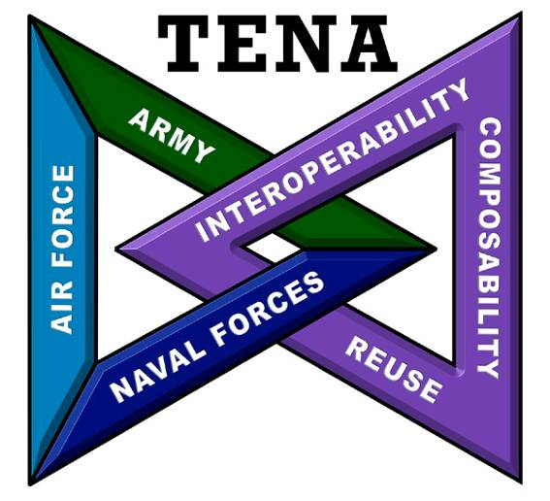



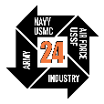
TENA: The Test and Training Enabling Architecture
Dr. Edward T. Powell
Test Resource Management Center
@IITSEC
NTSAToday

Slide 2
Outline
Using TENA
TENA Mission and Benefits
Some Uses of TENA Around the World
TENA in Detail
TENA Architecture Overview
Logical Ranges
Stateful Distributed Objects
The TENA Middleware
The TENA Data Collection and Data Management Tools
TENA Standard Object Models
Bridging live with virtual and constructive
TENA LVC Object Model example: Entity
TENA Instrumentation Object Model example: Radar
Putting it all together
Summary and Conclusions

Slide 3
Learning Objectives
Identify the four major aspects of TENA and be able to explain their role in promoting interoperability
Identify at least three major differences between TENA and simulation architectures such as Distributed Interactive Simulation (DIS) and the High-Level Architecture for Modeling and Simulation (HLA)
Each difference will be identified as TENA is described
Identify the major purpose and use of the various standard TENA Object Models

Slide 4
Using TENA
TENA Mission and Benefits
Some Uses of TENA

Slide 5
TENA Mission
In the past, range systems tend to be non-interoperable, “stove-pipe” systems
The purpose of TENA is to provide the architecture and the software implementation necessary to
Enable Interoperability among range systems, facilities, simulations, C4ISR systems in a quick, cost-efficient manner, and
Foster Reuse for range assets and for future developments
Support the warfighter
Enable simulation-based acquisition
Foster test and training integration
In the long term: SAVE MONEY!
Lay the Foundation for Future Test and Training Range Instrumentation

Slide 6
Benefits of TENA
All TENA software and support is free to users
Supports C++, Java, and .Net
TENA software is thoroughly tested and very reliable
TENA Auto-Code Generation makes creating a TENA application as simple as possible
Auto-generated starting points mean you never start with a blank page
Rapid development of real-time, distributed, Live-Virtual-Constructive applications
Auto-generated test programs make integration a snap
TENA’s technical approach emphasizes cost savings and reliability
The TENA software is hard to use wrong
TENA catches many user errors at compile time rather than run time
TENA Tools provide unprecedented understanding of an event
TENA has a standard object model enhancing interoperability
The TENA web site/repository has extensive documentation, training, and collaboration capabilities
TENA data is importable into the Knowledge Management/Big Data Analysis capability called CHEETAS, and soon to the RDT&E cloud capability called Serengeti.
TENA has a plan for evolution and funding to execute this plan.

Slide 7
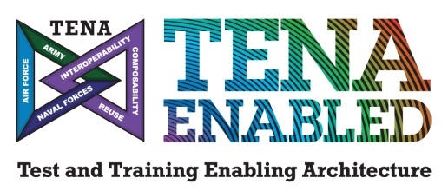
Test and Training Enabling Architecture (TENA) at a Glance
What does TENA enable?
Interoperability between inter- and intra-range assets
Elimination of proprietary interfaces to range instrumentation
Efficient incremental upgrades to test and training capabilities
Integration of Live, Virtual, and Constructive assets (locally or distributed)
Sharing and reuse of common capabilities across existing and new investments
What is included in the TENA architecture?
A common Middleware for data communication
Customizable data exchange models (object models) that standardize information exchange
Interoperability-enabling, auto-code-generated software libraries
A core set of tools that address common test and training requirements
Collaboration mechanisms that facilitate sharing and reuse
A connection to the Knowledge Management/Big Data Analysis (KM/BDA) Architecture

Slide 8
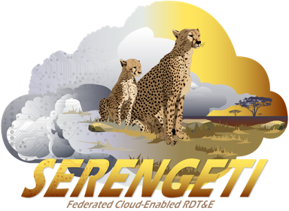

TENA is Part of the Joint Mission Environment Test Capability (JMETC)
A corporate approach for linking distributed facilities
Enables customers to evaluate their warfighting capabilities in a Joint context
Provides compatibility between test and training
A core, reusable, and easily reconfigurable infrastructure
Consists of the following products:
Persistent connectivity
Middleware
Standard interface definitions and software algorithms
Distributed test support tools
Reuse repository
Data management solutions
RDT&E cloud (soon)
A common joint testing process and customer support team for JMETC products and distributed testing
JMETC Networks Using DREN and SDREN
TENA Software, Object Models, Tools, Repository
Big Data Storage, Search, and Analysis

Slide 9
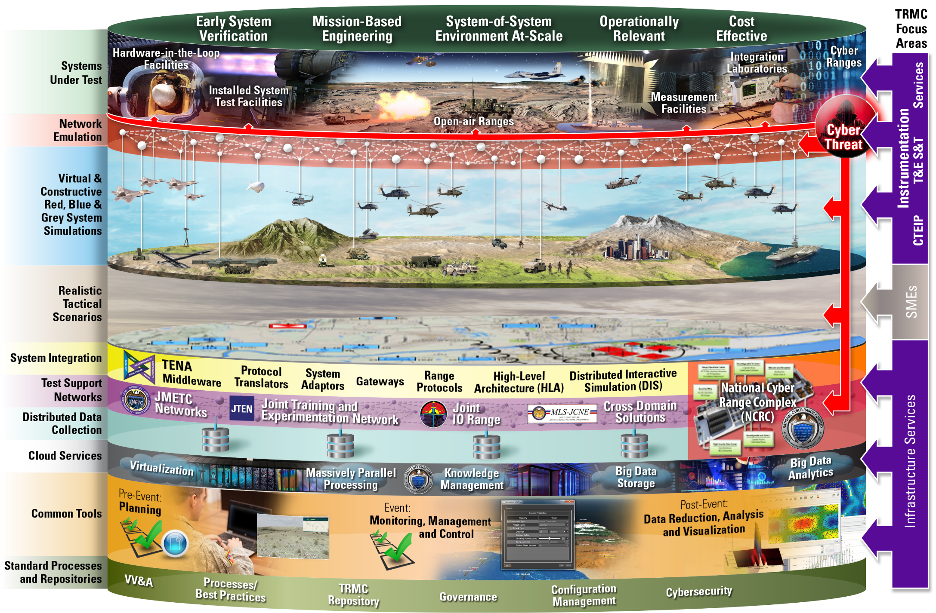
TRMC Provides an Agile Infrastructure for Distributed Testing

Slide 10
TENA is an Open Architecture
The Software Engineering Institute defines an Open System as “a collection of interacting software, hardware, and human components designed to satisfy stated needs with interface specifications of its components that are fully defined, available to the public, maintained according to group consensus, in which the implementations of the components conform to the interface specifications.”
TENA is maintained according to a consensus of its users assembled as the JMETC Technical Exchange (JTEX) TENA Configuration Control Board (CCB)
TENA exists and is being used to support real events
Government owned, no proprietary software
TENA is freely releasable (Distribution A) to non-US entities
We have many non-US users in Britain, France, Sweden, Denmark, etc.
There are no plans for standardizing TENA in the same way as DIS and HLA have been standardized using the IEEE
TENA’s business model is not the same as the DIS and HLA business models
A single middleware implementation and a single object model compiler are required to ensure interoperability

Slide 11
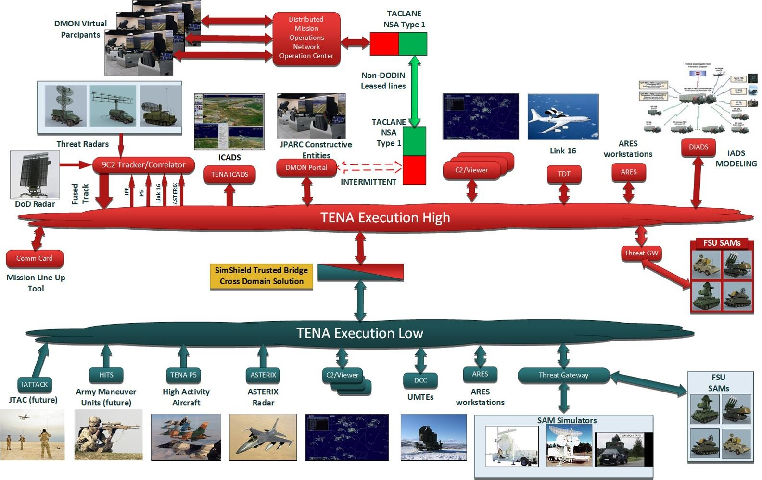
TENA in Training - JPARC

Slide 12
Test and Training Enabling Architecture (TENA) in Detail

Slide 13
Core Architectural Tenets of TENA
Promote Computer Enforceable System Interfaces
Use Auto-Code Generation to Raise the Abstraction Level
Let Computer Detect Interoperability Errors as Early as Possible
Design the Middleware to Make it Hard to Use Wrong
Anticipate Better Techniques and Technologies
Emphasize Live-Virtual-Constructive Interoperability

Slide 14
TENA Architecture Overview

Slide 15
TENA Interoperability Architecture Illustration
Different Protocols
Gateway
Typical TENA Execution
OM Transmogrifier
DIS, HLA
RelayNode
Different Network Characteristics
Data Collector
SQL, ODBC
Adapter
Web Binding
RF Radio, Satellite
Database
SNMP, TCP, Proprietary
Web Applications
Parquet
Knowledge Management System
Vendor System
JSON, HTTP, Thrift

Slide 16
Logical Range Simple Example
TENA specifies an architecture for range resources participating in logical ranges
Test Control Station
Radar
Remote
Viewer
Communication Mechanism (Network, Shared Memory, etc.)

Slide 17
Logical Range Simple Example
TENA specifies a peer-to-peer architecture for logical ranges:
Applications can be both clients and servers simultaneously
In their role as servers, applications serve TENA objects called “servants”
In their role as clients, applications obtain “proxies,” representing other applications’ servants. Only servers can write to their servant objects’ publication state
The TENA Middleware, the TENA objects, and the user’s application code are compiled and linked together
TENA Application A
TENA Application B
TENA Application C
User Application Code
User Application Code
User Application Code
Test Control Station
Remote
Viewer
Proxy
Proxy
Servant
Proxy
Servant
Servant
Servant
Proxy
Proxy
Proxy
Proxy
Servant
Proxy
TENA Middleware
TENA Middleware
TENA Middleware
Communication Mechanism (Network, Shared Memory, etc.)

Slide 18
Clients and Proxies, Servers and Servants
A proxy is a read-only stand-in for a servant
Proxies are obtained as a result of subscription
Client Application
Server Application
Proxy Object on Client
Servant Object on Server
User Application
Proxy for Tank 27
Tank 27
User Application
Remote Interface
Remote Interface
Remote Interface Implementation
Publication State Cache
Publication State
Local Methods Interface
Local Methods Interface
Local Methods Implementation
Local Methods Implementation
TENA Middleware
TENA Middleware
Network

Slide 19
TENA Objects are Compiled In
Why use compiled-in object definitions?
Strong type-checking
Don’t wait until runtime to find errors that a compiler could detect
Performance
Interpretation of methods/attributes can have significant performance impact
Ability to easily handle complex object relationships
Conforms to current best software engineering practices
How do you support compiled-in object definitions?
Use a language like the Interface Definition Language to define object interface and object state structure
Use code generation to implement the required functionality
Thus the concept of the TENA Definition Language (TDL) was created
Very similar to IDL and C++

Slide 20
How hard is it to create a new TENA Object Model?
1. Name the object model, including the version
file Example-Vehicle-v6.tdl
package Example {
enum Team {
Team_Red,
Team_Blue,
Team_Green };
2. Define the message or object types needed by the application
3. Define the attributes that characterize the messages and objects
class Vehicle {
};
string name;
Team team;
float64 xInMeters;
float64 yInMeters;
optional
const
4. Determine if any attributes are constant or optional
driveTo (float64 xInMeters,
float64 yInMeters);
5. Define any remote or local methods
};
TENA has a powerful meta-model for defining expressive object models, yet descriptive models are easy to create

Slide 21
The Logical Range Object Model
Logical Range Object Model (LROM)
Those object definitions, derived from whatever source, that are used in a given logical range execution to meet the immediate needs and requirements of a specific user for a specific range event
Like an HLA FOM for a given event.
The LROM is the common object model shared by all TENA resource applications in a logical range
Applications do not have to be linked against every object model in the LROM—only those the application cares about
F
App 3
App 1
E
D
B
C
A
App 2

Slide 22
TENA Communicates “Objects” in Multiple Formats
TENA Object in JSON format
TENA Object in TDL format
TENA Object in C++ format
TENA Object in SQL format

Slide 23
TSPI (Time-Space Position Information) v5 with Coordinate Conversions
Case 1: Reading and writing in the same coordinate system
Client Application
Server Application
Proxy Object on Client
Servant Object on Server
User Application
Platform 27
Platform 27
User Application
Geocentric- Position
TSPI Local Methods Interface
TSPI Local Methods Interface
Get
Set
Get
Set
Get
Set
Get
Set
Geocentric-Position()
Position Local Methods Interface
Private data
Position Local Methods Interface
Private data
Position()
Get
Set
Get
Set
Geocentric SRF
Get
Set
Get
Set
Geocentric- Position
Geocentric SRF
Coordinate Conversions Local Methods
Coordinate Conversions Local Methods
TENA Middleware
TENA Middleware
Network

Slide 24
TSPI v4 with Coordinate Conversions
Case 2: Reading and writing in different coordinate systems
Write in Geocentric (ECEF), read in Geodetic (latitude/longitude/altitude)
Client Application
Server Application
Proxy Object on Client
Servant Object on Server
User Application
Platform 27
Platform 27
User Application
Geodetic- Position
TSPI Local Methods Interface
TSPI Local Methods Interface
Get
Set
Get
Set
Get
Set
Get
Set
Geodetic Position()
Position Local Methods Interface
Private data
Position Local Methods Interface
Private data
Position()
Get
Set
Get
Set
Geodetic SRF
Get
Set
Get
Set
Geocentric- Position
Geocentric SRF
Coordinate Conversions Local Methods
Coordinate Conversions Local Methods
TENA Middleware
TENA Middleware
Network

Slide 25
TENA Repository
TENA Middleware
TENA Common Infrastructure
Purpose: to contain all the information relevant to TENA that is not specific to a given logical range
Current Repository Contents:
All TENA Object Models, both standard and user-designed
All TENA software (middleware, helpdesk cases, tools, gateways, reusable applications, and reusable components)
All TENA documentation
Lessons learned from previous uses of TENA
Provide an easy-to-use secure interface to all of this information
The Repository is a collection of technologies based around a web front end
TENA
Repository
EDMS

Slide 26
TENA Middleware Purpose and Requirements
TENA Middleware
TENA Common Infrastructure
Purpose: high-performance, real-time, low-latency communication infrastructure used by range resource applications and tools during execution
Requirements:
Support programming in C++, Java, .Net
Fully support TENA Meta-Model
Be easy to use and highly reliable
Many varied communication strategies and media
Including management of quality-of-service
Including object-level security services
Be high-performance, including
Support multiple information filtering strategies
Support user-defined filtering criteria
Support a wide variety of range-relevant platforms (HW/OS/compiler)
Be technology neutral
TENA
Repository
EDMS

Slide 27
Middleware 6.0.9 Computer Platform Support
Linux
Red Hat Enterprise Linux 7.9, 8.6, 9.0
Centos 7.9
Ubuntu 20.04.04, 22.04.01
macOS
12.6 Monterey
Windows
Windows 10, 11
Windows Server 2022 LTSC
Compilers for 6.0.9
Linux GCC 11.2.1, 8.4.1, 11.2.0, 9.4.0 (depending on Linux operating system)
Mac Clang 14.0.0 (ARM, Intel)
Windows Visual Studio 2022 (17.3.3)

Slide 28
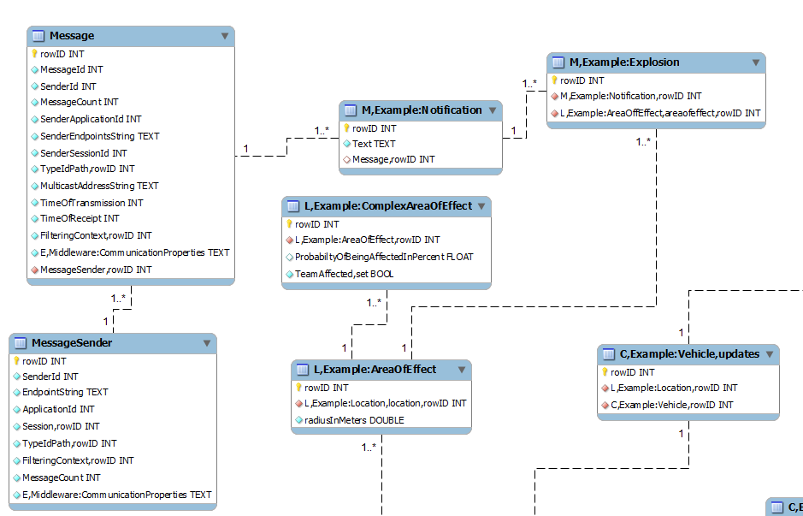
TENA Data Collection System Purpose and Requirements
TENA Middleware
TENA Common Infrastructure
TDCS Collector
Application that is code generated based on particular object model(s) to subscribe to object/message types of interest and store in database
Supports SQLite files
Playback Tool
Code generated application that will read collected data and replay selected object/message types
Ability to replay certain time segments, and adjust faster/slower
DB Exporter
Provides ability to extract certain data (types, time range) and put into format that is compatible with Microsoft Excel
Post-Event Metrics Analyzer (PEMA)
GUI tool used to analyze data associated with a TENA-based event
CHEETAS – large-scale data collection and analysis/knowledge management system for TENA (and other) data.
TENA
Repository
EDMS

Slide 29
Better Tools for Analysis
TRMC has been investing in better ways to manage and analyze large data sets
TRMC has developed CHEETAS* as the new knowledge management and big data analysis framework
CHEETAS also has custom tools developed for DoD-specific needs
How do we leverage these tools for TENA data?
Processes to manage collections of TDCS files
Processes to convert TDCS files into better formats for big-data analysis (e.g. parquet)
Consideration of potential improvements and modification of how we currently collect TENA data
* Cloud Hybrid Edge-to-Enterprise Evaluation & Test Analysis Suite

Slide 30

Knowledge Management/Big Data Analysis Software Architecture

Slide 31
TENA Communicates Data in Multiple Formats
TENA specifies the semantics of an object (data), not the specific representation.
TENA objects will transfer smoothly and at high speed into the KM/BDA system.
TENA Object in SQL format
TENA Object in SQL format
TENA Object in Parquet format

Slide 32
Will TENA Meet My Performance Requirements?
Users are encouraged to conduct experiments by customizing the auto-generated example programs to be representative of actual systems
Use actual object models, computers, and networks
Primary requirement for TENA is to support high performance, real-time distributed communication
TENA uses compiled code to avoid interpretive marshalling/demarshalling
Minimizes data copies, utilize single thread to perform network write, etc.
TENA enables test & training solutions
that are cheaper to build, field, maintain, and improve

Slide 33
Update Rate vs. “Wiresize” Trade-off (As Demostrated by the TRCE Program)
 | TENA 6.0.0 (Reliable) | TENA 6.0.0 (Best Effort) | TRCE LNC (No Compression) | TRCE LNC (Lossy Compression)
Total Update Size | 543 bytes | 511 bytes | 147 bytes | 98 bytes
Update Rate with 1 Publisher and 1 Subscriber | 6,187 Hz | 7,540 Hz | 2,352 Hz | 2,549 Hz
Update Rate with 5 Publishers and 5 Subscribers | 4,351¹ Hz | 8,305 Hz | 1,673 Hz | 1,884 Hz
3.5 x
TRCE demonstrated a reduction in wire size for TENA-Platform-v4 updates by a factor of 3.5 to 5.2
TRCE simultaneously demonstrated a reduction in throughput for TENA-Platform-v4 updates by a factor of 3.2 to 5.0
Reducing the update wire size reduced the update throughput
All update rates are stated as the average over all subscribers
Tests performed with 100 Mbps link & switch
¹ TCP flow control taking place during test
3.2 x
5.0 x

Slide 34
TENA Utilities: Making TENA Easier to Use
TENA Repository (automated software building, community source code collaboration)
TENA Wiki (website collaboration for user groups)
TENA Issue Tracking System (task tracking system for user groups)
TENA Installer (cross platform software installation)

Slide 35
TENA Tools: Helping You to Conduct and Manage Your Event
TENA Middleware (C++, Java, .NET support for ~50 computer platforms)
TENA Console and Canary (event management and network monitoring)
ClearPath (multicast network testing)
TENA Data Collection System (collector, database export, and playback tools)
Interface Verification Tool (Platform generator to support testing activities)
Web Binding (provides JSON/REST http interface to TENA systems)
RelayNode (bridges different communication domains)
SIMDIS TENA Plugin (3D visualization and analysis support for TENA object models)
TENA Video Distribution System (various tools related to video/audio stream support)
Mission Information Resource Controller (automated configuration for distributed systems)
Network Communication Tools (chat, file transfer, etc.)
SimShield Trusted Guard (Cross Domain Solution supporting many object models)
All TENA Utilities and Tools are Available from the TENA Repository

Slide 36
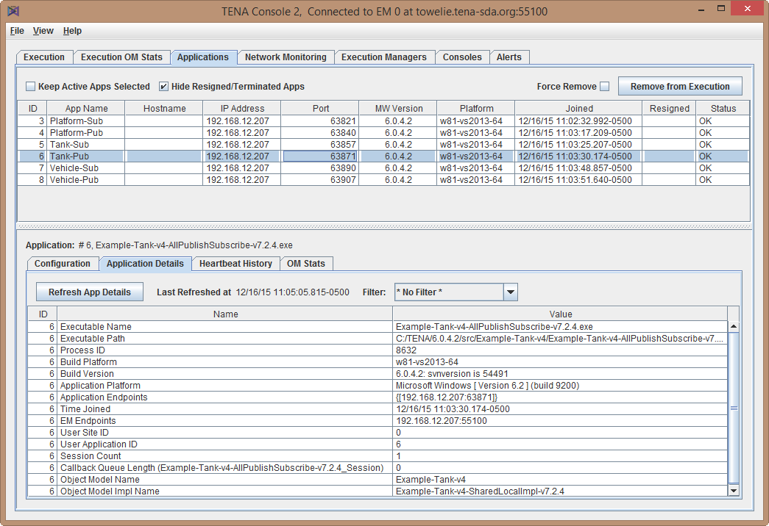
TENA Console Application Status Screenshot
TENA Console is a GUI-based event management tool used to evaluate and monitor applications and network
Application Diagnostics
Network Monitoring
Application Alerts
“unresponsive” applications can be removed from the execution
Basic application information provided in table
Application configuration parameters listed to indicate use of non-default values

Slide 37
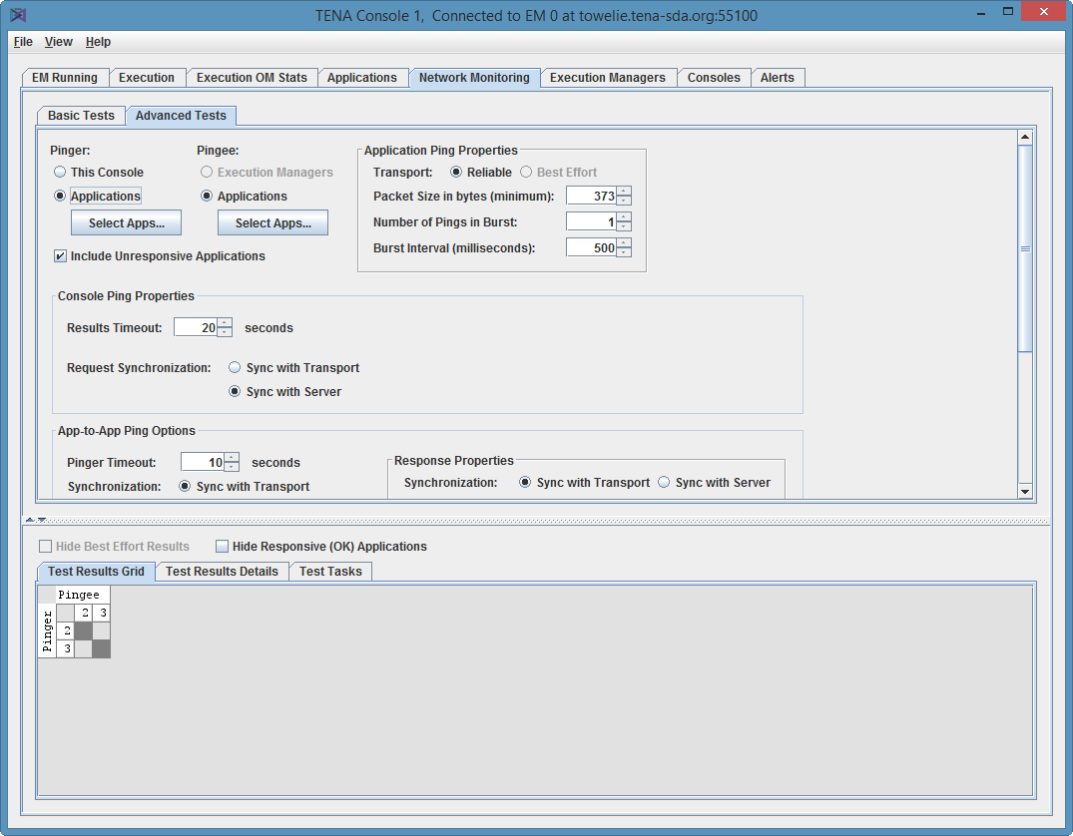
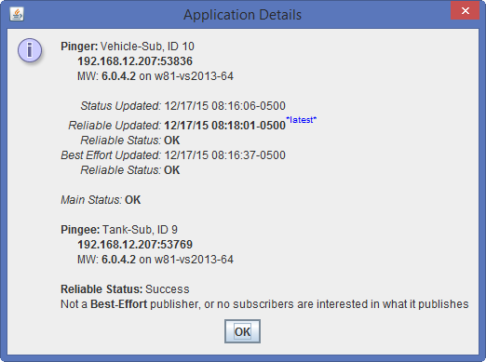
TENA Console Network Monitoring
Network Monitoring
Perform continuous TCP and UDP multicast communication monitoring
Obtain system alerts regarding the operation of the distributed event over the network

Slide 38
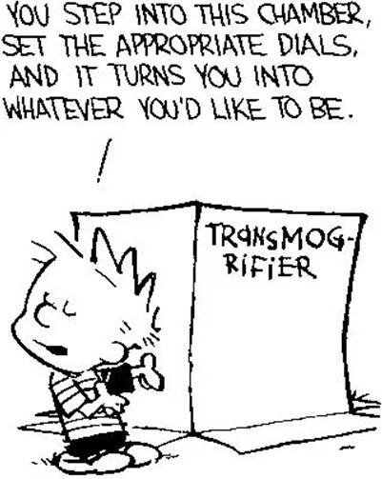
Gateways, Adapters, and Transmogrifiers
Protocol Translation
TENA helps support translation from existing protocols in order to provide a common distributed communication mechanism and common interfaces
Some communication protocols are widely used standards (e.g., DIS), some are range specific message-based protocols, and others are vendor proprietary
Gateways
Gateways are used to bridge different communication protocols, with a collection of applications using the legacy protocol and those applications/tools participating in a TENA Execution (TENA-to-Many)
From a TENA Execution perspective, there is no access to the individual applications using the legacy protocol as they are hidden behind the gateway
Adapters
Like Gateways, Adapters translate legacy protocols into common TENA interfaces, but are used for a single system (TENA-to-One)
Adapters act as a communication proxy for the system and can provide network isolation for IA purposes or allow side-by-side operation for testing
Transmogrifiers
A name given to OM-to-OM gateways that support transition between OM updates that are changed in a non-interoperable manner with previous versions

Slide 39
How do we integrate TENA into an existing environment?
Gradual and Overlapping Deployment
TENA can be introduced into an existing environment in a gradual manner
Existing systems will typically require Adapters
Adapters for Existing Protocols and Systems
TENA Adapters are built in a collaborative manner following a common software framework (with code generation) to create a library.
Adapters allow the range system information and services to be available using common system interfaces and distributed communication infrastructure without changing the code to the existing systems
Redundancy during Testing
Since existing range systems are not modified, the use of adapters permits side-by-side initial testing and operational deployment to minimize risk
TENA can be introduced to a range gradually and unobtrusively using Protocol and System Adapters

Slide 40
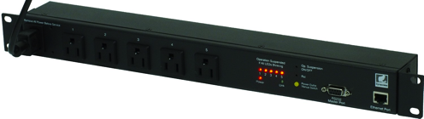
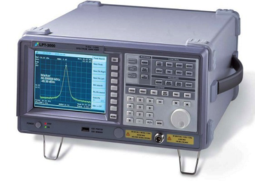
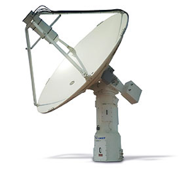
Adapter Illustration for a Telemetry Range Systems
Range Instrumentation Network
Event Management Tools
SNMP
Power Controller Adapter
Remote Configuration Control
VISA
Spectrum Analyzer Adapter
Remote Operator GUI(s)
Remote Operator
TCP/UDP
Telemetry Antenna Controller Adapter
Acme
Range Supervisor GUI(s)
Range Superviso
TCP
Telemetry Receiver Adapter
Data Collection, Analysis, & Playback
TCP/UDP
Telemetry Antenna Controller Adapter
Zeta
Data Visualization Tools
TCP
Telemetry Receiver Adapter
…

Slide 41
Where Do Adapters Make Sense?
Purpose of Adapters
Enable an existing range system to use TENA without modification
Permit side-by-side testing/operation of Adapters with existing range protocols
Typical Range System Use Cases that Benefit from Adapters
Legacy range systems that can’t be updated
Commercial system with proprietary interface
Systems without network communication
Needed Capabilities obtained with Adapters
Remote Monitoring and Control that can support multiple operators and supervisors
Operator efficiency improvements with ability to support multiple systems
Integrate a non-networked system into a common communication environment
Bring a legacy system into compliance with Information Assurance (IA) requirements
Support coordinated data collection in support of Range Characterization activities

Slide 42
Current Adapter Library
Current Adapters
ADSB
APC-7900 Power Strip Controller (SNMPv3)
CARLA Adapter
CARMA Adapter
FEBT
FPS-16 Radar (WSMR network protocols)
Flightgear
iBootBar Power Strip Controller
IRTS (Yuma real-time data processing system)
IVTS (Yuma GPS System)
KTM Optics (Yuma network protocols)
LPT Spectrum Analyzer (LP Technologies 3000, 6000)
MPS-25 Radar (Yuma network protocols)
MRTE Track Interface (Yuma network protocol)
MRTE Track3D Output (Yuma Network protocol)
NTSPI to Track Translator
PingStation II/III
Quasonix Antenna Control Unit
Quasonix RDMS 3
RDDS (Pax. River message protocol) Common TSPI
RTDPS (WSMR real-time data processing system)
Rohde & Schwarz FPS Spectrum Analyzer
TCS 600 Telemetry Antenna Control Unit
TCS M1L Telemetry Antenna Control Unit (Pax
Interface, Yuma network protocols)
BAE TRRM Radar (range radar replacement program)
Tripplite LX Power Strip Controller
V2X-Hub BSM, Mobility, Traffic Control Plugins
Weibel RTP-2100 Radar
X-Plane
Zodiac Telemetry Receiver RX-1
In Development
MOOG MPT-50 Adapter
Parriad X-5000 Decommutator
Source Code Publicly Released
APC-7900 Power Strip Controller Adapter
Platform to Track3D Translator
Power Strip Controller GUI
The TENA Team is collaborating with vendors on developing Range System Adapters for their products

Slide 43
Other TENA Integration Methods: Web Binding
Web Binding is automatically generated based on object model
Hub provides REST API to web clients to perform middleware operations (e.g., subscribe to type Vehicle and obtain updates)
TENA data sent to and from the Hub uses JSON encoding

Slide 44
Other TENA Integration Methods: Relay Node
RelayNode is used to bridge two executions that may have different communication characteristics
For example, one network segment may be for a low data rate link and an update would only need to traverse that link once, and then be replicated by the RelayNode to multiple subscribers
Illustration shows a typical scenario with a single WAN execution and multiple LAN executions

Slide 45
TENA Information Assurance (IA) Activities
Air Force Evaluated/Approved Product List (E/APL) – approved 11/18/10
Navy Application & Database Management System (DADMS) – approved 6/27/11
Army Certificate of Networthiness (CoN) – approved 5/22/12
S/DREN (Secret/Defense Research and Engineering Network) – approved
NIPRnet – obtained ATO 12/27/12
DIACAP – approved
Security approvals are renewed according to current Risk Management Framework
Cross Domain Solutions
TENA is used with Radiant Mercury cross domain guard for bridging information associated with certain Common Training Instrumentation Architecture (CTIA) events
TENA-enabled cross-domain solution SimShield v2.2.0.1 on baseline list
The TENA project is working with IA organizations to reduce cost and delays with ability to operate TENA applications

Slide 46
TENA Standard Object Models

Slide 47
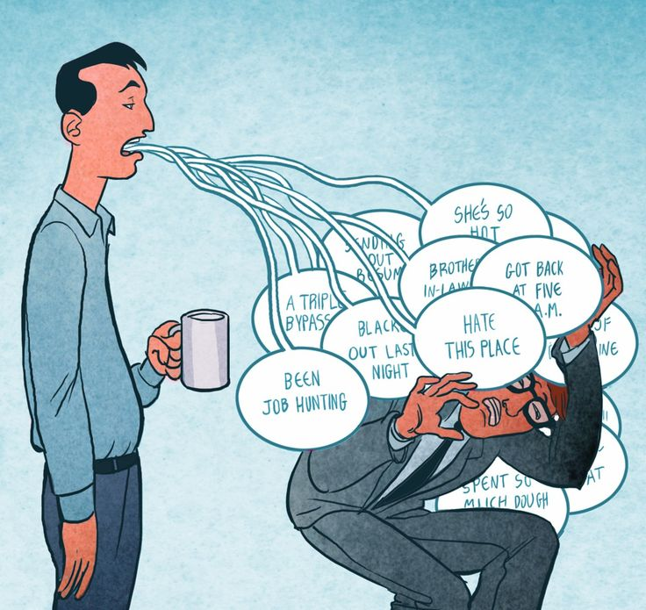
Some Basic Guidance on Object Model Design
Model the data exchange, not the entities
Persistent (SDO class) or ephemeral (message)
Remember, if no one wants the information, don’t put it in the object model
Just because you have some data doesn’t mean subscribers want it. ➔
Model only objects (TENA SDOs or Messages) that someone might want to subscribe to
Don’t overuse inheritance just because you can
With TENA, polymorphism does not require inheritance
Minimize the use of optional attributes
If subscribers need the attribute, then not having it available will cause these subscribers to fail, or use non-optimal work-arounds. If they don’t need it, leave it out.
While local classes are cool, there is no facility for users to create their own
Remote methods are also cool, but callers will block when calling them, so only use them when absolutely necessary.
Use Standard OMs where possible, or extend them if necessary
Many of these maxims are violated in the new TENA OMs that I am about to show you…

Slide 48
What are the Standard TENA Object Models?
TENA standard object models are those object models that have been designed in consultation with the TENA community and intended to be used for specific use cases.
TENA standard object models can be used separately, together, or with custom user object models; or be extended to meet user needs
Categories:
Classic TENA OMs, designed in 2002-2003 and in use for 20+ years. Based on TENA::Platform.
Training OMs, designed from 2005-2015, specifically for training (and named for JNTC, a former training organization that partnered in the development of TENA), extended the Classic TENA OMs.
Instrumentation OMs, designed to interface with many range instrumentation systems
LVC OMs, designed to solve the problem of matching Live ranges with Virtual and Constructive simulations.
Based on and seamlessly compatible with DIS v7 and HLA RPR FOMs

Slide 49
Why is it hard to integrate live systems and simulations?
Simulations produce certain data
Entity State PDU describes the true state of a simulated entity
Receivers are responsible for applying any uncertainty to the truth data
Range systems produce tracks
A “track” represents a measurement
A given entity might be represented by multiple tracks
Tracks can be from range measurements (radars, optics) or from entity telemetry (GPS).
Any given entity can and does have multiple GPS sensors
Each track has its own uncertainty, which can be different based on a number of parameters of the sensors and target
Many ranges assign a single “best source” as the “ground truth”
But this is not right
The basic problem is: how do multiple tracks become a single entity?
Simulation
Range

Slide 50
How do multiple tracks become a single entity?
There are no easy answers to this question
There is no “ground truth” on live ranges
It appears every range or program (or system!) decides
Some decide that one particular track is the “best source” and that track’s information populations the entity SDO or Entity State PDU.
Others use a fusion algorithm to come up with a weighted average
Some systems have multiple GPS sensors on the platform: which one represents the entity?
And don’t forget, GPS uncertainties grow at very high speed
The bottom line is that someone has to decide how to convert live tracks into simulated live entities, and it has to be done system by system.

Slide 51
TENA Standard Object Models: A Common Set of Data Definitions for the Entire Range Community
Classic
TENA-Platform-v4
TENA-PlatformDetails-v4
TENA-PlatformType-v2
TENA-UniqueID-v3
TENA-TSPI-v5
TENA-Time-v2
TENA-Engagement-v4
TENA-Embedded-v3
TENA-Munition-v3
TENA-AMO-v2
TENA-Exercise-v1
TENA-SRFserver-v2
TENA-GPS-v3
TENA-Radar-v3
TENA-Pointing-v1
TENA-SyncController-v1
Training
JNTC-AirRange-v2
JNTC-CounterMeasure-v2
JNTC-IndirectFire-v2
JNTC-Instrumentation-v2
JNTC-NBC-v2
JNTC-ObstacleMinefield-v2
JNTC-Threat-v2
Instrumentation
TENA-AudioVideo-StreamDescriptor
TENA-Geospatial-LineOfBearing
TENA-Geospatial-PointOfInterest
TENA-Geospatial-TSPIcovariance
TENA-Geospatial-Waypoint
TENA-Hardware-PowerController
TENA-Hardware-System
TENA-Instrumentation-IFF
TENA-Instrumentation-LiftoffIndicator
TENA-Instrumentation-Optics-System
TENA-Instrumentation-PointableSystem
TENA-Instrumentation-Radar-SurveillanceSystem
TENA-Instrumentation-Radar-TrackingSystem
TENA-Instrumentation-SpectrumAnalyzer
TENA-Instrumentation-Telemetry-AntennaControlSystem
TENA-Instrumentation-Telemetry-Decommutator
TENA-Instrumentation-Telemetry-Receiver
TENA-Instrumentation-Track-Azimuth
TENA-Instrumentation-Track-AzimuthElevation
TENA-Instrumentation-Track-RadialVelocity
TENA-Instrumentation-Track-Range
TENA-Instrumentation-Track-RangeAzimuth
Instrumentation (cont.)
TENA-Instrumentation-Track-State3D
TENA-Instrumentation-Weather-Station
TENA-WeatherServices-Parameters
TENA-WeatherServices-Server
LVC
TENA-LVC-Common
TENA-LVC-Engagement
TENA-LVC-Entity
TENA-LVC-EntityAppearanceCapabilities
TENA-LVC-EntityType
TENA-LVC-IDs
TENA-LVC-RadarSystem
TENA-LVC-Track
TENA-Time-v2
TENA-TSPI-v5

Slide 52
LVC OM High Level Objectives
Develop/maintain a Live-Virtual-Constructive (LVC) Object Model (OM) collection to enable interoperability between the live and simulation domains on test and training ranges
Supports the LVC use cases that include the need to inject simulated data into live systems, and make live data available to simulations
Evaluate/reuse other OM collections supporting LVC events
Use the Instrumentation OMs in the LVC domain where appropriate, and identify additional requirements
Provide operational guidance for using the LVC OM collection in LVC events
OMs alone are not sufficient for effective LVC events, and it is expected that certain application types and procedural guidance will be needed for the LVC community
Define tasks and tools needed to support the LVC OM collection
Notes:
HWIL fits into the virtual category of LVC. Though virtual, HWIL is sometimes called “live little L”. The lower case letter L implies that the hardware is live hardware, but is being operated in a simulated environment in a laboratory setting.

Slide 53
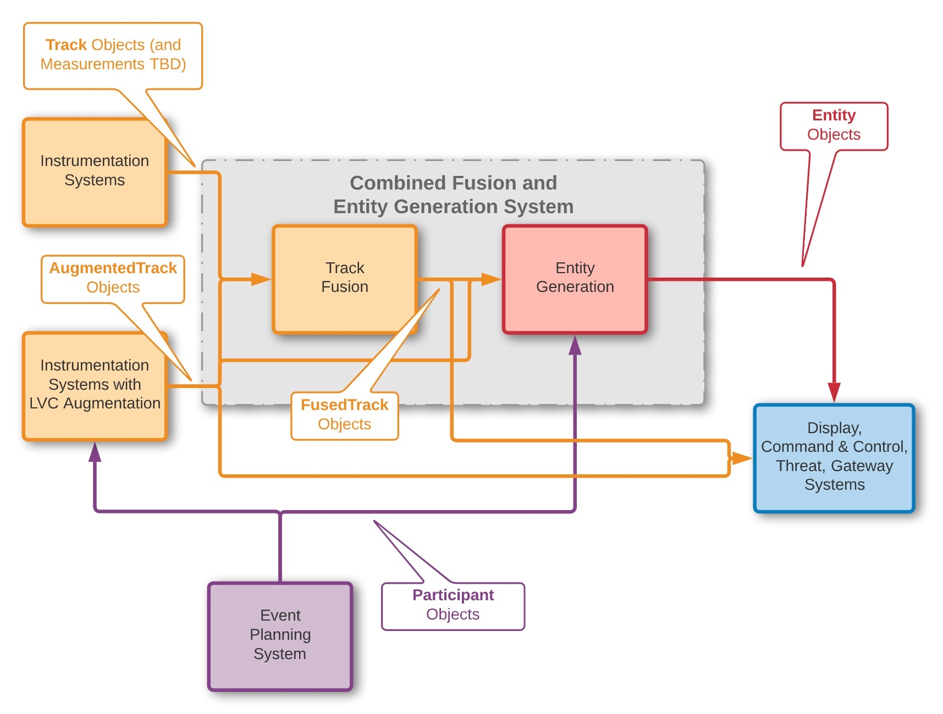
Generating an Entity via a Fusion System (This is an example, not a TENA product)

Slide 54
LVC Theory of Operations
In an LVC event, there should be exactly one Entity object for each participant
Entity objects for live participants are the common representation to be used by simulations when injecting live data, to ensure fair “gameplay”
Entity objects for simulated participants are the common representation to be used by live systems when injecting simulated data
Instrumentation systems provide TSPI estimates in the form of measurements and tracks related to live event participants (planned and unplanned)
TSPI data needs to be augmented with LVC data (e.g., Entity Type, Appearance, Damage State) to create an Entity object for live participants
Entity generation for an LVC event should be flexible and dynamic
Flexibility example – today’s event will use the TSPI from the Acme pod system, and for tomorrow’s event we will use the TSPI data from the Zodiac fusion system
Dynamic example – fusion system has abnormally terminated, so fallback to using the TSPI from the Big Canyon tracking radar system

Slide 55
Identifiers for LVC Entity and Related OM Types
In previous LVC Standard OMs, UniqueID was used as the identifier type for Platforms, Tracks, Events, Radios, etc. which was modeled after the DIS “triple-tuple” representation
The new TENA LVC OMs continue to use DIS "triple-tuple" for identifiers (siteID, applicationID, itemID) using uint16 numbers for each
TENA explored ability to use a generic string representation with common encoding/decoding for the triple-tuple to unify with the identifiers in the Range Instrumentation OM Collection, but values are used in Cross Domain Solution (CDS) filtering rules and need to be directly accessible
TENA LVC OMs use specific identifier types implemented by a local class where needed for EntityID, EventID, RadioID, TrackID
The local class interface is the same for all ID types
We explored using a generic ID local class (i.e., not type specific), but it introduces potential programming mistakes and we did not find a compelling reason as to why it was necessary

Slide 56
Instrumentation Object Models
The Instrumentation OMs are a collection of SDOs and messages used to support the real-time exchange of measurement information between range instrumentation systems
The Range Instrumentation OM collection currently consists of over 27 separate Object Models (i.e., TDL files). These 27 TDL files (OMs) contain over 100 different types
The collection also contains a set of base and support OMs including Geospatial::PointOfInterest SDO (aka "thing with TSPI")
Track Classes represent different types of measurements from range instrumentation systems depending on the system capability. Track::State3D class extends Geospatial::PointOfInterest SDO
The LVC Entity OM also extends from the Geospatial::PointOfInterest SDO
Inheriting from Geospatial:: PointOfInterest creates a common base class with Track::State3D that is used with generic display applications, fusion systems, and remote methods associated with instrumentation assignment operations
Leveraging Geospatial:: PointOfInterest for Entity will enable the LVC Community to better use the Range Instrumentation OM Collection (Track::State3D, TrackingRadarSystem, etc) to integrate with the Live Ranges

Slide 57
Some Examples of the New TENA Standard OMs
TENA::LVC::Entity
TENA::Instrumentation::Radar::TrackingSystem

Slide 58
Entity, State3D, and PointOfInterest
TENA::Geospatial::PointOfInterest
PointOfInterest just represents a point in time and space
State3D provides three dimensional (3-D) track data measured by an instrumentation system
Entity represents LVC event items, e.g., a real aircraft, an aircraft simulator, or a simulated anti-aircraft system
Many of the Entity class attributes have origins from the simulation domain
However, there are also some attributes that are more aligned with the live domain
Attributes relevant to both domains are required for adequate representation
TENA::LVC::Entity
TENA::Instrumentation::Track::State3D

Slide 59
PointOfInterest SDO
package TENA {
package Geospatial {
class PointOfInterest {
const string identifier;
optional string designation;
const string sourceIdentifier;
optional const string sourceDescription;
TENA::TSPI tspi;
optional float32 expandedUncertaintyInSeconds; ///< E.g., ±0.001 s, with ~95.45% confidence
optional float32 expandedUncertaintyInMeters; ///< E.g., ±1 m, with ~95.45% confidence
optional float32 expandedUncertaintyInMetersPerSecond; ///< E.g., ±1 m/s, with ~95.45% confidence
optional float32 expandedUncertaintyInMetersPerSecondSquared; ///< E.g., ±1 m/s² with ~95.45% confidence
optional float32 expandedUncertaintyInOrientation; ///< E.g., ±0.1 radians, with ~95.45% confidence
optional float32 expandedUncertaintyInAngularVelocity; ///< E.g., ±0.1 radians/s, with ~95.45% confidence
optional float32 expandedUncertaintyInAngularAcceleration; ///< E.g., ±0.1 radians/s², with ~95.45% confidence
optional TENA::Geospatial::TSPIcovariance tspiCovariance;
};
}; // package Geospatial
}; // package TENA

Slide 60
Entity “is a” PointOfInterest
class Entity : extends TENA::Geospatial::PointOfInterest {
const EntityID entityID;
const LVCindicator lvcIndicator; ///< Indicates if the entity is live, virtual, or constructive
const EntityType entityType;
Affiliation affiliation;
DamageState damageState;
DeadReckoningAlgorithm deadReckoningAlgorithm;
vector<EntityReference> sensorPedigree;
vector<TrackReference> trackPedigree;
/// If a single Track object is being used to set the Entity's TSPI (and no other member of the trackPedigree is
/// contributing, i.e., one Track was declared the "best source" and all others were ignored), this zero-based
/// vector index (zero meaning first element) is provided to indicate the index of that Track object in the
/// trackPedigree vector. This can be used by subscribers, should they want to obtain TSPI updates from the Track
/// object directly, e.g., because the Track object is being updated at a higher rate than the Entity object.
///
/// If TSPI data from more than one Track object was somehow "combined" or "fused" to set the Entity's TSPI, then
/// this attribute should not be set.
optional int16 vectorIndexForTSPIsource;
optional EntityType alternativeEntityType; ///< Used when the entity is disguised as a different type
optional string entityMarking; ///< Identifies the marking of the entity. DIS indicates that
optional CharacterSet entityMarkingCharacterSet; ///< Identifies the character set used in the marking
optional EntityAppearance appearance; ///< Characteristics such as flaming, lights on, etc.
optional EntityCapabilities capabilities; ///< Capabilities such as fuel supply, sling loadable, etc.
optional vector<ArticulatedPart> articulatedParts; ///< Defines articulated parts of the entity
optional vector<AttachedPart> attachedParts; ///< Defines parts attached to the entity
void setDamageState( in DamageState damageState ) raises ( TENA::RequestRefused );=
void setAppearance( in EntityAppearance appearance ) raises ( TENA::InvalidArgument, TENA::RequestRefused );

Slide 61
State3D class (SDO)
package TENA {
package Instrumentation {
package Track {
class State3D : extends TENA::Geospatial::PointOfInterest {
const TENA::Hardware::System * system; ///< A pointer to the particular TENA::Hardware::System that
/// produced the particular State3D
CorrectionMode correctionMode; ///< Indicates the nature of any corrections made to the data
optional string nameOfOtherCorrectionMode; ///< To be set if and only if correctionMode is
/// TENA::Instrumentation::Track::CorrectionMode_Other
boolean isPositionDirectlyMeasured; ///< True indicates the TENA::position was actually measured, not
/// computed from other measurements
boolean isVelocityDirectlyMeasured; ///< True indicates the velocity was actually measured, not
/// computed from other measurements
boolean isAccelerationDirectlyMeasured; ///< True indicates the acceleration was actually measured, not
/// computed from other measurements
boolean isOrientationDirectlyMeasured; ///< True indicates the orientation was actually measured, not
/// computed from other measurements
boolean isAngularVelocityDirectlyMeasured; ///< True indicates the angularVelocity was actually measured, not
/// computed from other measurements
boolean isAngularAccelerationDirectlyMeasured; ///< True indicates the angularAcceleration was actually measured,
/// not computed from other measurements
};
}; // package Track
}; // package Instrumentation
}; // package TENA
The TENA-Instrumentation-Track-State3D SDO
“extends” the TENA-Geospatial-PointOfInterest SDO
where it inherits both the TSPI and uncertainties

Slide 62
How to get Radar from a HardwareSystem
TENA::Hardware::System
Each class specializes in certain aspects:
Hardware::System just provides identifiers
ControllableSystem adds a bunch of remote methods to allow the system values to be set or unset
AzElPointableSystem represents a system, that can be pointed in a certain direction
RAEpointable* system adds the ability to point the system towards a specific 3D point in space
Finally, the Radar::TrackingSystem models a simple radar
Additional subclasses can be used to model more complex radar systems.
*RAE = Range, Azimuth, and Elevation
TENA::Hardware::ControllableSystem
TENA::Instrumentation::AzElPointableSystem
TENA::Instrumentation::RAEpointableSystem
TENA::Instrumentation::Radar::TrackingSystem

Slide 63
TENA-Hardware-System
class System {
const string identifier;
const string type;
optional const string siteIdentifier;
optional const string description;
optional const string manufacturer;
optional const string model;
optional const string serialNumber;
optional const string firmwareVersion;
optional const string softwareVersion;
optional float32 temperatureInDegreesCelsius;
optional string missionIdentifier;
optional string operatorContactInfo;
optional float32 averageUpdateRateInHz;
PowerStatus powerStatus;
optional string nameOfOtherPowerStatus; optional boolean onBatteryPower;
optional int16 batteryLevelPercentage;
optional boolean onGeneratorPower;
optional int16 generatorFuelPercentage;
OperationalStatus operationalStatus;
optional string nameOfOtherOperationalStatus;
optional string alertDescription;
};
I’m not saying this is an unreasonable design, but I am repeating the meme from before for no particular reason.

Slide 64
TENA-Hardware-ControllableSystem (extends TENA-Hardware-System)
class ControllableSystem : extends System
{
ControllerTokenMode tokenMode;
vector< ControllerInterface * > approvedControllerVector;
vector< ControllerInterface * > backupControllerVector;
void addToBackupControllerList( in ControllerToken token )
raises ( InvalidControllerToken, TENA::RequestRefused );
void removeFromBackupControllerList( in ControllerToken token )
raises ( InvalidControllerToken, TENA::RequestRefused );
void requestControl( in ControllerToken token )
raises ( InvalidControllerToken, TENA::RequestRefused );
void relinquishControl( in ControllerToken token )
raises ( InvalidControllerToken, TokenNotInControl );
void shutdown( in ControllerToken token )
raises ( InvalidControllerToken, TokenNotInControl, TENA::RequestRefused );
void calibrate( in ControllerToken token )
raises ( InvalidControllerToken, TokenNotInControl, TENA::RequestRefused );
void sanitize( in ControllerToken token )
raises ( InvalidControllerToken, TokenNotInControl, TENA::RequestRefused );
void setMissionIdentifier( in string missionIdentifier, in ControllerToken token )
raises ( TENA::InvalidArgument, InvalidControllerToken, TokenNotInControl, TENA::RequestRefused );
void setOperatorContactInfo( in string operatorContactInfo, in ControllerToken token )
raises ( TENA::InvalidArgument, InvalidControllerToken, TokenNotInControl, TENA::RequestRefused );
void setAlertDescription( in string alertDescription, in ControllerToken token )
raises ( TENA::InvalidArgument, InvalidControllerToken, TokenNotInControl, TENA::RequestRefused );
};

Slide 65
TENA-Instrumentation-AzElPointableSystem (extends TENA-Hardware-ControllableSystem)
class AzElPointableSystem : extends TENA::Hardware::ControllableSystem
{
const TENA::Position position;
const TENA::LSTPsrf measurementFrameOfReference;
TENA::Time timestamp;
PointingMode pointingModeAzimuth;
optional string nameOfOtherPointingModeAzimuth;
PointingMode pointingModeElevation;
optional string nameOfOtherPointingModeElevation;
boolean autotrackAzimuthEnabled;
boolean autotrackElevationEnabled;
float64 boresightRelativeAzimuthInDegrees;
float64 boresightRelativeElevationInDegrees;
TENA::Geospatial::PointOfInterest * commandedPointOfInterest;
optional float64 boresightCommandedRelativeAzimuthInDegrees;
optional float64 boresightCommandedRelativeElevationInDegrees;
optional const float64 boresightAzimuthMinimumLimitInDegrees;
optional const float64 boresightAzimuthMaximumLimitInDegrees;
optional const float64 boresightElevationMinimumLimitInDegrees;
optional const float64 boresightElevationMaximumLimitInDegrees;
void enableAutotrackAzimuth( in TENA::Hardware::ControllerToken token )
raises ( TENA::Hardware::InvalidControllerToken, TENA::Hardware::TokenNotInControl, TENA::RequestRefused );
void enableAutotrackElevation( in TENA::Hardware::ControllerToken token )
raises ( TENA::Hardware::InvalidControllerToken, TENA::Hardware::TokenNotInControl, TENA::RequestRefused );
void enableAutotrackAzEl( in TENA::Hardware::ControllerToken token )
raises ( TENA::Hardware::InvalidControllerToken, TENA::Hardware::TokenNotInControl, TENA::RequestRefused );
void disableAutotrackAzimuth( in TENA::Hardware::ControllerToken token )
raises ( TENA::Hardware::InvalidControllerToken, TENA::Hardware::TokenNotInControl, TENA::RequestRefused );
void disableAutotrackElevation( in TENA::Hardware::ControllerToken token )
raises ( TENA::Hardware::InvalidControllerToken, TENA::Hardware::TokenNotInControl, TENA::RequestRefused );
void disableAutotrackAzEl( in TENA::Hardware::ControllerToken token )
raises ( TENA::Hardware::InvalidControllerToken, TENA::Hardware::TokenNotInControl, TENA::RequestRefused );
void pointAzimuthInDegrees( in float64 azimuthInDegrees, in TENA::Hardware::ControllerToken token )
raises ( TENA::InvalidArgument, TENA::Hardware::InvalidControllerToken, TENA::Hardware::TokenNotInControl, TENA::RequestRefused );
void pointElevationInDegrees( in float64 elevationInDegrees, in TENA::Hardware::ControllerToken token )
raises ( TENA::InvalidArgument, TENA::Hardware::InvalidControllerToken, TENA::Hardware::TokenNotInControl, TENA::RequestRefused );
void pointAzElInDegrees( in float64 azimuthInDegrees, in float64 elevationInDegrees, in TENA::Hardware::ControllerToken token )
raises ( TENA::InvalidArgument, TENA::Hardware::InvalidControllerToken, TENA::Hardware::TokenNotInControl, TENA::RequestRefused );
void pointAtThisPosition( in TENA::Position position, in TENA::Hardware::ControllerToken token )
raises ( TENA::InvalidArgument, TENA::Hardware::InvalidControllerToken, TENA::Hardware::TokenNotInControl, TENA::RequestRefused );
void followThisPointOfInterest( in TENA::Geospatial::PointOfInterest * trackingPoint, in TENA::Hardware::ControllerToken token )
raises ( TENA::InvalidArgument, TENA::Hardware::InvalidControllerToken, TENA::Hardware::TokenNotInControl, TENA::RequestRefused );
void stopFollowingThisPointOfInterest( in TENA::Geospatial::PointOfInterest * trackingPoint, in TENA::Hardware::ControllerToken token )
raises ( TENA::InvalidArgument, TENA::Hardware::InvalidControllerToken, TENA::Hardware::TokenNotInControl, TENA::RequestRefused );
};
An SDO to model a system that can be pointed using azimuth and elevation, but not range.
Used to model a system that can be aligned with a 3-D ray, but not constrained to aim at only one 3-D point.

Slide 66
TENA-Instrumentation-RAEpointableSystem (extends TENA-Instrumentation-AzElPointableSystem)
class RAEpointableSystem : extends AzElPointableSystem
{
PointingMode pointingModeRange;
optional string nameOfOtherPointingModeRange;
boolean autotrackRangeEnabled;
float64 boresightRelativeRangeInMeters;
optional float64 boresightCommandedRelativeRangeInMeters;
optional const float64 boresightRangeMinimumLimitInMeters;
optional const float64 boresightRangeMaximumLimitInMeters;
void enableAutotrackRAE( in RAEselection selection, in TENA::Hardware::ControllerToken token )
raises ( TENA::Hardware::InvalidControllerToken, TENA::Hardware::TokenNotInControl,
TENA::RequestRefused );
void disableAutotrackRAE( in RAEselection selection, in TENA::Hardware::ControllerToken token )
raises ( TENA::Hardware::InvalidControllerToken, TENA::Hardware::TokenNotInControl,
TENA::RequestRefused );
void pointRange( in float64 rangeInMeters, in TENA::Hardware::ControllerToken token )
raises ( TENA::InvalidArgument, TENA::Hardware::InvalidControllerToken,
TENA::Hardware::TokenNotInControl, TENA::RequestRefused );
void pointRAE( in float64 rangeInMeters, in float64 azimuthInDegrees,
in float64 elevationInDegrees, in TENA::Hardware::ControllerToken token )
raises ( TENA::InvalidArgument, TENA::Hardware::InvalidControllerToken,
TENA::Hardware::TokenNotInControl, TENA::RequestRefused );
};
SDO to model a system that can be pointed at a specific location in space, i.e., at 3-D point, using range, azimuth, and elevation

Slide 67
TENA-Instrumentation-Radar-TrackingSystem (extends TENA-Instrumentation-RAEpointableSystem)
class TrackingSystem : extends TENA::Instrumentation::RAEpointableSystem
{
SensingMode sensingModeAzimuth;
optional string nameOfOtherSensingModeAzimuth;
SensingMode sensingModeElevation;
optional string nameOfOtherSensingModeElevation;
SensingMode sensingModeRange;
optional string nameOfOtherSensingModeRange;
float32 beamwidthAzimuthInDegrees;
float32 beamwidthElevationInDegrees;
float64 beamRotationInDegrees;
TENA::Instrumentation::Track::State3D * primaryTrackState3D;
optional float64 rangeGateMinInMeters;
optional float64 rangeGateMaxInMeters;
optional float64 signalToNoiseRatioInDecibels;
optional boolean trackDataIsCorrectedForRefraction;
void setSensingMode( in TENA::Instrumentation::RAEselection selection,
in SensingMode sensingMode,
in string nameOfOtherSensingMode,
in TENA::Hardware::ControllerToken token )
raises ( TENA::InvalidArgument,
TENA::Hardware::InvalidControllerToken,
TENA::Hardware::TokenNotInControl,
TENA::RequestRefused );
};

Slide 68
Summary of New TENA OMs
Ranges deal with “tracks,” simulations deal with “entities.” There are multiple ways of defining a range entity from various tracks:
Best source
Fusion
The TENA LVC object models allow TENA users to relatively seamlessly integrate with DIS and HLA RPR FOM-based simulations
Not all of DIS is currently covered, but will be eventually
The Instrumentation object models represent much of the instrumentation types on test and training ranges throughout the DoD
The combination of the LVC and Instrumentation OMs substantially cover all of the data exchange needs for most test and training ranges.
LVC
TENA-LVC-Common
TENA-LVC-Engagement
TENA-LVC-Entity
TENA-LVC-EntityAppearanceCapabilities
TENA-LVC-EntityType
TENA-LVC-IDs
TENA-LVC-RadarSystem
TENA-LVC-Track
TENA-Time-v2
TENA-TSPI-v5

Slide 69
Summary

Slide 70
TENA, HLA, and DIS
TENA
HLA
DIS
Government-owned
Free of charge to all users
Free support and training
Limited operating systems
Limited programming languages
Opaque network packets
Government provided
Requires centralized process
Failures detected immediately
Standard Object Model
Customizable data definitions
Robust meta-model
Objects and interactions
Some bandwidth optimization
Single middleware
Complex API
Multiple spatial reference frames
Type-safe interface
Centrally funded by TRMC
No “Time management”
Vendor-provided
Commercial, some open source
Commercial training
Limited operating systems
Limited programming languages
Opaque network packets
International standard
Some require centralized process
Some failure detection
Standard Object Model*
Customizable data definitions
Simplified meta-model
Object and interactions
Extensive bandwidth optimization
No inter-vendor interoperability
Complex API
Single spatial reference frame
Non-type-safe interface
Vendor maintained
“Time Management”
Vendor/Paper Standard
Commercial, some open source
Commercial training
Any operating system
Any programming language
Simple space efficient packets
International standard
No centralized process required
Fails silently
Standard set of PDUs
Mostly fixed data definitions*
Fixed records as meta-model
Objects are only implied
Dead-reckoning only
Many varying implementations
Relatively simple API
Single spatial reference frame
No standard interface
Volunteer maintained
No “Time Management”

Slide 71
Lessons for Your Test or Training Events
Use the most capable interoperability architecture when judged by your own requirements
Use multiple architectures connected with gateways or adapters only when that is the most cost-effective solution, and the use of the gateways/adapters will not compromise your event
Remember that interoperability architectures only solve half the battle. Smart event design and knowledge of distributed communication issues are still required
Beware of terrain mismatch leading to no fair fight
Beware of fidelity mismatch leading to no fair fight
Beware of semantic differences in interpreting the same objects
Integrating L with V and C is much more difficult that people imagine due to L having “tracks” and V and C having “entities”

Slide 72
Summary of TENA Capabilities
An Architecture for Ranges, Facilities, and Simulations to Interoperate, to be Reused, to be Composed into greater capabilities
A working implementation of the architecture
TENA Middleware currently works on Windows, Linux, and Mac
TENA Repository filled with information, tools, and object models
A process to develop and expand the architecture
JMETC Technical Exchange Meetings once or twice a year
A technical strategy to deploy the architecture
TRMC deployment process brings interoperability and reuse to test ranges
A persistent network to permanently connect test sites
JMETC network enabled with TENA allows new tests to be performed with much less lead time and expense compared to the past
A robust knowledge management and big data analysis system, and a cloud capability coming in 2025

Slide 73
Learning Objectives Revisited
Four major aspects of TENA:
Middleware – real time interoperability transport mechanism
Data Collection System – collect event data
Repository – place for reusable software/documentation
Object Models – common language for interoperability
Some key differences between TENA and DIS or HLA
TENA is a GOTS family of products and is provided for free to all users
TENA is focused on live ranges and LVC, rather than just simulations
TENA uses auto-code generation to provide rapid reliable development
Major purpose and use of standard TENA object models
Represent both tracks and entities
Integrate seamlessly with DIS and HLA RPR FOM
Represent all different types of range instrumentation that produces data during test and training events.

Slide 74
Important Contact Information
TRMC provides free technical assistance and training for any interested users.
TENA Questions, Feedback, and Requests: feedback@tena-sda.org
All references can be found at the websites below:
TENA Website: http://www.tena-sda.org or https://www.trmc.osd.mil/
JMETC Website: http://www.jmetc.org or https://www.trmc.osd.mil/

