Slide 1
Implications of AI for DoD Human Systems: training is a whole new ballgame
Special Event

Slide 2
Implications of AI for DoD Human Systems: Training is a Whole New Ball Game
Maturity and capability of artificial intelligence (AI) applications has skyrocketed
New advances in generative AI, large language models, autonomous agents, computer vision, dynamic interfaces, and adaptive training.
Implications for the broad capabilities of the DoD's training tools and systems into which they are being integrated
Implications for how humans use these augmented tools and capabilities,
How the roles, needs, limitations, and risks assumed by human users, operators, trainees, and stakeholders are changing
Panelists:
Brian Stensrud, PhD. Technical Fellow, AI Defense & Security CAE USA
Eric Stohr Sr. Human Factors Systems Engineer Basic Commerce & Industries (BCI), Ltd.
Ben Goldberg, PhD Senior Scientist US Army DEVCOM Soldier Center, STTC
Brent Smith Research, Development, & Engineering (RDE) Principal Advanced Distributed Learning (ADL) Initiative
Notes:
Experts in AI, human systems, and training design and implementation
discussion of how the challenges faced by training acquisition programs are changing with the maturation of AI,

Slide 3
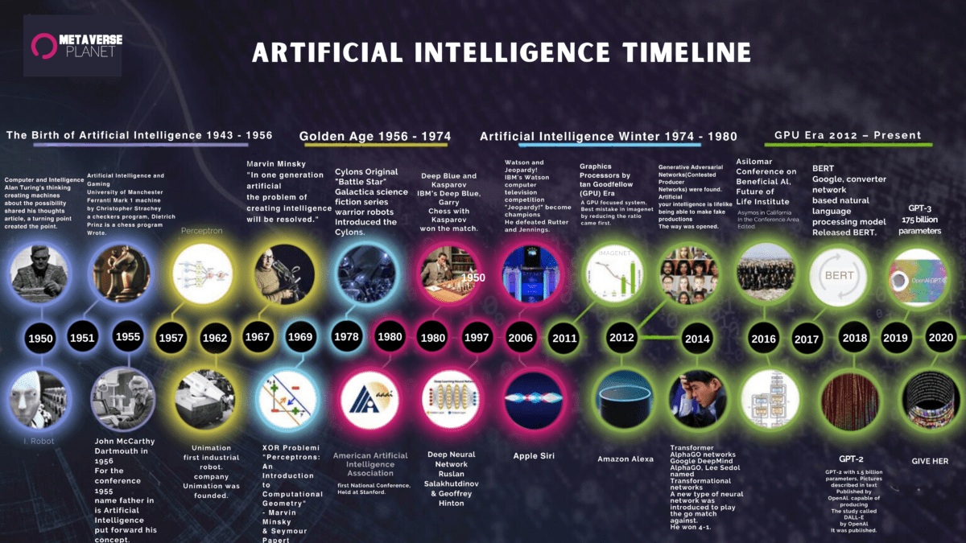
Notes:
Source metaverseplanet.net

Slide 4
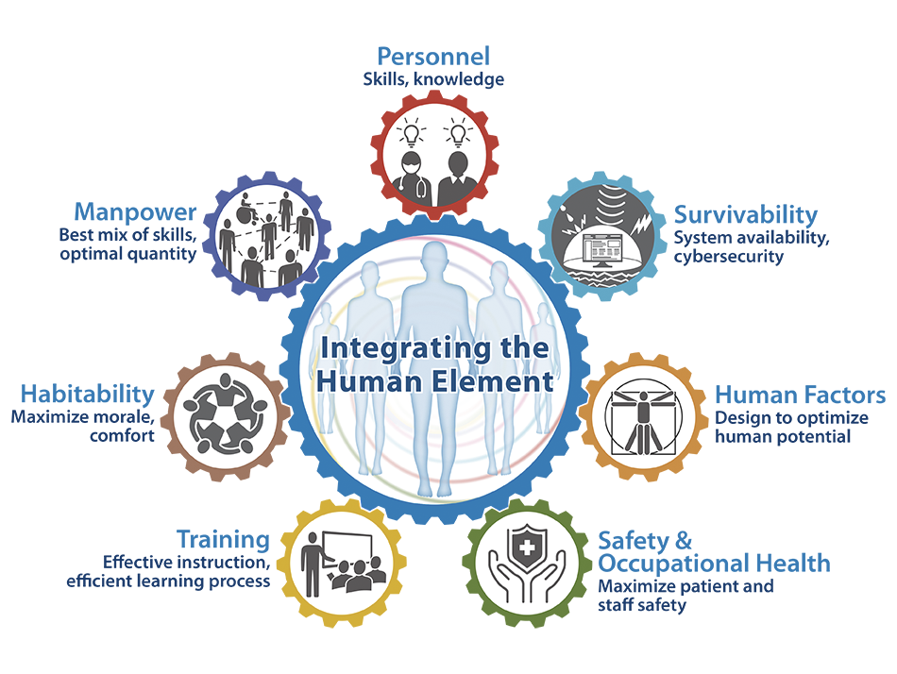
Human Systems Integration and its Domains
HSI is the systems engineering process and program management effort that provides integrated and comprehensive analysis, design, and assessment of requirements, concepts, and resources [across all 7 domains].
HSI captures the relationship between humans and the user’s operational environment informing how systems are designed and used relative to that relationship
[Goal of HSI] will be to optimize total system performance and total ownership costs, while ensuring that the system is designed, operated, and maintained consistent with mission requirements.
source: vumc.org
source: DAU acquipedia
Notes:
Source vumc.org

