Slide 1
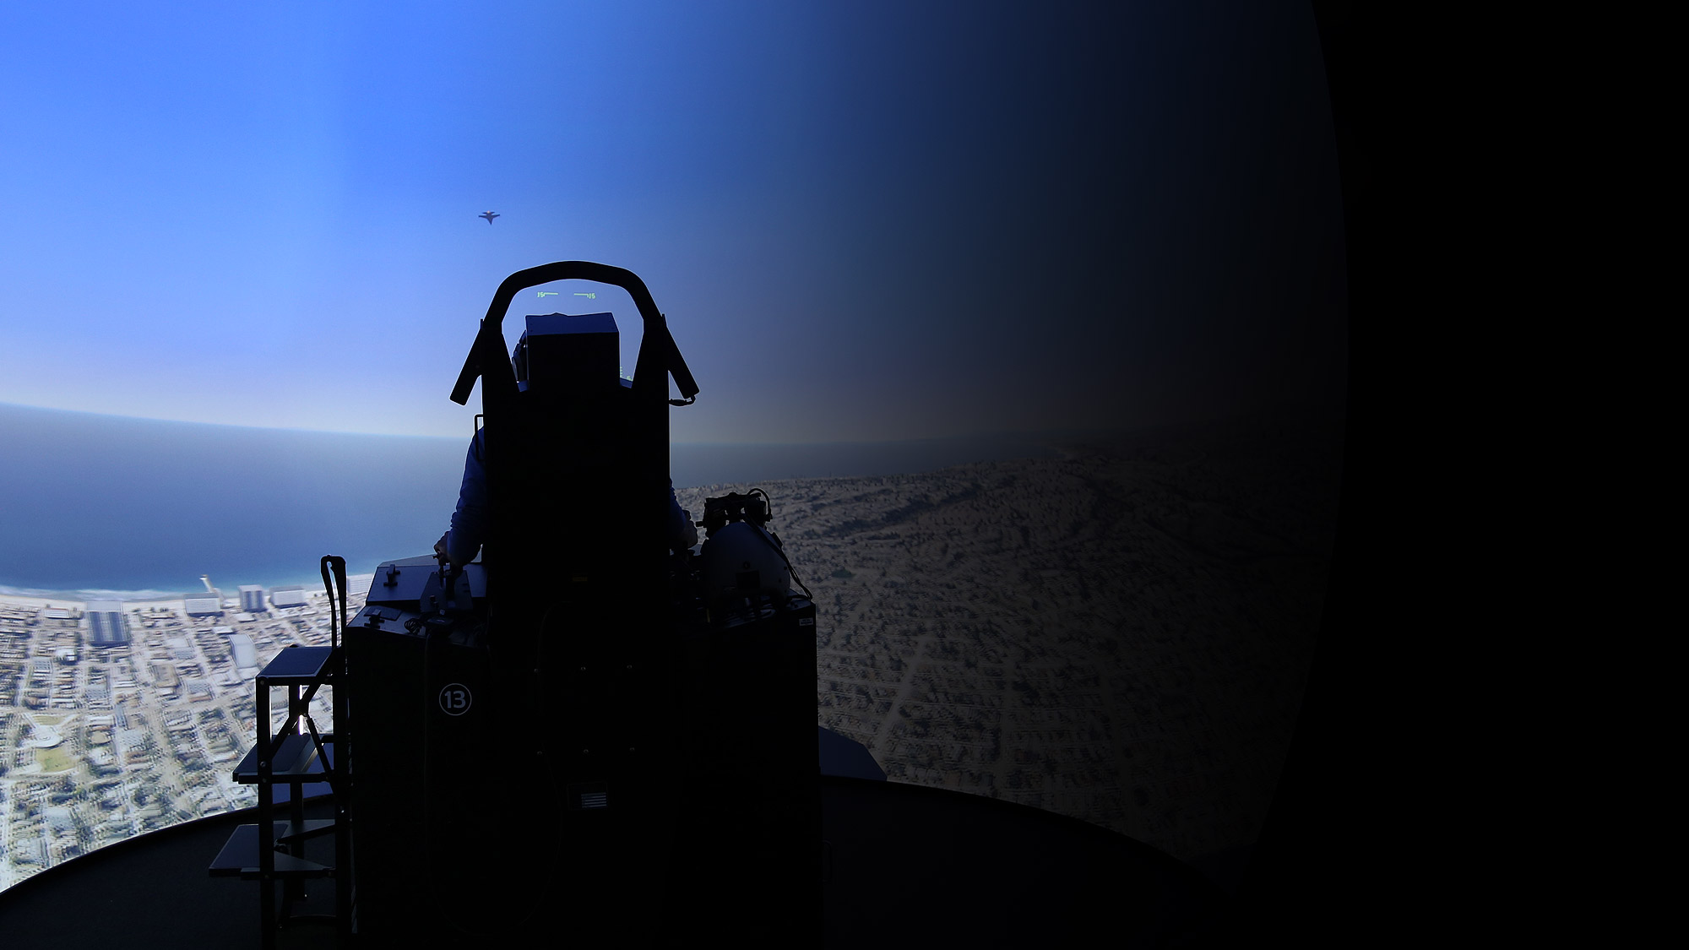


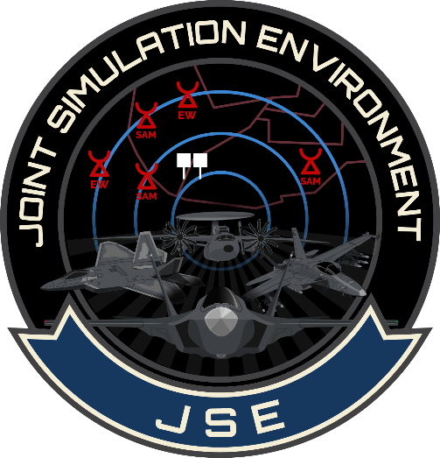
Joint Simulation Environment
NAVAIR Public Release 2024-0085. DISTRIBUTION STATEMENT A. Approved for public release: distribution unlimited.

Slide 2

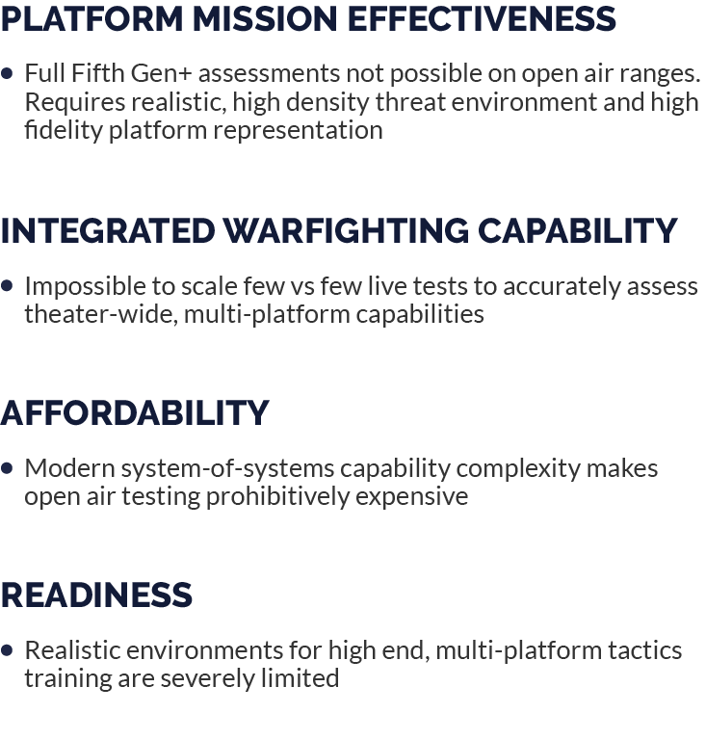

Why JSE?

Slide 3
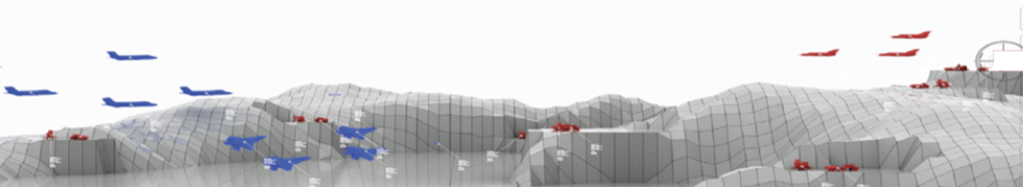
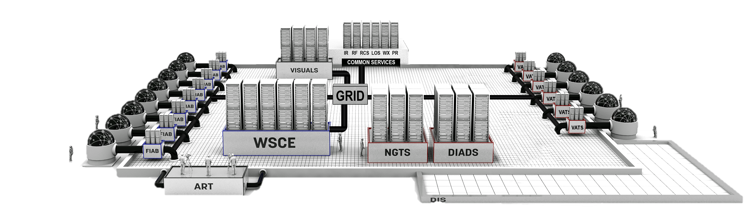







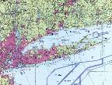


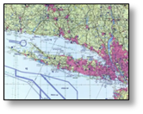
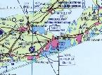


















The “Digital Range”
FIGHTERS / FIGHTERS-IN-A-BOX (FIAB)
VIRTUAL AIRBORNE THREAT SYSTEM (VATS)
VATS
FIAB
FUTURE AIRCRAFT
FUTURE PLATFORMS
GUN
WTF
RWS
CONSTRUCTIVE ENTITIES
SCENARIOS
AIR DEFENSE C2
IRCM
RFCM
FAAC
BATTLE MONITOR
Notes:
GRID: Global Re-usable Interface Domain; NGTS: Next Generation Threat System; DIADS: Digital Integrated Air Defense Simulation; WSCE: Weapon Server Common Environment;
ART: Analysis & Reporting Tool

Slide 4
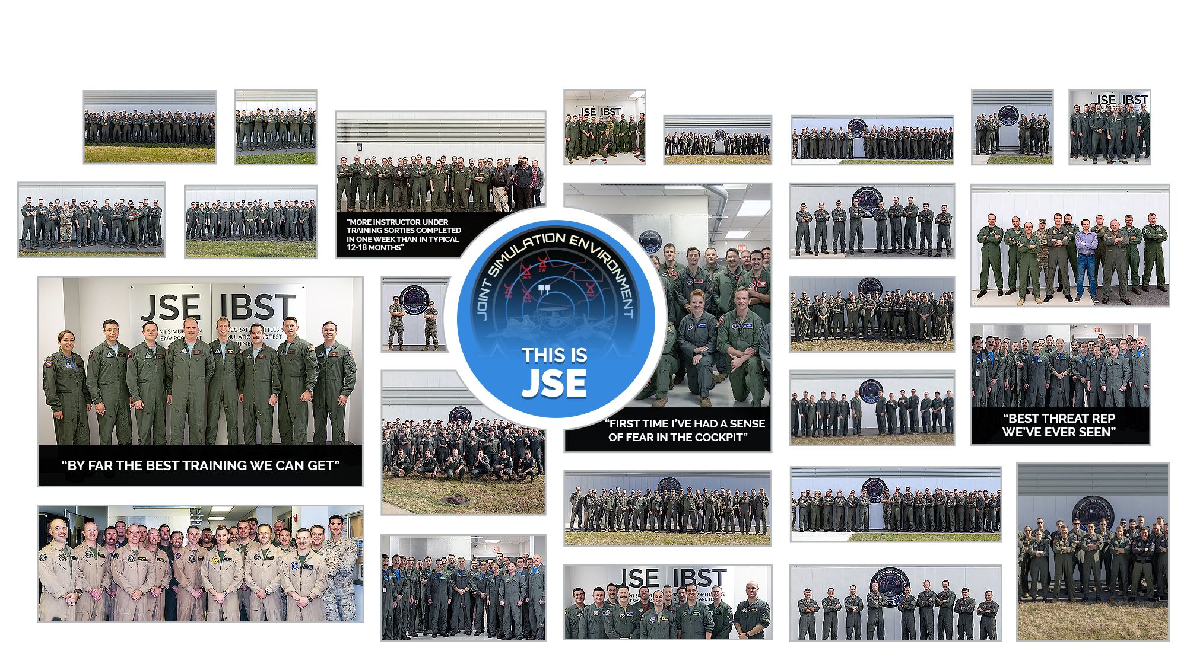
Joint Simulation Environment
Delivering High-End Warfighting Proficiency
FY24 Stats: 820 Pilots, 10k+ F-35 Sorties, 30k+ Weapon Engagements FY22-Now 1400+ pilots!
NAVAIR Public Release 2024-0179. DISTRIBUTION STATEMENT A. Approved for public release: distribution unlimited.

Slide 5

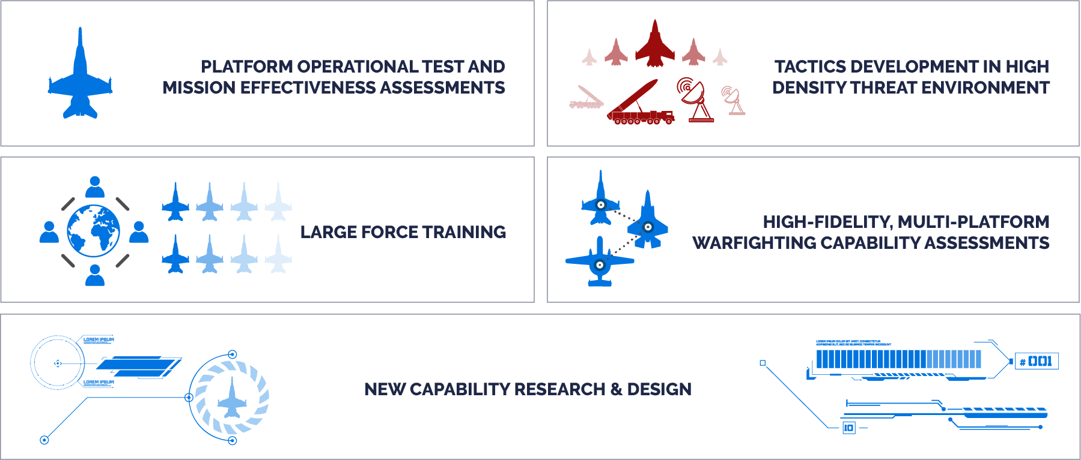
JSE Vision
To provide the DoD’s premier simulation environment
for Fifth Generation+ test and training.

Slide 6




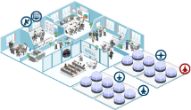

Navy Key Lines of Effort
Must fund development of “High Definition” platform, sensor, weapons models
Must pressurize industry partners to develop and deliver current models with urgency
Human-machine interfaces are critically important!
HD Model Development
JSE Pax
Integration
Models are delivered and integrated at JSE Pax
Performance verification, regression testing, and incorporation of new capabilities into the “production baseline”
Fallon ITF
Integration
Hardware/software must be acquired for insertion at Fallon Integrated Training Facility
ITF enables full CVW training and helps drive development priorities
Deployed
Solutions must be “packaged” for CVN deployment
Facilities must be identified to bring robust training capabilities closer to the warfighter
How do we preserve performance fidelity, to include the human-machine interface?

Slide 7

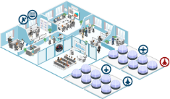


Key Lines of Effort
HD Model Development
Must fund development of “High Definition” platform, sensor, weapons models
Must pressurize industry partners to develop and deliver current models with urgency
Human-machine interfaces are critically important!
JSE
Integration
Models are delivered and integrated at JSE development & integration labs
Performance verification, regression testing, and incorporation of new capabilities into the “production baseline”
Hardware and software must be acquired to enable capability insertion at ITF, JITTC, etc.
ITF enables full CVW training and helps drive development priorities
JITTC-N enables Night 1 advanced training
DTTR-E/N enable mission level testing and experimentation
Ops Site
Integration
Deployed
Solutions must be “packaged” for CVN deployment
Facilities must be identified to bring HEF training capabilities closer to the warfighter
Unit Level
Solutions will leverage common JSE technical baseline
Facilities will be focused on training for a single MDS
7

Slide 8


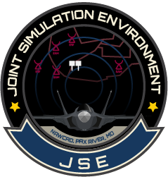





















JSE Conceptual Roadmap
CY23
CY24
CY25
CY26
CY27
BLUE
WEAPONS
BLUE
CONSTRUCTIVE
BLUE
VIRTUAL
PAX RIVER
NELLIS
EDWARDS
RED AIR
VIRTUAL
RED SAMS
(TMAP)
RED
CONSTRUCTIVE
Training
Event
Test
Event
SEMIANNUAL JSE BASELINE DELIVERIES WITH "BEST AVAILABLE" IC MODELS

Slide 9






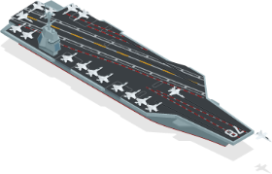


JSE Multi-Site / Multi-Solution Concept

SUPER SITE
CVN
INDUSTRY SITE

Highest fidelity platform representation with Man In The Loop (MITL)
Highest fidelity environment and threats
Highest fidelity threat representation
Supports high end training, tactics dev, and OT
CVN
Industry partners developing new capabilities and OFP in high fidelity, common environment
FLEET / CAF SITE
DEPLOYABLE SITE
Fidelity dialed back a notch
Smaller footprint, less hardware, and fewer support staff required
Reinforces learning achieved at “super sites” to maintain proficiency
Training solution on a small scale
Lower fidelity, all entities “constructive” except own ship
Reinforces learning at other levels to maintain proficiency while deployed
Continuum of capabilities fueled by super site high fidelity learning,
operational data collection, and common products

Slide 10
Keys to Success
Common, Government-owned digital environment → build it once and make available to all
Platform / weapon system investments in high fidelity models
Industry partnership to enable rapid integration of platform / weapon system models into common digital environment
Industry partnership to enable rapid deployment and sustainment of current platform models / systems / capabilities

Slide 11
Questions?

