Slide 1







Thank You NBT Sponsors!
PREMIER
GOLD

Slide 2
The future of XR-based, AI-Driven Simulation Technologies: What Effective Human Focused Systems will Look Like Beyond the Next 5 years

Slide 3
Massive Scale, Unprecedented Complexity: The Challenges & Advantages of AI-Enabled Modelling & Simulation Tech
Jason Kennedy
CEO & Co-Founder, Skyral
Naomi Hulme
Managing Director & Co-Founder, Skyral

Slide 4
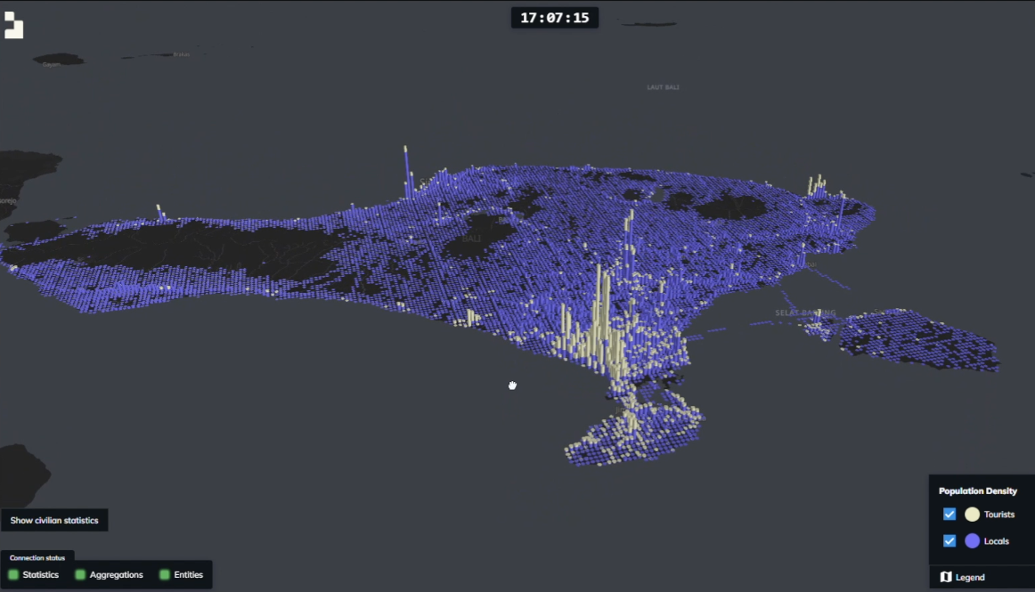

Slide 5
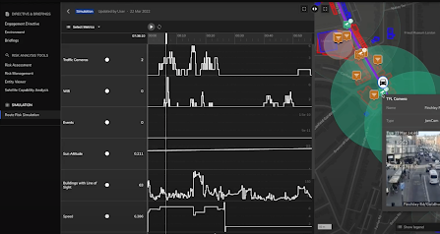

Slide 6

Questions?
Slido.com
# NBT2024
Massive Scale, Unprecedented Complexity

Slide 7
Extended Reality (XR) and Human Computer Interaction (HCI) – What’s Coming Beyond the Next 5 Years
Doug Bowman, Ph.D., Professor of Computer Science and Director of the Center for Human-Computer Interaction, Virginia Tech
Mark S. Dennison, Ph.D., Information Dynamics Team Lead, Battlefield Information Systems Branch, US DEVCOM Army Research Laboratory West
Daniel O’Brien, President of Americas, HTC VIVE

Slide 8
Questions?
Slido.com
# NBT2024
Extended Reality (XR) and Human Computer Interaction (HCI)

