Slide 1







Thank You NBT Sponsors!
PREMIER
GOLD

Slide 2
Novel Applications of Data

Slide 3
Synthetic training data for autonomous system training generated with AI from real-world sensor data
Hannes Walter
VP Product Management - 3D Simulation Environments
Blackshark.ai

Slide 4


Slide 5

Questions?
Slido.com
# NBT2024
Synthetic training data

Slide 6
The evolution of autonomous tactical AI - learning the lessons from Ukraine
Peter Morrison
Chief Product Officer
Bohemia Interactive Simulations

Slide 7
Questions?
Slido.com
# NBT2024
The evolution of autonomous tactical AI - learning the lessons from Ukraine

Slide 8
The Data Mesh and Zero Trust
Erica Dretzka
Director, Future Analytics Architecture
OSD CDAO
Jordan Gottlieb
Senior Advisor, Systems Engineer Technical Advisor, DoD CIO, Zero Trust Portfolio Management Office (PfMO)

Slide 9
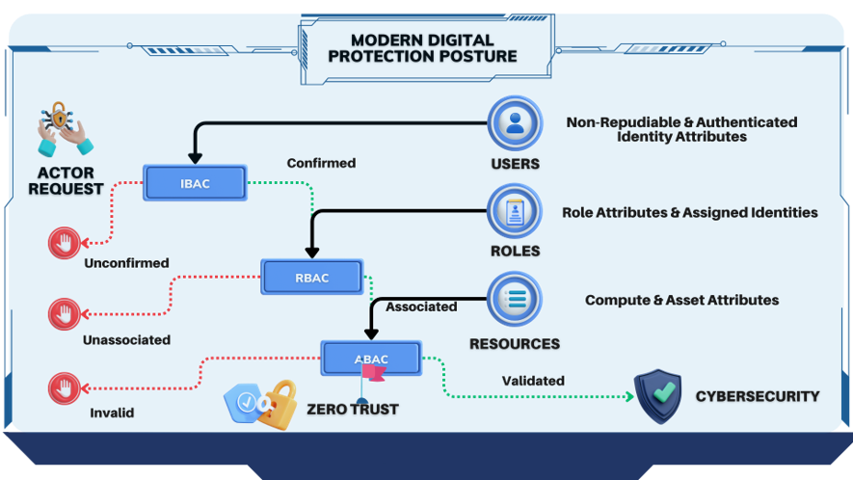
Notes:
Elements:
Access Management – management of individuals' access through the cyberscurity wall
Cybersecurity – defense of digital infrastructure
Zero Trust – authorized access based on dynamic policy

Slide 10
Notes:
ZT services target 2 pillars: Federated Governance and Data as a Product
UID:

Slide 11
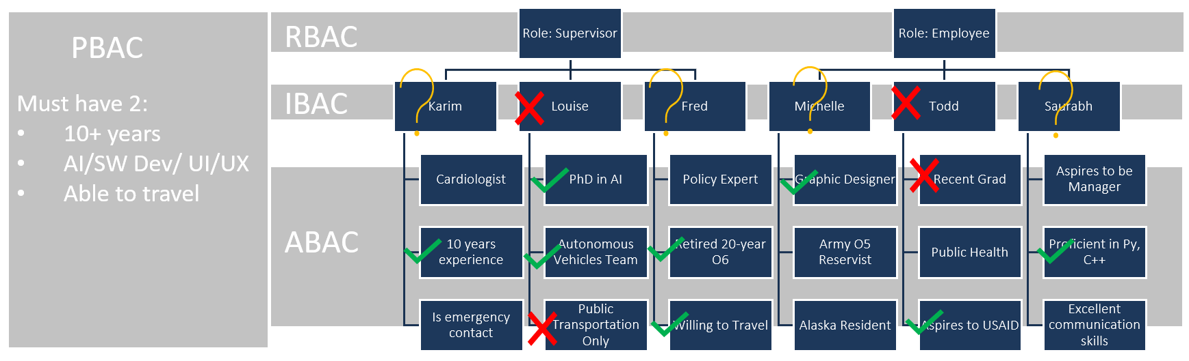

Slide 12






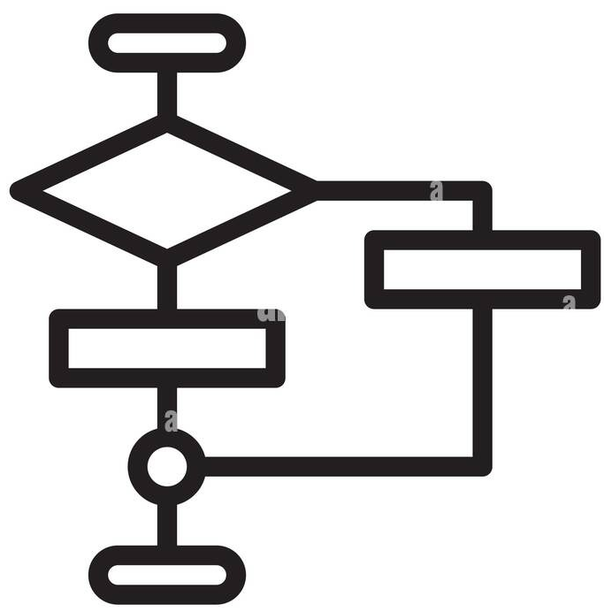

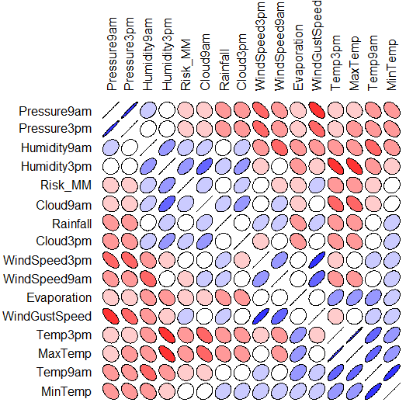
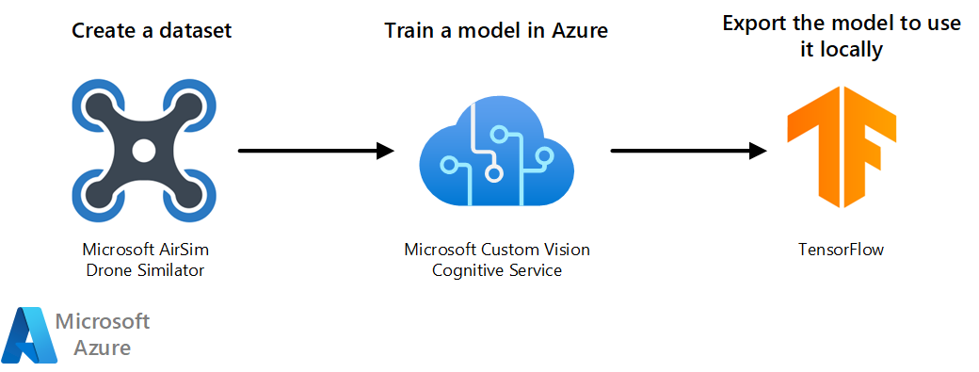




TensorFlow Tool request
TensorFlow Tools
Data Set
Data Set ID
Data Catalog
Algorithm Repository Query
Credentials
Algorithm
ZT µDomain
Pipeline Toolset
Pipeline Request
12

Slide 13
Contacts
Erica L. Dretzka Chief Digital and AI Office (CDAO), Chief Technology Office (CTO) Washington, DC erica.l.dretzka.civ@mail.mil | Mr. Jordan Gottlieb Chief Information Office (CIO), Zero Trust Portfolio Management Office (ZT PfMO) Systems Engineer Technical Advisor (SETA) Washington, DC jordan.gottlieb.ctr@mail.mil

Slide 14
Questions?
Slido.com
# NBT2024
The Data Mesh and Zero Trust

