Slide 1







Thank You NBT Sponsors!
PREMIER
GOLD

Slide 2
Large Language Models (LLMs)

Slide 3
The Great Hallucination
Brian Stensrud, PhD
Technical Fellow, Artificial Intelligence
CAE USA

Slide 4
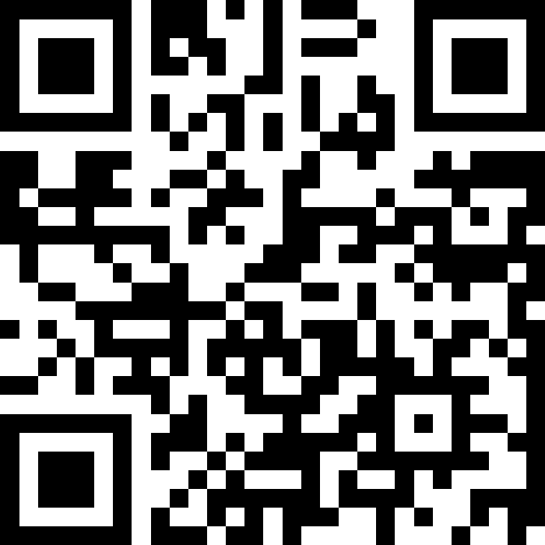
Questions?
Slido.com
# NBT2024
The Great Hallucination

Slide 5
Augmenting Humans with Compound AI: The Future of Military Training and Wargaming
Name
Title
Organization

Slide 7
Questions?
Slido.com
# NBT2024
Augmenting Humans with Compound AI

Slide 8
LLM Co-pilots for Domain Specific Modeling Languages
Matt Naveau
Chief Technology Officer
Tangram Flex, Inc.

Slide 9
[Replace with Slides from Speaker or delete this title]

Slide 12
Questions?
Slido.com
# NBT2024
LLM Co-pilots for Domain Specific Modeling Languages

