Slide 1

Certified Modeling and Simulation Professional
CMSP 3.0 - Reinvention
2 December 2024
Ivar Oswalt, PhD CMSP
The MIL Corporation
Dr. Oswalt contributed to this effort in his personal capacity and the views expressed are his own and do not necessarily reflect those of The MIL Corporation.

Slide 2
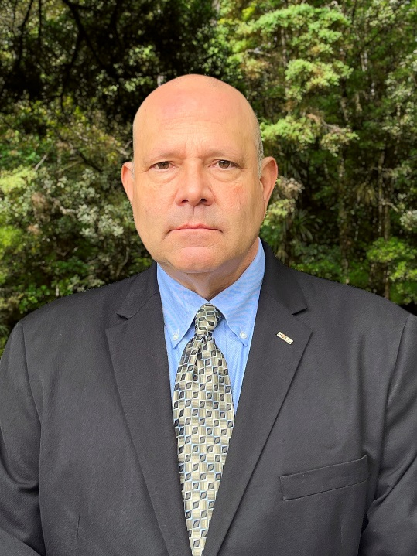
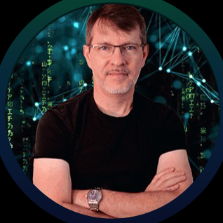
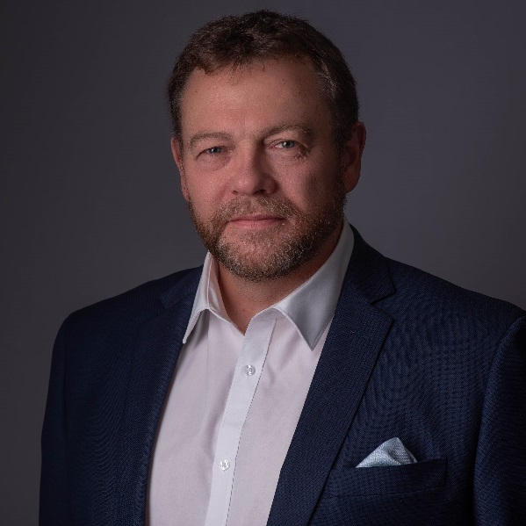

Overview of CMSP Special Event
A Quick Description of CMSP
Moderated Panel Discussion
Introductions
Panel Q&A
The Future
Audience Q&A
Slide 2

Slide 3

Overview of CMSP
Since credentialing is key to turning any job into a profession…
In 2002 NTSA, with SISO and SCS, established an M&S Professional Certification Commission (M&SPCC) and initiated CMSP 1.0
This Commission / Certification Board oversees the awarding of the Certified M&S Professional (CMSP) Designation: 1.0 (2001), 2.0 (2010), Now 3.0 (2019 -___)
It helps to professionalize M&S and to engender confidence that certified personnel possess a defined and significant level of current M&S expertise
CMSP provides differentiation, community awareness, professional networks
It is continuing to be developed and enhanced by an Executive Committee and five active Implementation Committees
Slide 3

Slide 4
Panel Presentation and Discussion
Panel Members Will Introduce Themselves and Describe Their Path to CMSP
And Speak To:
Why is CMSP Valuable?
How would you Describe its Importance to International M&S Professionals?
Ideas on How the Audience Members can Engage / Participate?
Way Ahead....
Slide 4

Slide 5
The Future of CMSP
3.0 includes four levels of certification (Intern, Apprentice, Practitioner, Master)
It employs a Learning Management System (Canvas)
There are new resources available, Pre-Tests, References, Courses, etc.
Enhanced CoI with Newsletter, Events, and Scholarship Program
Considering a Proctored and Oral Components of the Exam
Are Developing Collaborative Relationships with Others (e.g., MORS)
Stop by the NTSA Booth to Learn More!
And, There will be a Professional Development Workshop on Friday!
Finally, Next Slide is a Survey... Another way to Engage with CMSP 3.0!
Slide 5

Slide 6
Audience Q&A
Slide 6

Slide 7
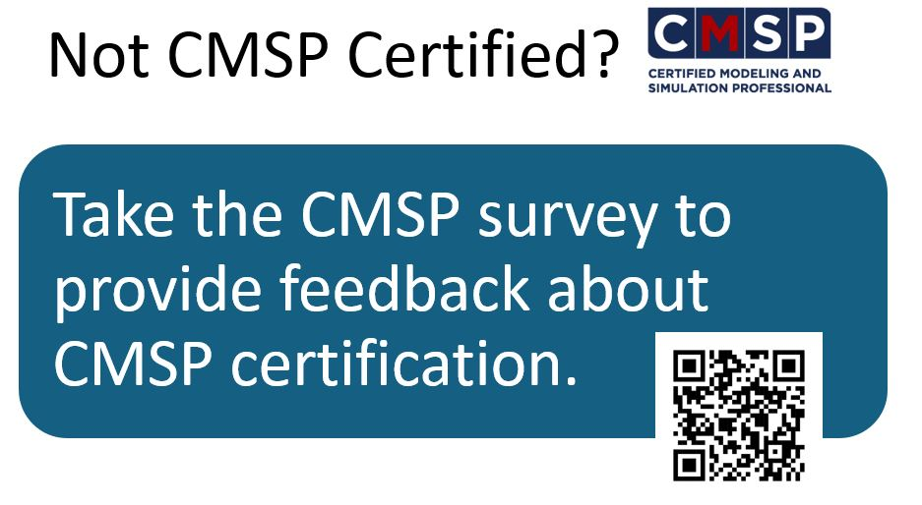
Inputs are Most WELCOME!
Slide 7

