Slide 1

Pm trasys Acquisition update
Distribution Statement A. Approved for public release: distribution is unlimited.
PROGRAM MANAGER, TRAINING SYSTEMS
Distribution Statement A. Approved for public release: distribution is unlimited.
2 December 2024
UNCLASSIFIED

Slide 2

Range training systems
UNCLASSIFIED
LtCol Rory Herman
Product Manager
Range Training Systems
UNCLASSIFIED

Slide 3

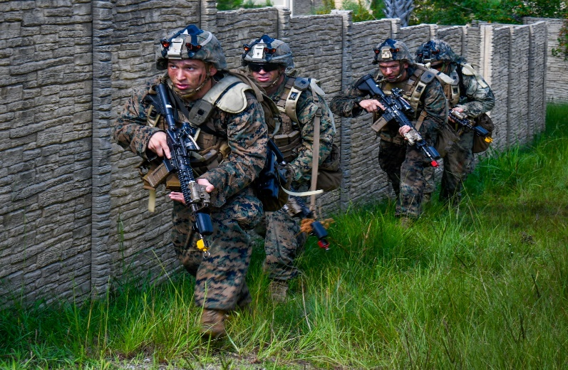
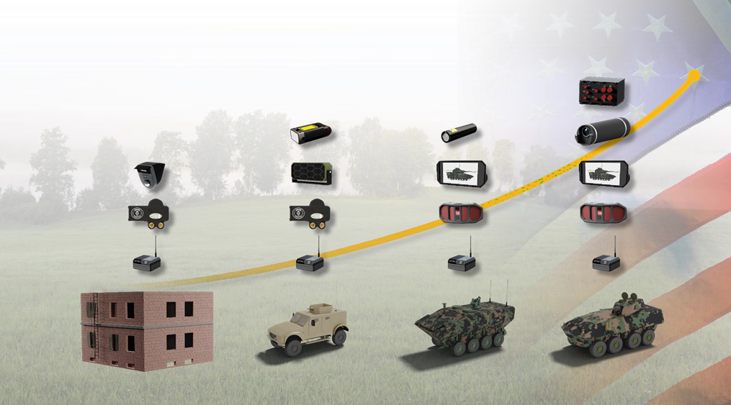
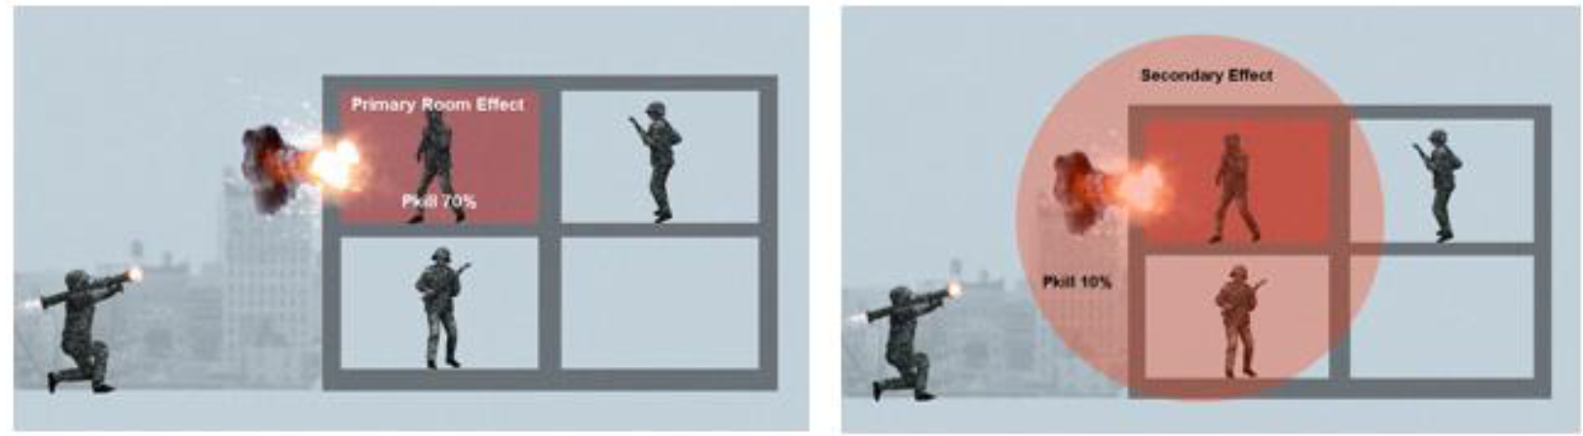
FoFTS INC 1:
PERSONNEL
FOFTS INC 1:
PERSONNEL
RTS PROGRAMS
Program Picture
Program Description
Requirements: FoFTS CPD ( 2014) , CRC/LOCs (2017-2023) , New CDD in draft
Description: FoFTS-Next Marine Corps Tactical Instrumentation System (MCTIS) provides realistic, non-live fire capabilities to perform Force on Force training using personnel devices as part of a suite of tactical engagement capabilities that enhance training around the world and across the range of military operations. The employment of MCTIS provides instant feedback and after-action capabilities which enhances both the realism and effectiveness of Force-on-Force training from small unit-level to large-scale training exercises.
AAO Quantity: 16 Bn Sets
Program Status
Upcoming Events
ACAT and Date of Designation: IV(M), 10 Aug 2018
MDA/PDA: Commander, MCSC
Date of most recent APB: 18 Dec 2023
IOC/FOC Dates: Q3 2024/Q3 2026
Accomplishments:
IOC achieved Q3 FY24
Successfully demonstrated interoperability with Live, Virtual, Constructive Training Environment for Commandant of the Marine Corps during his visit to 29 Palms
Successfully supported over 2,700 Marines & 300 Vehicles at MWX 2-24 and MWX 5-24
Event | Date
IOC | Q3 FY24
APB Update | Q1 FY25
Delta Fieldings | Continuous throughout CY24
MCTIS v1.1.0 | Q2 FY25
FOC | Q3 FY26
UNCLASSIFIED

Slide 4
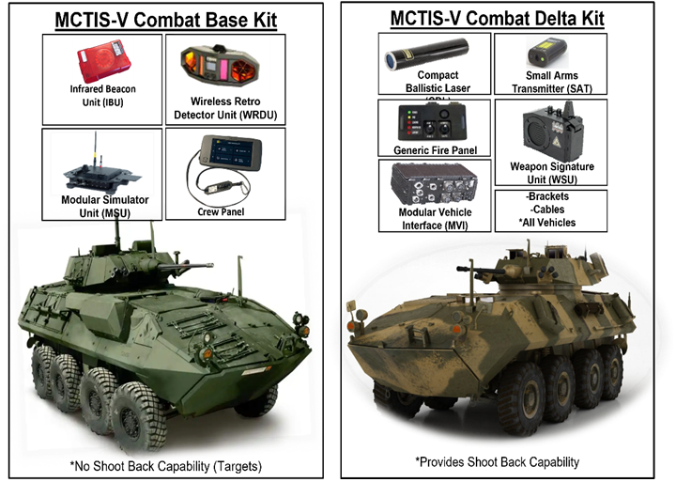

RTS PROGRAMS
FOFTS INC 2:
COMBAT VEHICLES
FoFTS INC 2:
COMBAT VEHICLES
Program Picture
Program Description
Requirements: FoFTS CPD ( 2014) , CRC/LOCs (2017-2023) , New CDD in draft
Description: The Marine Corps Tactical Instrumentation System-Combat Vehicle (MCTIS-CV) is a new capability for the FMF. MCTIS-CV will be mounted on combat vehicles to simulate realistic FoF training. MCTIS-CV will use laser transmitters, for both small arms and main armaments, for armored vehicles, laser detectors, shoot back capability, audio for control, tracking and after-action reviews. The MCTIS-CV will be used with Light Armored Vehicles (LAV) &Amphibious Combat Vehicles (ACVs).
AAO Quantity: Varies (see chart below)
Vehicles
Program Status
Upcoming Events
ACAT and Date of Designation: AAP, Q1 FY25 (anticipated)
MDA/PDA: Program Manager, Training Systems (anticipated)
Date of most recent APB: Q1 FY25 (anticipated)
IOC/FOC Dates: TBD
Accomplishments:
Started LAV-25/ACV-P TO 2: Jan 2024
Completed LAV-25/ACV-P TO 2 Technical Interchange Meeting (TIM) 1: Feb 2024
Completed LAV-25/ACV-P TO 2 Form/Fit/Function testing: May 2024
Completed LAV-25/ACV-P TO 2 System Requirements Review (SRR): May 2024
Surveyed OEM Test Location & Equipment for TO 3 Demo 1, Sep 2024
Event | Date
LAV-25/ACV-P TO 3 | Q1 FY25
MCTIS CV (Others) TO 1 | Q2 FY25
LAV-25/ACV-P Production OTA | Q2 FY26
MCTIS CV (Others) TO 2 | Q3 FY26
MCTIS CV (Others) TO 3 | Q1 FY28
MCTIS-CV (Others) Production OTA | Q2 FY29
UNCLASSIFIED

Slide 5
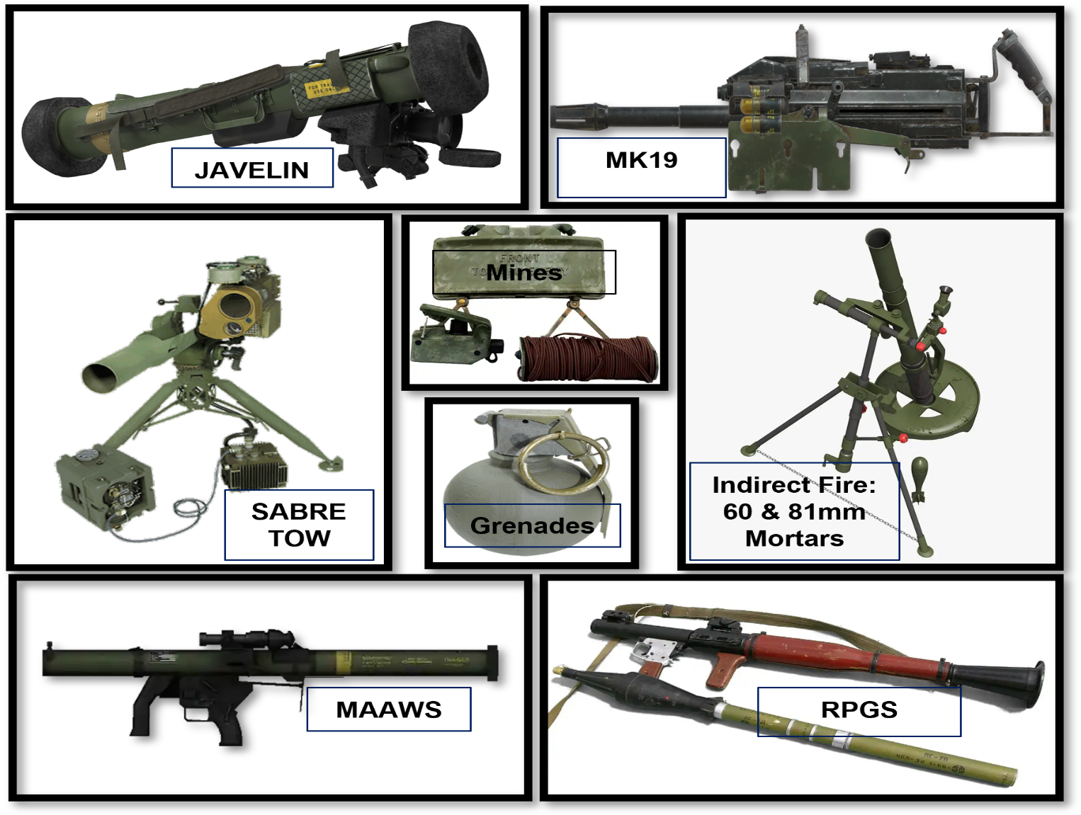

RTS PROGRAMS
FoFTS INC 3:
WEAPON SURROGATES
FOFTS INC 3: WEAPON SURROGATES
Program Picture
Program Description
Requirements: FoFTS CPD ( 2014) , CRC/LOCs (2017-2023) , New CDD in draft
Description: MCTIS-WS will provide weapon system instrumentation to the FMF to simulate/provide a “Train as you fight” environment.
AAO Quantity: Varies (See table below)
Weapon
Program Status
Upcoming Events
ACAT and Date of Designation: AAP, Q1 FY25 (anticipated)
MDA/PDA: Program Manager, Training Systems (anticipated)
Date of most recent APB: Q1 FY25 (anticipated)
IOC/FOC Dates: TBD
Accomplishments:
MCTIS-WS OTA Awarded to Serious Sim - Sep 2023
Grenades, Mines and Wireless Network Integration
Phase I Research and Analysis OTA completed - Jan 2024
Phase II API Design OTA Awarded – 1 Jul 2024
MCTIS-WS RFI to Industry
Received six (6) responses from Industry: Cubic, Ravenswood, Saab, Serious Simulation, SKIFTECH, Zen Technologies
Event | Date
WLN Integration Research OTA Award | Q4 FY23
WLN Integration Research White Paper | Q2 FY24
WS API Design/Development OTA | Q4 FY24
WS All Surrogates RFI | Q4 FY24
WS All Surrogates OTA (Multi-Award) | Q2 FY25
 | TBD
UNCLASSIFIED

Slide 6
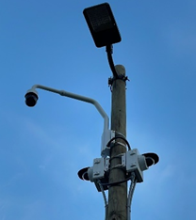
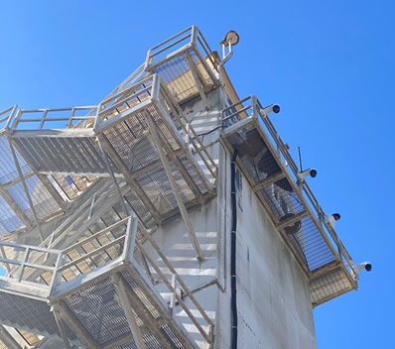
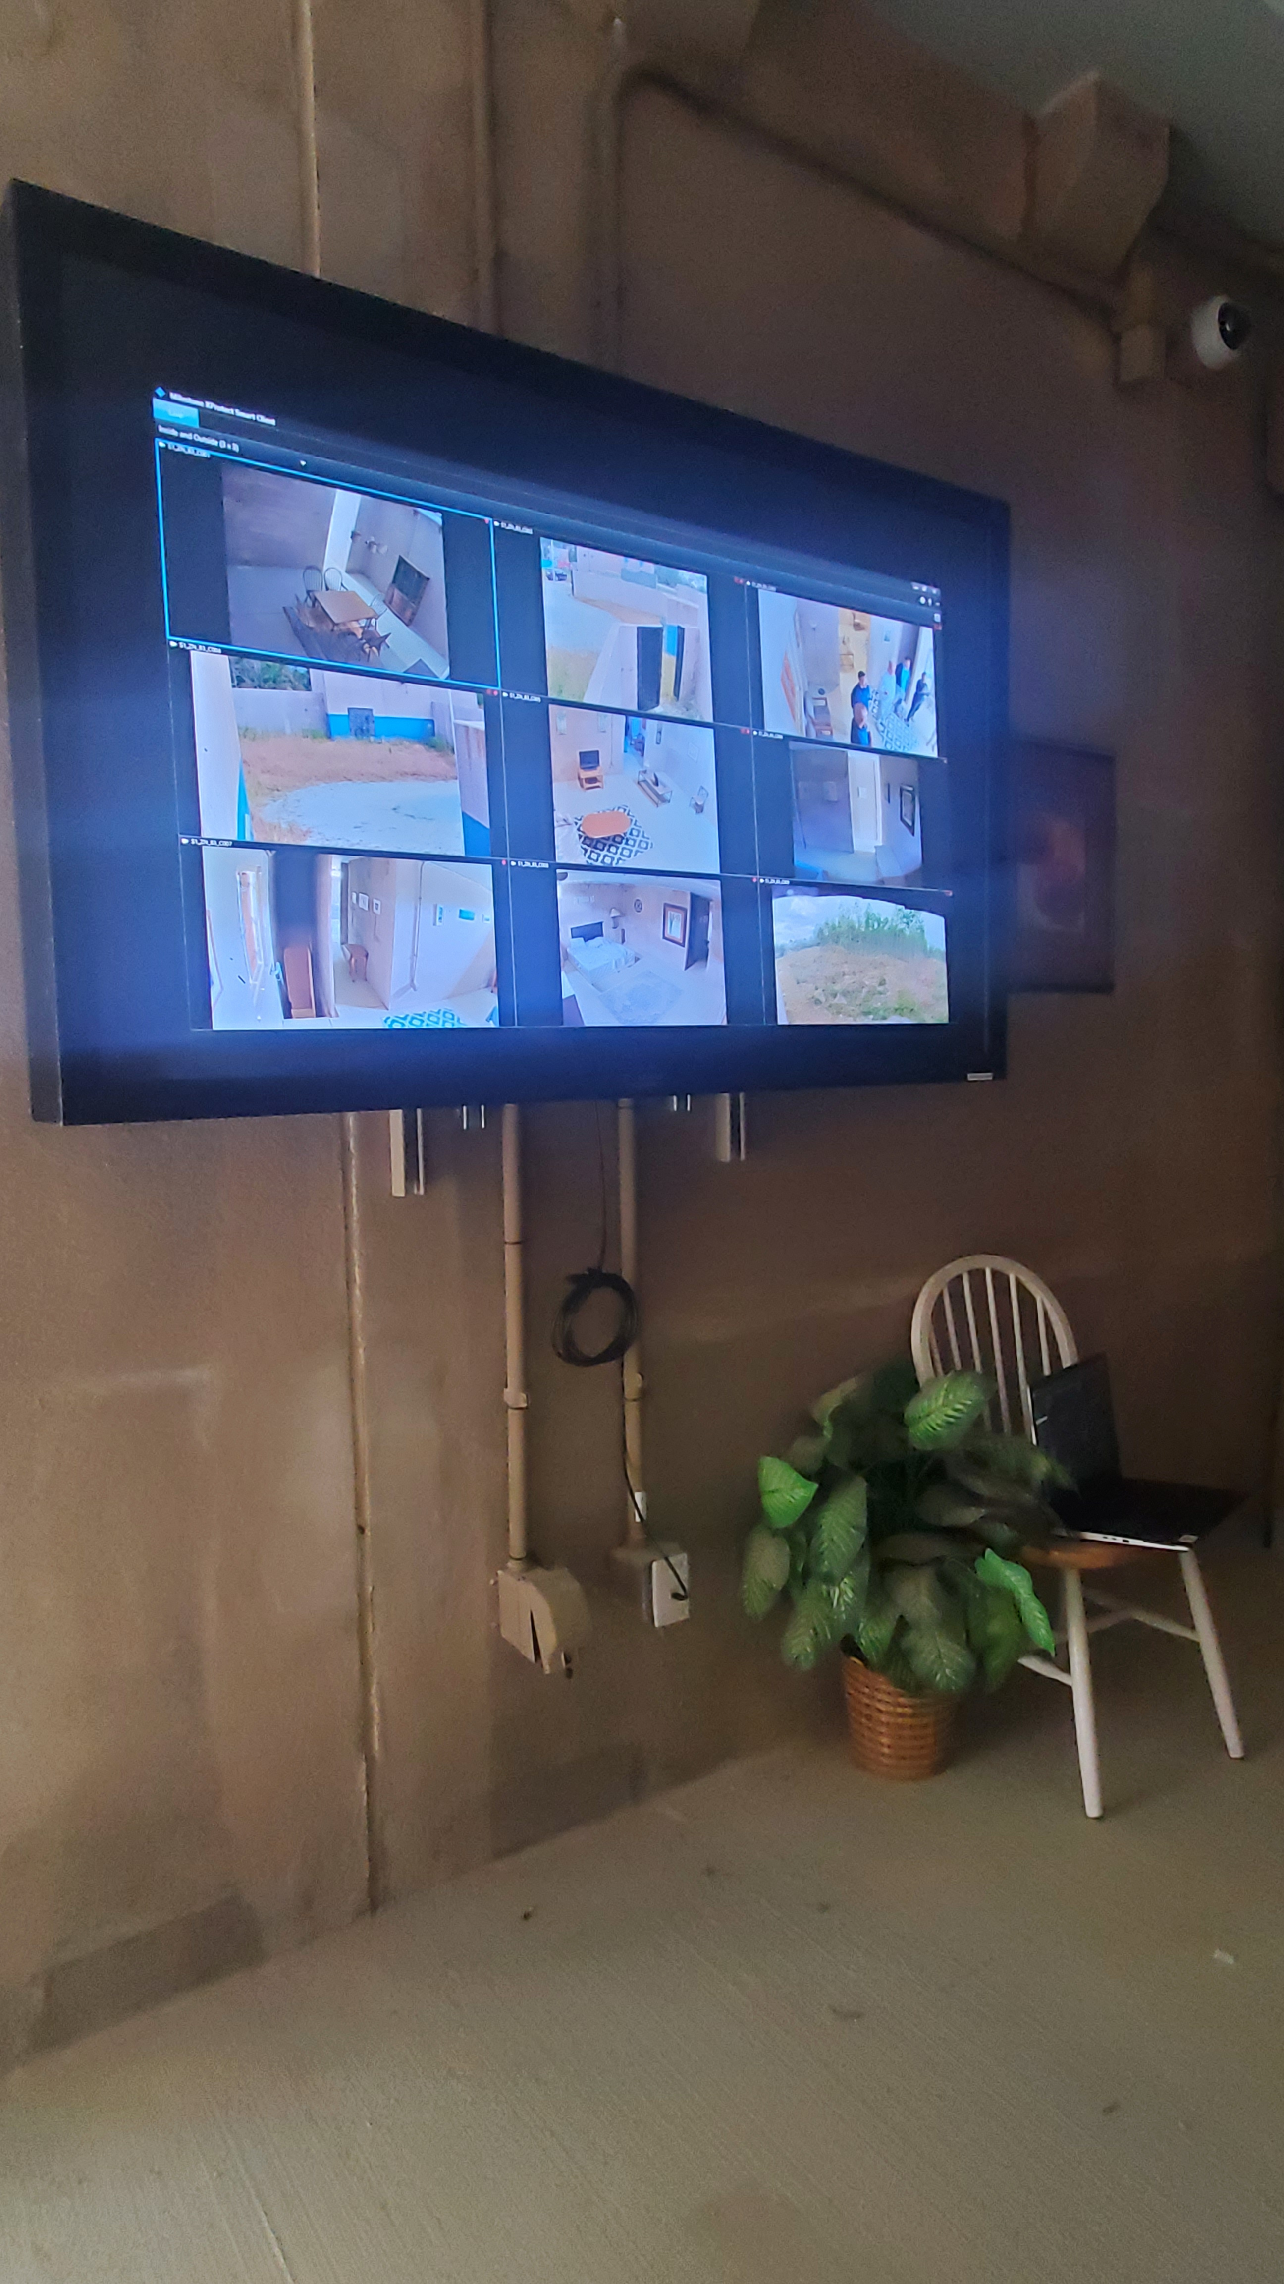
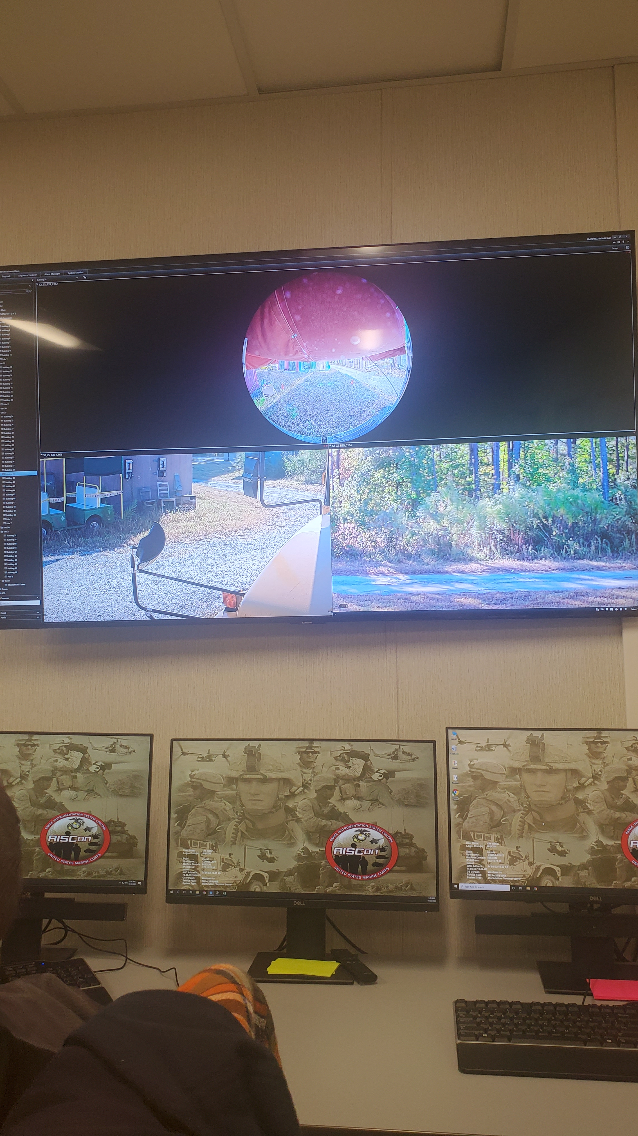
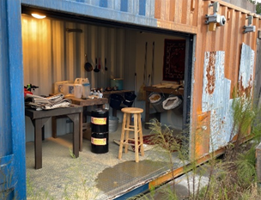
RTS PROGRAMS
TACTICAL VIDEO CAPTURE SYSTEM (TVCS)
Program Picture
Program Description
Requirements: RIS ORD (1999), LOC (2010), CRC (2021)
Description: Tactical Video Capture System (TVCS) provides video-based After-Action Review (AAR) capabilities to support Marine Corps training. TVCS provides these capabilities utilizing a Graphical User Interface, configurable video-based alarms that combines multiple cameras into a single view. This view captures the Marine’s Urban Warfare tactics and highlight strengths and weaknesses for use during both group and individual AAR evaluation sessions.
AAO Quantity: 11
Program Status
Upcoming Event
ACAT and Date of Designation: ACAT IV(M) 7 Sep 2010
PDA: PM TRASYS
Date of most recent APB: 15 Dec 2011
FOC Dates: May 2012
Accomplishments
Completed initial fielding for the Fleet Marine Force
Event | Date
Guam J-755 MILCON BOD | Q1 FY2025
Windows 11 Upgrade Integration | Q4 FY24 – Q2 FY25
Guam J-755 Gov't Acceptance | Q2 FY25
UNCLASSIFIED

Slide 7
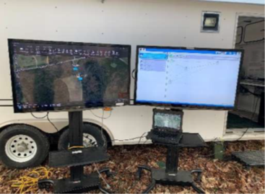
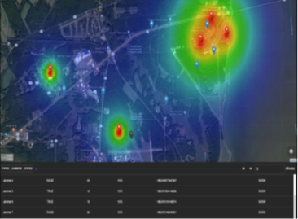
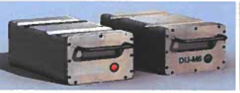
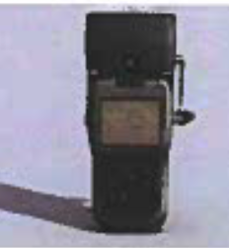
ELECTRONIC WARFARE GROUND INSTRUMENTED RANGES (EWGIR)
ELECTRONIC WARFARE GROUND INSTRUMENTED RANGES (EWGIR)
RTS PROGRAMS
Program Picture
Program Description
Requirements:
D-UONS for EWGIR 25 October 2019
Requirements Memorandum - 09 December 2022
Description: The EW GIR is intended to be integrated into existing Ground and MOUT Ranges to provide a realistic RF jammed and/or GPS spoofed training environment which will enhance small unit tactics and ability to engage near-peer adversaries.
AAO Quantity: 16 Required; 0 Fielded
29 Palms, Yuma, Bridgeport, CPEN, CLNC, MCBH, Okinawa, Fuji
Program Status
Upcoming Events
ACAT and Date of Designation: Pre-Program
MDA/PDA: PM TRASYS
Date of most recent APB: N/A
IOC/FOC Dates: TBD
Accomplishments
Currently coordinating with ONR on their small form factor capability via SBIR phase II contract.
Currently coordinating with PEO STRI and the Army's Threat Systems Management Office (TSMO) on future contract opportunities.
Performing Market Research
Event | Date
ONR SBIR Phase 2 Planned Kickoffs | Q1 FY25
Market Research Demo (MDMX 1-25) | Q2 FY25
UNCLASSIFIED

Slide 8
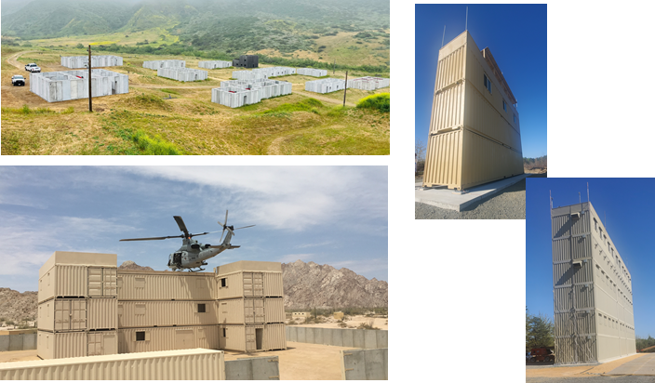
COMBAT TRAINING ENVIRONMENT (CTE)
RTS PROGRAMS
Program Picture
Program Description
Requirements:
MROC DM 18-2018 RTAM Capability Development Document, 1 August 2018
MCO 3550.10 Policies and Procedures for Range and Training Area Management, 15 February 2018
MCRP 8-10B.1 Marine Corps Operational Training Ranges Required Capabilities, 29 May 2009
Description: Military Operations on Urban Terrain (MOUT) training systems provide a challenging and complex urban training environment that replicates the difficulties units face as they communicate, coordinate, maintain situational awareness, navigate and track urban operations. These training systems include Home Station Training Lanes, MOUT, Climbing Towers, Sniper Towers, Forward Operating Bases, Airfield Seizure Facilities and Live Fire Shoot houses.
AAO Quantity: See note in Issues.
Program Status
Upcoming Events
ACAT and Date of Designation: Post-ACAT, 17 December 2015
MDA/PDA: PM TRASYS
Date of most recent APB: N/A
FOC Date: October 2014
Accomplishments
CLNC EOD 3 Wall kickoff meeting conducted.
FY25 RTSP project planning completed.
Event | Date
Yuma Site 56 Kickoff | Q2 FY25
MCBQ R-3B Grenade Observation Tower Gov't Acceptance | Q2 FY25
CLNC EOD 3 Wall Gov't Acceptance | Q2 FY25
CPCA R-800 Platoon Offensive Trenches Planned Award | Q3 FY25
CLNC Mobile MOUT Restoration Planned Award | Q4 FY25
UNCLASSIFIED

Slide 9
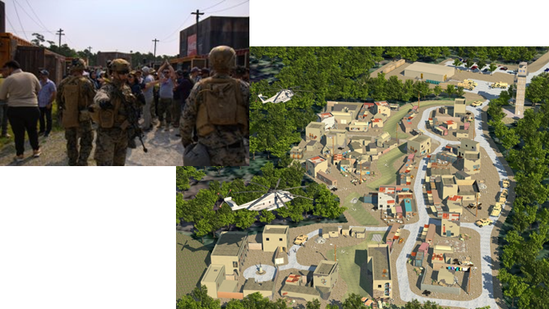
INFANTRY IMMERSIVE TRAINER (IIT)
RTS PROGRAMS
INFANTRY IMMERSIVE TRAINER (IIT)
Program Picture
Program Description
Requirements:
Immersive Trainer USN #08357UA, 1 June 2009
CG TECOM Urgent Statement of Need, 24 July 2009
Description: Infantry Immersion Trainers (IITs) are small-unit training ranges consisting of urban structures finished and decorated to replicate geo-specific locations. These training ranges are enhanced by the integration of direct fire training systems, virtual and special effects systems, role-players, and video instrumentation for use in after action reviews. Training in the IIT replicates current operational theaters and stresses small-unit actions on the small-unit leader’s tactical, moral, and ethical decision making within the context of operational culture.
AAO Quantity: 4
Camp Lejeune NC Indoor IIT, Camp Pendleton CA Indoor/Outdoor IIT, Marin Corps Training Area Bellows HI, and Camp Lejeune NC Outdoor IIT
Program Status
Upcoming Events
ACAT and Date of Designation: Post-ACAT, 17 December 2015
MDA/PDA: PM TRASYS
Date of most recent APB: N/A
FOC Date: 17 April 2011
Accomplishments
CGF IPT is collaborating with the Requirements Sponsor and Training Support Center for scenario planning and assistance in developing user assessments.
Event | Date
CGF User Assessments - CLNC | Q1 FY25
CGF Front End Analysis Completion | Q1 FY25
MITE RDTE Option Year 4 planned Award | Q4 FY25
UNCLASSIFIED

Slide 10
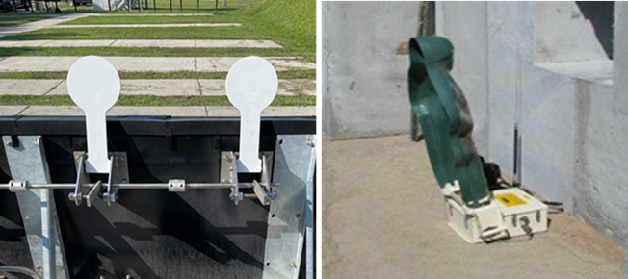
RANGE TRAINING AIDS PORTFOLIO (RTAP)
RANGE TRAINING AIDS PORTFOLIO (RTAP)
RTS PROGRAMS
Program Picture
Program Description
Requirements:
MROC DM 18-2018 Range and Training Area Management Family of Systems Capability Development Document, 1 August 2018
Description: Range Training Aids Portfolio (RTAP) includes Atmospherics, Battlefield Effects Simulators, and Targets. Targets are a subset under the overarching RTAP program, a program of record that is maintaining Marine Corps live fire training capabilities.
AAO Quantity: 132 Not in TFSMS yet. Working with Portfolio Manager to establish AAO.
Program Status
Upcoming Events
ACAT and Date of Designation: Post-ACAT, 17 December 2015
MDA/PDA: PM TRASYS
Date of most recent APB: None
FOC Date: May 2013
Accomplishments
CPCA R-103 Audio System Government Acceptance completed Q4 FY24.
Pu'Uloa Warning Lights material ordered.
Event | Date
Miramar Range 100 Short Bay Firing Foundation Government Acceptance | Q1 FY25
Cherry Point KD Rifle Range Audio System Government Acceptance | Q1 FY25
Pu'Uloa Warning Lights Government Acceptance | Q1 FY25
UNCLASSIFIED

Slide 11
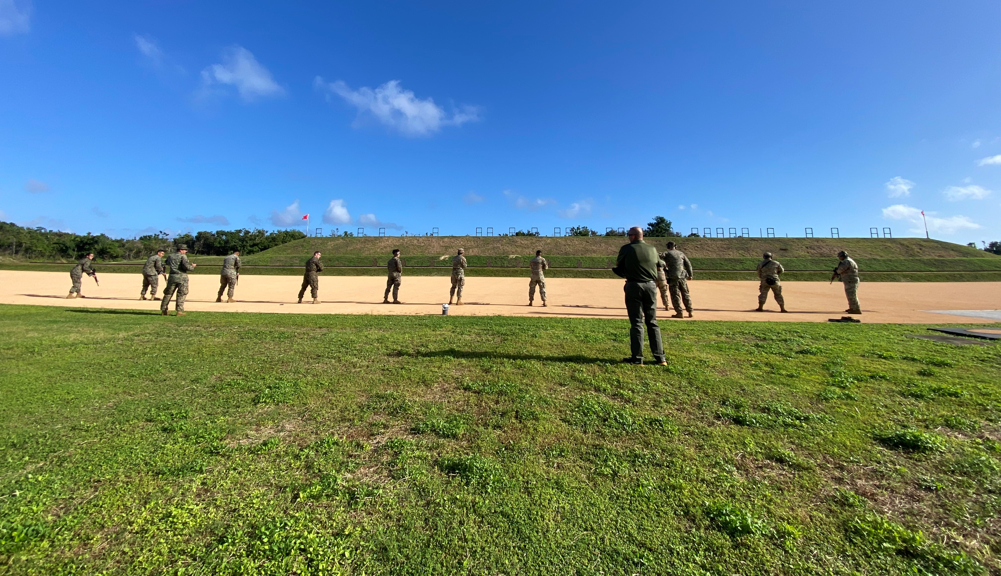
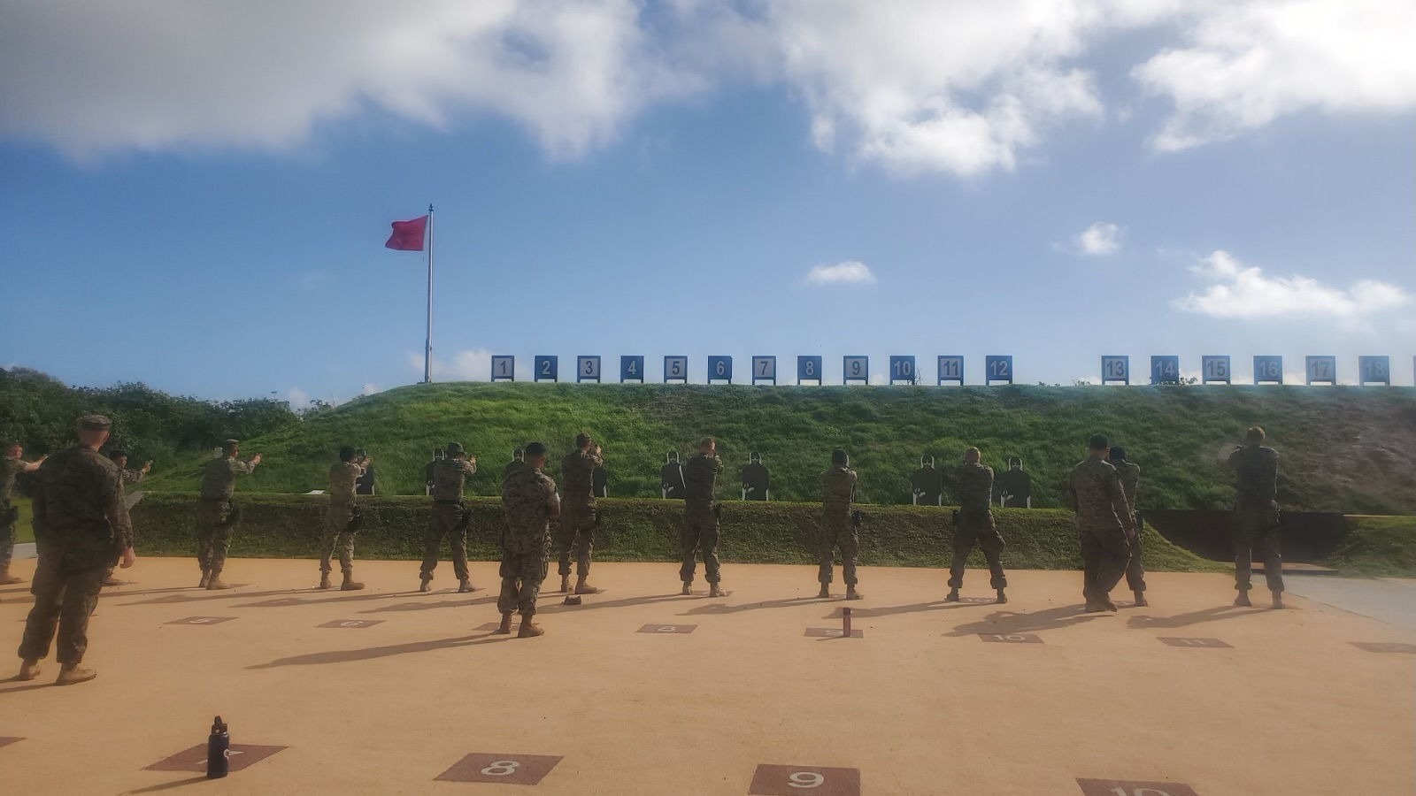
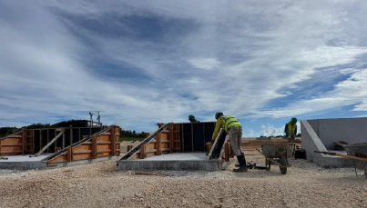
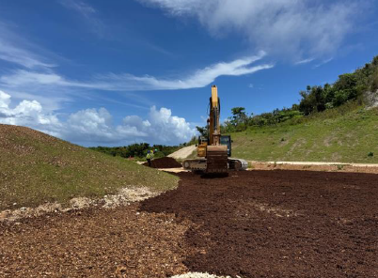
LIVE FIRE TRAINING SYSTEMS (LFTS)
LIVE FIRE TRAINING SYSTEMS (LFTS)
RTS PROGRAMS
Program Picture
Program Description
Requirements:
Requirements memorandum validation for Range Training Systems Upgrade of 12 July 2017
Letter of clarification dated 02 July 2018
Description: LFTS will procure, field, install, and sustain the equipment needed to operate (6) live fire ranges not previously fielded under the Range Training Aids Portfolio.
Camp Pendleton, CA
P-637 (Range 314C - Infantry Squad Defense Range)
Guam
P-715 (Ranges 2 to 5 - Live Fire Training Range Complex)
P-735 (Range 1 - Multi-Purpose Machine Gun Range)
AAO Quantity: 6
Program Status
Upcoming Events
ACAT and Date of Designation: AAP, 22 Dec 2017
MDA/PDA: PM TRASYS
Date of most recent APB: N/A
IOC/FOC Dates: Q4 FY23 / Q4 FY26
Accomplishments
GUAM P-715 target install completed Q4 FY24
GUAM P-735 procurement package being updated for late Q1 FY25 award.
Event | Date
P-735 Planned Award | Q1 FY25
P-735 MILCON Inspection | Q1 FY25
R-314C Planned Award | Q2 FY25
R-314C Planned MILCON BOD | Q1 FY25
P-735 Planned MILCON BOD | Q3 FY25
P-735 Install/GAT/NET (tentative) | Q4 FY25
R-314C Install/GAT/NET (tentative) | Q4 FY25
UNCLASSIFIED

Slide 12





TRACKLESS MOBILE INFANTRY TARGETS (TMIT)
RTS PROGRAMS
TRACKLESS MOBILE INFANTRY TARGETS (TMIT)
Program Picture
Program Description
Requirements:
Range and Training Area Management (RTAM) Family of Systems (FoS) Capability Development Document (CDD) of 1 Aug 18.
Trackless Mobile Infantry Targets Annex to the RTAM FoS CDD of 27 Jul 22.
Description: The TMIT Knowledge Based Training Services (KBTS) effort provides SMEs, targets, scenario planning and design, training concepts, operations and support, and AAR capabilities. TMITs are semi-autonomous, human-like, live fire robotic targets that provide realistic characteristics of a "thinking" opposing force.
AAO Quantity: 22 Sets (176 Targets)
Program Status
Upcoming Events
ACAT and Date of Designation: MCA Designation AAP 8 Sep 22
MDA/PDA: PM TRASYS
Date of most recent APB: Not required
IOC/FOC Dates: Mar 23/Nov 26
Accomplishments
Pending Contract Award
Event | Date
TMIT Contract Planned Award | Q1 FY25
UNCLASSIFIED

Slide 13
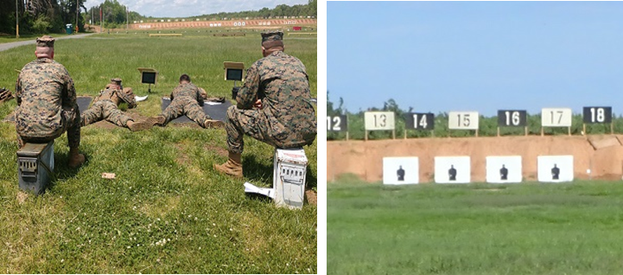
KNOWN DISTANCE AUTOMATED SCORING (KDAS)
KNOWN DISTANCE AUTOMATED SCORING (KDAS)
RTS PROGRAMS
Program Picture
Program Description
Requirements:
MROC DM 18-2018 (Ranges and Training Area Management (RTAM) Family of Systems CDD)
KDAS Annex to RTAM CDD 27 Dec 22
Description: The KDAS system provides real time target scoring by detecting and reporting the location of a bullet impacts on the target to within 5-12mm accuracy. These capabilities expedite annual rifle marksmanship qualifications (ARQ) by reducing time spent in the pits, providing rapid and accurate feedback to the shooters, and minimizing delays due to human error.
AAO Quantity:
20 Known Distance Automated Scoring (KDAS) Systems
Program Status
Upcoming Events
ACAT and Date of Designation: AAP May 2023
MDA/PDA: PM TRASYS
Date of most recent APB: N/A
IOC/FOC Dates: Q4FY26 / Q3FY30
Accomplishments
Market Research OTA reviews completed November 2024.
Planned Events | Date
Test Readiness Review (TRR) | Q2FY25
In Plant Acceptance Test (IPAT) | Q3FY25
End User Evaluation (EUE) | Q3FY26
UNCLASSIFIED

Slide 14
RTS PALT SLIDE
RTS PROGRAMS
RTS
 | Acquisition Approach | FY25 | FY26 | FY27 | FY28 | FY29 | FY30
Strategic Planning | Focus priorities include modernization efforts of Range Training systems that incorporates improved instrumentation (enhanced feedback / scoring), after action review technologies, new generation target systems / threat representations, denied / degraded environments, expanded military operations in urban terrain capabilities, and immersive training environments.
Force-on-Force Training Systems – Next (FoFTS-N) | Major Capabilities Pathway
Trackless Mobile Infantry Target (TMIT) | Major Capabilities Pathway
Electronic Warfare Ground Instrumented Ranges (EWGIR) | TBD
Live Fire Evaluation Tool (LFET) | TBD
Known Distance Automated Scoring (KDAS) | Major Capabilities Pathway
MCTIS –WS OTAs
MCTIS –WS Production Contracts
MCTIS Production and CLS
MCTIS Follow-on
KBTS
Trackless Mobile Infantry Target (SAIDIQ)
Proofs of Concept
KBTS
Development
Requirements Development
Development Contract
OTA
Market Research
OTA
Pending Requirement
Existing Contract
Future Effort/Contract
UNCLASSIFIED

Slide 15
Synthetic training systems
UNCLASSIFIED
Elizabeth Tygart
Product Manager
Synthetic Training Systems
UNCLASSIFIED

Slide 16
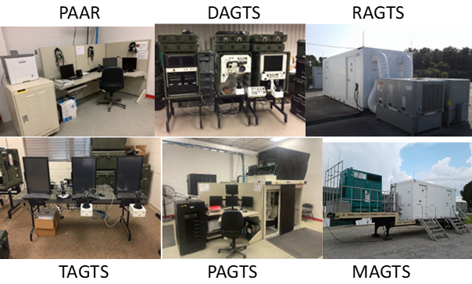
STS PROGRAMS
COMBAT VEHICLE TRAINING SYSTEM (CVTS)
Program Picture
Requirements Documents:
Mission Needs Statement (MNS) NO. TNG 1.14 dated 12 OCT 1993
Operational requirement Document (ORD) for CVTS dated 16 JAN 2002
LAV-25 Training Support Division dated 16 JAN 2003
Force Design for CVTS 2030 released Mar 2020
RTPD Letter of Clarification dated 14 APR 23
Description: CVTS is a high-fidelity advanced level gunnery trainer used to train Light Armored Reconnaissance (LAR) and Assault Amphibian Battalions. It provides individual, crew, section, and platoon training in perishable precision gunnery skills. LAV-25 Army’s Gunnery Training Systems (AGTS) is a required gate-to-live-fire per T&R manuals for LAR and AAV. System was procured using AGTS contract with Lockheed Martin and it shares a hardware baseline with the Army. AAV-TTs were procured via local PM TRASYS contract with Wegmann.
AAO Quantity: AAV-TT: 0 LAV-25 AGTS: 35
Program Funded to AAO: Yes
IED: 2035
ACAT and Date of Designation: POST ACAT (sustainment)
MDA/PDA: PM TRASYS
Date of most recent APB: 23 OCT 2013
IOC/FOC Dates: FY03/FY08
Accomplishments:
Completed contract close out activities with PEO STRI
DO4 Award for CVTS PDSS on 28 NOV 2024
Completion if In Service Review (ISR)
Approval of Circuit Breaker ECP (sustainment)
Approval of TOECR 546175 to change LAV-25 AAO from 42 to 35
Approval of TOECR 508835 to change AAV AAO from 6 to 0
Issues:
Waiting on approval of TOECR 553955 add Guam requirements of 2 (FY27)
Relocation of MAGTS from 1st LAR to SOI W
Relocation of all RAGTS, PAAR and MAGTS at 29 Palms from bldg. 1707 to bldg. 1239
Potential relocation DAGTS to Camp Fuji (3rd LAR)
Renewal of expired license plates
Event | Date
DO 4 PDSS IPAT | Dec 2024
DO 4 PDSS OSAT | Jan 2025
DO 4 PDSS Delivery and Install | Feb 2025
DO 5 Concurrency Upgrades Award | FY25Q3
TAGTS Disposal | Nov 24 – Jan 25
AAV-TT Disposal | Nov 24 – Jan 25
LAV-25 AGTS Guam/Tech Refresh | FY26Q1 – FY29
UNCLASSIFIED

Slide 17
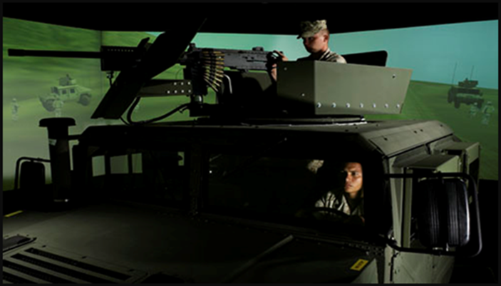
STS PROGRAMS
COMBAT CONVOY SIMULATOR (CCS)
Program Picture
Requirements Documents:
AAP Designation May 2016
MDD for CCS July 2016; MS C Jun 2017
ADM / Fielding Decision for CCS signed Dec 2020
FOC Letter signed Jun 2022
Description: CCS is an immersive training environment for convoy operations and TTPs. CCS provides training for vehicle operators and individuals in vehicle and small arms weapon utilization, C2 procedures, IED attacks, ambush attacks, evolving enemy tactics, response, and countermeasures.
AAO Quantity: 8
Program Funded to AAO? Guam (pending)
IED: 2030 in TFSMS
ATO: Current Windows 10 baseline expires 30 Jan 2026
UNCLASSIFIED
ACAT and Date of Designation: AAP 5 May 2016
MDA/PDA: PM TRASYS
Date of most recent APB: 20 May 2020
IOC/FOC Dates: Oct 2020 / Jul 2021 fielded (letter signed May 2022)
Accomplishments:
Weapons Currency: Replace M16s with M4s
M4 replacement complete at CLNC, 29 Palms, and Okinawa
M4 replacement on-going at CPEN
M4 replacement planned for KBAY upon inventory of weapons
Windows 11 Upgrade / Red Hat Enterprise Linux (RHEL) Upgrade:
Installation complete at all USMC and Navy locations
Issues:
Awaiting Guam fielding date change TOECR for FY27 and fielding configuration
Technology Refresh for fielded systems uncertainty with pending IED extension past 2030 IED
Event | Date
CLS OY1 Award | Awarded 31 Oct 2024
PDSS OY1 Award | Awarded 31 Oct 2024
PDSS Navy Funding Mod | 15 Dec 2024
CCS Guam/Tech Refresh | FY26Q4 – FY29
UNCLASSIFIED

Slide 18
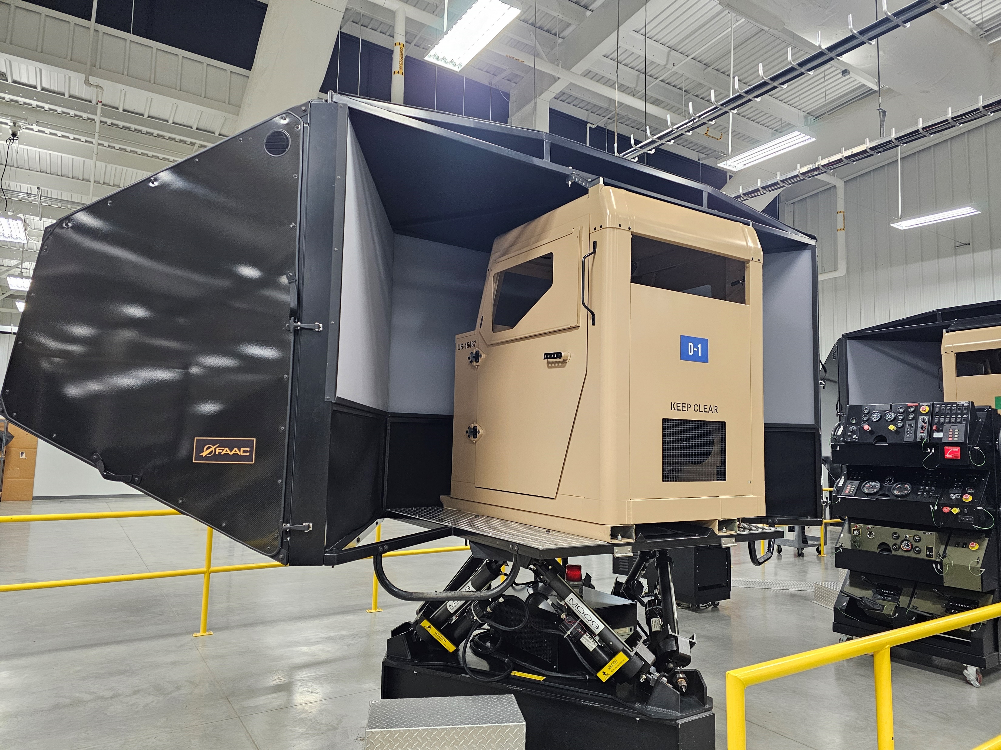
STS PROGRAMS
OPERATOR DRIVER SIMULATOR (ODS)
Program Picture
Program Description
Requirements Documents:
CPD for ODS 24 Nov 2010
CRC for MCDT 16 Mar 2020
RTPD Letter of Clarification for MCDT14 Apr 2023
CRC for MCDT 15 Jun 2023
LOT for MCDT 6 Mar 2024
Description: Operator Driver Simulator (ODS) is a computer-based driver simulator used to provide entry and sustainment level operator familiarization training and all incidental drivers. It provides student operators with immersive and realistic experiences in operating the selected vehicle on and off road in multiple training scenarios.
AAO Quantity: Required: 52 (48/4); Fielded: 52 (48/4)
Program Funded to AAO? Yes, MCDT Terminated and ODS IED extended to 2035
IED: ODS/LAV-DT is 2035; MCDT Terminated
Program Status
Upcoming Events
ACAT and Date of Designation: ACAT IV (M) 19 Apr 2012
MDA/PDA: PM TRASYS
Date of most recent APB: 15 Mar 2012
IOC/FOC Dates: 2007/2013
Accomplishments:
Contract Closeout in process
Government obtaining 30 non-conforming systems
Issues:
Materiel and Training Obsolescence (COA Brief TBD Nov 2024)
LAV-DT ATO
Event | Date
Non-conforming Goods Delivery | Q1FY25
ODS COA Brief | Q1FY25
ISR | Q3FY25
ODS ATO | October 2025
ODS Recompete | April 2026
UNCLASSIFIED

Slide 19
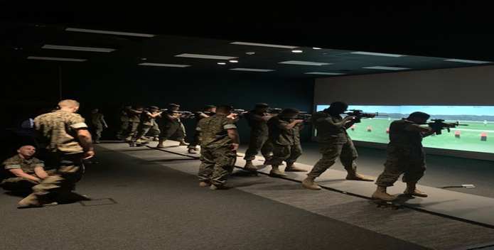
STS PROGRAMS
INDOOR SIMULATED MARKSMANSHIP
TRAINER (ISMT)
Program Picture
Program Description
Requirements:
CPD for ISMT 13 Sept 2011
LOC for ISMT 22 Feb 2017
CRC for ASALT 12 Aug 2021
RTPD Letter of Clarification dated 14 Apr 2023
CRC for ISMT 6 June 2023
Description: The ISMT is an interactive audio/video simulator that provides training in marksmanship, weapons employment, indirect fire, and tactical decision-making. The Advanced Small Arms Lethality Trainer (ASALT) will enhance confidence and proficiency with Marines shooting on the move while engaging multiple moving targets.
AAO Quantity: ISMT Required: 225; Fielded: 474; ISMT Divestment from 474 to 225 in progress. ASALT Required: 9; Fielded: 4
Program Funded to AAO? No; Shortfalls to meet ASALT AAO and CLS
IED: Sept 2035
ATO: Expires May 2027
Program Status
Upcoming Events
ACAT and Date of Designation: IV(M) Oct 2013
MDA/PDA: PM TRASYS
Date of most recent APB: 13 Mar 2014
Date of most recent ADM: 26 June 2023 (Return to Sustainment)
IOC/FOC Dates: Apr 2007/Dec 2007
Accomplishments:
OTA VR Javelin Prototype complete (No SUTTS)
Fielded MAAWS
ISMT night shooting assessment with WTBn (complete, capable)
Alignment with MCSC System Safety (Blast over pressure WRT TBI WG)
Issues:
CLS sustainment costs and system re-allocations (CLNC)
Funding to continue ASALT Marksmanship assessment
LVC-TE integration requirements.
Affordability for Nine (9) ASALTs
Event | Date
Recruit Depot ARQ Dry Run (Edson) | Nov 2024
New York Times MAAWS Demo CLNC | Nov 2024
M320/60mm mortar Deliveries | Dec 2024
ISMT Tech Refresh | FY25Q4
UNCLASSIFIED

Slide 20
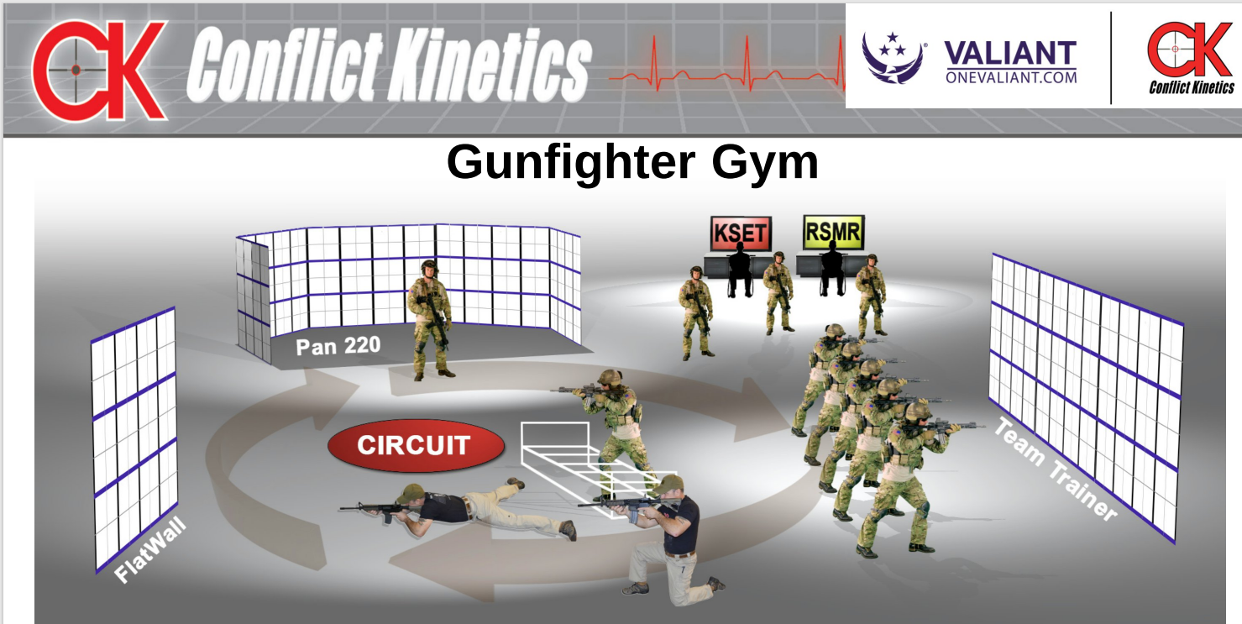
STS PROGRAMS
ADVANCED SMALL ARMS LETHALITY TRAINER (ASALT)
Program Picture
Program Description
Contract utilizes Training as a Service (TaaS) approach
ASALT addresses gaps listed in Marine Corps Rifle Marksmanship Lethality CBA 2018
Weapons Training Battalion and Naval Health Research Center performance analysis effort (ongoing)
ASALT has more advanced ballistics and performance metrics than current USMC simulators
Initial weapons include M18, M4, M27, M240
IMA and Night Shooting (Supports TECOM Marksmanship Campaign Plan)
Contract awarded to Valiant Global Defense Services, Inc. on 15 Sept 2023. Conflict Kinetics is subcontractor.
Program Status
Upcoming Events
Period of Performance (PoP) Proposed: Three Years
Base: FY23 Sept 2023 – June 2024
Option 1: FY24 June 2024 – June 2025
Option 2: FY25 June 2025 – June 2026
Contract Management/Oversite:
ASALT COR: Todd Butler
Acquisition Project Manager: Todd Butler
Locations:
Active Sites – CPEN, 29 Palms, CLNC, SOI-East
FY25 Planned Sites – SOI West, Okinawa
TBD Sites – Hawaii, Quantico, Guam, 5th Marines
Event | Date
ASALT Site Survey Camp Barrett | 6 Nov 2024
ASALT Site Survey 5th Marines CPCA | Nov 2024
ASALT Site Survey Okinawa | Dec 2024
SOI West and Okinawa Fielding | Jun 2025
ASALT Service Contract Award | FY26Q3
UNCLASSIFIED

Slide 21
FAMILY OF EGRESS TRAINERS (FET)
STS PROGRAMS
Program Picture
Program Description
Description: The FET portfolio consists of multiple Underwater Egress Training (UET) devices and Dry Rollover Egress Training Devices (DRET). These devices represent ground and amphibious vehicles as well as rotary and tilt-rotor aircraft platforms. Marines train in these devices in order to increase chances of survivability in a vehicle/platform roll-over event in dry and wet (submerged) conditions.
AAO Quantity: 67 Required; 67 Fielded (26 DRET/41 UET)
Current Locations: CLNC, CPEN, Okinawa, Kaneohe Bay, HI, Yuma, 29 Palms
Planned Locations (FY25): CPEN (Del Mar) and Camp Blaz, Guam
Program Funded to AAO? Yes
Program Status
Upcoming Events
ACAT and Date of Designation: ACAT IV (M), 03 November 2014
MDA/PDA: PM TRASYS
Date of most recent APB: 02 September 2014
IOC/FOC Dates:
FOC Attainment
MAET Aug 2008 SWET Aug 2008
HEAT Oct 2010 SVET Jun 2011
MET Jul 2012 JET Jun 2020
Accomplishments
Preliminary Design Review for MUET complete.
Issues
Need AAO changes and funding aligned to support increase of 3 JETs (2 CPCA / 1 GUAM) and MET reduction
Sustainment of XGH & Structures (i.e. when to take Horno, HI offline)
Event | Date
FOC Attainment | MAET Aug 2008 SWET Aug 2008 HEAT Oct 2010 SVET Jun 2011 MET Jul 2012 JET Jun 2020
Next ILA | Nov 2024
Item Exit Date | HEAT May 2030 SWET Dec 2026 SVET Dec 2030 MET Dec 2030 MAET Jan 2031 JET Dec 2035
UNCLASSIFIED

Slide 22
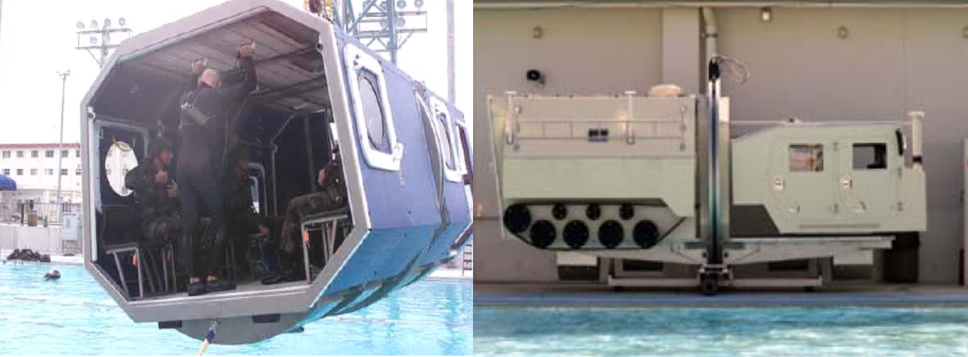
MULTI-USE EGRESS TRAINER (MUET)
STS PROGRAMS
Program Picture
Program Description
Requirements:
MROC CPD for Multi-Use Egress Trainer (MUET) 2011
CRC for Family of Egress Trainers (FET) 2022
Description: MUET is a one for one replacement of the existing SVET which replicates the HMMWV cab and AAV troop compartment. The MUET will replicate the ACV, JLTV and LAV and will be employed as a training support capability designed to enhance water survivability as a part of egress training. The MUET will support the training and possibly improve student survivability and support the instruction on the fundamentals of water survival.
AAO Quantity: 6 Required; 0 Fielded
Current Locations: CLNC, CPEN, Okinawa, Kaneohe Bay, HI,
Planned Locations (FY25): CPEN (Del Mar) and Camp Blaz, Guam
Program Funded to AAO? Yes
Program Status
Upcoming Events
ACAT and Date of Designation: AAP, October 2022
MDA/PDA: PM TRASYS
Date of most recent APB: N/A
IOC/FOC Dates:
IOC for threshold: Q3FY27
FOC: TBD
Accomplishments
NAWCTSD Product Line Management IDIQ DO#063 awarded 19 Sep 2023.
PDR closed out Jun 2024
Approved ECP relieving the program of the LAV requirement
Sole Source RFP Release 1 Nov (1 year ahead of schedule)
Issues
Behind OSD benchmarks
Event | Date
MS B | Oct 2023
SRR | Mar 2024
PDR | May 2024
CDR | Jul 2024
Procurement Award | FY25Q2
MS C | Dec 2024 (planned)
Fielding Decision | TBD
UNCLASSIFIED

Slide 23
STS PROGRAMS
STS PALT SLIDE
 | Acquisition Approach | FY25 | FY26 | FY27 | FY28 | FY29 | FY30
Strategic Planning
ODS | MCA - Operations and Sustainment
CVTS | MCA - Operations and Sustainment
ISMT | MCA - Operations and Sustainment
CCS | MCA - Operations and Sustainment
FET | MCA – Production and Deployment
MTWS | MCA - Operations and Sustainment
SAVT | MCA - Operations and Sustainment
DVTE | MCA - Operations and Sustainment
MCVP | TBD
LVC-TE | SWP – Execution Phase
MACCS | TBD
Extended support required for legacy programs pending new requirements
LVC-TE portfolio of programs transferred to Transition Team
Closeout
ODS Tech Refresh
LAV-25 PDSS
LAV-25 Contract (Guam)
LAV-25 Tech Refresh
ASALT Service Contract
ASALT Service Contract
ISMT Tech Refresh
CCS Contract (Guam)
Tech Refresh
MUET Production Contract
PDSS
MTWS LOS
SAVT LOT
SAVT Disposal Actions
PDSS
Joint Staff – J7 / Joint Live Virtual Constructive Architecture
LVC – Service Contract
Pending Requirement
Existing Contract
Future Effort/Contract
UNCLASSIFIED

Slide 24
Warfighter Training Support
LtCol Marcial Garcia
Product Manager
Warfighter Training Support
UNCLASSIFIED

Slide 25
WTS PROGRAMS
TOP-LEVEL ITEMS
Purpose of PdM Warfighter Training Support (WTS):
To provide professional, effective, and efficient support of fielding, sustainment, and disposal activities across the globe to ensure regional resources, relationships, and Marine Corps priorities are integrated into the complete acquisition life cycle of PM TRASYS products and services.
WTS Focus of Effort:
PdM WTS is an enabler for PM TRASYS (PdM STS & PdM RTS) and TECOM’s RTPD
Manages specific sustainment efforts to enable PdM STS/RTS to focus on emerging program needs
Provides liaison between regional stakeholders and PdM STS/RTS during planning and execution
Supports PdM STS/RTS fielding & disposal planning & execution.
PdM WTS manages all forward-positioned, on-site PM TRASYS representation
Training Liaison Officers (TLOs) provide the foundation of this support
TLOs are MARCORSYSCOM employees located in Quantico, CLNC, CPEN, 29P, MCBH, and Okinawa ; Guam TLO stand-up in Q1/2025
Program Support (Fielding, Supervision, Disposition)
Sustainment Contract Surveillance (A-COR)
Incident Management & Reporting
PdM WTS focuses principally on OMMC appropriation aligned with sustainment and training support services for the PM TRASYS portfolio
UNCLASSIFIED

Slide 26
WTS PROGRAMS
WTS DISTRIBUTION OF LABOR
Regional Support Group (RSG) – Mr. Adam Emanuel
Ground Training Systems Support (GTSS)
GTSS- East
GTSS- West
GTSS- OCONUS
Ground Range Sustainment Program (GRSP) &
Range Training Systems Projects (RTSP)
GRSP / RTSP- East
GRSP / RTSP- West
GRSP/RTSP- OCONUS
RTAM Support Contracts – (RTPD CORs)
Range Manager’s Toolkit (RMTK)
Range Training Area Management (RTAM) Military Operations (MILOPS)
Range Control Facilities (RCF)
Training Support Center (TSC)
Global Support Group (GSG) – Mr. Tim Bergland
Equipment Related Services – Systems (ERS-S)
Indoor Simulated Marksmanship Trainer (ISMT)
Dry Rollover Egress Trainers (DRET)
Operator Driver Simulator (ODS)/Marine Common Driver Trainer (MCDT)
Combat Vehicle Training System (CVTS)
Combat Convoy Simulator (CCS) USMC/Navy
Electronics Communication Services (ECS) – (STS CORs)
Deployable Virtual Training Environment (DVTE)
Indoor Simulated Marksmanship Trainer (ISMT)
Combat Convoy Simulator (CCS) USMC/Navy
MAGTF Training System Support (MTSS)
Battle Sim Center
MAGTF Staff Training Program
MCLOG & Others
TMIT
ASALT
Underwater Egress Trainer (UET)
Contracted Logistics Support
Role Players Support
Home Station Training (HST) &
Infantry Immersive Trainer (IIT)
Subject Matter Expert (SME) Support Services
GRSP/
RTSP
RSG
GSG
UNCLASSIFIED

Slide 27
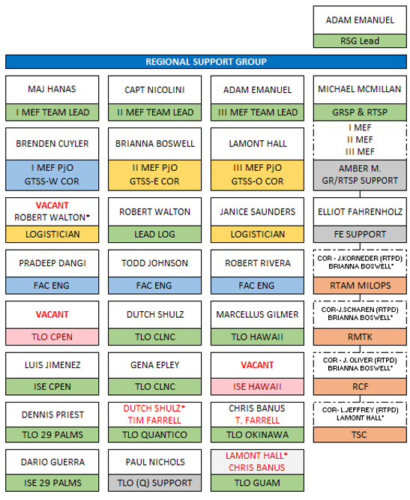
WTS PROGRAMS
WTS DISTRIBUTION OF LABOR
Regional Support Group (RSG) – Mr. Adam Emanuel
Ground Training Systems Support (GTSS)
GTSS- East
GTSS- West
GTSS- OCONUS
Ground Range Sustainment Program (GRSP) &
Range Training Systems Projects (RTSP)
GRSP / RTSP- East
GRSP / RTSP- West
GRSP/RTSP- OCONUS
RTAM Support Contracts – (RTPD CORs)
Range Manager’s Toolkit (RMTK)
Range Training Area Management (RTAM) Military Operations (MILOPS)
Range Control Facilities (RCF)
Training Support Center (TSC)
UNCLASSIFIED

Slide 28

WTS PROGRAMS
GROUND TRAINING SYSTEMS SUPPORT (GTSS)
The GTSS Contractor Logistics Support (CLS) personnel provide sustainment support for ground training systems at USMC bases, stations and training centers. The services provided include: system operations, supply services, maintenance, inventory management, training, and instruction for ground training environments.
Supported Locations
• GTSS- West: Principally Supports I MEF
California, Nevada, Arizona
• GTSS- East: Principally Supports II MEF & HQMC
North Carolina, South Carolina, Virginia, Georgia
• GTSS- OCONUS: Principally Supports III MEF
Hawaii, Japan, Guam
Challenges:
• Variation of Stakeholder Perspective (RTPD, Base, TRASYS)
• Configuration Management as routinely added training assets from Ground Range Sustainment Program (GRSP) and Range Training Systems Projects (RTSP)
Successes:
• WTS’s reformed approach with ‘Regional Support Group’ improves focus on regional stakeholders and contract nuances ; regional contract approach improves right-size management and risk/reward for this critical capability (must-pay)
• WTS’s assumption of the GRSP/RTSP program for PM TRASYS provides better alignment and awareness to ensure sustainment of these items
Milestone Name | Key Dates
GTSS-W (NAWC-TSD 2024-2028)
Task Order (OY1) Award by NAWC-TSD | CR - 28 Oct 2024
GTSS-E (MCSC / PM TRASYS through 2026)
Next Task Order (OY2) Award by PM TRASYS | Mar 2025
GTSS-OCONUS (MCSC / PM TRASYS transition)
Next Task Order (OY1) Award by NAWC-TSD | Mar 2025
UNCLASSIFIED

Slide 29
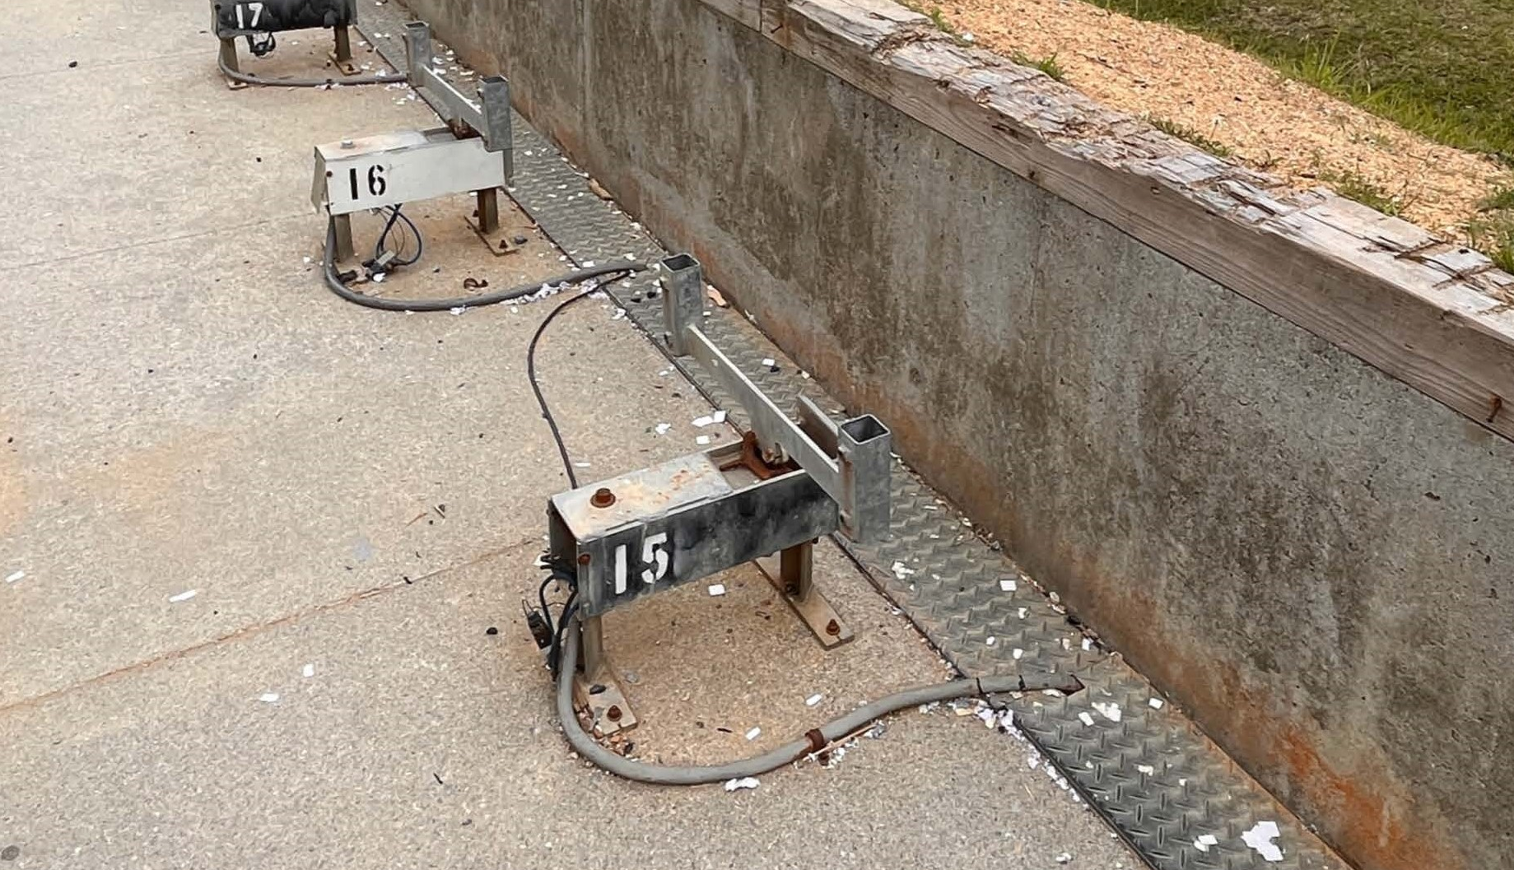
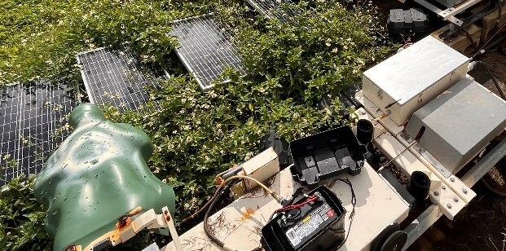
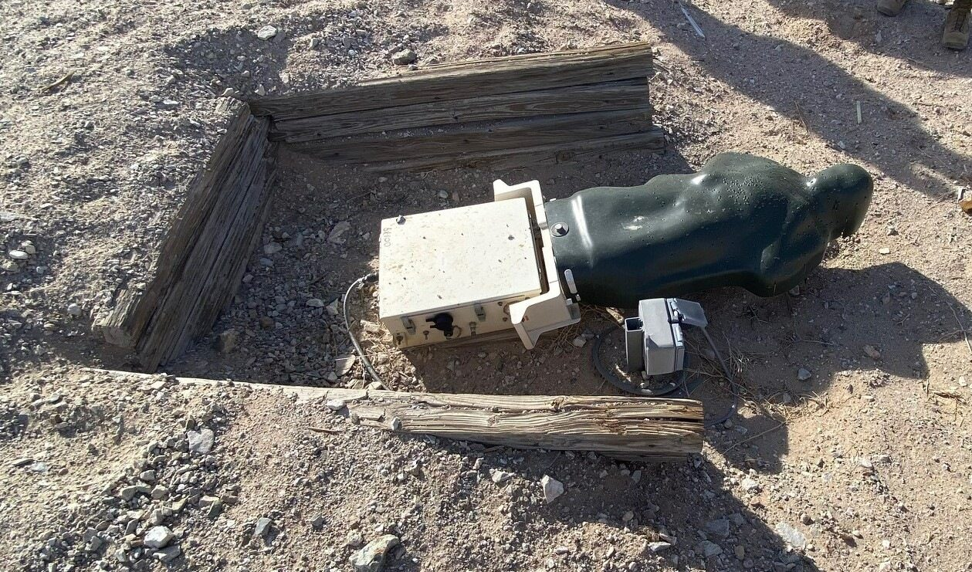
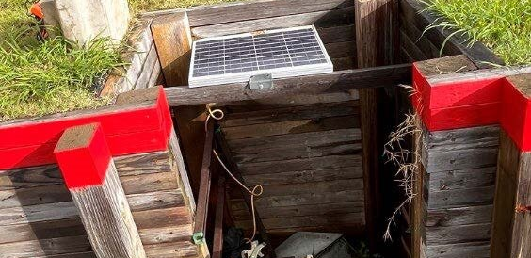
WTS PROGRAMS
GRSP/RTSP
Execution of RTSP projects, using O&MMC and PMC funds managed at the institutional level. The cost of materials and installation for GRSP projects will not normally exceed $250,000, while RTSP projects generally start at $250K.
Examples of projects include target lifters, worn targets, and range control equipment that cannot be accomplished within existing O&MMC budgets.
RTSP/GRSP are managed by RTPD.
Challenges:
Process requires constant interaction with stakeholders to define project scope and contributions by various agencies.
Successes:
Enhanced organization and communication with stakeholders, including RTPD.
Increased output of funded projects.
Process in development outlining GRSP/RTSP procurement activities.
Project Name | Key Dates
Lejeune AR-500 EFSATs | 1st QTR 2025
Okinawa R3 (Hansen) & R14 (Schwab) Range Carriage Replacements (Corona) | 2nd QTR 2025
Parris Island Target Carriages | 1st QTR 2025
Kaneohe Bay PITs | 2nd QTR 2025
Quantico WTBN R3 Target Carriages | 2nd QTR 2025
Quantico R15/8 EFSAT Target Replacement | 1st QTR 2025
Pendleton EMAT Replacement | 1st QTR 2025
X-MIT Controller | 1st QTR 2025
R1A 29 Palms PITS, Target Coffins, Battery Charger | 2nd QTR 2025
Quantico PIT ATS Target Replacement | 1st QTR 2025
UNCLASSIFIED

Slide 30

WTS PROGRAMS
RTAM MILOPS
The objectives of this contract is as follows: “The contractor shall evaluate, update and maintain the MILOPS GIS feature classes for use in all three (3) primary USMC enterprise business systems; GIS, Range Facilities Management Support Systems (RFMSS). During the length of the period of performance, the contractor shall support the range control offices with daily GIS products. The contractor shall produce cartographic products that leverage the investment in MILOPS data, primarily through daily support and the production of MIM and MIMICS map documents. The contractor will synchronize the validated data entries for conformity to policy and standards. Once verified, all necessary information is to be reported for inclusion in Property Record Cards (PRCs).
Awarded 15 Jul 2024 , PoP 15 September 2024 to March 14 2025.
Milestone Name | Key Dates
Award Date (6mo) | 15 Jul 2024
TO Start | 15 Sep 2024
Next Award Date | Feb 2025
Current TO End | 14 Mar 2025
UNCLASSIFIED

Slide 31
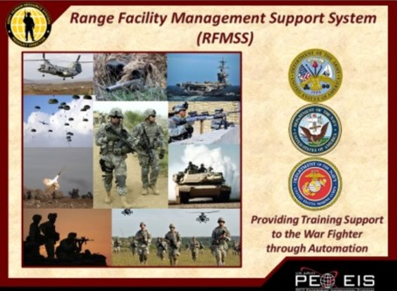
WTS PROGRAMS
RCF
Range Control Facilities (RCF) services for Range Facility Management Support System (RFMSS) support (administration, scheduling, fire desk, reports, GIS data); Integrated Range Status System (IRSS) services that prioritize and deconflict training requests, monitor real-time range activity, capture range status changes in real time, and collect range utilization data for TECOM RTPD.
Second 9-month incremental funding was awarded 23 May 2024 for $5,535,433
Milestone Name | Key Dates
Incremental funded awarded | 23 May 2024
PoP Start | 2 Apr 2024
PoP End | 2 Apr 2025
UNCLASSIFIED

Slide 32
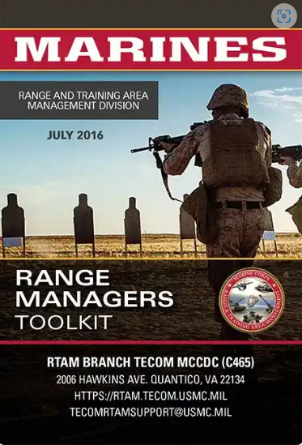
WTS PROGRAMS
RMTK
RMTK provides support for the update and development of 14 range safety tools in a desktop, web, and mobile environment for the range safety integration of new bombs and bullets. Provides venues for the sustainment and interoperability (changes to existing data). Provides a method to integrate range safety parameters into the tools and ensure all Service requirements are met. Allows the USMC to manage the tools with current industry best practices and recommendations. Will ensure that the RMTK tools run in the authoritative USMC GIS geospatial environment.
Tools are used by FMF, Range Controls, RTAM, All Services, and Foreign Military Sales (FMS) customers
The current TO was awarded in Nov 2023 for $1,991,166 for 12 months. *planning on incrementally funding next TO for 3 months
PM TRASYS will pick this contract up when the current TO ends in Nov.
PPC planned for 23 Sept 2024
Milestone Name | Key Dates
Current TO ends | 20 Nov 2024
PPC | 23 Sept 2024
Funding in House | 1 Oct 2024
Award | 20 Oct 2024
Next TO Start | 21 Nov 2024
UNCLASSIFIED

Slide 33

WTS PROGRAMS
RTPD - TSC
Delivers analytical, document development, and administrative services to support the U.S Marine Corps (USMC) Training and Education Command (TECOM), Training Support Centers (TSC) as they improve TECOM support to home station training by helping training units properly access and employ TECOM-funded training enablers and assist with unit training/exercise planning, document development and execution aboard Marine Corps installations and other training sites.
Awarded 24 Jun 2022
Contract expires 29 Dec 2025 (Base + 3 Options)
2d Option expires 29 Jun 2025
Modifications:
None
Other:
Project Officer duties transferred from Nate Webster to Lamont Hall (NSWC Panama City)
External COR – Lance Jeffrey (TECOM/TSC)
Option Milestone Name | Key Dates
Notification of Intent to Exercise Option Year 3 | 4/29/2024
Contract Award OY3 (LAST - $2.8M) | 5/30/2024
Re-Compete Milestone Name | Key Dates
PPC | 09/19/2024
Contract Award | 10/2025
UNCLASSIFIED

Slide 34
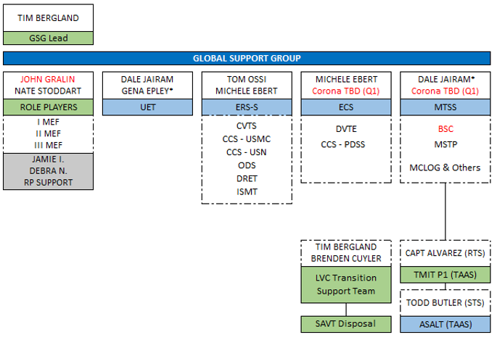
WTS DISTRIBUTION OF LABOR
Global Support Group (GSG) – Mr. Tim Bergland
Equipment Related Services – Systems (ERS-S)
Indoor Simulated Marksmanship Trainer (ISMT)
Dry Rollover Egress Trainers (DRET)
Operator Driver Simulator (ODS)/Marine Common Driver Trainer (MCDT)
Combat Vehicle Training System (CVTS)
Combat Convoy Simulator (CCS) USMC/Navy
Electronics Communication Services (ECS) – (STS CORs)
Deployable Virtual Training Environment (DVTE)
Indoor Simulated Marksmanship Trainer (ISMT)
Combat Convoy Simulator (CCS) USMC/Navy
MAGTF Training System Support (MTSS)
Battle Sim Center
MAGTF Staff Training Program
MCLOG & Others
TMIT
ASALT
Underwater Egress Trainer (UET)
Contracted Logistics Support
Role Players Support
Home Station Training (HST) &
Infantry Immersive Trainer (IIT)
Subject Matter Expert (SME) Support Services
UNCLASSIFIED

Slide 35
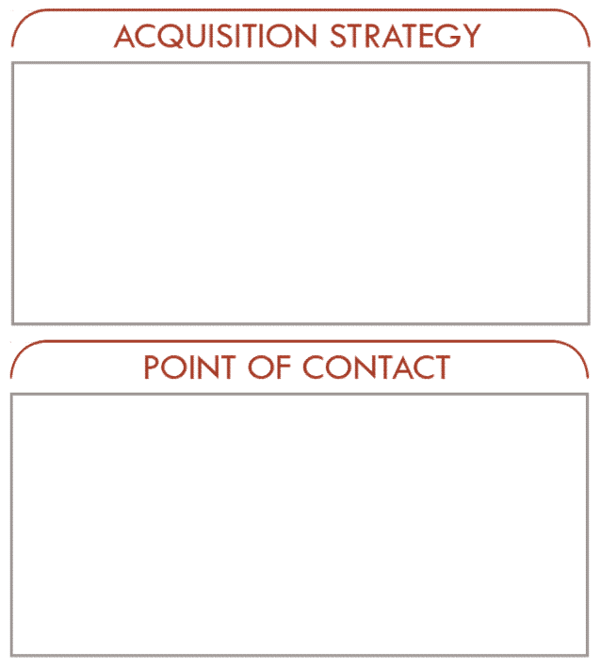
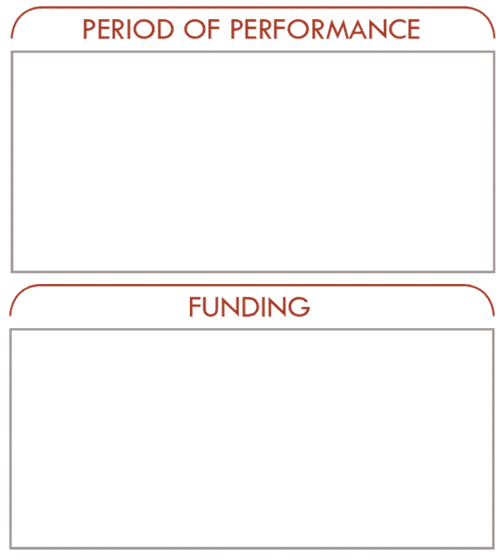
WTS PROGRAMS
TRASYS MULTIPLE AWARD CONTRACT: ERS-S
Equipment Related Services – Systems (ERS-S)
Description/Summary of Program Requirements
PM TRASYS awarded a Multiple Award Contract (MAC) in March of 2021 that is primarily aligned with the ERS Service Portfolio Group within DoD’s Taxonomy of Services. The ERS-S MAC scope is intended to be broad in nature and entails sustainment support for existing and future USMC training systems. Scope includes maintenance, logistics and training requirements. Systems supported under this contract are relatively complex items of training equipment, using electronic/mechanical means to reproduce conditions necessary for an individual or a crew to rehearse operational tasks.
Current Vendors
Ahtna
Guard Unit
Hatalom
Shock Stream
Small Business Competition
Multiple Award Contracts for the same or similar services
MAC: 29 March 2021 – 28 March 2031
Five-year base
Five one-year options
(1st option Mar 2024)
Supported Programs
LAV-DT | ISMT
ODS | CVTS
DRET | USMC & USN CCS
PM TRASYS
Phone: 407-381-8762
Email:pmtrasys@usmc.mil
Shared ceiling $249M
UNCLASSIFIED

Slide 36
WTS PROGRAMS
TRASYS MULTIPLE AWARD CONTRACT: ECS
Electronics and Communication Services (ECS)
Description/Summary of Program Requirements
PM TRASYS awarded a Multiple Award Contract (MAC) in August of 2021 that is primarily aligned with the ECS Service Portfolio Group within DoD’s Taxonomy of Services. The ECS MAC will include sustainment support for Post Deployment Software Support, On-going Software Development and Cybersecurity. Systems supported under this contract are relatively complex items of training equipment, using software applications to represent conditions of combat operations necessary for multiple echelons of training.
Current Vendors
AVT Simulations
Choisys Technology
Corps Simulation & Cyber Solutions
Dignitas Technologies
Engineering & Computer Simulations
Envision Innovative Solutions
Tactical Edge
Small Business Competition
Multiple Award Contracts for the same or similar services
MAC: 27 August 2021 – 26 August 2031
Five-year base
Five-one year options
(1st option Feb 2026)
PM TRASYS
Phone: 407-381-8762
Email:pmtrasys@usmc.mil
Shared ceiling $238M
UNCLASSIFIED

Slide 37
WTS PROGRAMS
TRASYS MULTIPLE AWARD CONTRACT: MTSS
MAGTF Training Systems Support (MTSS)
Description/Summary of Program Requirements
PM TRASYS awarded a Multiple Award Contract (MAC) in March of 2019 that is primarily aligned with the Knowledge Based Services Portfolio Group within DoD’s Taxonomy of Services. The MTSS MAC is structured for maximum flexibility, providing an expedited ordering process to procure knowledge-based services to satisfy training and education requirements for MARCORSYSCOM training support requirements.
Current Vendors
American Systems Corp
Calibre Systems
Valiant Global
Solutions Through Innovative Technologies
Science Applications
Corps Solutions
Obsidian Solutions
Multiple Award Contracts (MAC) for the same or similar services
Looking at SEAPORT and/or ACC-APG RS3 for near-term, follow-on supplements
MAC: 20 March 2019 – 19 March 2029
Task Order durations vary, typically 1 year
PM TRASYS
Phone: 407-381-8762
Email:pmtrasys@usmc.mil
Shared ceiling $245M
Currently Planned Obligations Reach Ceiling in 2027
UNCLASSIFIED

Slide 38

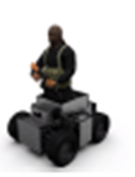

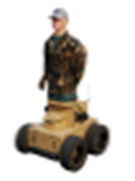
WTS PROGRAMS
MTSS: TRACKLESS MOBILE INFANTRY TARGETS (TMIT)
The TMIT Knowledge Based Training Services (KBTS) effort provides SMEs, targets, scenario planning and design, training concepts, operations and support, and AAR capabilities. TMITs are semi-autonomous, human-like, live fire robotic targets that provide realistic characteristics of a "thinking" opposing force.
TMIT locations include:
MCB Camp Lejeune, NC
MCAGCC Twentynine Palms, CA
MCB Camp Pendleton, CA
MCB Hawaii
MCB Okinawa, Japan
MCB Quantico, VA
Current Contract: “TMIT Step 1”
Base- 30 Mar 22- 19 Mar 23
OY1- 20 Mar 23-19 Mar 24
OY2- 20 Mar 24- 19 Mar 25
Upcoming Contract Actions-
No planned contract actions at this time beyond contract closeout.
Milestone Name | Key Dates
TMIT Step 1 OY2 Award (2mo increment) | 2/20/2024
TMIT Step 2 Anticipated Award | 11/26/2024
TMIT Step 1 End of Contract | 03/19/2025
UNCLASSIFIED

Slide 39
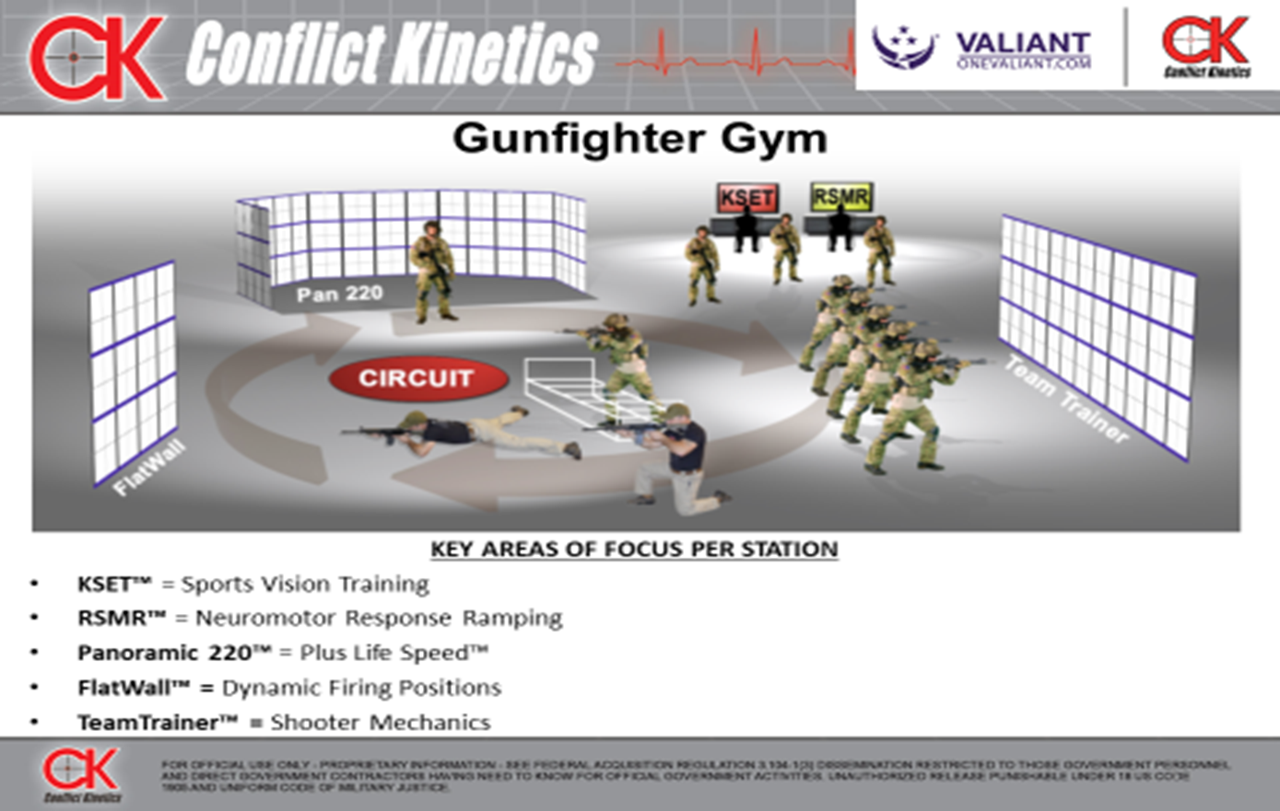
WTS PROGRAMS
MTSS: ADVANCED SMALL ARMS LETHALITY TRAINER (ASALT)
Contract utilizes Training as a Service (TaaS) approach
ASALT addresses gaps listed in Marine Corps Rifle Marksmanship Lethality CBA 2018
Weapons Training Battalion and Naval Health Research Center performance analysis effort (ongoing)
ASALT has more advanced ballistics and performance metrics than current USMC simulators
Initial weapons include M18, M4, M27, M240
IMA and Night Shooting (Supports TECOM Marksmanship Campaign Plan)
Contract awarded to Valiant Global Defense Services, Inc. on 15 Sept 2023. Conflict Kinetics is subcontractor.
Period of Performance (PoP) Proposed: Three Years
Base: FY23 Sept 2023 – June 2024
Option 1: FY24 June 2024 – June 2025
Option 2: FY25 June 2025 – June 2026
Contract Management/Oversite:
ASALT COR: Todd Butler
Acquisition Project Manager: Todd Butler
Locations:
Active Sites – CPEN, 29 Palms, CLNC, SOI-East
FY25 Planned Sites – SOI West, Okinawa
TBD Sites – Hawaii, Quantico, Guam, 5th Marines
Event | Key Dates
ASALT Site Survey Camp Barrett | 6 Nov 2024
ASALT Site Survey 5th Marines CPCA | Nov 2024
ASALT Site Survey Okinawa | Dec 2024
SOI West and Okinawa Fielding | Jun 2025
UNCLASSIFIED

Slide 40
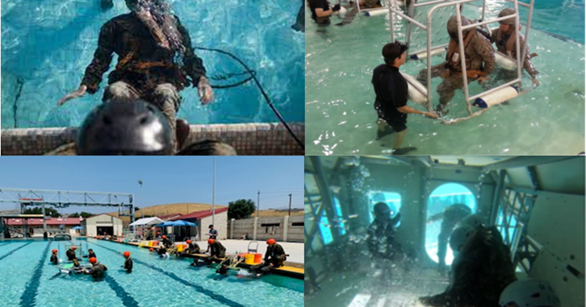
WTS PROGRAMS
UET CLS
Underwater Egress Training Contract Logistic Support (CLS) to train Marines and other authorized personnel how to egress from sinking or submerged platforms (i.e., aircraft, amphibious, and ground vehicles), including the use of life support equipment, e.g., Supplemental Emergency Breathing Devices (SEBDs) and Life Preserver Units (LPUs) to increase survival rates. Without this training, Marines could be rendered non-deployable.
Challenges:
Base prioritization of pool facility discrepancies. Work in progress with positive results.
Post-CG MFR DOR removal, collaborating with TECOM, Safety, and CMC Safety on max attempt policy for delayed AGE.
Successes:
Completed the 3rd training at 29 Palms and 1st Yuma sites.
Supported FBI Honolulu personnel.
Implemented the new POI.
RIMPAC 2024 450 students across 7 partner nations.
Milestone Name | Key Dates
Award TO3 (Surge) | 24 October 2024
Award TO4 (OY1, Consumables, and WD) | November 2025
Award TO5 (OY2, Consumables, and WD) | November 2026
Award TO6 (OY3, Consumables, and WD) | November 2027
UNCLASSIFIED

Slide 41
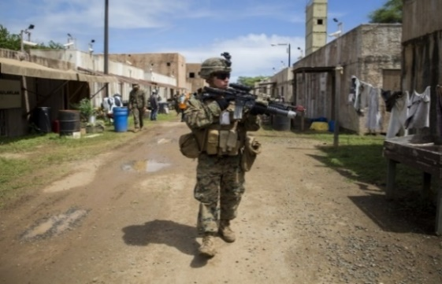
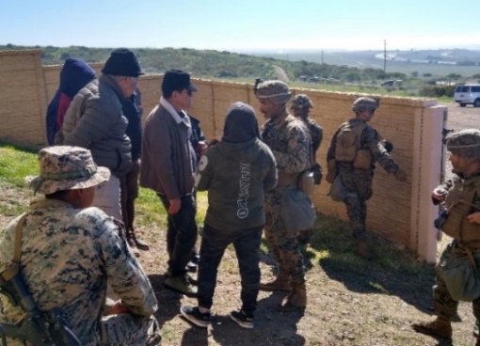
WTS PROGRAMS
HST, IIT & SME SUPPORT SERVICES – CONSOLIDATION
The Immersive Training Range Support program includes the IIT facilities and immersive support to HST, which are under the daily operational management of the respective U.S. Marine Corps (USMC) Installation Training Support Divisions (ITSD), Range Training Area Management Division (RTAM D), Range Control and Current Operations (G3). The ITRS program provides Marines with high-fidelity immersive training environments with the IIT facilities, specifically with RP and SME personnel support.
Leadership Team
Project Officer/COR: Nate Stoddart
Alaka'ina PM Analyst Support: 2x
RTPD A-COR: Brian Thompson
Challenges:
Shorter Task Orders reduces time for post-FY funding mods ; SAF Task Orders must be funded within the PoP
Successes:
Overhauled the Role Players Contract Strategy and Support Coordination Process in Q2-3 / FY24
Award of TO 09 FY24-FY25 Support in September 2024
Receiving positive feedback on the new approach to Role Players coordination and contracting
Milestone Name | Key Dates
TO 10, FY25, Dec-Feb Support: Requirements Due | 10/24/2024
TO 10, FY25, Dec-Feb Support: Award | 12/2024
TO 11, FY25, Feb-Apr Support: Requirements Due | 12/2024
TO 11, FY25, Feb-Apr Support: Award | 02/2025
UNCLASSIFIED

Slide 42
WTS PROGRAMS
WTS PALT SLIDES
 | Acquisition Approach | FY24 | FY25 | FY26 | FY27 | FY28 | FY29
Strategic Planning | Structured: PdM WTS is structured to improve support of fielding, sustainment, and other support provided to improve Warfighter training readiness. Agile: Use of MACs, SAIDIQs, SeaPortNxG, and other Joint Contracts for program sustainment, modernization, and other knowledge-based services. Flexible: Task orders allow for adding, curtailing, or eliminating organizations, locations, or services to meet evolving warfighter (Marine Corps and Joint partners) training and education requirements nested with Marine Corps Force Design. Effective: Maximize buying power, promoting competition, improving contracting efficiencies where possible, and managing risk throughout the acquisition lifecycle to optimize cost, schedule, performance.
MAGTF Training Systems Support (MTSS) | MTSS – MAC (now - FY29) Ceiling Max Expected ~FY27
IIT& HST Role Player Services | 8a / SAIDIQ
Training Support Center (TSC) Support | SEAPORT (now – FY26)
Range Control Forces (RCF) Support | SAIDIQ (now – FY28
Service Contract
Service Contract
MTSS Multiple Award Contract (Base)
BSC Task Orders
ACC-APG RS3/CHS-6, DTIC, CHS-6 or SEAPORT
TECOM (DTIC)
MSTP Task Orders
ACC-APG RS3/CHS-6 or SEAPORT
MCLOG & Others Task Orders
ACC-APG RS3/CHS-6 or SEAPORT
Service Contract
Transition to POR
TMIT Task Orders
ASALT Task Orders
ACC-APG RS3/CHS-6 or SEAPORT
SAIDIQ
6x Task Orders /Yr
6x Task Orders /Yr
6x Task Orders /Yr
6x Task Orders /Yr
6x Task Orders /Yr
SEAPORT
ACC-APG RS3/CHS-6 or SEAPORT
Task Order
Task Order
SAIDIQ
ACC-APG RS3/CHS-6 or SEAPORT
Task Order
Task Order
Task Order
Task Order
Existing Contract
Future Effort/Contract
UNCLASSIFIED

Slide 43
WTS PROGRAMS
WTS PALT SLIDES
 | Acquisition Approach | FY24 | FY25 | FY26 | FY27 | FY28 | FY29
Strategic Planning | Structured: PdM WTS is structured to improve support of fielding, sustainment, and other support provided to improve Warfighter training readiness. Agile: Use of MACs, SAIDIQs, SeaPortNxG, and other Joint Contracts for program sustainment, modernization, and other knowledge-based services. Flexible: Task orders allow for adding, curtailing, or eliminating organizations, locations, or services to meet evolving warfighter (Marine Corps and Joint partners) training and education requirements nested with Marine Corps Force Design. Effective: Maximize buying power, promoting competition, improving contracting efficiencies where possible, and managing risk throughout the acquisition lifecycle to optimize cost, schedule, performance.
Underwater Egress Trainer (UET) CLS | SAIDIQ (now - FY29)
Ground Training Systems Support (GTSS) East CLS | SAIDIQ (now - FY25) (FY25 - FY29)
Ground Training Systems Support (GTSS) West CLS | SAIDIQ (now - FY28)
Ground Training Systems Support (GTSS) O-CONUS CLS | SAIDIQ (now - FY29)
Range and Training Area Management (RTAM) MilOps | SAIDIQ (now – FY27)
Range Manager’s Tool Kit (RMTK) | SAIDIQ (now – FY28)
Service Contract
Service Contract
SAIDIQ
Task Orders
Task Orders
Task Orders
Task Orders
Task Orders
SAIDIQ
SAIDIQ
Service Contract
Task Orders (N-TSD)
Task Orders (N-TSD)
Task Orders
Task Orders
Task Orders (N-TSD)
Task Orders
SAIDIQ
SAIDIQ
Task Orders (N-TSD)
Task Orders (N-TSD)
Task Orders (N-TSD)
Task Orders (N-TSD)
Task Orders (N-TSD)
Task Orders
SAIDIQ
SAIDIQ
Task Orders
Task Orders (N-TSD)
Task Orders (N-TSD)
Task Orders (N-TSD)
Task Orders (N-TSD)
Task Orders (N-TSD)
SAIDIQ
SAIDIQ
Task Orders
Task Orders
Task Orders
Task Orders
Task Orders
Task Orders
SAIDIQ
SAIDIQ
Task Orders
Task Orders
Task Orders
Task Orders
Task Orders
Existing Contract
Future Effort/Contract
UNCLASSIFIED

Slide 44
WTS PROGRAMS
WTS PALT SLIDES
 | Acquisition Approach | FY24 | FY25 | FY26 | FY27 | FY28 | FY29
Strategic Planning | Structured: PdM WTS is structured to improve support of fielding, sustainment, and other support provided to improve Warfighter training readiness. Agile: Use of MACs, SAIDIQs, SeaPortNxG, and other Joint Contracts for program sustainment, modernization, and other knowledge-based services. Flexible: Task orders allow for adding, curtailing, or eliminating organizations, locations, or services to meet evolving warfighter (Marine Corps and Joint partners) training and education requirements nested with Marine Corps Force Design. Effective: Maximize buying power, promoting competition, improving contracting efficiencies where possible, and managing risk throughout the acquisition lifecycle to optimize cost, schedule, performance.
Electronics and Communications Services (ECS) Principally PDSS* | ECS - MAC (now – FY31)
Equipment-Related Services - Systems (ERS-S) Principally Ops/Maintenance* | ERS-S - MAC (now – FY31)
Supporting Arms Virtual Trainer (SAVT) | Post - ACAT (now – FY25)
Service Contract
Service Contract
ECS Multiple Award Contract (Base)
DVTE
TBD
CCS
CCS Follow-On (TBD)
Service Contract
ERS-S Multiple Award Contract (Base)
44
ISMT
ISMT
ISMT (SEAPORT)
CVTS
CVTS
CVTS
ODS/DRET
ODS/DRET
ODS/DRET
CCS - USMC
TBD
CCS - USN
TBD
SAVT
TECOM Decision
Disposal Contract
Existing Contract
Future Effort/Contract
UNCLASSIFIED

Slide 45
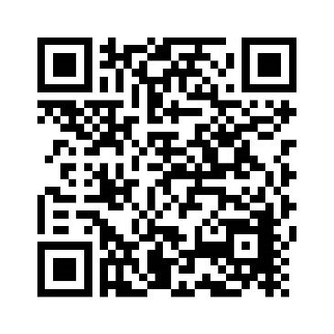
Questions?
Contact PM TRASYS at
pmtrasys@usmc.mil
(407) 381-8762
https://www.marcorsyscom.marines.mil/Program-Managers/Training-Systems
Visit our site:
UNCLASSIFIED

Slide 46
UNCLASSIFIED
UNCLASSIFIED

