Slide 1

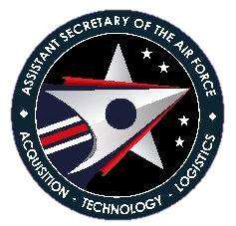
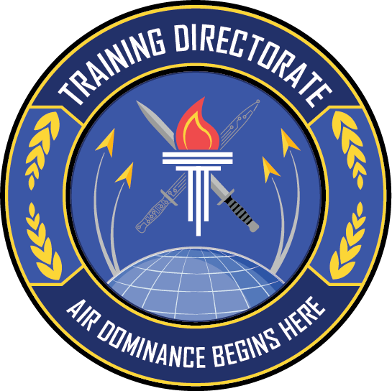
Air Force Acquisition Update - PEO Training 5 December 2024
Col Carlos Quinones
PEO Training
Carlos.quinones@us.af.mil

Slide 2
Current Environment
The current security environment is dynamic and characterized by aggressive state actors and transnational threats
PRC’s military advancements threatens our intended mode of warfare, imposes cost, and denies power projection
Russian aggression threatens European stability and challenges the rules-based international order
The current strategic environment requires a force aligned and focus on the attributes that will keep us competitive

Slide 3
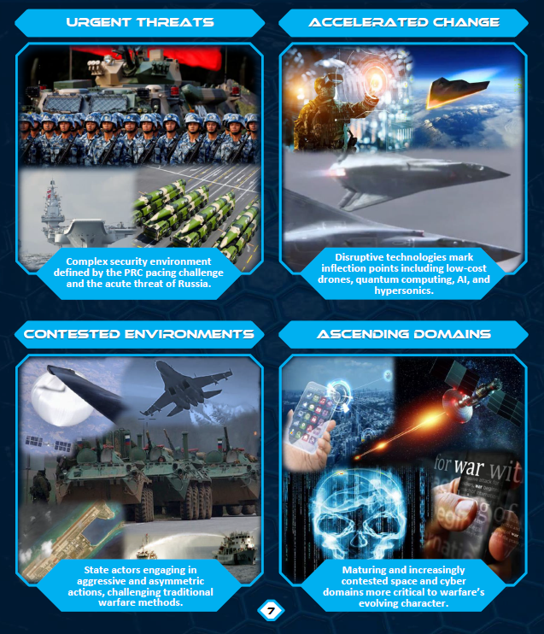
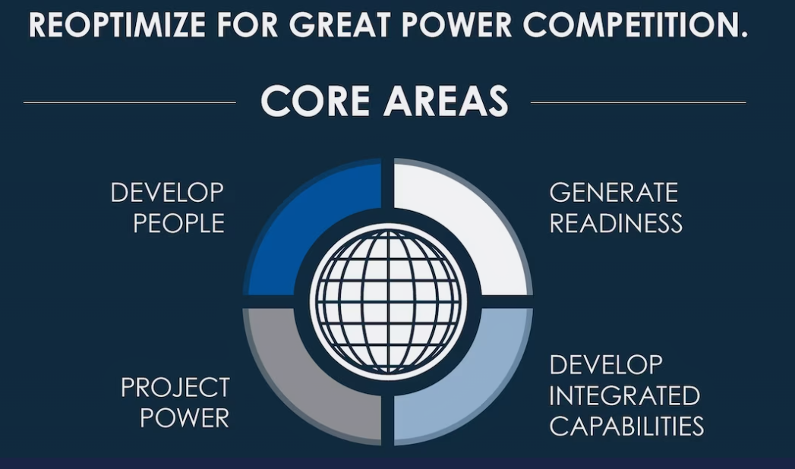
Optimizing for GPC

Slide 4
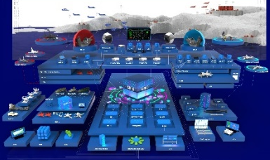
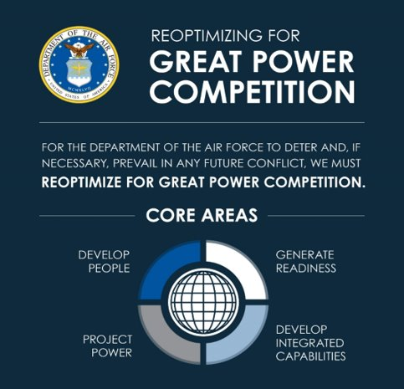

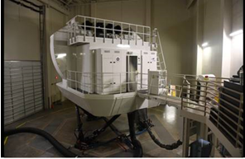
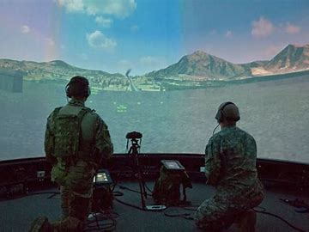

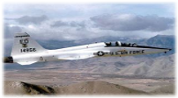
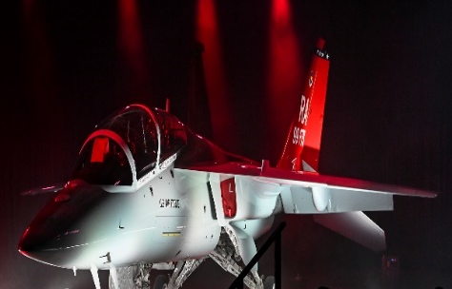
PEO Training
“We need these changes now; we are out of time to reoptimize our forces to meet the strategic challenges in a time of great power competition.”
~ Secretary of the Air Force Frank Kendall
JSE
Threat Emitter
T-53A
C-130J MATS
JCT TRS
SCARS
T-38 Talon
T-7A Red Hawk
PEO TRAINING

Slide 5
PEO Training Mission, Vision and Motto
Mission: Develop, deliver, and sustain integrated training capabilities to enable war-winning airpower.
Vision: To be the trusted provider of adaptive and innovative training capabilities – on target, every time.
Motto: Air Dominance Begins Here

Slide 6
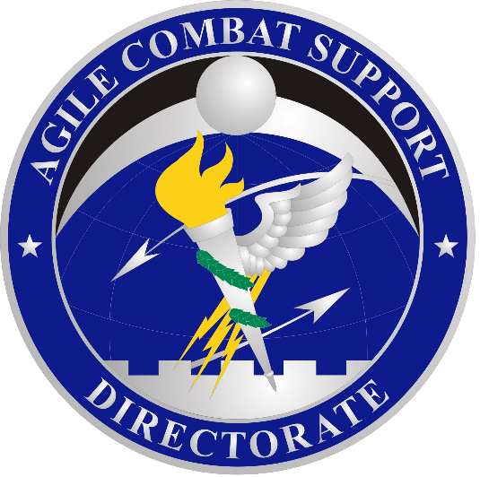

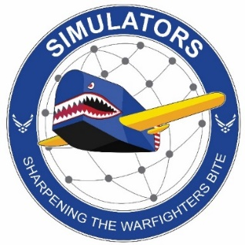




AFPEO Training 1.0
AFPEO
Training
AR/VR
Enterprise Training & Test
Cross-Cutting Enabler
Notes:
ACS is becoming the 1st ever PEO dedicated to providing materiel solutions to support the warfighter to more rapidly train. The PEO will be comprised of various training elements from other Directorates and will continue to execute the T&T COE which incorporates training and test into the SecAF’s Operational Imperatives.

Slide 7
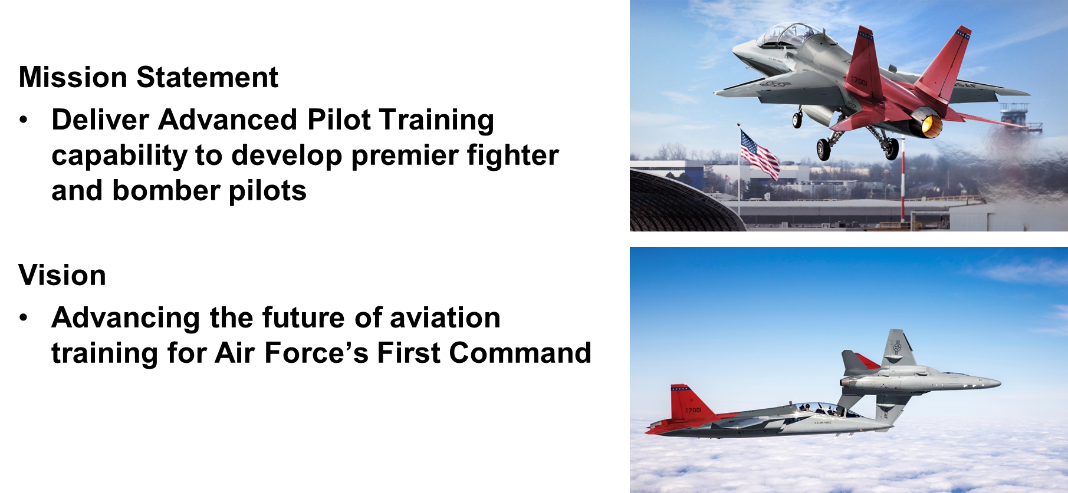

T-7A Red Hawk Division Snapshot
Single Contract for Aircraft and GBTS (Boeing)
Total Contract value: $9.2B
351 Aircraft and 46 Simulators by 2035
MTS as separate contract action in source selection
180+ members strong​

Slide 8



Legacy Training Aircraft Division Snapshot
50 Programs
supporting
1,500 Aircraft Supported
14+ Aircraft Variants
4
MAJCOMS
US Navy, US Army, NASA, Dept of State
42
Countries
Mission:
Develop, deliver, and sustain integrated capabilities for our domestic and foreign partners to support flying training operations, test support, and allied security
​​
Vision:
To be the trusted provider for innovative, responsive, proactive, and agile solutions to modernize and sustain Legacy Training Aircraft
Motto:
"LTAD...the Alpha and Omega of Air Power"
FY24
536 Contract Actions
300+ members strong stationed in 7 geographic locations
$1.4B Active Year
(includes $0.5B for FMS)
396 Funding Documents

Slide 9


Advanced Training Capabilities Div Snapshot
17 Programs
supporting
1,850+
Training Devices
280+
Training Portals
10
MAJCOMS
55
Program Offices
16
Foreign Partners
16 Worldwide Training Ranges
Mission:
Arming warfighters with advanced training capabilities to dominate evolving global threats.
Vision:
Experience competition before crisis or conflict to conquer any adversary.
FY24
400+ Members Strong
$2.2B Active Year
(includes $1.15B for FMS)
Delivering the Skill to Kill!

Slide 10


Simulators Division Snapshot
MISSION:
Lead the Development, Acquisition and Sustainment Necessary to Meet Every MAJCOM’s Simulation and Training Requirement
VISION:
Providing the World’s Best Training Systems to the Combat Forces of Today and Tomorrow
FY24
537 Contract Actions
63 Programs
400+ Members Strong
$1.1 B
Expiring Funds Executed
supporting
2,300+
Training Devices
Over 93% of the Air Force inventory
629
Funding Documents
9
MAJCOMS
29
Program Offices
23
Countries

Slide 11
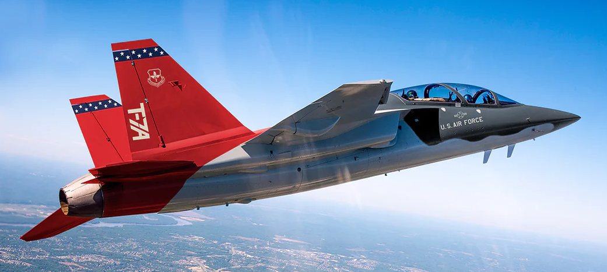
Training Directorate 2.0
AFPEO for Training
PEO
Training
1.0
Inventory
Org Structure
Rand Study
Training Summit
T&T
COE
“[Training is] inappropriately weighed in favor of what is available to fight a narrow range of scenarios today with what we currently have on hand.”
Gen Charles Q. Brown and Gen David H. Berger
11

Slide 12
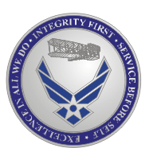
Training Directorate
Air Dominance
Begins Here!
We ARE…AF Training
Notes:
Updated Slide

