Slide 1
How stakeholders in niche markets can benefit from, and drive, interoperability standards and MOSA:Examples from the Medical Simulation arena
Moderators:
William Pike, PhD
Christopher McGroarty
US Army DEVCOM Soldier Center Simulation & Training Technology Center

Slide 2
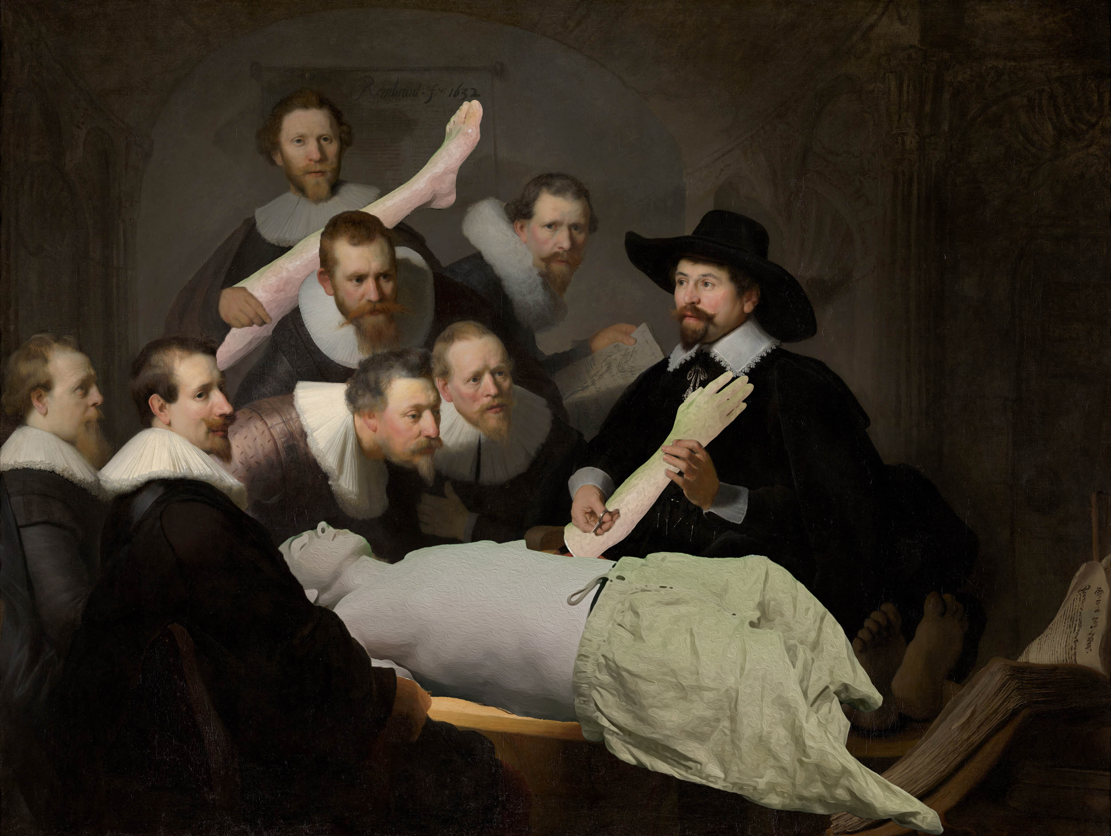
Credit: Mauritshuis, The Hague

Slide 3
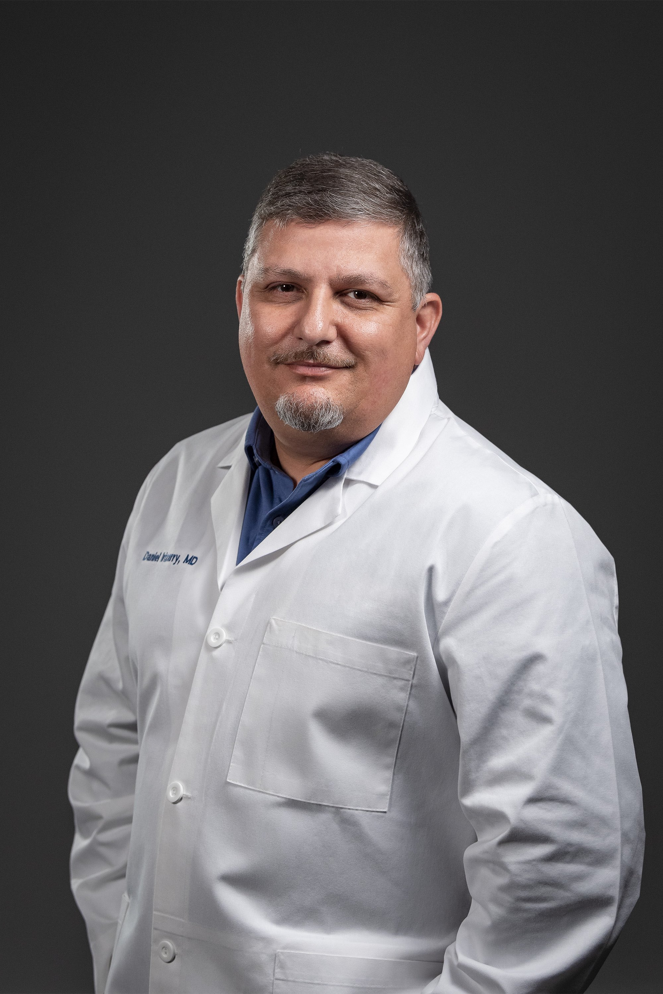
Panelists
Dan Irizarry, MD
Medical Advisor
TacMed Solutions

Slide 4
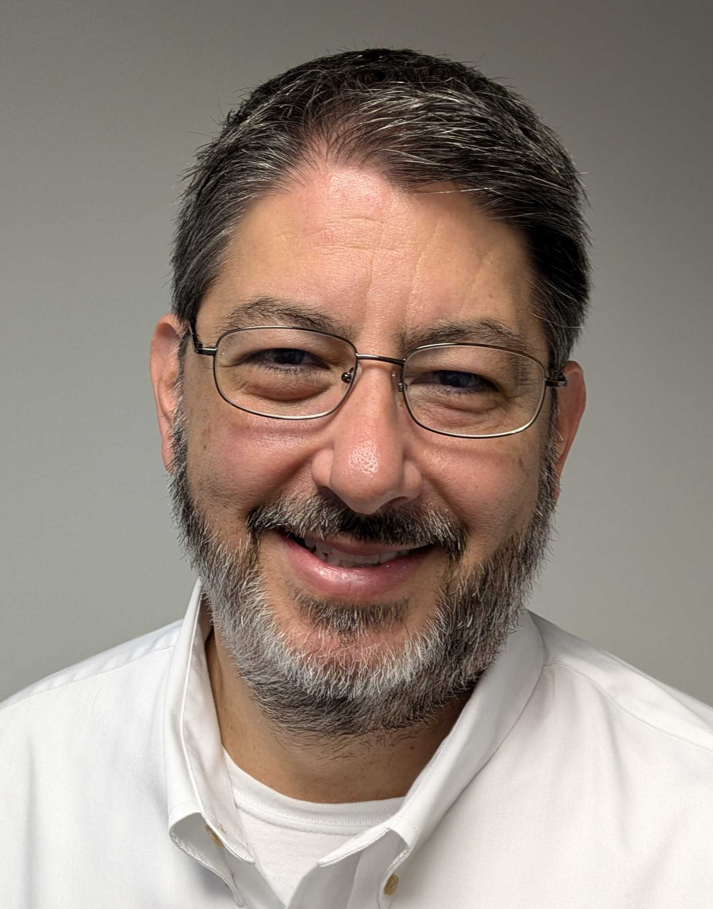
Panelists
Dan Silverglate
VP, Systems Architecture and Development
Vcom3D

Slide 5
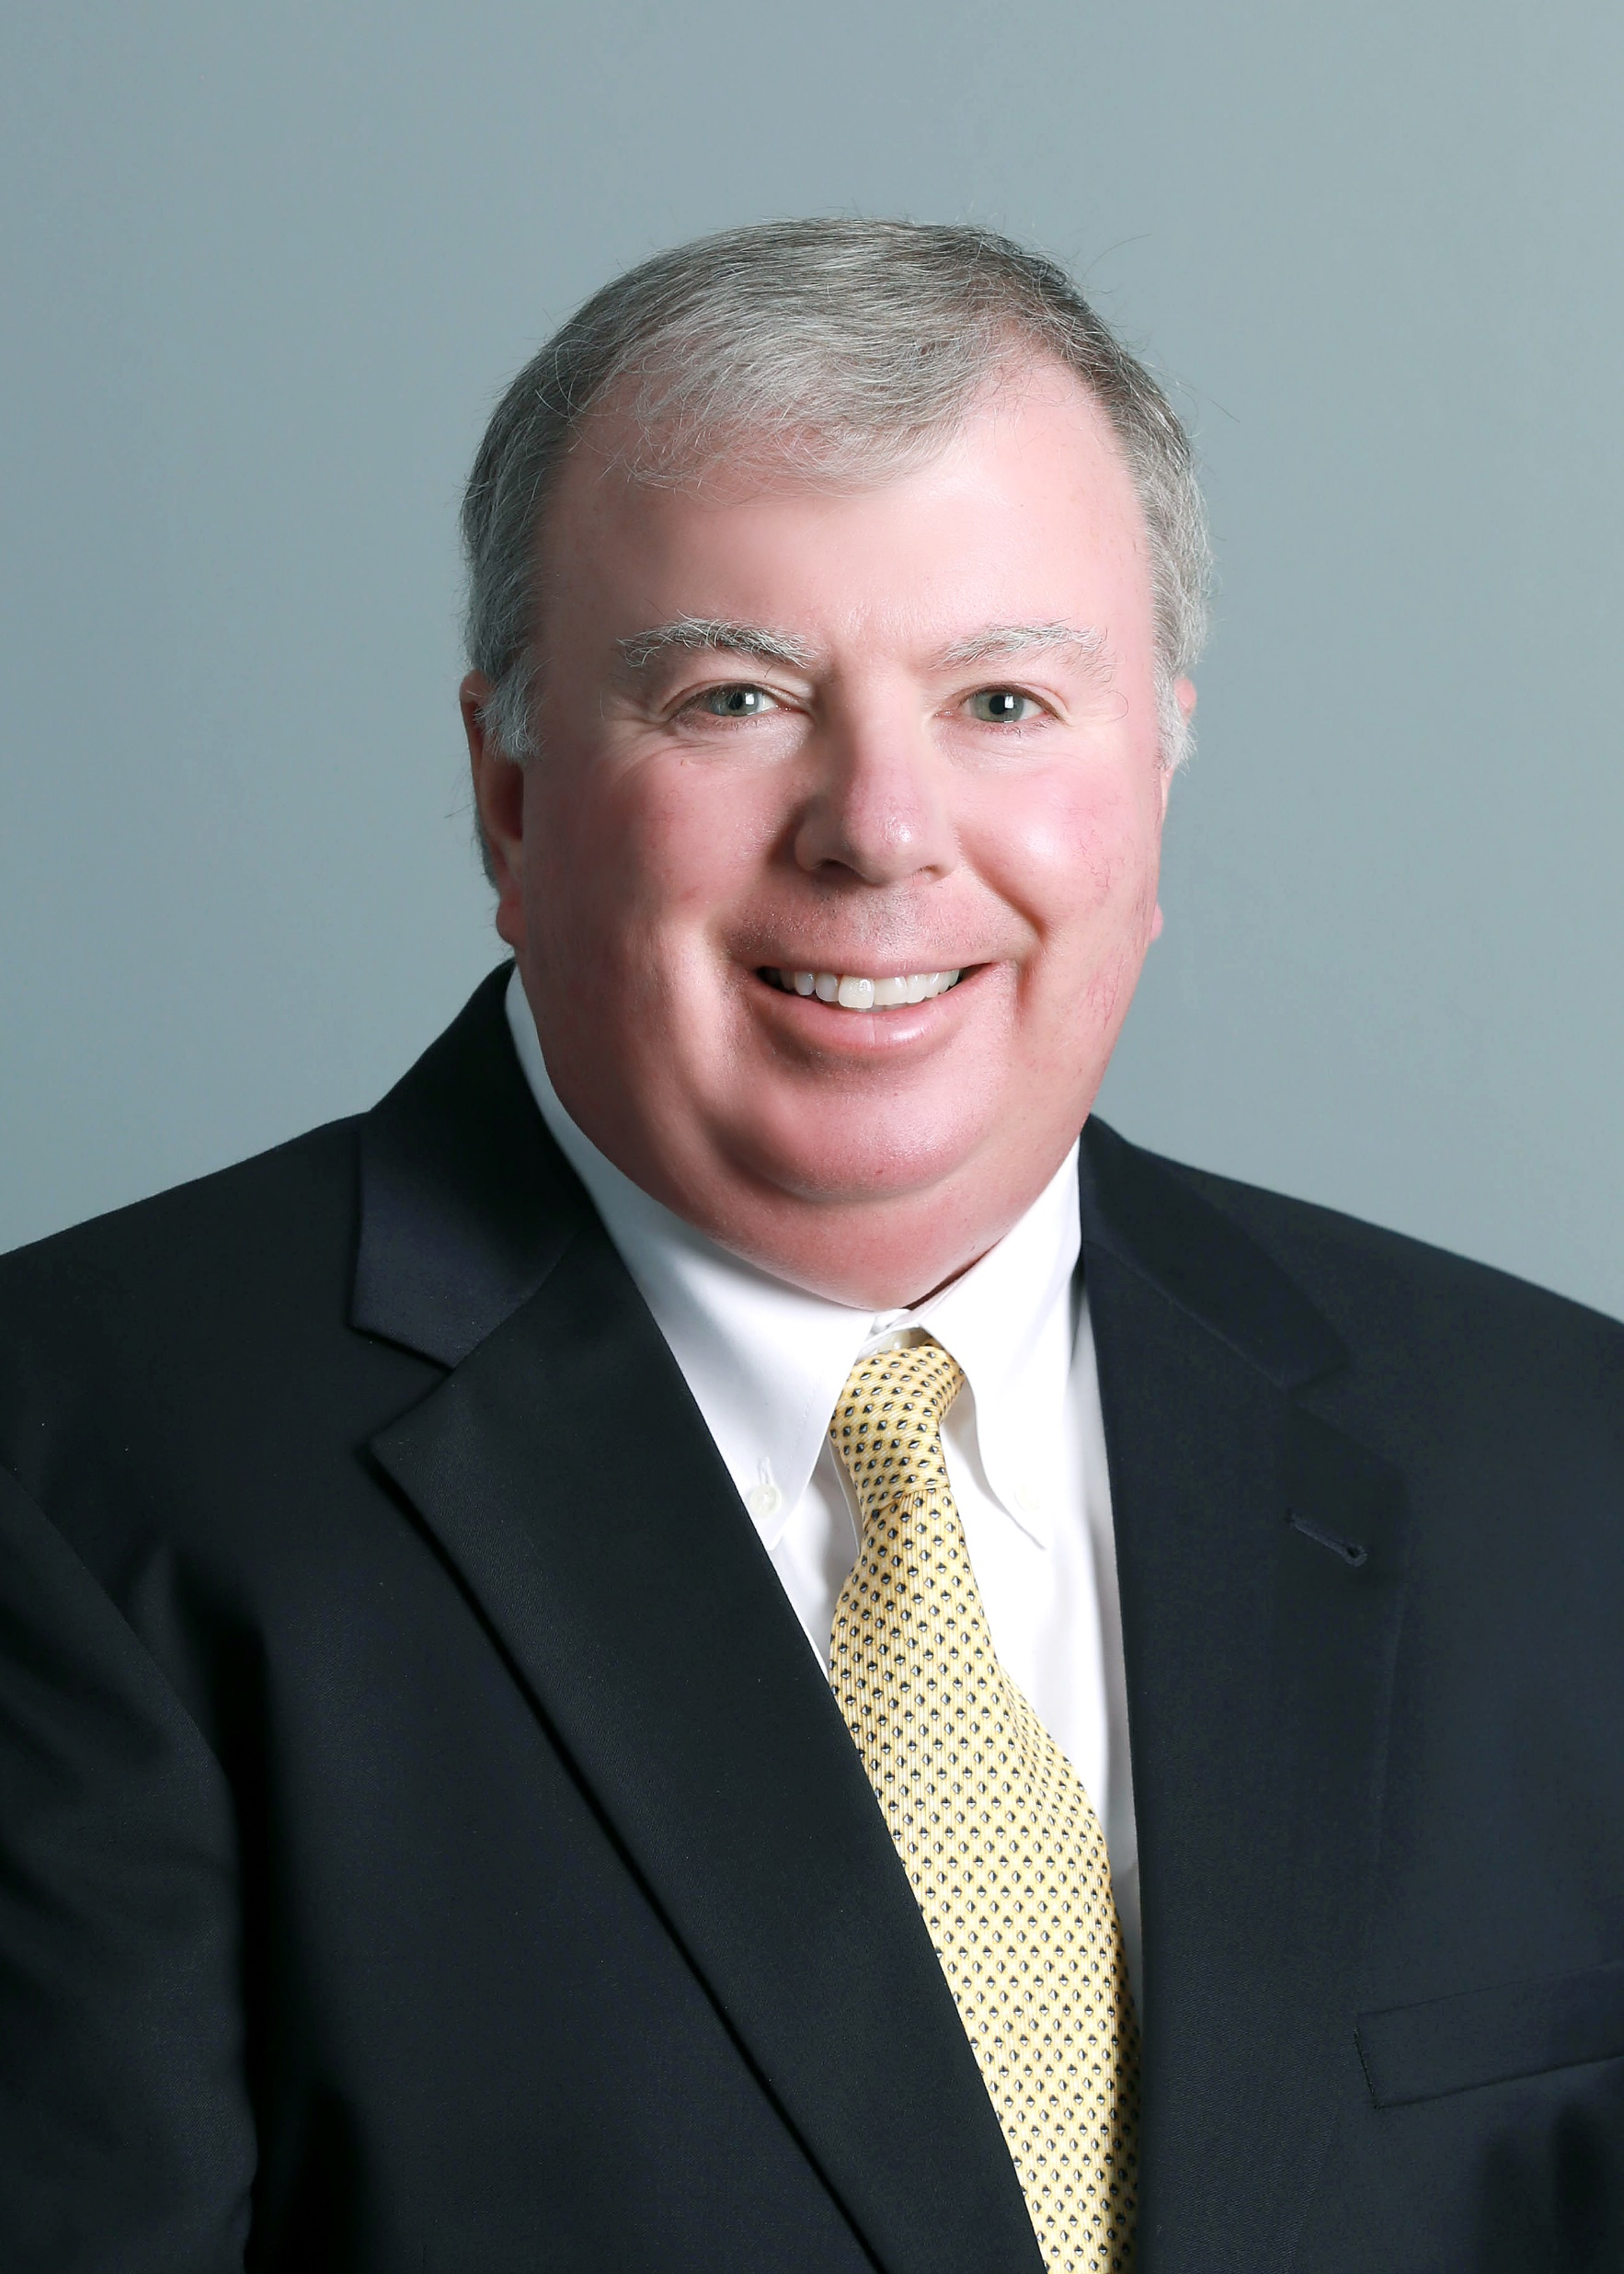
Panelists
Michael O’Connor
Chief Technologist
Trideum Corporation

Slide 6

Panelists
Brian Parrish
Principal Modeling & Simulation / Multi-Discipline Systems Engineer
MITRE Corporation

Slide 7
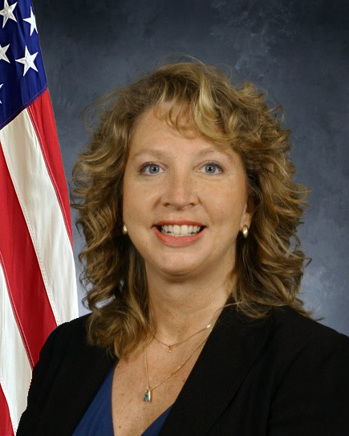
Panelists
Beth Pettitt, PhD
Chief, Medical Simulation Research
US Army DEVCOM-SC STTC

Slide 8
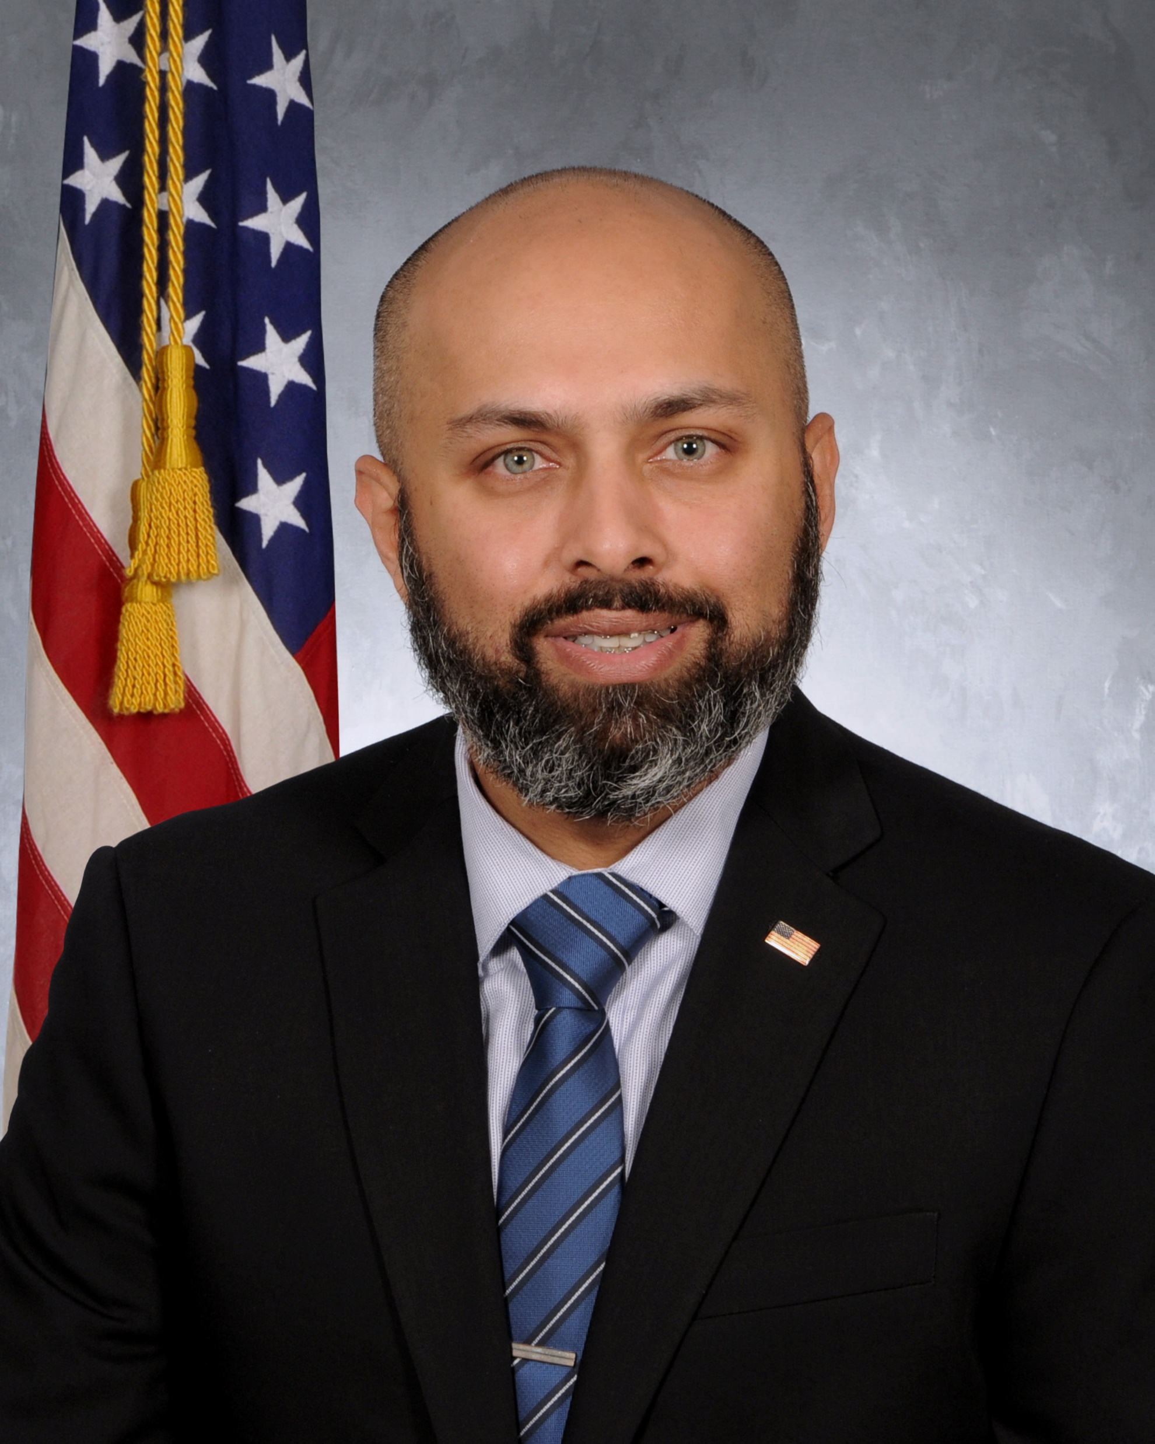
Panelists
Amit Kapadia
Chief Engineer, Program Manager Synthetic Environments (PM SE)
US Army PEO-STRI

Slide 9
Panel Format
Bill & Chris will question specific panel members
Responses will be limited to three minutes
Other panel members may follow up for a total of two minutes (i.e., five minutes per response/follow up)
Unused time goes to audience Q&A
15 minutes at the end will be reserved for audience Q&A
Note that while half of our panelists are involved in the medical simulation realm, we hope the panel is pertinent to any similar “niche” market

Slide 10
Q1
Brian Parrish
Why should a small firm be supportive of MOSA, or any other open systems architecture?

Slide 11
Q2
Dan Silverglate
As you have helped develop the Advanced Modular Manikin (AMM) and now Modular Healthcare Simulation and Education System (MoHSES) as candidate standards for human patient simulators, how have your peers in medical simulation companies responded?

Slide 12
Q3
Amit Kapadia
What are open system standards’ advantages to the acquisition world?

Slide 13
Q4
Beth Pettitt
What are open system standards’ advantages to the Science & Technology community?

Slide 14
Q5
Michael O’Connor
What are some of the roadbumps you encountered along the way developing standards and fostering their adoption?

Slide 15
Q6
Dan Irizarry
What are a few pros & cons to moving away from a proprietary business model to a more open, interoperability-based business model?

Slide 16
Q7
Brian Parrish & Beth Pettitt
How can the government incentivize industry, small businesses especially, to adopt open standards?

Slide 17
Q8
Dan Irizarry and/or Dan Silverglate
What are your thoughts on the same question, how can the government incentivize small businesses to adopt open standards?

Slide 18
Q9
Amit Kapadia
How can companies supporting niche markets influence the development of MOSA implementations in larger Programs of Record?

Slide 19

Questions from the Audience

Slide 20
Session PSMA 3: Medical Learning: Standards Required?
Today, 1:30 – 3:00 320G
Credit: Mauritshuis, The Hague

