Slide 1








Integrated Defense Against
Cognitive Warfare
Strengthening Minds, Fortifying Nations, Resilience Against Hybrid Threats
Notes:
Sae Schatz, PhD
sae.schatz@marshallcenter.org
May 2024
20 minutes The first part briefly covers some of the history that led us to modern Cognitive Warfare and emphasizes the importance of systems thinking, i.e., not getting too focused on one set of techniques but integrating them across subdomains. OUTLINE
- 0:00-0:01 (1 min) Introduction
- 0:01-0:13 (12 min) History
- 0:13-0:20 (7 min) Cog War Summary

Slide 2

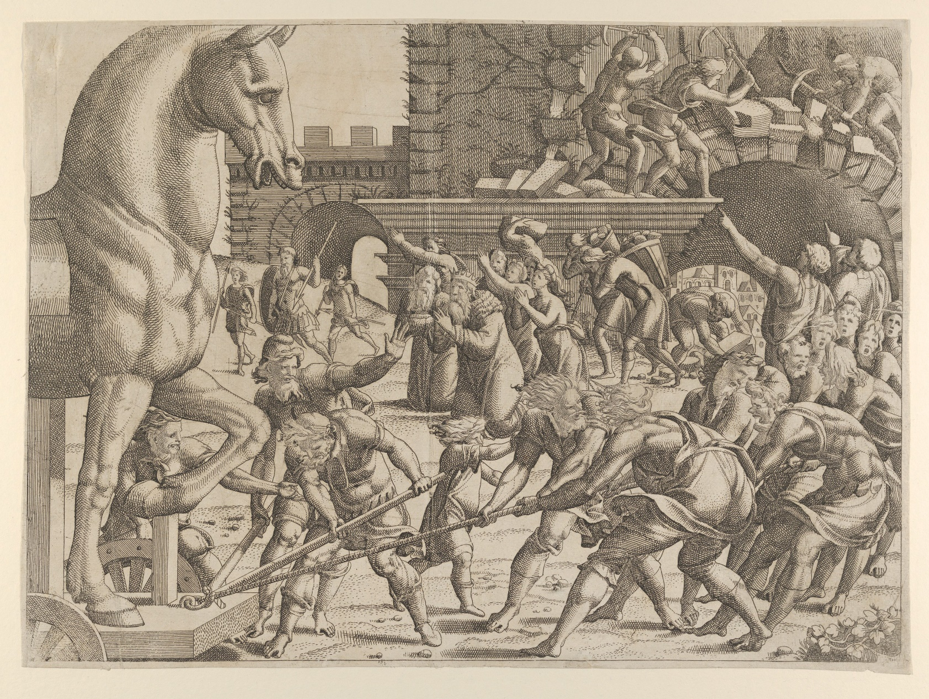
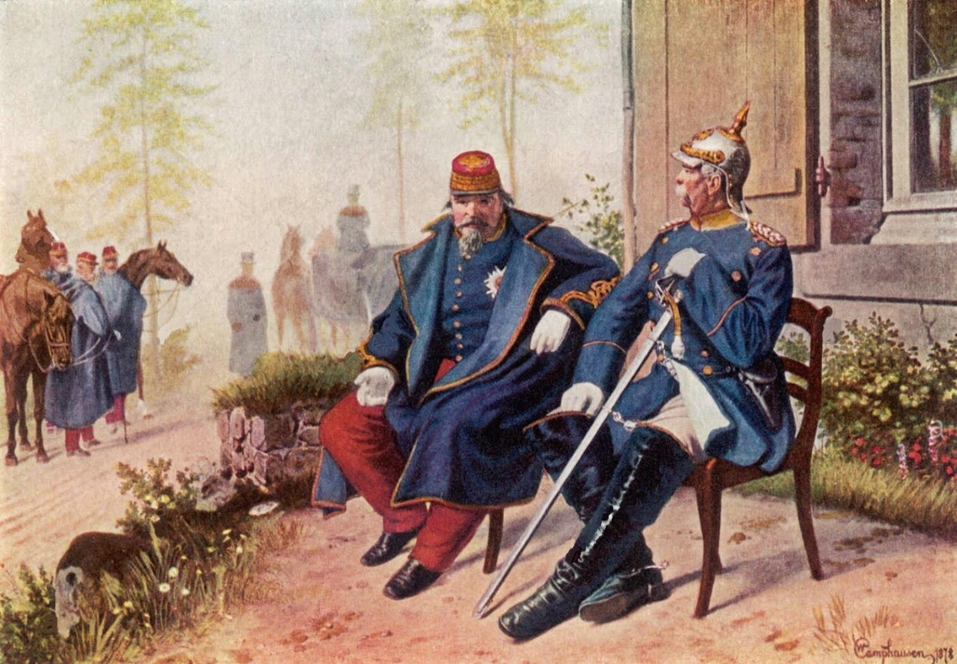
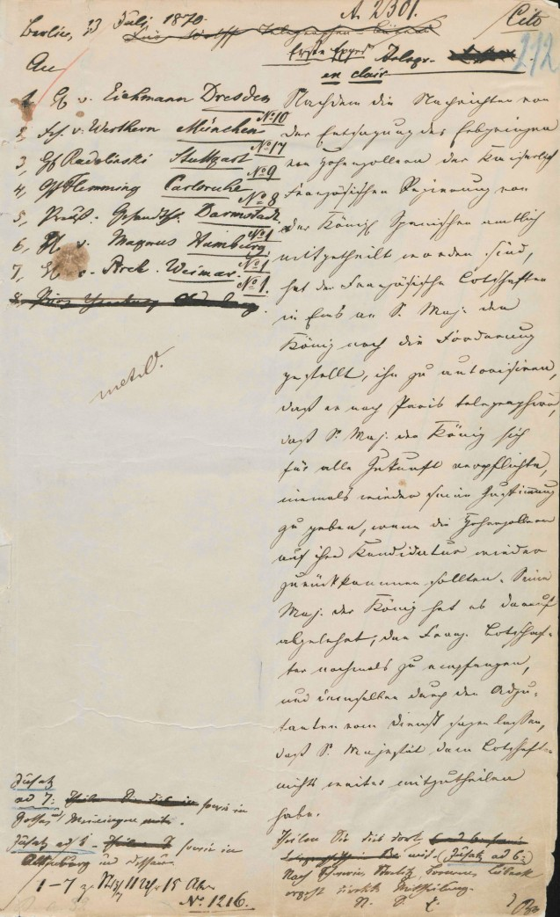
“All warfare is based on deception…”
Napoleon III
Otto von Bismarck
Franco-Prussian War (1880-1881) – Ems Telegram
Sun Tzu. The Art of War.
Notes:
Warfare has always weaponized information. Military deception and psychological operations meant to demoralize the enemy go back to the beginnings of history.
Prussia (a large part of the Germanic states that later became Germany), so the Franco-Prussian War can be considered war between France and Germany, a pre-cursor of WW1. The Franco-Prussian War started because France sent diplomats to convince Prussia to withdraw the candidacy of Leopold’s candidacy to be the king of Spain. Von Bismarck, the Prussian Minister, edited a telegram from King Wilhelm of Prussia to twist its tone, and released the edited version to the press that implied that the king and French diplomat had insulted one another and strained tensions. This pushed both countries, and especially Napoleon III, towards war – as Bismarck had desired.

Slide 3



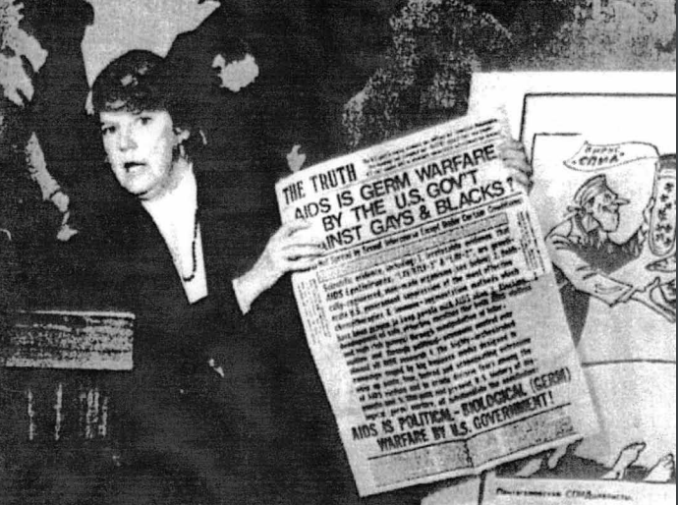

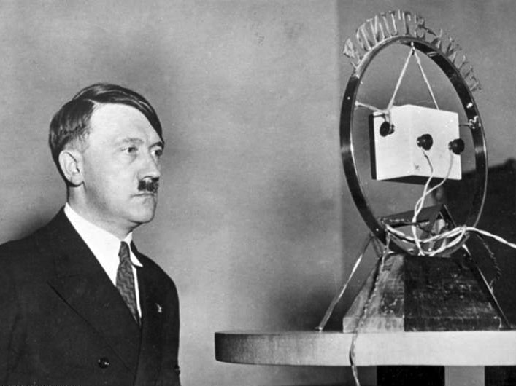
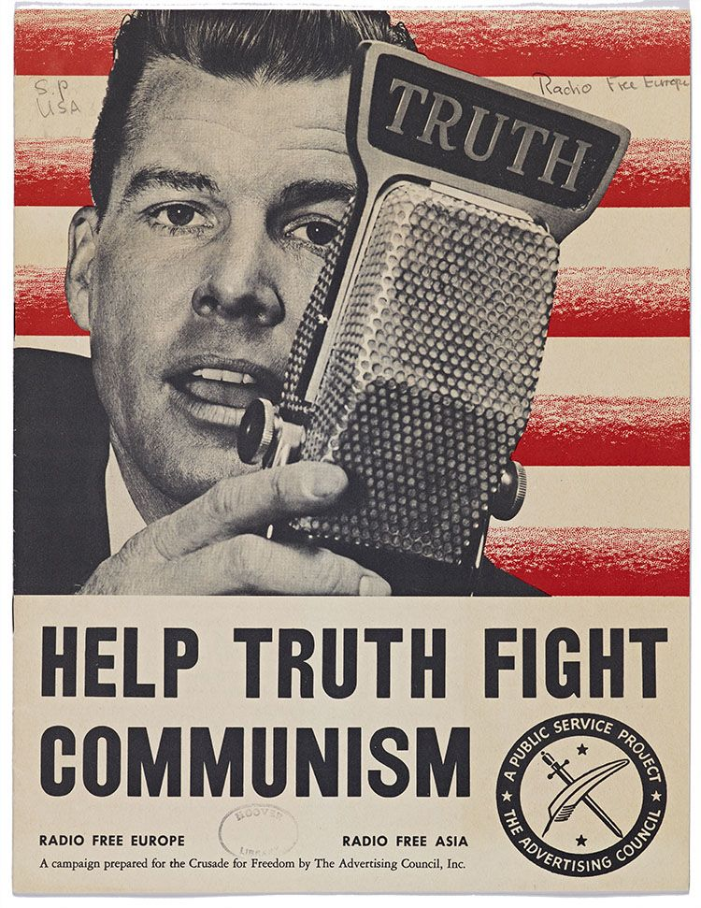
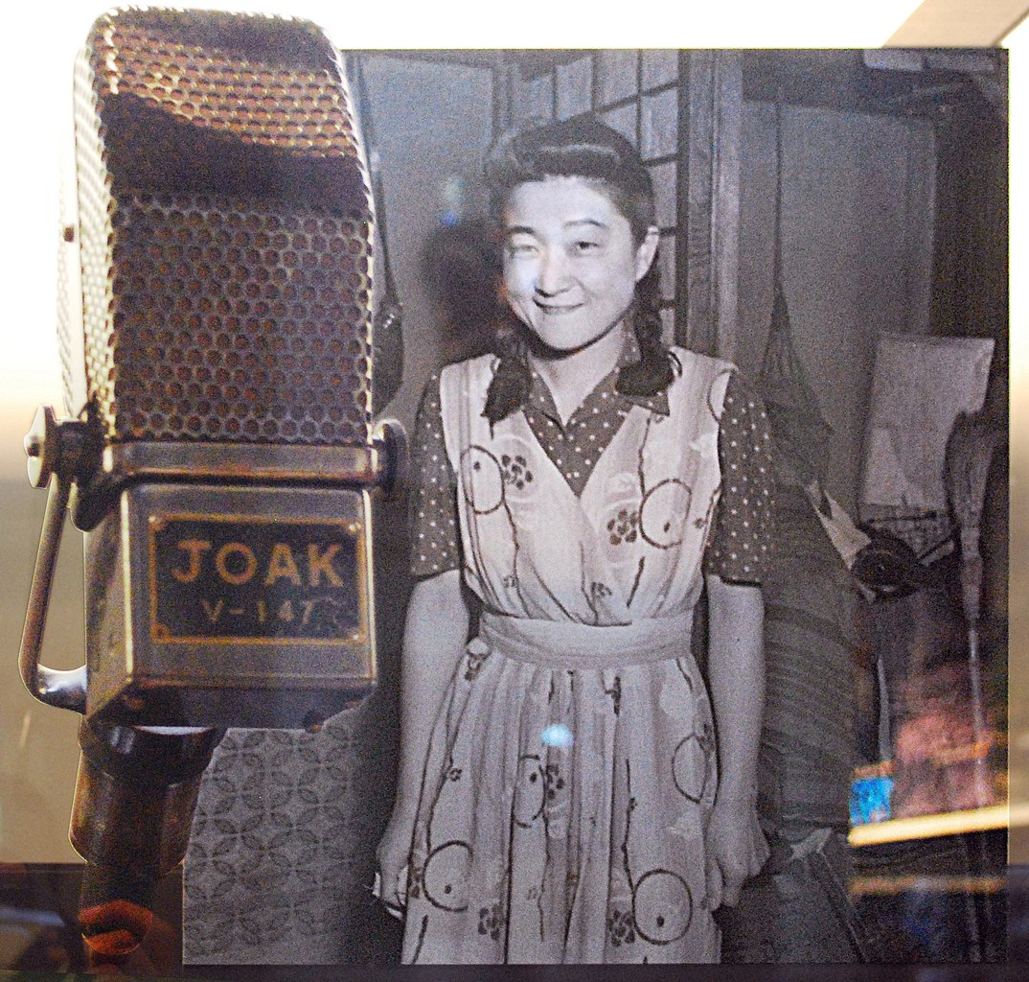
“SPECIAL DISINFORMATION OFFICE”
Trust me!
Military Deception
Psychological Operations
Дезинформация
KGB’s Operation INFEKTION
≈100 Years Ago
1923
1947
Political Warfare
Lubyanka building (former KGB headquarters) in Moscow
Notes:
Дезинформация = Dezinformatsiya
The Cold War significantly refined and expanded Information Warfare methods. The concept of political warfare gained prominence, providing an integrated framework for enacting information operations. During the Cold War, both the US and the Soviet Union used Information Warfare methods to advance their respective ideologies, including integrated campaigns using propaganda and PSYOP as well as intelligence, covert actions, and diplomatic maneuvering to influence public opinion.
Source:
Radio Free Europe: https://histories.hoover.org/truth-as-a-weapon
Operation INFEKTION: https://upload.wikimedia.org/wikipedia/commons/3/38/Deception%2C_Disinformation%2C_and_Strategic_Communications.pdf
British Propaganda: https://commons.wikimedia.org/wiki/File:Kriegsplakate_1_db.jpg
Tokyo Rose:

Slide 4
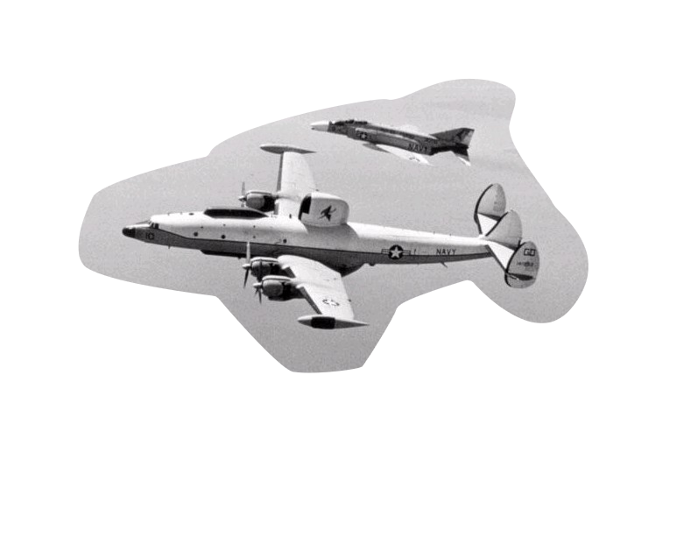
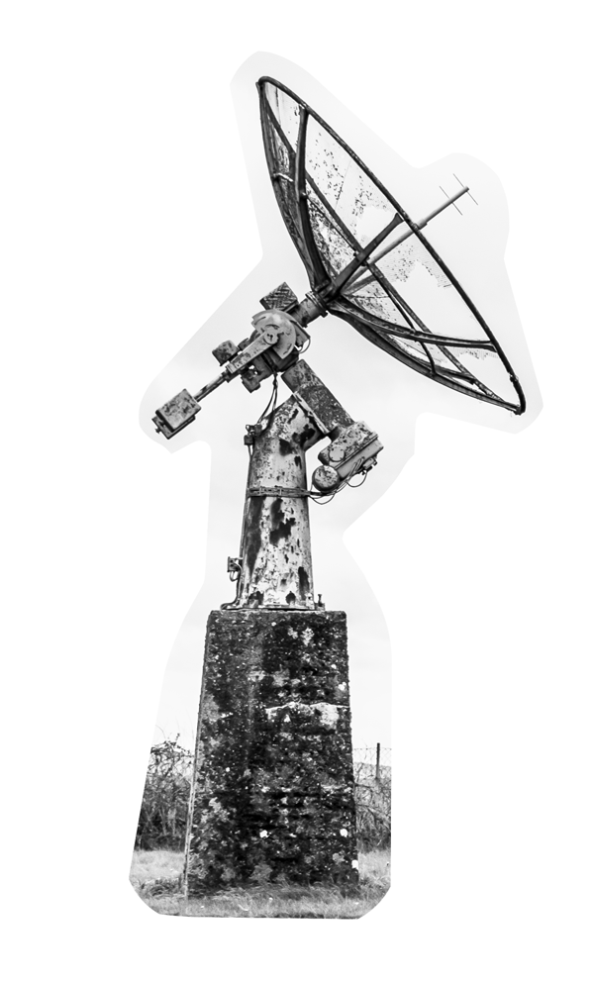

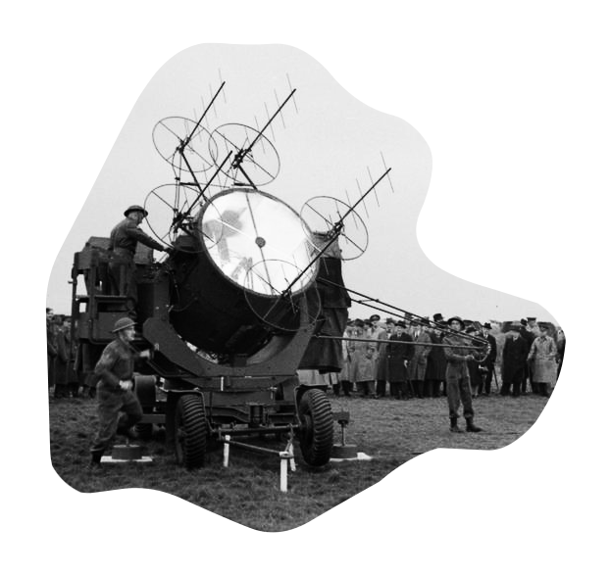
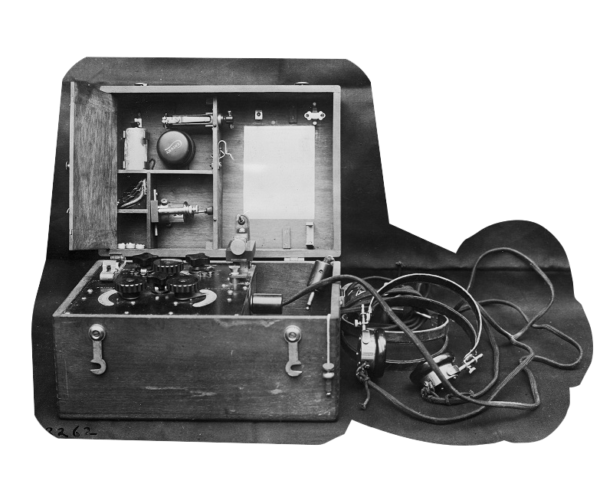
Trust me!
Electronic Warfare
Military Deception
Decoys
Psychological Operations
Radio  1900s
RADAR
1938
EW move and counter-move
Jamming
1923
1947
1950s
Notes:
1938 - The term "RADAR" was coined in 1939 by the United States Signal Corps as it worked on these systems for the Navy. The first radar set installed on board a major U.S. warship was the XAF, which was installed on the USS New York in 1938.
1940s - Radio was first used en masse by the military during World War I. During World War II, radios were an integral part of communications for airplanes, submarines, and tanks. The Armed Forces Radio Service was established in the 1940s to broadcast original programming.
1950s - Electronic Warfare matured significantly during the 1950s. Electronic warfare (EW) developed extensively in the United States in the 1950s. The goal of electronic warfare is to control the electromagnetic spectrum. The move-countermove cycle accelerated in response to Soviet military aggressions and advances in the 1950s. Active countermeasures such as jammers or decoys proliferated, thanks to technological advances that enabled EW systems with greater power, wider frequency ranges, and more complex waveforms, and which were small enough to fit aircraft as well as ships.
1946 – ENIAC computer for artillery tables (https://commons.wikimedia.org/wiki/File:Classic_shot_of_the_ENIAC.jpg)
1943 – Colossus for codebreaking (https://commons.wikimedia.org/wiki/File:Colossus.jpg)
Cold War, 1952: Industrial scale jamming
The Soviet Union fought an electromagnetic war on the home front throughout the Cold War, using radio jamming on an industrial scale in an unprecedented effort at mass censorship.
From a small start in 1948 to drown out broadcasts from the BBC and Voice of America, by1952 some 200 jamming stations were attempting a near wholesale block on western media outlets – including Vatican Radio. Before the programme came to an end in the late 1980s, more than 1,700 stations were operating, with an estimated combined output of 45 megawatts, and costing tens of millions of dollars a year to run. 1960s - The first large electronically steered phased-array radars were put into operation in the 1960s.
Ultra, Allied intelligence project that tapped the very highest level of encrypted communications of the German armed forces
Image:
1900s Radio is from WW1, SCR-41
1950s EW: MPs visiting No 554 Anti Aircraft Battery near Harwich watching a demonstration of a searchlight with radar equipment known as ELSIE - 90 cm Searchlight Control Radar (SLC) No 2 Mk VI - which entered service in 1942 and was of immense assistance to anti-aircraft when used against the flying bomb attacks of 1944.

Slide 5
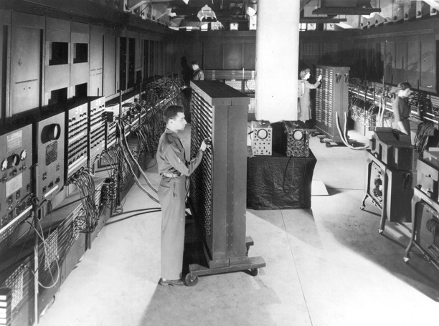
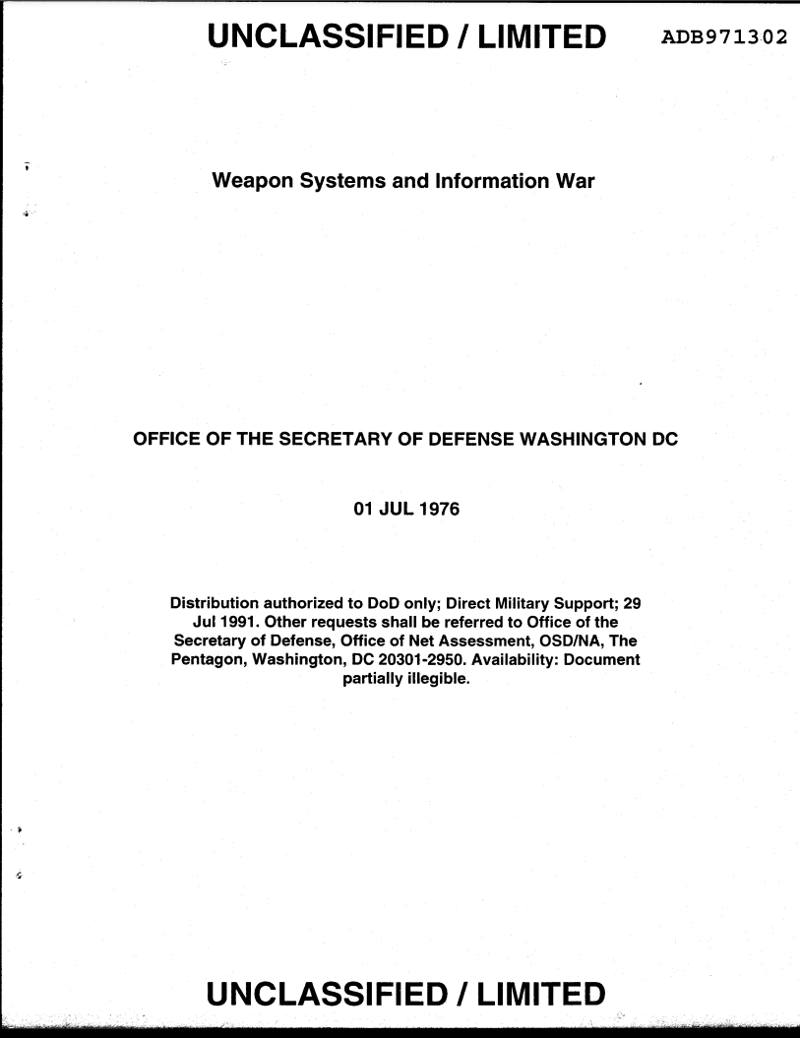
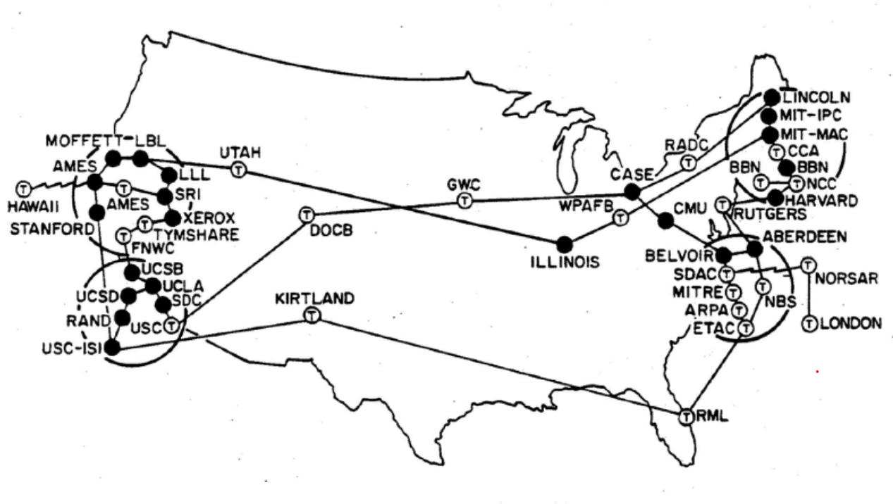
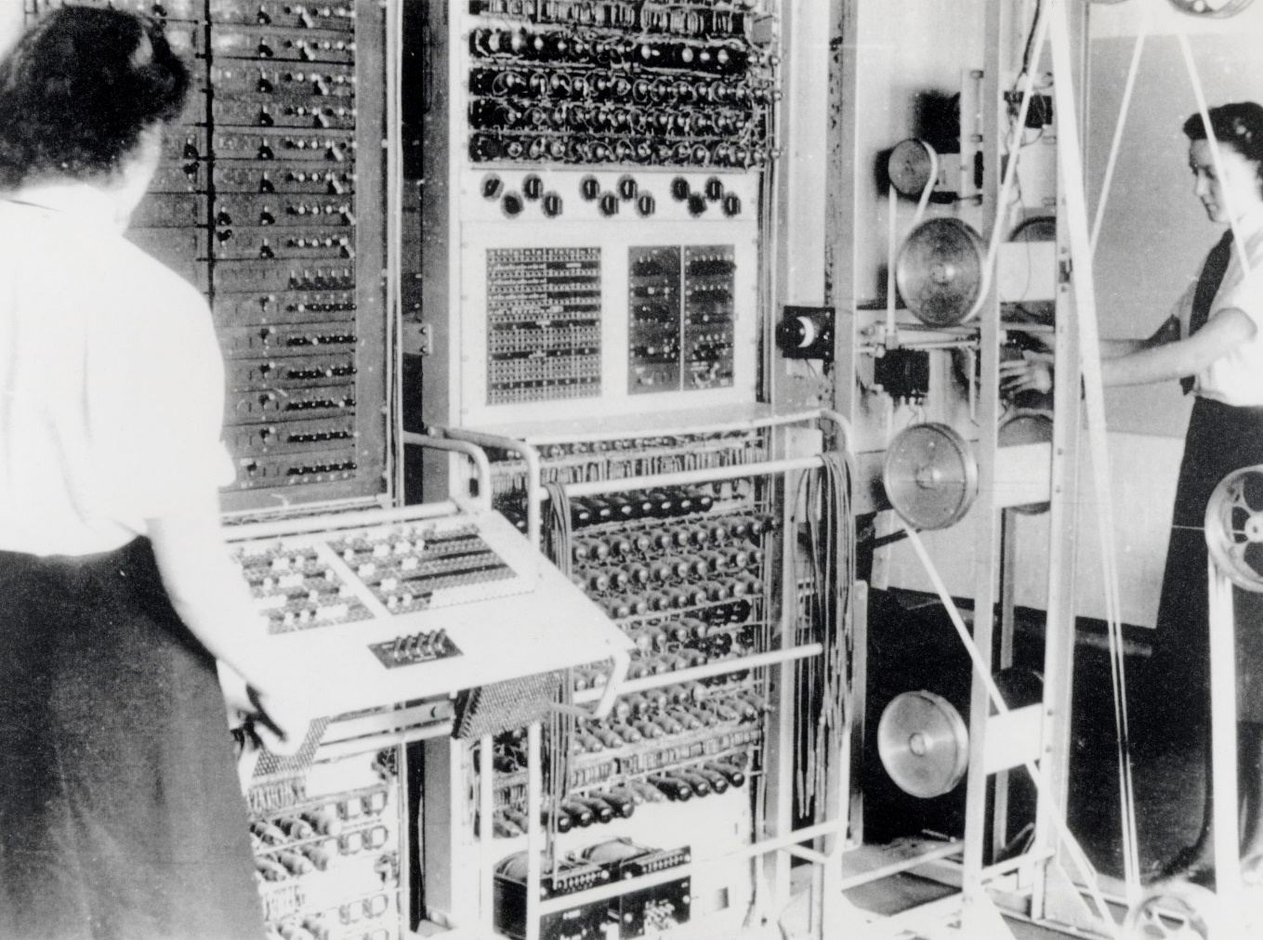
Military Computers
Information Warfare
Computer Networking
Electronic Warfare
Decoys
Radio  1900s
RADAR
1938
EW move and counter-move
ENIAC Computer  1946–1955
Jamming
ARPANET  1969
Colossus Mark 2 Computer  1944–1960
1923
1947
1960s
1970s
1950s
INFORMATION AGE
Notes:
1976 - The advancement of Information and Communication Technologies (ICT) during the latter portion of the 20th century brought more developments in this domain, and in 1976, Thomas Rona formally coined the term “Information Warfare” in a US Defense Department monograph, called Weapon Systems and Information War.

Slide 6
Political
Warfare
Information Warfare
Notes:
So, we see this real focus on information: Disguising it, transmitting it, faking it, processing it, and stealing it…
Tzu-Chieh Hung, Tzu-Wei Hung, “How China’s Cognitive Warfare Works: A Frontline Perspective of Taiwan’s Anti-Disinformation Wars,” Journal of Global Security Studies, Volume 7, Issue 4, December 2022, ogac016, https://doi.org/10.1093/jogss/ogac016.

Slide 7
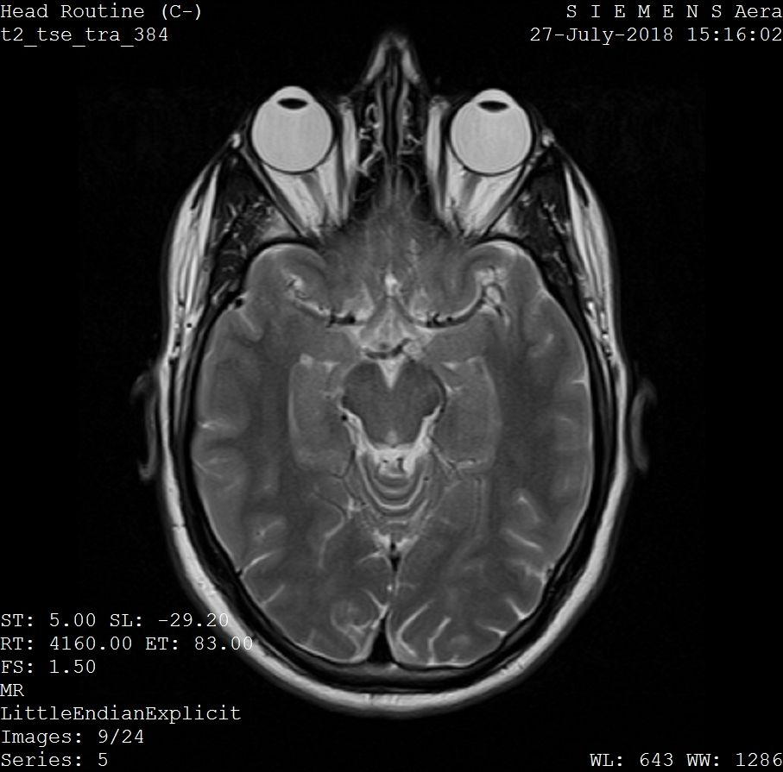
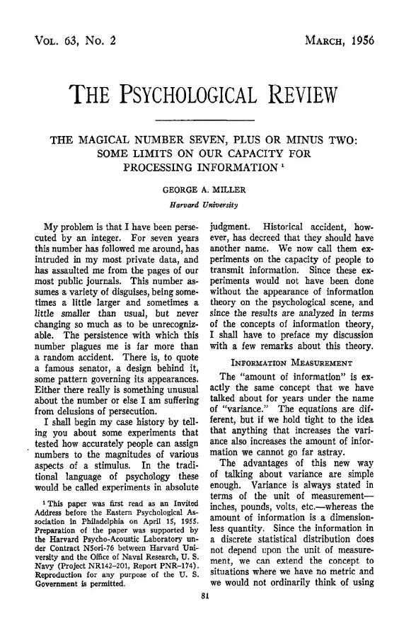

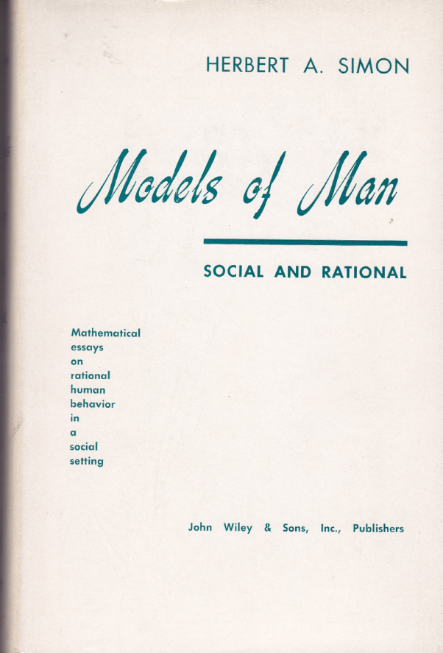
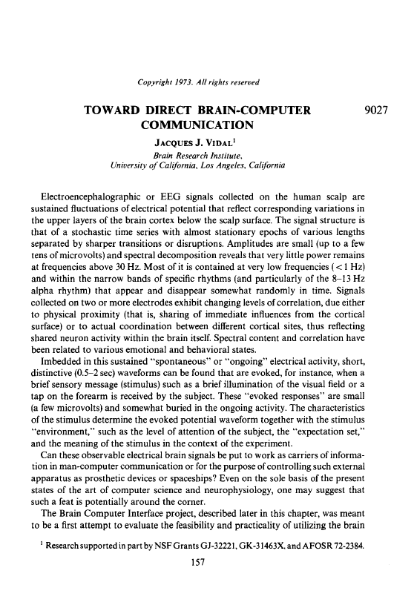
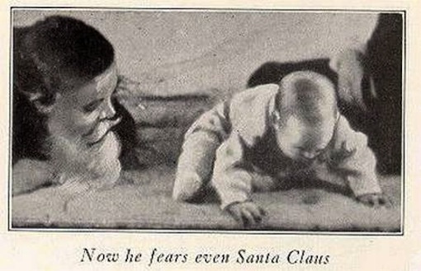
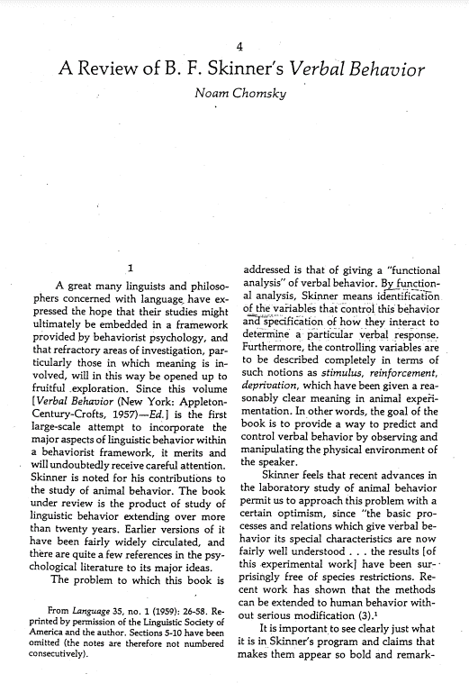
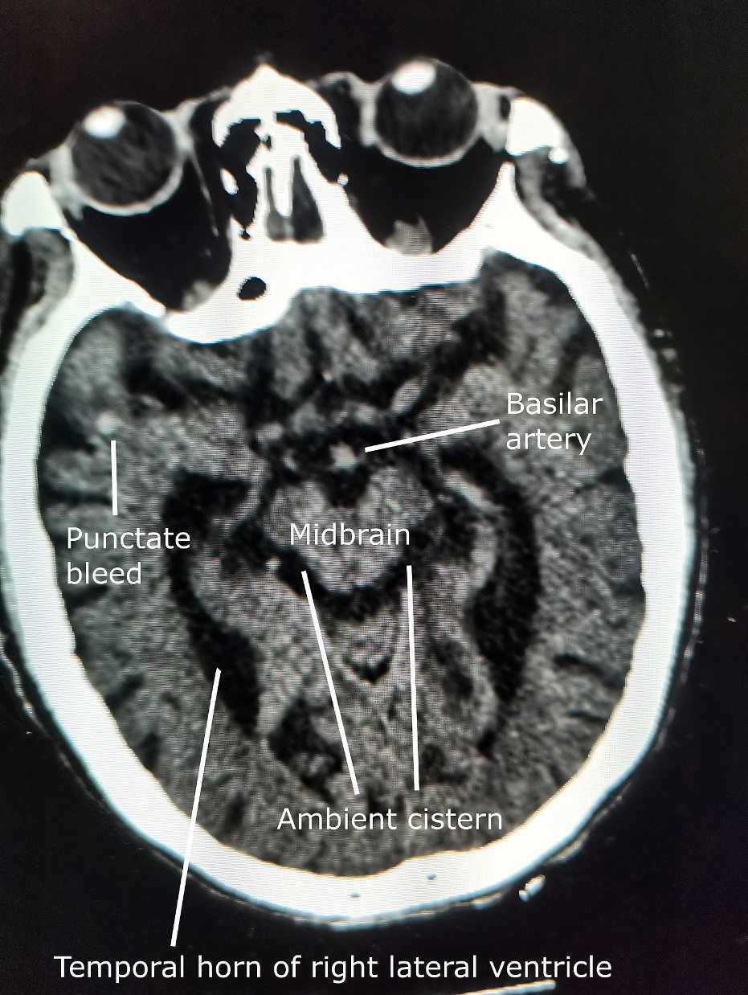
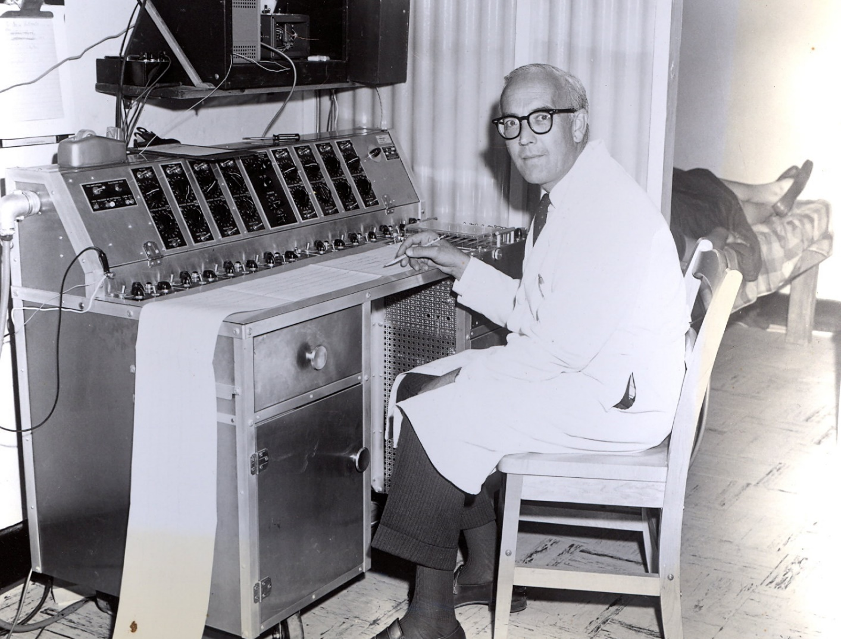
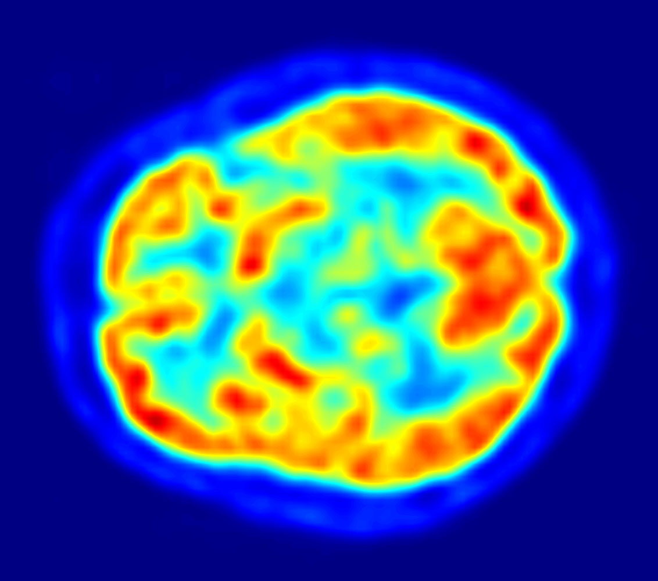

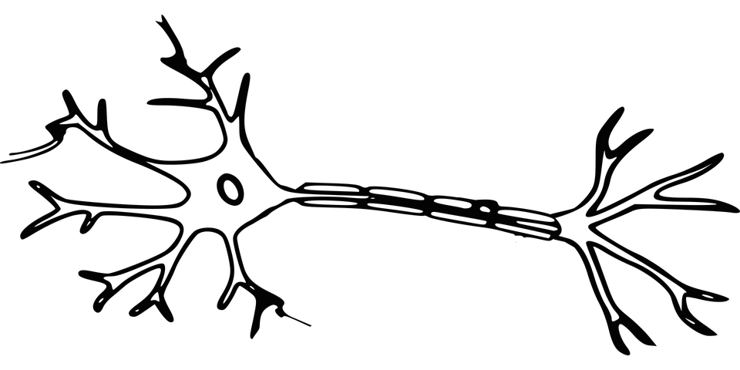
Chomsky’s critique of Behaviorism  1959
Starts the Cognitive Revolution
Brain–Computer Interface (BCI)  1973
Miller’s “Magic Number Seven”  1956
Introduces the concept of BCI
Introduces the Information Processing concept
Behaviorism  1900s
Neuroscience and Psychology
Neurons  1891
EEG  invented in 1929 (pictured here in 1965)
Magnetic Resonance Imaging (MRI)  1971–77
Herb Simon’s Models of Man  1957
Positron Emission Tomography (PET)  1975
“Bounded Rationality”
Computerized Tomography (CT)  1961–71
1950s
1960s
1970s
Notes:
At the same time, in a separate sphere of study, people were looking at human brains
1929: Electroencephalography (EEG) - Hans Berger records the first human EEG, opening the door to the study of brain electrical activity and its relationship to cognitive processes. Although we had had brain science and psychology before this (1891: Neurons discovered and 1900s: Behaviorism) it was really in the 1950 when neuroscience emerged as a distinct discipline and the new field of cognitive science was invented.
1955: First with new brain imaging techniques (Kety et al. 1955, first publication), which really began to propagate in the 1960s-70s
1961: Lassen and Ingvar map the human brain
1961: Oldendorf developed the basis for computerized tomography (CT)
1971: X-Ray CT (it wasn’t until the 1970s that CT was commercially viable)
Oldendorf’s studies in the late 1950s and early 1960s were acknowledged by Sir Godfrey Hounsfield in his own work that led to the invention of the X-ray CT scanner and the Nobel Prize for medicine in 1979.
Mid-1970s: Magnetic resonance imaging (MRI) was introduced.
1973: Vidal introduces the concept of BCI with his 1973 paper on the "BCI challenge"
1975: Phelps and Hoffman PET Scanner
Cognitive Psychology emerges to challenge behaviorism, focusing on mental processes, perception, memory, and decision-making (1950s-1960s)
Noam Chomsky's 1959 critique[7] of behaviorism, and empiricism more generally, initiated what would come to be known as the "cognitive revolution". Inside psychology, in criticism of behaviorism, J. S. Bruner, J. J. Goodnow & G. A. Austin wrote "a study of thinking" in 1956.
Bounded rationality was coined by Herbert A. Simon (Models of Man, 1957), where it was proposed as an alternative basis for the mathematical and neoclassical economic modelling of decision-making, as used in economics, political science, and related disciplines. A study completed by Allais in 1953 began to generate ideas of the irrationality of decision making as he found that given preferences, individuals will not always choose the most rational decision and therefore the concept of rationality was not always reliable in economic predictions.[9] In Models of Man, Simon argues that most people are only partly rational, and are irrational in the remaining part of their actions.
1970s first BMIs: A review pointed out that Vidal's 1973 paper stated the "BCI challenge"[13] of controlling external objects using EEG signals, and especially use of Contingent Negative Variation (CNV) potential as a challenge for BCI control. The 1977 experiment Vidal described was the first application of BCI after his 1973 BCI challenge. It was a noninvasive EEG (actually Visual Evoked Potentials (VEP)) control of a cursor-like graphical object on a computer screen. The demonstration was movement in a maze.[14]
1970s MRI: Raymond Damadian, a doctor, who wondered if the same methods could be used on living organisms to detect disease. In 1971, he concluded that since cancerous tissue contained more water than healthy tissue, it could be detected by scanners that bathed a part of the human body in radio waves and measured the emissions from the local hydrogen atoms.
In the early 1960s, early notions of AugCog started to circulate through the Defense Advanced Research Projects Agency (DARPA; formerly called ARPA), the DoD’s experimental, high-risk research wing. During this period, J. C. R. Licklider, a great visionary of computing and one-time Director of the DARPA Information Processing Techniques Office, wrote: “The hope is that, in not too many years, human brains and computing machines will be coupled together very tightly, and that the resulting partnership will think as no human brain has ever thought and process data in a way not approached by the information-handling machines we know today” (Licklider, 1960: 4).
- - - - - -
EEG Source: https://commons.wikimedia.org/wiki/File:Pr_L%C3%A9onide_Goldstein.jpg
Little Albert: https://commons.wikimedia.org/wiki/File:Little-albert.jpg
original photograph by philip cosson showing the first commercial CT head scanner Image uploaded from the English Wikipedia https://commons.wikimedia.org/wiki/File:Emi1010.jpg
See: https://www.asnweb.org/i4a/pages/index.cfm?pageid=3334 for a good history
MRI History: https://www.starimagingindia.com/blog/history-of-the-mri-machine/

Slide 8

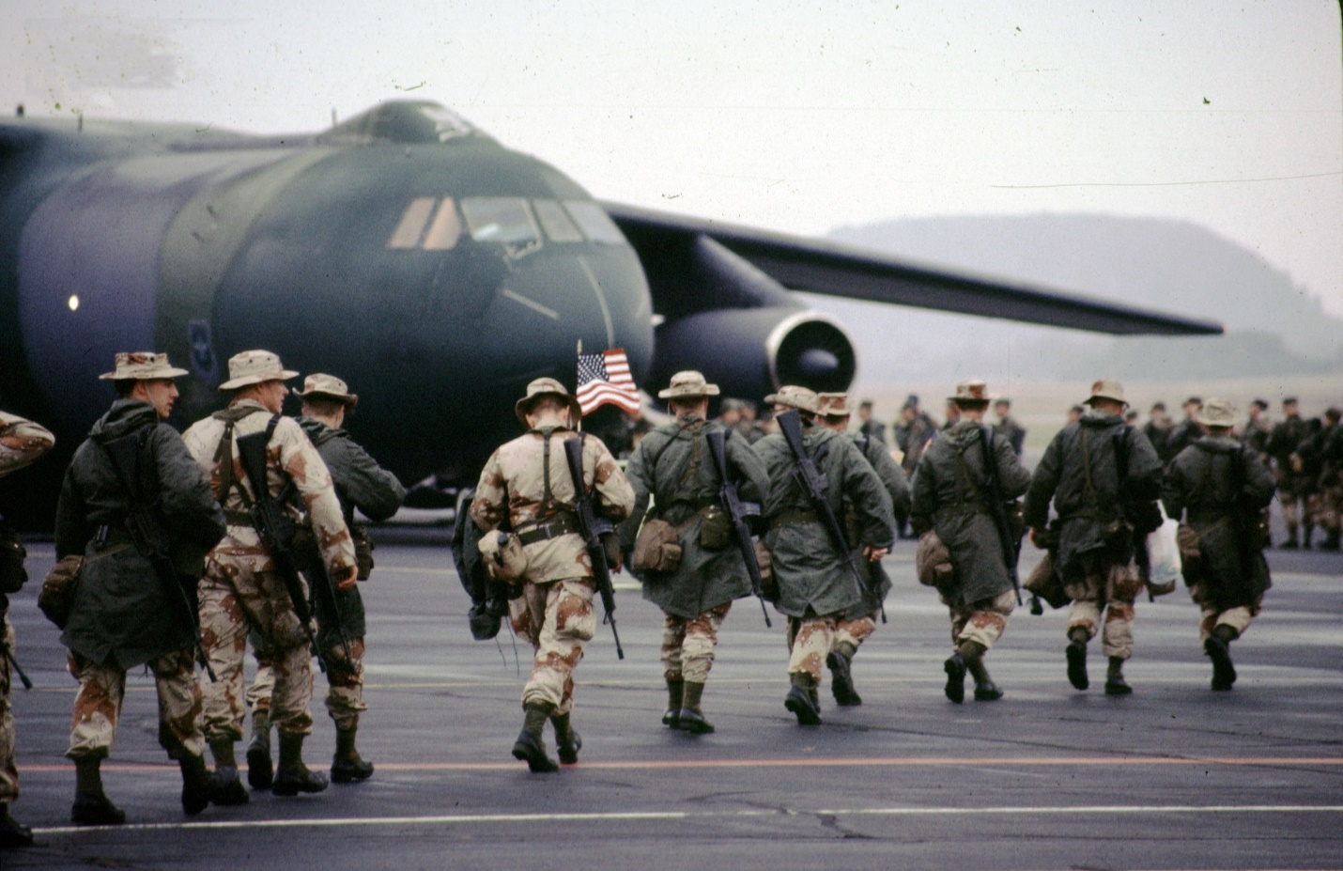


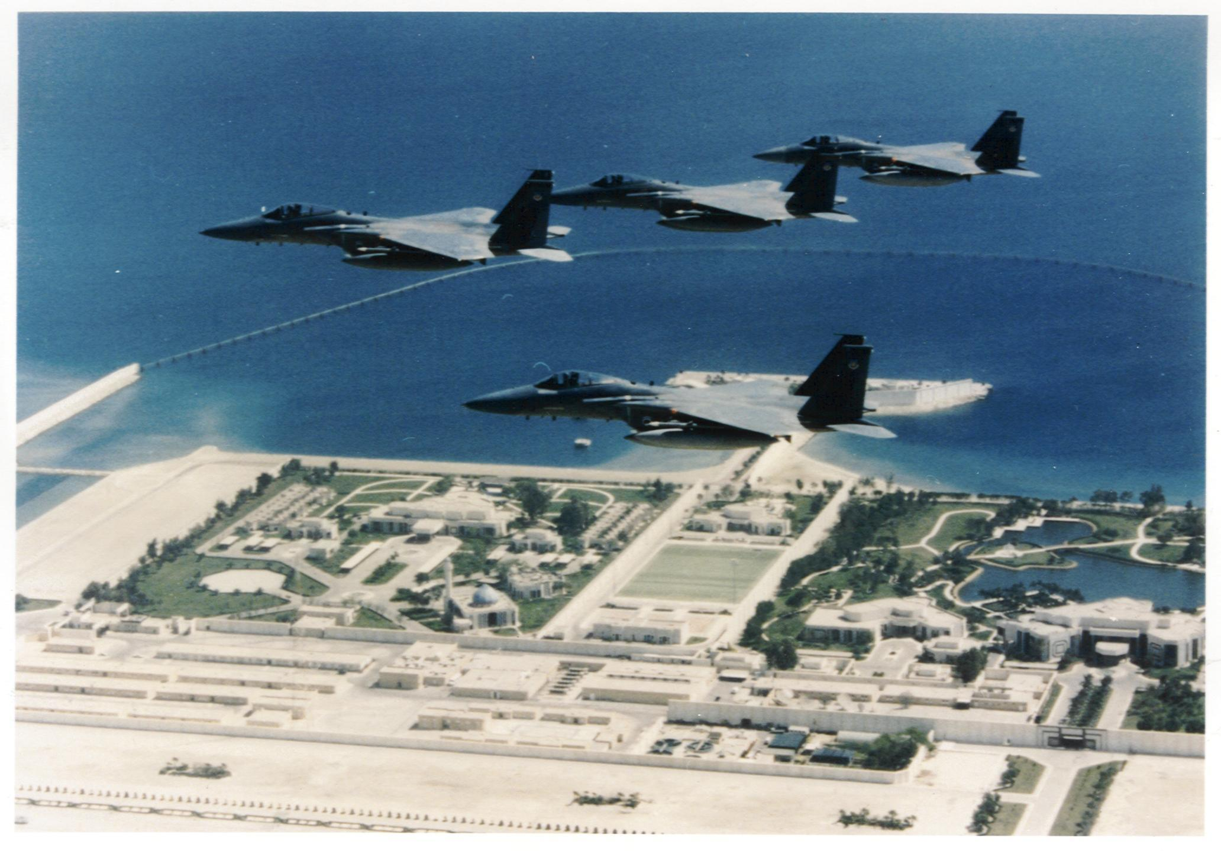
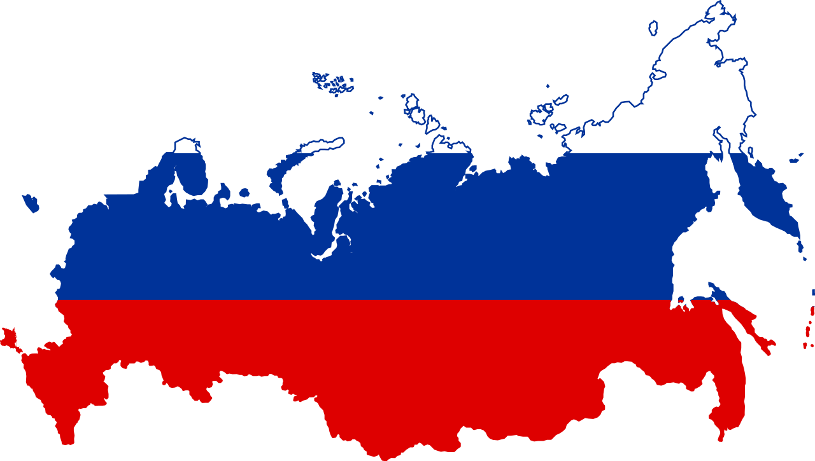
…the epitome of Information Warfare
– Major General Wang Pufeng (now known as the Father of Chinese Information Warfare)
Joint Information Warfare Center
Command for IW including PSYOP, military deception, and EW
Is this a Revolution in Military Affairs (RMA)?
Information Warfare is the “great transformation”
– Chinese military strategists as quoted by Mulvenon, 1999
Гибридная война
(gibridnaya voyna)
Desert Storm
1990s
Notes:
DESERT STORM – Causes everyone to take notice
Gulf War, 1991: GPS at war
The Gulf War saw the first extensive combat use of the fledgling global positioning system. Although the system was not to become fully operational for another four years, it was used in the conflict to enable coalition forces to navigate and co-ordinate operations in the unfamiliar terrain of Kuwait and Iraq. Despite its successes, notably with target tracking and smart missile guidance, the Gulf War also highlighted the susceptibility of GPS to jamming, with even some relatively unsophisticated Iraqi devices proving capable of masking the weak signal from the system’s satellites. GPS still remains vulnerable to jamming and spoofing today.

Slide 9
Political
Warfare
Cyber Warfare
Hybrid Warfare
Information Warfare
Notes:
Tzu-Chieh Hung, Tzu-Wei Hung, “How China’s Cognitive Warfare Works: A Frontline Perspective of Taiwan’s Anti-Disinformation Wars,” Journal of Global Security Studies, Volume 7, Issue 4, December 2022, ogac016, https://doi.org/10.1093/jogss/ogac016.

Slide 10

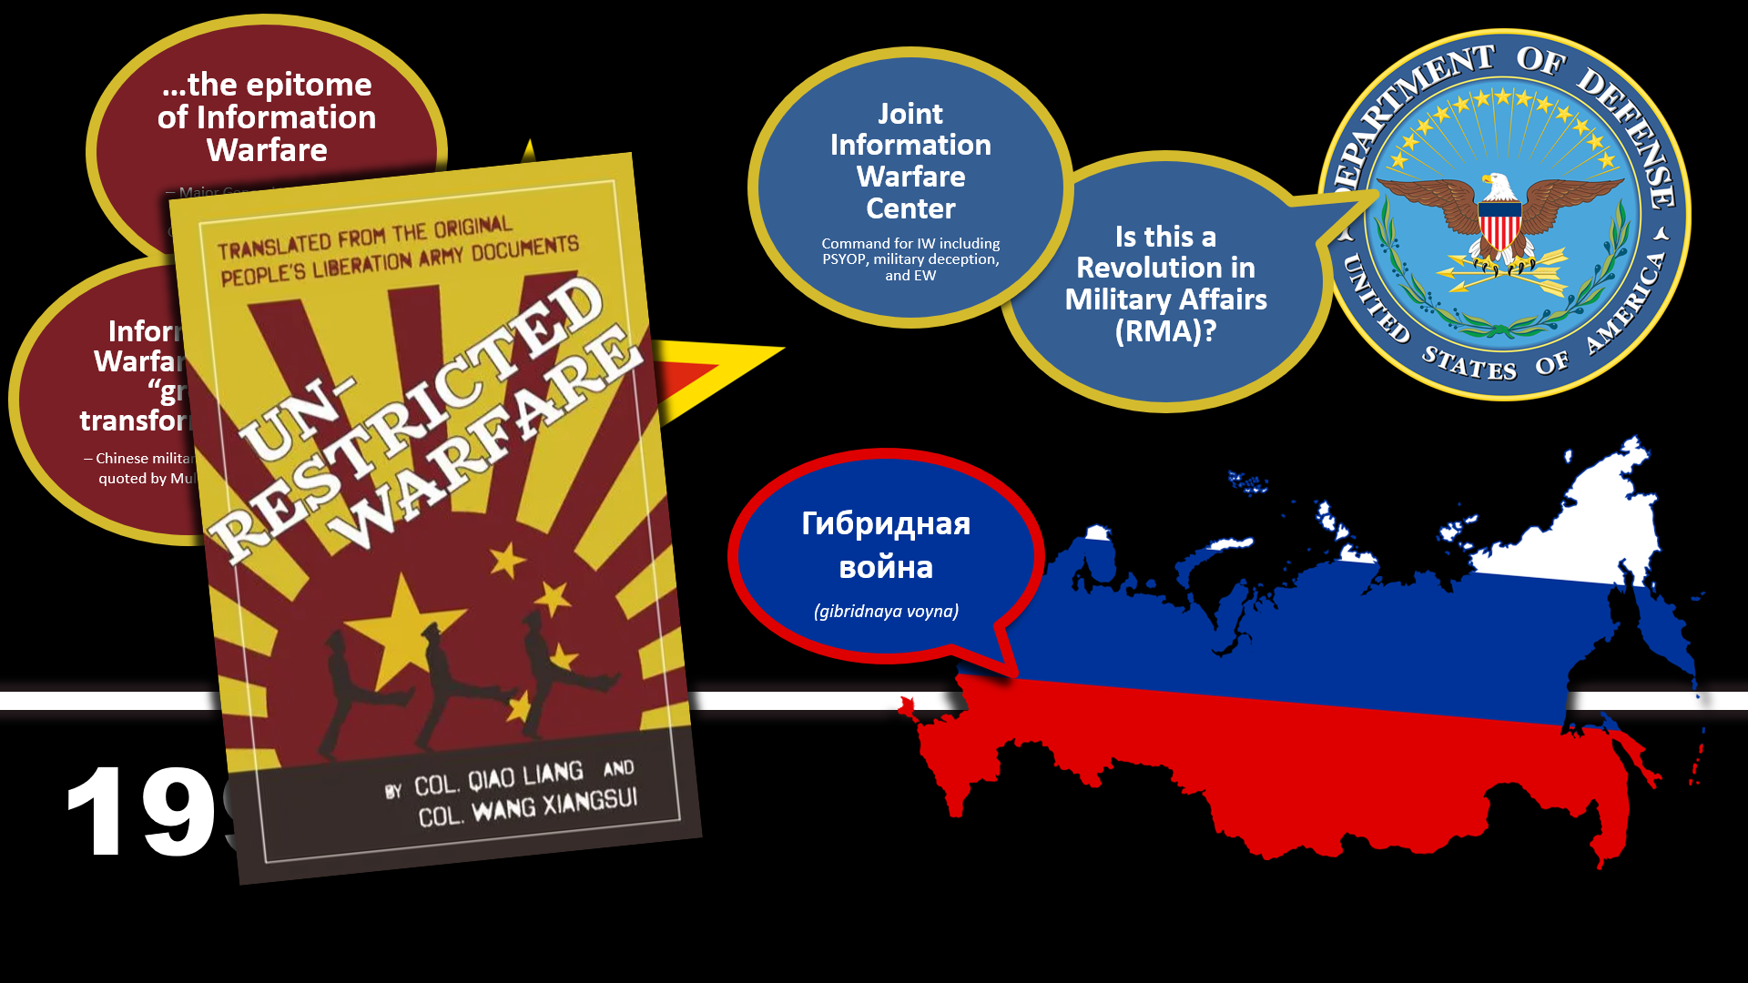

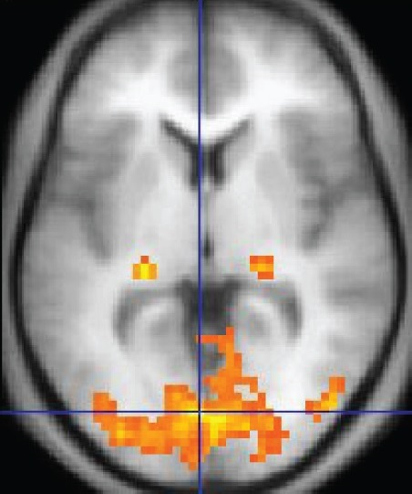
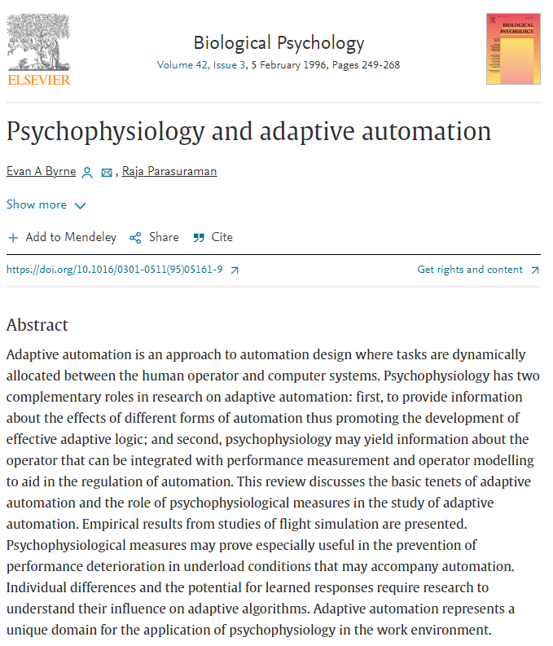


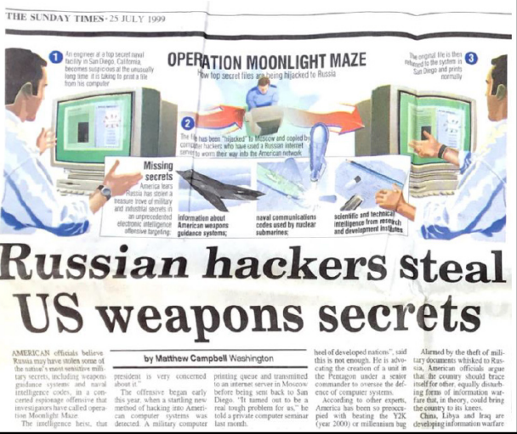
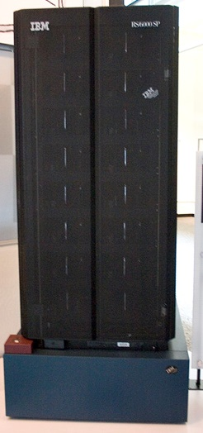

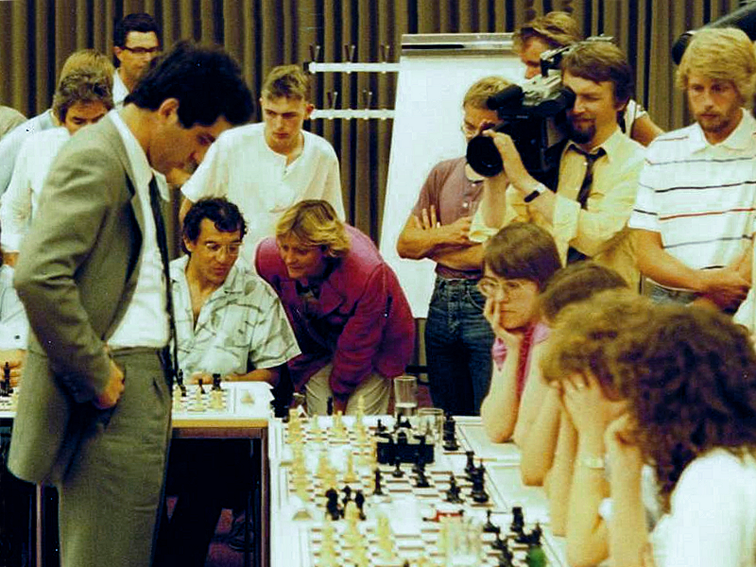
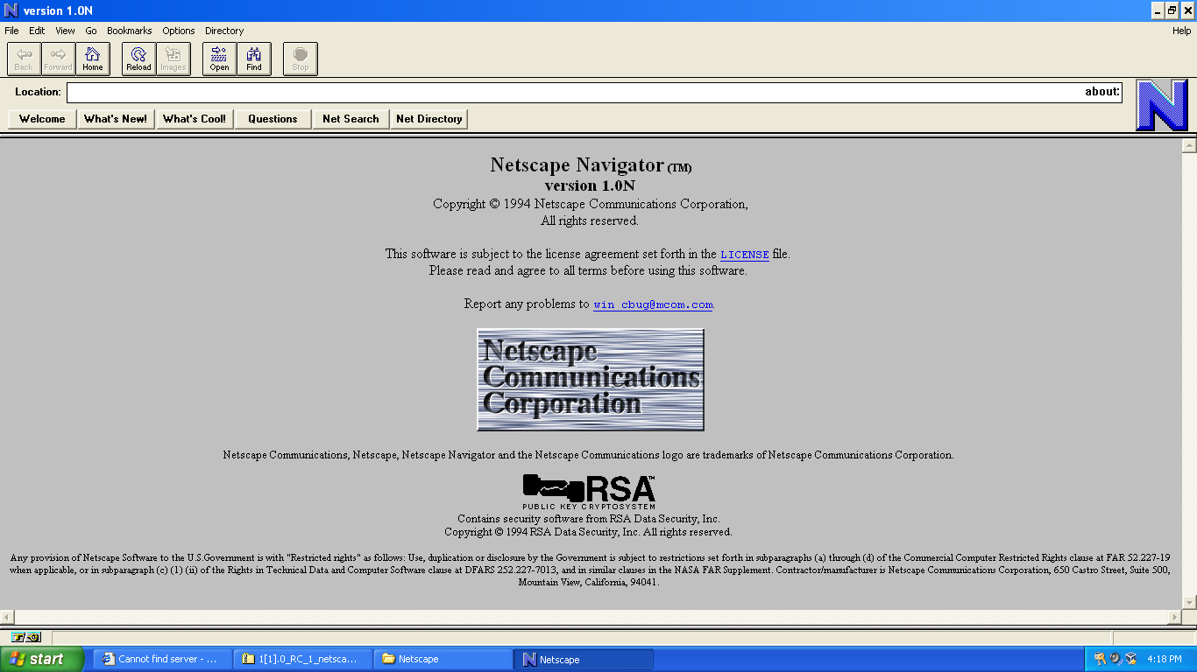

Machine Learning
W
W
W
AI Winter
AI
Big Data
Cyber
Brain Science
fMRI  1991
Adaptive Automation  1996
AugCog and workload
“Decade of the Brain”
Moonlight Maze (first APT)  1996–1999
1990s
Deep Blue beats Kasperov  1997
First commercial browser (Netscape)  1994
Deep Blue  1996
Notes:
https://en.wikipedia.org/wiki/History_of_neuroimaging
The zeitgeist of the 1990s – the so-called “Decade of the Brain” – was also key. A synergy among computer science, neuroscience, and cognitive psychology was developed, and new theories of Human−Computer Interaction (HCI) involving the usage of psychophysiological signals as triggers for automation grew from this integration. Byrne and Parasuraman’s (1996) classic article on real-time workload measurement and adaptive automation is representative of the theoretical perspectives of this exciting period—although it is noted that other researchers such as Scerbo, Schmorrow, Kollmorgen, and Gevins also published similar thoughts (Kruse & Schmorrow, 2005; Schmorrow & Kruse, 2004; Schmorrow et al., 2008; see also Scerbo 1996; Kollmorgen, 2007).
Bryne & Parasuraman - https://doi.org/10.1016/0301-0511(95)05161-9

Slide 11
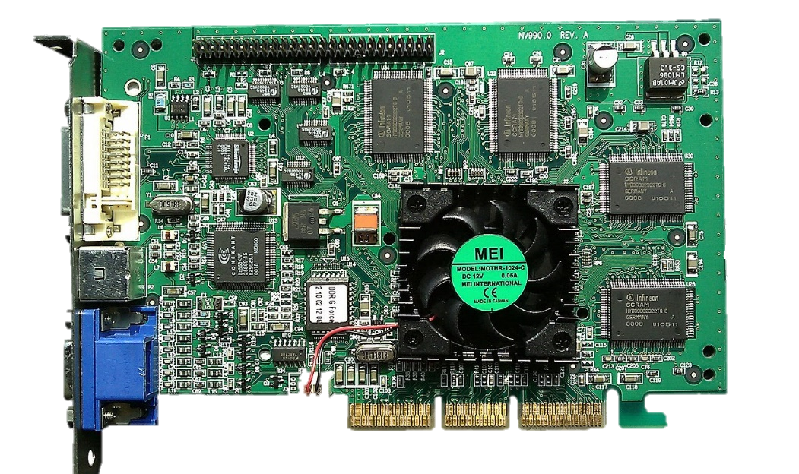
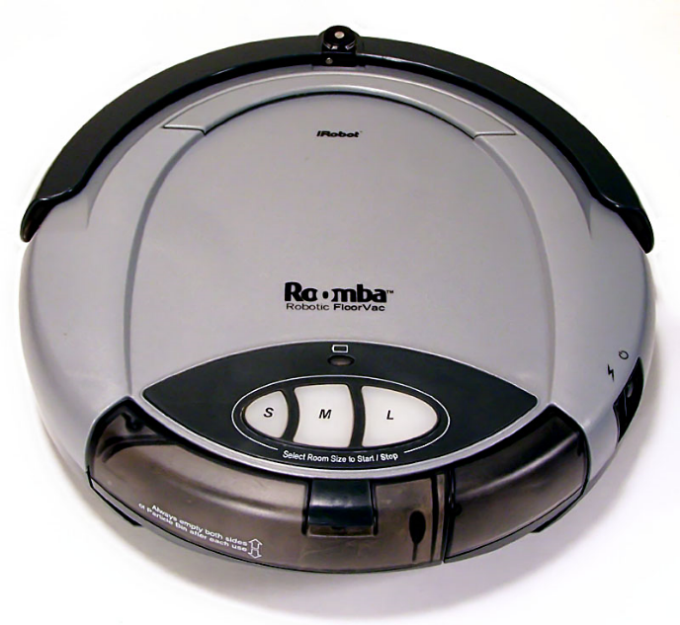
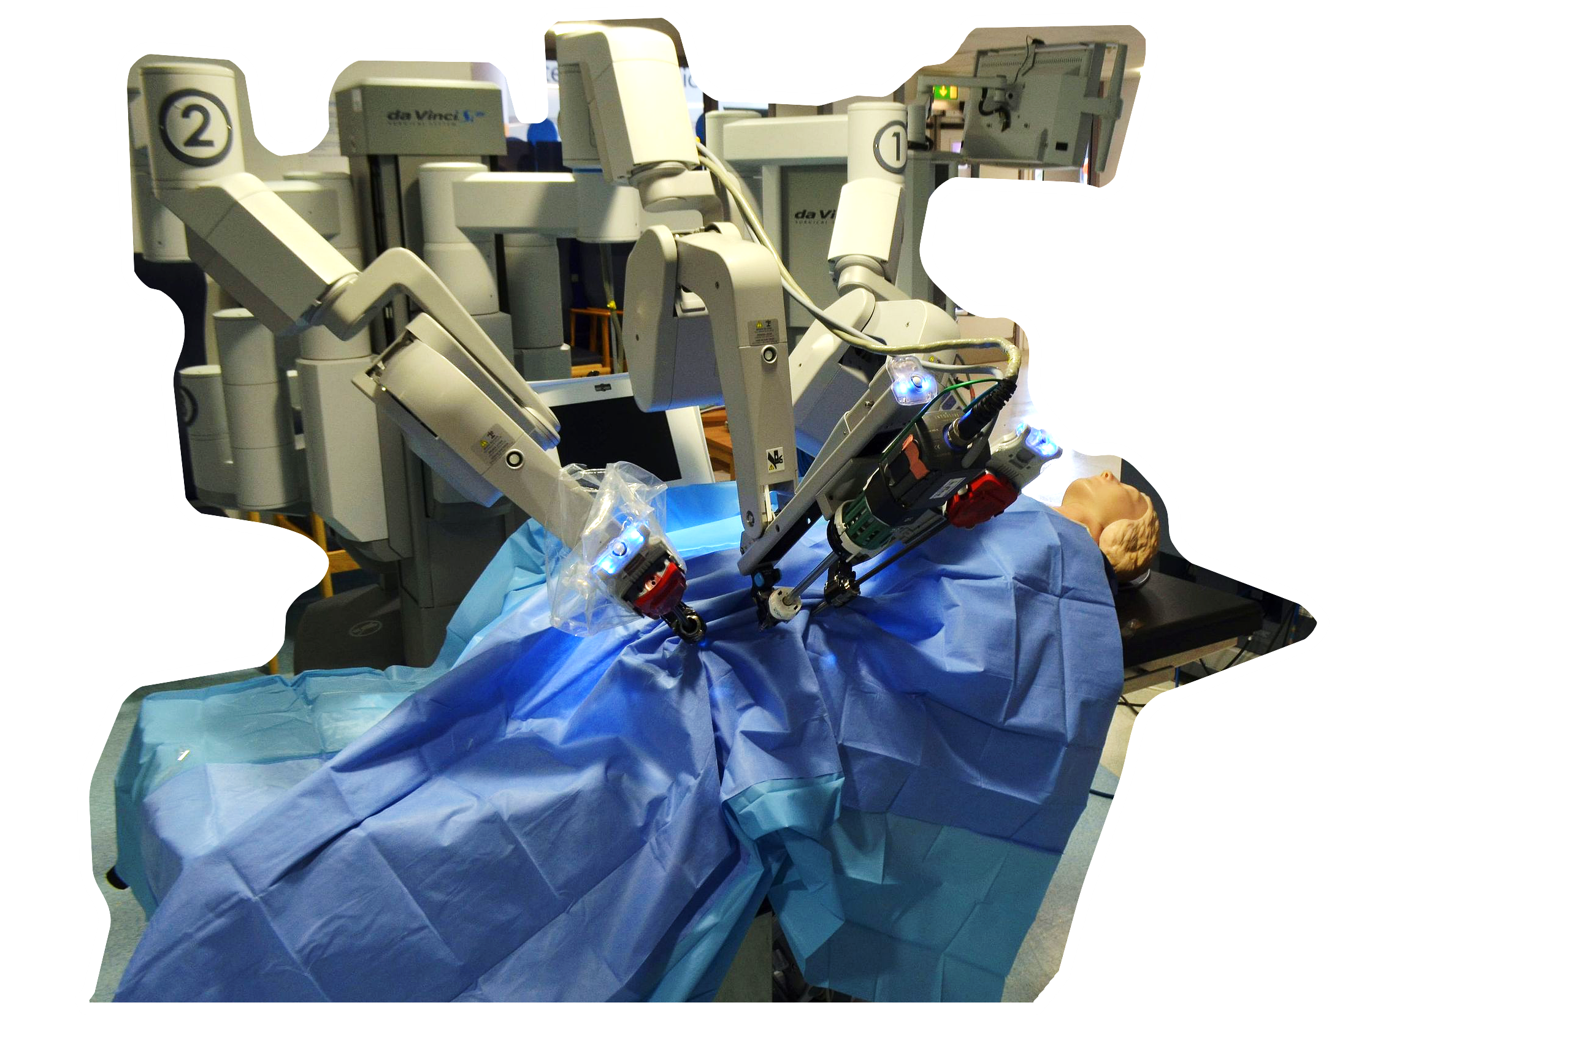
Deep Learning
Machine Learning
W
W
W
AI
Big Data
Cyber
Brain Science
General-purpose computing on GPUs  2001—
Roomba  2002
Adaptive Automation  1996
AugCog and workload
“Decade of the Brain”
Moonlight Maze (first APT)  1996–1999
1990s
2000s
Deep Blue beats Kasperov  1997
First commercial browser (Netscape)  1994
Da Vinci approved for surgery (US)  2000
Deep Blue  1996
Notes:
AI
1999: Nvidia popularized it in 1999 by marketing the GeForce 256 add-in board (AIB) as the world's first GPU.
…but it wasn’t until 2006 that GPUs became mainstream for high performance computing-- First GPU for general high performance computing as well as graphics processing, NVIDIA GT 80 chip/GeForce 8800 card.
2000: Intuitive Surgical’s da Vinci becomes the first robotic-assisted surgical system to gain approval by the U.S. Food & Drug Administration for general laparoscopic surgery. (da Vinci obtained FDA clearance in 1997 but only for visualization and tissue retraction. It was not until 2000 that the device could use its full instrumentation for general surgery indications including cholecystectomy and Nissen fundoplication.)
2002: First mass produced autonomous robotic vacuum cleaner from iRobot learns to navigate and clean homes
2006: Geoffrey Hinton coins the term “deep learning” to explain new algorithms that let computers recognize objects and text within images and videos.
1999+: The concept of cognitive radio was first proposed by Joseph Mitola III in a seminar at KTH Royal Institute of Technology in Stockholm in 1998 and published in an article by Mitola and Gerald Q. Maguire, Jr. in 1999.
- Cognitive radar has emerged over the past 15 years (since 2019) through synergy of cybernetics, waveform diversity, and knowledge-aided signal processing as a new vision for the future of radar systems that can address these challenges.
- Cellular telephone started this revolution in the 1980s
Cyber / Social
2002 Social networking and gaming site Friendster launches
2003 Business-oriented social networking service LinkedIn launches.
2003 Myspace launches
2004 Facebook, the most popular social networking service to-date, launches.
2004 Flickr, an image and video hosting website, launches.
2005 YouTube, a video sharing website that started as a dating site, launches.
2005 Reddit, an American social news aggregation, web content rating, and discussion website, launches
2005 Qzone, a Chinese social networking website, launches.
2006 Twitter, one of the most popular social networking sites worldwide, launches.
Internet Usage Chart: https://commons.wikimedia.org/wiki/File:Internet_users_per_100_inhabitants_ITU.svg
Graph of "Internet users per 100 inhabitants 1997 to 2017", years on the x axis, number of users on the y axis, according to the International Telecommunication Union (ITU)

Slide 12
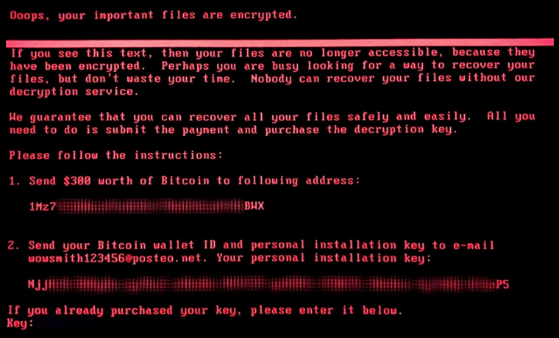


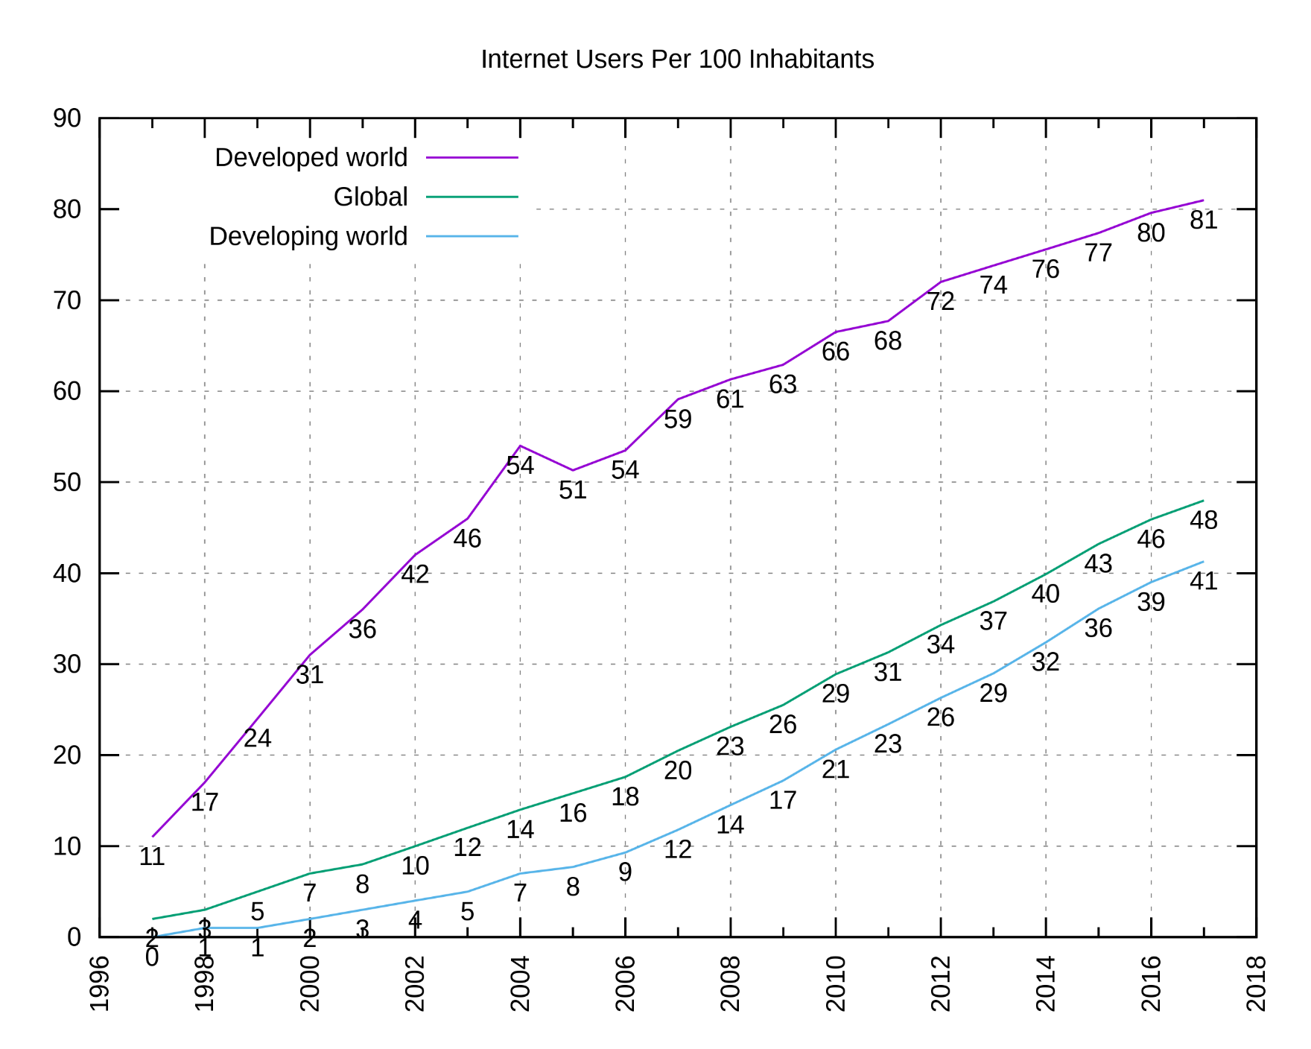

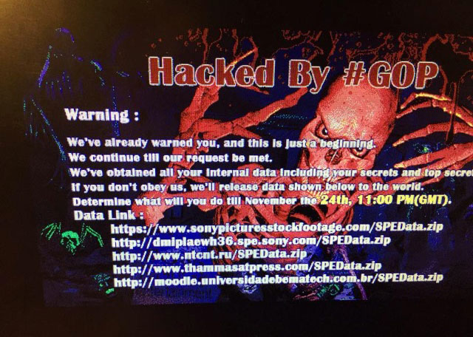



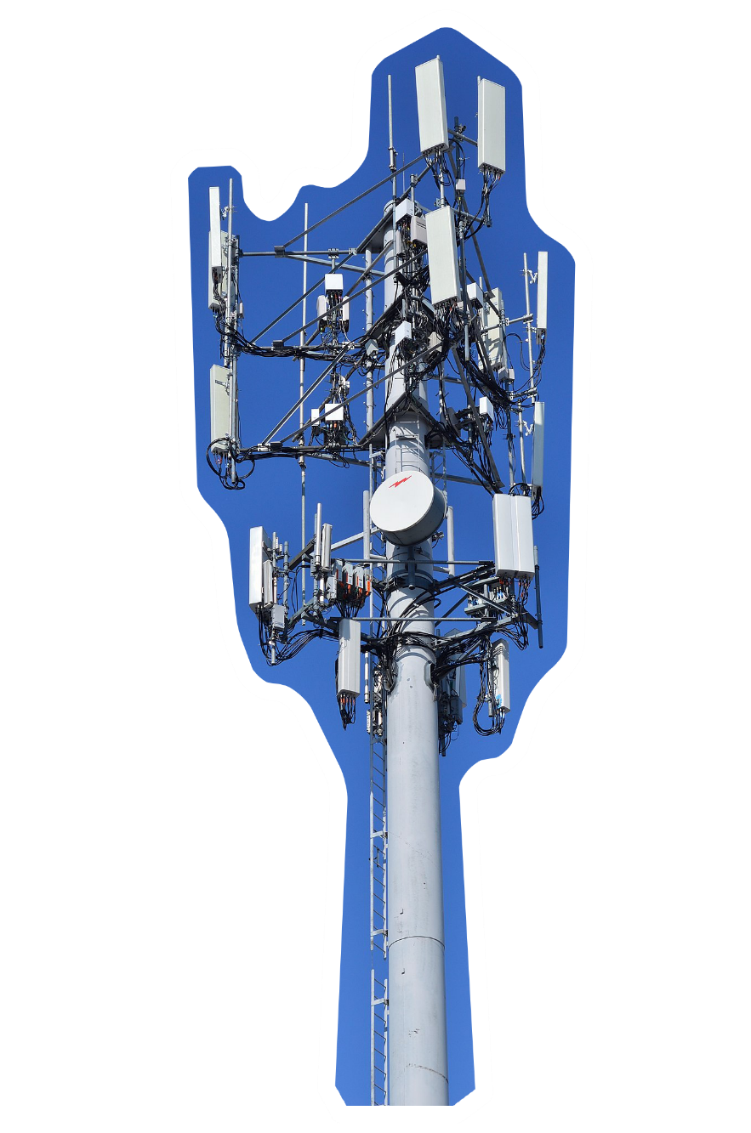

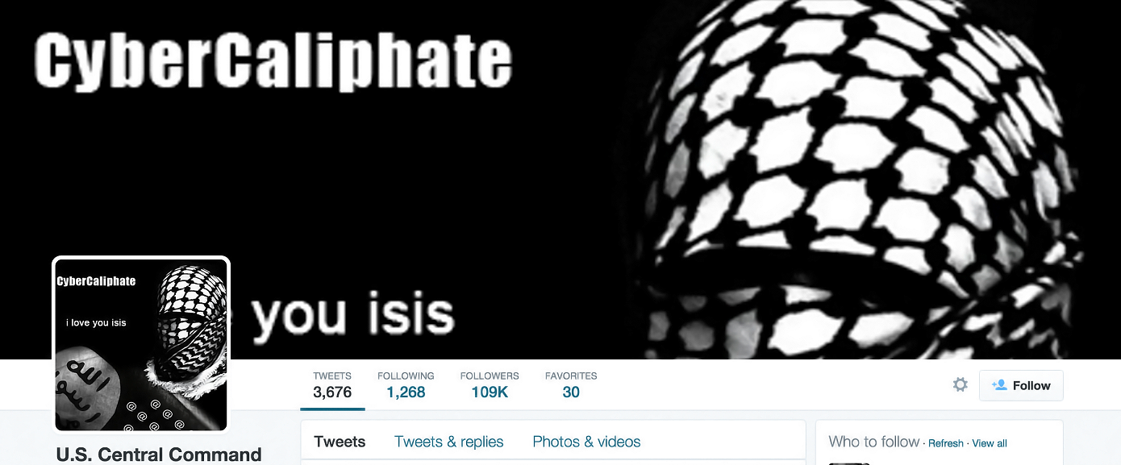








Cognitive radio  1999
AI
Electromagnetic
Cyber
Brain Science
NotPetya (Ukraine + world, APT28, Russia, $$$$)  2017
Estonia cyber attack  2007
Sony Pictures (APT38, North Korea)  2014
Stuxnet  2005
CyberCaliphate (TV5Monde, APT28, Russia)  2013
2000s
Shamoon (Saudi Aramco+ wiper, APT33 Iranian state)  2012
iPhone  2007
Major surge in worldwide internet use
Notes:
1999+: The concept of cognitive radio was first proposed by Joseph Mitola III in a seminar at KTH Royal Institute of Technology in Stockholm in 1998 and published in an article by Mitola and Gerald Q. Maguire, Jr. in 1999.
- Cognitive radar has emerged over the past 15 years (since 2019) through synergy of cybernetics, waveform diversity, and knowledge-aided signal processing as a new vision for the future of radar systems that can address these challenges.
- Cellular telephone started this revolution in the 1980s
Cyber / Social
2002 Social networking and gaming site Friendster launches
2003 Business-oriented social networking service LinkedIn launches.
2003 Myspace launches
2004 Facebook, the most popular social networking service to-date, launches.
2004 Flickr, an image and video hosting website, launches.
2005 YouTube, a video sharing website that started as a dating site, launches.
2005 Reddit, an American social news aggregation, web content rating, and discussion website, launches
2005 Qzone, a Chinese social networking website, launches.
2006 Twitter, one of the most popular social networking sites worldwide, launches.
Internet Usage Chart: https://commons.wikimedia.org/wiki/File:Internet_users_per_100_inhabitants_ITU.svg
Graph of "Internet users per 100 inhabitants 1997 to 2017", years on the x axis, number of users on the y axis, according to the International Telecommunication Union (ITU)
Stuxnet, 2005: Weaponising cyberspace; First uncovered by Kaspersky Lab in 2010, but thought even then to be at least five years older, Stuxnet is a malicious computer worm that caused significant damage to the Iranian nuclear programme. Widely believed to be a joint US/Israeli development even before Edward Snowdon explicitly said as much in 2013, it is arguably the world’s first true cyber-weapon. Specifically designed to target the programmable logic controllers which automate electromechanical processes, and highly clinical in the systems it affects, Stuxnet is reported to have caused Iran’s separation centrifuges to spin themselves to destruction, setting Tehran’s nuclear plans back by years.

Slide 13

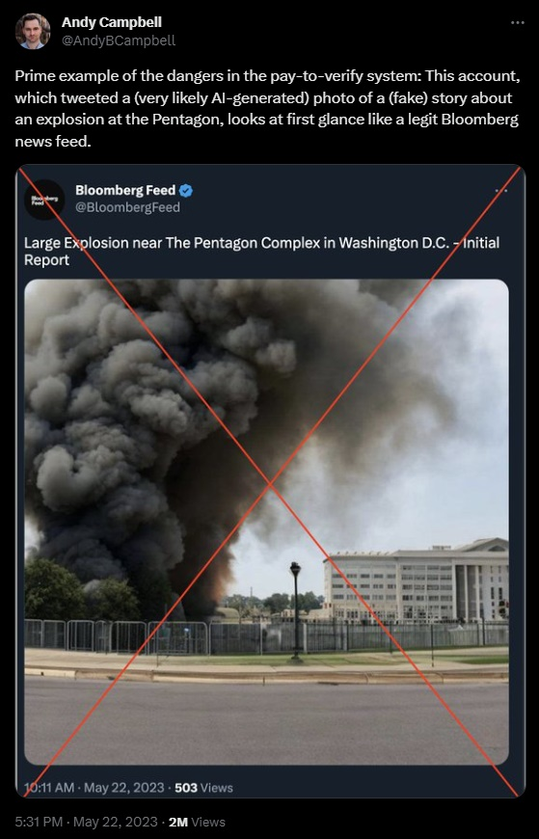



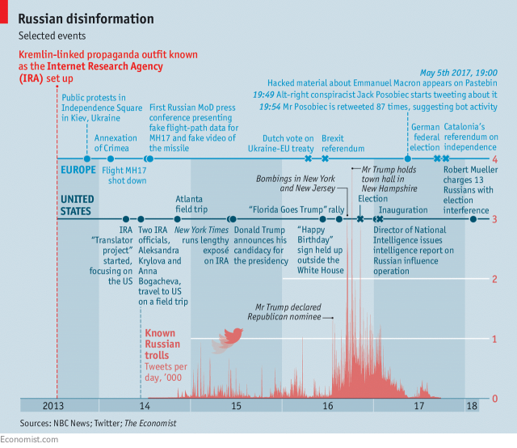
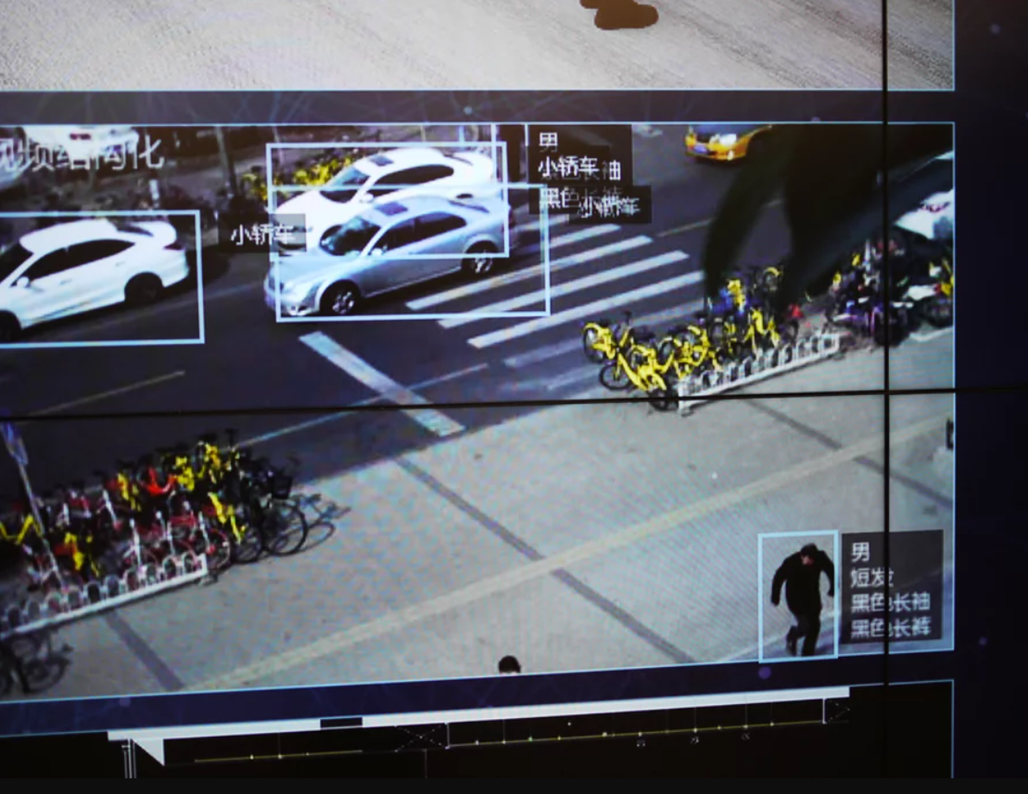


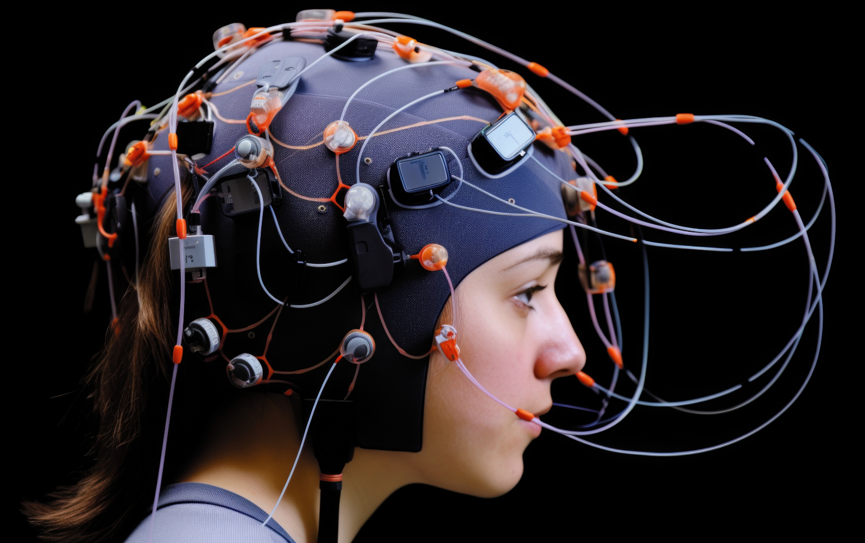
Havana Syndrome  2016+
BrainCo fifth-grader brain-monitoring study in China  2019
Monitoring in China (Rob Schmitz/NPR)
2000s
2010s
Pentagon deepfake (Andy Campbell)
Rise in disinformation  2013+
Major advances in BCI (e.g., Matt Nagle first artificial hand)  2005
Notes:
History of BCI: https://roboticsbiz.com/the-history-of-brain-computer-interfaces-bcis-timeline
Disinformation Graph: https://www.economist.com/briefing/2018/02/22/russian-disinformation-distorts-american-and-european-democracy
See also https://www.demdigest.org/russian-disinformation-distorts-american-european-democracy/
Video about China brain monitoring: https://www.youtube.com/watch?v=JMLsHI8aV0g
China Camera image: Megvii cameras capture images of a Beijing street.
Rob Schmitz/NPR
https://www.npr.org/sections/parallels/2018/04/03/598012923/facial-recognition-in-china-is-big-business-as-local-governments-boost-surveilla

Slide 14
Hybrid Warfare
Cognitive Warfare
Information Warfare
Cyber Warfare
Hung & Hung (2022)
Notes:
Tzu-Chieh Hung, Tzu-Wei Hung, “How China’s Cognitive Warfare Works: A Frontline Perspective of Taiwan’s Anti-Disinformation Wars,” Journal of Global Security Studies, Volume 7, Issue 4, December 2022, ogac016, https://doi.org/10.1093/jogss/ogac016.

Slide 15





INFORMATION
TAKE AWAY #1
Fighting against perceptions and cognition, using a complex, multi-domain toolkit
NEURO
COGNITION
DIGITAL (CYBER/AI)
ELECTROMAGNETIC

Slide 16
INFORMATION
TAKE AWAY #1
TAKE AWAY #2
Fighting against perceptions and cognition, using a complex, multi-domain toolkit
Cognitive Warfare is a form of systems warfare, with many interacting elements
NEURO
COGNITION
DIGITAL (CYBER/AI)
ELECTROMAGNETIC

Slide 17




Dr. Tagarev
Todor Tagarev, Ph.D.
Minister of Defense
(2023-2024)
Bulgaria
Dr. Gaber
Yevgeniya Gaber, Ph.D.
Professor,
Marshall Center
Ukraine
Dr. Nesic
Aleksandra Nesic, Ph.D. Foreign Service Institute, Department of State
United States
Dr. Rickli
Jean-Marc Rickli, Ph.D.
Head of Global Risk and Resilience, GCSP
Switzerland

Slide 18
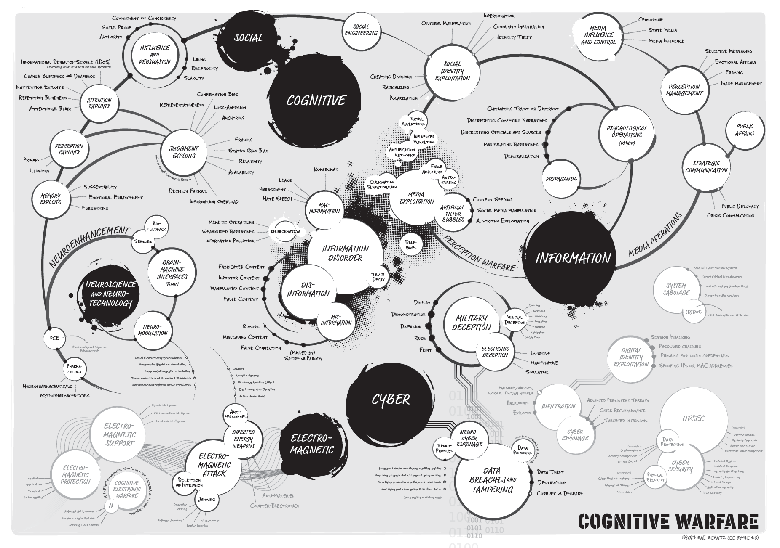

DOWNLOAD A COPY

Slide 19
Download a copy of the concept map: https://drive.google.com/file/d/1nwsCIGSLbwzIwUErF-MeV5QW4ursrgIE/view

