Slide 1
Workshop:
From Zero to Hero: VR Design and Assessment for Novice-to-Expert Progression
Jeanine A. DeFalco, PhD, University of New Haven
Madeleine Keehner, PhD, Brighter Research
Kristin Torrence, Cornerstone

Slide 2
Workshop Objectives
Apply the Principles of Simulation Design and Assessment:
  Participants will learn and apply fundamental principles involved in designing and assessing simulations, particularly in the context of "Measuring Deterrence."
Develop Skills in Task Analysis and Competency Mapping:
  Participants will learn how to conduct a detailed task analysis and map out competencies, aligning training and learning objectives with specific tasks to be assessed in a simulation.
Create Effective Storyboards for VR Simulations:
  Participants will acquire the skills to develop detailed storyboards that illustrate the trainee experience and assessment processes within a VR simulation, focusing on both summative and performative assessments.
Prototype and Iteratively Improve Simulation Designs:
  Participants will learn to create initial prototypes of their simulation designs, engage in iterative design processes by incorporating peer feedback, and refine their prototypes to enhance effectiveness and realism.
Integrate Real-World Assets into Simulation Assessments:
  Participants will understand how to incorporate real-world measuring tools into their simulation assessments, adapting their designs based on practical constraints and ensuring alignment with training objectives.
Notes:
Jeanine
Who needs to design? Who needs to make final decisions?
Memesis -
Design Challenges: balance between memetic representation of interaction and what is going to affect the learning.
Zone of proximal development.
Just because we can represent all of these things in the space doesn't mean we should.
Fine line - if there is a disparity between the real object and the representation, that will be a distraction to learner

Slide 3
Workshop Agenda
Part 1: Objectives, Definitions, and Foundational Concepts 8:00 am – 8:30 am
Part 2: Assessments and Task Analysis 8:30 am – 9:00 am
Part 3: Storyboarding for VR 9:00 am – 9:30 am
  Break 9:30 am – 9:45 am
Part 4: Prototyping 9:45 am – 11:15 am
  Break 11:15 am – 11:30 am
Part 5: Socialize and Reflect 11:30 am – 11:45 am
Part 6: Close Out and Final Thoughts 11:45 am – 12:00 pm
Notes:
https://docs.google.com/document/d/1toFoOqEFns9i6-SFhzKD4hg-lfJCqwaESHZO_Ow4czQ/edit?usp=sharing
Memesis -
Design Challenges: balance between memetic representation of interaction and what is going to affect the learning.
Zone of proximal development.
Just because we can represent all of these things in the space doesn't mean we should.
Fine line - if there is a disparity between the real object and the representation, that will be a distraction to learner

Slide 4
Part 1
Part 1: Objectives, Definitions, and Foundational Concepts 8:00 am – 8:30 am
    You will collaboratively design your own immersive simulation and assessments with other workshop participants.
    You will focus the simulation on Measuring to Insure Deterrence and Success.
    You will learn about the complexity and collaborative nature of designing immersive simulations and assessing for efficacy of learning.
Notes:
https://docs.google.com/document/d/1toFoOqEFns9i6-SFhzKD4hg-lfJCqwaESHZO_Ow4czQ/edit?usp=sharing
Memesis -
Design Challenges: balance between memetic representation of interaction and what is going to affect the learning.
Zone of proximal development.
Just because we can represent all of these things in the space doesn't mean we should.
Fine line - if there is a disparity between the real object and the representation, that will be a distraction to learner

Slide 5
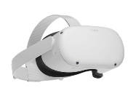
Definitions
    Assessment: A method that allows us to make valid claims about someone’s knowledge, skills, or aptitudes based on observable evidence.
    Immersive learning simulation: An in-headset learning environment to teach or train.
    Iterative design: Starting with high-level scoping, collaborating across teams, e.g., art, engineering, etc., to continue to refine in detail and complexity the blueprint of a design.
    Learning engineering: The systematic application of evidence-based principles and methods from educational technology and the learning sciences to create engaging and effective learning experiences, support the difficulties and challenges of learners as they learn, and come to better understand learners and learning.
Notes:
Memesis -
Design Challenges: balance between memetic representation of interaction and what is going to affect the learning.
Zone of proximal development.
Just because we can represent all of these things in the space doesn't mean we should.
Fine line - if there is a disparity between the real object and the representation, that will be a distraction to learner

Slide 6

Measuring to insure deterrence & success
Measuring to ensure deterrence and ensure success means that the designed training prepares the trainees and gives evidence of likelihood trainees will accomplish their future missions. Key elements of this process include:
  Assessment of Capabilities: Determining whether training is providing troops with the necessary skills and knowledge to respond effectively to potential challenges.
  Readiness Evaluation: Gauging the readiness levels of trainees and their ability to be deployed quickly and respond promptly to various situations.
  Strategic Alignment: Ensuring training objectives align with strategic deterrence goals, like maintaining a strong, visible presence to discourage adversaries or mission failures.
  Performance Metrics: Utilizing specific performance metrics to evaluate training outcomes, such as the speed of response, mission success rates, and adaptability.
  Simulated Threats and Challenges: Incorporating realistic scenarios in training exercises to simulate potential threats and assess how well military personnel can identify and neutralize them.
  Feedback and Improvement: Gathering feedback from exercises to refine training programs continually and keep forces adaptable and up-to-date.

Slide 7
Assessment Types and Uses
Core goals of assessment
To make valid claims about what a learner knows and can do based on observable evidence
  Knowledge, skills, and aptitudes (KSAs)
Different types of assessment
Performance based
Competency based
Different uses of assessment
  Formative or Summative
  High stakes or Low stakes
  Feedback, credentialing/badging
  Real time or delayed reporting
Entrustable Professional Activities
All assessments depend on evidence

Slide 8
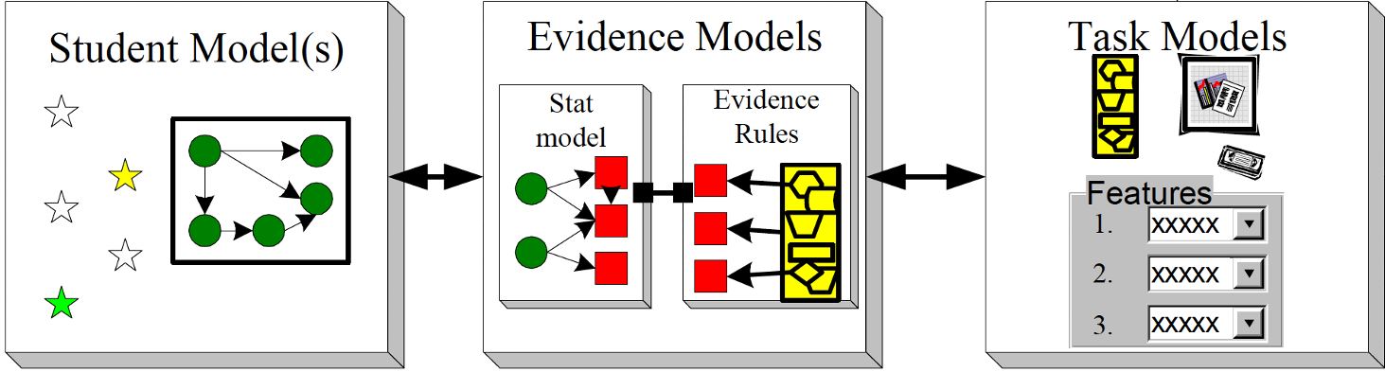

Evidence-Centered Design for Assessment
What claims do you want to make?
What evidence types will work?
How can you elicit the evidence?
Mislevy et al. (2012)
Immersive simulations can be designed to:
elicit evidence of knowledge, skills, or aptitudes
capture the evidence automatically
adapt and respond to the evidence in real-time
Design sims using ECD principles and you can connect evidence to competencies
Image created with assistance of DALL·E 2
Notes:
Decide what you want to assess and how (formative, summative, integrated learning and assessment, adaptive assessment)
Build a competency model that makes explicit the competencies you’ll be measuring and how performance looks at different levels
Identify observable evidence of competencies at different levels
Design tasks to elicit evidence that you can score and clearly connect to competencies in reporting because you have a competency model
Gather the people you’ll need if you want to do real-time adaptive
Gather validity evidence for your scores by comparing with experts
Iterate with stakeholders on scoring and reporting so they understand and trust the results

Slide 9
Observable Data in Digital Assessments
Observable data = any external action, verbalization, etc.
In a digital task, these can be automatically captured and logged
The log data, or process data, can be defined and labeled as evidence for the target competencies
The same behavior can mean different things in different contexts
The competency, evidence, and task models define which category an action falls into
Observable data - all captured actions and verbalizations
Observable data that are construct related but are not scorable evidence for claims
Observable data that are construct relevant and can be scored as evidence
Observable data that are direct responses to explicit test items and are scorable evidence for the target construct

Slide 10
Design complexity
Some fundamental principles that inform our approach:
Constructivist learning
Embodied cognition
Fidelity
  Spectrum of realism through magical realism
    Abstracting the real and making the real abstract
  Tele- and microscopic views
Autonomy, agency, motivation, and engagement
Constraints
  Platform
  Data extraction
  Animations and mechanics
  Movement and language
Collaboration across teams

Slide 11
Assertions
    Designing assessments in simulations is a backwards design process for educational and training simulations, requiring collaboration across many teams.
    Answering questions of fidelity and realism about interactions is central in assessment design.
    Designing for immersive simulations is complex and requires leveraging interdisciplinary expertise from intelligent tutoring space, gaming, cognitive psychology, curriculum design, engineering, and art.
Notes:
Memesis -
Design Challenges: balance between memetic representation of interaction and what is going to affect the learning.
Zone of proximal development.
Just because we can represent all of these things in the space doesn't mean we should.
Fine line - if there is a disparity between the real object and the representation, that will be a distraction to learner

Slide 12
Workshop Agenda
Part 1: Objectives, Definitions, and Foundational Concepts 8:00 am – 8:30 am
Part 2: Assessments and Task Analysis 8:30 am – 9:00 am
Part 3: Storyboarding for VR 9:00 am – 9:30 am
  Break 9:30 am – 9:45 am
Part 4: Prototyping 9:45 am – 11:15 am
  Break 11:15 am – 11:30 am
Part 5: Socialize and Reflect 11:30 am – 11:45 am
Part 6: Close Out and Final Thoughts 11:45 am – 12:00 pm
Notes:
https://docs.google.com/document/d/1toFoOqEFns9i6-SFhzKD4hg-lfJCqwaESHZO_Ow4czQ/edit?usp=sharing
Memesis -
Design Challenges: balance between memetic representation of interaction and what is going to affect the learning.
Zone of proximal development.
Just because we can represent all of these things in the space doesn't mean we should.
Fine line - if there is a disparity between the real object and the representation, that will be a distraction to learner

Slide 13
Part 2
Part 2: Assessments and Task Analysis (8:30am – 8:40am)
Introduce the design task: Measuring for Deterrence (healthcare sim or other, e.g., military, EMT)
Share links to reference materials (OSHA, Medical Standards)
Hand out high level outline of TA (see appendix)
Discuss learner persona: Novice
Pedagogical Agent (PA)
PARTICIPANTS (8:40am – 9:00am)
Working in groups, participants will fill in missing information for task analysis and refine/add learning objectives.
Share their work with other groups.
Notes:
EO notes - provide questions about the participant’s deliverables
Keep humans in the loop!
Consider design constraints: Time, sim length, LOs, etc.
Include SME, human interaction component to using the materials
https://www.hsdl.org/?view&did=3247

Slide 14
Design Task
Task: Create an immersive simulation that demonstrates best practices for measuring—domain and task of your choice.
Sim time length: 3-8 minutes
Deliverables:
Completed Task Analysis
Storyboard of initial design
Initial prototype
Final prototype

Slide 15
Assessments and Task Analysis (TA)
What’s included:
Learning outcomes
Knowledge, skills, and competencies to be included in the simulation as given from SME
What must be assessed
What needs to be added:
Exact learning objective(s) (LOs), with appropriate language
Environment
Procedure, or order that interactions take place
Tasks that give evidence of knowledge, skills, or competencies
Notes:
Participants will complete the rest of the Task Analysis

Slide 16
Performance and Assessment Analysis Tool
TASK LEARNING OBJECTIVES:
ENVIRONMENT
TASK STEP Distinct stages of the overall task | KNOW Prerequisite knowledge needed | PERCEIVE Stimuli picked up by the senses | INTERACTIONS Actions that give evidence of KSA | ASSESSMENTS What metrics define proficiency? Speed, precision, etc.

Slide 17

Learner Persona
Novice:
Average age is 25-40 years old
Learner has never had to properly measure before
Learner has no prior knowledge of precision measurement.
Learner is aware of fractions but struggles with mental calculations.

Slide 18

Pedagogical Agent (PA)
Who is the pedagogical agent (coach/instructor) guiding the trainee?
What is the relationship of the PA to the trainee to support developing expertise?
  Peer?
  Higher in rank?
  Domain expert?
How are they providing feedback?

Slide 19
Workshop Agenda
Part 1: Objectives, Definitions, and Foundational Concepts 8:00 am – 8:30 am
Part 2: Assessments and Task Analysis 8:30 am – 9:00 am
Part 3: Storyboarding for VR 9:00 am – 9:30 am
  Break 9:30 am – 9:40 am
Part 4: Prototyping 9:45 am – 11:15 am
  Break 11:15 am – 11:30 am
Part 5: Socialize and Reflect 11:30 am – 11:45 am
Part 6: Close Out and Final Thoughts 11:45 am – 12:00 pm
Notes:
https://docs.google.com/document/d/1toFoOqEFns9i6-SFhzKD4hg-lfJCqwaESHZO_Ow4czQ/edit?usp=sharing
Memesis -
Design Challenges: balance between memetic representation of interaction and what is going to affect the learning.
Zone of proximal development.
Just because we can represent all of these things in the space doesn't mean we should.
Fine line - if there is a disparity between the real object and the representation, that will be a distraction to learner

Slide 20
Part 3
Part 3: Storyboarding for VR (9:00 am – 9:05 am)
Guiding questions
Things to consider
Storyboard template
PARTICIPANTS (9:05 am – 9:30 am)
Working in groups, participants will create a storyboard of at least one of the tasks from the Task Analysis
Share their work with other groups.
Break (9:30 am – 9:45 am)
Notes:
Marina

Slide 21
Storyboarding

Slide 22

Storyboarding for VR Training
Guiding questions to build a skeleton:
What are the learning objectives of your simulation?
Who is the audience?
What are the major task steps required to achieve the learning objective(s)?
What smaller tasks are needed to transition between larger tasks?
What environment(s) is the user in?
Notes:
handout

Slide 23

Storyboarding for VR Training
Organize the tasks (large and small) in a logical order that supports the learning goal(s).
Map each task to the appropriate learning objective.
Consider the environment(s) needed and the orientation of the user (where is the user going to start and which direction will they face?).

Slide 24


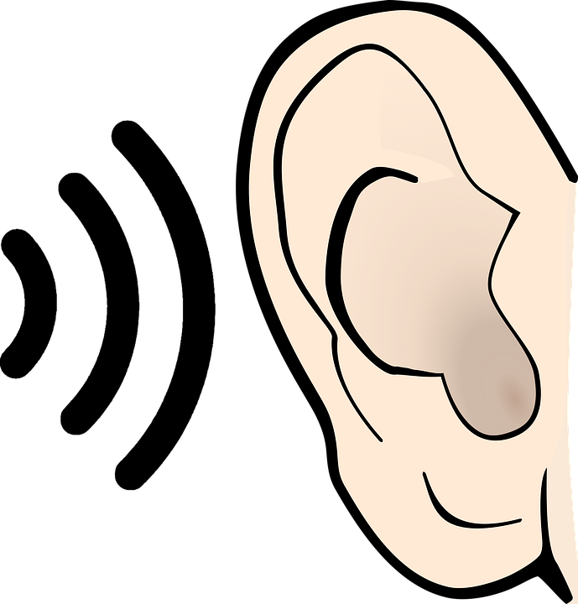
Storyboarding for VR Training
Add in the details needed for VR training:
Create the environment required for the learning objectives.
What is the user seeing?
What is the user doing?
Consider the use of controllers vs hand tracking.
  What buttons will be used?
  Do they need to be taught?
What is the user hearing?
Where is the user oriented?
What assets need to be interactable to give evidence of proficiency?
How will you guide and direct the user’s attention?
What happens if the user gets stuck?
How will completion metrics provide evidence of proficiency?
Notes:
handout
environment, instructional supports: visual indicators, floating text

Slide 25
Storyboarding for VR Training
Other factors to consider:
What assumptions are you making about your users?
What are best practices for teaching the skills to achieve the learning objectives?
How will you scaffold learning?
How can the VR space enhance the ability to reach those learning objectives?
What constraints exist that hinder the ability to achieve the learning objectives?
How fidelitous do the environment and interactions have to be to provide evidence of learning?

Slide 26
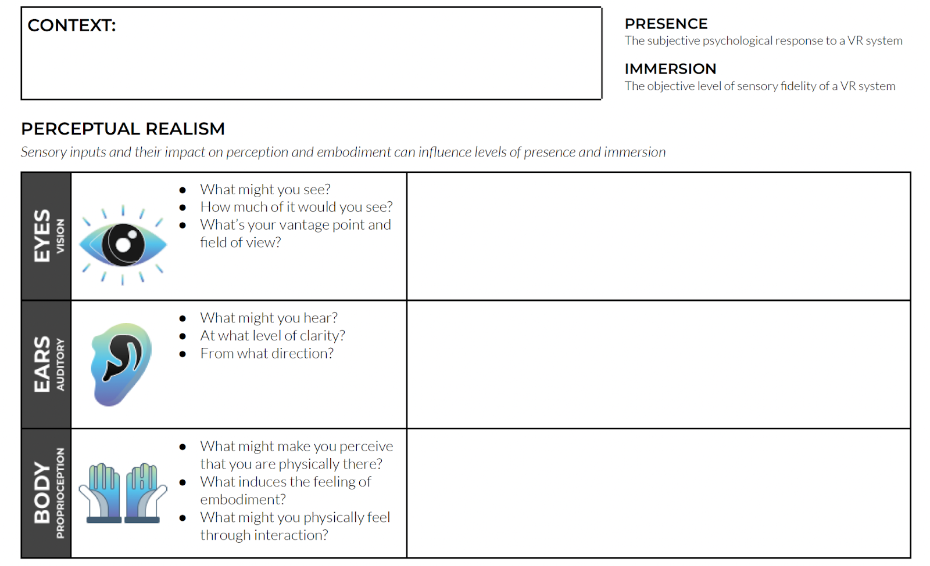
EXAMPLE: SENSORY INPUTS
Practicing using a micrometer on an array of objects in various environments
Target object(s) and target area of object meant to be measured. Micrometer tool and it’s parts. Peripheral machinery objects and space around target object to move about.
Metal clang with the micrometer touches the target object. Faint humming from machines.
Feel the micrometer in hand. Feel vibrations when metal touches metal. Feel the parts of the micrometer move. Ability to move around the target object.

Slide 27
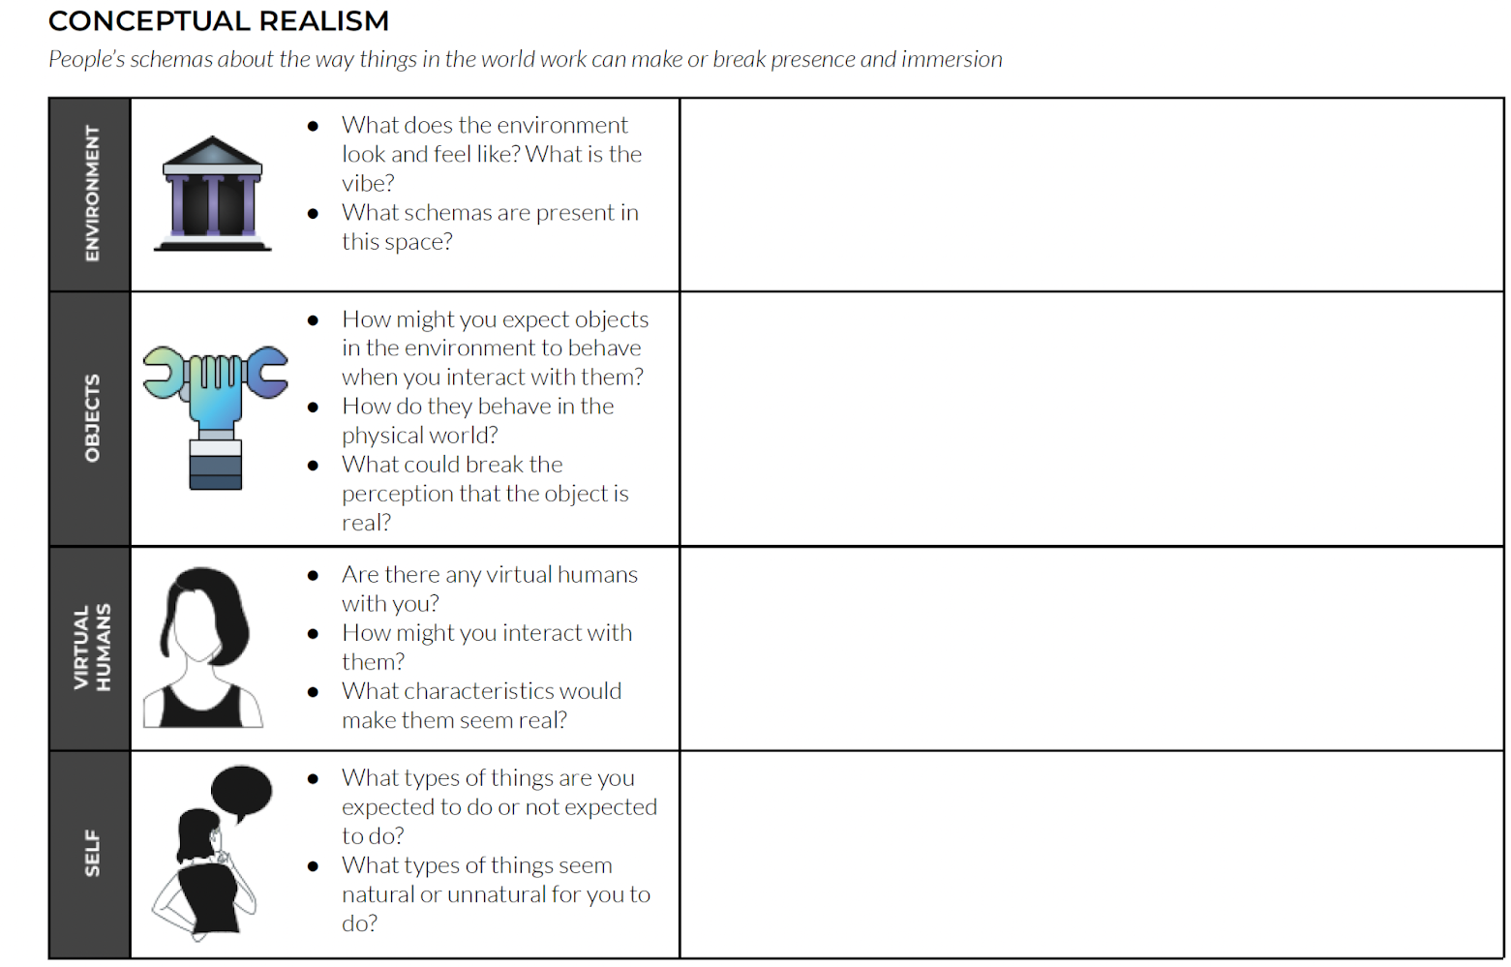
EXAMPLE: FIDELITY
A garage, field, or factory with machinery. Lots of old, worn metal objects and used tools. Cold, rugged.
Pick up tools (hammer, gauge, measurement tools), inspect them, use their features. Feel machines in the space. Turn them on or off. Micrometer’s thimble rotates and spindle extends and retracts. Close to natural scale
No virtual humans unless there is a joint measurement activity or a coach providing pointers and feedback on performance.
Expected to use both hands to operate micrometer, as in real life. View measurement markings and determine the value.

Slide 28
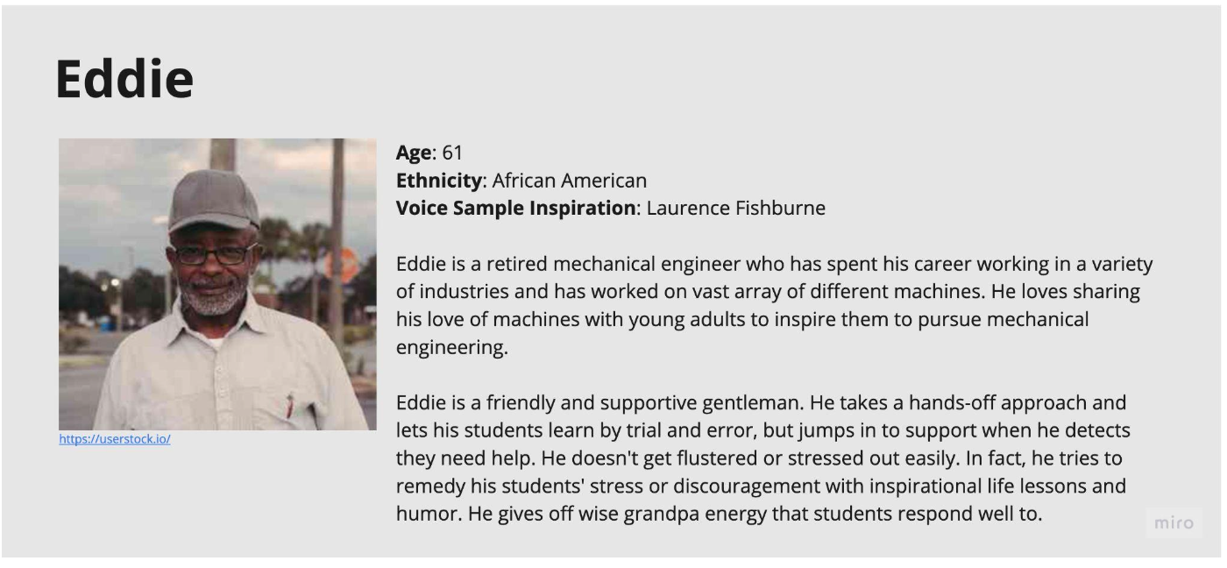
EXAMPLE: PEDAGOGICAL AGENT

Slide 29
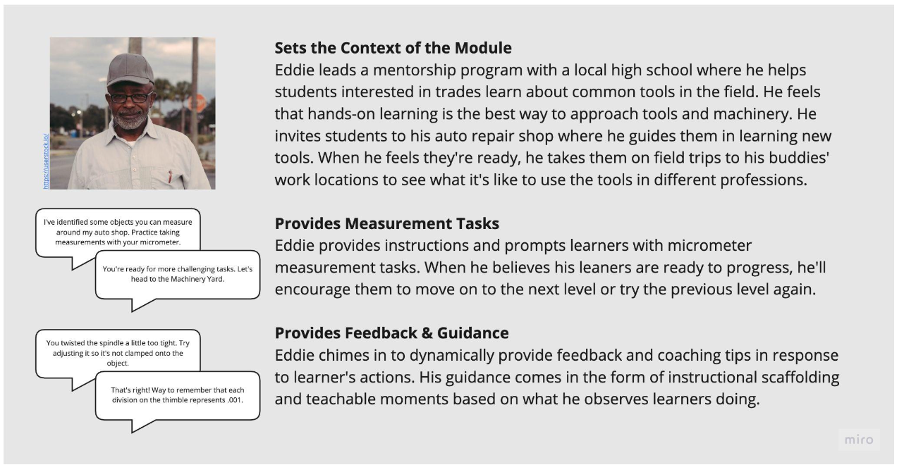
EXAMPLE: PEDAGOGICAL AGENT
learners

Slide 30
EXAMPLE: INSTRUCTIONS & FEEDBACK
Instructional prompts presented at the beginning of the task and triggered by inactivity
“Practice measuring some of the objects around my auto shop.”
Positive feedback triggered by correct action
“Way to twist that Thimble with the right about of pressure between the Spindle and Anvil!”
Corrective feedback triggered by incorrect action
  Brief: “Use your placement meter as a guide for correct positioning.”
  Explicit: “Shift the micrometer to the left until you reach the sweet spot on your placement gauge.”

Slide 31
Storyboarding for VR Training
Task:
Create a storyboard of at least one of the tasks from the Task Analysis that you want to assess.
Include:
Pedagogical Agent
Voiceover
Visuals/Assets
Interactions
Instructions/feedback
Order of events
Learning objectives mapped to each interaction for assessment evidence

Slide 32
Break 9:30 am – 9:45 am

Slide 33
Workshop Agenda
Part 1: Objectives, Definitions, and Foundational Concepts 8:00 am – 8:30 am
Part 2: Assessments and Task Analysis 8:30 am – 9:00 am
Part 3: Storyboarding for VR 9:00 am – 9:30 am
  Break 9:30 am – 9:45 am
Part 4: Prototyping 9:45 am – 11:15 am
  Break 11:15 am – 11:30 am
Part 5: Socialize and Reflect 11:30 am – 11:45 am
Part 6: Close Out and Final Thoughts 11:45 am – 12:00 pm
Notes:
https://docs.google.com/document/d/1toFoOqEFns9i6-SFhzKD4hg-lfJCqwaESHZO_Ow4czQ/edit?usp=sharing
Memesis -
Design Challenges: balance between memetic representation of interaction and what is going to affect the learning.
Zone of proximal development.
Just because we can represent all of these things in the space doesn't mean we should.
Fine line - if there is a disparity between the real object and the representation, that will be a distraction to learner

Slide 34
Part 4
Part 4: Initial Prototype (9:45 am – 9:55 am)
Define roles within the group
May use materials to mock-up props
Record a playthrough (optional)
Pair and share with group next to you
Volunteer group to share out with whole group
PARTICIPANTS (9:55 am – 10:30 am; 10:40 am – 11:15 am)
Pair and Share discussion
  Get feedback from other groups on design to integrate in next iteration
Return to groups and discuss feedback, identifying elements that can be incorporated in design
Iterate on design
Record playthrough
Share playthrough between groups
Notes:
Leslie - provide questions we will ask participants

Slide 35
Prototyping

Slide 36

INITIAL PROTOTYPE
“Prototyping can be defined as the conversion of an intangible idea, either related to the physical or digital world, into a tangible configuration to test its feasibility, validity or efficacy.” - theengineeringprojects.com
“A first full-scale and usually functional form of a new type or design of a construction” - Merriam-Webster Dictionary

Slide 37

INITIAL PROTOTYPE
Different types of prototypes:
Paper Prototype - Storyboards, user flow charts, Figma boards, or other 2D representations of a product
  Usually limited or no interactivity

Slide 38
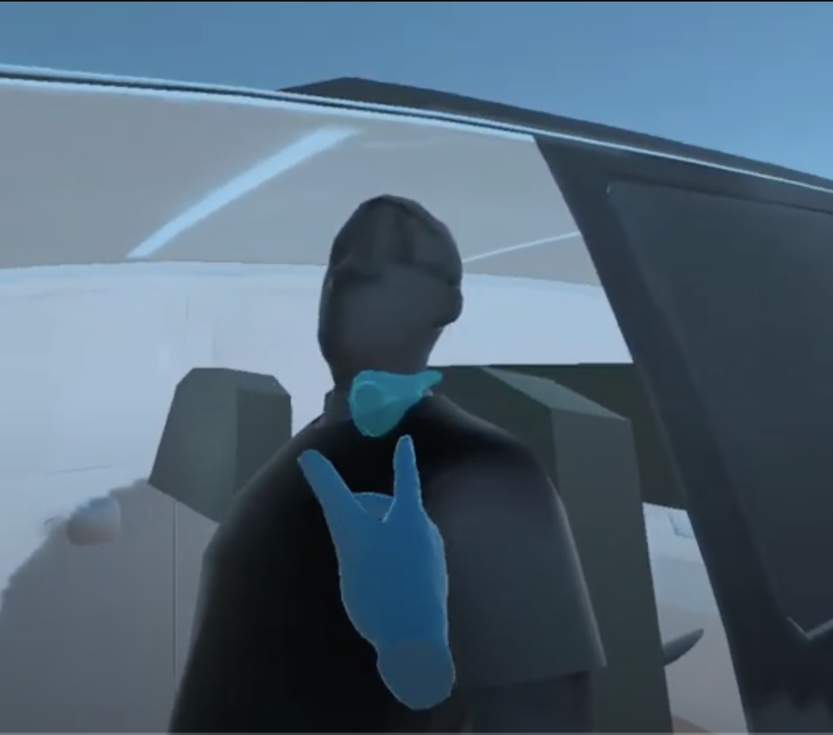
INITIAL PROTOTYPE
Different types of prototypes:
Gray Boxing – A build out 3D prototype that includes low-fidelity art, assets, models, or scenes
  Usually done within a software application such as Unity, Unreal, Blender, or Maya

Slide 39

INITIAL PROTOTYPE
Storyboard to Brown Box Prototype
Materials - Use common items to create low-fidelity mockups of the assets needed in your simulation
Tape, scissors, cardstock, markers (multiple colors), pipe cleaners, yarn, straws, tongue compressors/popsicle sticks, etc.

Slide 40

INITIAL PROTOTYPE
Storyboard to Brown Box Prototype
Team Roles - Choose who will be responsible for which task (roles will often overlap and that’s okay!)
  art/asset creation
  writer/director
  representative learner
  recorder (someone with a mobile device with video recording capabilities)
  notetaker/timekeeper
Roles icons created by HAJICON

Slide 41

INITIAL PROTOTYPE
Storyboard to Brown Box Prototype
Documentation - Use a mobile device to record the participant going through the entire simulation from end to end, even if all the details aren’t completely worked out yet
  Update written documentation as changes are made to the design
Cell icons created by Nhor Phai - Flaticon

Slide 42


INITIAL PROTOTYPE
Pair and Share with a Nearby Team
Locate a group nearby
Review & Provide Feedback
Share
Collaboration icons created by mangsaabguru - Flaticon
Notes:
Locate a group nearby to exchange recorded prototypes
Review & Feedback - As you review the prototypes, jot down potential points of feedback
Focus on the learning: interactions are important but only insofar as they affect the learning
Note any gaps in understanding
Note places where your prototypes overlap and places where they diverge
Share - Regroup with your partner team
Keep feedback constructive and respectful
Ask questions to better understand the thinking behind the other team’s design
Offer suggestions if appropriate for how the other team might improve any of the following:
learning design/cognitive load
interaction design
assessment design

Slide 43
Design Iterations

Slide 44



Iterative Design
Test & Evaluate
Design & Prototype
Test prototype, gather feedback, identify areas for improvement
Brainstorm design and create mockups
Iterative Design Process
Iterate
Prioritize feedback, revise, test, repeat
Notes:
Time: 3 min
Identify issues early - Ability to detect issues after each phase, reducing the chance for a “Domino Affect”.
Collect valuable feedback - Chance to gather feedback from stakeholders on an ongoing basis and make modifications after each phase. Valuable ideas and insights at can be shared by stakeholders at any point.
More time in the design phase - Proactive approach that allows you to dive into the process, dedicating more work hours and resources to the eLearning course design process.
Theory into practice - Ability to test theories, assumptions, and ideas without having to worry about making extensive modifications later

Slide 45
Benefits of Iterative Design
Identify issues early
Collect valuable feedback
More time to focus on design
Improved learning product
Theory into practice
Test & Evaluate
Design & Prototype
Brainstorm design and create mockups
Test prototype, gather feedback, identify areas for improvement
Iterative Design Process
Iterate
Prioritize feedback, revise, test, repeat
Notes:
Time: 3 min
Notes:
Identify issues early - Ability to detect issues after each phase, reducing the chance for a “Domino Affect”.
Collect valuable feedback - Chance to gather feedback from stakeholders on an ongoing basis and make modifications after each phase. Valuable ideas and insights at can be shared by stakeholders at any point.
More time in the design phase - Proactive approach that allows you to dive into the process, dedicating more work hours and resources to the eLearning course design process.
Theory into practice - Ability to test theories, assumptions, and ideas without having to worry about making extensive modifications later

Slide 46
Part 4
Part 4: Final Prototype (10:30 am – 10:40 am)
You’ve Got Mail
PARTICIPANTS (10:40 am – 11:15 am)
Return to groups and discuss feedback, identifying elements that can be incorporated in design
Iterate on design
Record playthrough
Share playthrough between groups
Notes:
Leslie - provide questions we will ask participants

Slide 47
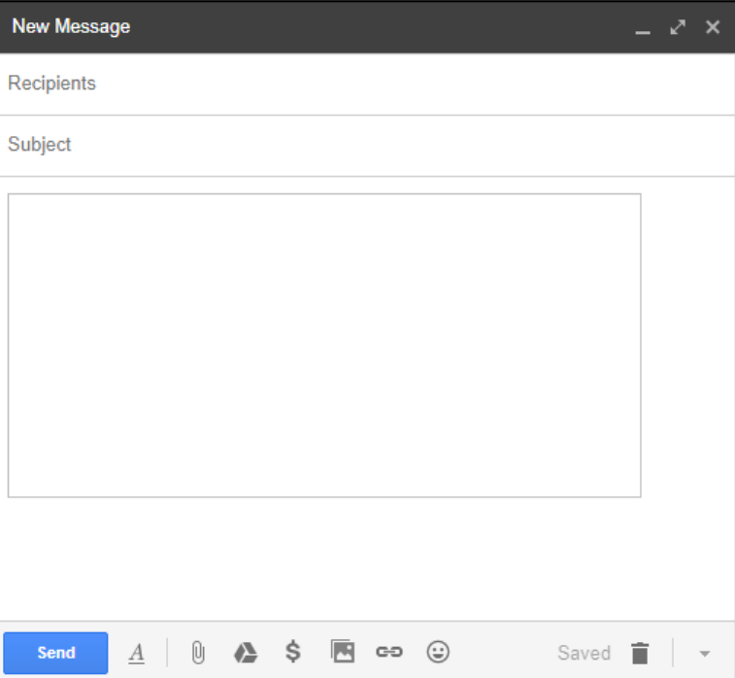
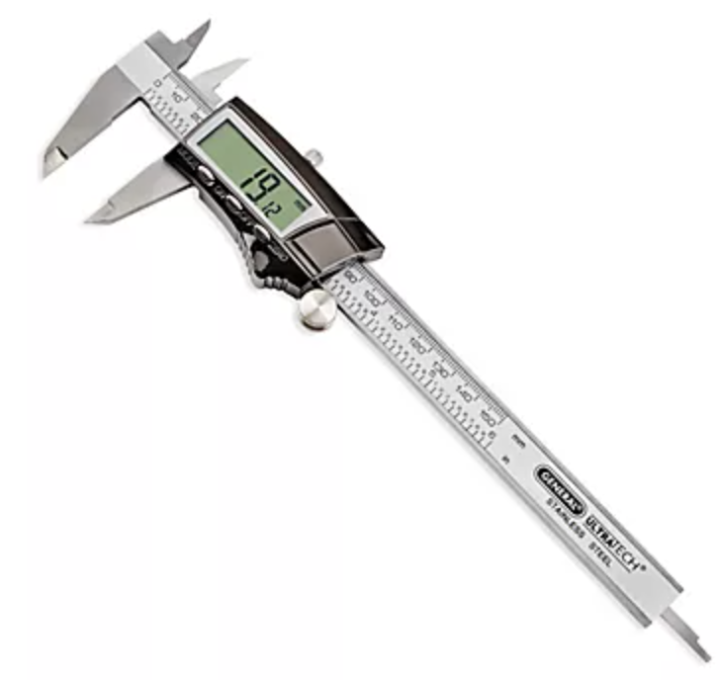
You’ve Got Mail!
From:
Art Team
To:
I/ITSEC Designers
Subject:
Measurement tool art asset ready
Hello team,
The measuring art asset is ready for your review. Please see the image attached. Please note that this is a static assets and it has no interactive elements. Let us know if you have any feedback.
Best,
Art Team
Measurement Asset
Reply
Notes:
Time: 2 min

Slide 48

You’ve Got Mail!
From:
Engineering Team
To:
I/ITSEC Designers
Subject:
Mechanic Follow-up
Hello team,
We received your inquiry regarding the two-handed
mechanic. We do have that functionality but unfortunately it can potentially cause bugs.
If possible, consider allowing the coach to serve as the other VR hand for support.
Best,
Engineering Team
(PNGwing.com, 2023)
Reply
Notes:
Time: 2 min

Slide 49

You’ve Got Mail!
From:
Subject Matter Expert (SME)
To:
I/ITSEC Designers
Subject:
Content Follow-up
Hello designers,
I received your question regarding the trainee using both hands to measure. Yes, this would be required.
Best,
Subjective Matter Expert (SME)
(PNGwing.com, 2023)
Reply
Notes:
Time: 2 min

Slide 50

You’ve Got Mail!
From:
Engineering Team
To:
I/ITSEC Designers
Subject:
Design Feedback
Hello designers,
We understand that you need the assets to perform differently as well as change the nature of the interaction. However, this will require another 2-4 weeks to build out these assets and interactions.
Best,
Engineering Team
(PNGwing.com, 2023)
Reply
Notes:
Time: 2 min

Slide 51
You’ve Got Mail!
From:
Site Instructors
To:
I/ITSEC Designers
Subject:
Assessment changes?
Hello designers,
In looking at the revised design with the static asset, we’re very concerned about this change. If the participants can’t manipulate the tool and do the interaction in the simulation the same way they would in the real world, how do we know they have learned anything?
Please let us know how you will design a solution to this assessment issue.
Regards,
Site Instructors
(PNGwing.com, 2023)
Reply
Notes:
Time: 2 min

Slide 52
Final Design Iterations

Slide 53


Iterate on Your Design
Review recent feedback
Identify areas for improvement
Prioritize revisions based on usability, functionality, or feedback
Implement revisions to your prototype
Test revisions to validate
Questions to consider:
(PNGwing.com, 2023)
What specific improvements am I seeking to make in this iteration?
What feedback or insights from stakeholders, team members, or users should I consider in this iteration?
Are there new constraints or limitations that I need to consider?
What opportunities for additional VR support or innovation can I explore in this iteration?
Notes:
Time: 5-10 minutes
What data or metrics will I collect during this iteration to evaluate its impact?
What assumptions or biases do I need to be aware of during this iteration?
Group Activity
Speaker notes:
Emphasize the need for continuous improvement based on user testing results.

Slide 54
Iterative Design
Test & Evaluate
Design & Prototype
Test prototype, gather feedback, identify areas for improvement
Brainstorm design and create mockups
Iterative Design Process
Iterate
Prioritize feedback, revise, test, repeat
Notes:
Time: 3 min
Identify issues early - Ability to detect issues after each phase, reducing the chance for a “Domino Affect”.
Collect valuable feedback - Chance to gather feedback from stakeholders on an ongoing basis and make modifications after each phase. Valuable ideas and insights at can be shared by stakeholders at any point.
More time in the design phase - Proactive approach that allows you to dive into the process, dedicating more work hours and resources to the eLearning course design process.
Theory into practice - Ability to test theories, assumptions, and ideas without having to worry about making extensive modifications later

Slide 55
FINAL PROTOTYPE
Storyboard to Brown Box Prototype
Documentation - Use a mobile device to record the participant going through the entire simulation from end to end.
  update written documentation as changes are made to the design
Cell icons created by Nhor Phai - Flaticon

Slide 56
Optional Break 11:15 – 11:30

Slide 57
Workshop Agenda
Part 1: Objectives, Definitions, and Foundational Concepts 8:00 am – 8:30 am
Part 2: Assessments and Task Analysis 8:30 am – 9:00 am
Part 3: Storyboarding for VR 9:00 am – 9:30 am
  Break 9:30 am – 9:45 am
Part 4: Prototyping 9:45 am – 11:15 am
  Break 11:15 am – 11:30 am
Part 5: Socialize and Reflect 11:30 am – 11:45 am
Part 6: Close Out and Final Thoughts 11:45 am – 12:00 pm
Notes:
https://docs.google.com/document/d/1toFoOqEFns9i6-SFhzKD4hg-lfJCqwaESHZO_Ow4czQ/edit?usp=sharing
Memesis -
Design Challenges: balance between memetic representation of interaction and what is going to affect the learning.
Zone of proximal development.
Just because we can represent all of these things in the space doesn't mean we should.
Fine line - if there is a disparity between the real object and the representation, that will be a distraction to learner

Slide 58
Parts 5 and 6
Part 5: Socializing and Reflecting (11:30 am – 11:45 am)
PARTICIPANTS
Socializing Designs
  Volunteer from group to walk through their simulation
Share Measuring For Deterrence
Part 6: Close out (11:45 am – 12:00 pm)
Reflect on Learning Engineering
Final Thoughts
Notes:
Nyomi

Slide 59
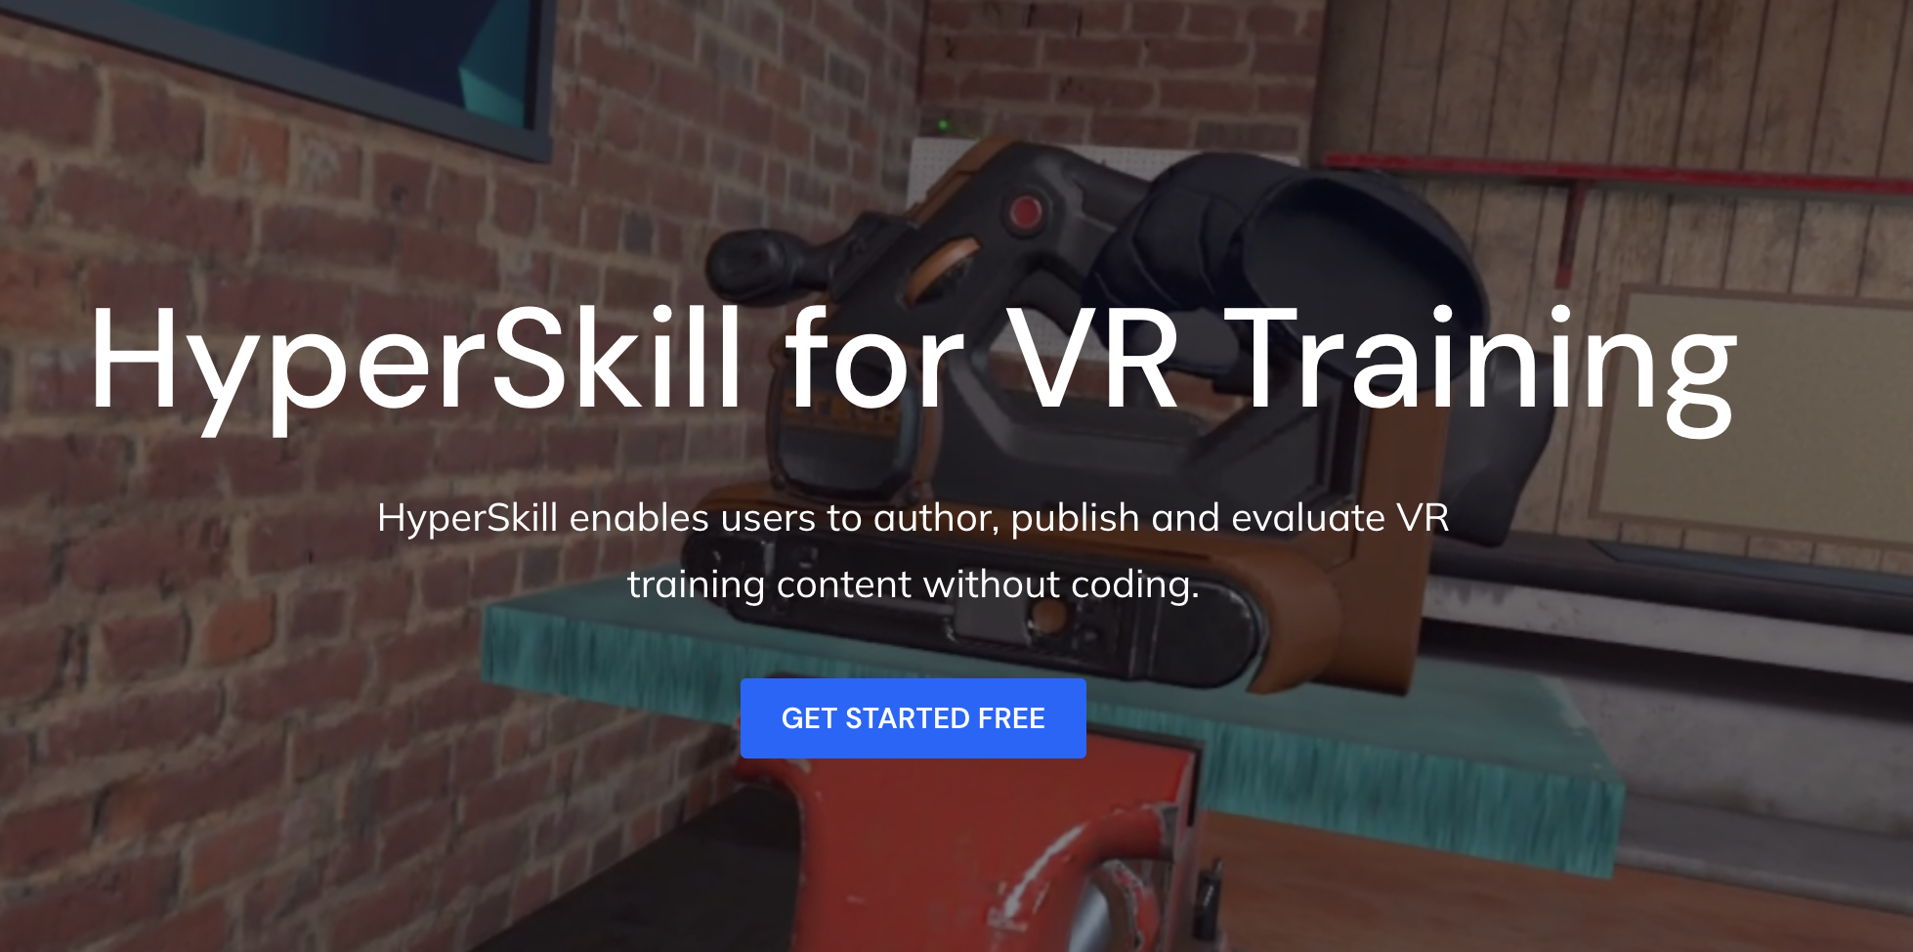
HyperSkill

Slide 60
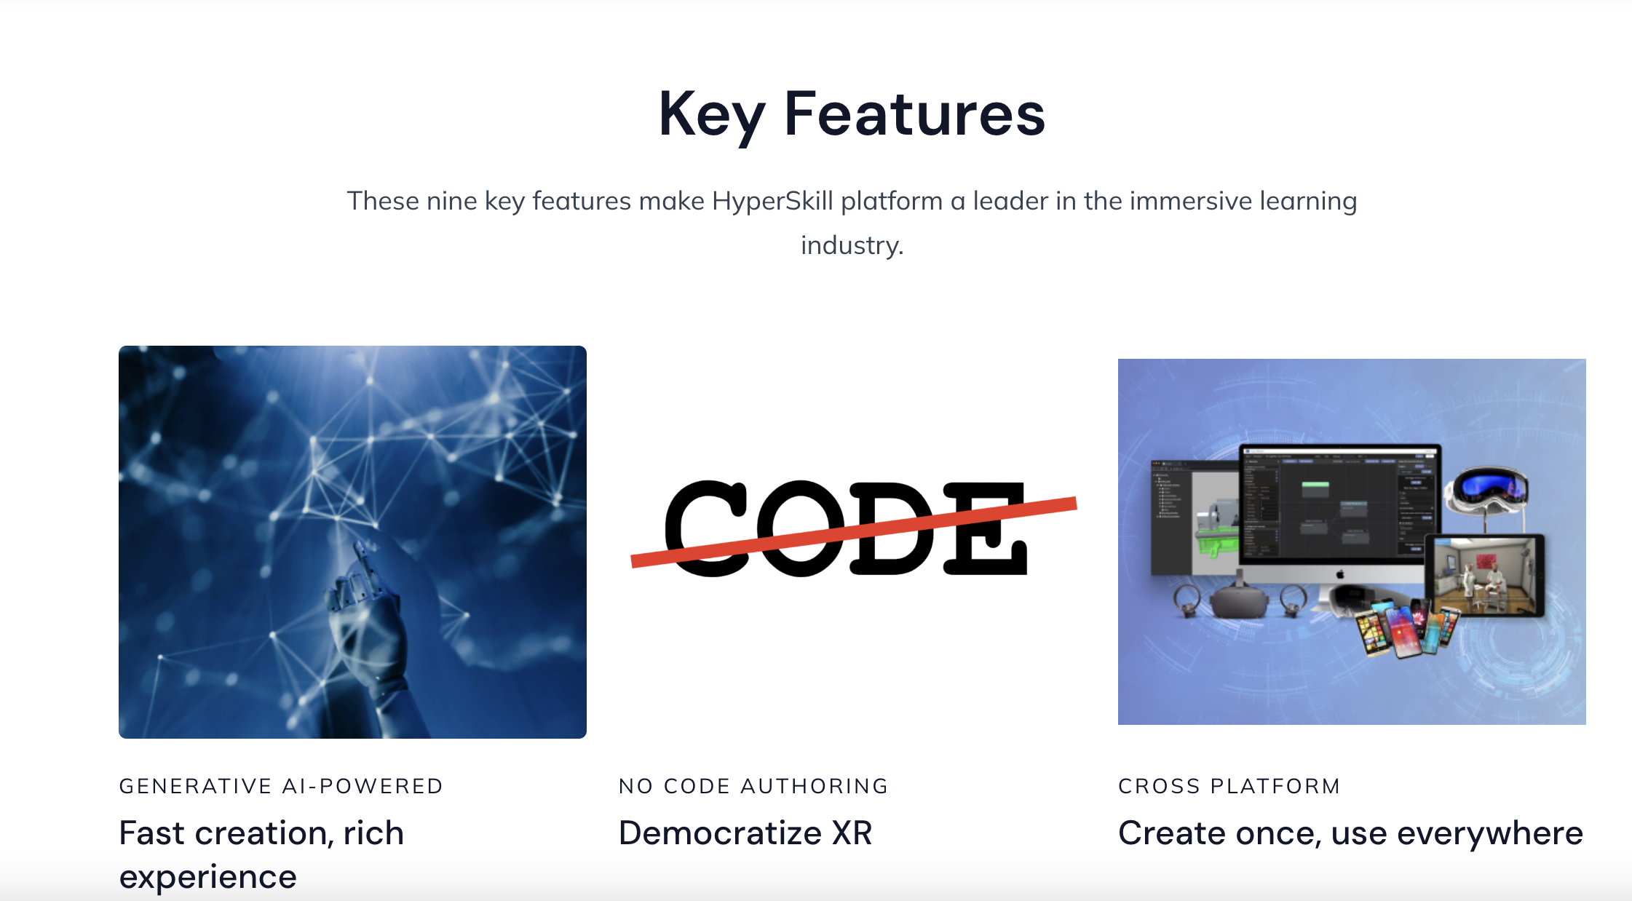
No Code Authoring

Slide 61
Socializing Designs

Slide 62

Reflect on Your Process
Questions to consider:
What changed from the first iteration of your product?
What issues did you need to address?
What limitations posed a challenge?
What lessons did you learn from any mistakes or challenges encountered?
How did unexpected constraints or limitations impact your progress? How can you mitigate them in the future?
What new goals and objectives should you set for the next iteration? How do they align with the lessons learned?
What personal insights or self-improvement opportunities did you gain from this reflection process?
(PNGwing.com, 2023)
Notes:
Time: 5 min
Group volunteer: 5-7 min
Group presentatoion

Slide 63
Final Thoughts
What was surprising?
What was difficult?
What remaining questions do you have about the process?

Slide 64
References and Supporting Materials

Slide 65
References
Abbas, Y., Martinetti, A., Nizamis, K., Spoolder, S., & van Dongen, L. A. (2021). Ready, trainer… one*! discovering the entanglement of adaptive learning with virtual reality in industrial training: a case study. Interactive learning environments, 1-30.
DeFalco, J. A., & Sinatra, A. M. (2019). Adaptive instructional systems: the evolution of hybrid cognitive tools and tutoring systems. In Adaptive Instructional Systems: First International Conference, AIS 2019, Held as Part of the 21st HCI International Conference, HCII 2019, Orlando, FL, USA, July 26–31, 2019, Proceedings 21 (pp. 52-61). Springer International Publishing.
Keehner, M. (2024, July 17-19) Designing simulations for assessment of competency: Insights from research and assessment science [Poster Presentation], Sim Ops 2024, Aurora, CO.
Keehner, M., Arslan, B., & Lindner, M. A. (2023). Cognition-centered design principles for digital assessment tasks and items. In R. J. Tierney, F. RizviK., & Ercikan (Eds.), International encyclopedia of education, section: Quantitative research/ educational measurement (4th ed., pp. 171–184). Elsevier.
Pappas, C. (2016, March 29). 5 Benefits of Iterative Design in eLearning. Retrieved June 1, 2023, from https://elearningindustry.com/5-benefits-of-iterative-design-in-elearning

Slide 66
References
Pappas, C. (2016, March 29). 5 Benefits of Iterative Design in eLearning. Retrieved June 1, 2023, from https://elearningindustry.com/5-benefits-of-iterative-design-in-elearning
OpenAI. (2023). ChatGPT (May 25 version) [Large language model]. Retrieved May 25, 2023 from https://chat.openai.com/chat (for reflection question ideas only)
Pathan, R., Rajendran, R., & Murthy, S. (2020). Mechanism to capture learner’s interaction in VR-based learning environment: design and application. Smart Learning Environments, 7(1), 1-15.
Reedy, G. B. (2015). Using cognitive load theory to inform simulation design and practice. Clinical Simulation in Nursing, 11(8), 355-360.
Sottilare, R. A., DeFalco, J. A., & Connor, J. (2014). ‒A Guide to Instructional Techniques, Strategies and Tactics to Manage Learner Affect, Engagement, and Grit. Design recommendations for intelligent tutoring systems, 2, 7-33.
Wang, A., Thompson, M., Uz-Bilgin, C., & Klopfer, E. (2021). Authenticity, interactivity, and collaboration in virtual reality games: Best practices and lessons learned. Frontiers in Virtual Reality, 2, 734083.
Xu, X., Kang, J., & Yan, L. (2022). Understanding embodied immersion in technology‐enabled embodied learning environments. Journal of Computer Assisted Learning, 38(1), 103-119.
Zhou, Y., Ji, S., Xu, T., & Wang, Z. (2018). Promoting knowledge construction: a model for using virtual reality interaction to enhance learning. Procedia computer science, 130, 239-246.

Slide 67
APPENDIX
OSHA Standards
Protecting Healthcare Personnel | HAI | CDC
SEQUENCE FOR PUTTING ON PERSONAL PROTECTIVE EQUIPMENT (PPE)
Healthcare Simulation Standards of Best Practice (HSSoBP)™
Healthcare Simulation Standards of Best Practice TM Simulation Design
Notes:
Booklet of handouts: Learning Objectives, Task Analysis, Guiding Questions - Storyboarding, Storyboard Template - 2-3 pages, Guiding Questions - Reflection

Slide 68
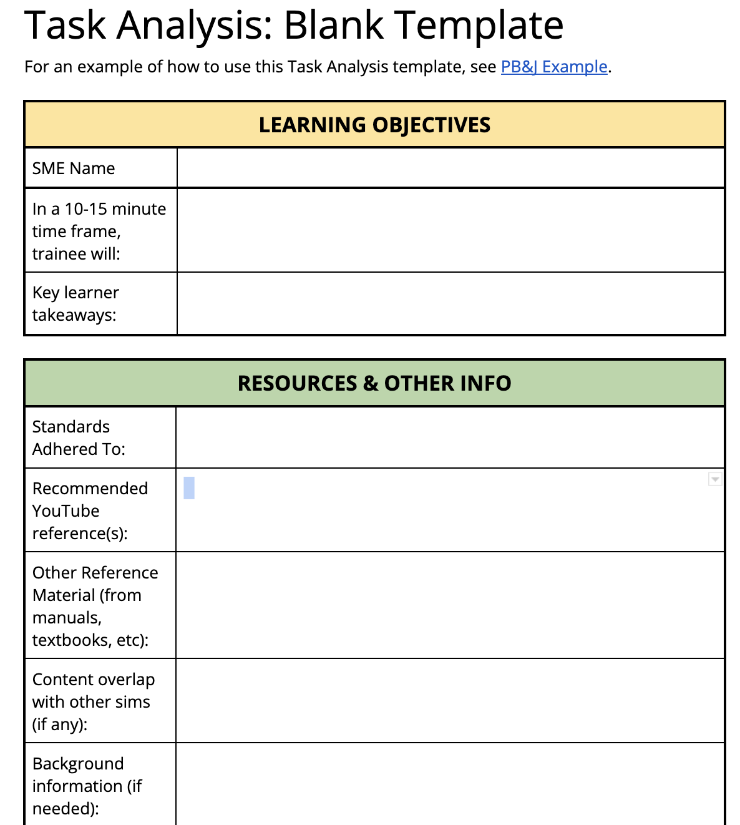

Slide 69
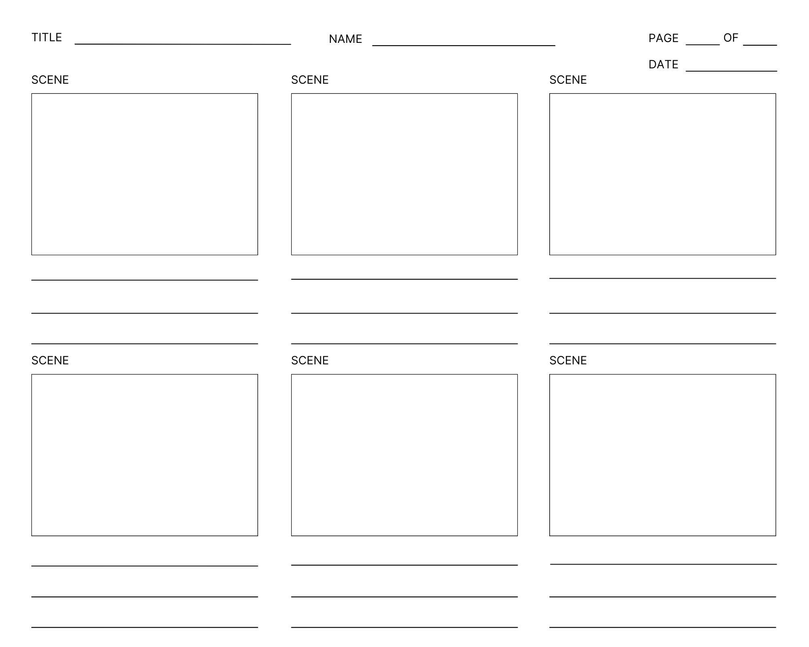
Storyboard Template Example
Notes:
Storyboard template example - handout

