Slide 1

Fundamentals of Artificial Intelligence (AI)
for Simulation-based Training
Brice Colby, Ph.D.
Randolph M. Jones, Ph.D.
Morgan Ulinski, Ph.D.
Elaine Choy, M.S.
Robert Sottilare, Ph.D.

Slide 2




Your Facilitators
Brice Colby, Ph.D.
Randolph Jones, Ph.D.
Morgan Ulinski, Ph.D.
Elaine Choy, M.S.
2

Slide 3
Welcome
This workshop is rated G and is appropriate for all audiences
What can you expect?
  Interactive demonstrations, discussions and other activities
  Understanding of various types of AI tools and methods
  Understanding of how various AI tools and methods are applied in simulation-based training
  Understanding the interplay between AI and simulation-based training technologies
  If you want these slides… email Brice at brice.colby@soartech.com for a pdf.
3

Slide 4
Agenda
Time | Topic | Presenter
0800-0820 | Artificial Intelligence Overview | Dr. Jones
0820-0840 | Modeling Tr(AI)ning | Dr. Colby
0840-0925 | Practical Applications of AI and Examples | Ms. Choy, Dr. Colby, Dr. Ulinski
0925-1005 | Applying AI Workshop | Team
1005-1035 | 30 min Break
1035-1135 | Group Work, then Discussion & Debrief | Team
 | Ethics, Challenges, & Future Direction of AI
1135-1150 | Concluding Discussion | Team
4

Slide 5
Artificial Intelligence Overview
Dr. Randolph M. Jones
0800-0820

Slide 6
What is Artificial Intelligence?
The science and engineering of making intelligent machines (John McCarthy, August 1955)
Three stages of AI
  Artificial Narrow Intelligence (weak AI) – no ability to think; performs a set of pre-defined functions
    Examples: Search algorithms, Siri, Alexa, self-driving cars, and Sophia the humanoid; almost all the AI-based systems built to date fall under the category of Weak AI
  Artificial General Intelligence (strong AI) – the stage in the evolution of AI where machines will possess the ability to think and make decisions just like humans; no current examples of strong AI
    Sci-Fi movie examples of strong AI: HAL 9000 (2001: A Space Odyssey), Ava (Ex Machina), Data (Star Trek: The Next Generation), and Samantha, the virtual assistant (Her, 2013)
  Artificial Super Intelligence (ASI) - the stage of AI when the capability of intelligent machines surpass the intelligence of human beings; no current examples of ASI
    Sci-Fi examples include Skynet (Terminator movie franchise) and other hypothetical situations depicted in movies and books where machines take over the world and destroy mankind
McCarthy, J. (1955, August). A proposal for the Dartmouth summer research project on artificial intelligence, August 31, 1955.
McCarthy, J., Minsky, M. L., Rochester, N., & Shannon, C. E. (1956). Artificial intelligence (AI) coined at Dartmouth.
6

Slide 7
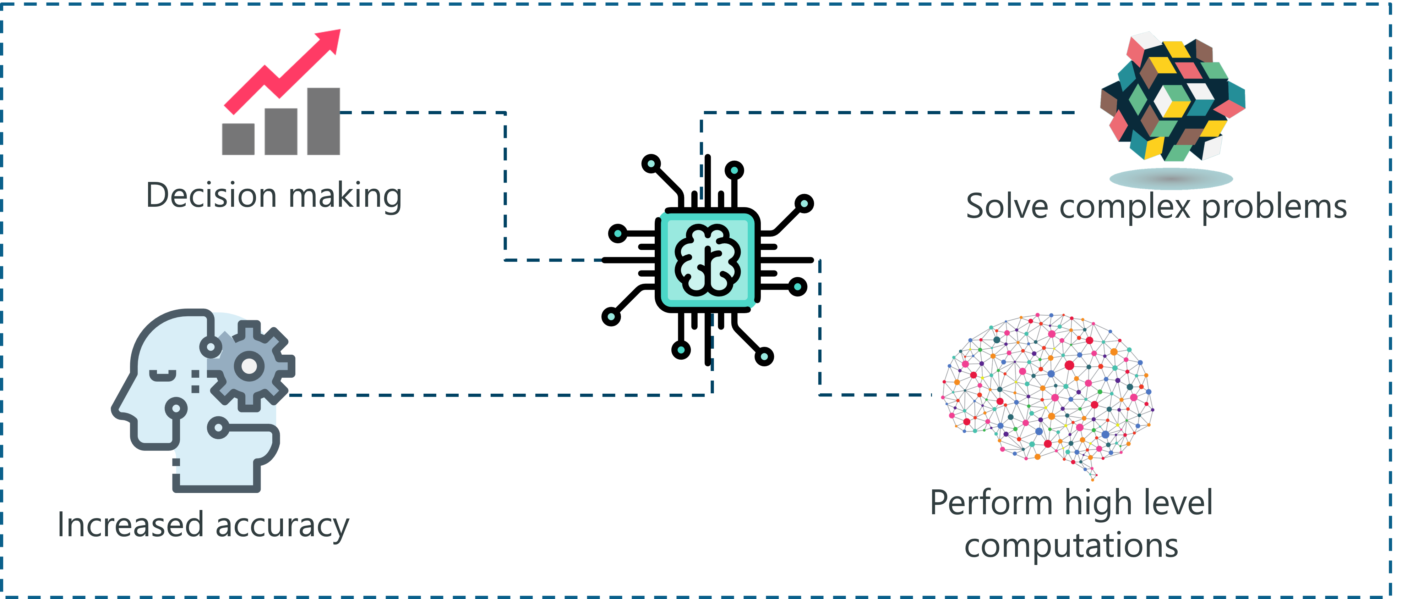
Things that AI can do…
Process data: AI can analyze and process large amounts of data quickly and efficiently.
Recognize patterns: AI algorithms can identify and recognize patterns within data
Classify and predict: AI can classify data into categories or predict outcomes based on patterns in the data
Make decisions: AI systems can make decisions based on data analysis and predefined rules or models
Automate processes: AI enable the automation of repetitive or mundane tasks, freeing up human resources for more complex or creative work
https://www.edureka.co/blog/types-of-artificial-intelligence/
7

Slide 8
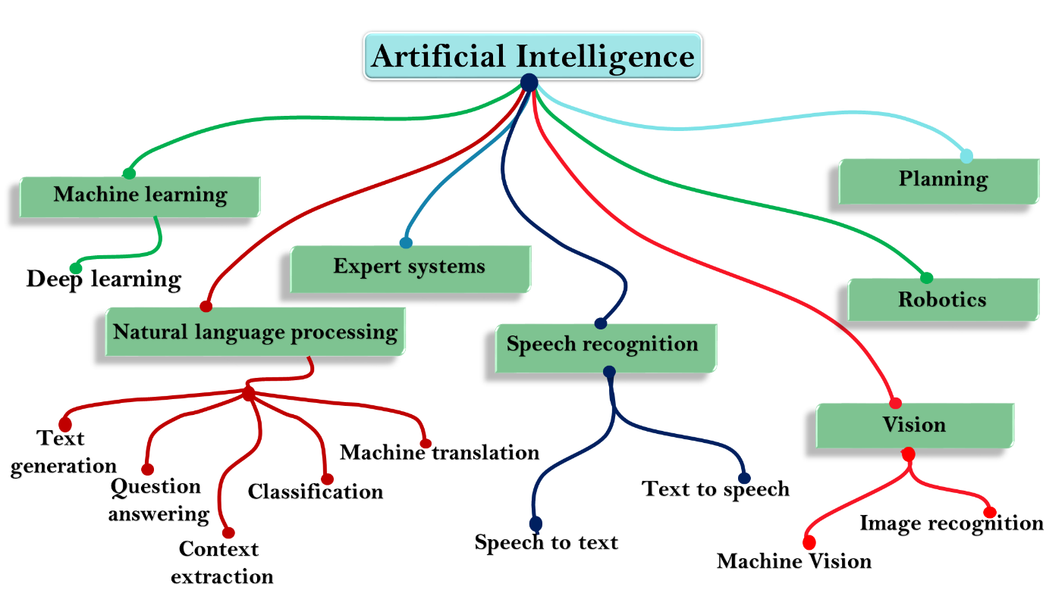
Things that AI can do…
Process natural language: AI can process and understand human language to enable language translation, sentiment analysis, interactive dialogue, and voice-controlled systems
Optimization: AI can optimize processes and systems by finding the most efficient solutions based on predefined goals or constraints
Simulate and model: AI can simulate real-world scenarios or model complex systems to analyze their behavior and make predictions
Personalize experiences: AI personalize experiences by tailoring content, recommendations, and interactions to individual users based on their preferences, behavior, and historical data
Generate stuff: AI can generate content, artwork, music, and other creative outputs based on predefined patterns or by learning from existing examples; ChatGPT falls into this category.
8

Slide 9
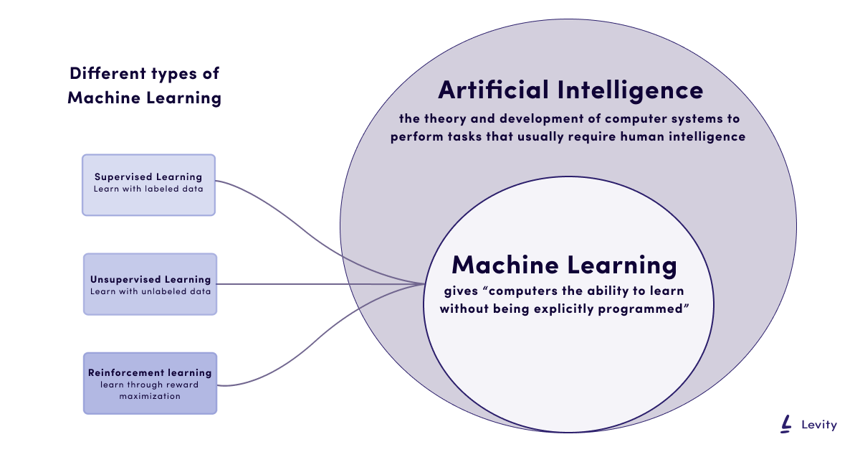
Functional Branches of AI
Machine learning is the most well-known type of AI…
  Supervised Learning
    Classification
    Regression
  Unsupervised Learning
    Clustering
    Dimensionality Reduction
    Association Rule Learning
  Semi-Supervised Learning
  Reinforcement Learning
  Transfer Learning
https://levity.ai/blog/how-do-machines-learn
9

Slide 10
Functional Branches of AI
but, there are many other types of AI…
Deep Learning
  Artificial Neural Networks
    Feedforward Neural Networks
    Convolutional Neural Networks (CNN)
    Recurrent Neural Networks (RNN)
      Long Short-Term Memory (LSTM)
      Gated Recurrent Unit (GRU)
    Generative Adversarial Networks (GAN)
  Deep Reinforcement Learning
  Deep Autoencoders
  Deep Boltzmann Machines (DBM)
Natural Language Processing (NLP)
  Text Classification
  Named Entity Recognition (NER)
  Sentiment Analysis
  Text Summarization
  Machine Translation
  Question Answering
10

Slide 11
Functional Branches of AI
Computer Vision
  Image Classification
  Object Detection
  Image Segmentation
  Facial Recognition
  Optical Character Recognition (OCR)
  Pose Estimation
Evolutionary Computation
  Genetic Algorithms
  Genetic Programming
  Evolutionary Strategies
Robotics
  Robot Perception
  Robot Control
  Path Planning
  Human-Robot Interaction (HRI)
Expert Systems
  Rule-Based Systems
  Case-Based Reasoning
  Fuzzy Logic Systems
  Knowledge Graphs
11

Slide 12
Functional Branches of AI
Planning and Scheduling
  Classical Planning
  Constraint Satisfaction
  Markov Decision Processes (MDP)
  Hierarchical Task Networks (HTN)
Probabilistic Reasoning
  Bayesian Networks
  Hidden Markov Models (HMM)
  Conditional Random Fields (CRF)
Swarm Intelligence
  Ant Colony Optimization (ACO)
  Particle Swarm Optimization (PSO)
  Bee Algorithms
Knowledge Representation & Reasoning
  Logic Programming
  Description Logics
  Ontologies
Speech Recognition
  Acoustic Modeling
  Language Modeling
  Speaker Recognition
12

Slide 13
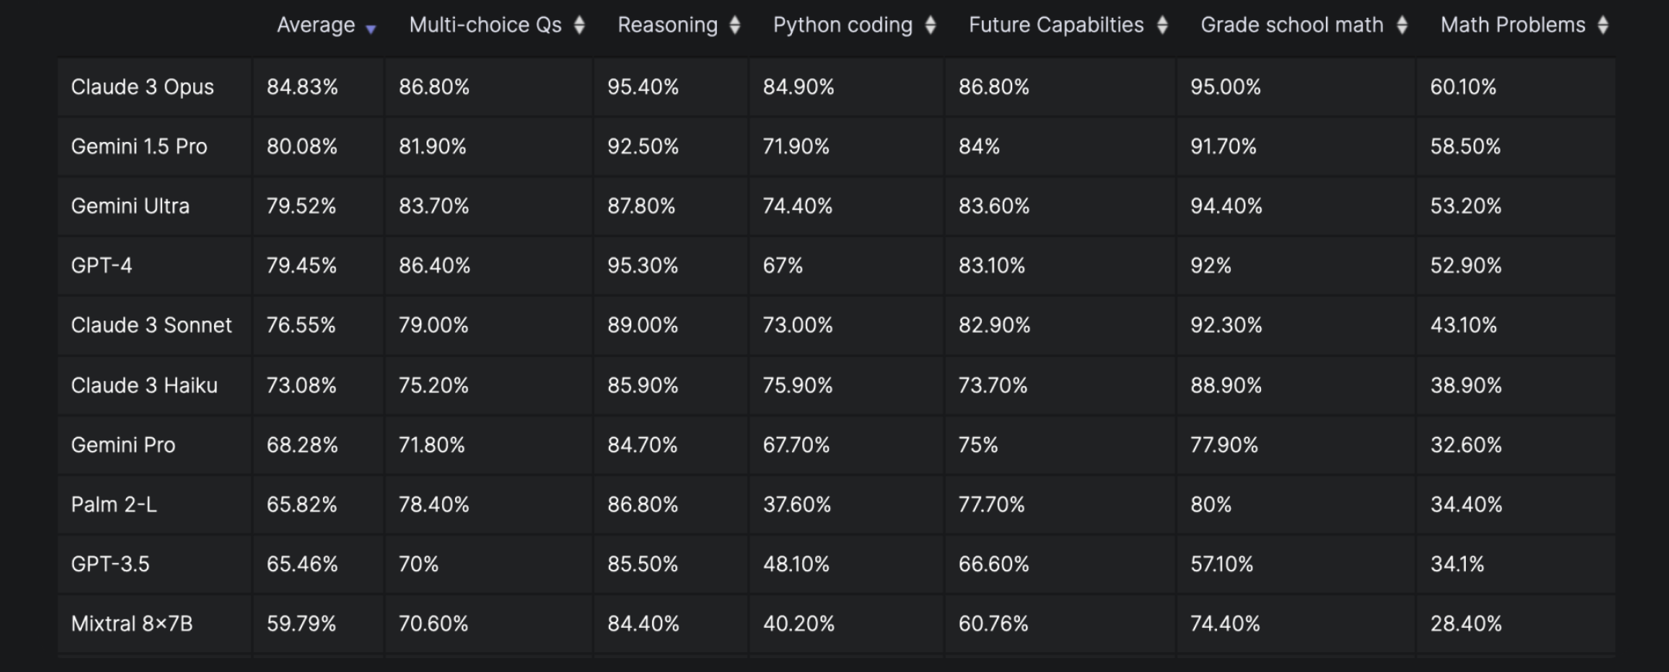
Current LLM Benchmark Performance
Results from velum.ai March, 2024

Slide 14
Modeling Tr(AI)ning
Dr. Brice Colby
0820-0840

Slide 15
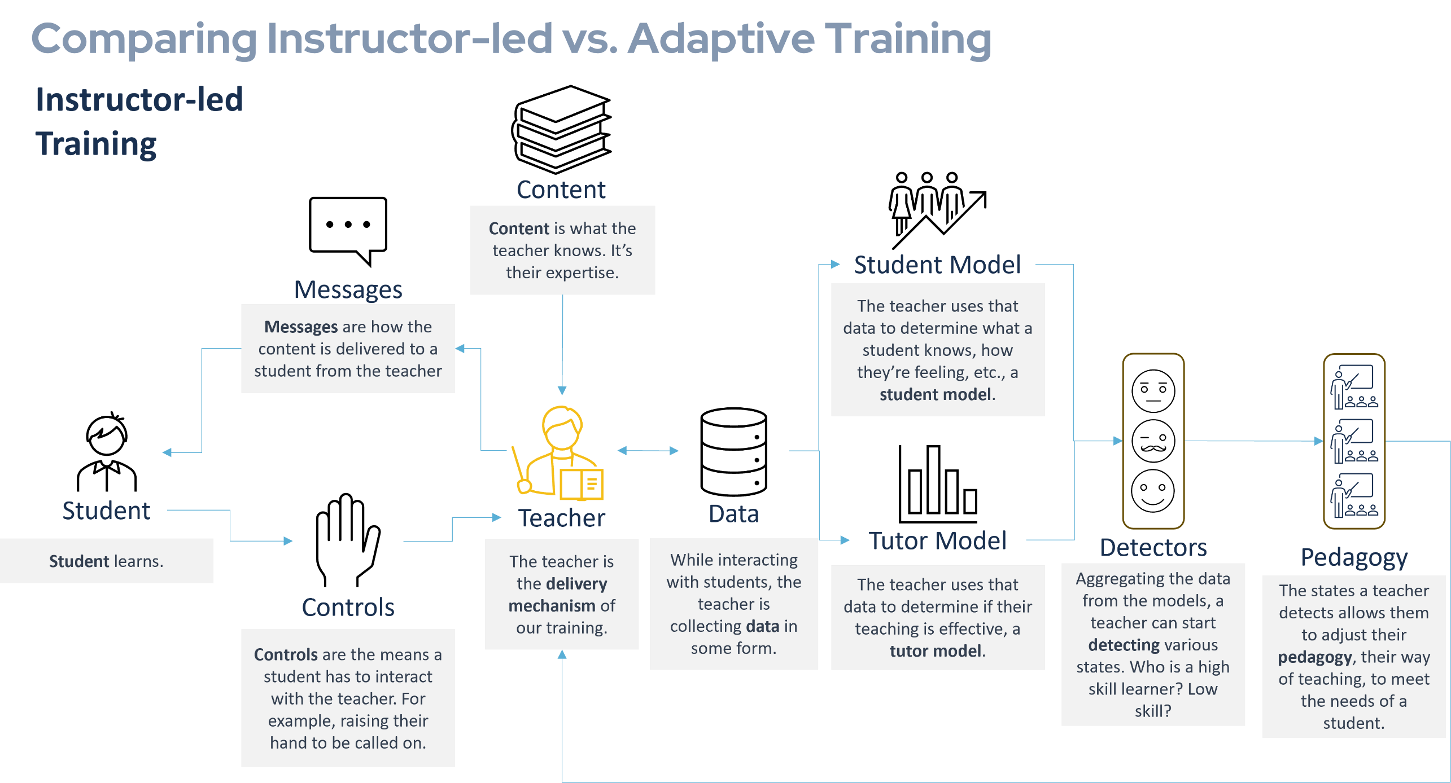
Modeling Tr(AI)ning

Slide 16
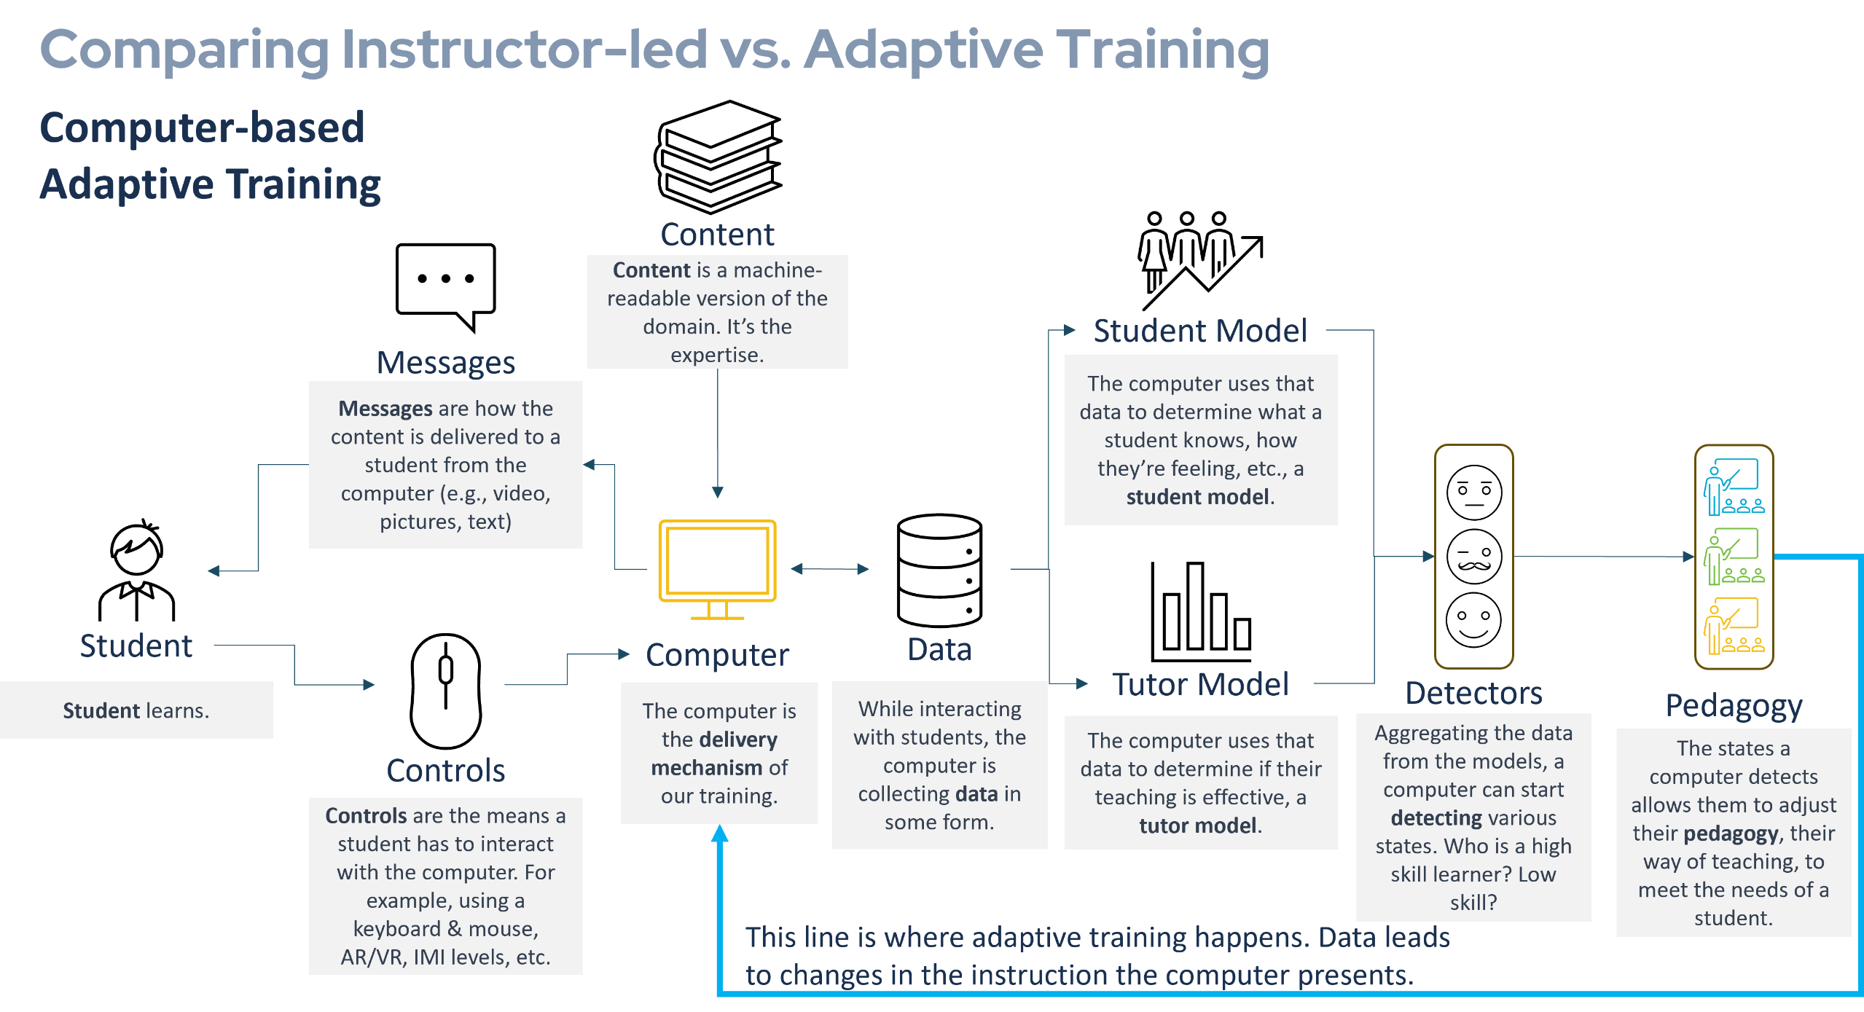
Modeling Tr(AI)ning

Slide 17









Modeling Tr(AI)ning
Examples of where AI can fit in…
Messages
Controls
Student Model
Tutor Model
AI Technique: LLM
Application: Generating context-sensitive feedback for assessment questions.
AI Technique: Image Recognition
Application: Converting handwriting on a tablet into a machine-readable format.
AI Technique: HMM
Application: Modeling student knowledge to predict future performance.
AI Technique: Reinforcement learning
Application: Determining the best adaptations given a certain student.
Content
Detectors
Pedagogy
AI Technique: NLP
Application: Generating an knowledge structure for a domain by feeding in a textbook.
AI Technique: Classification
Application: Generating context-sensitive feedback for assessment questions.
AI Technique: Expert Systems
Application: Creating heuristics for when to apply a certain approach.

Slide 18
Practical Applications of AI and Examples
Ms. Elaine Choy, Dr. Brice Colby, Dr. Morgan Ulinski
0840-0925

Slide 19
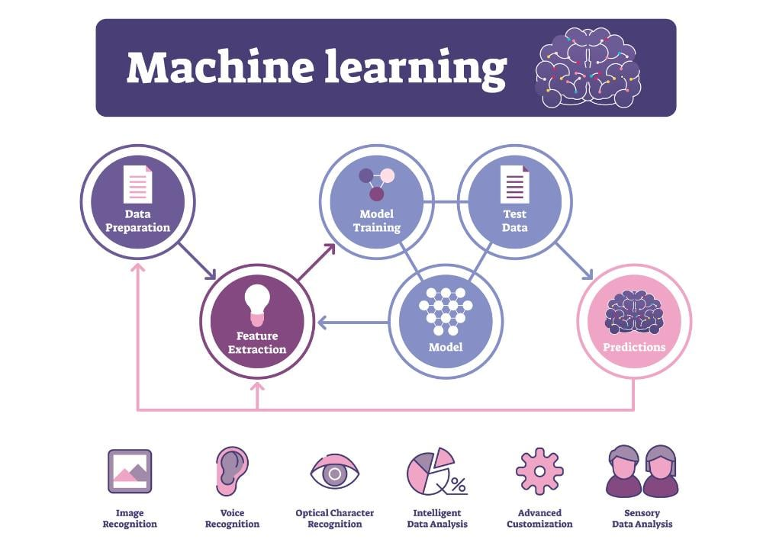
Machine Learning
Machine Learning and Modeling
Algorithms that give computers the ability to learn from data, and then make predictions and decisions
When do we use ML?
Human expertise doesn't exist
Humans can't explain expertise
Models are based on huge amounts of data
https://em360tech.com/tech-article/what-is-machine-learning-ml

Slide 20
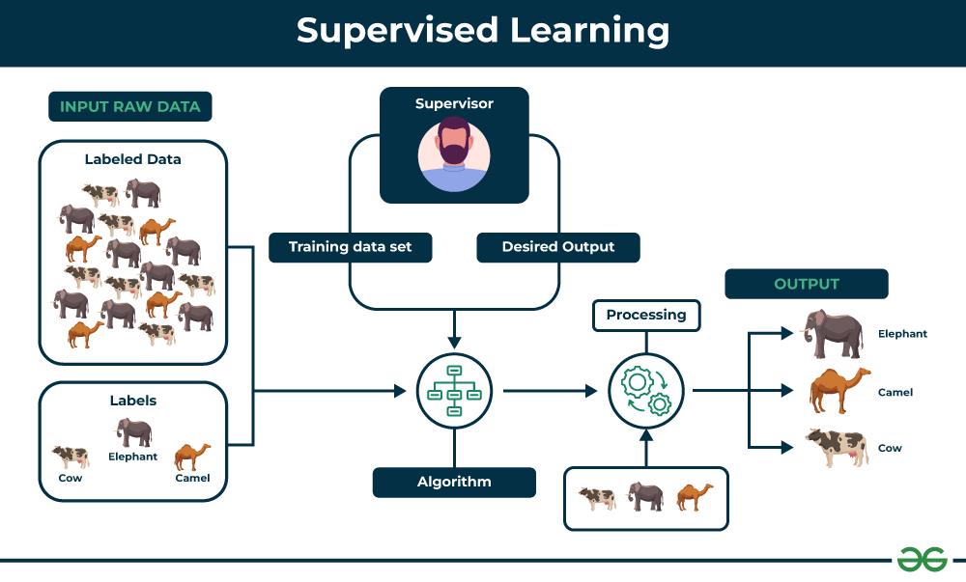
Machine Learning
Supervised Learning
Learns from labeled data
Classification
  Predict categorical values, like animal species, spam email, medical diagnoses
Regression
  Predict continuous values, like house prices, stock prices
https://www.geeksforgeeks.org/supervised-unsupervised-learning/

Slide 21
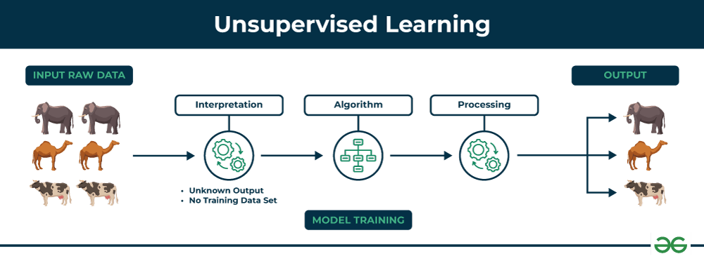
Machine Learning
Unsupervised Learning
Learns from unlabeled data
Clustering
  Discover and group similar data together, like target customers
Association Rule Learning
  Discover a rule that describes large portions of data, like scientific discovery
Semi-Supervised Learning
https://www.geeksforgeeks.org/supervised-unsupervised-learning/

Slide 22
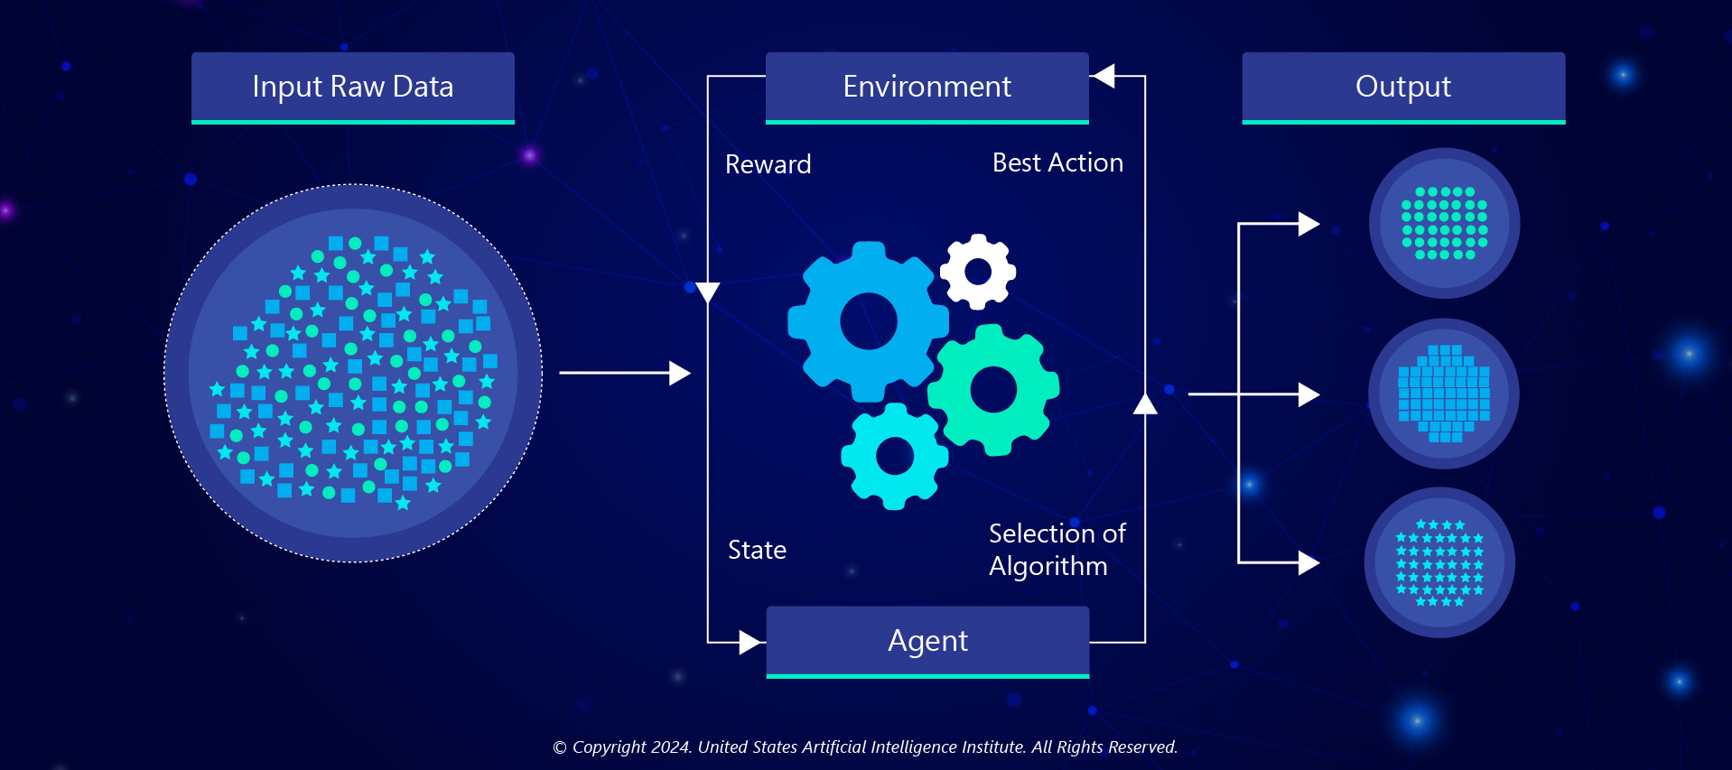
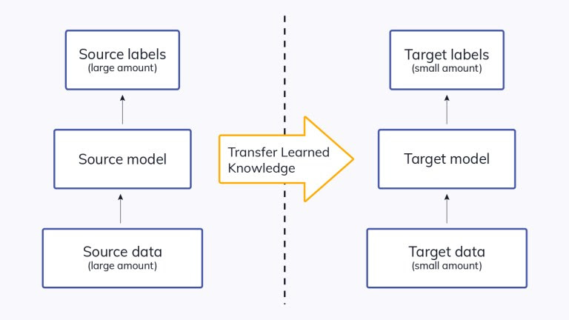
Machine Learning
Reinforcement Learning
Learns to make predictions and decisions based on optimal results
Transfer Learning
Learns from a pre-trained model and dataset

Slide 23



ML in Simulation-based Training
Military & Defense Training Enemy behavior simulated using reinforcement learning for unpredictable tactical responses in training. | Healthcare & Surgical Training Virtual surgery simulations with haptic feedback that mimic real-world conditions and assess surgeon precision and timing. | Automotive Driving Simulations Training drivers in simulators that predict reactions to bad weather or obstacles; autonomous vehicles trained in complex traffic environments.

Slide 24
Modeling Tr(AI)ning

Slide 25
Expert Systems
  Expert System for Behaviorism
What is an expert system?
  An AI program that mimics human expertise in a given domain
What are the parts of an expert system?
  Knowledge base: Expertise is stored in rules and facts
  Inference Engine: Applies logical rules to the knowledge base to solve problems
Example:
  Behaviorism
Knowledge Base
Facts
Positive reinforcement increase the likelihood of repeated behavior
Negative reinforcement also increases the likelihood of repeated behavior
Punishment decreases the likelihood of repeated behavior
Rules
IF a student completes a task correctly, THEN provide positive reinforcement
IF a student avoids a negative outcome, THEN recognize the behavior as negative reinforcement
IF a student engages in undesirable behavior, THEN apply punishment (e.g., loss of privileges)
Inference Engine
Scenario 1
Student completes homework on time
Inference engine matches with Rule 1
Positive reinforcement
Scenario 2
Student avoids detention with good behavior
Matches with Rule 2
Negative reinforcement
Scenario 3
A student disrupts class
Matches with Rule 3
Punishment applied like a time-out

Slide 26
Expert Systems
Integrating expert systems into pedagogy allows us to adapt the pedagogy, with a few other tools (like LLMs)
We can create personalized learning paths, provide real-time feedback, offer scaffolding and support, or provide adaptive assessments
  How Pedagogy Changes Learning
Data Point 1
Student is struggling with calculating the slope of a line.
Data Point 2
Student has done well with simple algebraic problems
Data Point 3
Positive reinforcement has worked well with this student
Expert System
“Apply Positive Reinforcement”
LLM Creates Personalized Feedback
Jimmy, you’ve done well when applying simple algebraic problems. You know how to solve 3x = 9. While the slope of a line has some more variables in it, I’m confident you can take what you learned previously and apply it here.

Slide 27
Expert Systems
  Application in Simulation-based Learning
Simulation-based Learning: Military Training Sims
Knowledge Base:
Inference Engine
Check the terrain (Fact 1)
Terrain is urban, applies Rule 1
System creates ambush scenarios
Monitors use of cover and adjusts enemy hit probability
Skill Development: Medical Procedure Training
Knowledge Base:
Inference Engine
A student performs a virtual surgery, with inference engine monitoring every step
Detects and applies Rule 1
Checks suturing steps and confirms completion
Fact 1: Enemy units use specific tactics based on terrain
Fact 2: Certain maneuvers have higher success rates in urban environments
Fact 3: Weather conditions affect visibility and movement
Rule 1: IF terrain is urban, THEN increase likelihood of ambush scenarios
Rule 2: IF visibility is low, THEN reduce accuracy of long-range weapons
Rule 3: IF soldiers use cover effectively, THEN decrease enemy hit probability
Fact 1: Proper sterilization is critical to avoid infections
Fact 2: Specific steps must be followed for suturing wounds
Fact 3: Complications can arise from improper incision techniques
Rule 1: IF sterilization is not performed, THEN increase infection risk
Rule 2: IF suturing steps are followed, THEN confirm completion
Rule 3: IF incision is improper, THEN flag for review and provide feedback

Slide 28
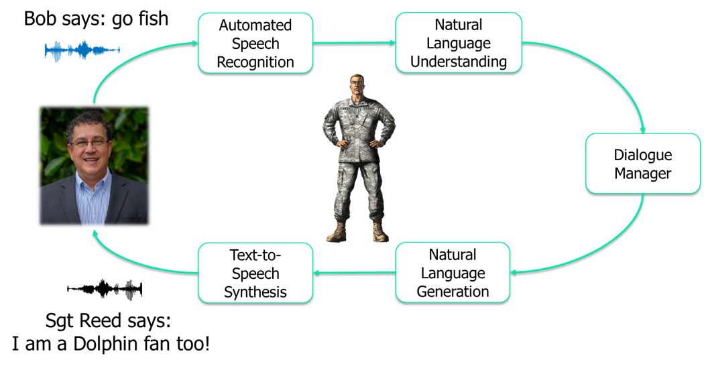
Natural Language Processing

Slide 29
Natural Language Processing
History of NLP
  1950s-1980s: Rule-Based Systems and Expert Systems
    Development of rule-based NLP systems using handcrafted rules.
    Example: ELIZA, a rule-based chatbot (1966)
  1990s: Statistical Methods
    Shift from rule-based systems to statistical models due to increased computational power.
    Example: Hidden Markov Models (HMMs) for speech recognition.
  2000s: Machine Learning and Data-Driven Approaches
    Rise of machine learning algorithms for NLP tasks.
    Example: Google's Word2Vec computes vector representations of words

Slide 30
Natural Language Processing
History of NLP (continued)
  2010s: Deep Learning Revolution
    Deep learning methods transform NLP.
    Examples: RNNs, LSTM networks, Seq2Seq models for MT
  2020s: LLMs and Generative AI
    Emergence of powerful generative models.

Slide 31
Natural Language Processing
Use of LLMs in simulation-based training
  Conversational agents and virtual instructors
    Realistic dialogues with virtual agents for interactive training
    AI-driven tutors
  Scenario generation and adaptation
    Enhancement of depth and variability of simulations
  Content creation and enhanced delivery
    Detailed explanations aid in understanding complex topics

Slide 32
Natural Language Processing
Real-world Applications of NLP in simulation-based training
  Healthcare
  Customer Service
  Law Enforcement & Military
  Corporate Training

Slide 33

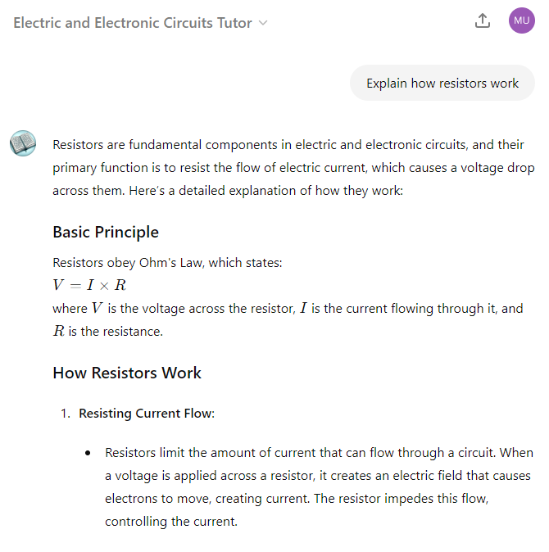

Natural Language Processing

Slide 34

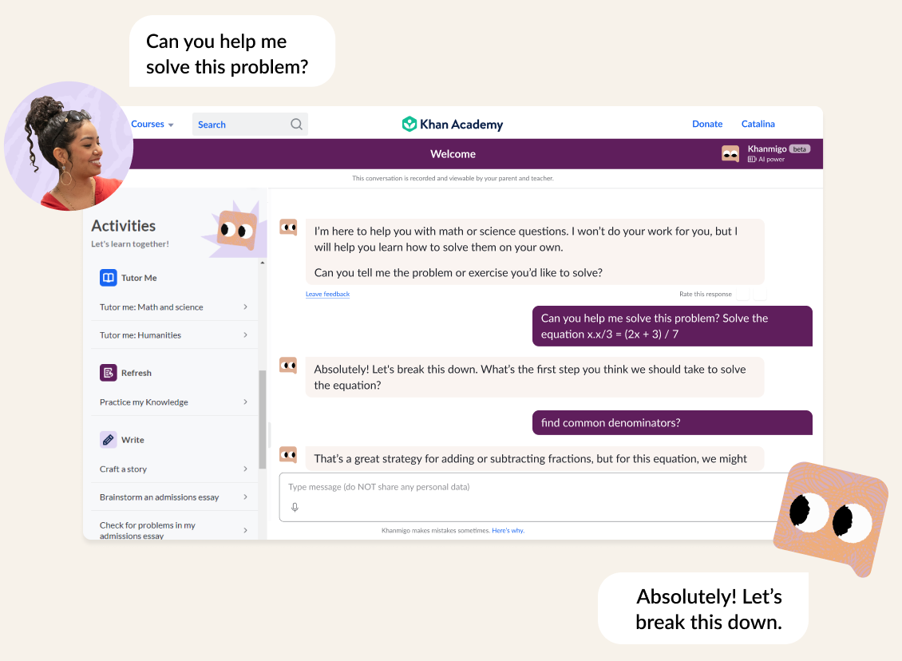
Natural Language Processing

Slide 35
Terminology Differentiation
 | Machine Learning | Natural Language Processing | Large Language Models | Generative AI
Definition | A subset of AI where algorithms learn from data to make predictions or decisions without being explicitly programmed. | A subfield of AI that focuses on the interaction between computers and human language. | A type of ML model specifically designed to understand and generate human language, trained on vast datasets. | A subset of AI designed to create new data (text, images, etc.) that mimics the structure of the input data.
Core Function | General-purpose learning and decision-making based on data patterns. | Processing and analyzing human language in text or speech form. | Understanding, generating, and predicting text by analyzing large-scale language data. | Creating new content (text, images, etc.) that closely resembles human-produced content.
Primary Application | Predictive analytics, recommendation systems, classification tasks, and regression. | Language translation, sentiment analysis, speech recognition, text classification. | Chatbots, text generation, question answering, summarization, and translation. | AI art, text generation (e.g., GPT), music composition, code generation.
Simulation-Based Training Examples | Scenario generation, Adaptive learning, Real-time performance feedback | Simulating chat conversations or multilingual environments to improve language translation. | Training models using virtual customer interactions to improve conversational agents (e.g., virtual customer support). | Training AI models in simulated video game worlds to generate dynamic content (e.g., characters, environments, or narratives).

Slide 36
Applying AI Workshop
Ms. Elaine Choy, Dr. Brice Colby,
Dr. Morgan Ulinski, Dr. Randolph M. Jones
0925-1000

Slide 37
Applying AI Workshop
Jigsaw – group up and identify AI solutions
  Create a group of 6
  Assign 2 people from your group to study each of the following using the job aids: ML, expert systems, GenAI
  Spend 10 minutes discussing additional practical applications of the technology to training
Notes:
Objective. Your task is to design a language learning app. Keep in mind how you can incorporate ML, expert systems, and GenAI as potential solutions.
The app does not need to be designed for any specific language.
The app should cover the basics of reading, writing, listening, and speaking.
The app should facilitate spaced repetition, meaning content is presented on scheduled intervals to address forgetting.
The app should incorporate a mastery system where users’ progress is based on proficiency measures.
The app should facilitate interaction with large language models (LLMs) for practice.

Slide 38
Applying AI Workshop
What are the main components of an expert system, and how do they interact?
What are the key differences between supervised, unsupervised, and reinforcement learning?
What is GenAI and how does it differ from other forms of AI?
What were some practical applications you came up with?

Slide 39
30min Break
Please return to your seat NLT 1030

Slide 40
Applying AI Workshop
Still in your groups of 6, work together to solve this design challenge
Design challenge: Your task is to design a language learning app. Keep in mind how you can incorporate machine learning, expert systems, and GenAI as potential solutions.
Requirements:
  The app does not need to be designed for any specific language.
  The app should cover the basics of reading, writing, listening, and speaking.
  The app should facilitate spaced repetition, meaning content is presented on scheduled intervals to address forgetting.
  The app should incorporate a mastery system where users’ progress is based on proficiency measures.
  The app should facilitate interaction with large language models (LLMs) for practice.
Notes:
Objective. Your task is to design a language learning app. Keep in mind how you can incorporate ML, expert systems, and GenAI as potential solutions.
The app does not need to be designed for any specific language.
The app should cover the basics of reading, writing, listening, and speaking.
The app should facilitate spaced repetition, meaning content is presented on scheduled intervals to address forgetting.
The app should incorporate a mastery system where users’ progress is based on proficiency measures.
The app should facilitate interaction with large language models (LLMs) for practice.

Slide 41
Applying AI Workshop
What kind of training solutions did your groups come up with?
How do you think the roles of teachers and students will change with the increasing use of AI in education?
Imagine an ideal classroom of the future where AI is fully integrated. What does it look like, and how does it function?

Slide 42

Key Considerations
DoD Release (2020)
Challenges of AI
Scalability and performance
  Computational demands
  Scalable solutions
Artificial General Intelligence
  Integrated learning and reasoning
  Evolution vs. learning
  Generalization vs. over-generalization
Interoperability
  System integration
  Standardization
Ethical and security concerns
  Bias and fairness
  Data security
Future Directions of AI
Advanced machine learning algorithms
  Enhance simulation accuracy and predictive capabilities
Generative AI
  Content creation
  Scenario variation
Real-time data integration
  Live data feeds
  IoT and sensor data
Ethics of AI
Responsible
  judgment and care in the development, deployment, and use of AI capabilities
Equitable
  minimize unintended bias
Traceable
  understanding of the technology, development processes, and operational methods, including auditable methodologies and data sources
Reliable
  safety, security, and effectiveness of such capabilities will be subject to testing and assurance
Governable
  detect and avoid unintended consequences
  ability to disengage deployed systems that demonstrate unintended behavior

Slide 43
Concluding Discussion
How will you apply AI methods to your own
training and simulation problems?

Slide 44
Thank you for attending!
Brice Colby, Ph.D. (brice.colby@soartech.com)
Randolph M. Jones, Ph.D.
Morgan Ulinski, Ph.D.
Elaine Choy, M.S.
Robert Sottilare, Ph.D.

Slide 45
Agenda
Time | Topic | Presenter
0800-0820 | Artificial Intelligence Overview | Dr. Jones
0820-0840 | Modeling Tr(AI)ning | Dr. Colby
0840-0925 | Practical Applications of AI and Examples | Ms. Choy, Dr. Colby, Dr. Ulinski
0925-1005 | Applying AI Workshop | Team
1005-1035 | 30 min Break
1035-1105 | Workshop Discussion and Debrief | Dr. Jones
1105-1120 | Ethics in AI | Ms. Choy
1120-1135 | Future Directions and Challenges of AI | Dr. Jones
1135-1150 | Key Takeaways and Conclusions | Dr. Ulinski
45

Slide 46
Ethics in AI
Ms. Elaine Choy
1105-1120

Slide 47
DoD AI Ethical Principles
DoD officially adopted five key ethical principles for AI in 2020
1. Responsible –
DoD personnel will exercise appropriate levels of judgment and care, while remaining responsible for the development, deployment, and use of AI capabilities
2. Equitable –
The Department will take deliberate steps to minimize unintended bias in AI capabilities
DoD Release (2020)

Slide 48
DoD AI Ethical Principles
3. Traceable –
The Department's AI capabilities will be developed and deployed such that relevant personnel possess an appropriate understanding of the technology, development processes, and operational methods applicable to AI capabilities, including with transparent and auditable methodologies, data sources, and design procedures and documentation

Slide 49
DoD AI Ethical Principles
4. Reliable –
The Department's AI capabilities will have explicit, well-defined uses, and the safety, security, and effectiveness of such capabilities will be subject to testing and assurance within those defined uses across their entire lifecycles
5. Governable –
The Department will design and engineer AI capabilities to fulfill their intended functions while possessing the ability to detect and avoid unintended consequences, and the ability to disengage or deactivate deployed systems that demonstrate unintended behavior

Slide 50
DoD AI Ethical Principles
How to track ethical AI?
Allocate funding to create a role representing ELSI
Identify relevant AI ethical dilemmas
Document and track ELSI decisions, especially its impact
Monitor and evaluate consistently
Date | Domain | Principle | ELSI Implication | Decision/Activity | Etc.
01JAN25 | Testbed Design | Governable, Equitable | Only offer mostly "correct" treatment options or the whole gambit? Also very effortful to offer all options. | Offer range of plausible treatment options and ensure it can be expanded.

Slide 51
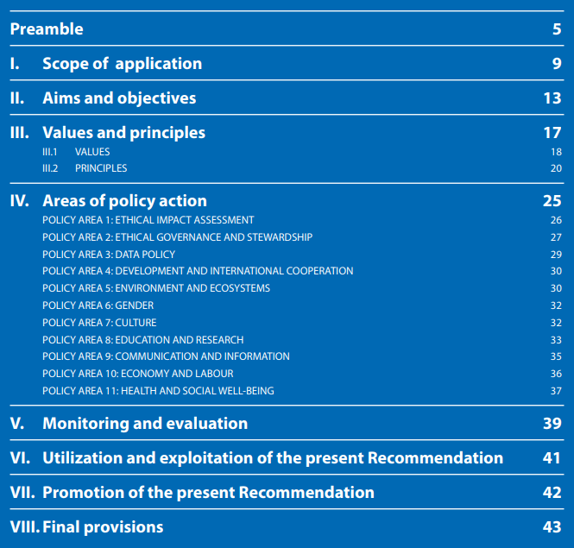

Ethics in AI
Further Reading:
Recommendation on the Ethics of Artificial Intelligence (2022)
by the
United Nations Educational, Scientific, and Cultural Organization (UNESCO)

Slide 52
Future Directions and Challenges of AI
Dr. Randolph M. Jones
1120-1135

Slide 53
Future Directions and Challenges of AI
Future Directions
Advanced machine learning algorithms
  Enhance simulation accuracy and predictive capabilities
Generative AI
  Content creation
  Scenario variation
Real-time data integration
  Live data feeds
  IoT and sensor data
Challenges
Scalability and performance
  Computational demands
  Scalable solutions
Artificial General Intelligence
  Integrated learning and reasoning
  Evolution vs. learning
  Generalization vs. over-generalization
Interoperability
  System integration
  Standardization
Ethical and security concerns
  Bias and fairness
  Data security

Slide 54
Concluding Discussion
Dr. Morgan Ulinski
1135-1150

Slide 55
Concluding Discussion
How will you apply AI methods to your own
training and simulation problems?

Slide 56
Thank you for attending!
Brice Colby, Ph.D.
Randolph M. Jones, Ph.D.
Morgan Ulinski, Ph.D.
Elaine Choy, M.S.
Robert Sottilare, Ph.D.

