Slide 1
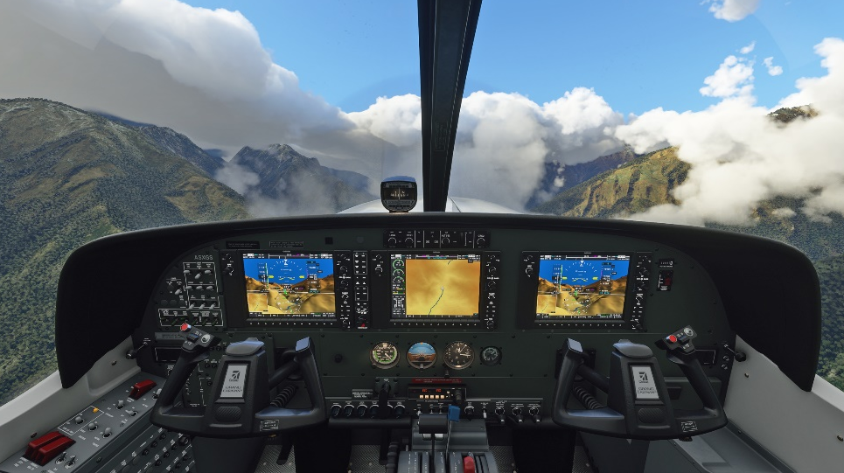
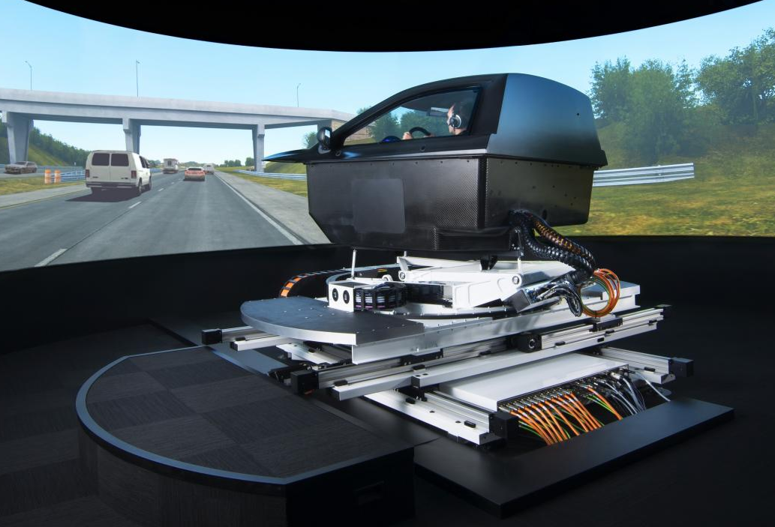
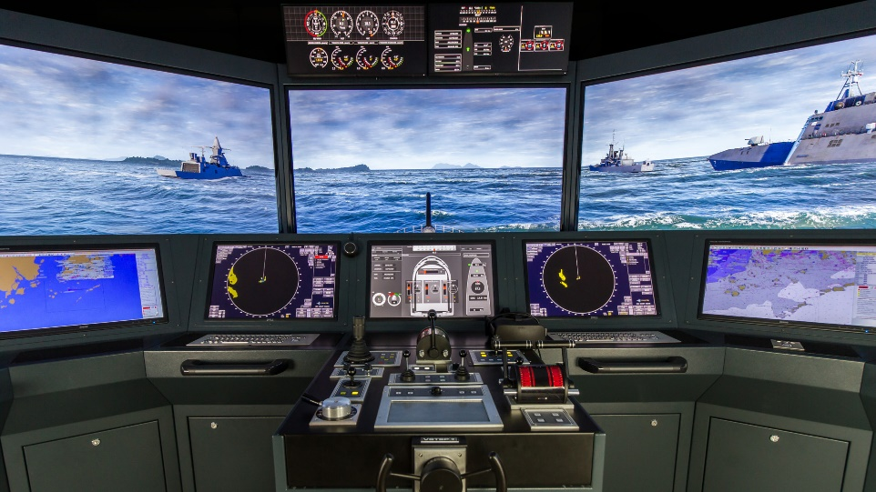


Beyond the Basics – An Interactive “deep dive” into Vehicle Modeling & Simulation (M&S) Fundamentals
Kevin F. Hulme, Ph.D., CMSP

Slide 2
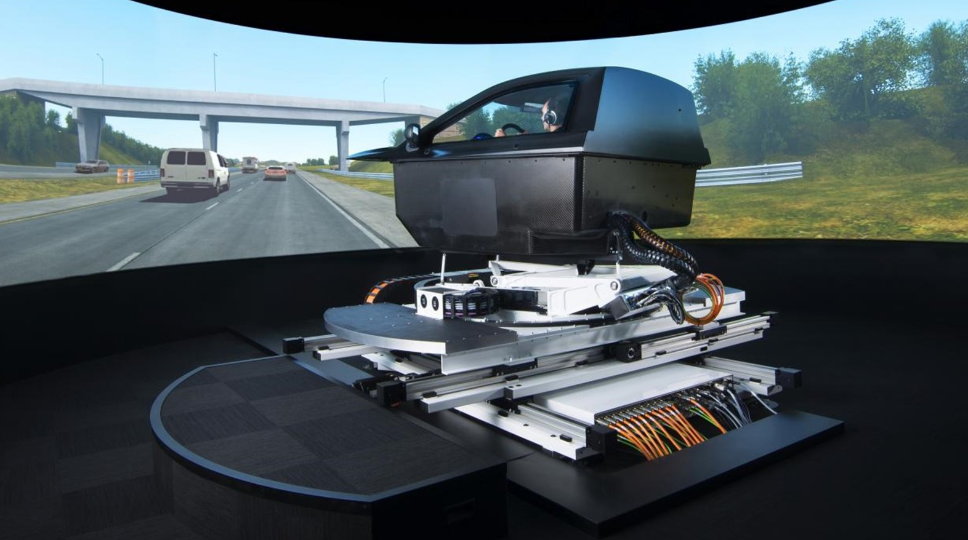

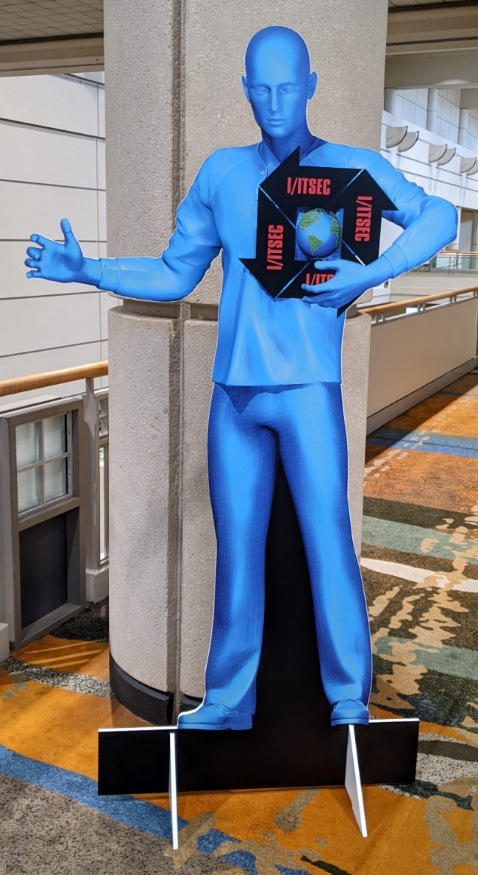
PDW Introduction
Beyond the Basics

Slide 3
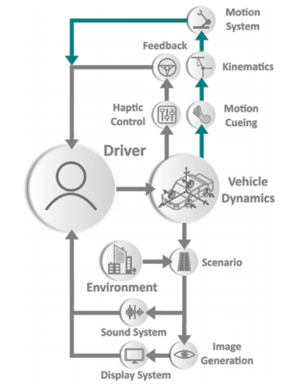
PDW Introduction
Agenda
PDW Introduction (8:00 – 8:20)
  Agenda | Speaker Intro | Who should attend? | Welcome to I/ITSEC 2024
  M&S Fundamentals | Historical context | MS Excel (justification) | BREAK
“Beyond the Basics” (8:30 – 11:40)
  Haptics/Inputs | Linear algebra / Excel Breakout | BREAK (8:30 – 9:05)
  Vehicle Dynamics | Differential Equations / Excel Breakout | BREAK (9:05 – 9:40)
  Motion Simulation | Data Filters / Excel Breakout | BREAK (9:40 – 10:15)
  Virtual Environments | Collision detection / Excel Breakout | BREAK (10:15 – 10:50)
  Displays, IGs, Sound | Optimization / Excel Breakout | BREAK (10:50 – 11:25)
  Special topics (11:25 – 11:40)
PDW Summary (11:40 – 11:45)
  “Beyond the Basics” recap
  Acknowledgements & Bibliography
PDW Conclusion / Q&A (11:45 – 12:00)

Slide 4

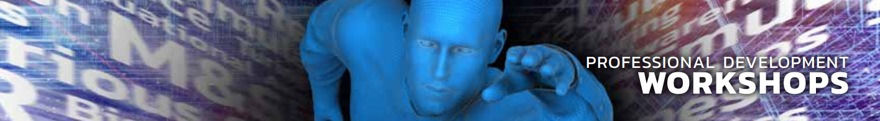
PDW Introduction
Speaker introduction / Attendee Justification
Kevin F. Hulme received his Ph.D. from the Department of Mechanical Engineering at the University at Buffalo, specializing in multidisciplinary optimization of complex systems
Kevin is the Program Manager for Stephen Still Institute for Sustainable Transportation and Logistics (SSISTL) and as Senior Research Staff in the Transportation Research and Visualization Lab (TRAVL)
Kevin’s current areas of focus include simulation science, applied modeling and simulation (M&S), and human factors in vehicle simulation
Kevin is a Certified Modeling and Simulation Professional (CMSP)
Attendees who seek Continuing Education for core M&S content (enhance Tutorials/Technical Papers)
Attendees who want to explore fundamental supporting M&S technologies (vehicle simulation)
Attendees who want to discover contemporary examples of M&S in research, education, training
Attendees who are considering M&S Professional Development (CMSP designation)

Slide 5
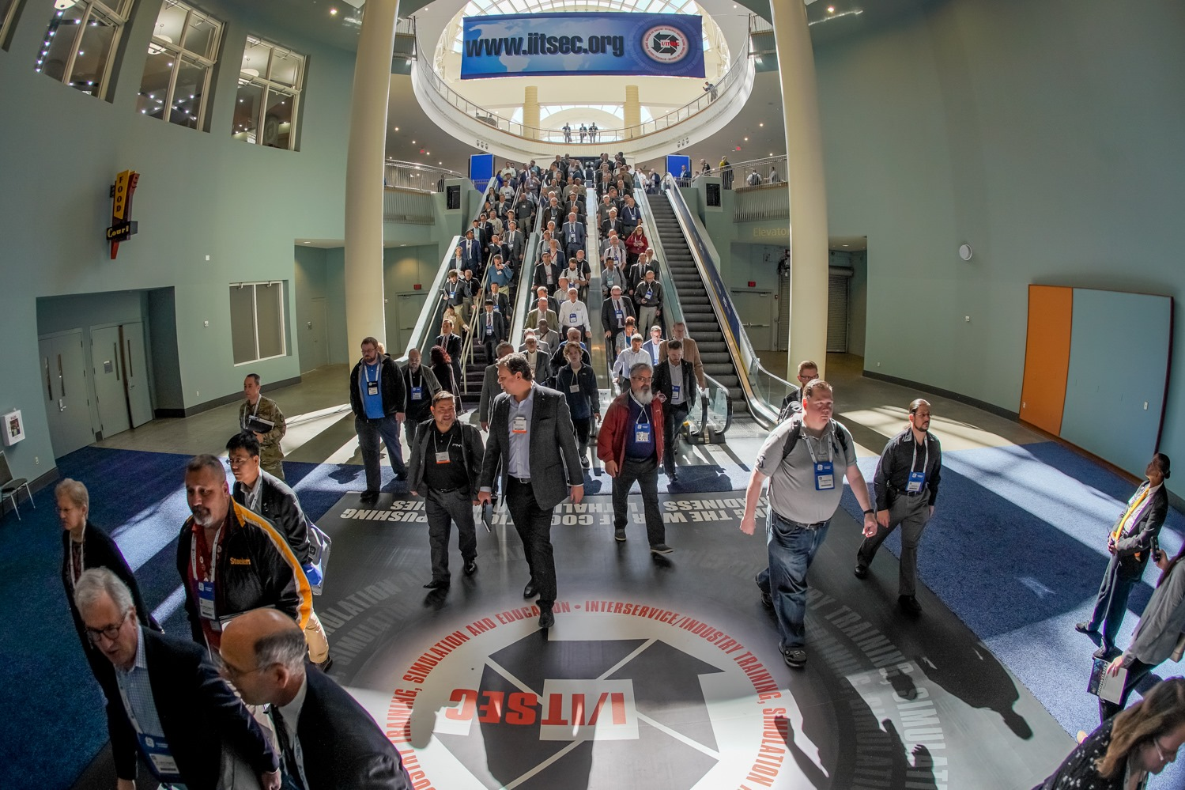
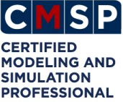

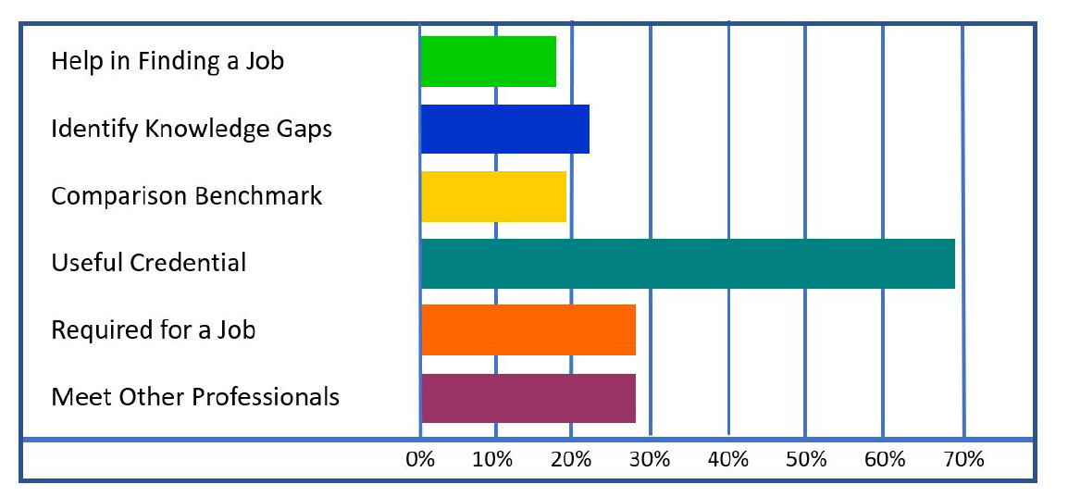
PDW Introduction
Welcome to I/ITSEC 2024
Lieberher, 2023
Oswalt, 2023
NTSA, 2024
I/ITSEC 2024 prevailing Conference theme
  “Assuring Deterrence through Integrated Training and Readiness”
  Integration: M&S, architectures (i.e., both hardware/software)
  Training/Readiness: Specialized competencies for enhanced mission preparedness
I/ITSEC Paired Events
  A continuum of Professional Development across a spectrum of activities
  Monday: Tutorials
  Tuesday-Thursday: Technical Papers (subcommittees)
  Exhibition Hall | Special Events (e.g., Serious Games) (week-long)
  Friday: Professional Development Workshops (PDW)
Certified Modeling & Simulation Professional (CMSP)
  Provides the M&S community with its own professional certification
  Core and Emerging CMSP Modeling Methods prevail in this PDW

Slide 6
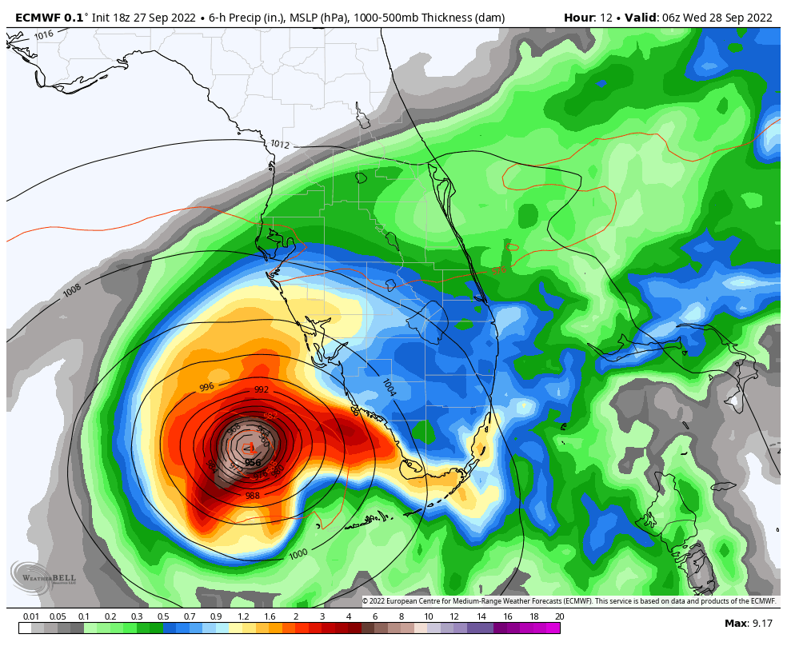
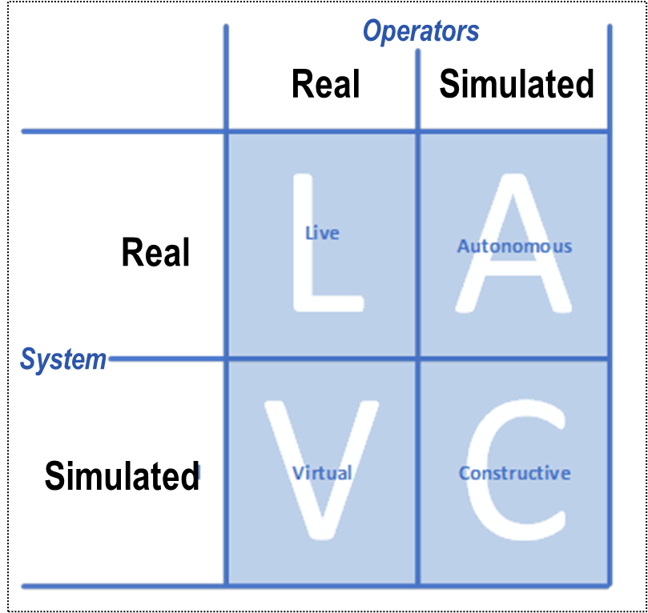
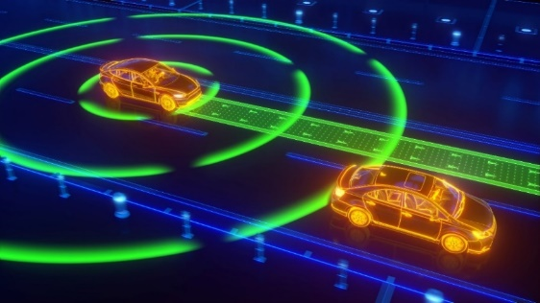
PDW Introduction
M&S Terminology
DoD, 1998
MST, 2020
Ahmed et al., 2021
Modeling & Simulation (M&S) – key definitions
  (M)odel: A product (physical or digital) that represents a system of interest
  (S)imulation: Applying a model to study system performance (over time/space)
Live-Virtual-Constructive (LVC) – a popular taxonomy for classifying M&S
  Live: real people / real system
  Virtual: real people / simulated system
  Constructive: simulated people / simulated system
  “Autonomous”: simulated people / real systems
Physics-based Modeling - incorporates physical characteristics (e.g., forces, moments, accelerations) directly into model
  Adaptations for next-generation Autonomous Vehicle (AV) models:
    Car-following (acceleration thresholds)
    Collision-avoidance (safety distance)
    Perceptual threshold (headway/speed)
Hurricane Ian (September, 2022)

Slide 7
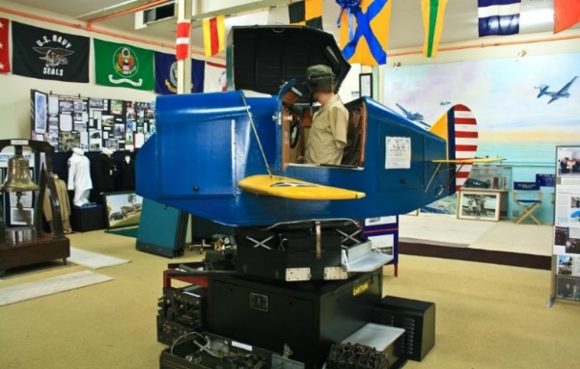
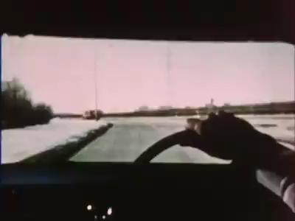
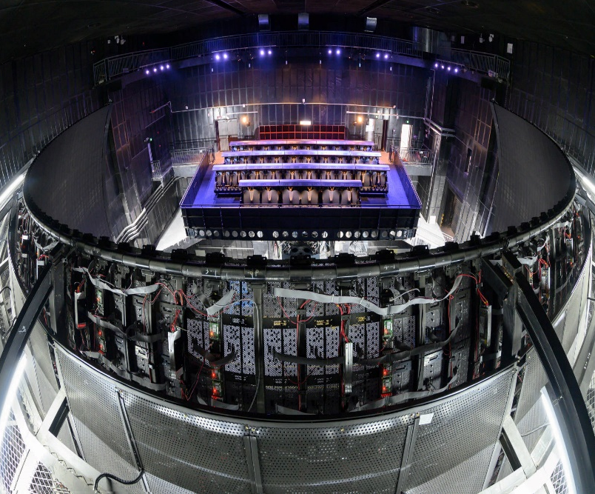
PDW Introduction
Vehicle Simulation
Jeon, 2015
McGowan, 2018
Historical context
LINK trainer (1929): first modern-day flight simulator
  No visuals – trained pilots to fly by instruments
  Early “hexapod” – air-driven bellows to create movement
GM Driving Simulator (1969): panoramic driving scenarios
  35 mm color film projector
  2-DOF (roll/pitch) with tilt coordination for acceleration cues
Entertainment vehicles (1970s): amusement ride simulators
  Simulator attractions have common components of M&S:
    Gaming elements (scenarios/storytelling)
    Large displays | Virtual/Augmented/Mixed realities
    Simulator cabin | ride dynamics | motion cueing
    Image generation, display technology, 3D sound simulation

Slide 8
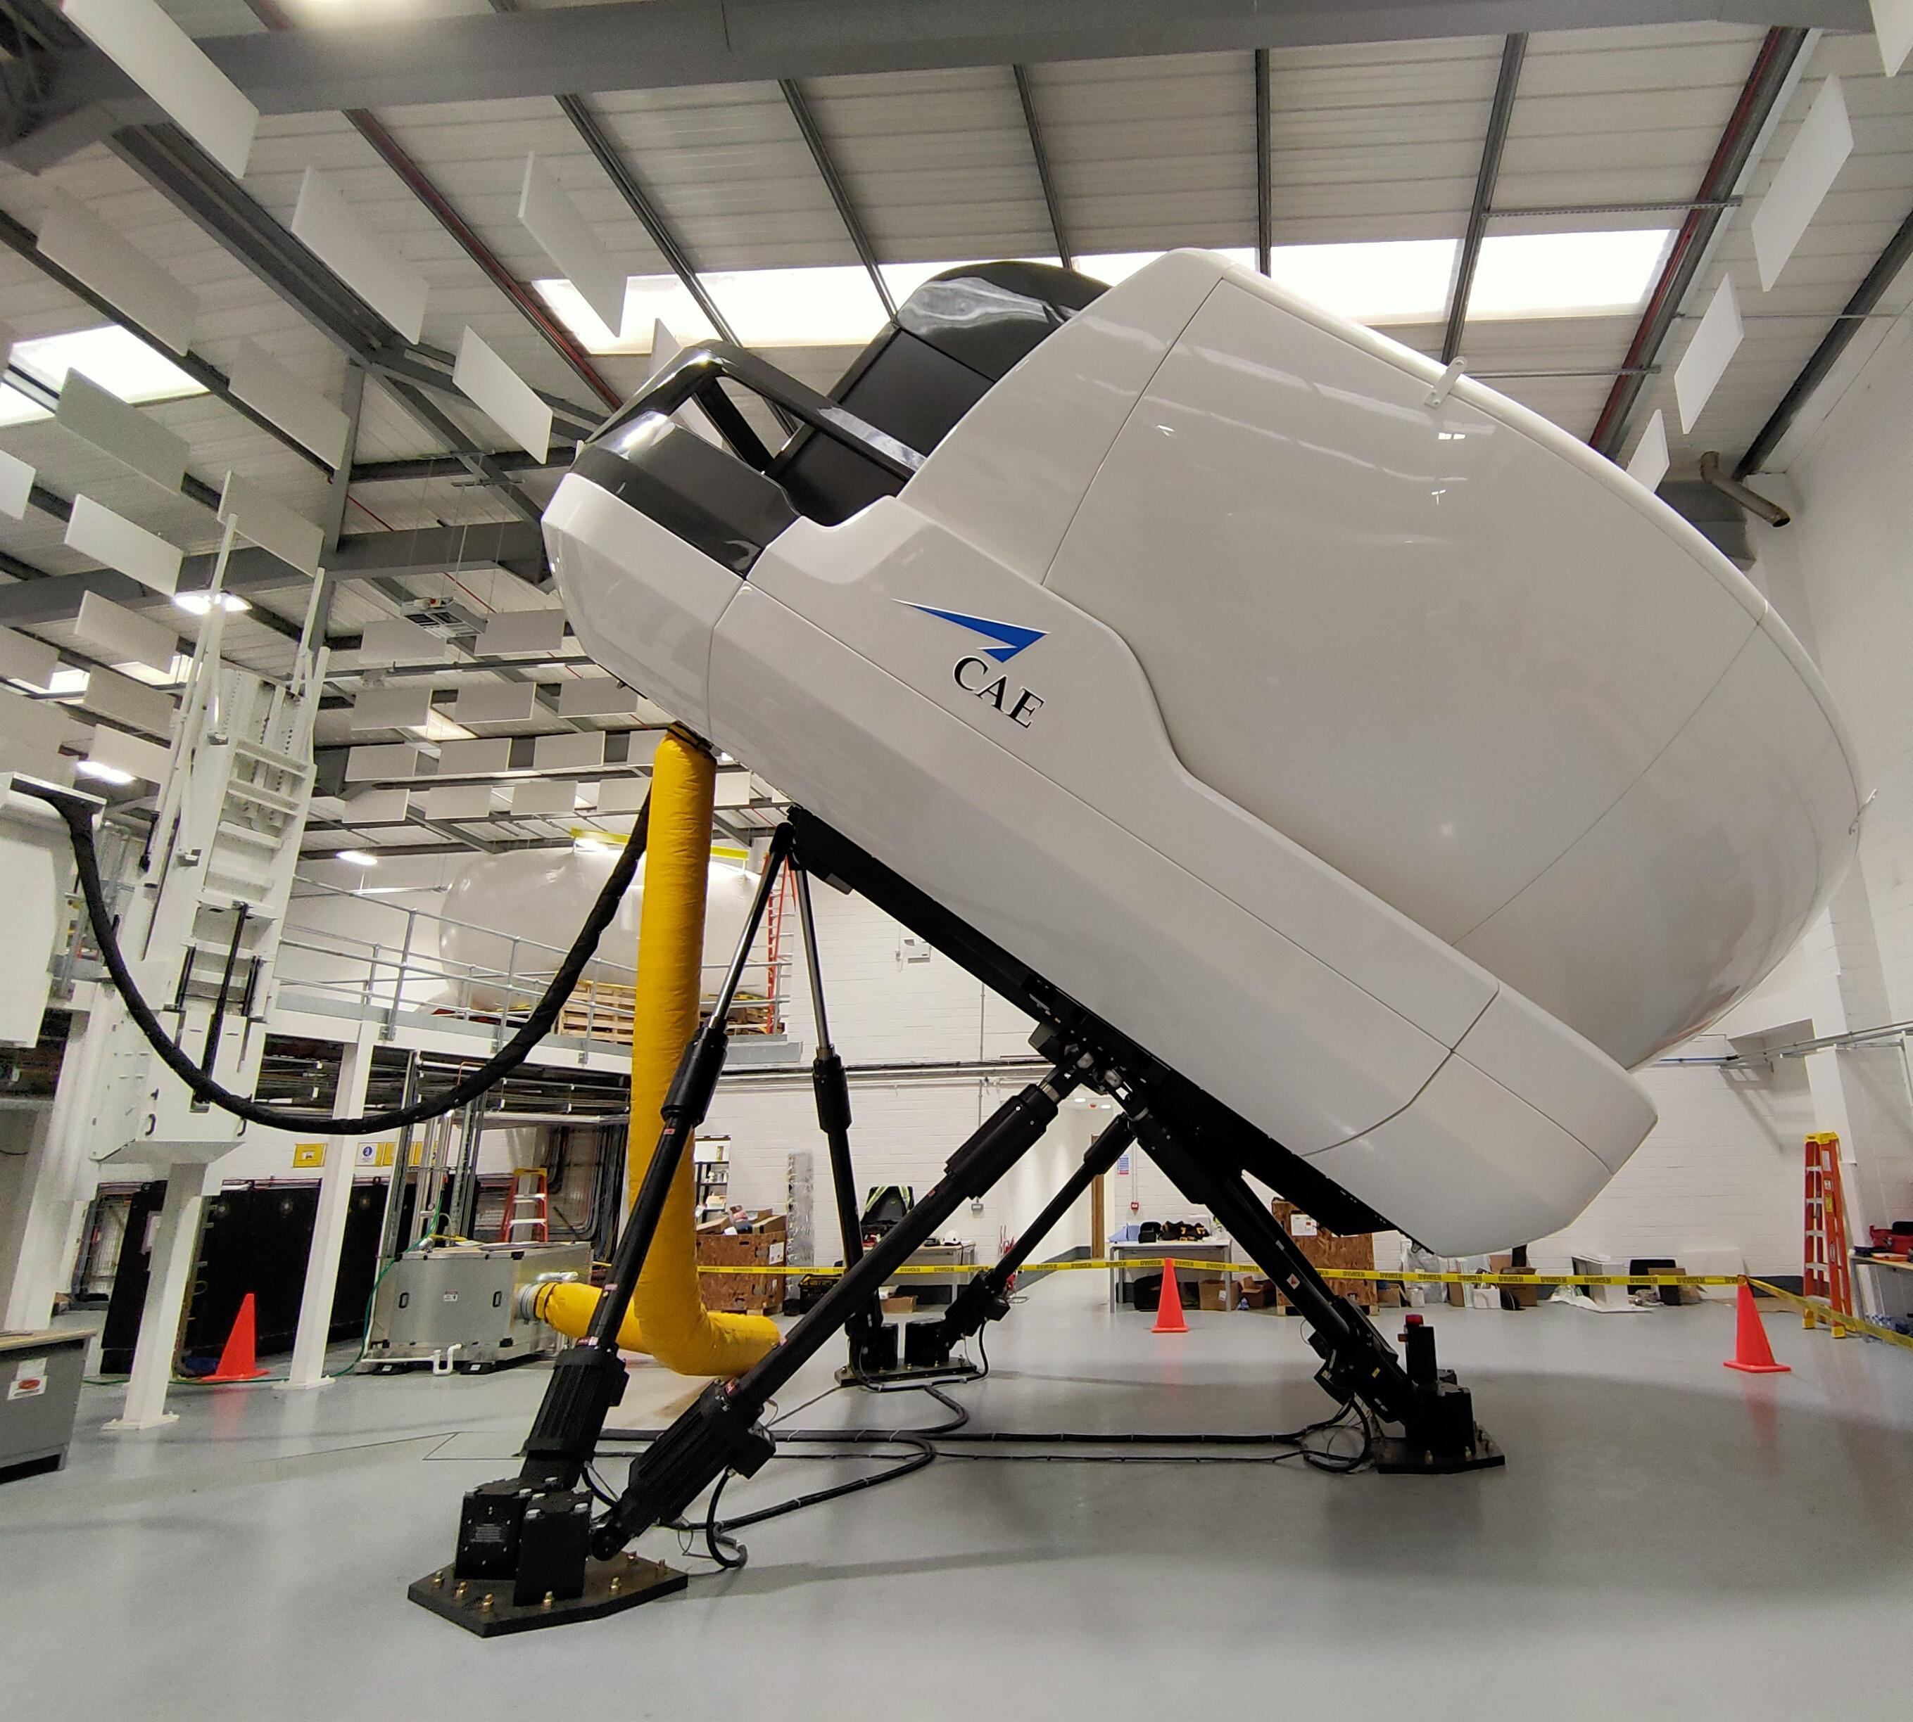
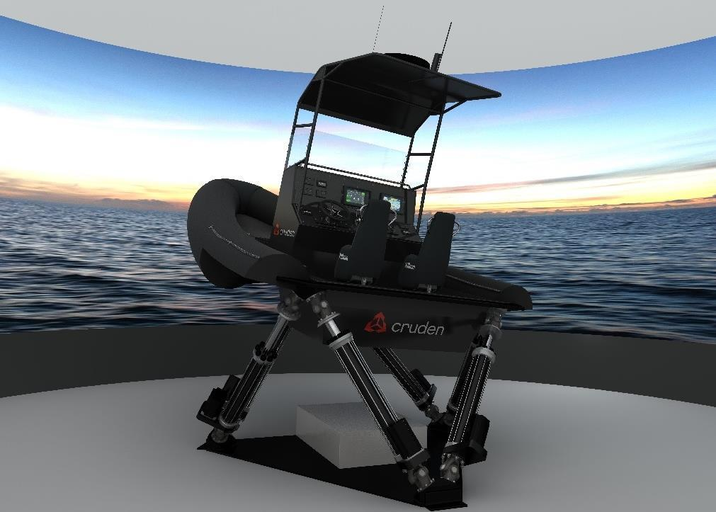
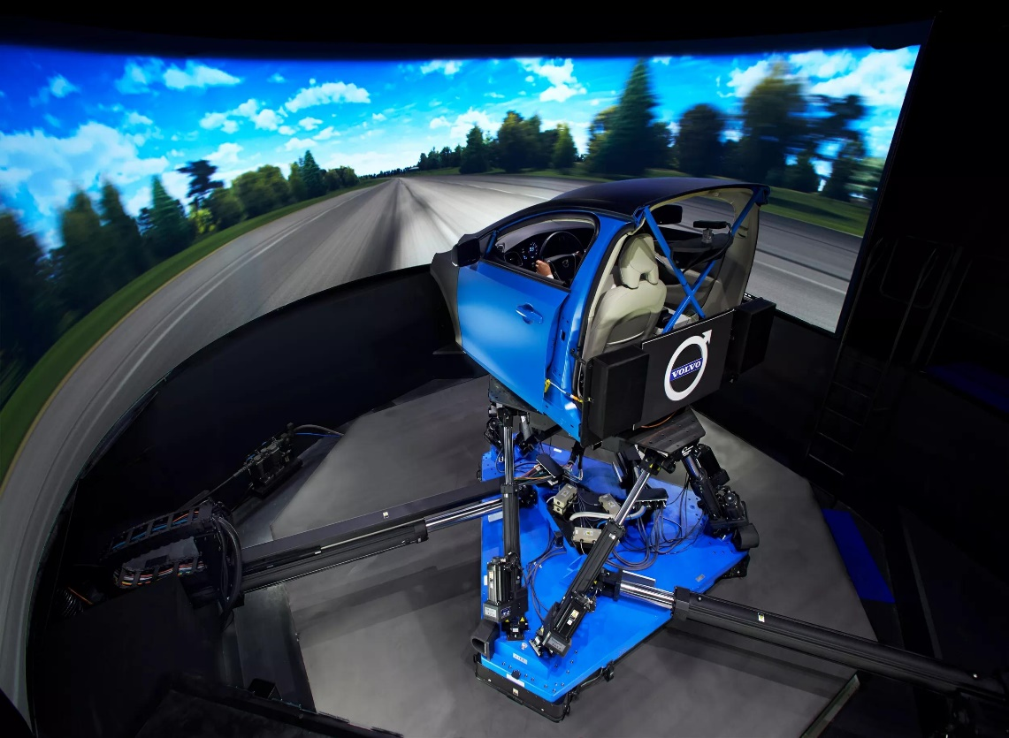
FLIGHT
MARITIME
DRIVING

Slide 9
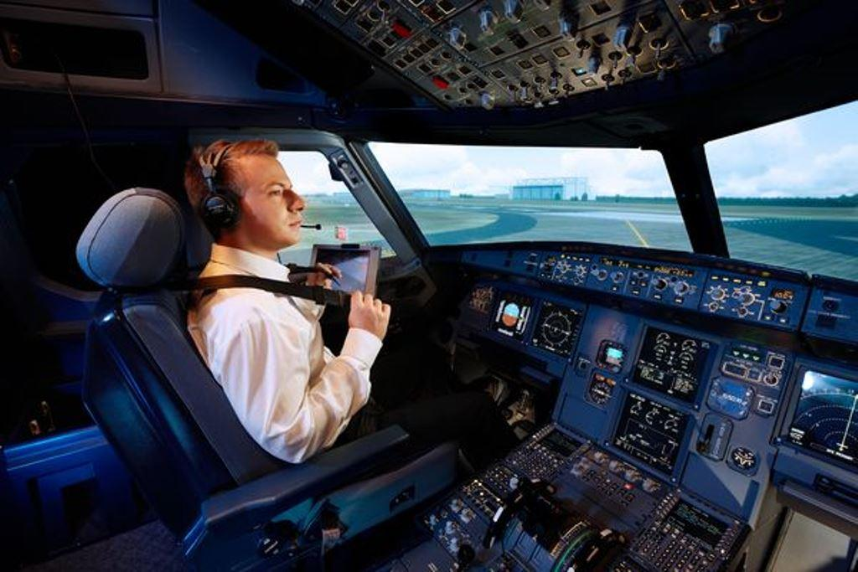
PDW Introduction
Vehicle Simulation
Bruck et al., 2021
Simulator Training Applications
Purpose of vehicle simulation
  Enhance Pilot/Driver Training effectiveness
  Enable safe analysis of human behaviors
How create a realistic (ground/flight/maritime) simulation?
  Various subsystems must be developed and integrated
  The (a) driver (pilot) and (b) vehicle remain at the center of this process
  Simulated (c) environment (e.g., input, motion, visuals, sound) also critical
This PDW introduces math/modeling aspects of these subsystems from a notional perspective
  Describe M&S theory (PowerPoint)
  Present a numerical solution approach (PowerPoint/Excel)
  Example implementation (Excel)
c
a
b
1
3
2
4
5

Slide 10


PDW Introduction
A word about MS Excel
Why MS Excel?
For the purposes of this PDW, Excel will enable us to
  Break out from PowerPoint periodically
  Visualize simulation subproblem mathematics
True vehicle simulations vary across time (t) and space (xyz)
  A real-time programming language (e.g., C/C++/C#, Java, MATLAB, Simulink) would be a more appropriate development tool
  That training lies beyond the scope of a 4-hour PDW
Excel serves as an intermediary between initial conceptualization and eventual implementation of a proper simulation
QR code for Excel breakouts:

Slide 11
M&S component: Haptics/Inputs
Solution method: Linear algebra
Beyond the Basics
1
1

Slide 12
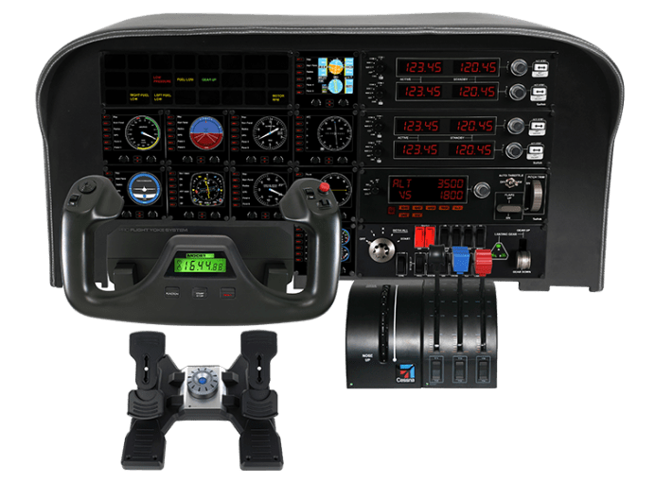
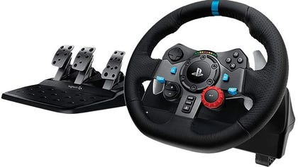
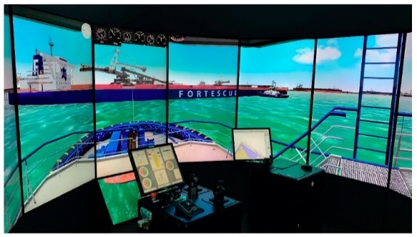
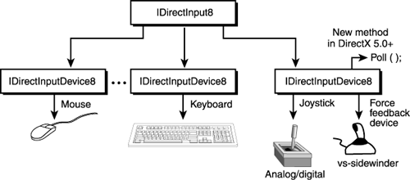
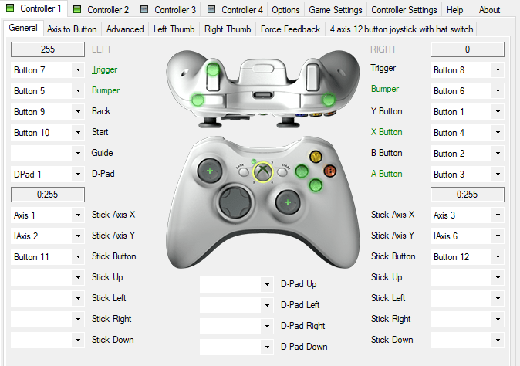
Haptics/Inputs
Gregory, 2009
Microsoft, 2022
Human Interface Device (HID): provide input to the simulation
  Perturbations result in a change in state - necessitates re-solving equations
Many device inputs provide feedback (e.g., haptic | force | visual | aural)
  Enhance realism, presence, immersion
Types of vehicle simulation control input devices:
  Steering, gas, brake, clutch, yoke, throttle, rudder, azimuth, tiller
Additional modeling inputs to enhance simulation fidelity:
  Surface elevation/traits, wind shear and gusts, fluid (wave) dynamics
To capture an input signal, an analog-to-digital interface is required
  DirectInput/Xinput (Microsoft) for creating action mappings, and device feedback
  Game Engines (e.g., Unity, Unreal) natively include API’s for input handling

Slide 13
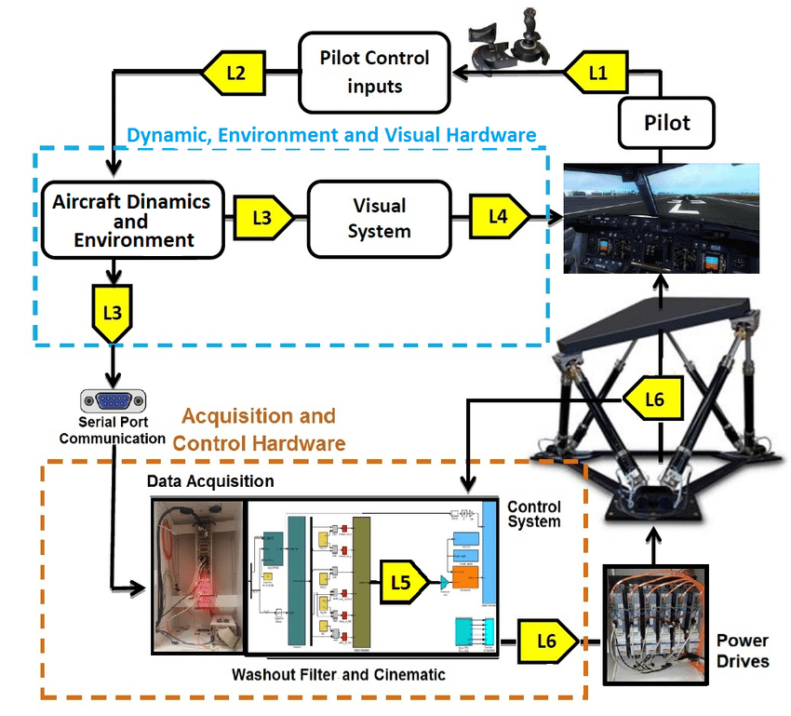
Haptics/Inputs
Lemes et al., 2018
Intel, 2024
Input Lag / Latency: user-perceived delay between taking an action (input) and the resulting change in the simulation (output)
  If not minimized, trainee orientation will become decoupled
  Potentially inducing disorientation; poor transfer of training
Within a simulation control loop, latency can accumulate from a variety of sources (e.g., see L1 to L6 in Figure)
  Controller (input) lag {L1} can be a primary source
Computer settings that often influence lag:
  Refresh rate (display technology)
  Frames-per-Second (FPS) (CPU/GPU)
  V-sync (relates the above)

Slide 14
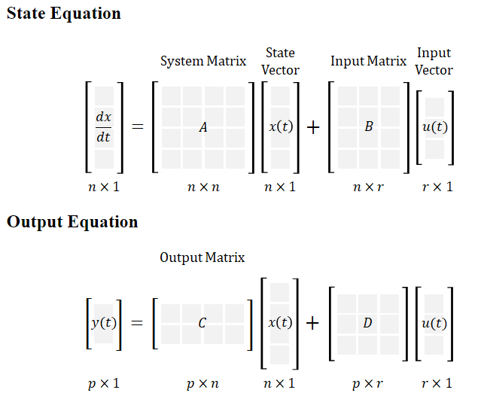
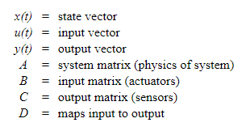
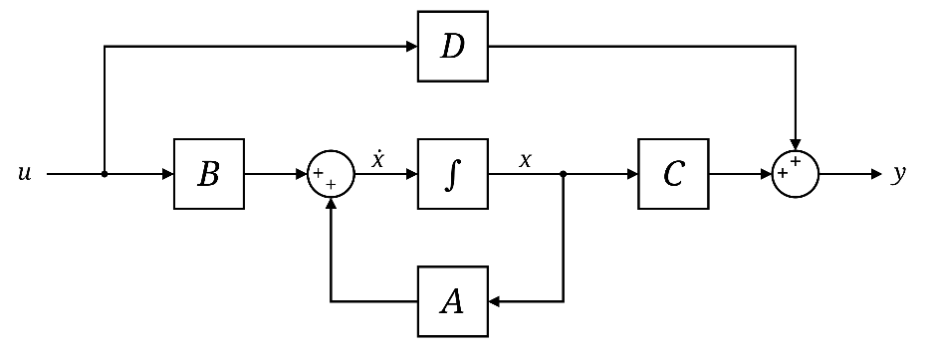
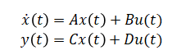
Haptics/Inputs
Cookierobotics, 2017
How do human-provided input(s) manifest in subsequent changes of the vehicle “state”?
State-space representation: mathematical model of a physical system - input, output and state variables related by first-order differential equations
  State variables inside the system that evolve over time: depend on values of initial conditions and input variables
  Output variables (which are linearly independent): depend on values of inputs and state variables

Slide 15
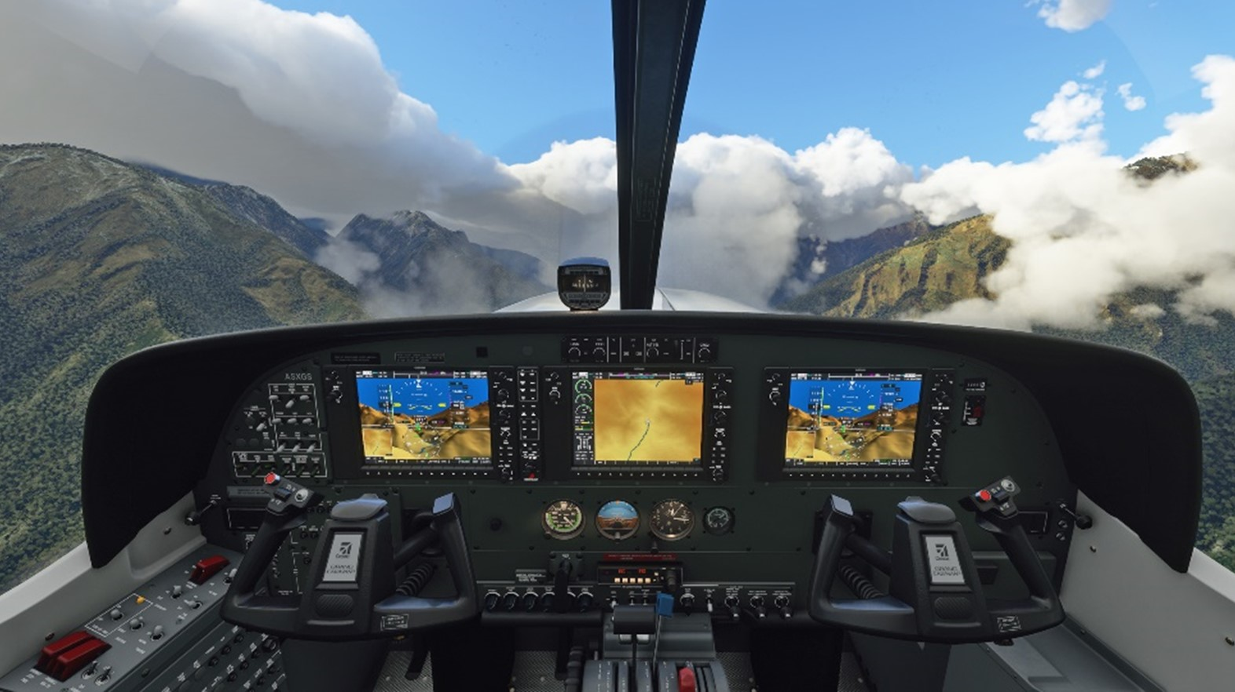
Numerical approach #1
Recall:
  Human Interface Device (HID): enables user to provide input to the simulation
  System input(s) manifest in vehicle state changes through a system of equations (based on matrices)
Linear algebra is a branch of mathematics that includes the study of:
  Vectors: Quantities that have both magnitude and direction
  Matrices: Tables of numbers (coefficients)
  Linear equations: Large systems of equations that can be solved (using matrices) in a standard form
  Linear transformations: Geometric manipulations of objects in 3D space
Let’s investigate some Linear Algebra essentials

Slide 16
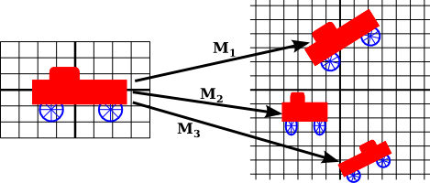
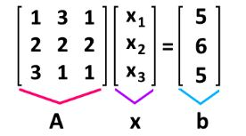
Linear algebra
CMU, 2016
Definition: a branch of mathematics that is fundamental to computer graphics - vectors, matrices, linear transformations
Serves as a bridge between geometry, physics, and computation
Once a system of linear equations has been defined, essentially you can ask the computer to solve [A][x] = [b]
With modern-day graphics API’s and game engines, these operations are handled internally or by software libraries
However, familiarity with general concepts and terminology is essential for usage, application, and debugging/problem-solving
[
]
[
]
[
]
coefficients
variables
constants

Slide 17
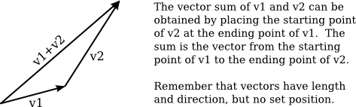

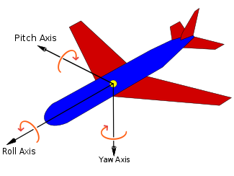
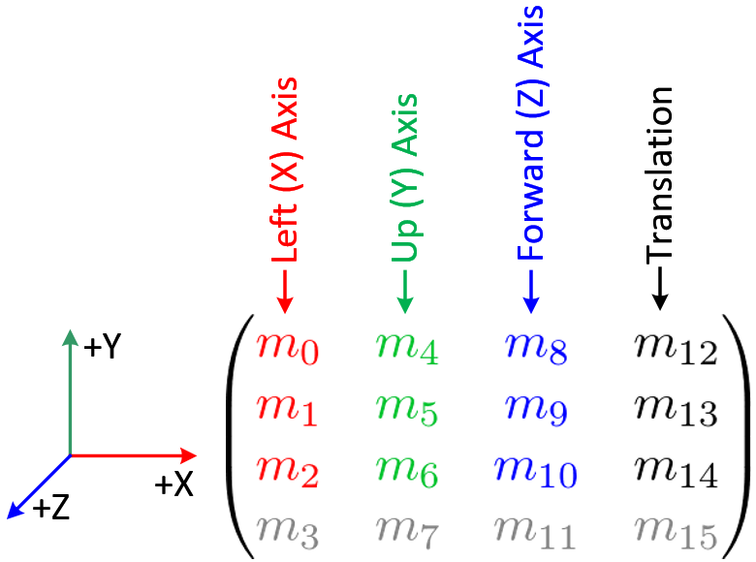
Linear algebra
Eck, 2021
A vector is a quantity that has magnitude and direction; used in computer graphics to represent spatial relationships (e.g., from an object to a light source)
A matrix is a two-dimensional array of numbers; a matrix with r rows and c columns is an (r x c) matrix
a)
b)
rotations
(3x3)
(3x1)
(3x1)
To multiply 2 matrices – “inner” dimensions must match

Slide 18
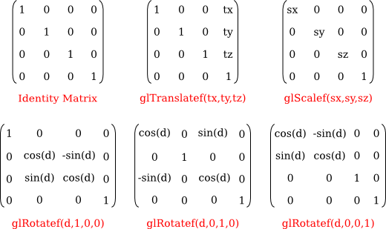
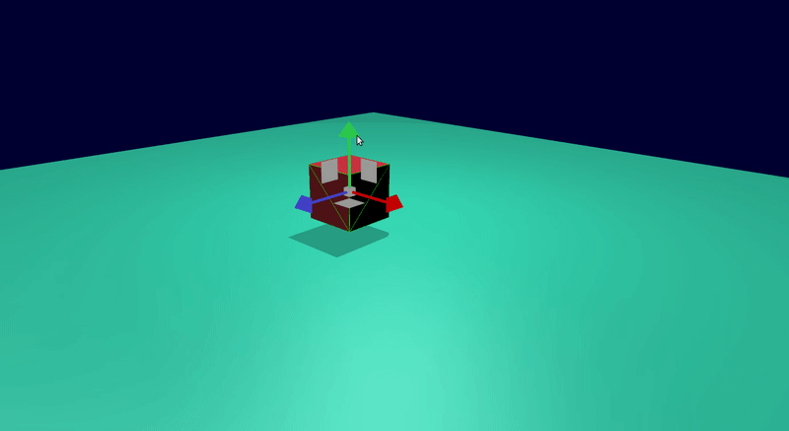
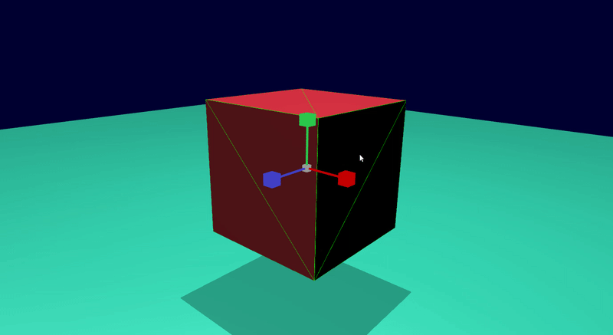
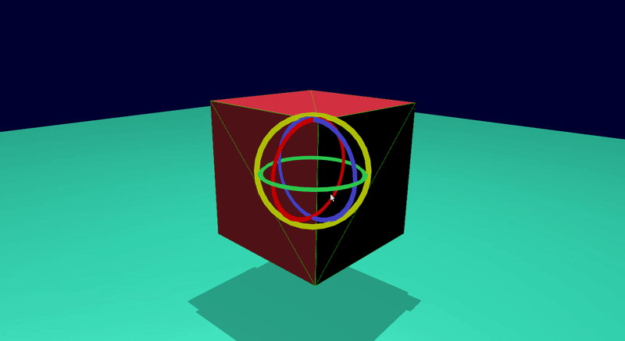
Linear algebra
Zhang, 2018
c)
Linear transformations can be represented by matrices; in computer graphics, are used to implement geometric operations (e.g., translation, scaling, rotation {XYZ})
Homogeneous coordinates (4x4) allow rotations/translations to be handled together
Translation (xyz)
Scaling (xyz)
Rotation (x) (y) (z)

Slide 19

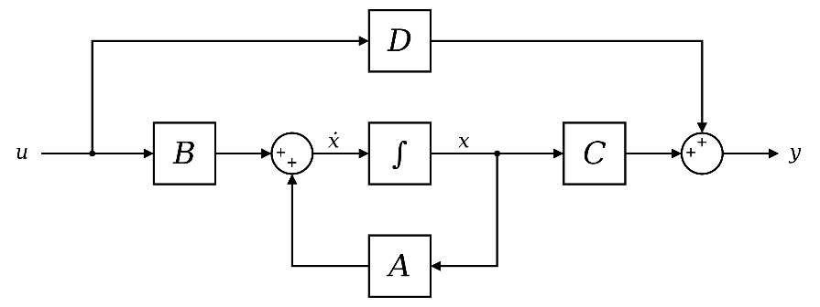
Breakout #1
Cheever, 2022
Matrix representations
Goals:
Demonstrate basic linear algebra operations in MS Excel
State-space: observe how INPUTS manifest in system (i.e., state/output) equations
Matrix Transforms: how do we manipulate world objects in 3D graphics space

Slide 20
M&S component: Vehicle dynamics
Solution approach: ODE’s
Beyond the Basics
2
2

Slide 21
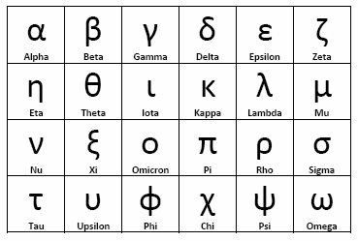
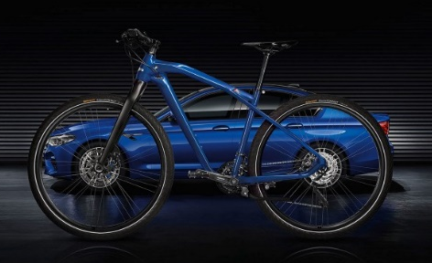
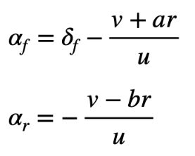
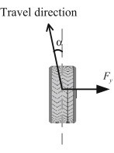

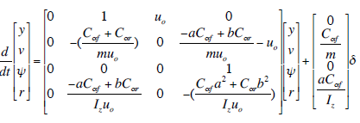
Vehicle Dynamics (intro / ground)
Rastogi, 2020
McCullough, 2020
Definition: The behavior of a vehicle in response to (pilot/environment) inputs
Longitudinal: “Fore/aft” (roll) | Lateral: “Sideways” (pitch) | Vertical: (yaw)
For this PDW: introduce equations/terminology and observe commonalities
The Bicycle Model: Front/rear wheels considered together
  Considers longitudinal (x), lateral (y), yaw (ψ) motion (i.e., negligible roll)
Tire sideslip: slip angles (α) front (f) and rear (r)
  Oversteer, understeer, neutral steer
Cornering stiffness: relates sideslip (α) and lateral force (F_{y})
  Constant C_{α} represents the cornering stiffness
Dynamic equations derived from Newton’s second law (F = ma):
  Model equations after manipulations:
Steering angle (input)

Slide 22
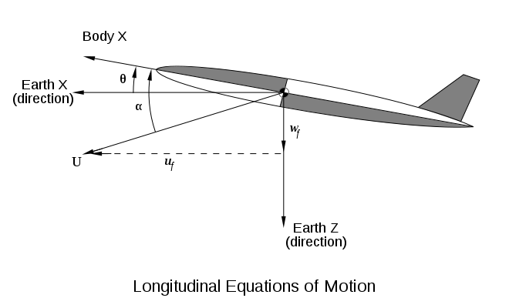



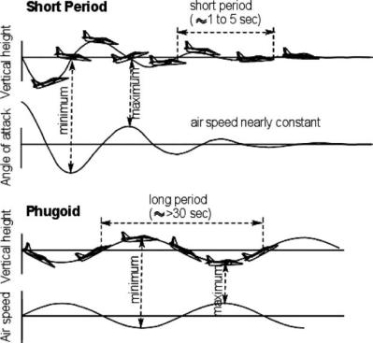

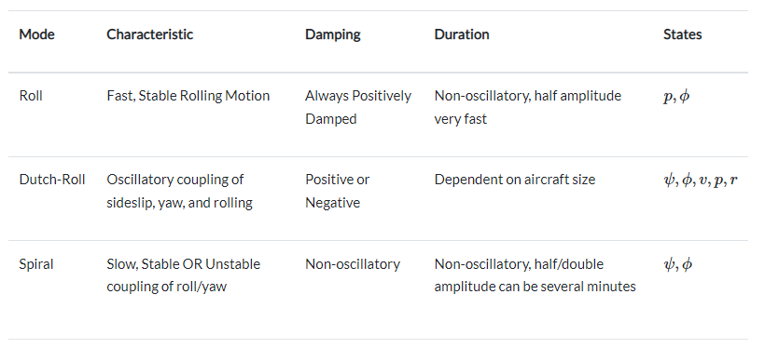
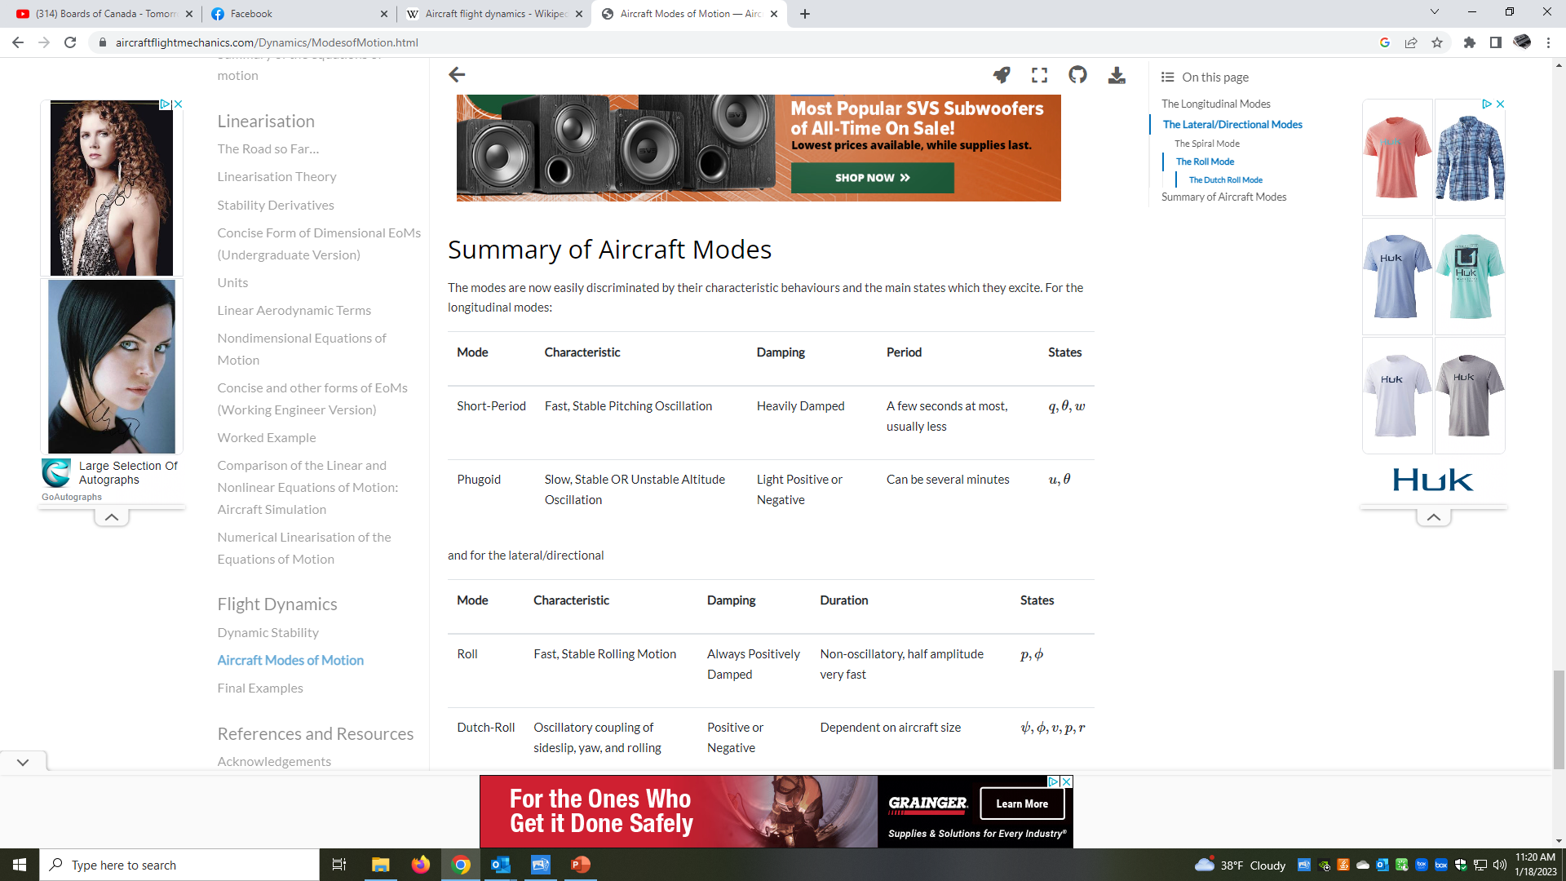

Vehicle Dynamics (flight)
Caughey, 2011
Smith, 2020
Equations of motion (F = ma)
Longitudinal modes: involves pitch motion
Short-period:
Phugoid:
Lateral modes: involve both yaw and roll motions
Roll mode:
Dutch Roll:
Spiral mode:
(incidence angle | α)
(speed | u)
(roll rate | p)
(sideslip angle | β)
(roll angle | Ф)

Slide 23






Vehicle Dynamics (marine)
Martelli, 2014
Menon, 2021
Ships are subjected to forces in all directions
  Wave loads, structural stresses, wind forces, turning forces
  Hogging/sagging: hull curvature due to force imbalance
  Slamming: hull crashes into wave crests | sudden deceleration
Equations of motion result from forces/moments:
  Hull (H), propeller (P), rudder (R), environmental (W), restorative (G)
12 primary state variables (see Table)
Lagrangian model for vessel motion:
  M: mass matrix | C: centripetal effects
  D: damping effects | g: restoring forces
Equations of motion (F = ma)

Slide 24
Numerical approach #2
Recall:
  Vehicle dynamics allow us to physically define the behavior of a vehicle in response to inputs from the pilot and the external environment
  The resulting mathematical model (F=ma) is often a system of differential equations
In mathematics, a differential equation is an equation that contains one or more functions with its derivatives
  An ordinary differential equation (ODE) has one independent variable along with its derivatives, which define the rate of change of a function at a point
  The primary purpose is to study the solution(s) that satisfy the equations
Let’s introduce Ordinary Differential Equations (ODE’s) for added context

Slide 25




Ordinary Differential Equations (ODE’s)
x-engineer, 2022
Definition: mathematical representation to understand dynamic behavior (i.e., over time)
  Describes the rate of change (i.e., derivative) of two variables (e.g., dy/dx; dx/dt)
  Ordinary implies one independent variable; partial differential equations have multiple
Classic example (mechanical system): a moving vehicle
  Force (F) = mass (m) × acceleration (a) – Newton’s second law
  Acceleration (a) = time rate of change of velocity (v) {a = dv/dt}
  F(t) = m * (dv/dt) – applied force varies with time
  (dv/dt) = F(t)/m
By solving this equation, we determine how the vehicle position (x) and speed (v) vary in time as a function of the traction force F(t)

Slide 26







Ordinary Differential Equations (ODE’s)
Bossio, 2021
Another well-known example: spring-mass-damper
  A simplification of a vehicle suspension system
Equations of motion obtained by applying (F=ma)
  Re-arranging yields a second-order differential equation
System response x(t) is dependent on constants mass (m), spring stiffness (k), damping coefficient (b/c) that define the natural frequency and damping ratio
natural frequency
damping ratio
critically
damped
underdamped
overdamped
Damping ratio < 1
Damping ratio > 1
Damping ratio = 1

Slide 27






Ordinary Differential Equations (ODE’s)
Terefe & Lemu, 2018
For efficient solution of a system of equations on a digital computer, numerical methods are commonly employed
Two approaches: Euler’s Method and Newton’s Method
Euler’s Method implements linear approximations (over a short distance) to estimate the solution
Newton’s Method is a root-finding algorithm for solving equations {f(x)=0} by successive approximation
x* = 0.68232

Slide 28

Breakout #2
Ordinary Differential Equations (ODEs)
Goals:
Demonstrate physics-based modeling in MS Excel
Observe simplified Bicycle model for the dynamics of ground vehicles
Illustrate basic numerical solution approach (i.e., Euler’s Method)

Slide 29
M&S component: Motion simulation
Solution approach: Moving average
Beyond the Basics
3
3

Slide 30


Motion Simulation (I/O)
Jones, 2017
Algorithm inputs: vehicle specific forces (i.e., accelerations) and angular velocities, ground inputs / vehicle orientation (roll/pitch)
Transfer of calculated data from vehicle dynamics model to motion system often needs to be filtered (i.e., real system: infinite; motion system: finite)
Common data filters:
  High-pass: remove low-frequency motions that could result in motion platform reaching actuator travel limits
  Low-pass: introduce low-frequency rotations (“G-Tilt”, or “Tilt coordination”) to replicate sustained accelerations
Algorithm outputs: linear (S) and angular (Ω) displacement cues

Slide 31



Motion Simulation (washout)
Force Dynamics, 2015
Acceleration onset: conventional motion cueing principle
Initial acceleration is replicated closely (can’t go further)
Proceed to a gradual zero movement phase (washout)
Below sensory threshold, return to neutral position (restoration)
G-Tilt: replace "real" acceleration with the force felt from gravity
Low frequency rotation of moving platform (w/ scene graph)
  G-vector differential (θ_{p}) between local/global vertical axes
  Creates the illusion of sustained acceleration (longitudinal/pitch | lateral/roll)
θ_{p}

Slide 32





Motion Simulation (G-Tilt)
Berger et al, 2007
Effective motion cues are often a bit of science and art
Example: longitudinal (fore/aft) motion cueing:
  Surge translation, velocity, acceleration (top row)
  Pitch motion | visual forward velocity/translation (middle row)
  Some vertical “noise” for realism (bottom row)
With motion cueing, our vestibular system is engaged; an inner ear complex to recognize linear/angular motion
A primary drawback: due to spatial limitations imposed on motion simulators, perceived discrepancies between the motion of the simulator and the “real world” will occur
+
+
=

Slide 33
Numerical approach #3
Recall:
  Motion cueing is commonly used for simulating the dynamics of a moving vehicle upon a device (i.e., a “hexapod” simulator) with a limited workspace
  Inputs include vehicle orientation, velocities, accelerations, and angular velocities
Digital filtering is a mathematical technique that selects specific segments of a larger data set that meets specific criteria and removes any irrelevant or unnecessary information
  Some filters remove high amplitude signals (i.e., high-pass)
  Some filters remove high frequency signals (i.e., low-pass)
Let’s investigate the basic utility of Low/High-pass filters
transient
steady-state

Slide 34




Low- and High-pass filters
Moog, 2022
MathWorks, 2024 a, b
Signal processing filters
Low-pass filter: passes signals with a frequency lower than cutoff frequency
High-pass filter: passes signals with a frequency higher than cutoff frequency
Common filters for motion cueing and motion simulation
Cutoff frequency: boundary frequency between a “passband” and “stopband”
  Common where calculated output power (dB) is one-half the input power
stopband
passband
stopband
passband

Slide 35

Moving average
Excel Easy, 2024
Signal processing filters
A special type of low-pass filter is a Moving Average
  Analyze data points by creating a series of averages of selections of the full data set
  Used with time series data to smooth out short-term fluctuations to highlight longer-term trends
Advantages: simple and efficient algorithm; effective at noise reduction
Disadvantages: phase shift must be compensated for (e.g., via prediction; tuning) and can lead to unexpected artifacts (e.g., smoothed peaks where there were valleys in the actual data)

Slide 36


Moving average
Smith, 1999
Signal processing filters
As the name implies, the moving average filter operates by averaging several points (M) from the input signal (x[]) to produce each point (i) in the output signal (y[]):
The calculated moving average can be “one-sided” or symmetrical around the output point
  Example: in an 11-point moving average, iterator j can run from 0-10 (one-sided), or from -5 to +5 (symmetrical)
The signal in (a) is a pulse buried in random noise. In (b) and (c), the smoothing action of the moving average filter:
  Decreases the amplitude of the random noise (usually good)
  Reduces the sharpness of the edges (could be bad)
a)
b)
c)

Slide 37


Breakout #3
Moving Average data filters
Goals:
Demonstrate basic data filtering in MS Excel
Visualize how smoothing a data signal is essential for motion simulation
Observe how Moving Averages can be used for (low/high-pass) motion filters

Slide 38
M&S component: Virtual Environments
Solution approach: Collision detection
Beyond the Basics
4
4

Slide 39





Virtual Environments
TrianGraphics, 2018
Rushton, 2020
Terrain databases
A digital representation of the terrain (e.g., mountains, hills, valleys, water) at discrete points
  Often massive 3D point collections that result from high-resolution elevation observations (i.e., lidar, sonar)
  Includes airports, terrain-tiled landscapes, road networks, signs, bridges, nautical charts, coastline, harbors
Example content for a Driving scene
  Landscape data: Ground Textures and Height Maps
  Model Libraries: 2D texture maps and 3D models
  Vector data (i.e., points/lines/polygons): define geometric boundaries
a
c
b
house
roads
park

Slide 40

Virtual Environments
Papelis et al., 2001
Terrain elements – static and dynamic
Static: implies non-moving objects that comprise the physical environment
  Includes roads, barriers, curbs, rough terrain
  How do we handle asset (e.g., vehicle) interactions with static objects?
Dynamic: implies world assets that vary with time
  Moving objects (e.g., subject vehicle, other vehicles, pedestrians); traffic control device states, etc.
  Programmed (dynamic) behaviors could be fully deterministic or autonomous

Slide 41

Virtual Environments
Harrington & Simon, 2022
Munim et al., 2023
Scenario authoring
Specification of elements in a virtual environment such that certain events appear
  Events commonly introduced to induce subject behavior/response
  Event timing can be critical to maintain consistency across subjects/experiments
Scenarios designed to identify knowledge gaps
  Improve pilot safety and train for situational awareness
  Examples: Inclement weather (e.g., rain, ice, fog) | Equipment malfunction (e.g., landing gear failure)
Scenario development informed by:
  Educational principles (e.g., Bloom's Taxonomy) – guidelines for successful training goals
  Key performance indictors (KPIs) (e.g., navigation performance, psychological factors, decision making)

Slide 42
Numerical approach #4
Recall:
  Virtual environments for vehicle simulators define components of the artificial world within which a human subject (trainee) participates
  A primary (static) component is the terrain database, which is a geometric digital definition of selected aspects of the surface of the Earth
Dynamic simulations will likely involve complex interactions between objects (i.e., collisions) in the virtual world
  Interactions with static objects (e.g., curbs, the ground)
  Interactions with dynamic objects (e.g., other cars)
Let’s investigate some mathematics behind collision detection

Slide 43



Collision detection
Teschner et al., 2005
Serrano, 2016
Collision detection basics
Definition: the geometric problem of detecting the intersection of two or more world objects
  An essential component within any dynamic simulation
Collision algorithms are more efficient for convex polygons
  Concave shapes have inner gaps/voids/cavities
  Simple shapes (e.g., circles, spheres, rectangles, boxes) offer easier collision detection
  However, they only approximate actual geometries (pros/cons)
False positive!

Slide 44




Collision detection
Workman, 2016
Collision detection basics
Sphere-based collisions - verify if the sum of the circle radii is less than the distance between the circle centers
Axis-aligned bounding box (AABB) - box has no rotation and its edges are parallel to the base axes of the scene
  With Oriented Bounding Box (OBB) – objects can be rotated
Point-in-polygon test: using “right hand” rule, for query point, sum all signed angles to the vertex edges (ABCD)
  If sum=360 degrees, point is inside polygon (e.g., P1)
  If sum=0 degrees, point is outside polygon (e.g., P2)

Slide 45



Collision detection
Baker, 2022
Collision detection basics
Bounding boxes:
  Represent (approximate) each car by a boundary rectangle
  Rectangles are not axis-aligned
  Requires vector math to identify overlap regions
Collision response:
  Simulation termination/restart?
  Vehicle change of direction (e.g., physics engine)?
  Simulation event (e.g., explosion) to indicate a crash?
Related vehicle applications:
  Computer vision (e.g., lane detection)
  Sensors for autonomous vehicles (e.g., V2X)
Parallel to red: long dimension
Parallel to blue: long dimension
Parallel to red: short dimension
Parallel to blue: short dimension
GAP!

Slide 46


Breakout #4
Ground vehicle collision detection
Goals:
Demonstrate collision detection basics in MS Excel
Compare techniques (e.g., spheres, AABB) for simplifying geometries (in 2D, 3D)
Observe trade-offs in detecting object overlap in a dynamic vehicle simulation

Slide 47
M&S component: Displays/IG/sound
Solution approach: Goal seeking/optimization
Beyond the Basics
5
5

Slide 48





Display systems
Aniwaa, 2021
Wen, 2022
Classifications of visual system technologies
  Digital Light Projection: projection onto a (curved/flat) screen surface
  Panel display: electronics (e.g., LCD, LED) use light emission/modulation
  Holography: utilizes light diffraction to display a 3D image
Adjustment parameters are technology-dependent
  Field-of-view (FOV): viewing angle to see the observable world
  Edge Blending: accounts for overlap at the projection seams
  Image Warping: transfers flat image onto a curved screen
Head-mounted Displays (HMD) technologies
  Virtual Reality (VR): full field-of-vision is virtual
  Augmented Reality (AR): live surroundings w/ virtual visual elements
  Mixed Reality (MR): physical and virtual worlds interacting
VR
AR
MR

Slide 49




Image Generators (IG)
AVT, 2020
MAK, 2024
IG fundamentals and Game Engines
An IG creates visual scenes from participant's perspective
  Primary: the visible spectrum for "out-the-window" (OTW) views
  Often multiple IGs required to display surrounding environment; other wavelengths for optical sensors (e.g., infrared; night vision)
A Game Engine is a software development environment
  Integrates graphics rendering, physics, sound, animation, and AI
  Applications: vehicle performance | ADAS (advanced driver-assistance systems) | connected autonomous vehicles (CAVs)

Slide 50


Sound simulation
Simpson et al., 2004
Dua & Charlton, 2019
Aural cues - basic concepts
A critical supplement to primary (visual) and secondary (motion) cues
  A soundtrack is essential for “storytelling” and for atmosphere (i.e., presence)
  Speed perception in vehicle simulation is commonly underestimated
  Load/store sound file | assign properties (i.e., gain, pitch) | playback sound event
Implications in contemporary vehicle simulation
  Driving Memory: Driver recall often difficult for familiar/routine excursions
    Music cues produced elevated recall details in driving simulator
  Target Identification: Pilots require real-time information on adjacent aircraft
    Spatial (3D) audio aided with response times in flight simulator

Slide 51
Numerical approach #5
Recall:
  Both screen-based technologies and portable systems (e.g., VR) are implemented to project the visual content of vehicle simulations
  Image Generators (IGs) and Game Engines are the subsystems that create the visual scene graphics (from the participant's perspective)
  Sound is an essential simulation cue
The development of high-fidelity vehicle-based models & simulations often requires trade-offs to achieve optimal performance
  Could require adjustment of settings related to hardware (e.g., CPU/GPU)
  Could require adjustment of parameters related to software (i.e., level-of-detail)
Let’s investigate some background on goal seeking and optimization

Slide 52




Optimization
Fedorov, 2015
Scene graph optimization candidate parameters
Display resolution: number of pixels (common: HD, 4K, 8K)
  Determining factors: size of display | viewing distance | budget!
Refresh Rate (Hz.): determined by display device
  Motion Blurring: can happen with fast-motion scenes
Frame Rate (FPS): determined by the computer
  Vertical Sync: synchronizes refresh/frame rates to eliminate artifacts
Nvidia control panel can help to balance detail vs. performance

Slide 53



Optimization
Stanford, 2024
Optimization (mathematical basics)
When you optimize something, you are attempting to “make it best”
  Objective function: f(x) is the output you're trying to maximize or minimize
  Problem variables: x (i.e., the design vector)
Large-scale problems require numerical solution
  Methods (many) to solve linear/nonlinear problems – lie beyond PDW scope
  Game engines have built-in capabilities to optimize scene graphics performance

Slide 54
Optimization
HBK, 2024
Taguchi Method - Orthogonal Arrays (OAs)
A “heuristic” optimization method for compressing experiments
  Goal: measure contribution of factors (x) to a prescribed outcome (F)
  Mathematically balanced - all factors/levels are considered equally
Example: L₈ (2⁷) OA
  2⁷ = 128 combinations (“full factorial”)
  8 (total) experiments per OA – {rows} (“fractional factorial”)
  Seven 2-level factors per OA – {columns}
After running the OA experiments - use Analysis of Variance (ANOVA) to determine relative impact of each factor (x)
L₈ | x₁ | x₂ | x₃ | x₄ | x₅ | x₆ | x₇ | F
1 | 1 | 1 | 1 | 1 | 1 | 1 | 1 | F₁
2 | 1 | 1 | 1 | 2 | 2 | 2 | 2 | F₂
3 | 1 | 2 | 2 | 1 | 1 | 2 | 2 | F₃
4 | 1 | 2 | 2 | 2 | 2 | 1 | 1 | F₄
5 | 2 | 1 | 2 | 1 | 2 | 1 | 2 | F₅
6 | 2 | 1 | 2 | 2 | 1 | 2 | 1 | F₆
7 | 2 | 2 | 1 | 1 | 2 | 2 | 1 | F₇
8 | 2 | 2 | 1 | 2 | 1 | 1 | 2 | F₈

Slide 55

Breakout #5
FPS Optimization for a Driving Scene Graph
Goals:
Demonstrate optimization essentials in MS Excel
Observe contributing factors (“x”) to FPS (“F”) within a driving scene graph
Visualize how Orthogonal Arrays can be used to determine parameter sensitivities

Slide 56
Special topics
Beyond the Basics

Slide 57



Special topics
Stanton et al., 2001
Özcan et al., 2013
Situational Awareness (SA)
The ability to understand/respond to a situation (e.g., forecast risk)
Melding environment information to one’s current mental state
Contributing factors: expertise, memory, inhibition, divided attention
Interdependence of memory, perception, and action
Consequences of inadequate SA are important factors of accidents

Slide 58


Special topics
Berkman & Akan, 2019
Presence and Immersion
A primary goal of simulation is to achieve a true replacement for the external world that seems just as real
Presence: feelings of engagement, naturalness, and authenticity within the virtual environment
  The sense of “being there” (spatial, cognitive, perceptive, emotional)
Immersion: the technical capability of a virtual system of making you feel that you are somewhere else
  Largely a function the simulator technology (visual/aural/haptic)

Slide 59


Special topics
Goo, 2004
Renaudo, 2018
APS, 2022
Negative (transfer of) Training
Performance degradation resulting from simulator exposure
  Acquisition of skills/habits that are fundamentally different from true vehicle system behavior
  Simulators cannot provide the necessary motion cues (g-forces) that a pilot must perceive to recover from extreme flight events
Example: AA Flight 587 (11/2001) plane crash in Queens, NY
  Aircraft took off in wake turbulence
  Pilots had been instructed (in simulator) to apply rudder
  Later determined that pilot’s aggressive rudder movements led to the structural failure of the fin section

Slide 60




Special topics
Whittinghill et al., 2015
Asadi et al., 2019
Ng et al., 2020
Simulator Maladaptation (sickness)
Symptoms: sweating, vertigo, nausea, vomiting
  Impact: 80% when exposure time is twenty minutes or more
Contributing factors:
  Equipment Features (e.g., F.O.V.) | Individual Differences (e.g., age)
Theorized sources:
  Postural instability | Vestibular | Vection | Eye movement
Mitigation: common techniques include the following
  Natural: fresh air, hydration
  Tactical: reduced exposure, proper cue synchronization
VR symptoms reduced w/ fixed reference object(s)
  After brief exposure, subjects did not notice the Virtual Nose
  Allowed for prolonged environment exposure prior to onset

Slide 61
PDW Summary
Beyond the Basics

Slide 62
Beyond the Basics - Summary
PDW Introduction
Haptics/Inputs
  Linear (matrix) algebra
Vehicle Dynamics
  Ordinary Differential Equations (ODE’s)
Motion Simulation
  Low/High-pass filters (Moving averages)
Virtual Environments / Scenarios
  Collision detection
Displays, IGs, sound simulation
  Goal seeking / optimization
Special topics
1
1
3
2
2
3
4
4
5
5

Slide 63

PDW Bibliography
PDW Introduction
Ahmed et al., 2021: A Review of Car-Following Models and Modeling Tools for Human and Autonomous-Ready Driving Behaviors in Micro-Simulation
  https://doi.org/10.3390/smartcities4010019
Bruck et al., 2021: A Review of Driving Simulation Technology and Applications
  https://doi.org/10.1109/OJVT.2020.3036582
DoD, 1998: DoD 5000.59-M
  https://www.acqnotes.com/Attachments/DoD%205000.59-M%20DoD%20Modeling%20and%20Simulation%20Glossary.pdf
Jeon, 2015: The Virtual Flier: The Link Trainer, Flight Simulation, and Pilot Identity
  https://doi.org/10.1353/tech.2015.0017
Lieberher, 2023: Training together is Vital to Deterrence
  https://www.usarpac.army.mil/Our-Story/Our-News/Article-Display/Article/3405013/training-together-is-vital-to-deterrence/
McGowan, 2018: Avatar: Flight of Passage: A Cinematic, Multi-sensory Experience that Soars
  https://www.vfxvoice.com/avatar-flight-of-passage-a-cinematic-multi-sensory-3d-experience-that-soars/
Military Simulation and Training (MST), 2020: True Blended LVC Combat Training
  https://bluetoad.com/publication/?m=34018&i=657661&view=articleBrowser&article_id=3655144&ver=html5
NTSA, 2024: I/ITSEC 2024 Call for Presentations
  https://www.iitsec.org/-/media/sites/iitsec/get-involved/2024/iitsec2024callforpresentations.pdf?download=1
Oswalt, 2023: Certified Modeling & Simulation Professional
  https://www.ntsa.org/-/media/sites/ntsa/cmsp/exam/iitsec-2023-cmsp-pdw---d---1-of-4---course---20231210.pdf

Slide 64
PDW Bibliography
1. Haptics/Inputs | Linear Algebra
Cheever, 2022: State Space Representations of Linear Physical Systems
  https://lpsa.swarthmore.edu/Representations/SysRepSS.html
CMU, 2016: Math Preview Part 1: Linear Algebra (Slide #3: Linear Algebra in Computer Graphics),
  http://15462.courses.cs.cmu.edu/fall2016/lecture/linalg/slide_003
Cookierobotics, 2017: State Space Model and Simulation
  https://cookierobotics.com/018/
Eck, 2021: Introduction to Computer Graphics (2.3 Transforms | 3.5 Some Linear Algebra)
  https://math.hws.edu/graphicsbook/c3/s5.html
Gregory, 2009: Game Engine Architecture: Chapter 8 – Human Interface Devices (HID)
  https://doi.org/10.1201/b10681
Intel, 2024: How to Fix Input Lag
  https://www.intel.com/content/www/us/en/gaming/resources/how-to-fix-input-lag.html
Lemes et al., 2018: Latency on a Stewart platform using washout filter
  https://doi.org/10.1017/aer.2018.35
Microsoft, 2022: Getting Started With XInput in Windows applications
  https://learn.microsoft.com/en-us/windows/win32/xinput/getting-started-with-xinput
Zhang, 2018: Translate, Rotate, and Scale Manipulators in 3D Modelling Programs
  https://ed.ilogues.com/2018/06/27/translate-rotate-and-scale-manipulators-in-3d-modelling-programs

Slide 65
PDW Bibliography
2. Vehicle dynamics | Ordinary Differential Equations
Bossio, 2021: Mass-Spring-Damper system animations
  https://commons.wikimedia.org/wiki/Special:Contributions/Guillermo_Bossio
Caughey, 2011: Dynamics of Flight Vehicles (course notes)
  https://courses.cit.cornell.edu/mae5070/DynamicEquations.pdf
Martelli, 2014: Marine Propulsion Simulation
  https://www.degruyter.com/document/doi/10.2478/9783110401509.5/pdf
McCullough, 2020: Vehicle Dynamics: An Introduction
  https://thef1clan.com/2020/07/27/vehicle-dynamics-an-introduction/
Menon, 2021: Ship Motions - The Ultimate Guide
  https://www.marineinsight.com/naval-architecture/ship-motions/
Rastogi, 2020: Two to Four: Bicycle model for Car
  https://archit-rstg.medium.com/two-to-four-bicycle-model-for-car-898063e87074
Smith, 2020: Aircraft Flight Dynamics: Aircraft Modes of Motion
  https://aircraftflightmechanics.com/Dynamics/ModesofMotion.html
Terefe & Lemu, 2018: Solution Approaches to Differential Equations of Mechanical System Dynamics
  https://doi.org/10.12913/22998624/85662
x-engineer, 2022: Introduction to Ordinary Differential Equations (ODE)
  https://x-engineer.org/ordinary-differential-equations-ode/

Slide 66
PDW Bibliography
3. Motion Simulation | Moving Averages
Asadi et al., 2019: A Knowledge Discovery in Motion Sickness: A Comprehensive Literature Review
  https://doi.org/10.1109/ACCESS.2019.2922993
Berger et al, 2007: Simulating believable forward accelerations on a Stewart motion platform
  https://doi.org/10.1145/1658349.1658354
Excel Easy, 2024: Moving Average
  https://www.excel-easy.com/examples/moving-average.html
Force Dynamics, 2015: How it Works
  https://www.force-dynamics.com/how-it-works
Jones, 2017: A Method for Automatic Tuning of Flight Simulator Motion Platforms
  https://doi.org/10.1142/S1793962317430048
MathWorks, 2024a: What is a Low-Pass Filter?
  https://www.mathworks.com/discovery/low-pass-filter.html
MathWorks, 2024b: What is a High-Pass Filter?
  https://www.mathworks.com/discovery/high-pass-filter.html
Moog, 2022: Motion Real-time Software Interface Manual
  https://www.moog.com/products/motion-systems.html {PDF manual for Gen3 1500 kg motion system}
Smith, 1999: The Scientist and Engineer's Guide to Digital Signal Processing Moving Average Filters
  https://www.analog.com/en/resources/technical-books/scientist_engineers_guide.html

Slide 67
PDW Bibliography
4. Virtual Environments | Collision Detection
Baker, 2022: 3D Theory - Example - Car Racing Game – collisions
  http://www.euclideanspace.com/threed/games/examples/cars/collisions/
Harrington & Simon, 2022: Designing a Simulation Scenario
  https://www.ncbi.nlm.nih.gov/books/NBK547670/
Munim et al., 2023: Scenario Design, Data Measurement, and Analysis Approaches in Maritime Simulator Training: A Systematic Review
  https://doi.org/10.1007/978-3-031-42134-1_4
Papelis et al., 2001: Scenario Definition and Control for the National Advanced Driving Simulator
  https://www-nrd.nhtsa.dot.gov/pdf/esv/esv17/Proceed/00219.pdf
Rushton, 2020: Raster vs Vector Maps: What's the Difference & Which are Best?
  https://carto.com/blog/raster-vs-vector-whats-the-difference-which-is-best
Serrano, 2016: Tips for Developing a Collision Detection System
  https://www.haroldserrano.com/blog/tips-for-developing-a-collision-detection-system
Teschner et al., 2005: Collision Detection for Deformable Objects
  https://doi.org/10.1111%2Fj.1467-8659.2005.00829.x
TrianGraphics, 2018: Terrain Generation for Driving Simulations
  https://www.asam.net/index.php?eID=dumpFile&t=f&f=1998&token=bd3ff9aecb6baf1c794770bc08f81a910005399e
Workman, 2016: Happy Coding: Collision Detection
  https://happycoding.io/tutorials/processing/collision-detection

Slide 68
PDW Bibliography
5. Display systems, IG, sound | Optimization
Aniwaa, 2016: The Ultimate VR, AR, MR guide
  https://www.aniwaa.com/guide/vr-ar/ultimate-vr-ar-mr-guide/
AVT, 2020: How to Build a Simulator – 6 – Visual Systems
  https://www.avtsim.com/how-to-build-a-simulator-visual-systems-image-generator/
Dua & Charlton, 2019: Audio on the go: The effect of audio cues on memory in driving
  https://doi.org/10.1016/j.trip.2019.100004
Fedorov, 2015: Frame Rate (FPS) vs Refresh Rate (Hz)
  https://www.avadirect.com/blog/frame-rate-fps-vs-hz-refresh-rate/
HBK, 2024: Taguchi Orthogonal Array Designs
  https://help.reliasoft.com/articles/content/hotwire/issue131/hottopics131.htm
MAK, 2024: Image Generators
  https://www.mak.com/mak-one/apps/vr-engage?view=article&id=204
Simpson et al., 2004: 3D Audio Cueing for Target Identification in a Simulated Flight Task
  https://doi.org/10.1177/154193120404801610
Stanford, 2024: Mathematical Optimization
  https://web.stanford.edu/group/sisl/k12/optimization
Wen, 2022: Evolution history of screen display technology
  https://www.linkedin.com/pulse/evolution-history-screen-display-technology-wendy-wen/?trk=pulse-article

Slide 69
PDW Bibliography
Special Topics
Asadi et al., 2019: A Knowledge Discovery in Motion Sickness: A Comprehensive Literature Review
  https://doi.org/10.1109/ACCESS.2019.2922993
Aviation Performance Solutions (APS), 2022: Transfer of Knowledge: Upset Prevention & Recovery Training
  https://apstraining.com/resource/transfer-of-knowledge-in-upset-prevention-and-recovery-training/
Berkman & Akan, 2019: Presence and Immersion in Virtual Reality. In: Lee, N. (eds) Encyclopedia of Computer Graphics and Games
  https://doi.org/10.1007/978-3-319-08234-9_162-1
Goo, 2004: NTSB Cites Pilot Error in 2001 N.Y. Crash
  https://www.washingtonpost.com/archive/politics/2004/10/27/ntsb-cites-pilot-error-in-2001-ny-crash/81e1b65a-3d71-47eb-84bb-72dee7e02b57/
Ng et al., 2020: A study of cybersickness and sensory conflict theory using a motion-coupled virtual reality system
  https://doi.org/10.1016/j.displa.2019.08.004
Özcan et al., 2013: Exploring the Effects of Working Memory Capacity, Attention, and Expertise on Situation Awareness in Flight Simulation
  https://corescholar.libraries.wright.edu/isap_2013/94
Renaudo, 2018: Simulation Can Be Habit Forming
  https://flightsafety.org/asw-article/simulation-can-be-habit-forming/
Stanton et al., 2001: Situational awareness and safety
  https://doi.org/10.1016/S0925-7535(01)00010-8
Whittinghill et al., 2015: Nasum Virtualis: A Simple Technique for Reducing Simulator Sickness in Head Mounted VR
  https://www.gdcvault.com/play/1022287/Technical-Artist-Bootcamp-Nasum-Virtualis

Slide 70




Acknowledgements
The PDW subcommittee: Benjamin Bell, Brian Vogt, Marco Lassus
Support: The Stephen Still Institute for Sustainable Transportation and Logistics (SSISTL), my home organization and our Transportation Research and Visualization Laboratory (TRAVL)
Inspiration: 2018 Flight and Ground Simulation (full-week course) at Binghamton University (since retired)
Legacy motion system donation: Moog, Inc. (East Aurora, NY)
Kevin F. Hulme, Ph.D., CMSP
Program Manager
University at Buffalo
The Stephen Still Institute for Sustainable Transportation and Logistics (SSISTL) | 204 Ketter Hall
716-645-5573
hulme@buffalo.edu
Please complete a PDW survey form!

