Slide 1

Serious G
Serious Game Design Workshop
Radhakishan Shetty, JANUS Research Group
Vance Souders, Thermo Fisher Scientific
Seth Crofton, Pocket Piñata Games

Slide 2
Learning Objectives
Apply iterative methods for designing a learning game
Apply methods to blend gaming and learning in the story, goals, instruction and gameplay of a serious game
Perform the high-level, basic tasks involved when starting a serious game design effort
Work effectively with other disciplines to design a serious game for learning
Value the use of design patterns in your approach
Design instructional mechanics and situations that apply your instructional techniques and support your gameplay
Review and revise your design

Slide 3
Workshop Flow
What’s involved in creating a serious game for learning?
Team building exercise
Analysis
Exercise 1: What are our requirements, domain and audience?
Exercise 2: What’s our game concept?
<Break> Try out different eXtended Reality (XR) Experiences
Exercise 3: What are our learning objectives? What are we assessing?
Core Design
Exercise 4: What’s our story?
<Break> Try out different XR Experiences
Exercise 5: How are we teaching?
Exercise 6a: What’s our gameplay?
Exercise 6b: What shouldn’t be in our game?
Experience Design
Exercise 7: Goal elements
Exercise 8: Control elements
<Break> Try out different XR Experiences
Exercise 9: Action elements
Exercise 10: Assessment elements
Exercise 11: Guidance elements
<Break> Try out different XR Experiences
Exercise 12: Feedback elements
What did we learn?
Recap exercise

Slide 4
Form Groups
With A Mix of
Each Role
PICK A ROLE THAT MOST CLOSELY MATCHES YOUR EXPERIENCE
Instruction – e.g., Instructional Designer, Trainer, Instructor
Game – e.g., Game Designer, Game Developer, Producer
Subject Matter Expert (SME) – e.g., Experience with procedures/tactics/equipment
Technical/Management – e.g., Manager, Software Developer, Artist

Slide 5
Rules of Engagement
Assign a scribe for each exercise
Group exercises will be creative exercises
All ideas are valuable – make sure to note them all
Keep things dynamic and ensure all viewpoints are heard
Group leaders will change
Group leader should keep an eye on the time
Group leader should report out to larger audience
We’re here to learn, so let’s all throw some fun in
Raise hand to ask questions during exercises

Slide 6
Team Building Exercise
You have 5 minutes total
Each member of group
Briefly discuss who you are and what your background is
Say the #1 challenge you see in serious game design and development
No repeats
(Scribe: Capture all challenges)
When you’ve all spoken, pick a name for your group together

Slide 7
What does it take to create a learning game?
Requires a Multi-Disciplinary Effort
Instructional designer, game designer, domain expert, developer, artist
Creating a good serious game involves making a number of explicit tradeoffs to balance budget, learning scope, depth of training and gaming features.
Get all stakeholders involved early
Careful attention to blending gaming and instruction throughout an (agile) iterative development methodology

Slide 8

Learning Games Span A Wide Range

Slide 9

Learning Games Span A Wide Range

Slide 10
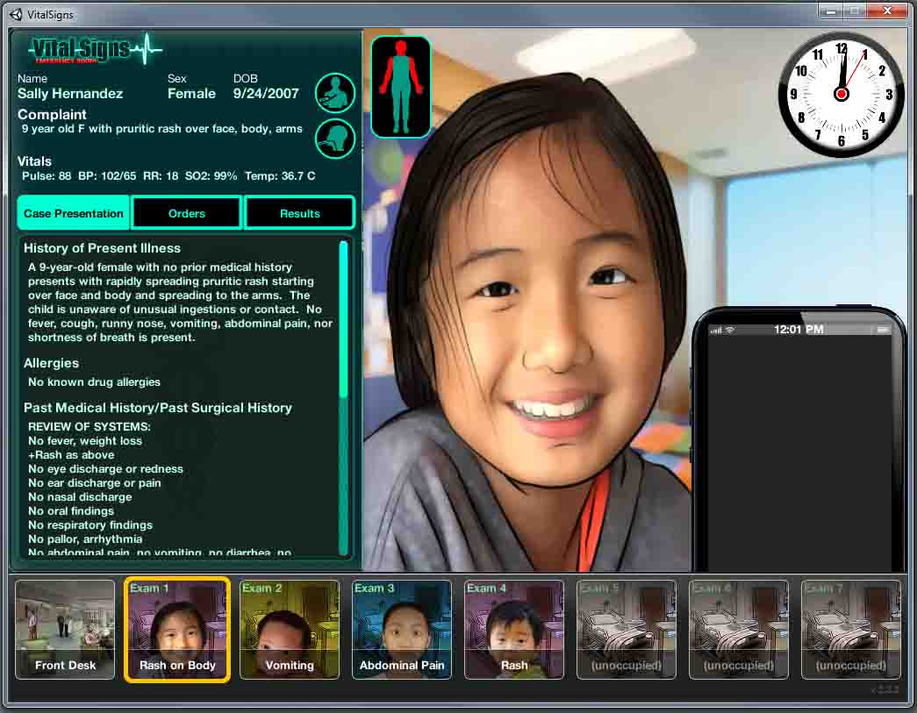
Learning Games Span A Wide Range

Slide 11
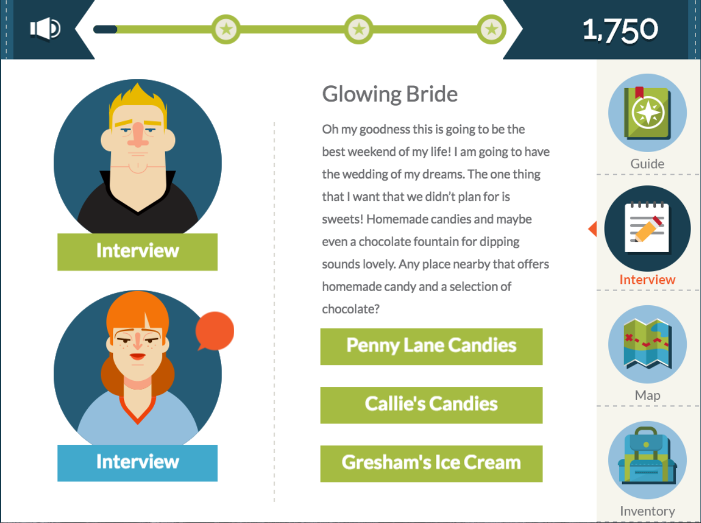
Learning Games Span A Wide Range

Slide 12
High Level Considerations
Learning game design choices are driven by:
Requirement constraints
Complexity of training
Level of fidelity
Limits on learning time
Role in the larger curriculum
Development constraints
Availability of game engine / tools
Cost of art / modeling
Development schedule constraints
Amount of subject matter expertise required
Challenge of advanced features (speech recognition, Artificial Intelligence (AI), etc.)

Slide 13
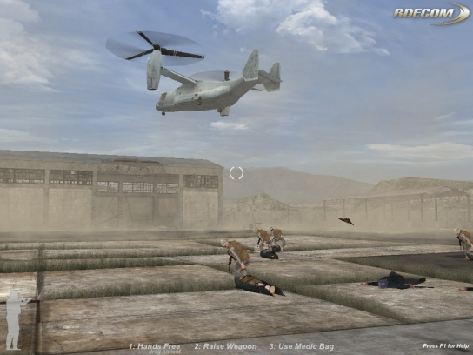
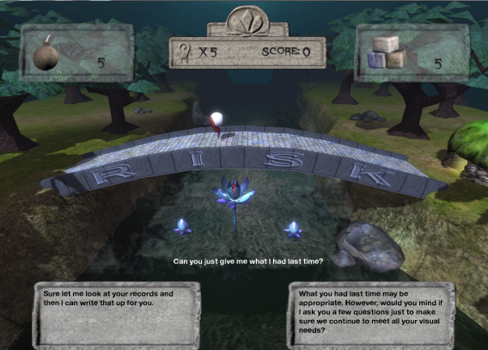
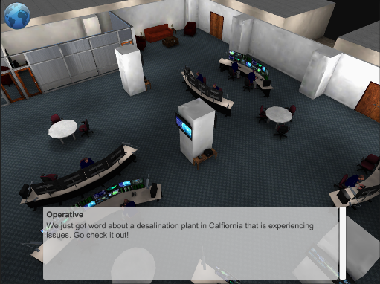
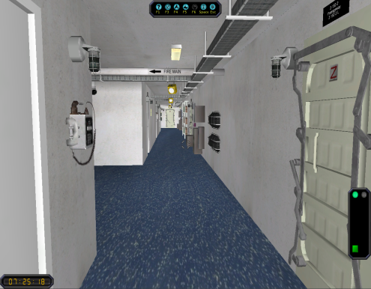
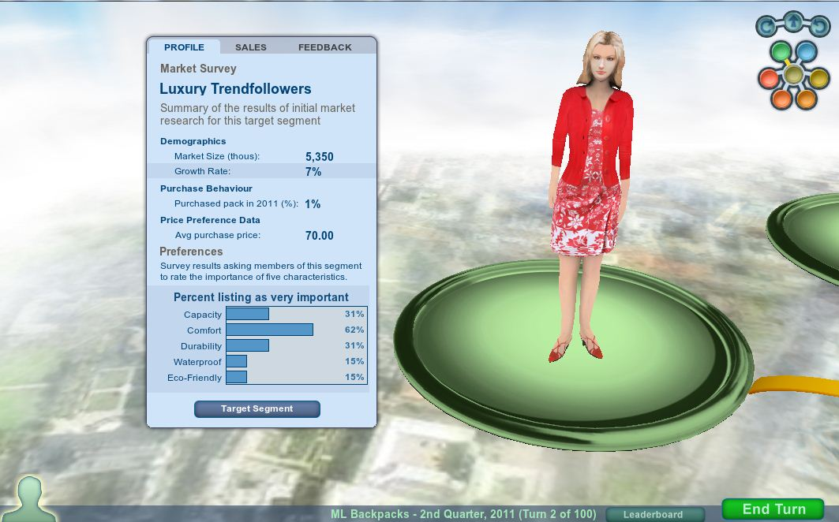
Common Types of Successful Learning Games
DARWARS Ambush!
(BBN)
Computer Based Corpsman
Training System (ECS)
RISK Bridge!
(BreakAway Games)
NullOps
(JANUS Research)
VESSEL Damage Control Trainer
(BBN)
Practice Marketing
(Muzzy Lane Software)

Slide 14
Let’s Build some Learning Games!
We will set the key requirements and some key learning goals
Each group will work on its own game design for their own unique problem
Each group defines their own learning objectives
We will focus on a guided practice approach to instruction

Slide 15
Pick your Subject Matter Expert & Training Topic
If you have military SME at your table:
Pick a relevant skill to teach or training problem to address
E.g., Small unit tactics, Effective communications
If you have a non-military expert at your table (e.g., K-12 instructor, health care professional, mountain climber, scuba diver, auto mechanic, chef, etc.):
Choose a skill to teach or problem to address
Pick a topic most of you are familiar with (e.g., driving, planning a trip, giving effective feedback, etc.)
Choose a skill to teach or problem to address

Slide 16
Exercise #1: What are our requirements, domain and audience?
Discuss only one of #1-5 in your group (as assigned), plus everyone come up with 1 anecdote #6 (scribe final results on pad). 5 minutes
Top 2 Deployment constraints [Requirements]
Top 2 Characteristics of students [Audience]
Top 2 Issues to address [Domain]
Top 2 Desired outcomes [Requirements]
Top 2 Current training methods and their key weakness [Audience]
Top 1 Anecdote that illustrates a typical error made by students …and appropriate solution [Domain]
→ Report Out. 2 minutes/group

Slide 17
Exercise #2: What’s our game concept?
On your team, pick one from A and one from B 3 minutes
Collaborative trainer (multi-player)
Individual Trainer (single player)
Introductory training for novices
Practice environment for novices with some prior training
Reinforcement/Refreshment environment for intermediate/experts
→ Mark your choice on your flipchart

Slide 18
Break
Feel free to try the different experiences around the room.

Slide 19
A B C D of Learning Objectives
Audience
Who will be doing the learning?
Behavior
What specific, observable, measurable action will they take?
Conditions
Under what circumstance must they perform?
Degree
To what degree must they perform? (Accuracy, time limit)
Here is a good reference for this: http://www.wku.edu/ste/objectives/components.php

Slide 20
Exercise #3: What are our learning objectives?
Choose objectives. 8 minutes
Identify 2 learning objectives that your group feels are most important for your game (scribe on pad)
If you have an expert, interview them to identify the key issues and related objectives [if not, discuss/decide collaboratively]
For each objective, identify at least one way to assess successful achievement of the objective
→ Report Out. 2 minutes/group

Slide 21
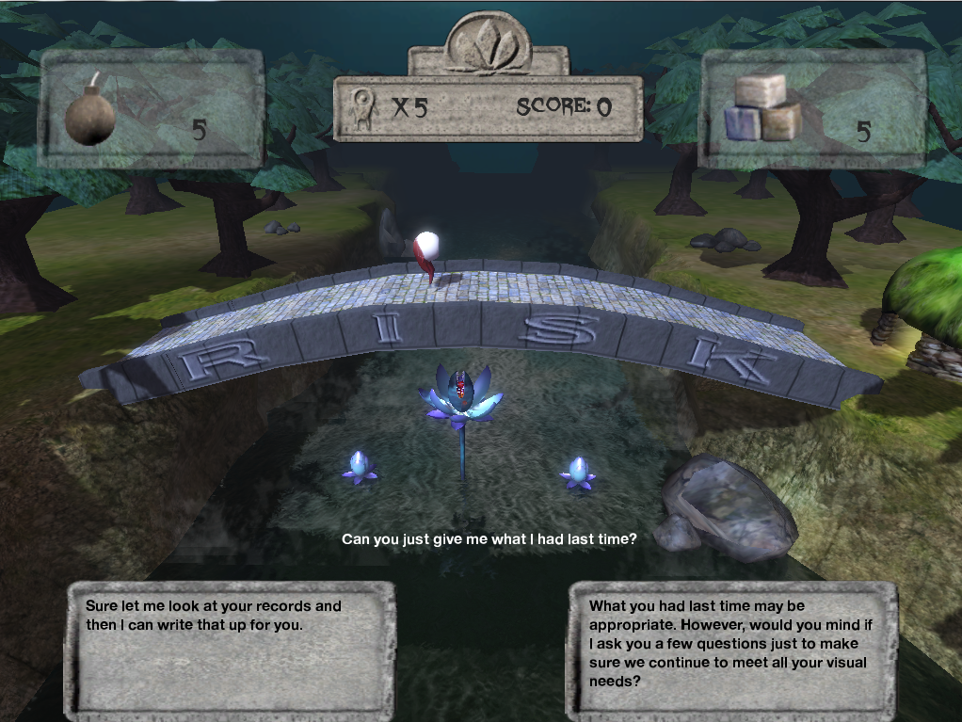
Implicit and Explicit Narrative

Slide 22
Exercise # 4: What’s our story?
Create a Story Arc 8 minutes
Review the learning objectives
What is the Conflict? How will it be resolved?
What happens at the beginning, middle, end? Align with learning objectives.
Report Out (All groups) 1 minute/group
Design Other Key Story Elements 12 minutes
Design a Plot Situation
What has just happened and what are our characters about to do? What are the key relevant facts, issues? What will the game goal be?
Design the Setting
What is the game world? Where are we? Describe the location – when is it, locale, buildings, equipment, season, etc.
Develop a Character
Gender, physical characteristics, background, goals and motivation, personal life, work/military life, quirks, relationships, etc.
→ Report Out (Facilitator directed) 10 minutes total

Slide 23
Narrative
Story choices can drive development of interesting character backgrounds, appealing settings, etc.
Story choices also drive motivating factors – solve the mystery, go on a quest, beat the enemy, save the prince
The story must:
Carry the learning objectives into the mind of the player
Provide interesting, meaningful context for the learning objectives
Stay relevant and not too complex or may increase extraneous load
As the story in the game unfolds, it captures the progression of instruction
It’s important to involve SMEs in early creative sessions to inform the team and help focus learning priorities

Slide 24
Story Elements
Plot — Good stories have an arc of action and events that create interest and lead the audience on a journey
Conflict/Resolution — Conflict and resolution create the energy in a story for the characters and the audience
Setting — A story has to take place in a defined “somewhere”
Characters — The audience needs to “see” someone enough like themselves to care about
Voice — Every story has a teller. Voice is the persona of that teller.
Emotion — Good stories contain both “facts” (whether or not they are objectively true), and feelings

Slide 25
What are we trying to blend?
Gaming
→ Entertainment (“Fun”)
Fantasy, Imagination
Suspension of disbelief
Challenging
Compelling (Senses)
Motivating (keep playing, intrinsic)
Flow (“in the zone”)
Learning
→ Self-improvement, Mental models, Learning outcomes
Cognition, Behaviors
Relevant, Appropriate
Target Expertise Level
Authentic / Context for Learning
Motivating (keep learning, extrinsic aspects)
Learning Continuum (“in the zone”)
Learning Game = All of the Above

Slide 26
Break
Feel free to try the different experiences around the room.

Slide 27
Instructional Design
Creating an instructional game involves many decisions about what to teach when and how to teach it
Instructional sequencing
Instructional methods
Assessment methods
Some guided practice elements (see handout)
Use of priming
Feedback techniques
Use of scaffolding

Slide 28
Exercise #5: How are we teaching?
Choose 1 or 2 of your learning objectives (from Exercise 1). Answer as many of these questions as you can. 10 minutes
How do you want the player to learn it?
What do you need to have in the game in order to elicit the behavior?
What kind of feedback will you use? What kind of guidance?
What is a key error you want the players to avoid in the game?
What is an example of good performance in the game?
(if collaborative trainer) How will different players be differentiated in their roles in the game?
(Note: See handout)
→ Report Out (Facilitator directed) 10 minutes total

Slide 29
Things to keep in mind
Cognitive Load & Authenticity
Intrinsic load
Inherent difficulty of the task or idea being taught
Extraneous load
Effort caused by factors not related to the topic of instruction
Germane load
Effort involved in processing information relevant to the topic of instruction
→ Avoid Extraneous. Keep it Germane.
→ High cognitive fidelity and sufficient physical fidelity (environment, objects and interactions)
Flow
Want experience to be cohesive, not disruptive. Keep them “in the game”.
→ Maintain balance between student control, cognitive load and authenticity, while minimizing disruptions

Slide 30
Exercise #6a: What’s our gameplay?
Design your gameplay by discussing all the topics below**. 10 minutes
** Keep in mind how the gaming element aligns with the instruction
ACTION: What does the player do in the game?
e.g., the quest, the tasks, the mission
CONSEQUENCES: What can happen to the player in the game?
e.g., injuries, gain abilities, achieve mission objective, fail
GAME DIRECTIVES: What does the game do to the player and how does the game “tell” the player?
e.g., increase challenge, add enemies, change the situation
GOALS: What wins the game and what loses the game?
e.g., align with key performance outcomes or key errors
MOTIVATION: What makes the player want to keep playing?
e.g., leveling up, gaining equipment, increase score, receive recognition
Iterate and agree on a cohesive gameplay 10 minutes
→ Report Out 2 minutes/group

Slide 31
Gameplay
Games are all about interactions
These interactions must align with learning objectives and not distract
Okay to have some level of whimsy (or gravitas)
Player interacting with objects, characters, other students and user interface
A game mechanic defines how a specific interaction works
Games put the student in situations where the student has to act and then experience the consequences
As much as possible, make EVERY choice meaningful for the learning (either positively or negatively)
Consequences should align with our instructional feedback
Hey! What SHOULDN’T be in our game?
Why?

Slide 32
Common Pitfalls during Experience Design
Multi-disciplinary conflicts and confusion amongst the team when discussing elements of the game and the instruction
“Oh wouldn’t that be cool” → Often drives gaming design choices
“Is it relevant and teaching at the right level” → Often drives instructional design choices
“It needs to be right” → Often drives customer/subject matter expert choices
Insufficient attention paid to the specifics of how to implement the instruction so that it works in the game
Underspecified design - especially of what NOT to do instructionally
Developers make unintended instructional decisions
Gaps between the instructional designer’s understanding of the game design and the game developer’s understanding of the implementation
Poor usability or effectiveness of gameplay experiences due to conflicting/inconsistent design elements.

Slide 33
Exercise 7 – 12 Overview
For exercises 7 – 12, your primary focus will be on designing a single, coherent learning experience within your game
e.g., a “level” or guided session
Use your instructional and gaming strategies from Exercises 5 and 6
Iterate and improve your strategies as needed
Example design patterns are provided for each type of element
See Design Pattern Handout
Use these, adapt them or define your own game elements from scratch.

Slide 34
Exercise #7: What are our goal elements?
Determine the specific instructional situations and instructional mechanics you will use to: 5 minutes
Introduce Goals
Encourage Buy-In
Reinforce Goals
Indicate Progress
Revise for consistency. 5 minutes
→ Report Out 10 minutes total
Please refer to your Goal Elements and Design Patterns handouts

Slide 35
Exercise #8: What are our control elements?
Determine the specific instructional situations and mechanics you will use to: 5 minutes
Manage Information
Control Progression
Support Replay
Provide Challenge
Revise for consistency. 5 minutes
Report Out 10 minutes total
Please refer to your Control Elements and Design Patterns handouts

Slide 36
Exercise #9: What are our action elements?
Determine the specific instructional situations and mechanics you will use to: 5 minutes
Deliver Activities
Enable Actions
Create Drivers
Elicit Behaviors
Regroup and discuss your choices. Revise for consistency. 5 minutes
Report Out 10 minutes total
Please refer to your Action Elements and Design Patterns handouts

Slide 37
Exercise #10: What are our assessment elements?
Determine the specific instructional situations and mechanics you will use to: 5 minutes
Gather Data
Track Behaviors
Interpret Capabilities
Report Performance
Regroup and discuss your choices. Revise for consistency. 5 minutes
Report Out 10 minutes total
Please refer to your Assessment Elements and Design Patterns handouts

Slide 38
Exercise #11: What are our guidance elements?
Determine the specific instructional situations and mechanics you will use to: 5 minutes
Determine Need
Create Guidance
Deliver Guidance
Access Guidance
Regroup and discuss your choices. Revise for consistency. 5 minutes
Report Out 10 minutes total
Please refer to your Guidance Elements and Design Patterns handouts

Slide 39
Exercise #12: What are our feedback elements?
Determine the specific instructional situations and mechanics you will use to: 5 minutes
Determine Delivery
Give Rewards
Impose Consequences
Facilitate Reflection
Regroup and discuss your choices. Revise for consistency. 5 minutes
Report Out 10 minutes total
Please refer to your Feedback Elements and Design Patterns handouts

Slide 40
What did we learn?
Apply iterative methods for designing a learning game
Apply methods to blend gaming and learning in the story, goals, instruction and gameplay of a serious game
Perform the basic tasks involved when starting a serious game design effort
Work effectively with other disciplines to design a serious game for learning
Value the use of design patterns in your approach
Design instructional mechanics and situations that apply your instructional techniques and support your gameplay
Review and revise your design

Slide 41
Thanks!
Kishan Shetty kishan.shetty@janusresearch.com
Vance Souders vance.souders@thermofisher.com
Seth Crofton Sethcrofton@gmail.com

