Slide 1


Navigating the Evolving Landscape of Distributed Simulation: Strategies for Success using DDS
Akkshaj Singh, Application Engineer/RTI
Rob Proctor, Staff Field Application Engineer/RTI
Dave Whitten, Sr Field Application Engineer/RTI

Slide 2
Agenda
08:00 - 08:30 Registration and continental breakfast
08:30 - 09:15 Introduction to OMG DDS with a pub/sub QoS demo
09:15 - 10:00 Integrating OMG-DDS into Gaming Engines (Unreal and Unity)
10:00 - 10:30 Break
10:30 - 11:15 Continuing with Gaming Engines
11:15 – 12:00 Connecting through a WAN (Real-Time WAN Transport)

Slide 3
Learning Objectives
At the end of this workshop, you will be able:
Describe the components of OMG DDS first introduced in the Monday Tutorial.
Compare the different Quality of Service (QoS) settings available in OMG DDS and describe how they interact.
Connect devices within your system with a data model that allows for adaptability and future growth.
To use OMG DDS within the Unreal Engines and Unity.
To connect applications through a WAN
Notes:
Comprehension
Application
Analysis
Synthesis
Evaluation

Slide 4
An Abbreviated Introduction to OMG DDS
A Suite of Standards

Slide 5

OMG Compliant DDS
OMG defines
API for portability
Wire protocol for interoperability
Multiple language bindings
C, C++,C++11, Java, .NET, Ada,Python, JScript
Multi platform support
Windows, Linux, Unix, embedded OS, Safety-certified OS
Cross-vendor portability
DDS API
QOS
Middleware
Real-Time
Publish-Subscribe
Wire Protocol (RTPS)
Cross-vendor interoperability
Notes:
RTI authored spec now managed by OMG
Spec includes API for programmers and application portability
and wire protocol for device interoperability
Connext DDS sits in the middle
Not all DDS middleware is created the same
RTI Platform is support is best
Platform is language/compiler and OS
Sunnyvale lab to test 100s of combinations

Slide 6
Multiple Platforms
C
C#
Mod. C++
Java
Trad. C++
Python
RTOS
Windows
MacOS
Android
VxWorks
Linux
PPC
x86
x64
ARM
x64
ARM
OMG DDS Databus
Notes:
You don’t need to worry about
Endian / little endian,
64bit / 32bit
C++ / Java / C#
Linux / Windows / Android
Platforms consist of different:
Hardware
Operating Systems
Compilers
Application Languages
Over 70 platforms when you consider the combinations

Slide 7
Standard for Standards
AUTOSAR
CMOSS
CARACaS
CIGI
FACE
GCIA
GVA
LOSA
MOCU
MOSA
NGVA
NOA
ALMAS
AMSM
OMS
ROS2
ROS-M
SOSA
TMSC
UMAA
UCS
More…
OMG DDS Databus
Notes:
AUTOSAR Adaptive
Connext DDS supported as a network binding in the AUTOSAR Adaptive Platform beginning with the 18.03 release
Control Architecture for Robotic Agent Command and Sensing (CARACaS).
Connext DDS is used as the connectivity framework in MOCU
Common Image Generator Interface (CIGI)
CIGI Next will be built on DDS and Connext DDS as the interface
Future Airborne Capability Environment (FACE)
RTI is an Open Group FACE Consortium member and Connext TSS was the world’s first certified conformant FACE Transport Services Segment (TSS)
Generic Vehicle Architecture (GVA)
The UK MoD GVA (DEF STAN 23-09) requires DDS
Land Open Systems Architecture (LOSA)
The UK MoD GVA is part of LOSA and therefore requires the use of DDS
MOCU (Multi-Robot Operator Control Unit)
Connext DDS is used as the connectivity framework in MOCU
NOA – Navy Open Architecture
NATO Generic Vehicle Architecture (NGVA)
The NATO version of the GVA (NGVA) standard (STANAG 4754) requires DDS
The Object Management Group (OMG) ALert MAnagement Service (ALAMS)
DDS is supported as a platform specific model
The Object Management Group (OMG) Application Management and Systems Monitoring (AMSM)
DDS is supported as a platform specific model
USAF Open Mission Systems (OMS)
DDS is a supported publish/subscribe protocol in the CAL
Open Robotics Robotic Operation System V2 (ROS2 / ROS-Military)
ROS2 is built on top of DDS as a connectivity framework, with RTI Connext DDS as an option
ROS-Military (ROS-M) is built on top of ROS2
Sensor Open Systems Architecture (SOSA)
RTI is an Open Group SOSA DDS/RTPS is a SOSA Interaction Binding
Tactical Microgrid Standards Consortium (TMSC)
TMSC requires DDS for communication
Unmanned Maritime Autonomy Architecture (UMAA)
DDS is a supported transport protocol
Unmanned Systems (UxS) Control Segment (UCS) Architecture
The UCS Architecture supports DDS. Most UCS implementations use DDS
More…

Slide 8
Data-Centric Publish-Subscribe

Slide 9
Data-Centric Model
Data objects addressed by Domain ID, Topic and Key
Domains provide a level of isolation
Topic groups homogeneous subjects (same data-type & meaning)
Key is a generalization of subject
Domain
Key (subject)
Topic
Data Writer
Data Reader
License Plate | Speed | Battery Remaining | GPS Location
DKW 8307 | 41 | 73% | 39.9524, -75.1636
YQC 4149 | 64 | 55% | 28.3794, -81.5494
Data Writer
Instance
Data Reader
YQC 4149 | 68 | 48% | 28.3903, -81.5141
YQC 4149 | 70 | 47% | 28.4118, -81.4802
Data Writer
Traffic Light | State | Time Left | Operational Mode
35803 | Green | 23 sec | Automatic
82915 | Red | 6 sec | Manual Override
Data Writer
Data Reader
Notes:
Introduction to definitions
This logically looks centralized, but in practice this is distributed

Slide 10
Datatype Info with Binary Data Transfer
<SENSOR>
<SensorID>438</SensorID>
<PlantID>192</PlantID>
<Value0>21.05</Value0>
<Value1>43.6</Value1>
<Value2>56.34</Value2>
<serial>14297<serial>
</SENSOR>
<SENSOR>
<SensorID>438</SensorID>
<PlantID>192</PlantID>
<Value0>16.37</Value0>
<Value1>13.9</Value1>
<Value2>88.03</Value2>
<serial>14297<serial>
</SENSOR>
<SENSOR>
<SensorID>438</SensorID>
<PlantID>192</PlantID>
<Value0>8.82</Value0>
<Value1>79.1</Value1>
<Value2>40.17</Value2>
<serial>14297<serial>
</SENSOR>
Data
Writer
Data Reader
Filter:
Value1 > 20
XML or JSON
Second Message
Third Message
struct MyType {
long sensorID; //@Key
long plantID; // @Key
float sensorVal0;
float sensorVal1;
float sensorVal2;
string serialNumber;
}
Data Reader
977a9c7bcb77a212967edfc6c44839323ad12de7e45aa4282216221f293d2b0eeba82a8e8f45a82c
977a9c7bcb77a212967edfc6c44839323ad12de7e45aa4282216221f293d2b0eeba82a8e8f45a82c
Filter:
Value1 > 20
Type Info Optionally Sent
Once During Discovery
Efficient Binary Representation
Notes:
XML and JSON fully describe the data in each message, but contain a lot of redundant information
Data readers can understand the data flowing through them
DDS can optionally send the type information once during discovery, then uses efficient binary representation
DDS doesn’t even need to send type info if both sides have pre-shared type information

Slide 11
DEMOS
Domain Participant
Working with a Data Model
Creating
Participants
Topics
Subscribers
Publishers
Data Readers
Data Writers
Publisher
Topic
Subscriber
<< creates >>
<< creates >>
DataWriter
<< uses >>
DataReader
<< uses >>
Publishes data to DDS Topic
Subscribes to data from DDS Topic
Notes:
For this first demo the key is to show how the creation of the different elements looks within the system. Simply opening two instances of Shapes demo and do the following:
Shapes Demo A
Create Square Writer
Create Circle Writer
Create Triangle Reader
Shapes Demo B
Create Triangle Writer
Create Circle Reader
Create Square Reader
Open Admin Console
Show the fact that each demo is its own participant
Show a topic and show how you can see the data structure of the topic
Show the fact that there is a single Subscriber and Publisher within each Participant
Show that DataReaders are contained within Subscribers.
Show that DataWriters are contained within Publishers.
Show that DataReaders and DataWriters match Topics.

Slide 12
OMG DDS Qualities of Service
And why they enable Data-Centricity
WITH DEMOS

Slide 13
Common Distributed Application Challenges
Application
Data Rate
Sub Sampling
Partitioning
Memory Management
Throughput
Reliability Tuning
Filtering
Presentation
Fault Tolerance
Transports
Data Coherency
Startup Order
Stale Data
BW Shaping
Segmenting Data
Device Watchdog
Latency Management
Data Caching
Meta-data
Asynch Sending
Transport
UDP
TCP
MQTT
1-1, 1-Many
1 to 1
1-1, 1-Many
No Reliability
Reliability
Reliability
Flow Control

Slide 14
Quality of Service: OMG DDS
Application
OMG DDS
Deadline
Time-Based Filter
Partitions
Resource Limits
Batching
Reliability
Content Filtering
Presentation
Latency Budget
Transports
Destination Order
Durability
Lifespan
Flow Control
Multi-Channel
Liveliness
Ownership
History
User, Group, Topic Data
Async Publisher
Transport
UDP
TCP
MQTT
1-1, 1-Many
1 to 1
1-1, 1-Many
No Reliability
Reliability
Reliability
Flow Control

Slide 15
OMG DDS Quality of Service: Simplified Usage
Deadline
Time-Based Filter
Partitions
Resource Limits
Batching
Reliability
Content Filtering
Presentation
Latency Budget
Transports
Destination Order
Durability
Lifespan
Flow Control
Multi-Channel
Liveliness
Ownership
History
User, Group, Topic Data
Asynchronous Publisher

Slide 16
DEMO 1
Specifying Quality of Service in configuration files
The best option
Specifying Quality of Service in code
Requires compilation
Effects of Reliability and History
These interact in interesting ways
Specifying Partitions in configuration and its effects.
“Partition A” vs. “Partition B”
[Blank Partition] vs. *
Notes:
This demo starts off relatively easily. Just open the QoS file for the shapes example and show some changes and how that interacts with the demo. Then show the same with a change in code (by uncommenting). The specific changes made should relate to reliability and history. Make sure to show an example of a Best Effort Writer failing to connect to a Reliable Reader. Also show how history works differently with different Reliability setting combinations (all 4 combos).
Partitions is an interesting one, it’s important to show here as we will mention it again when talking about security segmentation. Just show the difference between a named partition, a blank partition, and the “*” partition.

Slide 17

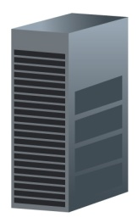
Data Aware Filtering
Airline NOC
RADAR Sensor
Data @ 0.5 Hz
Specific Airline Only
Best Effort
Data @ 100 Hz
All Altitudes
Airline Designation
Object Direction
Reliability Offered
1000 Sample History
Airport ATC
Databus Topic: “Radar”
Data @ 10 Hz
Distance < 50 Miles
Altitude < 5000 Feet
Reliability Enabled
Collision Avoidance System
Data @ 50 Hz
Approaching Only
Reliability Enabled
Get History
Notes:
How would you do this with sockets?
Ingest 100 samples, apply content filtering, throw out samples based on timing
And if the publisher changes timing it could affect the subscribers

Slide 18
DEMO 2
Time Based Filtering
How to do it
How it affects traffic
Content Filtering
How to do it
How it affects traffic
Late Joining Subscribers and Historical Samples
A look at how Durability interacts with Reliability and History.
Lifespan
Notes:
Publish Square data of different colors and sizes from two shapes demos. (For two instances of square)
Show Time-Based filtering using the Shapes demo. We can then show the change in traffic in wireshark.
Subscribe normally. Show wireshark.
Subscribe with a 2000ms time-based filter. Show wireshark.
Show Content filtering using the Shapes demo.
Subscribe using content filter. Show wireshark.
Use example to show content filtering based on size. Show wireshark.
Create a reliable volatile and reliable transient local instances of square with history 20 on both.
Subscribe reliably. Show how history must build.
Subscribe with transient local durability. Show how samples immediately show up.

Slide 19
Data Type Extensibility
v1.0 Application
v2.0 Application
Final Type
Type definitions are strictly defined
struct Track {
long id; //@key
float range;
float bearing;
}
struct Track {
long id; //@key
float range;
float bearing;
}
Extensible Type
Newer applications can add fields to existing base types
struct Track {
long id; //@key
float range;
float bearing;
}
struct AirTrack {
long id; //@key
float range;
float bearing;
float elevation;
}
Mutable Type
Type representations can differ from each other with additions, deletions and transpositions
Support for optional fields
struct Track {
long id; //@key
float range;
float bearing;
}
struct AirTrack {
long id; //@key
float elevation;
}
Notes:
Xtypes is part of the DDS standard
Type extensibility - how can parts of your system grow and evolve over time without breaking back-compatibility? - is so important that an entire specification in DDS exists just to define this behavior. This is called the Extensible Types or XTypes spec, and it provides an orderly migration path regardless of vendor.
Extensible (appendable) must add to the end, can’t remove, and can’t change keys
Mutable can add/remove, can re-order (with id()) but can’t change keys

Slide 20
DEMO 3
Data Type Extensibility
Data types can be extended to allow for additional functionality without breaking applications using the old version of the type.
Notes:
Use 4 shapes demos – Different colors
2 publishers (one using extended type)
2 subscribers (one using extended type)
Make sure to show how the matching is occurring in Admin Console.

Slide 21

Redundant Publishers
Airline NOC
RADAR Sensor
Data @ 0.5 Hz
Specific Airline Only
Best Effort
Data @ 100 Hz
All Altitudes
Airline Designation
Object Direction
Reliability Offered
1000 Sample History
Airport ATC
Databus Topic: “Radar”
Data @ 10 Hz
Distance < 50 Miles
Altitude < 5000 Feet
Reliability Enabled
Backup RADAR
Data @ 100 Hz
All Altitudes
Airline Designation
Object Direction
Reliability Offered
1000 Sample History
Collision Avoidance System
Data @ 50 Hz
Approaching Only
Reliability Enabled
Get History
Notes:
many -> many communication

Slide 22
DEMO 4
Ownership and Failover
Backup applications can exist on the system and be ready to supply data as a hot backup.
Ownership can change dynamically, depending on situation.
Notes:
Two publishers, exclusive, deadline=200
One subscriber, exclusive, deadline=1000
Pause publishing of the dominant publisher, showing failover occurring.

Slide 23
Connecting Systems built on Gaming Engines with OMG DDS

Slide 24
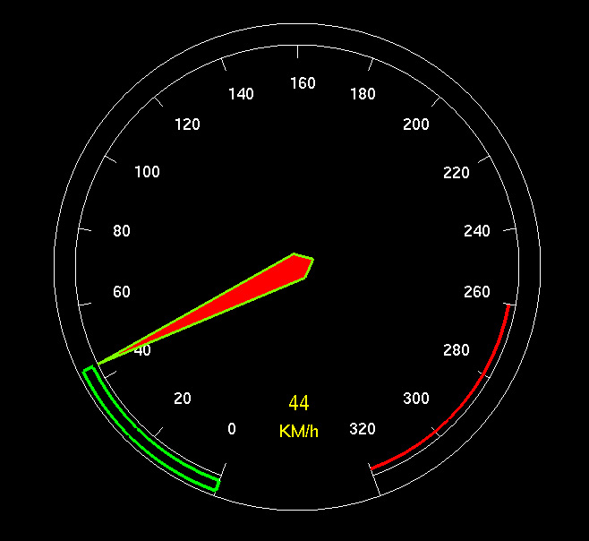
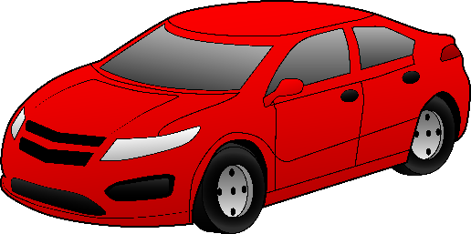
OMG-DDS Gaming Engine Example
Gaming Engine Application
Domain Participant
Generic Speed Gauge
struct CarInfoData {
Position coordinates;
float speed;
string<100> id; //@key
};
Publisher
CarInfo Data Writer
OMG DDS Databus
CarInfo
Notes:
During the PDW we will create this example step-by-step

Slide 25
Connecting OMG DDS with the Unreal Engine

Slide 26
Resources
Plugin
https://www.unrealengine.com/marketplace/en-US/product/simplified-real-time-data-sharing
Case + Code
https://www.rti.com/developers/case-code/unrealengine-sim
Plugin Tutorial
https://www.rti.com/hubfs/_Collateral/Simplified-Real-Time-Data-Sharing.pdf

Slide 27
OMG DDS and Unreal Engine
Enables interoperability between Unreal engine and RTI Connext.
Easy to use because it is used as a blueprint functions.
Generation of Unreal types from dds types.
All code generated in C++, possibility to modify it.

Slide 28
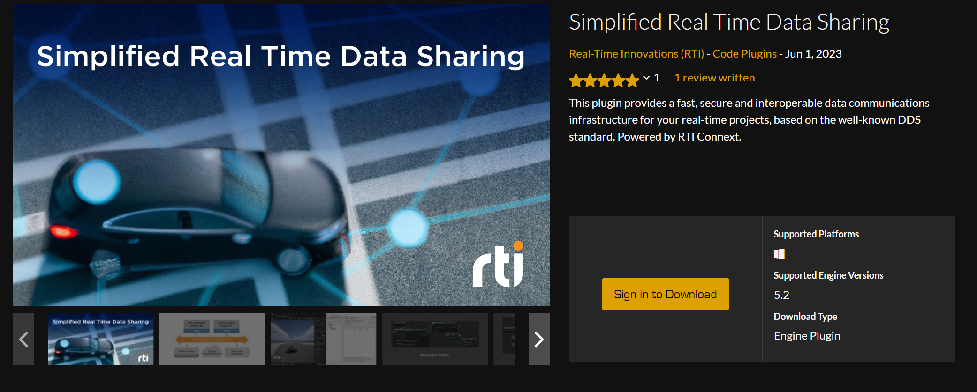
Unreal Plugin

Slide 29
Connecting an Unreal Engine simulation with DDS
Create Data Type and DDS entities in XML file
Add Simplified Real-Time Data Sharing Plugin
Add XML file to the Unreal Engine Project
Generate Code to Subscribe or Publish Data
Create the DDS Entities and publish data from Blueprint or Code

Slide 30
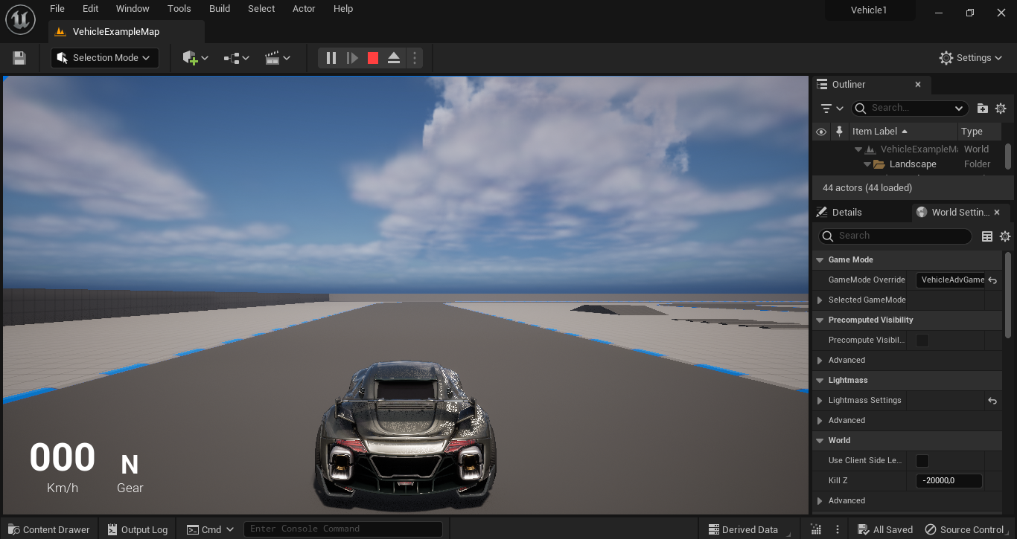
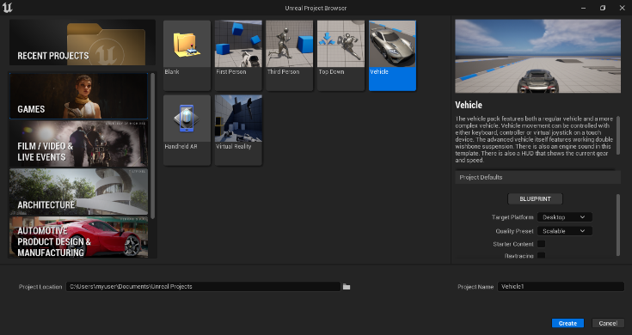
Creating the Example
Example based on the Games -> Vehicle example

Slide 31
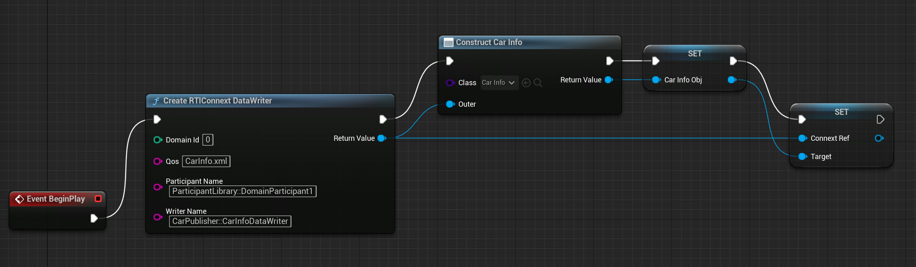
Initialization

Slide 32
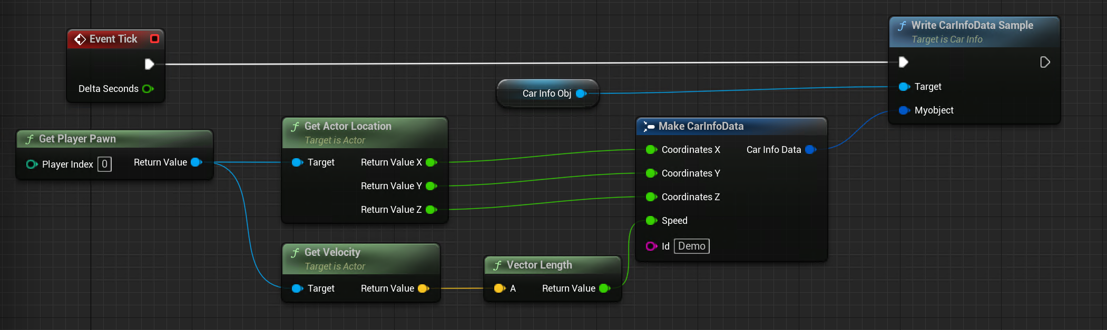
Publishing Data
Send Data Sample
Create Data Sample

Slide 33
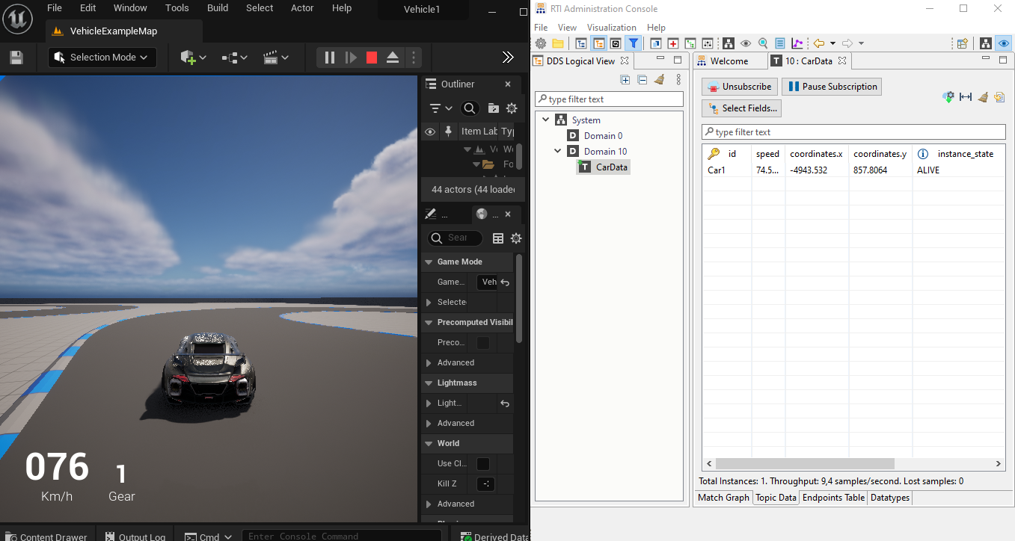
DEMO 5: Creating the Example Step by Step
Creating an Unreal Engine Application publishing DDS data based on the Unreal Engine vehicle example.

Slide 34
BREAK

Slide 35
Connecting OMG DDS with Unity

Slide 36
Resources
Case + Code
https://www.rti.com/developers/case-code/unity-gaming

Slide 37
Connecting an Unity simulation with DDS
Create Data Type and DDS entities in XML file
Add XML file to the Unity project
Add DDS assemblies to the Unity project
Create Scripts to subscribe or publish data
Attached script to the desired object

Slide 38
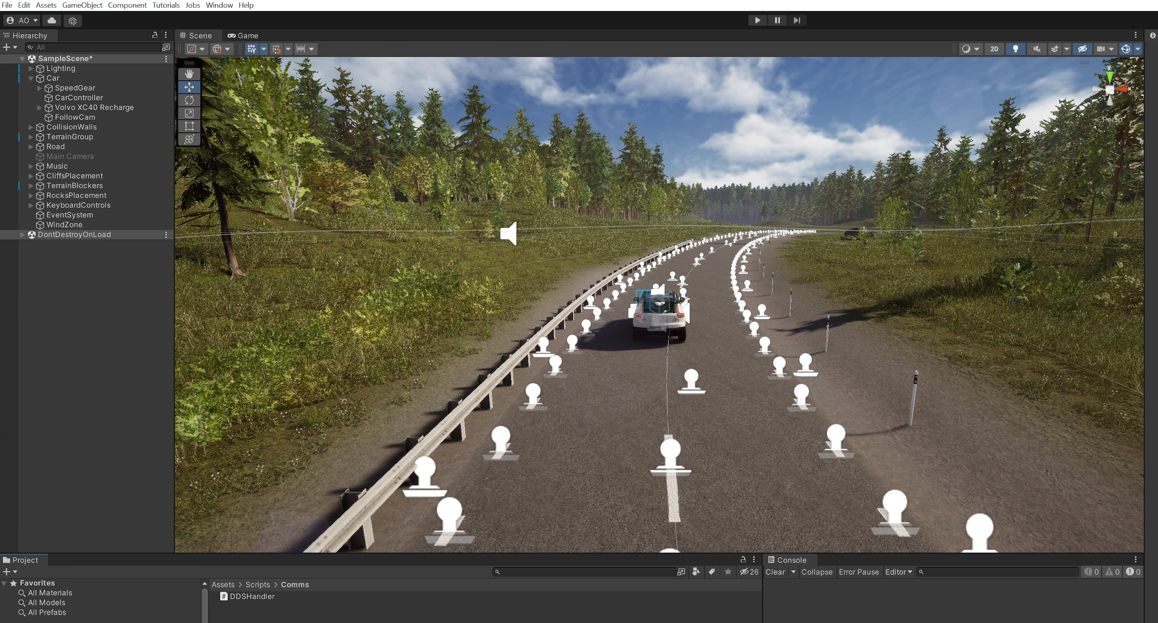
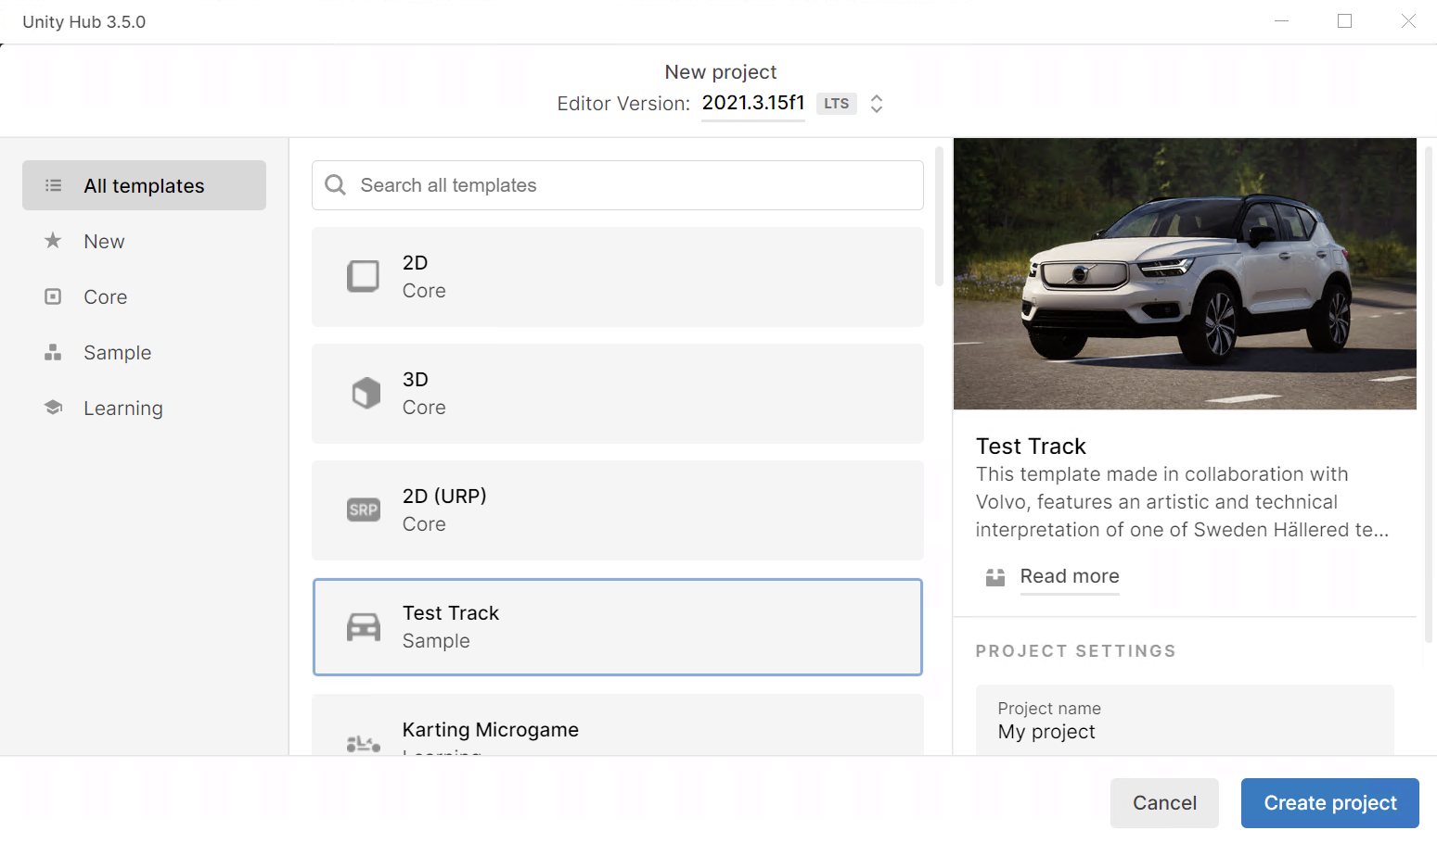
Example Project
Example based on the Test Track example

Slide 39
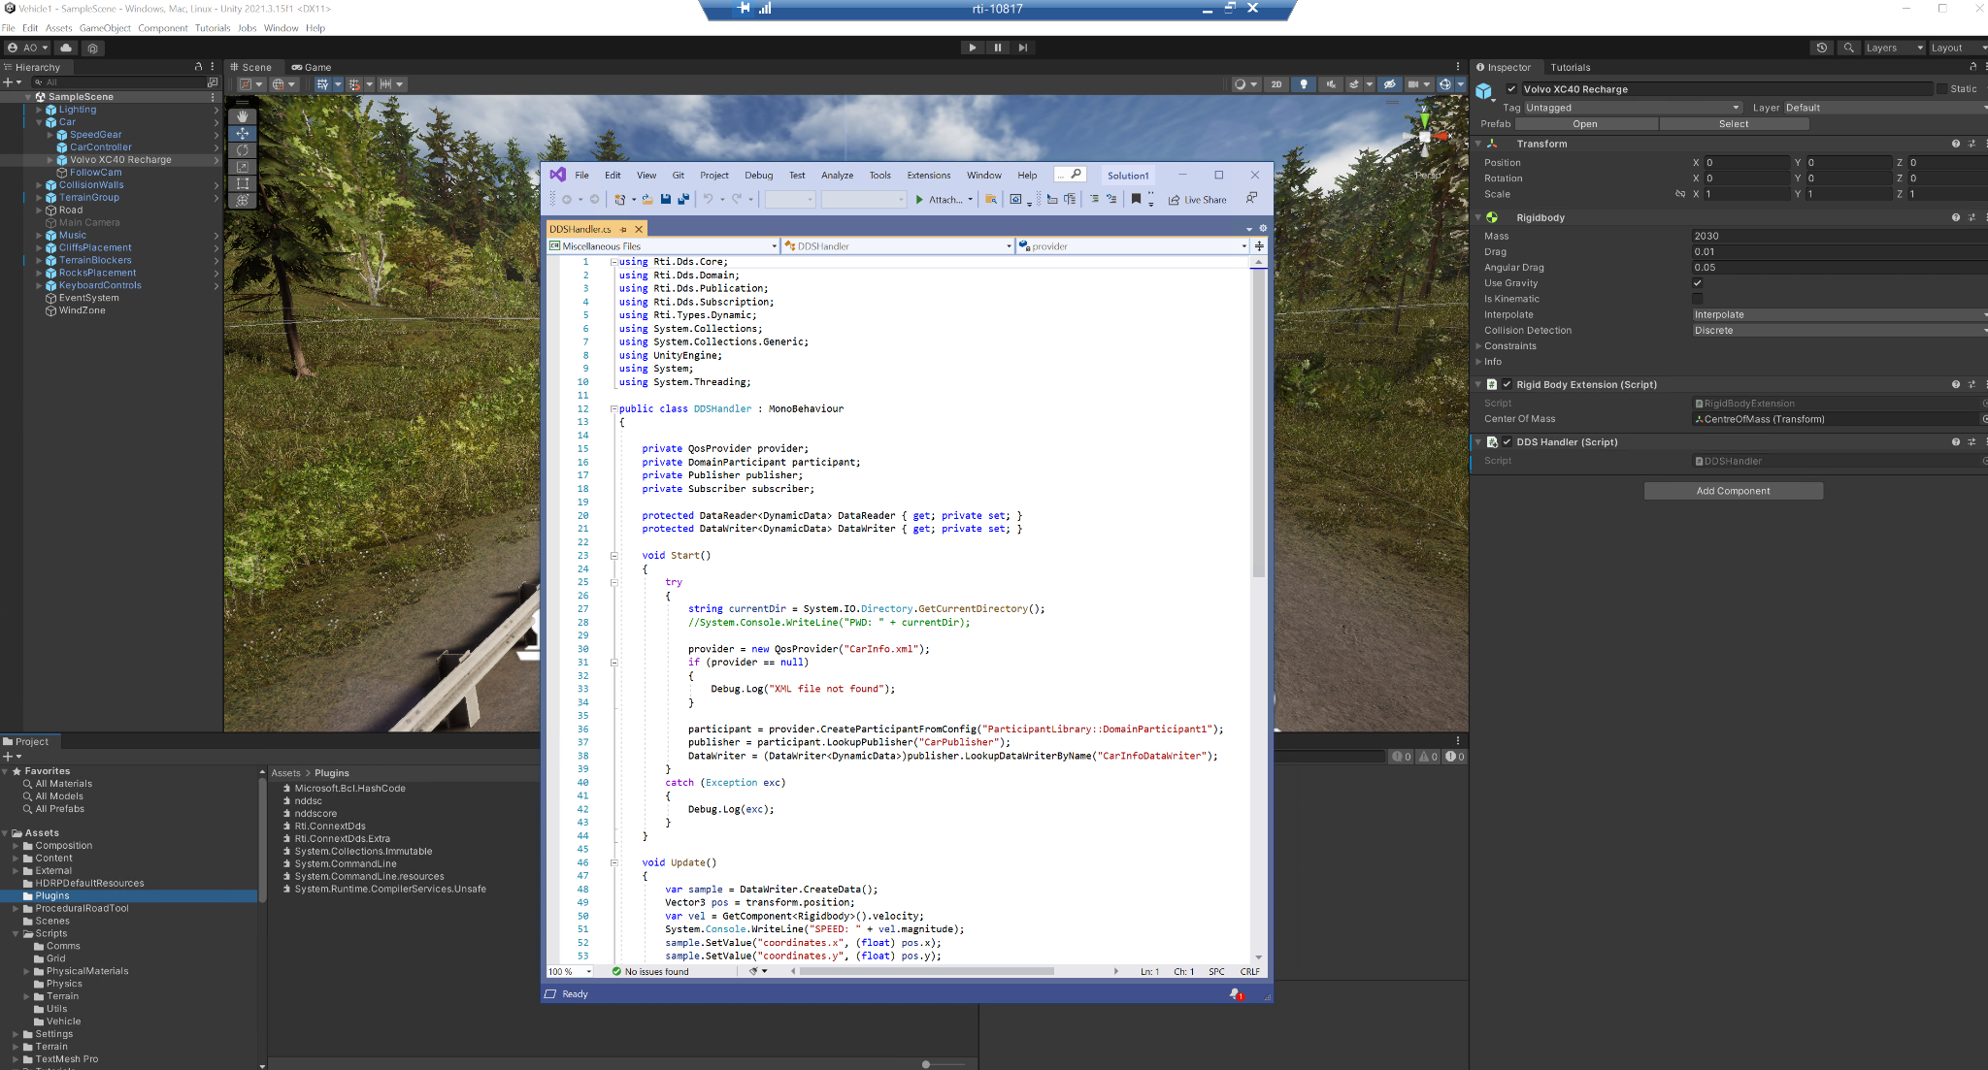
Initializing and Publishing Data
C# Script
Add Script to the Object
Adding Required Libraries

Slide 40
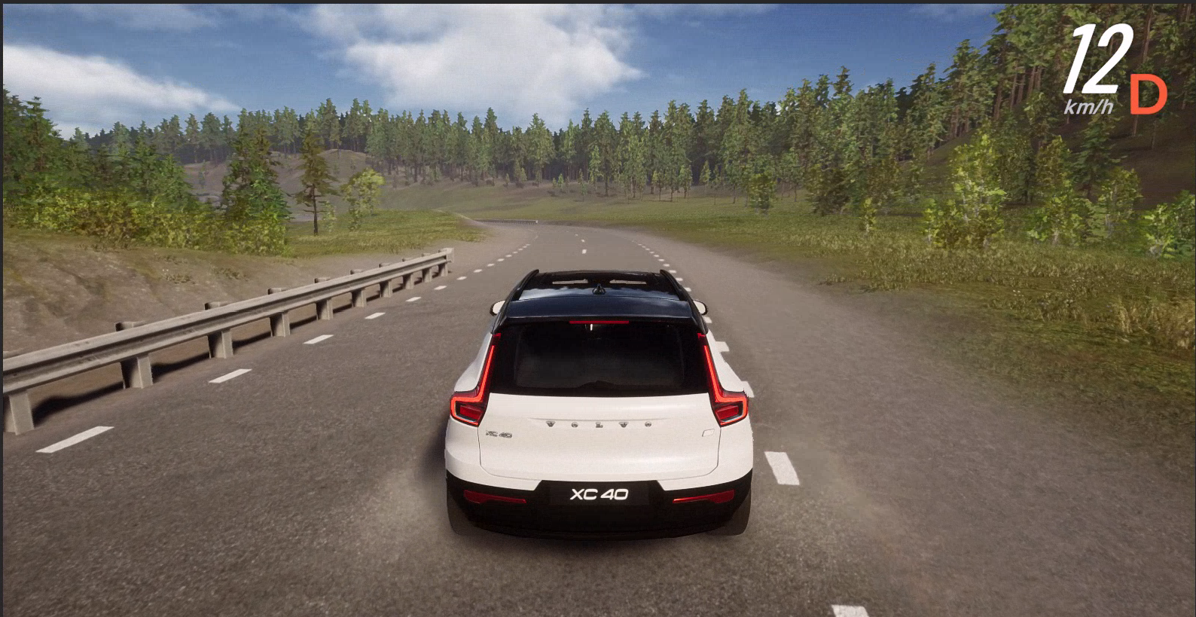
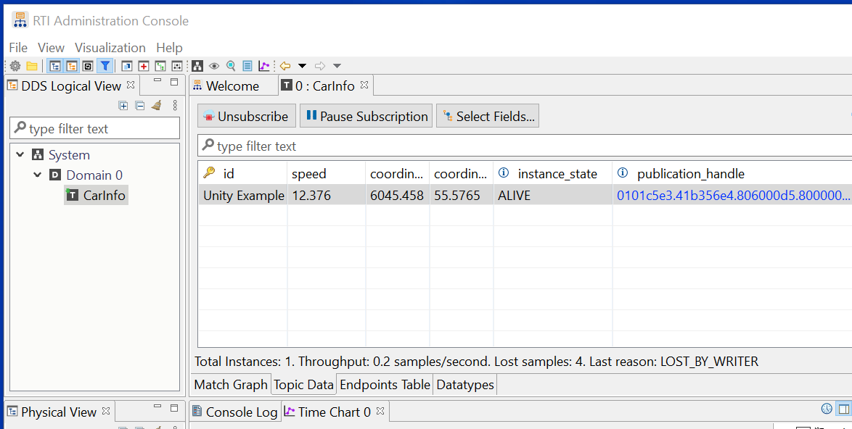
DEMO 6: Creating the Example Step by Step

Slide 41

Real-Time WAN Transport
Smart transport enabling secure, scalable, and high-performance communication over wide area networks (WANs), including public networks
Benefits include:
Peer-to-peer UDP based WAN connectivity
Network Address Translator (NAT) traversal
Support for IP mobility
No third party system dependence, such as STUN servers
DDS Databus @ Edge
Real-Time WAN Transport
DDS Databus @ WAN
Real-Time WAN Transport
DDS Application

Slide 42


WAN Connection with NATs
Provides eAddr2:ePort2 to Participant 1
Cloud Discovery Service
(60.10.23.45:2345)
Provides eAddr1:ePort1 to Participant 2
Cone
NAT
Cone
NAT
Internal Participant 1
Initial peer:
rtps@
60.10.23.45:2345
Internal Participant 2
Initial peer:
rtps@
60.10.23.45:2345
Private IP address:
iAddr1 : iPort1
Public IP address:
eAddr1:ePort1
WAN
Public IP address:
eAddr2:ePort2
Private IP address:
iAddr2:iPort2
Each Participant initially communicates with CDS
Cloud Discovery Service resolves the public addresses of an Internal DP and it communicates this addresses to other Internal DPs
Cloud Discovery Service also serves as a directory, so that a DP only needs to know about the CDS public address to connect to multiple peers automatically

Slide 43
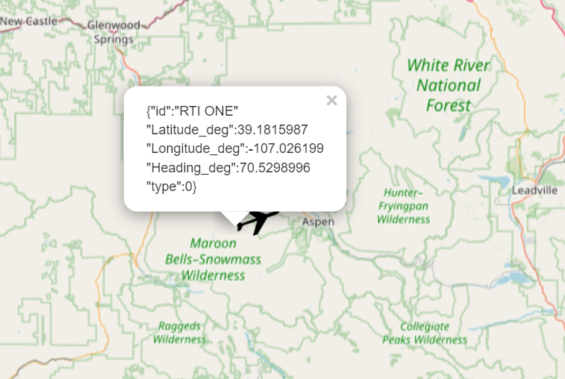



DEMO 7: Connecting it all together
AWS
CarInfo
OMG DDS Databus
EntityLocationUpdate

Slide 44

THANK YOU
Any Questions?
Contact us:
Rob Proctor, rob@rti.com
Dave Whitten, dwhitten@rti.com
Akkshaj Singh, asingh@rti.com

