Slide 1

From the Last of Us to the First of Us:
Rebuilding After a Zombie Crisis
Phase II
Dr. Tamara Griffith, Ph.D.,
Jerry Mize, MA,
Lisa Townsend, M.S.,
DEVCOM Solider Center Simulation and Training Technology Center
Chuck Wainman, SAIC,
Dr. Joan H. Johnston, Ph.D. DEVCOM Solider Center Simulation and Training Technology Center (Retired)
Grant Johnston Intern

Slide 2
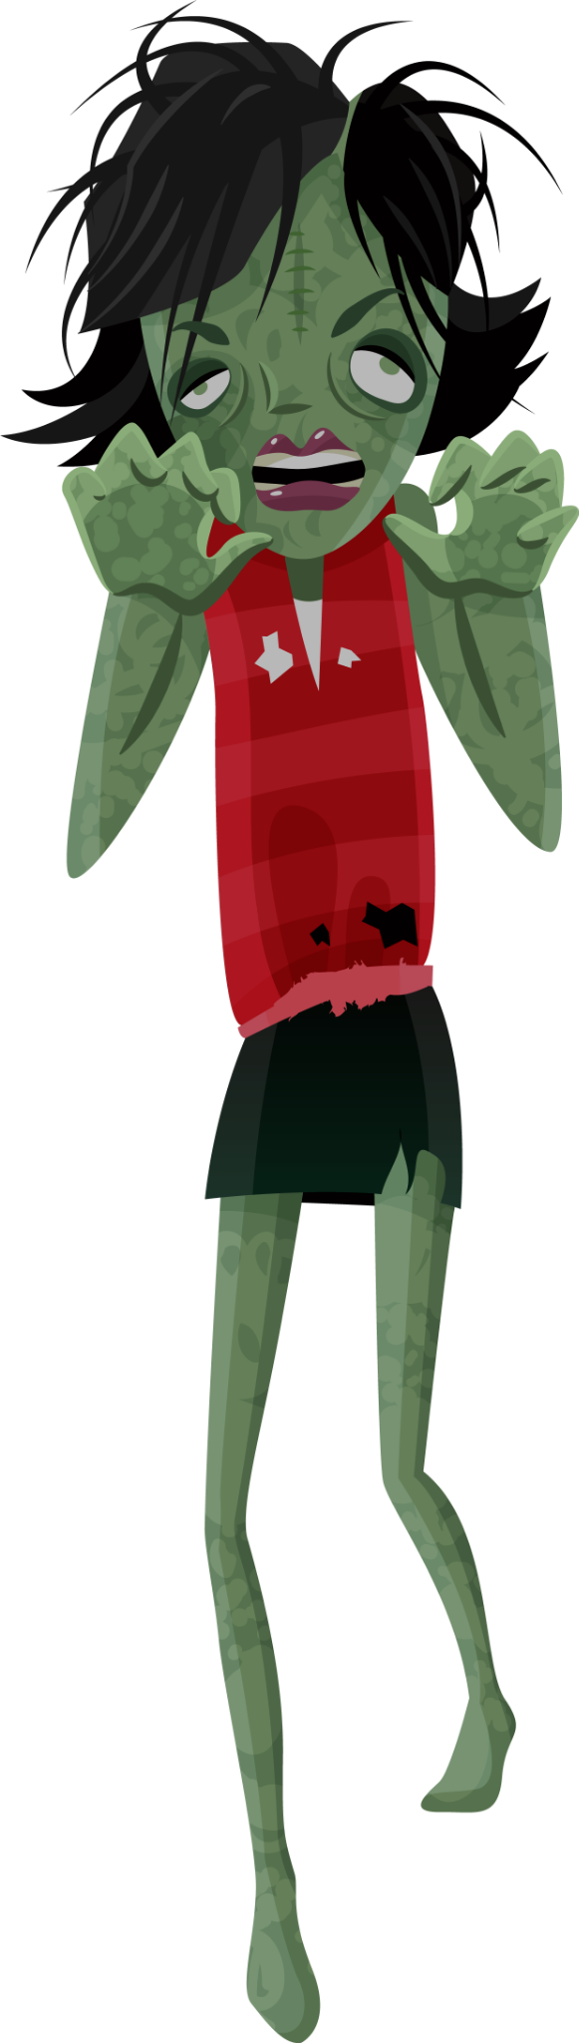
Welcome
Welcome to From the Last of Us to the First of Us: Rebuilding after a Zombie Crisis. You are participating in the second year of an exercise that simulates a post-crisis timeline.
This is an interdisciplinary exploration of how a civilized society might thrive, or fail to survive, after an infrastructure collapse.
While the scenario uses metaphor for engagement, it is inspired by a combination of real-world events involving public health, national security, and public resources (e.g., transportation, supply chain, cyber/information).
Last year, your goal was to survive at an individual level and you lived from day to day. This year, your location has achieved a steady state of food/water/safety to survive but you aren’t out of the woods yet. Zombies are still a threat, but they aren’t the only threat. This year, each play cycle represents a week.

Slide 3
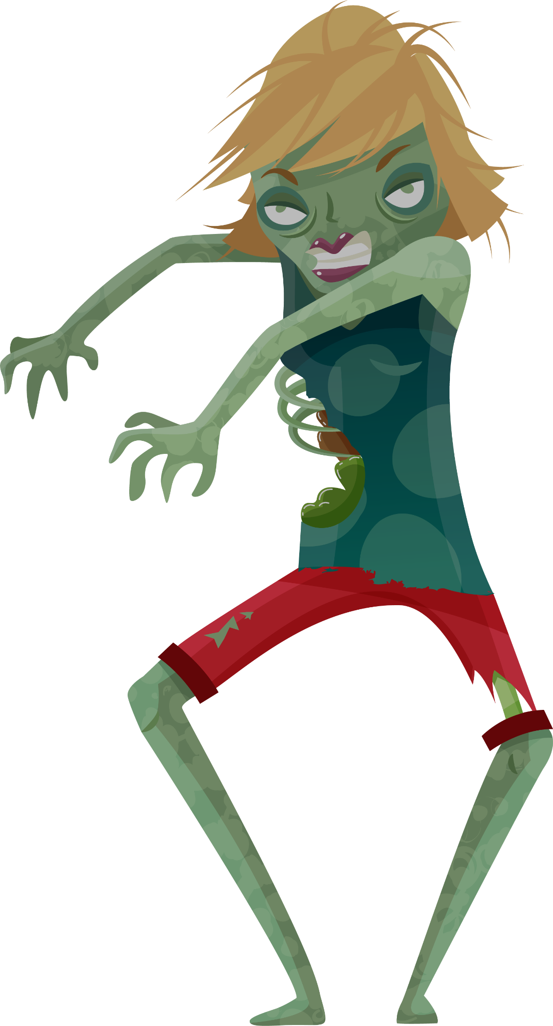
Backstory
It’s 2024, and it has been a year since the collapse. There is still a zombie threat. You are one of the managers of a small location that has strengths and weaknesses but has, so far, held up to the zombie crisis.
We are faced with the challenge of navigating through this changed world. We only have so many resources with much to be done to ensure our continued safety and survival. How you apply your resources can make or break the survival of your location.
Just as in real-life, for any decision you make, there will be a reaction or consequence. What will be your next decision?

Slide 4
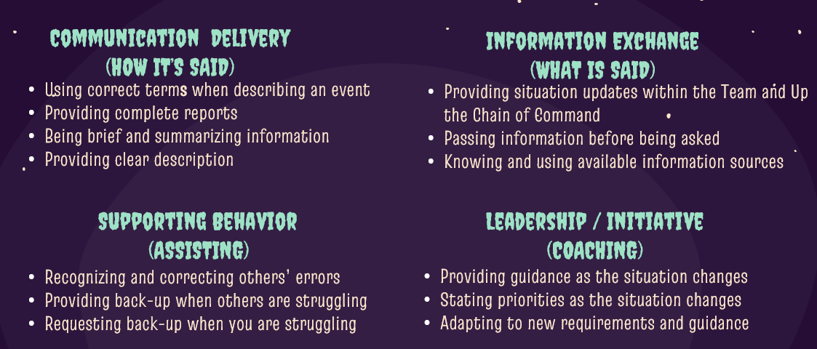
Teamwork Dimensions

Slide 5
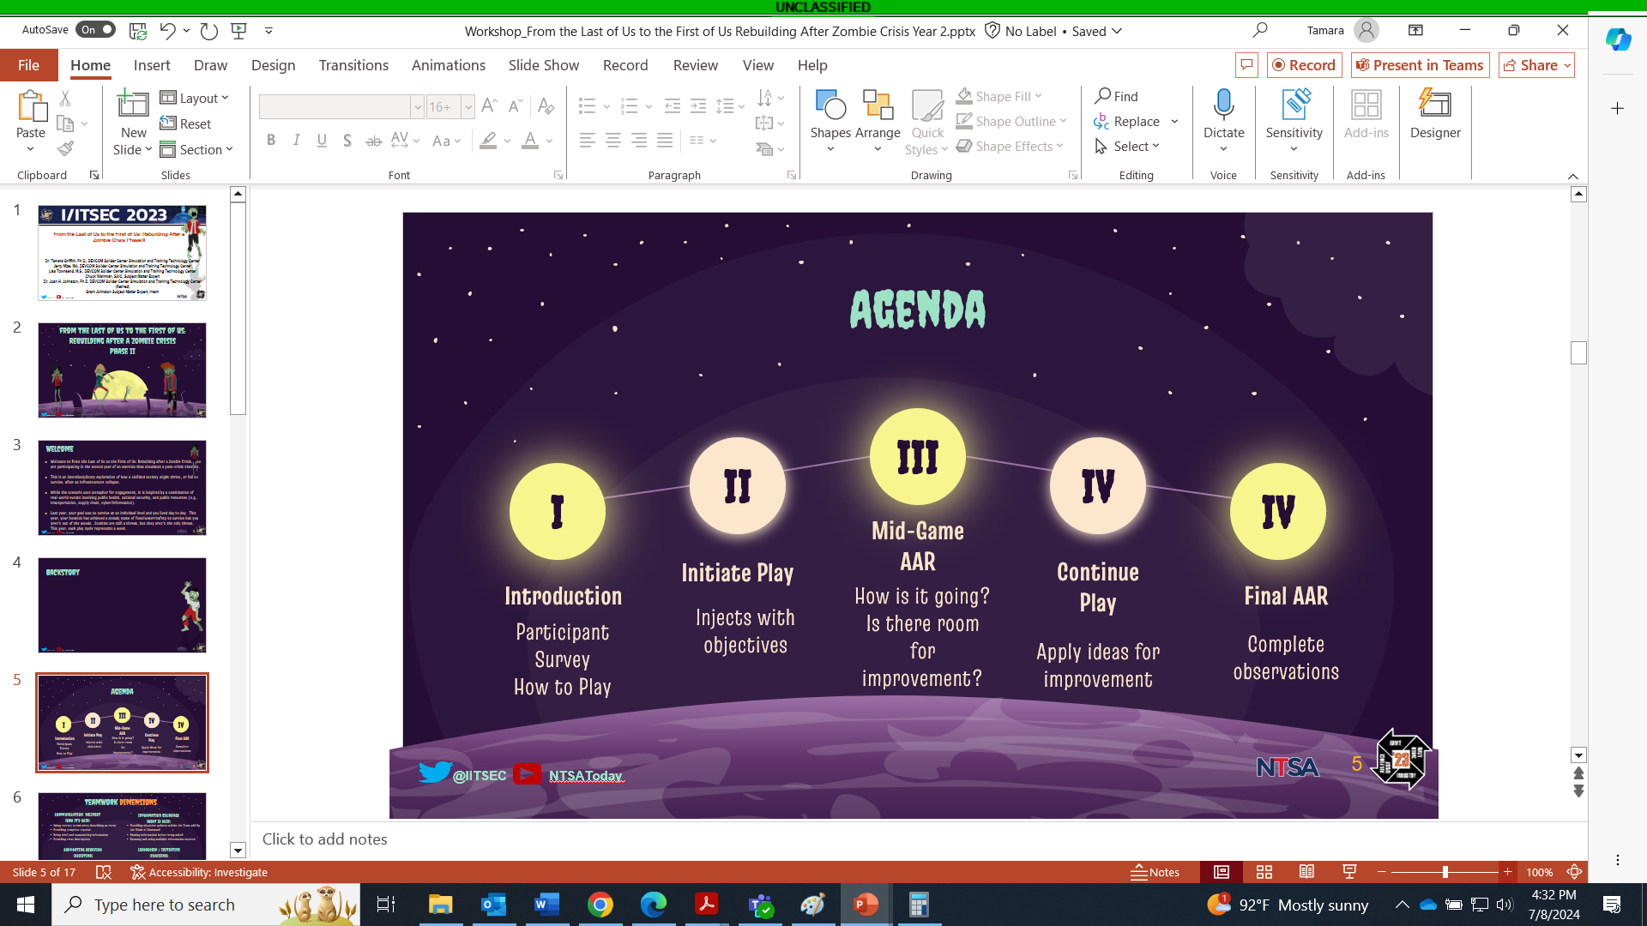
Agenda

Slide 6

Resources
In this simulation, human capital is your resource. People can help you achieve your goals if you apply them wisely. You will work with your teammates to apply your talent pool to accomplish goals at various levels.
Game Master - Introduces you to the scenario and provide basic guidelines. This is the master rule adjudicator.
Table Game Master - provides daily envelopes and observes actions and decisions. This is the local rule adjudicator.
Observers – Will collect insights to share during the AAR.

Slide 7
Game Space
There are two general locations to chose from:
A Military Base (Room #1)
A Rural Area (Room #2)
You will select which location where you’d like to play. Once you get there you will refine your selection further.

Slide 8

First Round
The first round is a tutorial round. You will learn:
Who is your crew
What are your tasks
How to apply resources
What are your goals

Slide 9
Tactical Pause
Midway through gameplay, there will be an AAR
What is going well?
What is going poorly?
How can we learn from this and improve?

Slide 10
Return To Gameplay
You have the opportunity to apply your learning to the second half of gameplay

Slide 11
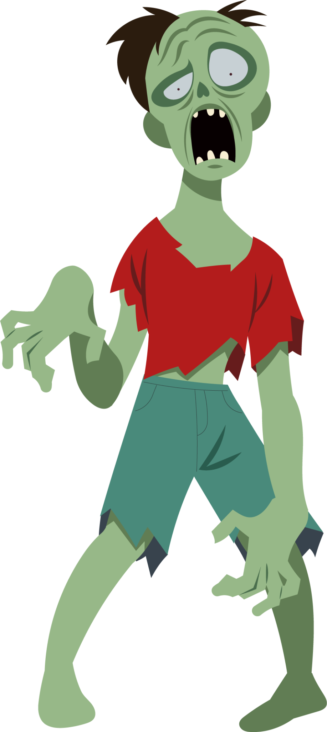
End of Game
Now you have the chance to quickly reflect on gameplay and shift focus to review actions

Slide 12
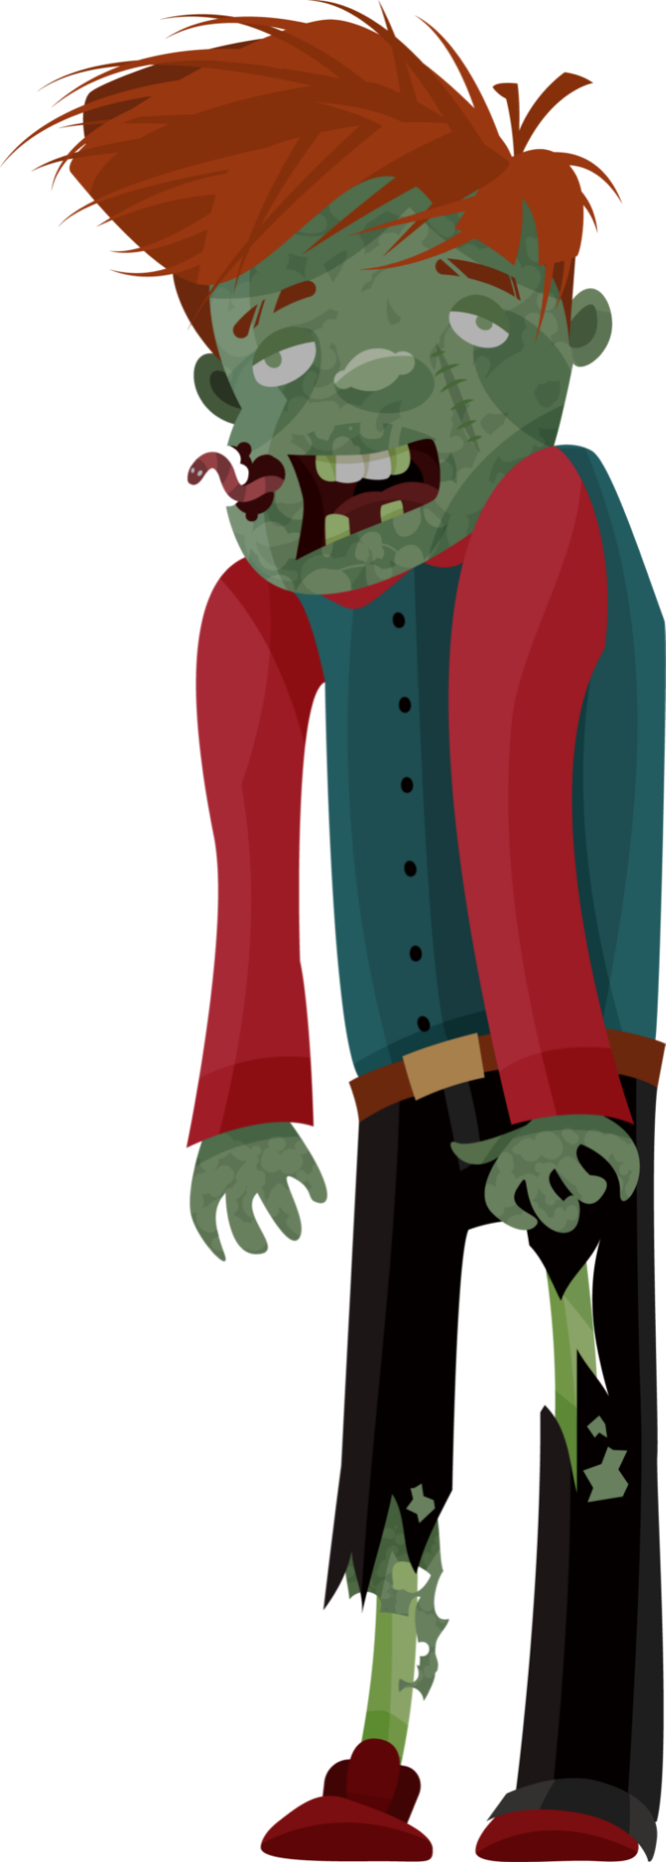
Team After Action Review
Facilitators assigned to each team will lead the teams in an after-action review with a focus on teamwork. Participants will refer to the teamwork definitions shown on the available reference card.
Participants will be encouraged to:
Establish the critical event timeline of the game rounds.
What emotional choices affected the logical decisions on resources.
Identify trigger events that challenged the team.
Talk about how they addressed the challenge.
Talk about other solutions and describe how they could impact the mission.
Identify performance goals for sustainment and improvements they would set if they were to engage in another round of play.
Following individual AARs, each team will be asked to share their AAR lessons learned with the other teams.

Slide 13
Whole Group After Action Review
The entire group will join together for an after-action review to discuss how inter-location interaction went:
Did teams negotiate, cooperate, dominate?
Did they establish further stability for their location?
What conflict arose?
How was it resolved, if it was resolved?
How can this experience be generalized to your life/work?
Following individual AARs, each Individual will be asked to complete end of game surveys.

Slide 14
Game After Action Review
Now we’d like to know how we can improve the game for next year
Was the game engaging?
Were you challenged?
What was most frustrating?
What gave the greatest sense of achievement?

Slide 15
Participant Takeaways
Participants should:
Understand the 4 dimensions of teamwork and how it has an impact on team processes including day-to-day operations, 1:1 feedback, team performance evaluations.
Understand how team development increases the number of teammates contributing and creates an environment where coaching and self-correction is encouraged.
Understand how to conduct an After-Action Review that focuses on improving teamwork using team-self correction.

Slide 16
Do you have any questions?
Thank you for your participation
Credits: This presentation template was created by Slidesgo, including icons by Flaticon, and infographics & images by Freepik.

