Slide 1

Evaluation of a Novel Team-Based VR Curriculum for Advanced Resuscitative Care
Jennifer Polson PhD, SimX, Inc.
Michael Barrie MD, SimX, Inc.
Michael Poppe MD, SimX Inc.
Col John R Dorsch DO, USAF (ret.), SimX, Inc.
Karthik Sarma MD, PhD, SimX, Inc.

Slide 2
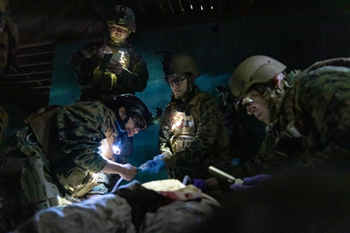
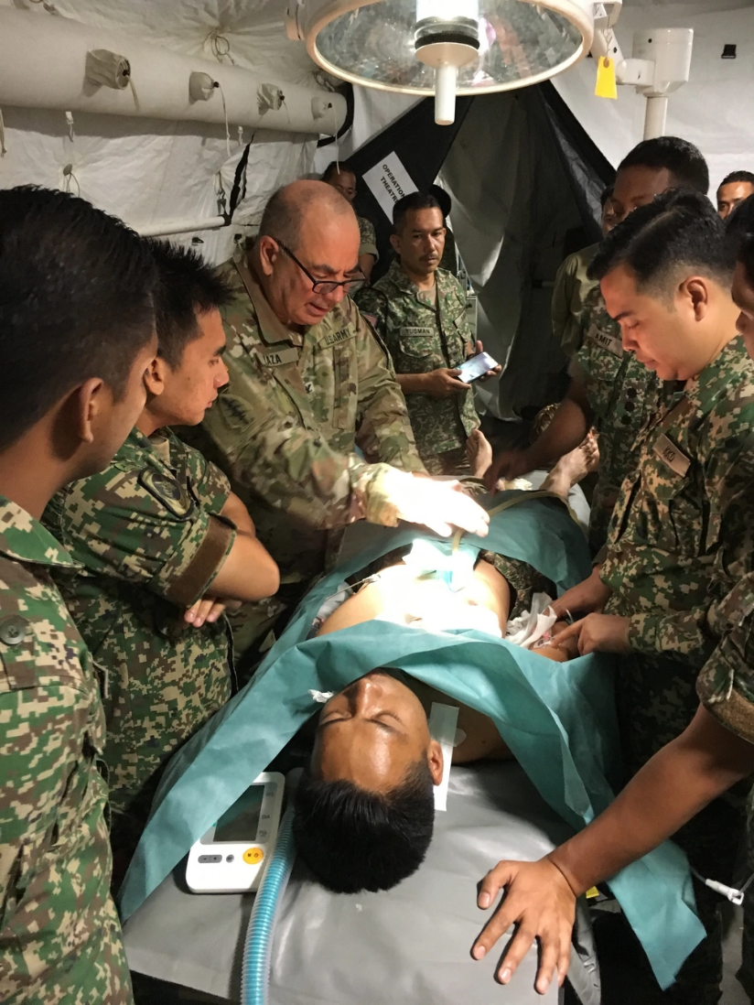
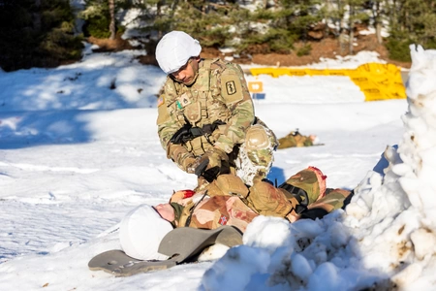
Mission Challenges for Advanced Resuscitative Care
Non-Compressible Torso Hemorrhage
  Major preventable cause of battlefield death
  Death possible within 30 minutes post-injury
  Effective treatments: blood transfusions and REBOA
  Early blood administration can cut mortality by 80%
  Specialized training essential for operational teams
  Maintaining proficiency during non-deployment is challenging
Traditional ASRC Training Limitations
  Heavy reliance on physical simulators and manikins
  Classroom learning lacks practical immersion
  Field exercises are costly and infrequent

Slide 3
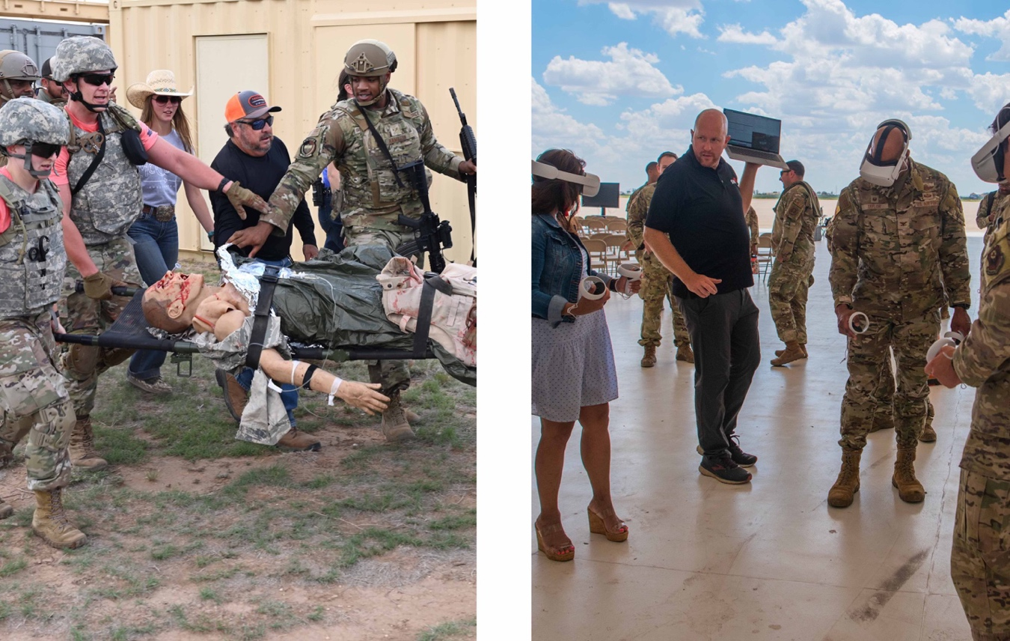
Virtual Reality and Manikin Simulation
Left: U.S. Air Force photo by 2nd Lt. Brandon DeBlanc. Right: U.S. Air Force photo by Airman 1st Class Mateo Parra. The appearance of U.S. Department of Defense (DoD) visual information does not imply or constitute DoD endorsement.

Slide 4
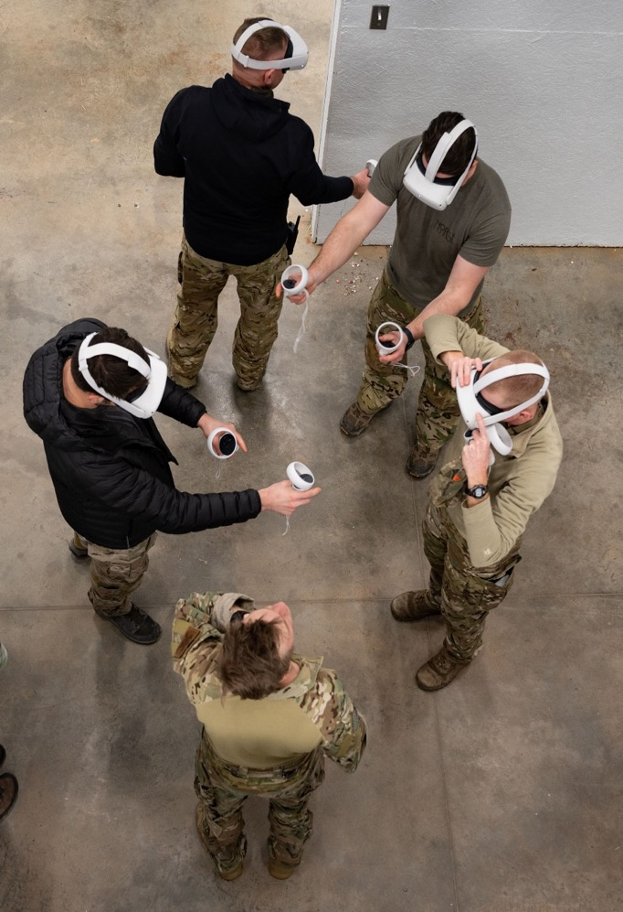
Virtual Simulation
Complex skills are difficult to develop and sustain over time
  10,000 repetitions
  “Train until you can’t get it wrong”
Additional training without additional time
  Need to gain efficiency – effective resource management
  Neural Priming
Flexibility and Standardization
  Adjust content to target evolving mission requirements
  Ability to train “anytime, anywhere”

Slide 5
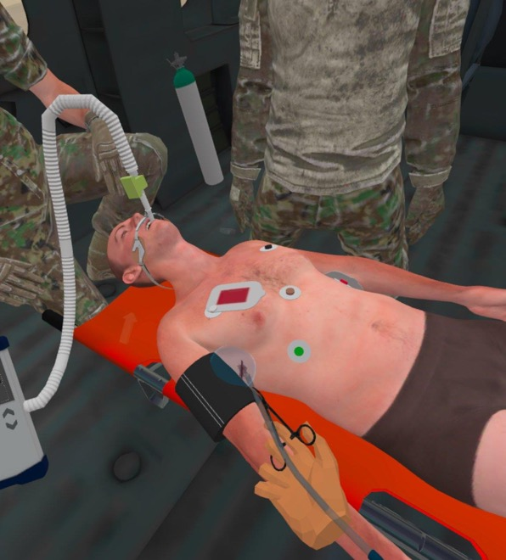
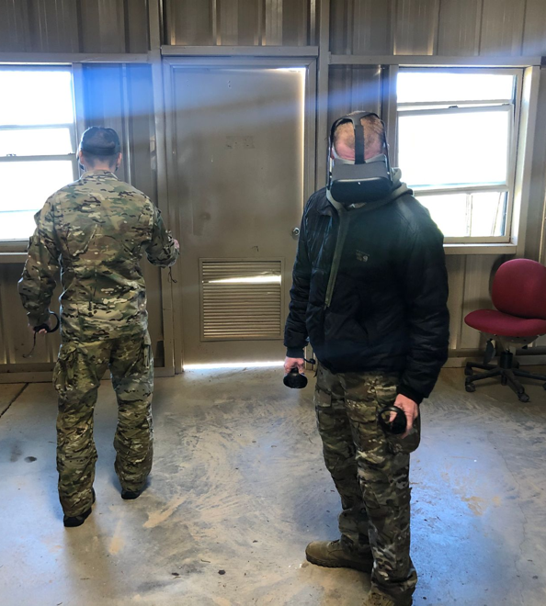
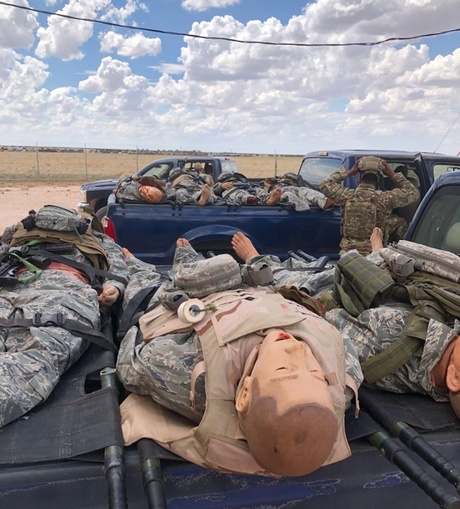
VALOR Program Objectives
Improve Realism
Increase Flexibility
Reduce Cost

Slide 6
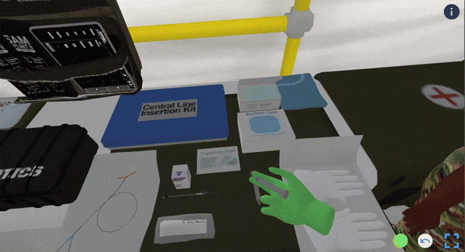
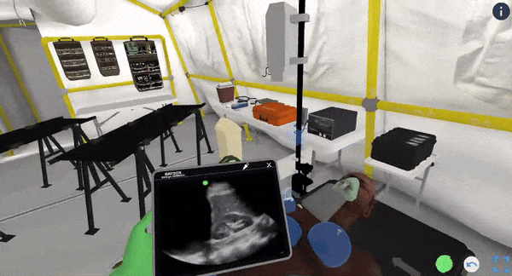
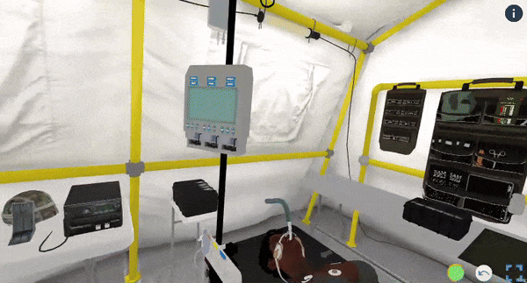
Curricular Design Principles
Development of Non-Technical Procedural Skills
Enhancement of Clinical Decision-Making Abilities
Integration of Team-Based Training Dynamics
Notes:
- The curriculum places a strong emphasis on cultivating non-technical skills needed to conduct successful operational medic. This includes leadership, communication, and resource management, all of which are critical for managing the unpredictable nature of battlefield medicine. Trainees are engaged in exercises that challenge them to manage logistics and personnel under pressure, mirroring real-world scenarios that require quick thinking and adaptive strategies.
- Central to the curriculum is the enhancement of the trainees’ ability to make rapid and accurate clinical decisions. Through interactive simulations that incorporate dynamic medical emergencies, participants are required to diagnose conditions, choose appropriate interventions, and modify treatment plans as scenarios evolve. This component is designed to strengthen the decision-making confidence of medical personnel, ensuring they are prepared to face any situation on the field.
- The training framework acknowledges the critical role of teamwork in military medical operations and is tailored to support both co-located and remotely coordinated team activities. The training uses virtual environments to simulate the necessity for synchronous operations and decision-making, fostering a robust understanding of how to function cohesively as a unit without requiring colocation for team training.

Slide 7
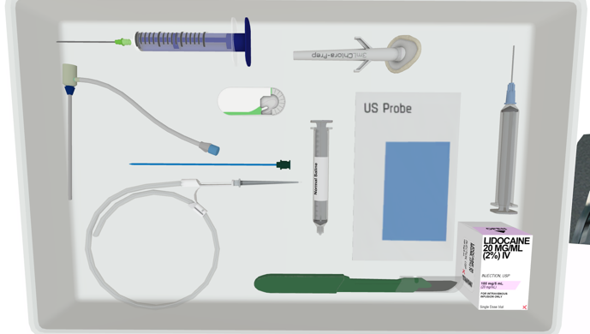
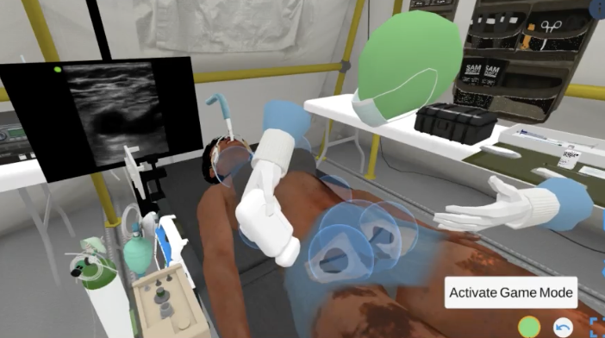
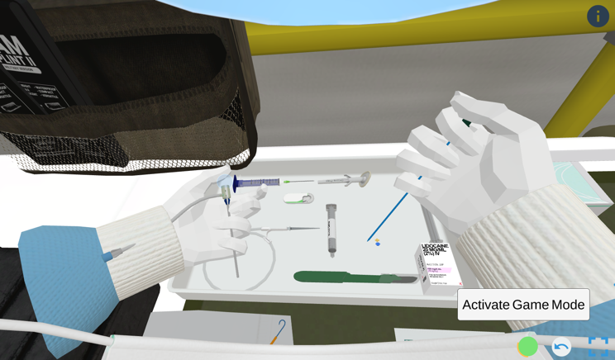
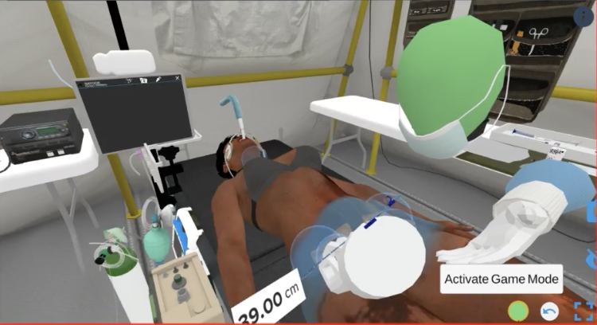
Virtual Asset Design

Slide 8
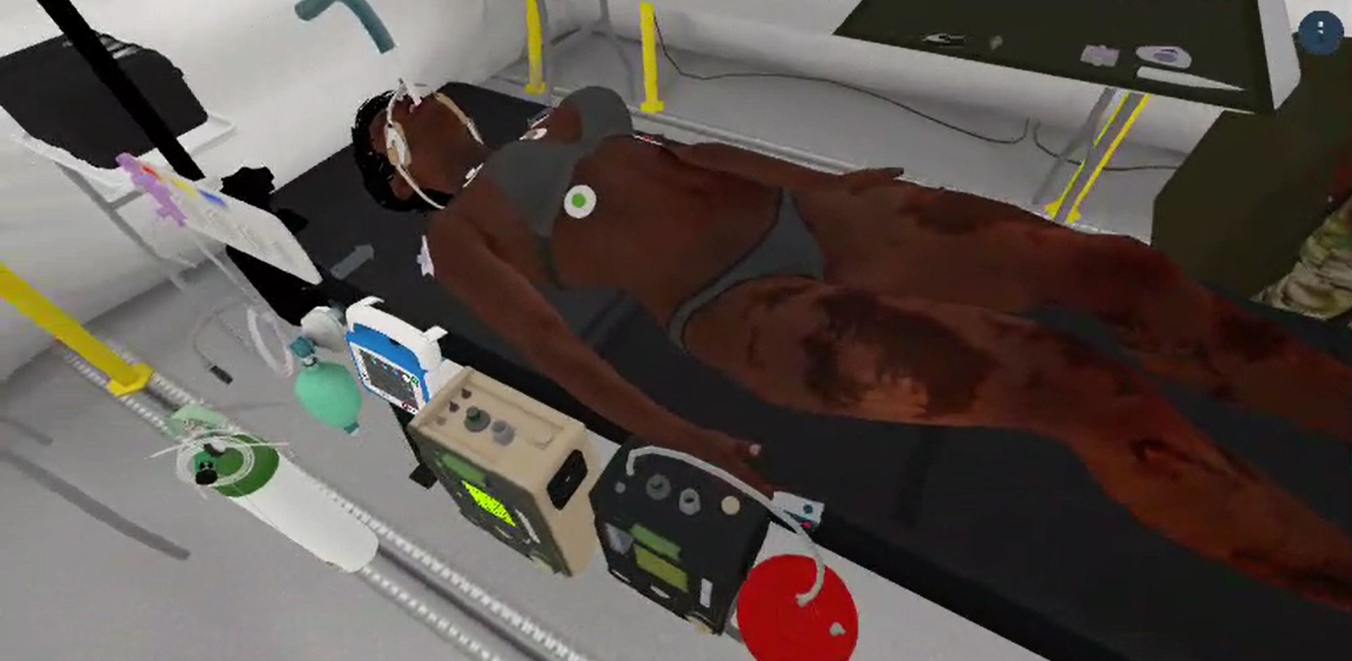
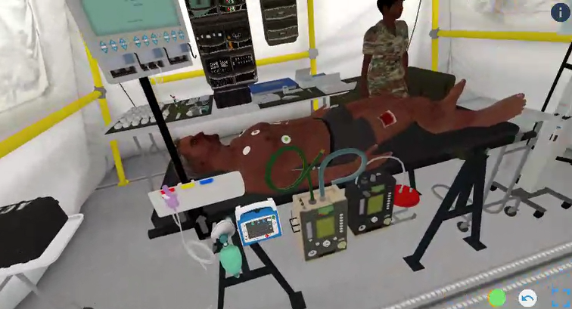
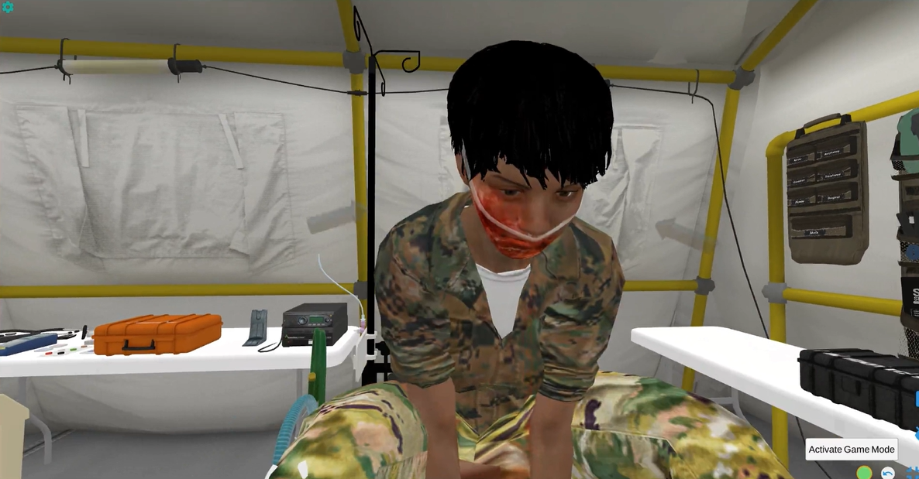
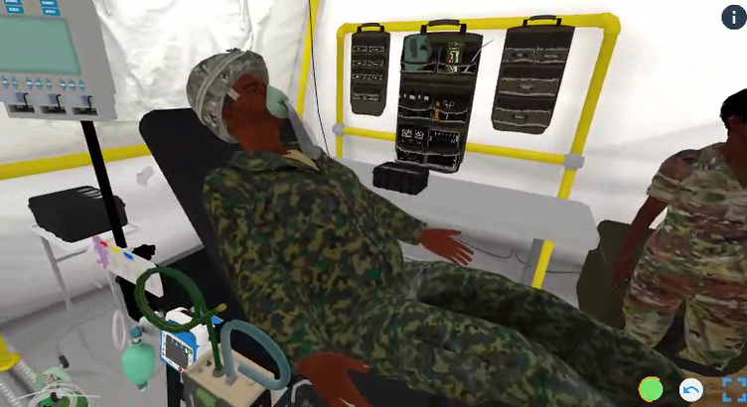
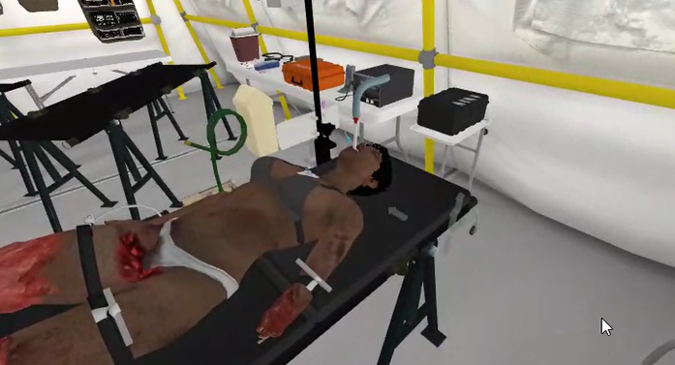
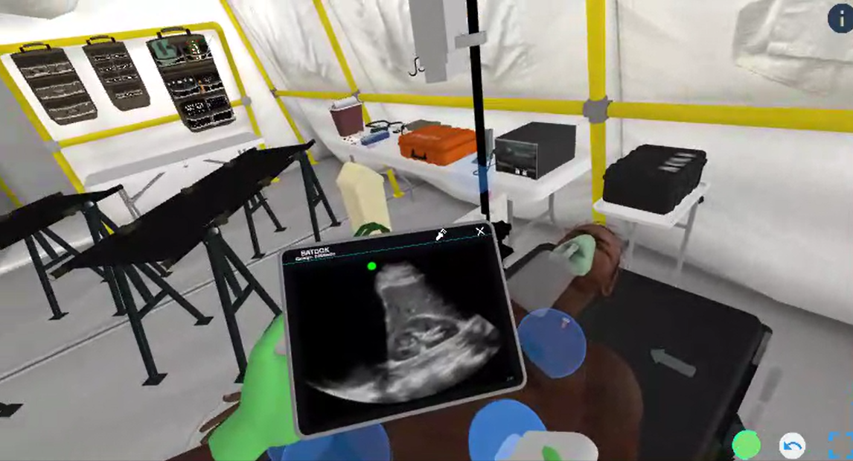
Curriculum Scenarios
Mounted Blast Injury
Extremity Injury
Difficult Airway
Junctional Wound
Dismounted Blast Injury
Penetrating Thoracic Injury
Notes:
Difficult Airway - This scenario involves a 24-year-old female US soldier who has sustained a high-velocity gunshot wound to the face, leading to significant soft tissue damage. The scenario focuses on managing a compromised airway in a forward surgical tent, where the patient presents with substantial oropharyngeal bleeding.
Penetrating Thoracic Injury - A 24-year-old male local national presents with a gunshot wound to the left chest. The scenario covers the application of chest seals and decompression needle placement to manage potential complications such as pneumothorax, along with the administration of tranexamic acid (TXA).
Mounted Blast Injury - Medics respond to a 24-year-old female US soldier who has been involved in a vehicle rollover following a mounted IED blast. The scenario requires rapid intubation due to a diminished Glasgow Coma Scale (GCS) and the initiation of whole blood transfusion to address hypotension.
Junctional Wound - A 30-year-old male local national has a gunshot wound to the right groin. The training scenario emphasizes the management of active bleeding where previous tourniquet application has been ineffective, requiring direct pressure and rapid decision-making.
Dismounted Blast Injury - This scenario describes a 22-year-old female US Marine who has sustained multiple traumatic injuries from a dismounted IED blast, including bilateral lower extremity amputations. Medics must manage a complex airway and hemorrhage control effectively, alongside initiating appropriate transfusion protocols.
Extremity Injury with PCC - Featuring a 22-year-old male US soldier with a prolonged tourniquet application following a gunshot wound to the thigh, this scenario focuses on the complications of prolonged field care, such as potential compartment syndrome and pain management.

Slide 9
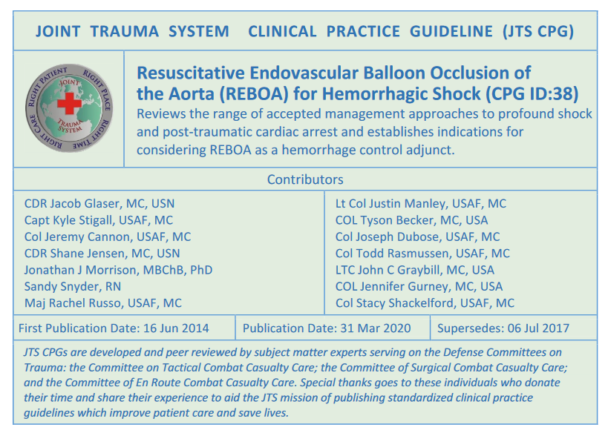
Curricular Coverage
Competency Area | Checklist Items
Current Recommendations | 16
Initial Management | 14
Alternative Therapies | 3
Resuscitative Thoracotomy | 1
Trans-abdominal Aortic Occlusion | 2
REBOA Procedure | 37
Arterial Access | 6
Arterial Line Attachment | 1
Balloon Position/Inflation | 5
Balloon Securing/Monitoring | 4
Operative/Procedural Bleeding Control | 2
Balloon Deflation | 3
Sheath Removal/Complications | 6
Documentation/Monitoring | 5
Coordination/Patient Movement | 5
REBOA Use by Non-Surgical Resuscitation Teams | 8
REBOA Pitfalls | 8
REBOA Indications & Contraindications | 6
Aeromedical Evacuation Considerations | 6

Slide 10
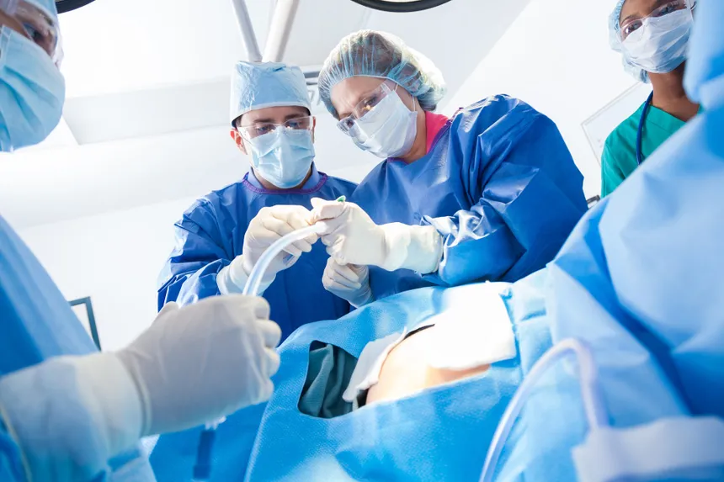
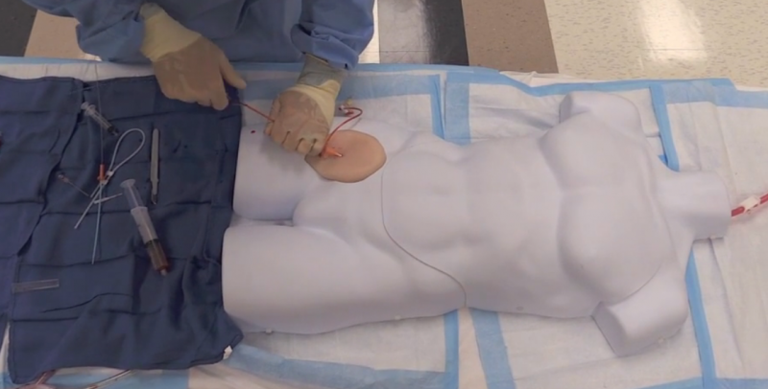
SME Identification & Evaluation
Subject Matter Expert Recruitment Criteria
  Prior or current active-duty military experience
  Attended an in-person REBOA-based training
  Placed a REBOA catheter in clinical setting OR live-tissue model
Evaluation Procedure
  Real-time virtual simulation of curriculum
  Checklist adapted from CPGs
  Curricular Competency Survey (Likert)
  Usability Survey (Likert)
Notes:
, including the American College of Surgeons’ Basic Endovascular Skills for Trauma (BEST) course or the ‘Resuscitation Adjuncts: Prehospital Transfusion & REBOA’ (RAPToR) Course

Slide 11
Survey Evaluation
 | Likert Score (7-point Scale)
Competency Area | SME 1 | SME 2 | SME 3 | Average
Recognition of Indications for REBOA | 6 | 7 | 7 | 6.7
Simulated Ultrasound Availability | 5 | 6 | 7 | 6.0
Equipment Simulation | 5 | 7 | 7 | 6.3
Arterial Access and Sheath Insertion | 4 | 6 | 7 | 5.7
Balloon Inflation Monitoring | 4 | 7 | 7 | 6.0
Management of REBOA Zone 1 Deployment | 6 | 7 | 7 | 6.7
Management of REBOA Zone 3 Deployment | 6 | 7 | 7 | 6.7
Complication Handling | 1 | 2 | 1 | 1.3
Comprehensive Trauma Scenarios | 6 | 7 | 7 | 6.7
Interdisciplinary Team Interaction | 5 | 7 | 7 | 6.3
Dynamic Response to Treatment | 6 | 7 | 7 | 6.7
Debrief Tools | 5 | 7 | 7 | 6.3
Documentation Practice | 5 | 3 | 4 | 4.0

Slide 12
Usability Results
Questions | 7-Point Likert Scale Average (n=3)
This simulation allows users to practice REBOA skills in high-fidelity simulation environments that mimic real-life scenarios. | 6.3
The platform offers scenarios that allow for the application of knowledge in both didactic and hands-on skills components, ensuring thorough preparation before actual utilization of the REBOA device. | 5.0
The platform includes modules/scenarios that replicate organized, curriculum-based REBOA training courses such as the American College of Surgeons’ Basic Endovascular Skills for Trauma (BEST) course or the “Resuscitation Adjuncts: Prehospital Transfusion & REBOA” (RAPToR) Course. | 5.5
Hands-on skills components are included in this curriculum to ensure comprehensive training in the use of REBOA. | 6.0
Anatomically correct models are used within the simulation to ensure accurate training of CFA access skills. | 6.7
This curriculum is useful for REBOA skill sustainment purposes in regard to the indications for its use. | 7.0
This curriculum is useful for REBOA skill sustainment purposes in regard to the deployment of the catheter system. | 6.7
This curriculum is useful for REBOA skill sustainment purposes for troubleshooting potential complications. | 1.7

Slide 13
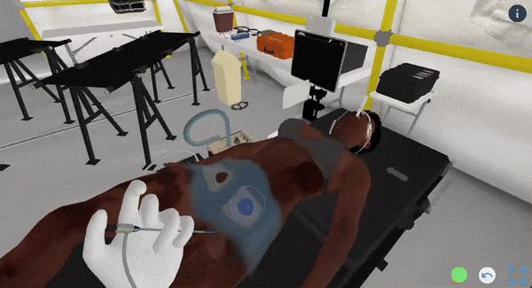
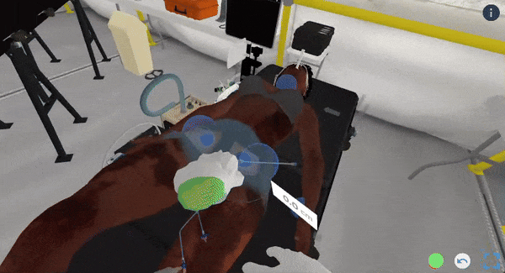
Conclusions & Limitations
Evaluation results
  Focus on early hemorrhage control and guidance
  Strong usability in high-fidelity simulations
  Areas for improvement: thoracotomy & sheath insertion
  Less comprehensive on managing complications
  Needs stronger coverage of troubleshooting skills
Limitations of VR Curriculum
  Primarily focused on surgical environments
  Limited scope for real combat scenarios
  Tactile feedback lacks realism in simulations
  Hinders effectiveness for precise manual tasks
  Need for technological advancements in VR
  Limited data linking VR training to field performance

Slide 14
Future Directions
Ongoing: Testing & Evaluation
  Cohort: trauma surgical personnel
  Usability & acceptance
  Time & cost burden
Future Directions
  Longitudinal performance monitoring
  Integration into current training paradigms

