Slide 1
Binary Source of Truth:
Leveraging Digital Twins to Enable Agile Systems Engineering
Kyle Simmons, Cavrnus Inc.
Notes:
- Thank you for coming in. The standard gratuitous reminder - silence phones, photos ok, no flash.

Slide 2
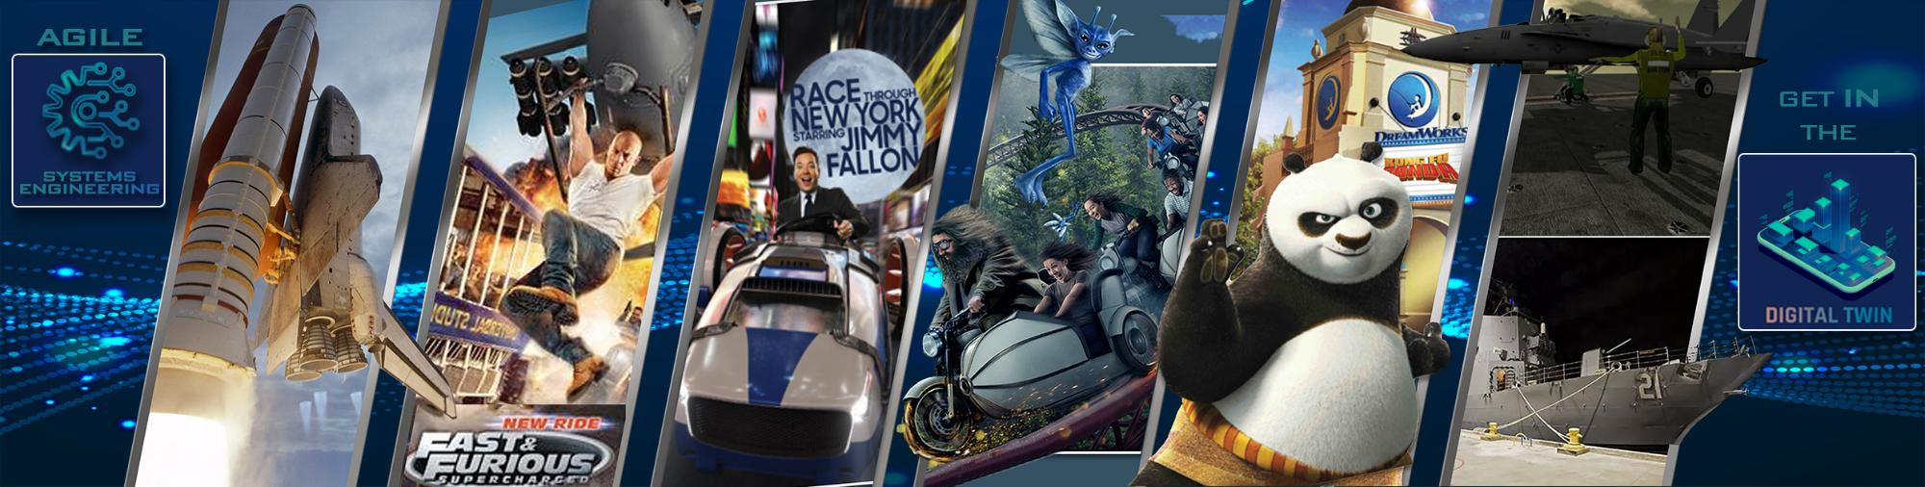
Binary Source of Truth
Introduction
About Kyle Simmons
Notes:
- Just a quick note about me. I have a background as a mechanical designer, software engineer, and VR applications. I've worked in the space program on the shuttle and ares programs, training simulators for the Navy and the Army, as well as designing theme park attractions at Universal Studios.

Slide 3
Binary Source of Truth
Systems Engineering Perspective
Buzz words over the years
Cyber-security
HumInt (Human Intelligence)
Remember when “Serious Games” was considered a crazy idea?
This year it’s all about Digital Twins
But why it still hard to create a mental paradigm for DT’s?
The concept is loosely defined and protean.
Seems like a lot of technology to solve a problem that already has a solution.
Notes:
- This year the buzz word is Digital twins. Every year we seem to focus heavily on one concept or another. Some of the terms that have been focused on over the years has been conceps like "cyber-security", "Human Intelligence". I remember when "Serious Games" came about and it was actually a bit contraversial. Now we take it seriously.

Slide 4
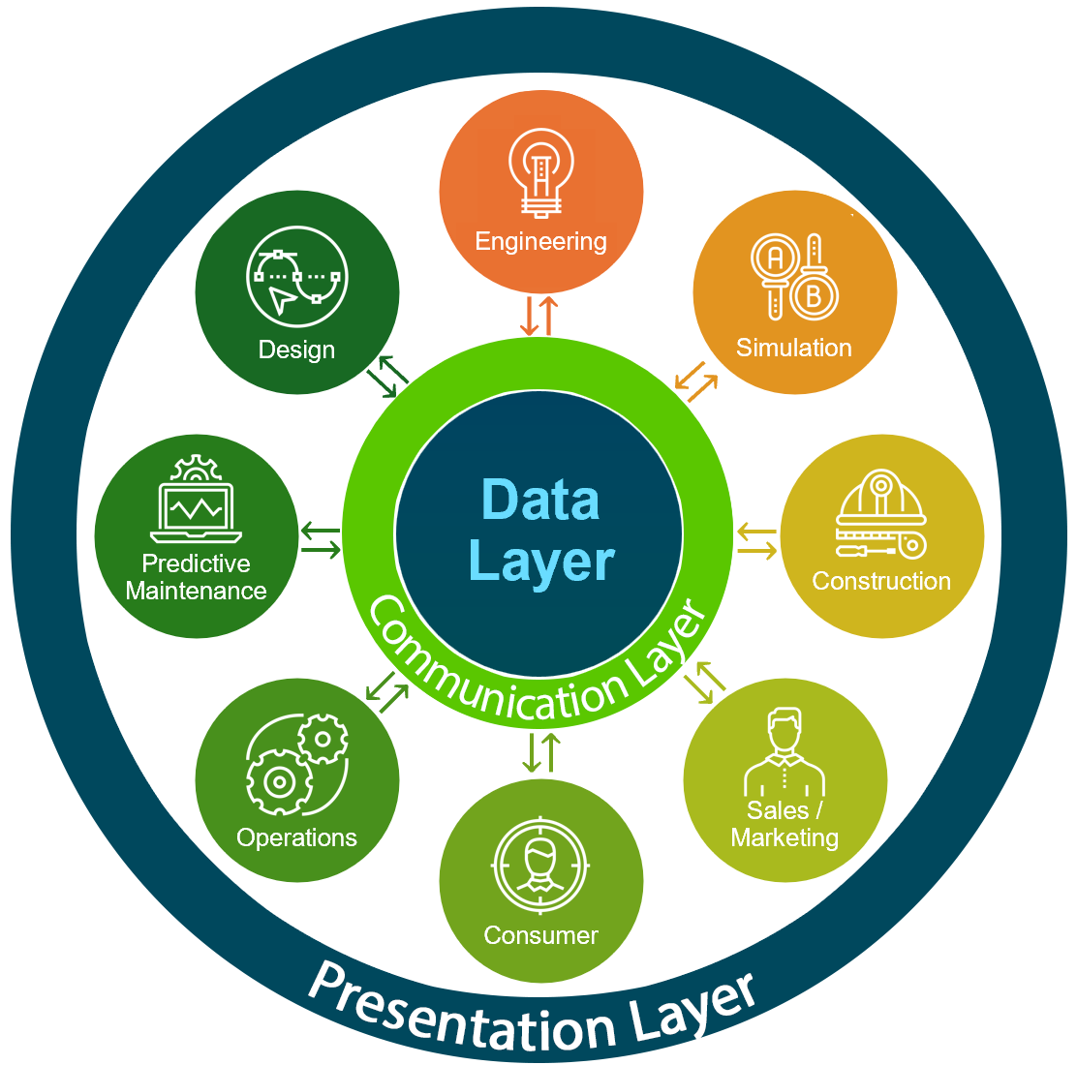
Binary Source of Truth
Systems Engineering Perspective
The Digital Twin
A virtual representation of physical objects, processes, or systems that allows us to simulate, predict, and optimize their real-world performance.
4
Notes:
- I won't bore you with yet another definition of a digital twin. You've probably been to numerous papers, tutorials, panels talking about it, exploring use cases, and describing how to build one.
- But why is still kind of an elusive concept? Since my first draft of this paper, I've talked to a lot of true experts in the field, and as much as I thought I already knew about digital twins going into 2024, I've learned that much more since drafting the initial abstract.
- Talking with people this week I'm hearing many of the same challenges as before, that the concept of a digital twin is still a hard thing for people to wrap their heads around. And I've come to understand two truths as to why.
- On the one hand, there are so many different applications, use cases, and solutions, that it seems like this very protean thing that is very hard to describe in a single sentence. It's not like a car where you can easily describe as a vehicle to move people around, with simple variations like a truck or bus.
- On the other hand, it also seems like a lot of technology to solve a problem that has already been solved in a bunch of other ways. I'll admit,there was a time about 15 years ago when I thought IoT was a rediculously superficial technology. Today I understand it as a critical component to making digital twins work. But the reason I was pessimistic back then was because I had gone to Home Depot, and on the clearance rack I saw an IoT egg tray. This was an egg tray you were supposed to plug into a USB port on your smart refrigerator. So if you were at the grocery store and didn't know how many eggs you had, you could look it up on your phone. In my opinion, it was a COMPLETELY pointless use of technology.

Slide 5
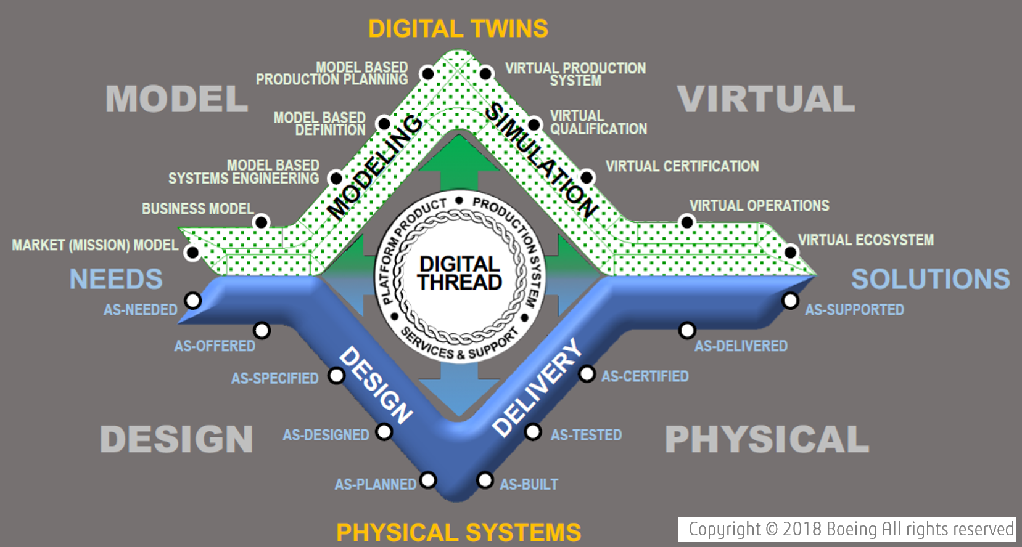
Binary Source of Truth
Introduction
Notes:
- Everyone here has reached an understanding of the value of digital twins, and at this point I think what each of us is doing is working to build a solid paradigm that we can use to grow our own understanding, as well as to promote it with other people in our organizations.
- To achieve this for myself, I decided to focus on DTs through a System Engineering Lens.
THE CORE VALUE OF DIGITAL TWINS
Data is the Foundation

Slide 6
Binary Source of Truth
Systems Engineering Perspective
Requirements
As Requirements are refined…
Requirements are better understood
Design Options
Design Options are constrained.
As product design continues ...
Leveraging iterative design techniques
Adapt to emerging behaviors
Evolves the system design
Refines system requirements to ever-increasing levels of fidelity.
Notes:
- Bassic concept In systems engineering, as requirements become more defined, Design options are constrained. And as the product design evolves, the requriements become better understood.

Slide 7
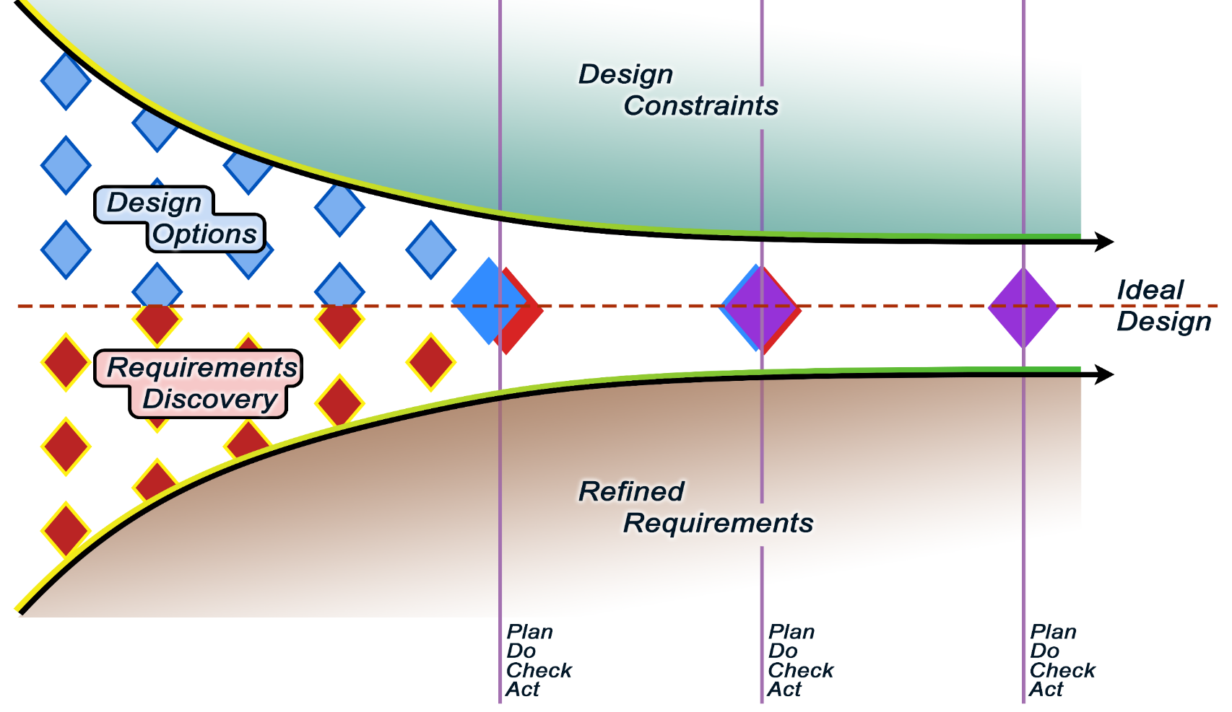
Binary Source of Truth
Systems Engineering Perspective
Notes:
Both the design as well as understanding of requirements continue to be refined to ever increasing levels of fidelity.
This evolves into a convergence towards the ideal design to satisfy the system needs.

Slide 8
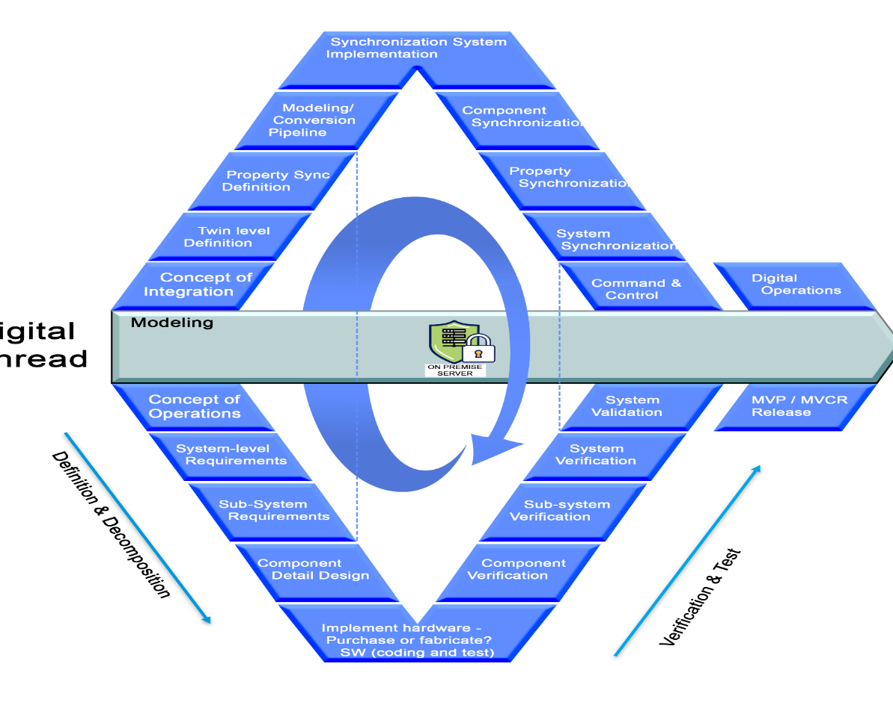
Binary Source of Truth
Using DTs to Enable Agile SE
Digital Twin
Physical Asset
Notes:
- This creates a critically valuable concept we call the "Single Source of Truth".The idea of a single source of truth is that we define one single place where the correct information can be found, whether that's an engineering requirement, a calculated value, a measurement, or whatever. Everything else in the system refers to that source.
- For example by introducing CAD standards, we can refer to a single CAD model for dimension and material conditions.
- We extend that in architecture, where different models for the architectural design, structural engineering, MEP, etc. are combined into a more comprehensive picture called BIM.
- But what happens when the physical building is constructed? Sometimes you have to make field edits. Sometimes design choices don't make sense and project managers decide to omit a design feature rather than wasted time and money constructing something unnecessary. It happens all the time.
- At that point, the architectural models, design drawings, and even the requirements are no longer the representation of ground truth. The physical asset itself is. If you want to be sure of a measurement, or the status of a particular component on your system, you have to go out to the physical asset and measure it yourself. Sometimes, this is difficult, such as on ship at sea. And sometimes it's impossible, such as a fluid pump in a nuclear power generator.

Slide 9
Binary Source of Truth
Systems Engineering Perspective
The cadence of status updates from the physical asset defines the validity of your documented "ground truth".
Notes:
- There are many approaches to capturing and documenting those variations. But even if we capture the state of the new construction and add that back to the documentation after its built, the physical asset will continue to evolve, as it ages, as it wears in, and as it gets repaired and updated. And so will the operations. The cadence of that effort to capture the status of the physical asset defines the validity of your documented "ground truth". And that's where the digital twin comes in.

Slide 10
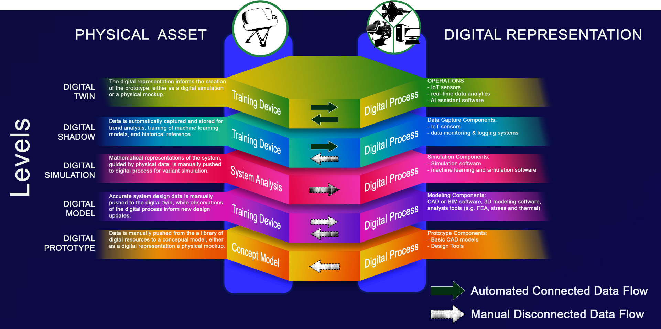
Binary Source of Truth
Digital Transformation
Digital Twin Technology in Military Training Simulators
Source: Modified from Applications of Digital Twins; Johnson et al. (2024)
Notes:
- When you have a fully syncronized digital twin, you have two ways to look at the system's ground truth-- the physical asset, and the digital twin which is informed by the physical asset's current state. This dual-view is your Binary Source of truth. It isn’t about having two different sources of truth, but rather leveraging digital twins to give you more than one perspective of the same ground truth.
- The concept of digital twins is perceived in so many different ways, with a tremendous variety of configurations and uses cases. It can be very confusing, and even overwhelming. And that’s where it becomes extremely valuable to look at a framework like this to characterize the level of interactivity between the physical asset and the digital representation. This graphic was derived from Dr. Suzette Johnson's paper on Applications for Digital Twins last Spring. Here you see how the interface between the digital and physical twins are categorized based on whether the data moves manually, as in the white arrows, or automatically at a rapid cadence, as in the black arrows.

Slide 11
Binary Source of Truth
Digital Transformation
DIGITAL PROTOTYPE
Data is pushed from digital resources to a conceptual model.
DIGITAL MODEL
Design data is pushed to the digital twin, while observations inform updates.
DIGITAL SIMULATION
Mathematical models are manually pushed to the digital process.
DIGITAL SHADOW
Data is pulled from the system for trend analysis, ML training, and reference.
DIGITAL TWIN
The digital representation pulls information from the prototype, and the prototype responds to commands from the digital rep.
Notes:
- We’ll come back to that graphic. But first lets look at some of these terms more closely from Dr. Suzette Johnson and team.
- These terms are categories in digital transformation that can help us delineate between the different digital representations of our engineering data.
- For example-In it's simplest form we can see where CAD fits in the ecosystem of digital engineering. Many people still think about CAD and BIM as digital twins. But since the information is carried manually from the CAD model to fabrication, it's better represented as a digital model. And that's still extremely useful.
- This week you've heard presenters like Louis Kim talking about collecting data from soldiers in the field to analyze human fatigue. This is very similar to using machine learning to analyze component parts for predictive maintenance, and both of these examples fall under Digial Shadows.

Slide 12
Binary Source of Truth
Digital Transformation
Digital Twin Technology in Military Training Simulators
Source: Modified from Applications of Digital Twins; Johnson et al. (2024)
Notes:
Looking back at the graphic more closely.
DIGITAL PROTOTYPE - Data is manually pushed from various digital resources, like sketch work and digital mockups.
DIGITAL MODEL - Design data is manually carried from the CAD to the fabrication, while observations inform updates to the design.
DIGITAL SIMULATION – Such as Finite element analysis, thermal analysis, or stress analysis is used to manually update both the physical design and the CAD model.
DIGITAL SHADOW - Data is automatically collected from the physical asset for trend analysis.
DIGITAL TWIN – The data connection automatically updates in both direcitons.

Slide 13
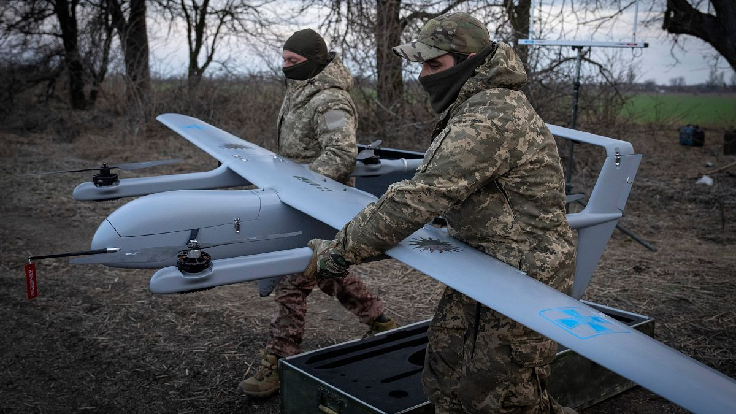
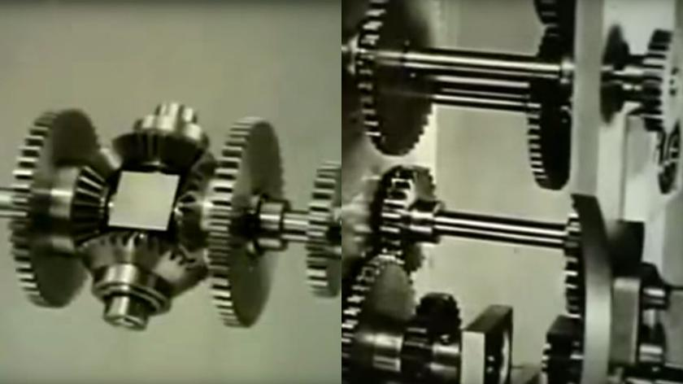
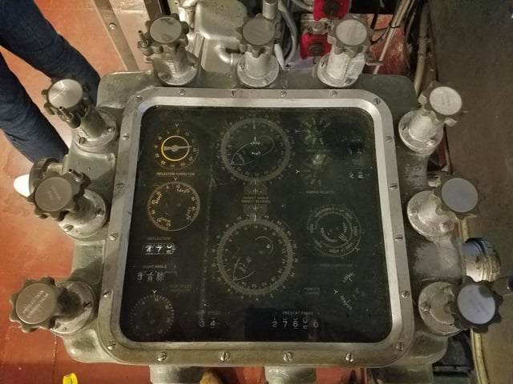
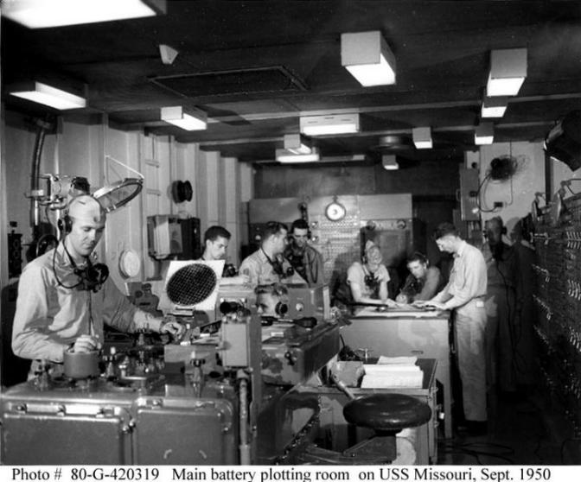
Binary Source of Truth
Using DTs to Enable Agile SE
Notes:
And this is where digital twins can be used to leverage Agile concepts in projects that traditionally strictly waterfall, such as an architectural project.
Rather than introducing digital twins after a system is constructed, such as a monitoring system during operation, there is tremendous opportunity when we integrate digital twin strategies during the initial design process. By introducing sensor devices, scanning technology, we can capture knowledge in real-time during construction. We can then use our understanding of what is being constructed to inform changes to the design. It can seem a little unnerving to suggest that we modify engineering drawings of a building half way through construction, but that is the essence of JIT engineering. And it allows us to effectively adapt the building’s design to mitigate threats due to variations, as well as leverage opportunities that come along after breaking ground.
And this isn’t just for architectural projects, but for training simulators, aerospace, weapons systems, and really anything else.
- Many people still argue that such an approach is unrealistic.
- But our technological marvels are not based on how realistic the technology is but how realistic our use of it.
- Let's think back 10 years ago, how realistic would it have been to say that we could generate a photorealistic Coke commercial with just a few text prompts?
- 20 years ago, how realistic would it have been to say that a country like the Ukraine could effectively fend off Russian ground assaults using unmanned aircraft?
- We can even view those technological marvels in reverse. Consider from the perspective of younger generations today who've spent most, if not all, of their lives in the digital age, seeing a mechanical computer for the first time. Imagine how hard it might be to comprehend using a hand-operated device, with nothing but gears, dials, and levers, to perform complex math, such as calculus and differential equitions. And yet this is what sailors did on board US Navy vessels during WW2 to calculate firing solutions.
- For younger generations whose entire lives have been immersed in digital computing, it seems unrealistic to

Slide 14
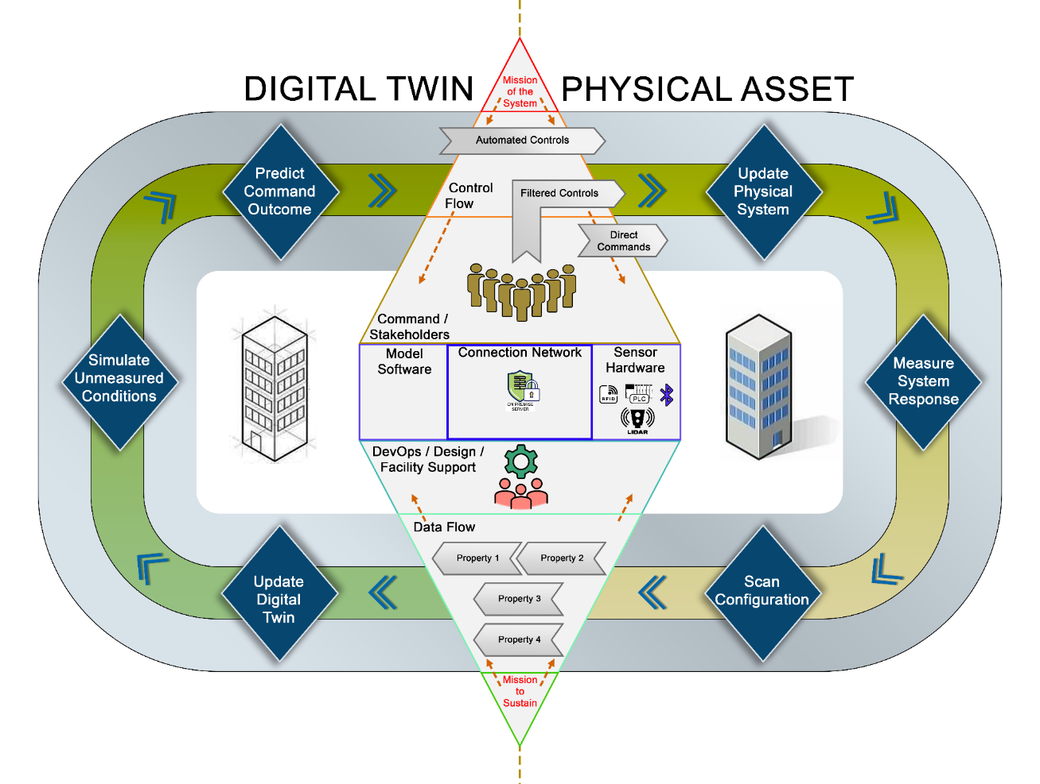
Binary Source of Truth
Future Directions
Notes:
- So what does all of that really mean? It means digital twins, and digital transformation in general, is not about building a bespoke device. It isn't a finish line, or a destination. Digital Transformation is about setting a course, choosing a heading and operating at a speed that will keep us moving toward our goals, while giving us the flexibility to adjust our course as needed to adapt changing environments.
- It seems overly flexible, but that’s ok, because it means we can go in any direction we need.
- The critical component to any level of digital transformation is that all-important Data layer.
- IN this representation of data flow in a digital twin, you can see where HWIL and HITL are both significantly positioned at the data layer, and that applies to both the command side of things which is focused on the Missions of the System, as well as the DevOps side, which focuses on the Mission to Sustain the system. The data layer is simultaneously the most critical component and the source of value.

Slide 15
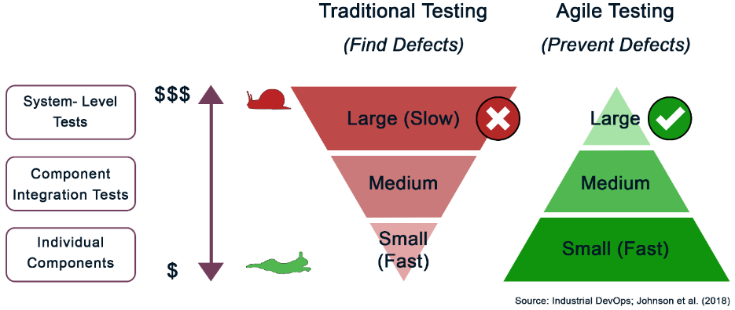
Binary Source of Truth
Advantages of Digital Twins
Integration Across Lifecycle
Conceptualization to decommissioning
Empowering Communication
Breaking down department silos
Leveraging Machine Learning
Predictive analytics and optimization
Enabling Agile Practices
Rapid adaptation to emerging requirements
Facilitating Transformative Technology
Real-time monitoring and risk reduction
Source: Industrial DevOps; Johnson et al. (2018)
Notes:
This suggests the importance of standardization. One nice thing about standards is that there are so many to choose from. But that’s ok. Because that variety of standards gives us flexibility to precisely solve whatever problem there might be. We just need standards so that different data systems can communicate. This is where we flip that challenge of digital twins on its head. It is no longer a challenge, but an opportunity.
And that also speaks to tremendous value of modularity. Digital twins are built up from a data layer, a presentation layer, a data collection layer, and a communications layer. Designing your digital twin using a modular architecture will allow you to expand its functionality WHEN YOU NEED it, improve it by swapping out newer or better technology down the road, and even scale it down to make it more efficient.

Slide 16
Binary Source of Truth
Digital Twin Technology
DIGITAL TWINS IN LVC TRAINING
 | Live | Virtual | Constructive
DIGITAL TWIN IN LVC TRAINING | Physical assets and real-world data | Human-in-the-loop interfaces bridging live and digital | Digital simulations and behavior models
LVC AS A DIGITAL TWIN | Synchronization between components | Generating and combining live and virtual data | Physical environment informing the digital twin
Notes:
Remember when we said it’s hard to wrap our heads around a simplified mental paradigm of what a digital twin is? Well, by embracing a larger Digital Transformation framework, we can view Digital Twins as part of a larger toolset to build a specific solution that precisely solves a problem at the lowest cost possible.

Slide 17
Binary Source of Truth
Sources
Johnson, S., & Yemen, R. (2024). The Application of Industrial DevOps Using Digital Twins- A Deep Dive Into Building Better Systems Faster. Enterprise Technology Leadership Journal, 1(1).
Johnson, S., Yemen, R., & et. al. (2018). Industrial DevOps. IT Revolution DevOps Enterprise Forum.
Madni, A. M., Madni, C. C., & Lucero, S. D. (2019). Leveraging Digital Twin Technology in model-based systems engineering. Systems, 7(1), 7. https://doi.org/10.3390/systems7010007
N., W. P., Thomas, L., Adrian, L., & Jim, M. (2024). A framework for assessing the costs and benefits of Digital Engineering: A systems approach. RAND National Security Research Division Report. https://doi.org/10.7249/rra2418-1
Pantano, M., & Galiber, F. (2019). Applying an Agile Approach with MBSE. 2019 Agile in Government Summit.

