Slide 1
Preparing for Large Scale Combat Operations (LSCO): Modeling and Simulation Approaches to Rapidly Improve Medical Training
Matthew Hackett, PhD.
DEVCOM Soldier Center

Slide 2
Presentation Outline
Background
Increased Casualty Volumes in Future LSCO
Challenges in Medical Evacuation and Care
Evolution of Medical Training
Approaches to Improve Medical Training
Potential Paths Forward
Conclusion

Slide 3
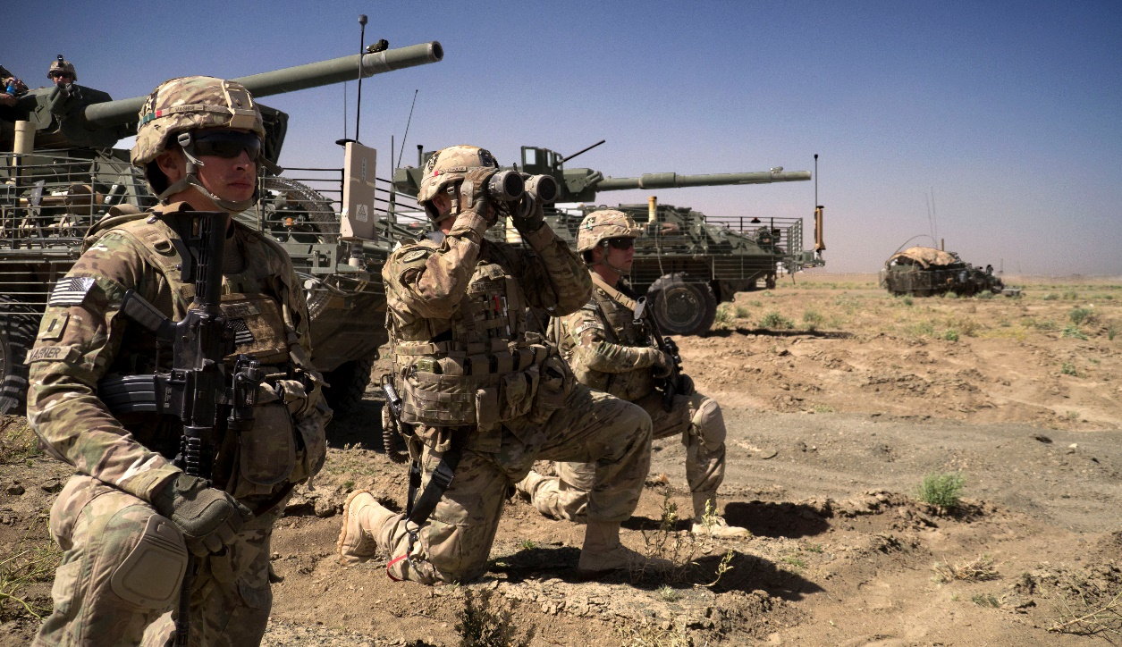
The Next U.S. War
In terms of casualties per day, the next war the United States is expected to fight will more closely resemble WWII than OEF/OIF/Desert Storm
GWOT: Dead/wounded no more than 30 in any one day
WWII: Up to 1000 dead/wounded per day for extended time
Ukrainian-Russo war
More contemporary example
Up to 870 casualties per day
Peer/peer conflict
Chinese “annexation” of Taiwan
Analysis predicts ~140 per day
Multi-week campaign

Slide 4
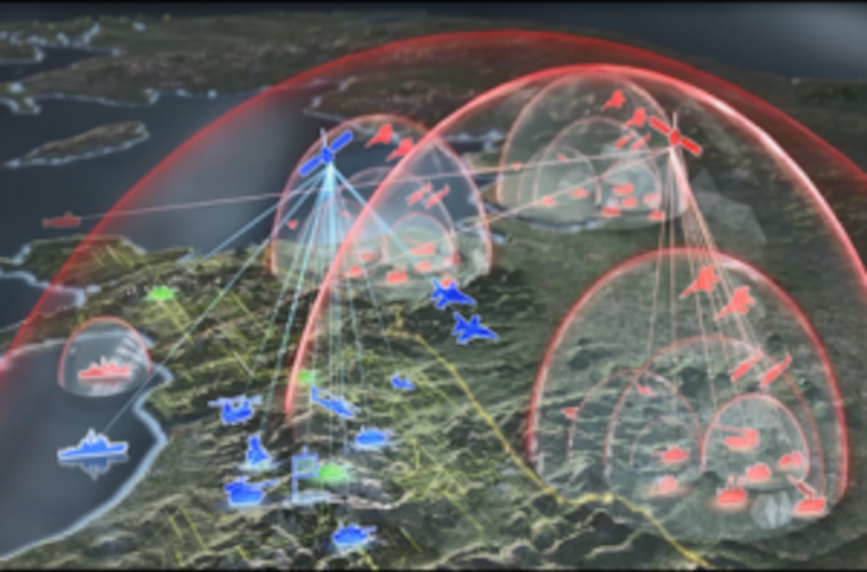
Medical Evacuation Challenges
Peer/Near-Peer Conflict will cause problems beyond number of casualties
Anti-Access/Area Denial (A2/AD)
Prevent opponent’s ability to enter an area (A2)
Limit opponent’s freedom of movement with an area (AD)
Will limit ability to MEDEVAC timely
Will erode the “Golden Hour”
Prolonged Casualty Care (PCC) as units must tend to wounded for much longer time periods
PCC = Increase in usage of Class 8 supplies

Slide 5
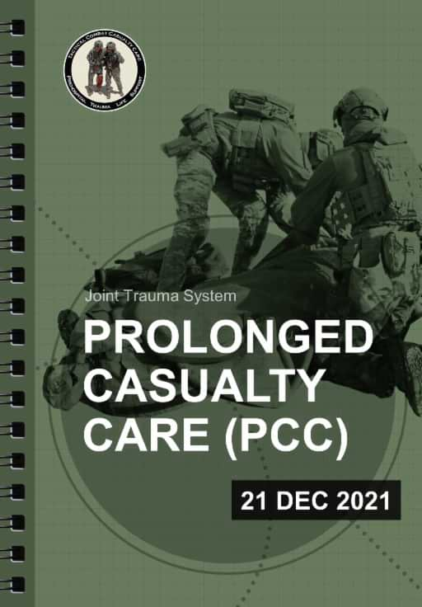

Prolonged Care
Military patient simulators designed to cover spectrum of Tactical Combat Casualty Care (TCCC)
Care Under Fire
Tactical Field Care
Tactical Evacuation Care
Like TCCC, Prolonged Casualty Care came from Special Operations medicine
Prolonged Field Care
Can take place across the care spectrum
A2/AD doesn’t stop in the battlefield

Slide 6
Mass Casualties
Increased casualties means Mass Casualty training must become more realistic
Units will be overwhelmed with casualties
Triage will become controlled (or not) chaos
Advanced patient simulators are too expensive for expected MASCAL exercise
Combine high-end manikins, low-end manikins, and live role players
Incorporate advanced technologies during exercises (e.g., Global Medic; Joint Emergency Medicine Exercise)

Slide 7
Evolution of Medical Training: Rethinking Patient Simulators
PCC impact to training
How long is training? One day? One week?
PCC can see units holding a casualty for 4 hours…8 hours…24 hours…72 hours…
Unrealistic to expect most training evolutions to last that long
Better use of time is to teach a little, practice a little, ad infinitum
Easier said than done
Physiology engines are designed for real time
True PCC training must present initial injury, allow for initial treatment, then move forward
Assess, treat, speed time up, go back to real time, assess, treat, speed up…
Just like in real world, Class 8 (including blood/plasma) in training is not unlimited

Slide 8

Improving Medical Training
Upskilling current population of Combat Life Savers and Combat Medics
Make combat medics Army Combat Paramedics
Integrate civilian & military training
Bring local Reserve Component medical units in on civilian MASCAL exercises
Utilize approaches seen during COVID19 pandemic response to combine military and civilian healthcare capabilities into a cohesive casualty response system

Slide 9
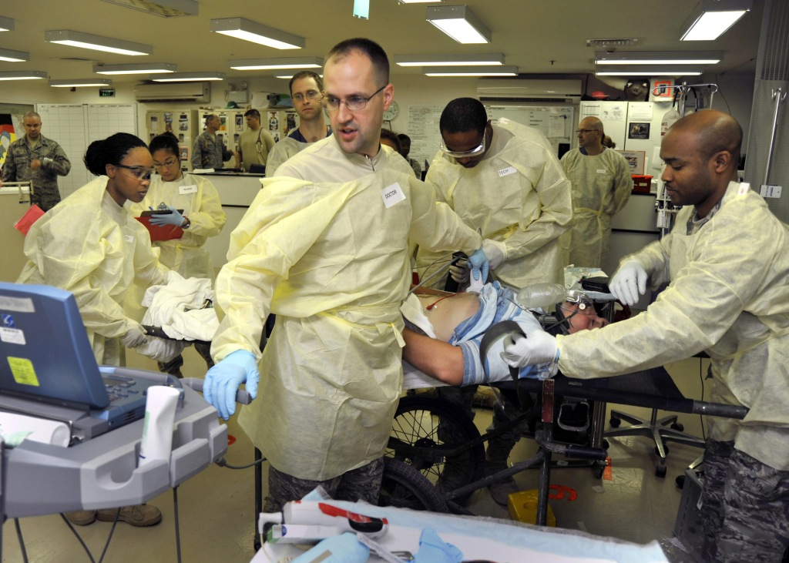
Utilizing Surrogate Medical Devices for Training
Surrogate devices enable providers to practice with realistic facsimiles of medical equipment, without the cost or risk to participants and trainees associated with real medical equipment
Gives benefits of in-situ simulation without the expenses and complexity!
How do we scale in-situ simulations to massive casualty scenarios?

Slide 10
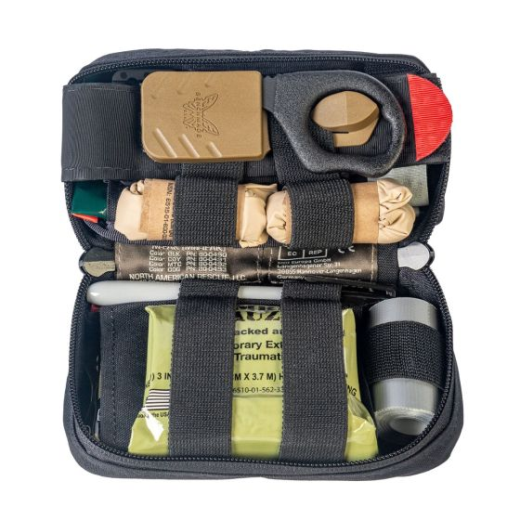
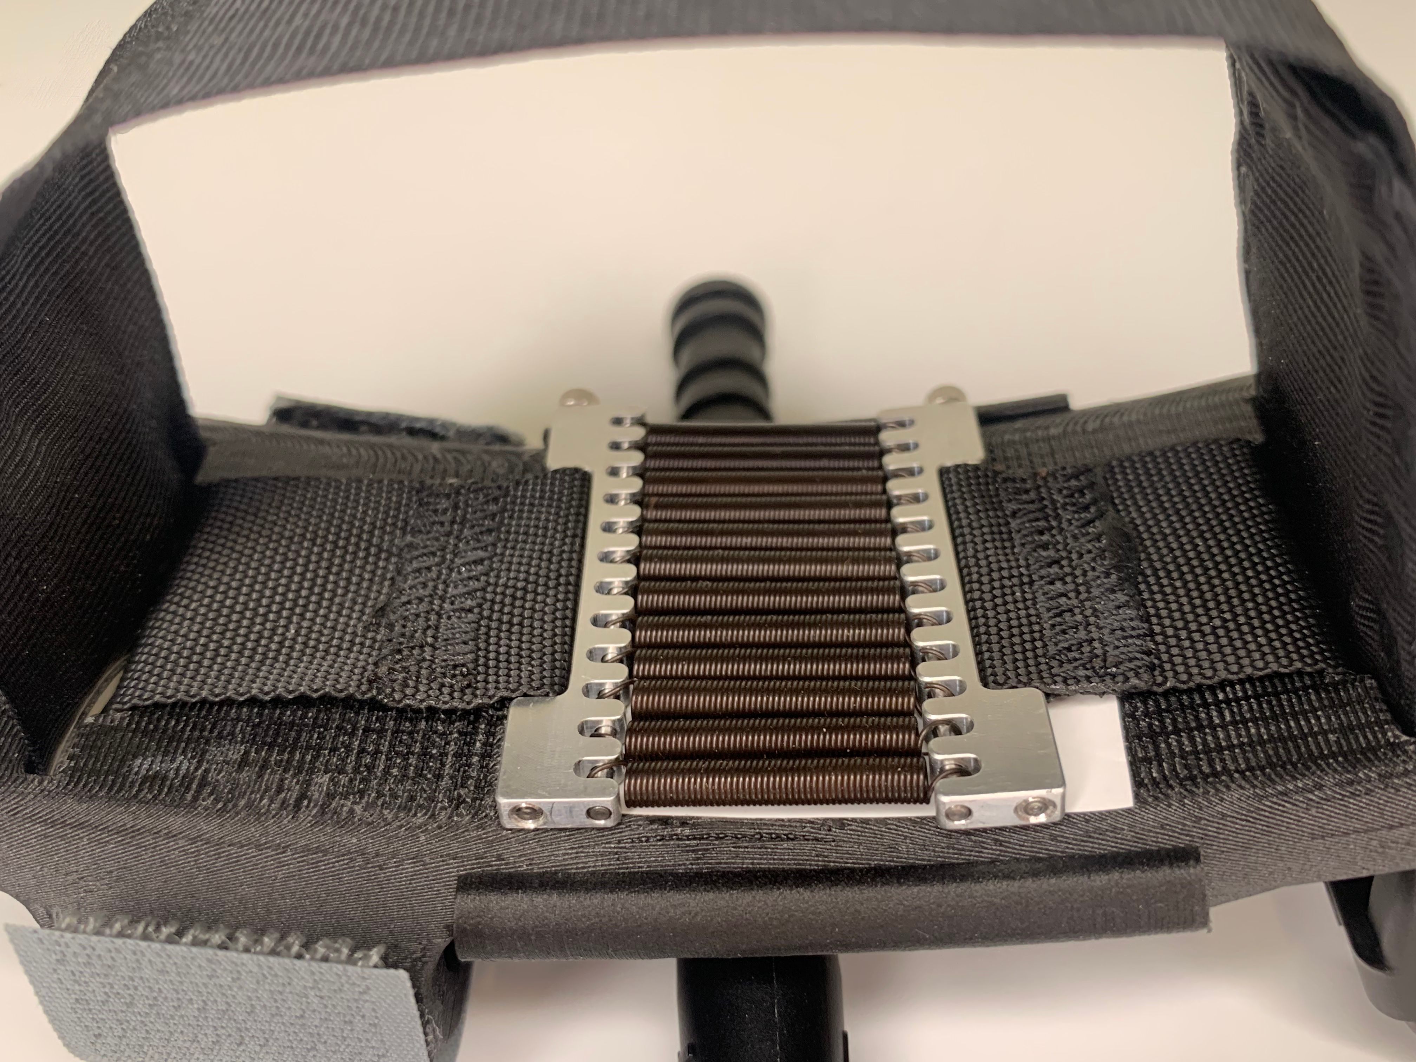
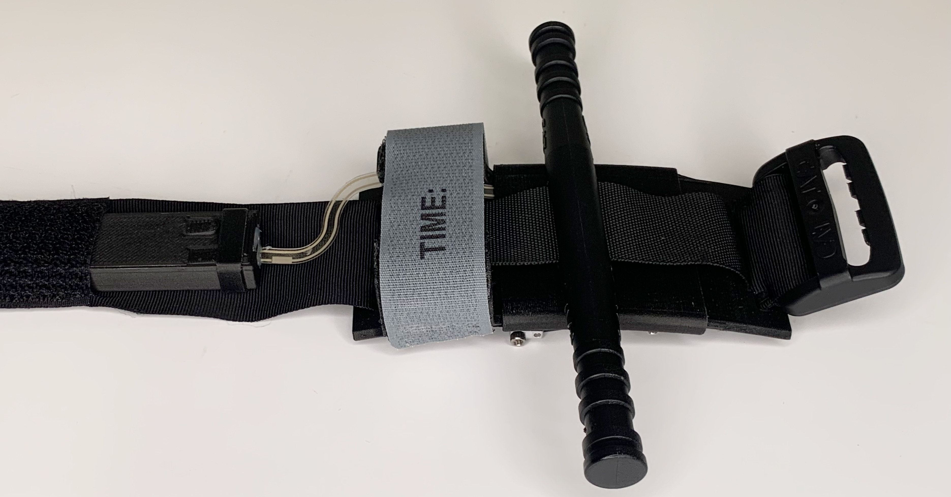
Simulation Approach: Utilizing Surrogate Medical Devices for Training
Surrogates devices will be modified medical equipment or realistic facsimiles, instrumented to provide performance data
Initial surrogates will focus on a surrogate IFAK kit
Current capabilities
Surrogate Tourniquet
Israeli Bandage (in development)
Needle (in development)

Slide 11
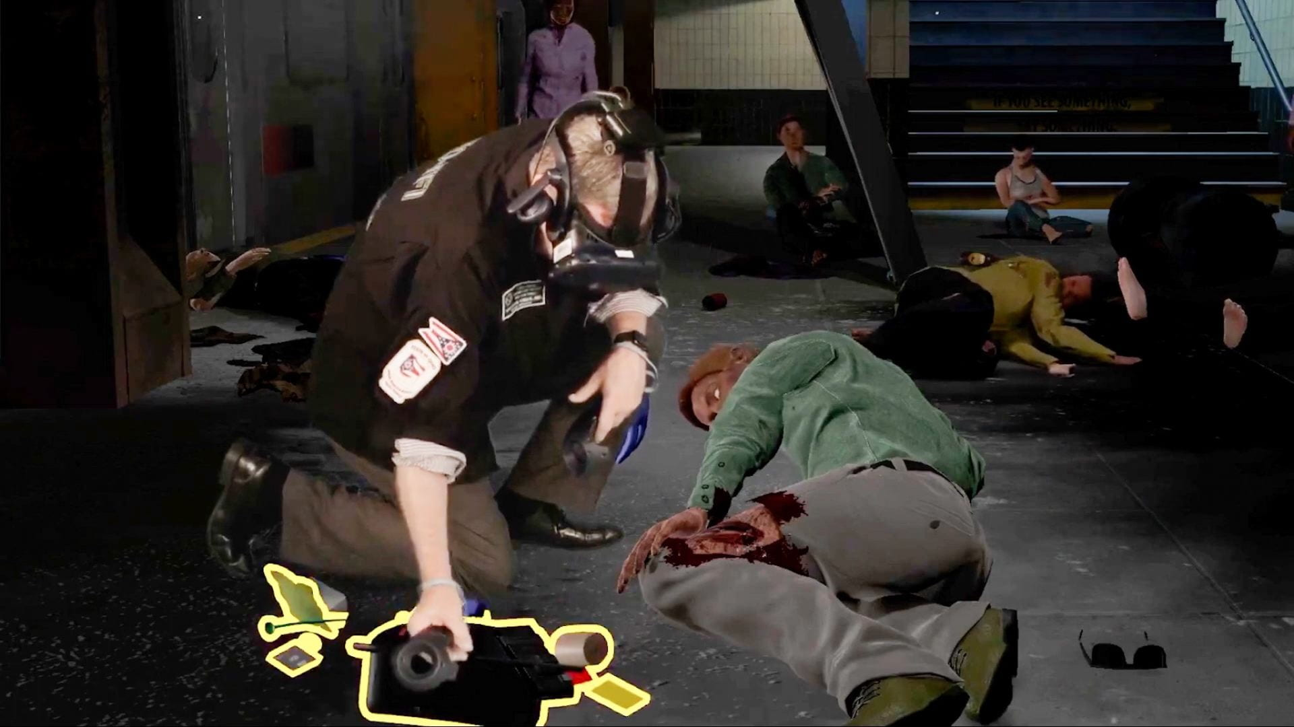
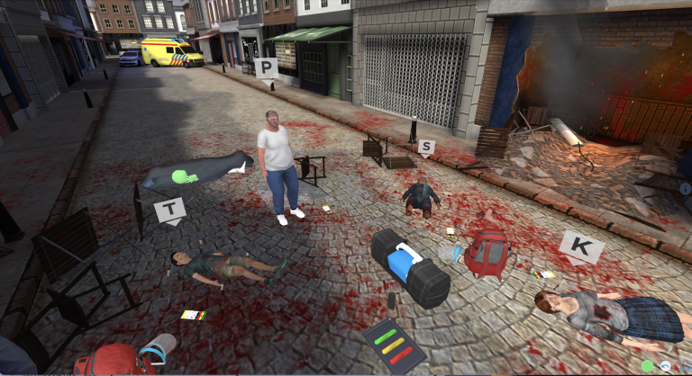
Technology Approach: Leveraging New Technologies
Virtual and Mixed Reality can provide environments and the volume of casualties that are difficult to replicate in real world simulation environments
Triage decisions
Patient handoffs
Multi-casualty management and team communication
Ohio State University Triage Simulation
SimX MASCAL Scenario

Slide 12
Creative Approach: Integrating Existing Technologies
Combining existing manikins, task trainers, patient actors, and serious games can yield impressive results for multi-casualty scenarios (Change & Murphy, 2007)
Challenges include:
Significant effort required to organize and execute
Lack of interoperability for simulations
Requires extensive expertise to design scenario and operate a variety of simulation technologies
Some companies offer this on a limited scale, but providing this capability to the larger force is an issue

Slide 13
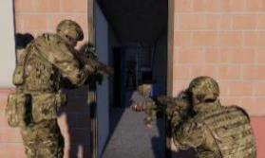
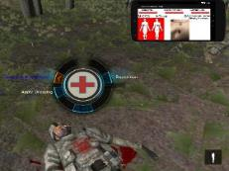
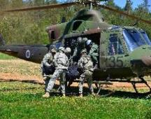
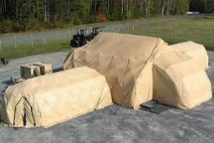
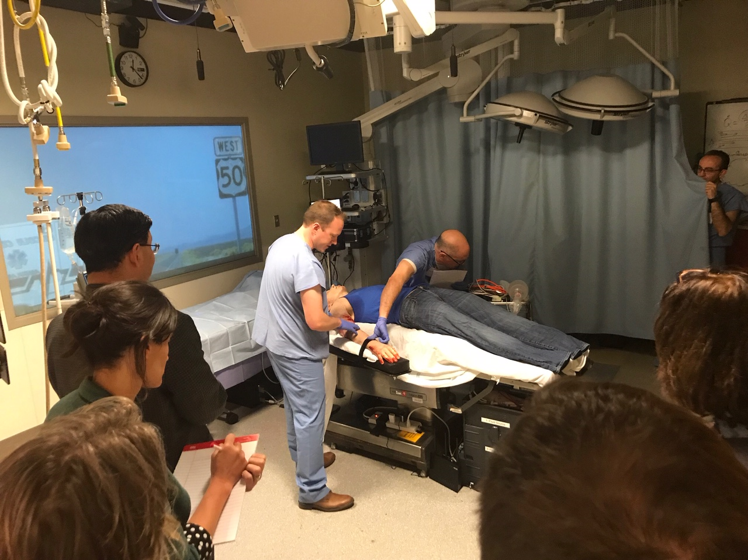
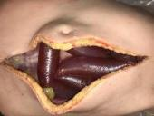
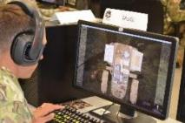
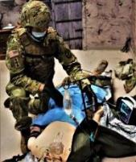
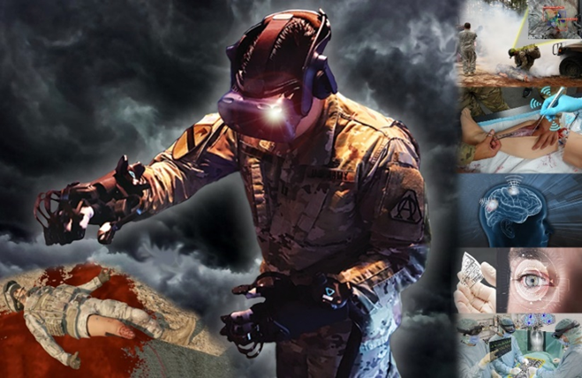
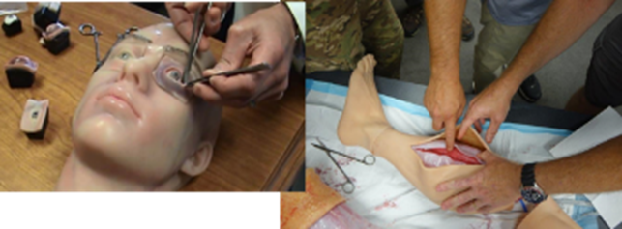
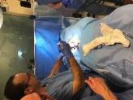
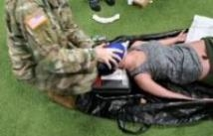
Federated Models with Data Pass-Through
POI
CCP
Evac
FST
Time, Location
Combat State
RTI (COLLECTIVE TRAINING)
Interoperability Architecture
Time, Condition, Physiology, Treatment
MED-FOM Injury/Treatment/Condition (Time +/-)
Operational
Medicine
Human Performance Models
Big Data
AAR
CUF
TFC
CCC/PCC
Surgery
DATA

Slide 14
Potential Paths Forward: Artificial Intelligence and Machine Learning
DARPA Triage Challenge
Creating autonomous triage capabilities to unburden providers and improve patient outcomes
AI-driven Decision Support
Gives providers additional guidance regarding current patient status, health trajectory, treatment decisions, pharmacological dosing, and more
Human agent teaming
Utilizing robotic assistants to render autonomous or semi-autonomous care for patients, potentially in areas that are denied for human activities
How do these integrate with simulation and training?

Slide 15
Conclusion
LSCO operations with increasingly complex engagements will fundamentally change the landscape for military medicine
A2/AD will degrade the ability to rapidly evacuate patients to definitive care
Significant issues include
Longer patient hold times
Contested logistics
Massive casualty loads
How do we utilize simulation and training to create a ready medical force?

Slide 16
Path Forward
Utilize existing technologies to create a blended solution capable of simulating the complexities of LSCO environments
Research and develop emerging technologies to provide trainees with understanding of the constraints and challenges with future operating environments
VR / AR
Surrogate equipment
Leverage AI / ML / autonomous systems to support the care provider
Conduct human-in-the-loop assessments to determine the impact on workload
Integrate within the training ecosystem

Slide 17
Questions / Comments
Contact: Matthew Hackett, PhD Matthew.g.Hackett.civ@army.mil

