Slide 1
Automated Event-Based Competency Analysis:
Detecting Evidence from Training Data
Cristina Boyer, The Boeing Company
Tess Olson, The Boeing Company
Nolen Yehlik, The Boeing Company

Slide 2


Virtual Competency Based Training
Increased information management responsibilities for pilots highlight need for soft skill competencies
Instructor shortages highlight the need for virtual training environments
Soft Skill Competencies
Virtual Training
Workload Management
Communication
Leadership and Teamwork
Problem Solving and Decision Making
Situation Awareness
+
=
How to begin?

Slide 3
Event Based Approach to Scenario Authoring
Full Scenario
Event-Based Scenario

Slide 4
Event-Based Approach to Competency Assessment
Problem Solving and Decision Making
PSD.02 Seeks accurate and adequate information from appropriate sources
Behavior Detection
Event: Necessary to Divert
Check weather
Check performance calculations
Divert to nearest suitable airport

Slide 5
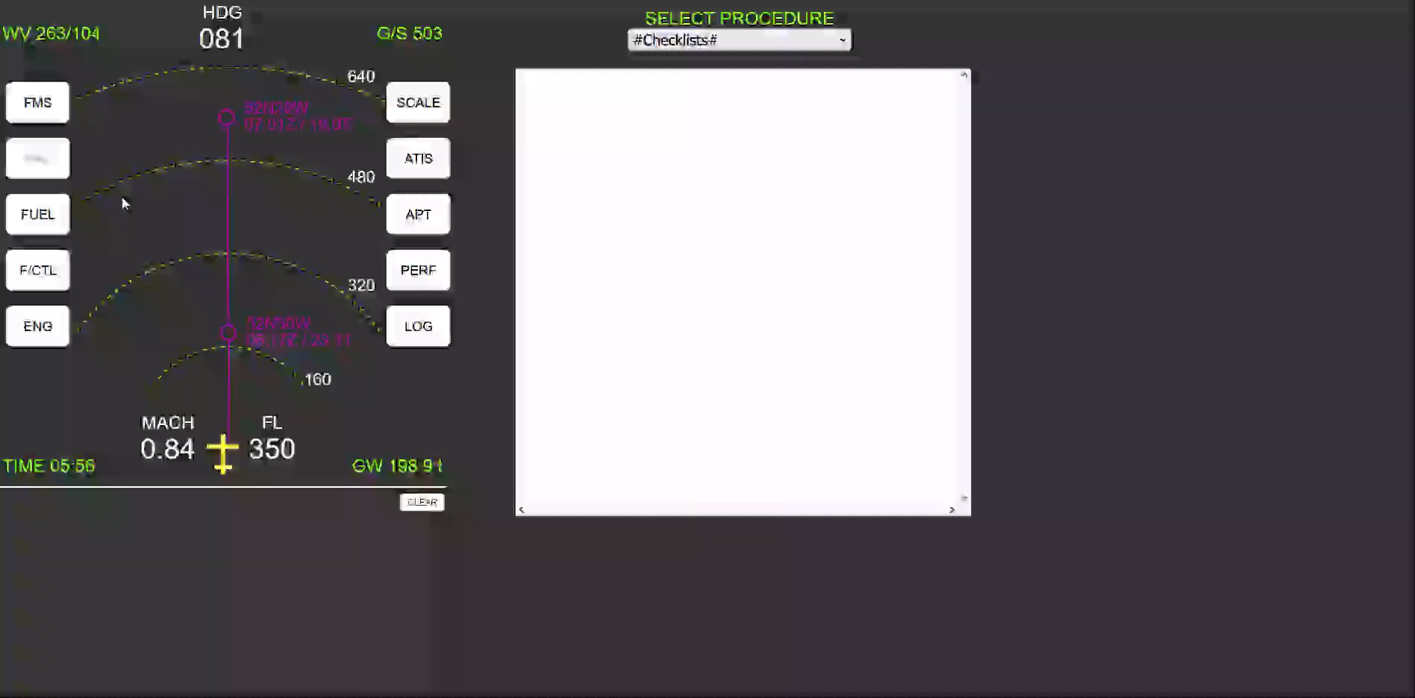
Desktop Simulation Training Environment

Slide 6

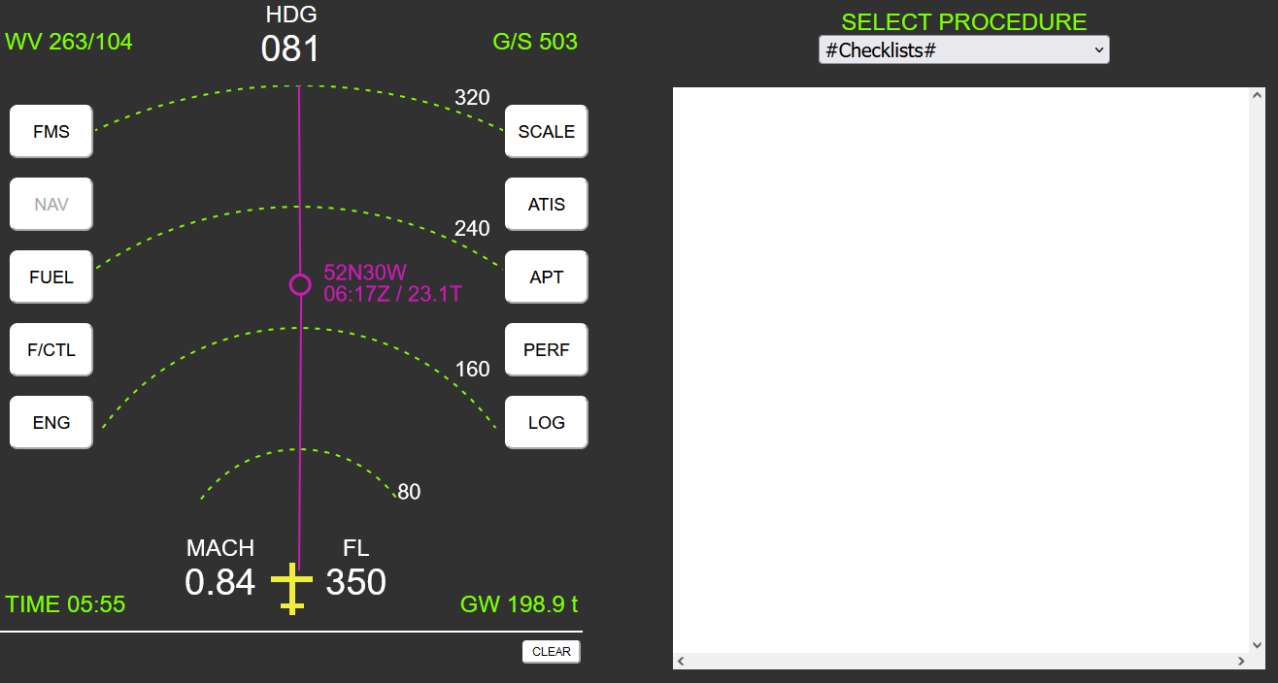

Technology Setup
Student performs training in simulation
Data sent to Behavior Detection
Performance stored in Learning Record Store (xAPI)
Behavior Detection
AssessPerformance()
{
…
}
Learning Record Store

Slide 7
Study Hypothesis / Research Questions
An exploratory study designed to determine whether the data generated can be trusted and accurate.
Hypothesis
  Hypothesis 1: The system can accurately detect simulated events and student pilot actions.
  Hypothesis 2: The system would follow a general consensus of instructor pilot subject matter experts when evaluating the same scenarios.
Research Questions
  How close are measurements of same item across simulations identifying behavior?
  How do categorical judgements compare between instructors before and after seeing the results from the system?

Slide 8

Study Procedure
Study Scope: Compare automatic observations with live instructor SME observations of completed or incomplete observable behaviors.
Study Participants
  Student Participants (n=2): Representative flight students who were former airline pilots and are employed by Boeing
  Instructor Participants (n=8): Current Boeing employed flight instructors subject matter experts (SME) who are actively instructing type rating courses
Study Schedule
  Student Participants: Single time block of 2 hours encompassing a single sim flight
  Instructor Participants: Single or dual session(s) encompassing 2 sim flight scenarios and root cause analysis debrief

Slide 9
Student Procedure
2
3
4
Demographic and Overview
Simulator and Flight Briefing
Start Recording of Session
1
5
Informed Consent
Moderator Started Sim
8
7
6
No Moderator Assistance
Export Data & Recording
Complete Simulation
Begin Data Collection

Slide 10
Instructor Procedure
2
3
4
Demographic and Overview
Simulator and Flight Briefing
List predicted OBs based on Briefing
1
5
Informed Consent
Start Assessment of Sim Session
9
8
7
6
Repeated steps 5-8 for session two
Follow up Root Cause Analysis
Compare Results to Auto. System
Review Participant assessment

Slide 11
Results
PRO 02 – Applies relevant operating instructions, procedures, and techniques in a timely manner.
PRO 05 - Monitors aircraft system status.
PSD 02 - Seeks accurate and adequate information from appropriate sources.
SAW 01 - Monitors and assesses the state of the airplane and its systems.
SAW 06 - Develops effective contingency plans based upon potential risks associated with threats and
errors.
1 | 2 | 3 | 4 | 5 | 6
Strongly Disagree | Mostly Disagree | Somewhat Disagree | Somewhat Agree | Mostly Agree | Strongly Agree

Slide 12
Results
Highest
Rating
= The rating given by an instructor SME for a given OB
*Note: Participants MI01, MI06, and MI08 assessed only one scenario.
Lowest
Rating
MI01
MI02
MI03
MI04
MI05
MI06
MI07
MI08
1 | 2 | 3 | 4 | 5 | 6
Strongly Disagree | Mostly Disagree | Somewhat Disagree | Somewhat Agree | Mostly Agree | Strongly Agree

Slide 13
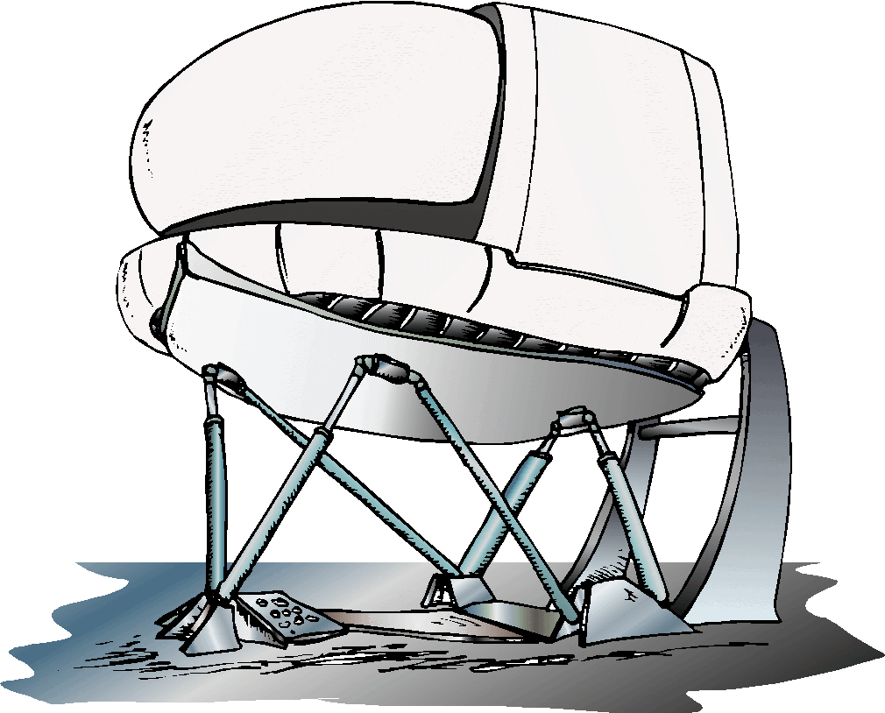
Artifacts / Sim-isms
Negative (detracting) instructor comments were discussed in scenario debriefs
The Root Cause Analysis uncovered four artifacts
  Premature Conclusion of Sim Session
    Sim concludes upon the selection of a diversion airport or a predefined time interval
  Precession Timing
    Sim did not account for the precise timing when opening the crossfeed valve
  Weather Information
    Sim weather information introduced ambiguity for “most suitable” diversion airport
  ETOPS Cleared Airports
    Sim diversion airport locations did not account for the inclusion of ETOPS cleared airports

Slide 14
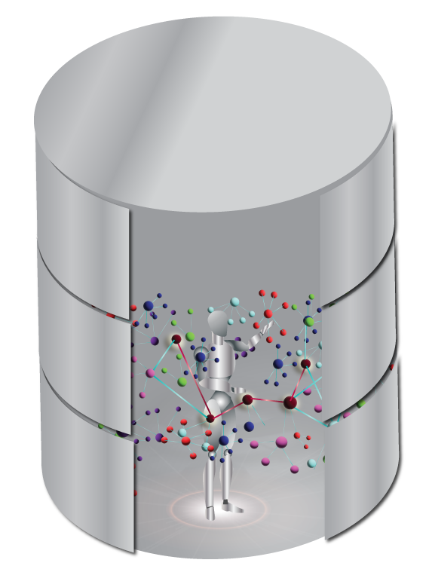
Practical Implications
Framework for simulation event definitions:
  Library of training event elements
  Network of elements mapped to observable behaviors
  Effective and efficient tailoring of automated detection systems
Technology Collaboration
  Link tech developers to instructional designers and training instructors
  Evolve technology to adapt with growing pilot training needs

Slide 15
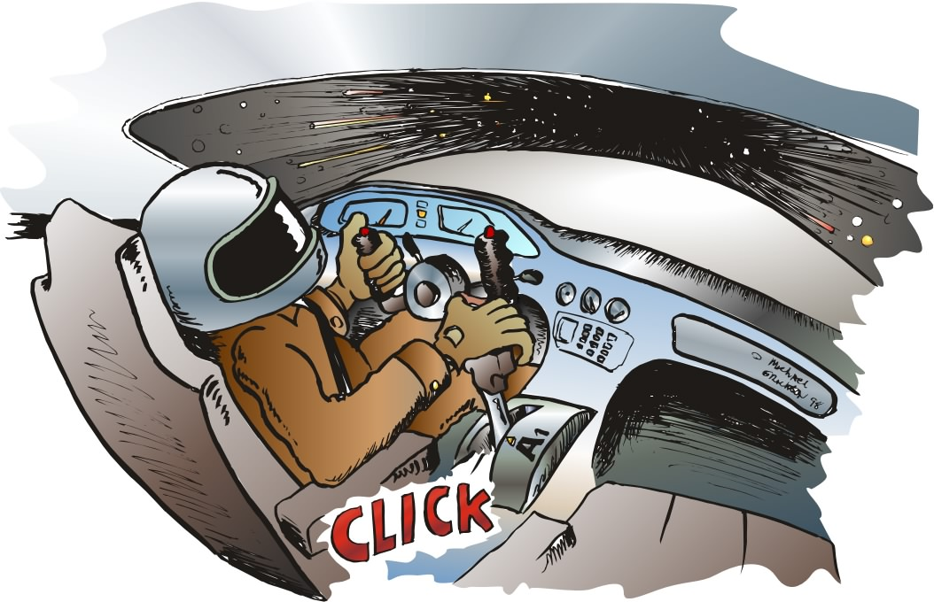
Conclusion
Behavior Detection System
  Potential to maximize instructor reach to students
  Gather objective evidence during scenario-based training
  Track student proficiency throughout career
Future Research
  Testing consistency
  Effect on Inter-Rater Reliability
  Efficiency in assessments

