Slide 1
B-ACE: An Open Lightweight Beyond Visual Range Air Combat Simulation Environment for Multi-Agent Reinforcement Learning
Andre R. Kuroswiski, Aeronautics Institute of Technology (ITA) / Brazil
Annie S. Wu, University of Central Florida (UCF)
Angelo Passaro, Institute for Advanced Studies (IEAv) - Brazil

Slide 2
Summary
Introduction
Background and Related Work
B-ACE Environment
Case Studies

Slide 3
Introduction
OBJECTIVE
Present Beyond Visual Range (BVR) Air Combat Environment (B-ACE), an open-source simulation framework for developing Multi-Agent Reinforcement Learning (MARL) based agents in BVR air combat, balancing accessibility, performance, and realistic tactical decision-making.
Notes:
Objective: Introduce the B-ACE environment and its purpose in air combat simulation and reinforcement learning.
Key Points:
B-ACE is a lightweight simulation framework using the Godot engine.
It is designed for research in Multi-Agent Reinforcement Learning (MARL) in Beyond Visual Range (BVR) air combat.
Highlights the need for open, accessible, and shareable military simulation environments.

Slide 4
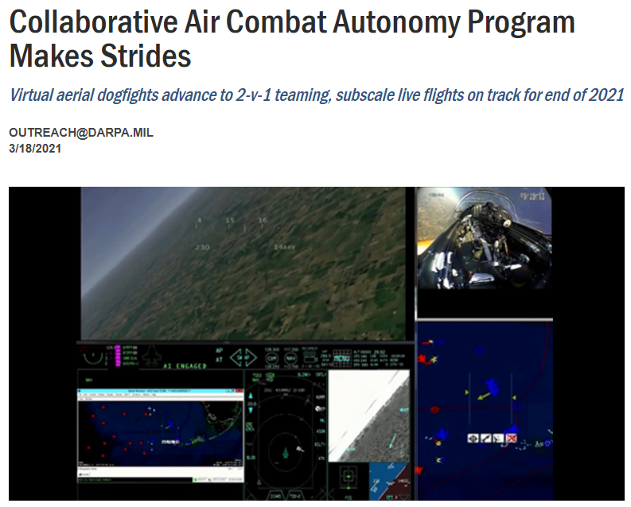
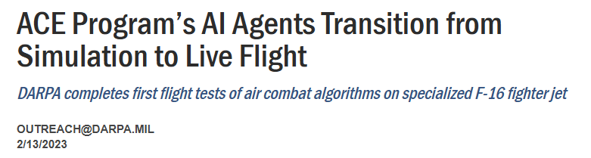
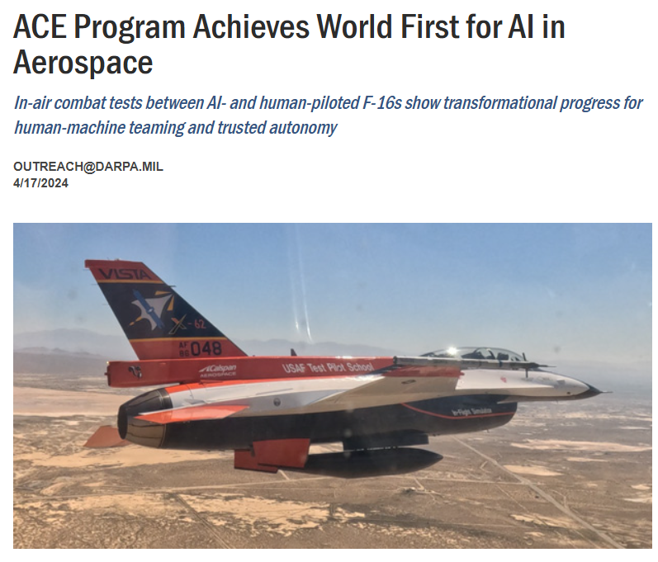
Introduction
Notes:
Highlight the recent advancements in autonomous air combat systems by presenting the evolution of the ACE program. The journey progressed from virtual engagements in 2021 to achieving a significant milestone this year with real-flight tests involving autonomous F-16s, showcasing groundbreaking development in the field.

Slide 5
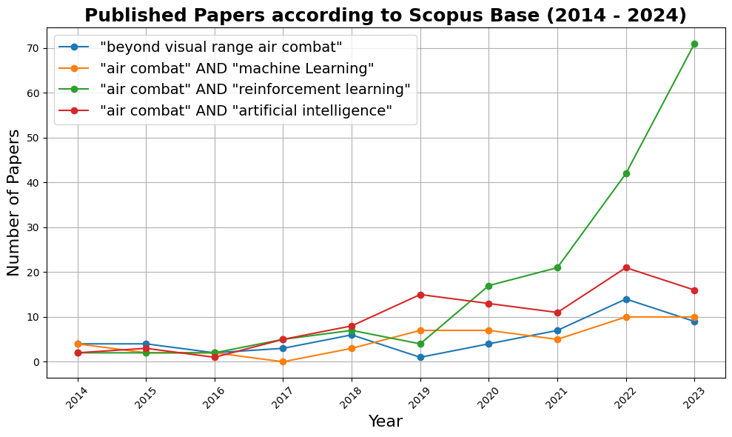
Introduction
Published papers according to Scopus Base (2014-2023)
Notes:
Demonstrate how academic research is both following and leading the growing interest in applying AI to autonomous air combat systems. Highlight the increasing focus on Reinforcement Learning due to its adaptability and effectiveness in developing solutions for dynamic and complex scenarios like air combat autonomy.

Slide 6
Summary
Introduction
Background and Related Work
B-ACE Environment
Case Studies

Slide 7
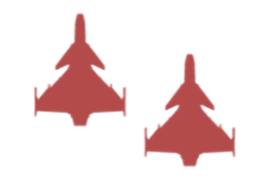
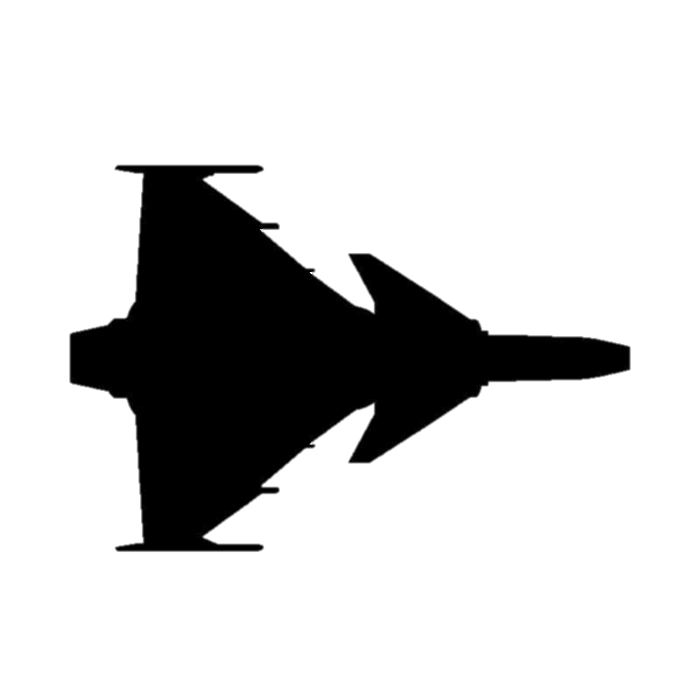
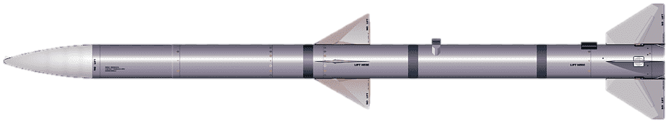
Beyond Visual Range (BVR) Air Combat
20 to 200 km
Challenges for AI Development
Cooperative and Adversarial Scenario
Long-Range Engagement
Incomplete and Uncertain Information
Delayed Feedback and Long Planning Horizon
Adversarial
Cooperation
Long Range Missiles
Radar Detection
Notes:
Basic Concepts of BVR (Beyond Visual Range) Air Combat:
Close Cooperation Among Allies: Effective teamwork is critical, as coordination and shared information between allied forces significantly impact tactical decisions and outcomes.
Long-Range Engagements: BVR combat relies heavily on radar systems for detection and long-range missiles for engagements. Success is often determined before visual contact is made.
Incomplete Information: Pilots and systems must operate with limited data about enemy positions and intentions, relying on sensor inputs that may be incomplete or delayed.
Uncertainty in Combat Situations: Key uncertainties include:
The current state and effectiveness of enemy missiles.
Whether a missile has been launched by the enemy.
Delayed Feedback: Actions, such as launching a missile, do not yield immediate results:
It takes time to determine if a missile hit its target successfully.
Similarly, there can be delays in detecting if the enemy has launched a missile.
Dynamic Enemy Behavior: The behavior of enemy forces can drastically alter tactical approaches, requiring adaptive strategies.

Slide 8

Multi-Agent Reinforcement Learning Approach
LEARNING IS HERE
$$POLICY$$
$${Agent}_{1…n}$$
$${Agent}_{1…n}$$
$${Agent}_{1…n}$$
$${Agent}_{1…n}$$
$${Agent}_{1…n}$$
$${Agent}_{1…i}$$
Aircraft State
Enemy Info
Mission Obj
etc.
Aircraft Maneuvers
System Operation
Weapons Launch
etc.
$$S_{t}^{i}$$
$$R_{t}^{i}$$
$$A_{t}^{i}$$
(State)
(Reward)
(Action)
$$R_{t+1}^{i}$$
$$Environment$$
$$S_{t+1}^{i}$$
AIR COMBAT SIMULATION
Notes:
Explain the basic concepts of the RL/MARL with examples of what that means in the Air Combat scenario

Slide 9
Simulation Environments for BVR Air Combat
Limitations in Literature Solutions
Limited Access to Proprietary Simulators: Many BVR air combat simulators, like NGTS, AFSIM, and TACSI, are restricted to government or defense industry partners.
Scalability Issues for Machine Learning: Real-time training simulators such as NGTS are not optimized for the massive computational demands of machine learning applications.
High Development Effort for Custom Solutions: Open-source frameworks like JSBSim and MIXR require significant development effort.
Lack of Publicly Available Solutions: While there are some promising proprietary and custom simulators, very few environments, like BVRGym, are publicly available.

Slide 10

The Godot Game Engine as a Simulation Framework
ADVANTAGES
LIMITATIONS
Open-source: Full customization and new features
Cost-effective: Free under MIT license
Strong performance: Comparable or even superior to commercial alternatives.
User-friendly: Easy learning and fast prototyping (GDScript, C#, C++)
Smaller community: it is growing, but far behind compared to Unity/Unreal
Fewer plugins, assets, and ready-made solutions: Require more own development
Limited industry adoption and support: Less mature for large-scale, complex projects

Slide 11
Summary
Introduction
Background and Related Work
B-ACE Environment
Case Studies

Slide 12
B-ACE: Models Design
Models Design Concept
Simplicity: Prioritizes higher-level decision-making over detailed aircraft, sensors and other components models.
Generic, but representative data: The environment avoids using restricted military data, enabling open, accessible research while still addressing core BVR combat dynamics.

Slide 13
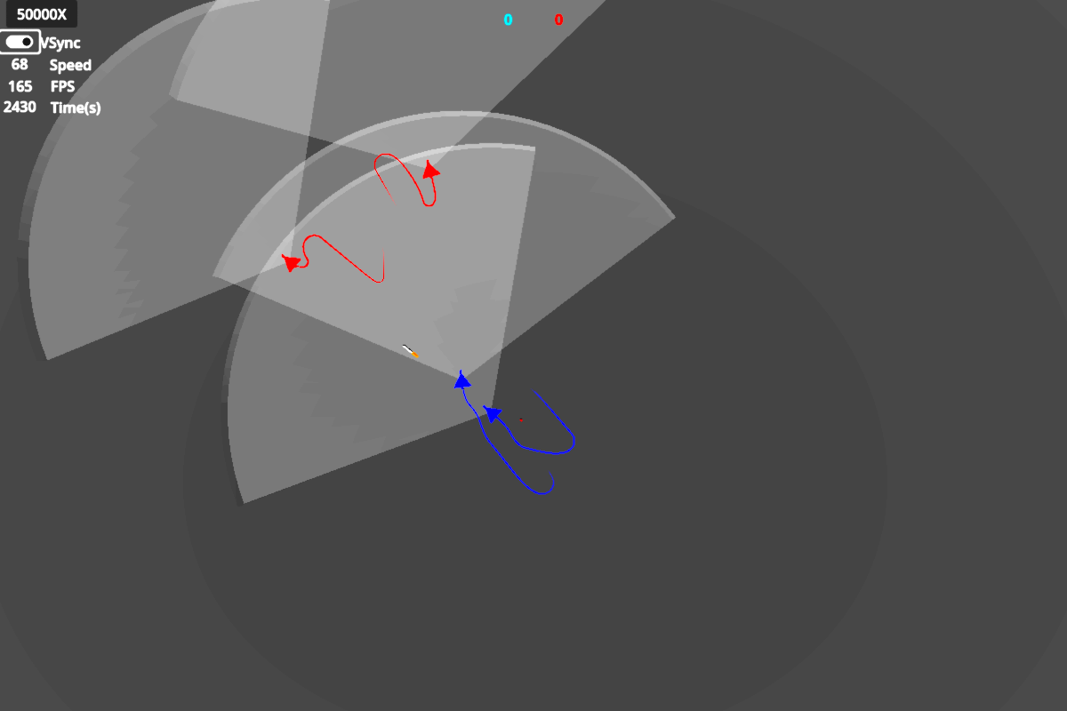
B-ACE: Visualization Example
Radar Detection
Critical Position
In Flight Missile
3 minutes trail
Notes:
Simplified Visualization for Model Development and Evaluation:
Essential Support for Model Development: The visualization focuses on essential elements that assist in tracking and evaluating the behavior of models during their development process. This streamlined approach ensures clarity and effectiveness in debugging and performance assessment.
Native Godot Integration: Built natively in the Godot engine, the visualization is highly adaptable and can be easily expanded with additional resources or interactive elements. This flexibility enables seamless integration with evolving simulation requirements.
Current Focus on Basic Functionality: The current implementation prioritizes a basic yet functional design. It allows developers to monitor agent behaviors effectively, ensuring that the core objectives of the environment are met without introducing unnecessary complexity.

Slide 14


B-ACE: Aircraft, Sensors, and Weapons
Aircraft Model: Utilizes simplified movement models accepting heading, flight level and G-force commands, without detailed fuel consumption or engine modeling.
Radar Model: Defined by three key parameters: maximum detection range, horizontal field of view, and vertical field of view.
Missile Model: Focused on key characteristics—maximum speed and time of flight—with support for real-time Weapon Engagement Zone (WEZ) calculations.
Notes:
Simplified Models for Tactical Focus: While complex models like JSBSim provide detailed aerodynamics, they introduce significant computational overhead, limiting the evaluation of higher-order decisions. Our approach simplifies the models to prioritize tactical behavior. These simplified models are open and can be enhanced as needed.

Slide 15
B-ACE: Aircraft Performance and Conditions
Altitude Effects: Incorporates simplified linear effects of altitude on aircraft speed and G-force, requiring agents to adapt decisions to altitude changes.
Default Aircraft Specs: Max speed of 650 knots, max G-force of 9g, and radar range of 50 nautical miles with a 60-degree field of view.
Missile Capabilities: Six missiles per aircraft, capable of flying for 50 seconds at speeds of 3,600 km/h.

Slide 16
B-ACE: Environment Interaction
Simulation Update Rate: Aircraft actions update at 20 Hz for dynamics, while radar and behavior processing occur at 1 Hz.
Communication Assumptions: Effective communication is assumed among allied agents, with future possibilities for modeling communication limitations.

Slide 17
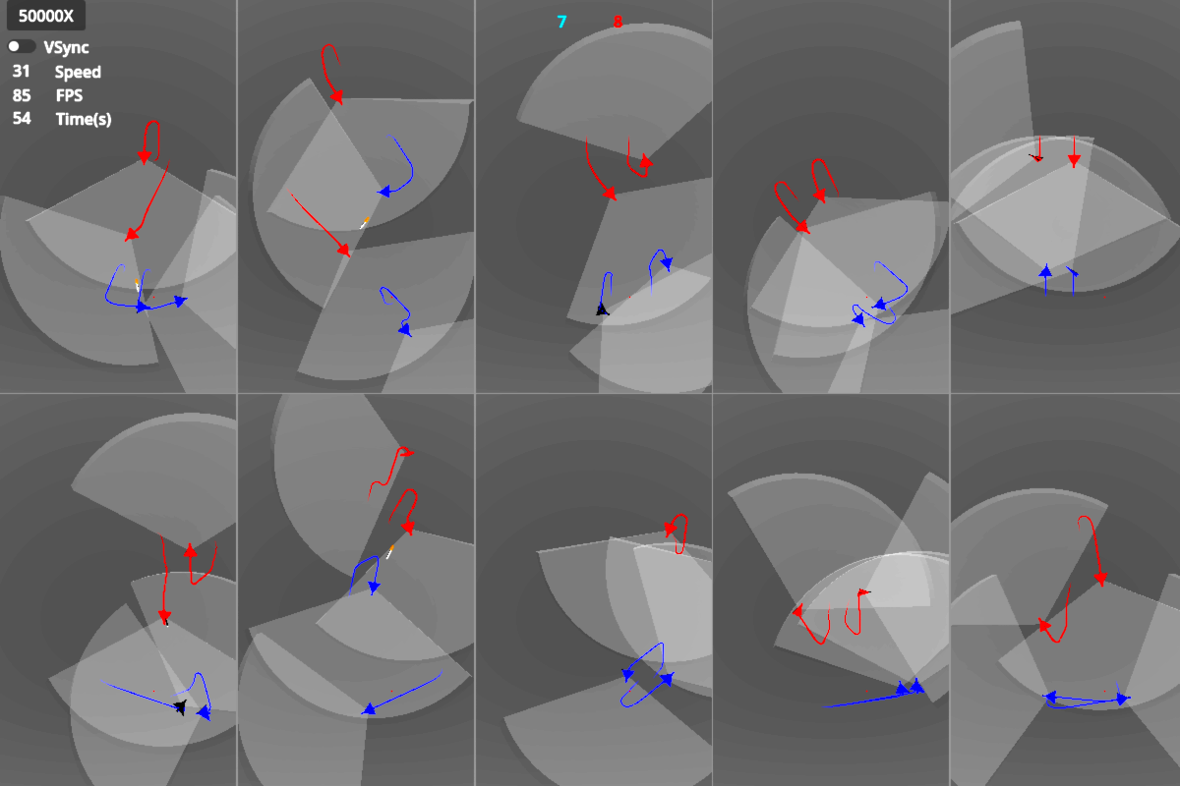
B-ACE: Experiment Mode
Notes:
Example of B-ACE in Experiment Mode: Essential for supporting development by enabling data collection, metamodel generation, and accelerating the development process.

Slide 18

B-ACE: MARL States Definition

Slide 19
B-ACE: MARL Rewards Design
Mission Objectives Related | Default
Reward for successfully completing a mission | 10.00
Shaping reward related to mission objectives | 0.001
Rewards
Shaping Reward
Penalty
Shaping Penalty
Aircraft Hit Related | Default
Reward for hitting an enemy | 3.000
Penalty for being hit | -5.000
Rewards/Penalties: Core feedback given based on an agent's actions, where rewards reinforce successful outcomes and penalties discourage undesirable.
Shaping Rewards/Penalties: Additional rewards given to guide agents toward desired behaviors during learning, helping accelerate the training process.
Radar Tracking Related | Default
Shaping penalty for losing track of an enemy | -0.100
Shaping reward for maintaining track of an enemy | 0.001
Missile Usage Related | Default
Shaping penalty for firing a missile | -0.100
Shaping penalty for missing a target with a missile | -0.500

Slide 20
B-ACE: MARL Action Design
Maneuver Action Inputs: Agents control key flight dynamics:
Heading: Adjust direction (change from -180° to 180°).
Flight Level: Modify altitude (change relative to current level).
G-Force: Set desired G-force for maneuvering.
Missile Firing: Decide when to fire a missile.
Continuous and Discrete Action Spaces: Supports both continuous values for precise adjustments and discrete actions for simplified decision-making.

Slide 21
Summary
Introduction
Background and Related Work
B-ACE Environment
Case Studies

Slide 22
Case Studies
Case Studies showcase potential applications, however, are ongoing research that will be further elaborated and evaluated in future publications.
1. Weapon Engagement Zone (WEZ): Modeling missile effectiveness for high performance predictions.
2. Finite State Machine (FSM) Baselines: Optimizing scripted agents for comparison with MARL approaches.
3. MARL Agent Development: Training agents using Proximal Policy Optimization (PPO) and Deep Deterministic Policy Gradient (DDPG) in cooperative and competitive scenarios.

Slide 23
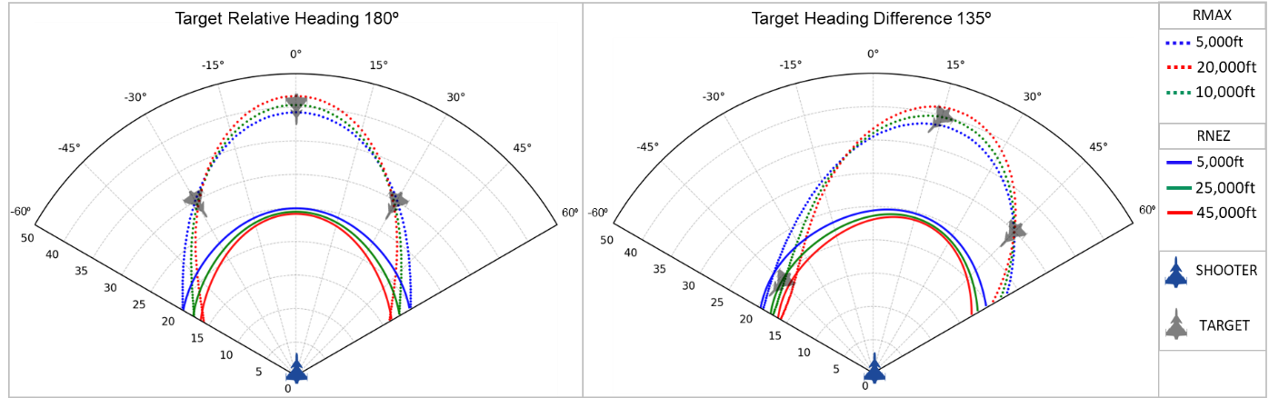
Case Study 1: Missile Weapon Engagement Zone Determination
Data from thousand simulations executed in Experiment Mode in parallel allowed to create a Regression Model for high performance predictions of the missile effectiveness
Example of predictions generated by the WEZ model for the default B-ACE Missile
Notes:
Rmax , the maximum range at which a missile has a chance of hitting the target; Rnez, the range with a high probability of hitting the target regardless of defensive maneuvers .

Slide 24
Case Study 2: Optimizing FSM Behavior
Genetic algorithm (GA) allowed to find a diverse and optimized set of FSM based behaviors agents (changing key parameters).
3 Worst
3 Best
10 Best
Stop Criteria
30 Repetitions/Enemy
Enemies parameters
B-ACE
GA
Agent Config
Mean Score

Slide 25
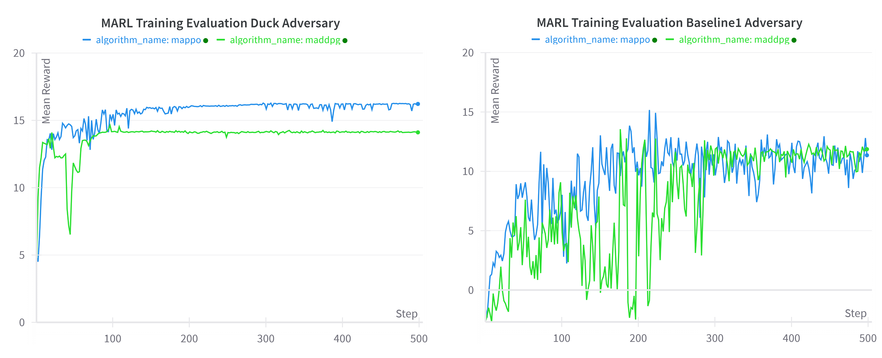
Case Study 3: MARL
Mean Reward for MARL training in a BVR 2x2 Air Combat Scenario using Multi-Agent PPO and Multi-Agent DDPG
Notes:
Those were the initial MARL that still a working in process and we are preparing a specific paper for the next year.

Slide 26
Summary
Introduction
Background and Related Work
B-ACE Environment
Case Studies

Slide 27
B-ACE: Agents Missions
Thank You
Further questions: please contact Andre Kuroswiski at kuroswiski@ita.br
Code available at https://github.com/andrekuros/B-ACE/
Notes:
Objective: Introduce the B-ACE environment and its purpose in air combat simulation and reinforcement learning.
Key Points:
B-ACE is a simulation framework using the Godot engine.
It is designed for research in Multi-Agent Reinforcement Learning (MARL) in Beyond Visual Range (BVR) air combat.
Highlights the need for open, accessible, and shareable military simulation environments.

Slide 28



B-ACE Environment
Beyond Visual Range (BVR) – Air Combat Environment
B-ACE
Open BVR Air Combat Simulation
2. Adheres to Reinforcement Learning standards (Gymnasium and PettingZoo)
3. Lightweight Simulation, balancing performance and realism
4. Presents Godot Engine as an alternative for military simulation research
Notes:
Overview of the Simulation Environment Design:
Generic Models for Flexibility: The environment uses generic models that replicate the fundamental characteristics of BVR air combat. This approach ensures there are no restrictions due to proprietary or classified data, promoting open and accessible research.
Ease of Integration with RL/MARL Solutions: The design prioritizes compatibility with off-the-shelf RL/MARL frameworks. This reduces prototyping and evaluation time, allowing researchers to focus on algorithm development and testing.
Simplified Simulation for Focused Decision-Making: Many aspects of the simulation have been simplified to enhance computational performance. The focus is placed on critical tactical decisions rather than spending resources on learning basic maneuvers, enabling faster and more meaningful results.
Showcasing the Godot Engine: The environment also serves as a demonstration of the capabilities of the Godot Engine. With its growing community and potential, Godot provides a robust and flexible platform to support future research and development in autonomous air combat systems.

Slide 29
B-ACE: Agents Missions
Defensive Counter Air (DCA):
Objective: Defend a critical position from enemy aircraft, using tactics to neutralize or deter threats.
Airstrike Operations:
Objective: Advance to a target position while avoiding enemy forces. The primary goal is to reach the objective, but engagements are necessary for self-defense.
Success Metrics:
DCA: Success is defined by preventing enemies from reaching the critical position.
Airstrike: Success is defined by advancing and reaching the target position while minimizing engagement.
Time Constraints: Each mission scenario is simulated over a maximum of 36,000 steps (equivalent to 30 minutes in real-time).

